Slide 1
Integration and Alignment
I-CDR Welds of Port Tubes on Monolith Vessel
Fabien REY
Integration Services

Slide 2
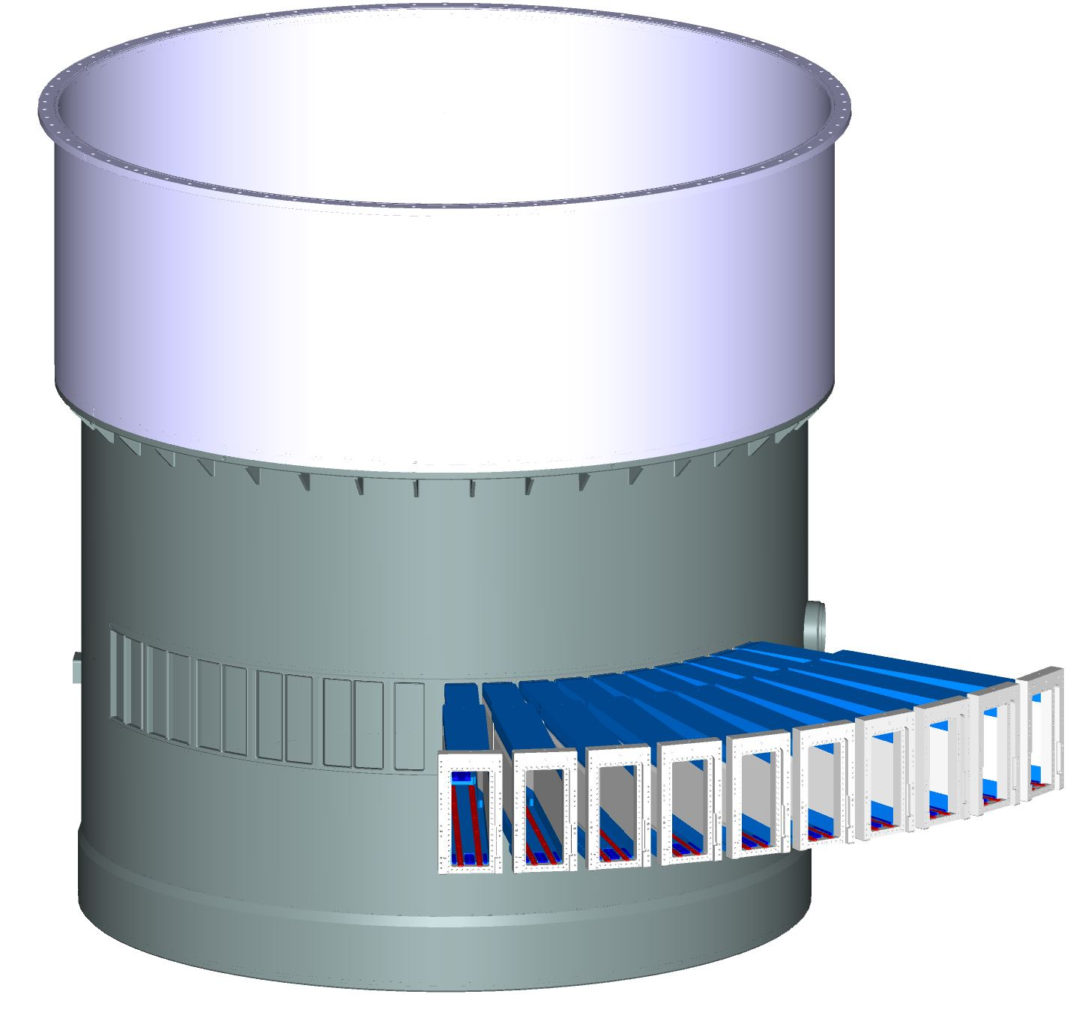
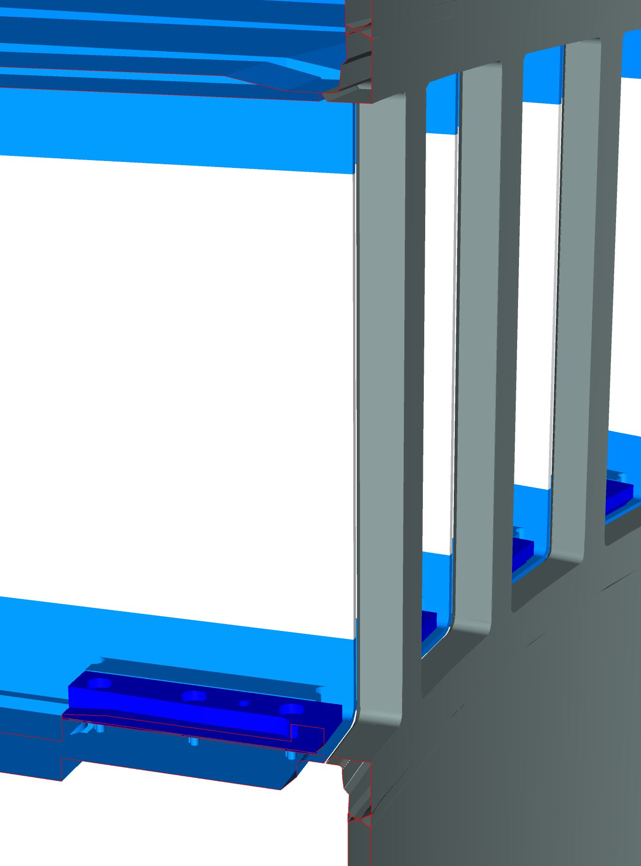
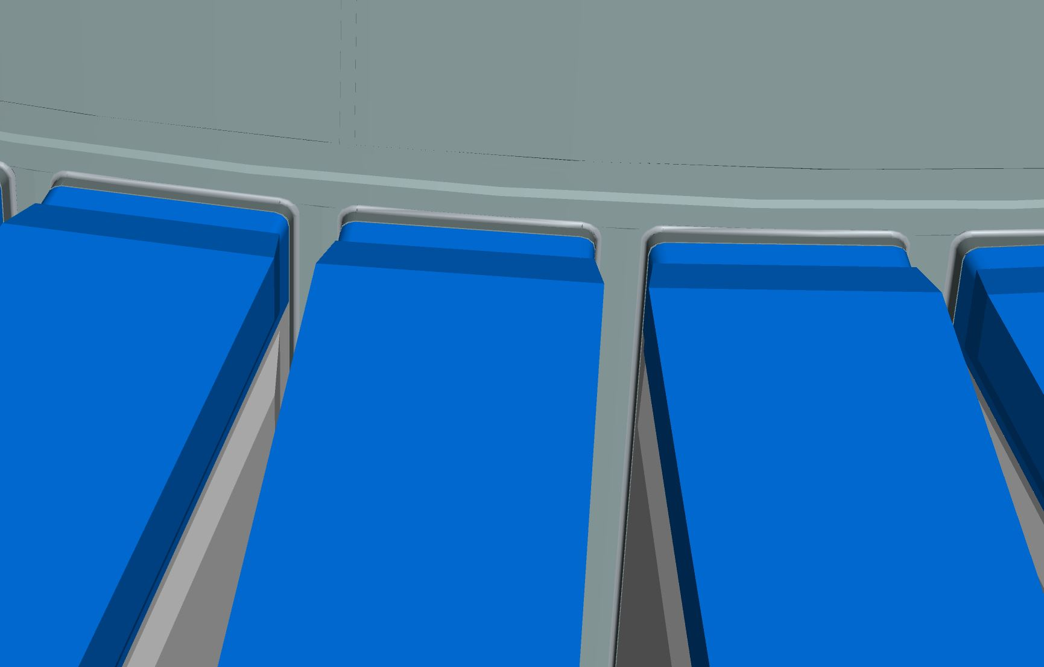
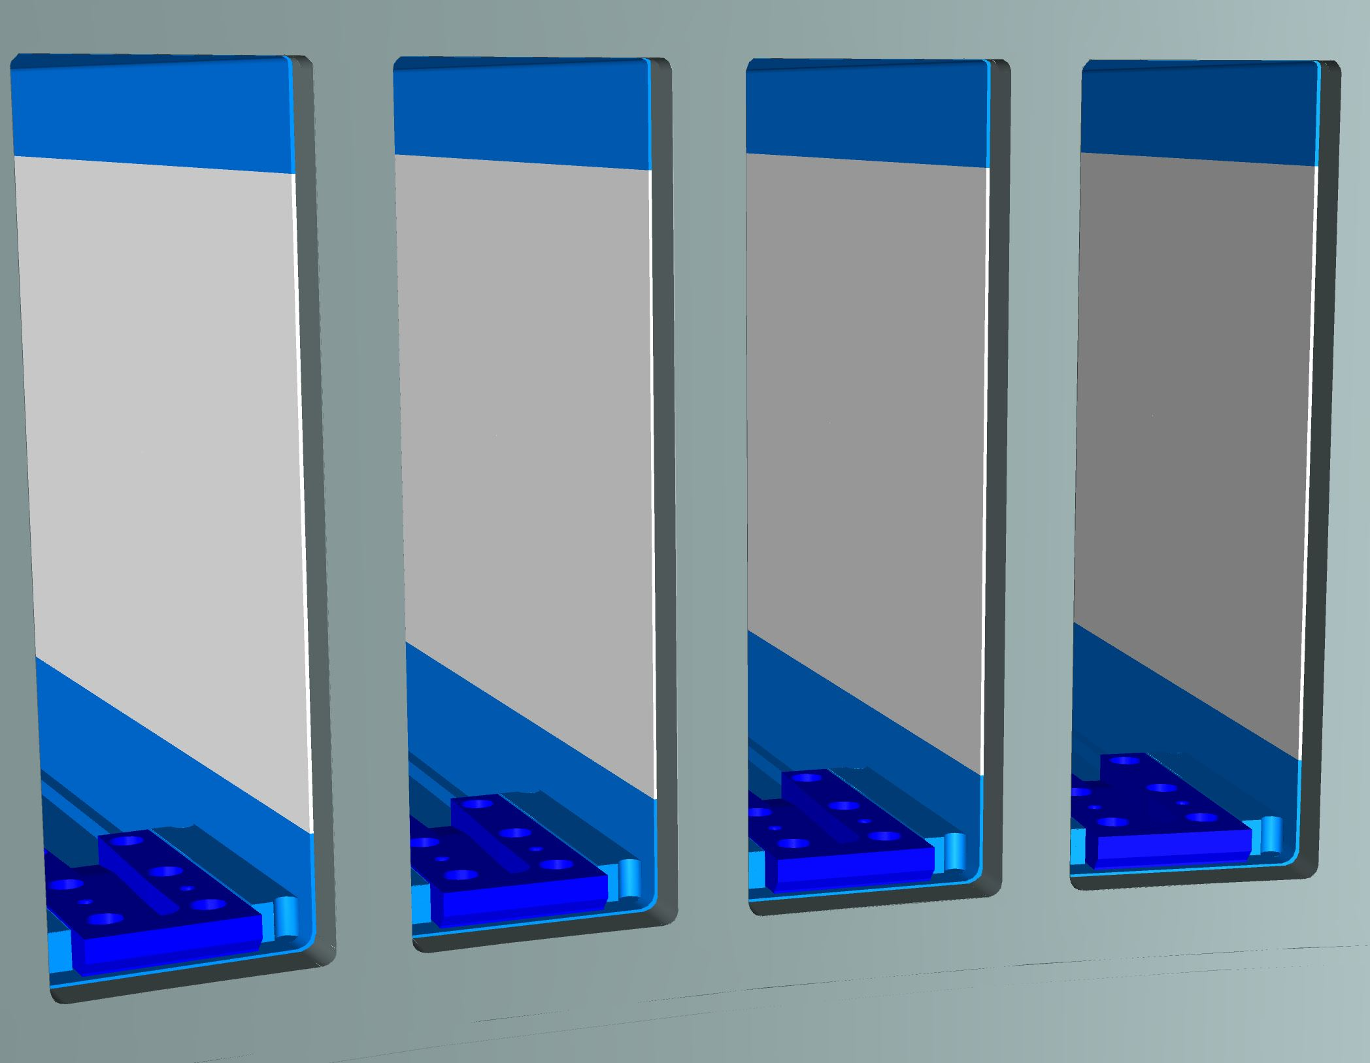
Welds Port tubes- Vessel
Visualization of the welding area
Port tube
Outside Tubes TOP
Weld
Outside Tubes Bottom
Vessel
Inside vessel
Section view Port Tubes-Vessel

Slide 3
Agenda
1 A bit of Geometry
2 Spatial Interfaces for Port tubes and Lower Monolith Vessel
3 Nn-Bar
5 Transportation
6 Alignment Set-up
Conclusion

Slide 4
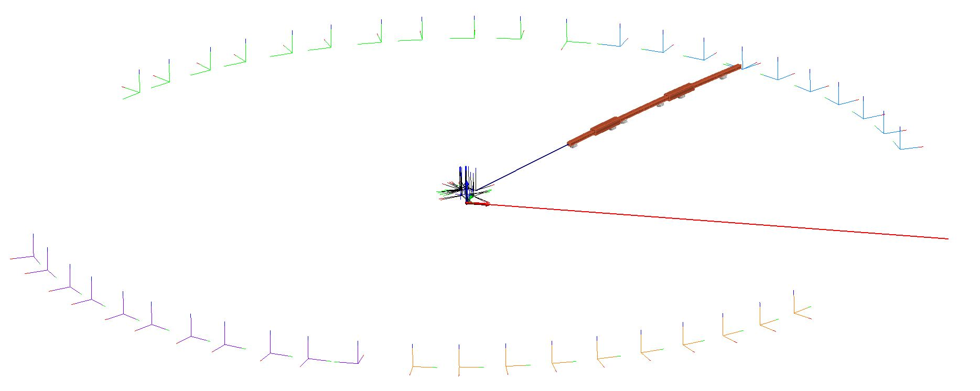
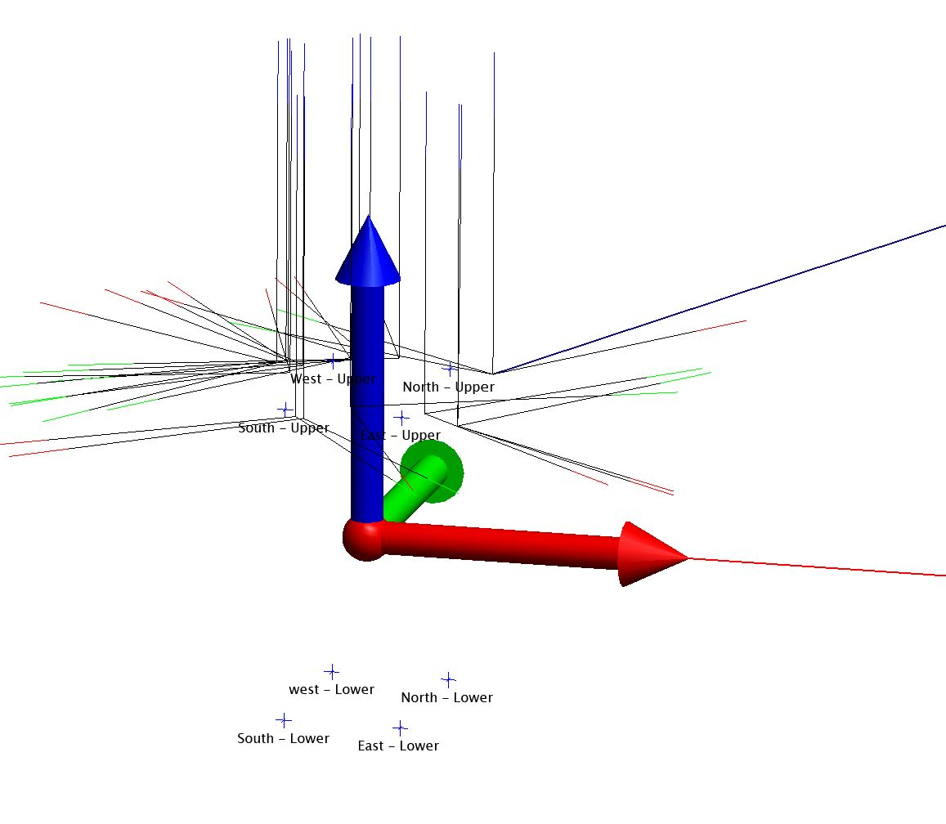
A bit of Geometry
Beam Port Coordinate System
West Sector
North Sector
Neutron Beam Optical Assembly
Neutron Beam
Proton Beam
Instrument Source Coordinate System
Target Coordinate System
Z
South Sector
East Sector
Y
Focal Points
TCS
X
4 Upper
4 Lower

Slide 5
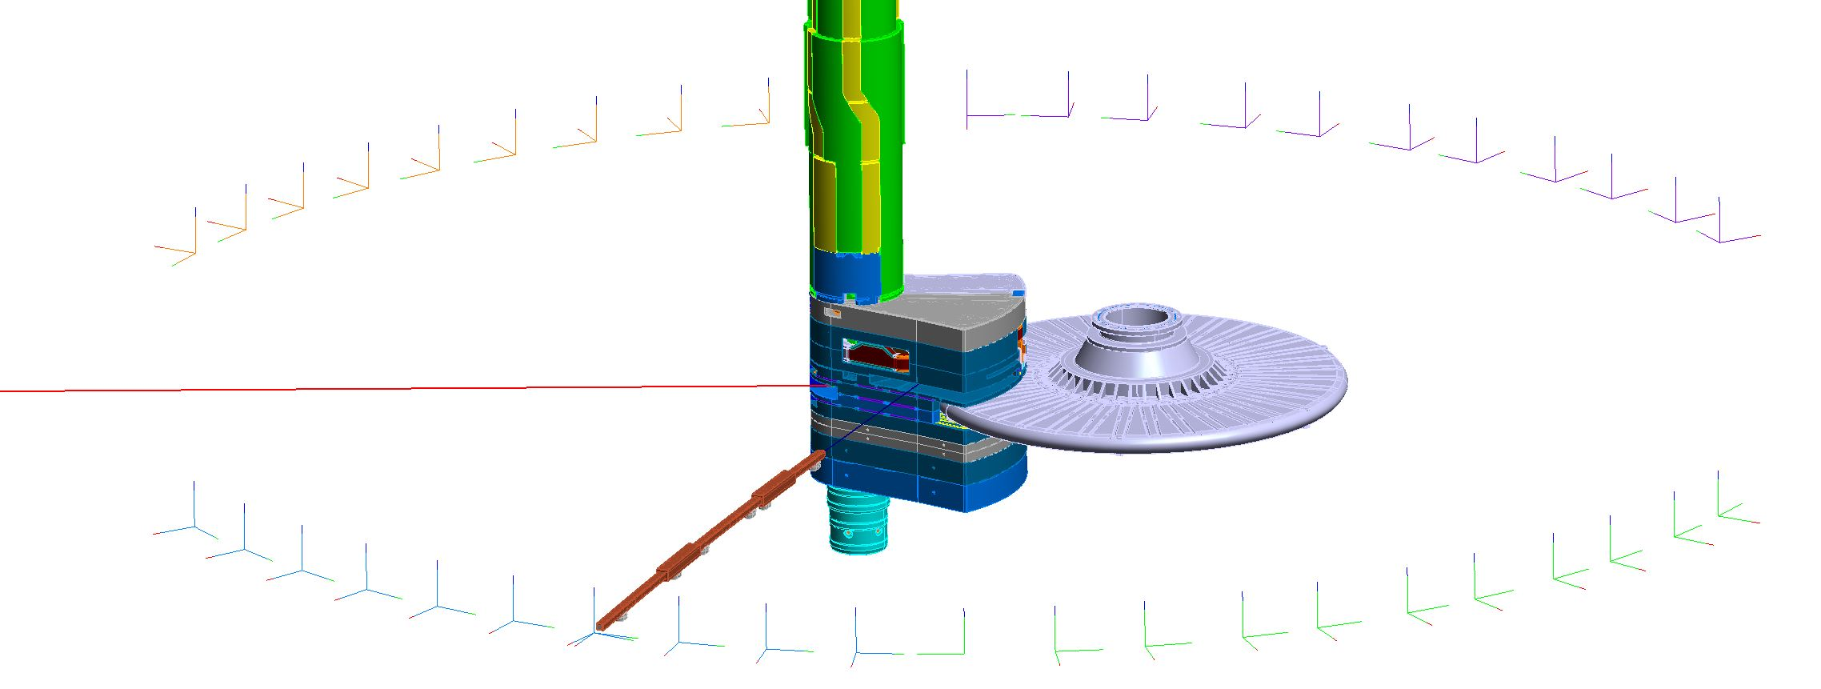
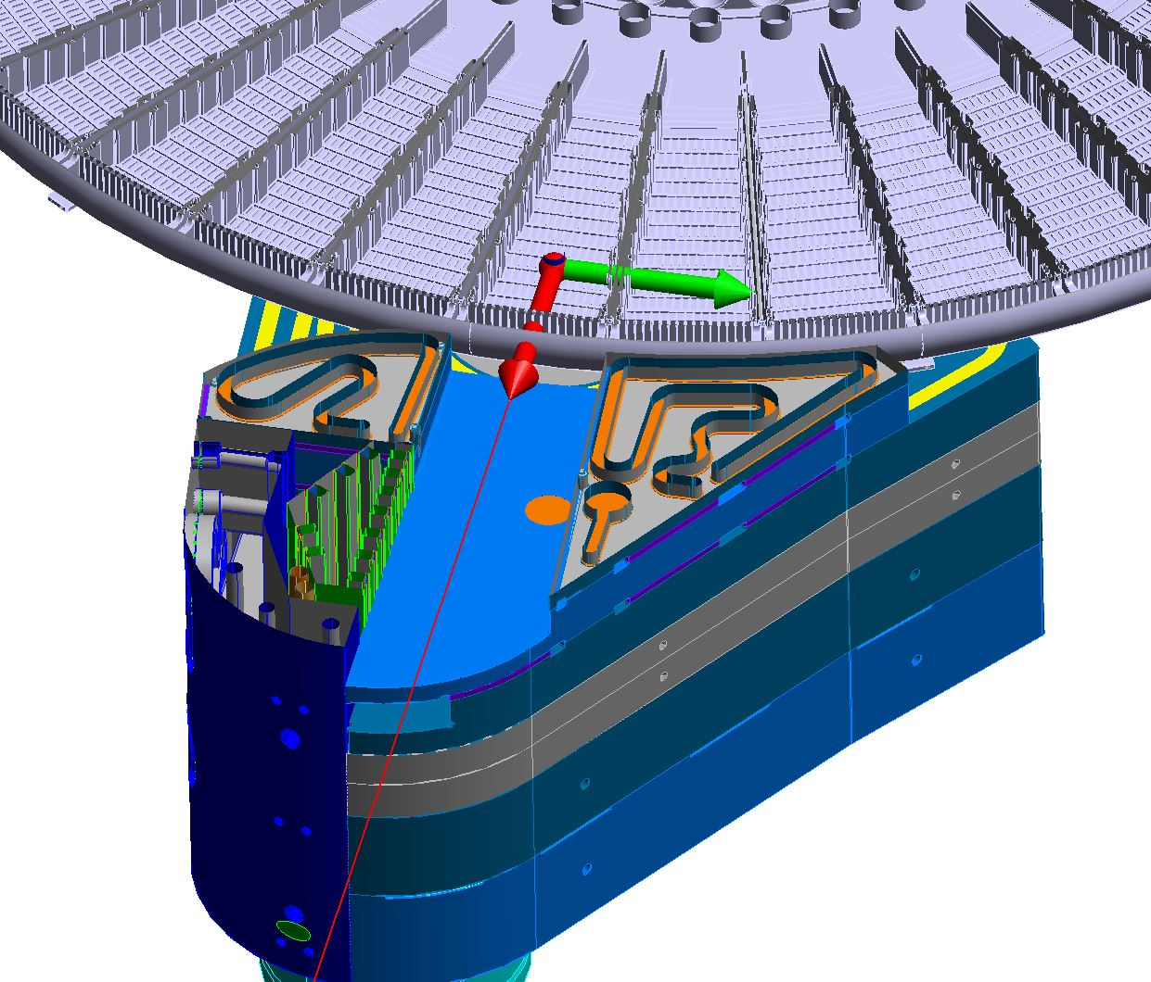
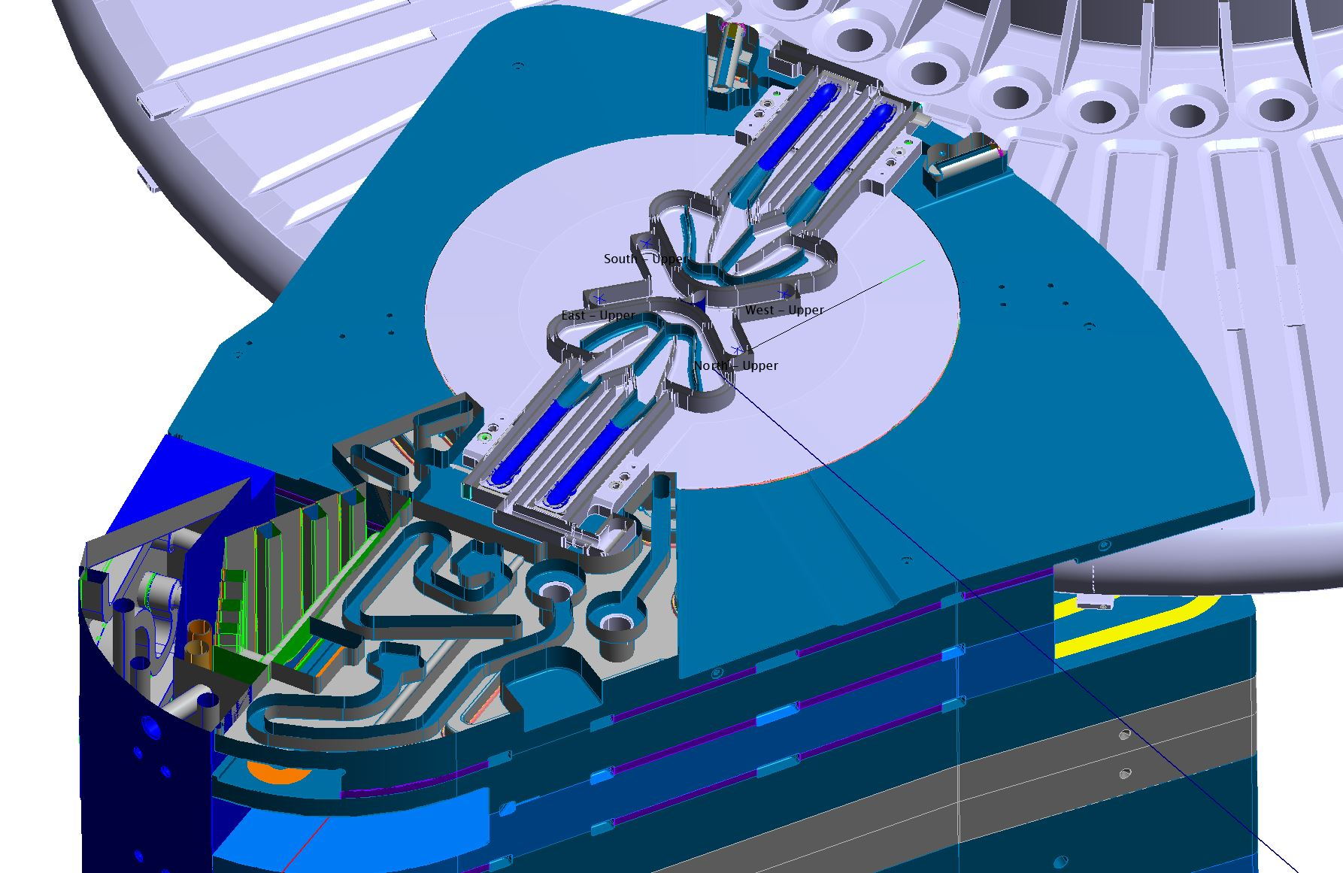
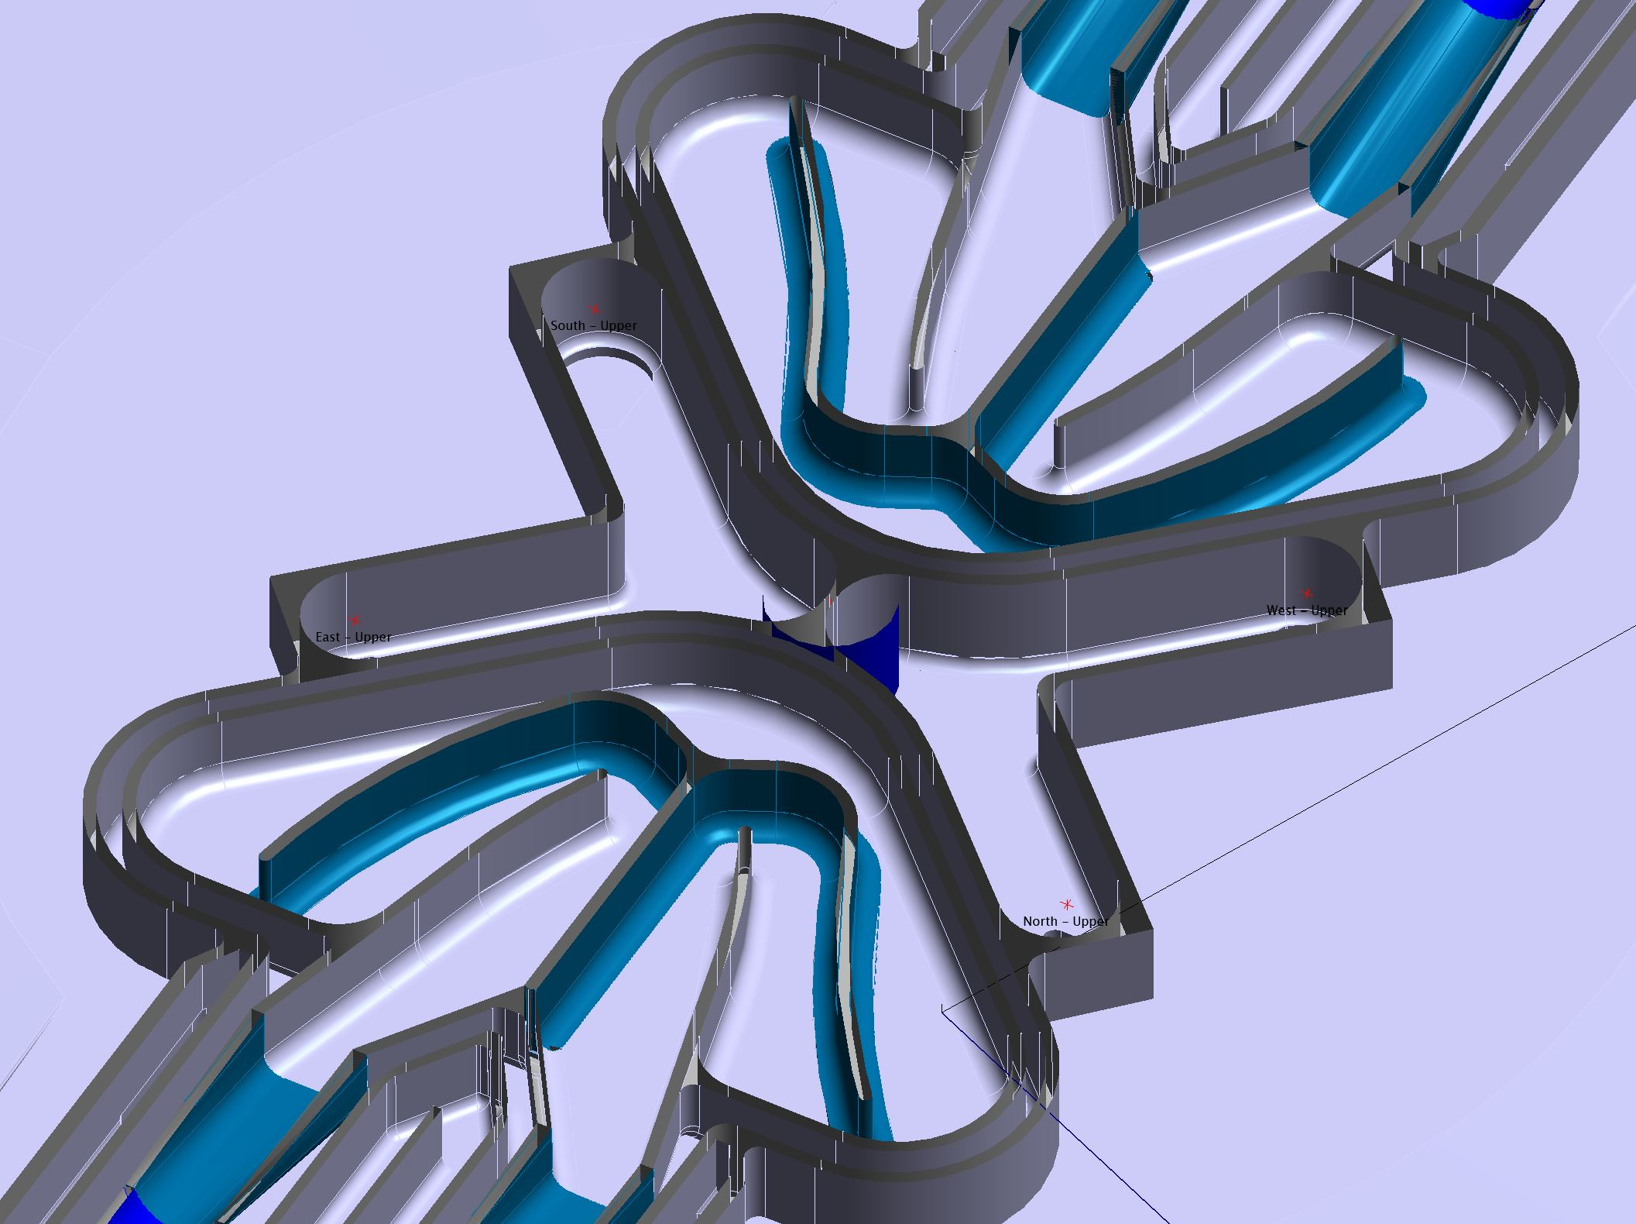
Moderator Reflector
Wheel
Horizontal Cut TCS
Horizontal Cut Moderator
Zoom on Upper focal points and ISCS

Slide 6
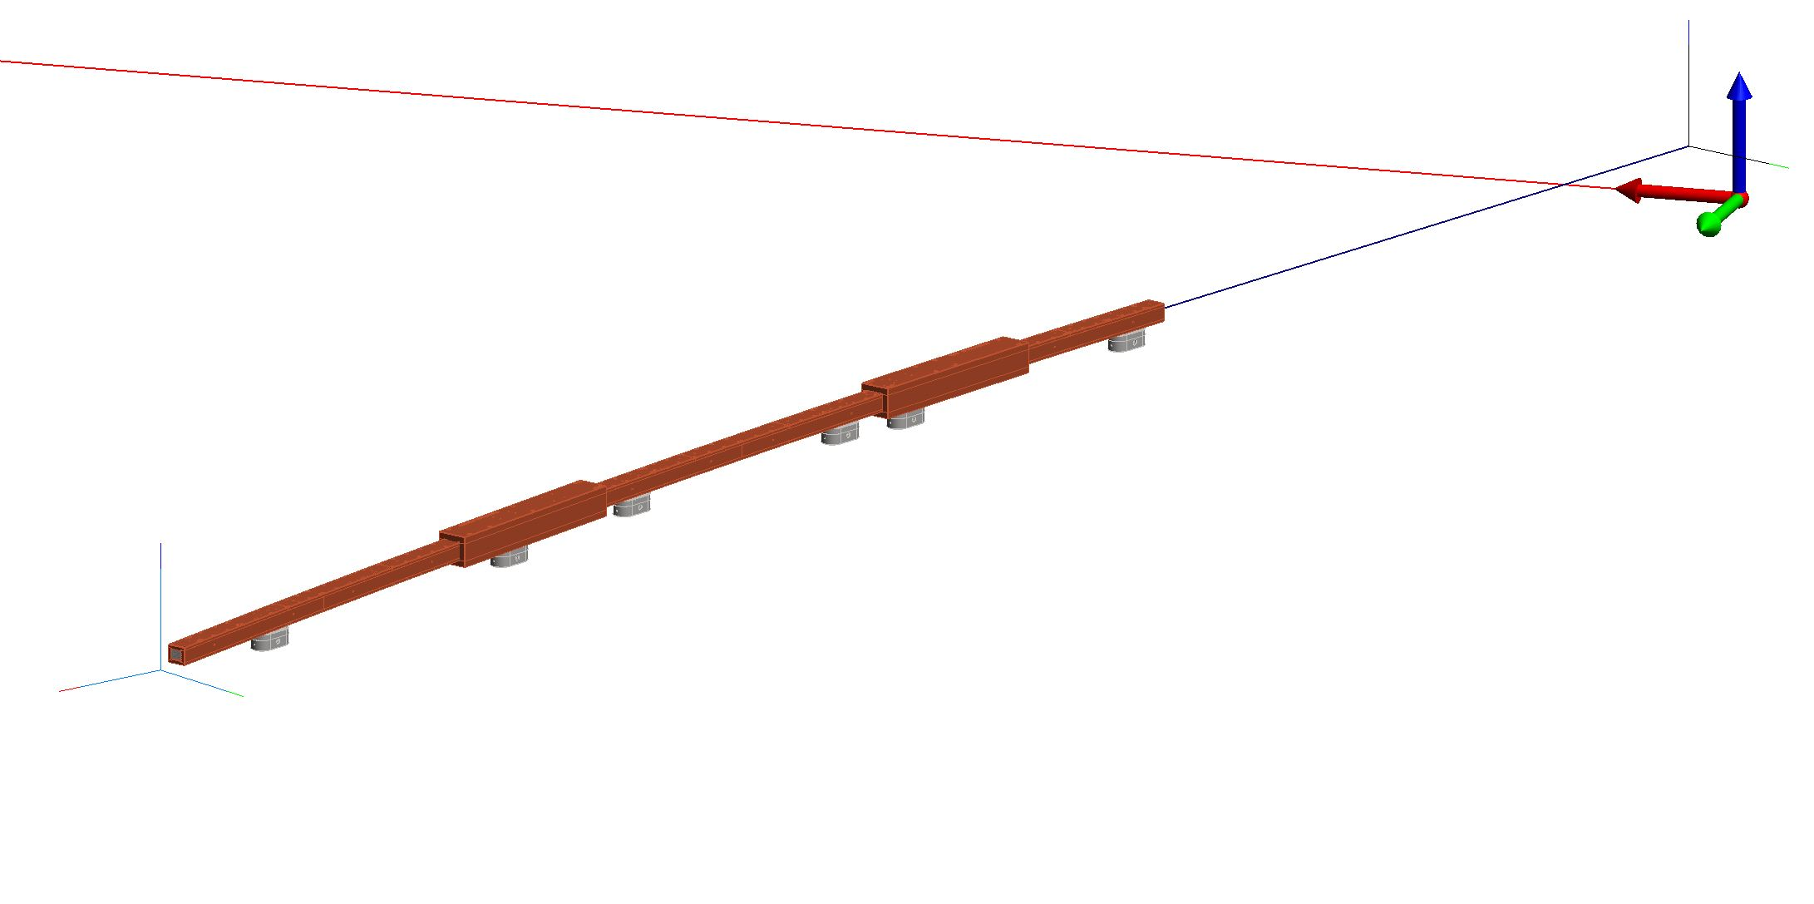
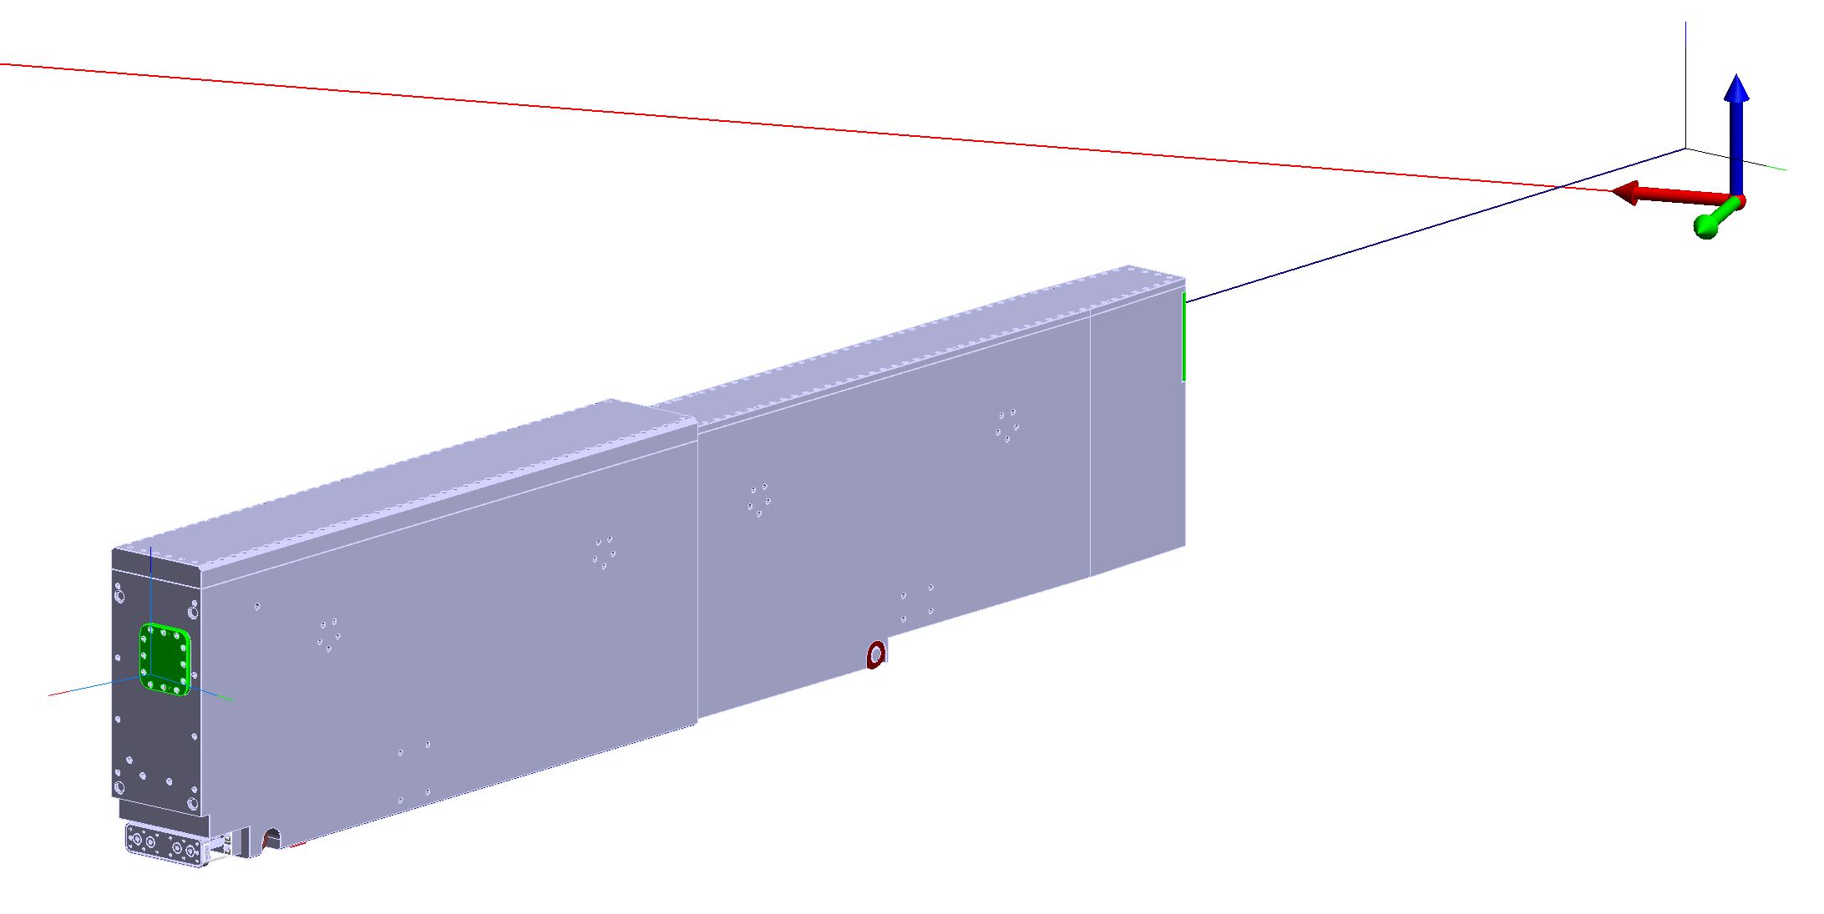
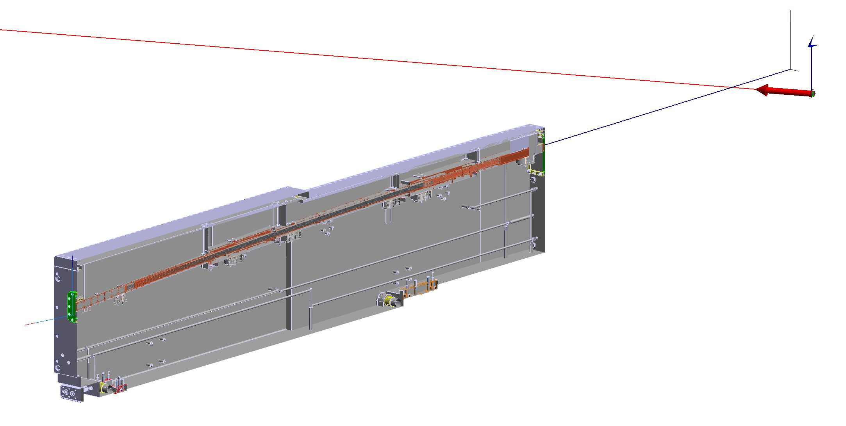
Optics are pre aligned inside the NBPI
Neutron Beam Optical Assembly
NBOA
Final position of NBPI defines the end position of the NBOA
Neutron Beam Port Insert
NBPI
NBOA vs NBPI
Adjustability | Clearance
+- 1mm all directions | 2-5 mm
Section View showing integration of NBOA inside NBPI

Slide 7
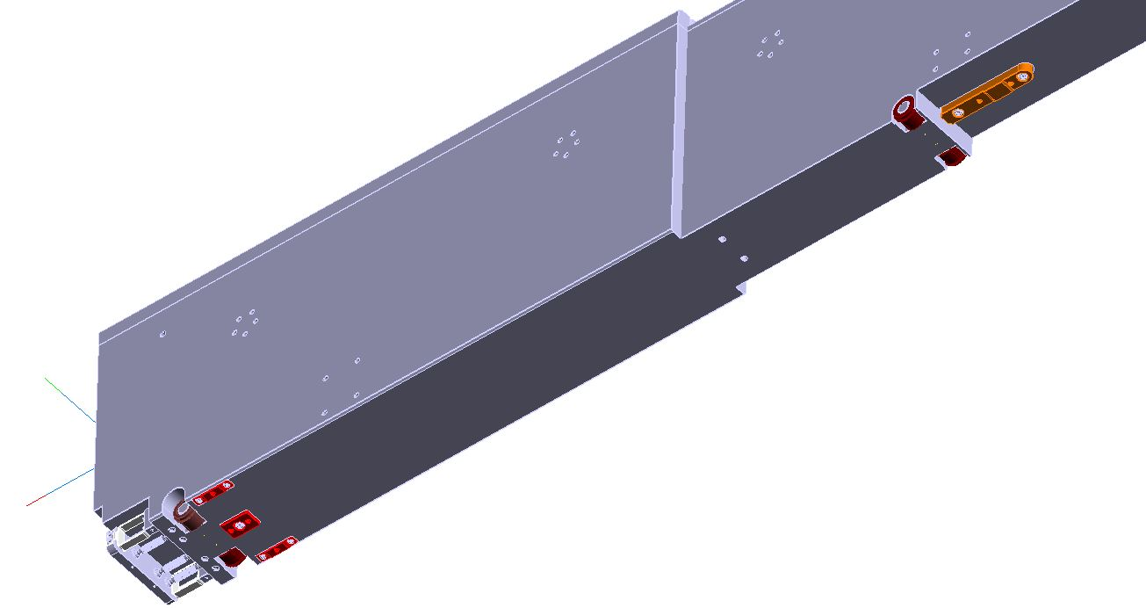
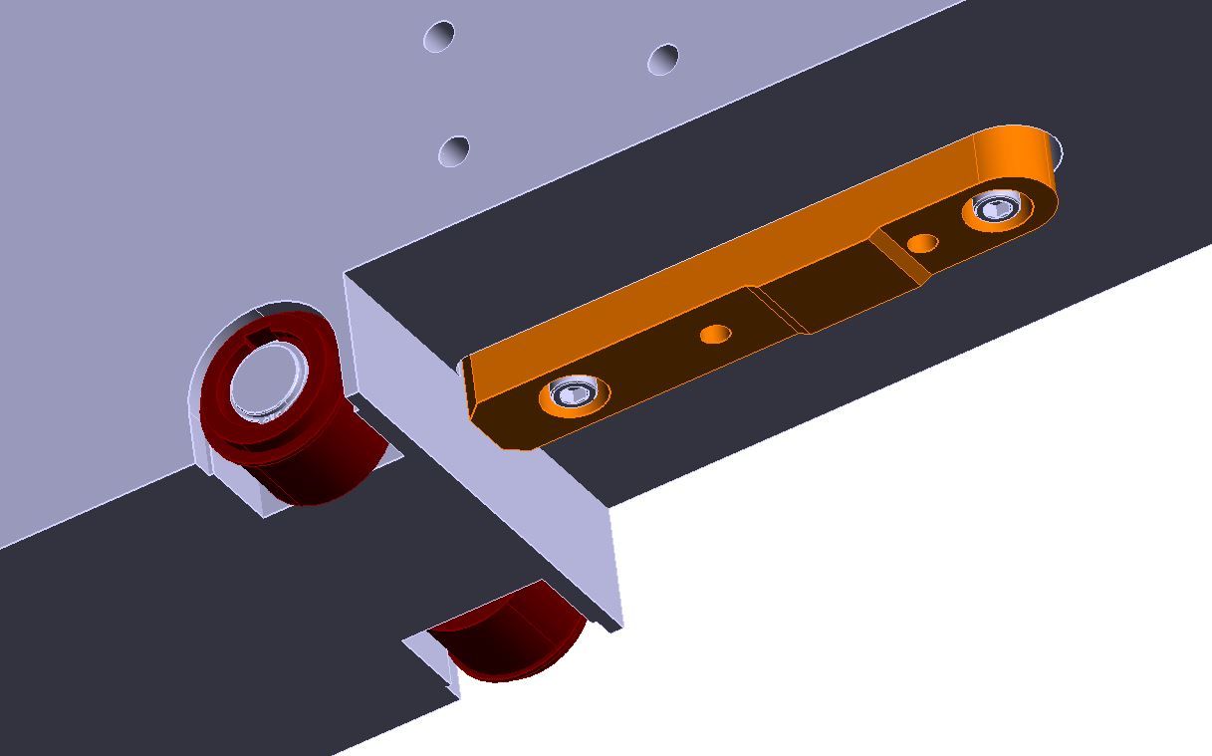
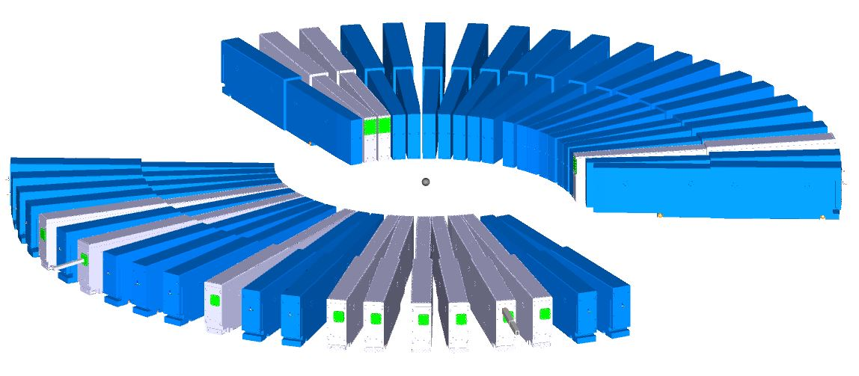
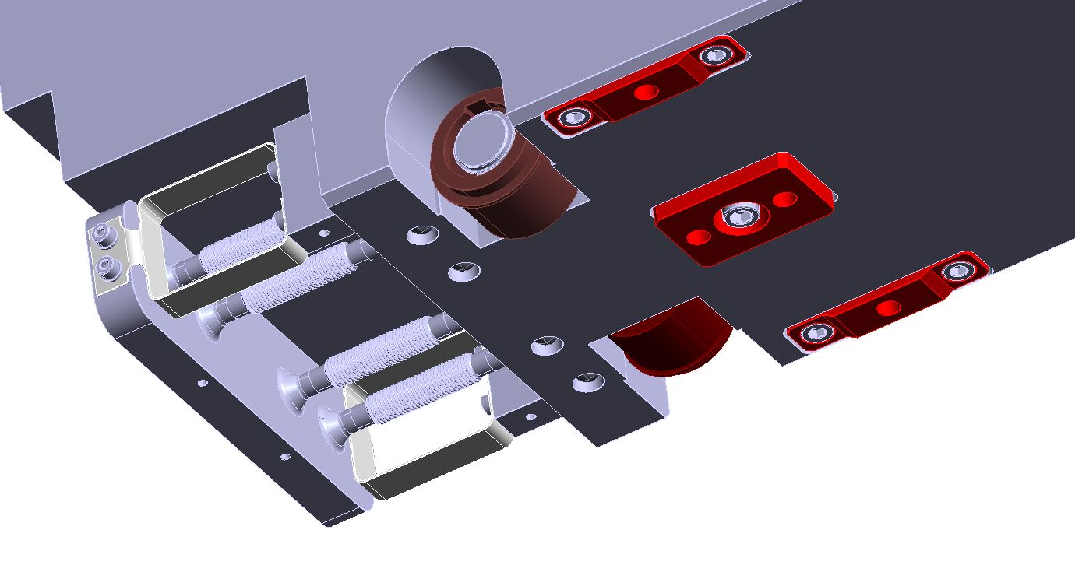
Rolling System
4 WHEELS
NBPI
Tz
Rx Ry
Ty
Rz
Positioning System
Tx
With optics or plugs

Slide 8
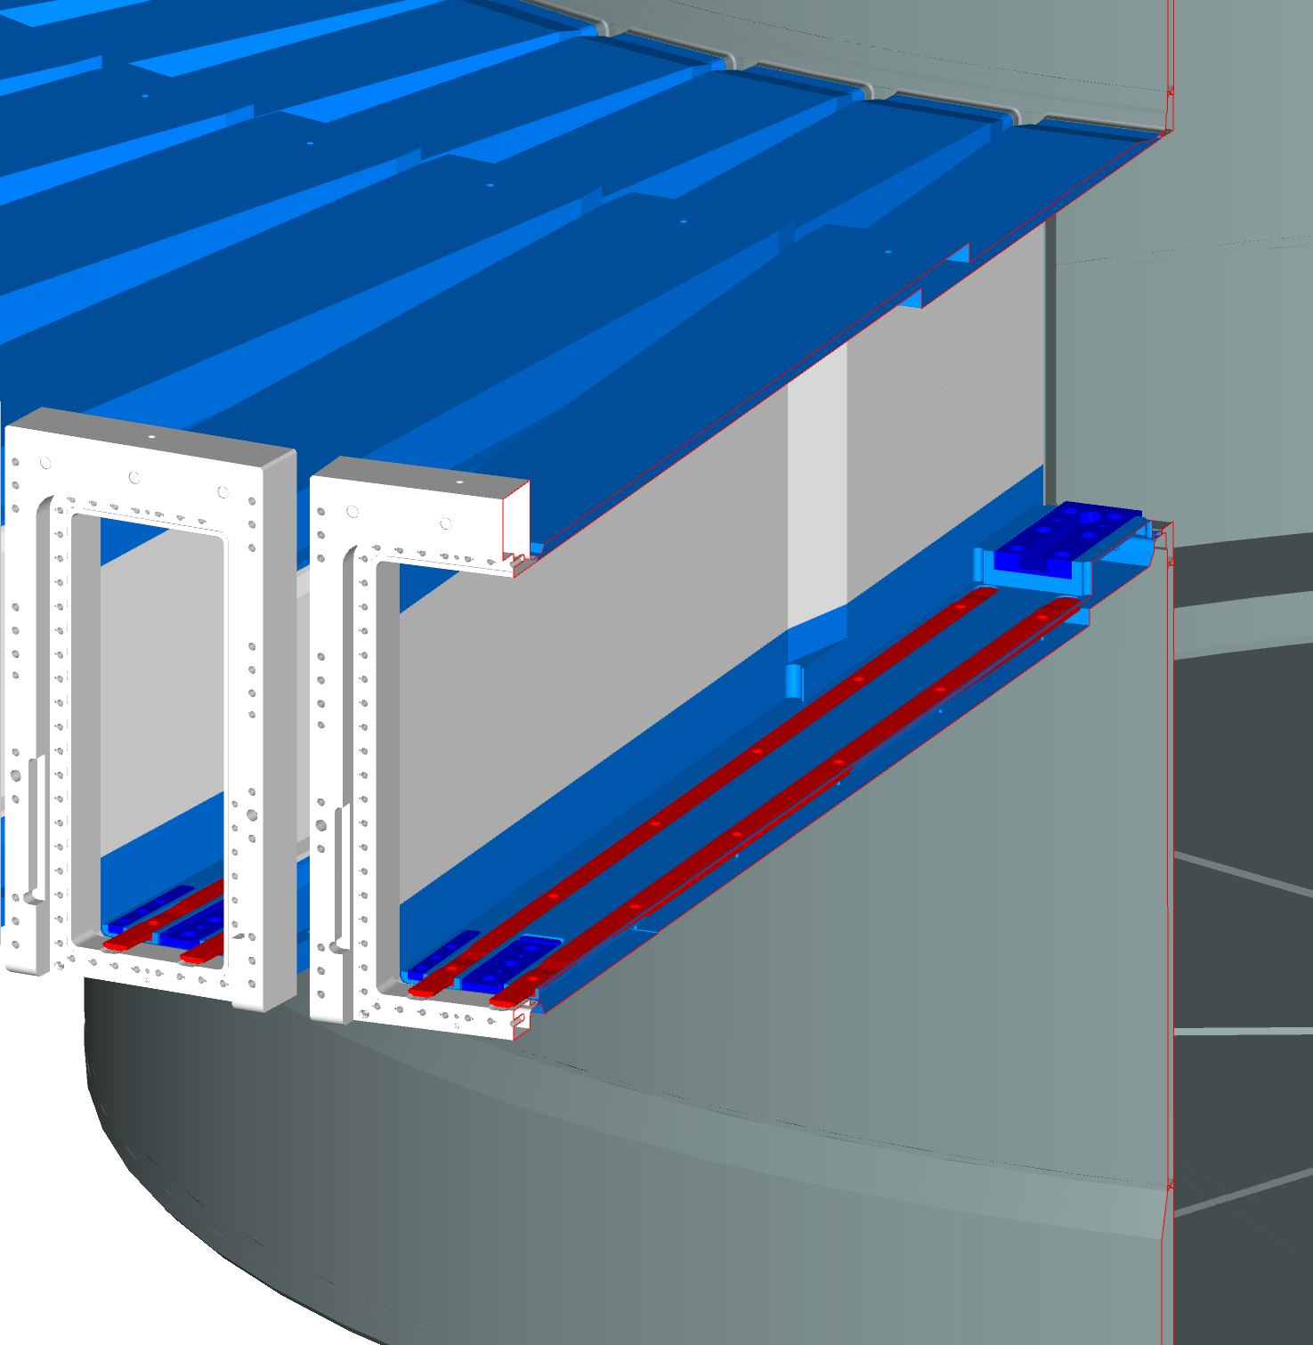
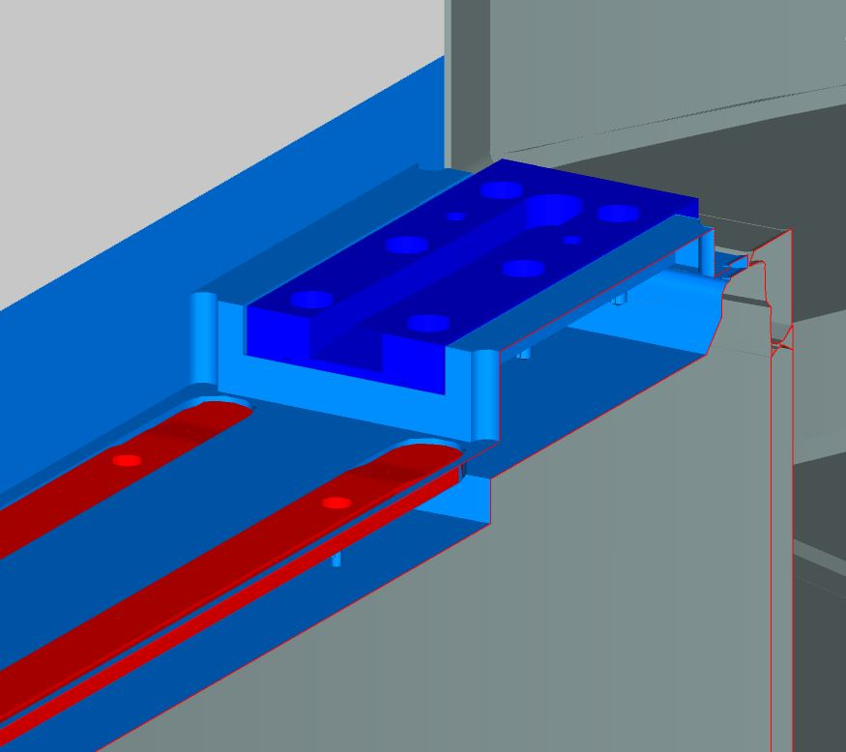
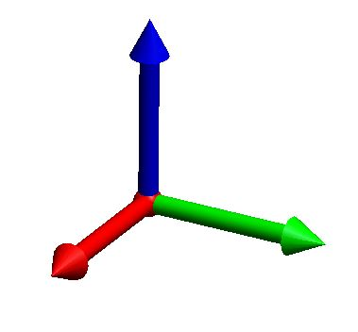
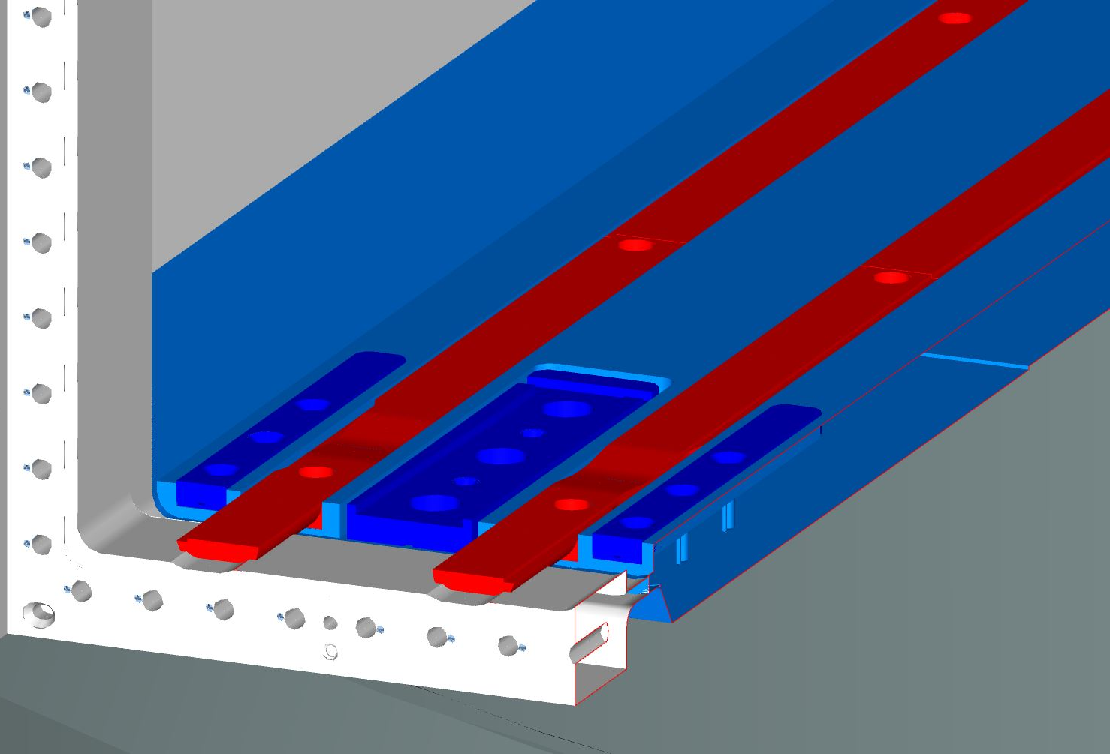
Port Tube : Rails and Alignment Features
Alignment Features
Alignment Features will be adjusted to nominal position.
NBPI will roll on the guides and land on the Alignment Features.
Z
BPCS
Y
X
Rails
Alignment Features vs Port Tube
Adjustability
+- 1mm all directions
Alignment Features

Slide 9
Weld Port Tube - Vessel
Neutron Optics
ALIGNMENT CHALLENGE
Optics pre aligned inside
Neutron Beam Port Insert
Insert rolling on rails and landing on alignment features
Rails and Alignment Features
Alignment of features after port tube installation
The position of Port Tubes after welding is critical to enable the correct positioning of the neutron optics.
In operation , the position of optics will continuously depend on the position of port tubes ( thermal deformations).
Port tube

Slide 10
Spatial Interfaces
WELD
Port Tube
Vessel
Inside Port tube
Outside Port tube
Inside Vessel
Outside Vessel
NBPI (and NBOA)
Bottom Plate
Fill-in shielding
Neutron beam Windows
Light Shutter System
Inner Shielding
NBPI ( and NBOA)
Concrete puck
Vessel Support
Outer Shielding
Contact and Clearance
Contact
Contact and Clearance
Clearance
Clearance
Clearance
Contact
Contact
Clearance
Contact

Slide 11
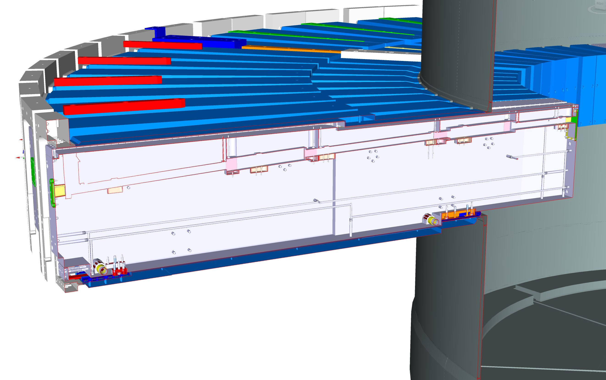
Spatial Interfaces Port Tubes
Inside – 1 NBPI
NBPI inside Port Tube

Slide 12
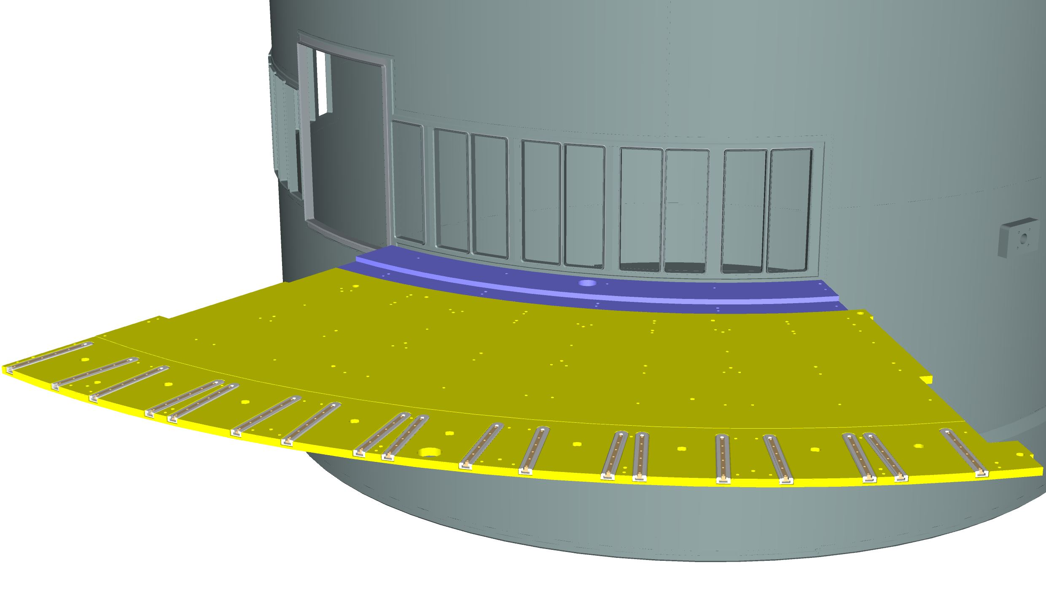
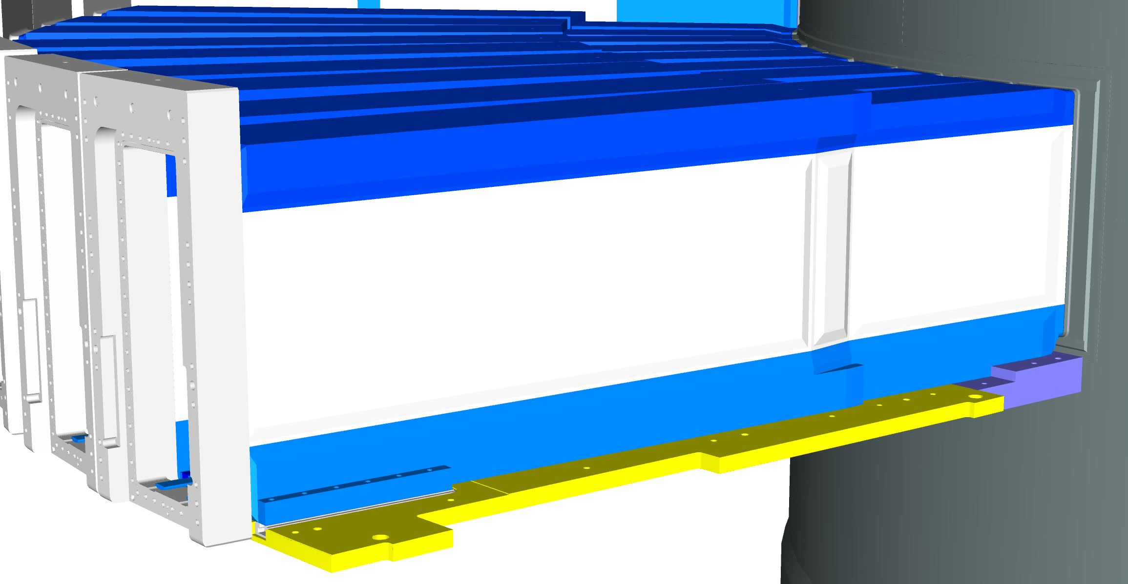
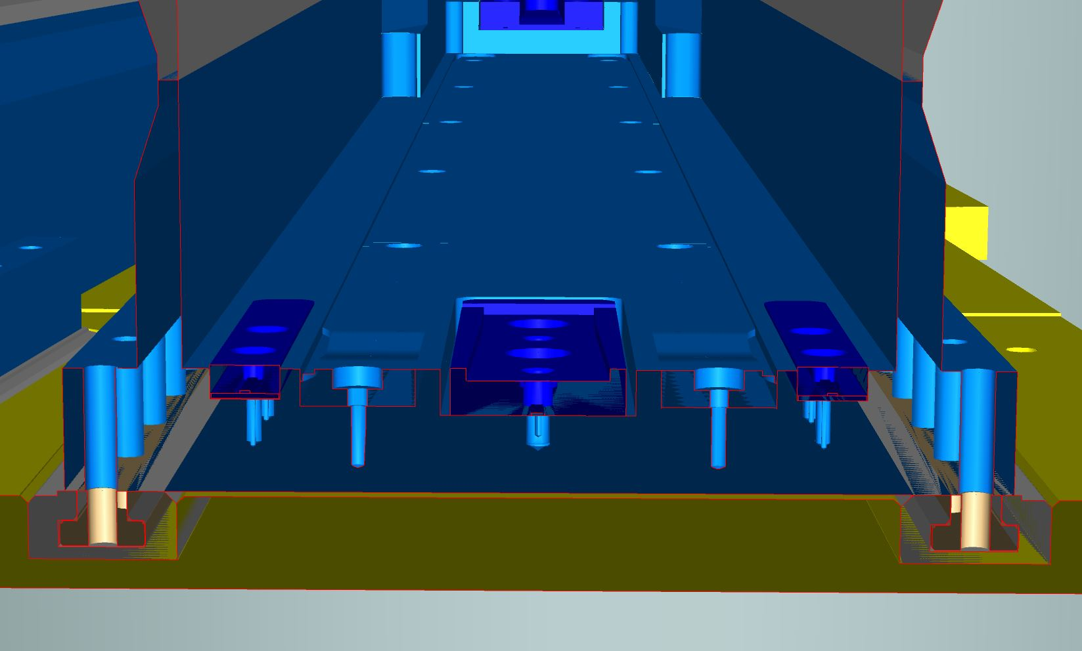
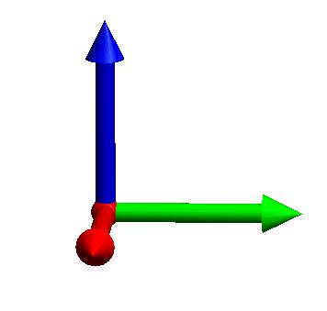
Spatial Interfaces Port Tubes
Outside – 1 Bottom Plate
2 rails / Tubes
Z
Sliding along BPCS-X direction
Y
Contact surface
Bottom Plate
X
Port Tube
Port tube is screwed on the sliding bars.
Sliding Bar
Stainless Steel Insert
Bottom Plate

Slide 13
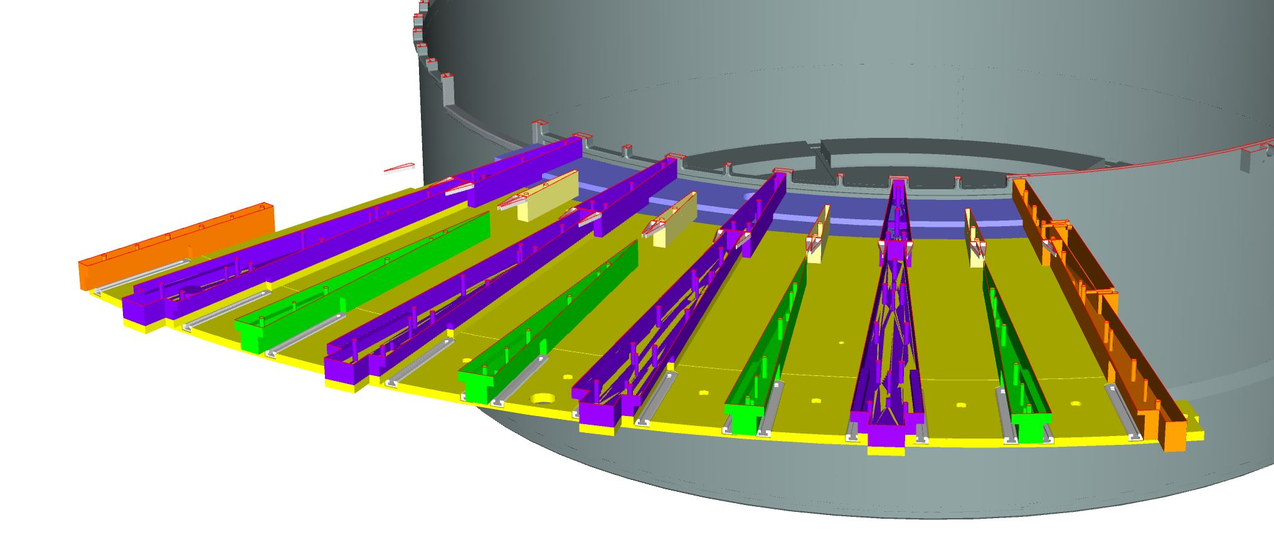
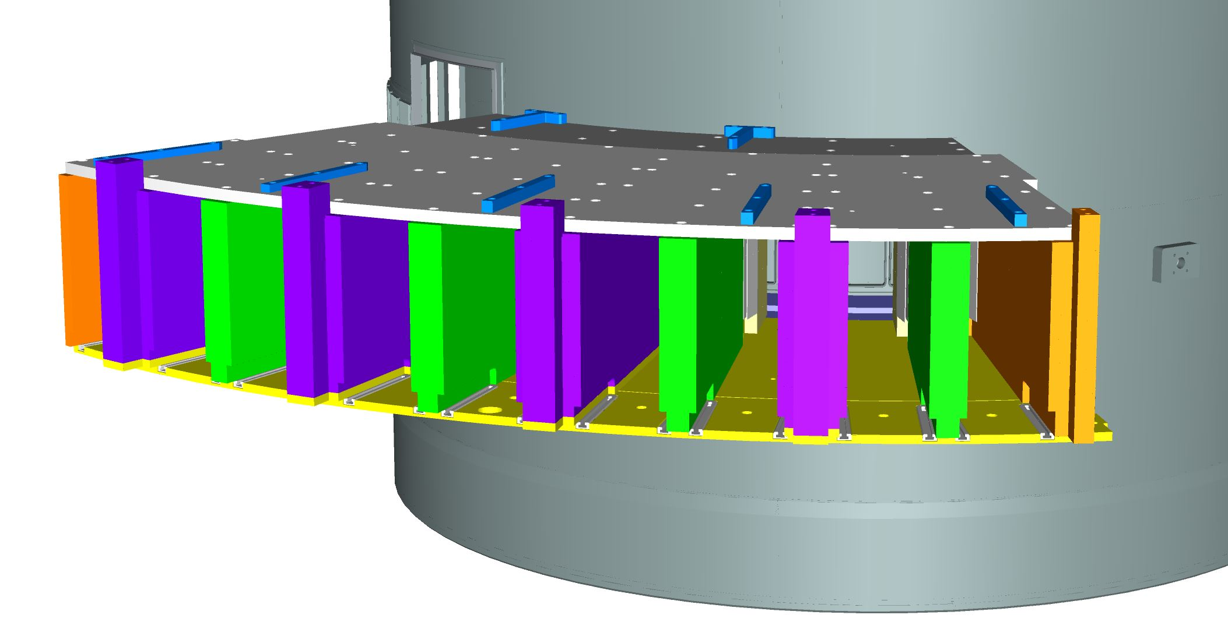
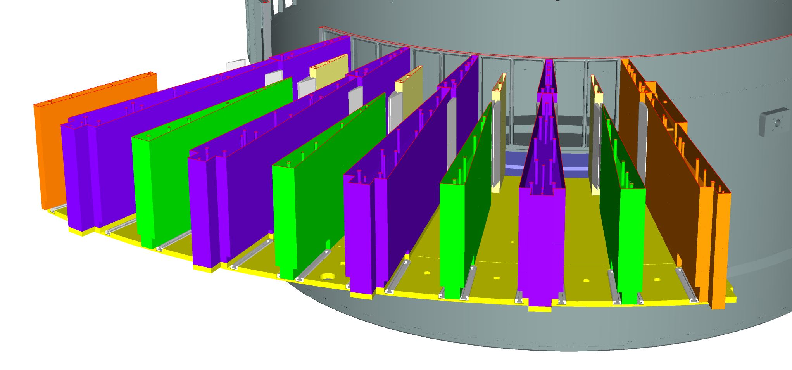
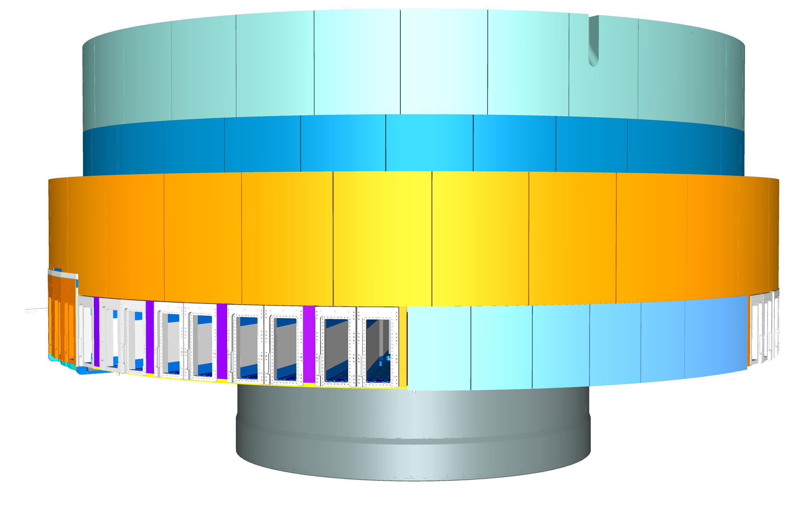
Spatial Interfaces Port Tubes
Outside – 2 Fill-in shielding
Horizontal Section views of the shielding wedges
Steel wedges for shielding
Outer shielding Final

Slide 14
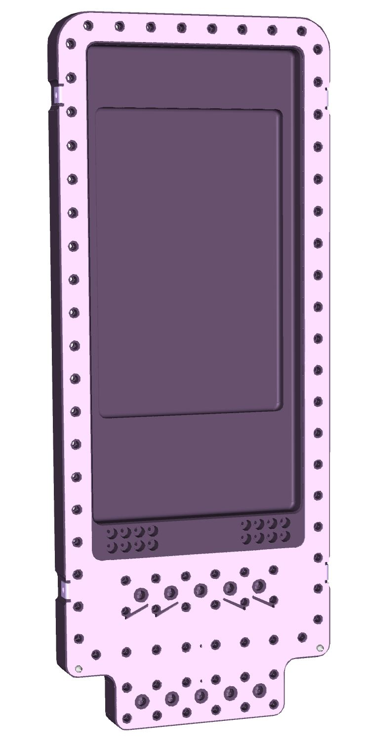
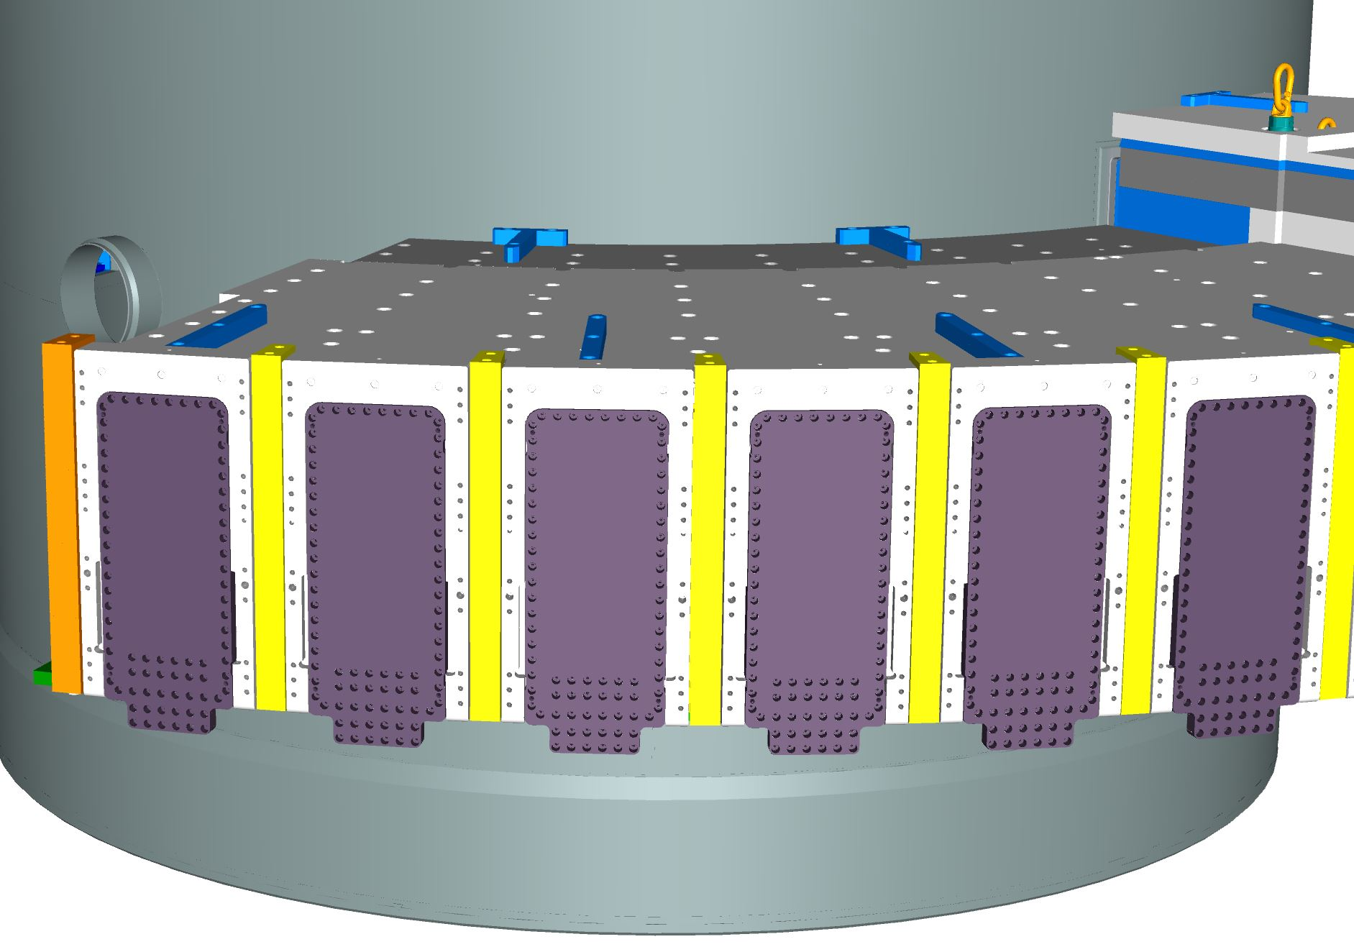
Spatial Interfaces Port Tubes
Outside – 3 Neutron Beam Windows
Neutron Beam Windows
- inside tube side -
Neutron Beam Windows screwed on port tubes

Slide 15
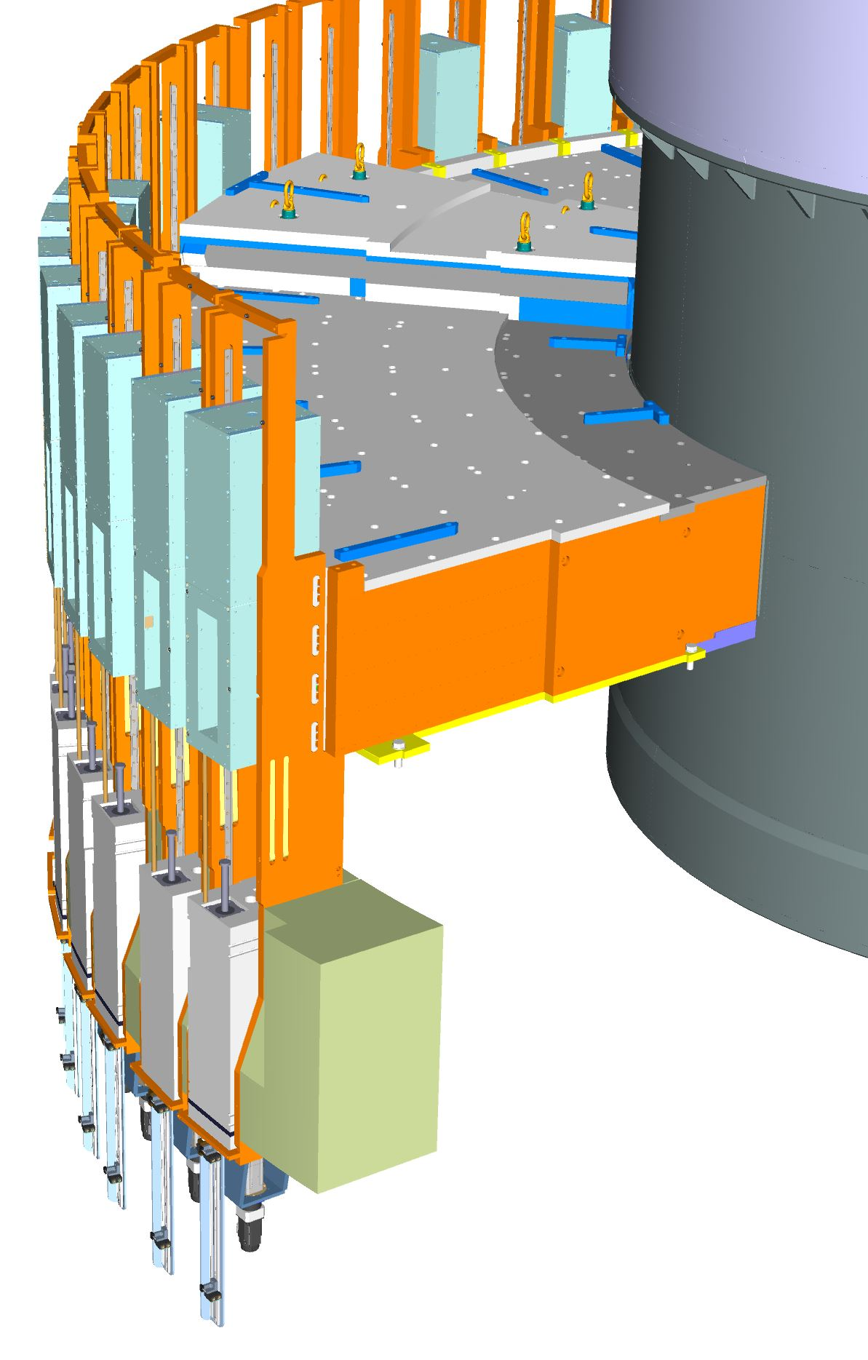
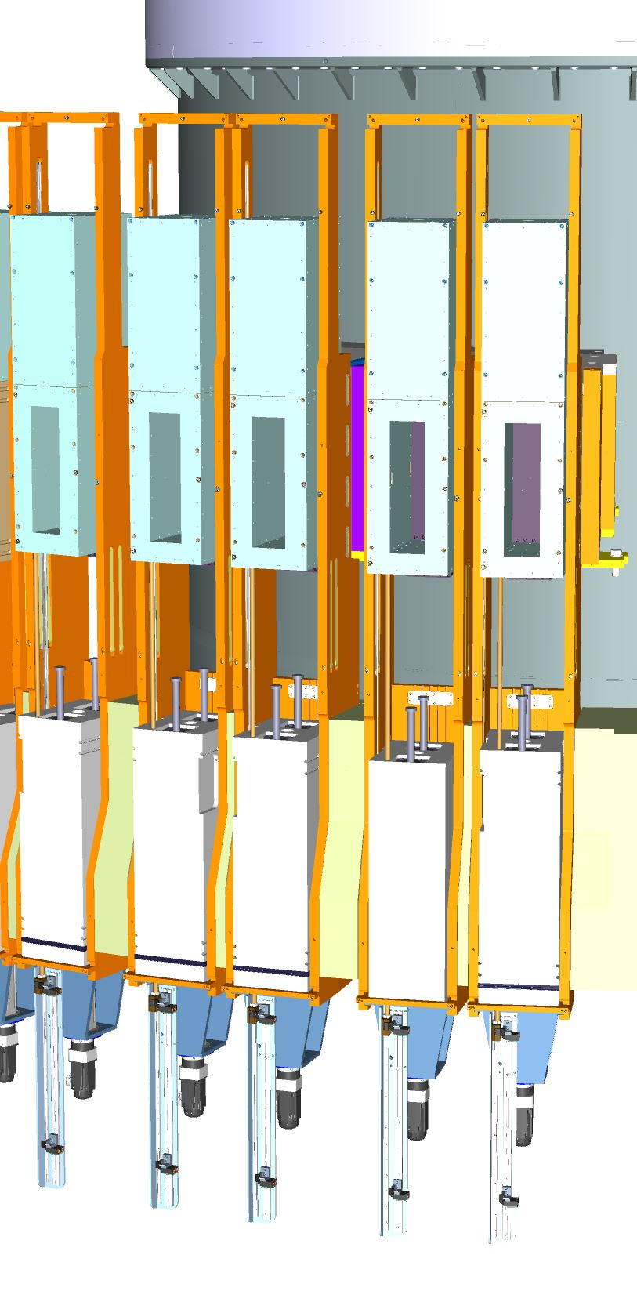
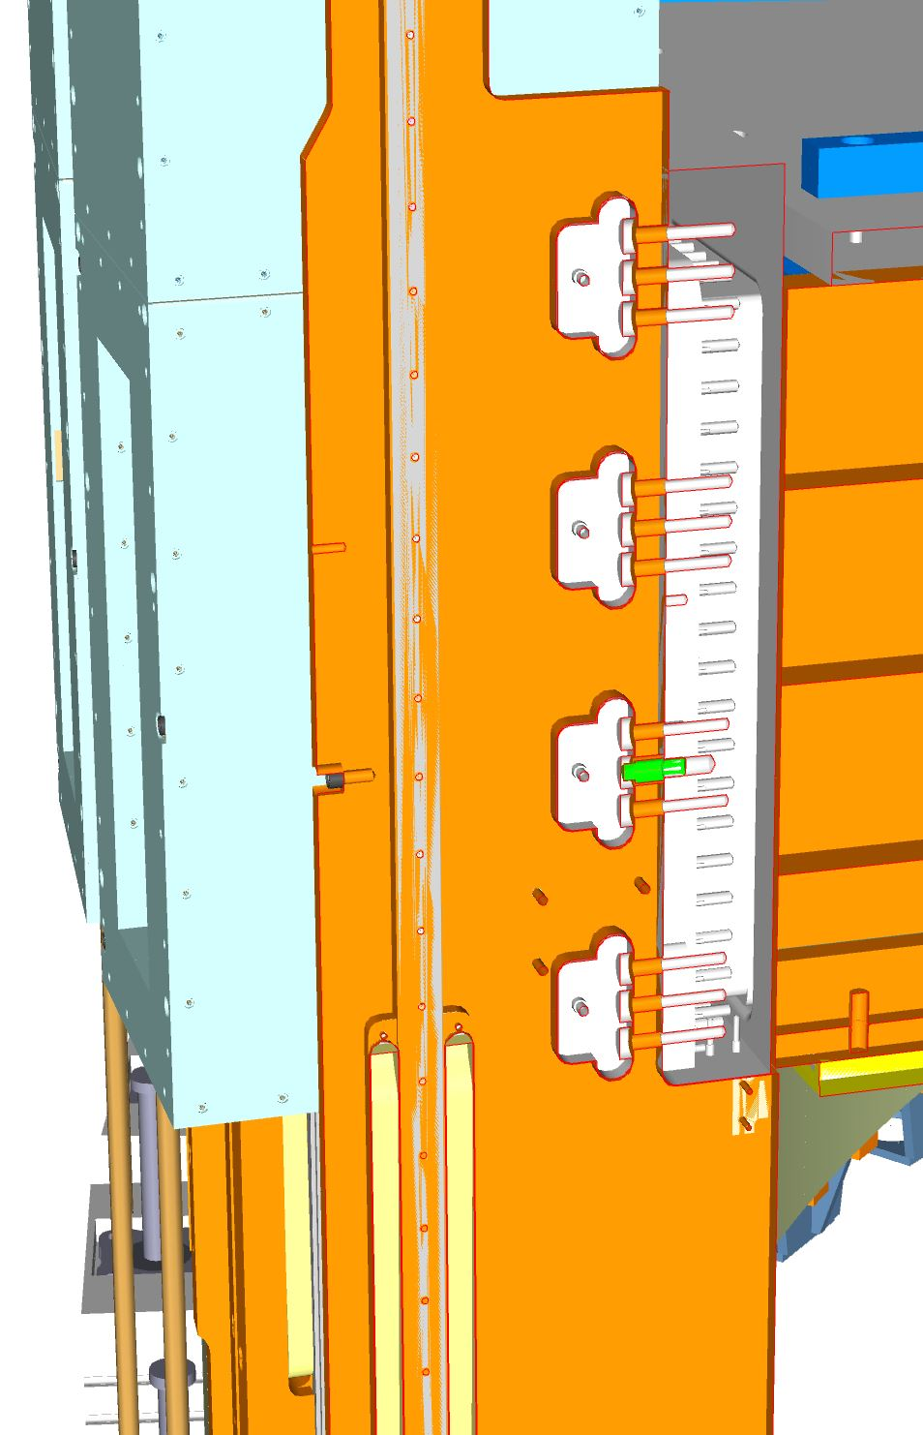
Spatial Interfaces Port Tubes
Outside – 4 Light Shutter System
Light Shutter System is screwed on Port tube flange
Centering Pin

Slide 16
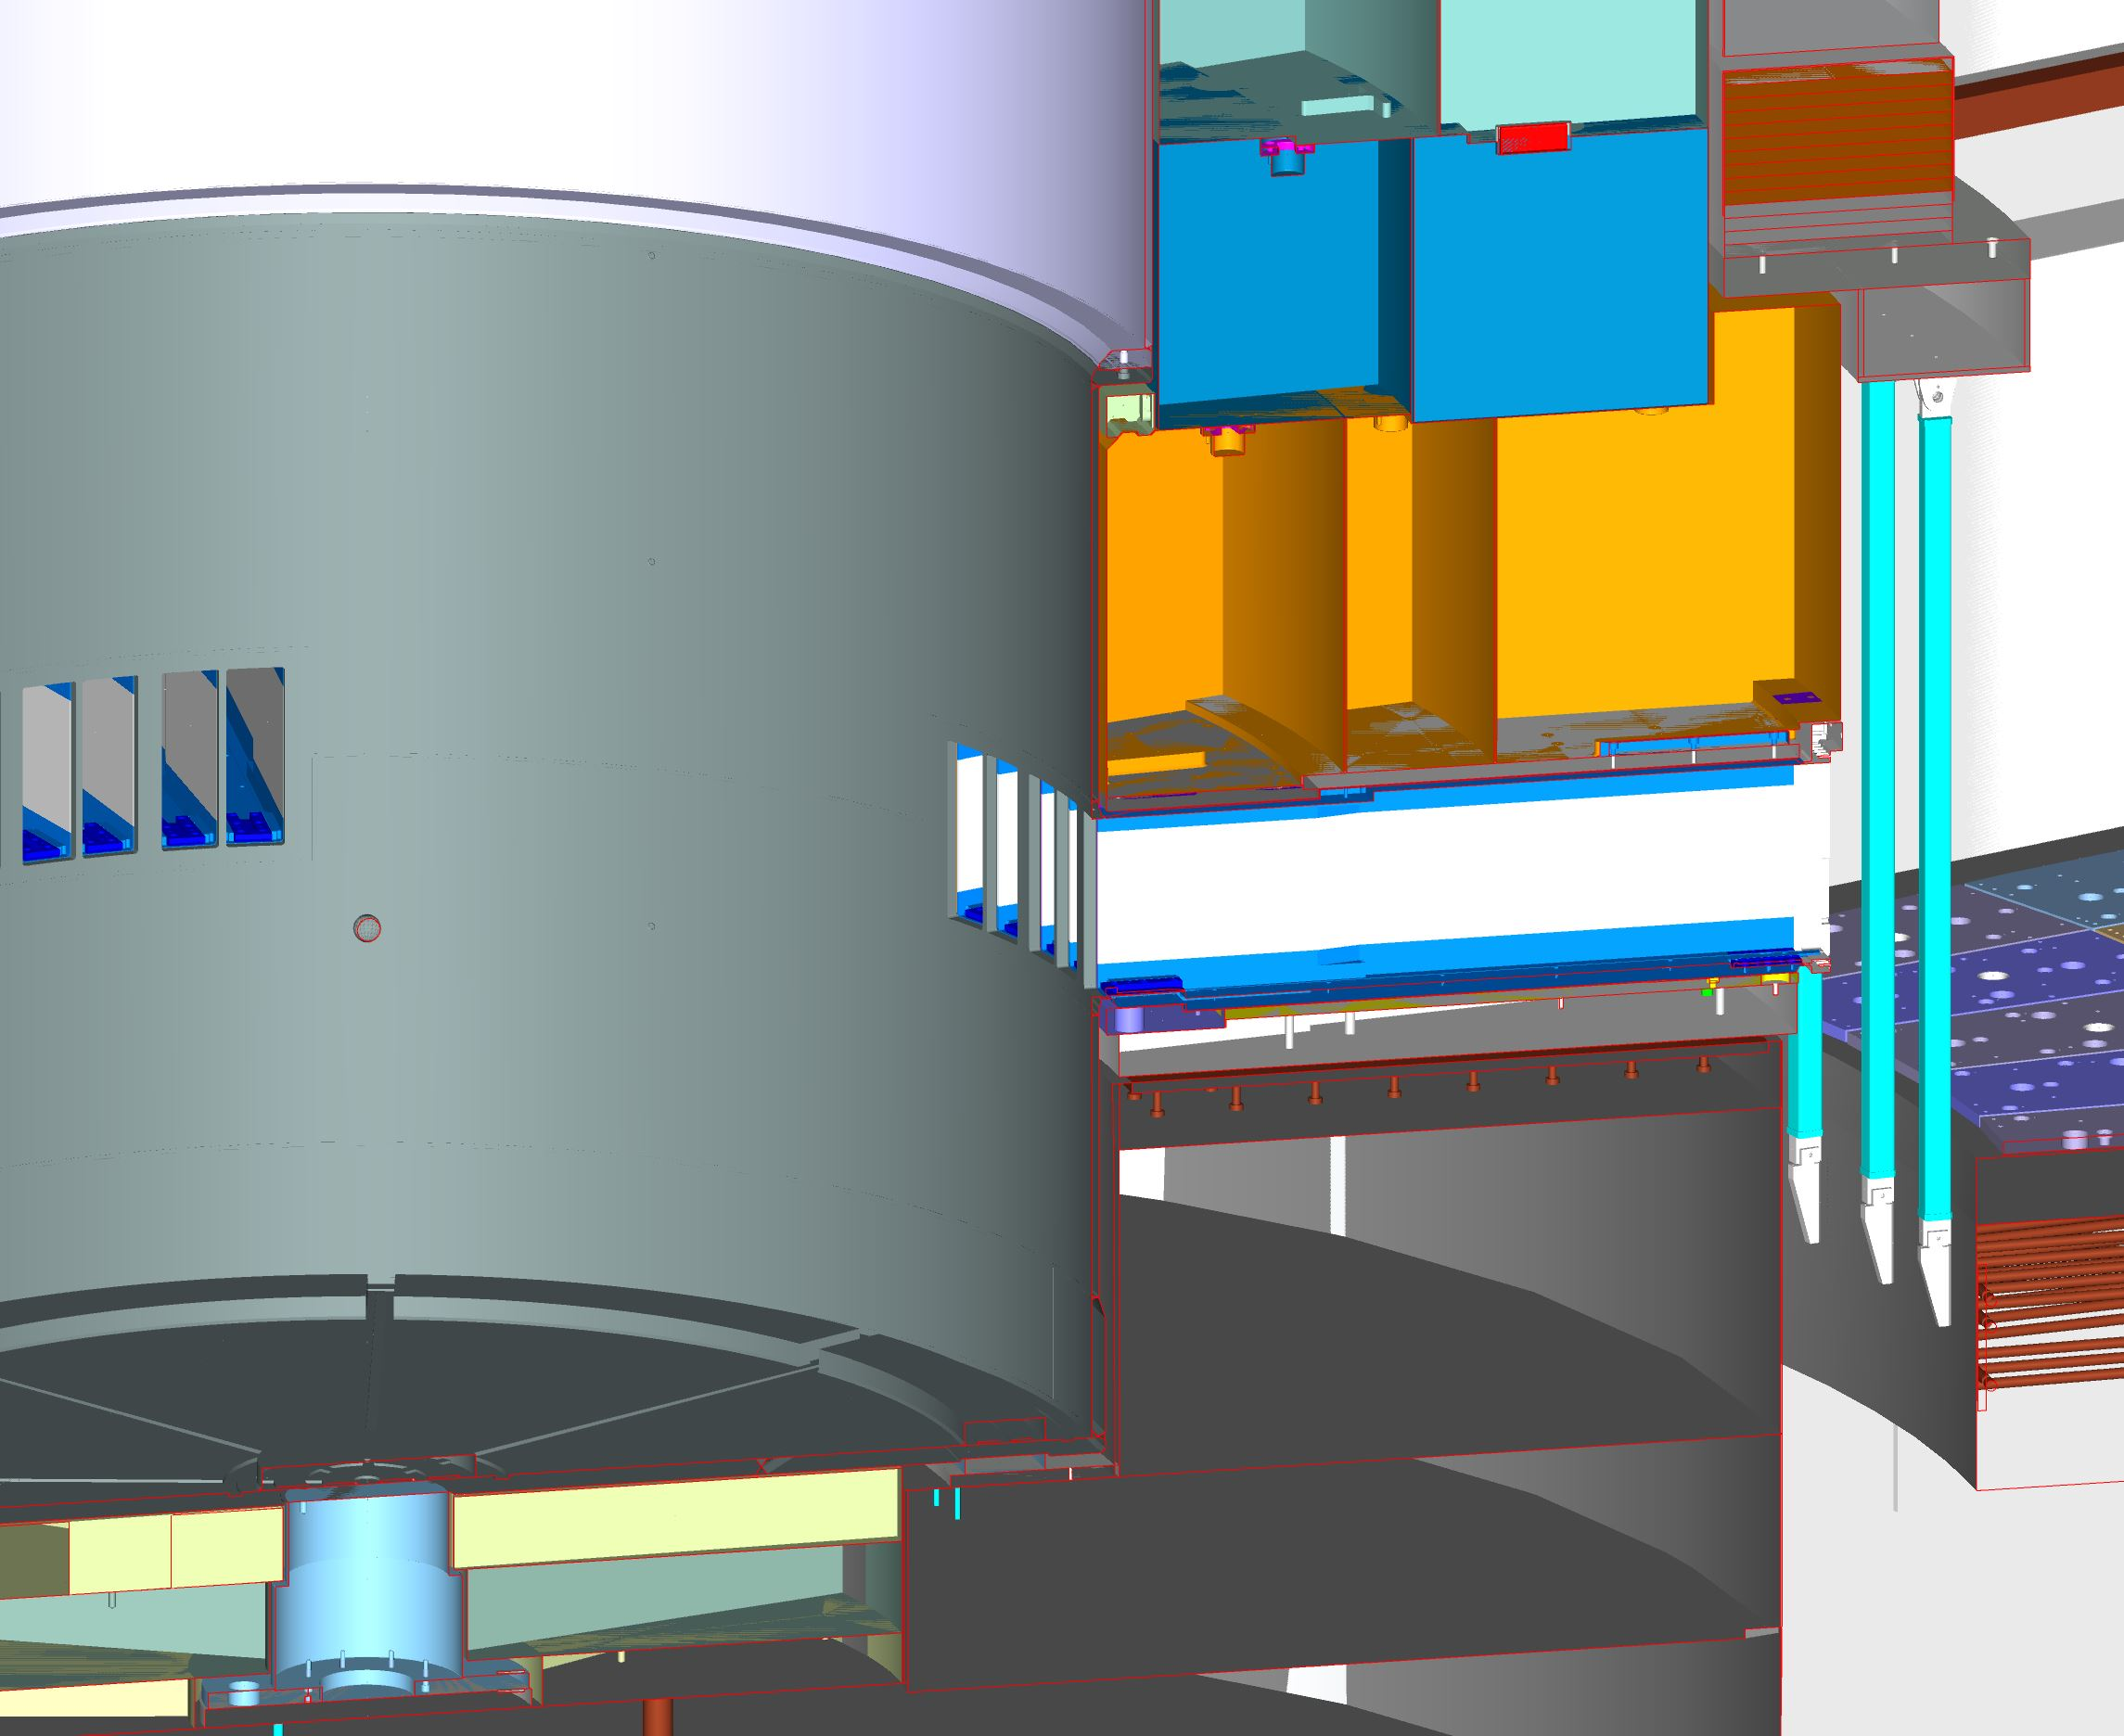
Spatial Interfaces Vessel
Outside
Outer Shielding
Port Tube
Bottom Plate
Base Plate
Concrete Puck
Vessel Supports

Slide 17
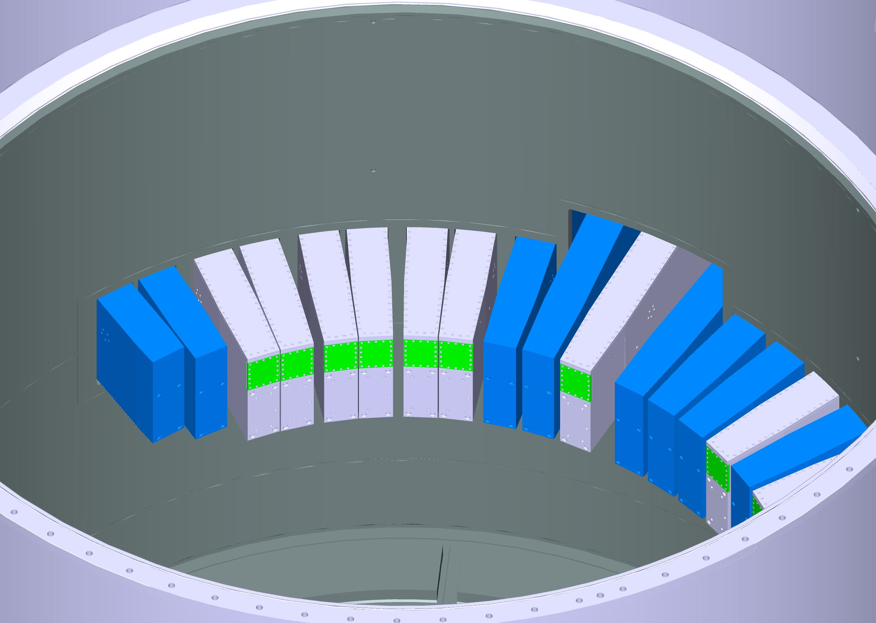
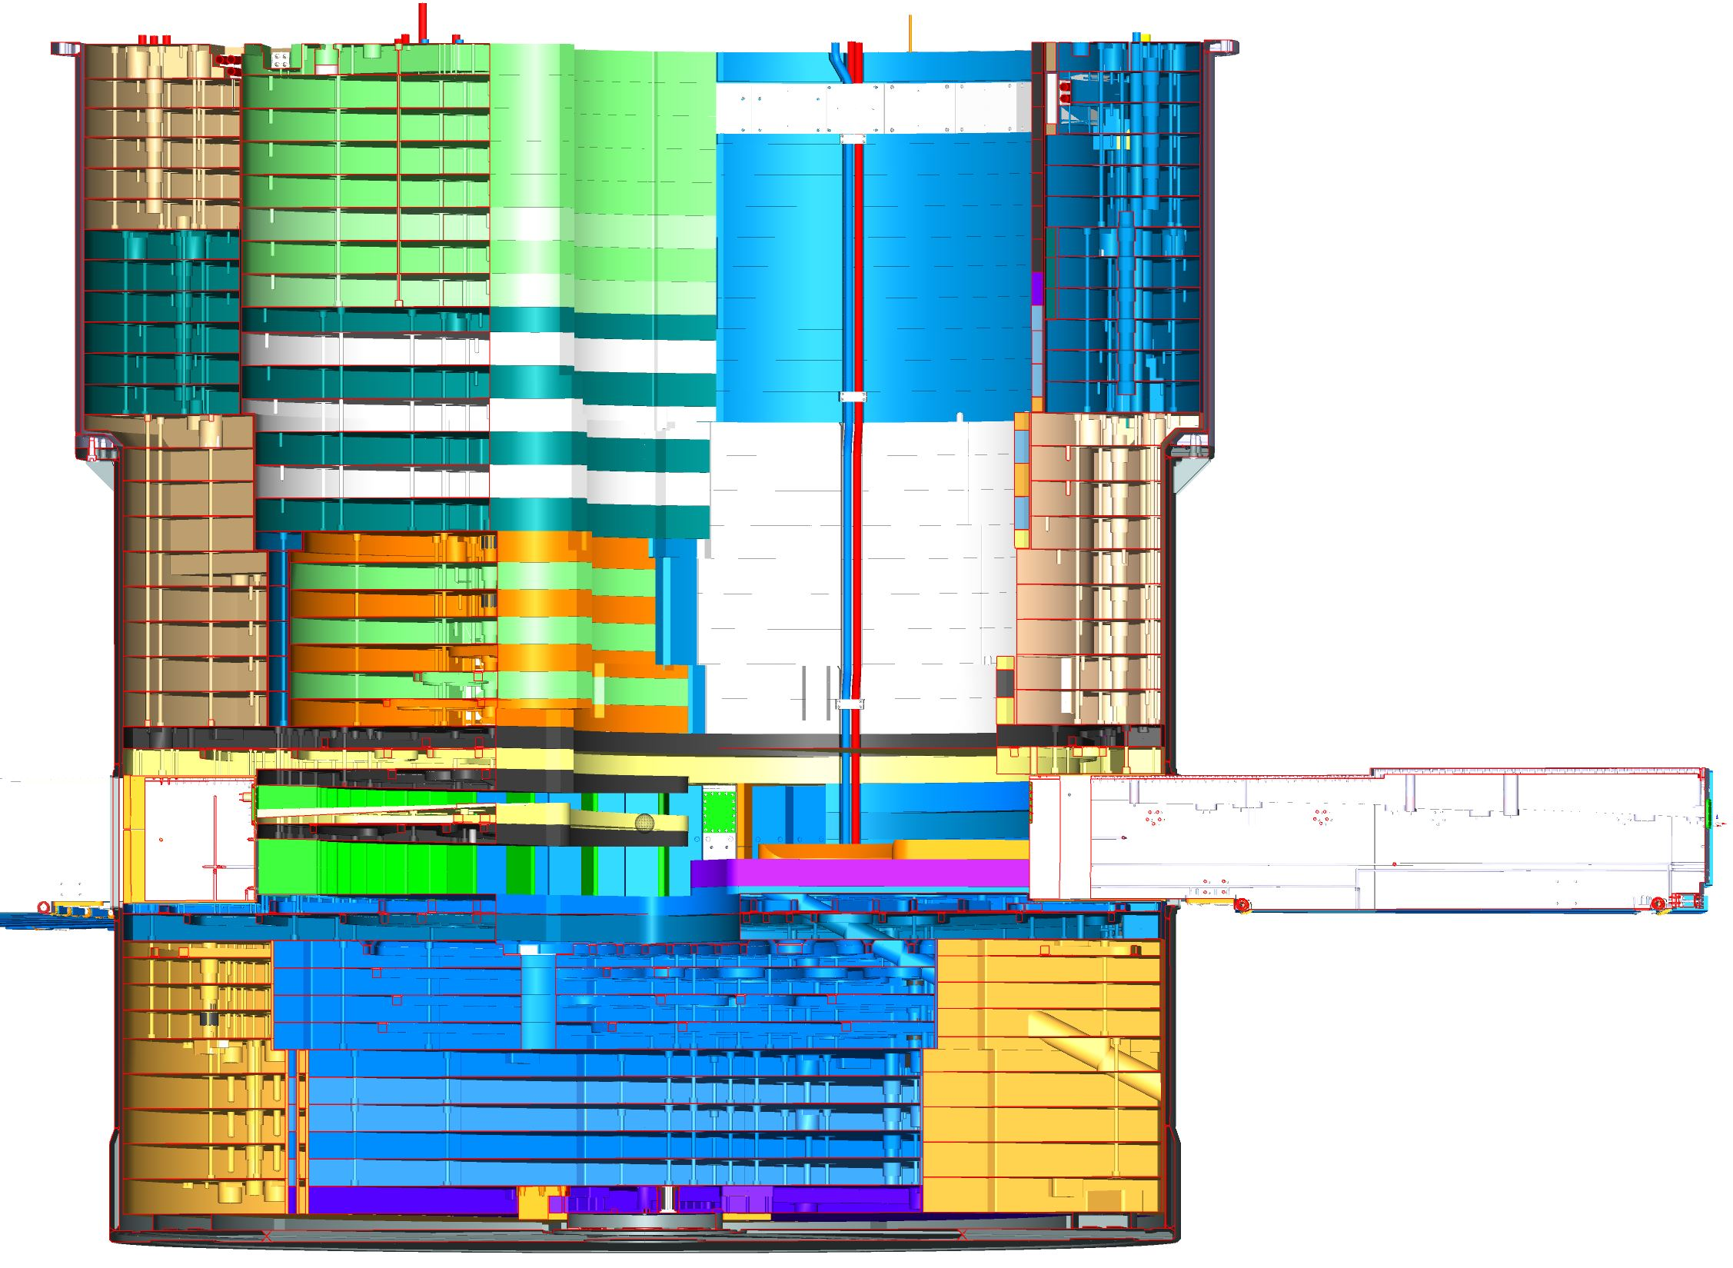
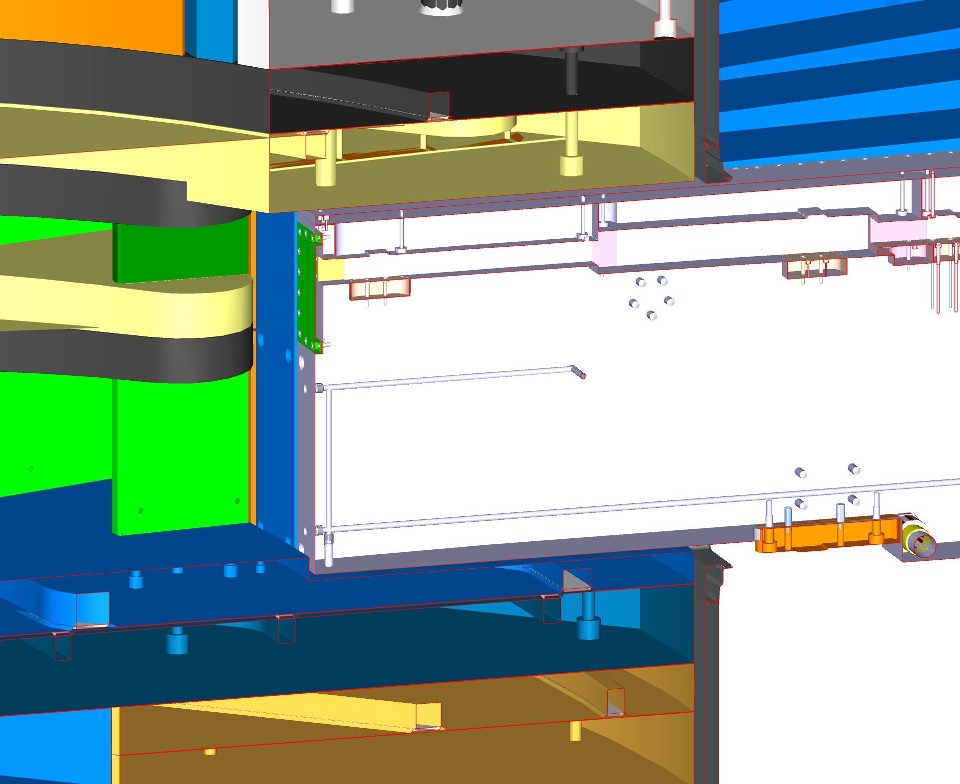
Spatial Interfaces Vessel
Inside
All NBPI inside Vessel
Section View
Vessel – Inner Shielding - NBPI

Slide 18
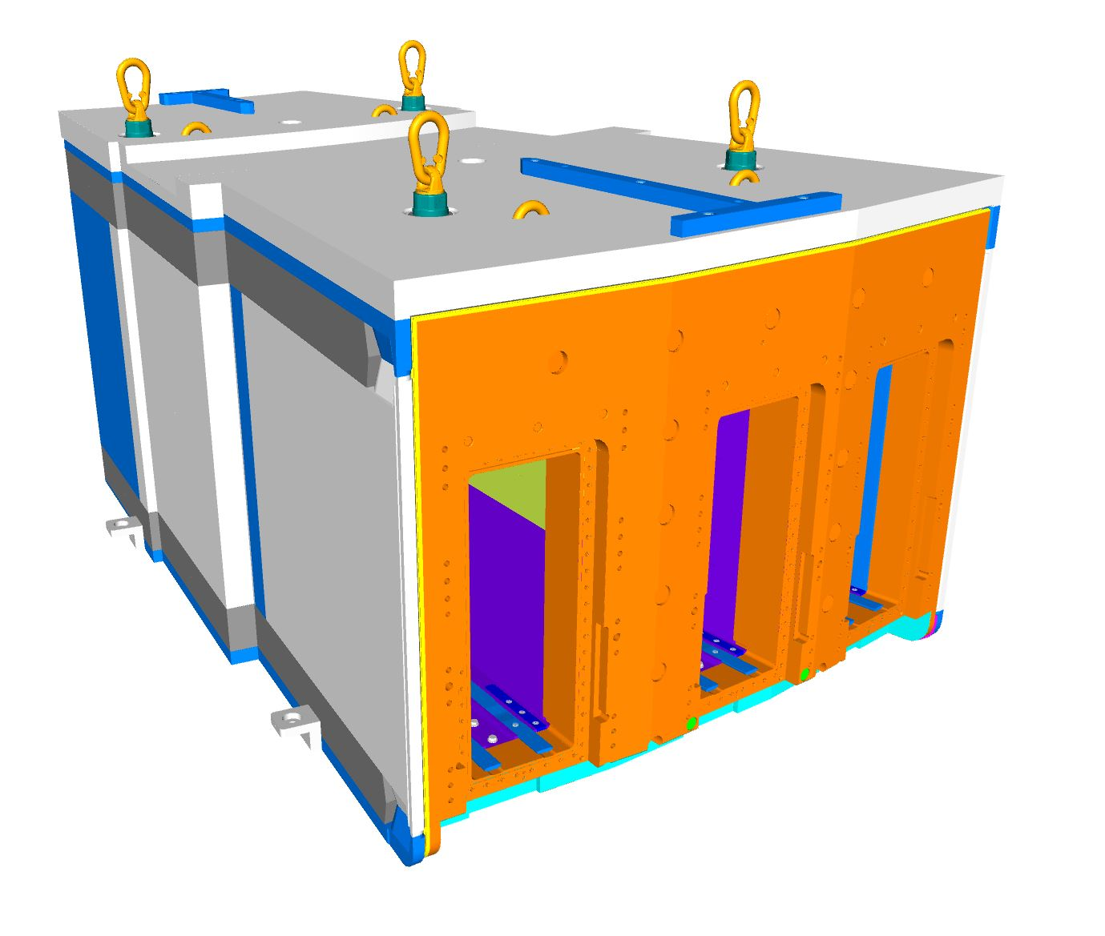
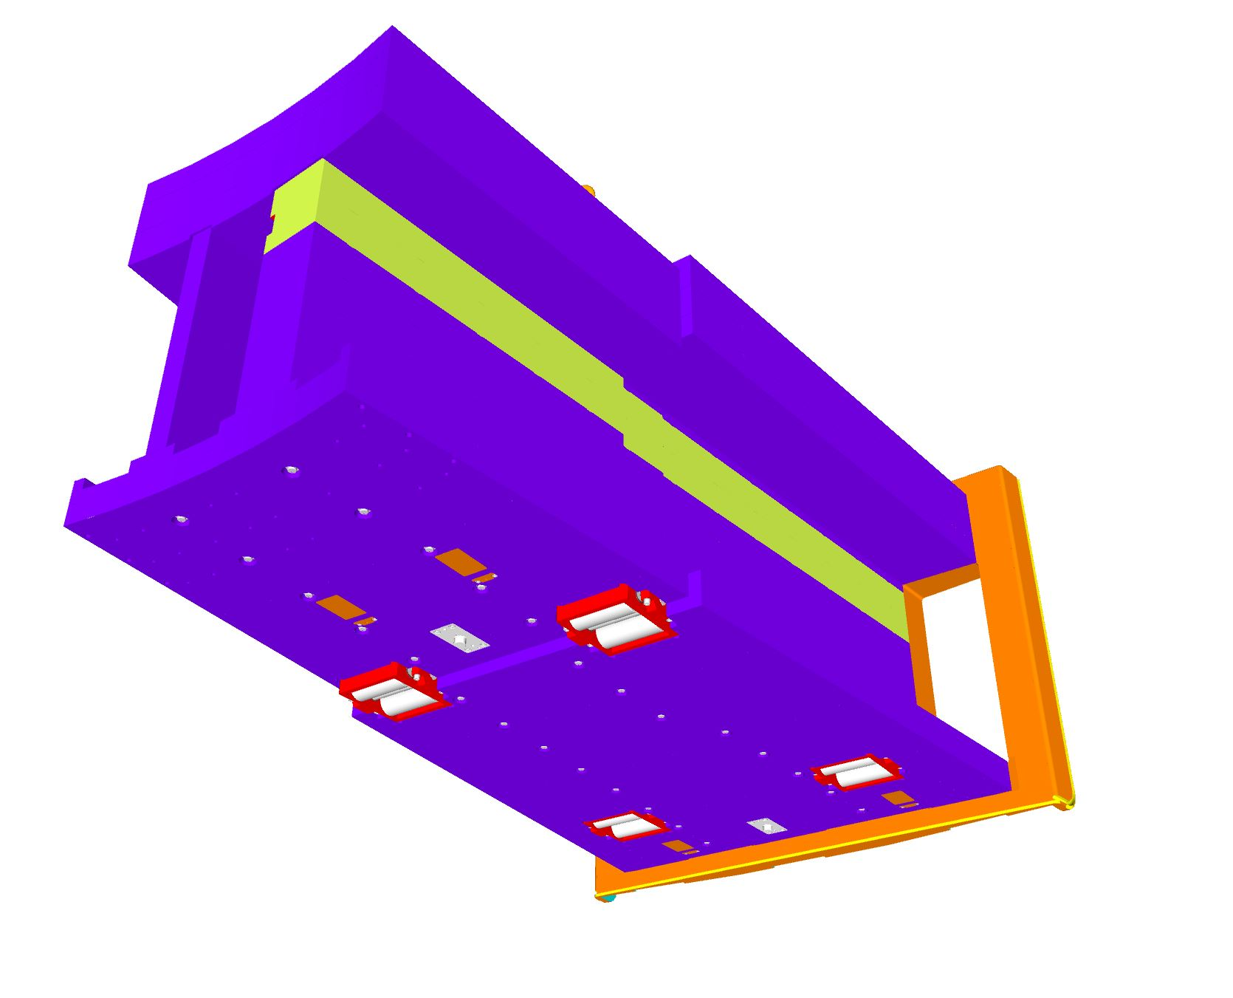
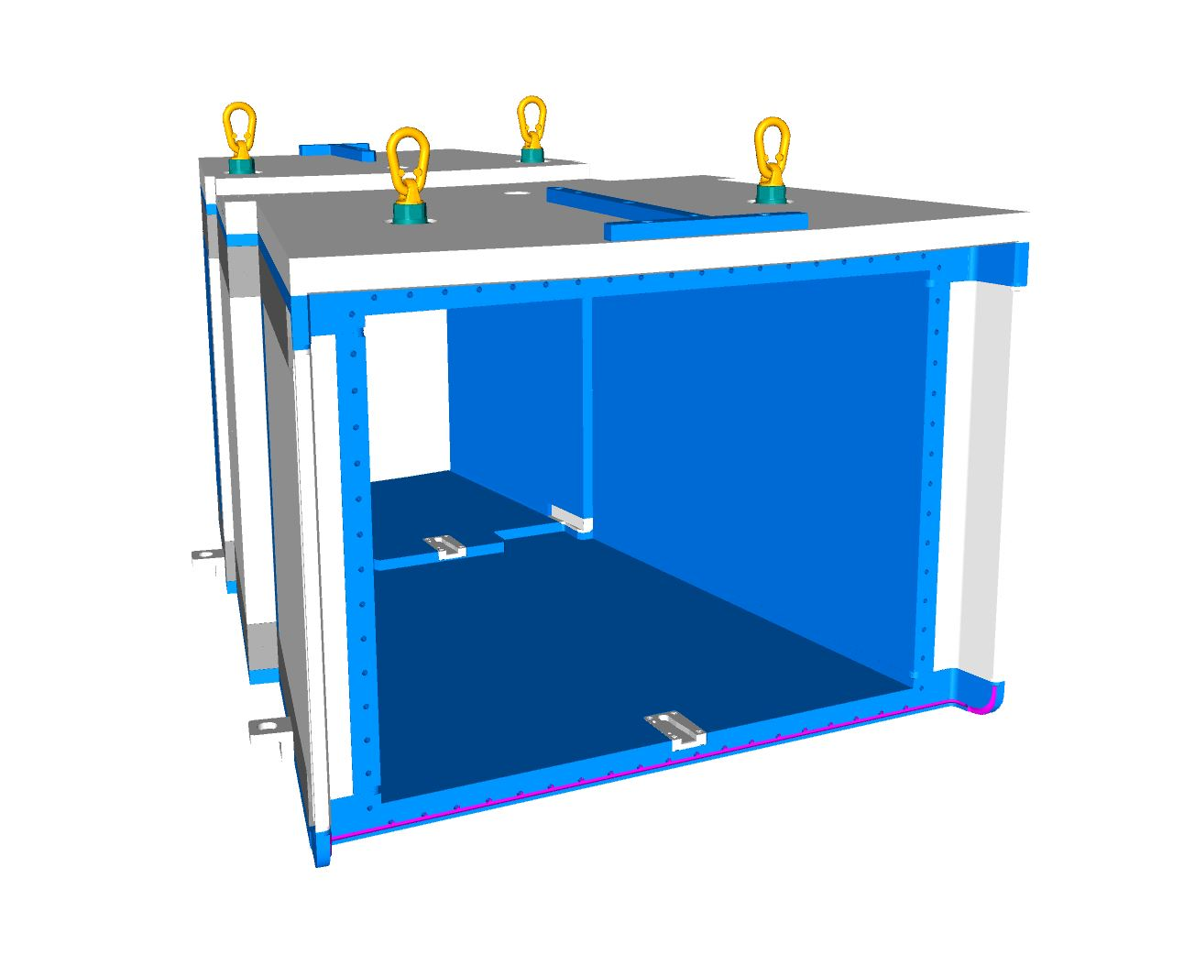
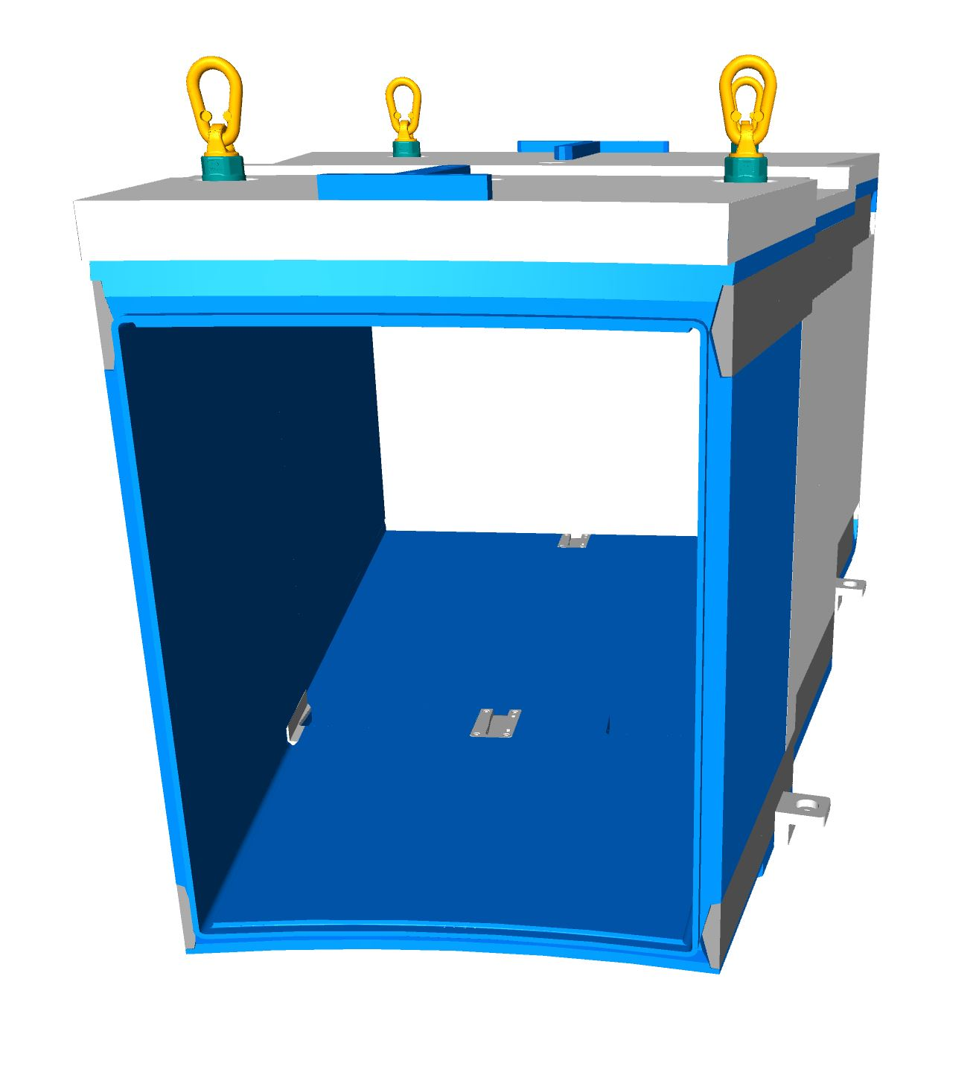
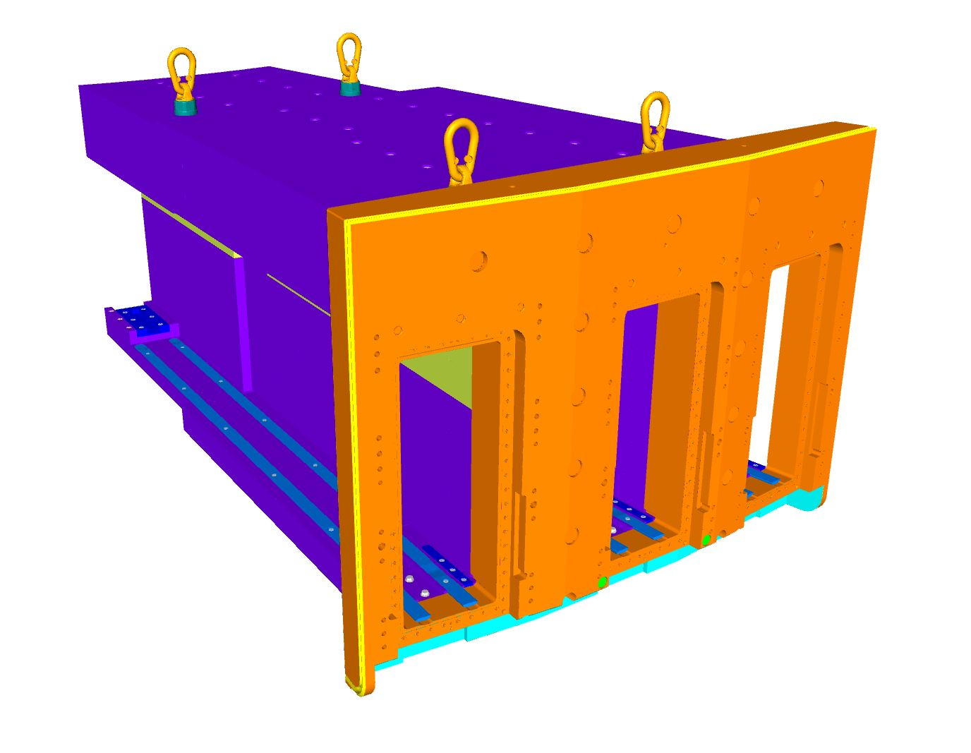
NnBAR
NnBar Assembly
Specific constraints
- Weight: 11+17 = 28 T
- Frame standing on baseplate prior welding
NnBar Frame
NnBar Extraction Adapter

Slide 19
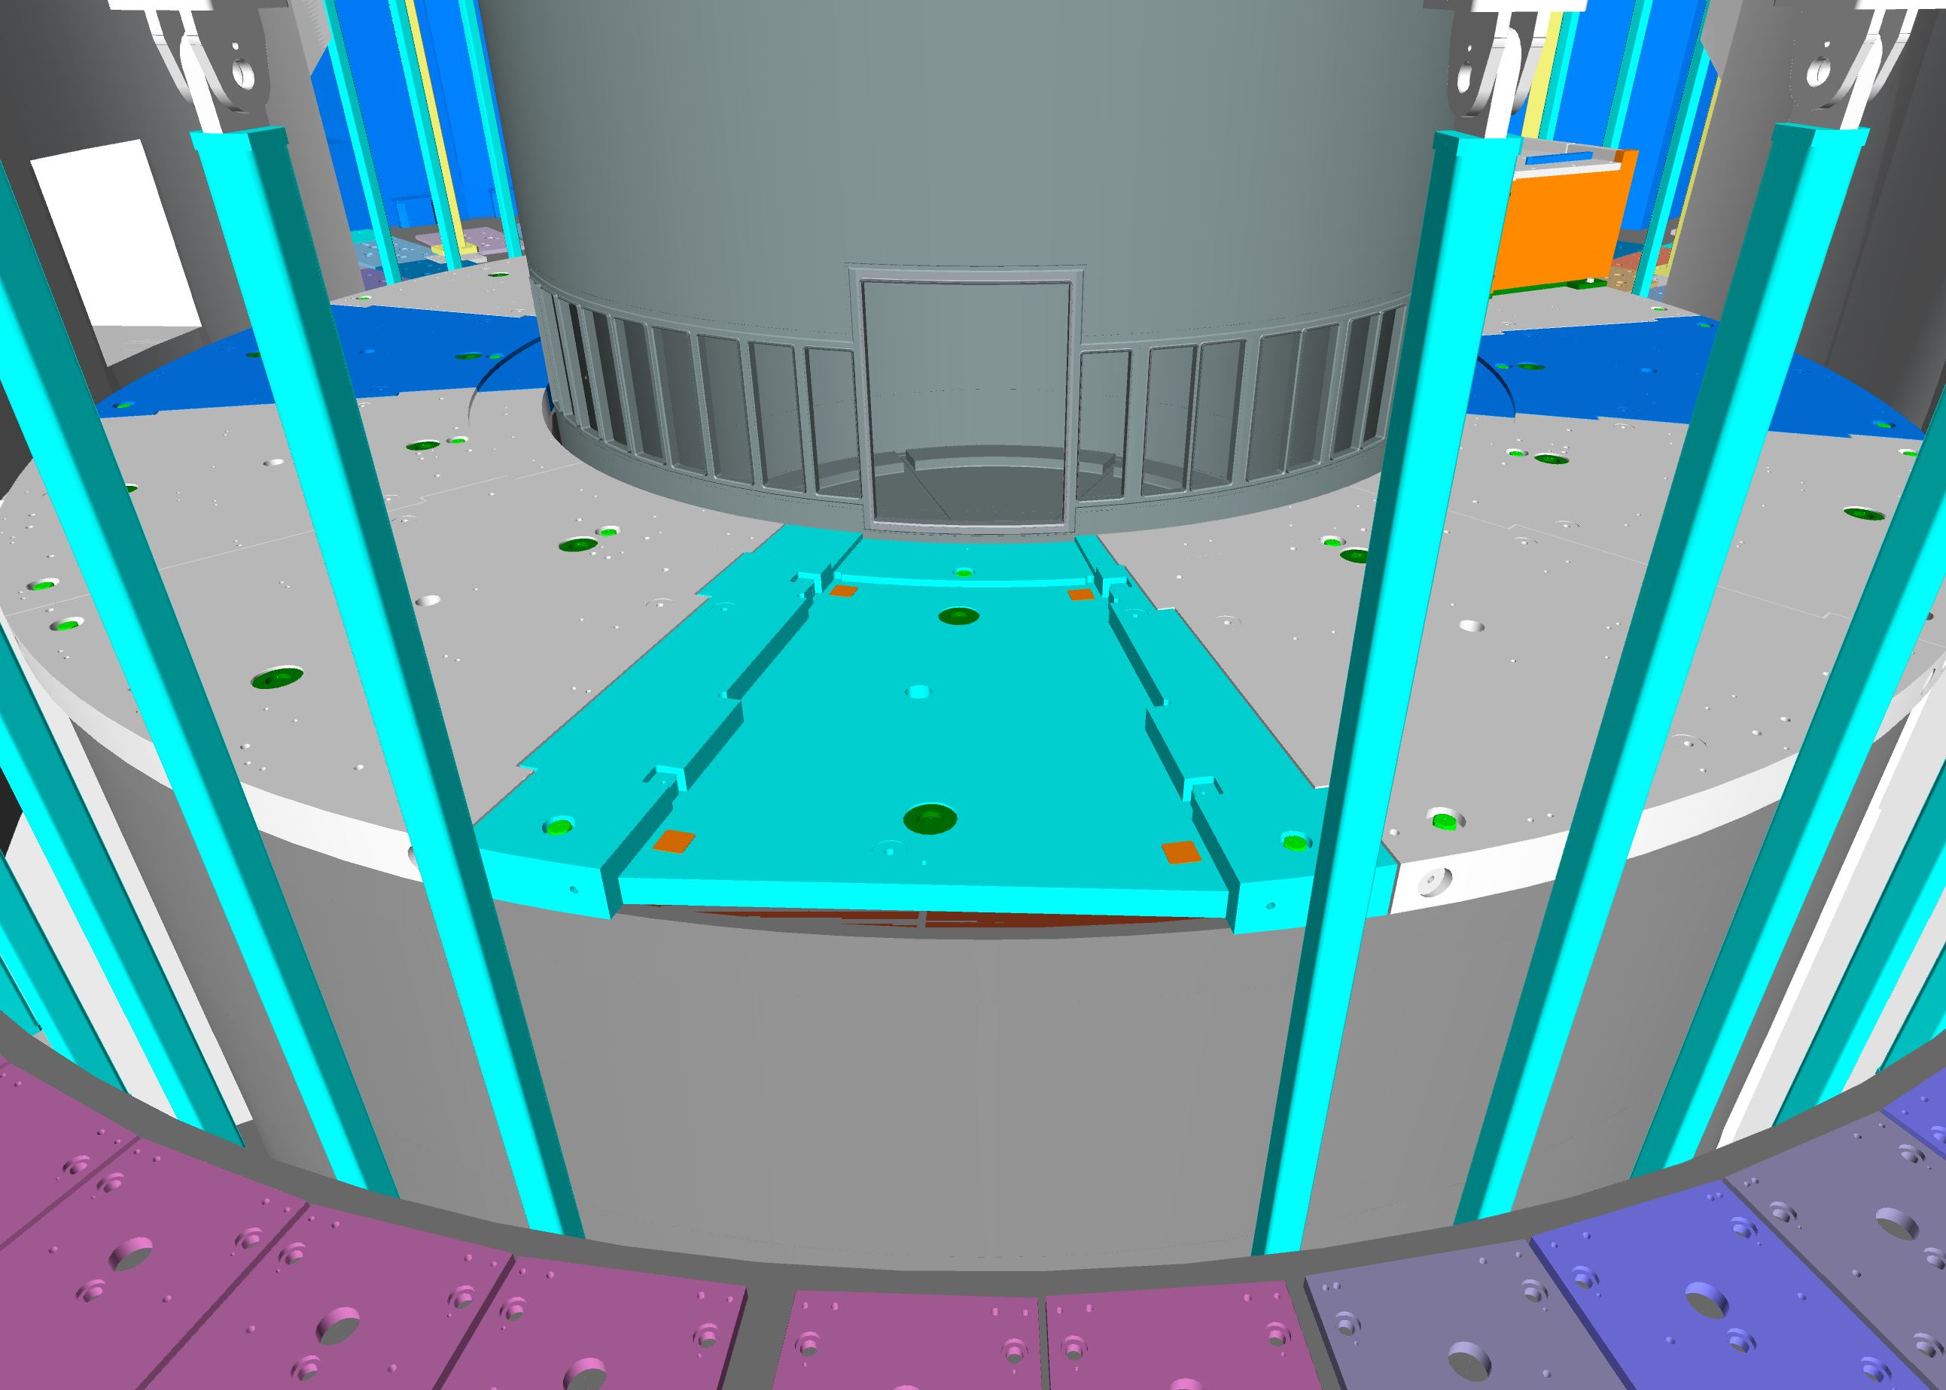
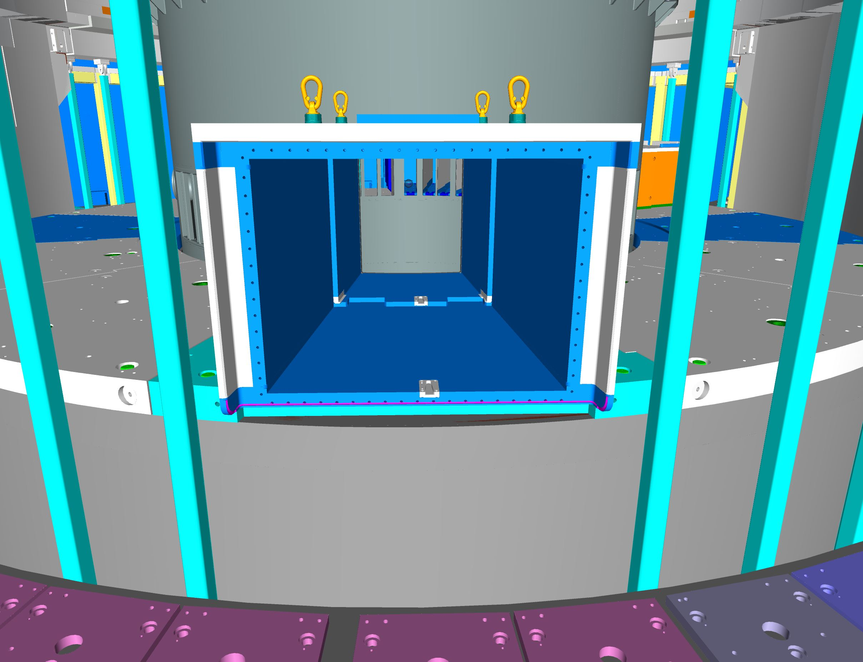
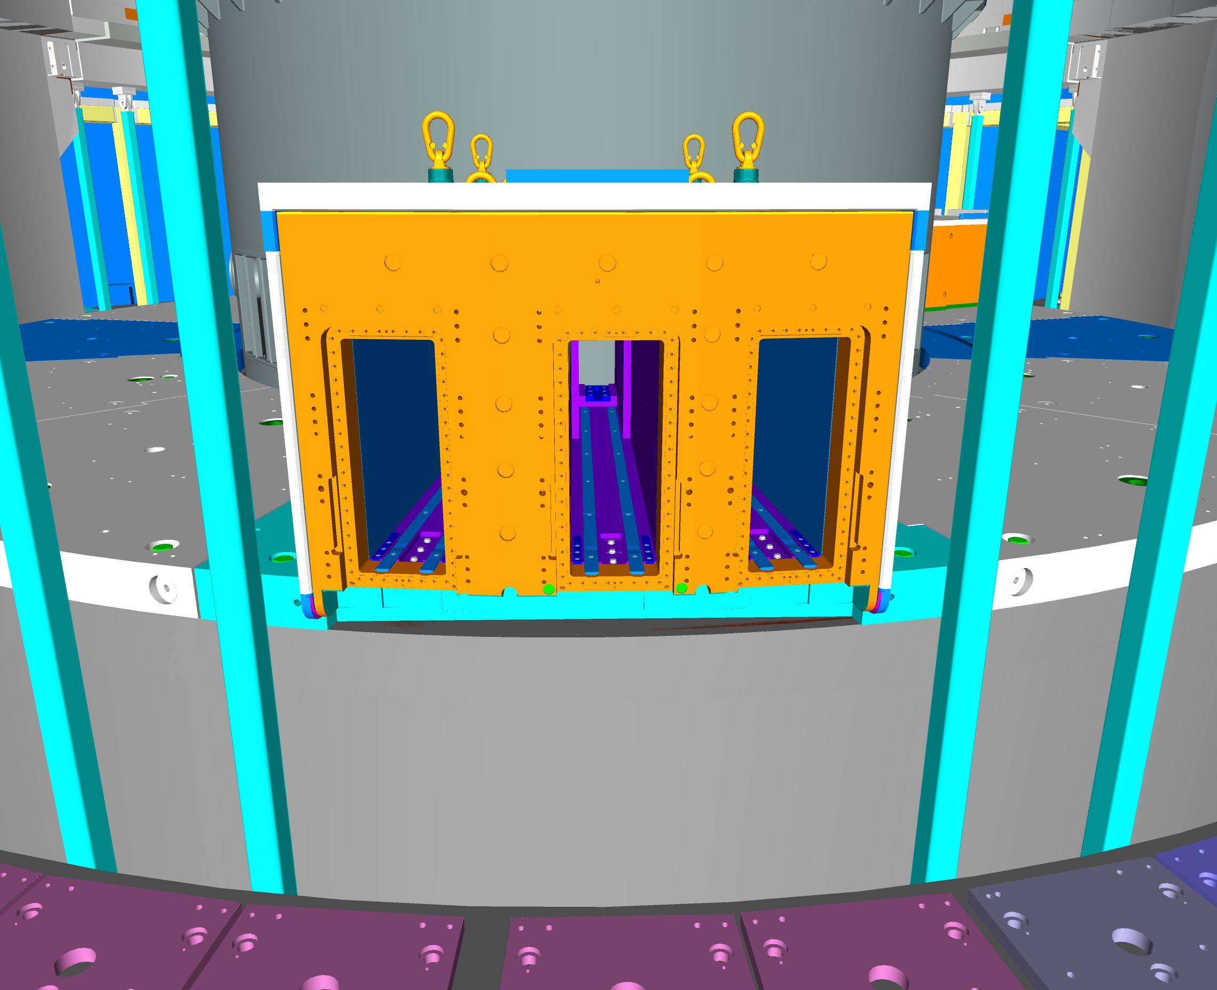
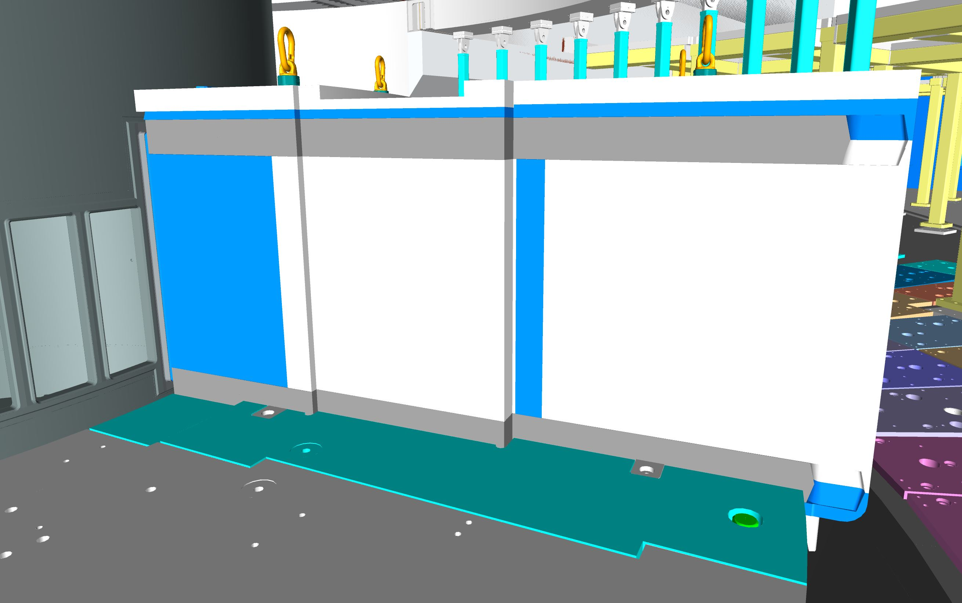
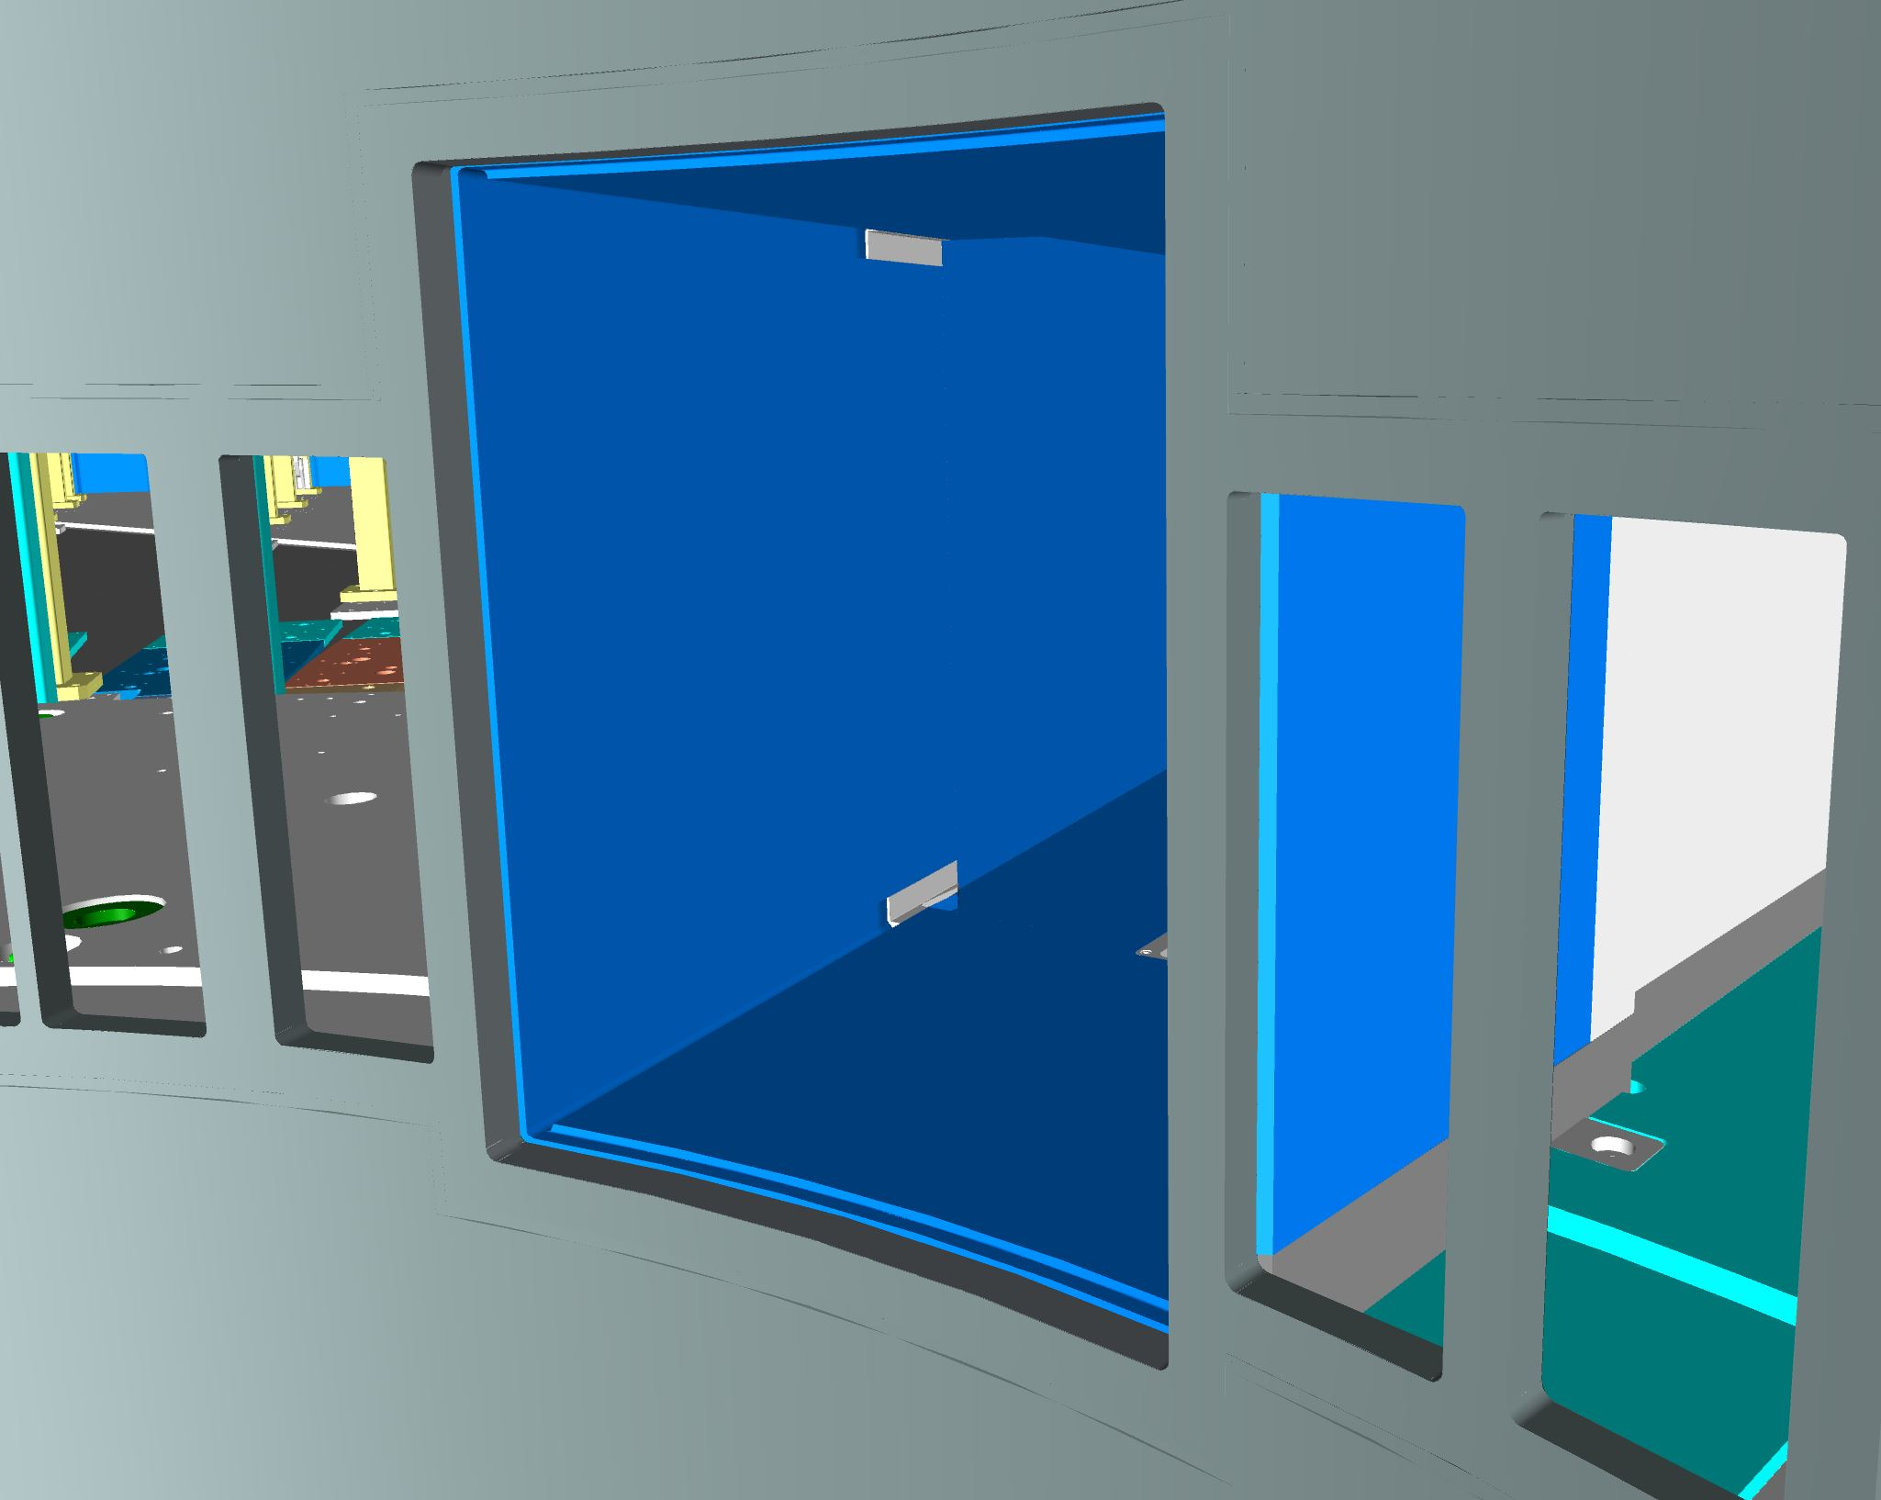
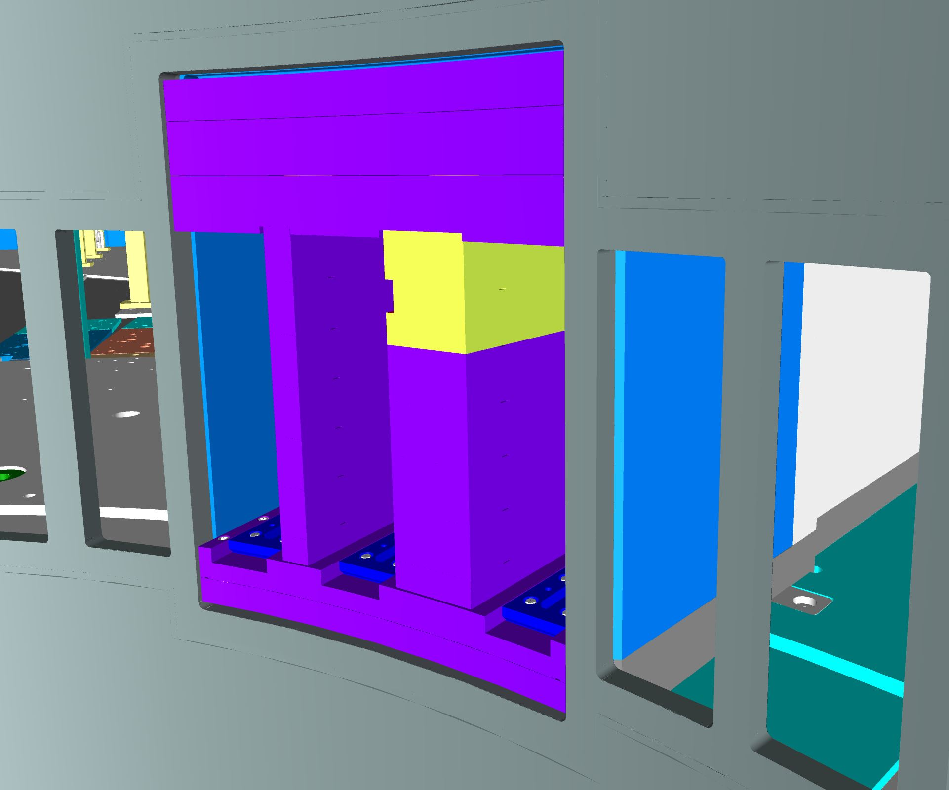
NnBAR
Baseplate bellow NnBar
NnBar Frame in place
Frame and Extraction Adapter
Possible fixation Frame to Base Plate
Inside vessel views : Frame and Adapter

Slide 20
Transportation
Route inside D02 Building
D02 Section View
Possible routes for Transportation in D02 : Tubes and NnBAR

Slide 21
Transportation
D02 Section Views
Naviswork – 3D model
TRUVIEW – 3D scan

Slide 22
Alignment Set-up
2
Laser tracking technology
AT 960 + T probe + Metrology Stand
Alignment network available:
1
- On concrete walls around the vessel
- On the top of base plate
- Fiducial inside vessel (may be subject to deformations of the vessel)
- 2 stationing
- Initially only position 1 ( possible extra check with position 2 )
- When port tube installation advance , no more visual to network from inside vessel
Need of position 2

Slide 23
Alignment Set-up
Position 1 : inside vessel
Network measurement
On vessel fiducials
On top of base plate references

Slide 24
Alignment Set-up
Position 2 : outside R6 Pillars
Network measurement
On Alignment Network ( concrete walls)
On top of base plate references

Slide 25
Conclusion
Port tubes are critical elements for the positioning of the neutron optics .
Port tubes and Vessel have several spatial interfaces : direct contact or millimeter clearances
NnBar specificities have been presented.
Transport route is well established
Alignment strategy is in place.

Slide 26
Work location
Bottomplates missing on pictures

Slide 27
Finish presentation

