Slide 1
3
Mechanical design.
Robert Svensson
Work Unit Lead for Neutron Beam Port Blocks,
Monolith systems, Target Division

Slide 2
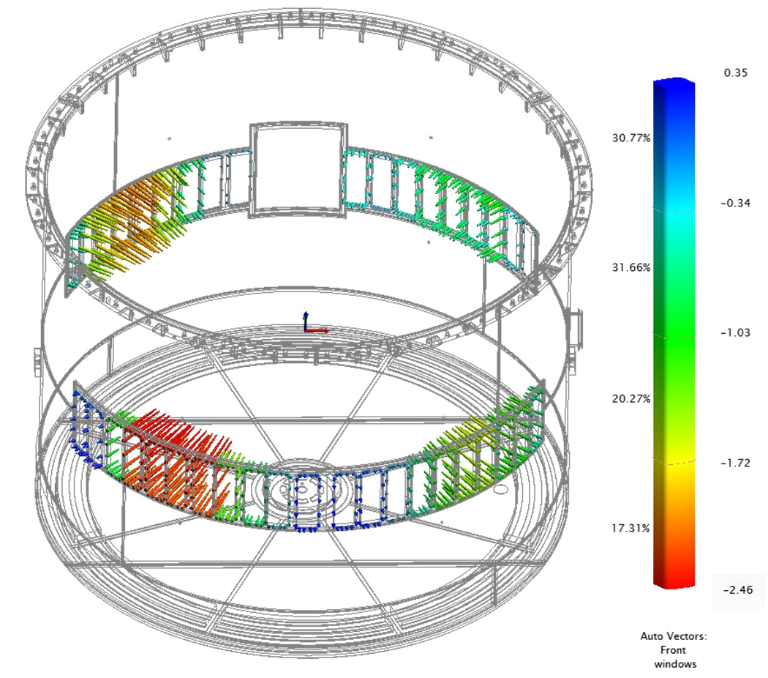
Potential deformation of vessel main cylinder during welding
Background:
In 2020, AVS highlighted that there is a risk that the vessel will deform when the port tubes are welded.
To simulate this is not easy as the current amount of un-relieved stress is unknown.
Measurement of the vessel after final machining.
Vector from nominal to measured.
Mitigation:
New design of the Neutron Beam Windows
Allow shimming of the LSS
Extra clearance must be added between the port tube and bottom plate step to avoid a collision even if we are out of the worst case scenario.
mm

Slide 3
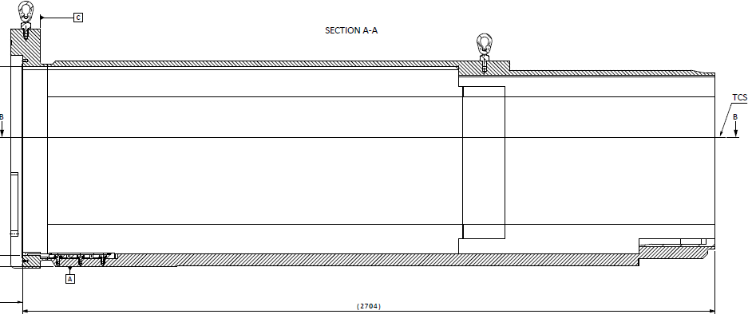
X-position of the port tube
Background:
The interface between the port tube and the Neutron Beam Window / Light Shutter System was earlier stated to be within +/- 1mm. However, the stack-up ends up in 0 to -10 mm.
Solution:
A new design of the NBW to allow it to compensate for the port tube X-position.
Shim out the LSS to maintain its relation to NBW.
Benefit:
The instrument/NBW/LSS will be positioned
at nominal in X-direction.
Shim to LSS frame.
New window design.
Insert to be located at nominal position.

Slide 4
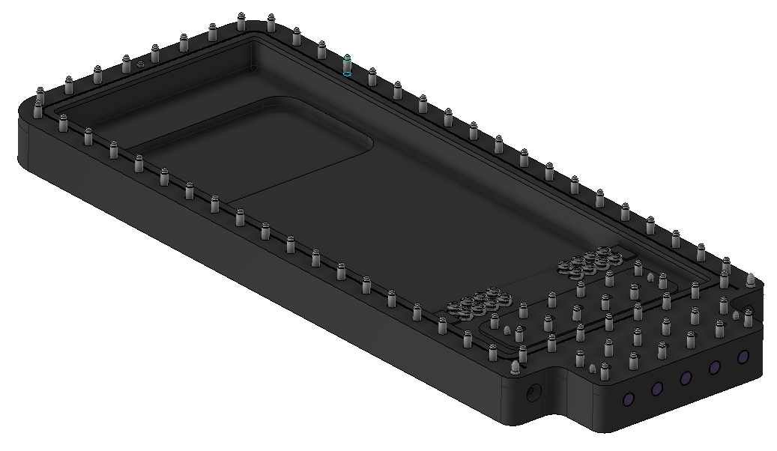
New NBW design
The thickness of the window where the beam passes will always be the same.
Thickness to be adapted to the tube’s final X-position.

Slide 5
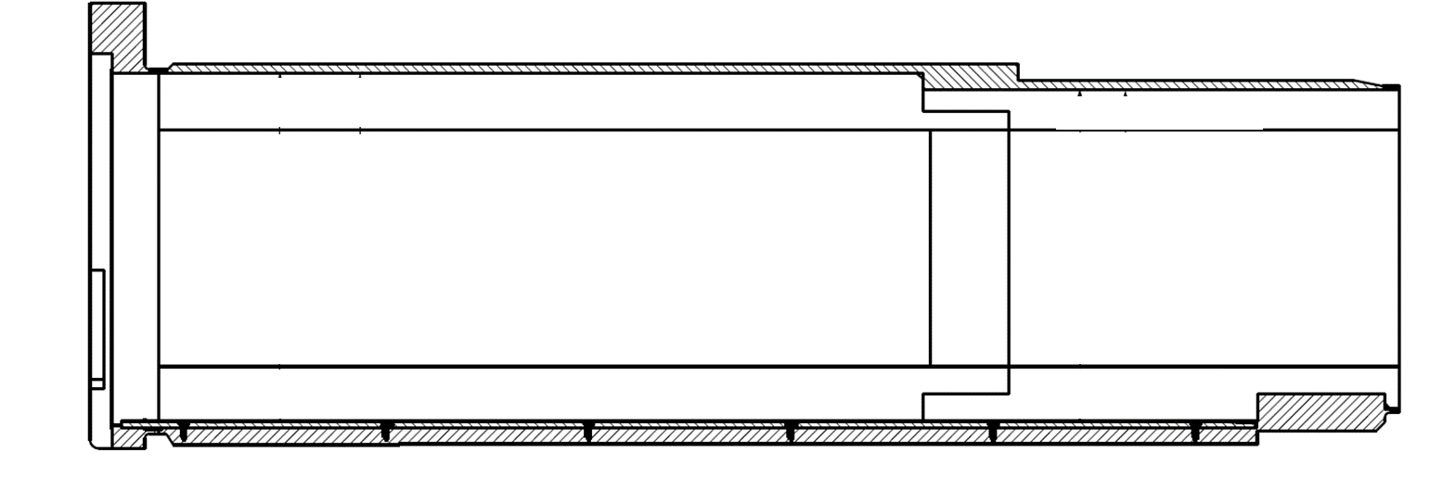
Tolerance stacking in X-direction (Radial)
As installed (welded)
Installation tolerance (welded) 0,0 -10,0 mm
Welding transverse shrinkage ± 1,5 Stated in the feasibility report to 3-6mm
Means 0 to -10 mm
Geometrical uncertainties ± 1,5 (Porttube lengths resolution) * (Monolith Vessel window frame position) (Pre-welding alignment alignment)
Vessel main cylinder deformation 0,0 -4,0
From ESS-3185128 Port tube Installation Drawing
0 -1 -2 -3 -4 -5 -6 -7 -8 -9 -10 (mm) BPCS-X
CAD nominal X 0 TCS R5500
BPCS-X Positive direction
* To compensate the position of the vessel windows there will be three different port tube lengths.

Slide 6
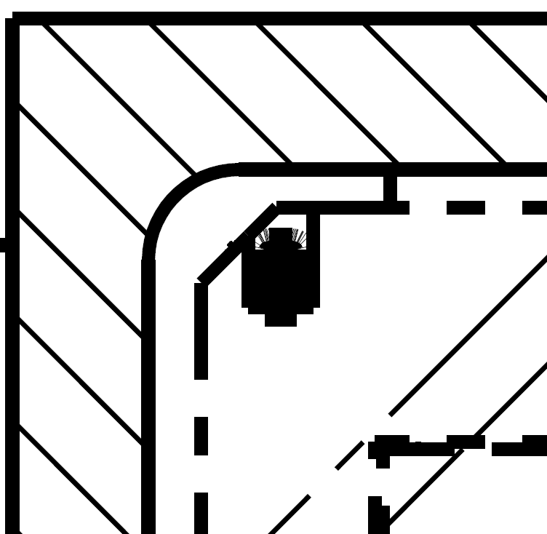
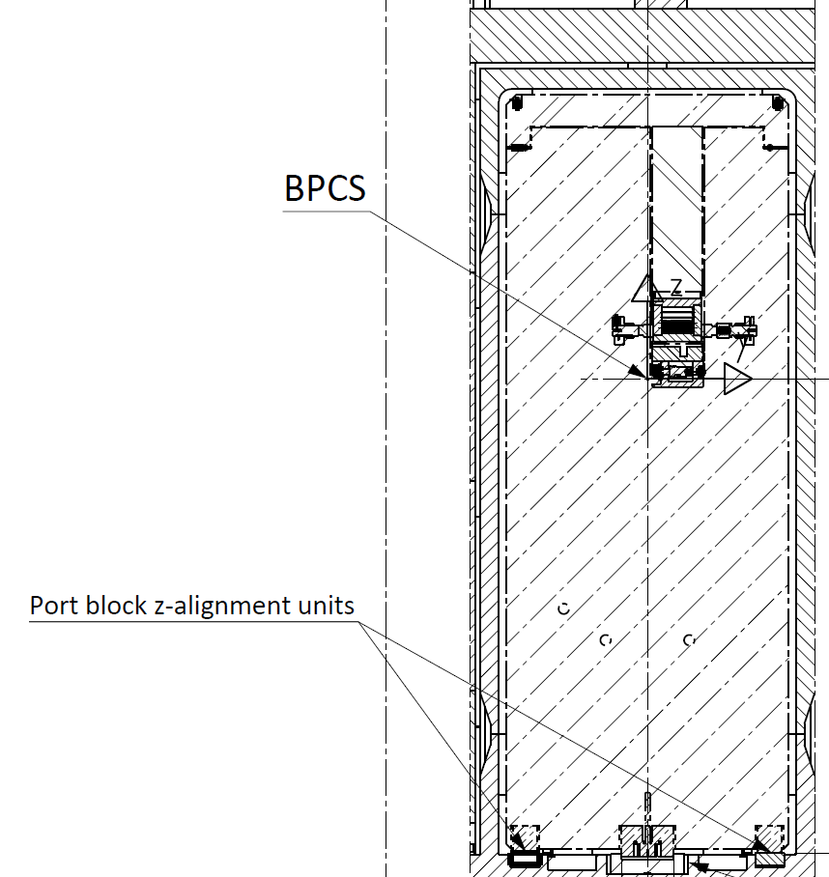
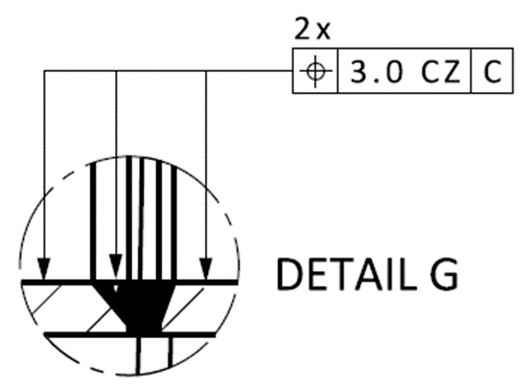
Tolerance stacking – Y-direction (Sideways)
As installed (welded)
Port tube
BPCS-Y
NBPI
From ESS-3185128 Port tube Installation Drawing
Nominal Clearance 7,0 mm
Manufacturing Port tube ± 0,75
Installation Alignment ± 0,75
Minimum Gap 2,0 (operation condition)
Manufacturing NBPI ± 0,5
0 1 2 3 4 5 6 7 (mm) BPCS-Y

Slide 7
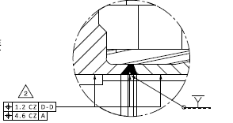
Tolerance Stacking – Z-direction (Height)
As installed (welded)
Nominal Clearance 5,0 mm
From ESS-3185128 Port tube Installation Drawing
Port tube
Manufacturing Port tube ± 1,0
Welding / Alignment ± 1,5 Including alignment ±0,2
NBPI
(mm) BPCS-Z 0 1 2 3 4 5
Minimum Gap 2,0 (operation condition)
Manufacturing NBPI ± 0,5

Slide 8
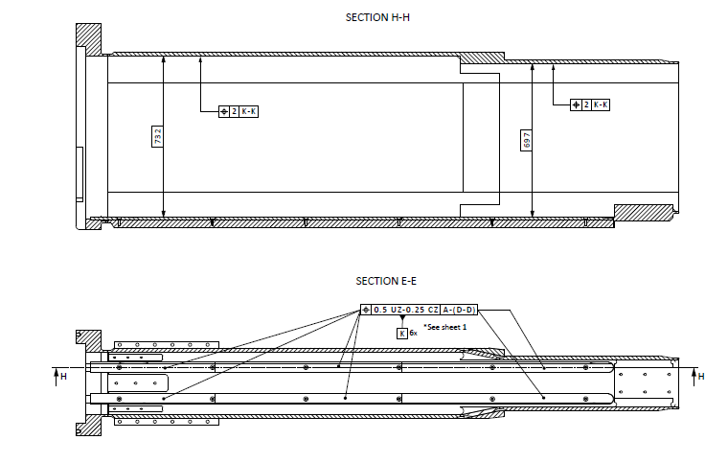
Tolerance Stacking – Z-direction (Height) Insertion of NBPI
As installed (welded)
From ESS-3185128 Port tube Installation Drawing
Nominal Clearance 3,5 mm
Port tube
Manufacturing Port tube ± 1,0 Toward rail
NBPI
Welding / Alignment ± 0,5
(mm) BPCS-Z 0 1 2 3
Gap 1,1* (insertion condition)
From ESS-2969343.3 Port tube functional Drawing
Manufacturing NBPI ± 0,9
* Minimum gap was agreed to 2,0 mm. This can be solved by lowering the rail and/or the wheel on the NBPI.
NBPI = Neutron Beam Port Insert

Slide 9
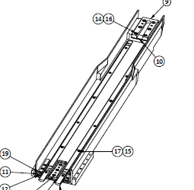
Final tolerance towards the insert
The alignment block in the port tube will be adjusted so the final position of the alignment surface to the insert will be within ± 0,2 mm in all directions. The insert will always end up at nominal position.
Z
* Adjustability range ± 1 mm
X/Y
*Adjustability range ± 1 mm in Y
and +10 mm in X.
Y/Z
* Adjustability range ± 1 mm
in X/Z
Z
* Adjustability range ± 1 mm

Slide 10
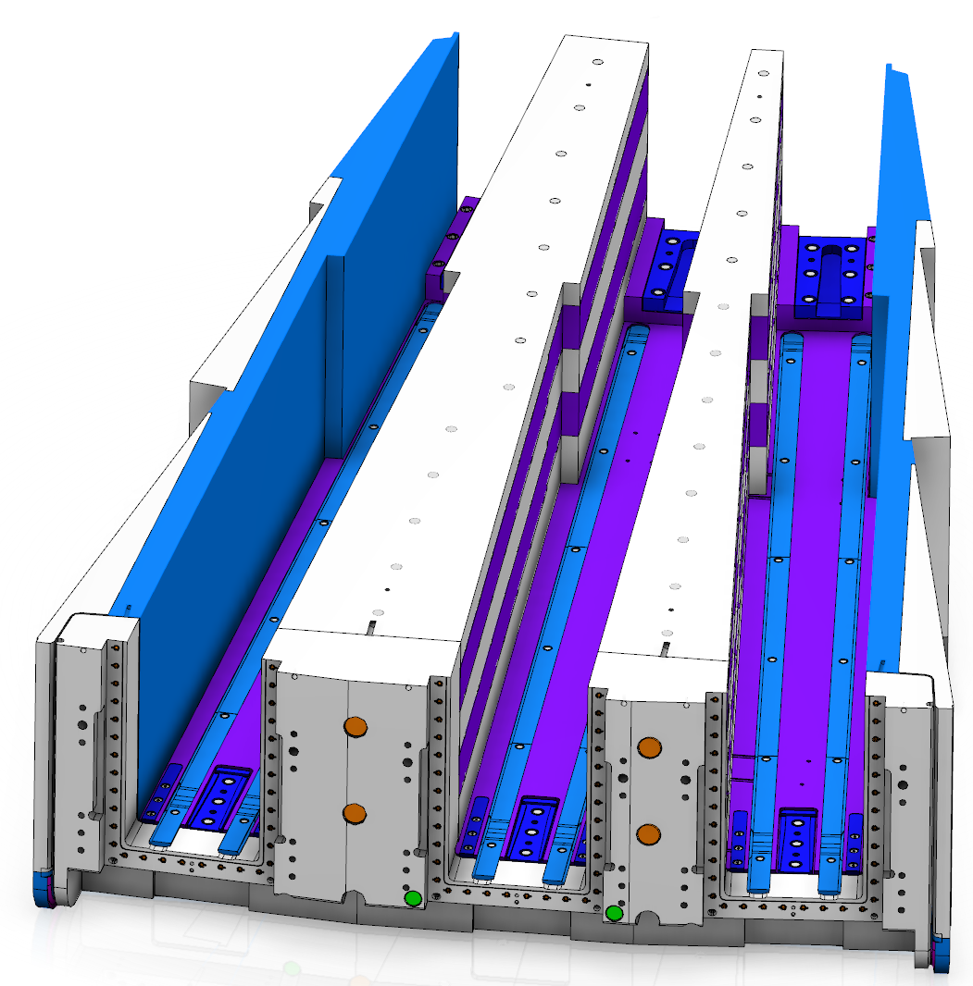
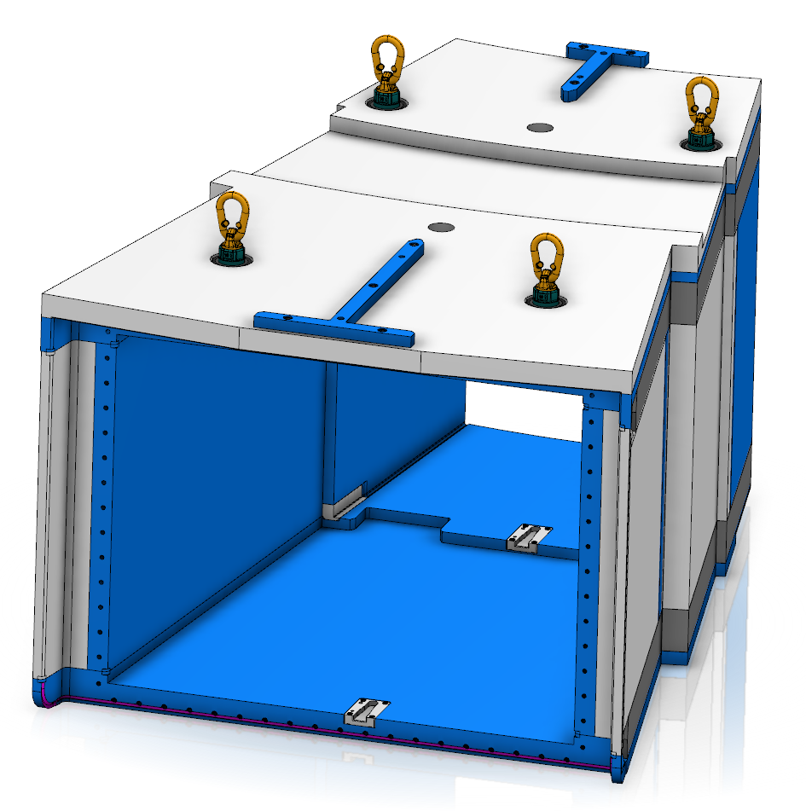
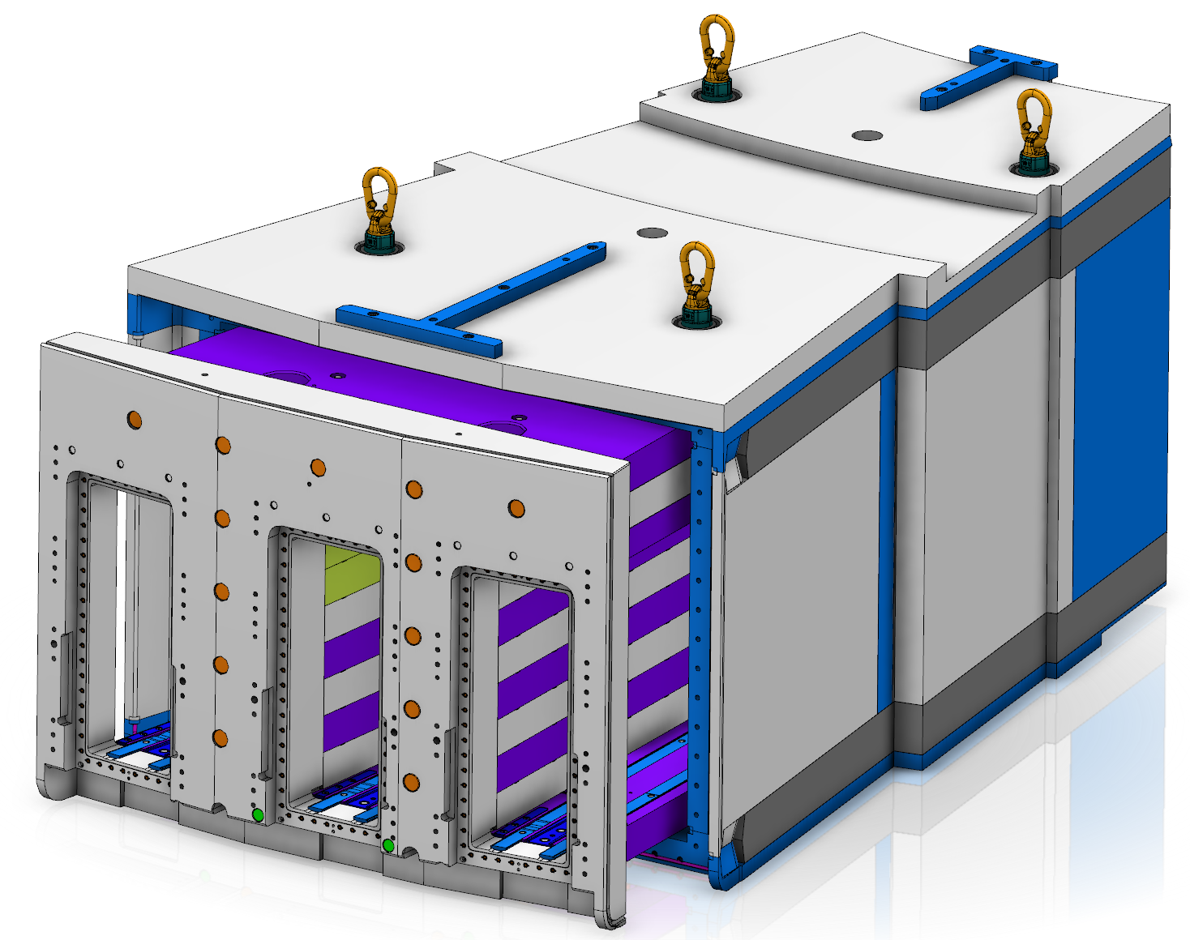
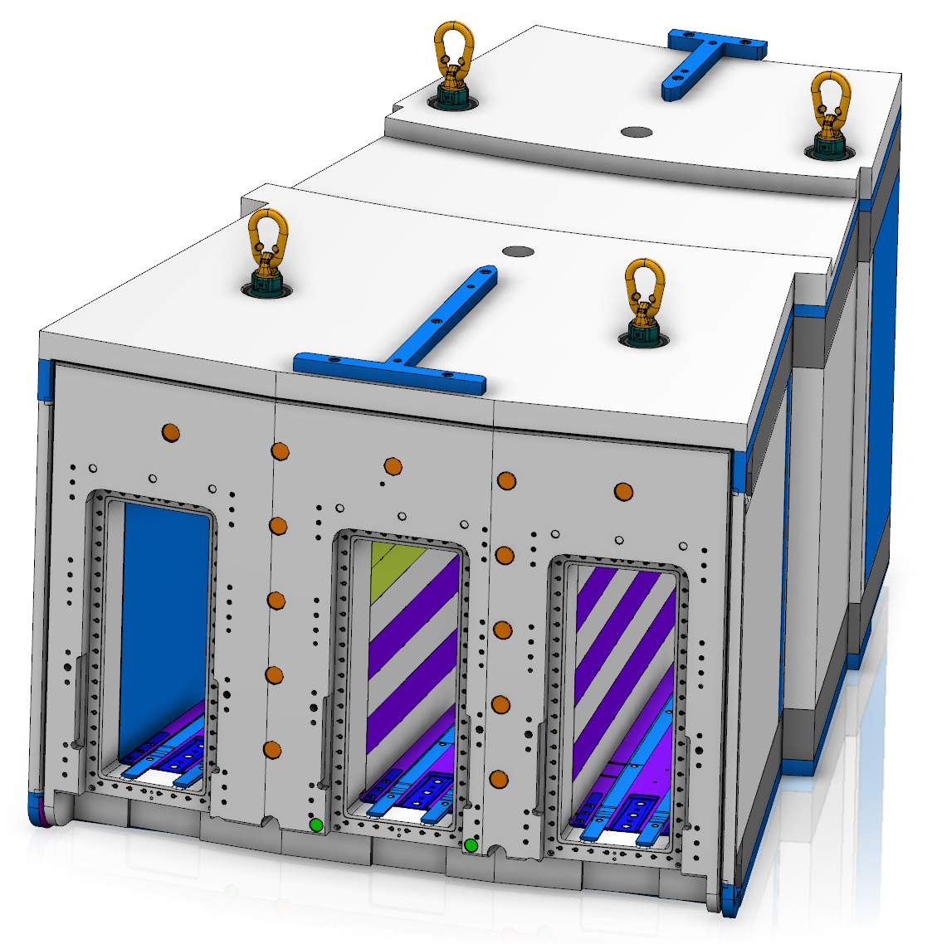
NN-bar frame and adapter
The requirements and predicted shrinkage for the NN-bar is equal as for the port tube.
However, the NN-bar has 2+2mm narrower instrument slots due to its narrow design. This might result in space problem for future instruments.
Welding distortions might further worsen the situation.

Slide 11
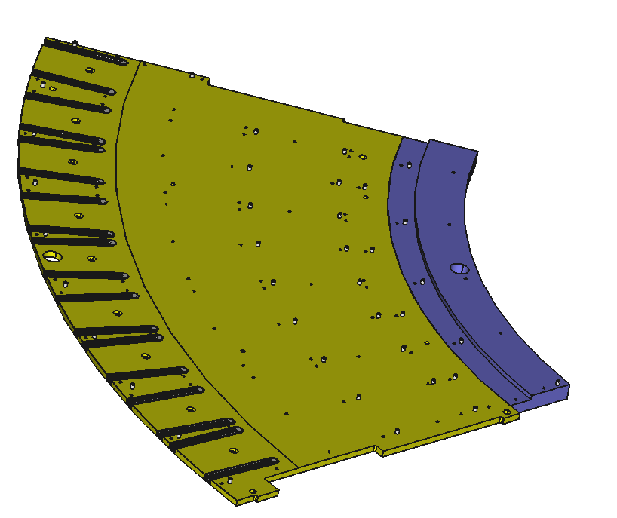
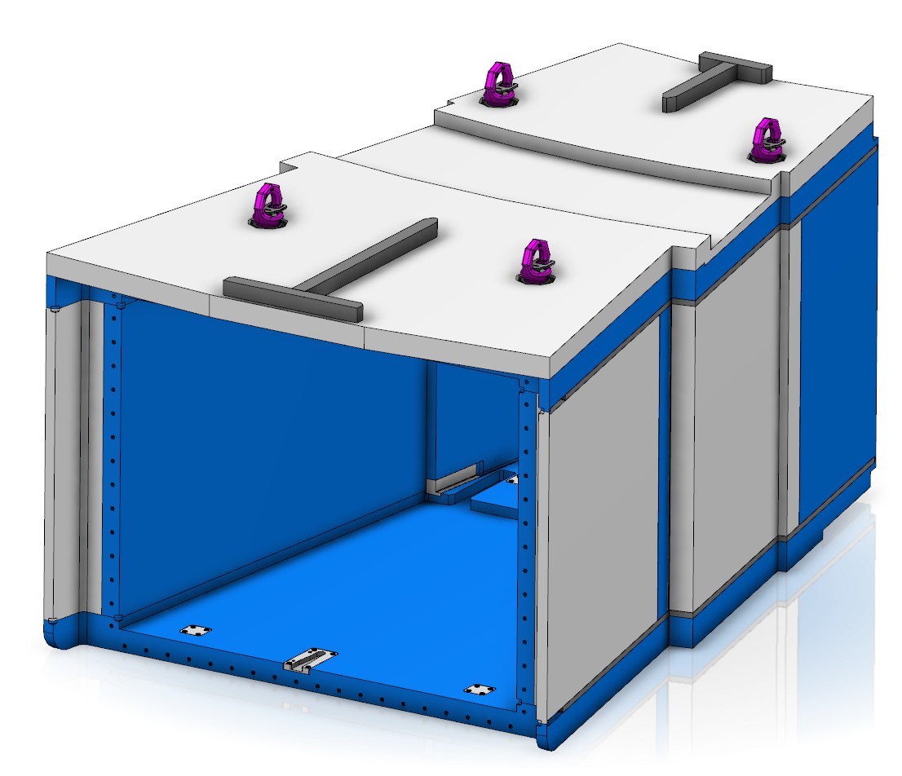
Required work to increase the clearance in X
To allow the port tubes to move inwards, up to 10mm, the following modifications need to be performed:
Top and bottom plate
The bottom plate are time critical and might delay the port tube welding.
All wedges
NN-bar

Slide 12
Finish presentation

