Slide 1
Potential Alternative Welding Sequence
Sara ghatnekar Nilsson, wpm Monolith systems, target division

Slide 2
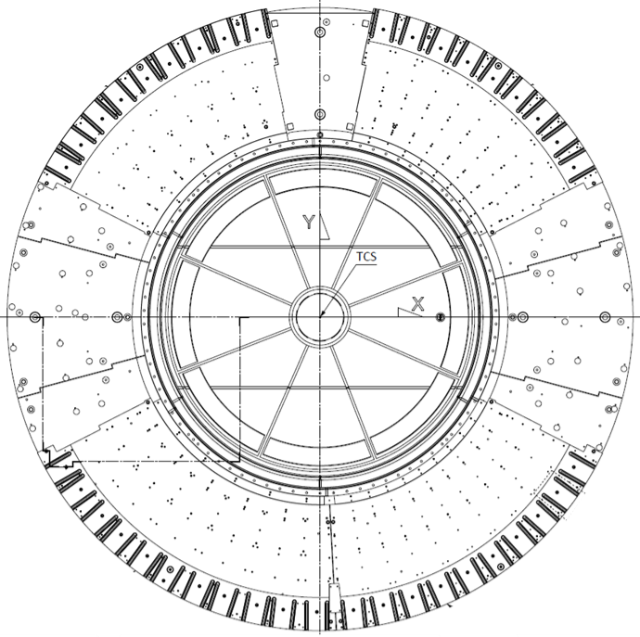
Background information and current strategy
The currently assumed installation schedule is based on all Bottom plates and Port tubes placed around the Vessel before welding starts.
This welding strategy is based on Ensa’s welding feasibility study in which they have taken tube placements, tack-welding and welding sequences into account, as the optimal alternative for highest quality.
As a consequence, for this alternative, the welding on site cannot start until all tubes are placed around the Vessel.
  The first welding starts in July or later.
  No time to do alterations, e.g. tube length, etc.

Slide 3
Alternative welding sequence
An alternative is to install one/all Bottom plates and start a “full” scale test with three tubes. The benefits are:
  Mitigates the risk of overall delays if unforeseen welding distortions occur, and ESS gains know-how on welding tubes to the Vessel.
  Potential unknown unknowns might be discovered earlier.
  If successful, ESS gains time in the installation schedule.
The most suitable location could be in the North sector, or in the South, since those sectors have ports not yet allocated for any instruments.
N2 - N4
S8 - S10

Slide 4
Suggested 3 tubes test welding
1- Tack-weld Port tubes 1, 2, 3
2- Survey window frame geometry A to E
3- Weld root pass on Port tube 2
4- Survey window frame geometry A to E
5- Weld up to 5mm on Port tube 2
6- Survey window frame geometry A to E
7- Weld up to 8mm on Port tube 2
8- Survey window frame geometry A to E
If any surveying session indicate any considerable window frame distortions, then the test will be stopped.
3
A
2
1
E
B
D
C

Slide 5
Suggested 3 tubes test welding
Baseplate (installed)
Bottom plate (support for tubes, 4 in total)
3 tubes in place
3 tubes in place (view from inside of the Monolith Vessel

Slide 6
Alternative is to do a 6 tubes test welding
1- Tack-weld Port tubes 1 - 6
2- Survey window frame geometry A to F
3- Weld root pass on Port tube 2 and 5
4- Survey window frame geometry A to F
5- Weld up to 5mm on Port tube 2 and 5
6- Survey window frame geometry A to F
7- Weld up to 8mm on Port tube 2 and 5
8- Survey window frame geometry A to F
If any surveying session indicate any considerable window frame distortions, then the test will be stopped.
3
A
2
1
E
B
C
F
D
4
5
6

Slide 7
Interpretation of the result
If considerable distortions occur on any of the window frames, then stick to the plan to tack-weld all Port tubes before start of final welding.
If no considerable distortions, then it might indicate that it is possible to start weld Port tubes before all tubes are tack-welded.
If the test reveals any other, yet unknown issues, we will have more time to develop suitable remedies.

Slide 8
Impact on schedule
Relative delivery dates based on ENSA schedule from Feb 2021
May
June
July
Aug
Sept
Oct
Nov
Optimized for time schedule
Tube
1-3
Tube
4-10
About two months
Welding tubes upon receipt
Tube
11-20
Tube
21-30
Tube
31-39
Optimized for welding performance
Tube
1-39
Welding all tubes at the same time

Slide 9
Finish presentation

