Slide 1
ESS Vacuum System: Brief Overview
Marcelo juni Ferreira
Vacuum System Engineer
AD and ICS Retreat mtg 2014
11 December 2014

Slide 2
Outline
Introduction: Vacuum for beginners,
ESS Vacuum System,
Vacuum requirements,
Vacuum standardization model,
Vacuum control System,

Slide 3
Introductions: Vacuum for beginners
How many molecules of air we have at the surface of a cube with 1 liter volume?
N₂ diameter = 3.7 x 10⁻¹⁰ m; cube side = 0.1 m
Number of the molecules in 1 m² :
1 /3.7 x 10⁻¹⁰ x 3.7 x 10⁻¹⁰ = 7.3 x 10¹⁸ mol/m²
Molecules at the surface of a cube:
6 x 0.1 x 0.1 = 0.06 m² x 7.3 x 10¹⁸ mol/m² = 4.4 x 10¹⁸ mol.
How much pressure we can build inside the 1 liter with this molecules?
Reference: 2.65 x 10²² mol./liter at room pressure.
∴7.3 x 10¹⁸ mol/liter 1.6 x 10⁻² mbar
Or 1:50.000 from atmosphere (1 atm ≈ 1000 mbar ).
Warm Linac from 10⁻⁵ mbar – 10⁻⁹ mbar
Cryo modules ≈ 1 x 10⁻¹² mbar
A.G. Mathewson CERN-94-01-V2

Slide 4
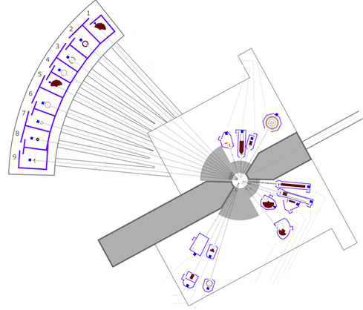
ESS Vacuum system
Target
Warm LINAC
Cold LINAC
The ESS organization charges the ESS Vacuum Group (VG) with the responsibility for all ESS vacuum systems including not only the Accelerator, but also Instruments and Neutron Beam Lines and the Target.
The main task of the ESS VG is to support the in kind contributions on the vacuum system and the integrated vacuum design of the ESS complex.
Neutron Beam lines
Vacuum: state of a rarefied gas or the environment corresponding to such a state, associated with a pressure or a mass density below the prevailing atmospheric level (ISO 3529).

Slide 5
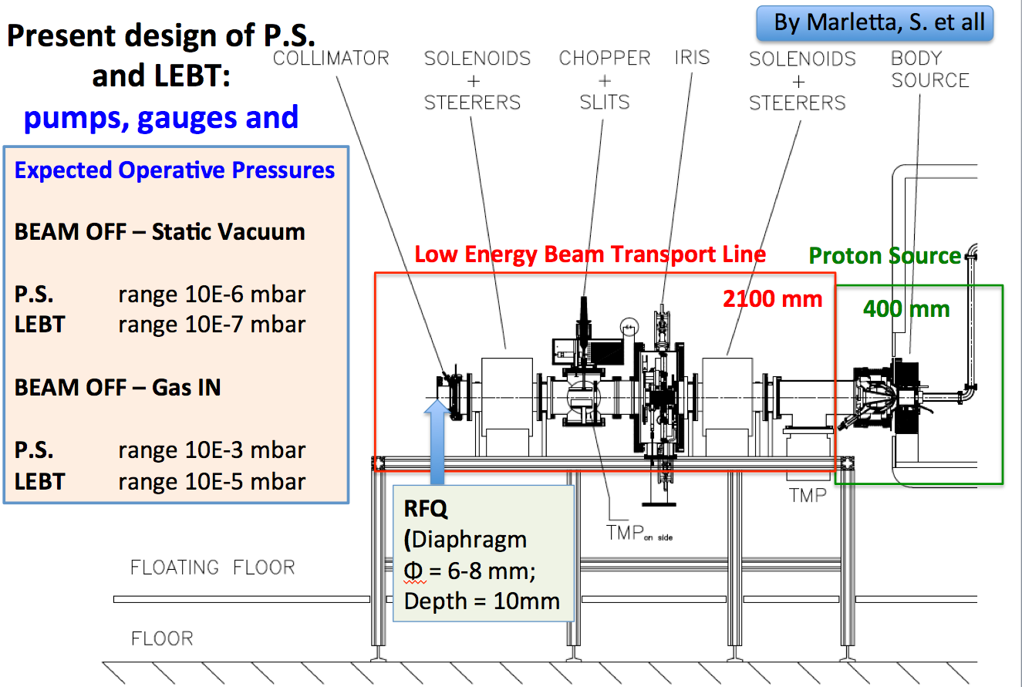
Vacuum Requirements: warm LINAC Proton Source (PS) and Low Energy Beam Transport (LEBT)

Slide 6
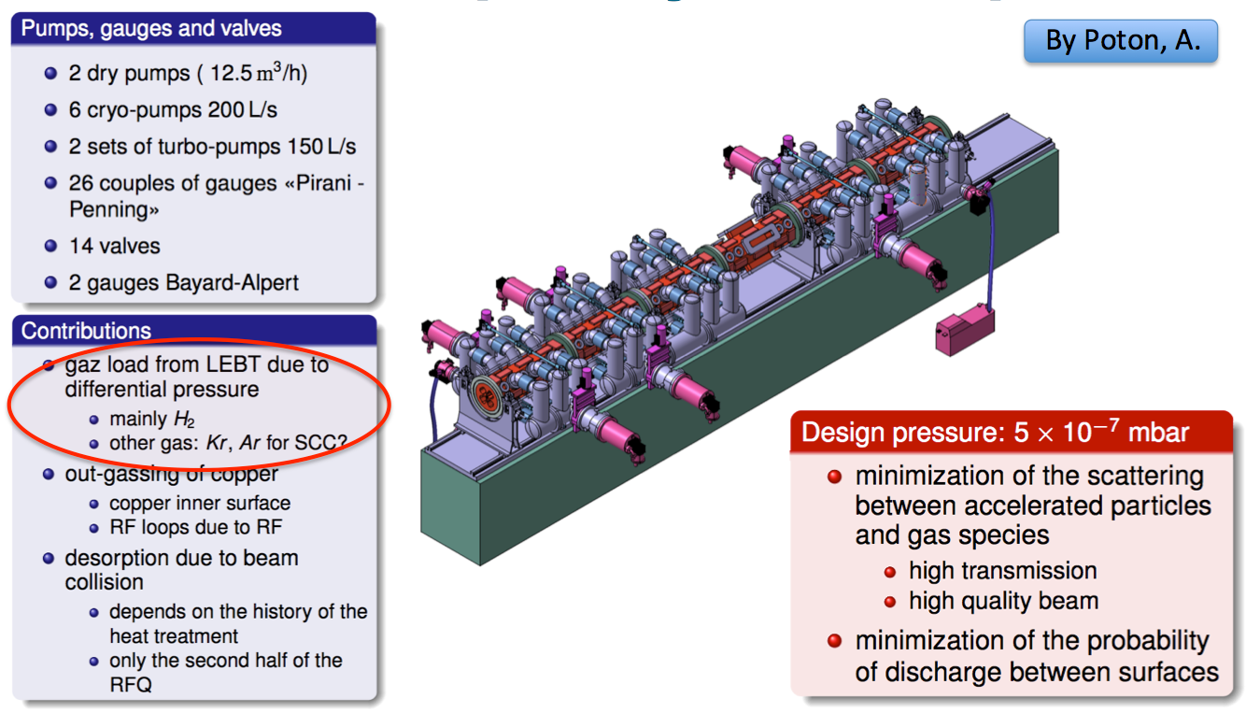
Vacuum Requirements: warm LINAC Radio Frequency Quadrupole (RFQ)

Slide 7
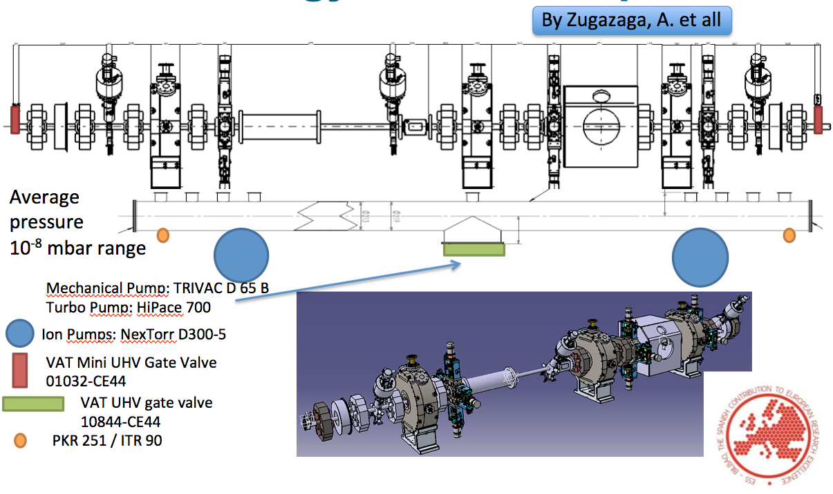
Vacuum Requirements: warm LINAC Medium Energy Beam Transport (MEBT)

Slide 8
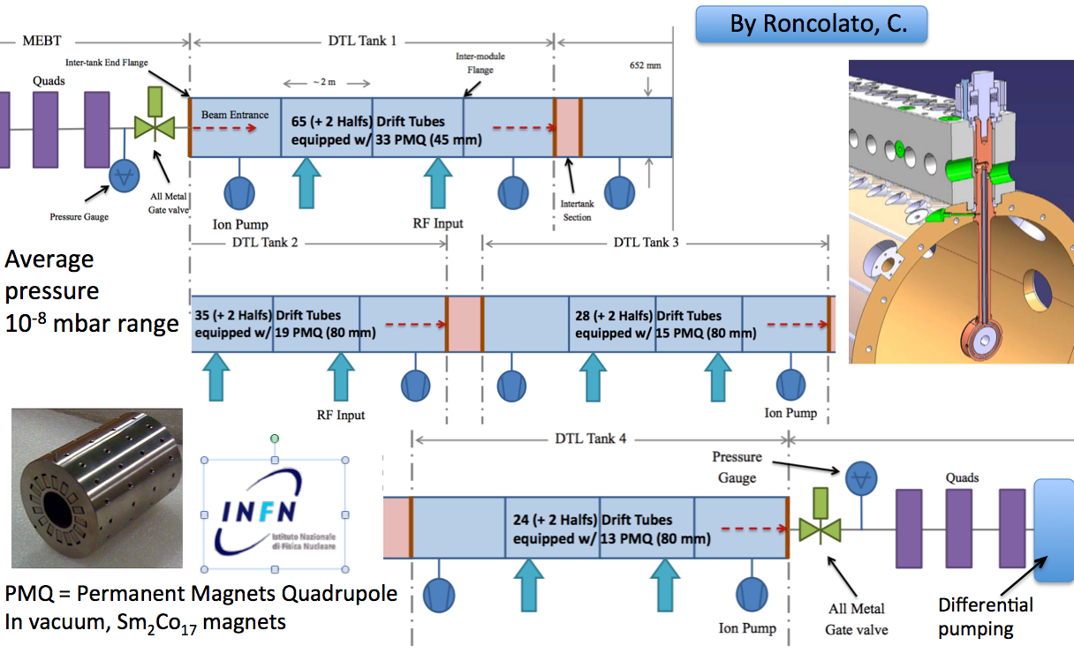
Vacuum Requirements: warm LINAC Drift Tube Linac (DTL)

Slide 9
Vacuum Requirements: “warm/cold” LINAC Low & High Energy Differential Pumping (LEDP & HEDP)
LEDP is located between the last DTL tank and first spoke cavity: pressure 10⁻¹⁰ mbar range, particle free required as the cavities
The HEDP is located between the last cryomodule and start of the High Energy Beam Transport (HEBT) and has similar features to the LEDP.

Slide 10
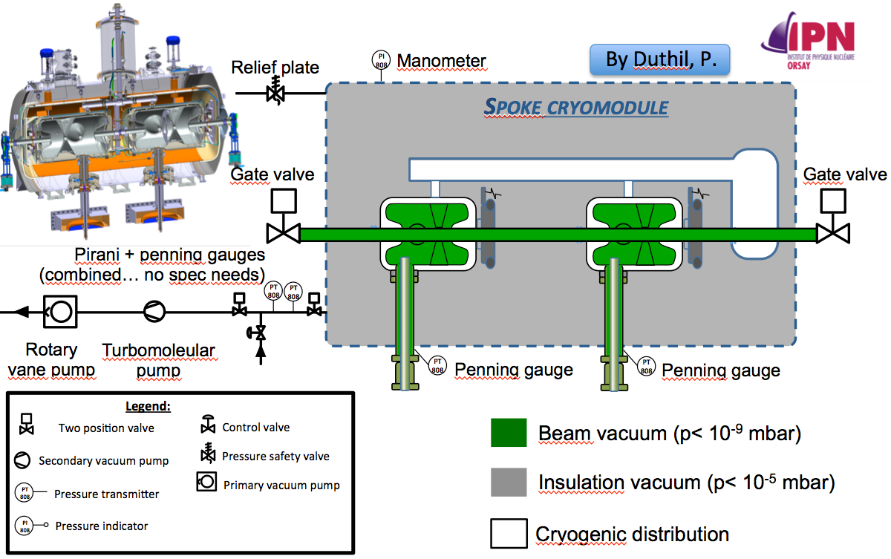
Vacuum Requirements: cold LINAC Spoke Cryomodule

Slide 11
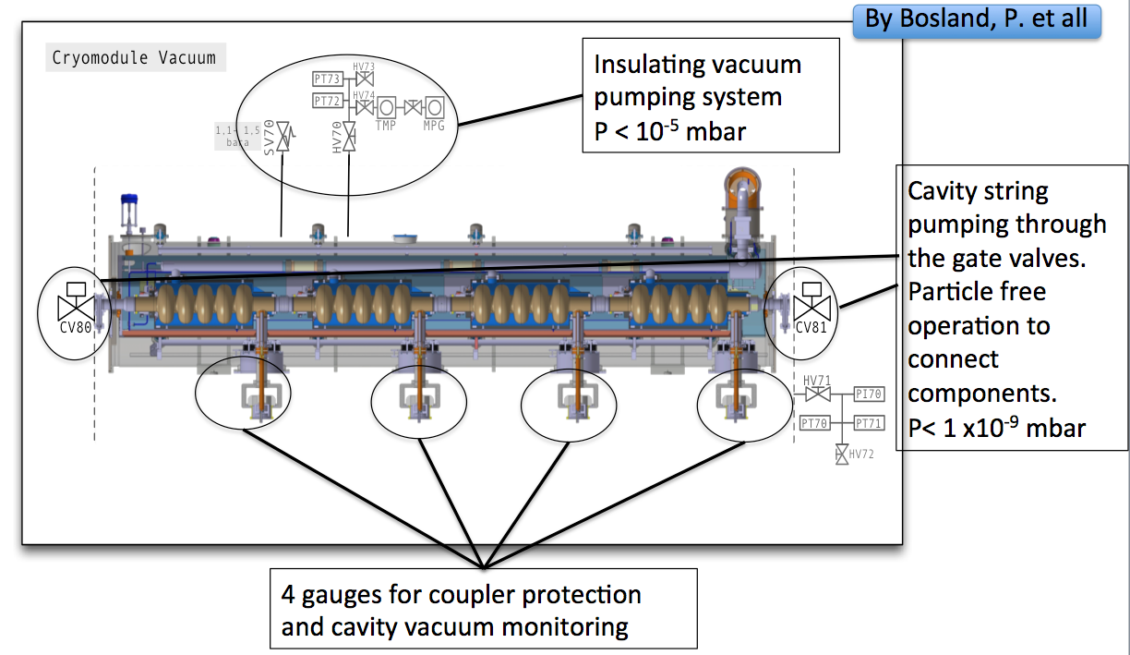
Vacuum Requirements: cold LINAC Elliptical cavity (medium/high Beta)

Slide 12
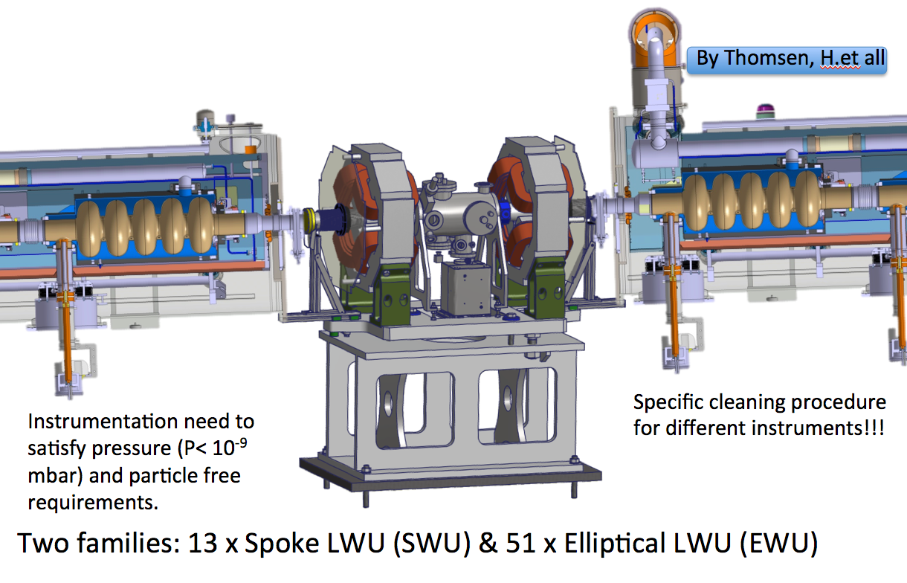
Vacuum Requirements: “warm” LINAC Linac Warm Unit (LWU)

Slide 13
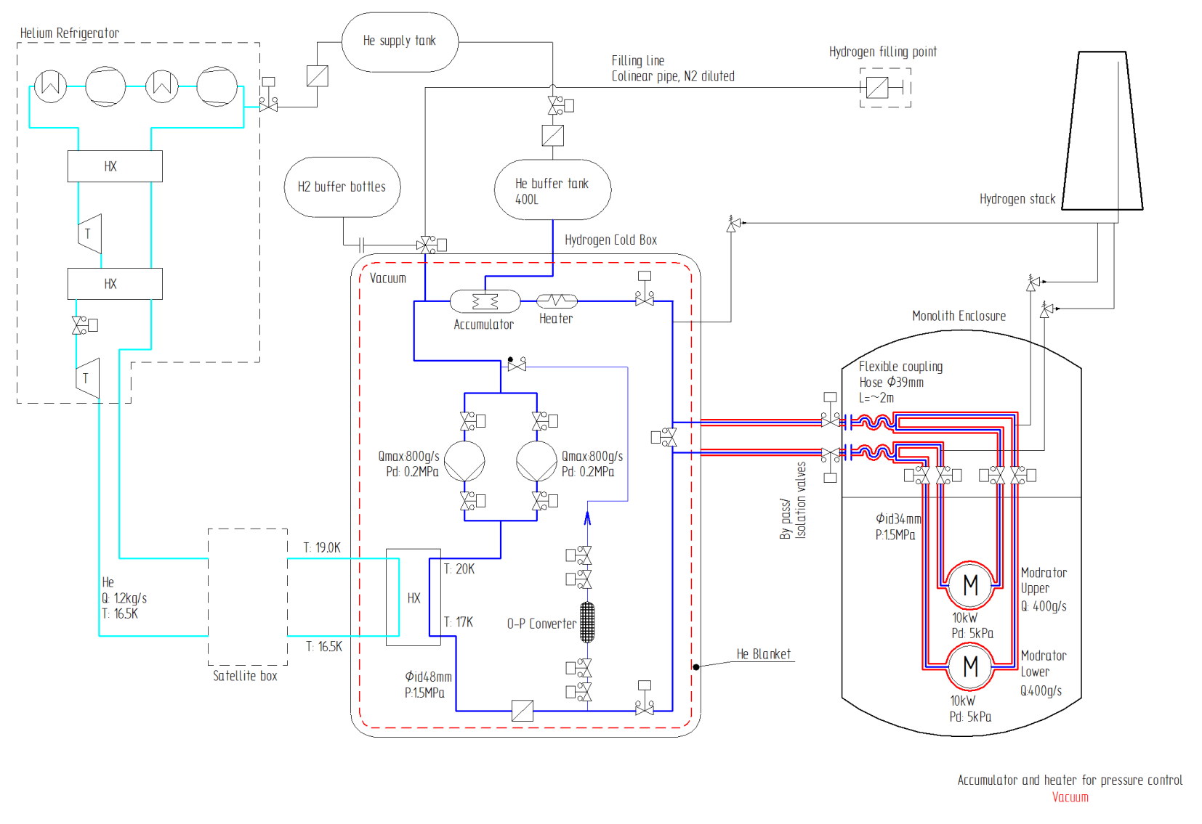
Vacuum Requirements: Target
The baseline design for the vacuum system for insulation, consists of several vacuum pumps providing a rough vacuum for purging and a medium/hard vacuum for insulation of the cryogenic cooling system.
The purging system must be able to handle both He and H2 as media in the system.
The vacuum for insulation will be an active vacuum that will handle both the cryostat vacuum and the piping adjacent to the system. This vacuum might be contaminated by H₂O, H₂ and He .
Scope:
The vacuum for insulation, piping, cryostat vacuum and vacuum for purging. Specification for support system, safety system, integration, installation and test.
Vacuum system marked with red

Slide 14
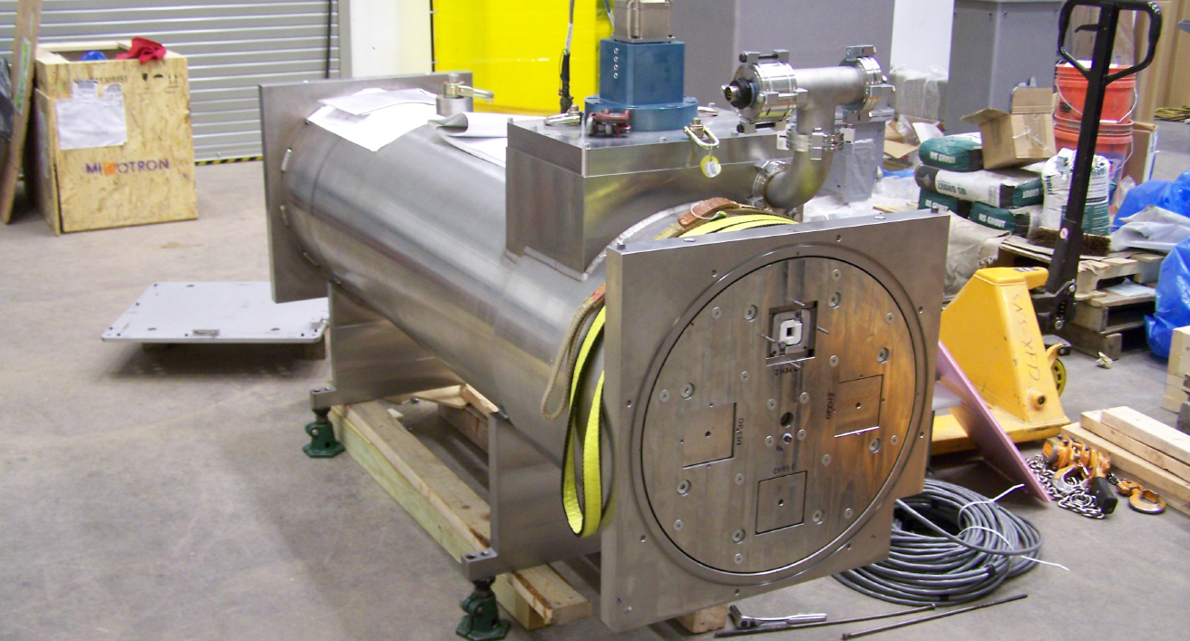
Vacuum Requirements: Neutron beam lines and Instrument

Slide 15
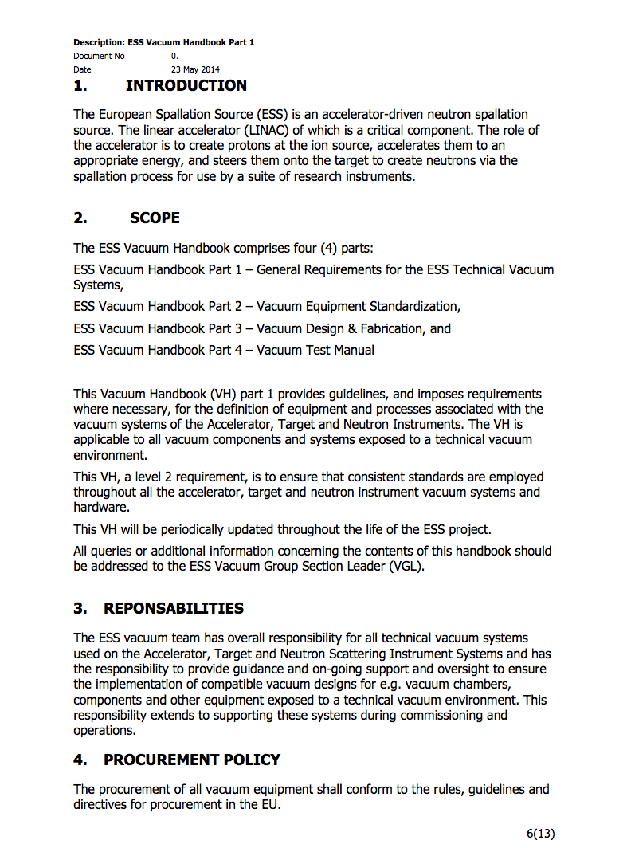
Vacuum Standardization
Vacuum Standardization meeting Feb/2014,
ESS Vacuum Handbook as main document, cover all requirements for accelerator, target and instruments,
Vacuum Policy applied for all “in kind” contributions.
http://europeanspallationsource.se/accelerator-documents

Slide 16
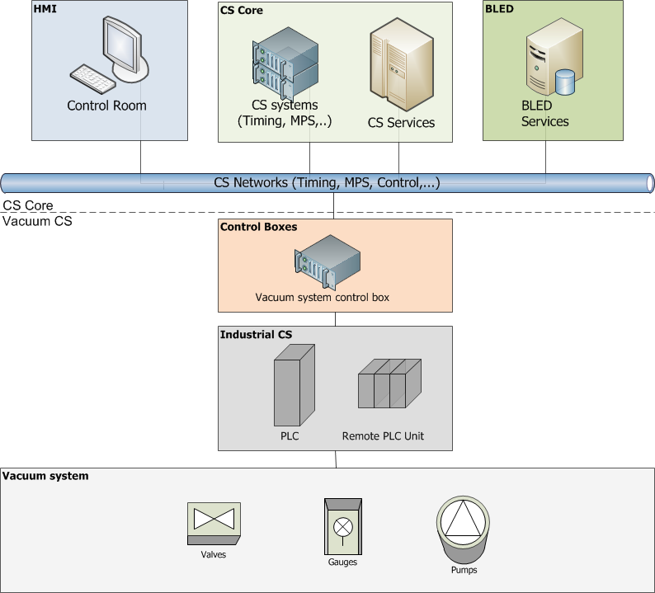
Vacuum Control System
Epics Domain
ICS Group responsibility
Vacuum Group responsibility

Slide 17
Thank you for your attention!

