Slide 1




Status of Elliptical Cavities Cryomodule Demonstrator ECCTD
Franck PEAUGER, CEA Saclay
On behalf of the ECCTD team:
C. Arcambal, G. Devanz, P. Bosland, P. Hardy, F. Leseigneur, J. Plouin, G. Ferrand, F. Eozenou, C. Servouin,
D. Roudier, L. Maurice, X. Hanus, C. Madec, JP. Poupeau, N. Bazin, N. Berton, V. Hennion, JP. Charrier, O. Piquet,
P. Carbonnier, B. Renard, P. Sahuquet, A. Hamdi, CEA Saclay
G. Olivier, JP. Thermeau, IPN Orsay
C. Darve, N. Elias, ESS
AD and ICS Retreat mtg 2014
11 December 2014

Slide 2
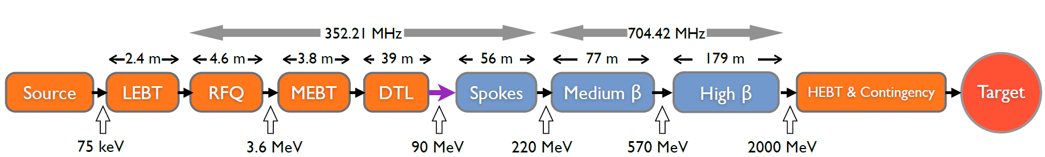
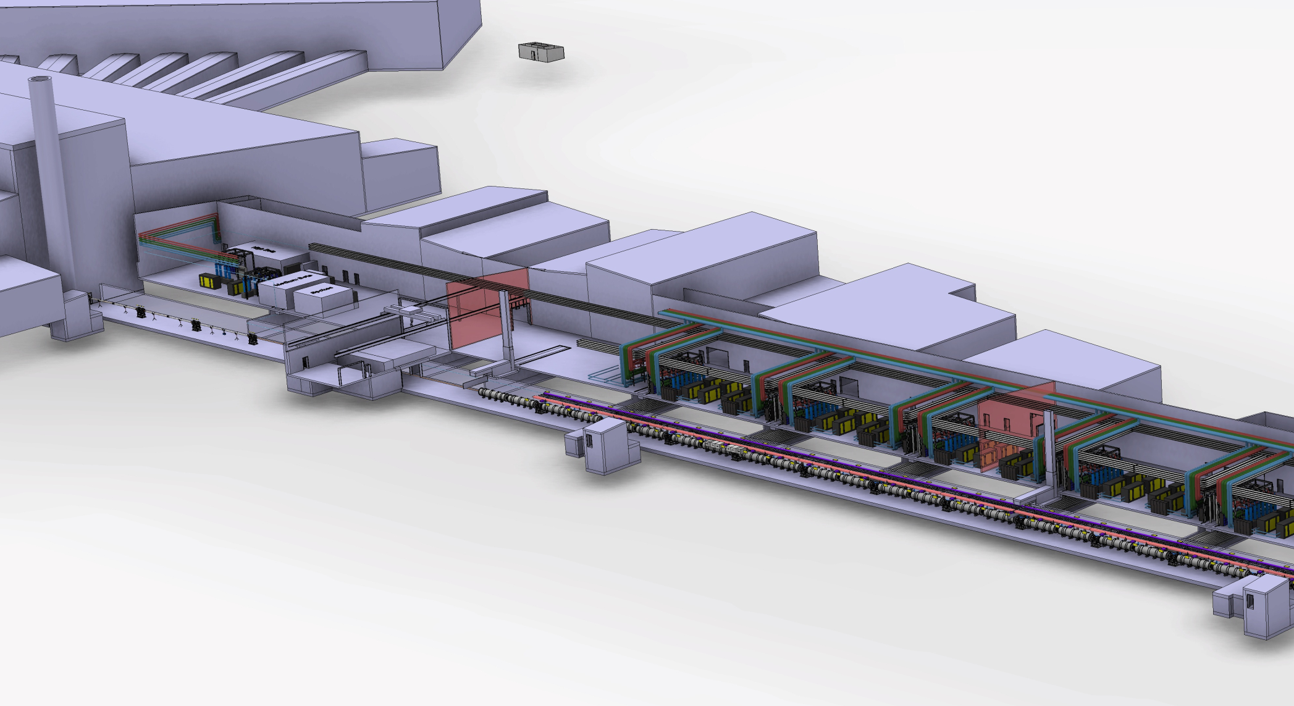

ECCTD in ESS Superconducting linac
Klystron gallery
 | MEDIUM-β | HIGH-β
β | 0.67 | 0.86
# CM | 9 | 21
Cav. /CM | 4 | 4
# Cav. | 36 | 84
CM L [m] | 6.584 | 6.584
Sector L [m] | 77 | 179
Elliptical cavity Cryomodules ECCTD
Proton Beam
→ 70% of the total length of the linac

Slide 3
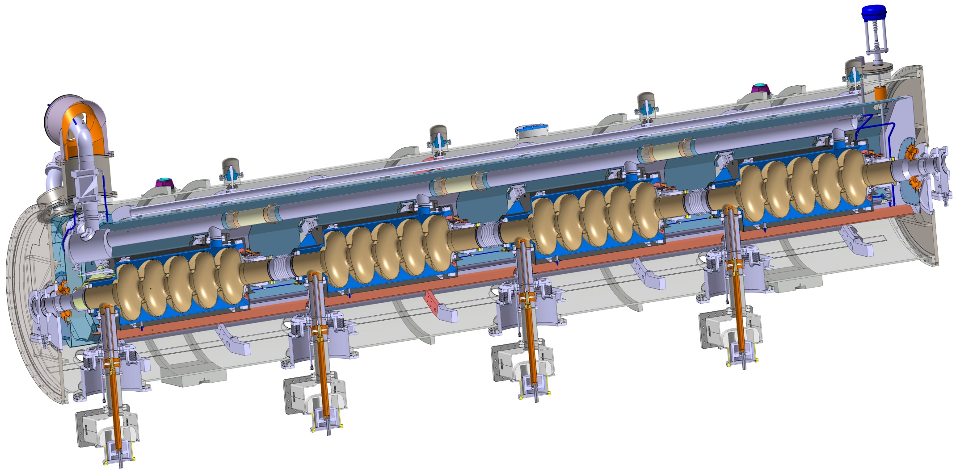
Cryomodule design
Similar to CEBAF/SNS cryomodule concept with 4 cavities per cryomodule
Common design for medium (6 cells) and high beta (5 cells) cavities
Regulation He valve
Thermal shielding
Alignement fiducial
Vacuum valve
Jumper connection
Magnetic shielding
Spaceframe support
Heat exchanger
Diphasic He pipe
Proton Beam
Cavity with Helium tank
Intercavities belows
Power coupler
Cold to warm transition
G. Olivier

Slide 4
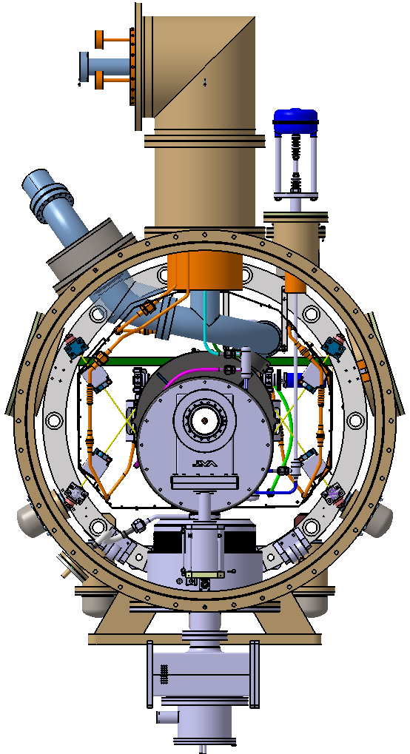
²
Bursting disk
Spaceframe
Cold tuning system
Access trap
Cavity supporting rods
Three supports at 120°C for the spaceframe
Vacuum vessel
Cryomodule support (no ground support design yet)
G. Olivier

Slide 5
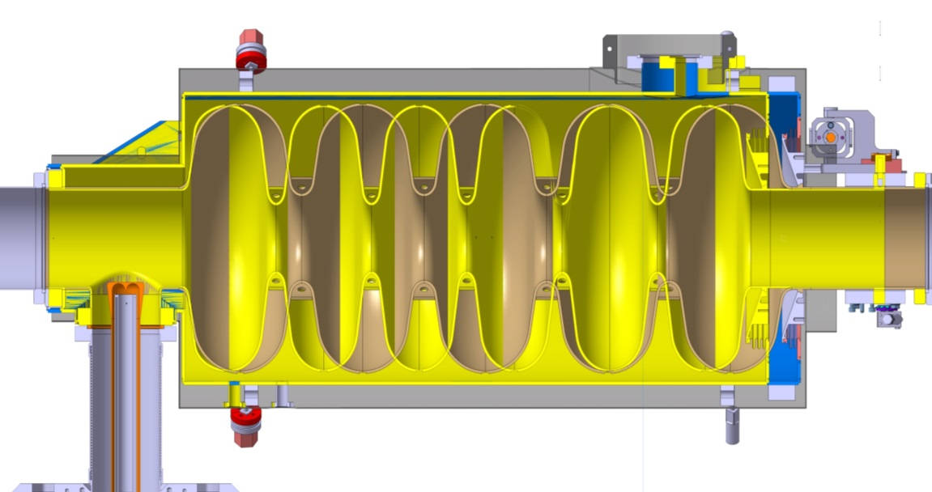
Cavity design
Magnetic shielding
Tank (Ti)
Cold tuning system
 | Medium | High
Geometrical beta | 0.67 | 0.86
Frequency (MHz) | 704.42
Operating temperature (K) | 2
Maximum surface field in operation (MV/m) | 44 | 44
Nominal Accelerating gradient (MV/m) | 16.7 | 19.9
Nominal Accelerating Voltage (MV) | 14,3 | 18,2
Q₀ at nominal gradient | > 5e9
Cavity dynamic heat load (W) | 4,9 | 6,5
Q_{ext} | 7.5 10⁵ | 7.6 10⁵
High beta (0,86):
5 cells
Length 1316,91mm
Medium beta (0,67):
6 cells
Length 1259,40mm
57,5 mm
 | Medium | High
Iris diameter (mm) | 94 | 120
Cell to cell coupling k (%) | 1.22 | 1.8
π and 5π/6 (or 4π/5) mode separation (MHz) | 0.54 | 1.2
E_{pk}/E_{acc} | 2.36 | 2.2
B_{pk}/E_{acc} (mT/(MV/m)) | 4.79 | 4.3
Maximum. r/Q (Ω) | 394 | 477
Optimum β | 0.705 | 0.92
G (Ω) | 196.63 | 241
Challenging accelerating gradients and Q₀
No HOM couplers
  HOM frequencies and internal cavity shape must be carefully controlled
G. Devanz, J. Plouin,
G. Constanza

Slide 6
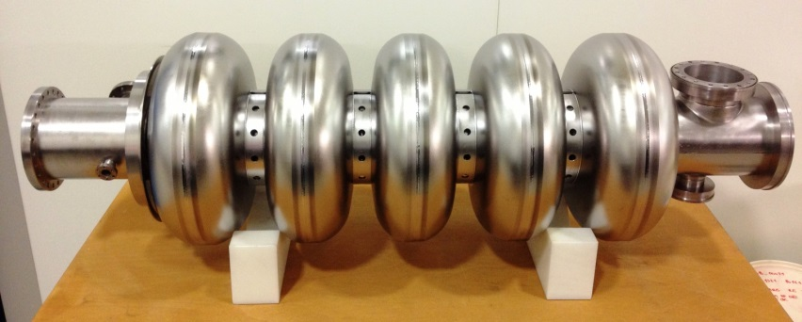
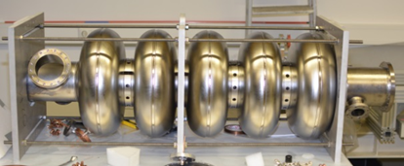
The two prototype high beta cavities
HOM ports only for HOM measurements
Niobium from Tokyo Denkai
Kick-off in Sept. 2012
Trimming operations of dumbbells in presence of CEA staff
P01 manufactured by E. ZANON (Italy)
P02 manufactured by RI (Germany)
F_{π} = 703.553 MHz
F_{π} = 703.704 MHz
Design, at 300 K before chemical etching:
F_{π} = 703.822 MHz

Slide 7
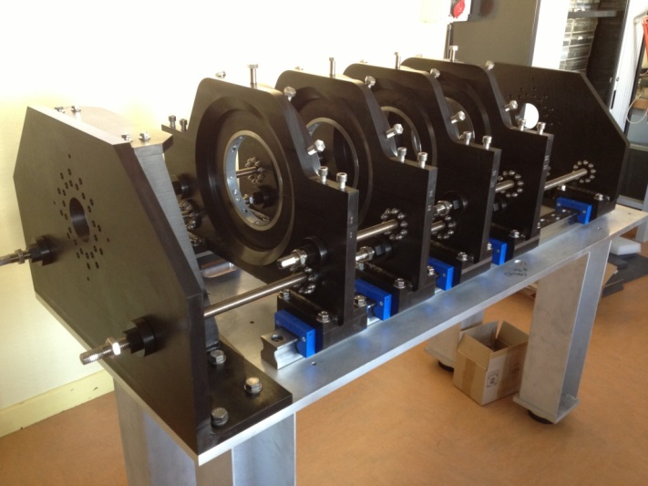
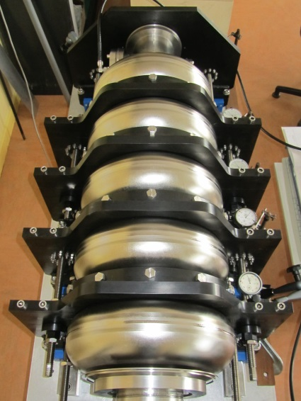
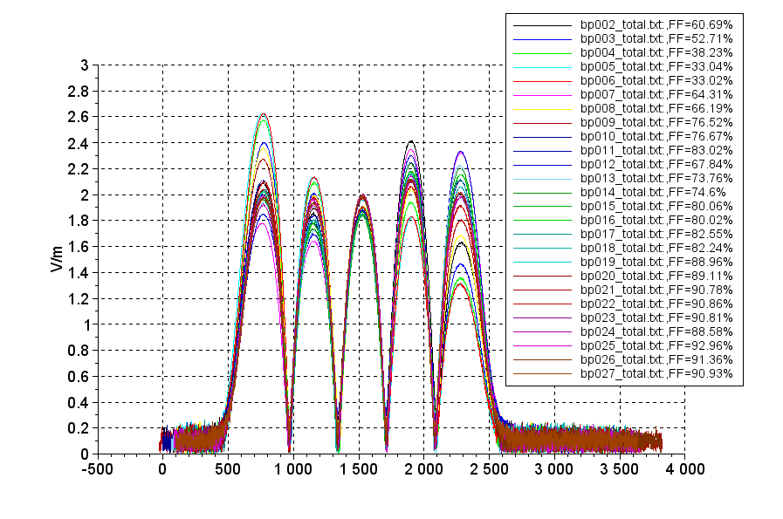
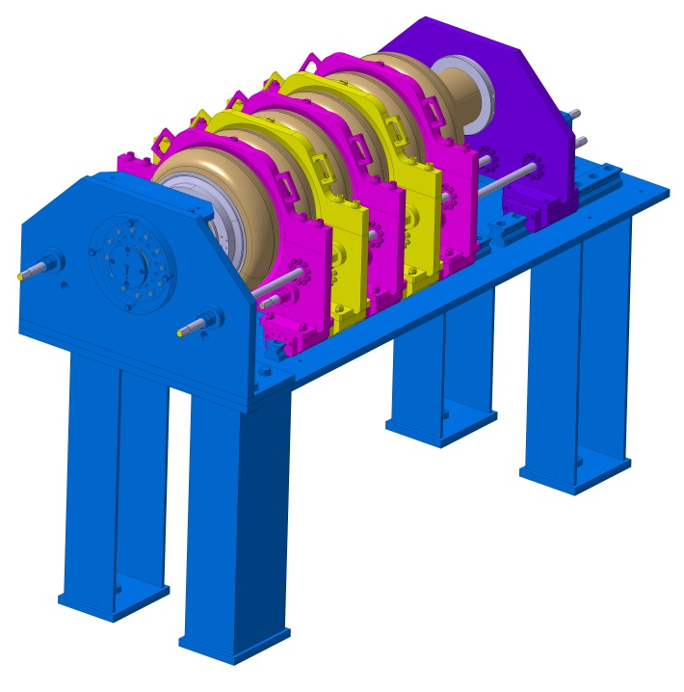
Field flatness tooling at CEA
Exemple of cavity tuning (High beta Prototype n°2 from RI)
Tooling for high beta ready
D. Roudier
→ adapted for prototypes only (not for large series cavities)
Tooling for medium beta
New pieces ordered

Slide 8
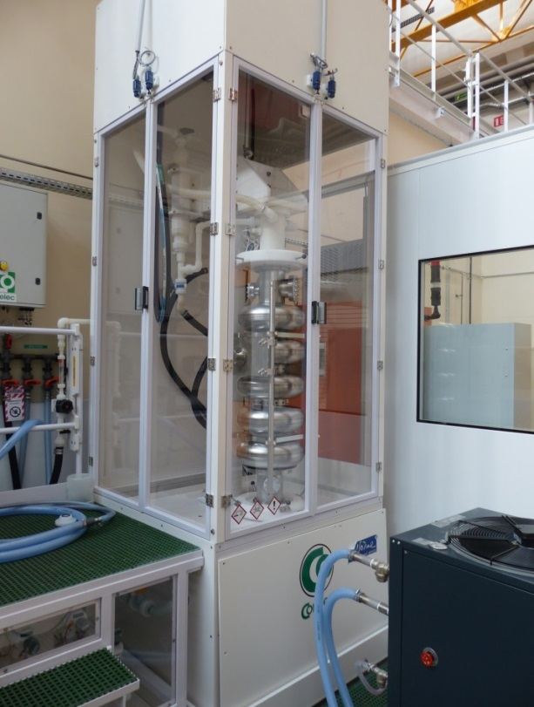
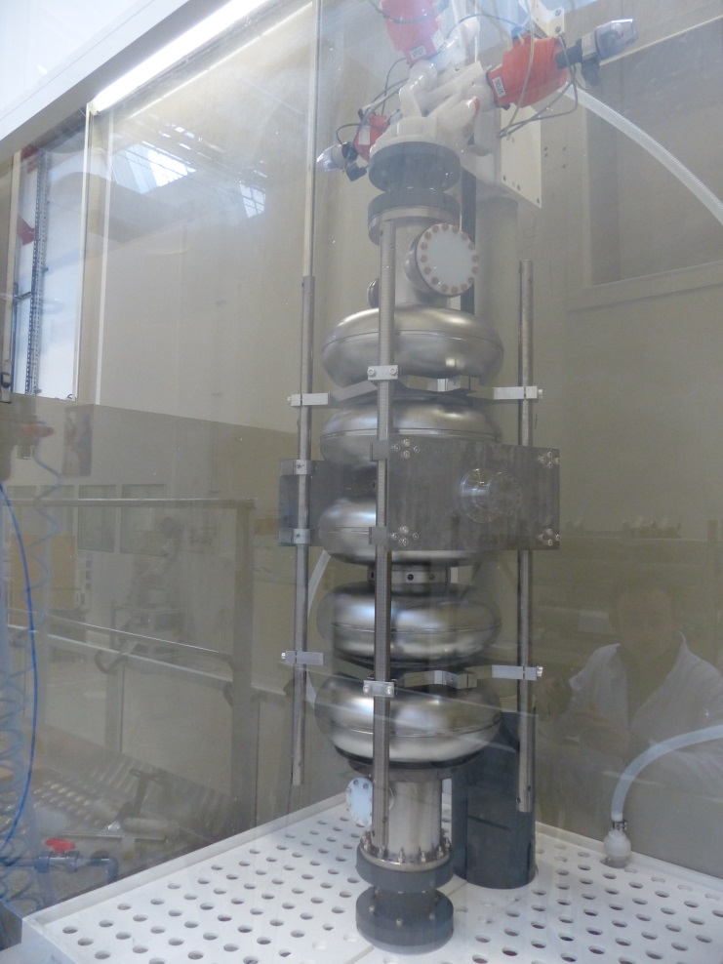
Chemical treatment set-up
F. Eozenou, C. Servouin
Vertical EP or BCP
BCP
→ Two independant installations compatible with 704 MHz cavities and one is qualified

Slide 9
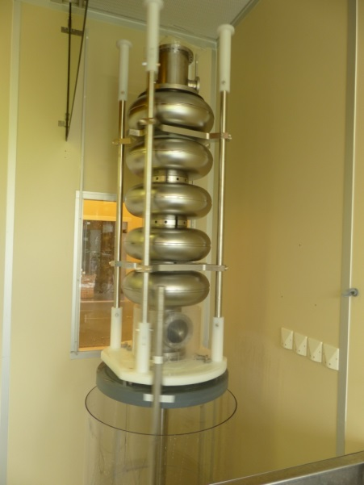
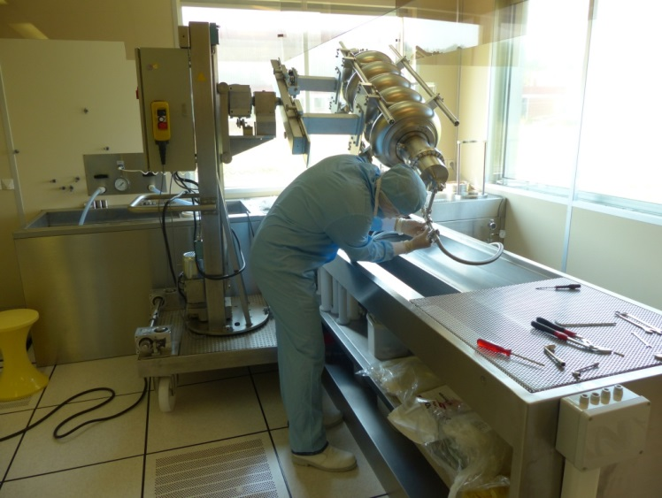
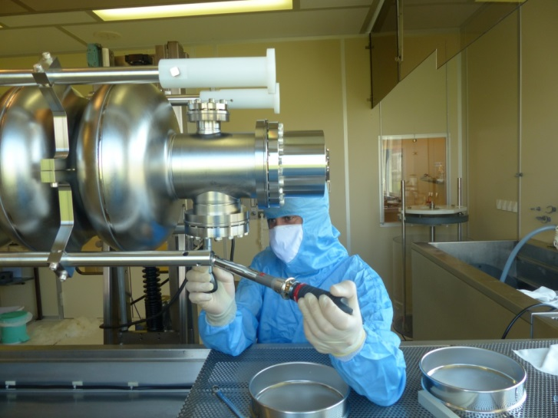
Cavity clean room assembly with High Pressure Rinsing
Flanges and antenna pick-up assembly under class 100 laminar flow
HPR 100 bars - Ultra pure water
For the moment we have used our “historical” small clean room (Orme des Meurisiers site)
The new clean room (Saclay site) will be equipped with a newly developped HPR system and will be qualified in 2015
F. Eozenou, C. Servouin

Slide 10
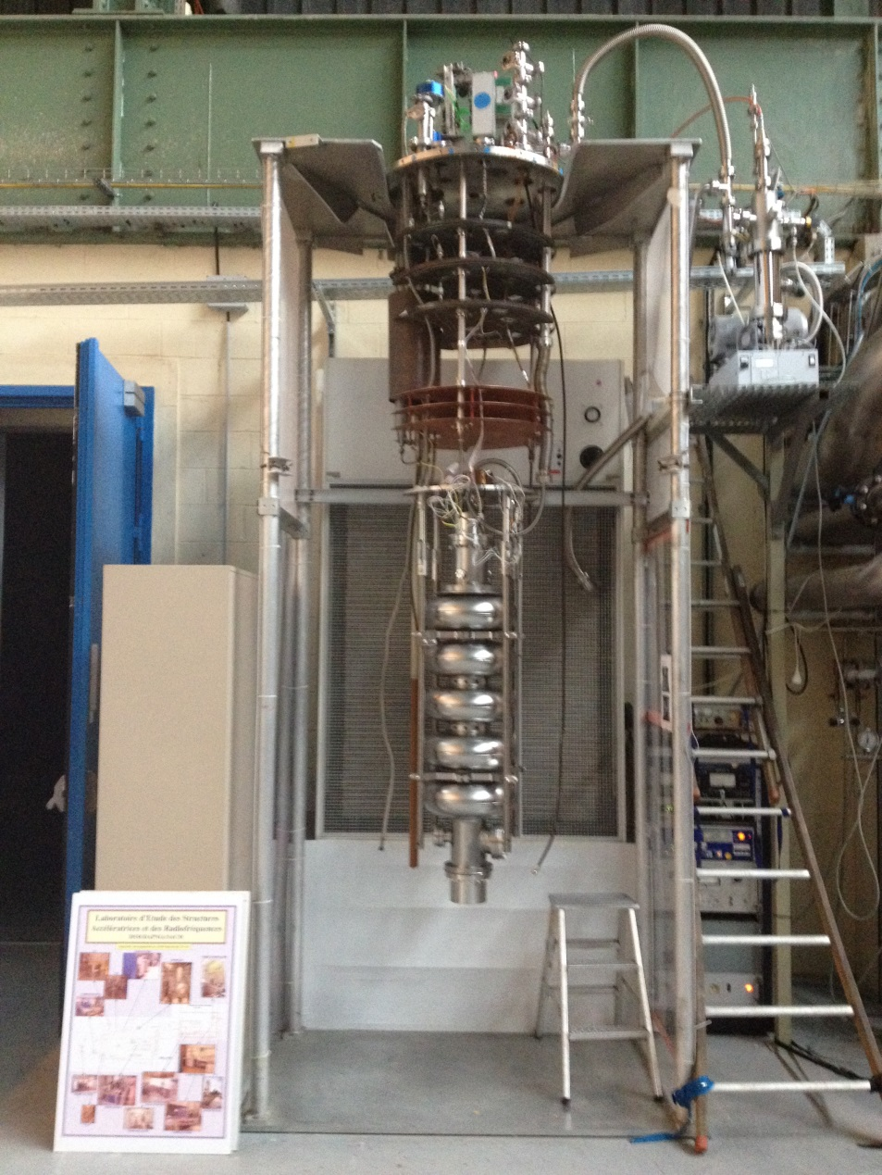
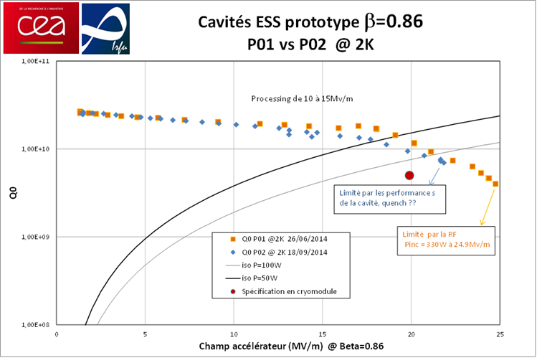
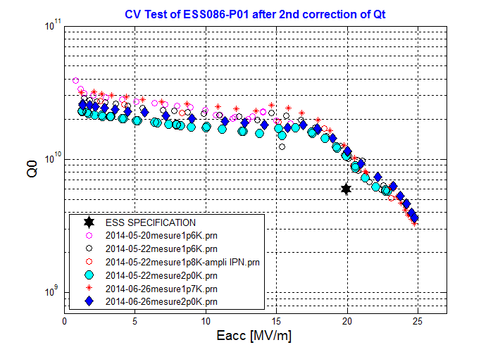
Vertical test results
High beta prototype cavity n°1 from ZANON
Both prototype cavities already met the ESS requirements after the first test
→ Very encouraging results
Mounting on vertical insert , Connexion to RF system and vacuum pumping station

Slide 11
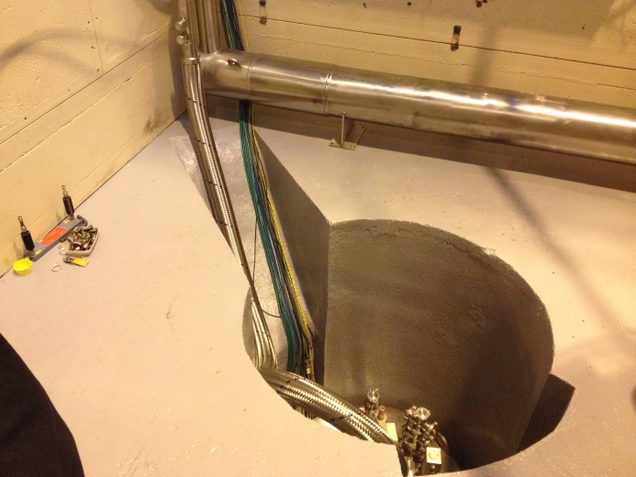
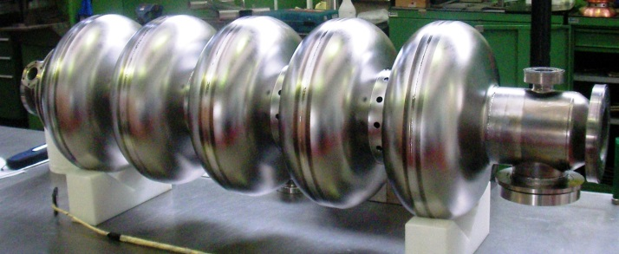
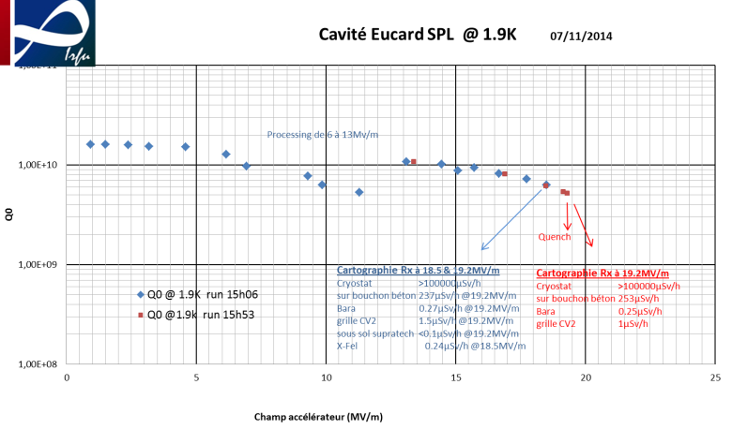
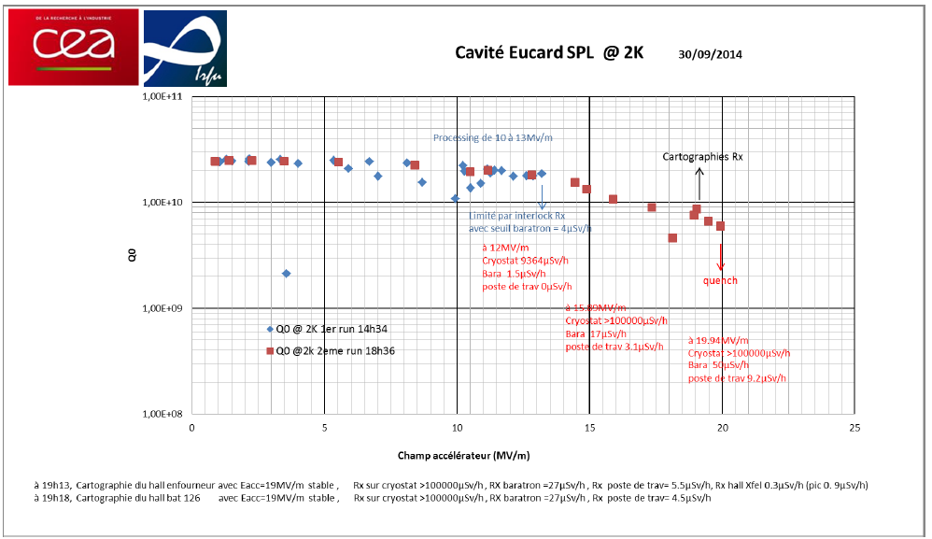
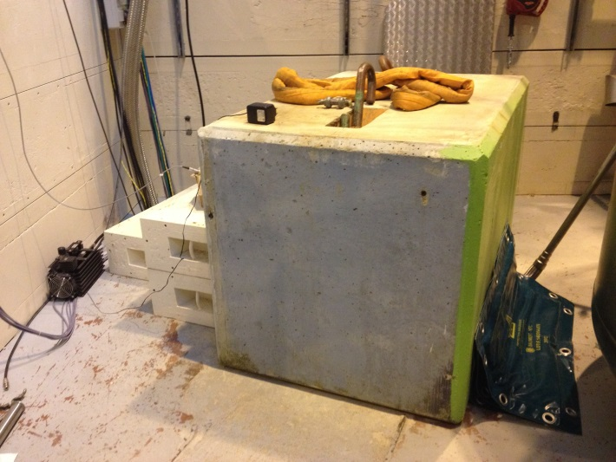
Radioprotection improvement for CV tests
Vertical cryostat
Eucard / SPL beta=1 704 MHz cavity
at 19 MV/m, radiation level decreased from 50 to 0.25 µSv/h close to workstation (public limit < 0.5 µSv/h)
Concrete blocks

Slide 12
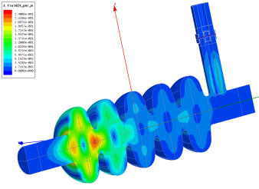
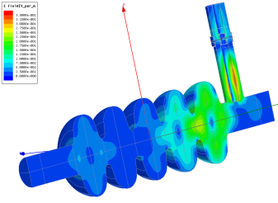
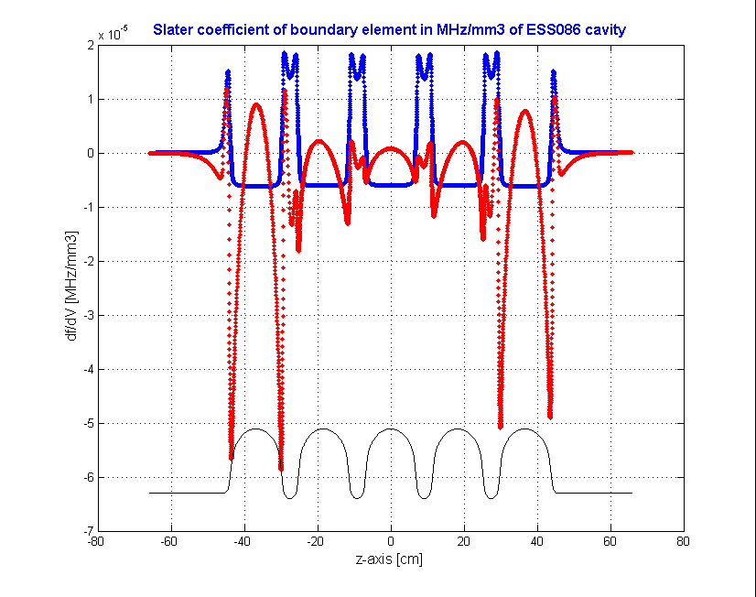
Dangerous HOM close to 1408.8 MHz
Design
Slater coefficient
704 MHz
1421,32 MHz
Freq (Hz) Q Max. r/Q
1,420314E+09 1,58E+05 8
1,421856E+09 4,30E+03 17
~ same frequency without power coupler
Theory (at 300K) | Measure P01 | Measure P02
1418.178 | 1402.254 | 1407.848
1418.674 | 1404.666 | 1408.258
ESS Requirement (at 2K):
→ HOM at more than 5 MHz from beamline frequencies (here 1408.84 MHz)

Slide 13
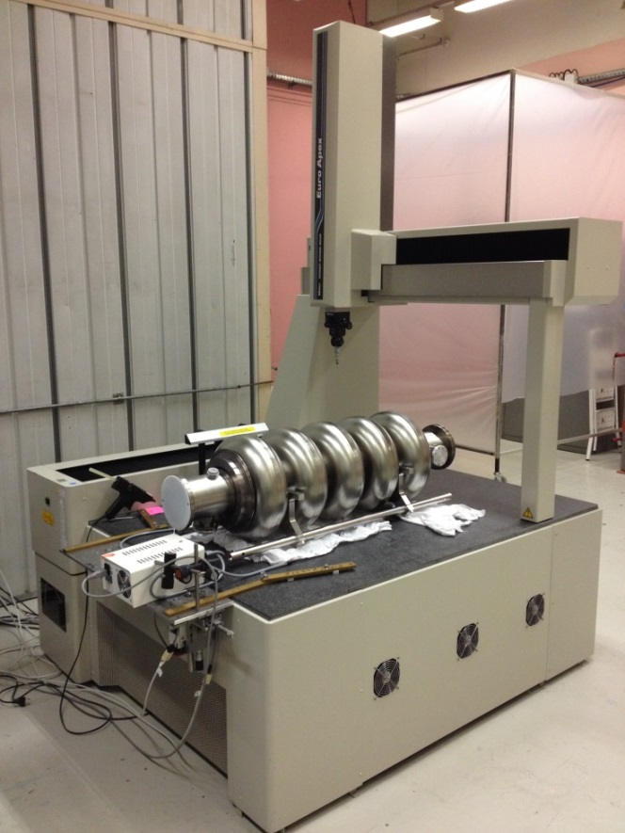
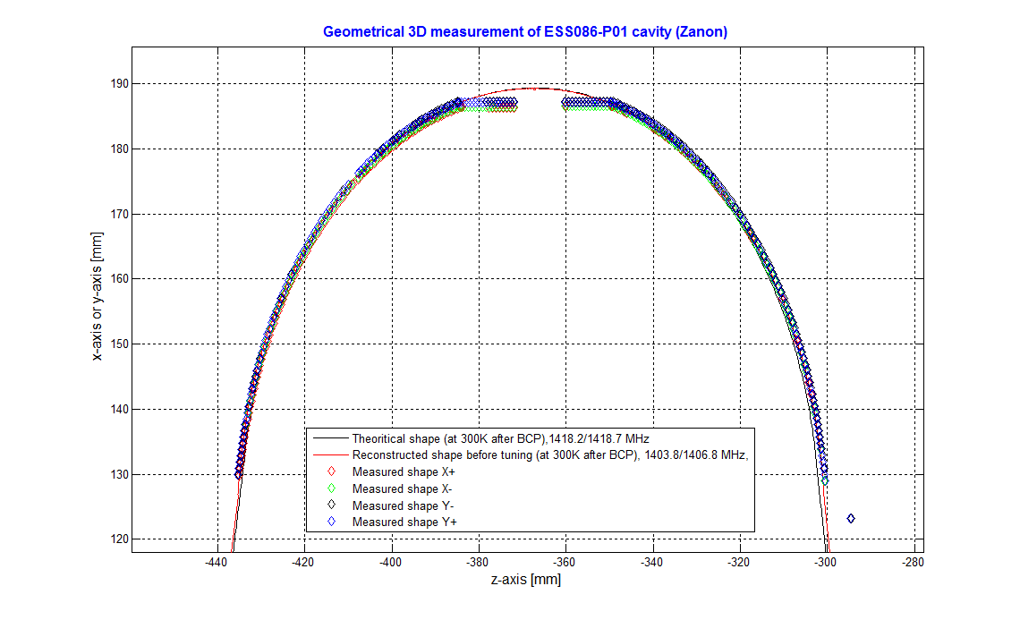
3D geometrical measurements
⇒ Measured shape reconstructed in HFSS
Theory (300K) | Measured on P01 | Calculated with measured shape (HFSS)
1418.178 | 1402.254 | 1403.8
1418.674 | 1404.666 | 1406.8
⇒ The frequency diminution of the two dangerous HOM is understood by a strong internal shape deviation in this region
Deviation of 1.4 mm

Slide 14
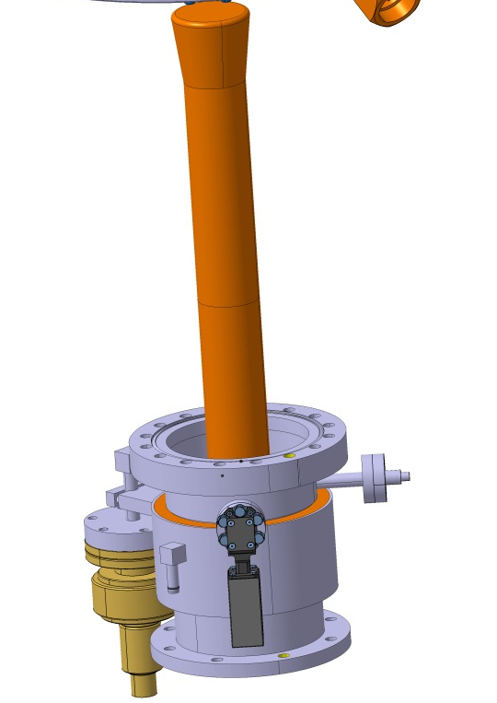


Power coupler procurement strategy
→ For the prototype cryomodules, the coupler procurement is divided into three parts
8 x RF window+antenna
→ TOSHIBA
6 x double wall external conductor
→ 2 companies in tender
6 x Door Knob
→ Spec. in progress

Slide 15
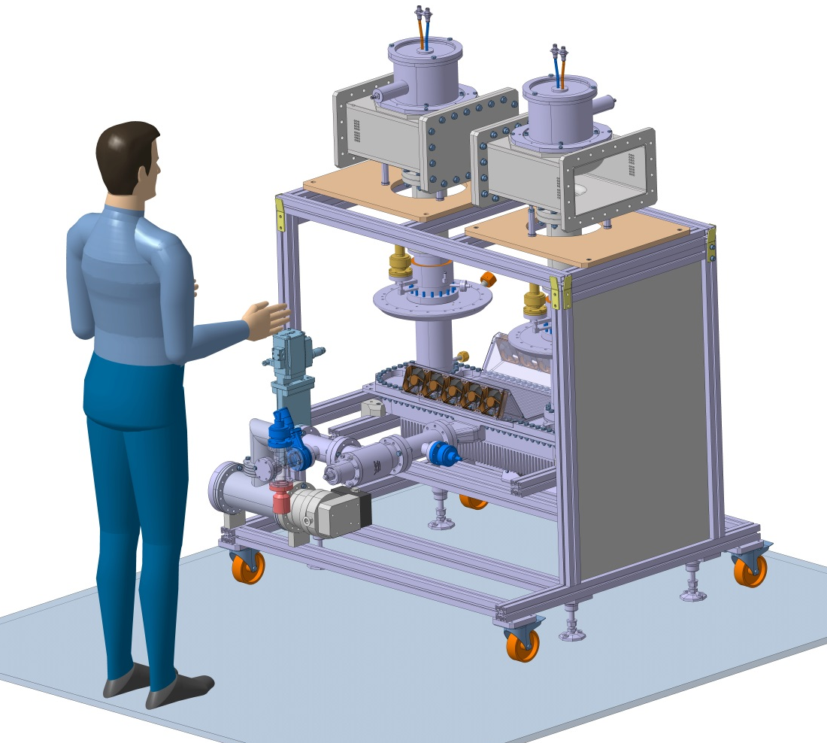
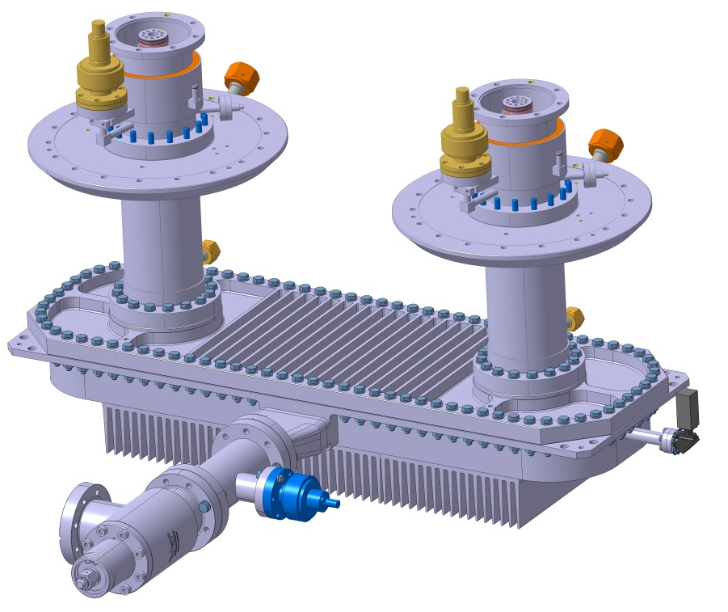
Power coupler conditioning set-up
Assembled in clean room
Tested with a 1.1 MW klystron and variable short circuit / matched load

Slide 16
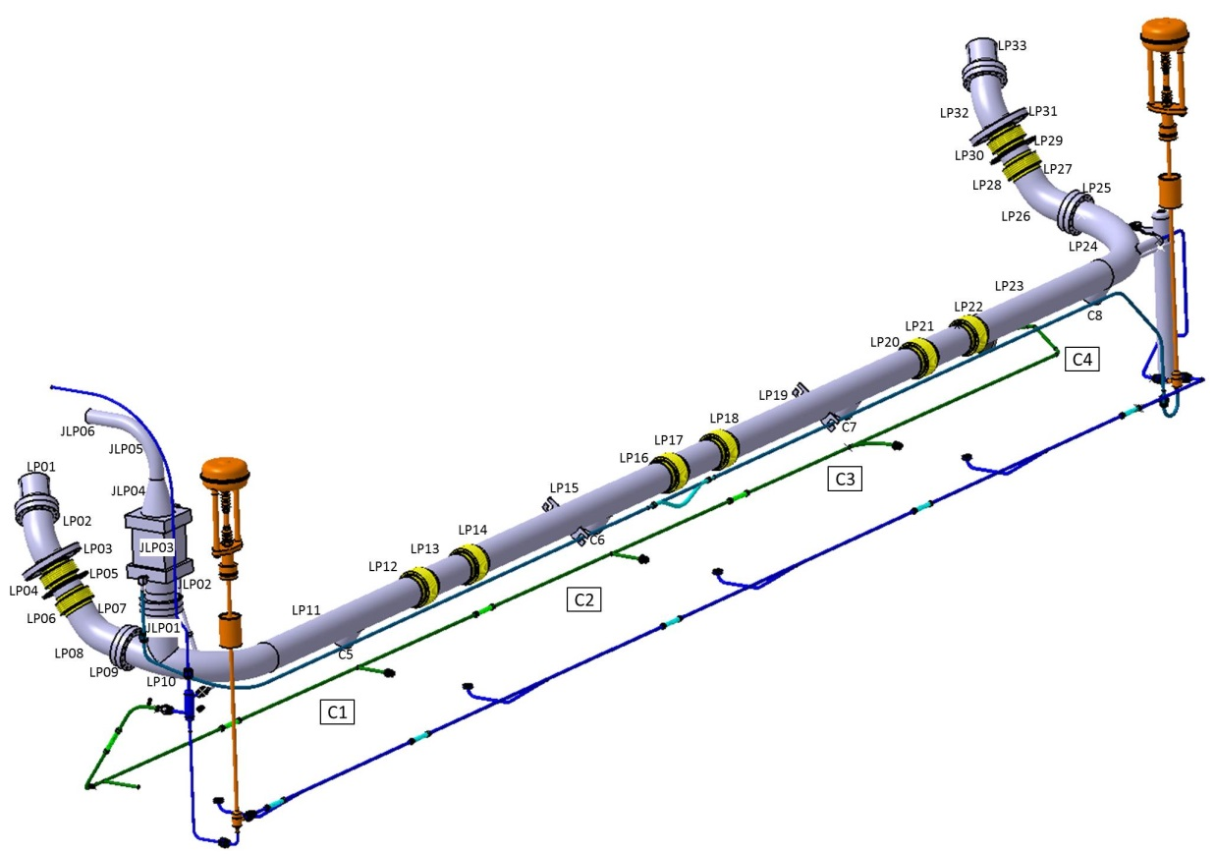
Internal cryogenic circuit
bursting disk
Regulation Valve
The circuit is designed to reduce as low as possible the overpressure in case of beam vacuum failure by using a continuous DN100 diameter for the diphasic pipe, large curvatures and 2 DN100 bursting disks at each extremity.
To valve box
Heat exchanger
Cooling down Valve
bursting disk
JP Thermeau

Slide 17
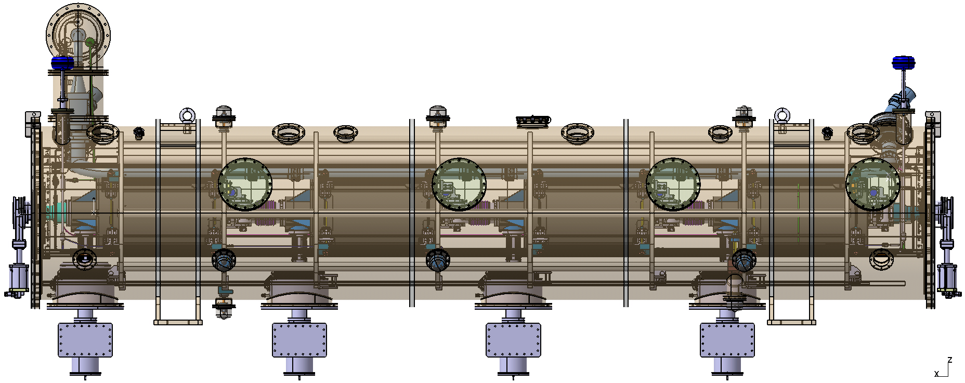
Instrumentation for prototype cryomodule
DN160 – 3 connectors
Cernox extremity
Pt100-50K extremity + 2 couplers
Pt100-300K extremity + 2 couplers
DN160 – 3 connectors
Cernox cavity 2
Cernox cavity 3
Cernox cavity 4
DN160 – 3 connectors
Heater + He level
Motor Cold Tuning System
Piezo Cold Tuning System
DN160 – 3 connectors
Cernox extremity + cavity 1
Pt100-50K extremity + 2 couplers
Pt100-300K extremity + 2 couplers
DN40
Instrumentation vacuum
DN100 – 2 N-type connectors
RF pick-up cavity 3
RF pick-up cavity 4
DN100 – 2 fiches N
RF pick-up cavity 1
RF pick-up cavity 2
DN40
Spare
DN100
Vacuum pumping
(Spare)
DN100
Vacuum pumping
G. Olivier, C. Darve, N. Elias

Slide 18
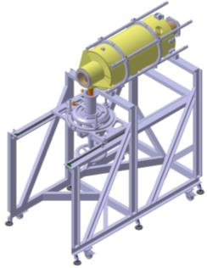
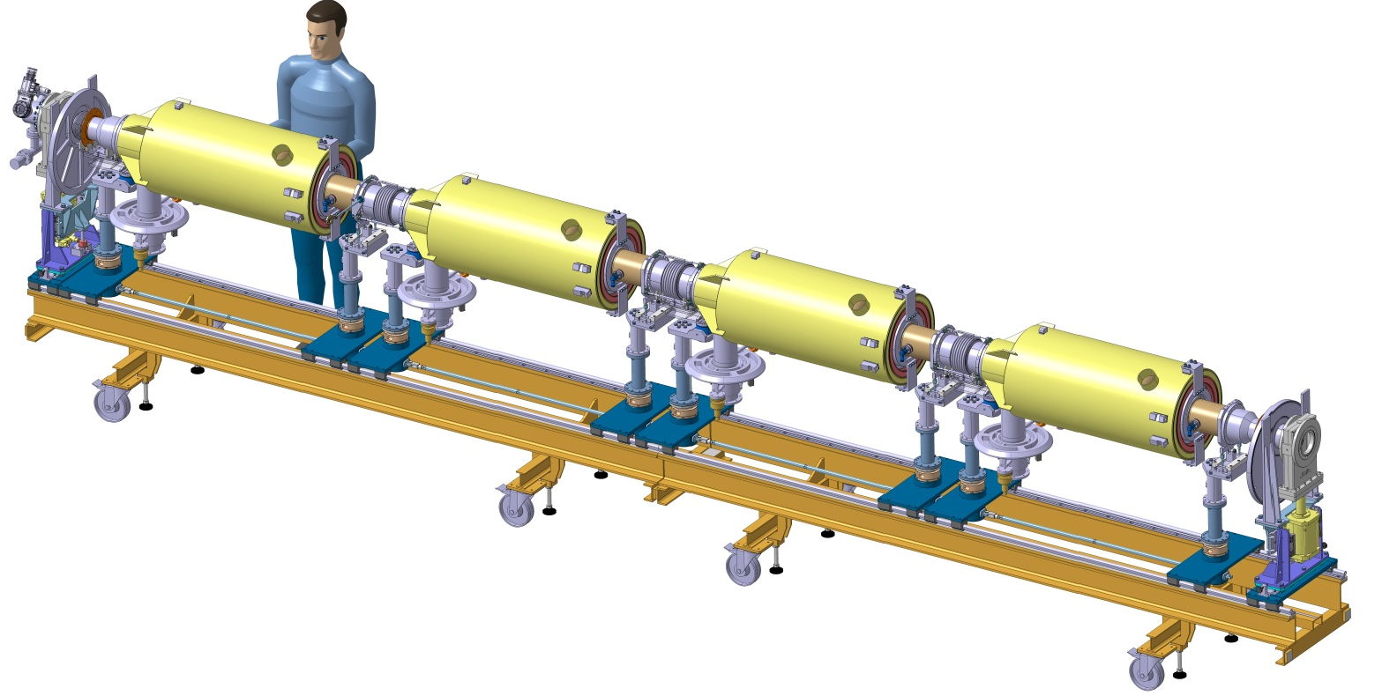
Cavity string clean room assembly
Coupler / cavity assembly vertically
Tooling compatible for both cavity types
Adjustment of the coupler position relative to the cavity flange
Cart in two parts with clean room rails
Each cavity is supported by two posts and beam valves on one post
Cavity string put under vacuum for the first prototype
N. Bazin, C. Madec, JP Poupeau, Ph. Hardy, F. Leseigneur

Slide 19
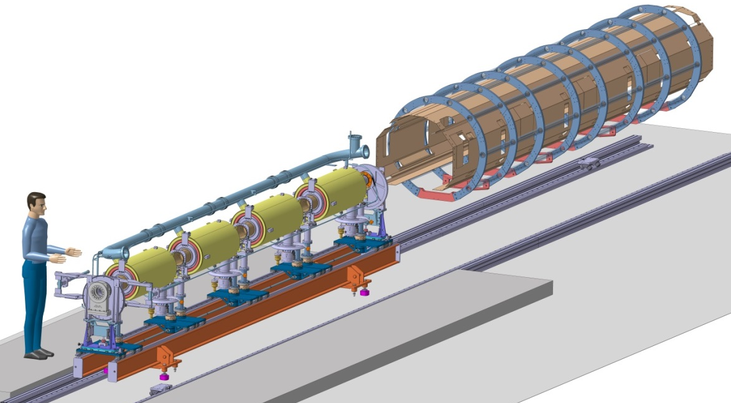
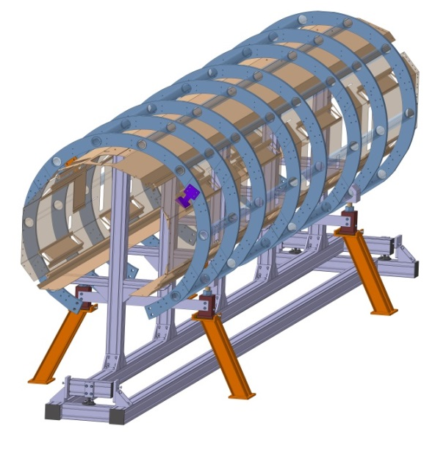
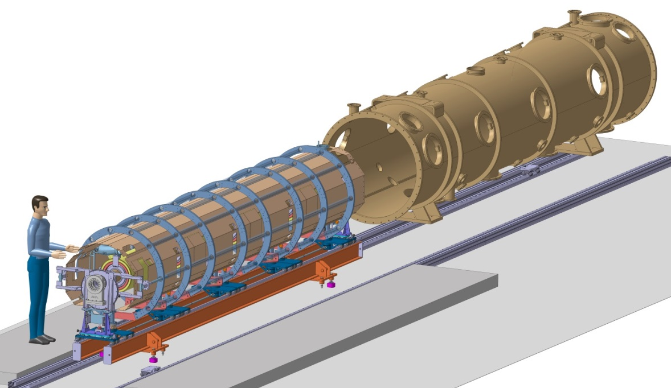
Spaceframe and thermal shielding insertion and cryostating
Design of toolings and assembly procedure almost finished

Slide 20
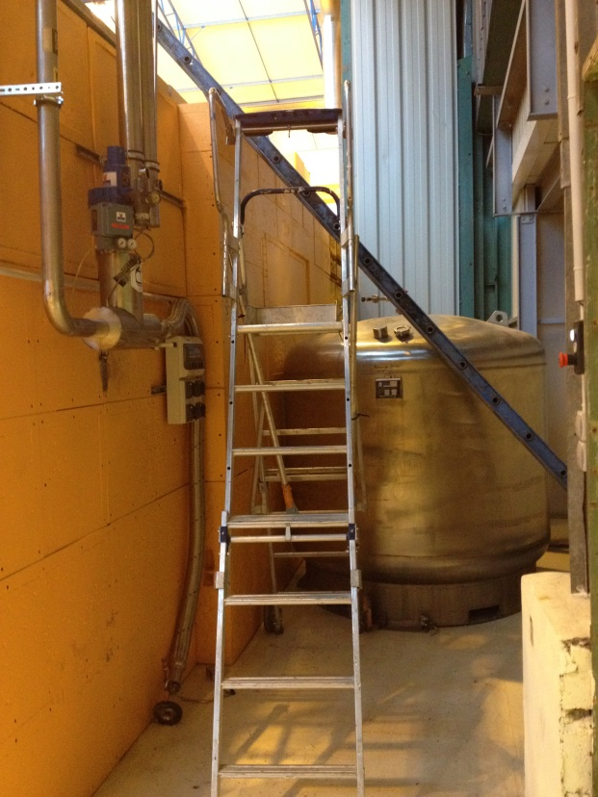
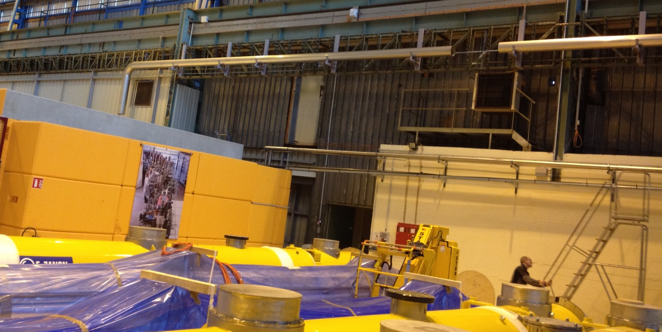
Test stand new cryolines installation
Dewar LHe
2000 L
Test bunker
(cryomodule will be installed inside)
Pumping line DN250
He return line
Cryogenic line
He Supply, 50 m long
(from CERN)
JP Charrier,
P. Sahuquet,
B. Renard

Slide 21
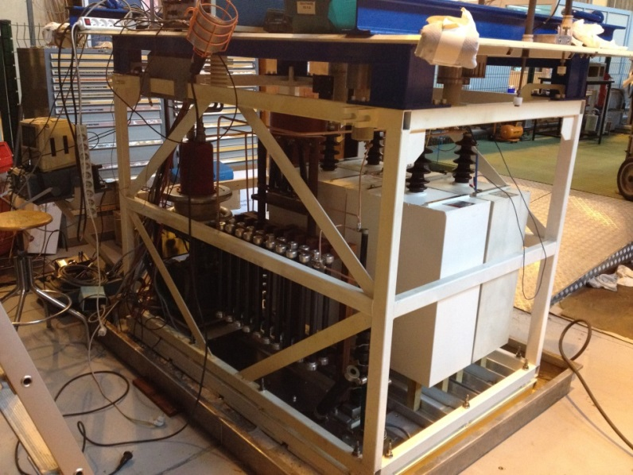
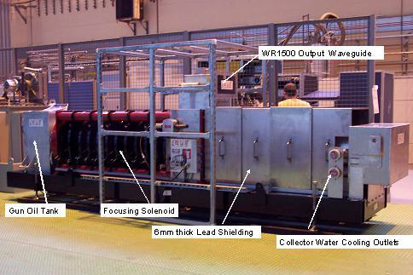
704 MHZ - 1 MW RF power source upgrade
Objective: increase the pulse length from 2 ms to 3.5 ms
C//C’=10µF
(Energie=60,5kJ)
R’//R2=25 Ohms
(tenue: 84kJ)
C’
R’
Adding of new capacitors and resistances in parrallel on the HV modulator
Conditionning of the CPI 1.2 MW klystron up to the ESS duty cycle will start soon
A. Hamdi, M. Desmons, F. Ballester

Slide 22
Conclusion
Important orders (cavities, couplers) are placed
Good progress in understanding the HOM issues on the high beta prototypes
Compliance with Pressure Equipment Directive (PED) under study for the cryomodule « alone »
  But will we have additionnal external constraints for the full accelerator ?
High power tests of the first cryomodule with medium beta cavities foreseen mid of 2016

Slide 23
Extra slides

Slide 24
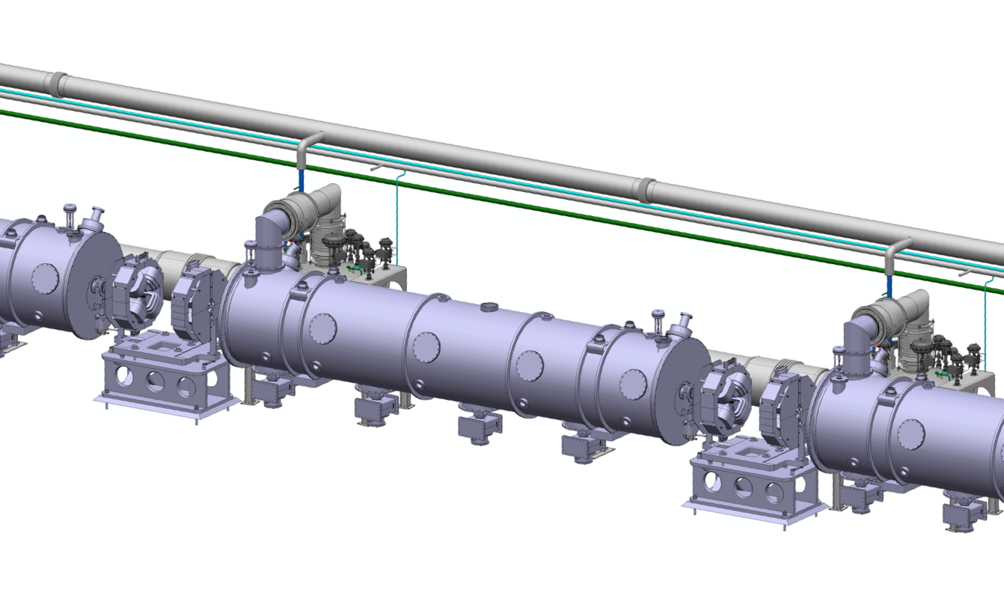
ECCTD in ESS Superconducting linac
Design philosophy:
Segmented:
  Independent cryogenic cooling and control
  Warm-up of a individual cryostat is possible
  Individually removable cryostats for repair is possible
Focusing elements at warm temperature
Warmline
Cryoline
Valve box
Elliptical cavity cryomodule
Interfaces with ESS:
  Accelerator Cryoplant
  Cryogenics Transfer Line
  Vacuum system
  RF waveguide and LLRF
  Integrated control Systems
  Machine protection system
  Test stands
Quadrupole
Proton Beam

Slide 25
Cryomodule Development plan
Design, build and test an Elliptical Cavity Cryomodule Technological Demonstrator (ECCTD)
2012 - 2016: with medium beta cavities
  Work done within the FR-SW agreement
  Collaboration IPNO and IRFU
2014 – 2017: with high beta cavities
  Early In-kind
CEA SACLAY in charge of of the “cavity package”, the cryomodule assembly and RF power tests
Cavities + helium tank
Power coupler design, manufacturing, RF tests
Piezo tuner
Magnetic shield
Tooling: field flatness, cavity preparation, cryomodule assembling, …
Cryomodule assembly
Tests stand for cryogenic and RF power tests
Tests of the ECCTD cryomodule
IPN ORSAY in charge of the cryostat,
design and fabrication
Vacuum vessel
Space frame – cavity supports
Thermal screen
Superinsulation
Internal cryogenic pipes
Instrumentation

Slide 26
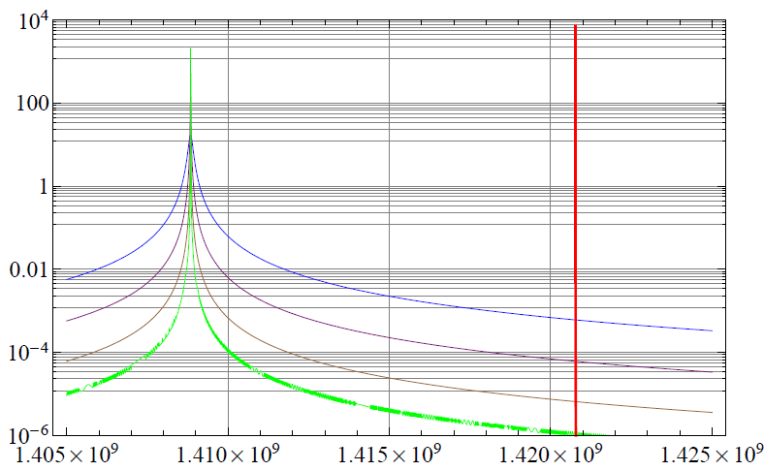
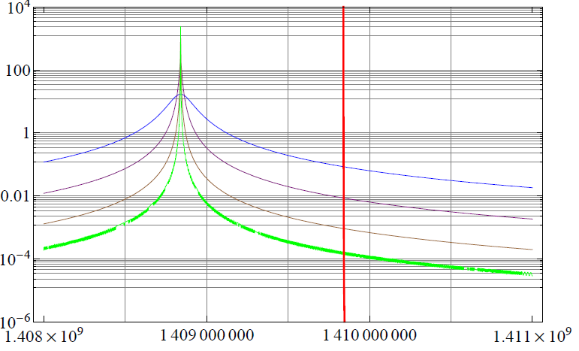
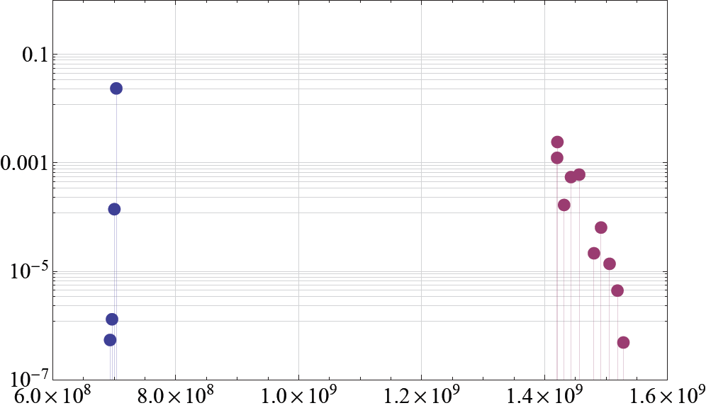

Power deposited on the non-propagating longitudinal modes
Most dangerous mode : 2nd mode of the 1st HOM L-band at f= 1420.764480 MHz
What would happen if this mode was at 1 MHz from the beam line ?
1 MHz
Q_{L}=10⁴
Q_{L}=10⁵
Q_{L}=10⁶
Q_{L}=10⁷
Q_{L}=10⁴
Q_{L}=10⁵
Q_{L}=10⁶
Q_{L}=10⁷
f= 1409.84 MHz
Pav. (W)
f= 1420.764480 MHz
Pav. (W)
Max. expected average power for each mode
1408.84 MHz
f (Hz)
1408.84 MHz
f (Hz)
Very important : distance between mode and beam harmonics
Q_{ext}=10⁵, Q₀=10⁸
Q_{ext}=10⁴, Q₀=10⁴
Conclusion: If longitudinal HOMs are more than 1MHz away from beam harmonics:
-no extra damping is necessary
-more damping harmful
Pav. (W)
Low power even for
worst cases!
G. Devanz –WP 4-5 Audit - Orsay
26
f (Hz)

Slide 27
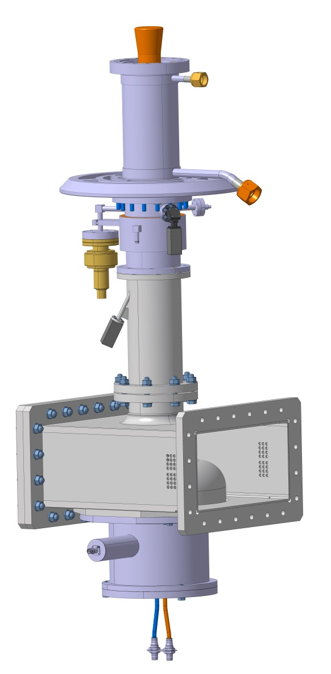
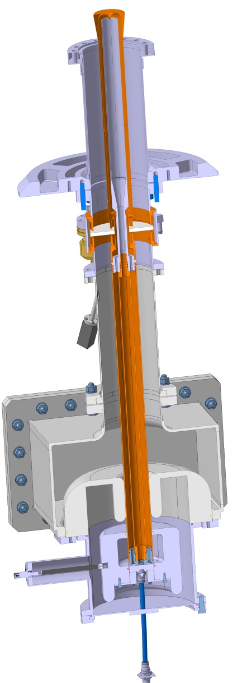
Fundamental power coupler
Pmax = 1.1 MW peak at 10% duty cycle → critical component
  Conical tip for stronger coupling
Outer conductor cooled with Liquid He in the vac. Vessel
  Inner conductor (water cooling)
Vacuum gauge
Arc detector (PM) vacuum side
RF ceramic window
Arc detector (PM) air side
Coax to rectangular RF transition (Door Knob)
  HV bias with RF trap

Slide 28

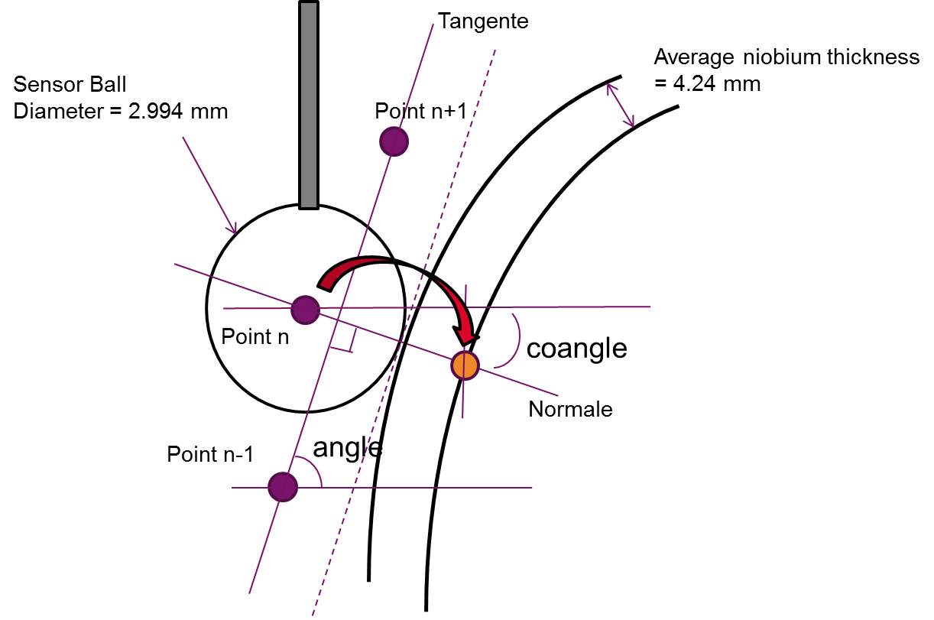

Slide 29




HOM mode identification
Bead pull on ESS086 P02 (03/11/2014) after +/- 0,5mm traction / compression of cell 1

Slide 30

Cell 1
Cell 2
Cell 3
Cell 4
Cell 5

Slide 31
Qx calculation
Double wall external conductor different
(same antenna)
C. Arcambal

Slide 32


Magnetic shielding design
Catia Model Vs simulated model in CST
Thickness = 2 mm
Material caracterisation used in the studies
At 700 MHz , ΔRs/ΔH = 0.3 nOhm/mG.
Goal: limit the magnetic field to ΔR_{s} max = 4 nW equivalent to:
B_{res} max = 14 mG = 1.4 µT
J. Plouin

Slide 33


Cryomodule elements procurements (by IPN Orsay)
…
call for tender started in Dec. 2014
Delivery foreseen in Oct. 2015
G. Olivier

Slide 34



Magnetic shielding design
Tesla
Tesla
Tesla
1.5 µT
1 µT
Magnetic field on the cavity surface for Hy=40 A/m
Tesla
Technical specification and call for tender will start beginning of 2015
4 (medium beta) + 4 (high beta) will be ordered
Magnetic field on the cavity surface for Hz=40 A/m
J. Plouin

Slide 35


Cold tuning system
Saclay V type adapted for ESS cavities
+/- 3 mm range
1+1 piezo
Cold motor and planetary gearbox (1/100e)
Piezo support has a stiffness 10 times higher than the cavity ⇨ piezo preload at 2K is independant of the cavity springback force
Type V for SPL beta = 1 5-cell prototype
G. Devanz

Slide 36
Heat loads
Values in Watts

Slide 37
Helium cooling scheme of the CM
Vacuum pumping
Cavity tank filling with LHe at 4,5 K
Pumping to produce Superfluid He at 2 K
Thermal shield cooling with LHe at 40 K
Power coupler cooling (outer conductor) with He at 4.5 K – 3 bar (supercritical fluid) → not possible at CEA, cryogenic adaptation to be performed
Power coupler cooling (window and inner conductor) with water
Special boxes allowing the axial moving and the thermalization of the thermal shield

Slide 38
Pressure vessels European rules
Relative pressure
Vessels
Pipes
Elliptical cavity
1 bar
50 L
PS<0,5bar:
The equipment is not on the scope of the 97/23/CE directive
Article 3.3
The equipment must be designed and manufactured according to workmanlike way
Category I
The manufacturing must be more documented, especially with internal production control
Objective: stay within « Article 3.3 » area

Slide 39
Helium pressure relief devices
Cavity pressure test
1,43 PS
Safety devices
2,72 bar
Safety devices
Maximum allowable overpressure
PS + 10%
2,09 bar
Bursting disks
+/- 10%
Absolute pressure
PS
Max. allowable press.
P_{SET} + 10%
1,9 bar
1,891 bar
1,81 bar
P_{SET} Set Pressure
Bursting disk
Bursting area
P_{SET} – 10%
European rules compliance Article 3.3
1,729 bar
(overpressure when opening)
P_{MAX APERTURE} = + 10 % P_{OPENING}
Safety margin
59mbar
1,670 bar
P_{OPENING} = + 5 % P_{SET}
1,609 bar
Relief valve
MAWP 1,58bar
P_{SET}
Opening area
P_{CLOSING} = - 5 % P_{SET}
1,551 bar
P_{MIN CLOSING} = - 10 % P_{CLOSING}
(hysteresis before closing)
1,496 bar
1,431 bar
(1,3 +10%)
Safety margin
65mbar
WP upper limit
WP
Working pressure = nominal pressure
1,301 bar
ESS Helium factory, circuits
and operating modes

Slide 40


Cryoline design
To valve box
2 bursting disk at each tip
+ upstream safety relief valve (with he guard)
A 36° angle is set up for the tank nozzle in order to allow the insertion of the cavity string and the cooling circuit inside the spaceframe
Heat exchanger
36°
The circuit is designed to reduce as low as possible the overpressure in case of beam vacuum failure by using a continuous DN100 diameter for the diphasic pipe, large curvatures and 2 DN100 bursting disks at each extremity.
Worst scenario: beam vacuum failure
38KW/m² applied on the cavity wall
Accidental overpressure: 550mbar reduced
to 230mbar after rupture of the disks

Slide 41





1
Beam axis reported to reflector bracket on beam flanges
2
Alignment of the cavity string within 1,5 mm of the beam axis
3
Vessel alignment with respect to cavity string
4
Alignment made by laser tracker
Reflector brackets
(vessel alignment)
Alignment of the cryomodule in the tunnel (source ESS)
Reflector brackets
(coupler flange)
Reflector brackets
(cavity flange)
1,5" Corner cube reflector
(source ESS)

Slide 42


Cavity string transfer out of the clean room
Transfer the cavity string from the clean room cart to another support for the post-clean room assembly (40 cm step between the floor of the clean room and the floor of the hall)
Alignment constraints between the rails of the clean room cart and the rails of the post clean room support: 0.1 mm
The loaded post clean room support shall be manipulated with a crane -> mechanical constraints on the design

Slide 43


Cold mass assembly

Slide 44


Cryostating

