Slide 1
Cooling ESS
Anton Lundmark
Cooling System Engineer
www.europeanspallationsource.se
10 December 2014

Slide 2

Outline
Scope
Design objectives
CUB
Accelerator
Target
NSS

Slide 3
What are the different scopes?
CF Process
Cooling Water production (CUB)
Site distribution
Main headers in buildings
Heat recovery systems
ESS Energy Team
District Heating
CF HVAC
Heating
Cooling
“Work package 16”
CW requirement coordination
CW interface to “machine” Contaminated CW systems
Local CW systems
Accelerator design teams
Target design teams
NSS design teams

Slide 4
Design objectives
Reliability “..never cause shutdown of accelerator..”
Availability 6500 hours per year at full load
“..never have total CW shutdown..”
Stability Supply temperature +/- 1 °C
Supply pressure +/- 0,1 bar
            Flexibility Wide operating range
Design margins for critical components
Recycling Recover waste heat
Responsible High energy efficiency

Slide 5
CUB Process Layout

Slide 6
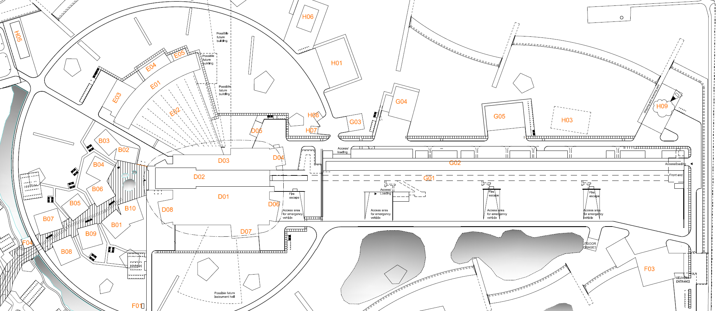
Process piping – main distributiuon
”HVAC” piping in ground
2 m underground piping
From CUB
Process piping in ground
1 m box culvert (surface)
3 m underground piping
1 m future
G02 + G04
D04 + D05
D05
CUB
expansion
area
G02-1
G02-2
G02-3
To Campus area
D04
Subst. 1
Subst. 2
Subst. 3
Logistic Center

Slide 7
WP16 interfaces to Accelerator/Conventional facilities
Central Utility Building
WP16
Cooling
WP3
NC linac
WP4
Spokes
WP5
Elliptical
WP6
Magnets
WP8
RF
WP10
T.S.
WP11
Cryo
WP17
Power conv.
Ion source
LEBT
RFQ
DTL
MEBT
Couplers
Couplers
HEBT
LWU
Klystron body
Kly. collectors
Amplifiers
Power supp.
Circulators
Load
LLRF
Klystron body
Kly. collectors
Amplifiers
Modulators
Power supp.
Circulators
Load
LLRF
Helium cooler
Oil cooler
Motor cooling
Turbine breaker

Slide 8
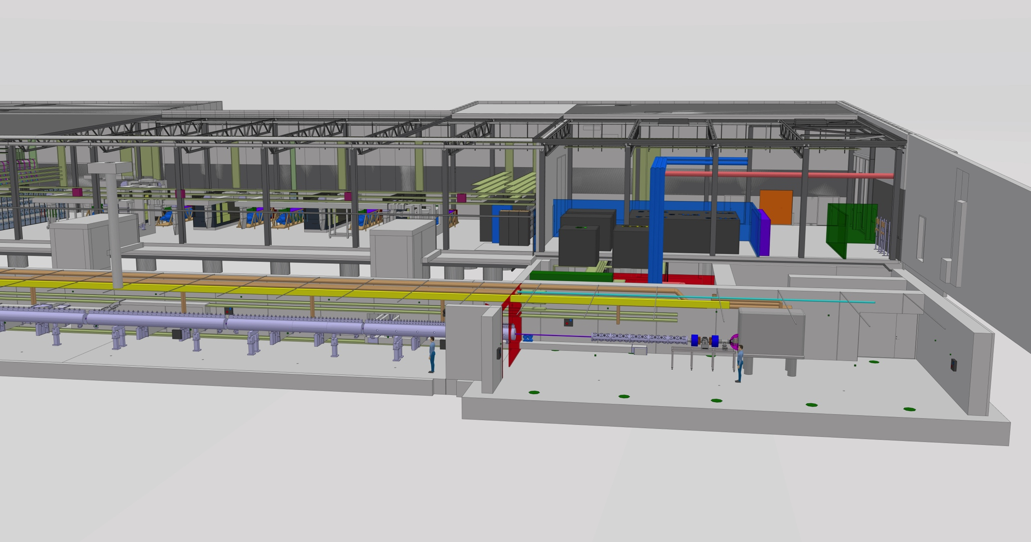
Front End Building

Slide 9
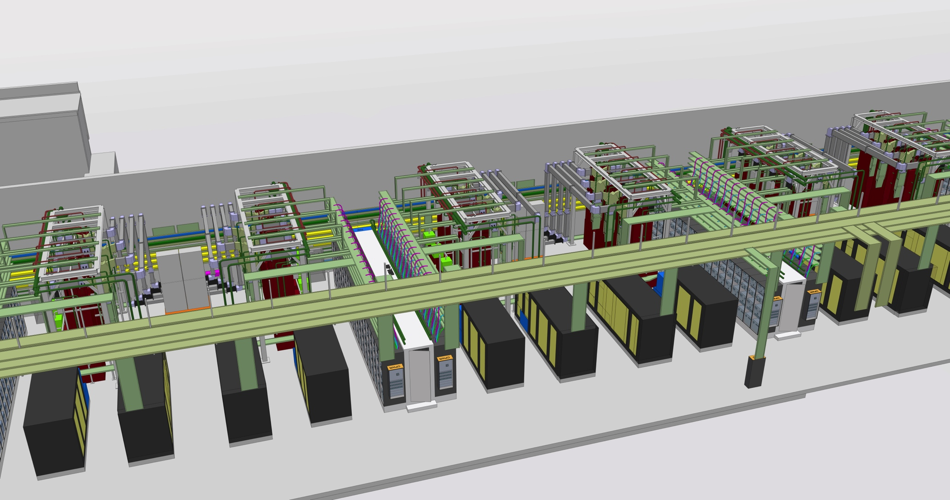
RF Gallery

Slide 10
Accelerator Cryoplant Cooling
25C
Middle temperature Return
37C
27C
Middle temperature Supply
He to cold box
25C
Compr. motor
39C
83C
High temperature Return
32C
27C
Middle temperature Return
He from cold box
90C
85C
Helium compressor
Helium cooler
Oil vessel
90C
85C
32C
27C
Oil
cooler

Slide 11
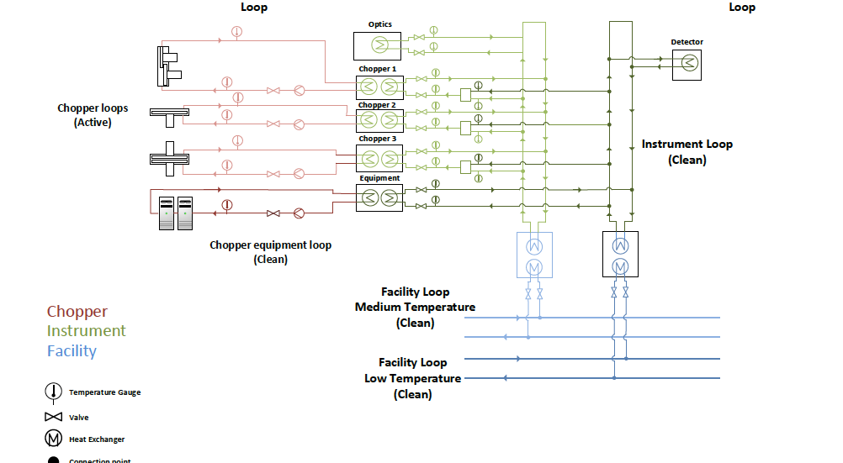
NSS

Slide 12
NSS Labs
Labs will have multiple components requiring cooling
  Reflectometers/diffractometers
  Furnaces
  Cryogenic refrigerators
  Electronic racks
  Etc.

Slide 13
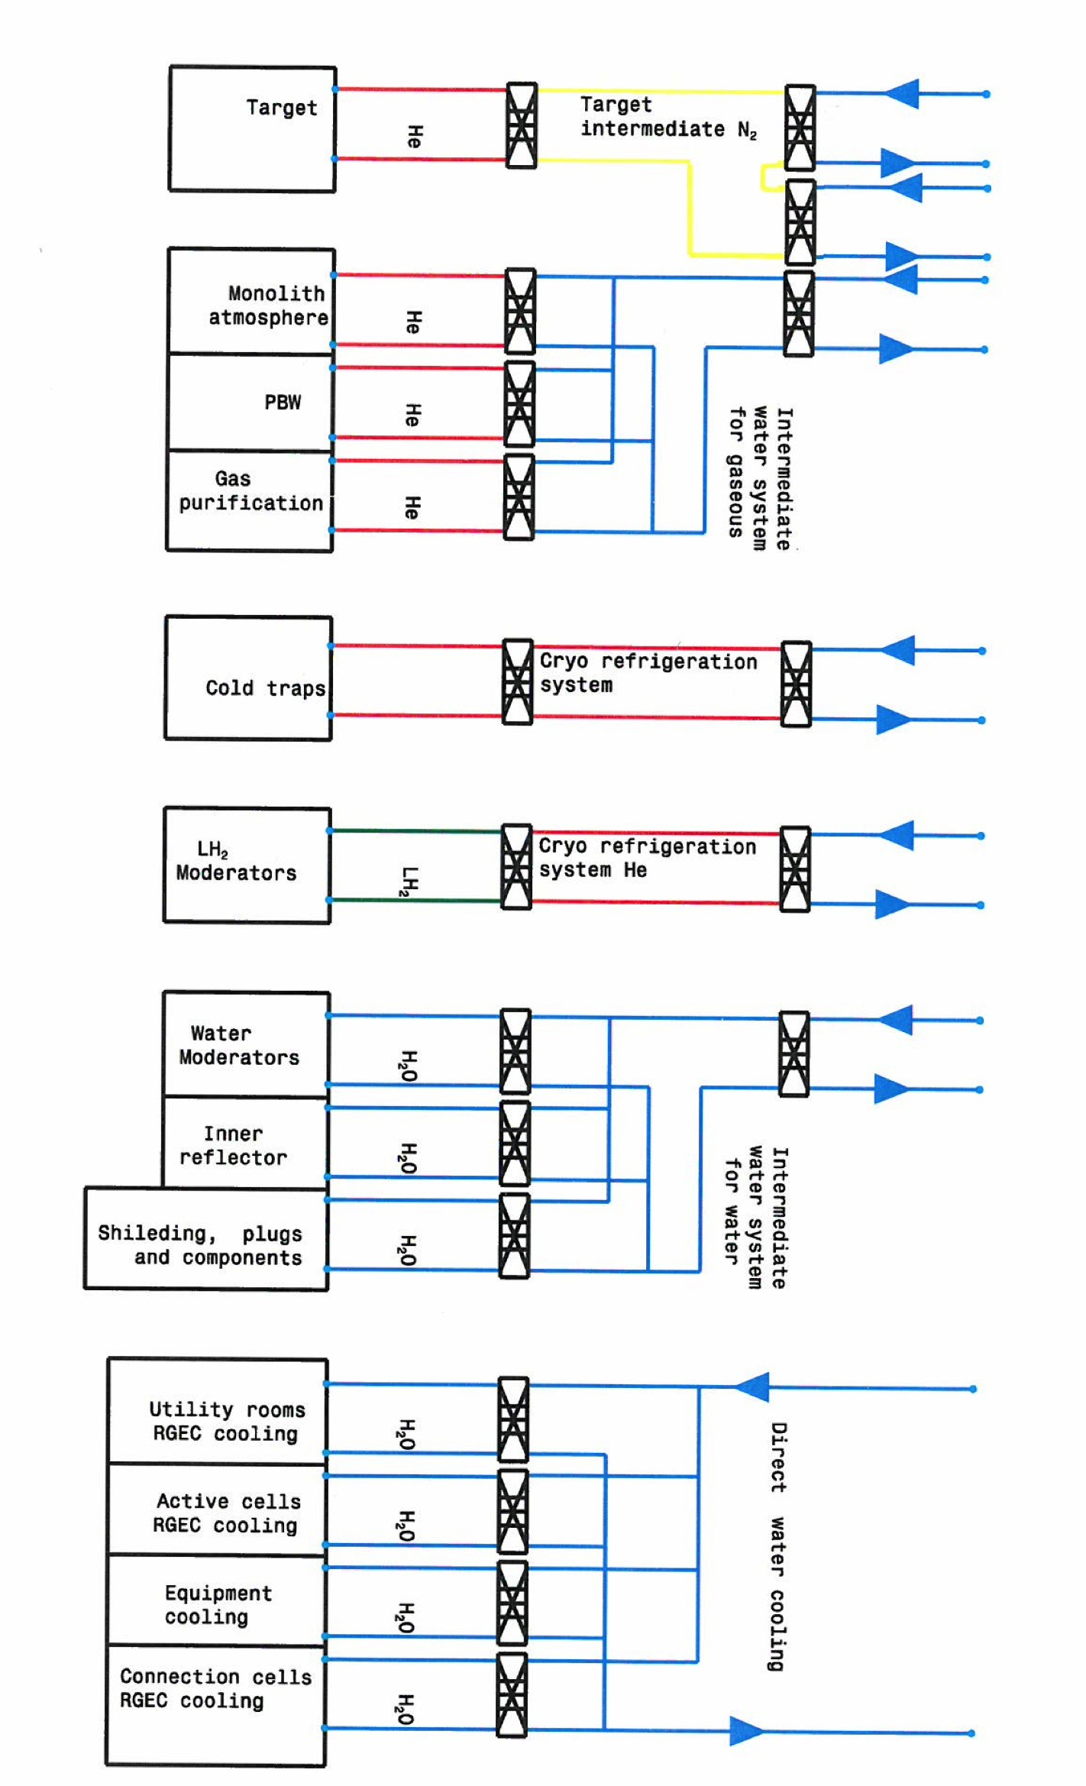
Target cooling systems
CW Low
supply
CW Low
return
CF cooling system scope
CW High
return
To Cryo cooling
Specialized Technical Services cooling scope
DO 00070
Target cooling scope
DO 00035
DO 00034

Slide 14
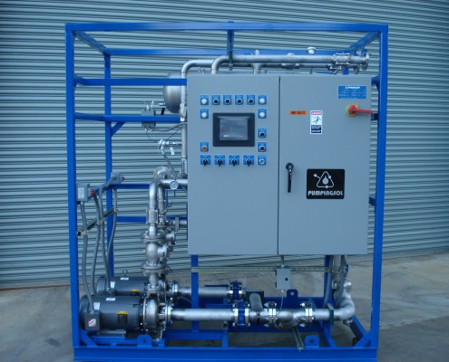
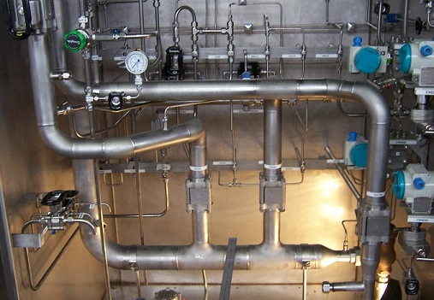
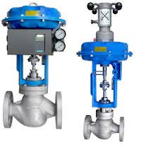
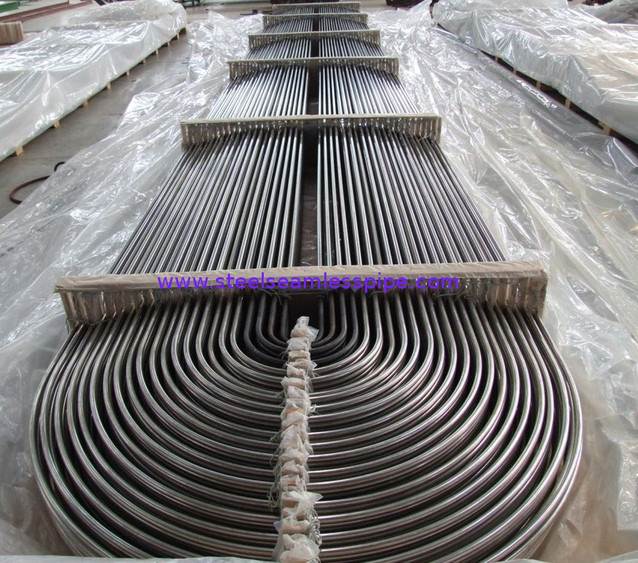
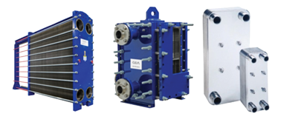
Typical components

Slide 15
?
Questions?
If you have questions later, don´t hesitate to contact me!

Slide 16
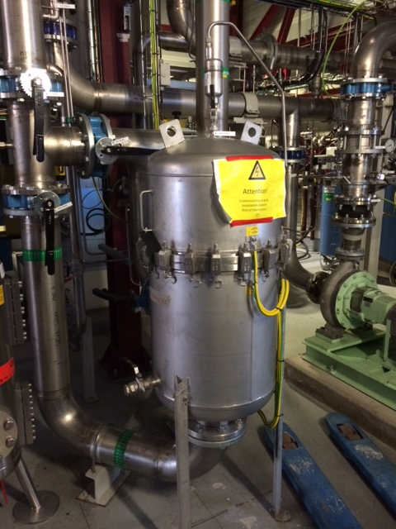
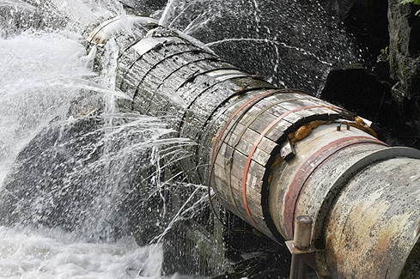
Thank you!

