Slide 1
NON INVASIVE TRANSVERSE BEAM PROFILE MONITORS
Charlotte Roose
AD and ICS Retreat mtg 2014
11 December 2014

Slide 2
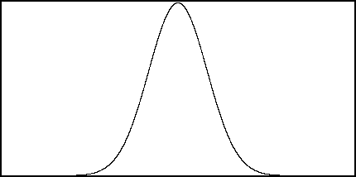
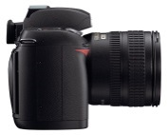
PROJECT
Transverse Beam Profile Monitor of a High Intensity Beam
Non Invasive Methods using the interaction between the beam and the residual gas
Composed of H₂ (65-80%) the rest being a mixture of CO, CO₂, CH₄, Ar and H₂0

Slide 3
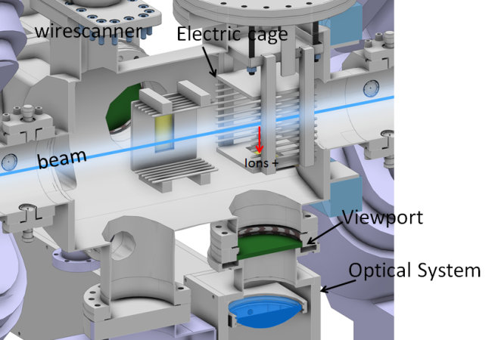
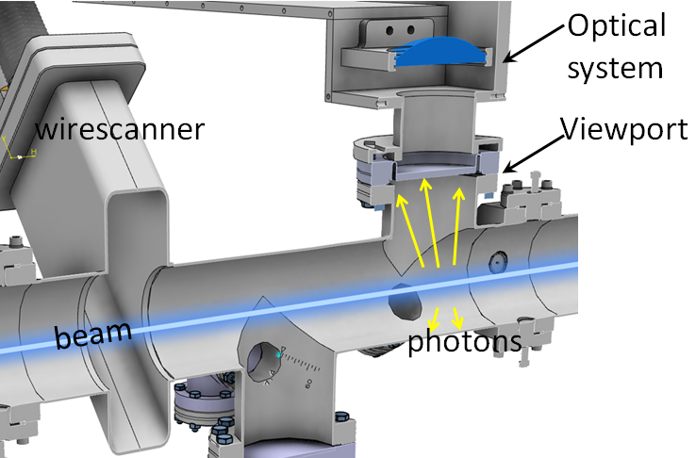
PROJECT
Beam Induced Fluorescence monitor
Ionisation Profile Monitor

Slide 4
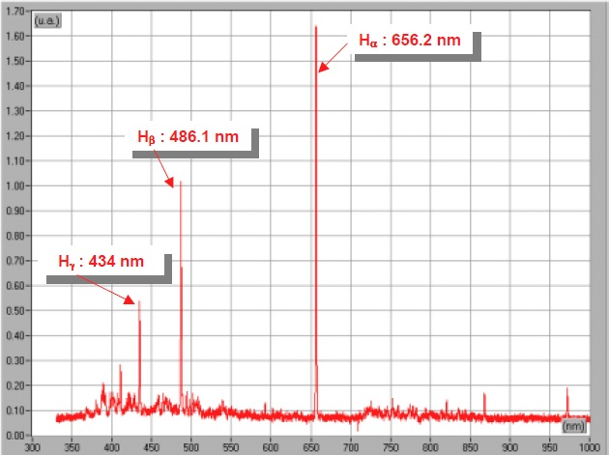
BEAM INDUCED FLUORESCENCE MONITOR
H₂ wavelength spectrum
Space avalaible 10 cm
10⁻⁷ – 10⁻⁸ mbar
300 K
Energy: from 75 keV to 90 MeV and 2 GeV
[1]
Spectrum analysis of a residual gas composed of 98% of H₂ interacting with a 95 keV proton beam
[1] B. Pottin ’Etude d’un profileur optique de faisceaux intenses de protons par absorption laser’, PhD diss, Université Paris Sud, France, 2013

Slide 5
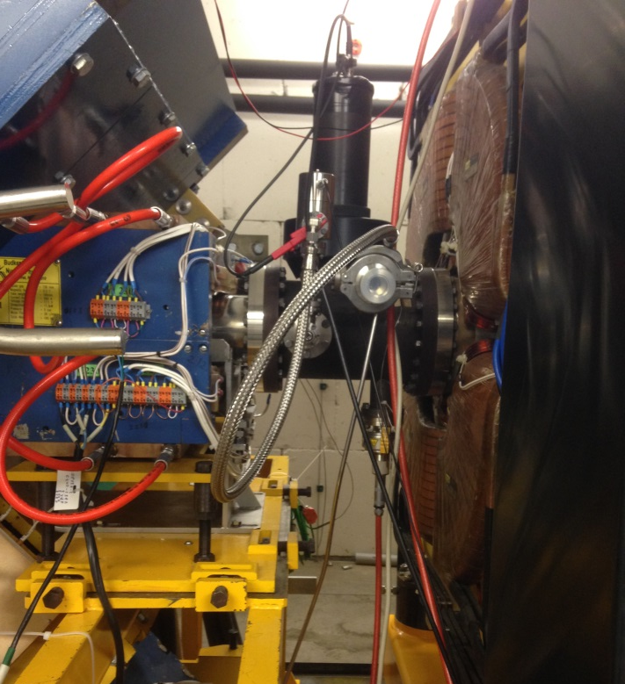
BEAM INDUCED FLUORESCENCE MONITOR
Fluorescence Yield
Experiment at the COSY facility
Energy at 45 MeV, 135 MeV, 500 MeV, 1 GeV and 2 GeV
Around 10¹⁰ particles
H₂ gas inject into the ring with a maximum pressure of 10⁻⁶ mbar
Notes:
COSY is a cooler synchrotron and storage ring for protons in the momentum range between 600 and 3700 MeV/c (corresponding to 175 and 2880 MeV). Protons with the desired energy are available for experiments with the circulating beam ("internal experiments") as well as for experiments with the extracted beam ("external experiments").

Slide 6
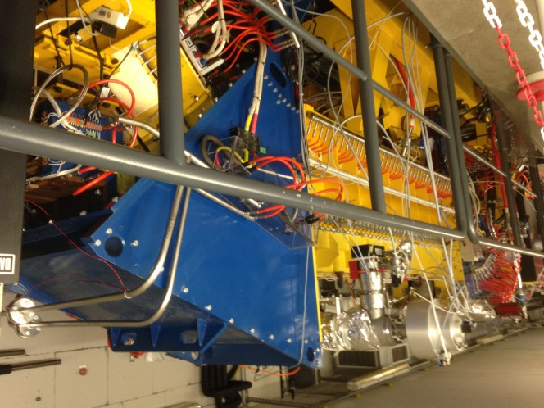
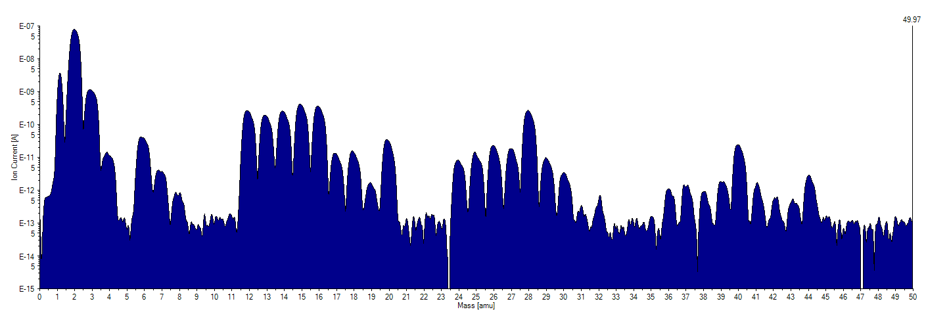
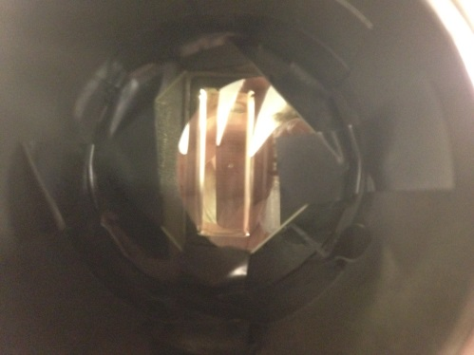
BEAM INDUCED FLUORESCENCE MONITOR
Fluorescence Yield
Experiment at the COSY facility
Mass spectrometer to check the gas composition evolution
Test with a filter to cut photons coming from N₂ fluorescence
→ More in January
Notes:
COSY is a cooler synchrotron and storage ring for protons in the momentum range between 600 and 3700 MeV/c (corresponding to 175 and 2880 MeV). Protons with the desired energy are available for experiments with the circulating beam ("internal experiments") as well as for experiments with the extracted beam ("external experiments").

Slide 7
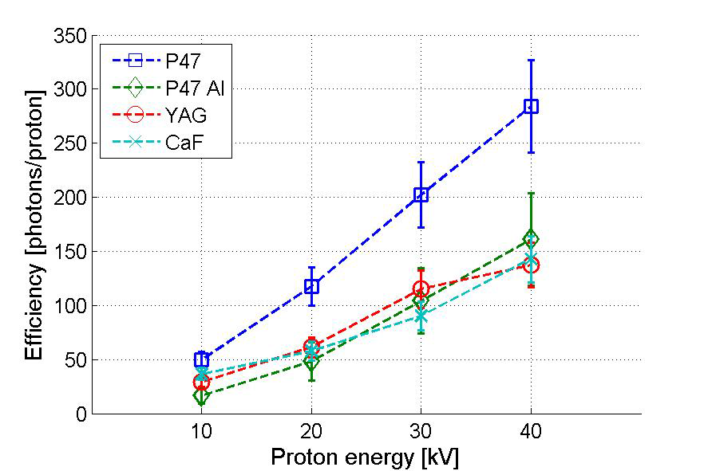
IONISATION PROFILE MONITOR
Scintillator screen
P47 screen with a ITO layer
P47 screen with an Al layer
YAG:Ce screen with a conductive layer
CaF2:Eu screen with a conductive layer
Space avalaible 327 cm and 359 cm
10⁻⁹ mbar
2 K
Energy: from 90 MeV to 2 GeV
→ Degradation ?

Slide 8
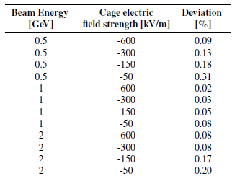
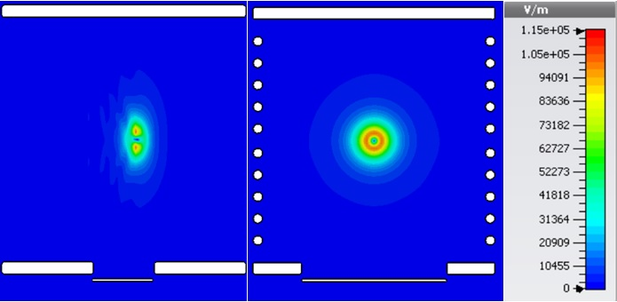
IONISATION PROFILE MONITOR
Space charge influence on the IPM Design
Dynamic electric field strength produced by a moving bunch was simulated with the use of the Particle-in-Cell solver of CST
MATLAB routine to track the H+ secondary ions moving in the total electric field
Preliminary results

Slide 9
THANK YOU FOR YOUR ATTENTION
This project has received funding from the European Union’s Seventh Framework Programme for research, technological development and demonstration under grant agreement no 289485

