Slide 1
Numerical modelling of cold helium safety discharges from the cryogenic distribution line
Jonathan Persson
MSc. Engineering Physics
AD and ICS Retreat mtg 2014
11 December 2014

Slide 2
Problem formulation
Failure modes, such as vacuum loss in CDL
System protection
ODH - Oxygen Deficiency Hazard
Is venting from CDL to atmosphere viable option?
My part:
Numerical model to simulate relief pipes
Various geometries, worst case scenarios

Slide 3
Linac CDS – function and layouts
Linac Cryogenic System
Linac
Cryoplant
Layout
Cryogenic
Transfer
Line (75 m)
Cryogenic Distribution Line (310 m)
comprising 43 valve boxes
Auxiliary process lines
Endbox
Splitting
box
21 High Beta Cryomodules (174 m)
9 Medium Beta
Cryomodules
(75 m)
13 Spoke
Cryomodules
(54 m)
Superconducting section of the Optimus linac (303 m)

Slide 4
Problem formulation
Problem setup
Relief system of valves and burst disk
Main focus on the joint vent line for mechanisms
Back pressures
Steady-state vs. Transient models
How well do worst cases correspond?
Heat transfer modeling
Bare pipe, frosting and air condensation

Slide 5
End box – 3D model isometric view

Slide 6
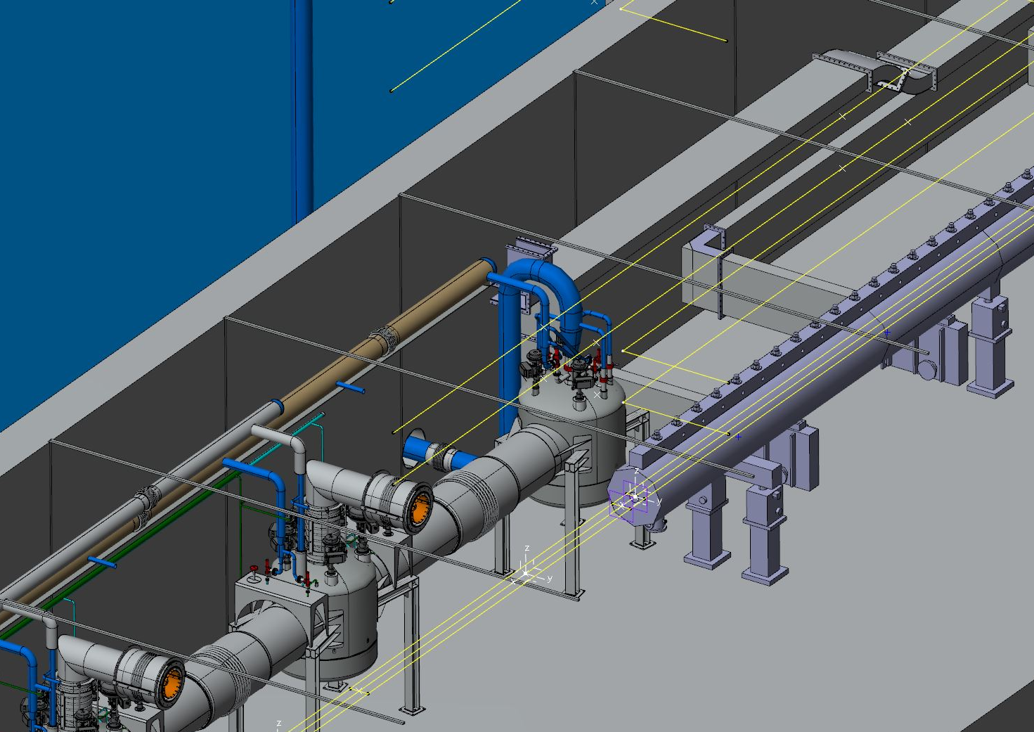
End box in the ESS linac tunnel

Slide 7
Methods
Main modelling software
ANSYS Fluent (first ANSYS CFX, OpenFoam considered)
CAD, Mesh, Pre-processing, Solver, Post-processing
Good 2D (axisymmetric) modelling
C-scripts for ”User Defined Functions”
Hepak – reference data software
Thermodynamic properties of He
Similar sources for stainless steel and comparable gases
Matlab
Analytical approximations for verification
Fanno flow, Rayleigh flow and combination

Slide 8
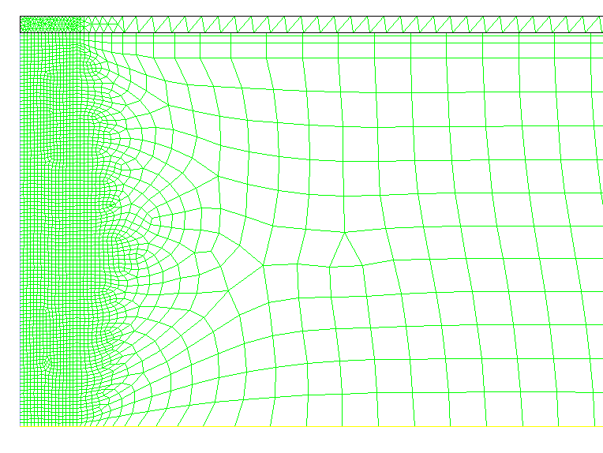
Methods – Meshing axisymmetric 2D
Tri-dominant
Inflation
Inlet
Quad-dominant
Centreline

Slide 9
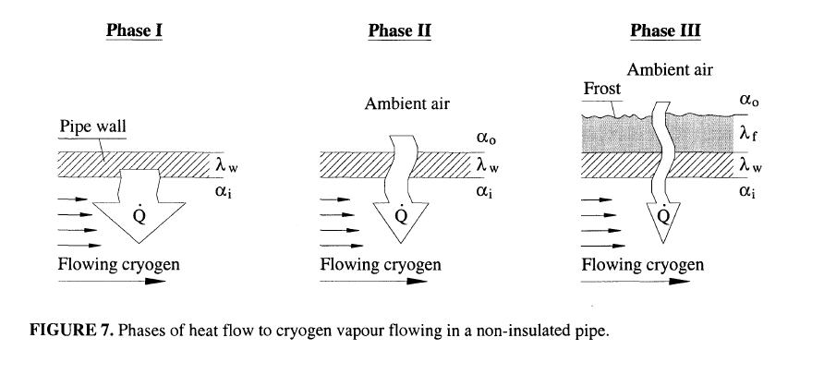
Methods – Pre-processing
Turbulence: available alternatives
k-ω (SST/Standard) (Best results for Fanno flow)
k-ε (Realizable)
Reynolds stress tensor (k-ε)
Transition SST (k-ω)
Heat transfer : (Forced convection dominant – Dittus-Bölter eq)

Slide 10
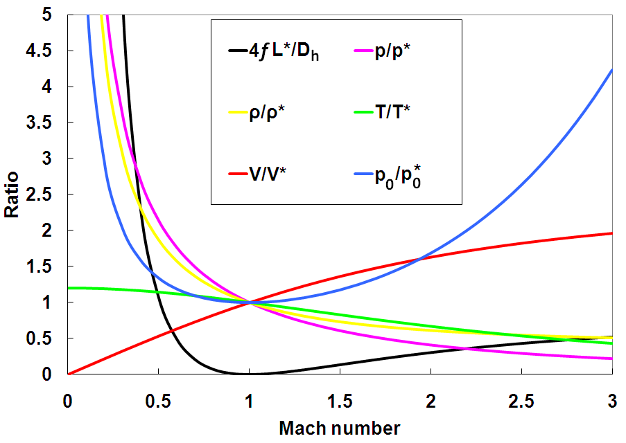
Post processing - verification cases
Fanno flow
Only friction (as derived from Moody chart)
Rayleigh flow
Only heat transfer
Assumptions
Quasi-1D flow
Perfect gas
Constant

Slide 11
Desired results
Validation & benchmarking
No experiments found; venting of cold He
Set of comparable, scalable cases
Transient simulations: ${\dot{m}}_{max}=f\left(∆p, D\right)$
Steady simulations: $\dot{m}=f\left(∆p, D\right)$
Investigation of specification of optimal choice for different setups

Slide 12
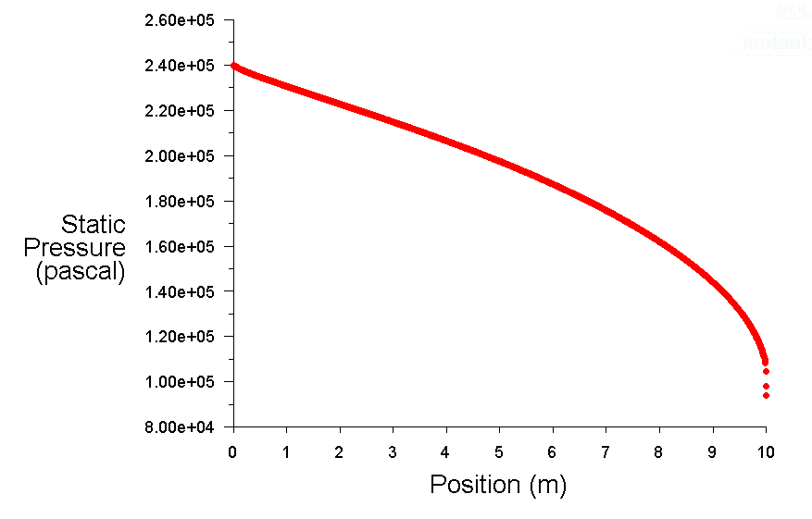
Fanno flow – example comparison

Slide 13
Fanno flow – example comparison
1D-flow assumption reasonable
Velocity profile assumed almost flat (except boundary zones)
Model error of 1.3% for mass flow rate, $\dot{m}$
Internal error for model 0.2%
Comparable with assumptions

