Slide 1
SPL Wire Position Monitor System
Wojciech Żak
mgr inż.
AD and ICS Retreat mtg 2014
11 December 2014

Slide 2
Outline
Application of the OWPM in the SPL Mock-up
Idea of the Optical Wire Position Monitor
Calibration at warm
Tests at liquid nitrogen
Fiber optics
Conclusions

Slide 3
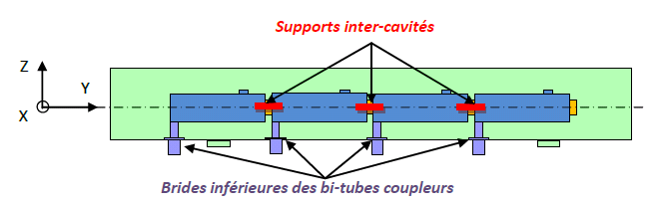

SPL SCM Cavity position monitoring specs:
Static position or slow movements: absolute movements (x,y,z) of each of 4 cavities during steady state operation and cool-down/warm-ups (300-2K)
Vertical range 0-2 mm
Precision < 0.05 mm
Resolution < 0.01 mm
Possibly vibration measures (0-1 kHz)
Stretched wire
Opto-coupler sensors
Last cavity support
Courtesy of V. Parma

Slide 4
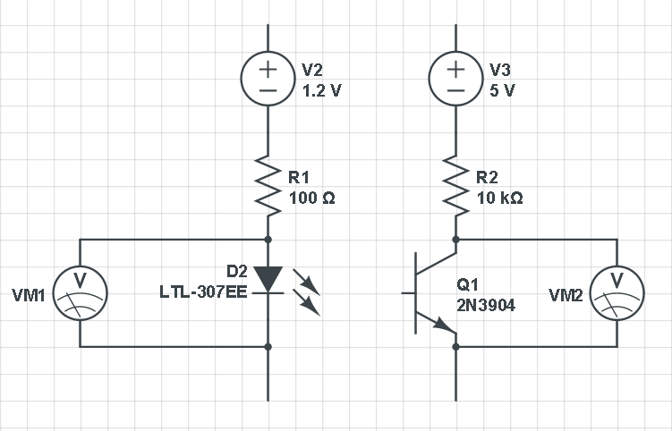
How does it work?
wire

Slide 5
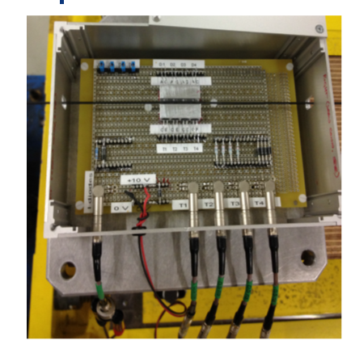
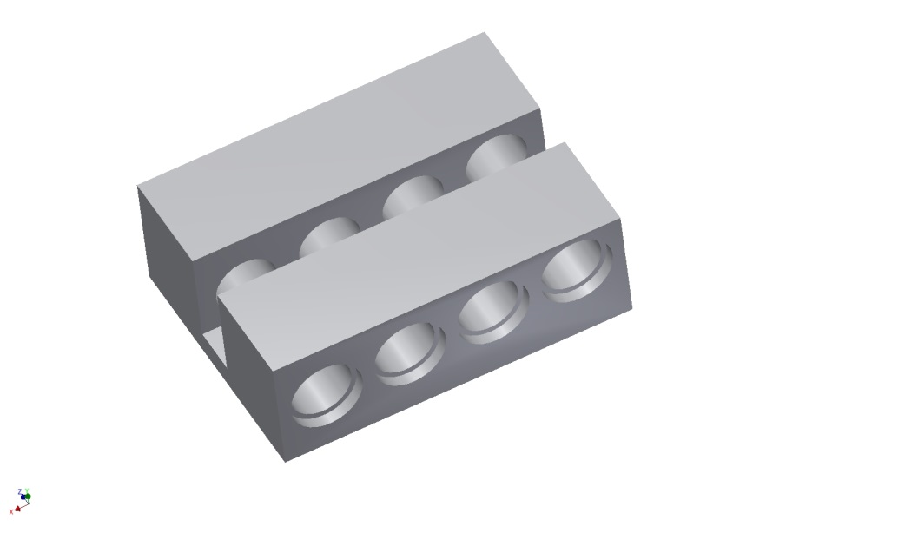
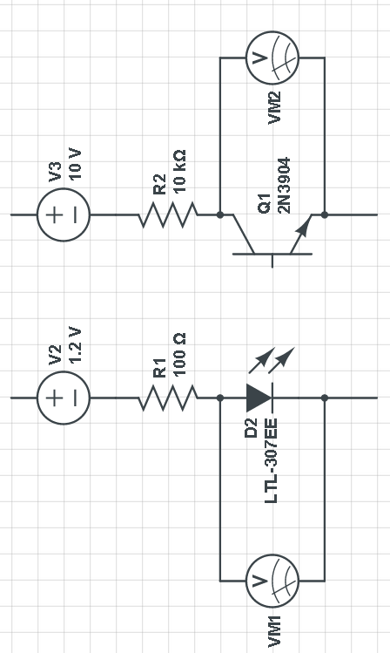
Tests setup for room temp
We expect to cover 0.5 mm range with one LED, to fullfill requirement our sensor will be equiped with 4
wire
Box to shield the environment light noise,
setup with 2.5mm wire
Wire was move by high-precision, linear stages, providing an accuracy of 1 µm on 150 mm maximum displacement.

Slide 6
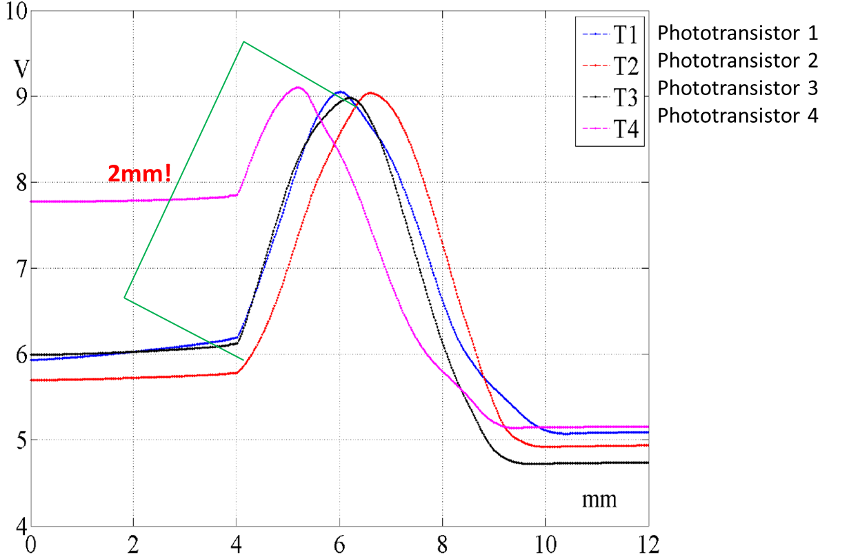
Results
Output voltage signal variations according to the movement of the 2.5mm wire
Courtesy of C. Petrone

Slide 7
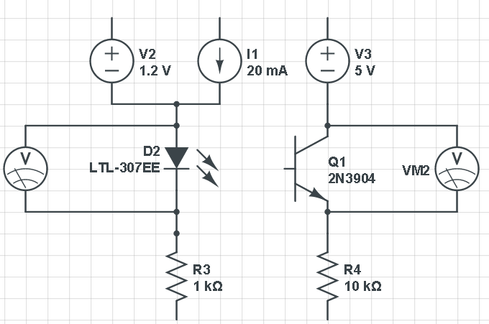
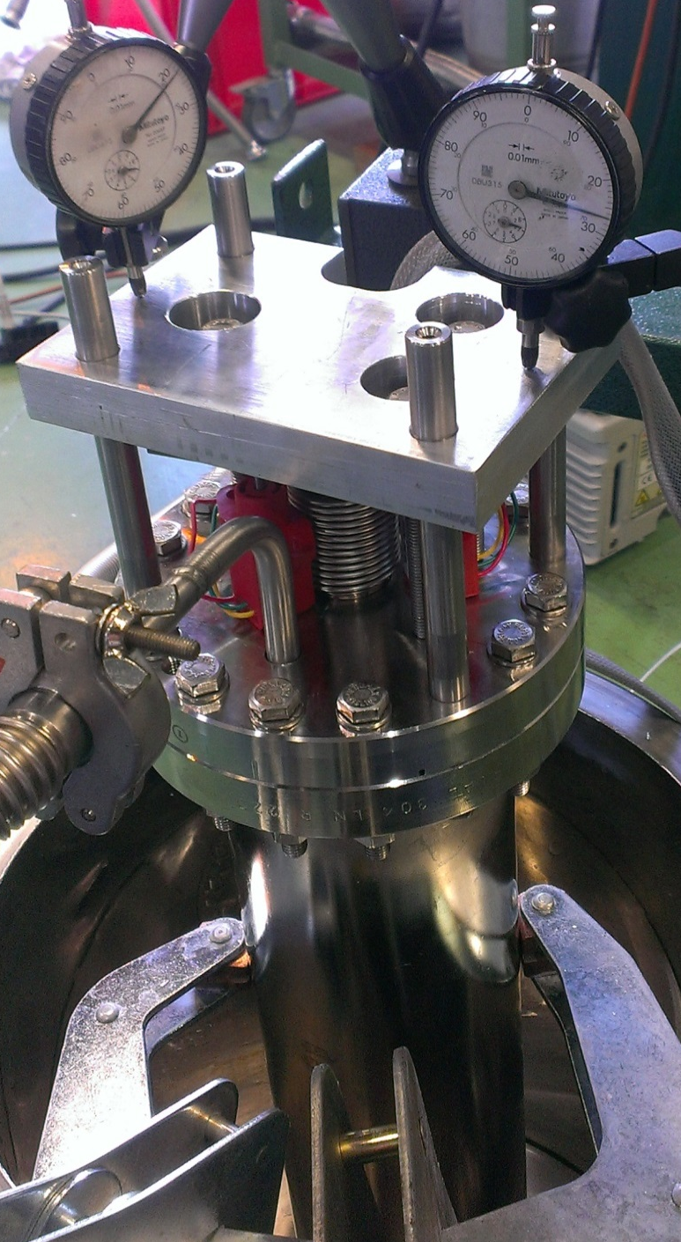
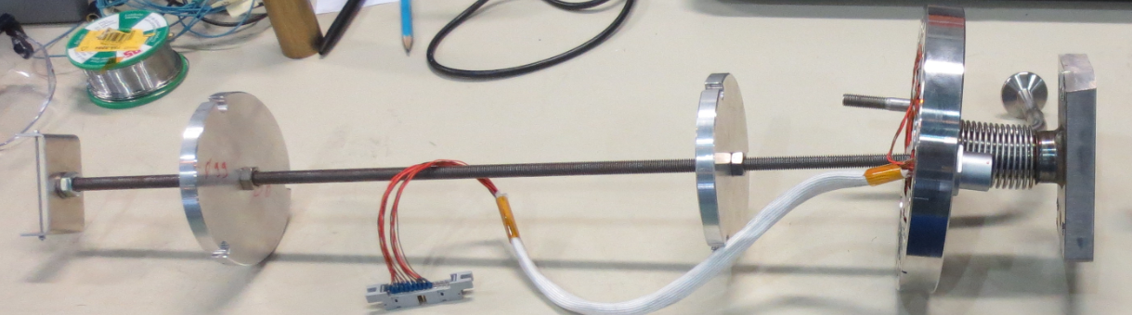
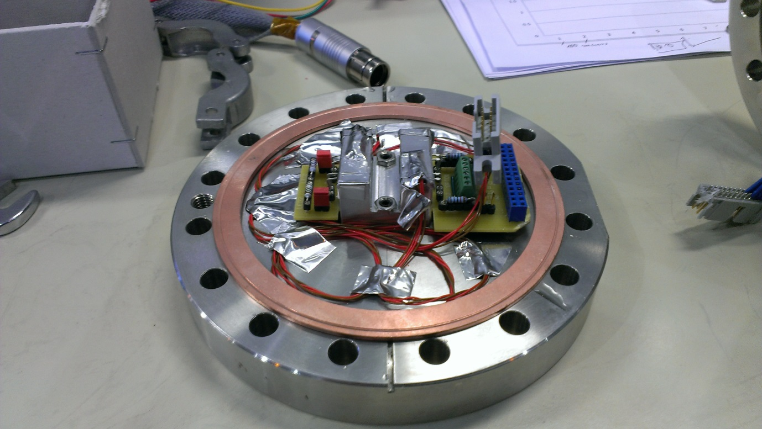
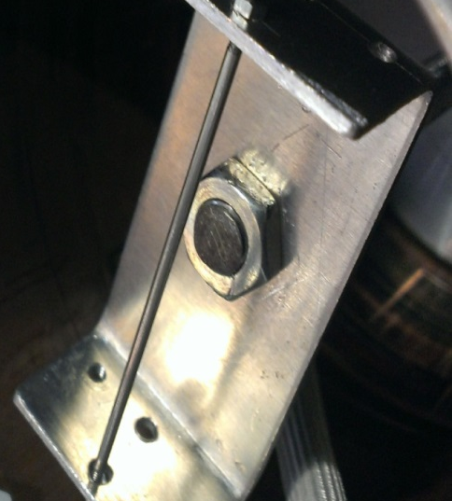
Test setup for LN

Slide 8
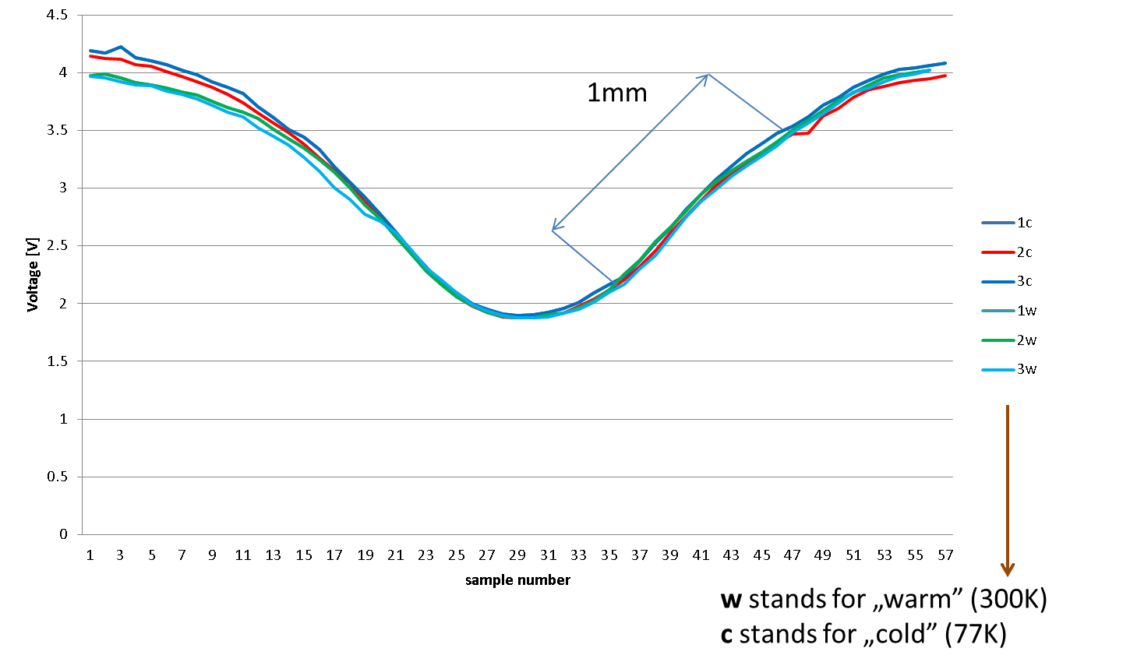
Results of tests in LN

Slide 9
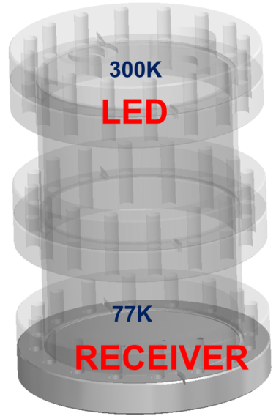
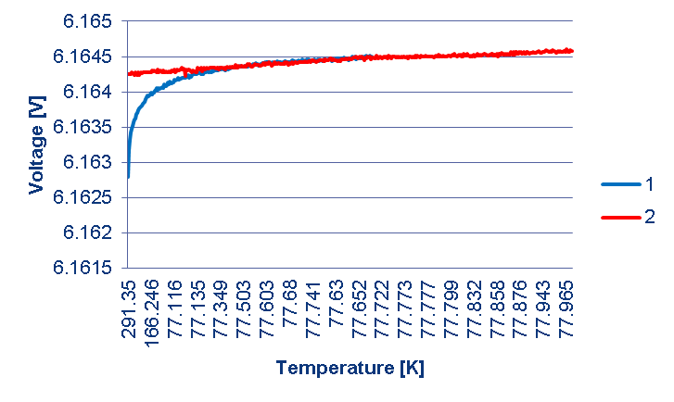
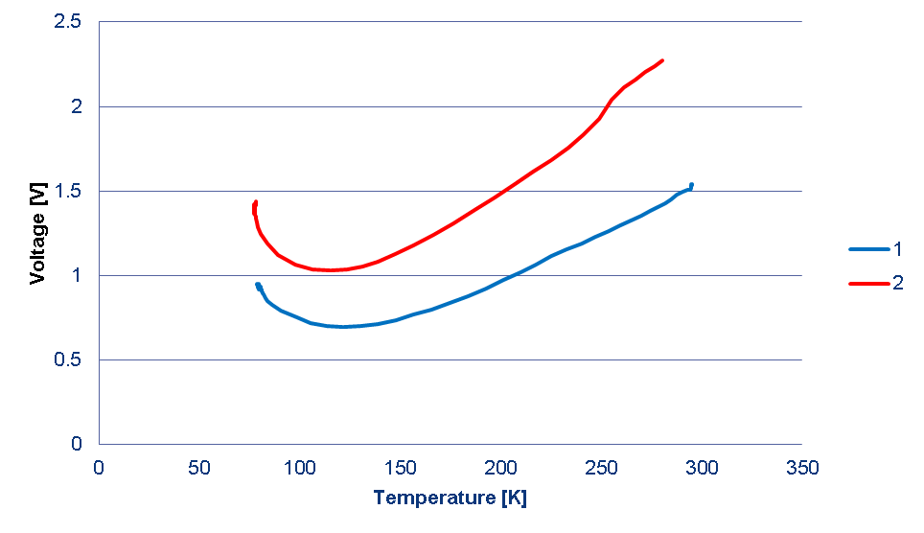
Behavior of components with temperature
Stability over time for phototransistor 2
Temperature stability of the LED
Stability over time for phototransistor 1
Phototransistor 2 after 2 tests in a row

Slide 10
Intermediate conclusions
Despite quite good results at room temperature and steady state conditions in low temperature the are some disadvantages:
No linear reaction with temperature
We’re “blind” during transient period
Properties of phototransistors strongly depends on the temperature
Receiver has different behavior even from the same series
We need “Cinderella” to find enough pairs for our sensors (64 in total)
Sensors should be equipped with a temperature sensors
Final application: 64 sensors => 10 wires each => 640 cables
temperature independent sensor
put as much as possible electronic outside the cryostat

Slide 11
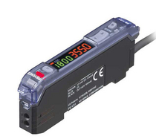
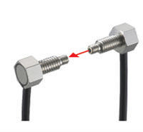
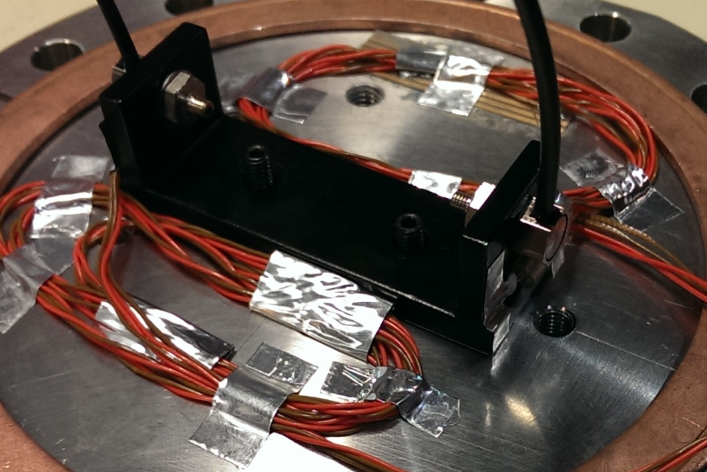
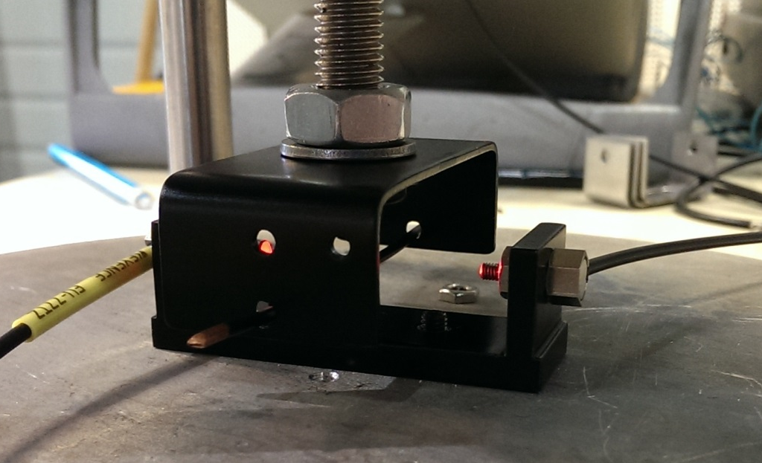
Fibre optic
Commercially available product:
Out of the shelf
Relatively cheap
Really easy to use
Flexible in configuration
But never:
tested in cryogenic temperature
used for this application
Couresty of Keyence Corporation

Slide 12
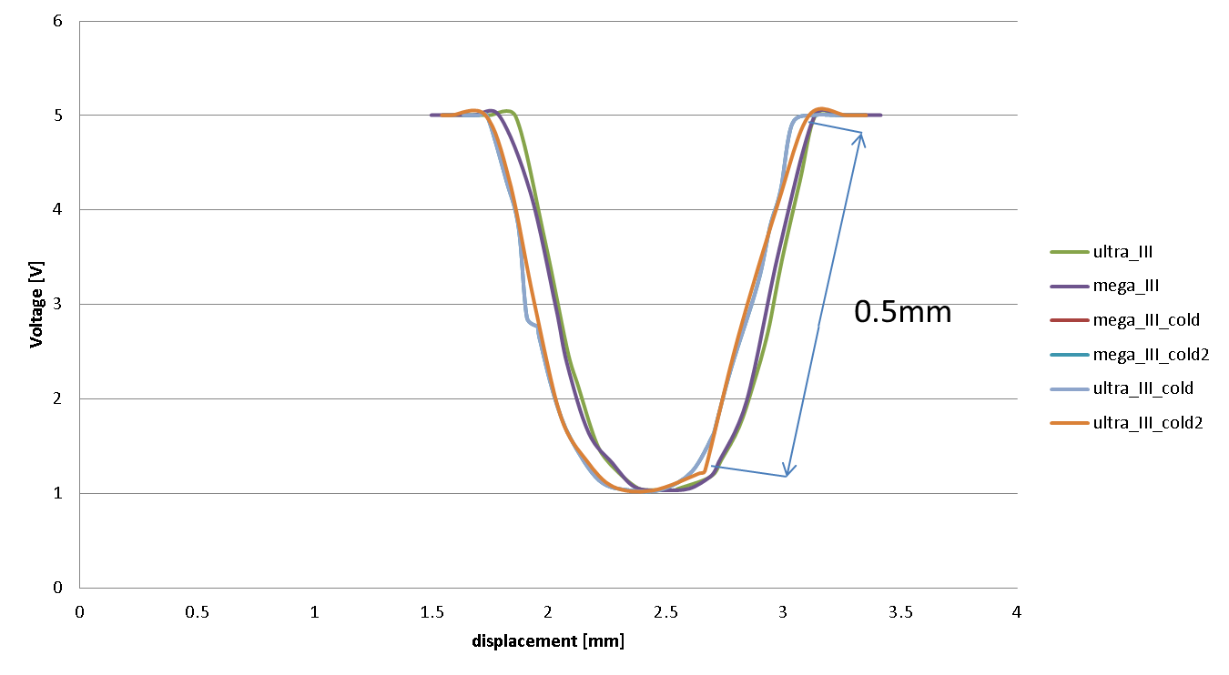
Results (1mm dia wire)

Slide 13
Voltage change with temperature for fibre optic
0.7mV
~1 nm

Slide 14
Future steps
Test bigger fibers (1.5 mm internal dia)
Build the feed thru
Find black, mat, paint
Check cross-talk
Order more units
Try different lenses
Test everything in the SPL mock-up

Slide 15
Thank you for you attention!
Questions?

Slide 16
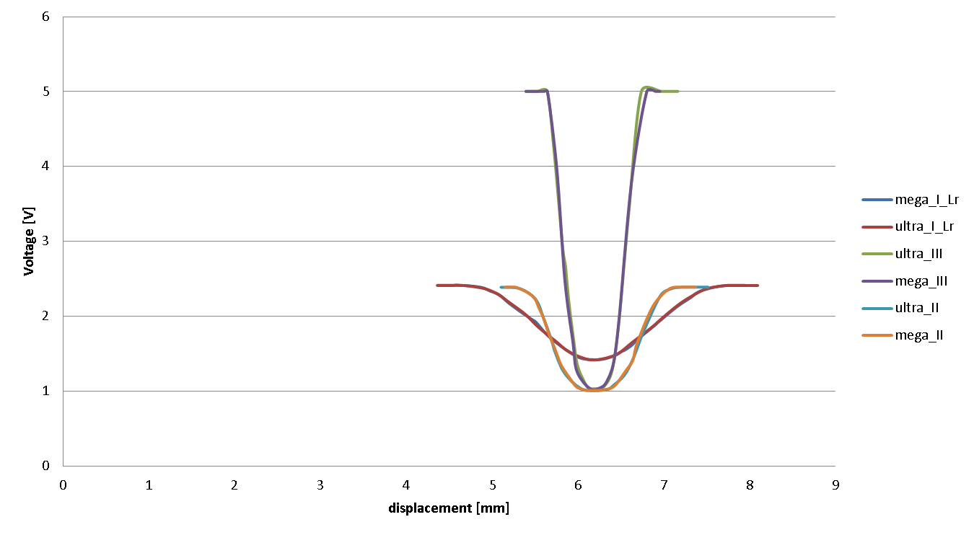
Different power settings

