Slide 1
LEGAL WORK @ ESS
www.europeanspallationsource.se
AD & ICS Retreat
11 December 2014

Slide 2
Background
Been in place since 2012
Ohad Graber-Soudry recruited to build division
Currently 6 members in the team
Panel of external legal advisors

Slide 3
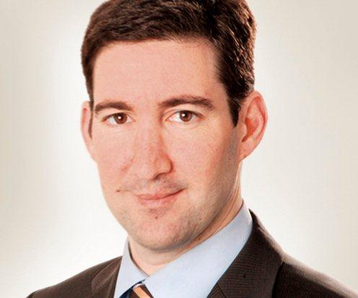
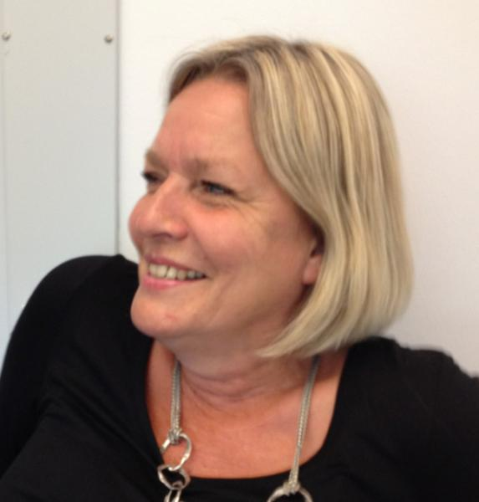
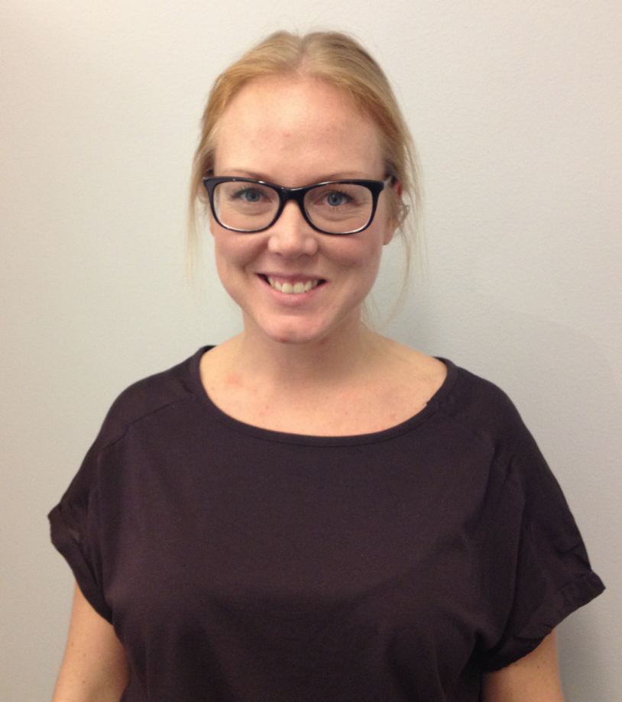
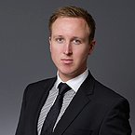
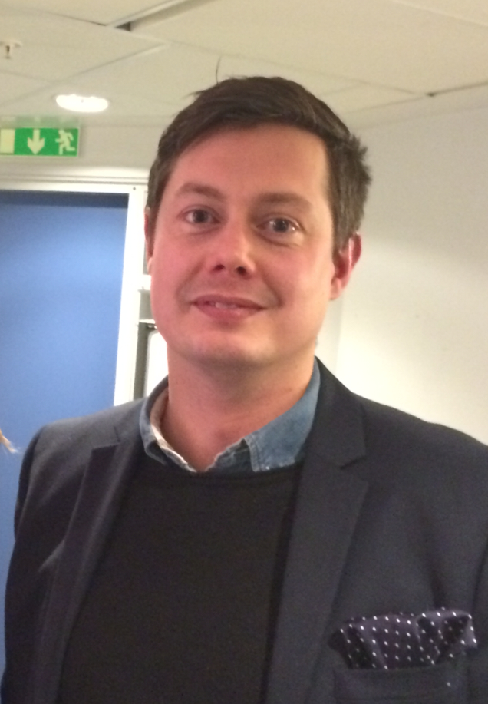
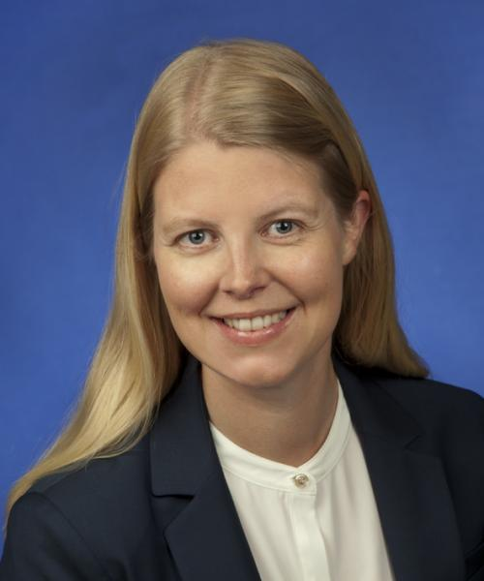
The team
Ohad
Graber-Soudry
Head of Legal
Inglis Persson
Legal Administrator
Elna Jönsson
Legal Officer*
(IP & Innovation)
*Mondays, Tuesdays and Thursdays
Fredrik Livendahl
Legal Officer
(Commercial & IT)
Johan Långberg
Legal Officer
(Contract administration)
Karin Börjesson
Legal Officer
(Tax)

Slide 4
Responsibilities
As the Administration Directorate a support function
Support the ESS to meet its objectives and act within the law
Preventing or reducing the risk of liability and subsequent litigation

Slide 5
Overall tasks
Drafting, reviewing and negotiating legal documents
Advising the procurement of works, services and supplies by ESS to ensure compliance with applicable law
Advising on corporate governance, legal strategy and ensuring regulatory compliance
Managing the sourcing of external legal advice
Develop and provide templates for different kind of contractual arrangements
Management of the contract archive

Slide 6
Some practical examples
Engaging third parties – together with procurement
Purchase vs. non-purchase
your input – the basis for the agreement!
Review of legal documents before signature
Consistency, coherence and minimize legal risks
ESS templates vs. the counterpart’s
Contract management – interpretation of existing provisions
Increased costs, late or defect delivery
General legal advise
Practical notes & memos on specific topics
Legal fika seminars
In-kind, ERIC, Procurement, IPR, Tax etc.
Weekly coordination meetings -> your input

Slide 7
On-going and upcoming issues
Transfer from ESS AB to ESS ERIC
ESS ERIC Statutes
ESS ERIC Procurement rules
IP & Data Policy
Heads of Agreements & In-kind Contracts
Procurement of e.g. klystron, cryo and power

Slide 8
Thank you for listening!
If you have any questions, thoughts or suggestions
feel free to drop by!

