Slide 1
Overview of Procurement
AD and ICS Retreat Meeting 2014
Supply, Procurement and Logistics Division
www.europeanspallationsource.se
11 December 2014

Slide 2
Supply, Procurement and Logistics (SPL) Division
Head, SPL Division
Team Assistant
Procurement
5x procurement officers
1x procurement intern
Logistics
Under development
1x Logistics consultant
Project Support & Administration Directorate
Supply, Procurement and Logistics Division
Projects
Legal Division
In-kind Group
Planning
Finance
QA &ESH
External relations (ILOs)
SPL Division is responsible for procurement in ESS, including:
Normative function: setting procurement procedures, rules, guidelines, etc; monitoring, oversight
Procurement and Contracting: running procurement processes and awarding contracts, contracts management
Logistics (under development)
Close coordination with other parts of ESS

Slide 3
Legal basis and policy for ESS Procurement
Currently, ESS procurement is guided by European Procurement Directive 2004/18/EC on public procurement, implemented through the Swedish Public Procurement Act (LOU), and the following principles:
Open competition, accessibility to Industry, accountability, transparency and equal treatment
Efficient, effective and ethical use of resources, sustainability
Objectivity and clarity in ESS procurement business process
Tenders >EUR207K following EU procurement process, published on EU tender website
EU competitive procedures - open, restricted, negotiated, competitive dialogue
Tenders <EUR207K following Swedish Public Procurement Act
<EUR50K – direct award procedure (always aiming for competition)
>EUR50K – requires publication and competitive process
Implemented through ESS Procurement Policy for 2014-2015 (dated June 2014)
EU treaty principles, value for money, publicity, integrity, innovation, sustainability
ESS ERIC procurement rules under development

Slide 4
Procurement process
Definition of need / Procurement plan
Request for procurement / budget approval
Technical specification / statement of work
[Procurement strategy]
Finalise / issue appropriate procurement document / process
Early communication of indicative procurement plan through ESS website and ILO network
Signed off by appropriate authorities within ESS before launching the tender process (e.g. Purchase Authorization / Consultancy Approval)
Drafted and sign off by appropriate technical experts within ESS
Document outlining procurement objective, market landscape, evaluation criteria, tender methodology, risks, etc. Drafted by procurement and sign off by appropriate experts in ESS
Includes draft contracts [with legal]
----------
Tenders above certain thresholds to be published in appropriate media (unless specific exemptions apply)
Tender opening
Evaluation & award recommendation
Award
Contract
Contracts Management
Delivery / acceptance of goods / services
Engage with a procurement evaluation board with relevant expertise
Finalisation of contract [with legal]
----------
Following appropriate signatory authorities in ESS
----------
Final awards to be published in appropriate media, upon finalisation of contracts
Together with technical owners
Together with technical owners and logistics function
4
**Timing of the process depends on value and complexity

Slide 5
Process for new requests (for goods, services, consultants)
Completes the appropriate request form/s (available in Procurement Word templates).
Requests signature to PCC Owner and subsequent authorities if applicable according to the value
Submit signed request to procurement@esss.se
Requestor
SPL Manager assigns the case to one or several Procurement Officer/s
Procurement Officer/s in-charge communicates with Requestor
SPL Division
5. Discussion and preparation of strategy and documents
Procurement Officer and Requestor
6. Procurement Officer launches the appropriate process
Procurement Officer

Slide 6
What are we doing…
Procurement
Supporting projects / admin for procurement needs
Developing/issuing procurement documents (tenders, etc) and issuing orders / contracts (together with legal)
35 new requests in November (+ on-going procurements)
Building the procurement function in ESS
Procurement training
Defining procurement processes, procedures, guidelines
Developing internal templates
Developing Agresso procurement module
ESS ERIC procurement rules (together with legal)
Logistics
Initial mapping completed end October
Developing strategy for logistics solution for ESS
Some near-term logistics support for lending to IK partners
Defining logistics processes, procedures, guidelines
6

Slide 7
How we can support / SPL’s role?
Finding solutions to meet ESS procurement and logistics needs (engage with us early!)
Procurement planning (schedule!)
Procurement strategies, depending on needs and market landscape
Market surveys / requests for information
Internal and external collaboration (suppliers / vendors, ILO network, etc)
Ensuring appropriate process and legal requirements are followed
Limiting financial exposure risk and achieving best value for money for ESS
Responsible for conducting procurement, contacting and communication with suppliers / vendors during the procurement process
7

Slide 8
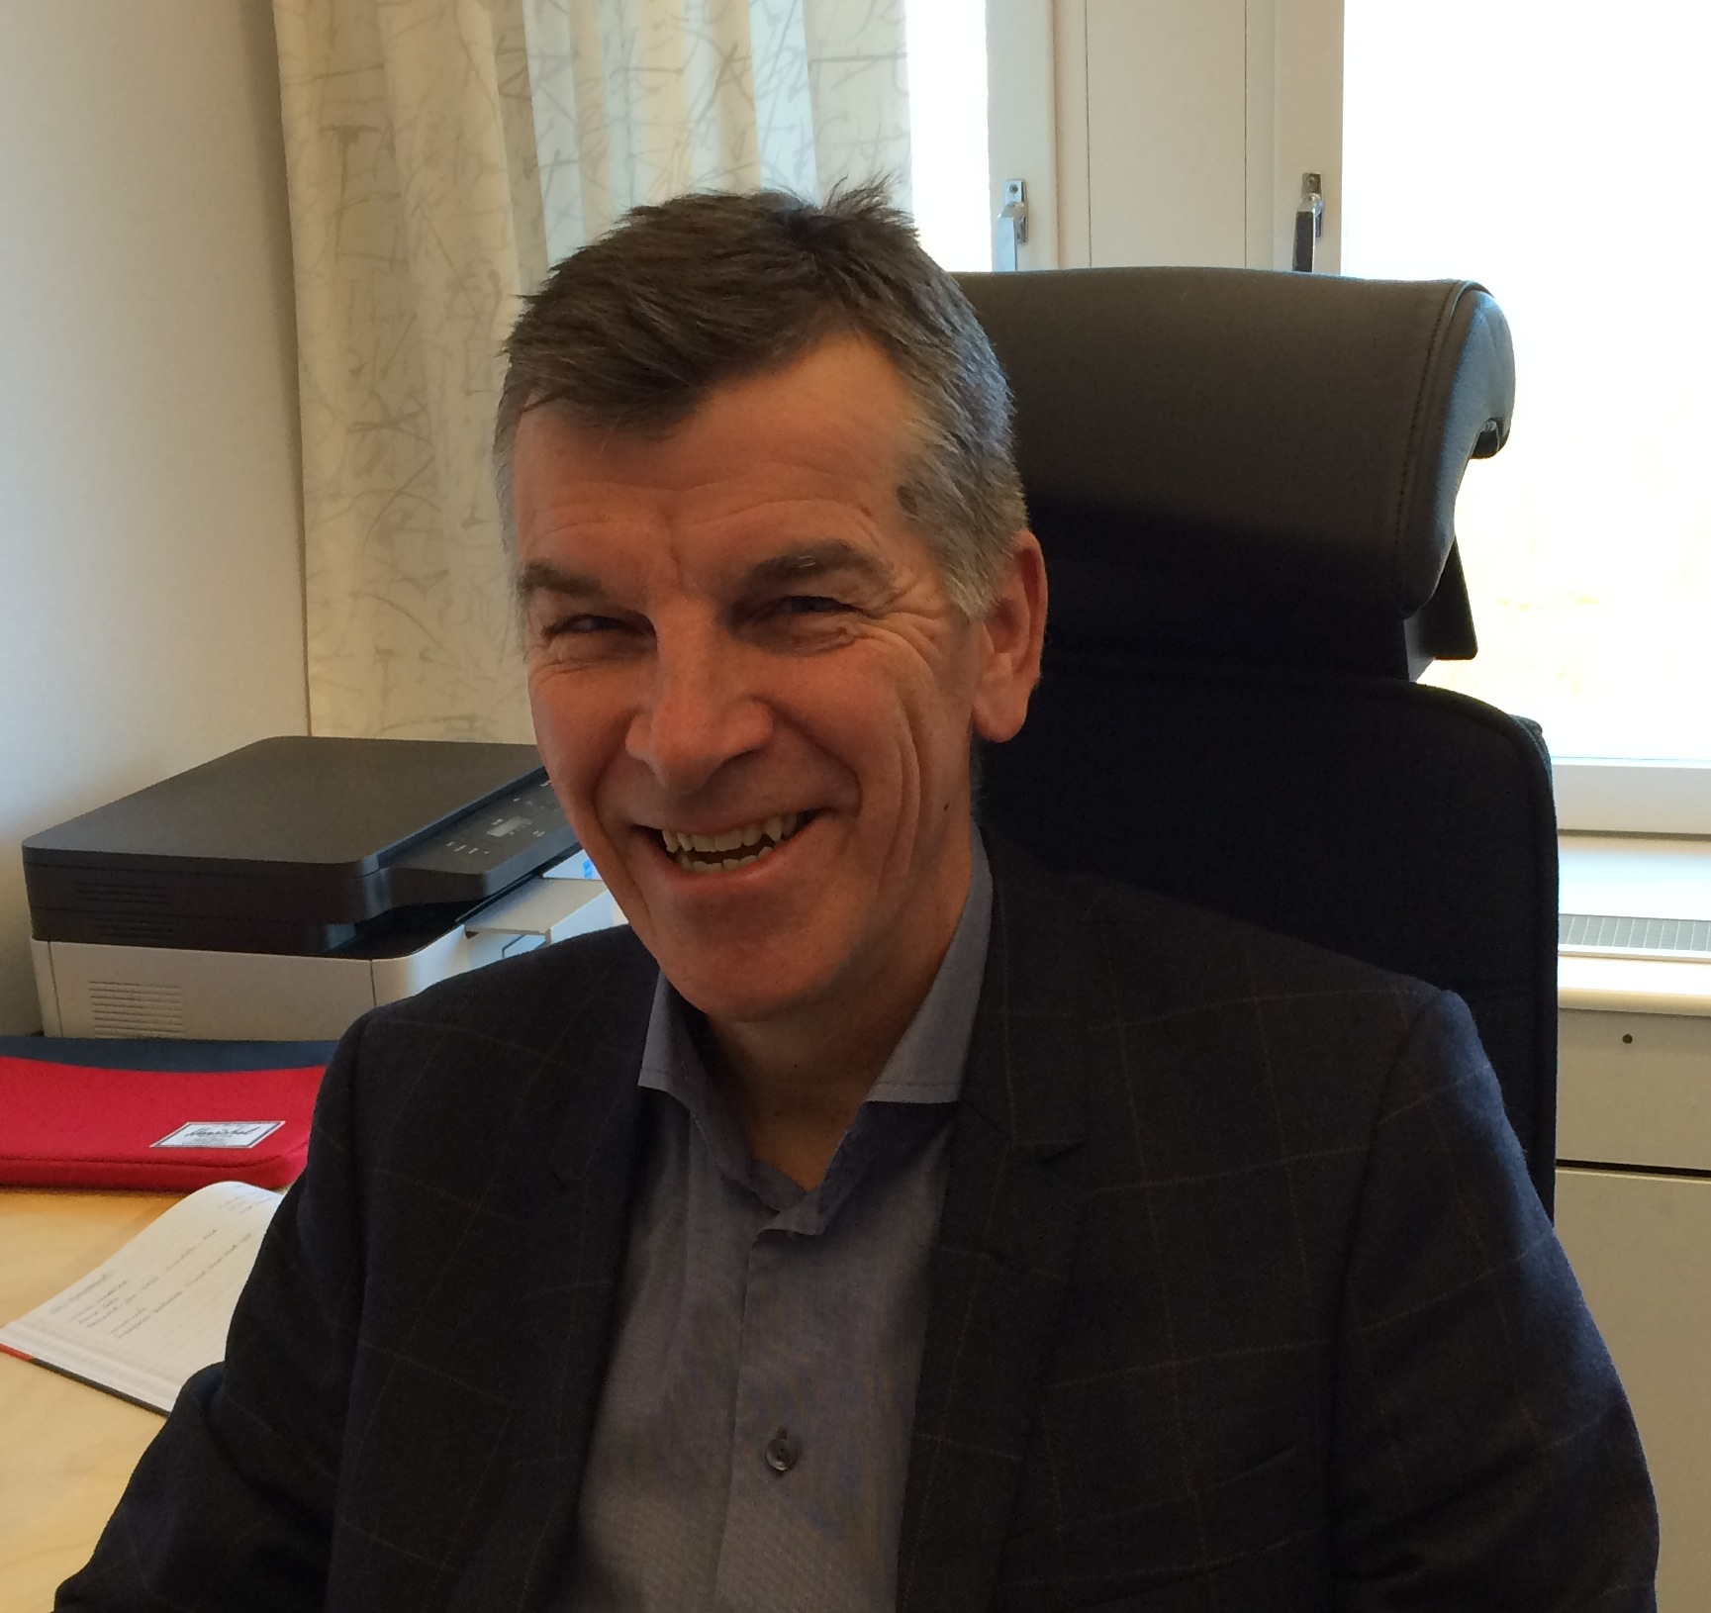
Thank you!
Meredith Shirey
Head of SPL Division
Mirko Menninga Senior Procurement Officer
Malcolm de Silva Senior Procurement Officer
Luis Ortega
Procurement Officer
Liisa Zander
Procurement Officer
Georgeta Barbieru
Procurement Officer
Shilan Babanzadeh
Team Assistant
Jan Lundin
Logistics Consultant
Cristina Echenagusia Intern
Contact us individually or at procurement@esss.se

