Slide 1
Interlock Systems for Machine Protection
Manuel Zaera-Sanz
Interlocks Engineer – ICS / Protection Systems
AD and ICS Retreat mtg 2014
11 December 2014

Slide 2
Murphy’s laws on critical systems...
“Sooner or later, the worst possible combination of circumstances will happen”
“If a system stops working, it will do it at the worst possible time”
“Any SW bug will tend to maximize the damage”
“The worst SW bug will be discovered six months after the field test”
“Damage to an object is proportional to its value”
“If something can go wrong, it will go wrong”

Slide 3
Some real-world examples...
An error in a data type conversion for horizontal speed computation provoked the explosion of the Ariane V first flight (Jun 1996)
A design fault of the upper stage of the Soyuz rocket (freezing the fuel of the thrusters), sent Galileo satellites into wrong orbits (August 2014)
Philae robotic lander (Rosetta mission) landed in a shadow area of the comet due to a failure in the harpoons propulsion system (Nov 2014)
The RADAR of the NORAD defense system misunderstood the moon by an enemy missile (1979)
A 767 plane (United Airlines) was frozen due to the system for fuel saving was “too much” efficient (Aug 1983)
An error in a soviet missile implied that the target was Hamburg instead of the Artic ocean (Dec 1984)

Slide 4
Barriers to prevent failures: Fault Avoidance (FA) & Fault Tolerance (FT)
FAULTS
FAULTS
Barrier I
FA
Barrier II
FT
Barrier III
FT
ORIGIN
CONSEQUENCES
DESIGN &
SPECIFICATION
F
A
I
L
U
R
E
S
SOFTWARE
FAULTS
E
R
R
O
R
S
IMPLEMENT. &
VALIDATION
INTERNAL
PHYSICAL
CAUSES
HARDWARE
FAULTS
EXTERNAL
PHYSICAL
CAUSES
INTERACTION &
OPERATION

Slide 5
Those barriers are not enough...
Interlocks for machine protection:
Protection of equipment, taking the proper actions to avoid any damage with a high confidence (highly dependable) defined in a previous risk analysis
Interlocks for machine protection at ESS:
Devices used to protect the investment, i.e., our linear accelerator (its equipment) and the target, by taking the proper actions to stop/allow beam operation and abort/allow powering

Slide 6
Our mission statement
Objectives:
Protect the Investment (1800 MEURO)
A LINAC without interlocks is “like a car without brakes”
Protect the beam: No beam => No neutrons
Provide the evidence
How ? Using programmable electronics and hardwired links => Slow and Fast machine protection systems

Slide 7
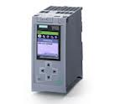
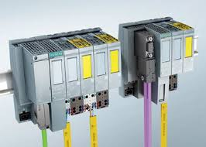
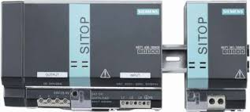
Slow machine protection systems
Equipment to be protected:
Magnets (Magnet Powering Interlocks)
Vacuum system
Insertable devices (Faraday cups, wire scanners)
Target system
How ?
Using PLCs (Programmable Logic Controllers)
Following standard IEC 61508 (no need of certification)

Slide 8
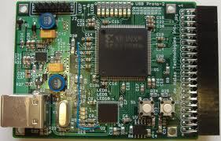
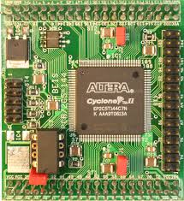
Fast machine protection systems
Equipment to be protected:
Ion source status
Choppers
Steerers
RFQ (Radio Frequency Quadruple)
Raster Magnets
Beam diagnostics (Beam Loss Monitors, Beam current monitors)
RF system
How ?
Using FPGAs (Field Programmable Gate Arrays)
Following standard IEC 61508 (no need of certification)

Slide 9
Conclusions
Interlocks for machine protection is protecting an investment of 1800 MEURO LINAC => Critical system
Unique and complex machine with many non-linear components and interactions
High power pulses of up to 5 MWatt @ 14Hz
High availability required (95 %)
Failures may occur even if fault avoidance and fault tolerance techniques are used, therefore a high dependable interlocks system is required

