Slide 1
RAMI analysis at ESS (RAMI = Reliability Availability Maintainability Inspectability)
Enric Bargalló
ESS accelerator reliability expert
www.europeanspallationsource.se
December 11, 2014

Slide 2
RAMI definitions
Reliability: Probability of success over a certain period of time
E.g. probability that the proton beam will not have any trip for one hour
Availability:
Maintainability: capability of performing maintenance to a system or component.
Inspectability: capability to inspect, test and monitor a system and its possible failures.

Slide 3
RAMI at ESS
ESS goal: science produced by the users
High brightness neutron beam
High availability and reliability of the beam
RAMI goals:
Translate users needs to technical requirements
Analyze the design to see if the requirements can be achieved
Propose changes if necessary
Give a global overview of the future operation of the machine in the design phase

Slide 4
Users at ESS
22 instruments
Beam time for a user: from 1 day to 7 days
Neutron beam needs:
Kinetic experiments
90% reliability for the duration of the measurement
Failure: Beam trip with a duration of more than 1/10th of the measurement length
Integrated-flux experiments
90% beam availability and 80% average beam power for the duration of the experiments
Beam unavailable: power less than 50% for more than one minute

Slide 5
RAMI for the users
The global ESS availability figure is not the most important
What is important for them is the distribution of failures:
Failures (or beam trips) of less than 1 hour can be easily accepted
Failures from 1 hour to 48 hours are the most problematic
Failures longer than some days will imply to reschedule the experiments (also happen in reactors)

Slide 6
Possible kinetic ESS requirements compared with values achieved at SNS
Data from SNS provided by Charles C. Peters

Slide 7
Possible requirements for Integrated-flux experiments (compared with SNS)
Data from SNS provided by George Dodson

Slide 8
RAMI focus
Reduce number of failures (reliability)
Quality of the components
Simplicity of the design
Failures of components don’t imply ESS to stop
Redundancies
Flexibility (overcapacity, operate at reduced beam power…)
If implies to stop ESS
Be able to foresee it (inspectability)
Reduce duration of the downtime (maintainability, spare parts, manpower…)

Slide 9
How are we going to do it?
Some things can’t be foreseen
We have to start commissioning and operation
Might be related to a catastrophic events
Risks that have been accepted or unknown risks
A lot of things can be only done in the design phase!!
It might be impossible to change afterwards!!
Many things can be highlighted right now and we can start finding solutions
The sooner, the cheaper and easier

Slide 10
RAMI approach
Clarify goals and requirements and allocate the among subsystems
Estimate the accomplishment of the requirements (iterative)
Guide the design, construction, commissioning and operation phases to obtain high RAMI performances
Other outputs
Maintenance plans
Manpower
Logistics and spares
Estimation of degradation of beam parameters
…

Slide 11
Organization
XFWG on reliability
RAMI group
Accelerator
Enric Bargalló
Andreas Jansson
Target
Eric Pitcher
Instruments and science
Ken Andersen
Arno Hiess
Robert Connatser
ICS
Annika Nordt
Site infrastructure
Ronny Sjöholm
Systems engineering
Johan Waldeck
Accelerator
Enric Bargalló
Iñigo Alonso
Target
Alex Garcia
Instruments and science
Peter Sångberg
ICS
Riccard Andersson
Site infrastructure
Björn Yndemark

Slide 12
Thanks for your attention!

Slide 13
Kinetic experiments
The key metric is beam reliability: minimize the probability of having a beam trip during a measurement.
Kinetic experiments needs:
A reliability of at least 90% should be provided for the duration of the measurement. The measurement will be considered failed when the beam power is reduced to less than 50% of the scheduled power for more than 1/10th of the measurement length.

Slide 14
Integrated-flux experiments
The key metrics are beam availability and average beam power
Integrated-flux experiments needs:
At least 90% of the experiments should have at least 90% of beam availability and more than 80% of the scheduled beam power for the duration of the experiments. The beam will be considered unavailable when its power is less than 50% of its scheduled power for more than one minute.

Slide 15
Reliability data from other facilities

Slide 16
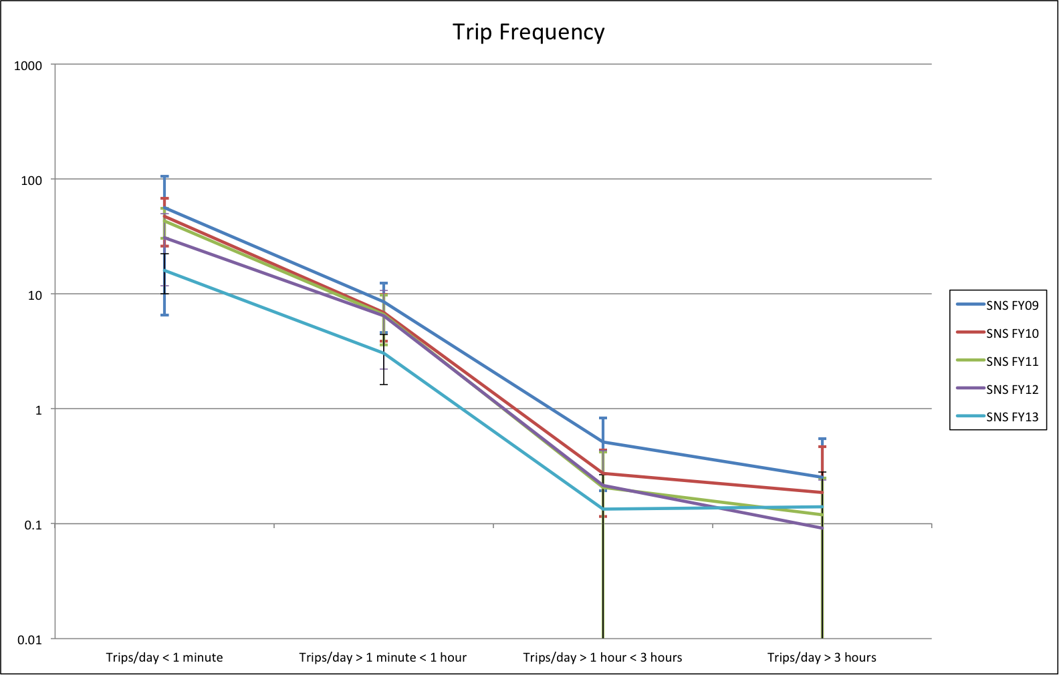
SNS trip frequency evolution

Slide 17
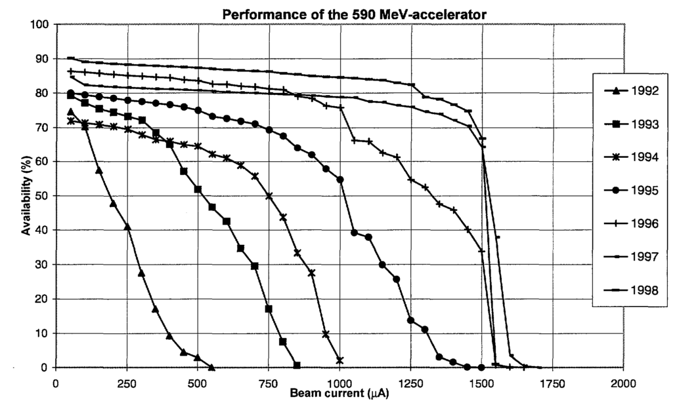
PSI: Availability vs. Beam current
Availability decreases with the beam current but increases with facility maturity

Slide 18
A. Estimate accomplishment of requirements
ESS requirements
Users
Stakeholders
Allocation
Top-down
Experiences in other facilities or experts opinion
Requirements allocation and definition
Accelerator requirements
Allocation
Systems requirements
Previous analyses
Global model
Redefine requirements
Number of stops and durations
Comparison with other facilities
Individual models
Reallocate requirements
Models and RAMI parameters estimation
Functions
Failures
Trips
Bottom-up
Change design
Systems and components
Trips in similar systems
Trips in similar components
Components’ requirements
Operations information
Reliability data
Availability
Reliability
Outcomes

Slide 19
Requirements allocation
Allocation structure should consider:
Possibility to track requirements
Easy to compare with other facilities
Easy to model and to analyze
L2
ACC – LINEAR ACCELERATOR (LINAC)
‘ACCSYS’
ESS SYSTEMS ‘PROJECTS’
PWRC*
PS*, HV Power Convertors*
ISrc
Ion Source
Specialties
BMD
Beam Magnets &, Deflectors (BM*)
EMR
EM Resonators
(Bunchers, RFQ, DTL tanks,
CMs)
PBI
Proton Beam Instrumentation
L4
SUPPLIED BY WP 3
SUPPLIED BY WP 6
SUPPLIED BY WP 3,4,5
SUPPLIED BY WP 7
DISCIPLINE SYSTEMS (Mapping to WBS Work Packages shown)
SUPPLIED BY WP 6,8
RFS
Radio Frequency Systems
VAC
Vacuum
CRYO
Cryo Plant (ACP*) & Distribution (CDS*)
WTRC
Water Cooling
CNPW*
Conventional Power
SUPPLIED BY WP 8
SUPPLIED BY WP 12
SUPPLIED BY WP 11
SUPPLIED BY WP 15
SUPPLIED BY WP 15
Labels to identify LINAC sections
Subsystems and components following the PBS

