Slide 1
Klystrons for ESS
Chiara Marrelli
AD and ICS Retreat mtg 2014
11 December 2014

Slide 2
Principles of klystron operation
A continuous electron beam is emitted from the thermionic cathode and accelerated by the high voltage between cathode and anode
The beam enters in the input bunching cavity, where it sees the RF field coming from the preamplifier. Because of the oscillating field, some electrons are accelerated, some others are decelerated, depending on the phase with which they enter the gap
The beam is velocity modulated
Velocity modulation becomes density modulation in the drift, and the beam is bunched
Due to bunching the beam current gets a strong RF component at the frequency of the input signal
The RF component of the beam current excites an RF field in the output cavity with a phase that opposes the electron motion.
Cathode
(DC Beam)
RF input
RF output
Collector
The beam slows down and it gives its kinetic energy to the field, which is extracted through the output coupler, while the electrons dissipate their residual energy on the collector as heat; since the electron beam has worked as amplifying medium the output field is much stronger than the input signal, resulting in a gain (usually over 40 dB, up to 60)
Idler cavities are normally used between the input and the output cavity to enhance the bunching.

Slide 3
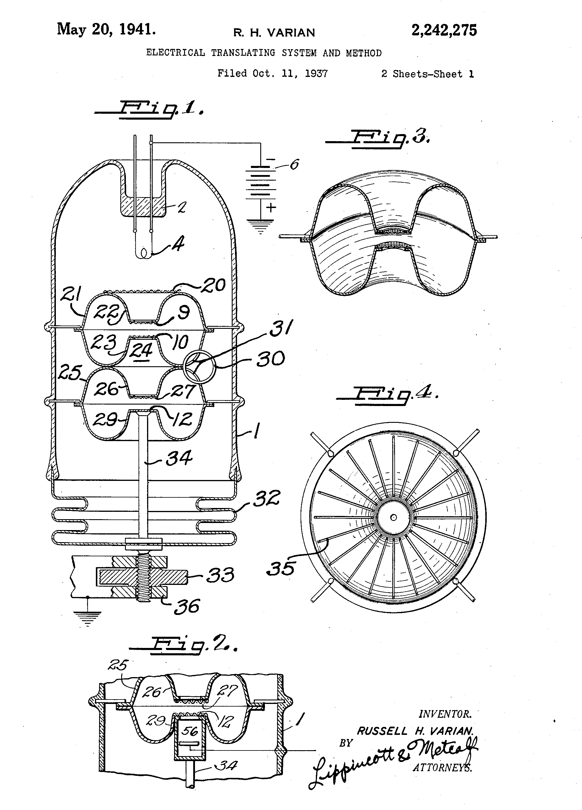
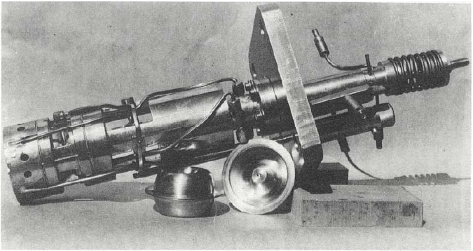
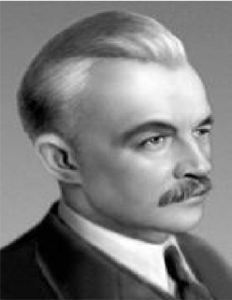
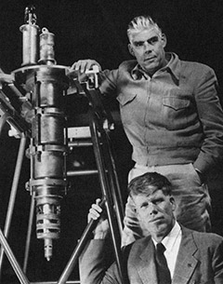
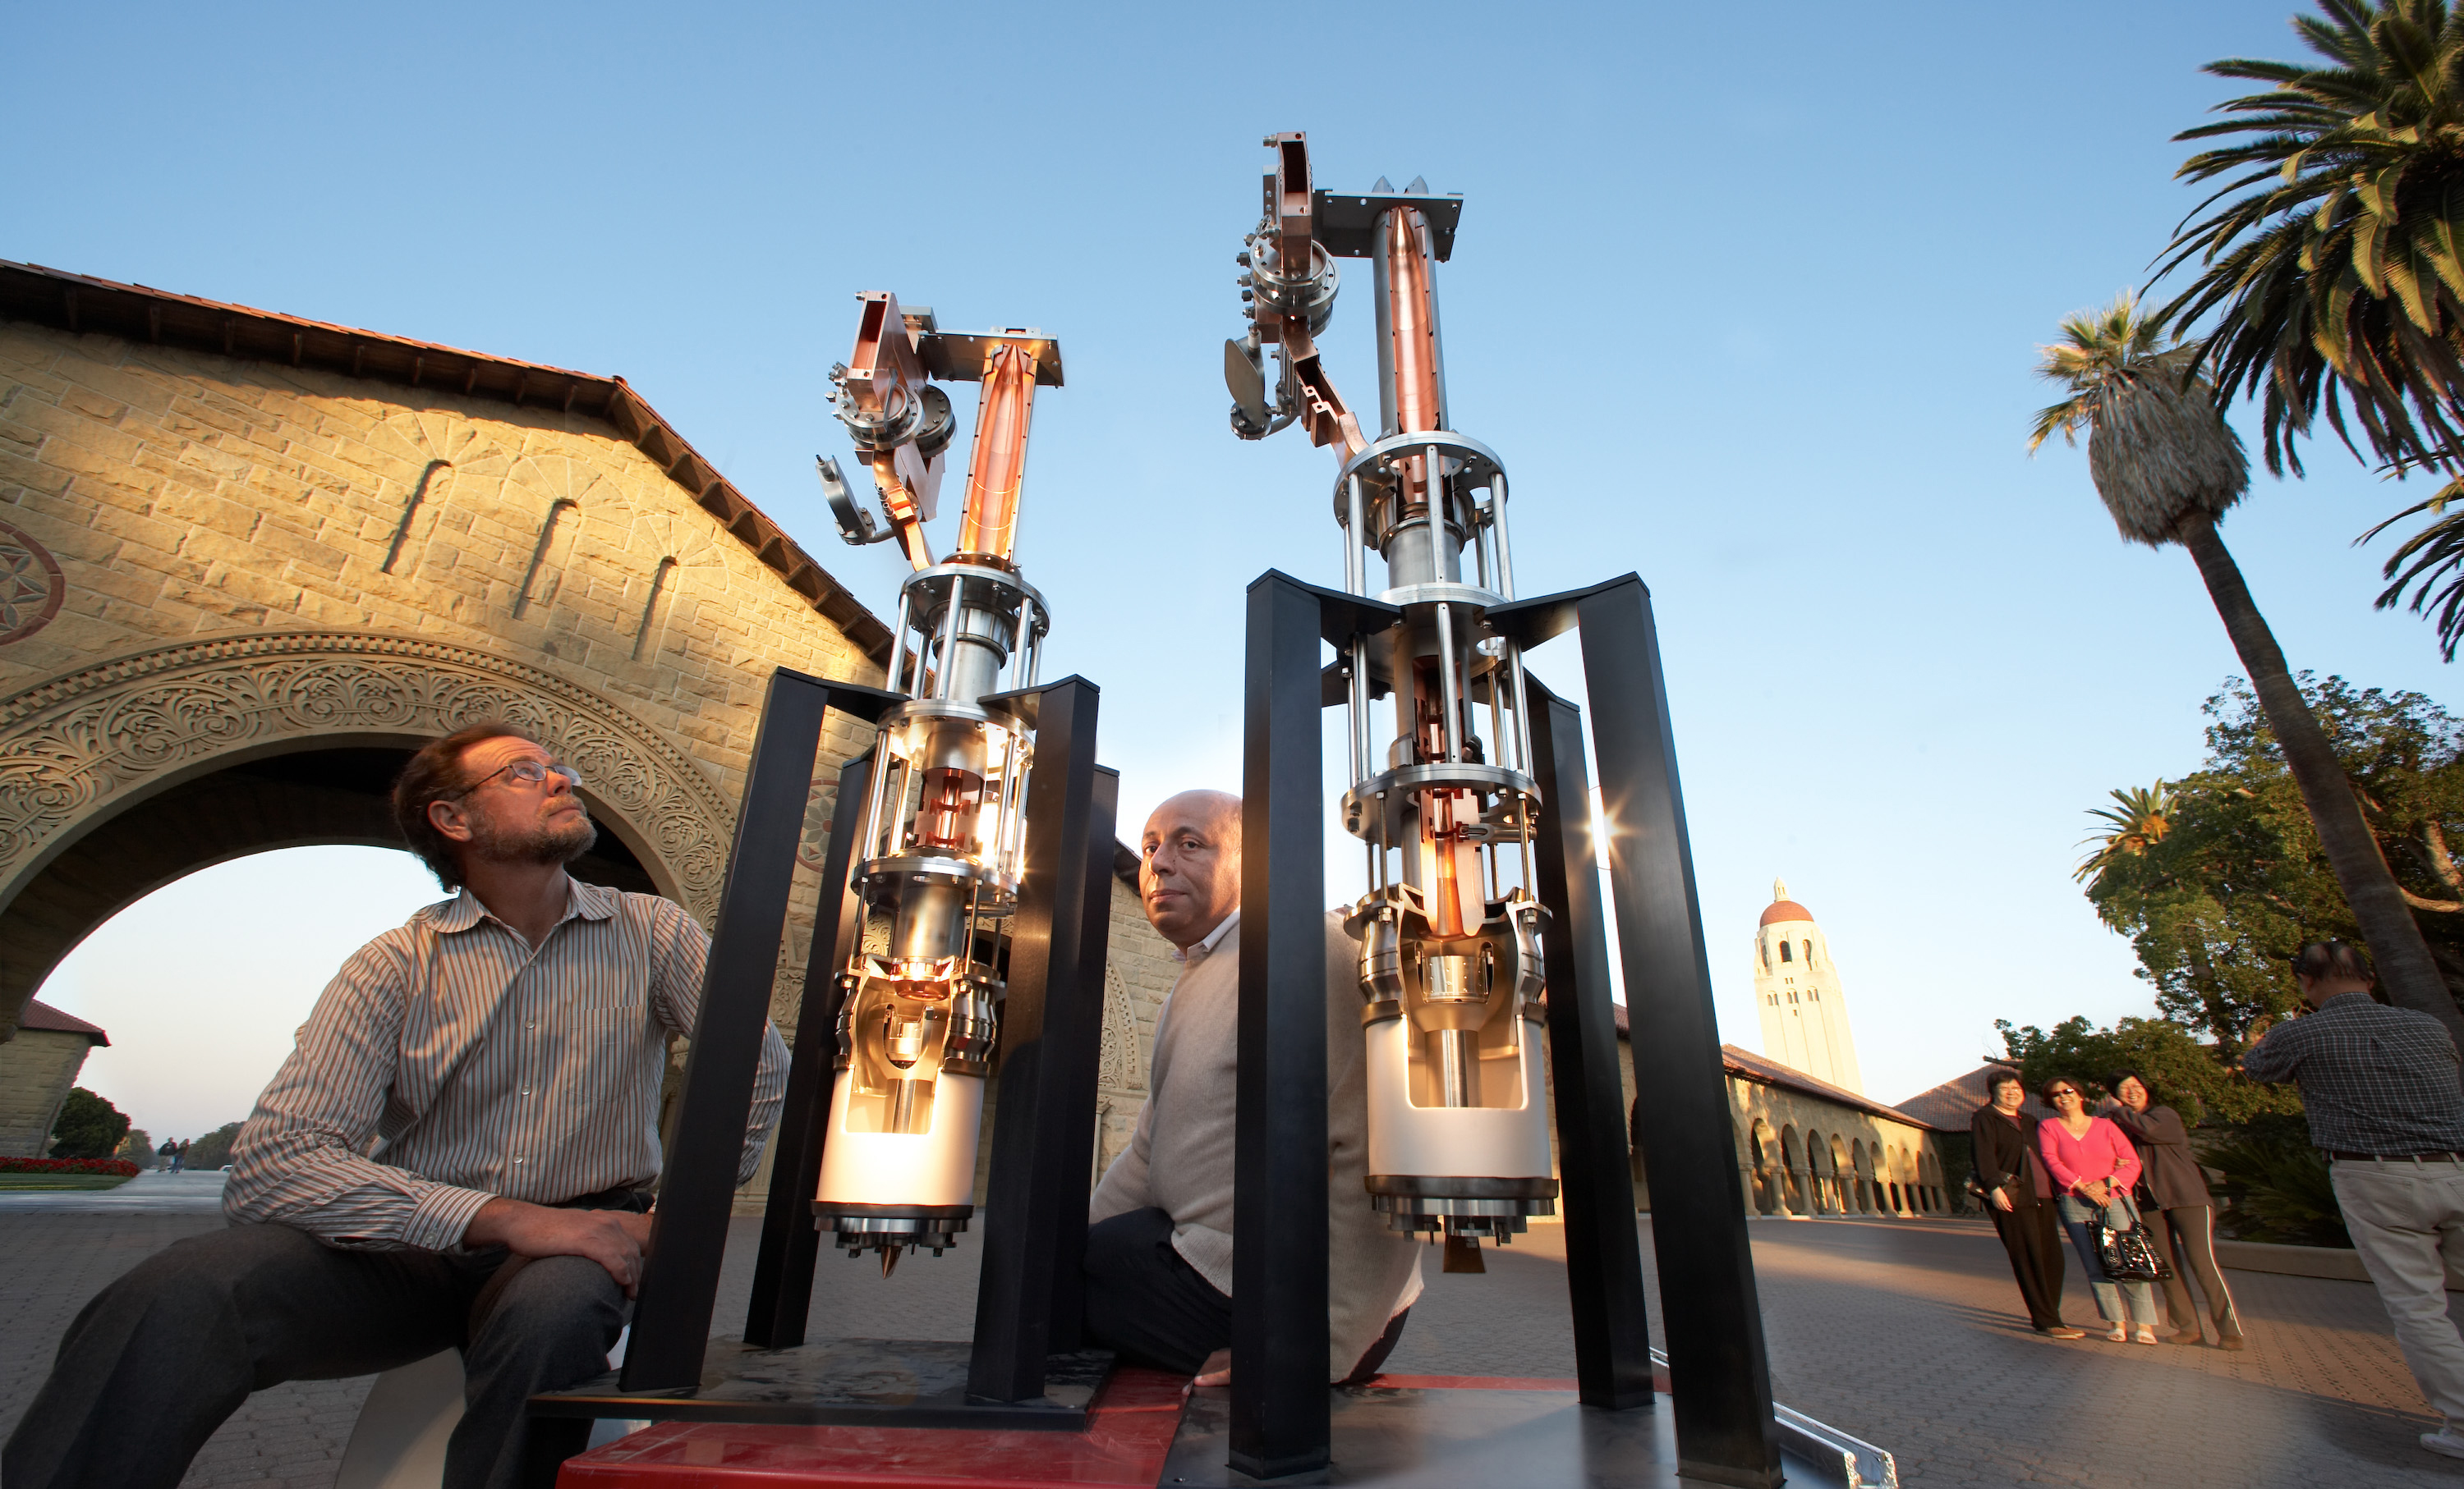
Klystron: a bit of history
Officially invented by the Varian brothers and Bill Hansen in 1937 in Stanford (but papers on velocity modulation had already been published some years before by Rozhansky and the Heils in Europe and Russia).
D. A. Rozhansky
Russel and Sigurd Varian
The Stanford “model A” klystron
A picture explaining the klystron principle from the Varian patent
Oskar and Agnessa Heil
The device was named “klystron” from the Ancient Greek verb κλυζω, which refers to waves hitting the shore + the suffix –tron, for the electrons. Other etymologies are possible though
(κλυστηρ, as the klystron is an evacuated tube)….
Klystrons cutaway models in the Stanford main quad

Slide 4
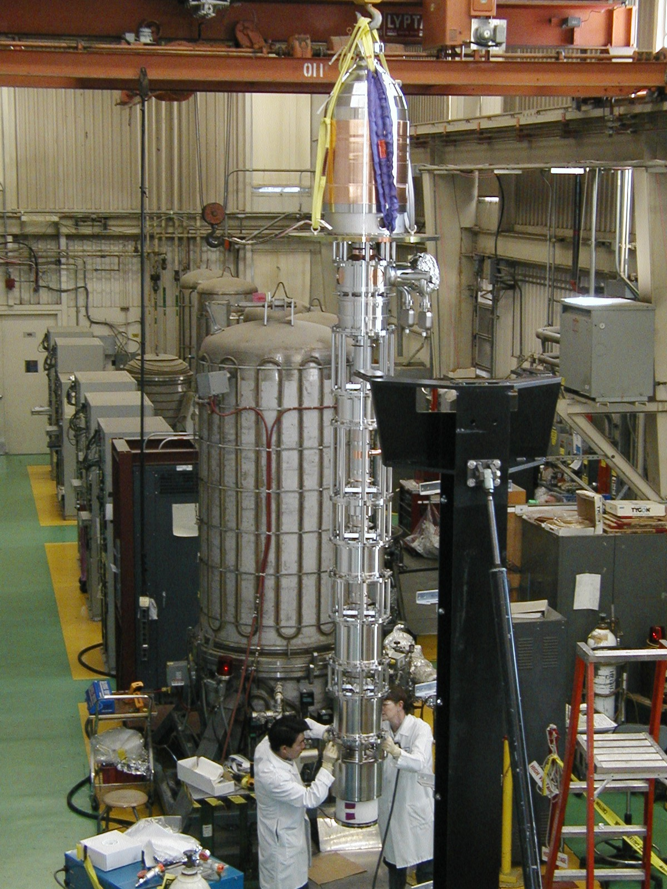
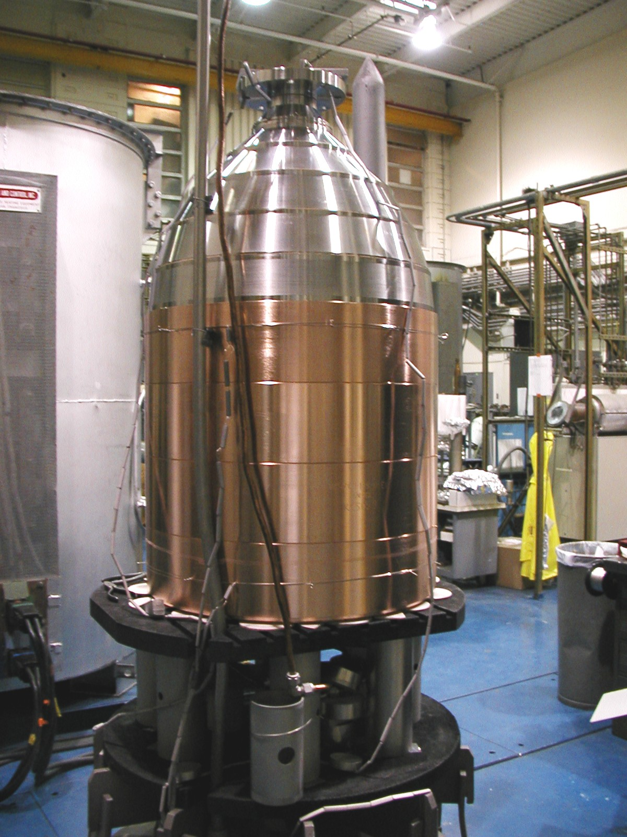
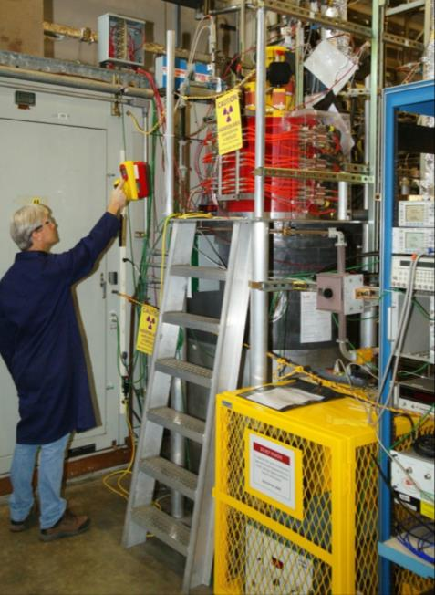
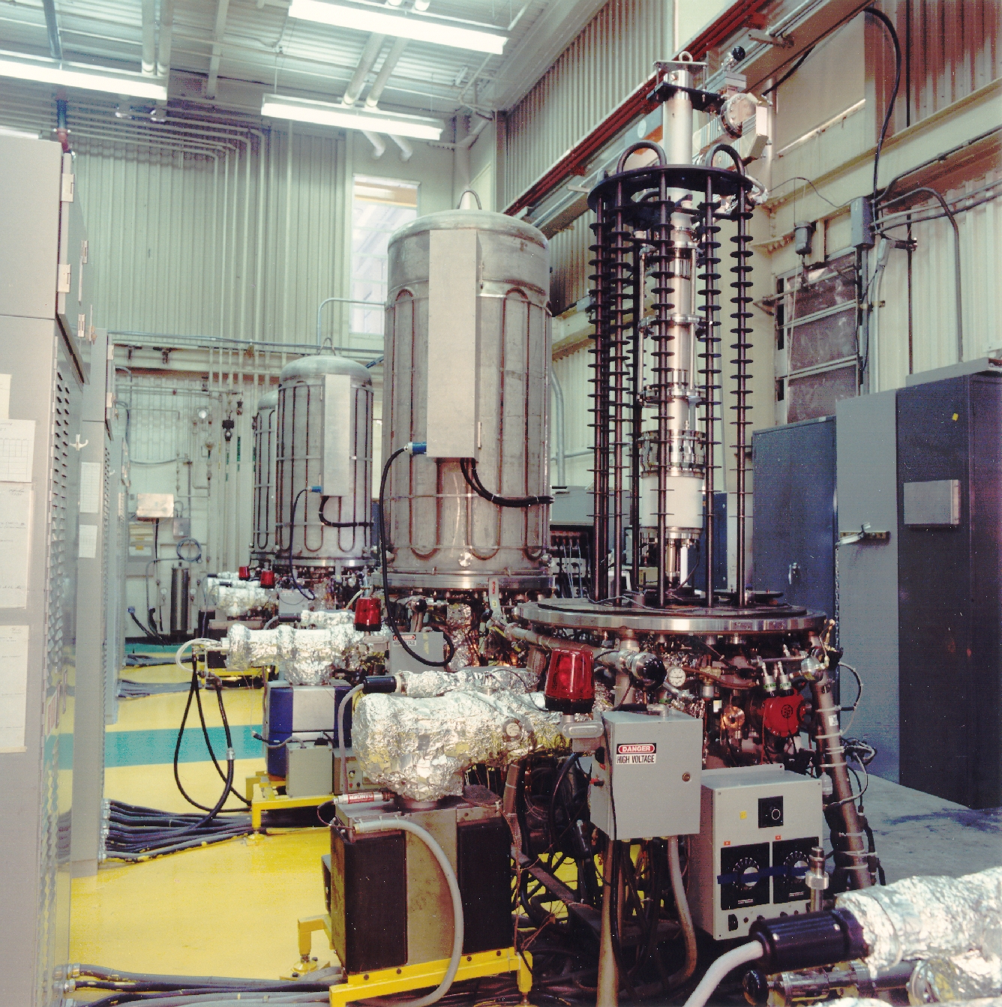
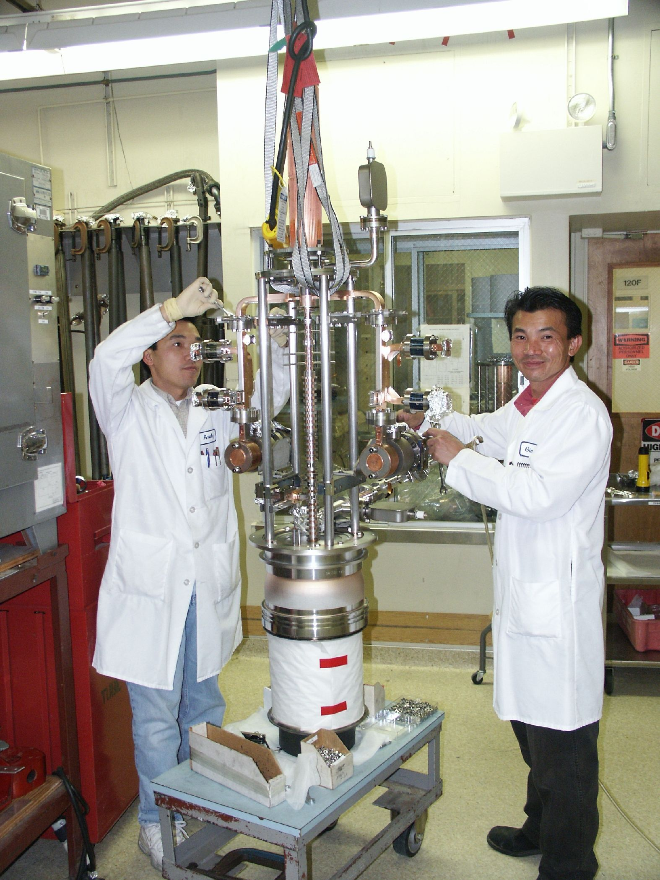
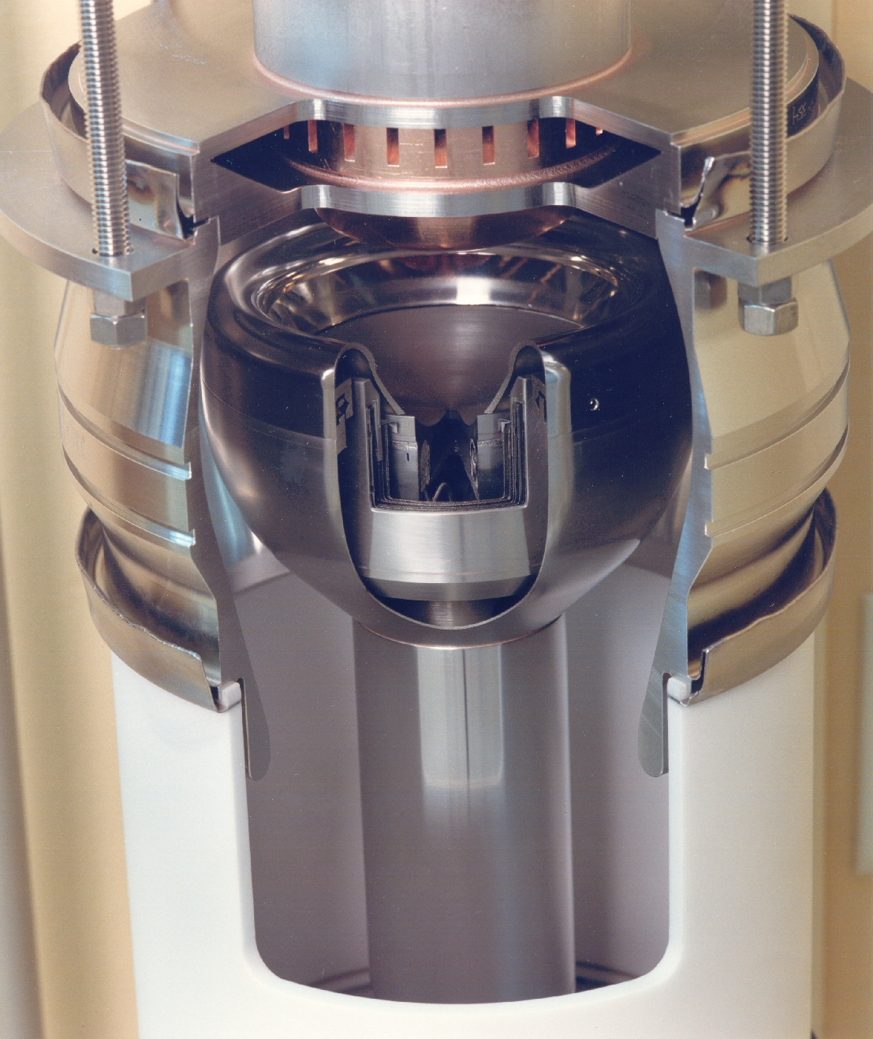
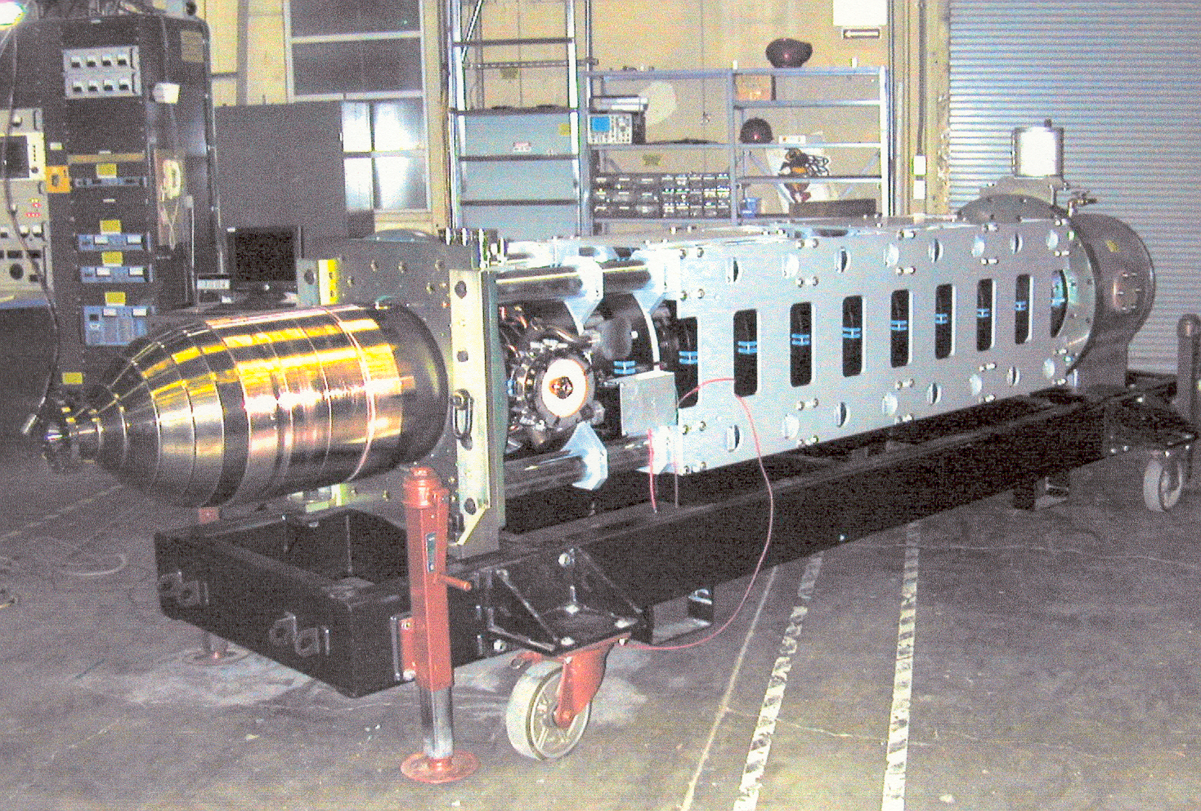
How does it look like?
Final assembly of the B-factory klystron at SLAC
CPI-XL5 during commissioning at SLAC
Array of four 5045 bakeout ovens (SLAC)
B-factory klystron (1.2 MW CW, 476 MHz) collector
Final assembly of the 75-XP3 klystron (SLAC)
B-factory klystron with solenoid
Cut of a 5045 electron gun

Slide 5
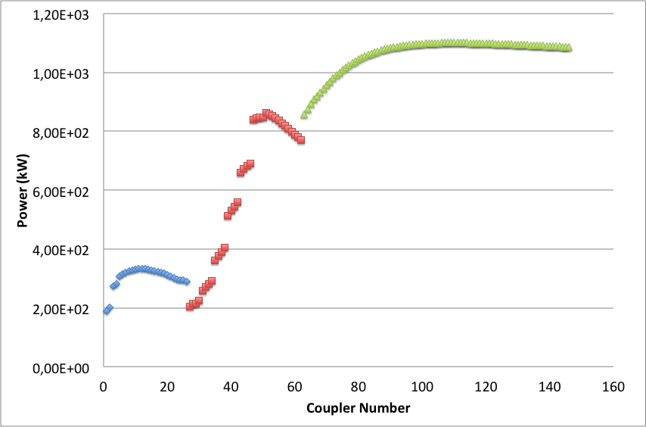
ESS accelerator power profile
Average beam power: 5 MW
Pulse repetition rate: 14 Hz
Beam pulse length: 2.86 ms
High availability required (>95%)
Superconducting Linac:
Normal-conducting Linac:
1 RFQ: 1.6 MW at 352 MHz required in input + 30% (overhead + losses);
5 DTL tanks (2 couplers/DTL): 2.2 MW at 352 MHz required in input + 30% (overhead + losses);
Six 352 MHz, 3 MW klystrons
26 spoke cavities: 352 MHz, maximum power at coupler 332 kW; two tetrodes (TH 595 from Thales) will be combined
84 High beta elliptical cavities: 704 MHz, input power from 835 kW to 1.1 MW (plus 30% overhead); 1.2 MW MB IOTs (or klystrons as backup)
36 Medium beta elliptical cavities: 704 MHz, input power from 207 kW to 866 kW (plus 30% overhead); 1.5 MW Klystrons

Slide 6
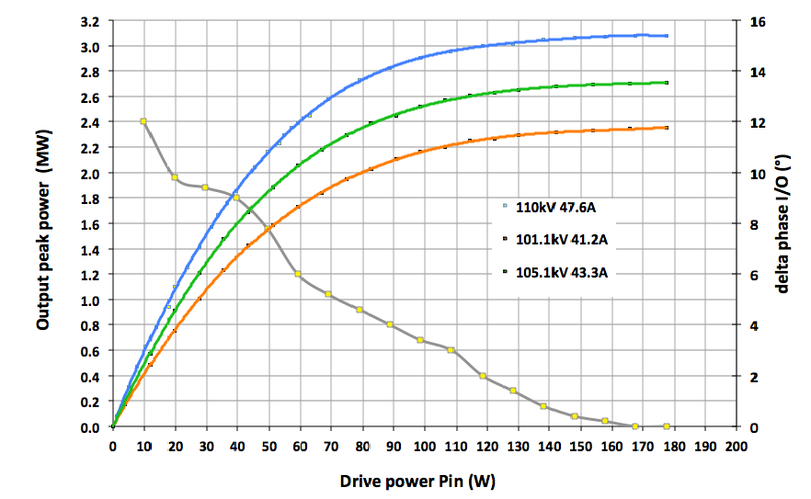
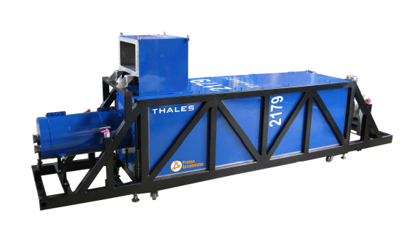
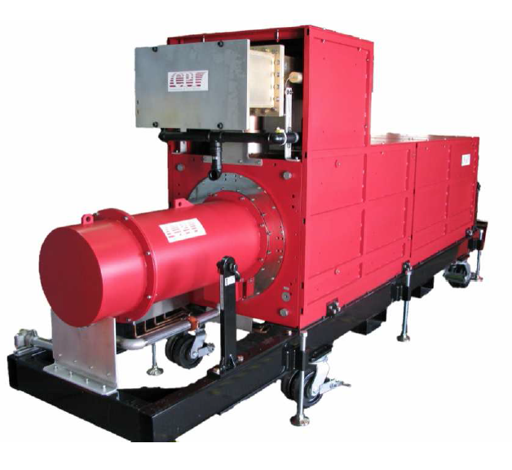
RFQ and DTL
1 RFQ (1.6 MW input power at 352.21 MHz)
5 DTL tanks (2.2 MW input power at 352.21 MHz for each DTL, two couplers per DTL)
Klystron specs:
Nominal output power | 3 MW
Frequency | 352.21 MHz
BW | ≥ +/- 1 MHz
Pulse width | 3.5 ms
Repetition rate | 14 Hz
Perveance | 1.3*10⁻⁶
Efficiency | >52%
VSWR | Up to 1.2
Power Gain | ≥ 40 dB
Group Delay | ≤ 250 ns
Harmonic Spectral content | ≤ -30 dBc
Spurious Spectral content | ≤ -60 dBc
Saturation
Courtesy of Thales ED
25% overhead + 5% losses in RF distribution
2.1 MW saturated power from the RFQ klystron
2.9 MW saturated power from the DTL klystrons
CPI VKP-8352A
Two klystrons currently available:
Thales TH2179
Dimensions: 5.3 m x 1.5 m x 1 m

Slide 7
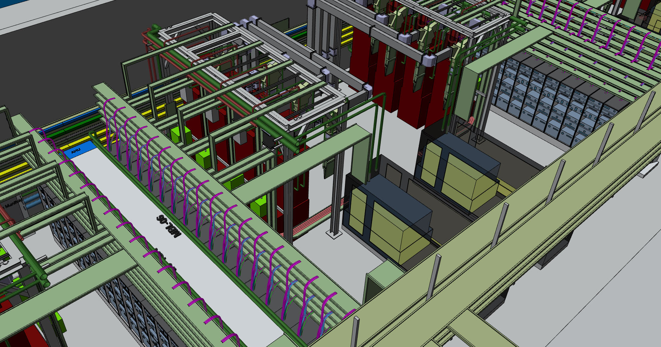
704 MHz klystrons for Medium (and High?) Beta
36 Medium beta elliptical cavities: 704.42 MHz, input power from 207 kW to 866 kW (plus 30% for losses compensation and overhead) -> saturated power from klystrons up to 1.15 MW
Klystron specs
Nominal output power | 1.5 MW
Frequency | 704.42 MHz
BW | ≥ +/- 1 MHz
Pulse width | 3.5 ms
Repetition rate | 14 Hz
Perveance | 0.6*10⁻⁶
Efficiency | >60%
VSWR | Up to 1.2
Power Gain | ≥ 40 dB
Group Delay | ≤ 250 ns
Harmonic Spectral content | ≤ -30 dBc
Spurious Spectral content | ≤ -60 dBc
Vertical orientation to fit in the gallery
Open call for tenders started in October 2014 for two prototypes
Four candidates (Thales, Toshiba, L3 and CPI)
Two contracts will be awarded before the end of 2014; delivery expected in 15 months.

Slide 8
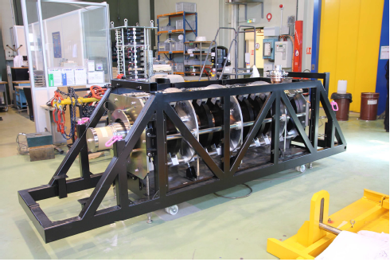
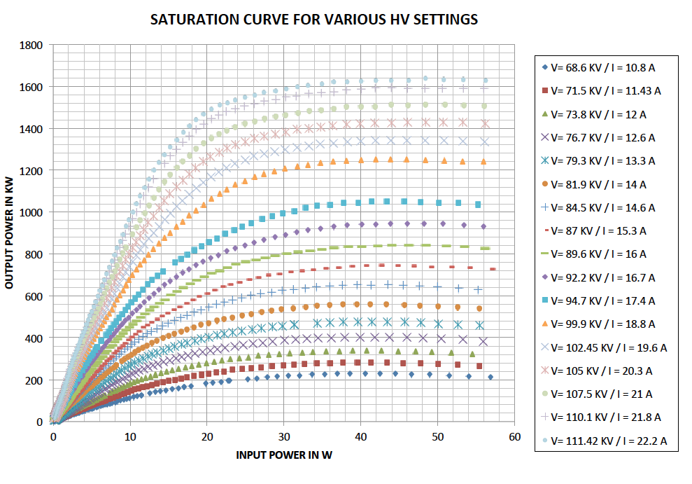
Some result from the TH2182 klystron testing at CERN
CERN recently bought from Thales a klystron very similar to the one needed by ESS; the klystron has also been tested at ESS parameters
Nominal output power | 1.5 MW
Frequency | 704.42 MHz
Beam Voltage | 111.4 kV
Beam current | 22.2
Repetition rate | 2 Hz
Pulse length | 1.8 ms
Efficiency | 66%
Saturated Gain | 45.15 dB
Group Delay | 130 ns
Courtesy of Thales ED and CERN

Slide 9
Improvement of energy efficiency at ESS
ESS will be a “green” facility: this means that it must guarantee at the same time:
Machine reliability
Energy efficiency
Development of multibeam IOTs (more efficient than klystrons at the ESS specifications)
Choice of the best power source for each section of the linac
Improvement of klystron efficiency
Energy recovery
Joined high efficiency klystron activity of labs and industry
Use of the energy waste to produce… HOT WATER

Slide 10
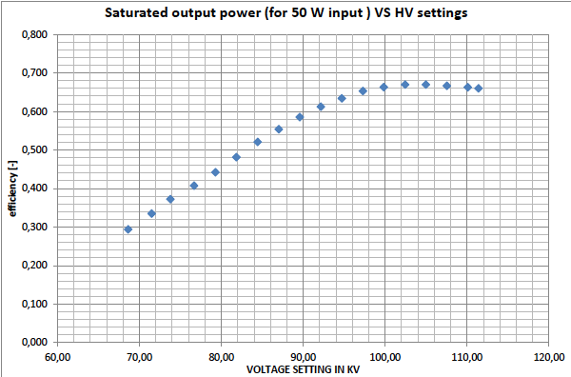
Klystron efficient operation at ESS
Klystrons reach maximum efficiency at saturation (not more than 65% for our 704 MHz klystrons, and 55-57% for the 352 MHz klystrons).
Due to need of overhead for regulation purposes we can’t operate them in saturation but we need to stay in the linear region; this will reduce the efficiency
Not only!
The power levels required from the klystrons in the medium beta section vary from 272 kW to 1.14 MW; if we operate all the klystrons at the same design beam power ( ≈112 kV, 22 A) efficiency will be as low as 11% for the first amplifiers of the section!
It is then important that we are able to operate the klystrons at reduced beam voltages
Efficiency VS high voltage for the Thales TH2182 klystron (704 MHz)
But this is not enough! Efficiency varies with the beam voltage

Slide 11
Klystron operation at reduced beam power
Why does efficiency go down?
(simplified) Example: AJDisk simulation, beam RF to DC current along the klystron
When reducing the beam voltage and current the space charge forces between the electrons vary and reduced plasma wavelength changes
In other words, the klystron electrical length is modified -> the cavity position, strictly related to the r.p.w., is not optimal anymore
Furthermore, the impedance of the beam increases -> the external Q of the output gap is also not optimal anymore
134 kV, 24.5 A, 1 GHz, η_{sat} =74%
100 kV, 15.8 A, 1 GHz, η_{sat} =58%
Possible solutions:
The plasma wavelength can be slightly changed by acting on beam radius -> changing magnetic focusing field
The external Q of the output cavity can be adjusted by varying the matching of the output cavity (output VSWR)
All these solutions will be discussed with the klystron suppliers
The current profile changes and the cavity position is not optimized anymore
Notes:
Plasma wavelength is the wavelength of the plasma oscillation in the electron beam, due to the fact that the space charge acts as an elastic medium between the bunches. The result is the formation of waves. The wavelength is “reduced” because we take into account that the effect of the drift tube reduces the effect of space charge, thus modifying the wavelength of this oscillation.

Slide 12
Heat recovery from klystrons
Even if we improve efficiency, not all the kinetic energy of the electrons is converted to RF power. After the interaction with the RF field in the output cavity, the electron beam is dumped in the klystron collector, where the residual energy of the electrons is dissipated as heat.
ESS plans to recover this heat and send hot water (80 °C) to the Lund district.
Two different water circuits will be used for the cooling:
Medium temperature circuit (25 °C) for the cooling of klystron body, solenoid and gun tank.
High temperature circuit (50 °C) for the cooling of the klystron collectors.
Cooling with 50 °C temperature has never been done for any extended period of time; the risks and implications of this should be evaluated to estimate the impact on:
Klystron lifetime (each klystron costs ≥ 350 k€)
Machine operation
The cooling strategy has to be carefully studied

Slide 13
Thank you for your attention!
References:
R.H Varian and S. F. Varian,”A High frequency oscillator and amplifier”, Journal of Applied Physics, vol. 10, n 15, (1939).
R.H Varian, “Electrical Translating System and method”, US Patent n. 2,242,275, May 20, 1941.
G. Cariotakis, “High power klystrons: theory and Practice at the Stanford Linear Accelerator Center”
http://tikalon.com/blog/blog.php?article=klystron
http://www.lightsources.org/imagebank/image/ssr042
M.J. Smith, G. Phillips, “Power klystrons Today”, 1994.
E. Jongewaard, G. Cariotakis, SLAC klystron lectures.
B. Woolley, “High gradient test results from X-box1”.
Thales Electron Devices, private communication
Cern Site Acceptance Test of the TH2179 klystron
J.W. Gewartowski, H.A. Watson, “Principles of electron tubes”, 1965.

