Slide 1
Pulsed Magnet Power Supply Feasibility Study
Göran Göransson
AD and ICS Retreat mtg 2014
11 December 2014

Slide 2
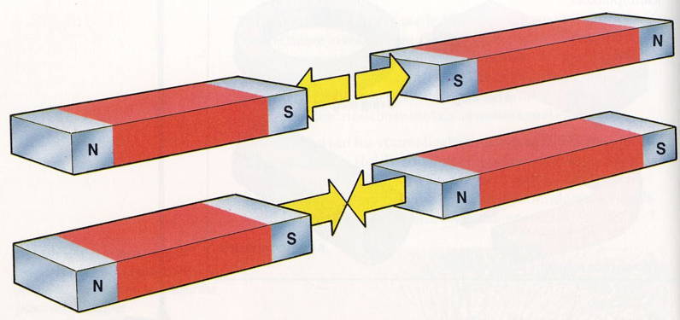
What is a magnet?
A magnet (from Greek μαγνήτις λίθος magnḗtis líthos, "Magnesian stone") is a material or object that produces a magnetic field. This magnetic field is invisible but is responsible for the most notable property of a magnet: a force that pulls on other ferromagnetic materials, such as iron, and attracts or repels other magnets.

Slide 3
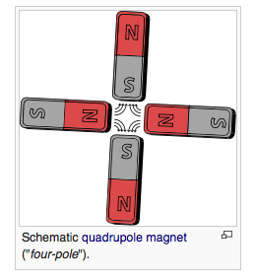
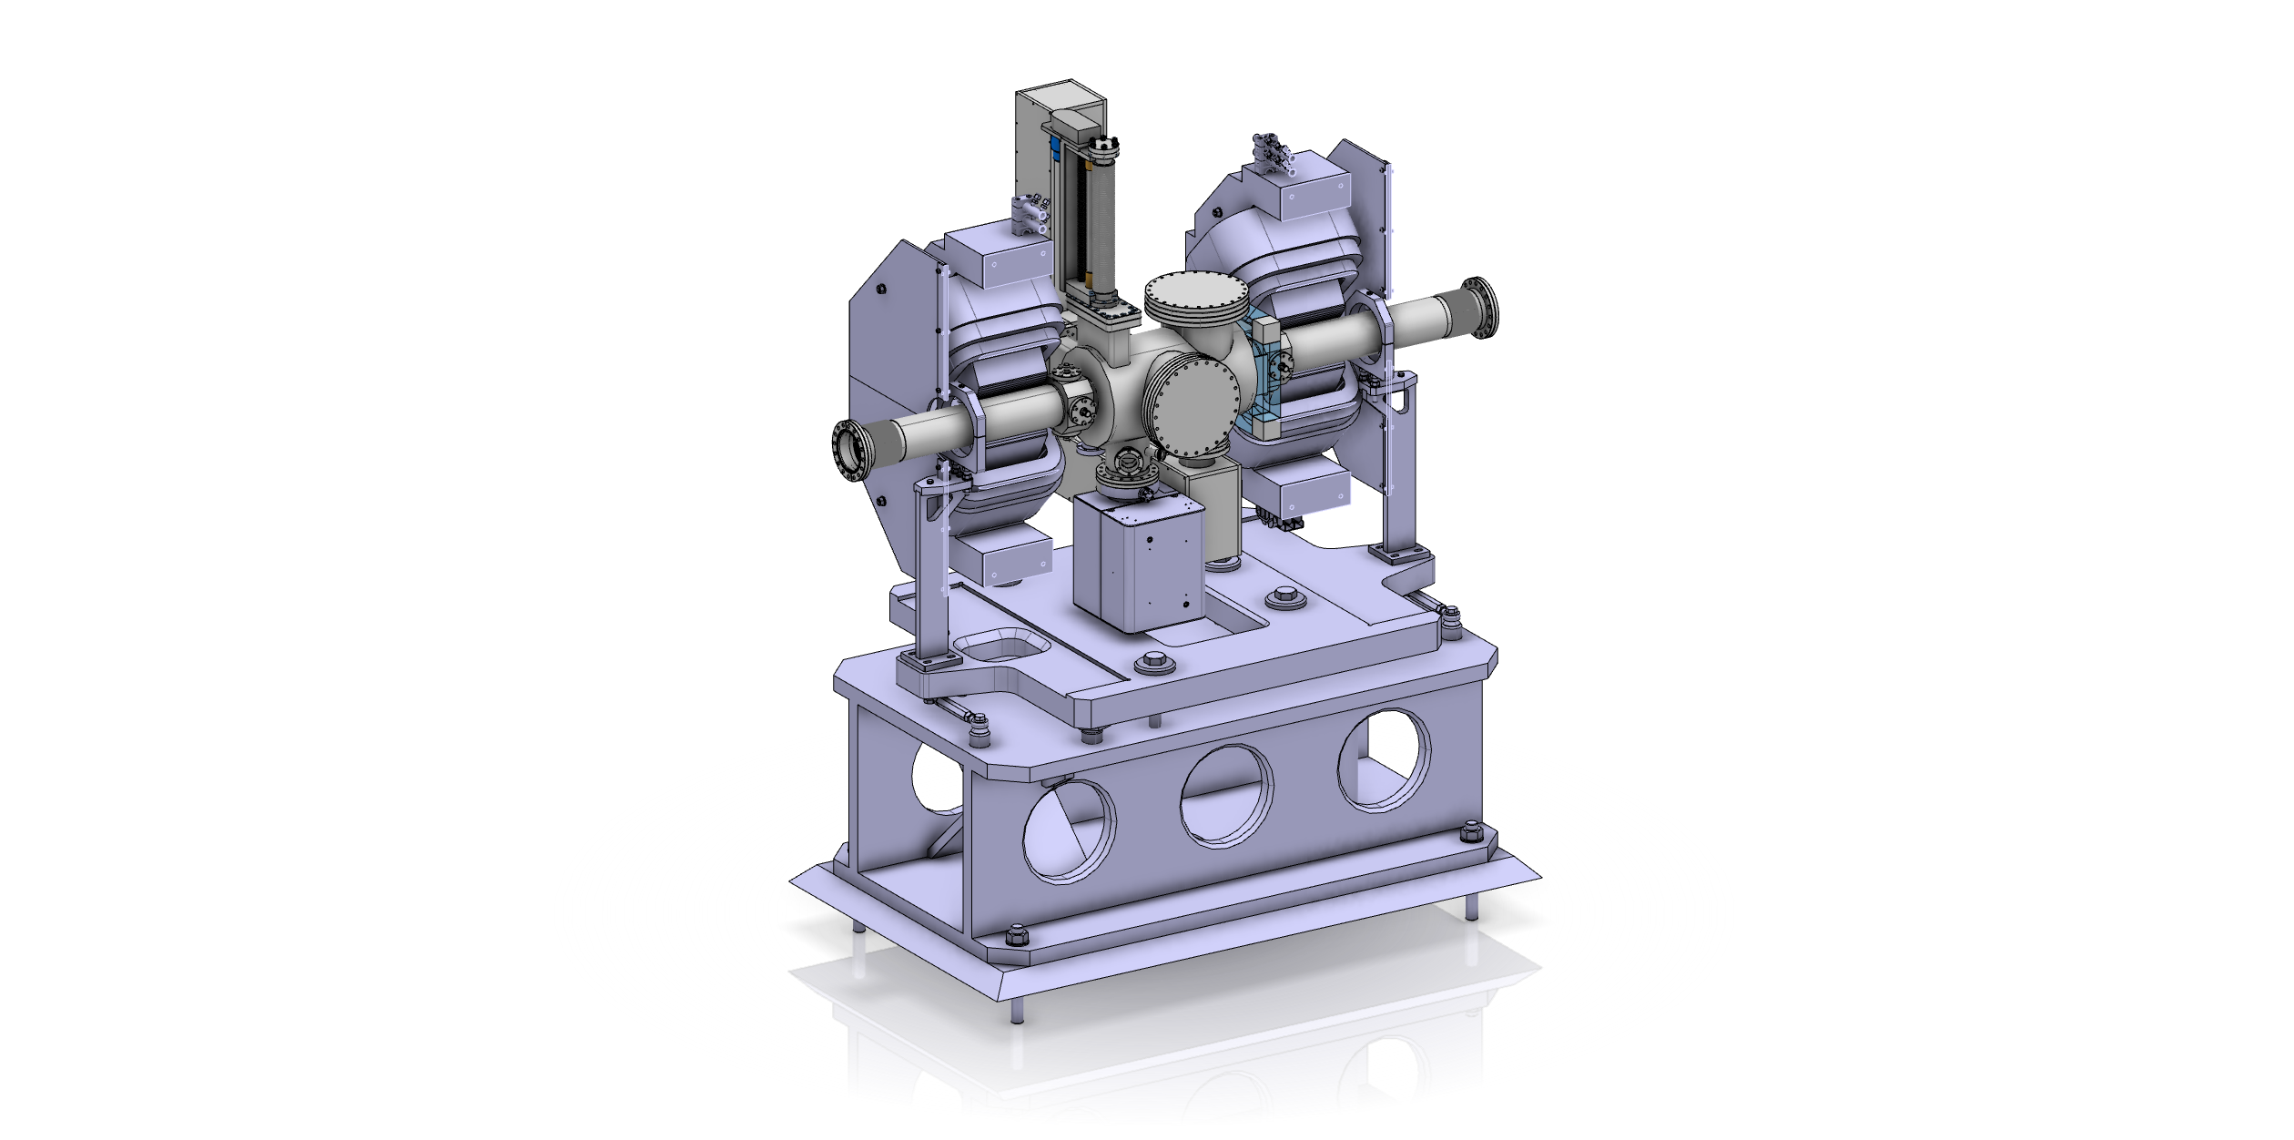
Present Baseline for Linac Warm Units
Water-cooled DC quadrupoles

Slide 4
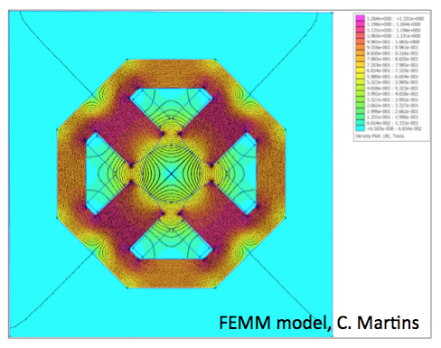
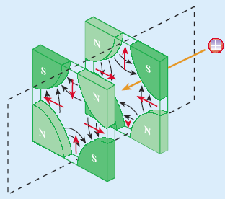
Quadrupole FEM simulation / Focusing
Magnet field cancels out in the middle of the magnet. This gives an effective way of focusing the beam that is sent through the pipe. This can be done in two stages (defocusing quadrupole (QD) and focusing quadrupole (QF).

Slide 5
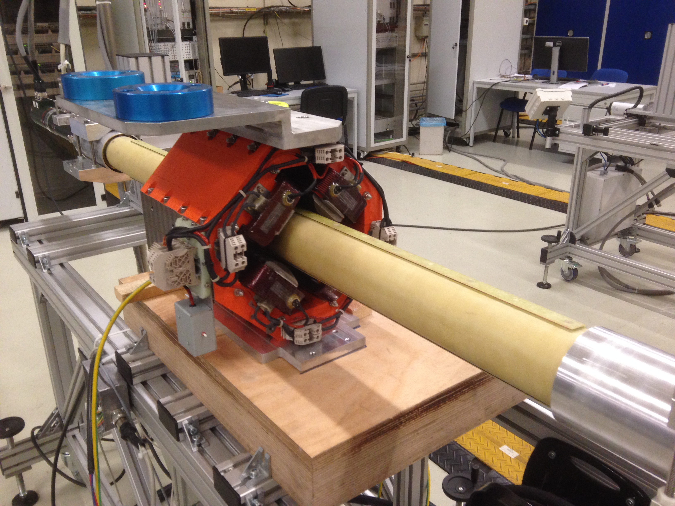
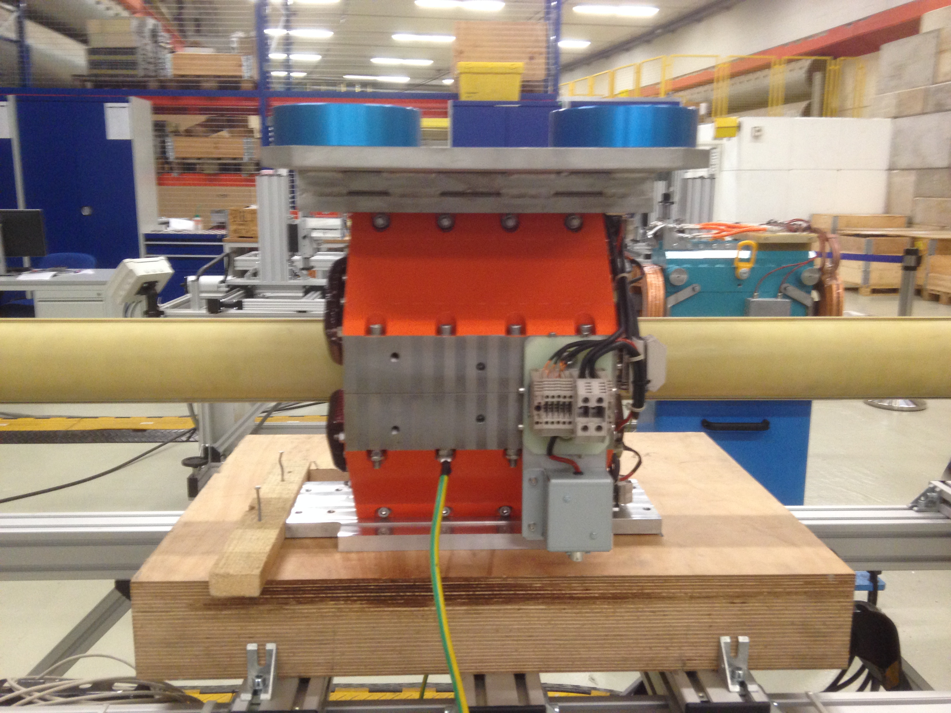
Real pulsed magnets in Cern (Linac 4)

Slide 6
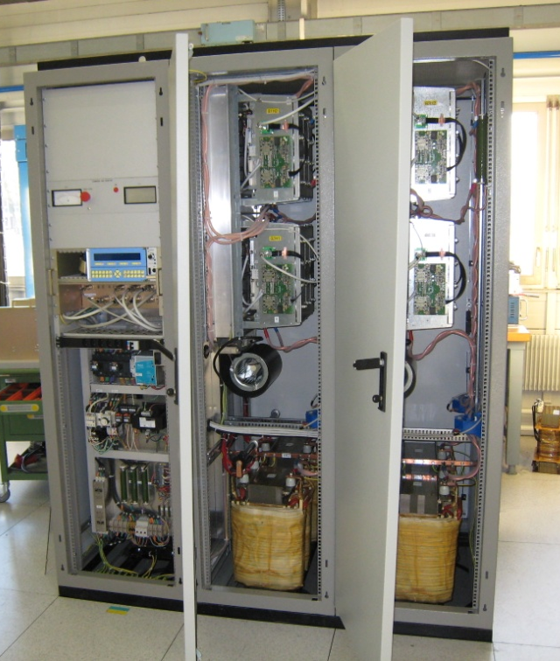
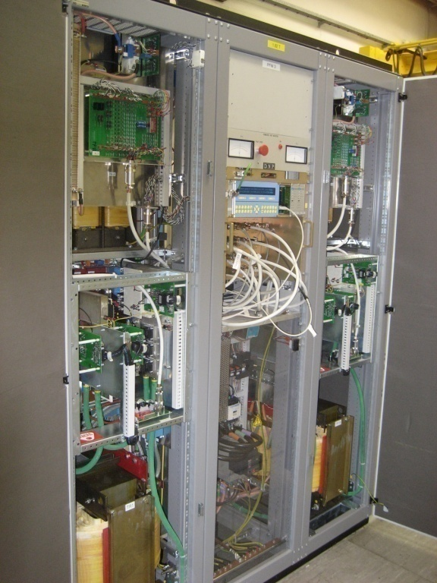
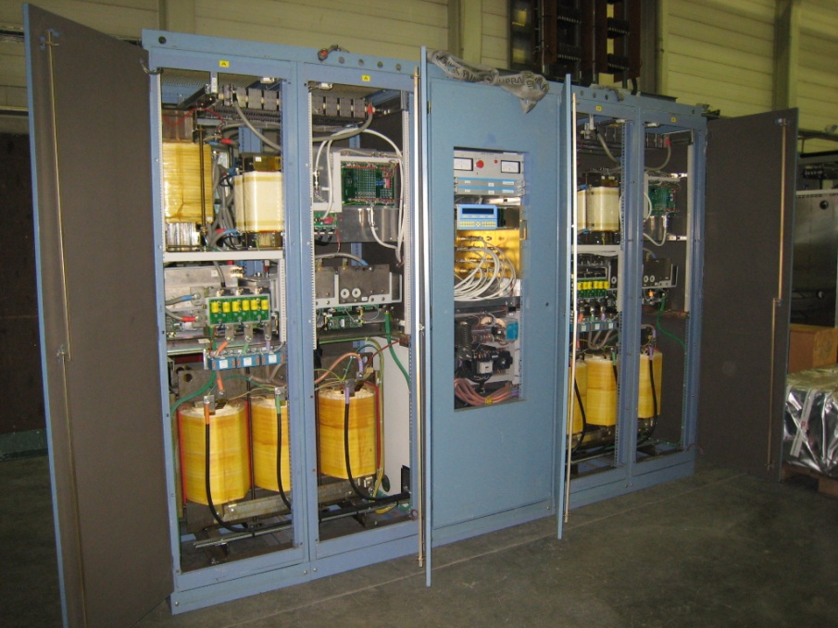
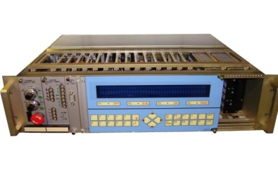
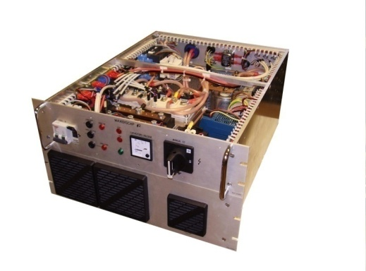
Pulsed power supplies
(CERN examples, PS and Linac4 accelerator)
PS Gamma Transition Quads
(Pulsed: +/- 500A_{pk}, +/-6kV_{pk})
PS Pole Face Windings
(Pulsed: +/-250A_{pk}, +/-1.2kV_{pk})
PS B8 Quads
(Pulsed: +/-1600A_{pk}, +/-600V_{pk})
Linac2, Linac3 & Linac4 Quads (Pulsed: 300A_{pk}, 1kV_{pk}, 1ms/5 Hz)
500V
voltage
PS = Proton Synchrotron
Electronics
crate 19”, 3U
300A
current
Power crate 19”, 6U
1 ms

Slide 7
Considering Pulsed Quadrupoles
The main motivation for pulsing the quadrupoles is to: Reduce the power dissipation and avoid water-cooling - Important cost savings in infrastructure installation, operation and maintenance. - Major improvement in the reliability and availability of the accelerator.
This concerns 130 out of 151 water-cooled magnets (86%).
Reduction of electrical power consumption by about 300kW possible, this corresponds to a saving of about 90 % in power which will decrease the running costs.

Slide 8
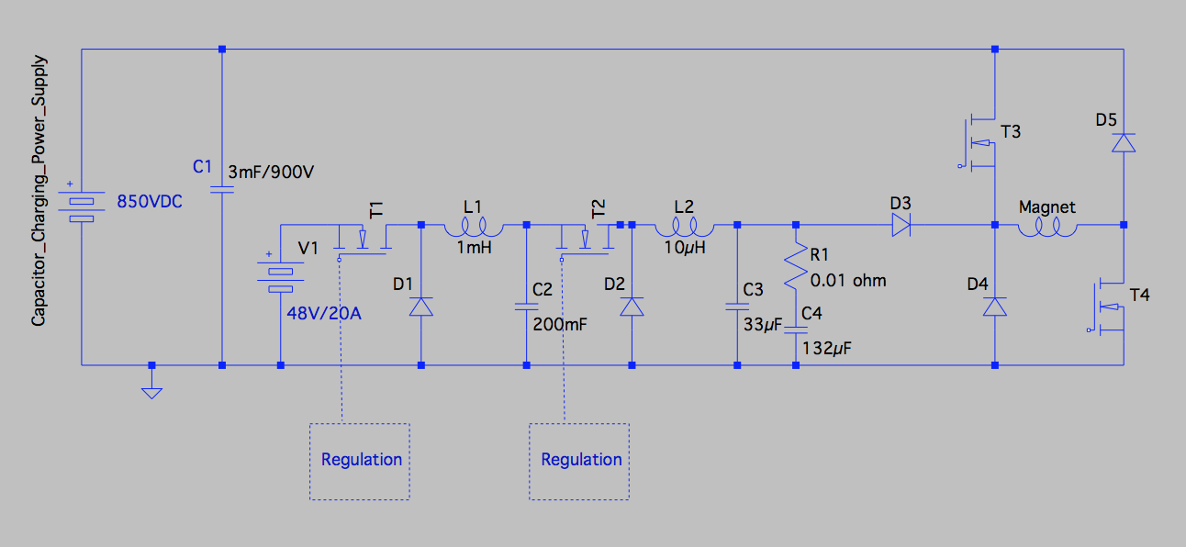
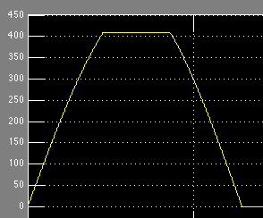
Pulsed power supplies – a new topology for quadrupole magnets
Pulse current | 410 A
Pulse voltage | 850V
Pulse current rise/fall times | 4.5 ms
Pulse flat-top duration | 4 ms
Pulse Rep. Rate | 14 Hz
Magnet current
– typical pulse
- T3 & T4
closed
- T4 & D3
closed;
- T2/D2 switching
- T1/D1 switching
- T3 & T4
open;
- T2/D2 open;
- T1/D1 switching

Slide 9
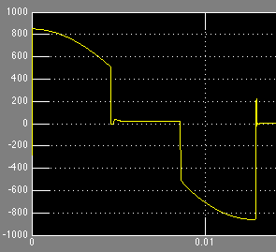
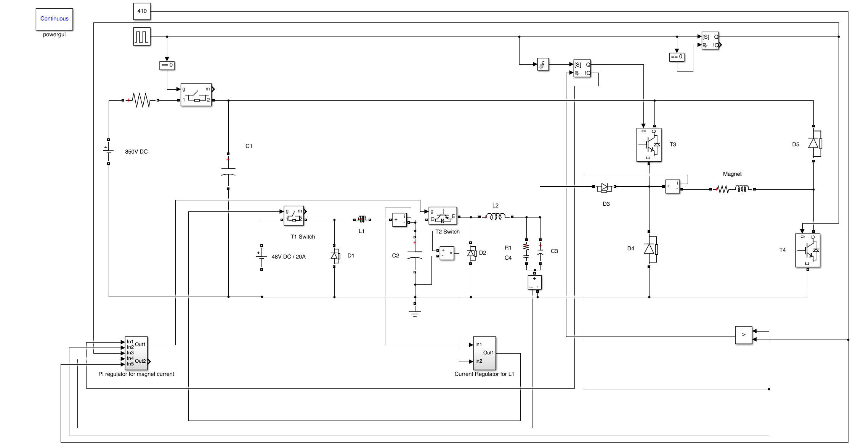
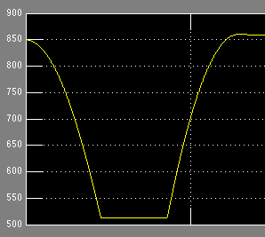
Pulsed power supplies – simulation results
Magnet current – Zoom #1 at flat-top (A)
Magnet current (A)
500 ppm
Magnet voltage (A)
Magnet current – Zoom #2 at flat-top (A)
25 ppm
Capacitor bank voltage (V)

Slide 10
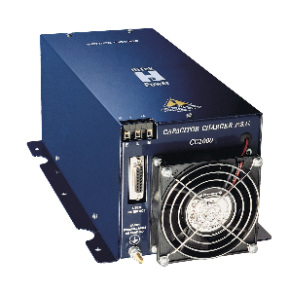
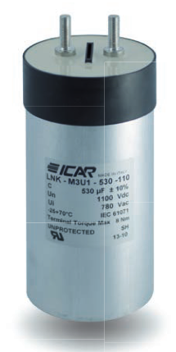
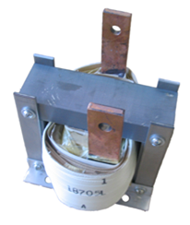
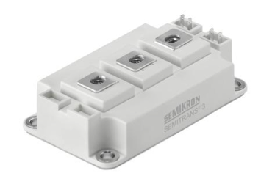
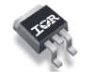
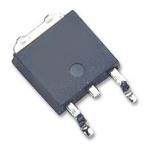
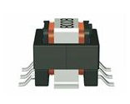
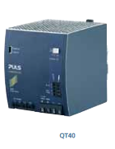
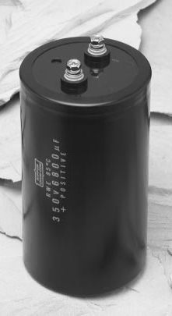
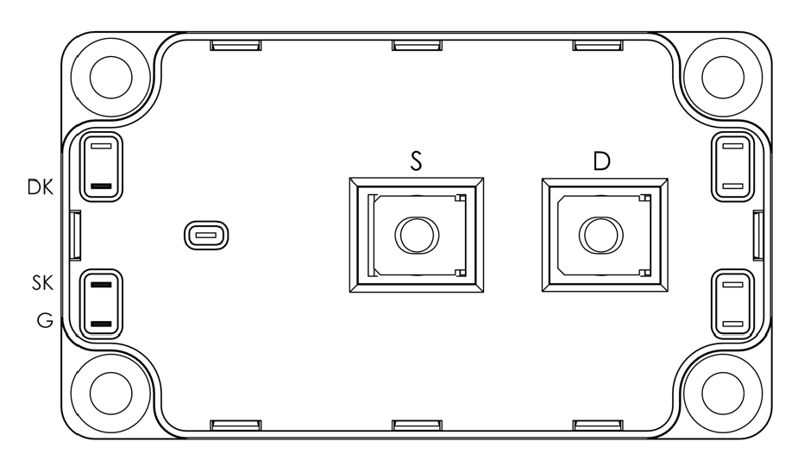
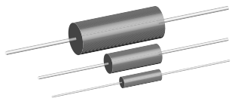
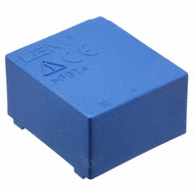
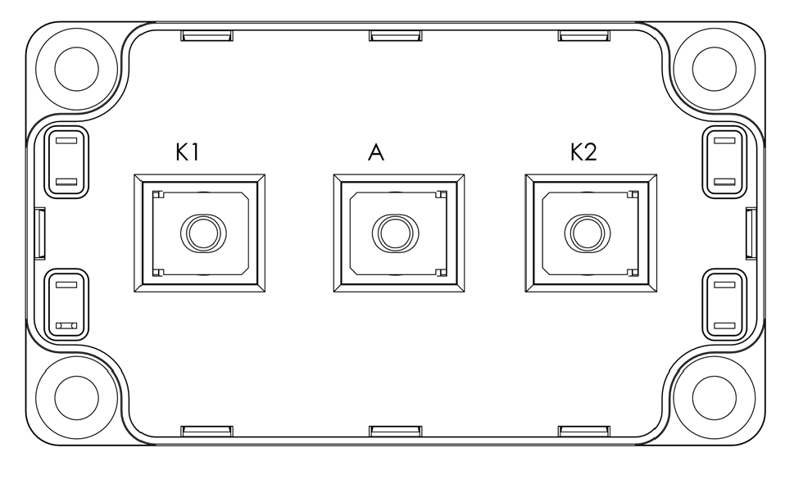
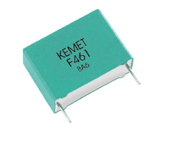
Pulsed power supplies – Bill Of Materials

Slide 11
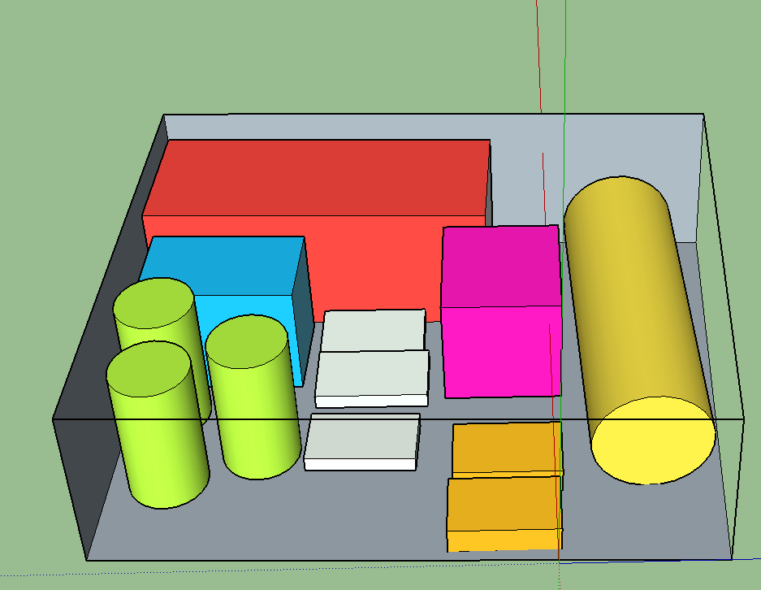
Pulsed power supplies – preliminary volume assessment
19” rack; (483 mm)
4U height; (178 mm)
600 mm depth;

Slide 12
Cost estimate pulsed power supply / magnet
Total cost estimate (series of 100 units):
Components: 3000 Euro;
Assembling : 300 Euro;
Testing: 150 Euro;
Total production cost: 3450 Euro;
Overheads (40% of total production cost): 1350 Euro;
Profit (50% of total production cost + overheads):2400 Euro;
Total: ~ 7200 Euro / unit not including non recurring engineering costs
Estimated cost of a DC power supply:
~ 1 Euro / watt x 6000 watt = ~ 6000 Euro
Pulsed magnets are cheaper because of smaller dimensions and no cooling connections required.

Slide 13
CONCLUSIONS
The feasibility of pulsed quadrupole magnets and associated power supplies has been evaluated and the following conclusions could be made:
Water cooling can be avoided on all quadrupole magnets and power supplies (except Rastering quads);
No costs associated to water cooling distribution in the tunnel (materials + installation). Only dogleg dipoles and Rastering quads need to remain DC and water cooled;
Reduction of electrical power consumption by about 300kW which decreases the running costs;
Reliability improvement of the accelerator due to inexistence of water leaks (both on magnets and power supplies);
Total cost of magnet, cable and power supply is more or less identical when comparing DC with pulsed operation;
Presented at the technical board meeting in November 2014. Decision to be taken in February 2015;

Slide 14
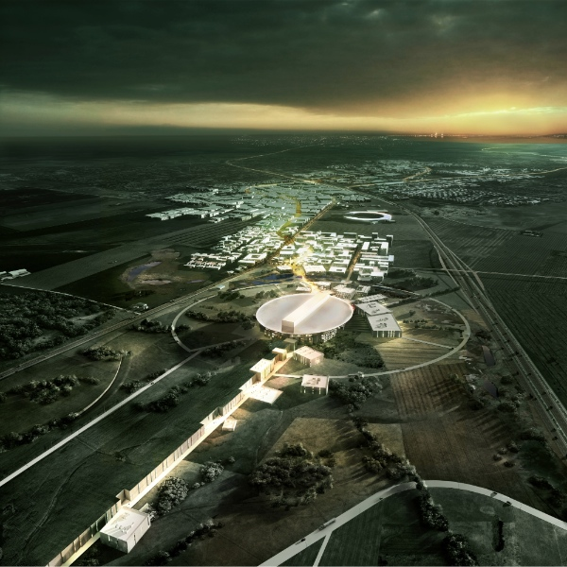
Thank you!

