Slide 1
Controls Configuration Deluge and How ICS Manages It
R. Fernandes
www.europeanspallationsource.se
December 11, 2014

Slide 2
Motivation
At ESS hundreds of IOCs will be deployed across the facility and these will control thousands of devices generating up to one million of signals (PVs). Most will evolve over time.
How do we manage this complexity?

Slide 3
Proposed Solution
A set of applications that enables the collection, storage, and distribution of configuration data needed to install, commission, and operate ESS control system.
It is composed of the Cable Database, the Controls Configuration Database (CCDB) and the IOC Factory.
Possible users of these applications include the Accelerator, Target, Neutron Instruments and Conventional Facility divisions.
WU 3.1

Slide 4
Cable Database
The Cable Database can be used for registering tens of thousands of cables that will exist at ESS.
~ 90 approved cable types are currently available.
Cables can be registered one-by-one or in a batch fashion (with automatic cable numbering according to ESS standard).
Notification of owners’ cables when they change state.
Query capabilities.
Print labels (near future).
Current status: in production since September 2014.

Slide 5
Controls Configuration Database (CCDB)
The CCDB manages thousands of devices that will be in operation at ESS.
Register devices (e.g. cameras, PLCs, motors).
Associate properties to devices (e.g. manufacturer, serial number).
Define relationships between devices (e.g. powers, controls, contains).
Current status: production expected in March 2015.

Slide 6
IOC Factory
The IOC Factory is responsible for managing 600+ IOCs that will be deployed across ESS.
Provide a consistent approach on how these IOCs are configured, generated and deployed.
Rely on the CCDB to get information about the devices that an IOC interface.
Current status: first alpha version expected in Q1 2015.

Slide 7
Systems Integration Overview
WU 3.2
WU 3.3
WU 2.4
Role-Based Access Control (RBAC)
Naming System
ICS Software Infrastructure
Authentication & Authorization
Name verification
IOC deployment
Cable Database
CCDB
IOC Factory
WU 3.1

Slide 8
Important Features
Web-browser interface with public access and mandatory authentication (through RBAC).
Programmatic interface (through RESTful services).
Standard software stack (WildFly, Java EE, PostgreSQL).
Single sign-on (near future).

Slide 9
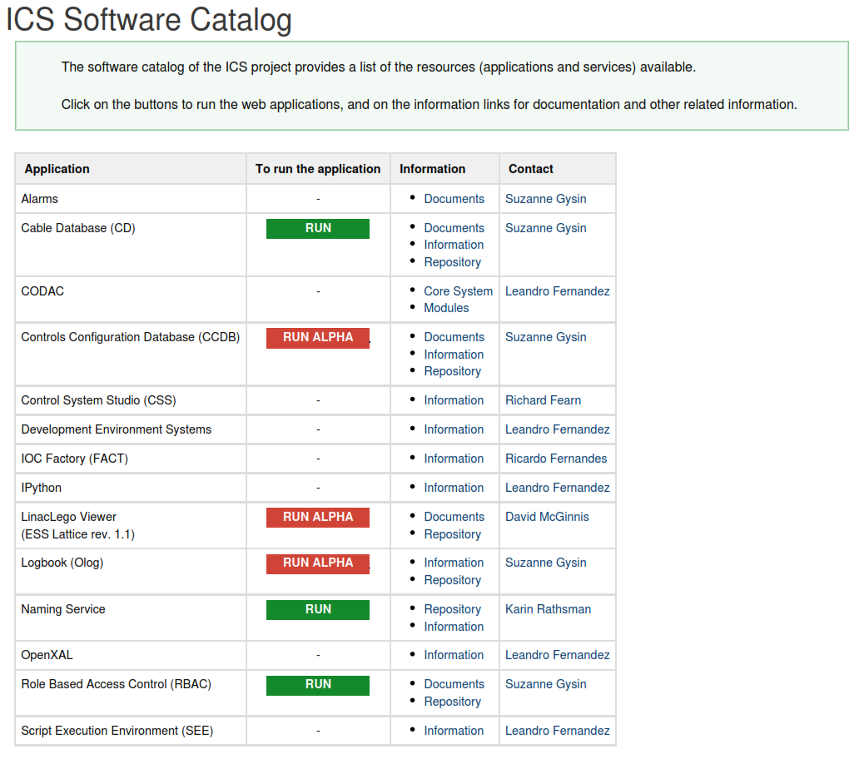
Software Catalog
https://ess-ics.atlassian.net/wiki/display/ID/ICS+Software+Catalog

Slide 10
Acknowledgments (alphabetical order)
Cyrille Thomas (AD)
Daniel Fernandez (ICS)
Eugene Tanke (AD)
Evangelia Vaena (AD)
Jonas Widing (EISD)
Klemen Strnisa (ICS/Cosylab)
Leandro Fernandez (ICS)
Miha Vitorovic (Cosylab, main developer of the CCDB)
Miroslav Pavleski (Cosylab)
Karin Rathsman (ICS)
Sunil Sah (Cosylab, main developer of the Cable Database)
Suzanne Gysin (ICS)
Timo Korhonen (ICS)
Ursa Rojec (ICS/Cosylab)

Slide 11
Thank you!

