Slide 2
Welcome to common STAP meeting ‘Users & Samples’ and ‘Sample Environment’
April 2021
PRESENTED BY Arno Hiess

Slide 3
Agenda
1 Scientific Activities Division: Team, Purpose and Implementation
2 STAP: Members, Charge, Documents, Agenda, Practicalities
3 Some Highlights from Q1/2021

Slide 4
1
Scientific Activities Division:
Team, Purpose & Implementation

Slide 5
Scientific Activities Division
The Team providing ESS User and Sample Services
Scientific Activities Division
DEMAX
Deuteration & Macromolecular Crystallization Group
SULF
Sample and User Labs Group
SCUO
Scientific Coordination
and User Office
SE
Sample Environment Group
ensures ability to prepare deuterated samples and macromolecular crystals:
• provide deuteration and crystallisation services and operate user support labs.
• ensure method development and training.
ensures ability to receive, handle, ship, characterise, synthesize, condition, mount, orient, align samples:
• provide support to user when handling samples in preparation or during their beamtime.
• commission and integrate new equipment and instrumentation
• operate on-site chemistry and life science labs.
enables user access, supports its communities, encourages colla-borative scientific activities:
• manage user programme
• provide community interaction
• oversee scientific coord. and in-house scientific activities
• organise outreach to industry
• Participate in “welcome function” for visiting scientists.
Enables to perform experiments with multiple parameters T, p, fields, mech. constraints, humidity, gas loading, fluid control:
• installs, operates, calibrates, maintains, repairs SES
• operates SE workshops
• coordinates liquid helium cycle
• develops / procures new SES
• integrates SES for rapid change over and standardised control.
Functional Description - ESS-3132857

Slide 6
towards integrated user & sample services
Bringing it all together …..
Equipment
Availability
Safety, Robustness, Reliability, Ease-of-use
Maintenance, Workflow, Cost, Schedule
Maximal range
Multiple parameters
Precision, accuracy
Stability, control speed
Total range sweep
Return to ‘off’
Equipment
Change-over
Parameters
Mobility
Modularity
Rapidity
Reproducibility
Work flow
Sample Change
Positioning precision
Reliability, speediness
Labs
Prepare and characterize
Align, condition, mount
Register, tag, store, ship, dispose
Sample Environment Suite = Pool equipment + Instrument Specific Devices
Laboratory Suite = General User Labs + Instrument Labs and Prep. Areas

Slide 7
Science Directorate Operational Functions
We are part of a bigger team …
Experiments
Sample
Environment
SE
User
Services
Sample
Services
Sc. Coord.
User Office
SCUO
Lab Services
SULF
Based on ’Science Directorate –
WBS during Steady-State Ops’
Review 2016 - ESS-1957058
DEMAX
Deuteration
Macrom. Crystal.

Slide 8
Science Directorate Operational Functions
We are part of a bigger team …
Experiments
Neutron
Instruments
Instr. Control
Data Services
Instrument
Technologies
Sample
Environment
SE
User
Services
Sample
Services
Sc. Coord.
User Office
SCUO
Lab Services
SULF
Based on ’Science Directorate –
WBS during Steady-State Ops’
Review 2016 - ESS-1957058
DEMAX
Deuteration
Macrom. Crystal.

Slide 9
Science Directorate Operational Functions
We are part of a bigger team …
Experiments
Neutron
Instruments
FM, Design
Manufacture
Metrology
Cryogenics
Vacuum
IT
Instr. Control
Data Services
Instrument
Technologies
Sample
Environment
SE
Communication
Public Engagm.
User
Services
Sample
Services
Welcome
Site Access
Visits
Sc. Coord.
User Office
SCUO
Logistics
Procurement
Waste
Lab Services
SULF
Based on ’Science Directorate –
WBS during Steady-State Ops’
Review 2016 - ESS-1957058
Governance
Administration
DEMAX
Deuteration
Macrom. Crystal.

Slide 10
2
STAP:
Members
Charge
Documents Agenda Practicalities

Slide 11
STAP Members
Welcome to new members !
STAP ‘Sample Environment’
STAP ‘Users & Samples’
Andy Church | STFC
Robert Barker | U Kent
Stefan Carlson | MAX IV
Michael Hofmann | TUM
Bianca Haberl | SNS
Klaus Kiefer | HZB
Ina Lommatzsch | MLZ
Jeremy Lakey | U Newcastle
Tamim Darwish | ANSTO
Gavin Stenning | STFC
Janell Thomson | SNS
Luke Daemen | SNS
Thomas Shea | ESS

Slide 12
Documents and Charge
All this reading ….
Documents
General information: acronym decoder, site orientation, functional description
Update from team for each STAP: NN_STAP_Update
Slides from various presentations at the different sessions
Charge - Common Topics:
completion construction scope
line organisation for operation
balance between construction deliverables and operational activities

Slide 13
Documents and Charge
All this reading ….
Charge - Users and Samples:
SCUO: functionalities user office software, preparing for industrial users
DEMAX: method development, user engagement, pilot sub-calls, balance core business <> others
SULF: progress on-site user labs installations and sample handling/ sample management, lab instruments/equipment, support of ESS project, work balance core business <> other tasks
Charge - Sample Environment:
Progress on and prioritisation of individual sample environment systems.
Proposed integration strategy (best practice) and need for helium recovery infrastructure
Comment on magnetic force measurement, pumping cart project
Roles for operational support: roles of user, instrument team and / or sample environment team
Balanced investment (both in equipment and expertise) for short-term and longer-term needs

Slide 14
STAP Agenda and Practicalities
Details are on indico page …
One zoom link per day; several rooms to accommodate parallel and break-out sessions
DMSC STAP participation: User Office Software and SE Software Integration
Instrument STAP participation: Sample Environment Delivery Plan for Instruments
U&S Break-out Sessions TU (intro 13:00 - 13:15, break-out 13:15 - 14:30, feedback 14:45-15:30
DEMAX Tamim, Jeremy ZF, HWK, AL, FP, JFP, JA
SULF Gavin, Luke, Thomas Monika, Melissa, Katrin
SCUO Ina, Janell Grethe, Bea, Fredrik
SE Breakout Sessions TU (intro 13:00 - 13:10, break-out 13:10 – 13:50, feedback 13:50 – 14:30)
SE – Temperature & Field Stephan, Klaus Alex, Richard, Tobias, Andreas
SE – High Pressure & Mechanical Processing Bianca, Michael Caroline, Malcolm, Lauritz
SE – Fluids Andy, Robert Alice, Harald, Niklas
Breaks: zoom break-out rooms

Slide 15
3
Highlights Q1/21

Slide 16
Scientific Activities Division: Users & Scientific Coord
Towards an ESS User Programme
+ Research Report 2020 incl. publication report
+ Science Day 2021 in virtual format
+ Good progress DMSC User Office Software
+ Delivering on guidelines for industrial usage as part of B2 building on previous reports incl. SEI
o Sustainability of multi-stakeholder topics (software, user meeting) pending resource availability.

Slide 17
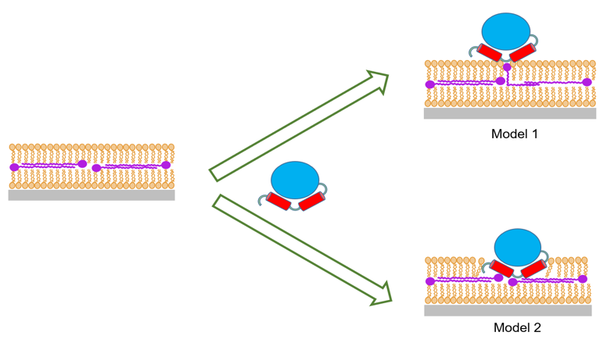
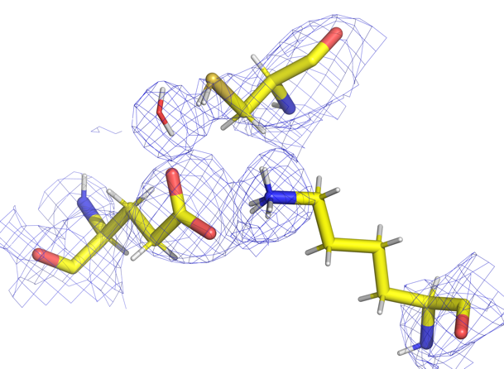
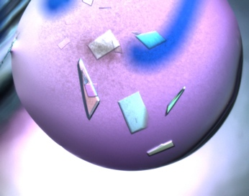
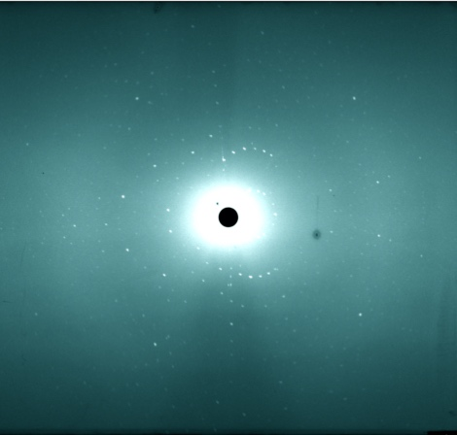
User Science enabled by DEMAX proposals
Effect of the saponins on hydrogenated and deuterated phospholipid membranes from yeast P. pastoris – SANS on D11 (ILL) Sep 2020.
New insights into the interaction of Class II dihydroorotate dehydrogenases with ubiquinone in lipid bilayers as a function of lipid composition
d₆₃POPC used to resolve Q₁₀ location in centre of bilayer - moves up to bind to enzyme
C145
W73
Molecular structure of maltoside surfactants controls micelle formation and rheological behavior; SANS data collected at D11 (ILL)
K111
E41
Large crystals of NitN amidase from Antarctic polyextremophile to study enzymatic mechanism; NPX data collected at LADI (ILL), X-ray data from BioMAX (MAX IV)
https://doi.org/10.1016/j.jcis.2020.08.116

Slide 18
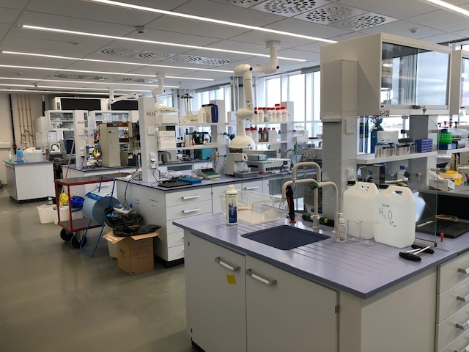
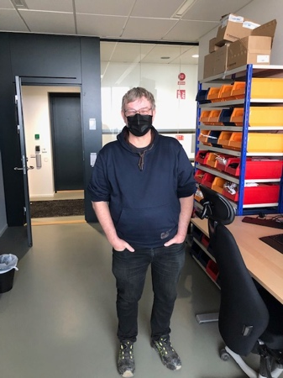
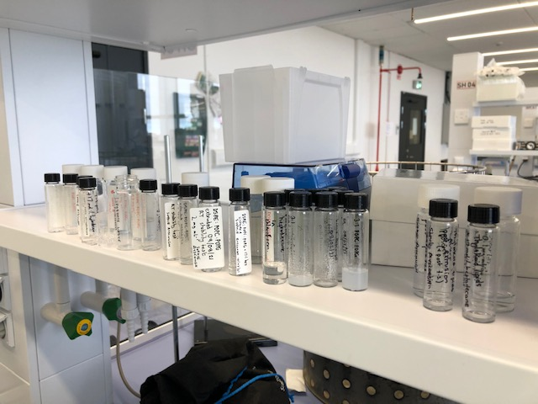
Scientific Activities Division: Chemistry Services SULF
Work during C19 at E04 continues with masks and collaborations …
+ Preparing multi-annual framework for future fit-out of technical / scientific spaces in D04 and D08
o Only few UK contractors back to finish E04 but accepting some delay on E03; D08 and D04 need to start.

Slide 19
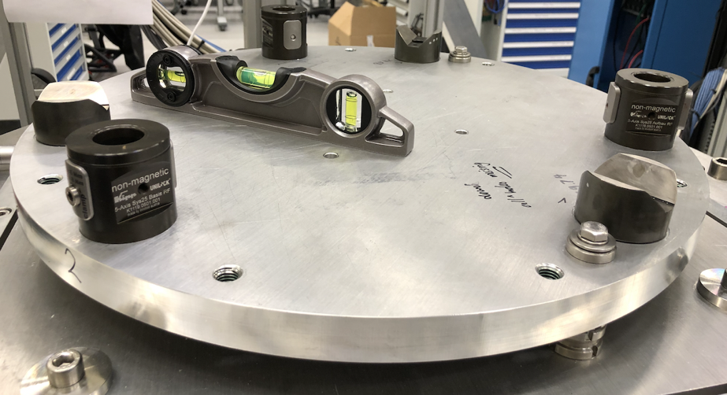
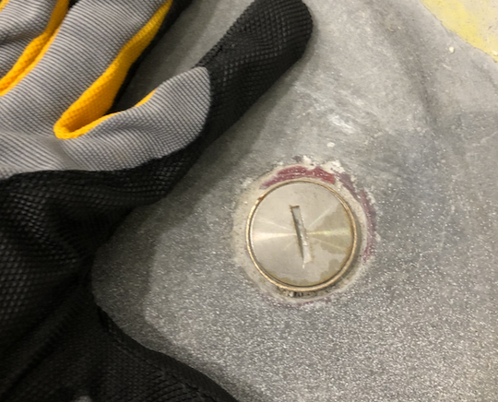
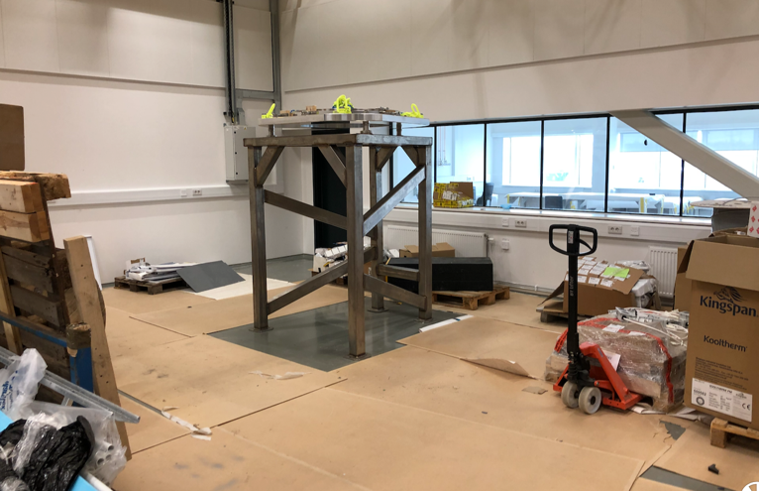
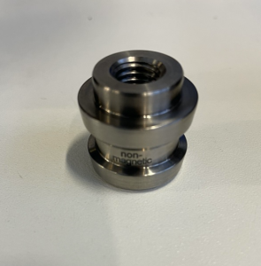
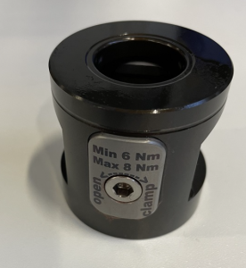
Scientific Activities Division: Sample Environment
Providing some ‘Conditions’ for real ….
+ non-magnetic kinematic mounts KIPP successfully tested, iFrame installed
+ move to E03 in preparation; B02 SE collaboration area to e used with YMIR
Fiducial points in E03 for accurate SES alignment
Position of the iFrame dedicated to alignment of top loading SES

Slide 20
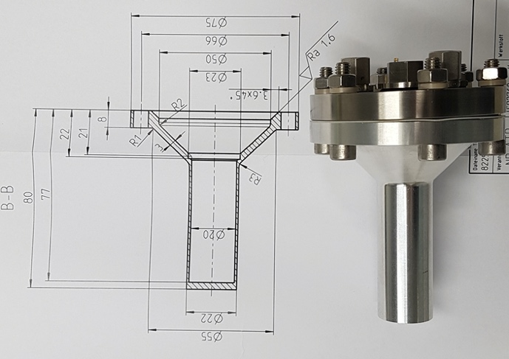
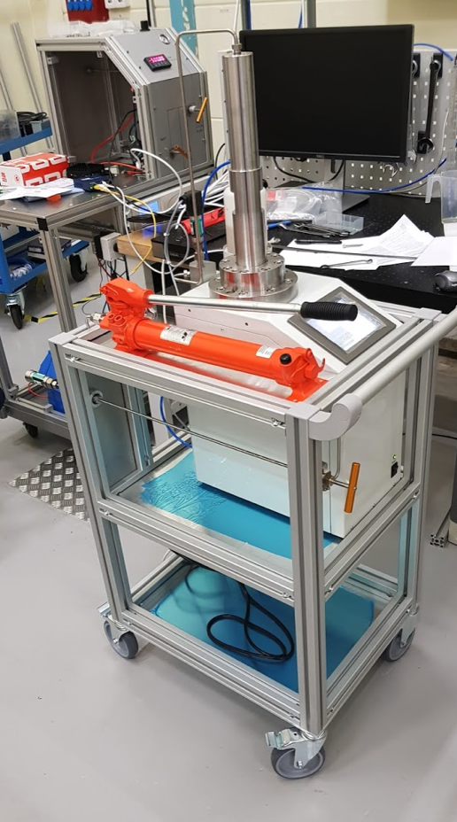
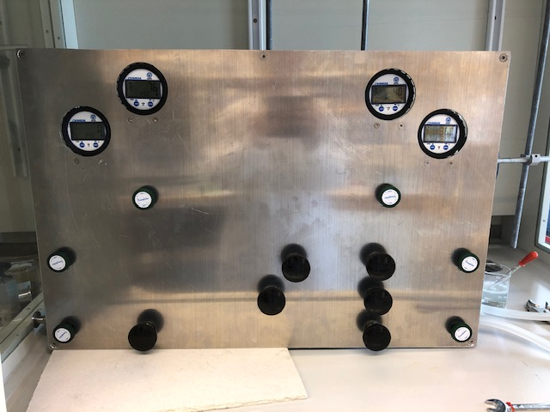
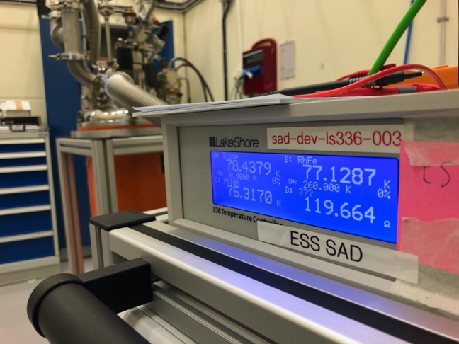
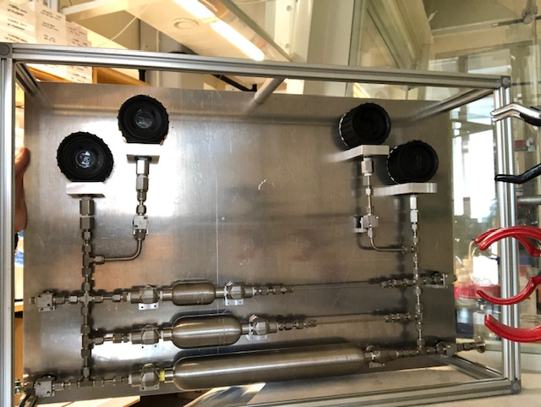
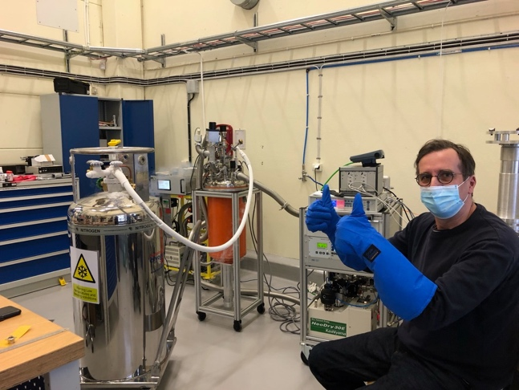
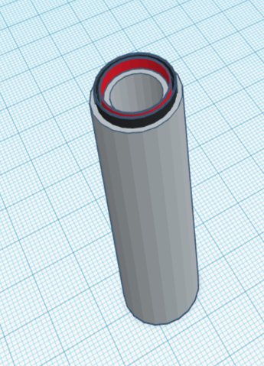
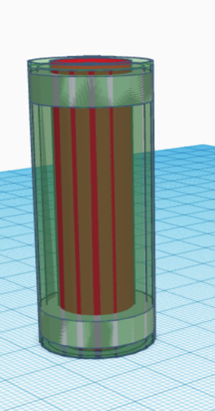
Scientific Activities Division: Sample Environment
Providing some ‘Conditions’ for real ….
+ PE high pressure system operational incl. mechanical and software integration (into EPICS)
+ Electrochemistry development progressing well; Orange Cryostat cooled down.
+ Gas Manifold ready; Collaborative development GISANS humidity cell concluded (manuscript)
+ Many systems approaching CDR

Slide 21
Finish presentation

