Slide 1
User Office Software
Fredrik Bolmsten
26 April 2021

Slide 2
Agenda
Overview
Proposal workflow
Template system
Reviews
Workshops
Scope & Integrations
Questions

Slide 3
Team
Permanent
  Fredrik Bolmsten - Section lead
  Jekabs Karklins - Software Engineer
  Max Novelli - Data Curation Scientist
Temporary:
  Henrik Johansson - Software Engineer(2023-01-31)
  Martin Trajanovski - Software Engineer(2021-06-15)
Recruitments
  2 User Office Developers - Paused

Slide 4
Overview
Memorandum of Understanding with STFC for User Office Core development
Based on experiences and lessons learned from Max IV, STFC, Los Alamos, SNS, ILL
Currently supports proposal submission, technical review, external review and shipments
Template based system that allows for changes without the need for coding
Strong focus on API and message brokers, this allows the system to interact with third party software
Ongoing development to connect with the EAM system for sample and shipment handling
Start of scheduling software for proposal and sample environment booking

Slide 5
Proposal workflows

Slide 6
Various proposal types demand different workflows
We considered “General call”, “Industry”, ”Rapid access”, and “In-house commissioning”
The system is built in a very flexible way and modules/steps can easily be re-arranged if workflow should to change

Slide 7
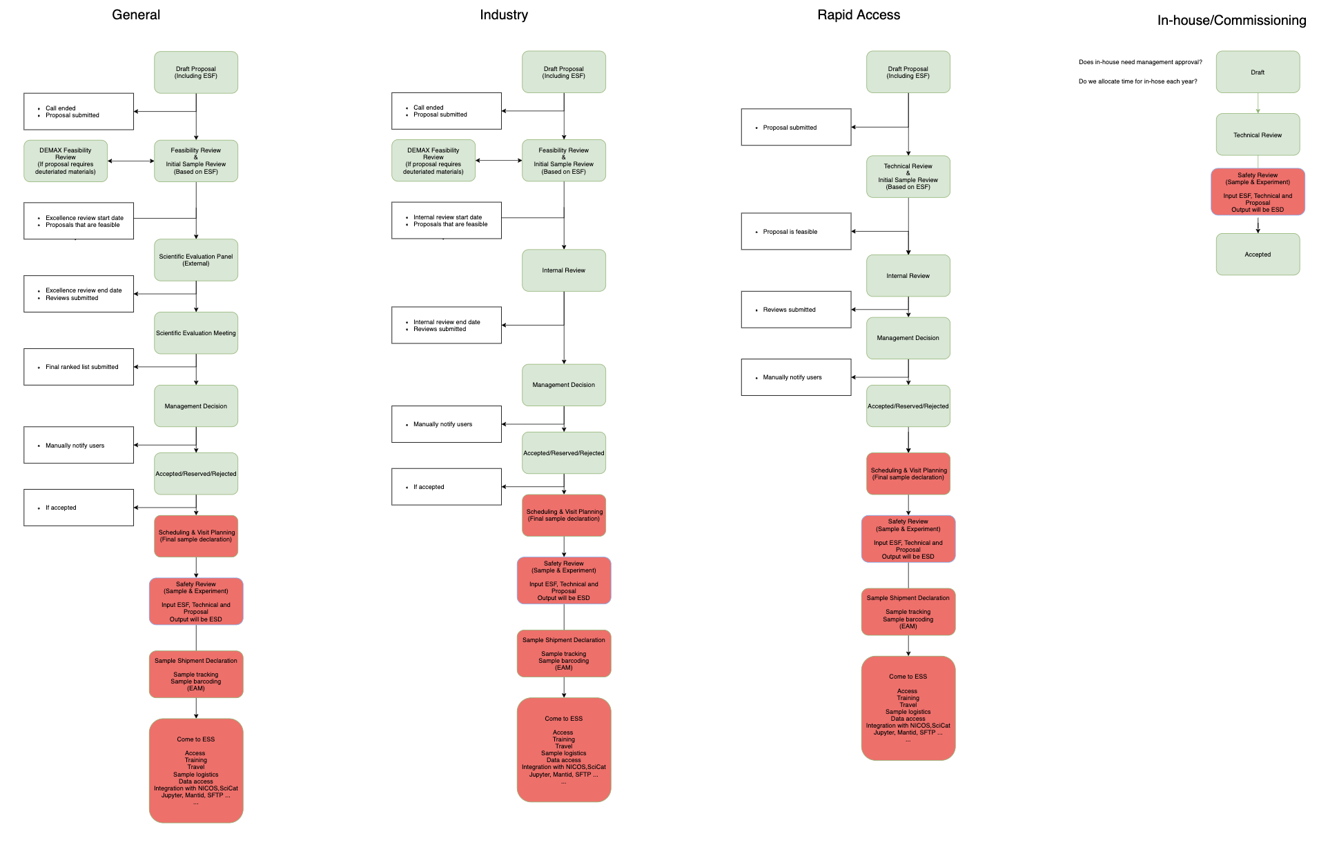
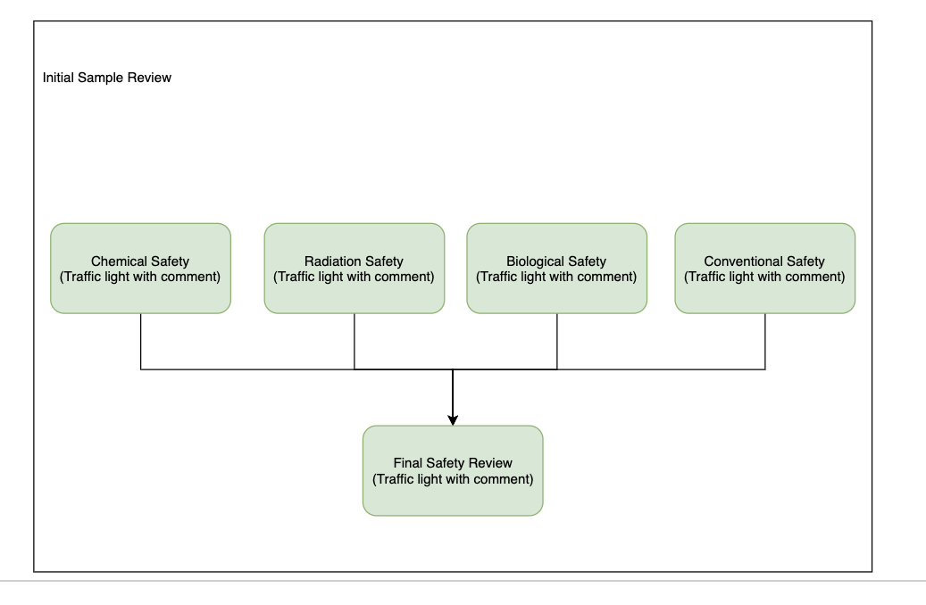
Workflows
Green: UO software can accommodate these steps (proposal submission to final decision)
Red: no digital tools exist to support these steps

Slide 8
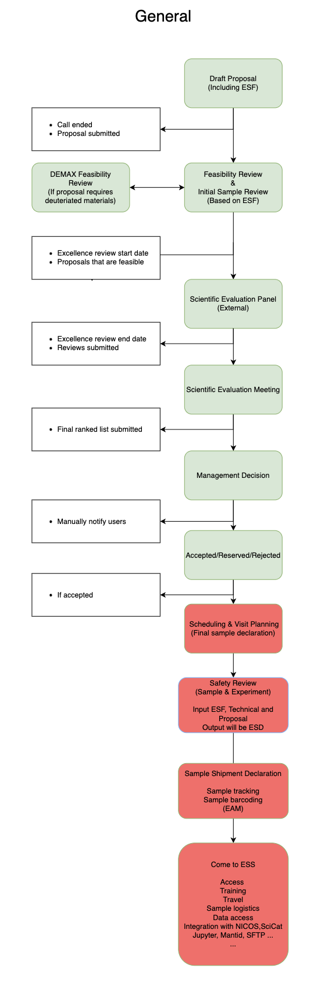
General call

Slide 9
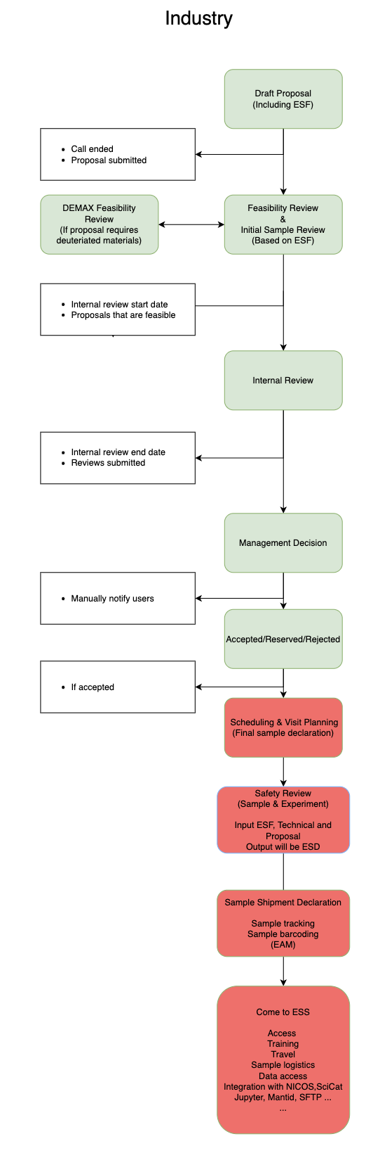
Industry

Slide 10
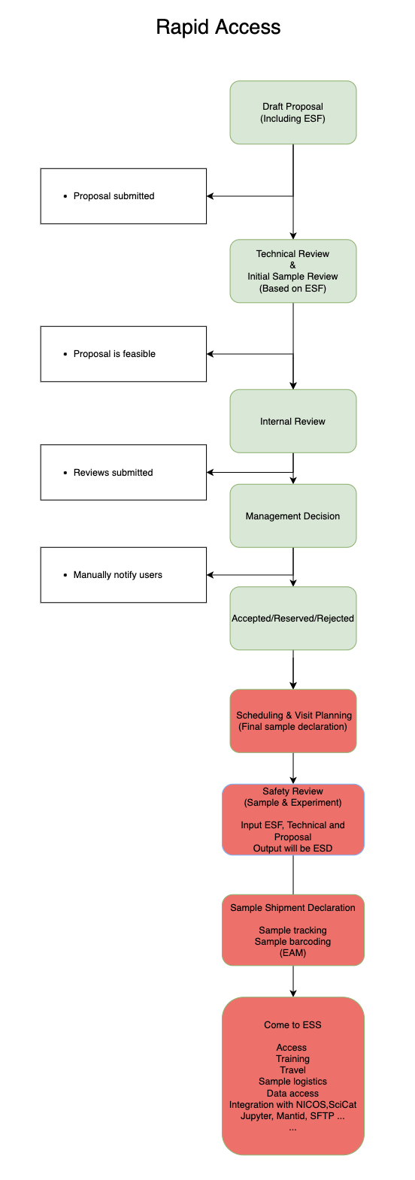
Rapid Access

Slide 11
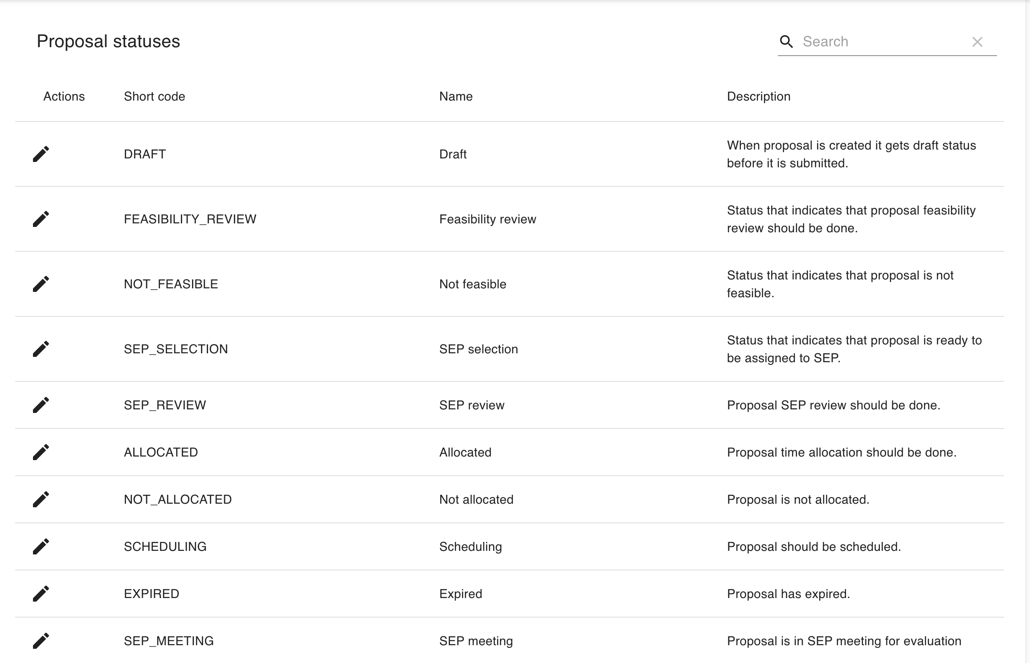

Slide 12
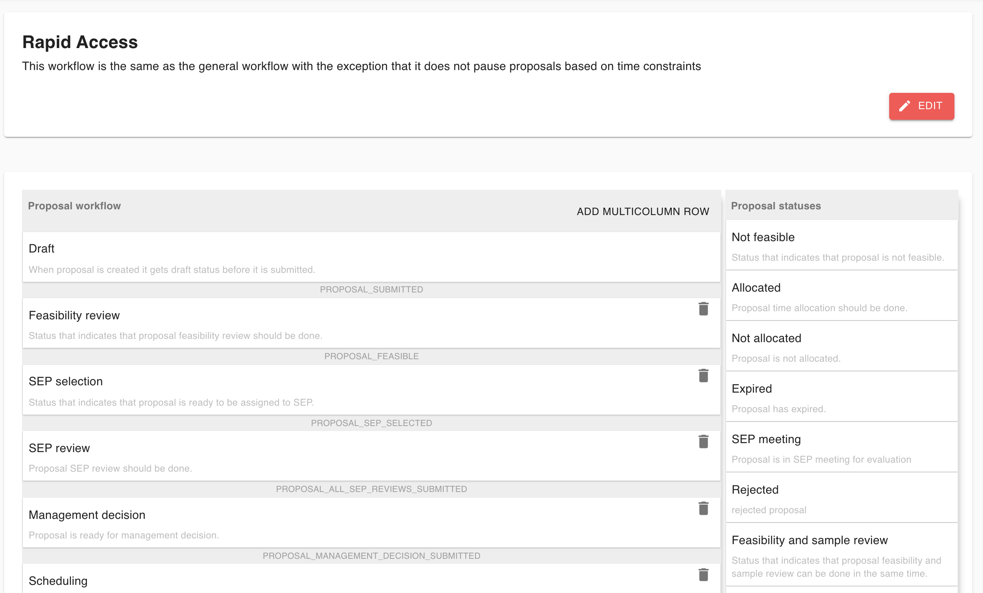

Slide 13
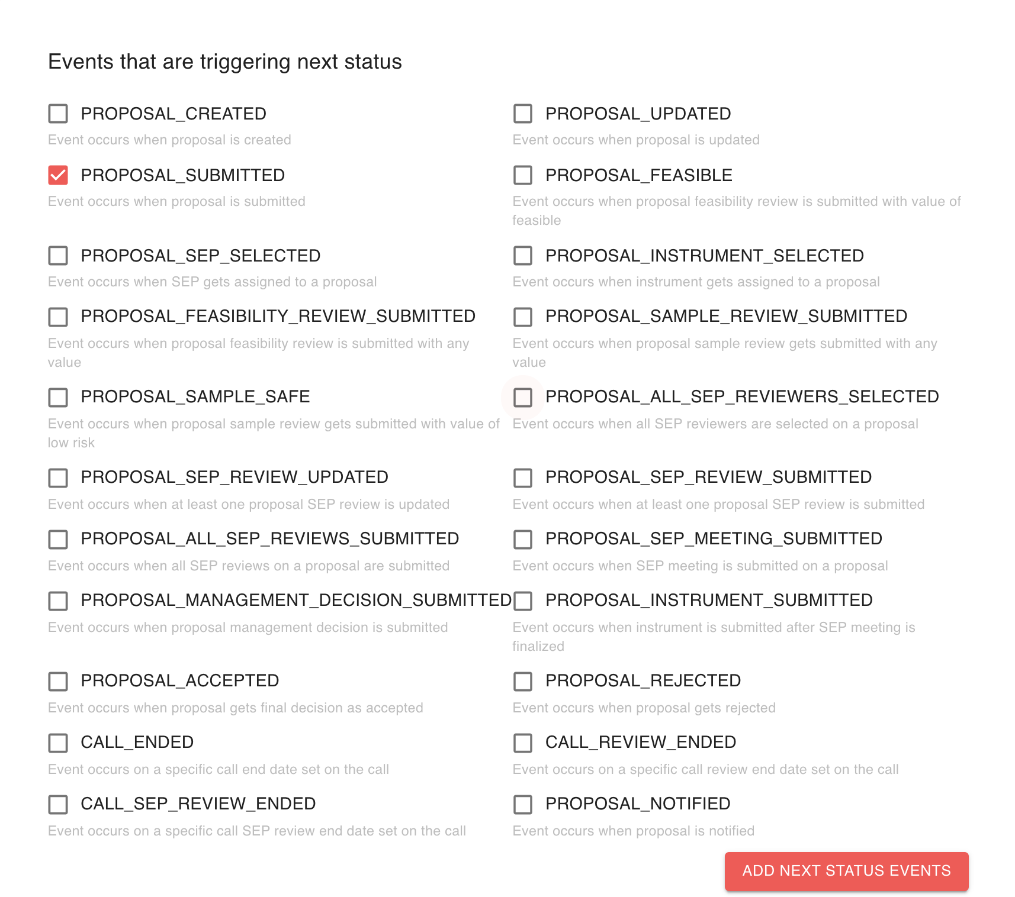

Slide 14
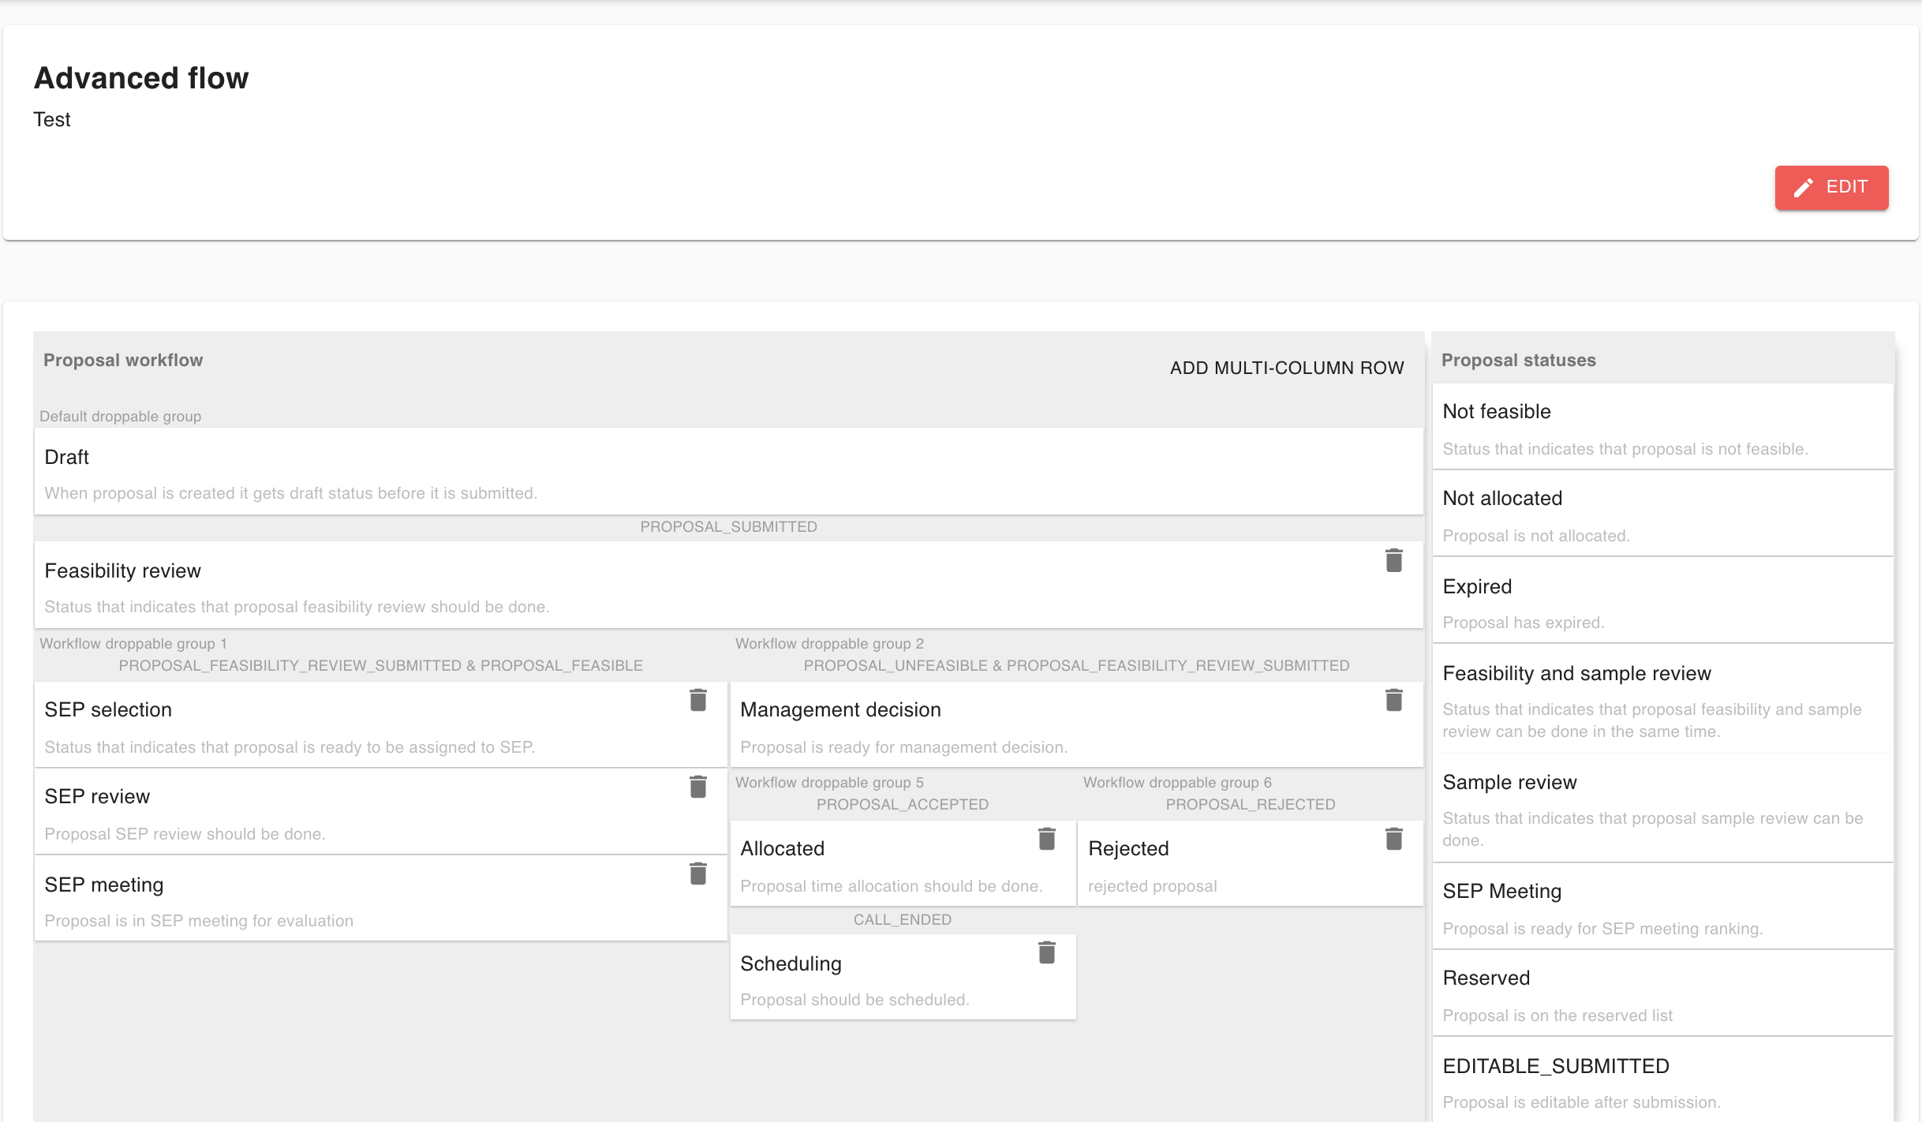

Slide 15
Templates

Slide 16
Proposal and Sample templates
The system supports multiple templates and template types
Each template consists of a number of question modules such as:
  Number
  Text
  Date
  File upload
A initial ESS proposal template has been created based on ISIS, ILL and SNS proposals

Slide 17
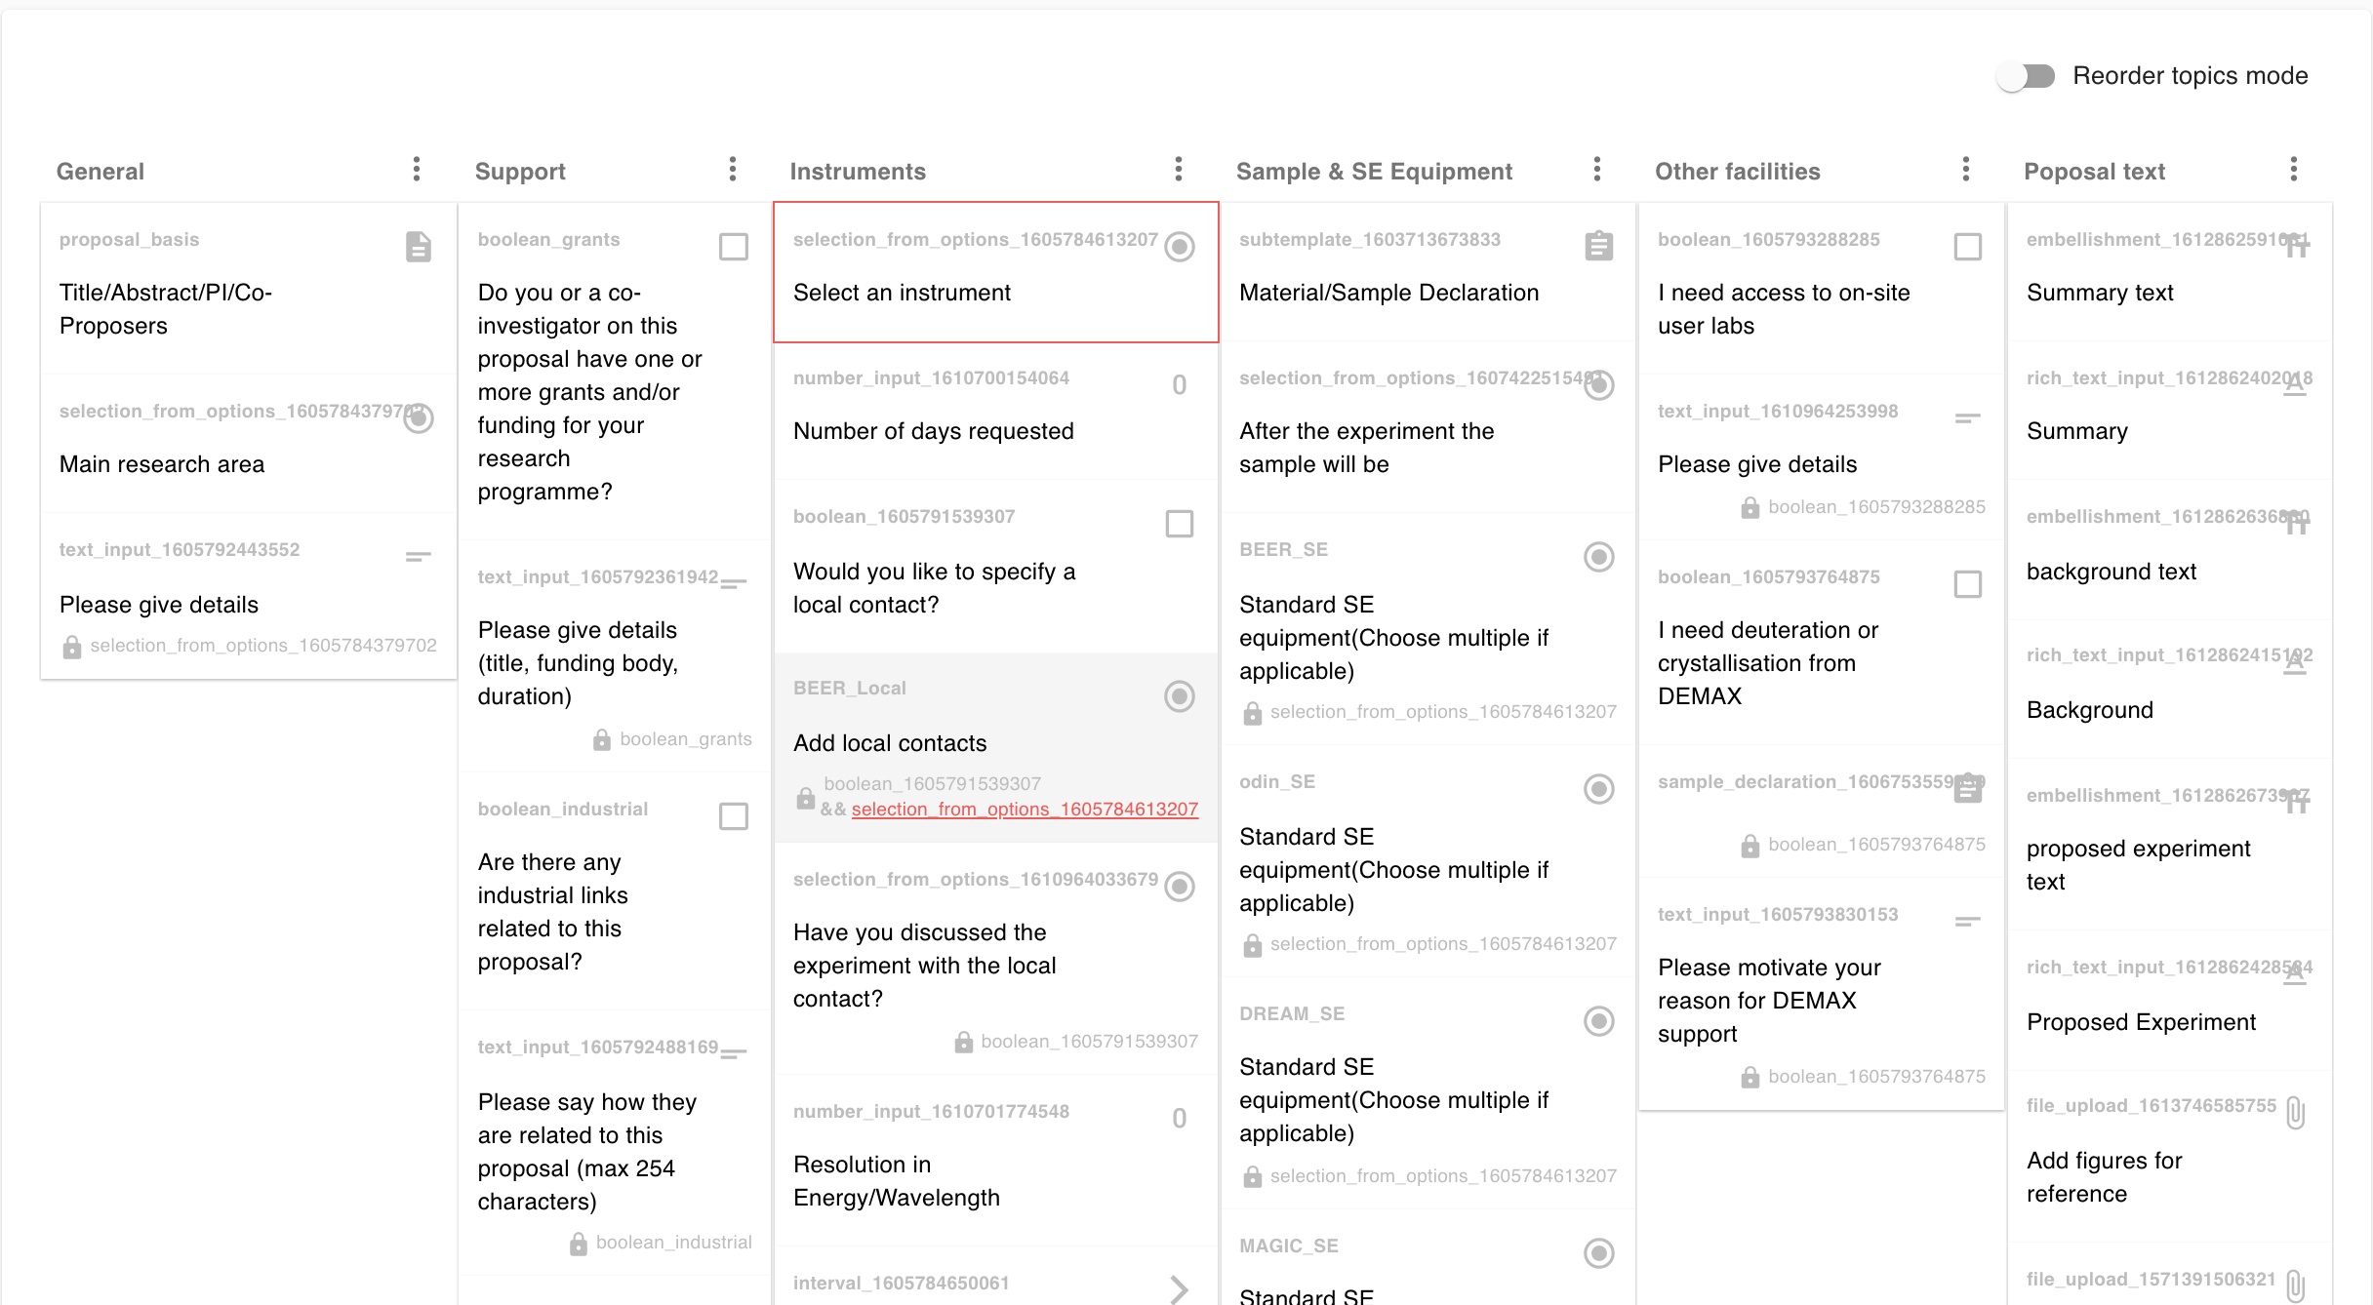

Slide 18
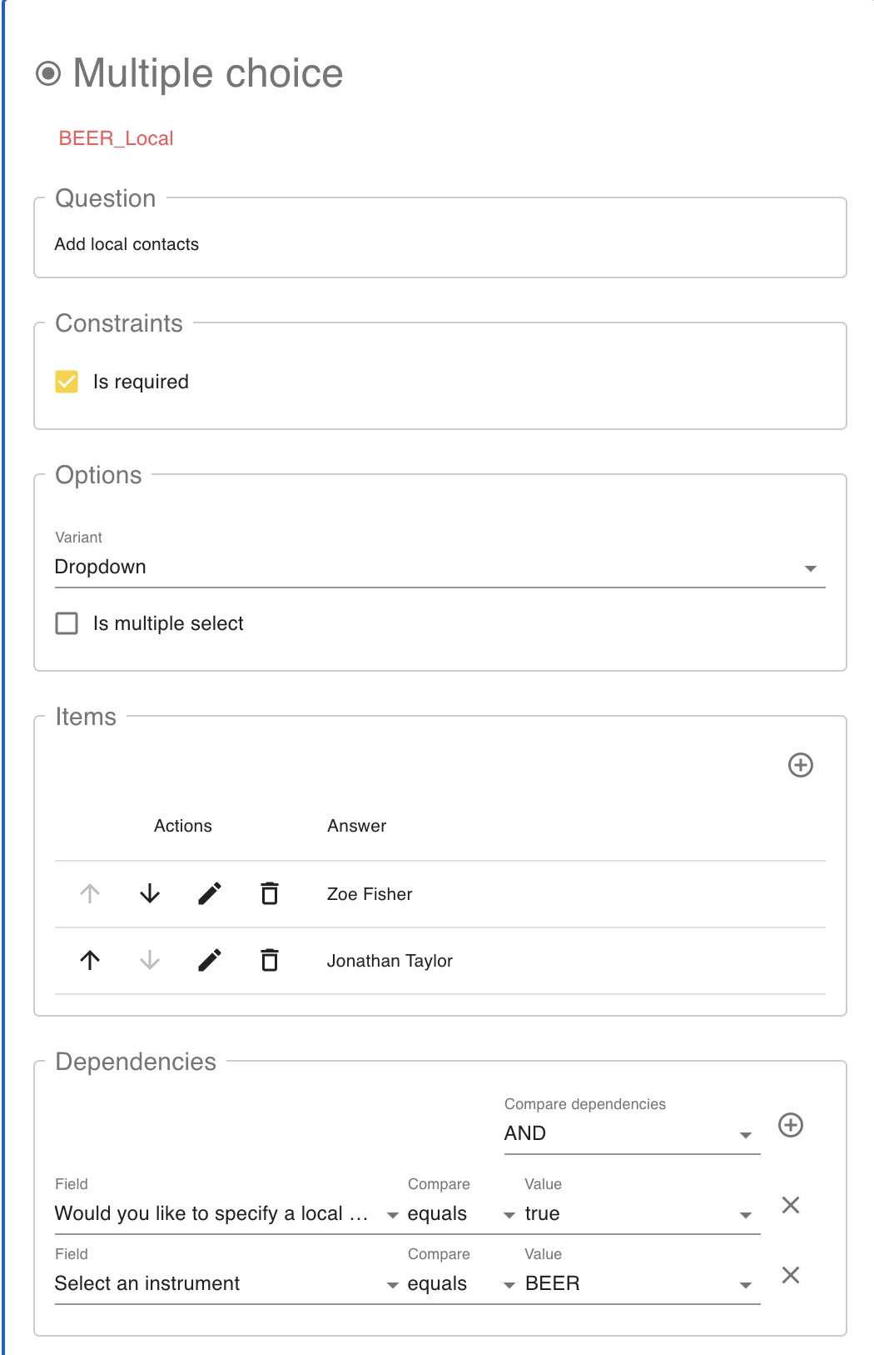
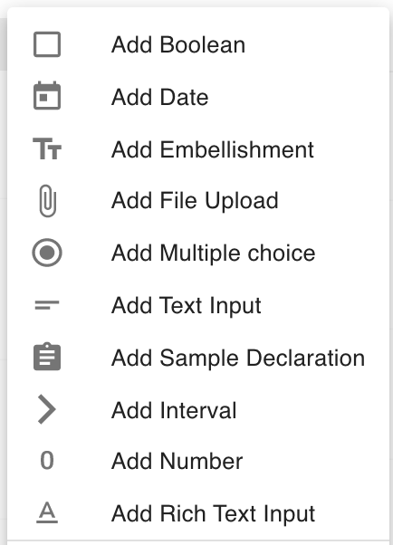

Slide 19
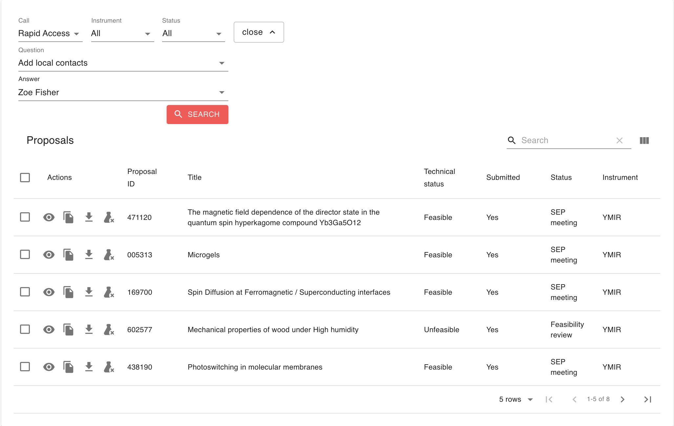

Slide 20
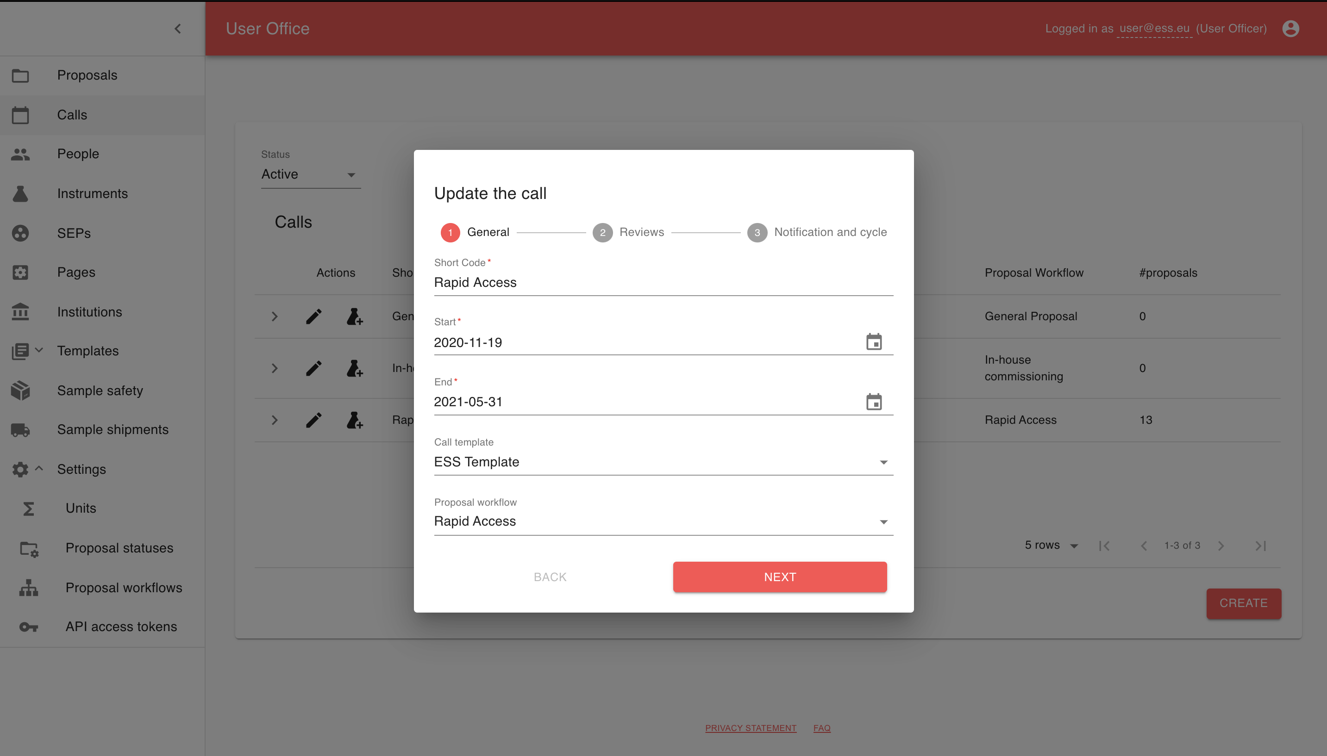

Slide 21
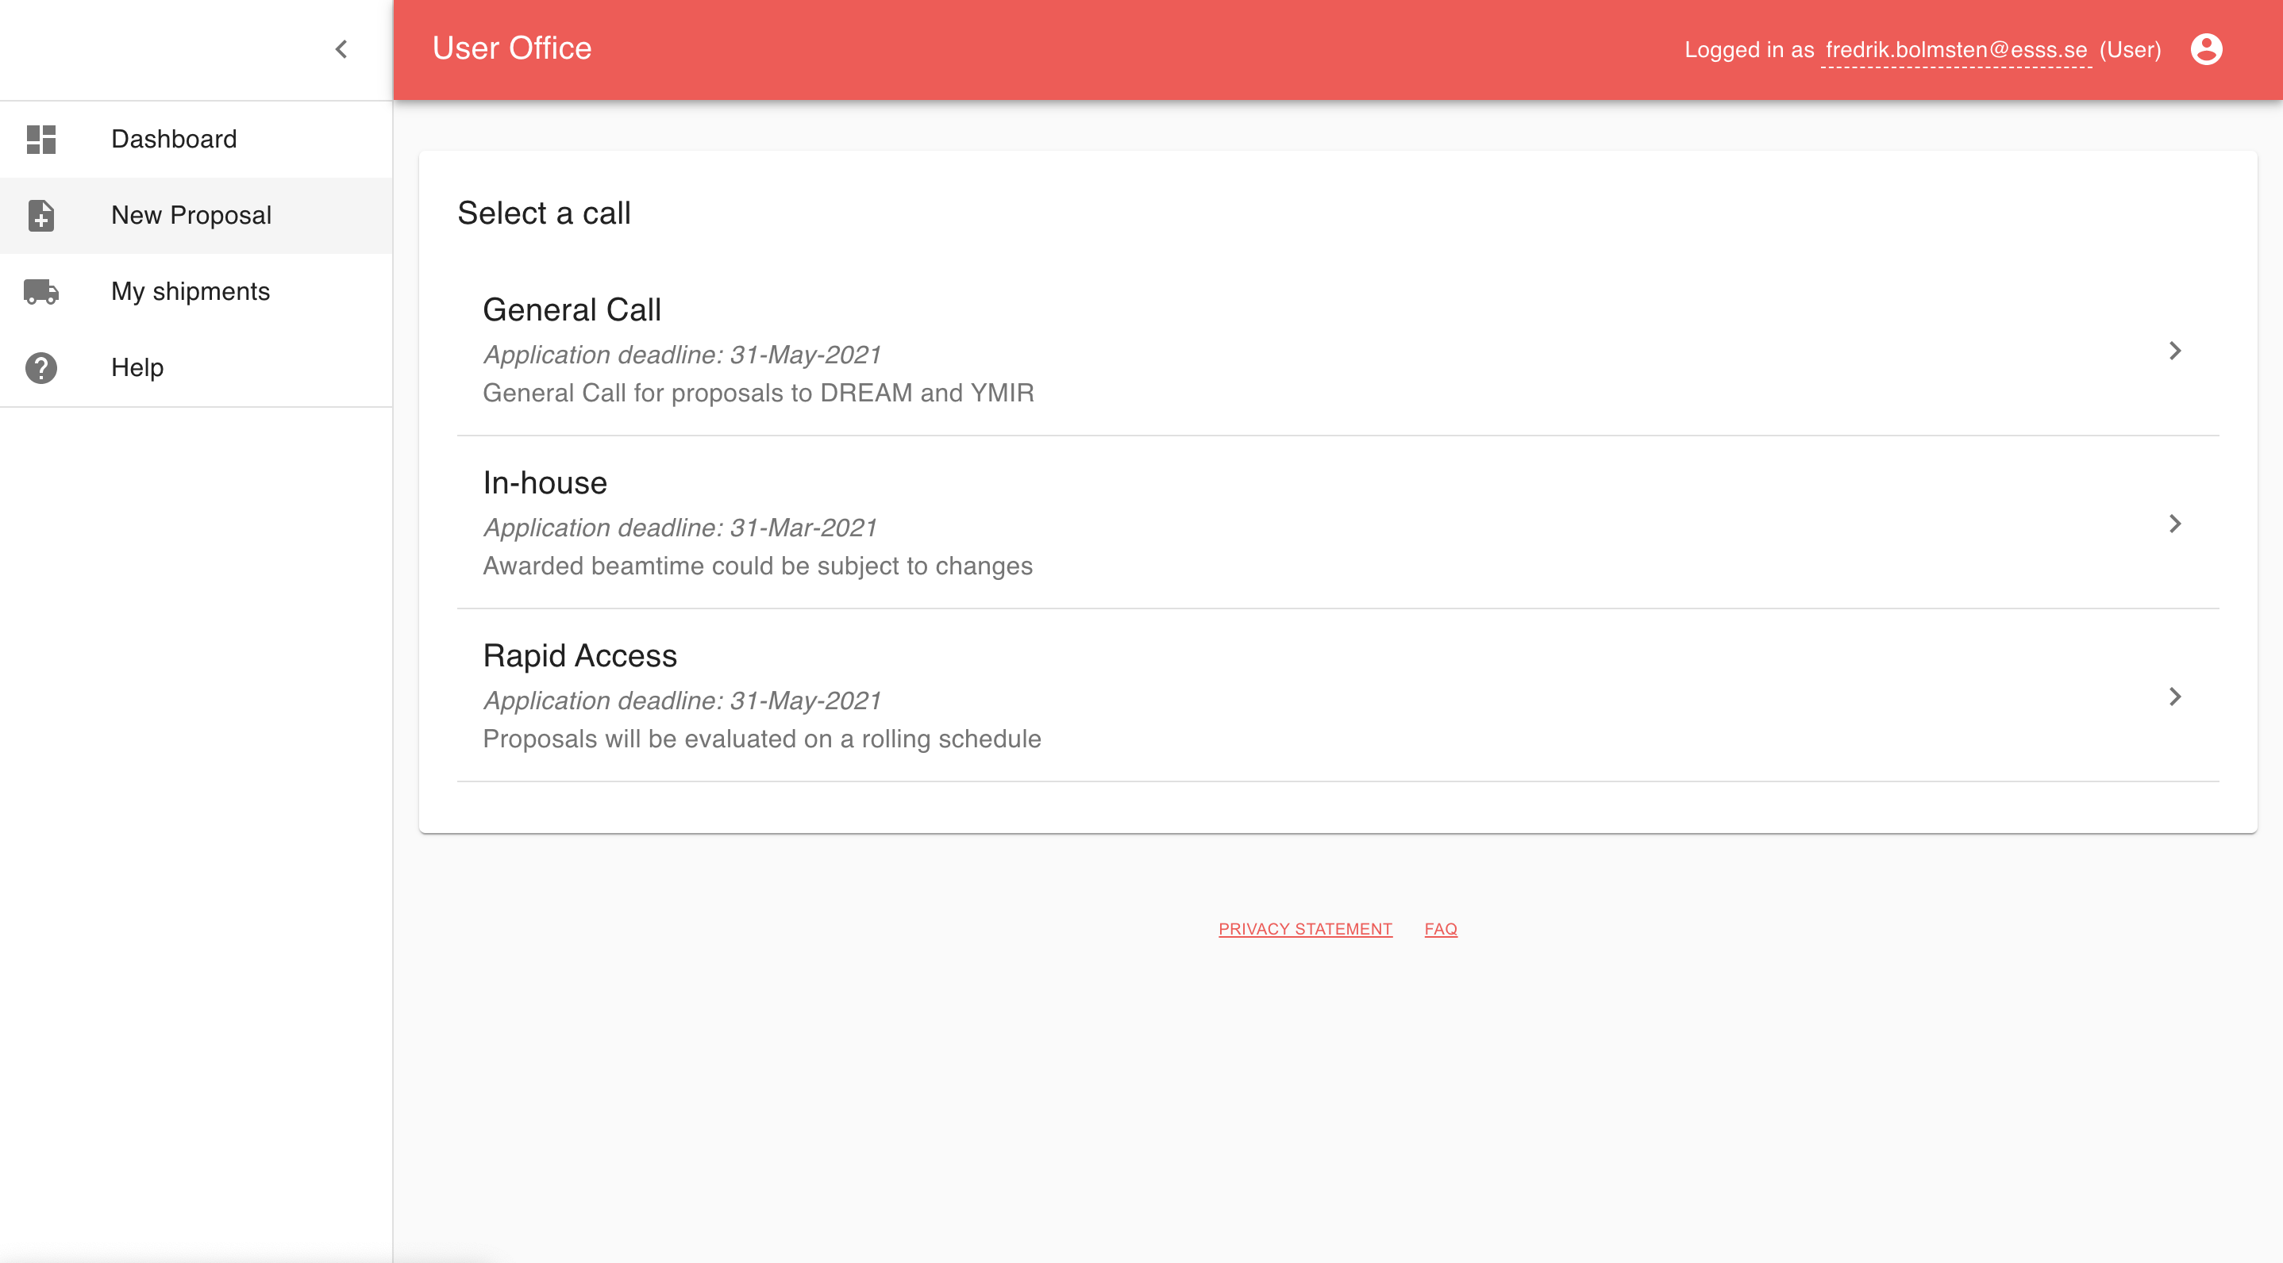

Slide 22
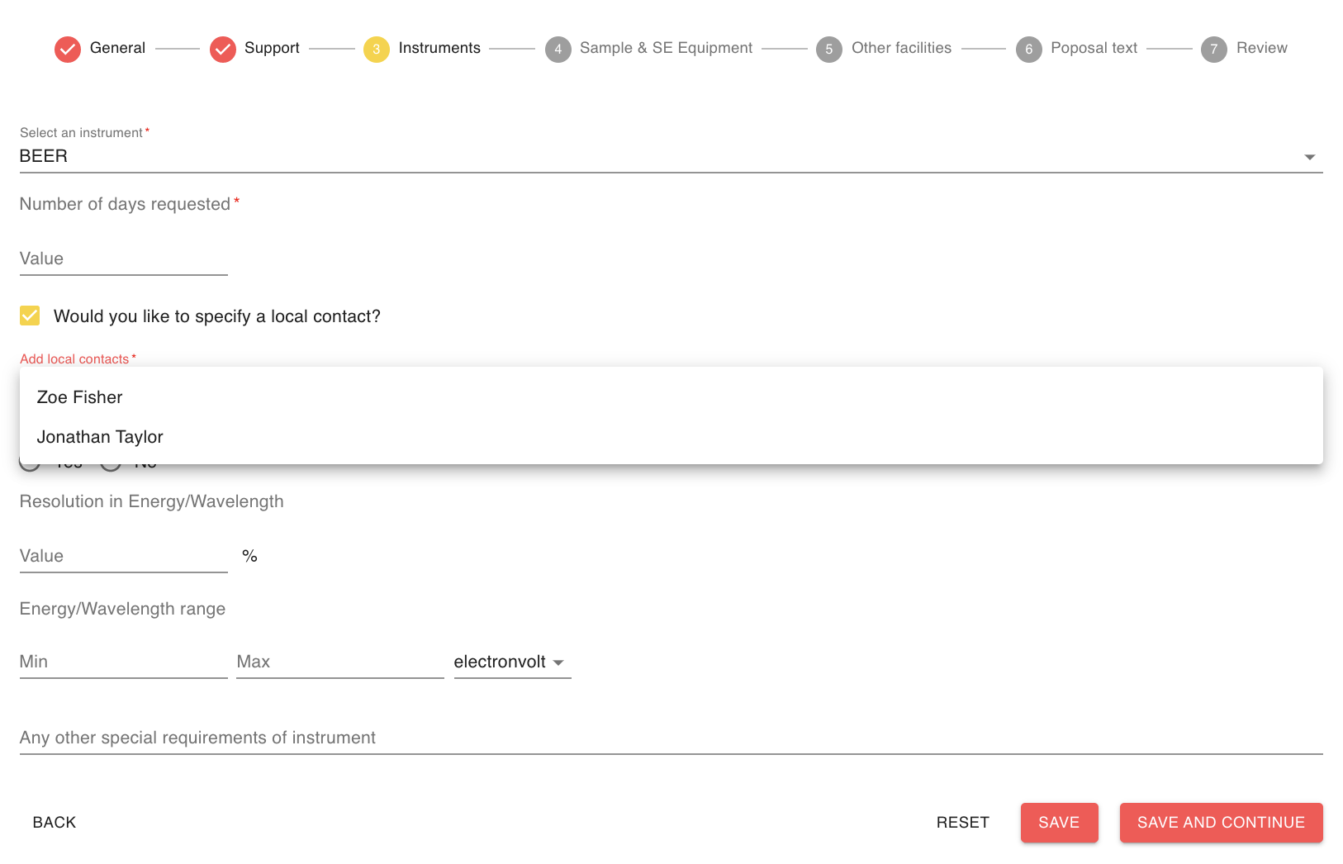

Slide 23
Reviews

Slide 24
Scientific Evaluation Panels
Support for multiple panels
Each panel consist of a chair, secretary and reviewers
Instrument beamtime for a panel is allocated in relation to proposals in the call and assigned instrument
End result is a ranked list of proposals with an indicative cut-off point for approval

Slide 25
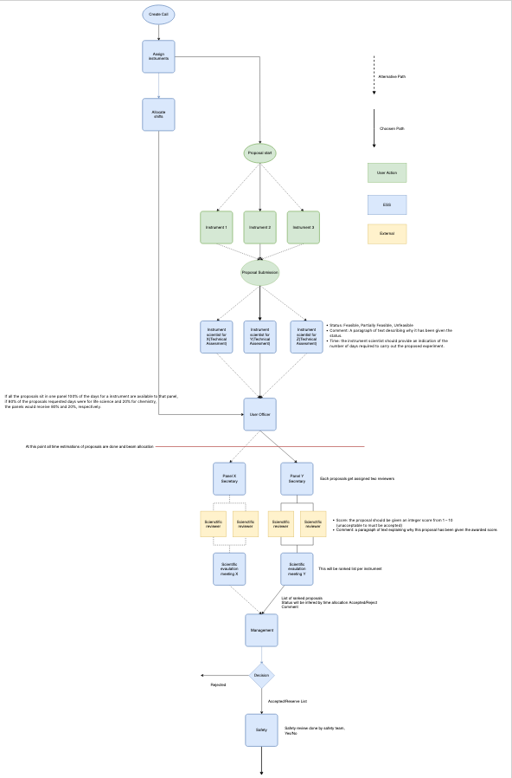

Slide 26
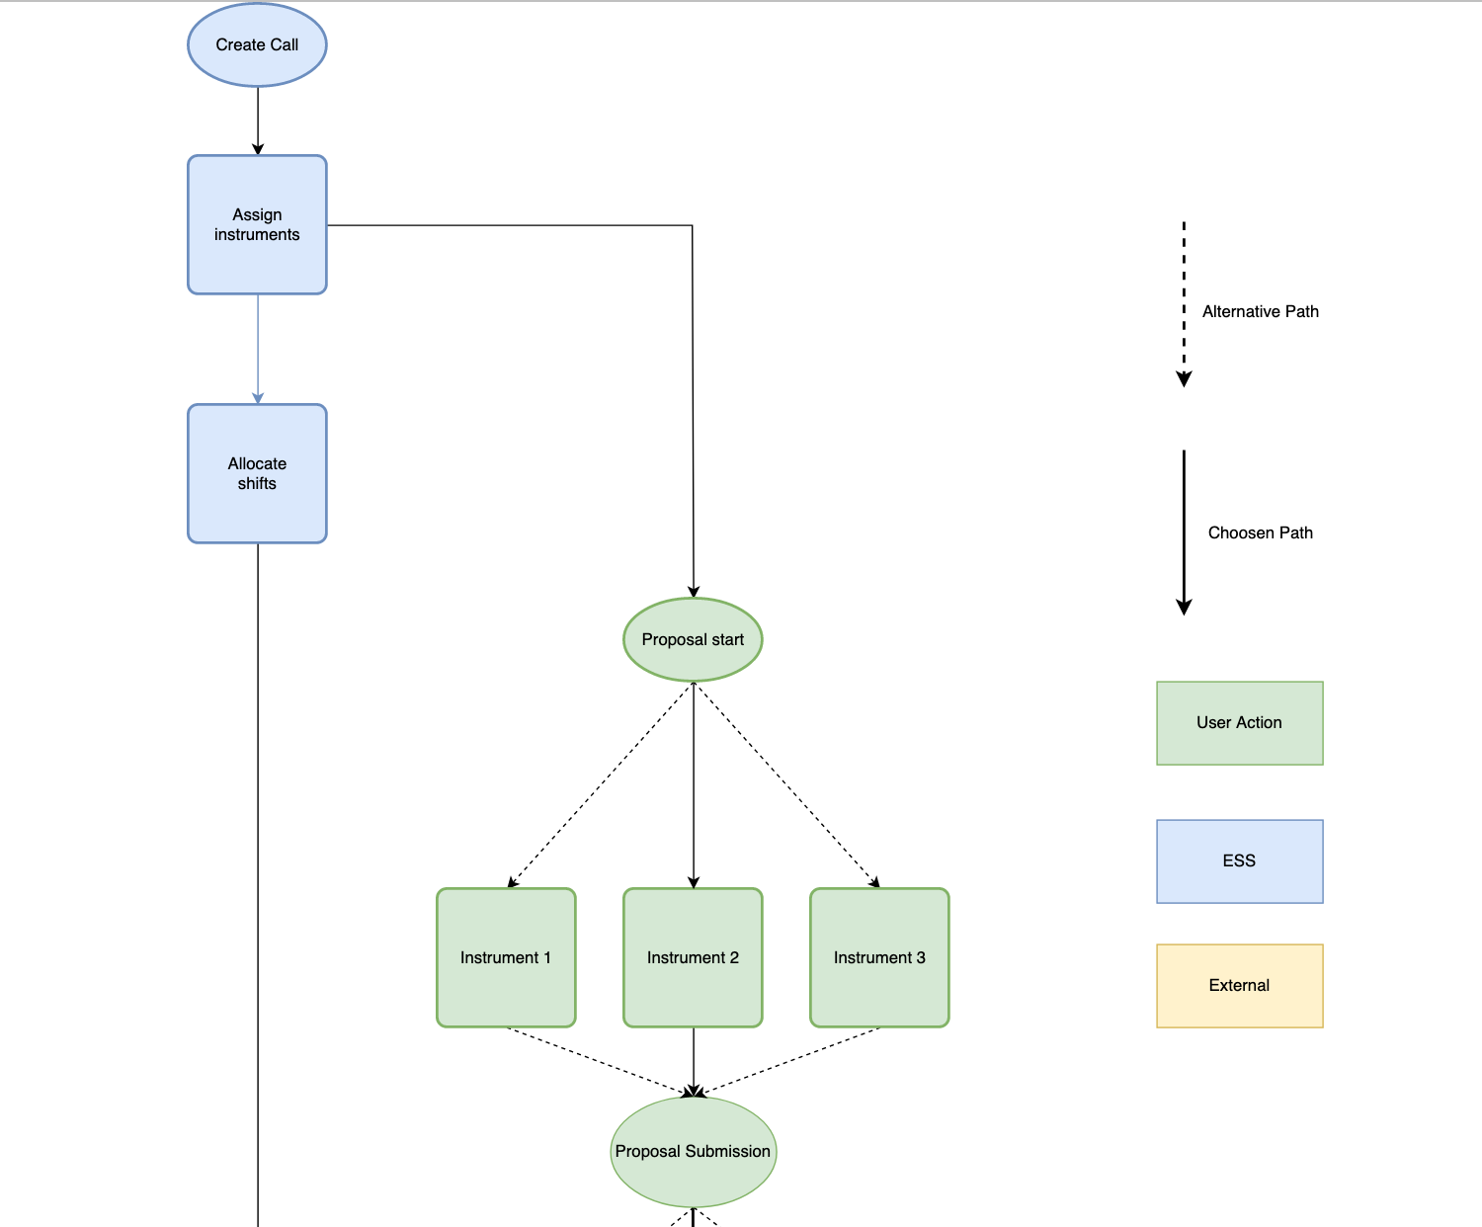

Slide 27
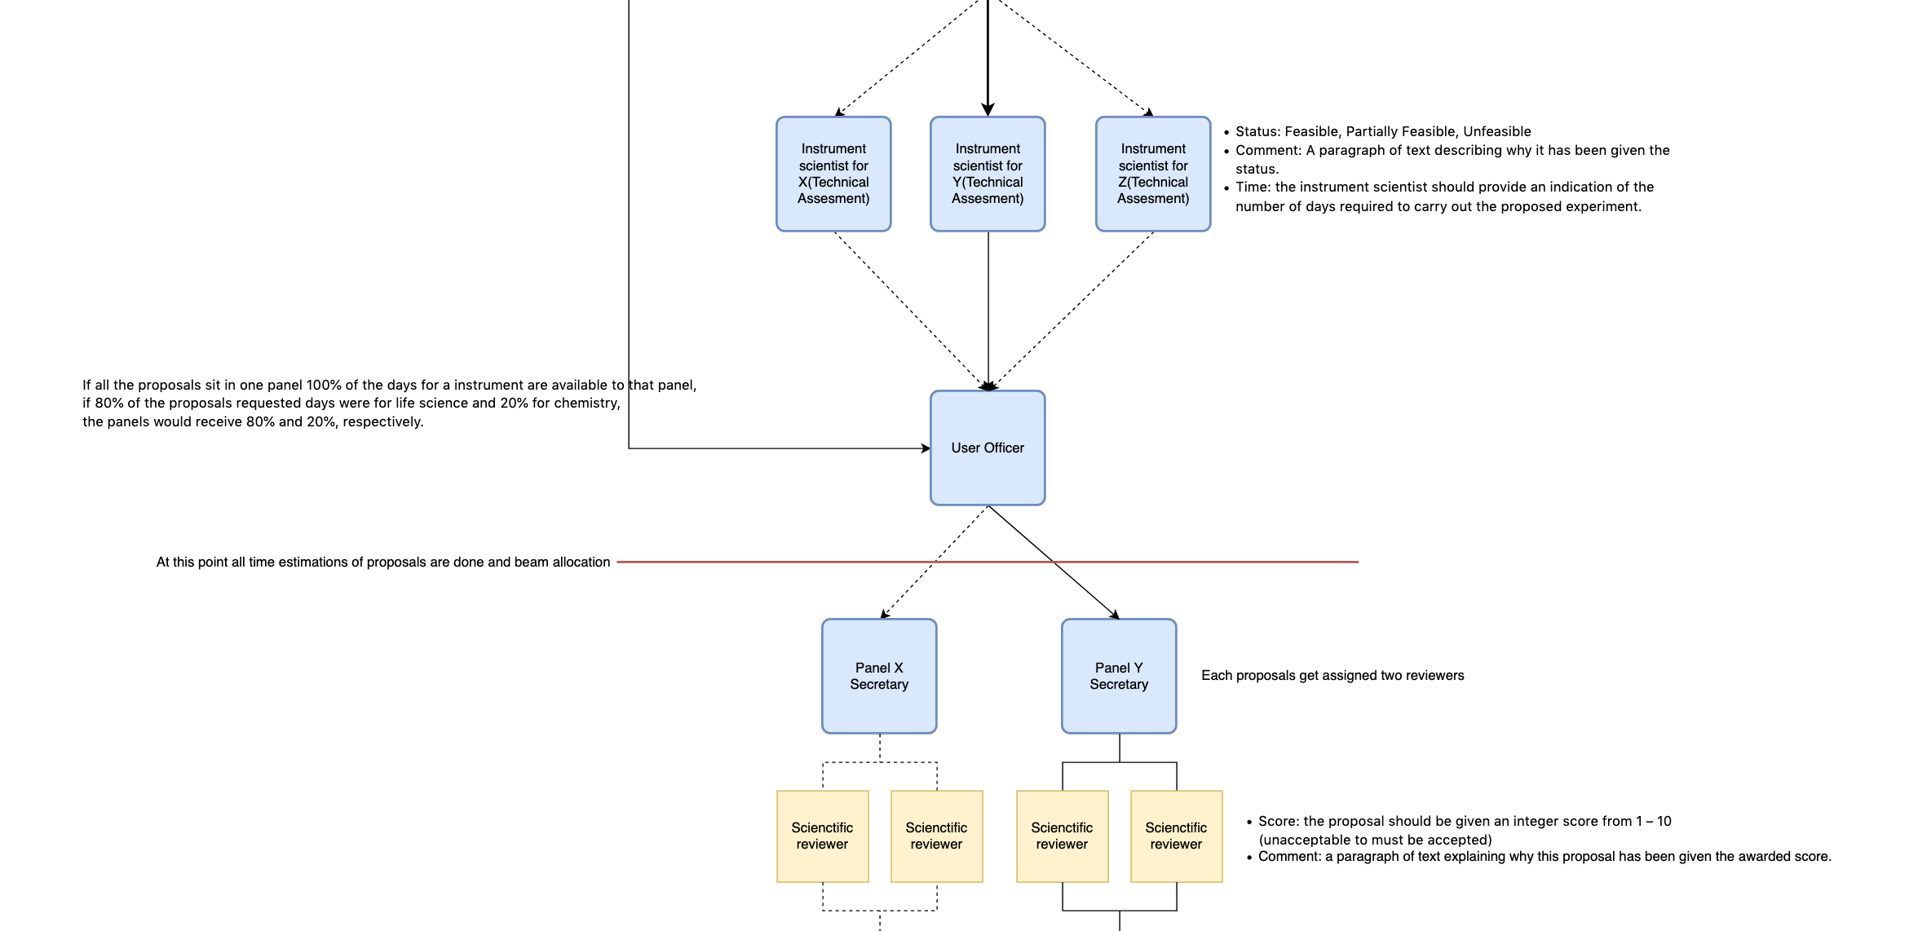

Slide 28
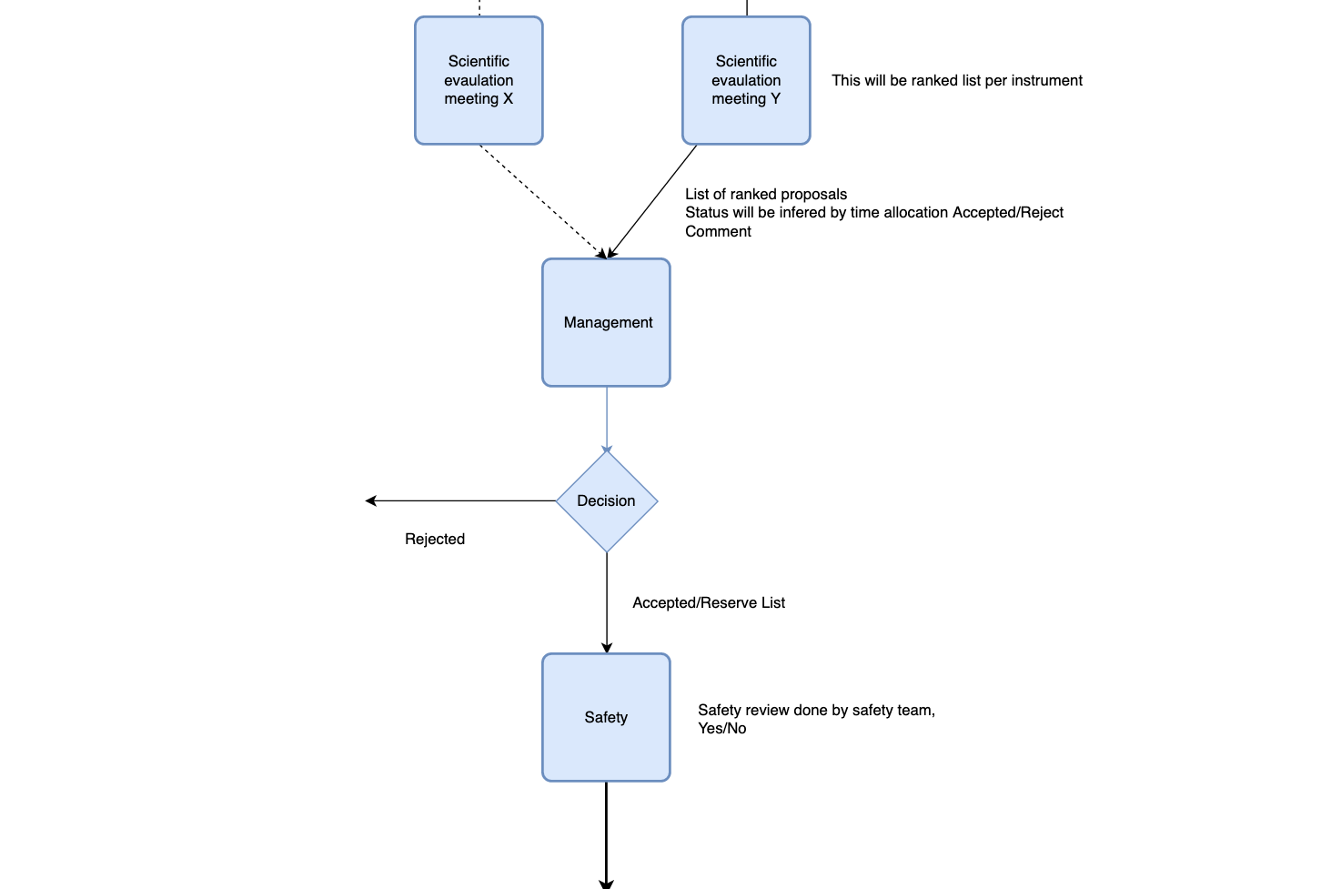

Slide 29
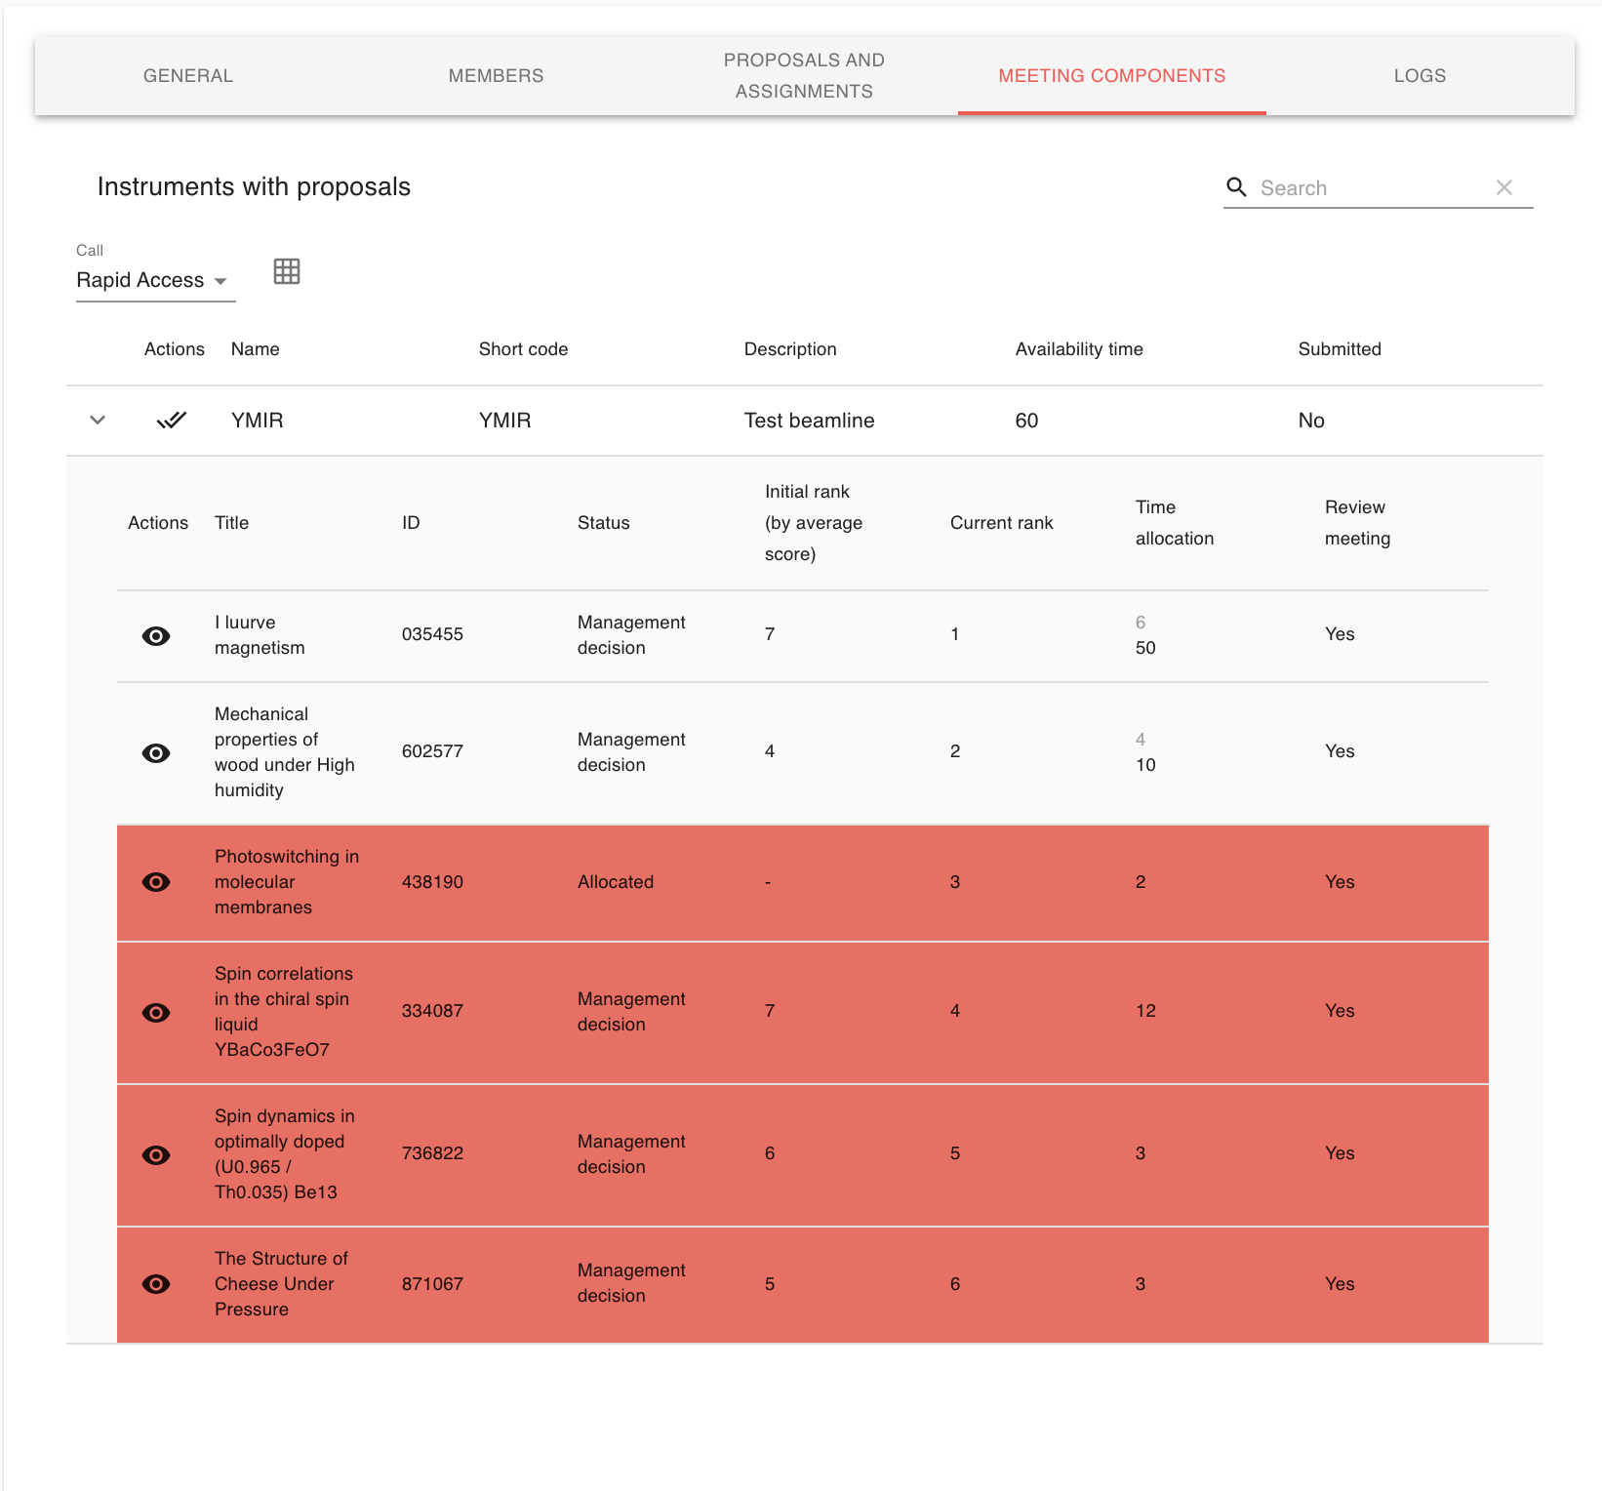

Slide 30
Workshops

Slide 31
Instrument Scientist workshops
Workshop 1 - Done
  Proposal submission
  Feedback: Add rich text input, More support for picture formats, New PDF design, Support for advanced proposal search
Workshop 2 - Done
  Technical and Excellence Review
  Feedback: Assigned technical reviews, Add information regarding standard deviation for proposal reviews, minor UI fixes
Workshop 3 - Upcoming
  Shipment
  Scheduling

Slide 32
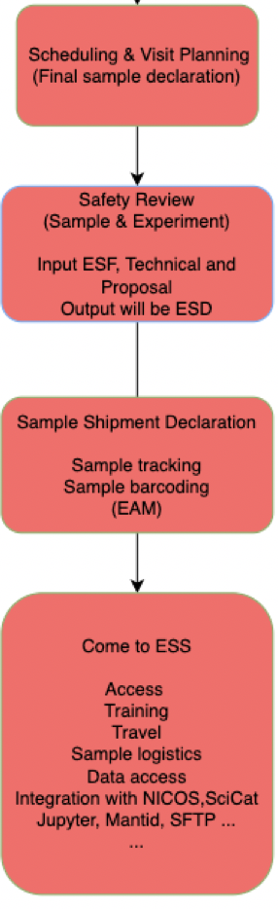
Scope
&
Integrations

Slide 33
Scope & Integrations
User Office
Communications
Scheduling
Training
Welcome
Data processing
Sample safety
Data collection
Metadata catalogue
Sample tracking
User visit management
Radiation protection
Access
Experiment report
Finance
Data processing
Statistics
File access

Slide 34
User Office Software baseline
User registration for DEMAX call (December)
Dynamically create DEMAX proposal template
Send email via templating service in order to enable metrics such as read status, bounce…
Scientific review for proposals from the first call (February)
Integration with user authentication service provided by IT
Scheduling of resources such as machine, proposal, staff and equipment
Sample declaration
Integration with the storage system for handling of user access
Visit and access cards flow
Meta-data catalogue integration
Integration with EAM regarding sample management
Sample safety review for proposal
Technical review for proposal
Learning management system integration
Scientific review for all proposals
SciChat integration
Preparation for commissioning call
Integration with NICOS
KPI statistics
Publication
Feedback reports
On-going support and development
2019
2020
2021
2022
2023
User Office Software re-baseline with current recruitment plan - outdated
Integration with user authentication service provided by IT
Scheduling of machine and proposal
Meta-data catalogue integration
SciChat integration
Integration with the storage system for handling of user access
Integration with NICOS
Sample safety review for proposal
Integration with EAM regarding sample management
Visit and access card flow
Scheduling of equipment and staff
Preparation for commissioning call
On-going support and development
Learning management system integration
Feedback reports
On-going support and development
KPI statistics
Publication
On-going support and development
2021
2022
2023
2024
2025

Slide 35
User Office Software
Resources
The main risk for ESS is higher costs in mid to long term as both more manual work will be needed as well as other systems that will be procured to cover the lack of functionality. Based on experiences from other facilities this leads to a costly scattered IT-landscape that is badly suited to support users and staff.
The team is currently dependent of external funding for development as resources has been continuously pushed forward by ESS management.
Options:
  Increase staffing
  Use contractors
  Push back delivery
  Reduce scope

Slide 36
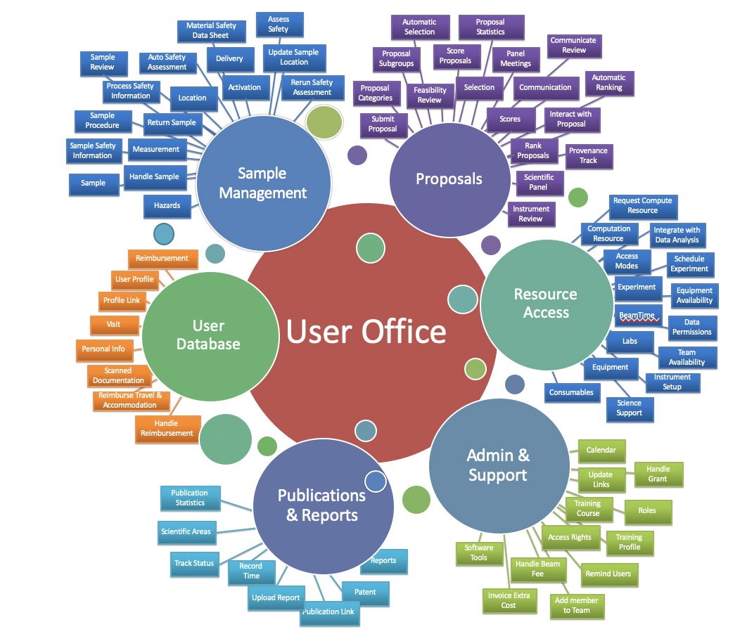

Slide 37
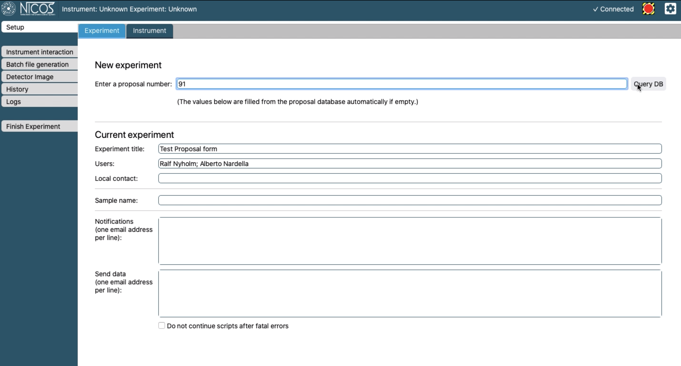
NiCOS integration

Slide 38
Scheduling

Slide 39
