Slide 1
SULF – Sample and User Laboratory Facilities
STAP Samples and User – April 2021
PRESENTED BY Monika Hartl

Slide 2
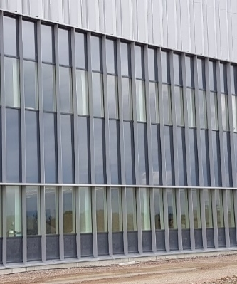
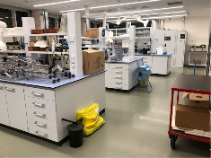
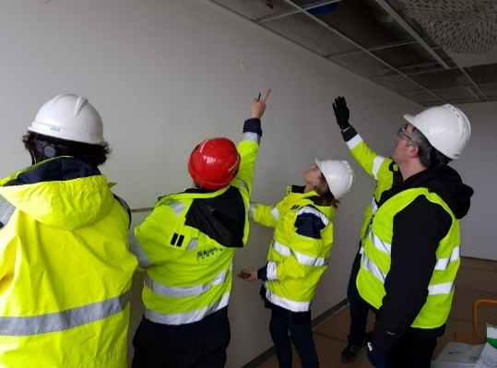






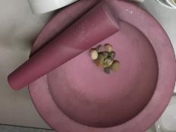
1
1
SULF
introduction and status
SULF intro & status
On-site installation
2
1 postdoc + 2 master students
Support of ESS projects
Melissa Sharp, Katrin Michel, Monika Hartl, Alice Corani,
Sophie Ayscough, Emelie Wiklund, Anton Järild
3

Slide 3
Sample and User Laboratory Facilities
Group within the Scientific Activities Division SAD
Groups within SAD
    Sample environment SE
    Scientific Coordination and User Office SCUO
    Sample and User laboratory facilities SULF
    Deuteration & macromol. crystallization DEMAX
Key facts (construction)
€2.62 M budget
€1M lab fit-out (STFC)
€70k RML glove boxes (U. Tartu)
In-kind projects essentially finished!
  Supports sample handling, e.g. preparation and characterization of samples close to the instrument, before, during, and after the experiment.
  Supports ESS operations, e.g. materials characterization in case of failure for technical and science directorate, cooling water analysis (qualitative)
Key facts (operation)
3 FTE (now) => 6 FTE (total)
Budget per year (not confirmed):
€100k labs-infra/equipment
€ 10k consumables
€ 15k equipment (small)
Currently 2 FTE less than planned by 2021
SULF

Slide 4
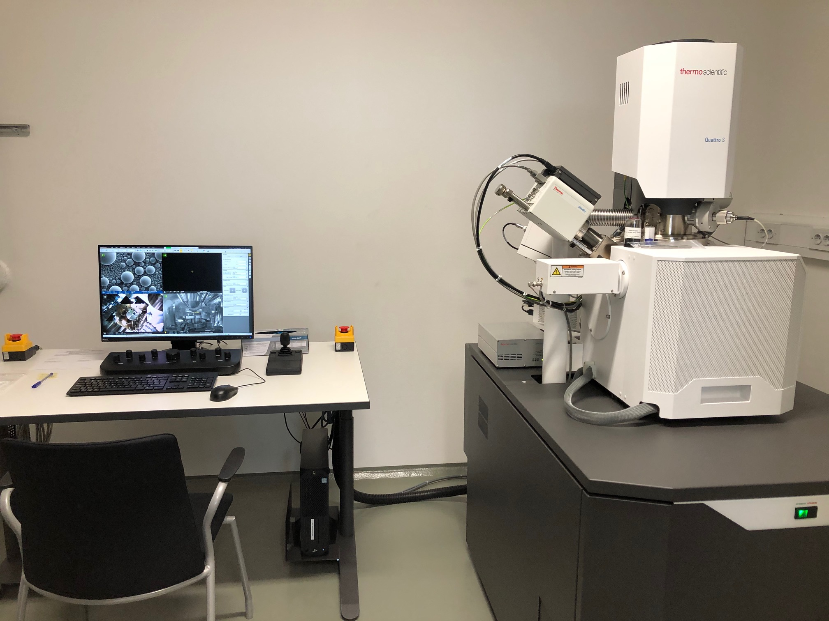
Why are user laboratories necessary?
Short, medium and long term needs -> see part 3 of the talk
Short term needs:
  Support for the construction project for critical path sub-projects to ensure “ready-for-beam-on-target” (RBOT) and “beam-on-target” (BOT).
Medium term needs:
  Support for the commission phase (initial ops) of the machine
  Providing Radioactive Materials Laboratory in time for BOT
Long term needs:
  Preparing for First Science
  ESS operations support
Well-functioning labs come with expertise of the scientific and technical staff.
Scanning Electron Microscope

Slide 5


SULF scope – now and later
Now ------------------------------------------------------------------- Later
SULF
Lab installation for SULF and other groups
In-kind projects
Lab operation & sample handling
ESS project support & science
Construction & Facility Management
Operating user laboratories for ESS neutron scattering users
2.5 FTE
+ 0.5 FM
interaction
ESS-related scientific needs
+3 FTE
(rad)
(chem)
(bio)
=>6 FTE
3 bldgs.
1310 m²

Slide 6


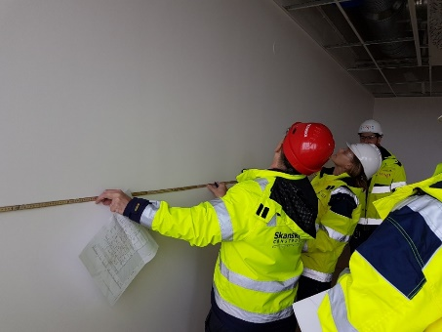
SULF interactions
Project coordination
  Who: stakeholders, SANBER (contractors), SKANSKA, QA
  Lab installations: planning, procurement, scheduling, surveying, lab owners
  Support for instrument labs (sample storage, ventilation, …) -> transition to NSS
  Safety/quality of installed labs and planned labs
Area coordination
Who: workers in E03/E04, SANBER, SKANSKA, FM
  Keep track of work in E03/E04: planning, scheduling, arranging
  Stay on top of safety and housekeeping in the area including risk assessment
  ADVANTAGE: flexibility in scheduling!
Construction Support
Who: Facility Management, stakeholders
  Assuring services are supplied (house vacuum, waste water testing, internet,…)
  Change-requests for requirements not met (ducting, radiators, doors/ badge readers ….)
  Requests (drilling through walls, loading on floors…)
  Engineering drawings for ESS
  Electrical document changes (consultant)
SULF and partner measuring
Notes:
Assuring requirements are met and services are supplied in the correct locations
Change-requests (electrical distribution panels, house vacuum, waste water….)
Facilitating information exchange between our in-kind partner and CF for lab fit-out
Interface when related to laboratories and chemistry
Support for instrument specific laboratories (information on safety, utilities, …)
including chemical ventilation (fume hoods,…)
Containment ventilation for the caves (gas flow experiments, & decomposition; gas & vacuum exhaust

Slide 7
SULF interactions
ESS project support (more information: part 3)
Lab Operations: Safety, security & training
Who: OHS, RP, Security, Training
  Safety: day-to-day, safety walk-downs, quarterly safety meetings
  Training: transition to online training for labs
  Security: Access discussions and practicalities –now and later
  RP: Radiation monitors
Lab Operations:
Who: Cryo Group, OHS, Logistics, SCUO, FM
  Delivery: gas cylinders, l-N₂ waste containers/removal
  Chemical inventory system
  Shipping: delivery of perishable items to freezer
  Sample handling / shipping (test shipment from outside EU) – connection to user office software
ESS Project support & science:
Who: Target, Accelerator, Instruments, SAD
  Collaboration with Target (joint instrumentation for materials research)
  Collaboration with Accelerator (luminescent screen development)
  pH and conductivity measurements of water
  Collaboration within SAD – gas handling, electro-chemistry
Portal
Supervised
Free
H&F
Notes:
Assuring requirements are met and services are supplied in the correct locations
Change-requests (electrical distribution panels, house vacuum, waste water….)
Facilitating information exchange between our in-kind partner and CF for lab fit-out
Interface when related to laboratories and chemistry
Support for instrument specific laboratories (information on safety, utilities, …)
including chemical ventilation (fume hoods,…)
Containment ventilation for the caves (gas flow experiments, & decomposition; gas & vacuum exhaust

Slide 8
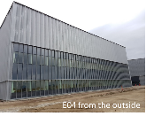
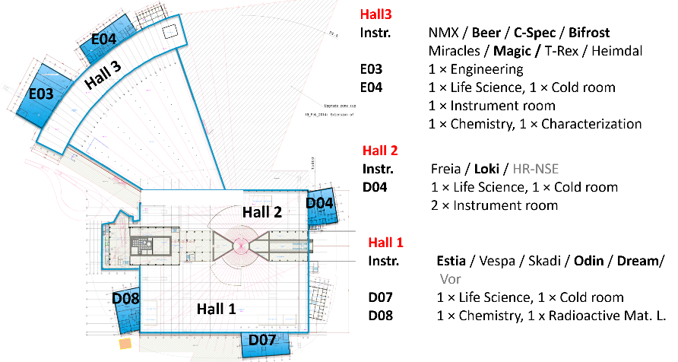
SULF: installation
SULF has moved to site (office move in Jan. 20 // labs in Dec 20)
Handover E03/E04 12/2019
Laboratory in operations 01/2021
D04/D08
Fume hoods will be installed May/June 2021
before hand-over
Critical for BOT
Radioactive Materials Lab
X

Slide 9
SULF Timeline / Schedule
Still on track provided no further delays due to pandemic
Lab ready for
operations
Early installation of fume
Hoods possible D04/D08
break
D08
D04
RML (D08)
RML is on critical path for BOT!
E03/E04
D04
D08
Full access:
E04 / E03
2019 | 2020 | 2021 | 2022 | 2023 | 2024 | 2025 | 2026
RBOT
FS
SOUP
BOT
RBOT=ready for BOT
BOT = Beam On Target
FS = First Science
SOUP = Start of User
Program
BEER/ MAGIC / CSPEC / BIFROST / ESTIA
ODIN/ DREAM / LOKI (first three instruments)
Installation
Hot commissioning/
Setting up
Operation
Notes:
D04: hand-over March 30, 2021
D08: hand-over August 10, 2021
D08: partial access
NOW
Basic setups for chemistry incl. soft condensed matter and life science (E04) and engineering (E03).
Radiological Materials Laboratory (RML) for handling activated samples and materials
LATER
Fit-out of remaining labs in D04, D07 and D08
Capital investments into the specific science areas for the instruments to provide complementary lab equipment
ALWAYS
support the ESS project and operations with materials characterization (Accelerator, Target, Science)

Slide 10
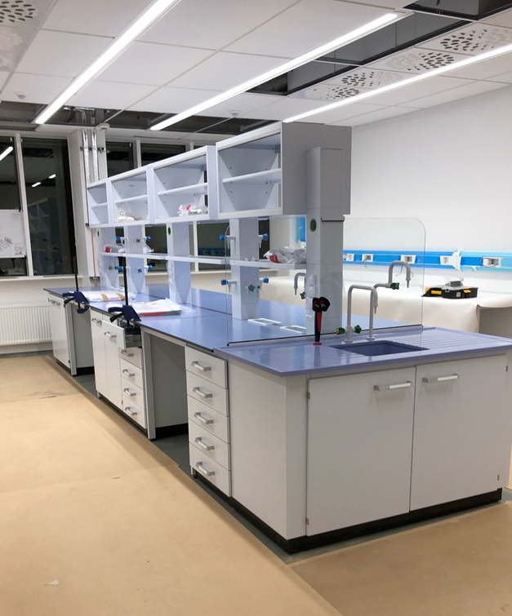
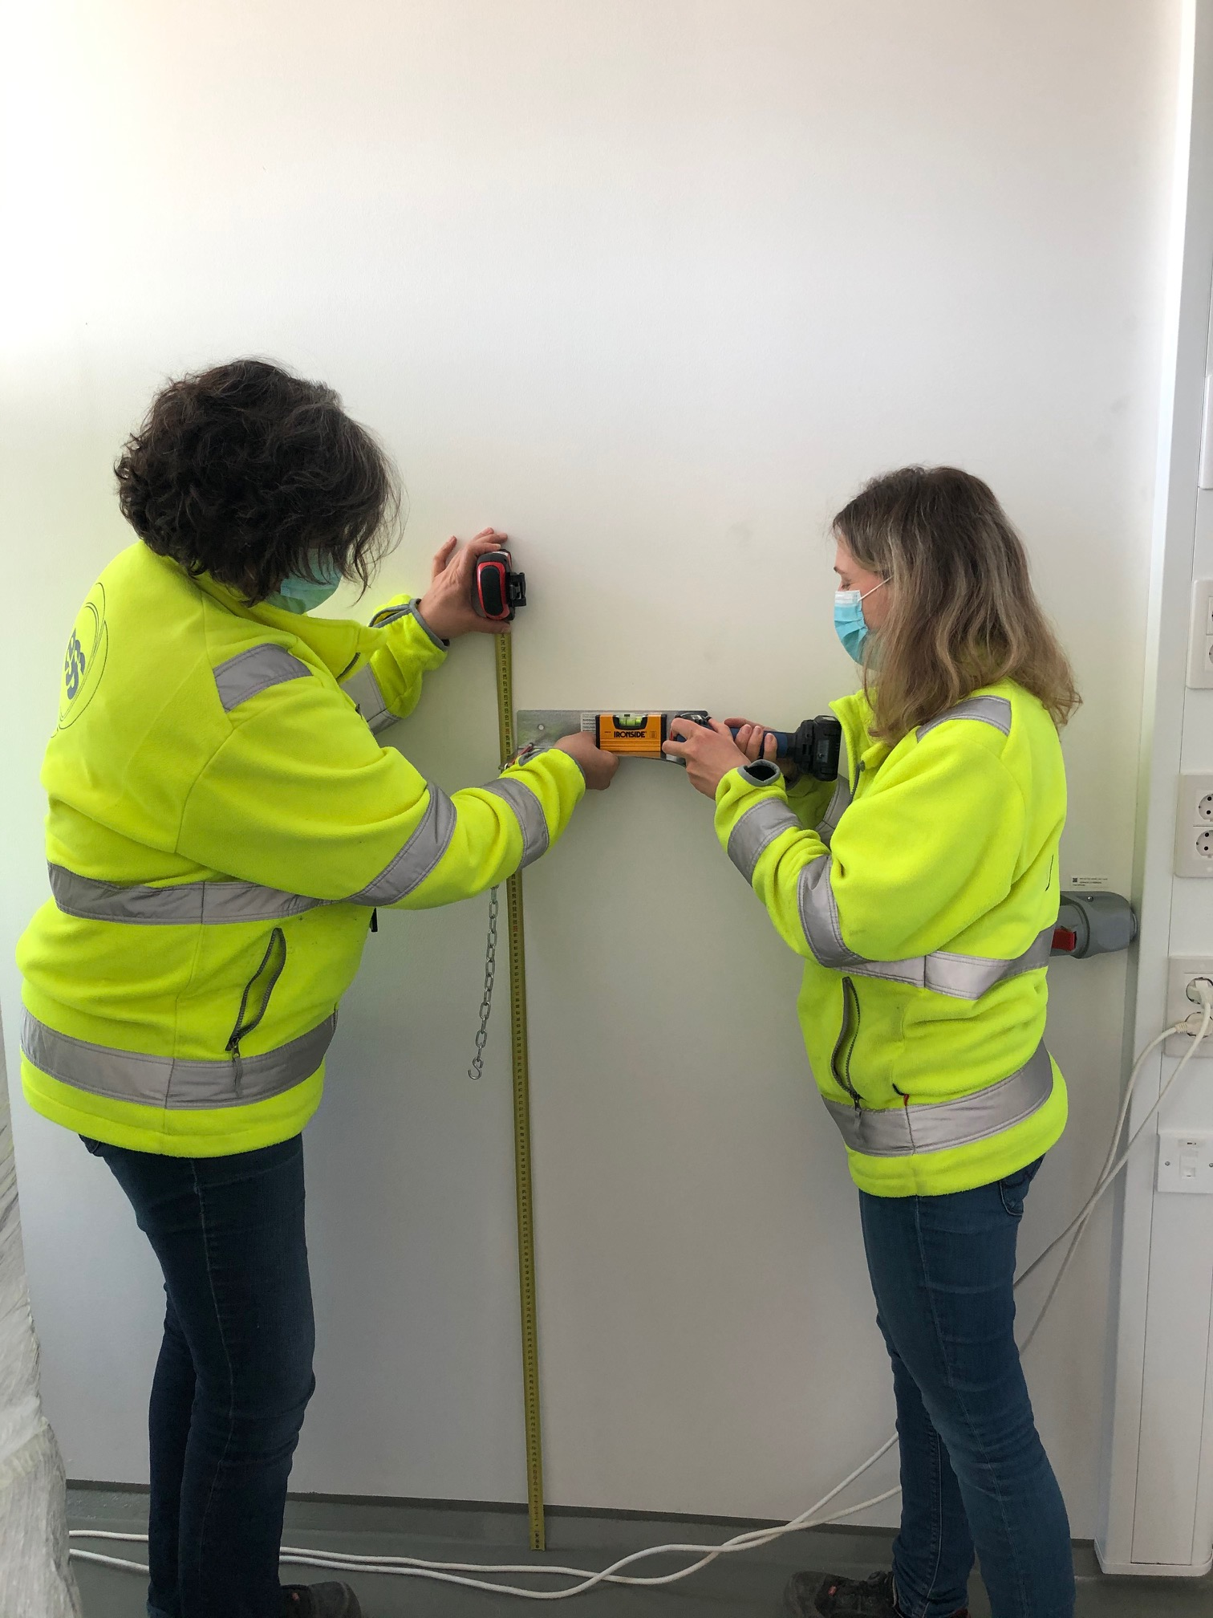
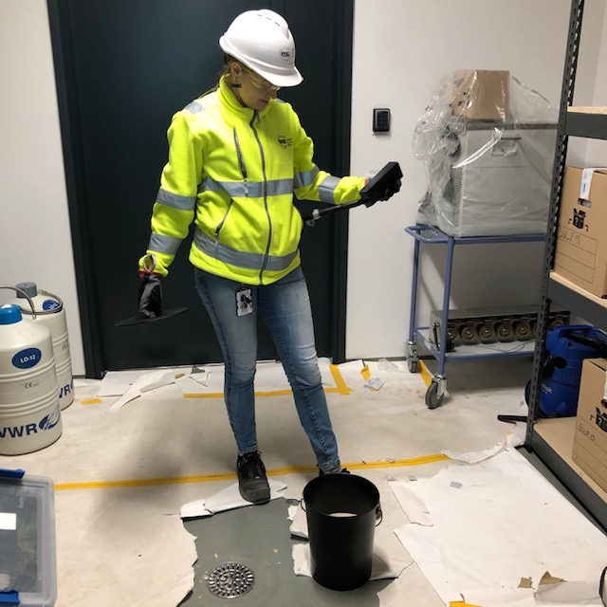
Mitigations for Covid-19 related delays
What can SULF do?
  SULF staff is allowed on site as we need to work in the labs following C19 rules (limited number of people, masks, distance, C19 test)
  In dialog with ESS-internal C19 group to keep rules up to date, e.g. discuss vaccination as reason not to quarantine
  SULF mantra: Don’t stop working – keep preparing restart of construction
  Keep close contact with lab-outfitter (Sanber), establish to-do list to prepare for worker’s return (hiring of equipment, training, scheduling…)
  Get construction work done that is not part of the fit-out and can be done with local workers (corrective action on building, data patch panels, waste water …) or by ourselves (ultrapure water, shelves,…)

Slide 11
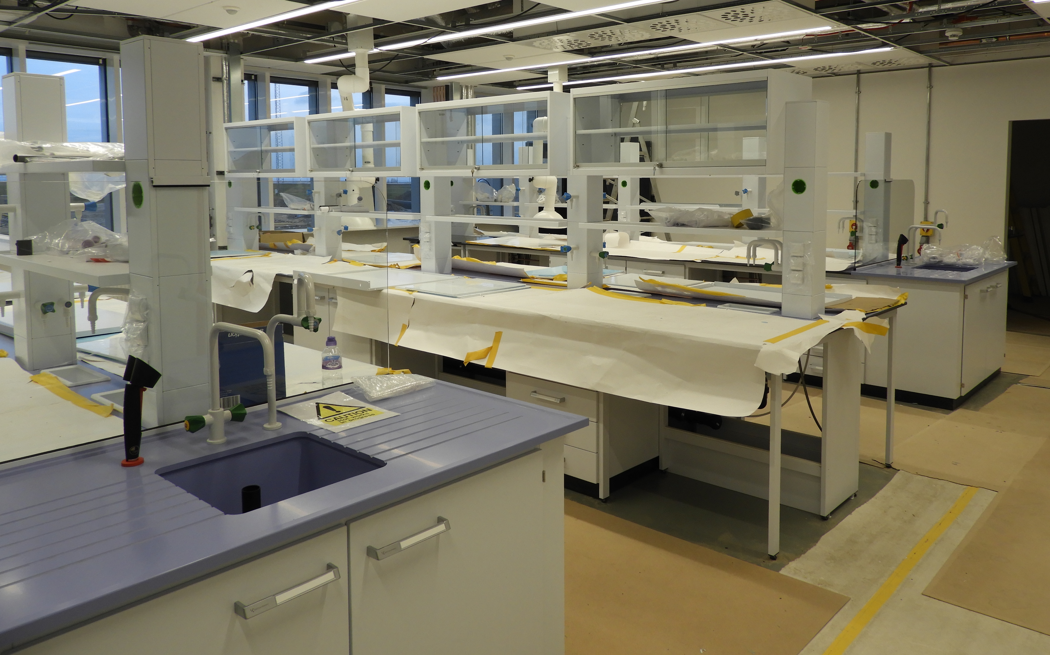

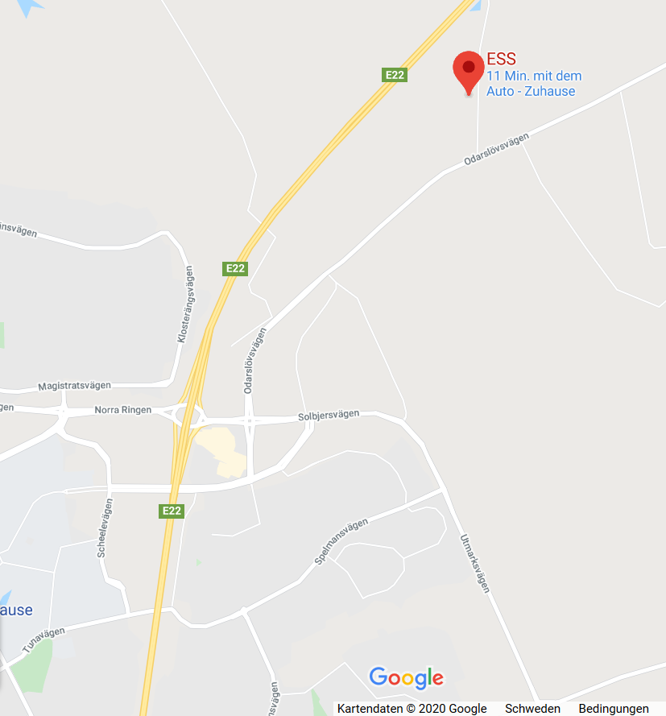
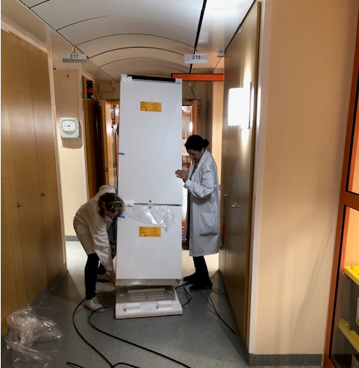

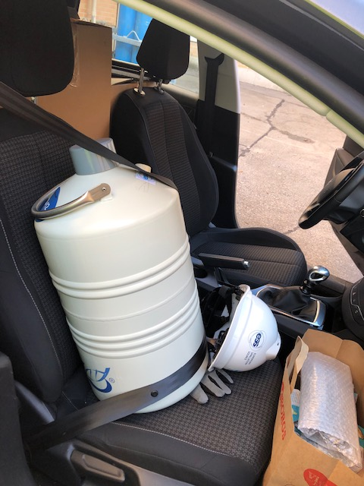
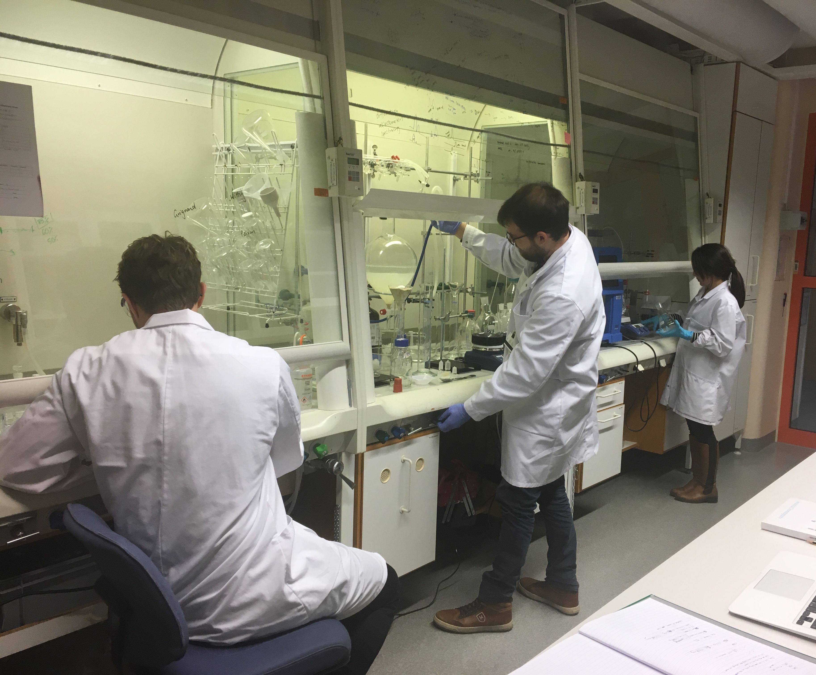
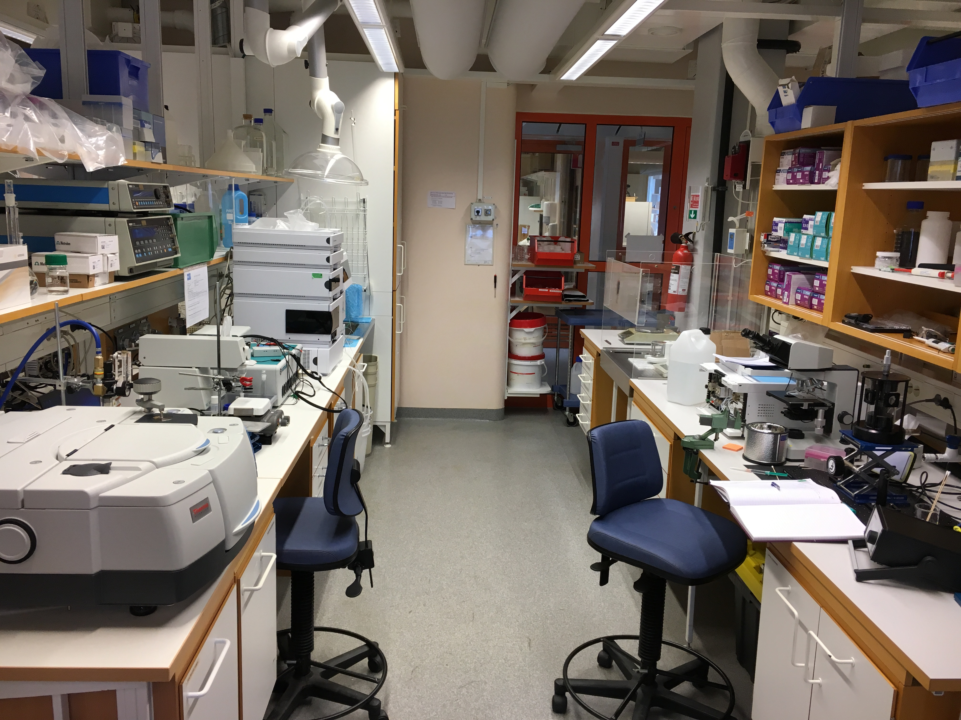

SULF achievements
Since spring 2020
Move of equipment and chemicals from rented lab to permanent lab successfully finished in January 21.
Electrical panels all upgraded, documented and power is on thanks to our consultant Gustav Svendsen.
Both SULF in-kind projects are successfully finished (pending report)
SULF is still well in time with delivery of milestones.
SULF procured a powder diffractometer (STAP suggestion 2020) and operates a Scanning Electron Microscope (Target) -> detailed equipment list in breakout session
SULF labs in E04 are officially in operations!
E04
SUCCESSFUL MOVE
OF LABS TO ESS
Chemistry Lab shared with DEMAX

Slide 12
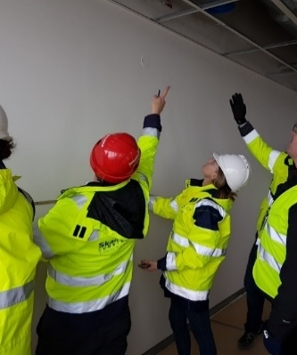
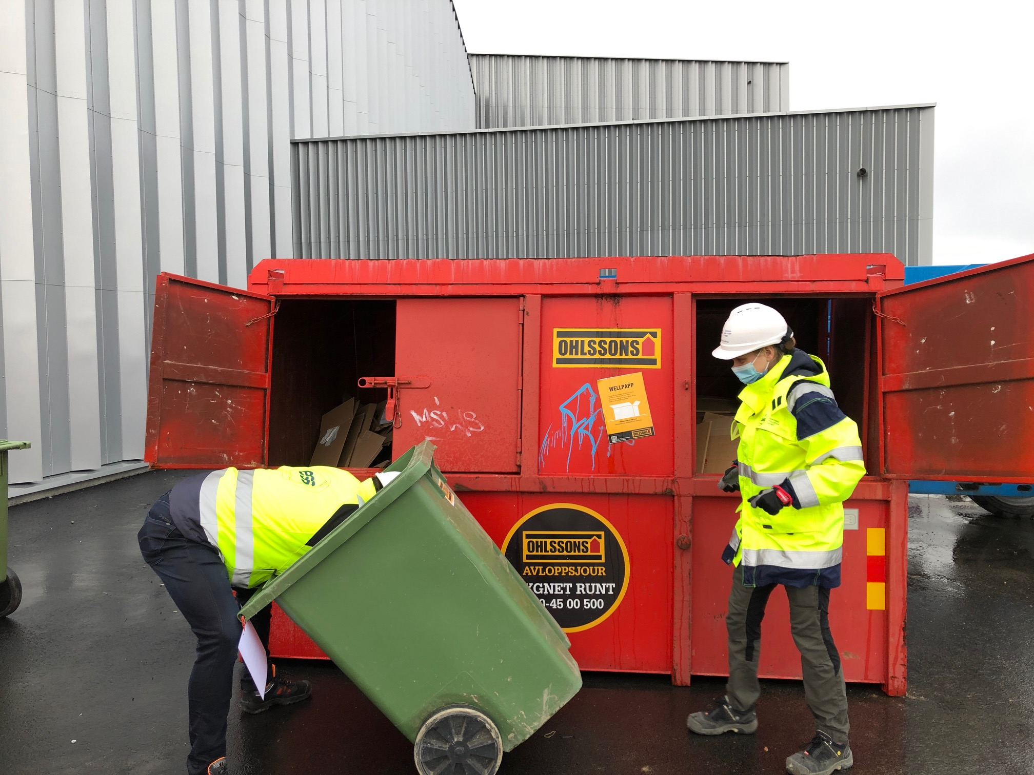
1
2
SULF intro & status
SULF –
on-site installations
On-site installation
2
Support of ESS projects
Management at work
3

Slide 13
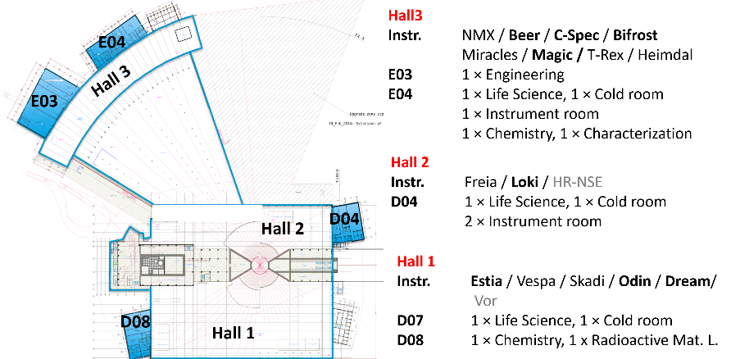
Lab fit-out for E04/RML/D04 – in-kind
ISIS, STFC, UK provided user laboratories in E04, D04 and RML
Laboratory fit-out in-kind by STFC (M. Jura):
E04: level 100 (ground floor):
  Large LS&SCM laboratory with spectroscopy room, and fridge/freezer (cold) room (4 FHs, 2 extraction points)
  Physical Characterization & cutting& polishing lab
level 110 (first floor)
Large Chemistry Laboratory (4 FHs, 4 extraction points)
D08: level 100
Radioactive Materials Laboratory (4 FHs)
D04: level 100
  Large chemistry laboratory with appliance room, instrument room and fridge/freezer room (5 FHs, 4 extraction points)
UK in-kind: Labs have been fitted out
In-kind complete.
Notes:
This is a 3D picture of one of our large laboratories. The list on the right shows the laboratories that were part of our in-kind tender that was won by SANBER LTD, UK. As we informed you last time, we had issues with VAT tax that had to be paid for installation work by our UK in-kind partner. Our solution is now that the in-kind partner STFC will pay for the furniture and hardware while ESS will pay for the installation work out of the SAD installation budget. We will use the same company that won the bid for tender.

Slide 14
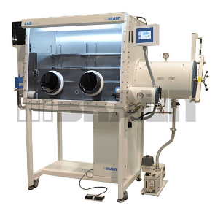
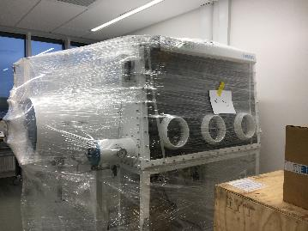
Glove boxes for the RML – in-kind
University of Tartu, Estonia, provides two glove boxes
The RML (radioactive materials lab) will have two glove boxes:
  “dry box” = 3-arm glove box with access port for sample stick/ cladded area
  “reaction box” = 2-arm glove box with solvent trap
  Glove boxes have arrived safely and are waiting for installation (April 26)
Estonian in-kind: Glove boxes for radioactive materials will be commissioned in our X-ray lab
Will move to D08 when RML is ready. In-kind complete.

Slide 15
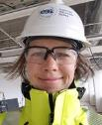
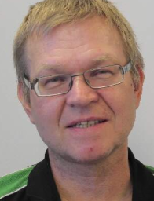
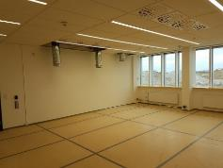

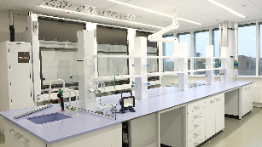

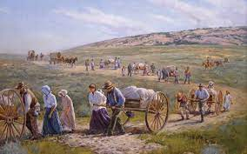
What did we do in construction so far?
Support the construction of chemical and technical labs & instrument utilities
SULF = Interface to CF when related to laboratories and chemistry (requirements, services, supplies) hand-over of an empty shell –> fit out to a functional room
In-kind STFC
MAGIC
MORE MAGIC
ESS
SULF supports & coordinats lab fit-out for other groups (sample environment, detector, optics, motion control)
First to move offices – had to organize move to E04…
Pioneer History—Westward Expansion
To E04
  and whatever else was needed….
  (toilet paper, coffee, waste bins, printing supplies…)
Notes:
Assuring requirements are met and services are supplied in the correct locations
Change-requests (electrical distribution panels, house vacuum, waste water….)
Facilitating information exchange between our in-kind partner and CF for lab fit-out
Interface when related to laboratories and chemistry
Support for instrument specific laboratories (information on safety, utilities, …)
including chemical ventilation (fume hoods,…)
Containment ventilation for the caves (gas flow experiments, & decomposition; gas & vacuum exhaust
MS: by interacting with instruments we assure them that they will have nearby labs on day 1, so they do not spend money and time on things that we provide centrally

Slide 16
Finished installations: E04 Level 100
ground floor
Life science Lab
(NMX, CSPEC, MIRACLES)
Detector lab
X-ray diffraction
Physcial Characterization
(gases missing)
Spectroscopy room
Cold
room (later)
Motion Control lab
storage
Cutting/ polishing
SEM

Slide 17
Finished installations: E04- Level 110
First floor
Area used for installing instruments
Sample Environment Offices
SULF Offices
Basic Chemistry lab (BIFROST, TREX, MAGIC, BEER,)
Area used for installing instruments
storage

Slide 18
Finished installations E03 – SLIME
Optics Techn. Lab
SLIME – engineering and imaging (BEER/ODIN)
Target Safety Systems moved into
SLIME lab
Sample Env. Techn. Lab
SULF installation storage area
TSS needs a place to develop the safety controls for the target until they can move into the target building later on this year. SULF supported with changes to electrical fit-out to suit TSS needs.
Sample Env. Techn. Lab
Loading Bay
TSS

Slide 19
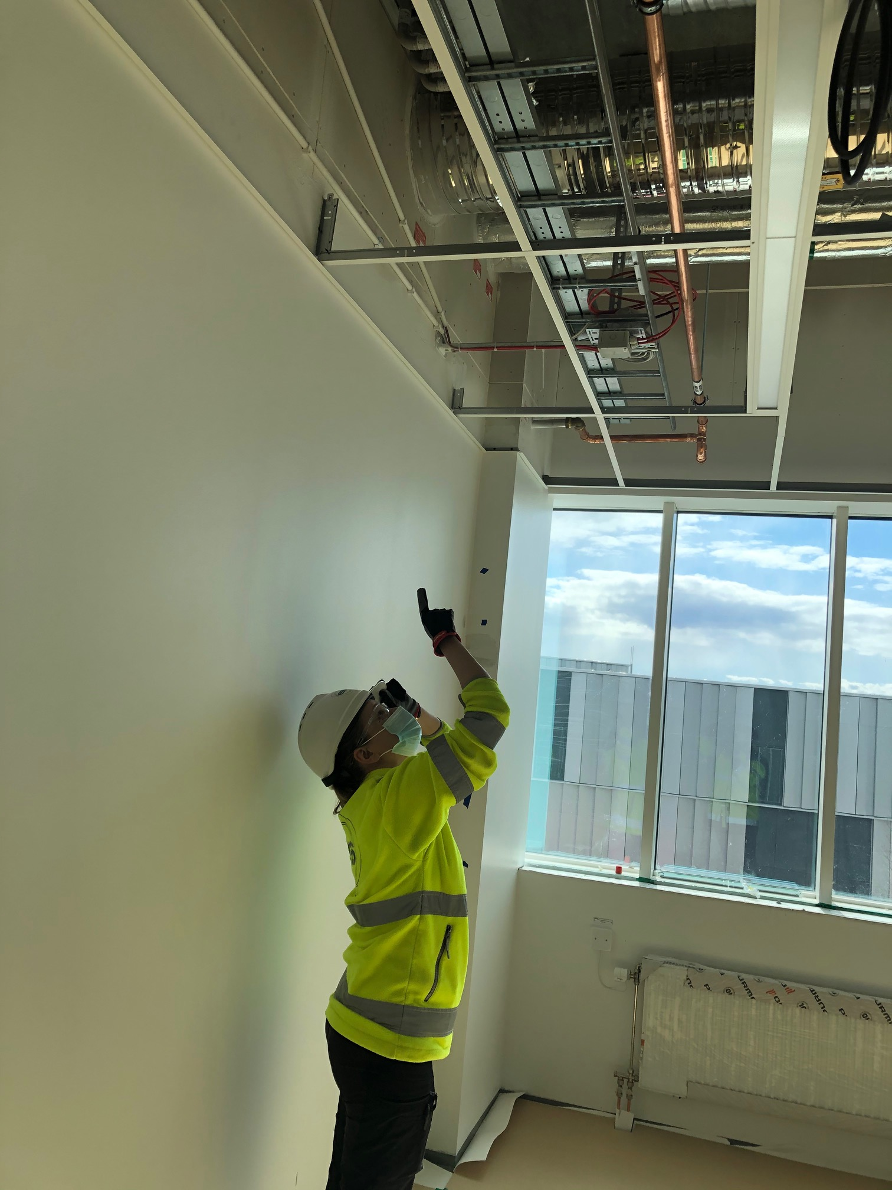
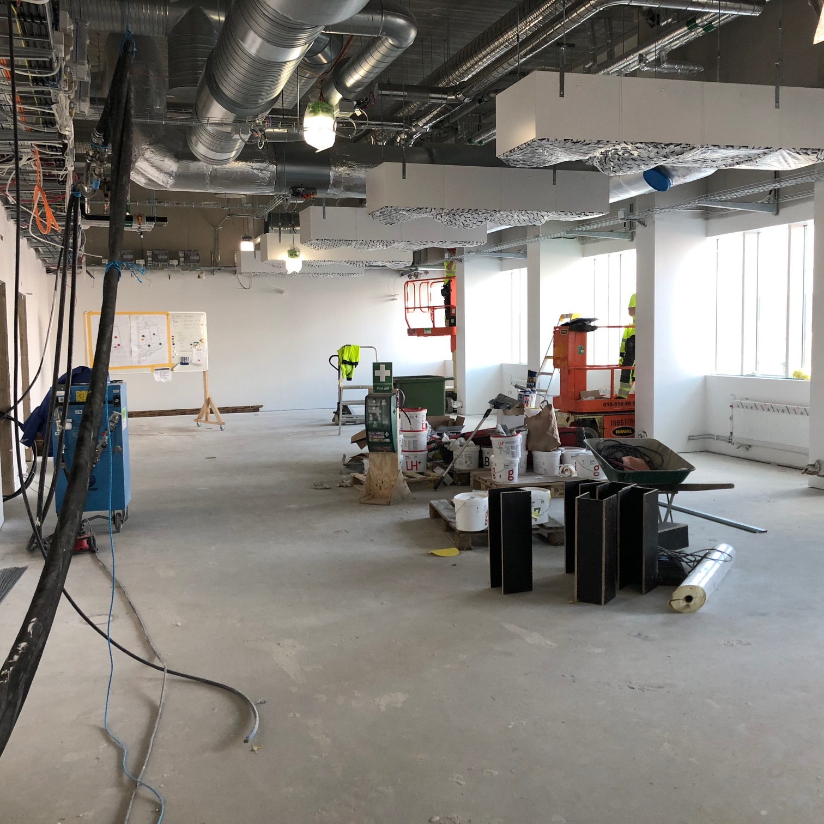
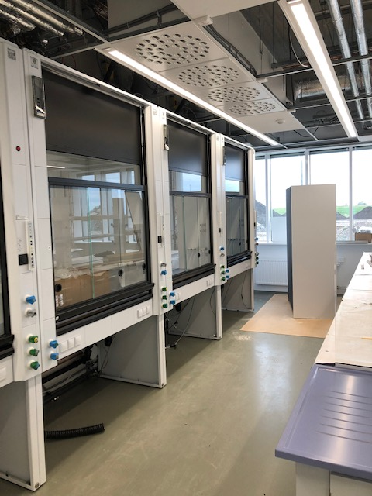
Next step in installations – fume hoods
May/June 2021 – fume hood (FH) installation in D04 and D08
Why do we install before hand-over:
Lessons learned from E-buildings: better to install before building is finished (less corrections needed afterwards).
Testing of the building control and ventilation system in one effort – less work/time/costs for SKANSKA and for us.
STATUS of next installation step:
  procurement for FHs and installation is done – contract with Sanber
  Weekly coordination meetings with SKANSKA ongoing
  Koettermann, Germany, started to manufacture
  Site shifts for us will start again May 3rd -> supervision of installation

Slide 20
Next steps: D08 Installations FHs
15 Fume hoods to install in all areas
D08.100: ground floor
D08.110: first floor
Radioactive Materials Laboratory (RML) Critical for beam on target, 4 FHs
Changing area in front of RML – cabinets/benches
Sample Storage – cabinets/benches/inert cabinet
Chemistry Laboratory servicing DREAM (only chemlab for D01) 6 FHs
Energy Research/H₂ lab (ATEX rated) 1FH
Furnace Room with special ventilation; support for cond. matter synthesis
Surfaces and Interfaces Room (SIN): hard cond. Matter, with thin films, nanoparticles 1 FH
Sample storage
Chem. Lab (DREAM/ ODIN)
Sample Env. Techn. Lab
H₂ lab
Optics Techn. Lab
storage
Furnace room
RML
SIN/ cond. matter
DAC

Slide 21
Next steps: D04 Installations FHs
13 Fume hoods to install in all areas
D04.100: ground floor
D04.110: ground floor
Chemistry Laboratory servicing D03 (LOKI/FREIA) & D01/East side (ESTIA, SKADI, VESPA) 6 FHs
Life Science Laboratory for LOKI/FREIA & collaboration with SE next door 5FHs
spectroscopy room, appliance room, cold room (not constructed yet)
Life science Lab (LOKI/ ESTIA)
Chem. Lab (VESPA, ESTIA, SKADI)
Sample Env.
spectroscopy
Detector lab
Cold room
appliances

Slide 22

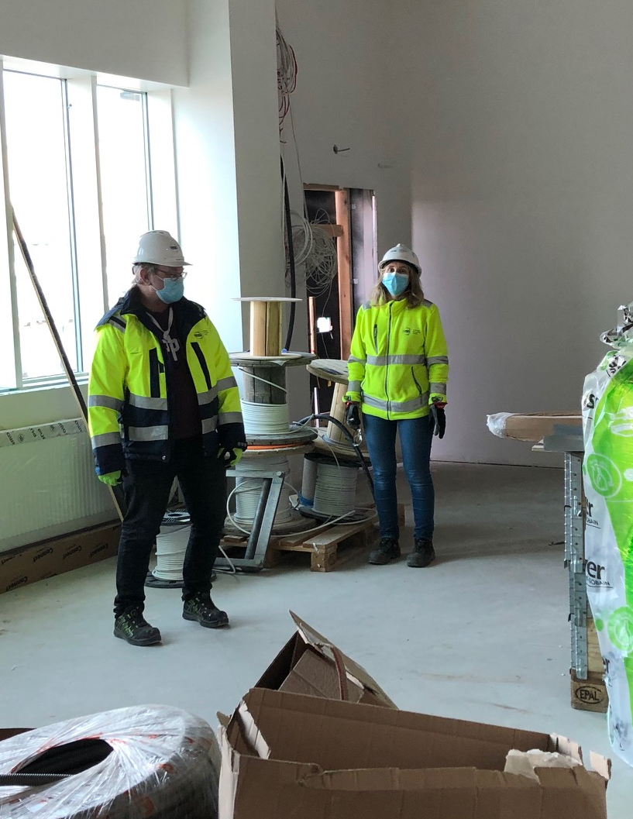


Summary – on-site installation
In-Kind projects:
- both finished pending the report / both successful
- good partnerships established to ISIS and University of Tartu
- scientific and technical collaborations will remain
Installations:
- installations in E04/E03 chemical labs completed;
- fume hoods installation in May/June 2021 on track;
- safety between ESS and SKANSKA well coordinated
- logistic and rigging team both know us by now – works well.
- ESS bureaucracy still extensive (see previous STAP)
Future installation after handover:
- furniture/utilities for D04/D08 requires tender
- need more help from procurement
SULF is on track and therefore does not qualify for extra support

Slide 23
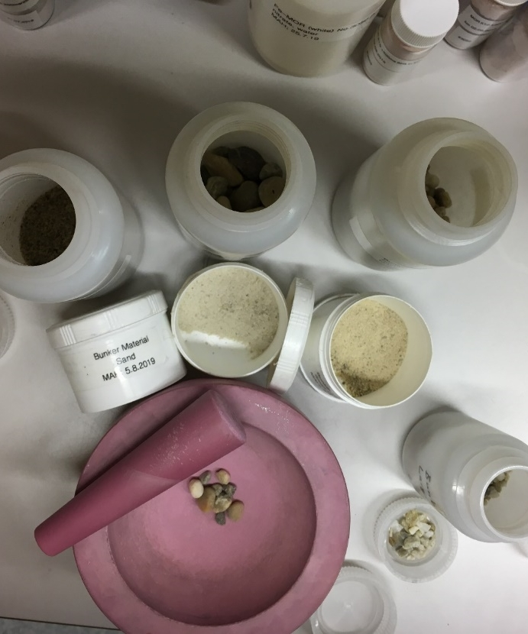
1
3
SULF –
chemistry services
for the ESS project
2
3

Slide 24
SULF – one chemistry lab for ESS
Expertise and experience resides in SULF
REASONS to have one chemistry lab for all ESS located at ESS instead of several small scale labs in each division:
  The expertise is in SULF as shown by various involvements, nationally and internationally.
  Having to go to an outside lab is expensive and takes longer.
  Activated materials cannot easily be sent outside.
We have/are gaining expertise and experience
  Neutron scattering & chemistry (incl. chemistry work for accelerator and target)
  Close collaborations with sample environment, materials group (target), beam diagnostics group -> benefitting both sides.

Slide 25
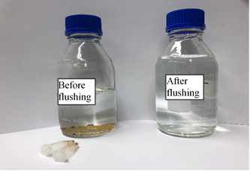
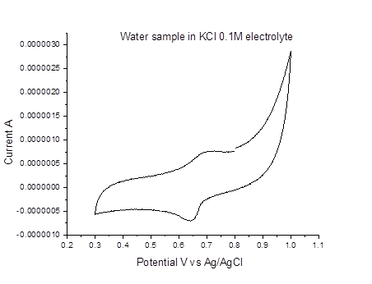
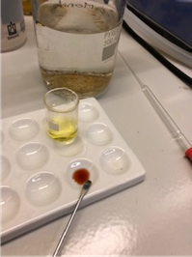
Why are user laboratories necessary?
SNS user
lab
Short, medium and long term needs
Water analysis
Short term needs of ESS:
  Support for the construction project for critical path sub-projects to ensure RBOT and BOT.
    Material site-acceptance test for the bunker project.
    Support target moderator workpackage & in-kind partner (FZJ) in developing setup for online ortho/para-hydrogen ratio verification of the liquid hydrogen moderator.
    Support for the radiation hardness of grease project (critical material decision for the target wheel workpackage)
    Support for target system engineering material configuration management (collaboration with spallation physics group) – Be, beam dump water analysis, target concrete analysis,….
Cyclovoltammogram
current / A
Fe²⁺/Fe³⁺
Potential vs. Ag/AgCl

Slide 26
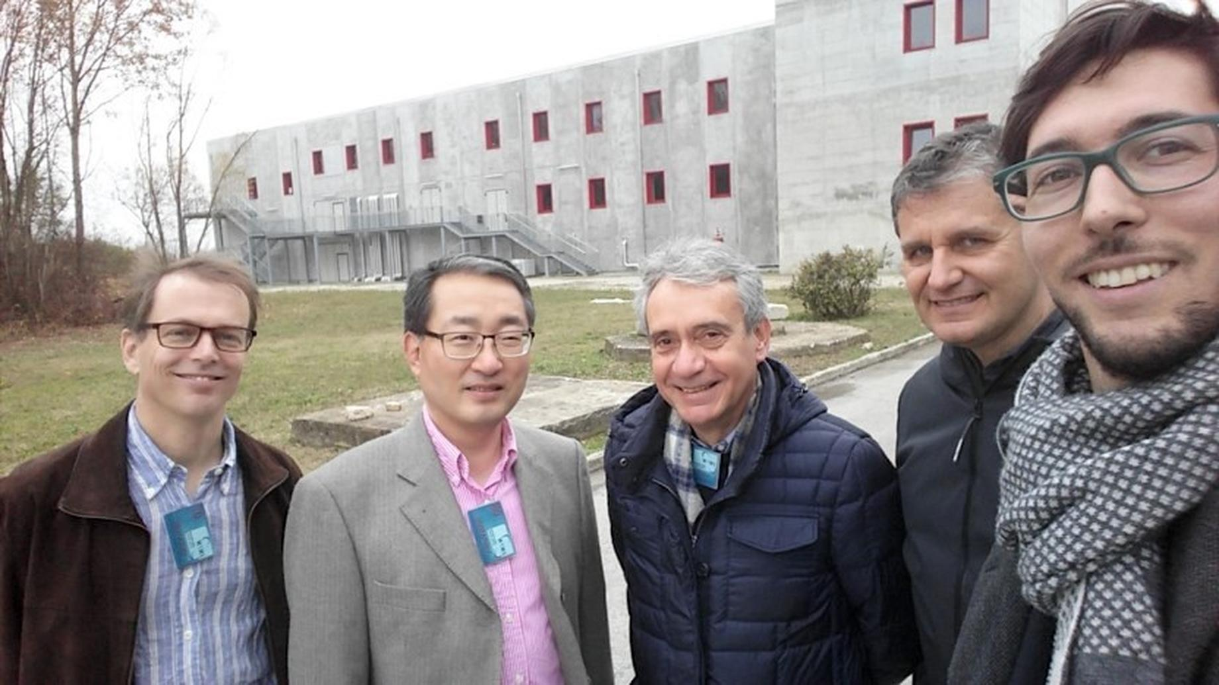
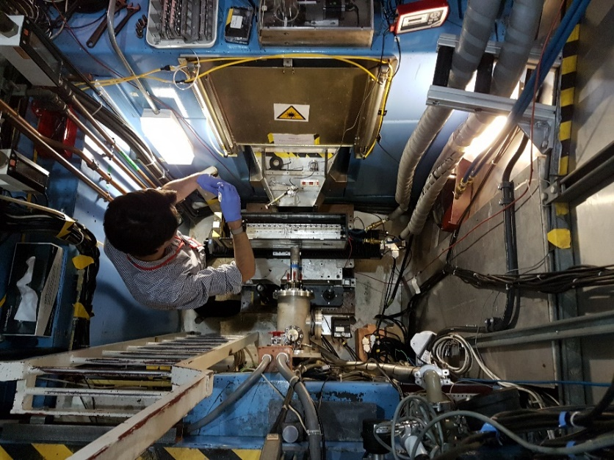
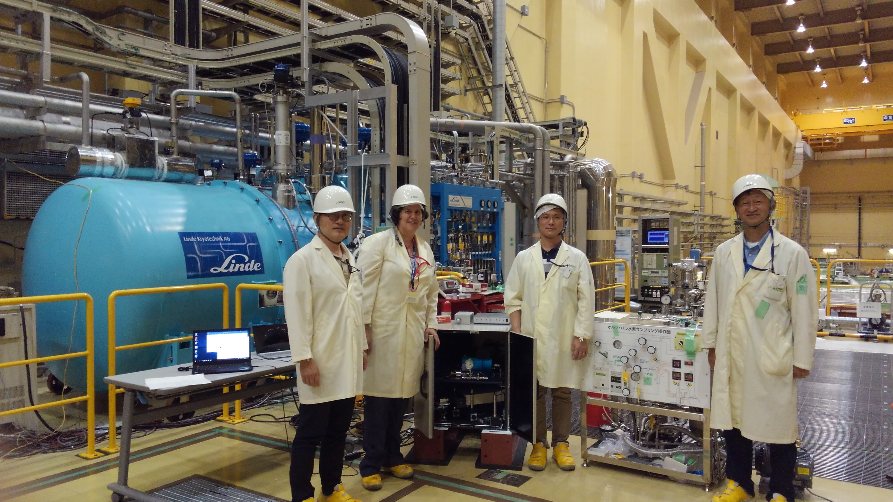
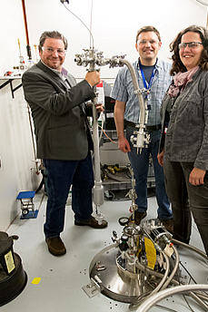
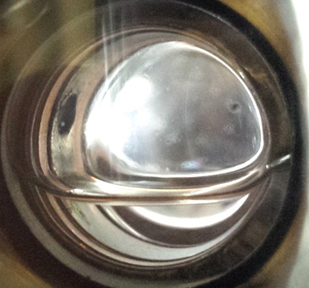
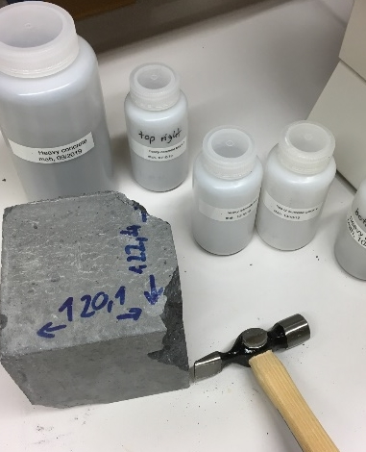
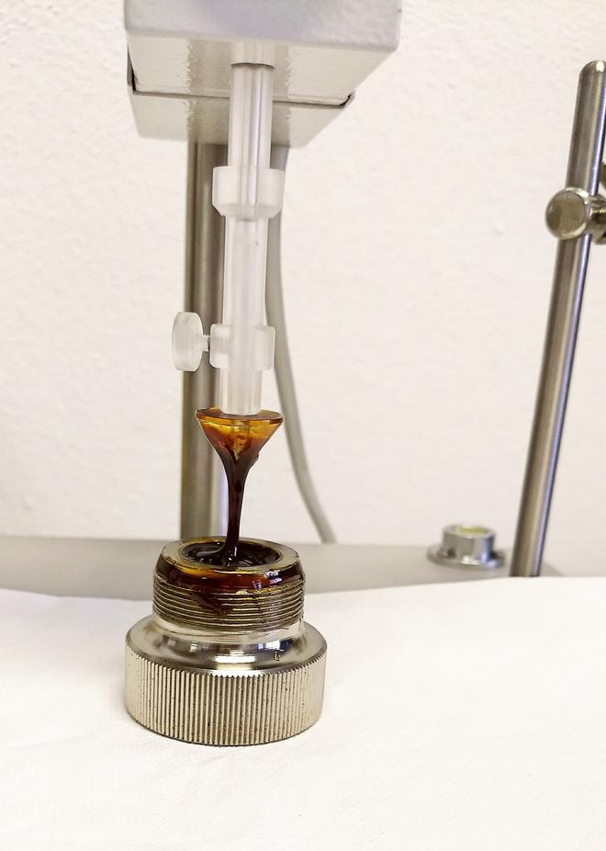
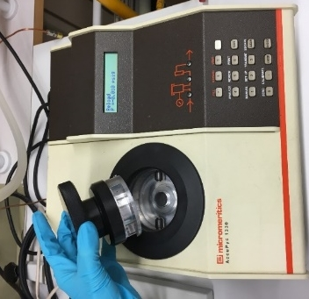
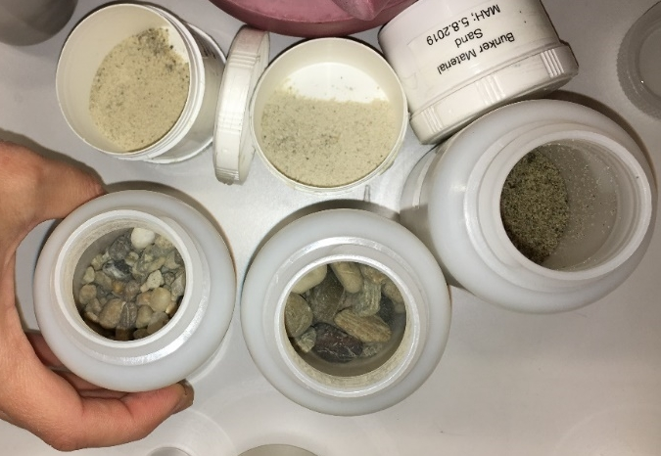
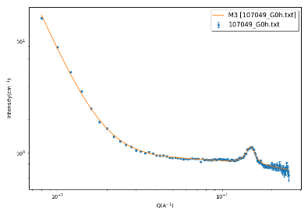
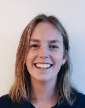
SULF short term support
for the ESS construction project and initial ops
Radiation Hardness of Grease
(collab. Lena Reactor/U. Pavia)
Elemental Analysis of materials
Bunker and shielding,
target materials
Ortho-para Hydrogen research
for moderator (coll. ESS/JPARC/SNS)
Target wheel, choppers,…
Target Moderator/ online monitoring
ISIS beamtime
June 2019
Added capability for SULF:
Microwave digestion furnace
Fusion instrument
Expecting in May: ICP-OES
(Previously ball-mill and 10t press)
SANS
Broad peak fct.
Notes:
Goal: elemental composition of ESS bunker construction materials
preparing samples for measurements
measuring XRF (currently in collaboration SNS/ISIS)
facilitating ICP-OES measurements (LU)
density measurements with SULF gas pycnometer
Added capability for SULF for the user program:
Ball mill has been ordered (project funds) -> useful for obtaining powders, synthesis & activation of samples
Used XRF is on the way -> useful tool for determining elemental composition for elements heavier than Na
ICP-OES procurement is being evaluated -> elemental composition for elements (also light elements)

Slide 27
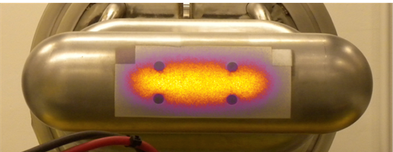
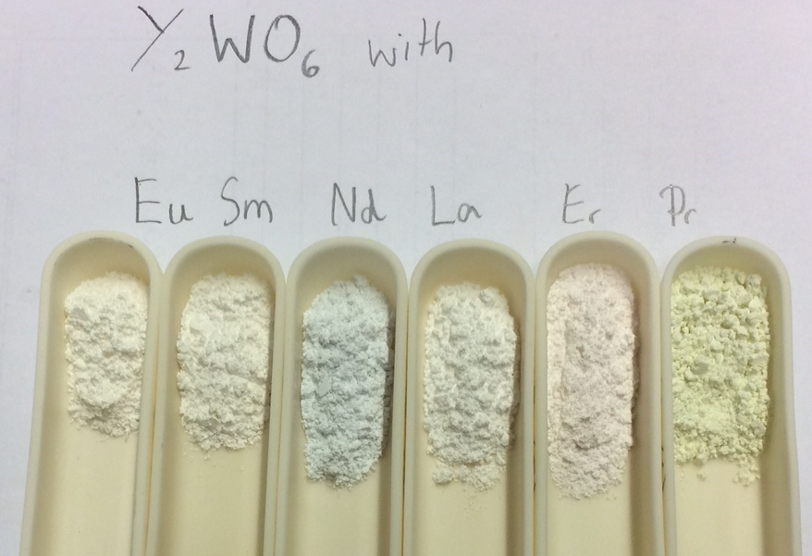
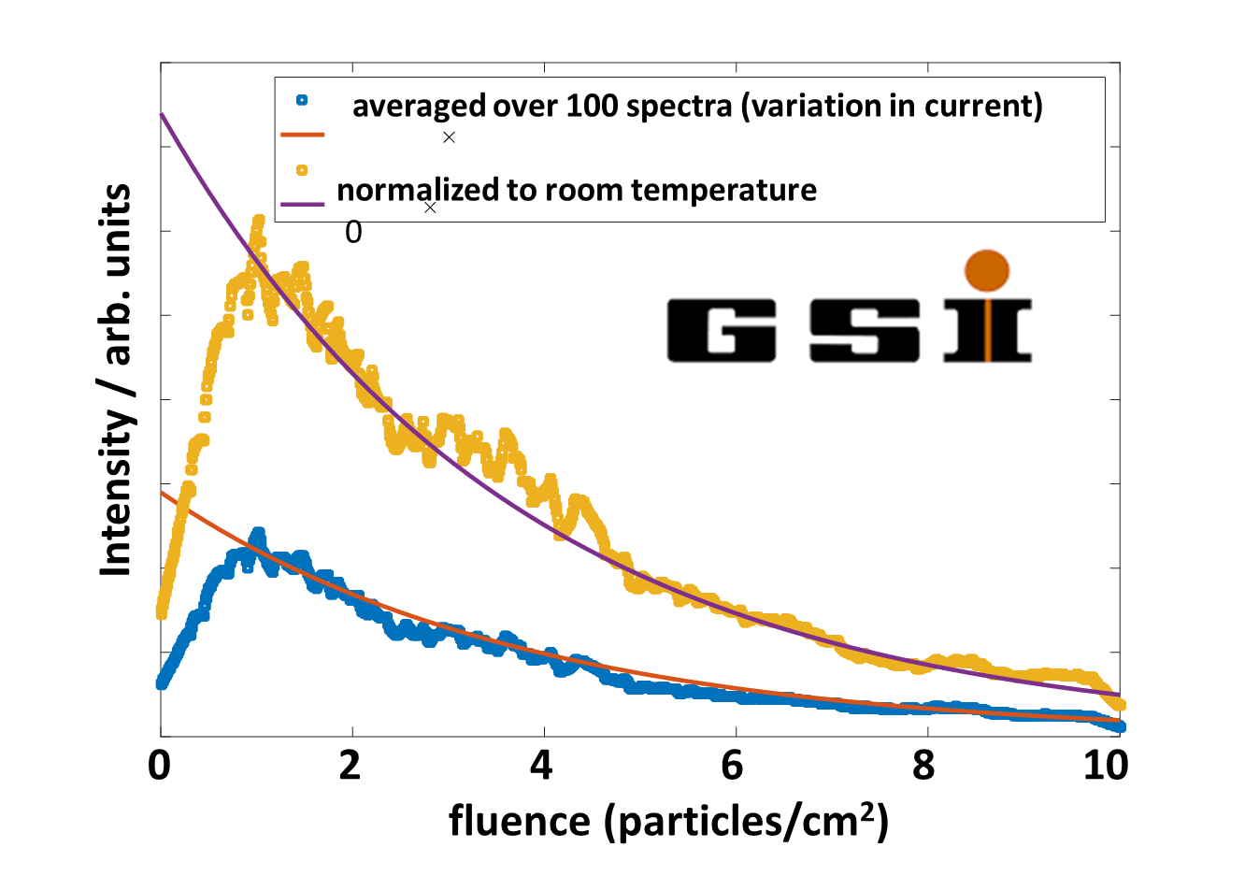
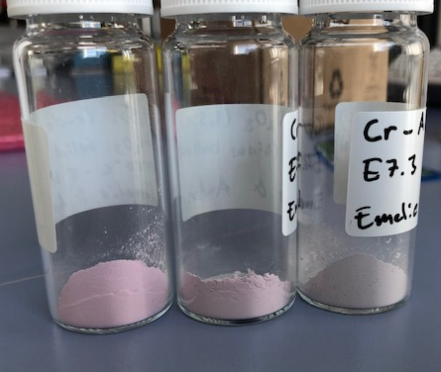
Why are user laboratories necessary?
Short, medium and long term needs
Medium term needs:
  Support for the commissioning phase (initial ops) of the machine
    Support for accelerator on the material choice for the luminescence screen on target wheel. (beam steering, performance and safety critical)
    Provide cooling water and material analysis as needed
    Support installation of ortho/parahydrogen monitoring system
  Providing Radioactive Materials Laboratory in time for BOT
    Only permanent area at ESS for analysing activated materials
Beam Diagnostics
Luminescence Screen on target wheel (collab. SNS)
Master thesis:
Emelie and Anton
(Cr-doped Al2O3, YAG)
Ball-milled
samples

Slide 28



Why are user laboratories necessary?
Short, medium and long term needs
Long term needs:
  Preparing for First Science (ESS is built for small samples and in-situ experiments ->SULF needs to cater to these requirements.
    prepare, modify and load samples
    characterize samples before, during and after the experiment
    Last minute adjustments => saving beam time & costs
  ESS operations support
    Materials characterization for machine and science directorate in case of failure
ISIS
User labs
SNS user
lab
ISIS
Materials
labs
Well-functioning labs come with expertise of the scientific and technical staff.
State-of-the-art neutron sources have labs not just sample loading stations !
ESS User Labs

Slide 29




SULF support: preparing for first science
SULF/sample environment joint projects
from lab to in-situ
neutron scattering
SULF
Sample environment/ FLUCO
0.5 0.5
FTE FTE
  User Lab
  Basic electrochemistry tools
    Voltammetry/polarography/impedance
  Sample preparation
    Glove box / Clean area
    Prepare battery,charge/discharge
  Sample Environment
  In-kind U. Tartu – electrochemistry cell
  Cells compatible with neutron experiment, in situ and operando
      Coin cell, SANS measurements.
      Annular cell for inelastic, diffraction exp.
NS
instrument
    Electrochemistry (e.g. cycling of batteries)
    Levitator (testing levitator settings in lab before beamline)
    Gas handling manifold (gas loading at the beamline or in the lab)
Gas handling manifold for corrosives (e.g. NH₃).
Using UV/VIS to test levitator

Slide 30




SULF support: preparing for first science
Human Frontier Science Program Grant
Do hydrocarbons induce membrane curvature in photosynthetic organisms?
Cyanobacteria are intricately organized, incorporating an array of thylakoid membranes into the cells. This is the site of photosynthesis.
Cyanobacteria produce hydrocarbons, and hydrocarbons are known to accumulate inside their membranes
Melissa’s part: Neutron scattering, e.g. NSE/SANS at ILL, SNS and/or FRM-II
Sophie’s research has provided SULF with extended capabilities in life science research:
EO4 now equipped for growth of cyanobacteria (and in future other bacteria)
Autoclave and Shaker Incubator with LED lights installed.
Dynamic Light Scattering instrument and FT-IR accessory for liquids procured:
C&EN magazine, 2015,
93(40), p.10

Slide 31
SULF - conclusions
Catering to neutron scattering instruments as they come online
SULF is on track with
Laboratory fit-out and has moved to the ESS site.
Preparation for the user program including safety and sample handling
SULF adds value
scientific support for machine and science directorate already during construction
building up capabilities in time for First Science in collaboration with other groups
SULF is crucial
Support for in-situ experiments / experiments with sensitive samples
Minimizing beam time loss by checking/modifying samples
Support for materials characterization for all of ESS during operations

Slide 32

Thank you for your attention
STAP charge for SULF (summarized):
Is SULF on track and staffing sufficient ?
How to best equip the labs?
What is useful for ESS to support the project?
How do we keep to the core business?
SULF Group
We sulf problems !

Slide 33
SULF: what are the focus points now ?
Katrin (100%), Melissa (50%), Monika (100%), Alice Corani (50%) = 3 FTE
Project coord.
Construct. Support
ESS Lab operation
ESS project Support & Science
Katrin Michel – laboratory technician (100% SULF)
  E04 operations • Day-to-day safety •project support
Melissa Sharp – laboratory scientist (50% SULF, 50% CF/FM Interaction)
  Construction (FM) • Life Science Grant/Postdoc • Installation
Monika Hartl – laboratory scientist/GL (99% SULF, 1% VESPA)
  Installation coord. • ESS support • Construction (Safety, quality)
Alice Corani: laboratory technician sample enviro (50% SE, 50% SULF)
  E04 operations • gas supply • electrochemistry (coll. FLUCO)
  Sophie Ayscough: postdoctoral research assistant (100% Grant)
  Emelie Wiklund, Anton Järild: master students (coll. Beam Diagnostics)
Notes:
So, who is doing what in the SULF team and to what percentage? We have three SULF members currently out of which Katrin is the only one 100% working for SULF. Melissa and Monika are 50% and 70% respectively. We are currently in the process of hiring a lab technician for FLUCO that will work 50% of the time for SULF. That leaves us with 3.5 FTEs left to hire before we start the user program.
In our SULF retreat we took one day to focus on distributing our the work on our six topics among the three SULF members. As you can see, each of us is leading two tasks. If we look in detail, however, all of us are contributing in all areas. The future lab technician that we will share with FLUCO will be focusing on laboratory work in Medicon Village and executing collaborative work with FLUCO (between sample environment and labs). The 3.5 lab technicians that we are planning on hiring will likely be focusing on radiological chemistry, general chemistry and soft matter with focus on bio.
When we look in detail at the group members you can see that our expertise actually fits together - ….

