Slide 2
SE Integration
Workflow and Solutions
Experiment Control and Data Curation (ECDC)
Anders Pettersson

Slide 3
Agenda
1 NICOS High level control system
2 Different solutions Same User Experience same
3 Overview of SE integration
4 EPICS
5 Octopy
6 SE integration workflow
7 Summary

Slide 4
1
NICOS
High Level Control System

Slide 5
NICOS
All devices shall be available in NICOS
Instrument cabin
User and Expert interface
Qt based
Extensible and customizable
Scripting
Python CLI
Plotting live data

Slide 6
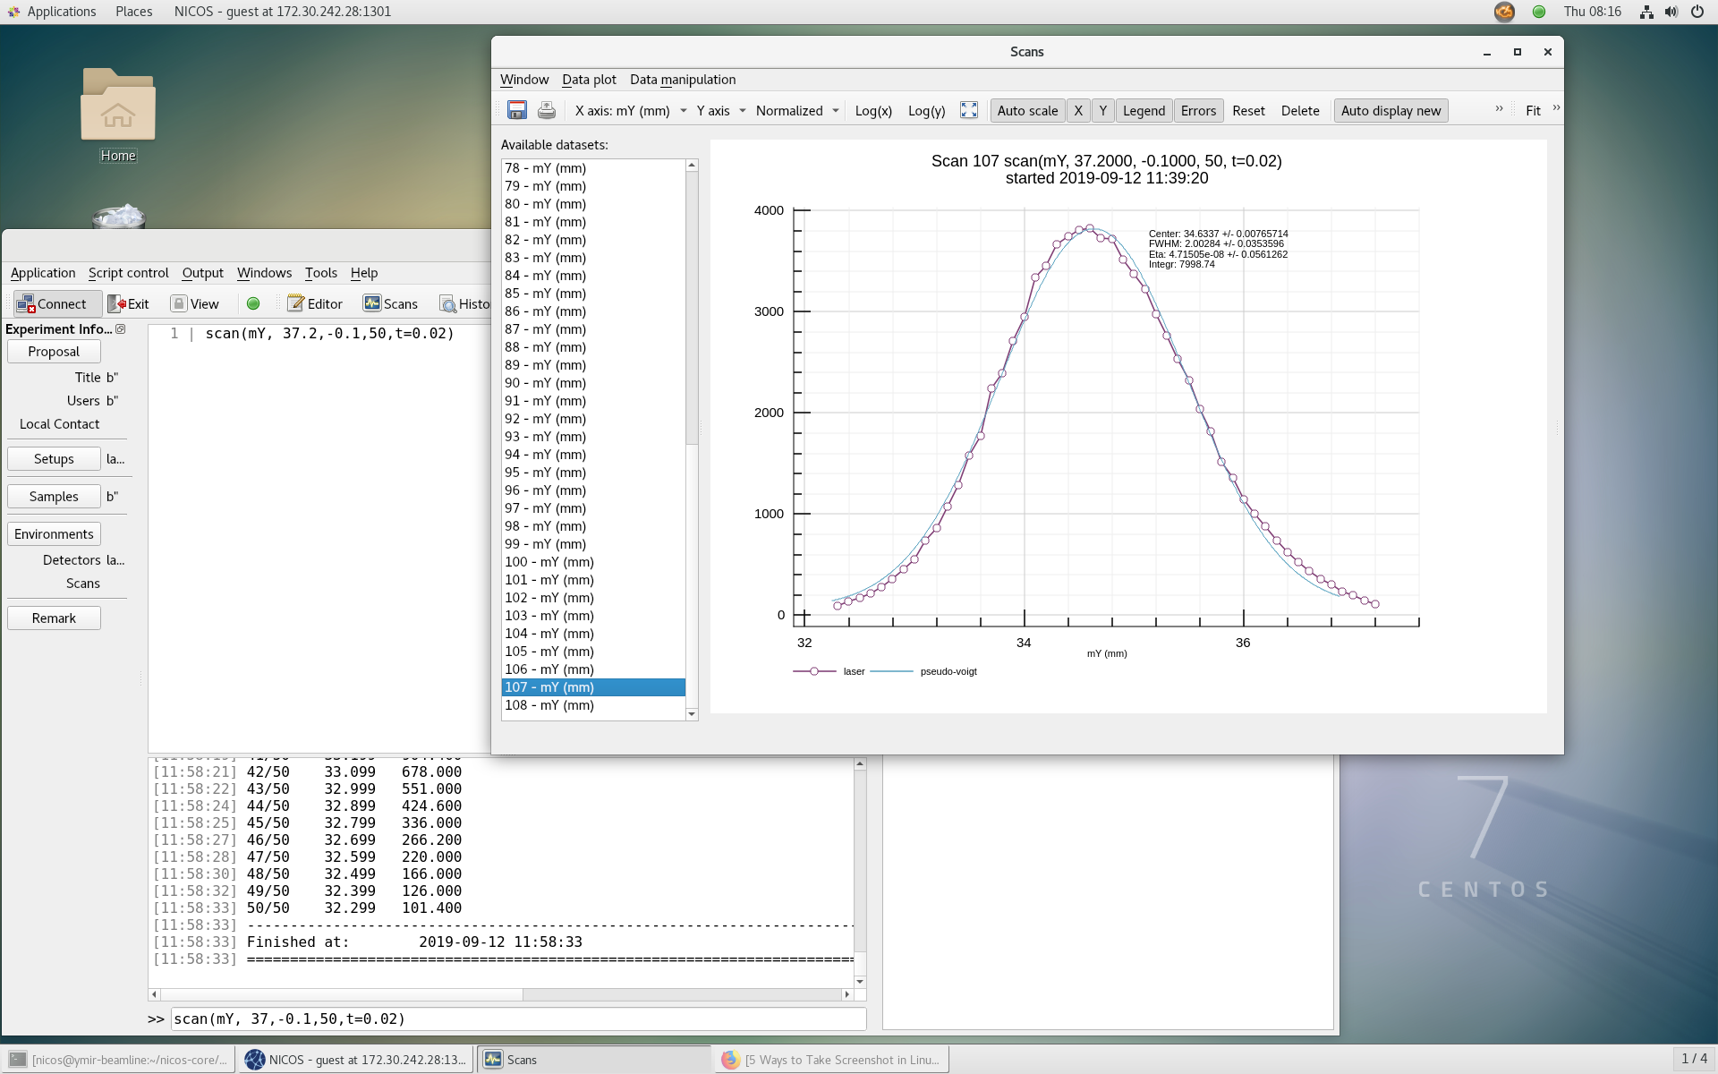
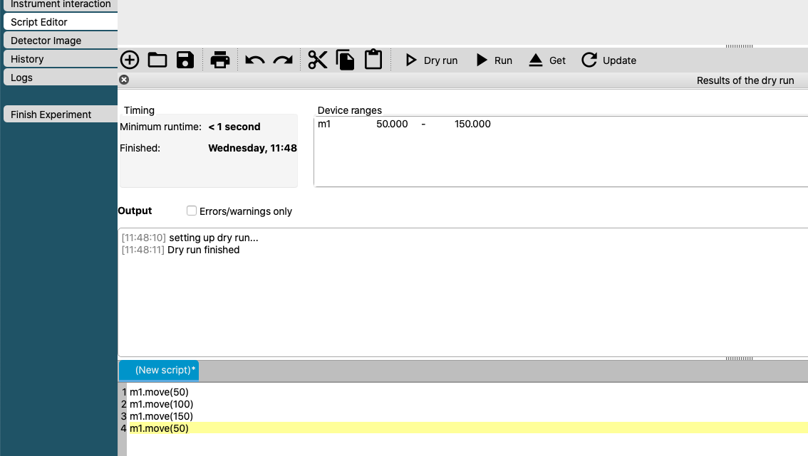
NICOS
Signals
What signals to expose?
Data
User parameters
Expert parameters
Maybe not?
Proprietary data evaluation software
Low level hardware configuration parameters available in device software

Slide 7
2
Different Solutions
Same User Experience

Slide 8
Different solutions Same User Experience
Use case: EPICS for standard systems
EPICS
Standard devices are straightforward to integrate and control in EPICS
Robust
Deployment supported by ICS under development
Comes with software infrastructure like GUIs, Archiver, Save and Restore, etc
Community integrations available

Slide 9
Different solutions Same User Experience
Use case: Octopy for device requiring a DLL (potentiostat)
Not straightforward with EPICS
Labview not supported by ICS
ICS only supports Linux machines (DLL requires Windows)
”Normal” complexity with Octopy
Octopy python based, runnable on most systems
Notes:
Octopy provide a solution where EPICS is limited

Slide 10
Different solutions Same User Experience
Use case: Octopy Development systems Orange Cryostat, Rig1, LS336 Tctrl calib, Camera
Octopy is SE’s tool with which to encapsulate SE low level complexity and expose a standard interface
Configurations are modular and can be changed dynamically
Leverages power of existing Python libraries
Python scripts can be added in a modular way
Logic accessible to SE staff (if familiar with Python)

Slide 11
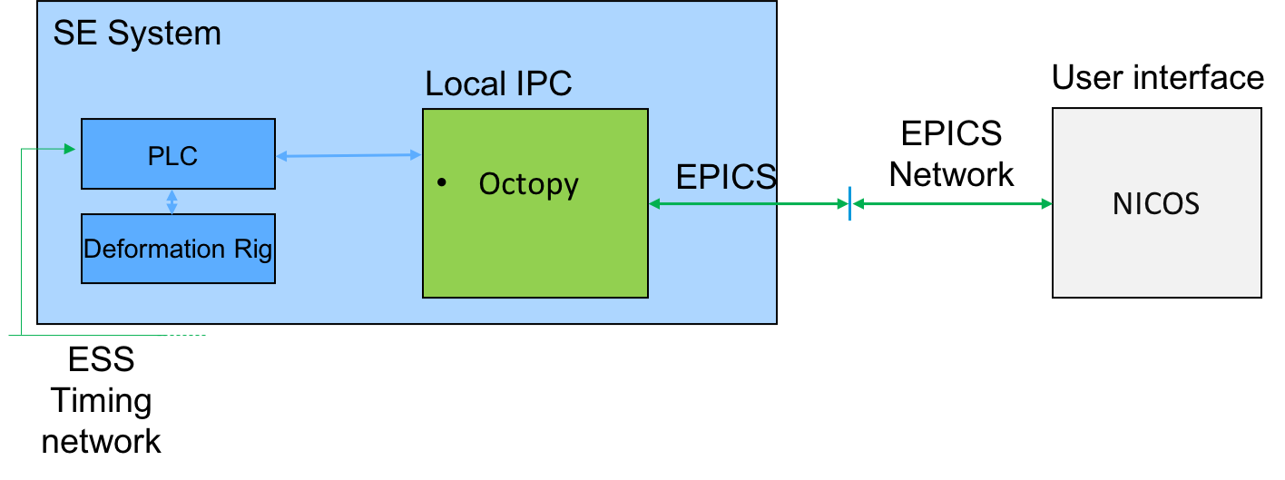
Different solutions Same User Experience
Use case: Higher timestamping resolution
Development of timestamping system
PLC (Beckhoff) synchronize to ESS time through PTP
Standard MQTT library is used for PLC to push data to Octopy -> EPICS
Same setup is used in Rig1 project. PLC (cRio NI) with labview use MQTT library to push data to Octopy-> Epics
The PLC + PTP approach provide solution for timeresolution 10-100us and sample rate 1-10ks/s
Detector readouts can be used for higher resolution

Slide 12
Different solutions Same User Experience
Use case: Octopy for SECoP Devices
Translate a SECoP device to EPICS
Develop a ESS SE system for SECoP
Network

Slide 13
3
Overview of SE integration

Slide 14
Overview SE integration
The Sample Environment System
SE System
SEE
SEE
ESS Timing network
Communication over :TCP/IP, Serial, RS232, Etc..
A selection of commands defined in device manual
Information collected in JIRA issue

Slide 15
Overview SE integration
The SES integration
SE System
Local IPC
EPICS
Octopy
EPICS Process Variables (PV)
Technical Network
SEE
SEE
ESS Timing network
Integration phase
Integrators setup communication with SE system
Implementation of requested logic
Notes:
The integration ”coding” is provided either as ESS standard EPICS or in specific cases in Octopy , local SE control system

Slide 16
Overview SE integration
Experiment Control System (ECS) and NICOS
SE System
User interface
Local IPC
EPICS
Octopy
EPICS Process Variables (PV)
Technical Network
NICOS
SEE
SEE
ESS Timing network
EPICS
forwarder
Filewriter
NeXus/HDF5
Kafka
Setup in NICOS
Data accessed by EPICS forwarder
Notes:
Exposeing signals on EPICS enable access on ESS controls infrastructure

Slide 17
4
EPICS

Slide 18
EPICS
Integrated Control Systems Division - ICS WP12
EPICS - Experimental Physics and Industrial Control System
EPICS is the signal layer backbone at ESS
Every remote controlled signal or data need to be available as an EPICS PV (Process Variable)
All SE hardware is integrated into EPICS
ICS WP12 provide integration working close with ECDC
ECDC priorities NSS integration tasks
All data will be timestamped in EPICS
Notes:
Open source facility control system/Scada system used at large research facilities (radio telescope array, telescopes, synchrotrons, Xfel etc).

Slide 19
EPICS
CS-Studio
EPICS additional Tools
EPICS is also a collection of tools:
Archiver
CS-Studio (GUI)
Alarm handling
Save and restore
Deployment system Etc..
NB. Archiver not fully compatible with ESS EPICS, Save and Restore not tested, (3rd ) Deployment system under development)
Archiver
Alarm handler

Slide 20
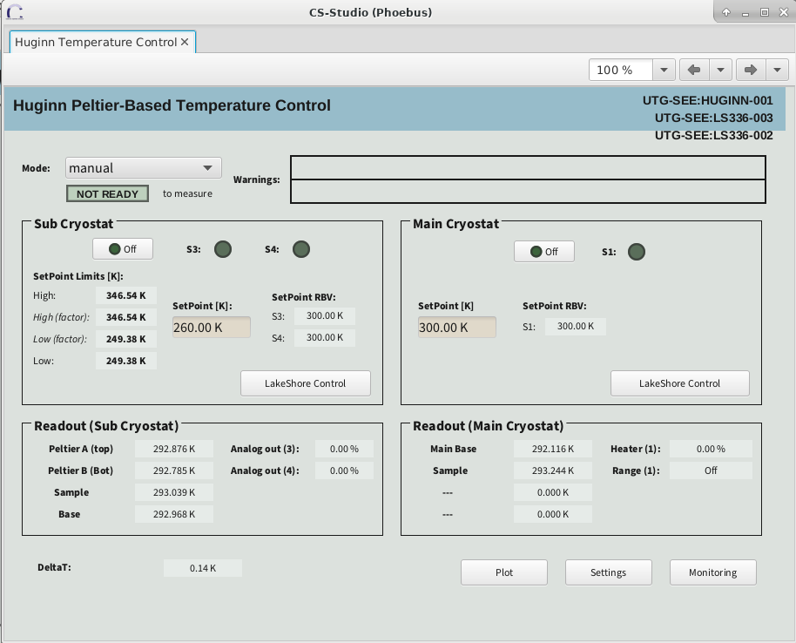
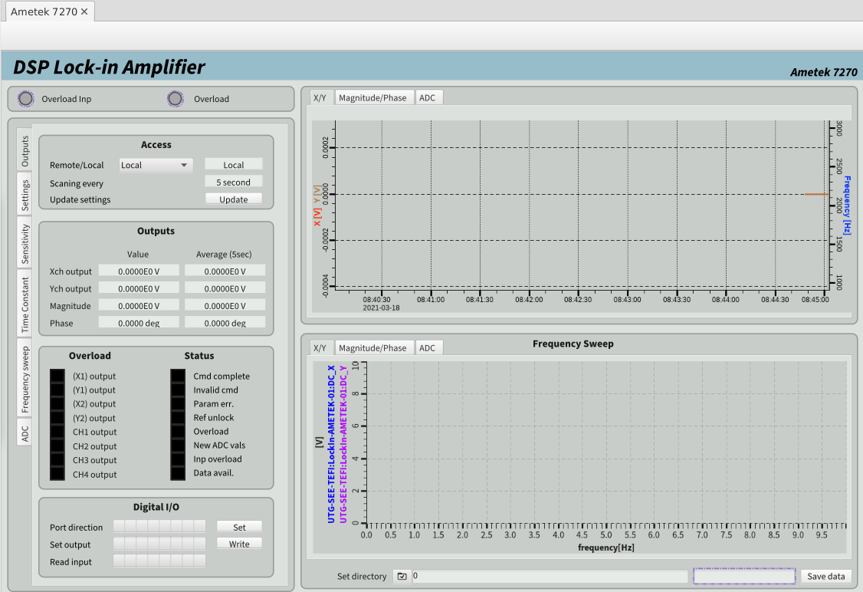
EPICS
CS-Studio Phoebus GUI, Archiver
From SE perspective
CS-Studio Phoebus -> Engineering Interface (mainly SE team)
Troubleshooting/development interface
Archiver –> long term SE monitoring
Not the interface for the Science User
Potentially providing device hardware configuration parameters not exposed to User.
Will not provide scripting

Slide 21
5
Octopy

Slide 22
Octopy
Local SE control system implementing SECoP
Developed by Sample Environment for low level controls of a SES
Meets the SE needs for flexibility and modularity
Developed to be compatible with ESS EPICS infrastructure
Allows addition of logic
Can communicate with SECoP ECSs and will be able to translate SECoP devices to EPICS
SECoP provides a self describing feature potentially reducing ECS integration effort
Compatible with EPICS tools (in theory…)
Sample Environment Controls

Slide 23
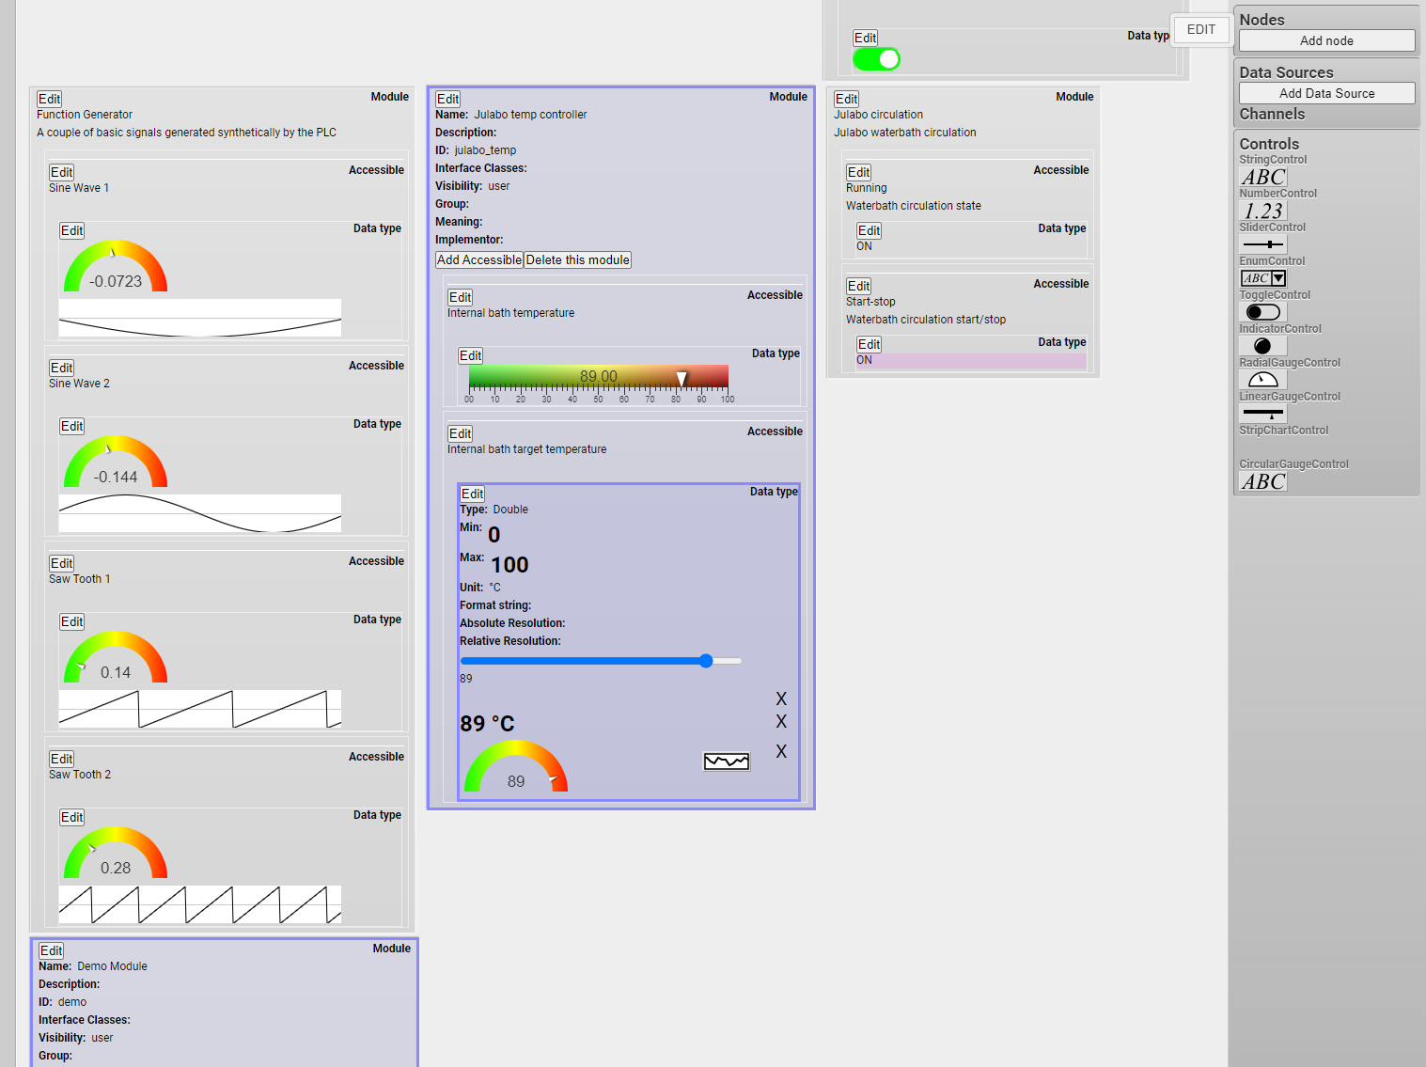
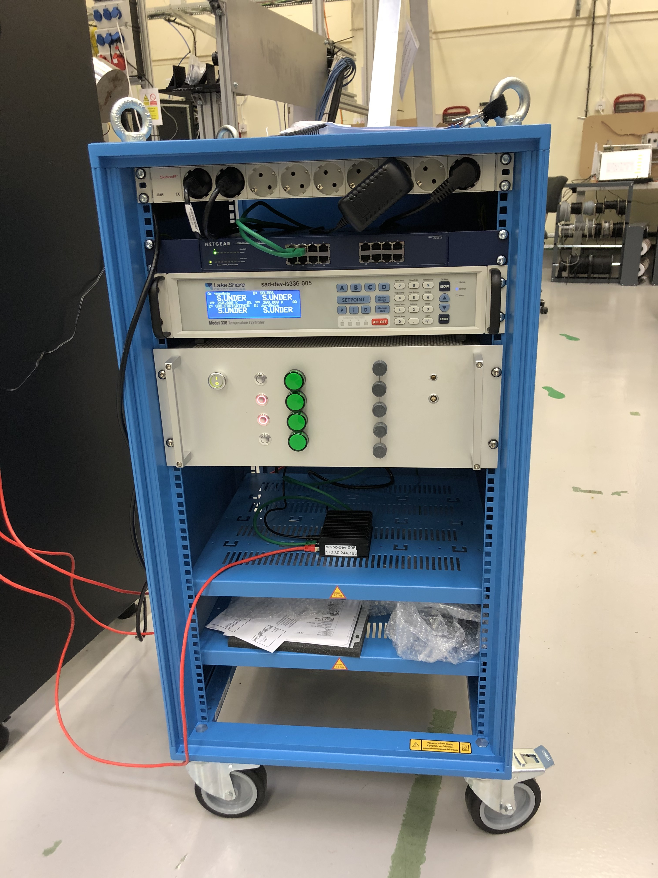
Octopy
Project status
Octopy SE development system:
JULABO(sim) -> EPICS IOC -> Octopy -> EPICS
Beckhoff PLC -> MQTT -> Octopy -> EPICS
LakeShore336 -> TCP/IP -> Octopy -> EPICS
Status:
GUI for creating and editing of configurations
Signals can be integrated/added from GUI
CS-Studio Phoebus compatible
Operational by summer
Seamless integration with EPICS ecosystem still in progress

Slide 24
6
SE Integration Workflow

Slide 25
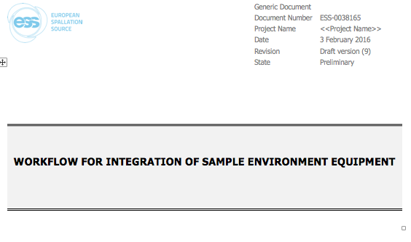
SE Integration Workflow
Workflow document
SE integration workflow document
Describes integration process
Intended to help flow of information
Adjustable to size of project

Slide 26
SE Integration Workflow
Workflow
STEP 1
Client fills out the integration request template when a SE device is ready for integration
Notes:
Trigger an integration project

Slide 27
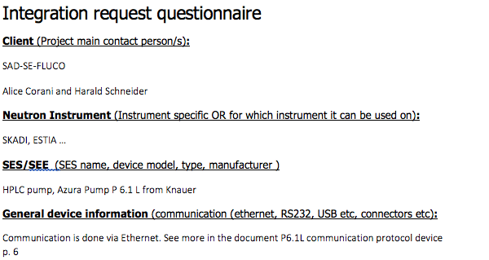
SE Integration Workflow
Integration Request
Client/subject matter expert provide
Clear information/scope
Integration reference
Catch safety considerations
Lists signals
Template evolved over multiple projects
Notes:
MESI/ECDC can support

Slide 28
SE Integration Workflow
Main phases
Acceptance testing
Is the client happy?
Purpose:
Align that project is done
Stakeholder meeting
General description
Use cases
Required logic development
Project JIRA issue
Purpose:
Catch challenges early
Involve integrators
Meet!
Both side Q/A
Main Integration effort
Integration in ESS control systems
Purpose:
Enable remote control of SE by user
Enable writing experiment data
Project start
Purpose
Refine timeline
Prepare support
Engineering document
Document system/new logic
Purpose:
Provide clear description of new logic for integrator/developers
Reduce misunderstandings
Notes:
MESI supports projects on mechatronics and control.
ECDC supports in controls and interpretation of commands etc.
Design process can be iterative

Slide 29
SE Integration Workflow
SE/ECDC/ICS interaction
An integration requests triggers a new ECDC JIRA issue
Issues are prioritised for integration and queued into ICS sprints
NICOS integration starts as EPICS integration is finalized
The JIRA issue collects information and keeps stakeholders updated/involved

Slide 30
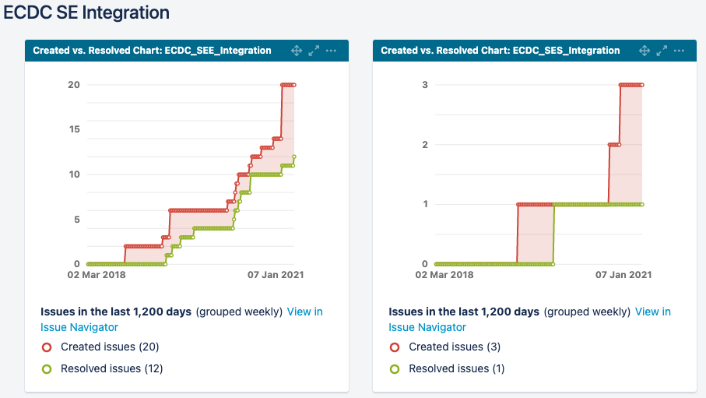
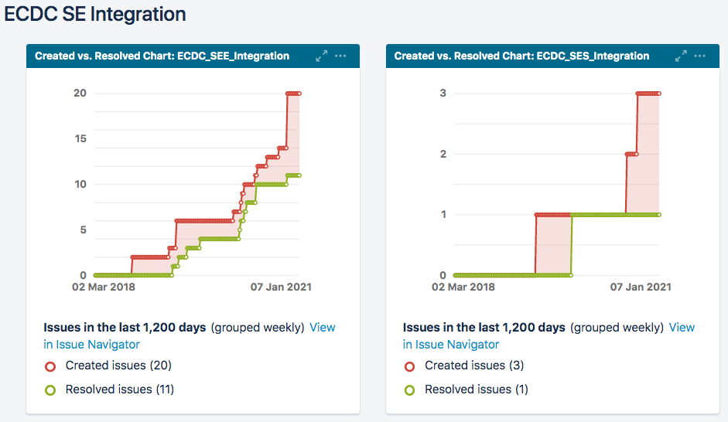
SE Integration Workflow
Individual SE systems and Sample Environment Systems
Indicative statistics, not fool-proof

Slide 31
7
Summary

Slide 32
Summary
Functional workflow from Hardware to UI
SE provide good input
EPICS integrators positive to workflow
Structure essential! (++ in Covid)
Limited integration resources
Situation will get worse over time, when more equipment (also non-SE) arrives and instrument installation begins – strong need to accelerate completion of projects
Complementary integration solutions
Octopy used by SE
to build complete SES with internal logic
expose a standard interface without involving ICS/ECDC in selection of hardware
YMIR helps drive SE controls
B02+E03 etc big step towards final structure

Slide 33
Thank You for listening!

