Slide 1
Luminescence Materials for the ESS target
Anton Järild jarild.anton@gmail.com
+46 70 235 14 56
Emelie Wiklund
emelie.v.wiklund@gmail.com
+46 70 068 53 52

Slide 2
Introduction to the proton beam imaging system
ESS: most powerful proton beam in the world!
Illuminating undesired areas can activate materials
Damaging the equipment.
Safety hazard!
Proton beam imaging
Only way to know where the proton beam is probed.
Verify the status of the beam at all times.
Assures the safety of the equipment!

Slide 3
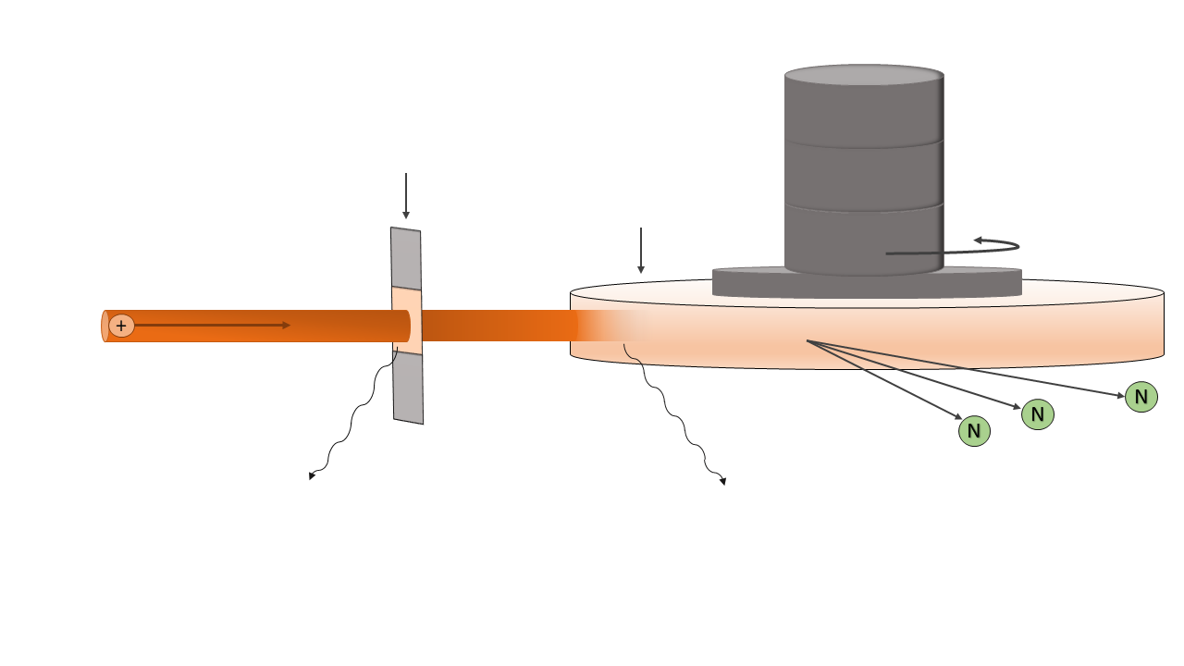
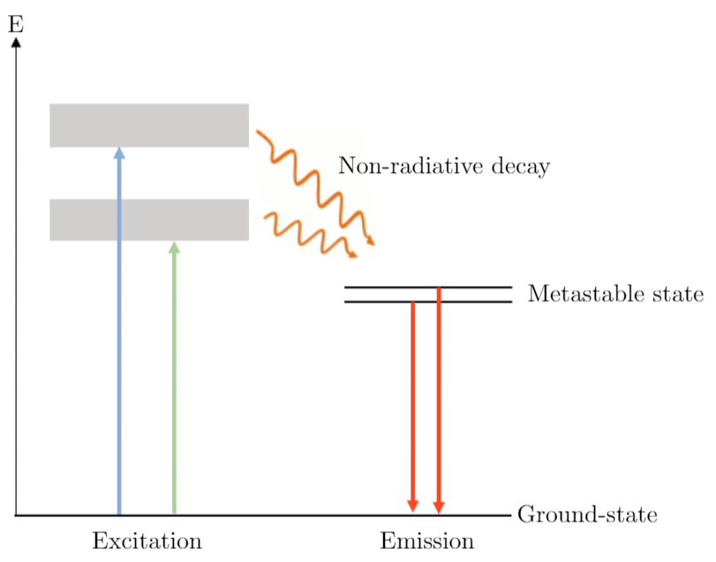
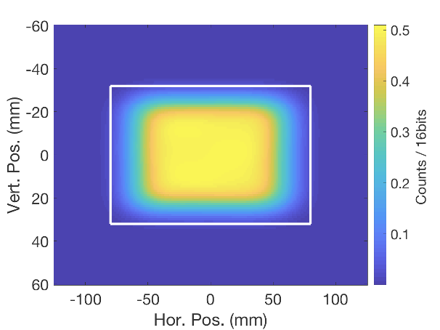
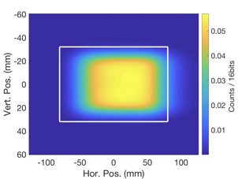
The design of the proton beam imaging system
The principles of luminescence
Proton beam window
Target wheel

Slide 4
Requirements on the luminescent material
Brightness (SNS)
Compatibility with thermal spraying
Radiation tolerance
The luminescence lifetime
Corrosive resistance
Temperature dependency
ESS in collaboration with SNS, University of Oslo and University West.
Development of luminescent materials for proton beam imaging.

Slide 5
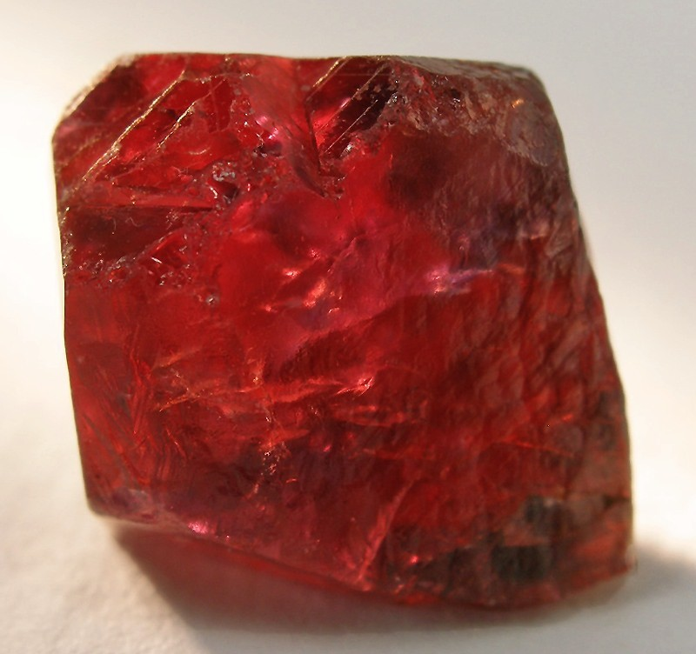
Luminescent material: Cr-doped alumina
The benchmark material for ESS.
Host matrix: Al₂O₃
Good mechanical properties and radiation resistance
Doping: Cr³⁺- ions substitute with Al³⁺.
Gives luminescent properties! Al₂O₃ crystal structures: α, η, γ etc.
Cr-doped α-Al₂O₃: - Pink or red color. - Bright luminescent properties.
Cr-doped α-Al₂O₃ single crystal (Ruby)
Adapted from https://www.mindat.org/photo-215330.html (2021-05-31)

Slide 6
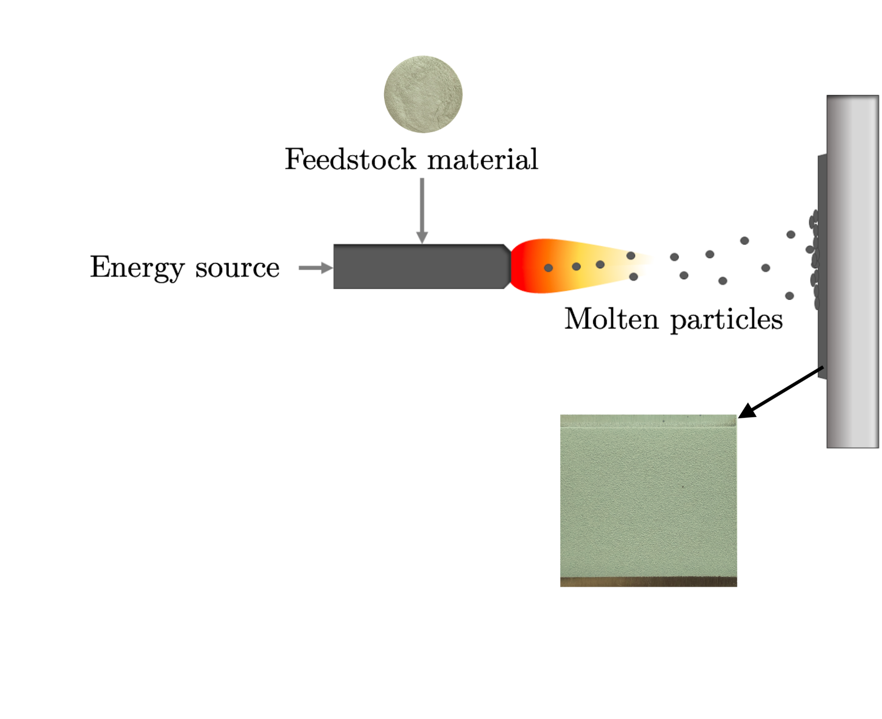
Spraying technique: Flame spraying
One of the requirements: Compatibility with thermal spraying to produce coating.
Flame temperature: 3000 °C
Coating thickness: 20-300 μm
University West in Trollhätan
Material used at SNS: Cr₂O₃ and Al₂O₃
Torch reaction: Cr₂O₃+Al₂O₃→ Cr-doped alumina.
Sprayed samples are green. Not α-alumina? Particle size?

Slide 7
Scope: Develop a new precursor with better luminescent properties
Characterizing the sprayed samples with the old precursor.
Synthesis of new Cr-doped alumina precursor.
Scale-up for pilot run on flame-spraying.
Characterization methods:
Photoluminescence spectroscopy (PL)
X-ray diffraction (XRD)
Scanning electron microscope (SEM)
Differential scanning calorimetry (DSC)

Slide 8
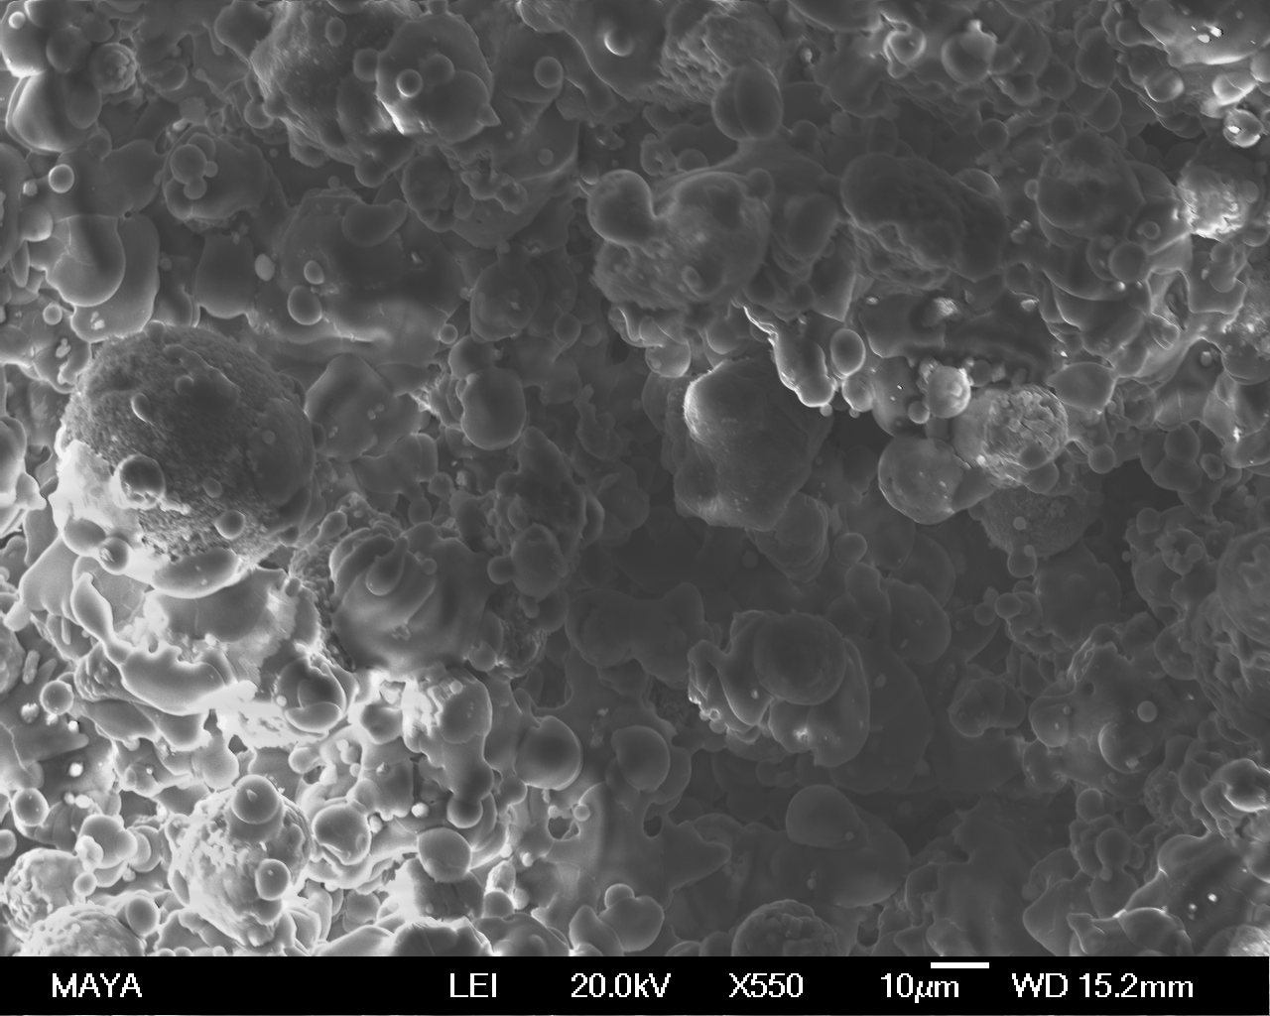
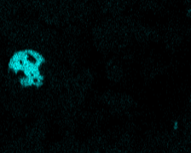
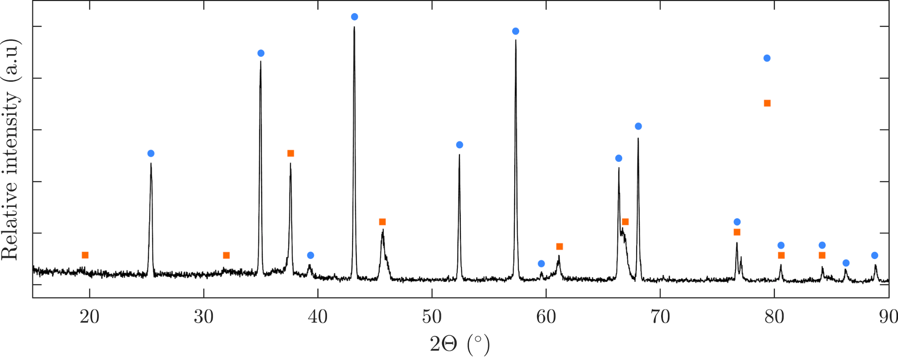
Results: Coatings on aluminium plates
Image of sprayed sample
SEM-image
SEM-EDS
Cr₂O₃ particle
50 μm
X-ray diffraction
α-Al₂O₃
η-Al₂O₃

Slide 9
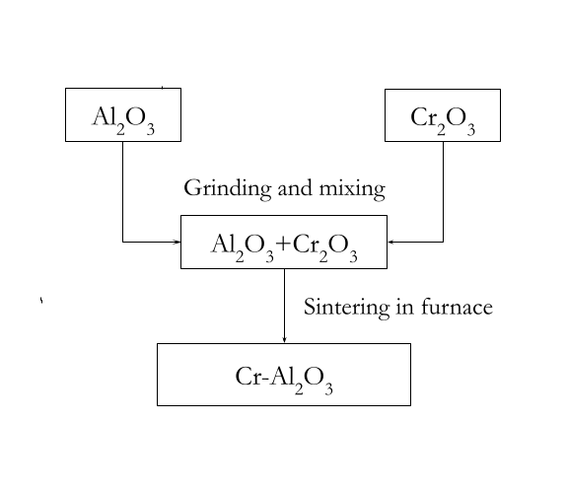
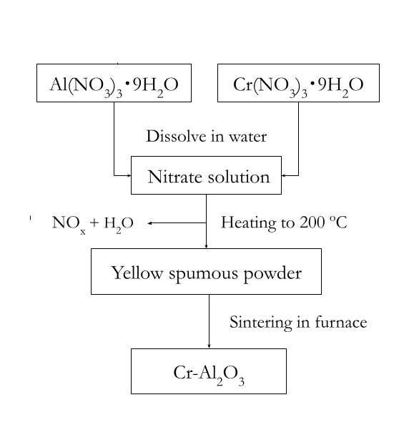
New precursor recipe: Two synthesis routes
Solid-state synthesis
Nitrate decomposition synthesis
Sintering at 1100 ºC and 1550 ºC for 8 hours.

Slide 10
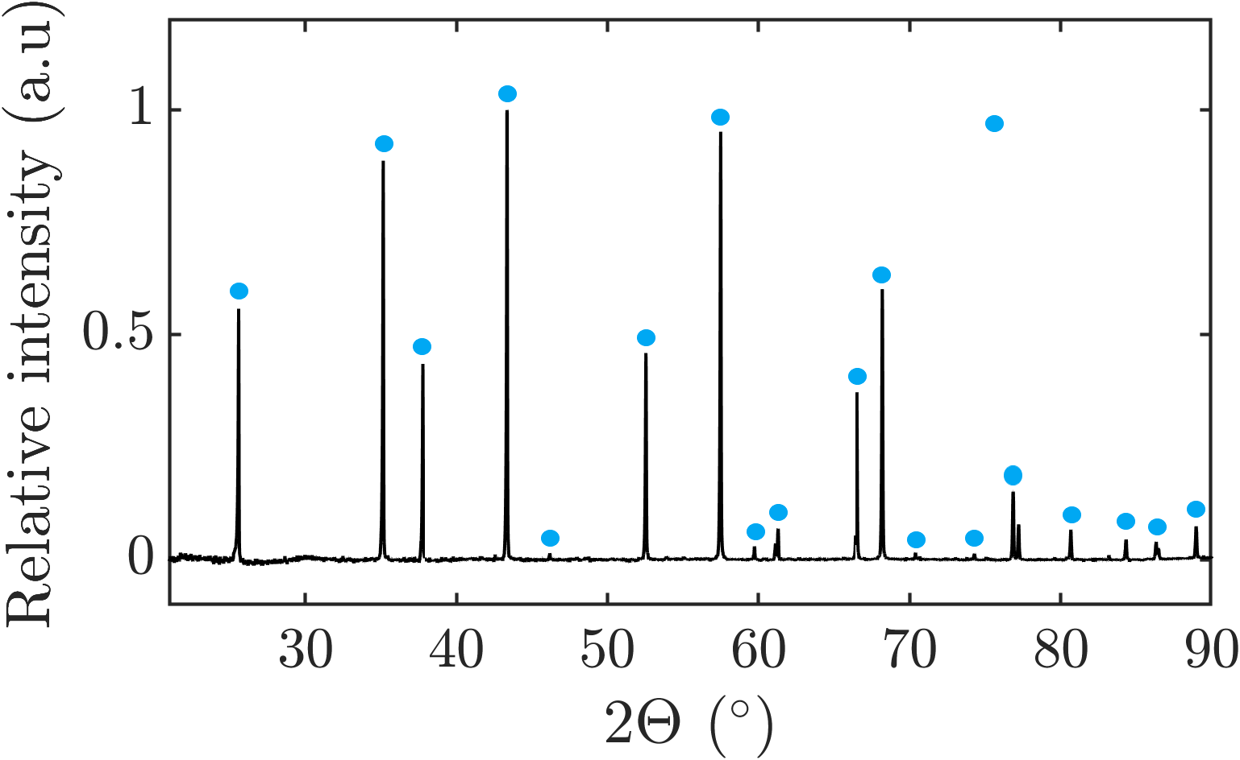
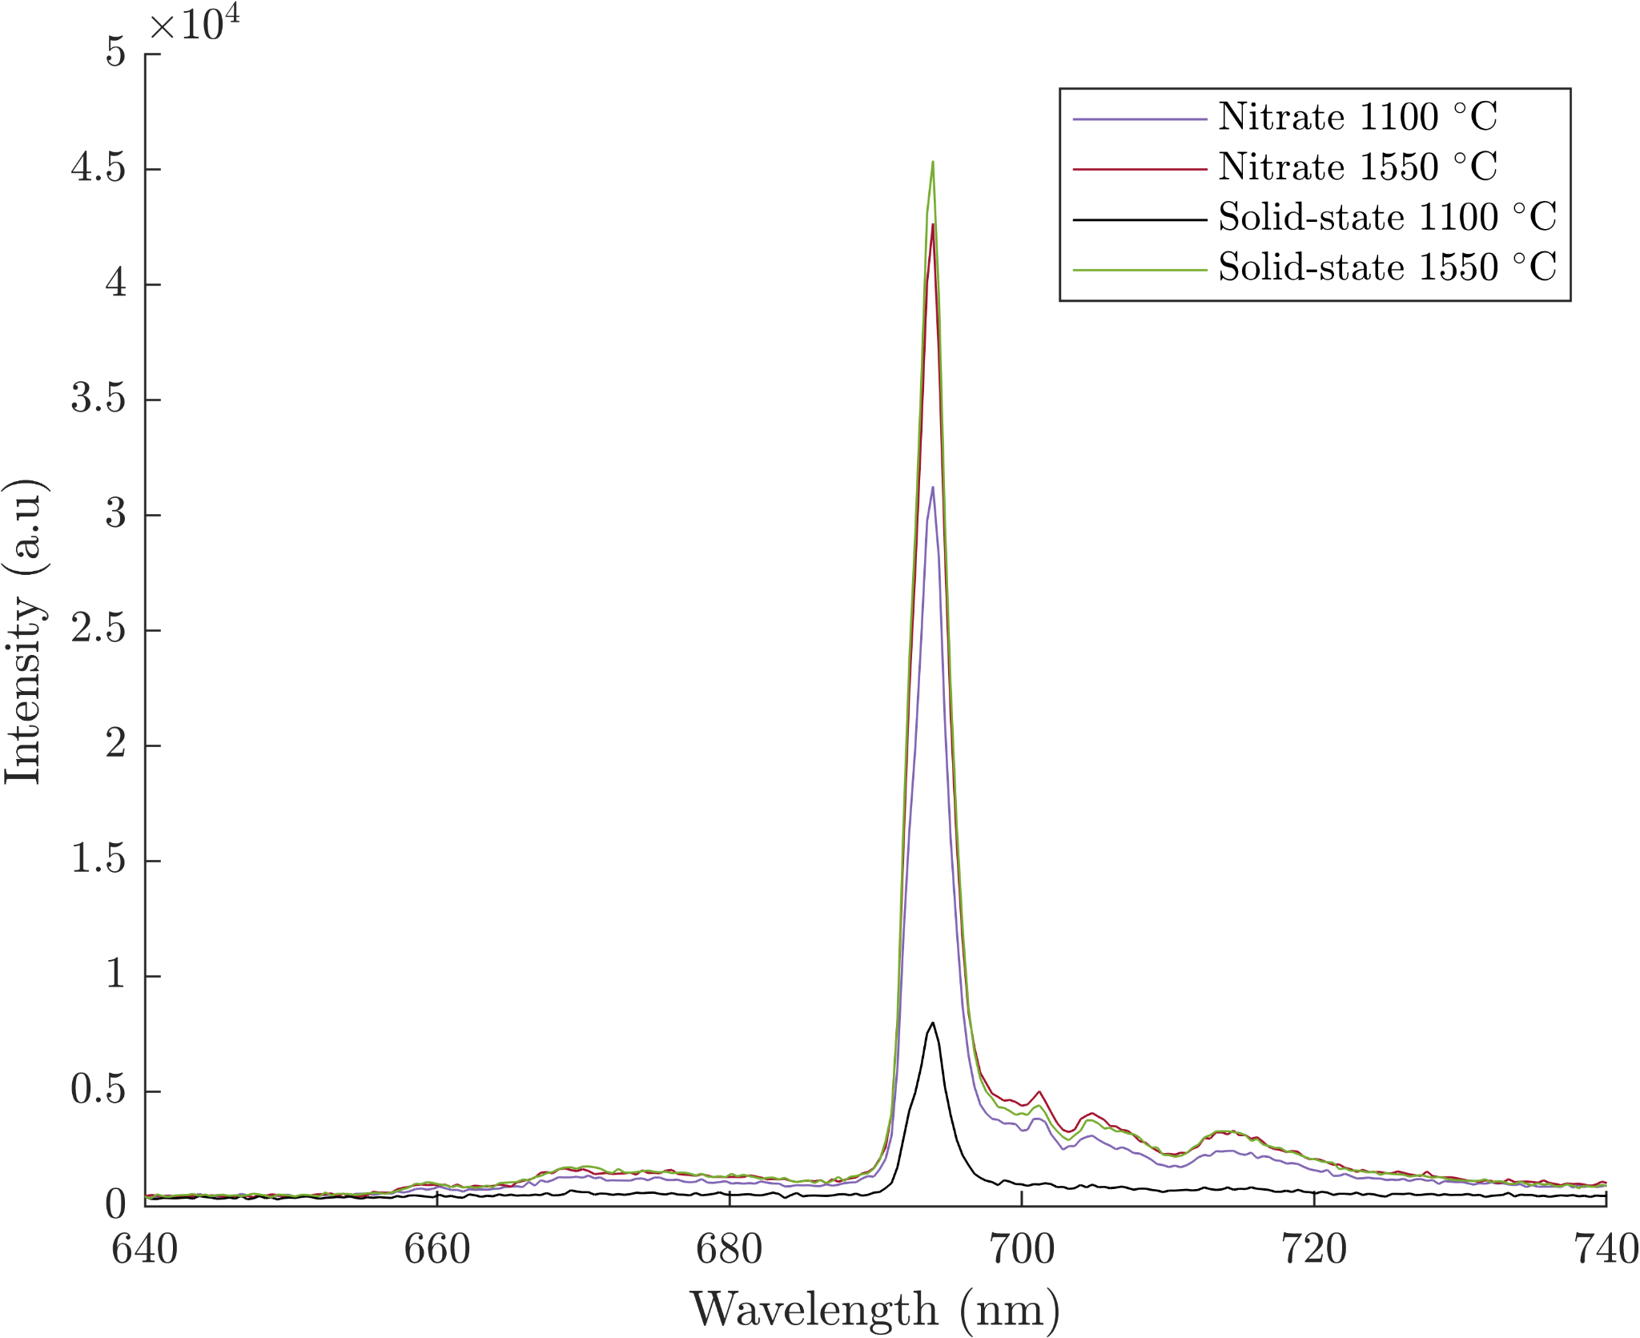
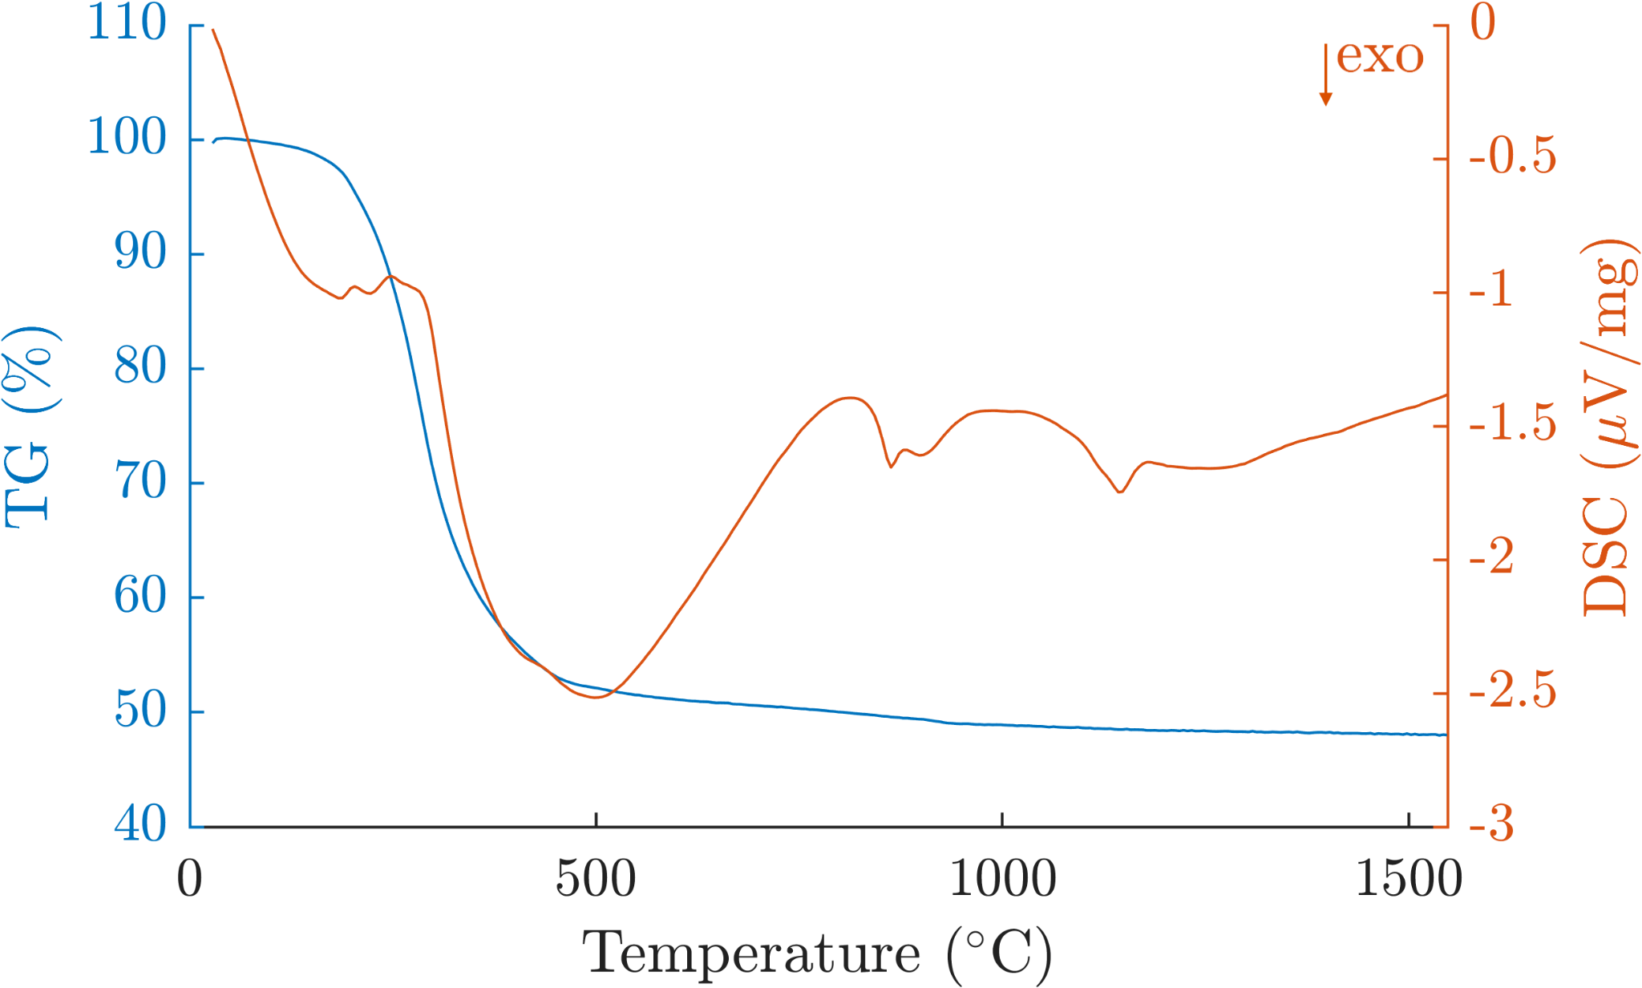
Synthesis of Cr-doped Al₂O₃ powder
XRD
α-Al₂O₃
Photoluminescence emission spectra
DSC/TG
η-Al₂O₃
α-Al₂O₃

Slide 11
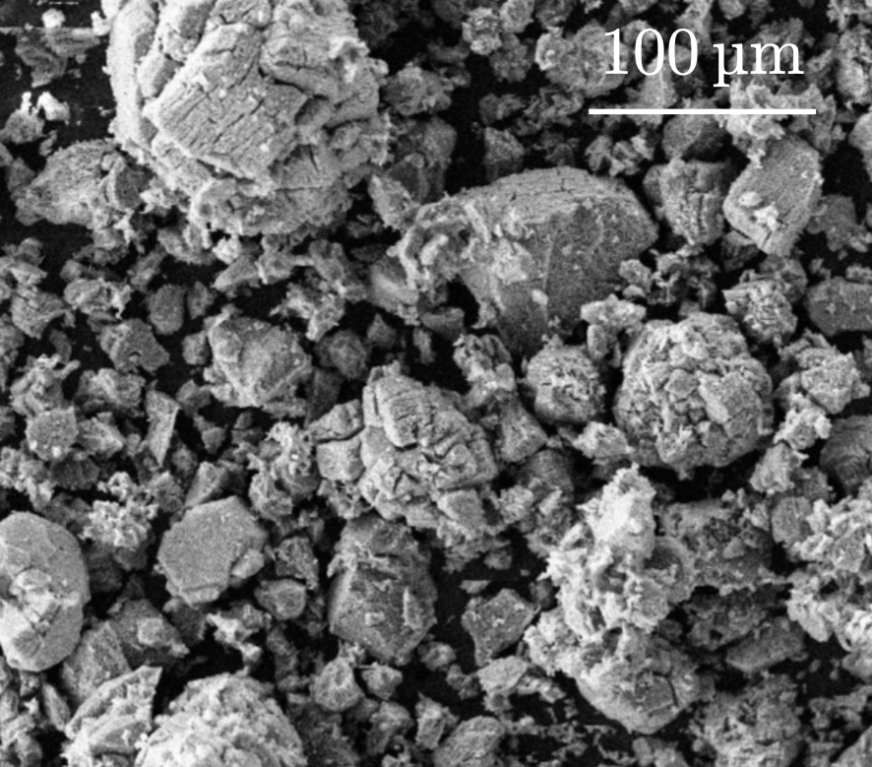
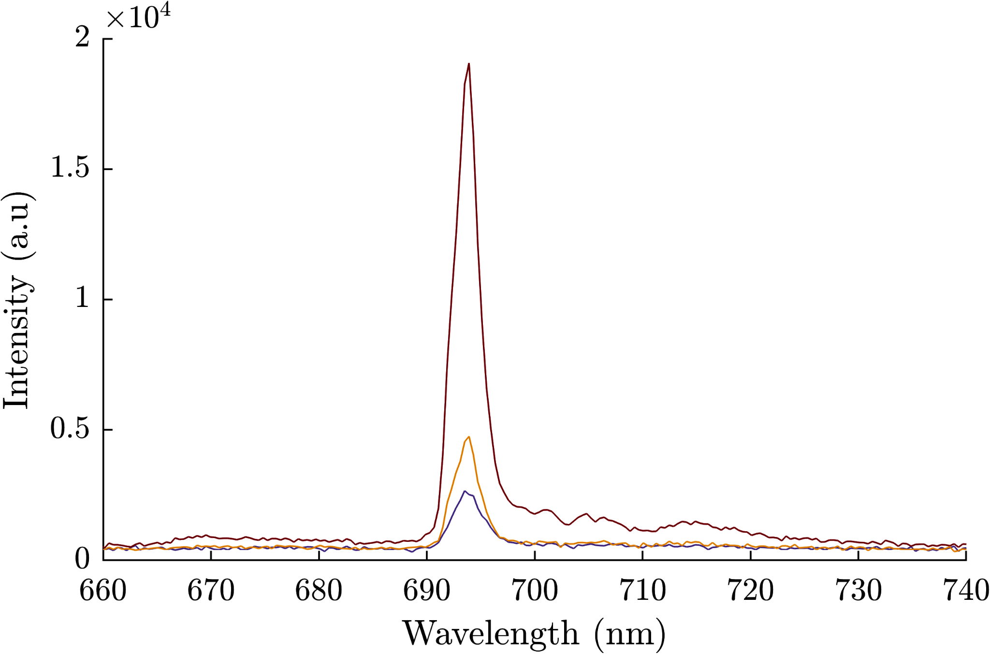
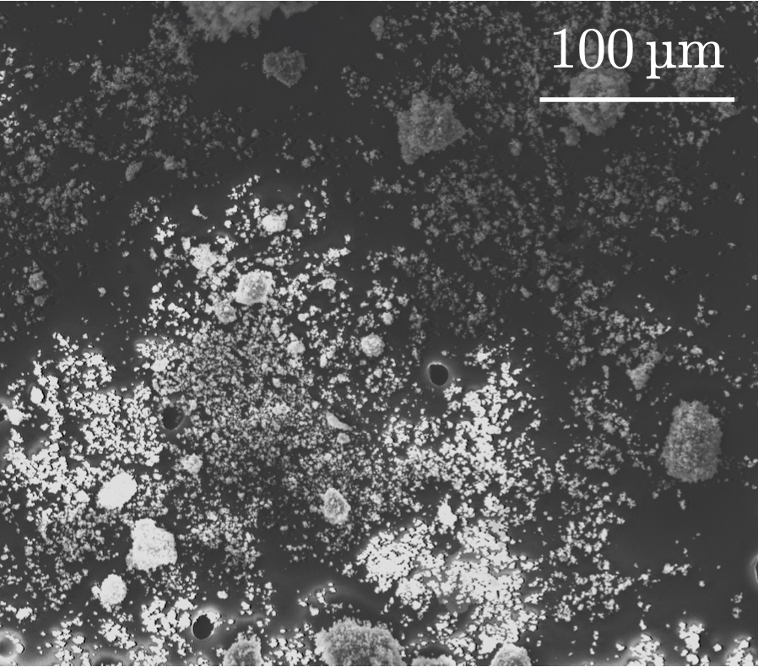
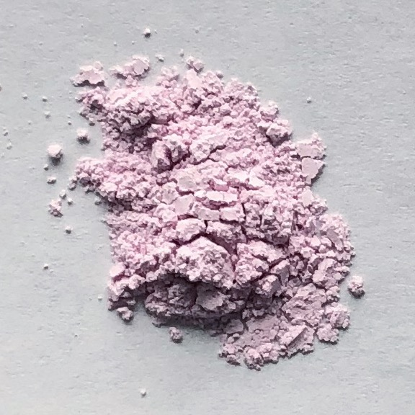
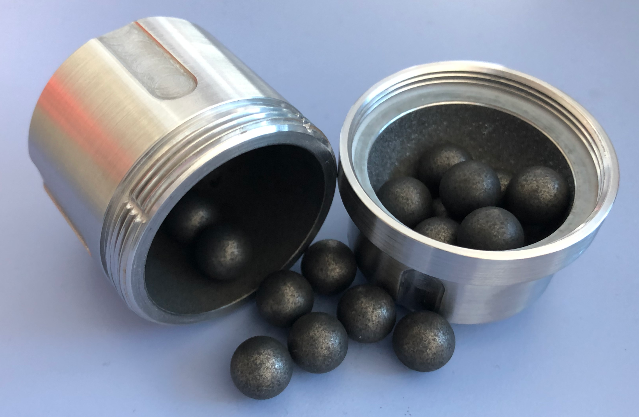
The effect of ball milling on photoluminescence properties
Before ball milling
SEM - showing the size of the particles
Photoluminescence emission spectrum
After ball milling
After ball milling and sintering

Slide 12
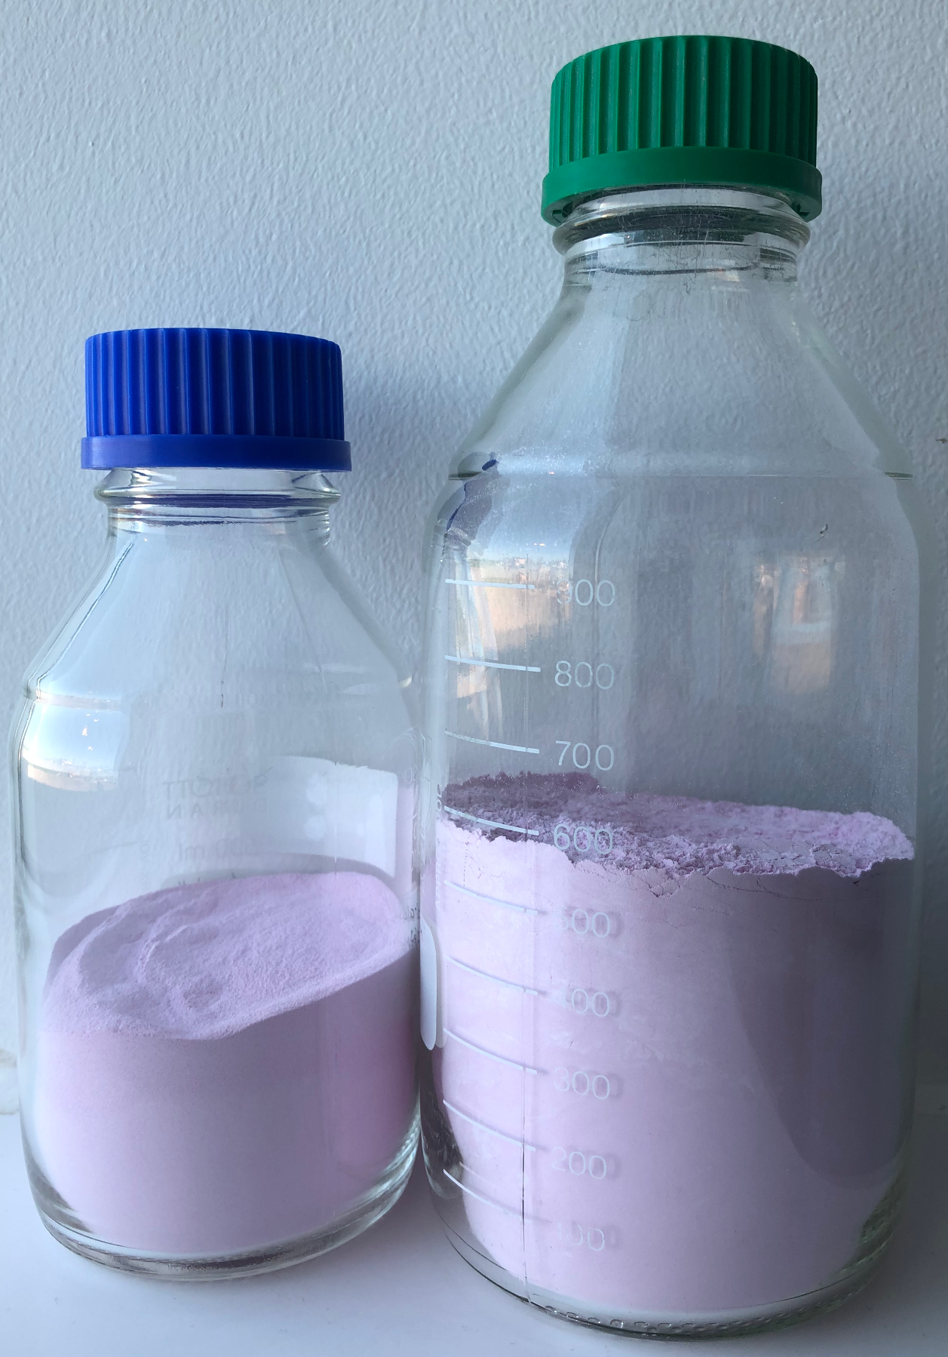
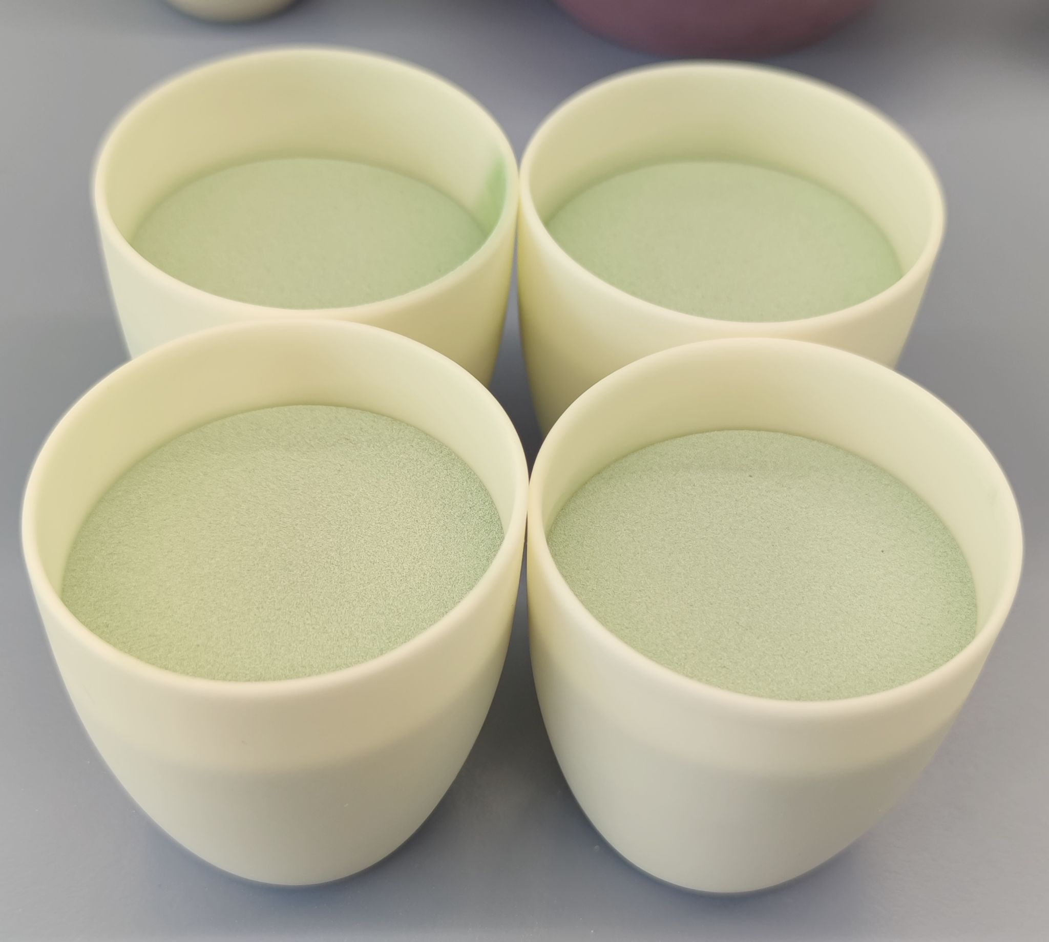
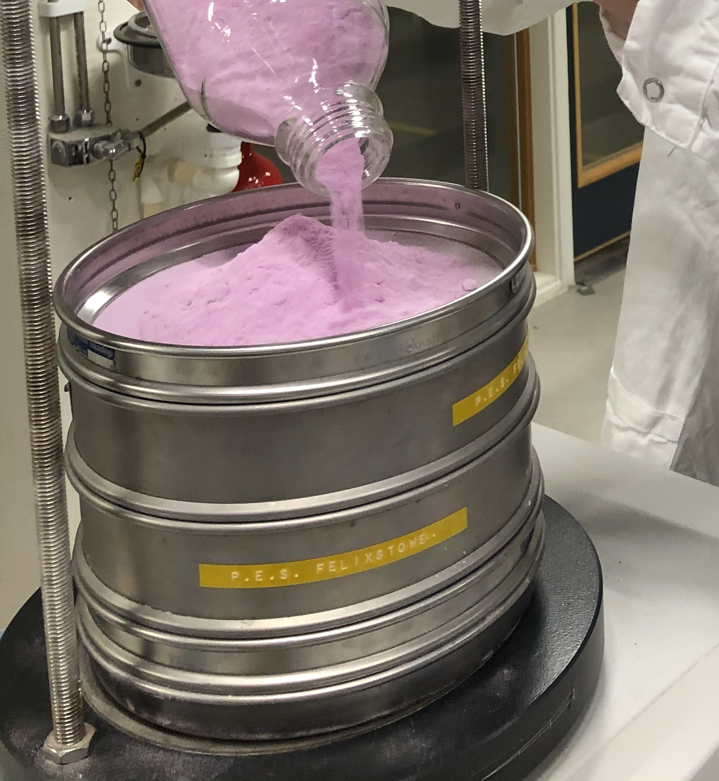
Up-scaling Cr:Al₂O₃ - pilot testing for flame spraying
1 kg
Solid-state method, pre-sintering at 1550 °C for 8 h
Sieving to ensure particle size is below 60 µm
Possible to produce at ESS

Slide 13
Thanks for listen!
Any question?

