Slide 1
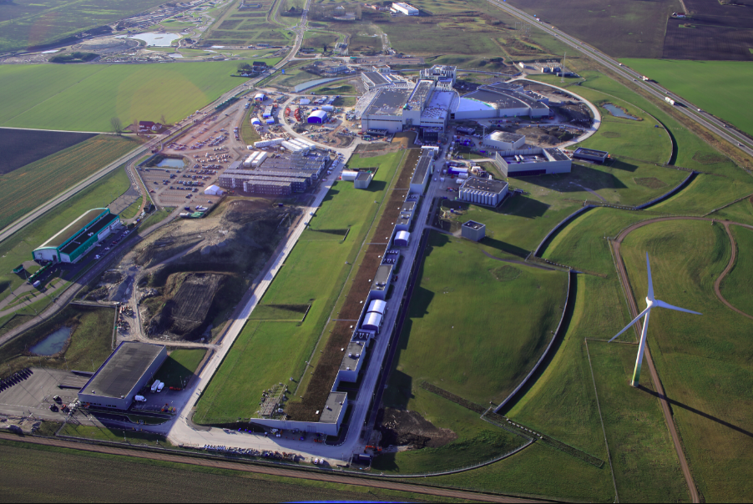
Background Studies of the High-Intensity Baryon Extraction and Measurement (HIBEAM) Experiment at the European Spallation Source
Author: blahoslav rataj
Supervisors: Valentina Santoro and David Silvermyr
Adapted from Nordeng, Perry. “Aerial View over ESS Site.” European Spallation Source, Jan. 2021, europeanspallationsource.se/media-bank.
Notes:
Change title

Slide 2
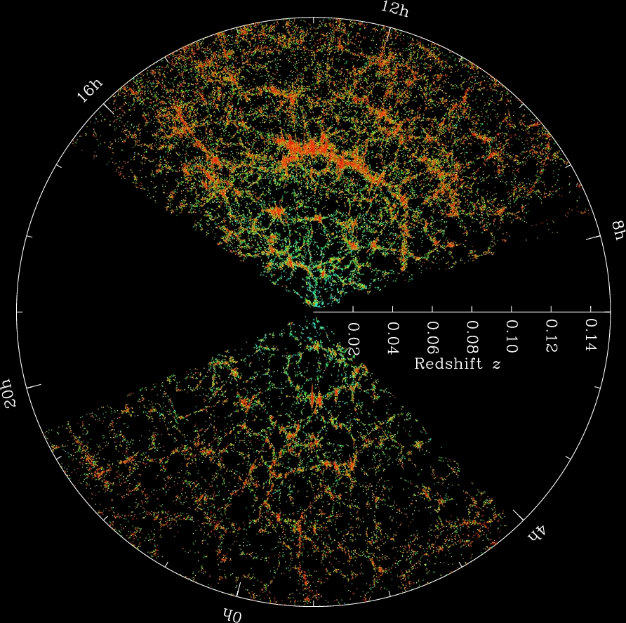
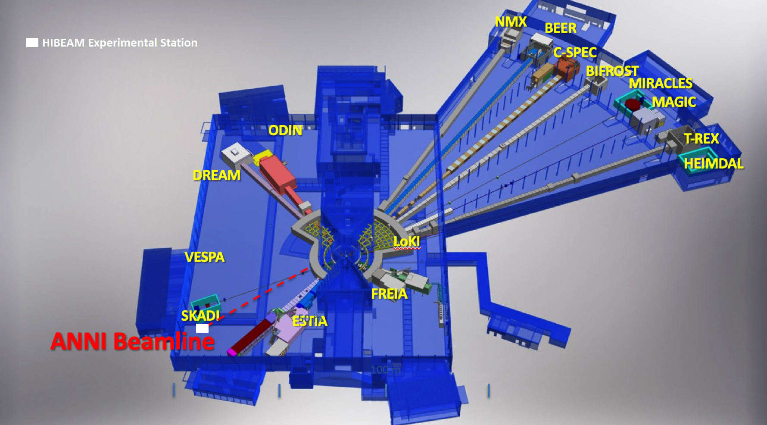
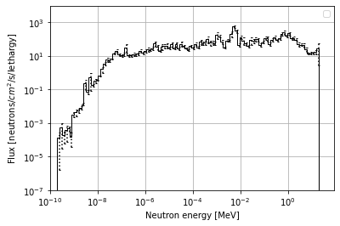
Outline of the master's project presentation
(i) Scientific motivation for n – n' (and n – n̅)
(ii) HIBEAM experiment and ANNI beamline at ESS
(iii) Methodology, ANNI geometric model
(iv) Experimental results to estimate the fast neutron background and effective dose
(v) Discussion of the results and outlook
1

Slide 3
Large fraction of constituents in the Universe not yet understood
Known matter makes only 5% of the content of the Universe
There must be hidden constituents called dark matter
Can only detect extra gravity from an unknown source when observing galaxies
2

Slide 4
Evidence for dark matter that is made of a hidden sector of particles
Large-scale structures of the Universe
Adapted from Blanton, M. “SDSS Galaxy Map.” The Sloan Digital Sky Survey, 2018, www.sdss.org/science/orangepie.
3

Slide 5
Definition of neutron in sterile neutron (n – n') oscillations
n' is sterile neutron
Neutron of dark matter
Sterile to EM, weak and strong forces
Searches for n - n' oscillation at High-Intensity Baryon Extraction and Measurement (HIBEAM)
n provided by the ANNI beamline
n’ can be part of the mirror world of particles -> hypothesised constituents of dark matter
4

Slide 6
Sakharov conditions and baryogenesis
Asymmetry between matter and antimatter was initiated in the early times of the Universe
$$\frac{n_{B} – n_{B}}{s}≈6 x {10}^{−10}$$
n_{B} = number density of baryons
n_{B̅} = number density of antibaryons
s = entropy density
The asymmetry could develop under Sakharov conditions only
Baryon number (B) violation
Charge-parity (CP) violation
Deviation from thermal equilibrium
5

Slide 7
European spallation source (ESS)
Currently under construction
Protons accelerated -> Collision with tungsten target -> Neutrons produced -> Neutrons moderated -> Neutrons enter different beamlines
5 MW average power of accelerated protons
Will produce the highest flux of neutrons that enter the moderator in the World
The beamlines will ultimately deliver neutrons to 22 experiments
6

Slide 8
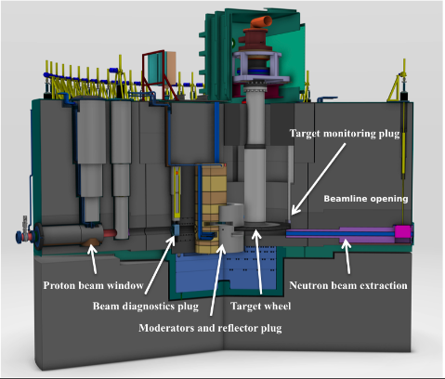
European spallation source (ESS) - target monolith
Adapted from Coney, Linda R. et al. “Development of the target safety system for the ESS target station.” Proceedings of the 21st meeting of the international collaboration on advanced neutron sources. 2015.
7

Slide 9
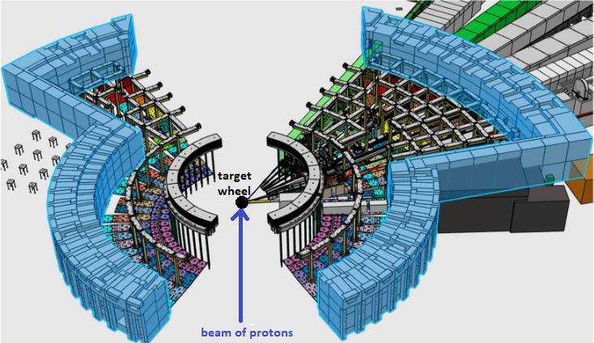
European spallation source (ESS) - bunker
E5 position: ANNI
Adapted from Addazi, Andrea. et al. “New high-sensitivity searches for neutrons converting
into antineutrons and/or sterile neutrons at the European Spallation Source.” arXiv preprint arXiv:2006.04907. 2020.
8

Slide 10
ANNI beamline
ANNI
"A pulsed cold neutron beam facility"
Also called "fundamental physics beamline“
Position E5
Delivers cold neutrons (approximately < 1 eV) from the moderator to HIBEAM
Suppresses fast neutrons
Includes bent sections
Extends from 2 m to 22 m relative to the center of target monolith
9

Slide 11
Position of ANNI and HIBEAM
Adapted from Addazi, Andrea. et al. “New high-sensitivity searches for neutrons converting
into antineutrons and/or sterile neutrons at the European Spallation Source.” arXiv preprint arXiv:2006.04907. 2020.
10

Slide 12
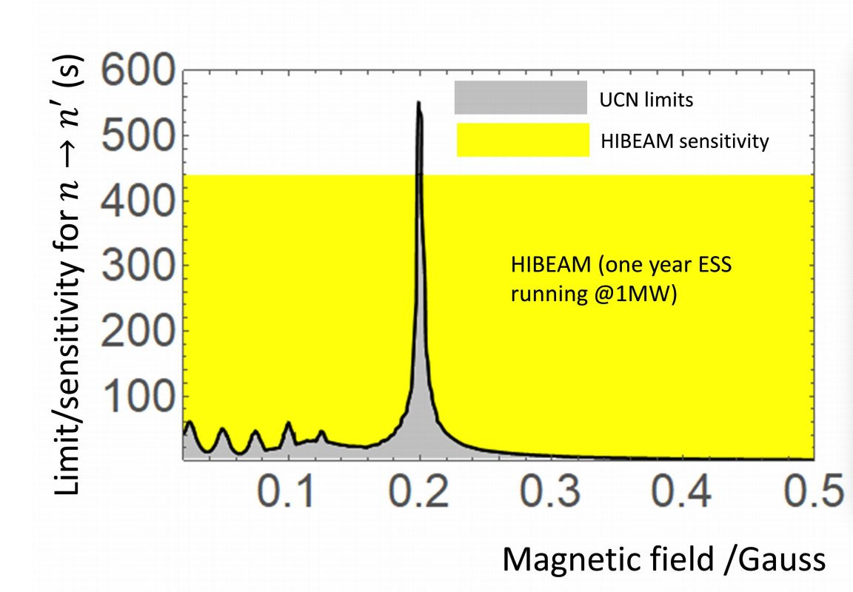
HIBEAM experiment for n – n' oscillation searches
Searches for oscillations of the in-beam neutrons
Regeneration (n -> n’ -> n) and (n -> n’ -> n)
Searches for these modes never done
Improvement in sensitivity for disappearance (n –> n’):
Challenging to observe
Adapted from Addazi, Andrea. et al. “New high-sensitivity searches for neutrons converting
into antineutrons and/or sterile neutrons at the European Spallation Source.” arXiv preprint arXiv:2006.04907. 2020.
11

Slide 13
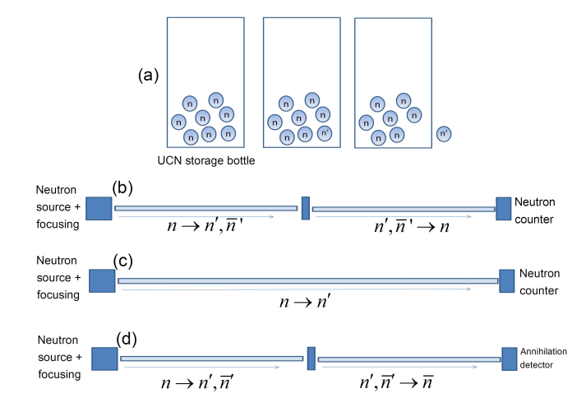
HIBEAM experiment for searches for n – n' oscillations
Regeneration
Absorber
Disappearance
Adapted from Addazi, Andrea. et al. “New high-sensitivity searches for neutrons converting
into antineutrons and/or sterile neutrons at the European Spallation Source.” arXiv preprint arXiv:2006.04907. 2020.
12

Slide 14
Aims of the project
Estimate background of fast neutrons at the end of ANNI
Estimate the magnitude of effective dose outside the bunker and propose shielding for radiological protection
Optimize the thickness of the shielding
Limit: The maximally allowed magnitude of effective dose outside the bunker: 1.5 μSv/h
13

Slide 15
Methodology
Create geometrical model of ANNI in CombLayer (C++)
Run simulations in Particle and Heavy Ion Transport code System (PHITS)
Use the ESS proton source term initially
Measure spectra at 22 m -> the background estimation
Measure dose map outside the bunker for different materials and thicknesses of the shielding
14

Slide 16
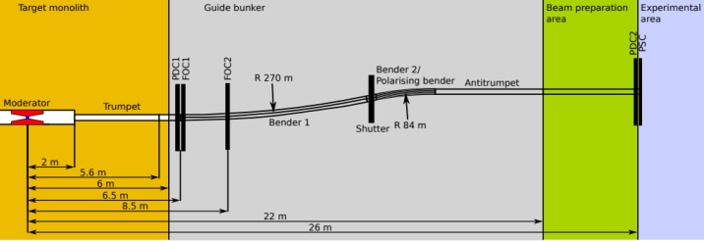
The ANNI geometric model proposal
Adapted from Soldner, Torsten, et al. “ANNI – A Pulsed Cold Neutron Beam Facility for Particle Physics at the ESS.” EPJ Web of Conferences, edited by T. Jenke et al., vol. 219, 2019, p. 10003. Crossref, doi:10.1051/epjconf/201921910003.
15

Slide 17
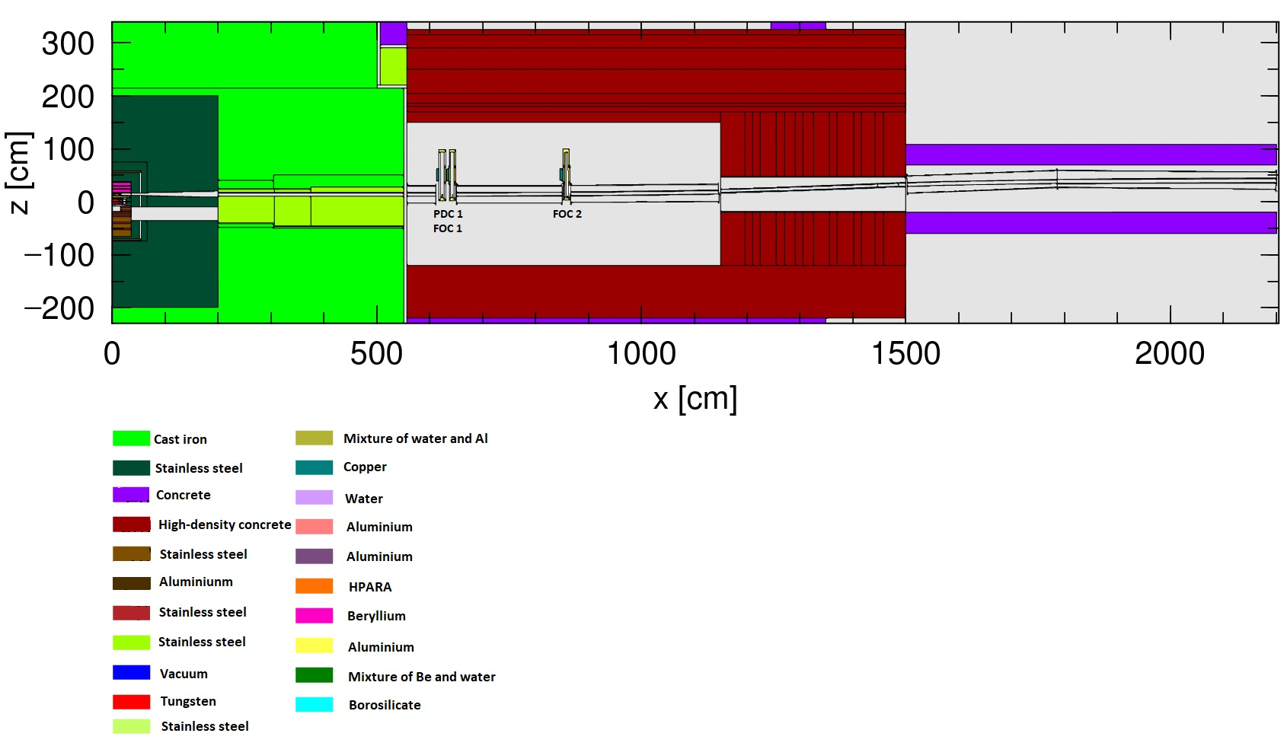
Side view of the ANNI beamline geometry produced in CombLayer
16

Slide 18
Variance reduction with fictive neutron sources
Proton source term
Magnitude of error on readings large
Time to simulate events large
Possible solution: use neutron fictive source term defined at the ANNI beamline opening
Provided: ESS test beamline source term (normalization factor = 7.97E+12)
Created: The ANNI beamline source term
17

Slide 19
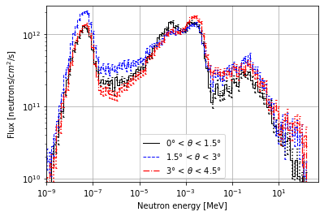
Energy distribution of the ANNI beamline neutron source term
18

Slide 20
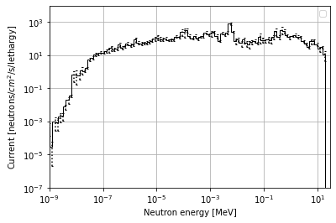
Spectra at 22 m produced with the ficticious source terms
(i) Test beamline source term
(ii) ANNI beamline source term
19

Slide 21
Dose map produced with the ESS test beamline source term (PRELIMINARY)
70 cm thick shielding made of HD concrete
(i) Top view of the ANNI beamline
(ii) Side view of the ANNI beamline
20

Slide 22
Discussion
The physics of reflective mirrors not included
Reducion of cold neutrons in the neutron guide of the beamline
The suppression of fast neutrons in the neutron guide of the beamline
Bent sections
Bent sections -> fast neutrons are not reduced as much as expected
Shileding -> 70 cm thick shielding made of HD concrete seems not to be effective enough
May help to use 2 layers: Steel and Concrete
21
Notes:
(work is going to understand if there is some problém in the calculations or it is a real effect in this case discussion with ANNI people will be done )

Slide 23
Outlook
Further studies of the cold neutrons propagating in ANNI with McStas
Test how the background of fast neutrons affects HIBEAM sensitivity
Further discuss the design of ANNI for the future ANNI proposal
22

Slide 24
Summary of the master's project presentation
(i) Scientific motivation for n – n' (and n – n̅)
(ii) HIBEAM experiment and ANNI beamline at ESS
(iii) Methodology, ANNI geometric model
(iv) Experimental results to estimate the fast neutron background and effective dose
(v) Discussion of the results and outlook
23

