Slide 1

High entropy alloys – magnetism and neutron diffraction
Johan Cedervall
johan.cedervall@mmk.su.se

Slide 2



Those who did the work
Simon R. Larsen
Dennis Karlsson

Slide 3
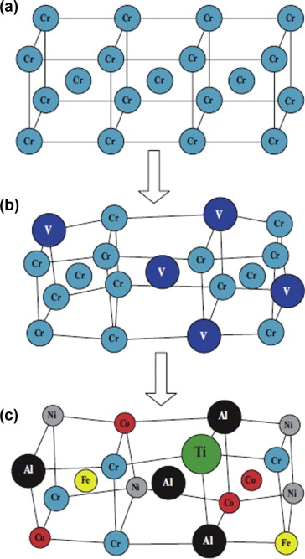


High entropy alloys
HEAs known for simple structure
Solid solution – i.e. randomly dispersed atoms
Often include a large amount of magnetic elements
Entropy stabilized
Can tune lattice type with Valence Electron Concentration (VEC)
D.B. Miracle, O.N. Senkov, Acta Materialia 122 (2017) 448-511.
P. Koželj et al., Physical Review Letters 113 (2014) 107001.

Slide 4
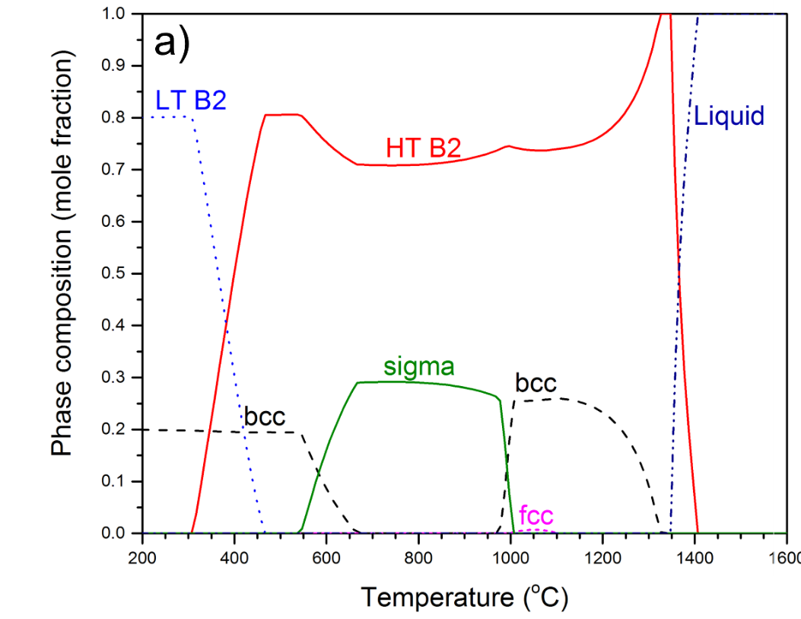
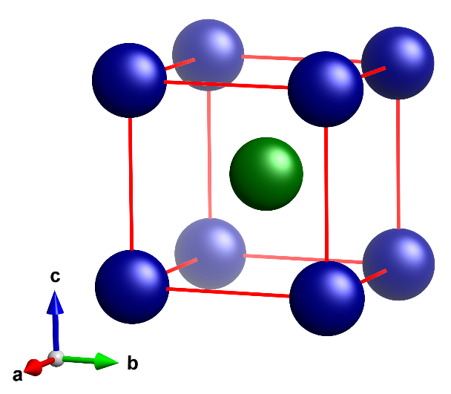
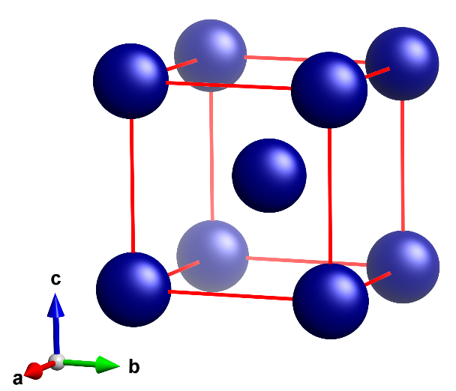
AlCoCrFeNi
High entropy alloy?
  Dependent on synthesis conditions
    Gas atomisation
    Arc melting
  B2/bcc structures
Narrow single phase regions
  Spinodal decomposition
Additions of Mn changes the magnetic behaviour
D. Karlsson et al., Additive Manufacturing 27 (2019) 72–79.

Slide 5
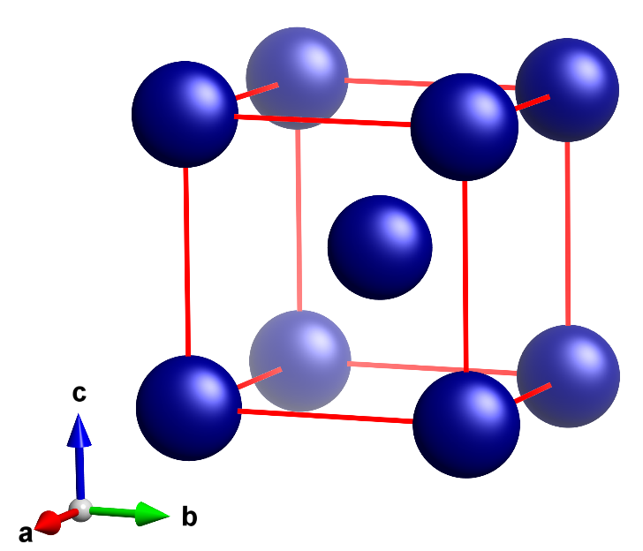
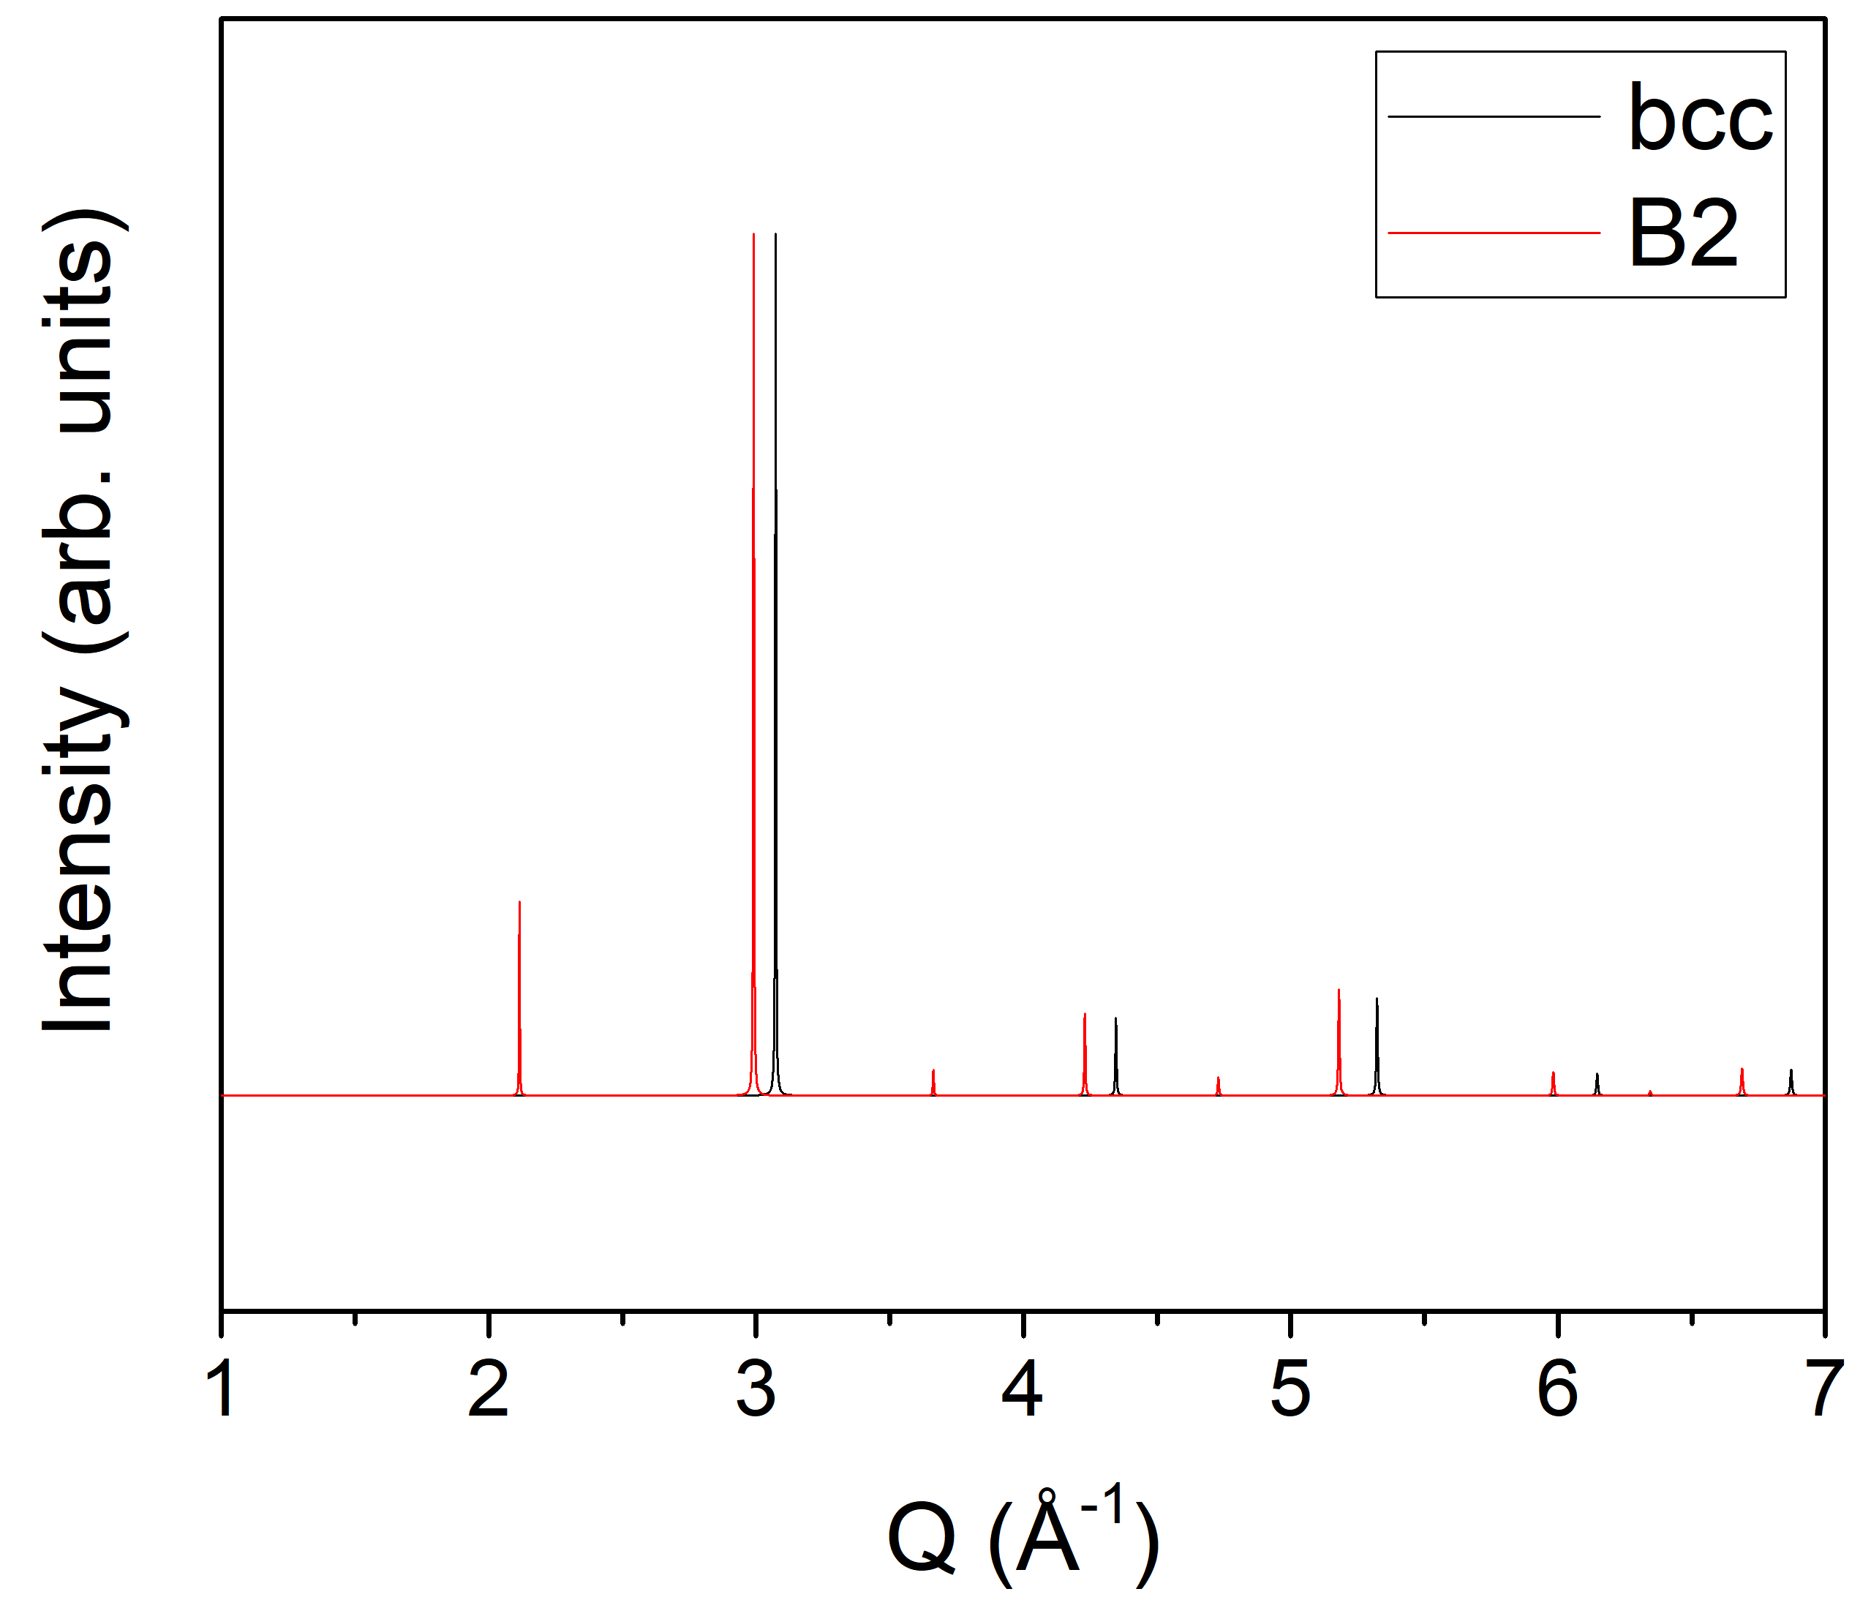

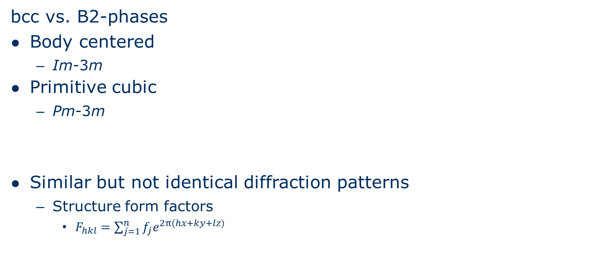
AlCoCrFeNi
bcc vs. B2-phases
Body centered
  Im-3m
Primitive cubic
  Pm-3m
Similar but not identical diffraction patterns
  Structure form factors
    $F_{hkl}=\sum_{j=1}^{n}{f_{j}e^{2π(hx+ky+lz)}}$

Slide 6
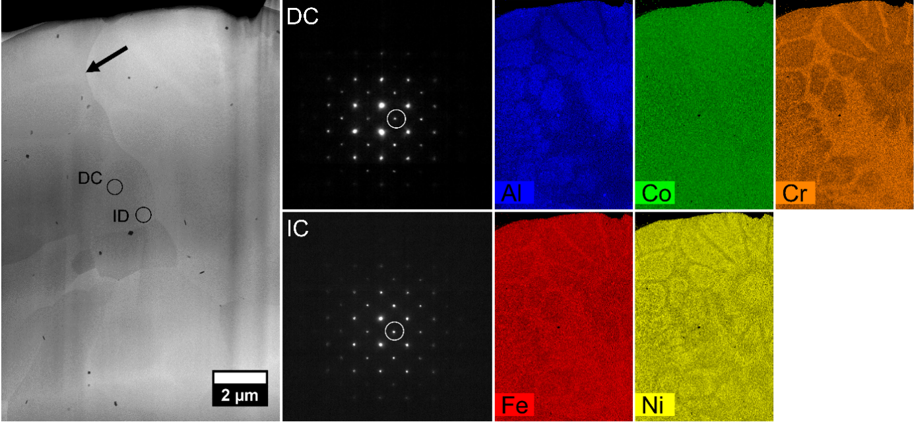
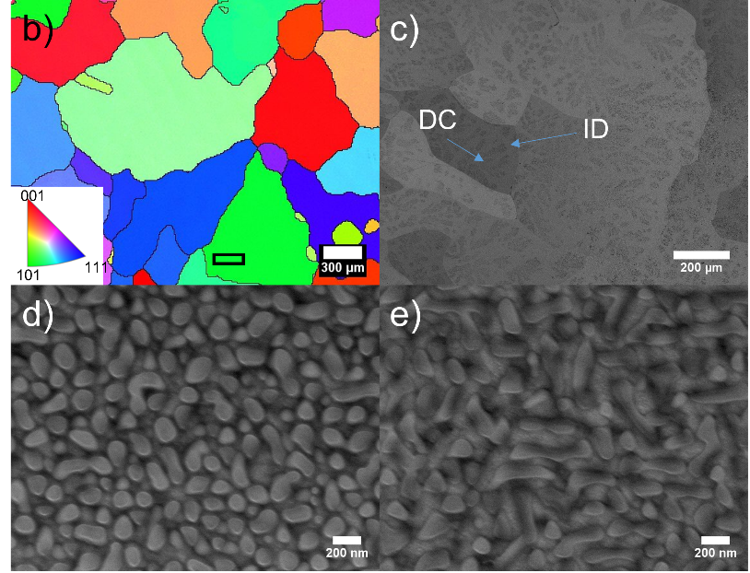
AlCoCrFeNi
Gas atomisation
2 regions with different composition
  Dendritic core (DC)
  Interdendritic (ID)
Both displays the forbidden 100 reflection → B2 structure
Induction melting
Two separate phases
  bcc
  B2
D. Karlsson et al., Journal of Alloys and Compounds 784 (2019) 195-203

Slide 7
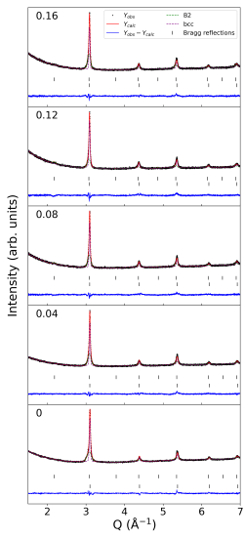
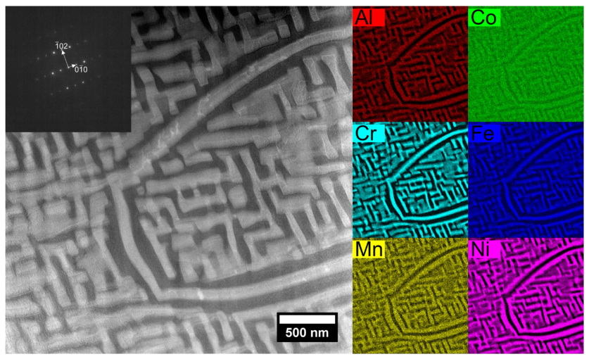
AlCoCrFeMn_{x}Ni
Mn additions with changes the bcc/B2 phase mixture
Microstructure is similar to AlCoCrFeNi synthesised with induction melting

Slide 8
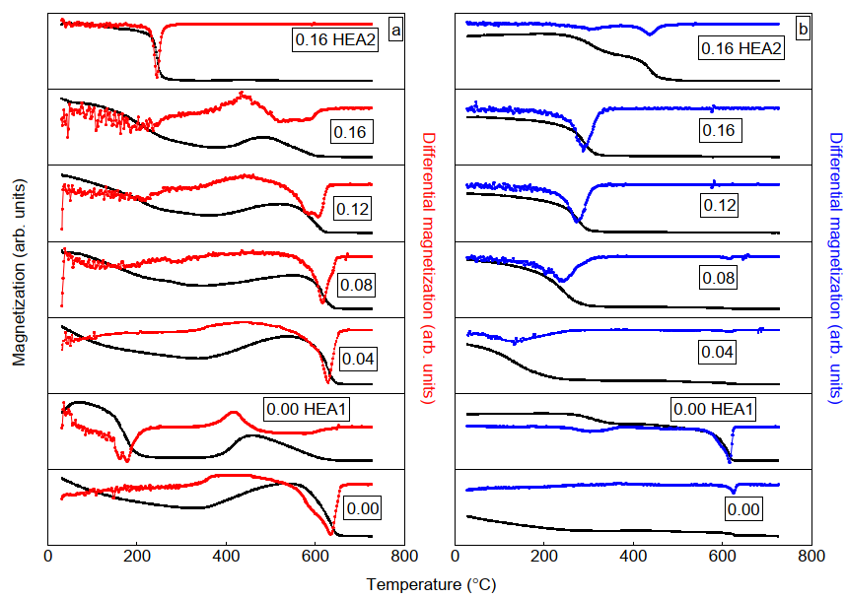
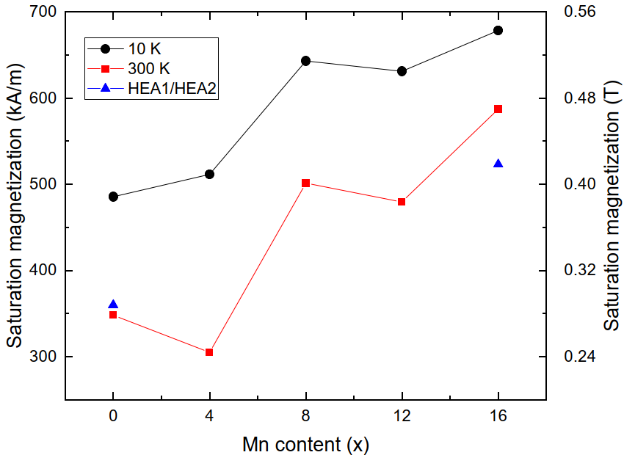
AlCoCrFeMn_{x}Ni
Magnetic transition temperature decreases with additions of Mn
The saturated magnetic moment increases with increasing Mn-content
Small difference in magnetic saturation for the gas atomised samples
Big difference in thermal magnetic behaviour

Slide 9
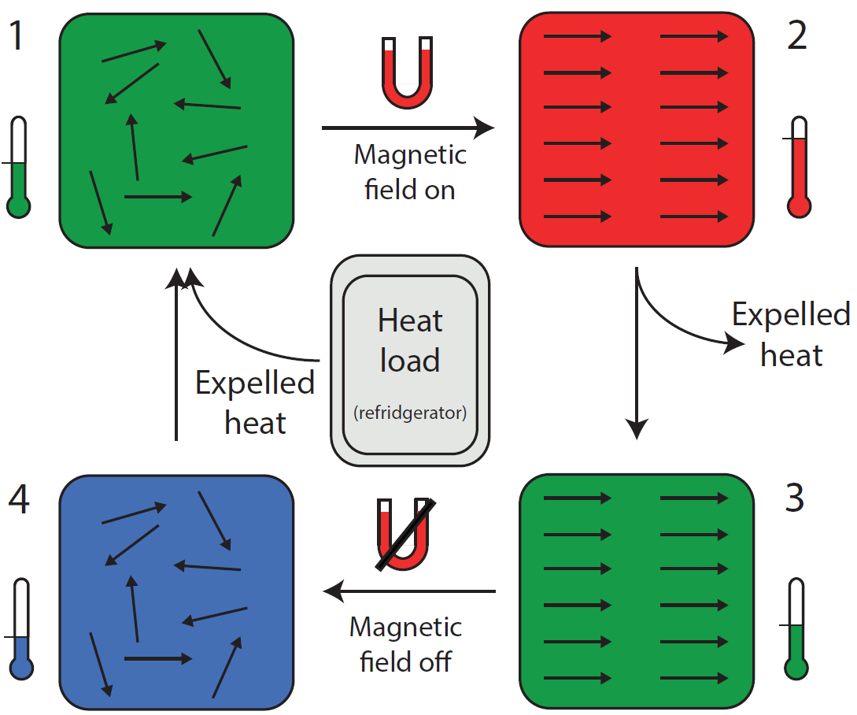
AlCoCrFeMn_{x}Ni
Applications in magnetic refrigeration?
  Magnetic transition at RT
  Large response to a small magnetic field
  Big change in magnetic entropy upon magnetisation

Slide 10
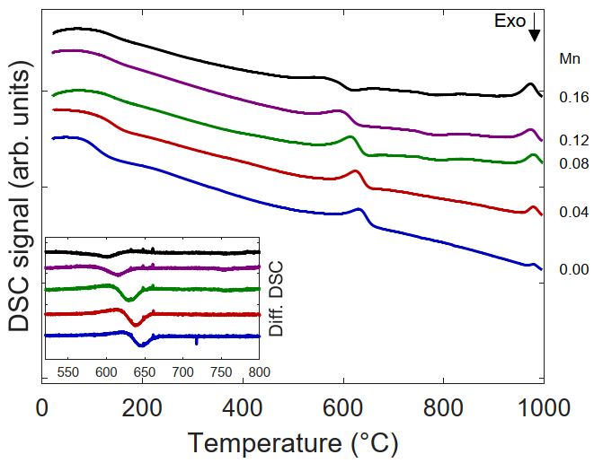
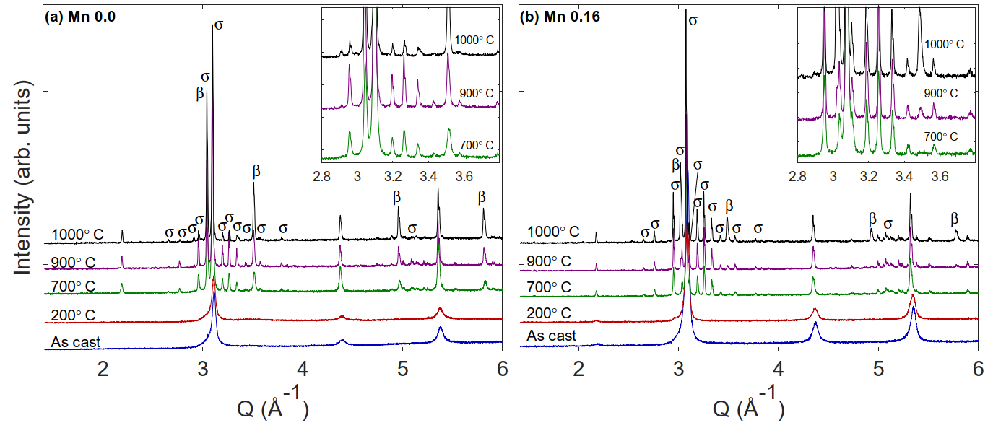
AlCoCrFeMn_{x}Ni
Differential scanning calorimetry
Phase transition temperature decreases with Mn-content
  Similar to magnetometry
Phase decomposition to σ- and fcc phases upon heating

Slide 11
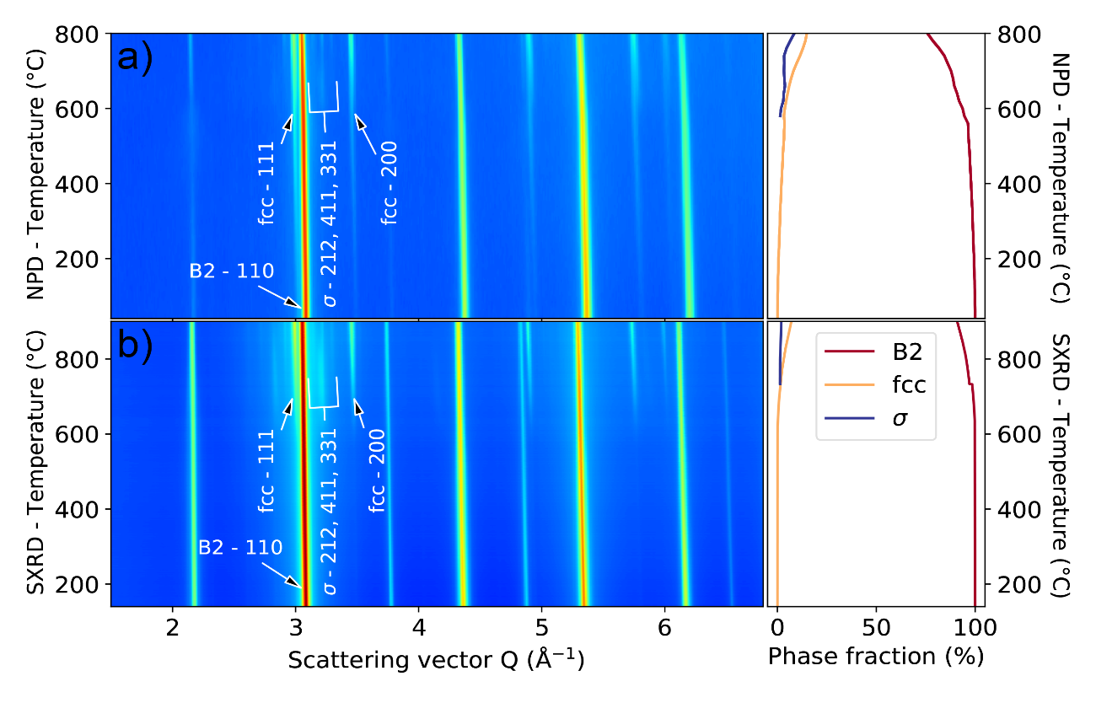
AlCoCrFeNi - In-situ diffraction
Atomised powder
B2 → σ + fcc
Heating rates
  NPD: 1 h measuring time for each temperature
  SXRD: 10 K/min

Slide 12
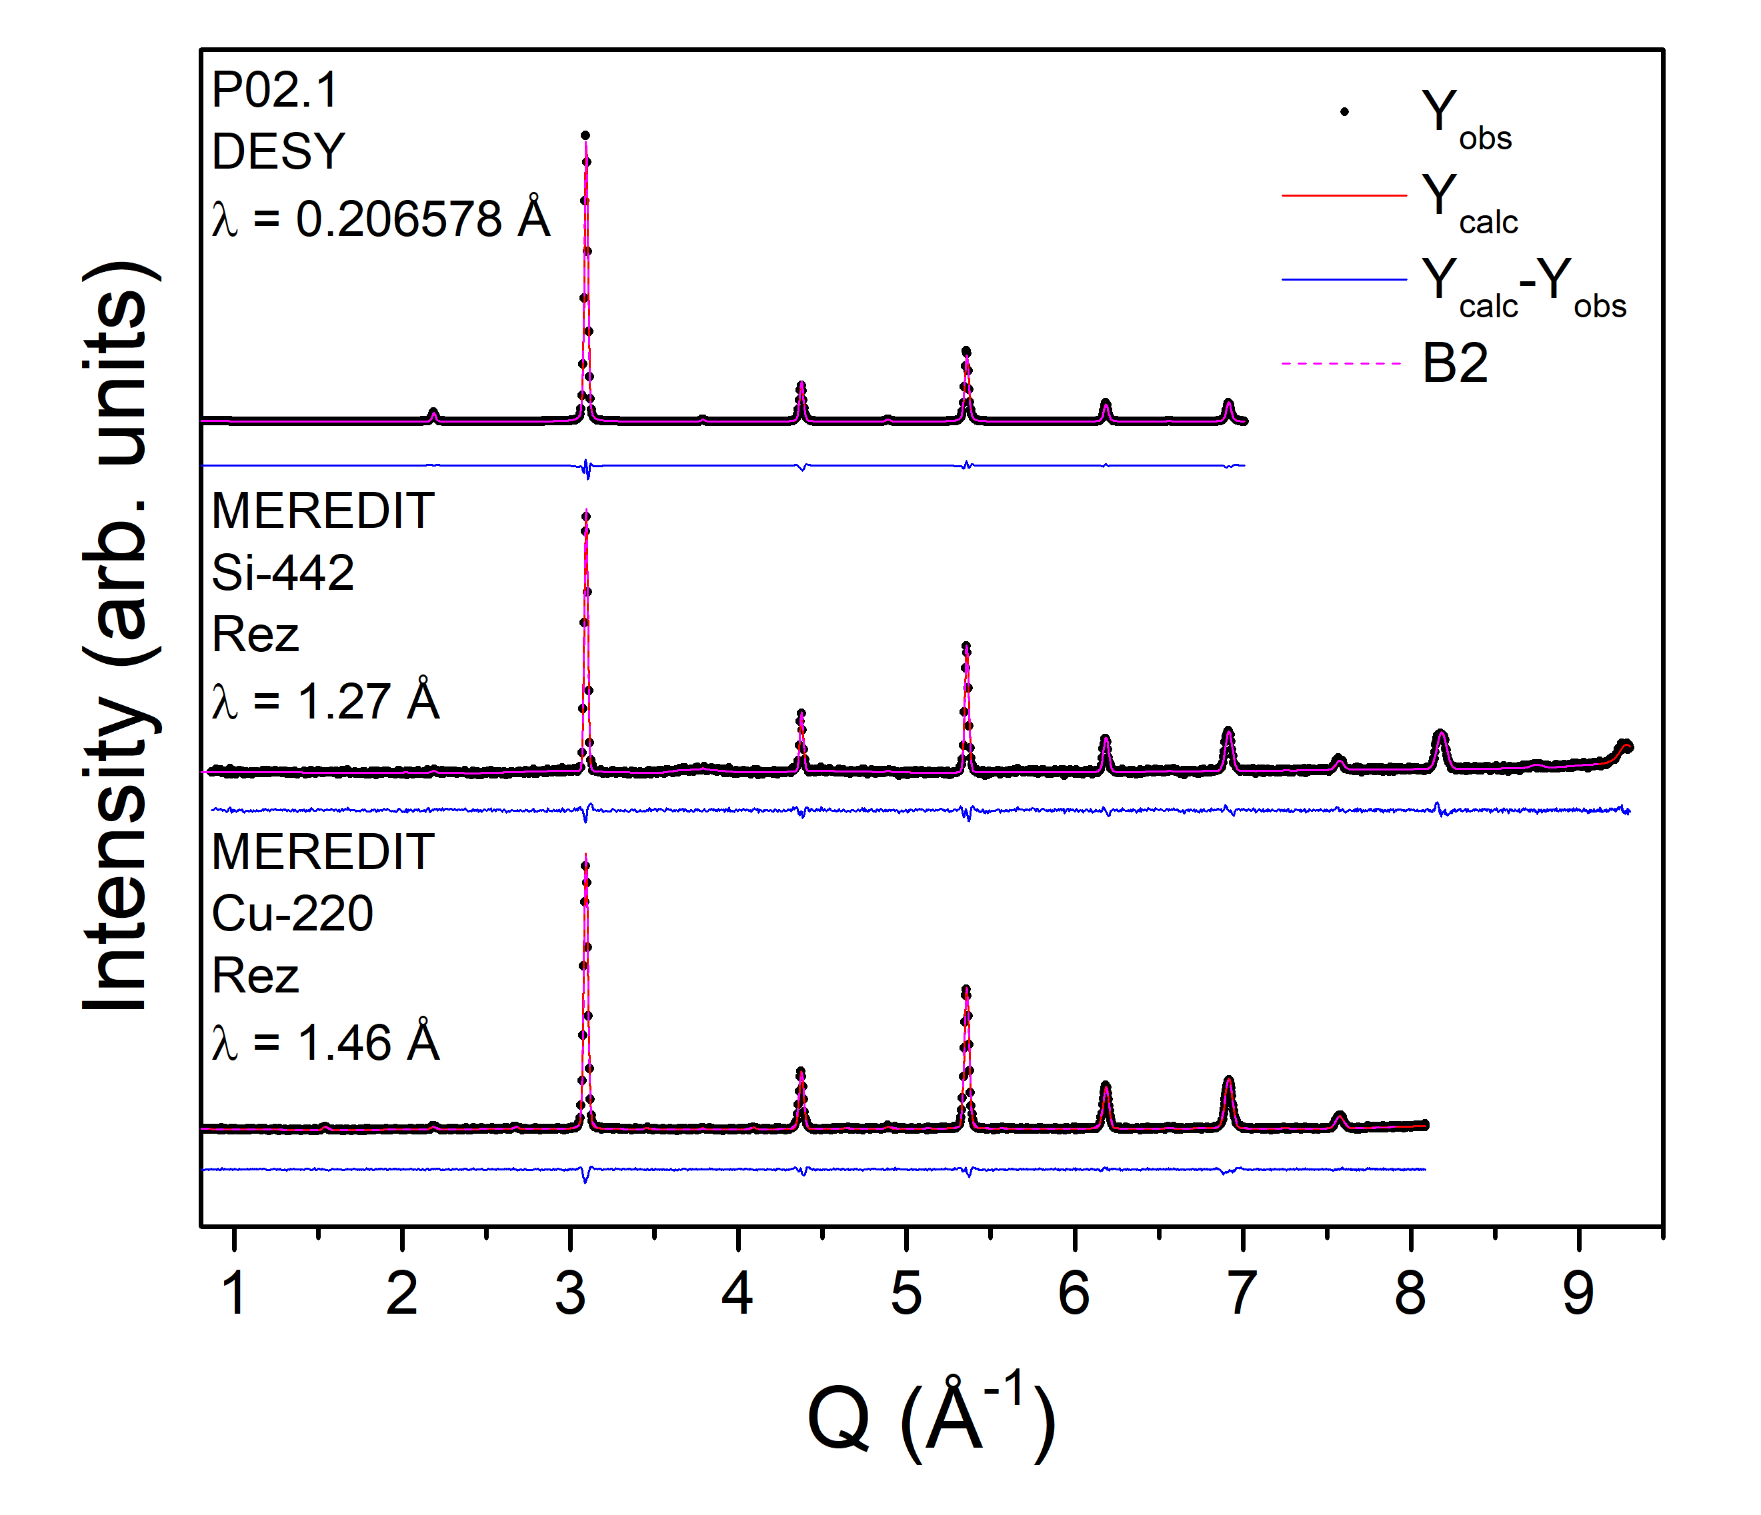
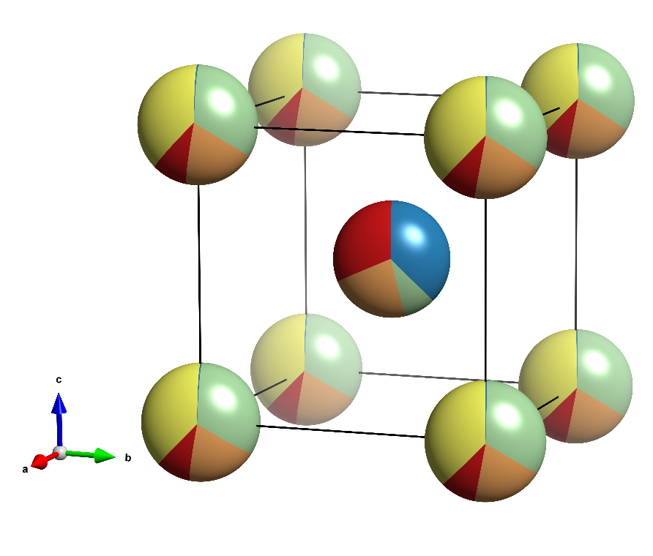
AlCoCrFeNi – atomic occupancies
Joint refinements of XRD and NPD patterns
Pure B2 phase
Different site
occupancies

Slide 13


Conclusions
High entropy alloys are not the best way to describe AlCoCrFeMn_{x}Ni given the small single phase region
B2 and bcc competing phases when syntesised from melt
  Cooling rate dependant
Soft magnetic, with increasing M_{sat} with increasing Mn-content
Irreversible magnetic thermal effects due to decomposition of the alloys
Specific elemental site occupation in the B2 structure
D. Karlsson et al., Additive Manufacturing 27 (2019) 72–79.

Slide 14






Acknowledgements
Simon R. Larsen
Dennis Karlsson
Daniel Hedlund
Henry Stopfel
Peter Svedlindh
Lars Riekehr
Ulf Jansson
Peter Harlin
Christian K. Christensen
Jo-Chi Tseng
Premysl Beran
Thomas Hansen

