Slide 1
SKADI
Current Status
STAP-Meeting 20.04.2021
April 2021 | Sebastian Jaksch, Alexis Chennevière, Romuald Hanslik, Stefphan Butterweck, Ralf Engels, Uwe Clemens, Sylvain Désert, Pascal Lavie, Teddy Kozielewski, Henrich Frielinghaus et al.

Slide 2
Progress Overview
Sample cave
  Change request for partially non-magnetic cave approved
  Cave design well progressed
  PDR for cave design complete
  Interface with ESTIA will be clarified: Supervised+Inaccessible zone
  Design and construction on track for 2023
Detector interfaces between detector housing and tube ongoing
  No neutrons for testing ☹
  Interfacing with DMSC+Detector group still challening, but working on it
In-Bunker installation
  Kickoff with SNAG has taken place
  SNAG full until summer, but the installation is simple, a lot of similar parts can be taken from other projects
  Full start in summer
  Construction starting Jan 2022
  Installation ready until mid 2022 for first bunker opening window

Slide 3
Progress Overview continued
Chopper kick-off meeting has taken place
  IDR for choppers immanent
Answers to call for tender for collimation and detector tube received.
  Going through the quotes now: Four quotes received
Common collimation wall with ESTIA is progressing
Detector shielding CDR is finalized now, waiting for publication
Collimation shielding will probably go along with detector shielding

Slide 4
ESS Instrument suite
Small-K Advanced Diffractometer (SKADI) -
Small-angle neutron scattering (SANS) instrument
ZEA-1 | Technology for Excellent Science

Slide 5
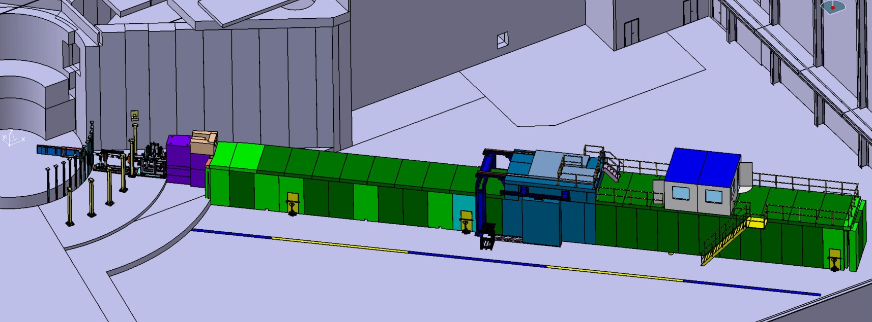
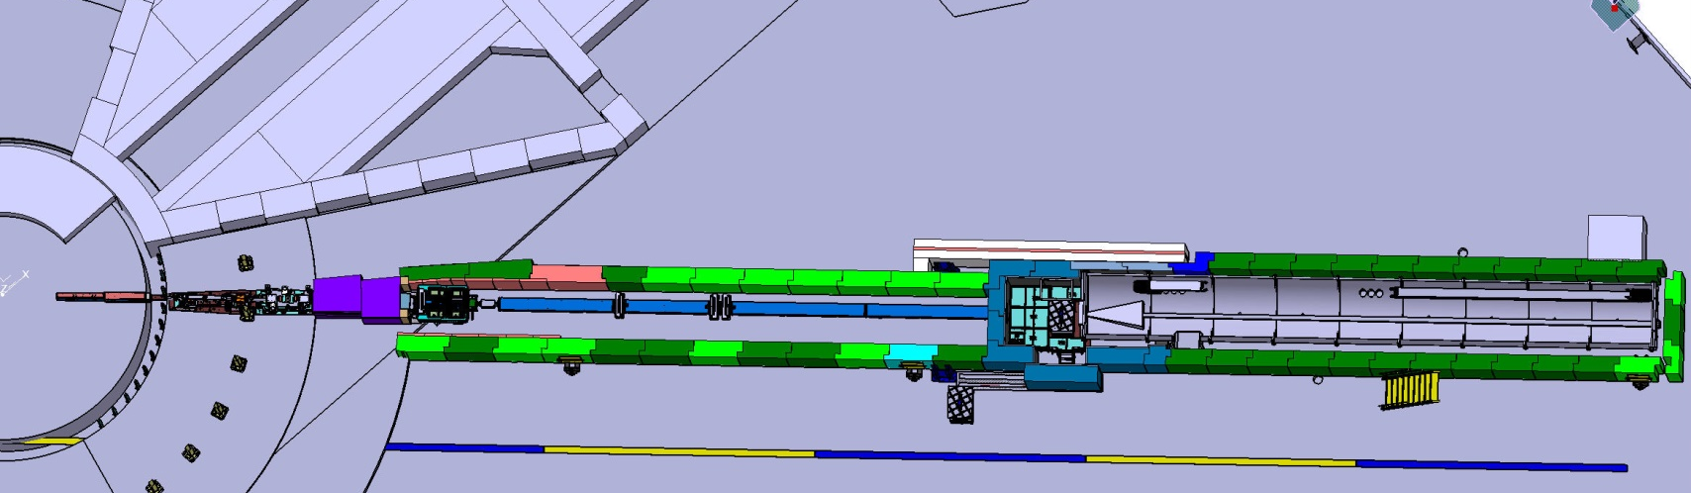
SKADI layout (short reminder)
SKADI Complete with the shielding - E3-Port

Slide 6
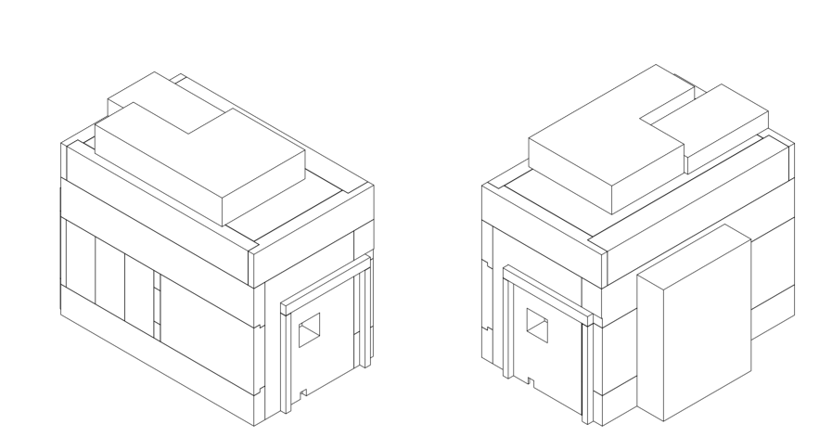
Sample Cave
Design progressing well
Floor loading is a potential issue: ESS takes over additional costs – Coordination with ESTIA to achieve common loadspreading

Slide 7
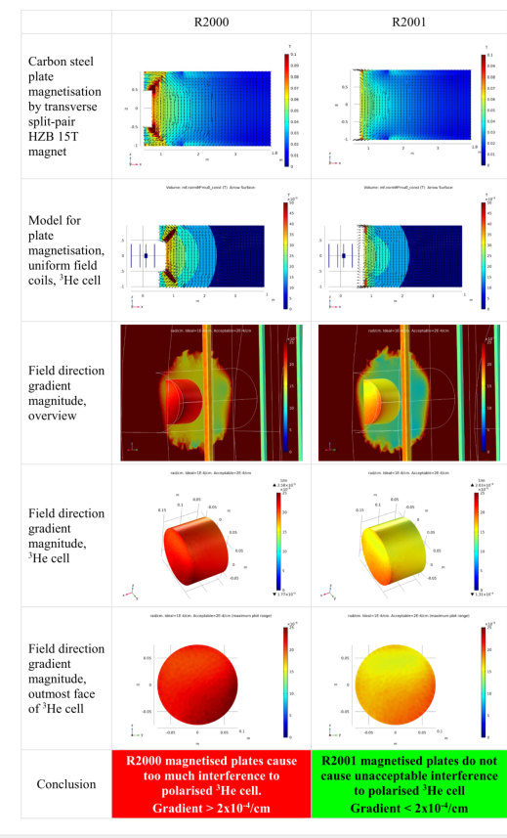
Sample Cave continued
MCA components will meet ESS standards, discussions with PSS/safety ongoing
Compartmentalization of walls reflects non-magnetic and carbon steel areas as a cost saving excercise: Simulations now show the systems is capable of handling 15 T non-directional magnets

Slide 8
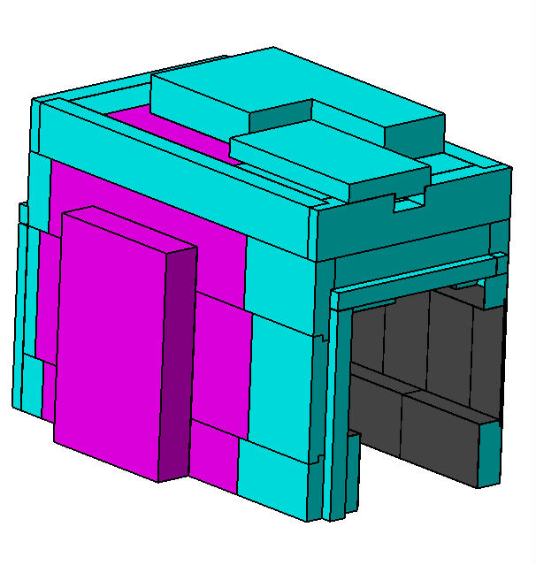
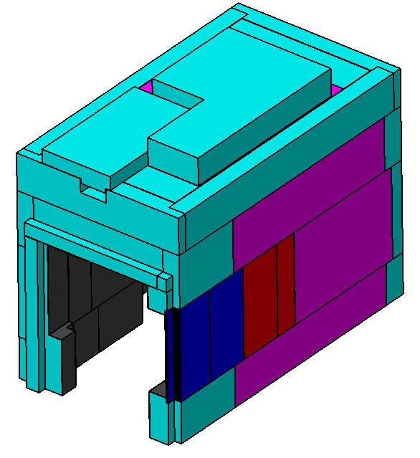
Sample Cave continued

Slide 9
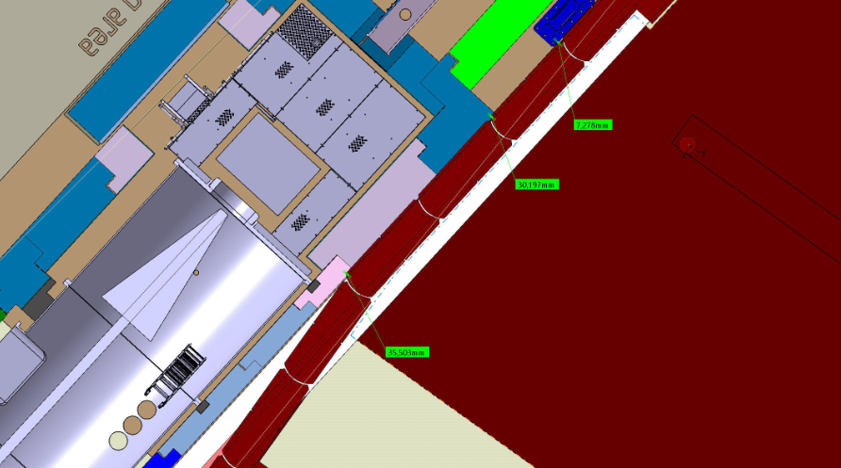
Sample cave layout overview
Center of Detector tube is not the neutron beam axis
Detector tube diameter = 2410mm
Detector flange outer diameter = 2590mm

Slide 10
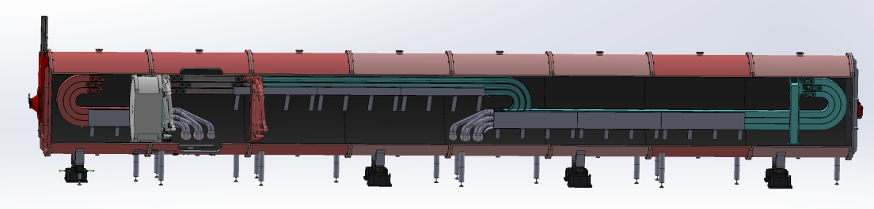
Detector and interfaces
CTV passed: 05/10/2020
Call for tender finished, now going through the quotes

Slide 11
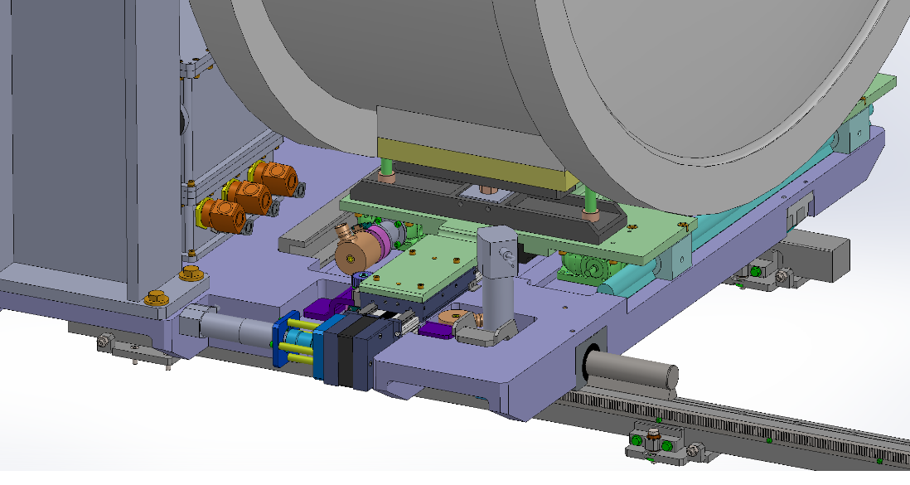
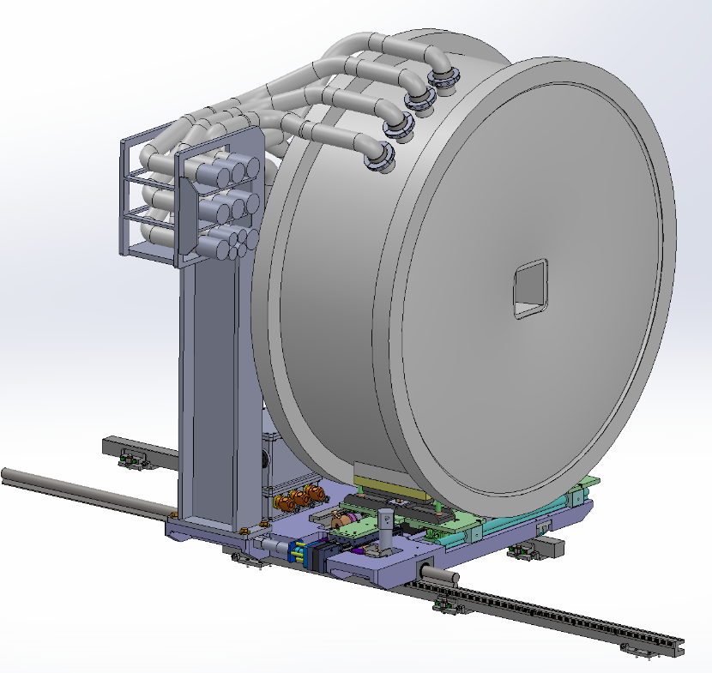
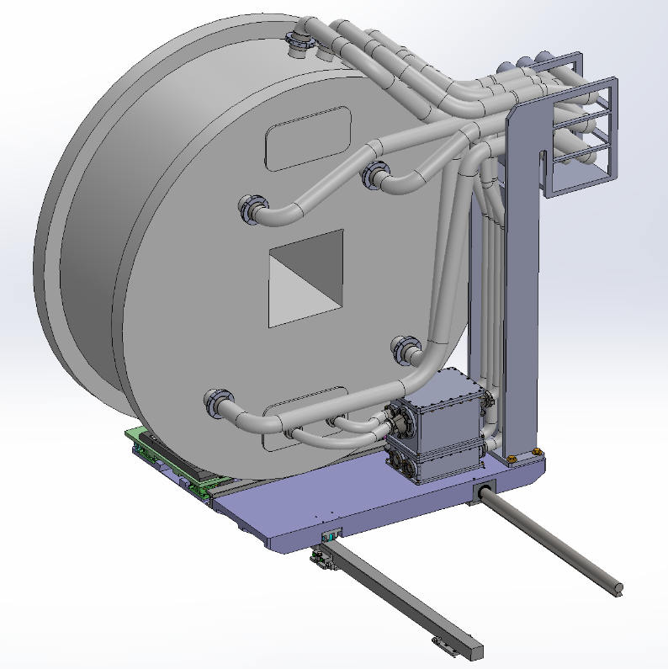
Detector and Interfaces continued
Interface with FZJ:
- Mechanical design is on track
- Need better communication for testing

Slide 12
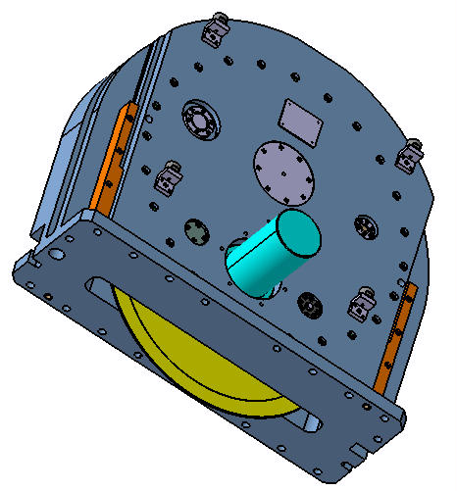
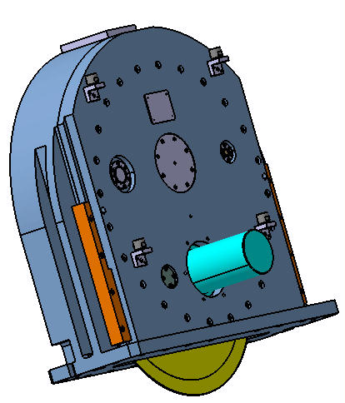
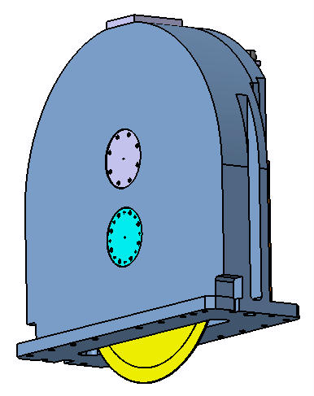
Choppers
Name | Chopper Type | Distance to ISCS (m) | Operating speeds max/min (Hz) | Rotor Radius (mm)
BW1 | Single | 15,5 | 14/7 | 310
BW2 | Single | 20,85 | 14/7 | 310

Slide 13
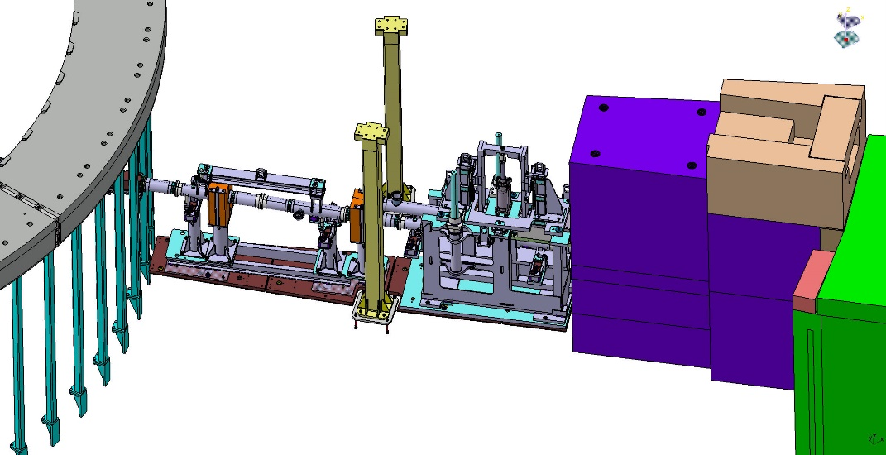
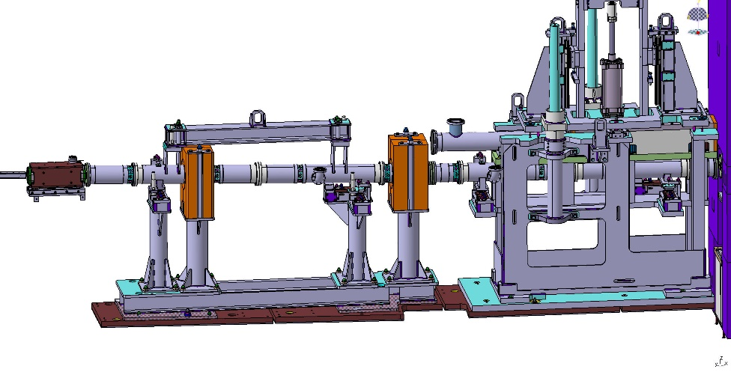
In-bunker
SNAG won the bid for the tender
Detailed design will start in summer
Production begins in Jan 2022
Heavy shutter interfaces have been designed, heavy shutter already under design – will go through TG process together with the rest of the installation

Slide 14
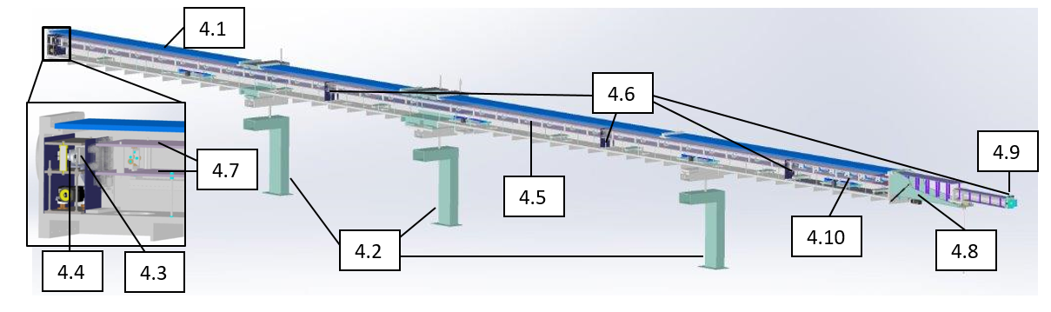
Collimator
CTV passed: 27/02/2019
Call for tender finished, now examining quotes

Slide 15
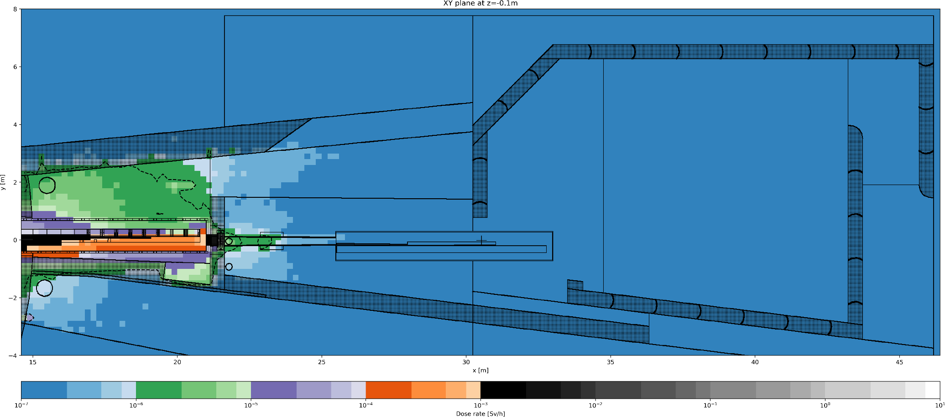
Collimator Shielding: Impact on ESTIA
CTV passed: 16/11/2018

Slide 16
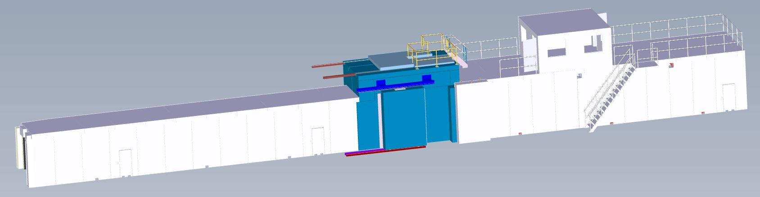
Detector Shielding
Detector Shielding CTV scheduled for 22nd of April

Slide 17
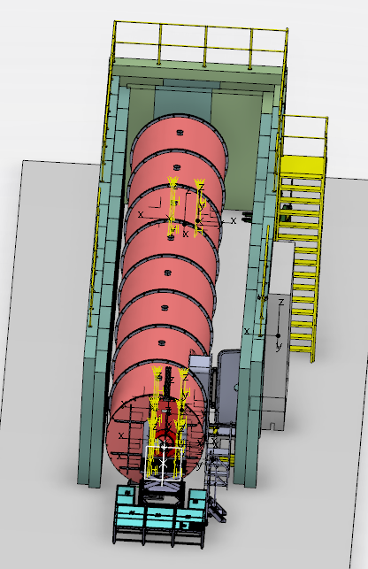
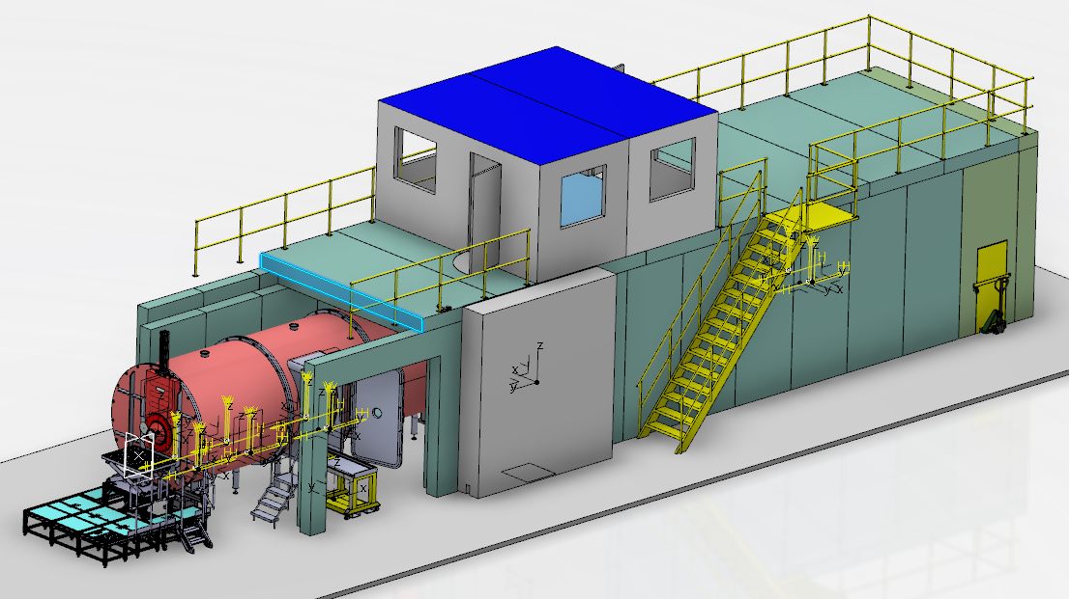
Detector Shielding continued
Shielding size was increase for the detector tube
Allows to walk/work alongside the tube inside the shielding
Access door was also increased in size
Simplified access for removal/maintenance of detector (can be reached with a custom carriage)

Slide 18
Schedule
Component | Delivery and Installation last STAP | Delivery and Installation current
NBOA | Q1-20 | ???
In-Bunker | Q3-24 | Q2/Q3-22
Polarizer, Fast Shutter | Q1-23 | Q1-23
Choppers | Q3-23 | Q3-23
SCS | Q2-24 | Q2-24
Monitors | Q1-23 | Q1-23
Sample Area | Q2-23 | Q2-23
Hutch Area | Q4-23 | Q4-23
TG3-Full | Q4-21 | Q4-21
TG4-Full | Q2-24 | Q2-24 (the only 2024 component is the detector, which is fully in our hands
TG5-Full | Q3-25 | Q3-25
Delayed
At risk
On track
Non-critical
TG3 in Q4-2021 is a risk due to:
Covid delays
Manufacturer overload
Rehiring of additional engineers
Not under instrument team control, but we are monitoring the situation

Slide 19
Thank you for your attention

Slide 20

Advertisement: SANS Special Issue
Recent Advance in Small Angle Neutron Scattering
New instrument designs
Instrument upgrades and fundamental improvements
Sample environment technologies and experimental support
Data treatment
Exemplary experiments on systems that allow a general use, also for other systems
Dedicated different geometries/techniques linked with SANS, such as GISANS
https://www.mdpi.com/journal/applsci/special_issues/small_angle_neutron_scattering#info

Slide 21
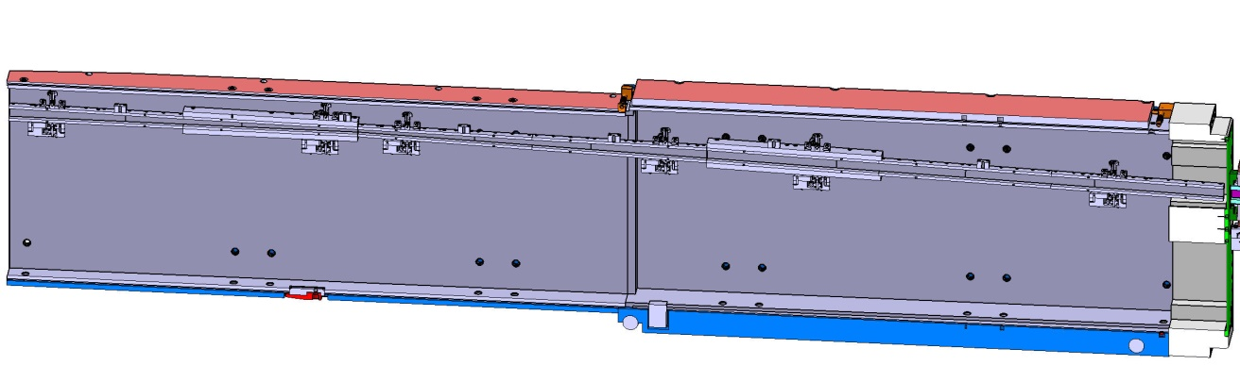
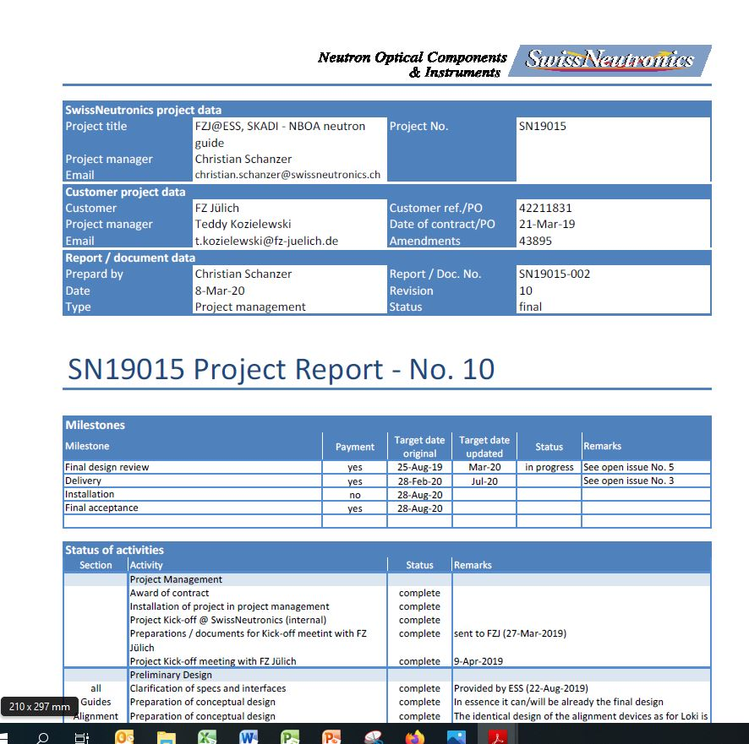
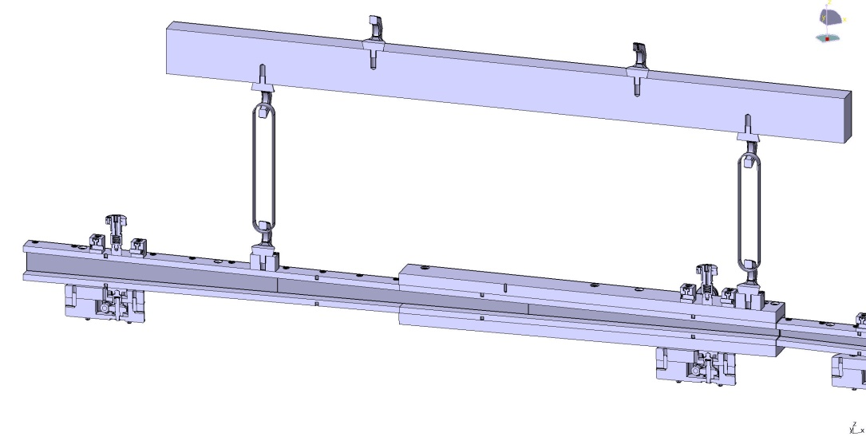
13.6.7.1.1 Beam extraction system
NBOA
Final design review in progress.
Delivery delays caused by Covid-19 pandemic are to be expected.

Slide 22
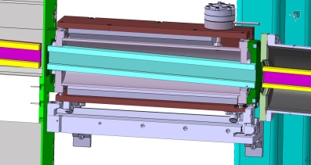

13.6.7.1.1 Beam extraction system
Bridge beam guide
Reflector (neutron guide)
with intergrated lifting beam
Vertical heavy shutter

Slide 23
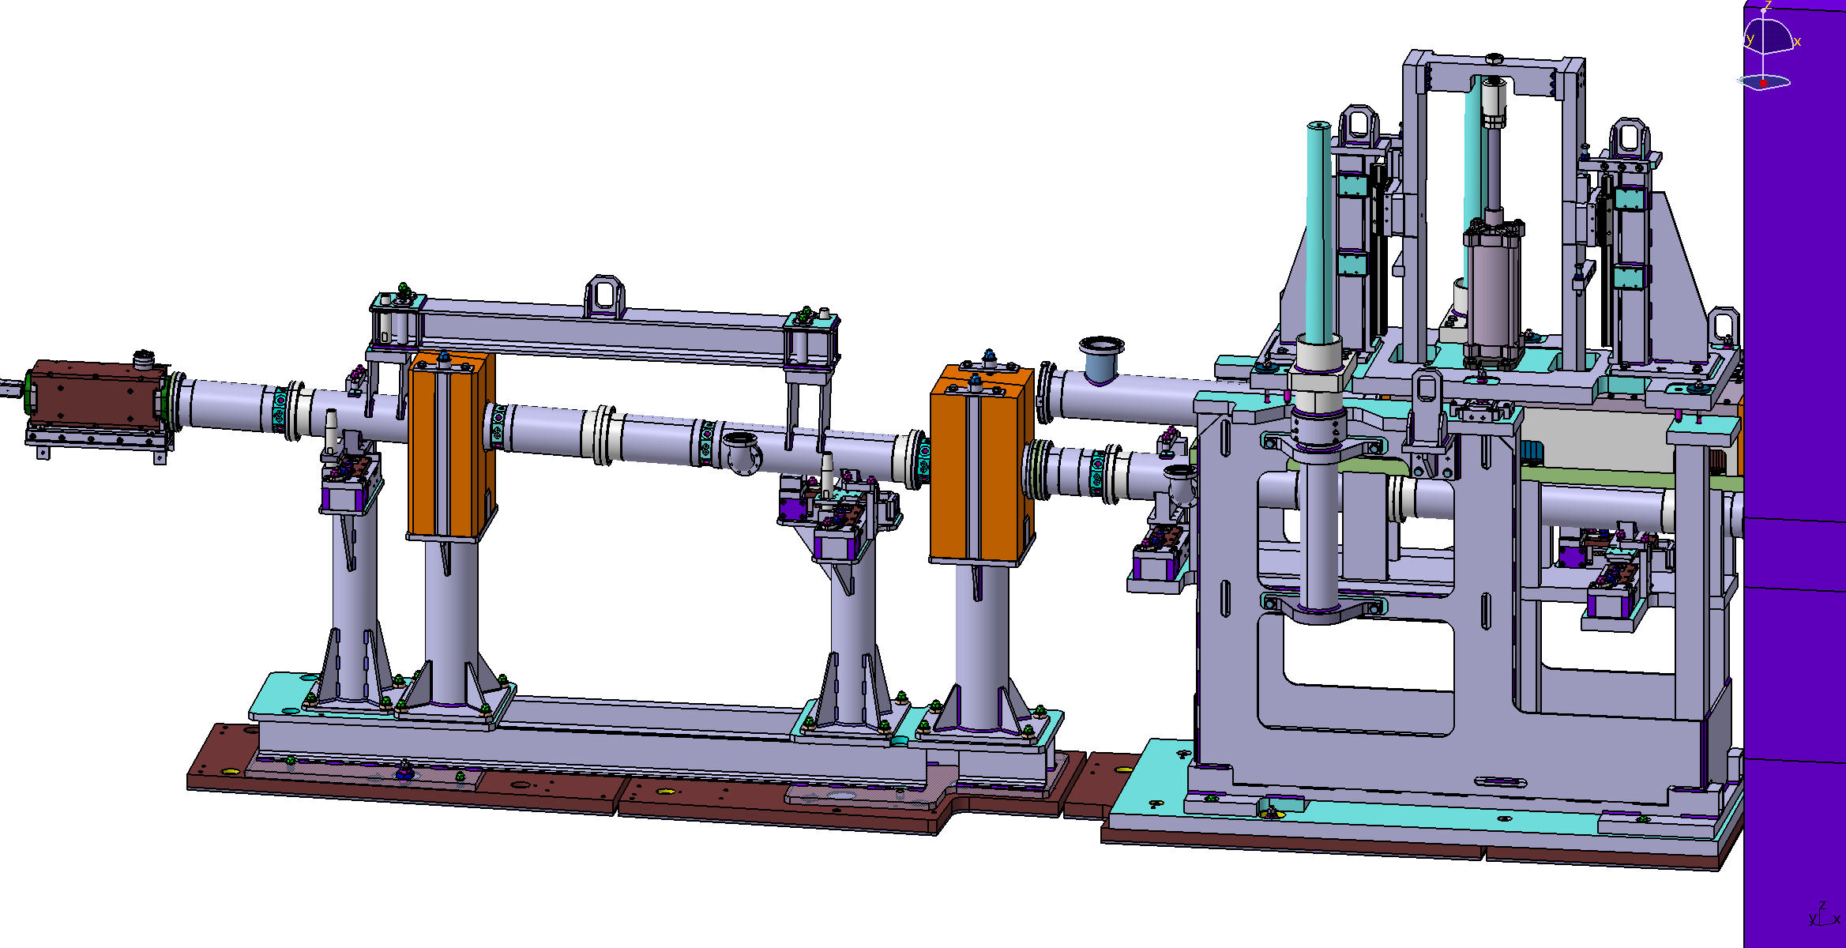
13.6.7.1.1 Beam extraction system
Overview complete reflector in bunker
Bridge beam guide
Reflector (neutron guide)
with intergrated lifting beam
Vertical heavy shutter

Slide 24
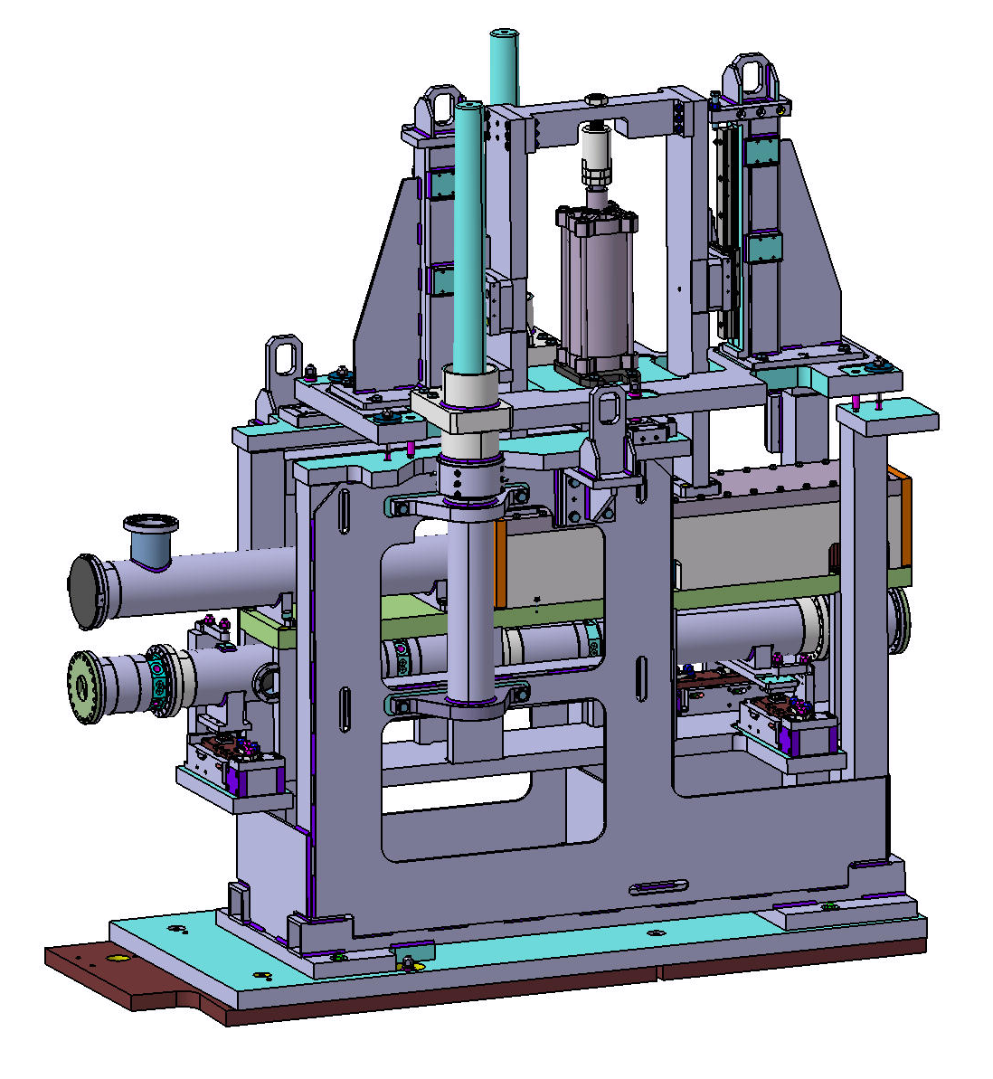
Heavy Shutter new design
2470
2530
275
Linear guides and bearings are lubricant-free.
Neutron flux
Reflector with housing ca.300kg
Shutter
Ca.350kg

Slide 25
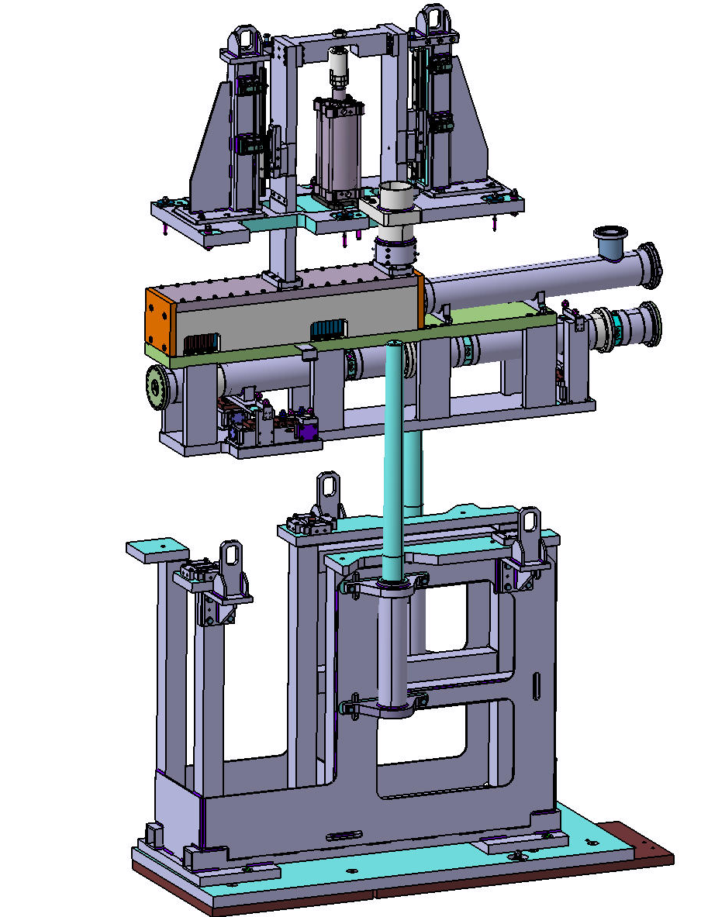
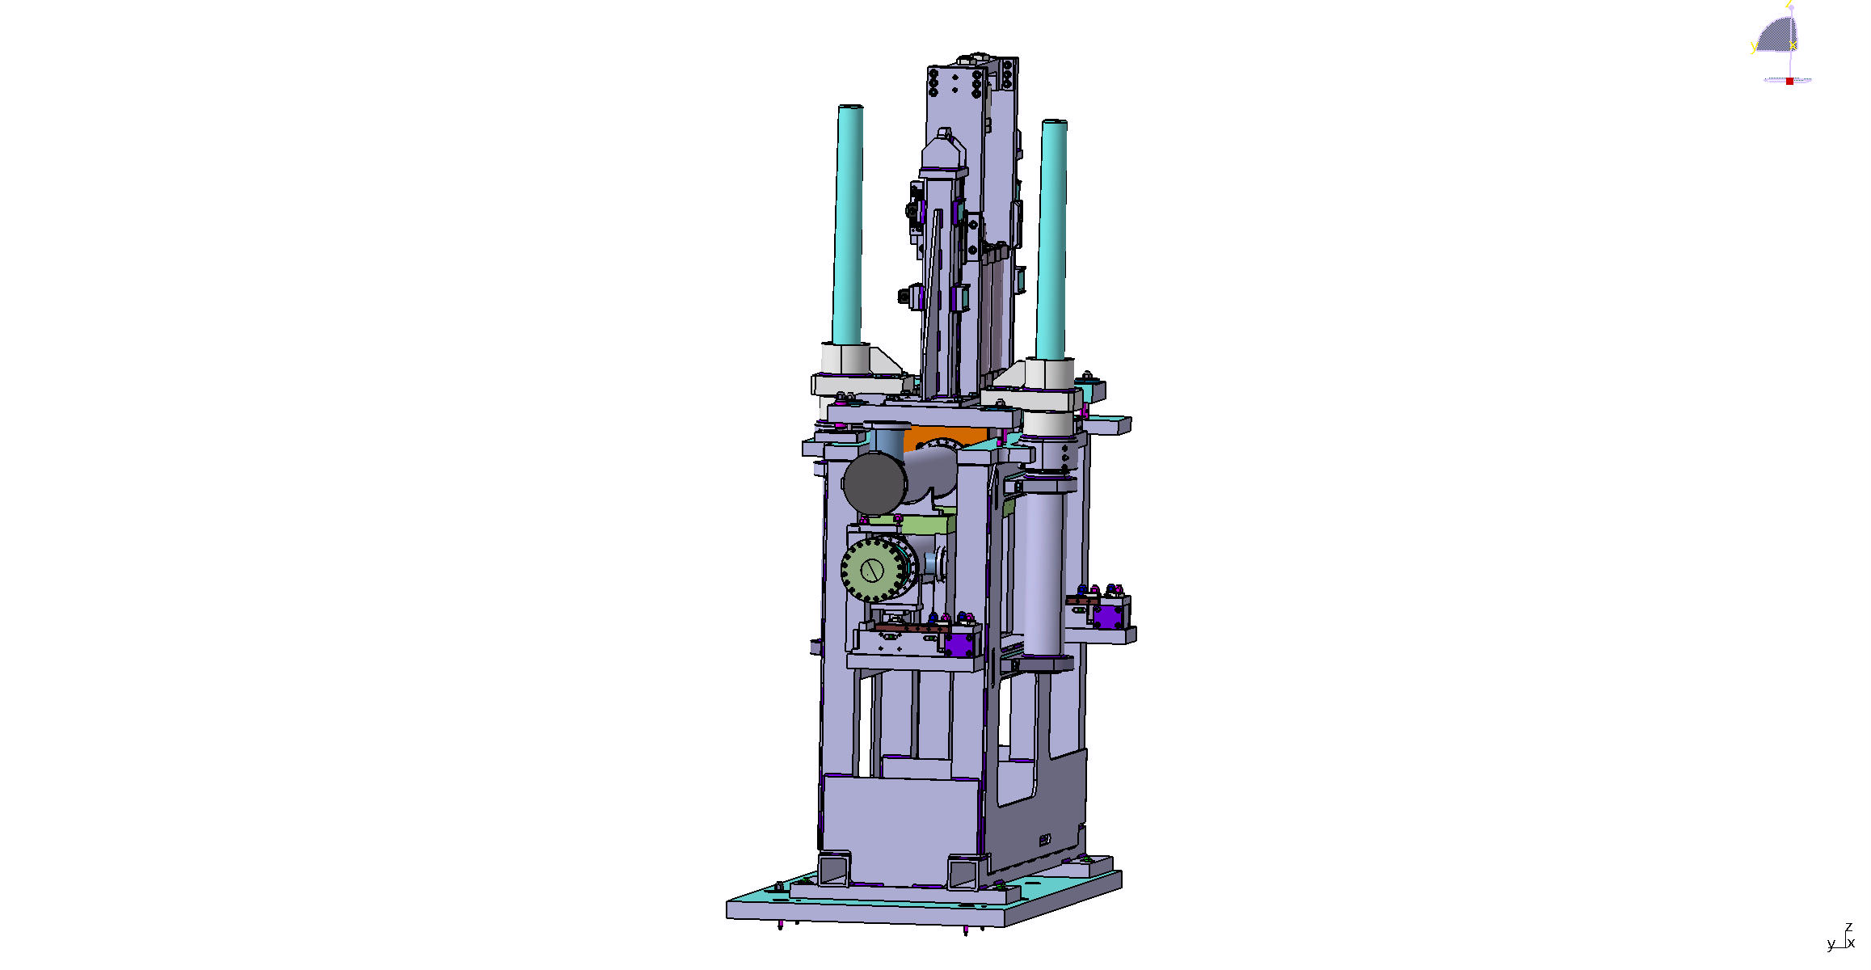
Heavy Shutter new design
2458
1040
1260
1958
900
2100
25

Slide 26
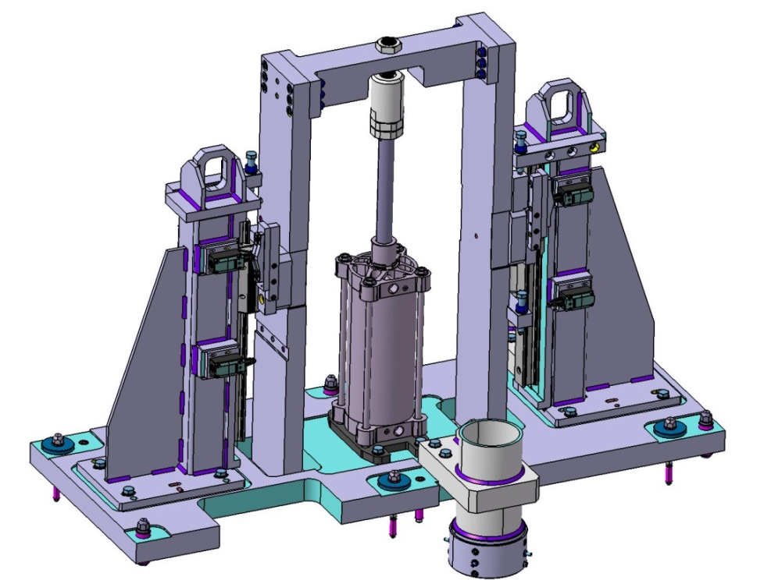
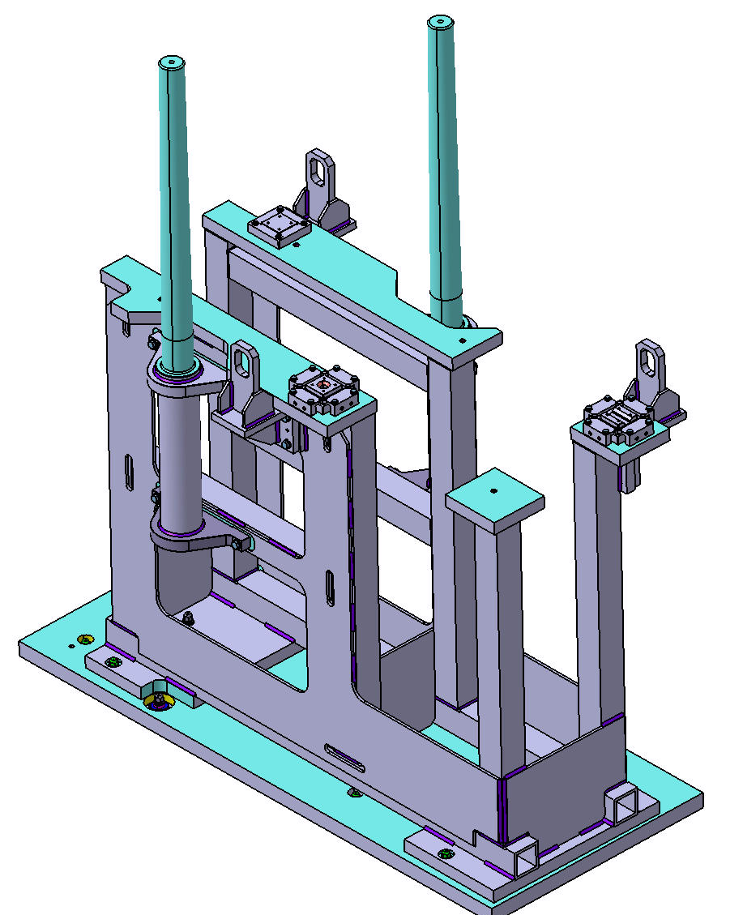
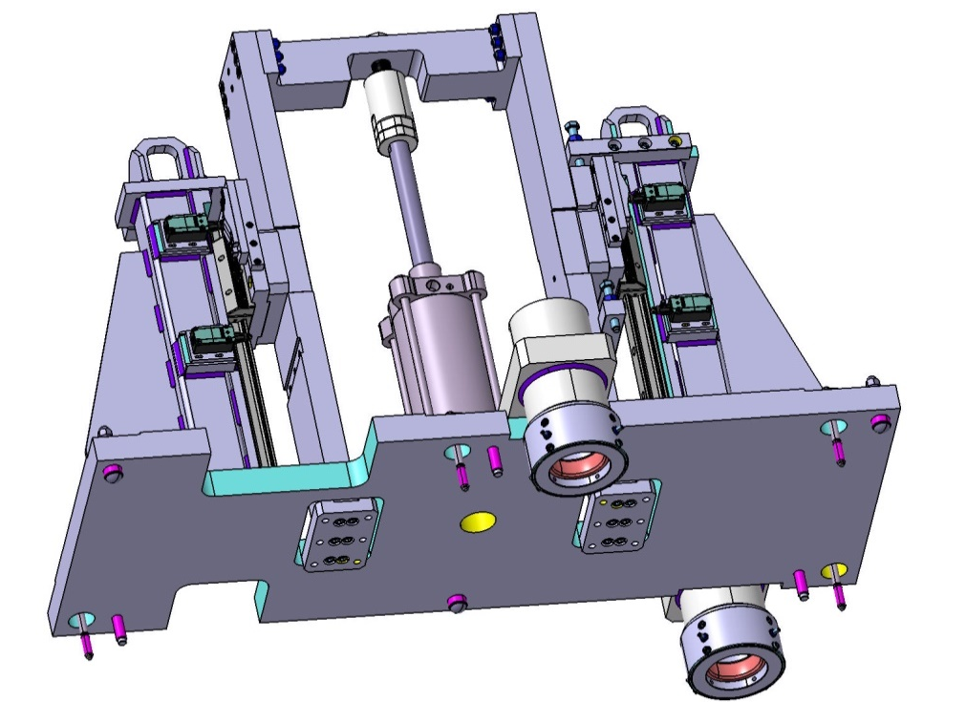
Heavy Shutter new design
Adjustment elements
26

Slide 27
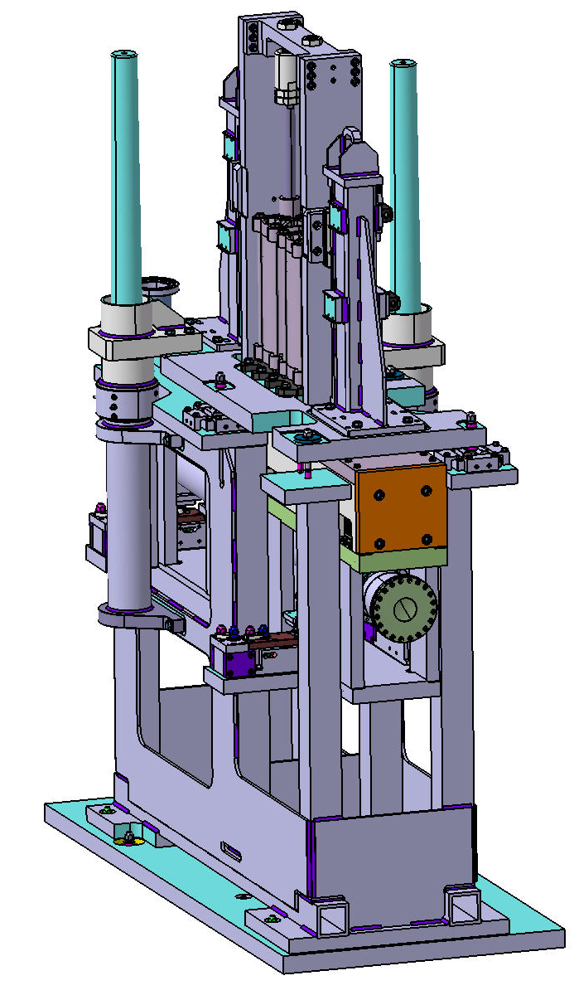
Heavy Shutter overview
Forward view
Rear view
27

Slide 28
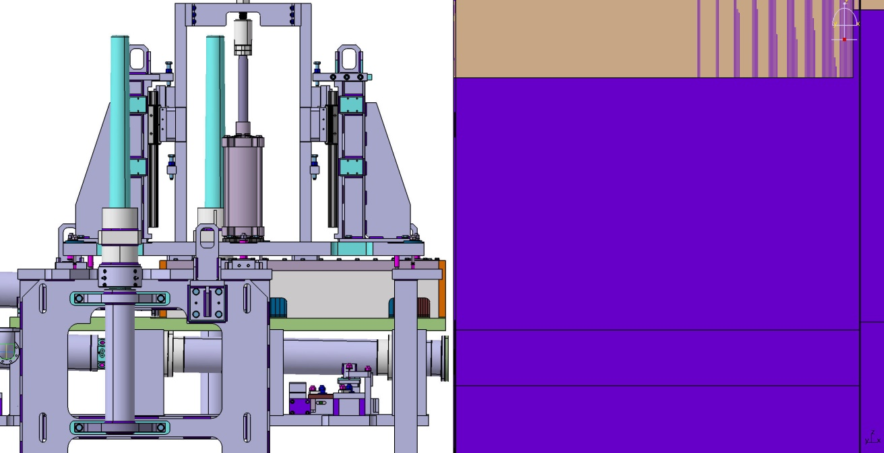
Heavy Shutter with the bunker wall
39
28
28

Slide 29
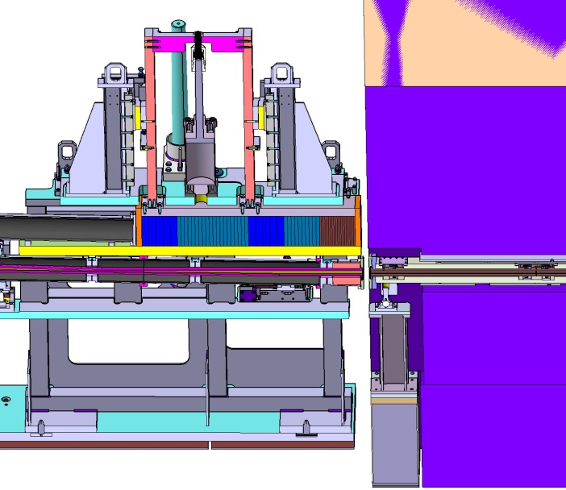
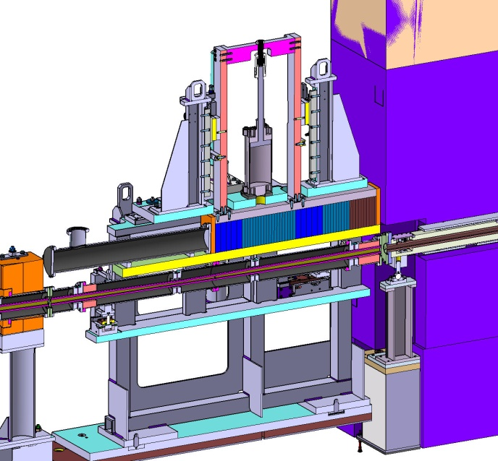
Heavy Shutter with the bunker wall
It is planned to shield the gap with a shielding cover. This is machined on site in order to avoid concrete tolerance issues.
29

Slide 30
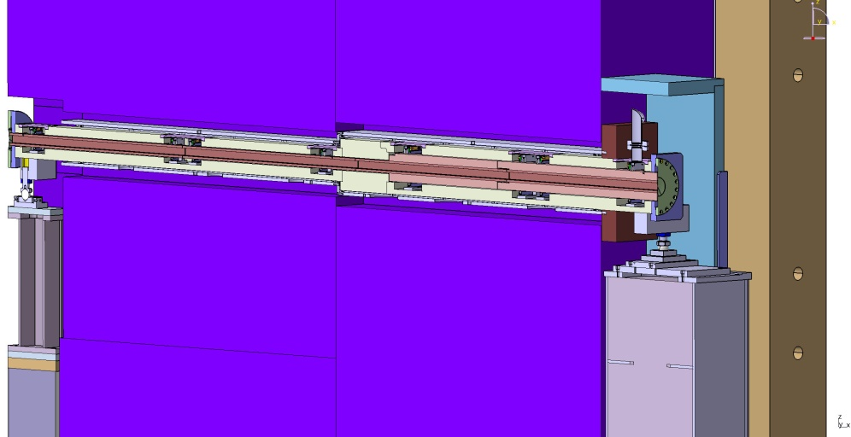
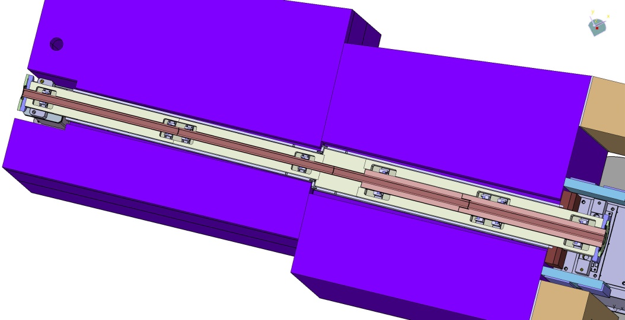
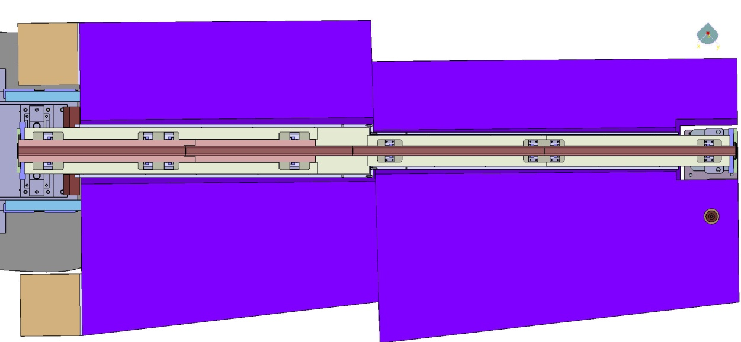
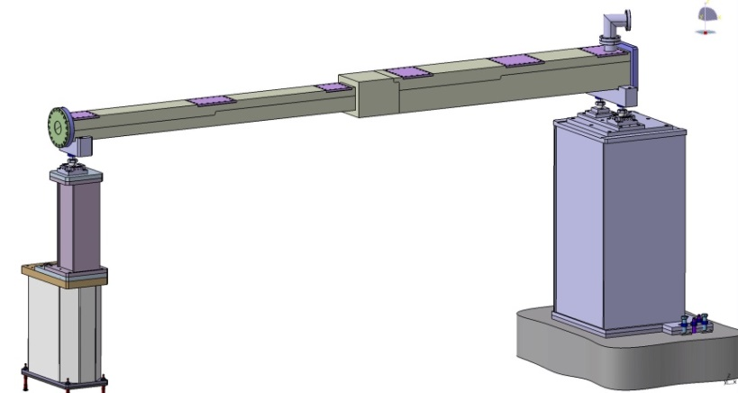
13.6.7.1.7 Flight Tube (Feed through bunker wall)
ESS has sent us the modified feed through bunker wall. The feed through was increased in size to provide more room for the previous spacer plates. But this has no effect on our design.

Slide 31
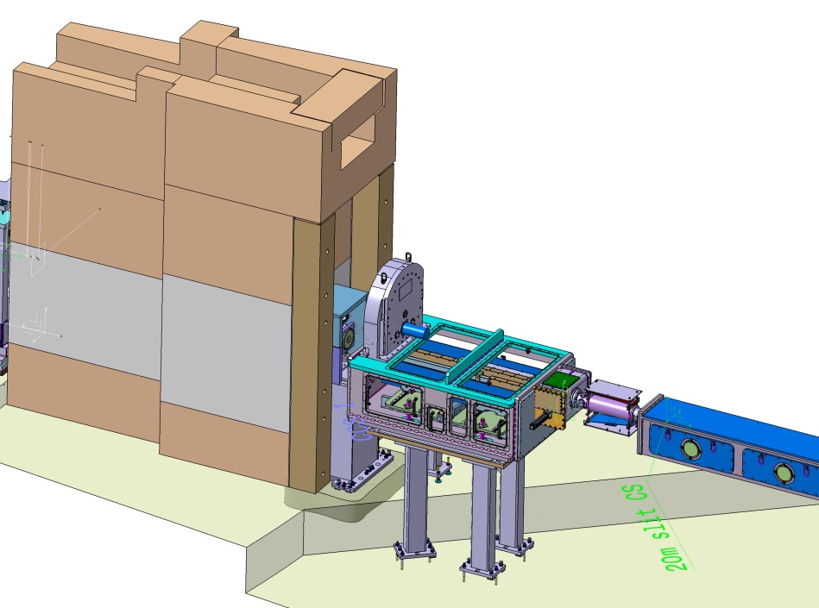
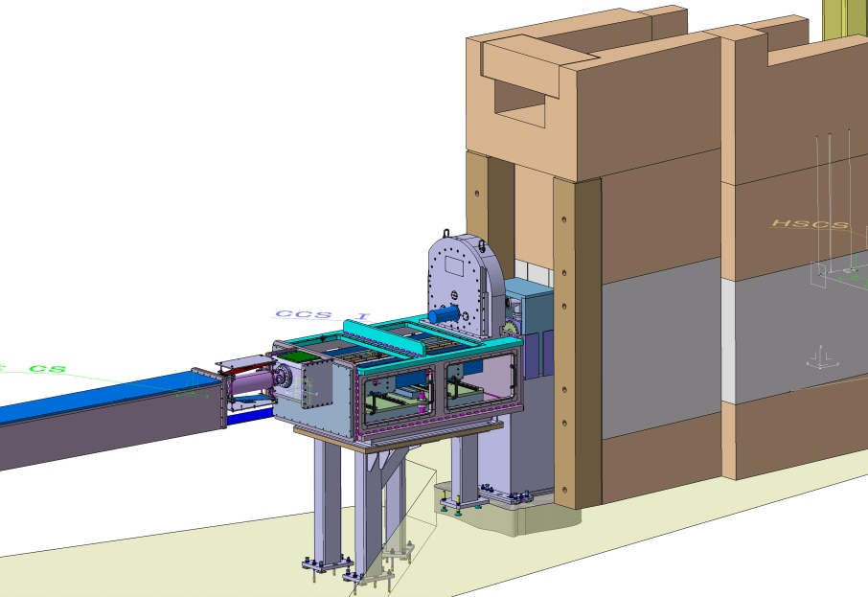
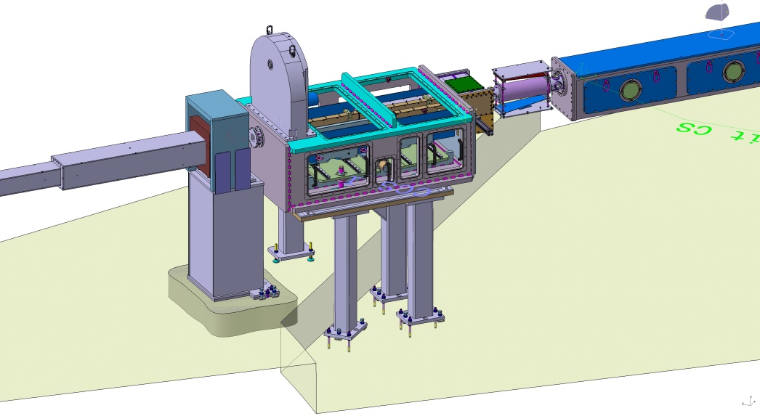
13.6.7.1.5 Beam Filtering System
Polarizer

Slide 32
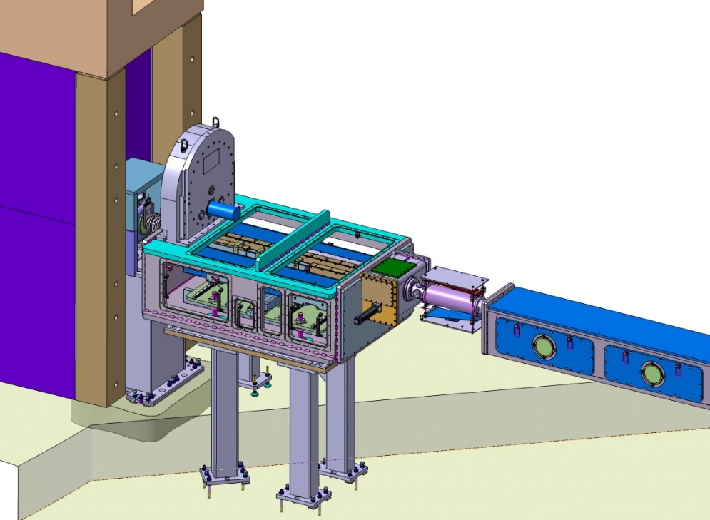
Polarizer
Polarizer
Fast Shutter
Spin Flipper

Slide 33
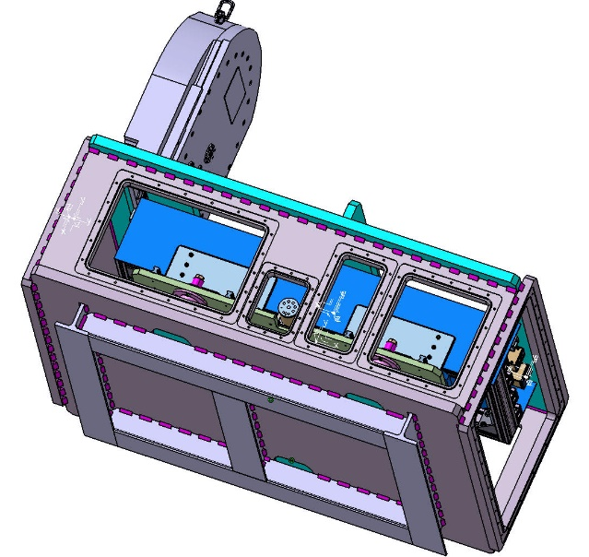
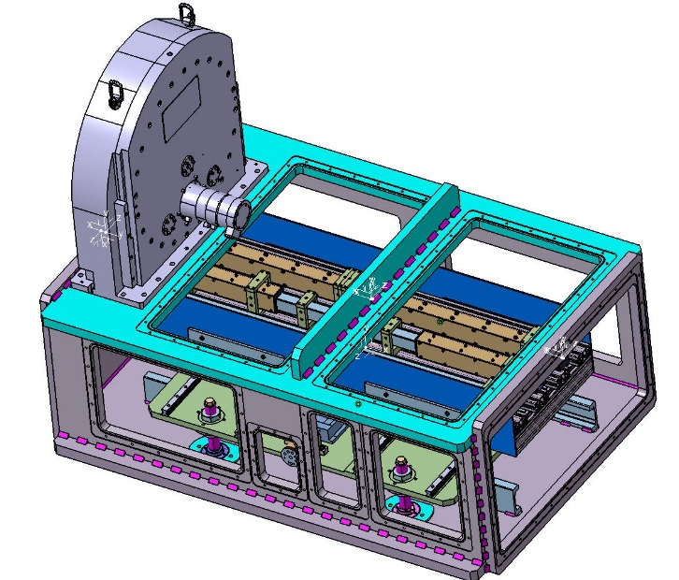
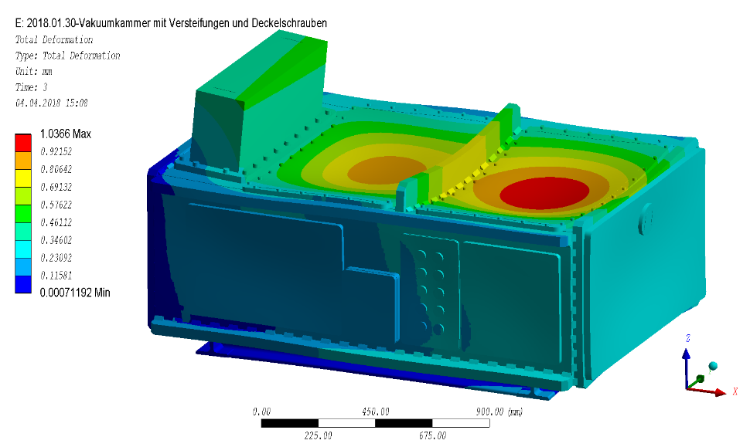
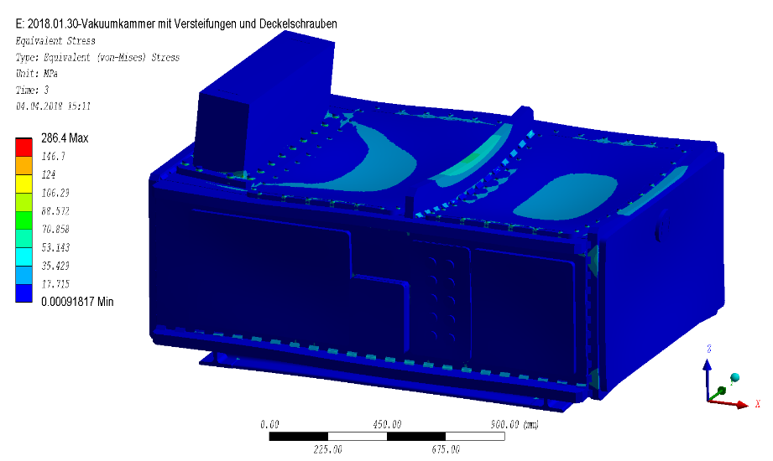
13.6.7.1.5 Beam Filtering System
Polarizer
Concept design for Polarizer ready.
Vacuum vessel was calculated by calculation group ZEA-1.
We stopped at that point because we put the prioritization on the bunker inside components.

Slide 34
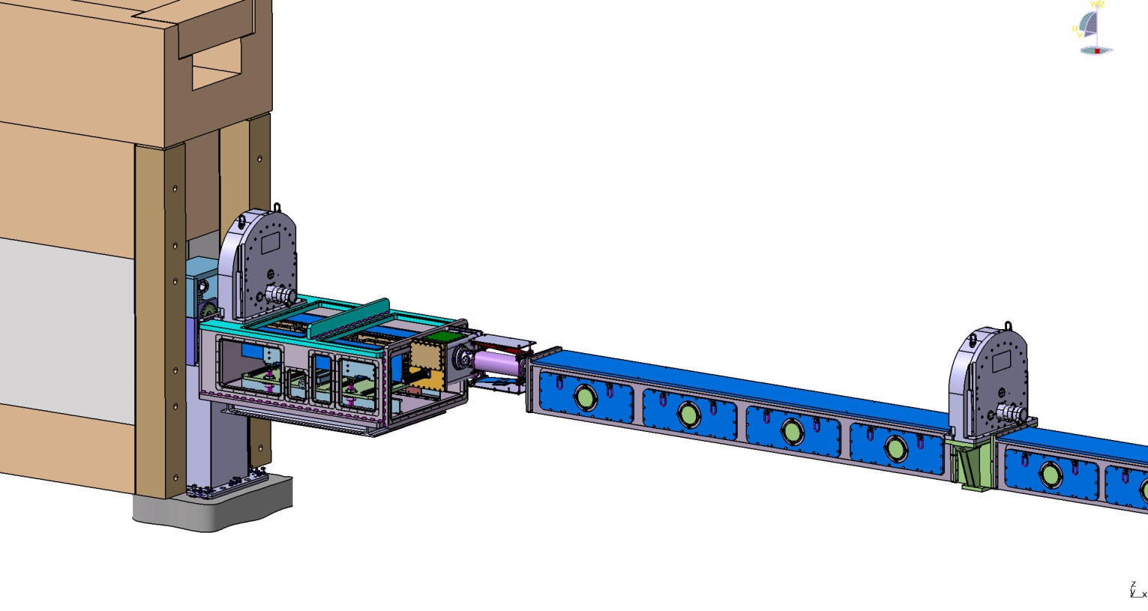
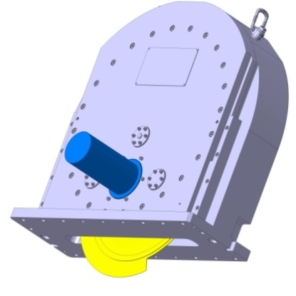

Chopper system overview
Name | Chopper Type | Distance to ISCS (m) | Operating speeds max/min (Hz) | Rotor Radius (mm)
BW1 | Single | 15,5 | 14/7 | 310
BW2 | Single | 20,85 | 14/7 | 310

Slide 35

Chopper assemblies
Discs
Discs Radius – 310mm
Discs material - not yet defined. Possible materials:
Alloy | Standard | Note
Aluminium 6061 | ISO 6361 | proposed
GRP (ISOVAL TM) | ISOVOLTA TM V0.7/16 | To be verified
CFRP |  | proposed
Bearing type: Magnetic bearings

Slide 36

13.6.7.2 Sample Exposure System
Sample Area update
Modified Sample Area Shielding:
  Only one door from the operating side, detector access with pallet jack
  Shielding wall to Estia modified

Slide 37


13.6.7.2 Sample Exposure System
Sample Area update
Energy chain
More space is needed on the detector housing side in detector tube. So the center of the detector tube is not the center of the beam axis.
For this reason the diameter of the detector tube is larger and the detector tube is shifted to the ESTIA side.

Slide 38

13.6.7.2 Sample Exposure System
Sample Area
300 mm thick steel walls
Center of Detector tube is not the neutron beam axis
Detector tube diameter = 2410mm
Detector flange outer diameter = 2590mm

Slide 39

13.6.7.2 Sample Exposure System
Sample Area update
5300
3000
300
600

Slide 40



13.6.7.2 Sample Exposure System
Sample Area Update

Slide 41

13.6.7.2 Sample Exposure System
Sample Area Update

Slide 42



13.6.7.2 Sample Exposure System
Sample Area Update
Stainless steel

Slide 43


Detector housing
Detector front view
Detector rear view
656 mm
ᶲ 1740 mm
Front cap
Trumpet
Rear flat head
Lid
Forward view
Rear view
43

Slide 44


Detector housing
762 mm
- Sensor holder from Ti,
- Another components
from AlMg4,5Mn0,7
- Bolts from Ti
ᶲ 1740 mm
Front cap
6 mm thick (Al)
Trumpet
Sensor holder (Ti)
Rear flat head
25 mm thick (Al)
44

Slide 45


Detector housing
max. 55 mm
6 mm
Detector housing cut
45

Slide 46




Front cup
Front Cap – Linerized stresses at 1.2 bar differential pressure
Sum of membrane and bending stress $(P_{m}+P_{b})$
Membrane stress $P_{m}$
Stress limits
membrane stress $P_{m,max}=46 MPa≤f=73 MPa$ ✓
membrane + bending stress ${\left(P_{m}+P_{b}\right)}_{max}=91 MPa≤1.5⋅f=110 MPa$ ✓

Slide 47




Front cup
Front cup was milled from an aluminum block according to the stress calculations
47

Slide 48




Detector cooling
Temperature Chips + Boards - First calculations
Die erste Reihe Platinen hat keine Luftschlitze an der Rückseite!
$$\dot{V}=5000\frac{l}{min}$$
$$\dot{V}=10000\frac{l}{min}$$
48

Slide 49


Detector cooling
Air outlet
Lengthened air nozzles
with cooling air
Air buffer chamber
Cooling air inlet
49

Slide 50


Detector cooling
Lengthened air nozzles
with cooling air
50

Slide 51

Test equipment for cooling validation
Test device for the verification of the calculation results
Air outlet
670 mm
620 mm
520 mm
Air buffer chamber
Cooling air inlet
51

Slide 52


Test equipment for cooling validation
Test device for the verification of the calculation results
Air outlet
Air buffer chamber
Cooling air inlet
52

Slide 53




Impressions

Slide 54



First Tests
Mesurement of AgBeh, slits, ….
Semi-transparent beamstops/attenuators not strictly necessary, but improve S/N ratio
Software and hardware work as expected
Improvements on 4-pi scatterer normalization ongoing

Slide 55

Detector
Air outlet
Tests for full scale cooling being prepared
Up to now, no heat issues (never exceeded 65°C without active cooling)
Air buffer chamber
Cooling air inlet

Slide 56



Detector
Working on a tender box for simple removal of full detector
Housing will be possible to handle with instrument crane through side access door

Slide 57




test Housing assembly
167
ᶲ400
265

Slide 58



Test Housing assembly

Slide 59


Test Housing assembly

Slide 60


Detector and Interfaces continued
Hardware works
Tests needed
Tests rely on (partially) working DAQ system

Slide 61
Detector and Interfaces continued
Front cup was milled from an aluminum block according to the stress calculations

