Slide 1
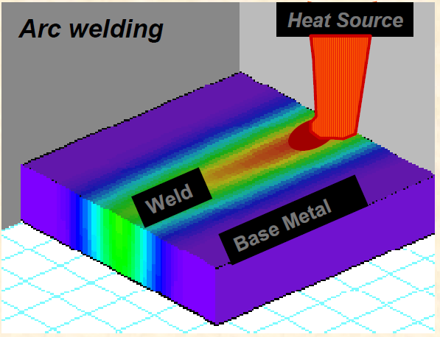
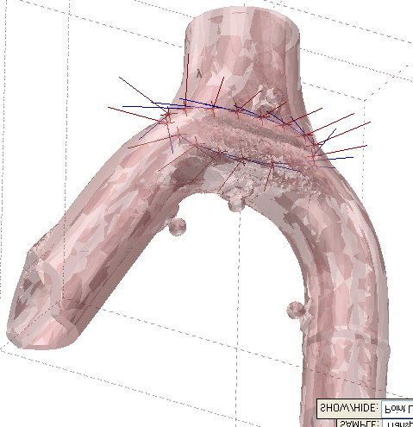
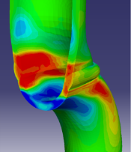

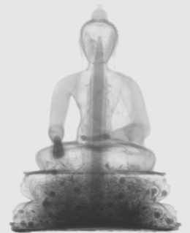
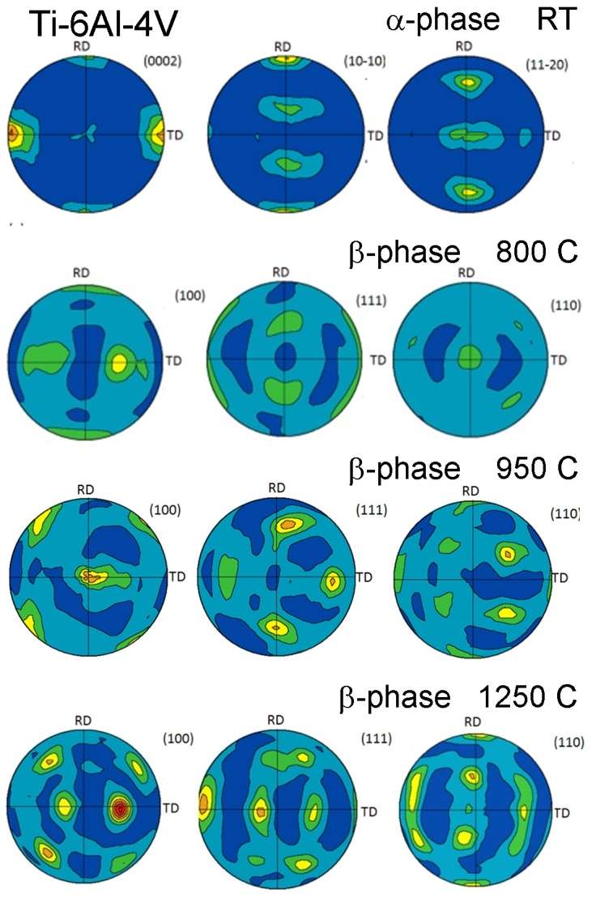
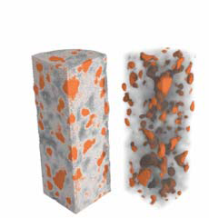
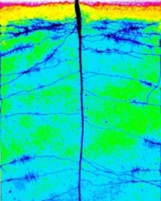
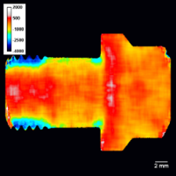
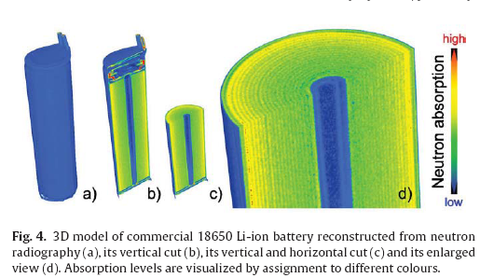
Building IMAT: the instrument scientist’s perspective
W. Kockelmann (ISIS)
Science Case
Power generation
Fuel and fluid cell technology
Aerospace & transportation
Civil engineering
Earth sciences
Archaeology & heritage science
Soft matter, biomaterials, agriculture
Notes:
IMAT will cover varied scientific topics and applications such as:
Novel materials studies (Ni-based / Co based superalloys, piezo electric ceramics, shape-memory alloys etc)
Aerospace applications (e.g. titanium alloys, and welding techniques)
Nuclear industry materials (e.g. steel and Zr alloys)
Cultural heritage (archaeological objects and art objects, typically metals; reconstruction of ancient fabrication methods)
Agriculture: e.g. water uptake in plants, water transport through soil and roots;
Geological materials (mainly texture analysis to study tectonic processes)
Aerospace & transportation
e.g. structural integrity/ component inspection / novel welding +joining technologies;
Civil engineering
e.g. integrity of load-bearing structures; reinforced concrete;
rising of liquids in concrete; concrete void & density distribution;
Power generation
e.g. structural integrity of pipework / pressure vessels; hydrogen embrittlement in Zr welds; residual stresses of casts/weldings; stress relieving techniques; hydrogen-induced cracking in high-strength steel welds;
Fuel and fluid cell technology
e.g. water/lithium distributions in fuel cells/batteries; blockages, sediments;
Earth sciences
e.g. deformation mechanisms in polymineralic rocks; water flow in porous media;
Archaeology & heritage science
e.g. inorganic materials characterisation; ancient fabrication techniques;
Soft matter, biomaterials, agriculture
e.g. real-time distributions of water/hydrogen; water uptake in plants; growth patterns;

Slide 2
IMAT Methods
Real-space
+ TOF Imaging
Spatially resolved
Diffraction
“Tomography guided” diffraction
Phase analysis
Strain & Stress
White beam
Radiography/
Tomography
Energy-selective
Imaging
Interprete images
Texture
Notes:
.

Slide 3
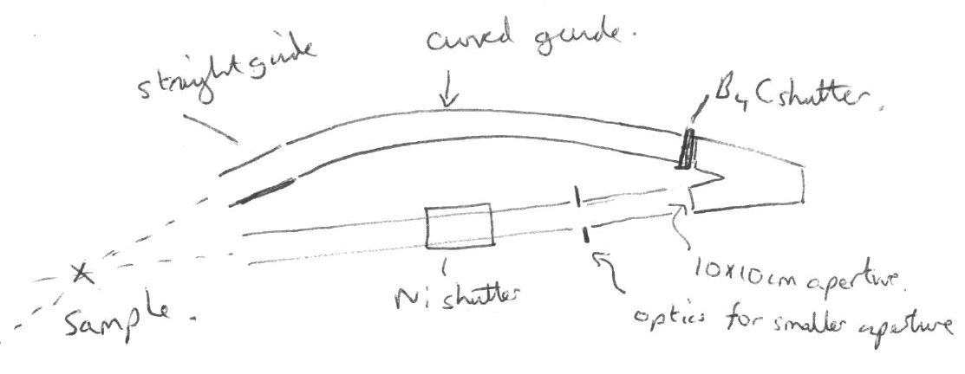
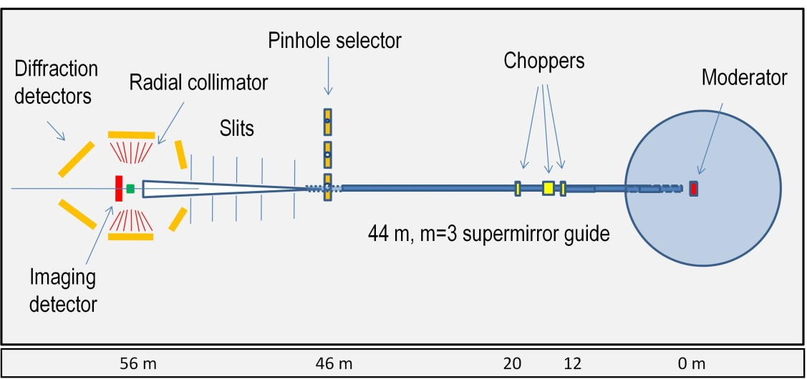
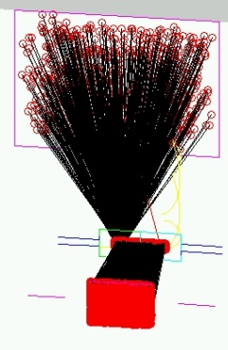
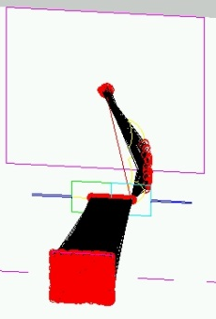
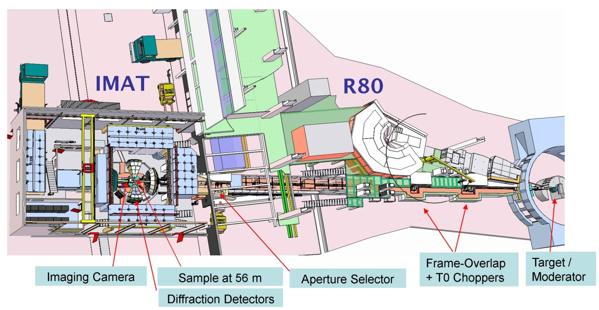
Early Instrument Concepts
1
3
2
4
‘Developed’
Outline Design 2010

Slide 4
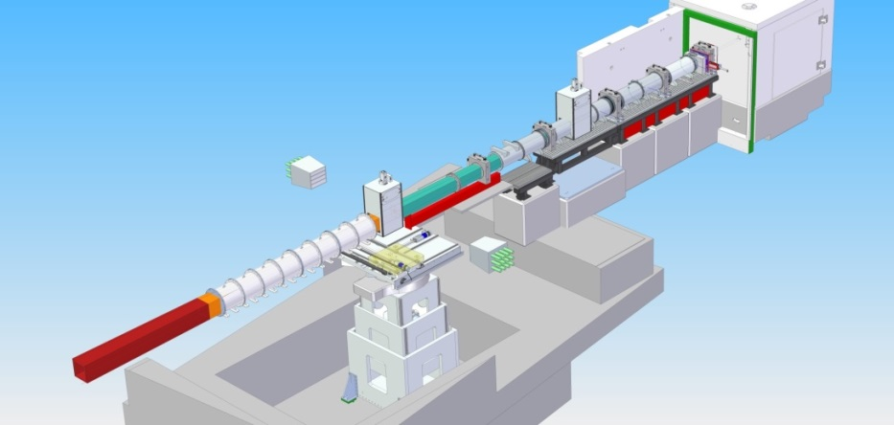
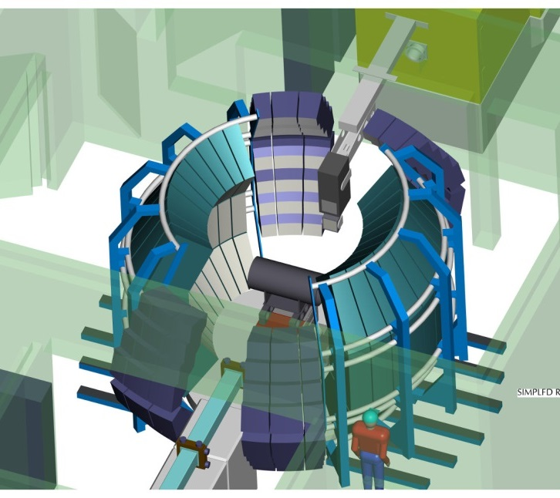
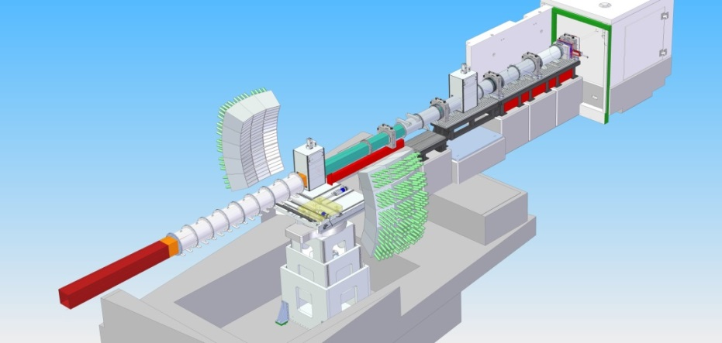
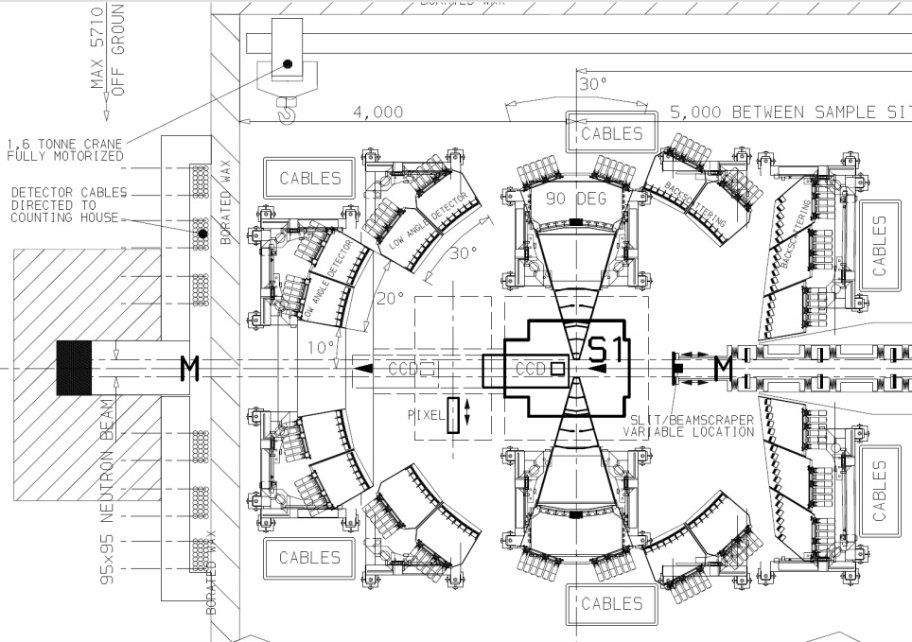
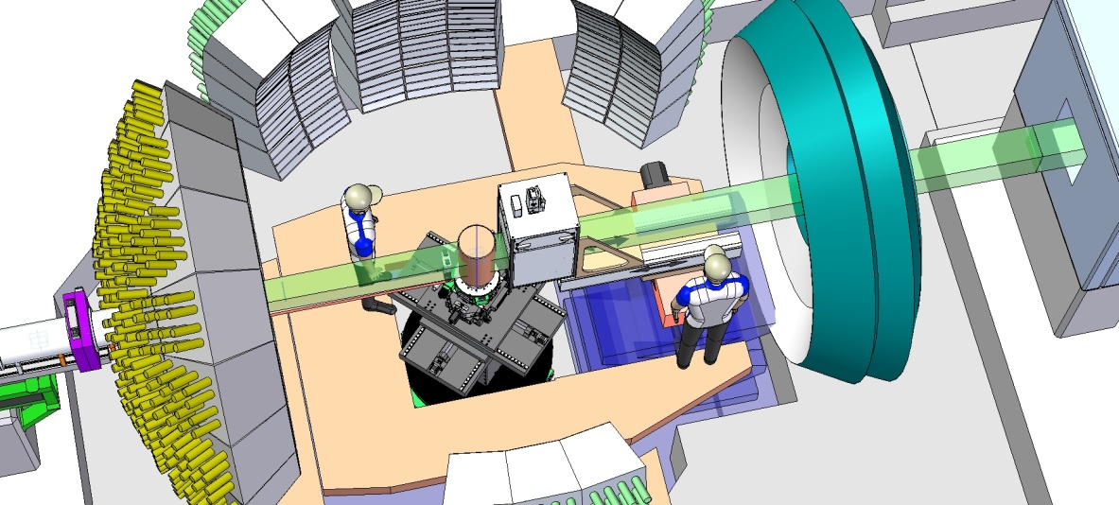
Early Instrument Concepts
and upgrade paths
What we’ll get
2015
What we
wanted
2017
20XX

Slide 5
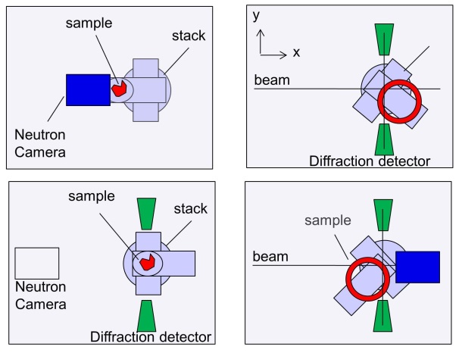
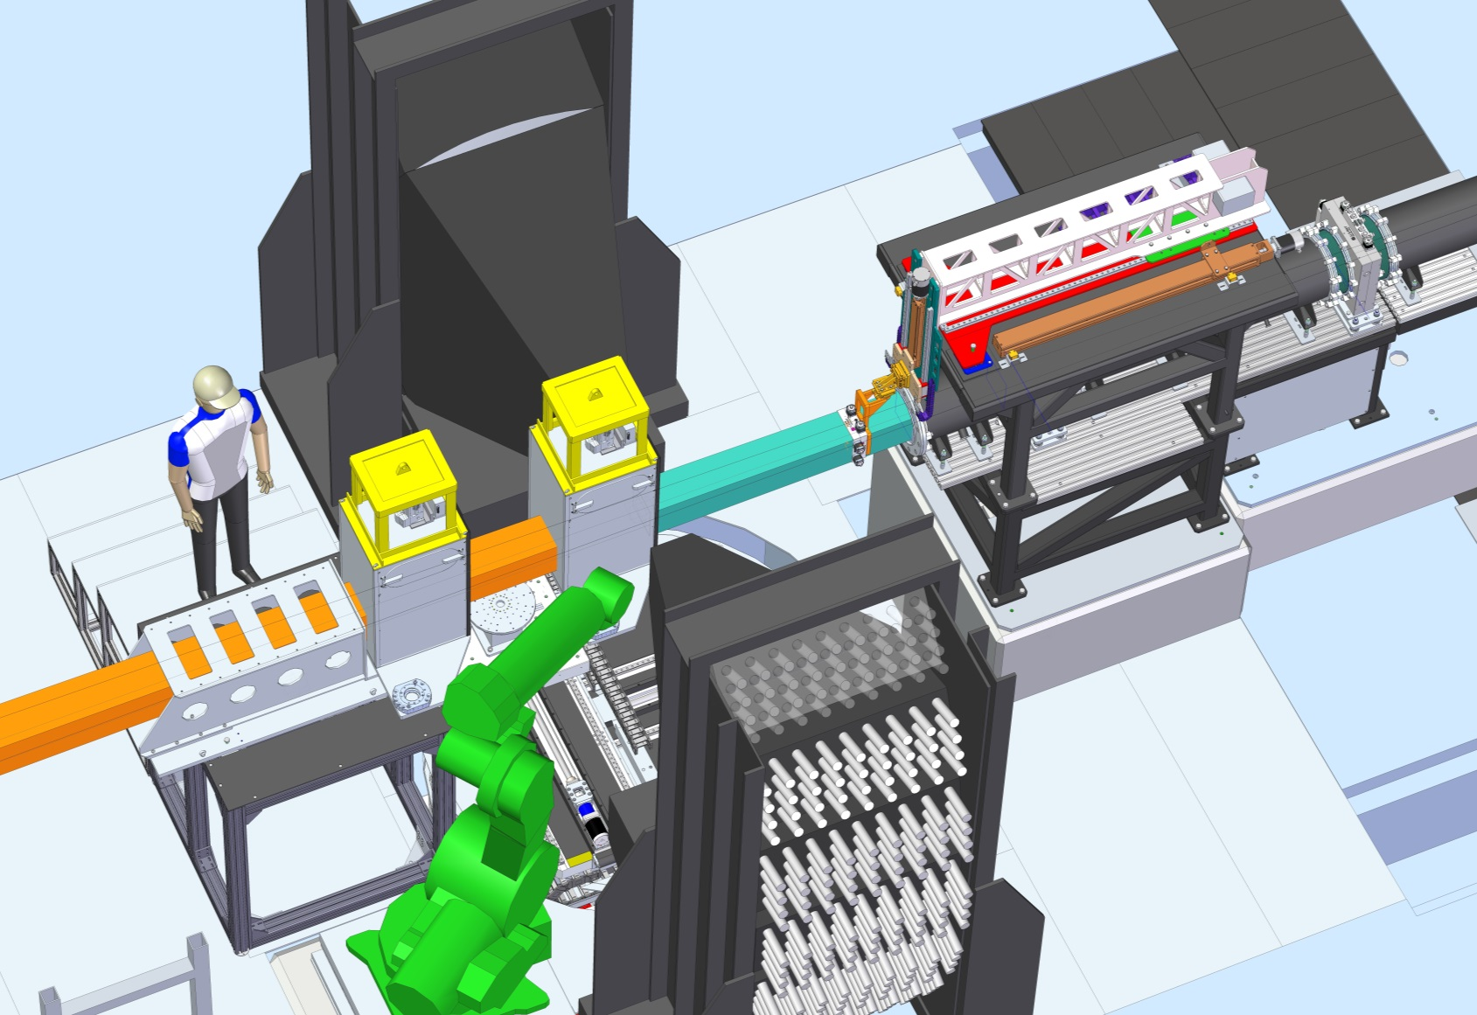
Scientists and Engineers working together
A beamline evolves.
Every design step may impact on performance and operation of the instrument.
Major changes to the beamline are costly.
e.g: change moderator port + sample position:
→ TOF resolution + operational space gained.
Every component needs to be specified and detailed.
→ Re-evaluate/consider neutronic performance at every step
→ Consider operation of the instrument at every step

Slide 6
Scientists and Engineers working together (2)
Lead Scientist’s role: protect the science case and user-friendly operation of the instrument
Evaluate instrument performance continuously
Stay in control of decisions
Lead Engineer’s + PM’s role: deliver (best) instrument on time / budget
Re-evaluate schedule/budget continuously
Stay in control of decisions
Both:
Understand day-to-day operation of instrument
Consider improvements/safety/upgrades at every step
Make decisions in a timely manner
Communication is key!
At any time

