Slide 1
IMAT Design Evolution
Jim Nightingale
ISIS Lead Engineer on IMAT instrument

Slide 2
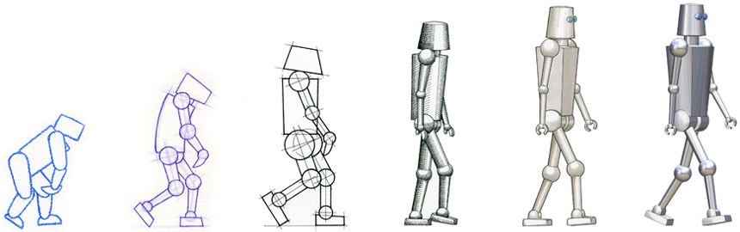
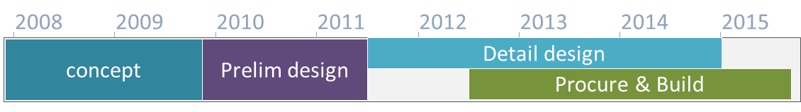
IMAT Design Evolution

Slide 3
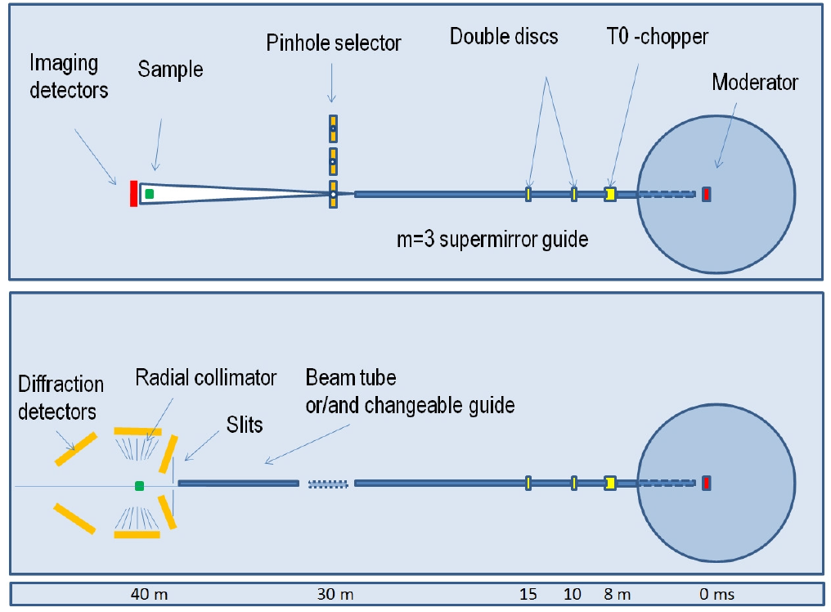
Instrument Concept & Layout
2008 Draft Proposal
Notes:
Elliptical guide concept
Curved guide considered but would remove neutrons below 2Å
Straight guide decision

Slide 4
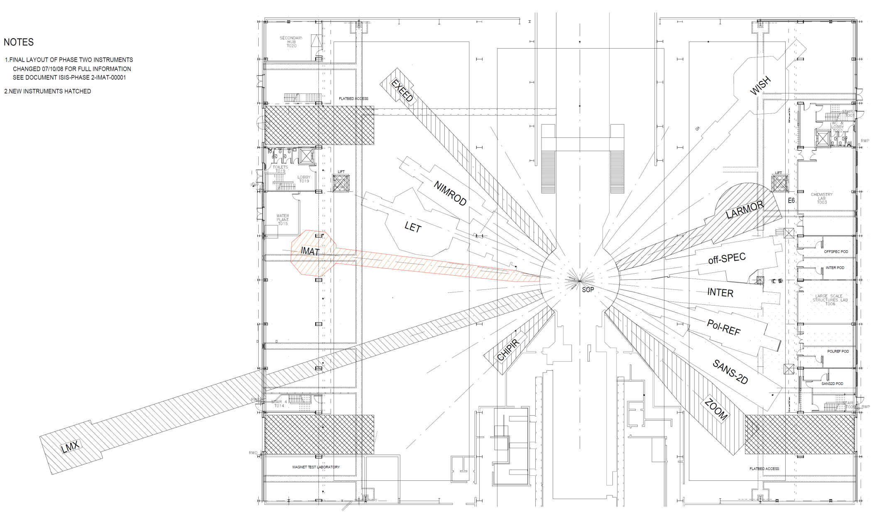
Instrument Concept & Layout
IMAT position proposal
?
?
?
?
?
?
?
?
Notes:
IMAT best placed on coupled hydrogen moderator to maximise neutron flux for imaging
Broad neutron wavelength (0.5 – 10A) effective energy-selective imaging, bragg edge analysis

Slide 5
Nov 2009 – Feb 2010
Decision on position and length
40m
W8
W5

Slide 6
Nov 2009 – Feb 2010
Decision on position and length
40m
W8
W5

Slide 7
Nov 2009 – Feb 2010
Decision on position and length
37m

Slide 8
Nov 2009 – Feb 2010
Decision on position and length
52m

Slide 9
Instrument Concept & Layout
Jan 2010 - IMAT position decision
Kockelmann, W., Zhang, S. Y., Chapon, L. C. (2010) IMAT: performance evaluation report
Impact:
Increase of instrument cost = £2m
Increased complexity of design & build
Increased timescale for evaluation and sign-off
Notes:
Increase of £2m due to length / building
Process of evaluation / benefit / signoff

Slide 10
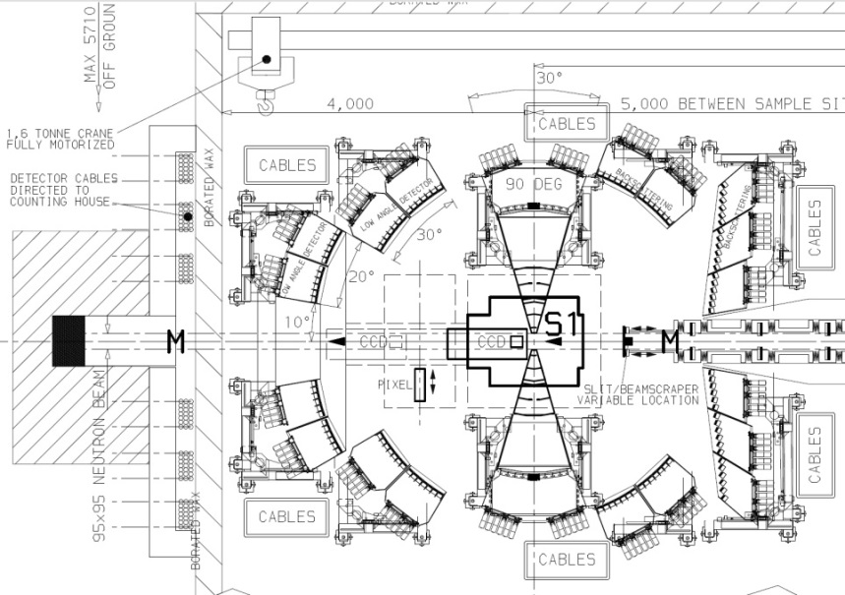
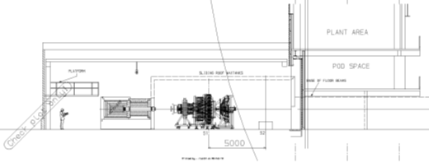
Instrument Preliminary Design
Feb 2010 – First outline design
Notes:
Impact of building location:
Facility soak-away needed re-siting
Facility HV supply cable diversion
Extensive existing building water treatment plant alterations
R80 Building structural columns in the way
Section with no overhead crane affecting design, assembly and operations

Slide 11
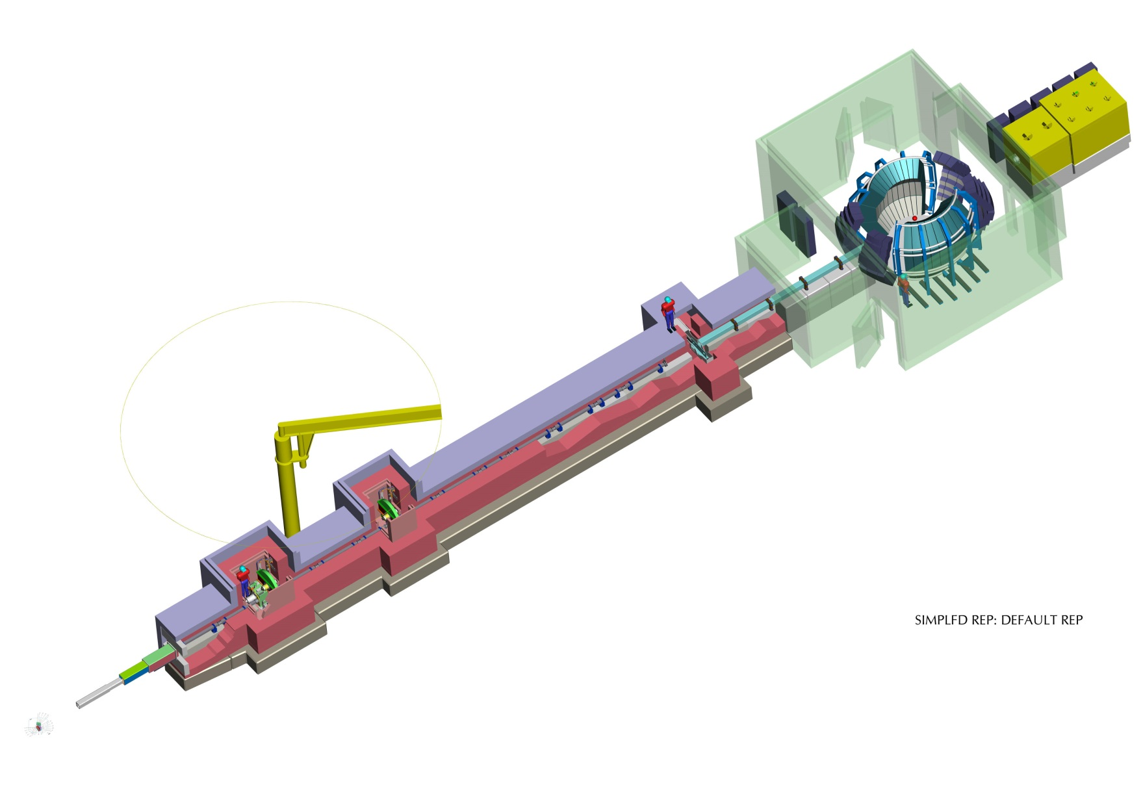
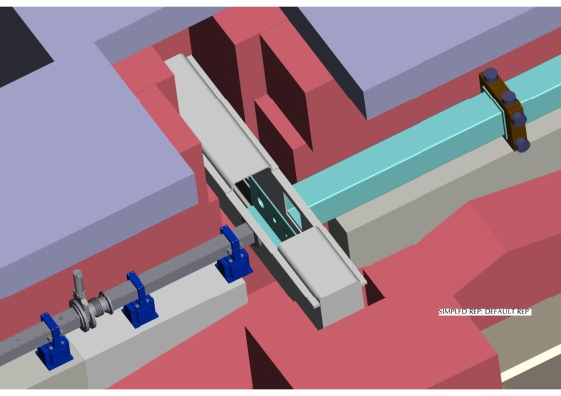
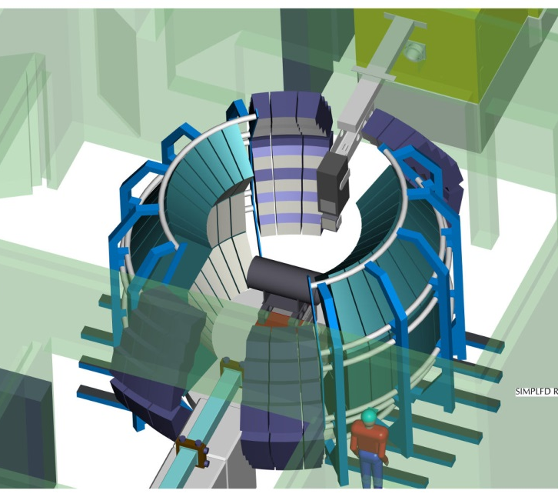
Instrument Preliminary Design
Feb 2010 – First outline design
Notes:
Horizontally translated pin-hole selector
Early detector array design

Slide 12
Instrument Preliminary Design
Feb 2010 – First outline design
Notes:
Impact of building location:
Facility soak-away needed re-siting
Facility HV supply cable diversion
Extensive existing building water treatment plant alterations
R80 Building structural columns in the way
Section with no overhead crane affecting design, assembly and operations

Slide 13
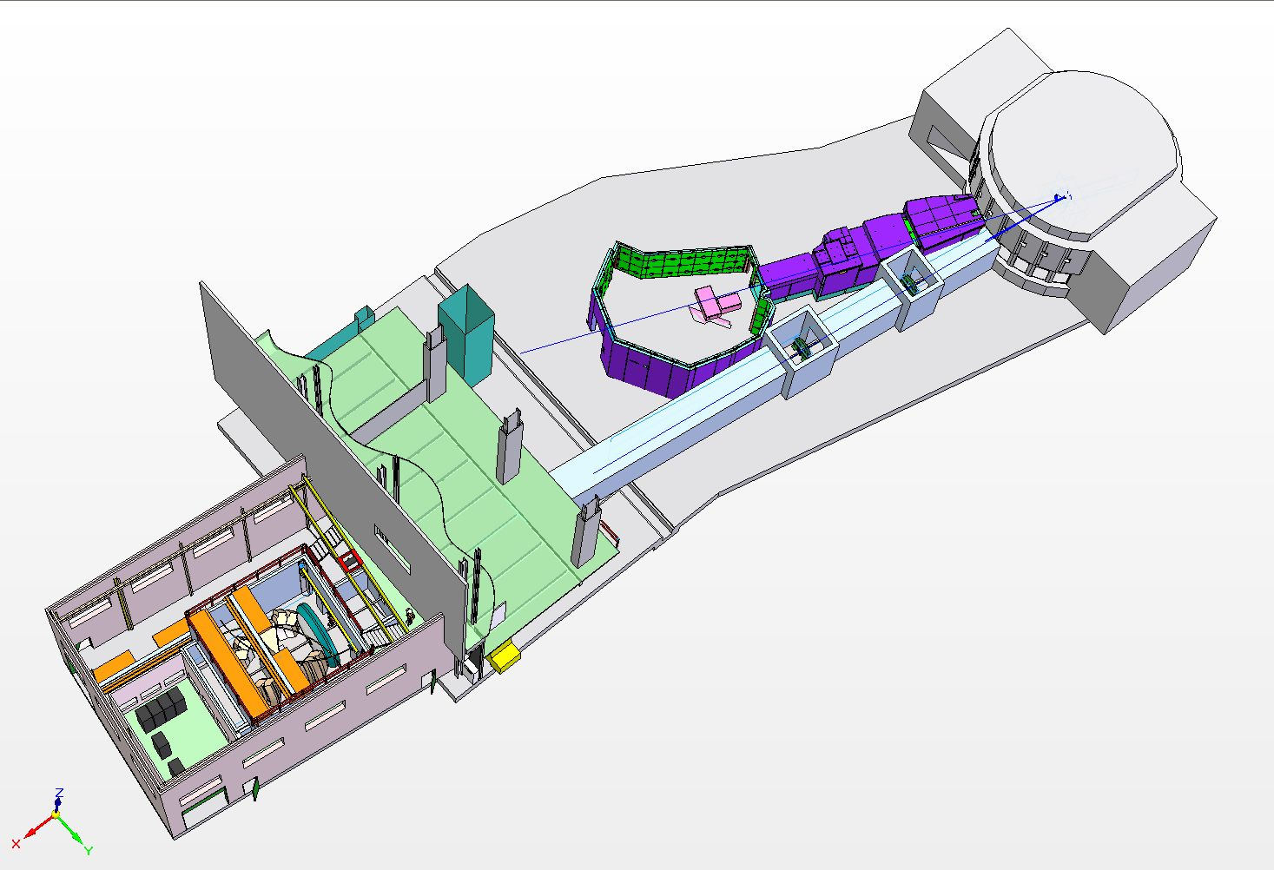
Instrument Preliminary Design
May 2010 – Revised outline design
Beamline offset at an angle of 1⁰ in order to avoid clashing with neighbouring instrument and facility structure
Chopper positions altered to suit space restrictions
Building added

Slide 14
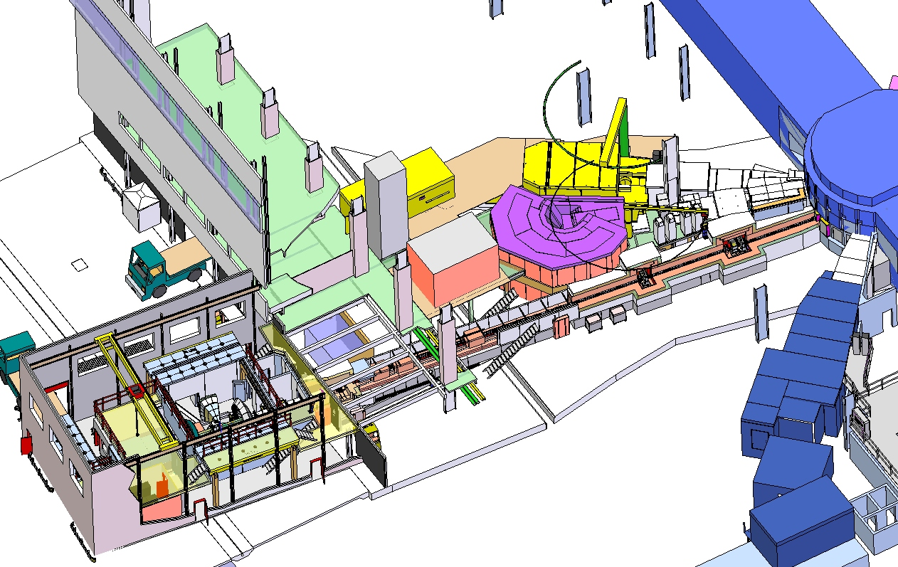
Instrument Preliminary Design
July 2010 – Developed outline design
Evolution:
Realistic shielding space envelope
Access around beamline
Space for instrument control equipment

Slide 15
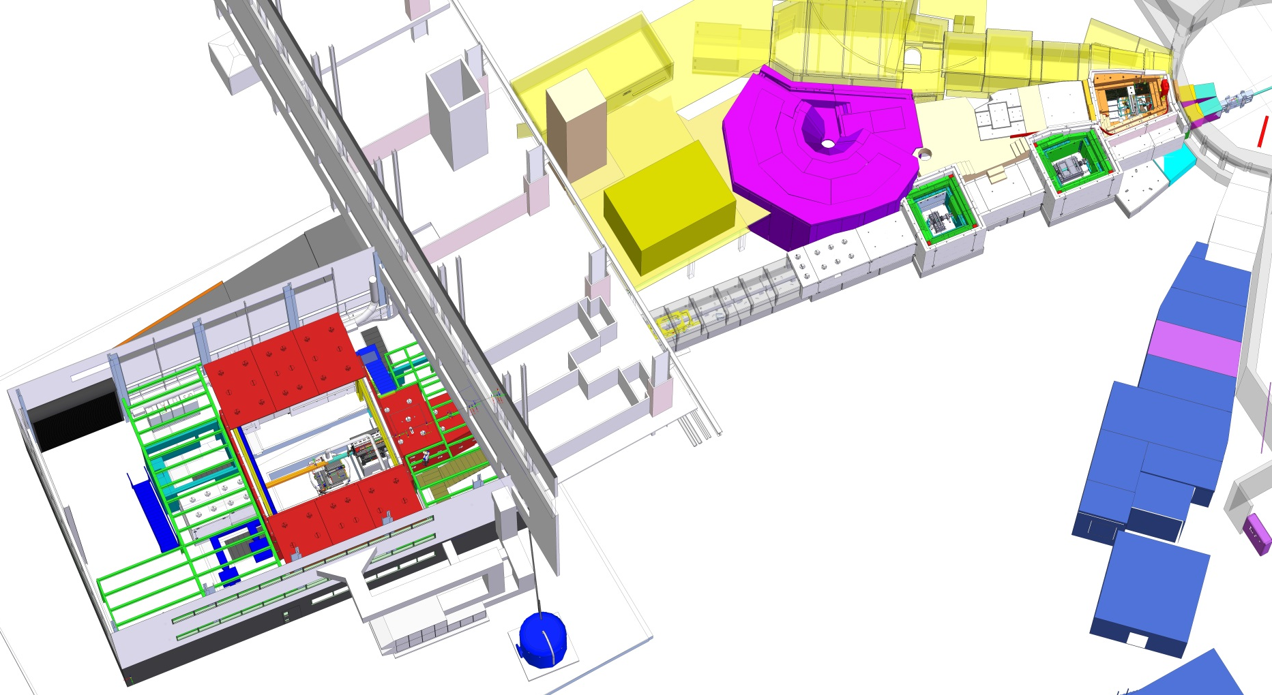
Instrument Detail Design

Slide 16
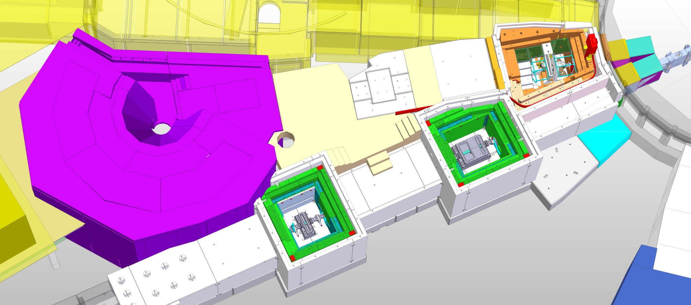
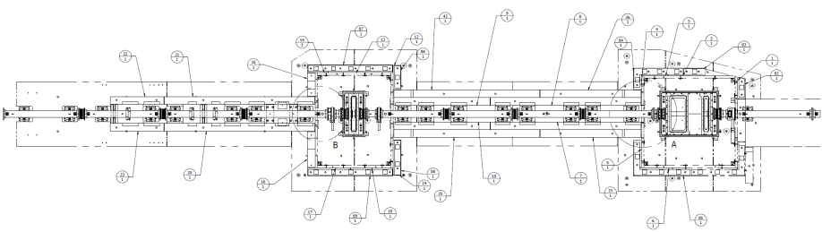
Instrument Detail Design
Detailed design
Evolution:
Access and operational improvements to chopper pits
Access platforms
Combined front end chopper pit
Notes:
Over 500 new pieces of IMAT shielding in this view alone.
With the guide, choppers & monitors – there’s well over 1000 specially designed parts

Slide 17
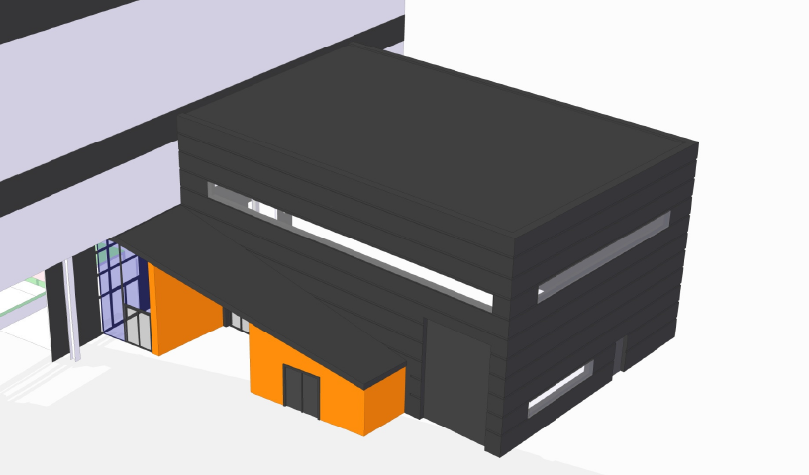
Instrument Detail Design
Nov 2011 – Detail Design
Increased height to accommodate overhead crane
Increased window coverage
R80 Entrance foyer
Main Entrance

Slide 18
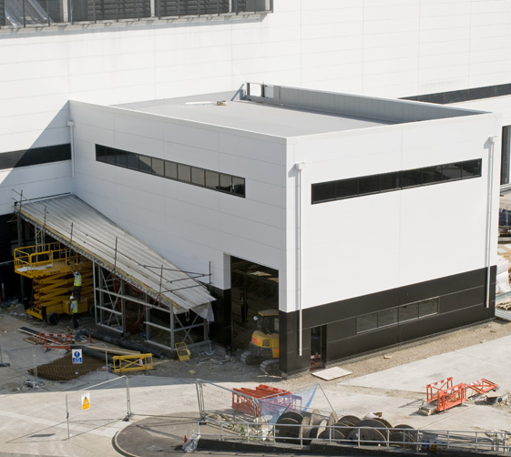
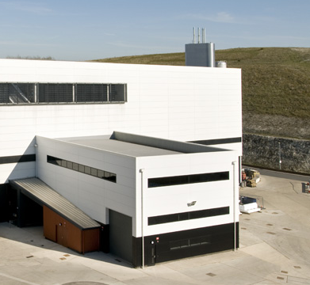
Extension Building Design & Build

Slide 19

Detector/Camera Evolution

Slide 20
Detector/Camera Evolution

Slide 21
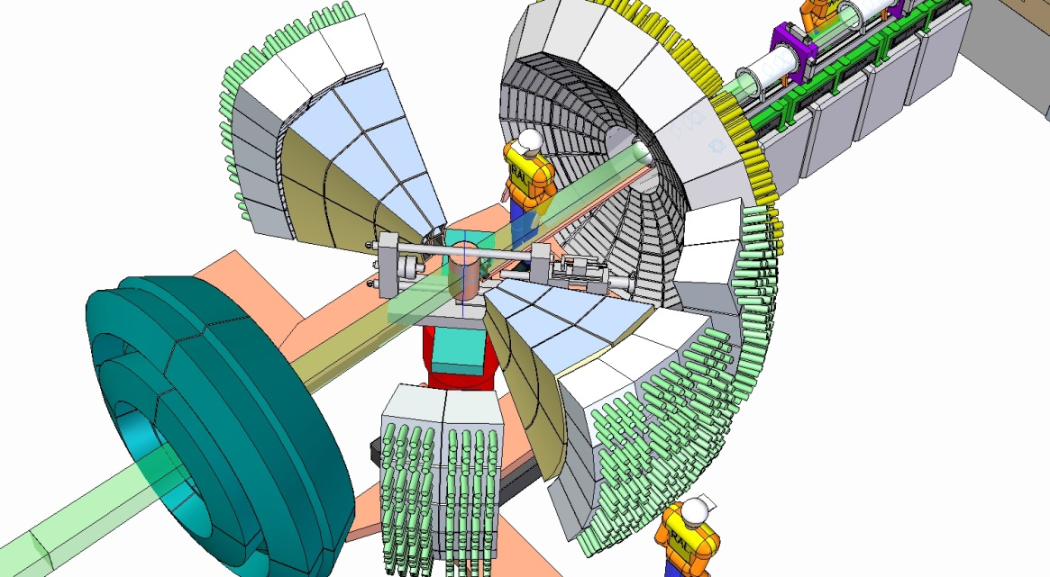
Detector/Camera Evolution

Slide 22
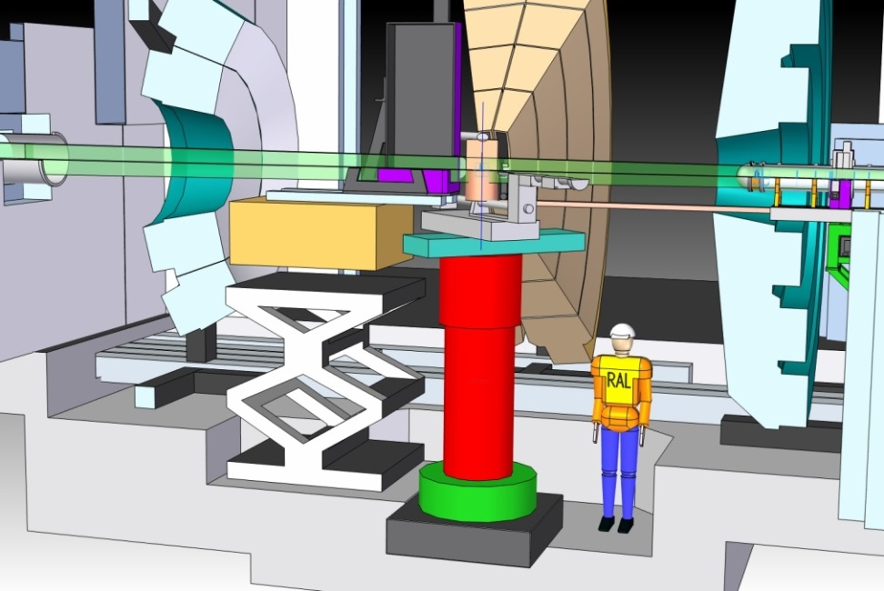
Detector/Camera Evolution

Slide 23
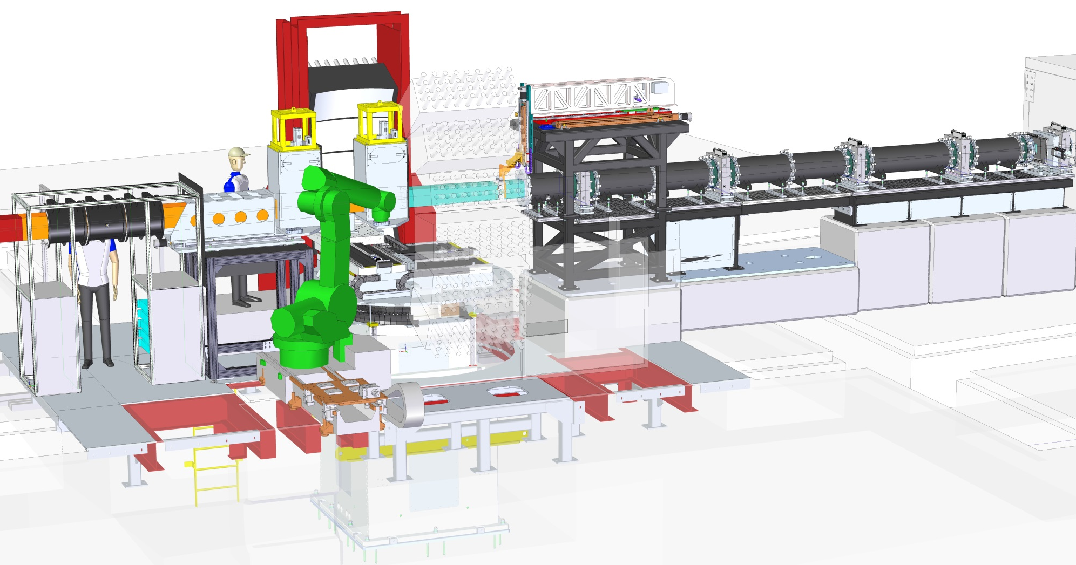
Detector/Camera Evolution

Slide 24


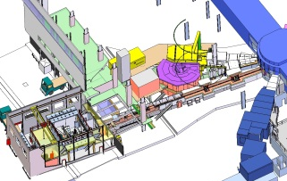

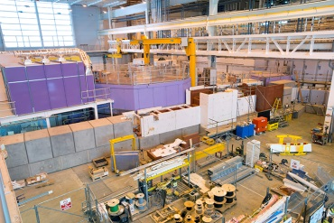
IMAT Design Evolution
Design continues to change throughout the life of the project
Major obstacles are addressed early on but many minor problems need to be solved throughout the design
Opportunities arise during the design and often need decisive action

