Slide 1
LoKI Status Tollgate 2
Instrument Team
Andrew Jackson
Clara Lopez
www.europeanspallationsource.se
2014

Slide 2







The LoKI Team
Lead Instrument Scientist
Andrew Jackson
Lead Instrument Engineer
Clara Lopez
Scientific Partners
Prof. Adrian Rennie, Uppsala University
Prof. Lise Arleth, Copenhagen University
Dr. Joachim Kohlbrecher and Dr. Gergely Nagy, PSI
Kalliopi Kanaki, Anton Khaplanov, Scott Kolya (Detectors)
Erik Nilsson, Robin Petterson (Choppers)
Carolin Zendler (Optics)
Natalyiia Cherkashyna (Shielding)
Anders Sandström (Motion Control)
Torben Nielsen (Software)
Anders Petterson (Sample Environment)
Peter Ladd, Marcelo Ferreira (Vacuum)
Stuart Birch (PSS)
Richard Hall-Wilton, Iain Sutton, Phil Bentley
Thomas Gahl, Arno Hiess, Jon Taylor, Tobias Richter,
Thomas Rod, Stewart Pullen, Hanna Wacklin
ESS Bilbao
U. Milan-Bicocca
CNR & INFN
Wigner Institute
STFC

Slide 3
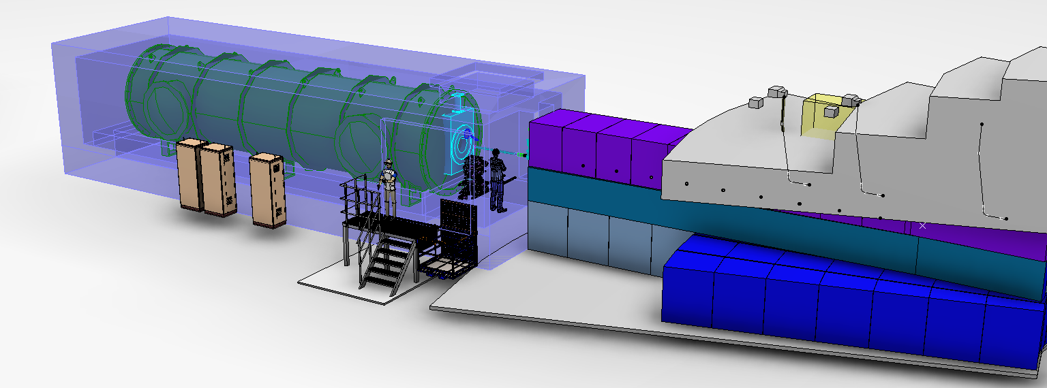
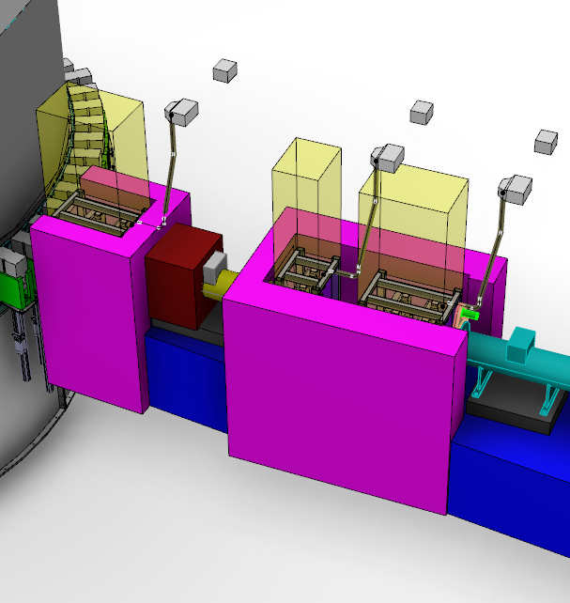
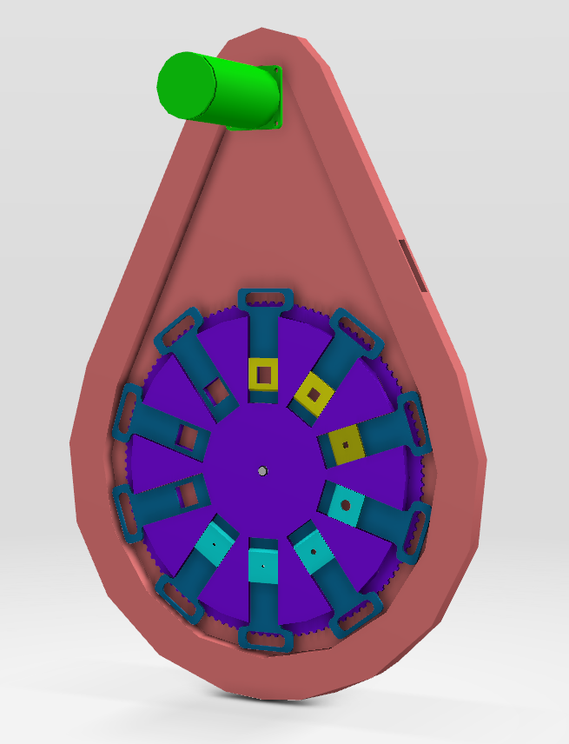
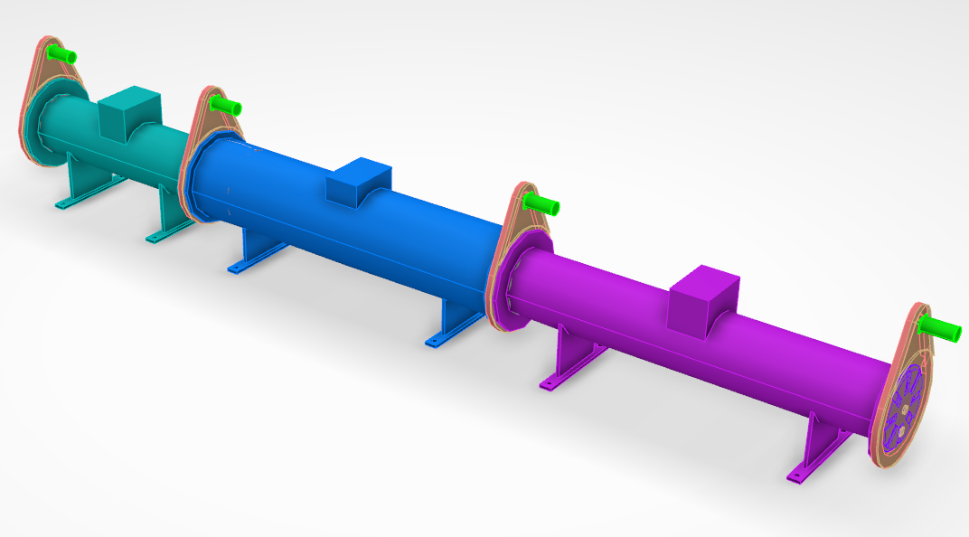
LoKI
Instrument Shielding
Bunker Shielding
Experimental Cave
&
Detector Vessel
Collimation changers
Aperture Changers
Chopper System

Slide 4
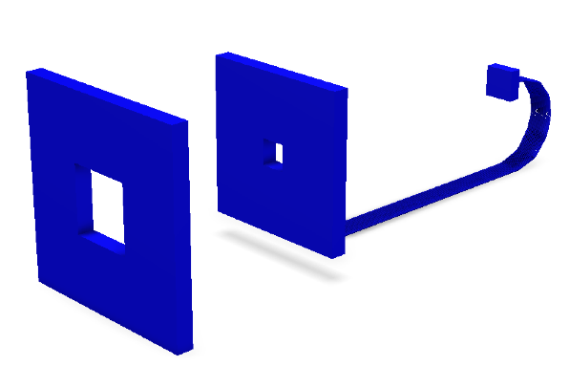
Budget – Full Scope
Full coverage of window frame style detectors
Resolution Enhancing Choppers
Full suite of sample environment
14 M€
 | Cost | Work | FTE
01 Shielding | €1 098 909 | 5480 | 3.04
02 Neutron Optics | €798 603 | 4167 | 2.31
03 Choppers | €1 185 418 | 7819 | 4.34
04 Sample Environment | €770 568 | 6104 | 3.39
05 Detector and Beam Monitors | €5 319 091 | 29322 | 16.29
06 Data Acquisition and Analysis | €0 | 0 | 0.00
07 Motion Control and Automation | €330 912 | 4187 | 2.33
08 Instrument Specific Technical Equipment | €3 635 157 | 28595 | 15.89
09 Instrument Infrastructure | €796 810 | 3380 | 1.88
10 Vacuum | €0 | 0 | 0.00
11 PSS | €114 640 | 800 | 0.44
Total | €14 050 108 | 89854 | 49.92
Spend Profile

Slide 5
Budget – Category A Scope
64 cm x 64 cm detector moveable from 2m to 10m
1.2m diameter vacuum vessel
Associated reductions in cave size and cabling etc.
No option to install resolution enhancing choppers
SE is only sample changer and no support from SE group
8.8 M€
Does not meet top level requirements and cannot be upgraded to instrument that does for reasonable cost
 | Cost | Work | FTE
01 Shielding | €948 909 | 5480 | 3.04
02 Neutron Optics | €798 603 | 4167 | 2.31
03 Choppers | €811 726 | 6632 | 3.68
04 Sample Environment | €62 688 | 56 | 0.03
05 Detector and Beam Monitors | €2 069 970 | 16854 | 9.36
06 Data Acquisition and Analysis | €0 | 0 | 0.00
07 Motion Control and Automation | €330 912 | 4187 | 2.33
08 Instrument Specific Technical Equipment | €2 995 157 | 28595 | 15.89
09 Instrument Infrastructure | €670 178 | 3096 | 1.72
10 Vacuum | €0 | 0 | 0.00
11 PSS | €114 640 | 800 | 0.44
Total | €8 802 783 | 69867 | 38.81
Spend Profile

Slide 6
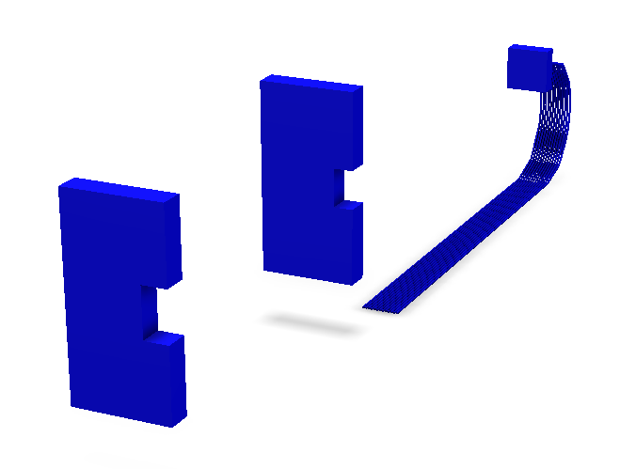
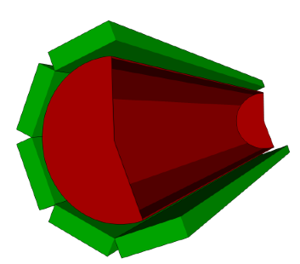
Budget – Initial Scope
Half detector coverage
Consider barrel detector – cost/performance considerations
Option to install resolution enhancing choppers
Basic suite of SE to enable partner experiments
12.1 M€
Meets top level requirements
 | Cost | Work | FTE
01 Shielding | €1 098 909 | 5480 | 3.04
02 Neutron Optics | €798 603 | 4167 | 2.31
03 Choppers | €876 230 | 6904 | 3.84
04 Sample Environment | €370 508 | 3603 | 2.00
05 Detector and Beam Monitors | €4 198 620 | 30158 | 16.75
06 Data Acquisition and Analysis | €0 | 0 | 0.00
07 Motion Control and Automation | €330 912 | 4187 | 2.33
08 Instrument Specific Technical Equipment | €3 556 533 | 27441 | 15.25
09 Instrument Infrastructure | €796 810 | 3380 | 1.88
10 Vacuum | €0 | 0 | 0.00
11 PSS | €114 640 | 800 | 0.44
Total | €12 141 765 | 86121 | 47.84
Spend Profile

Slide 7
Schedule – Phases and Milestones
TG2
TG3
TG4
TG5
2014 |  | 2015 |  | 2016 |  | 2017 |  | 2018 |  | 2019
Phase 1
 |  | 02 Project Management
 |  | 03 Design
 |  |  | 04 Procurement and Fabrication
 |  |  |  |  |  |  | 05 Installation
 |  |  |  |  |  |  |  | 06 Cold Commissioning
2014 |  | 2015 |  | 2016 |  | 2017 |  | 2018 |  | 2019
Detector Geometry Decision
Detectors Installed
Early Procurement Choppers
Choppers Installed
Early Procurement Optics
Shielding Procurement
Optics Installed

Slide 8
Staging : Initial to Full Scope
The additional fit out of the remaining window frame detector coverage, as foreseen in the full scope, would cost approximately 1.5 M€ on the assumption that while detectors would be cheaper by then, there would be additional manpower costs for restarting work. This could be paid for from a combination of operations budget and/or external grants.
Adding the resolution choppers would cost around 400 k€ and is something that we could envisage obtaining from external funding.
Sample environment would be paid for from an on-going programme using a combination of operations funds, external grants and collaborations with users.

Slide 9
Tollgate 2 - Review
Review held December 12th 2014
~500 pages of documentation delivered
Panel members:
James Treadgold (Chair)
Richard Heenan (ISIS – STAP Chair)
Charles Dewhurst (ILL – STAP)
Peter Schurtenberger (LU – STAP)
Bertil Winér (ESS – ES&H)
François Javier (ESS – Nuclear Engineering)
Panel recommendation:
B. The instrument project should move into the final engineering design phase with a list of recommendations to be evaluated

Slide 10
Tollgate 2 - Recommendations
If the barrel detector is to be seriously considered, simulations and prototype measurements are urgently required, followed by reporting to the STAP.
A more detailed scientific specification for both detectors is required.
The bunker shielding and beamline needs to be designed and evaluated as a matter of urgency.
The Beam port needs to be fixed as soon as possible.
The challenges of the bunker, services and equipment handling and maintenance are a key technical risk and need to be addressed.
Operations and maintenance need further review.
Safety needs to be more thoroughly considered including hazard identification and analysis.
The plan and its level detail should be revisited. It may not be a useful tool to drive the project.
Plan now in place to address these recommendations

Slide 11
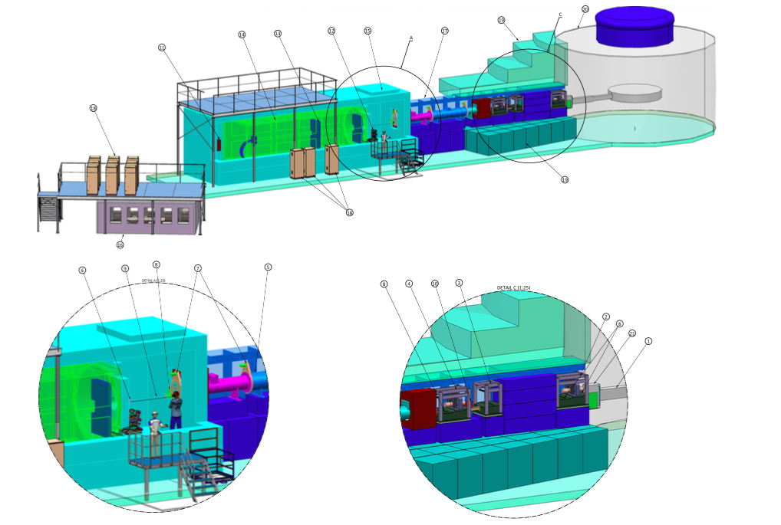
Questions?

