Slide 1
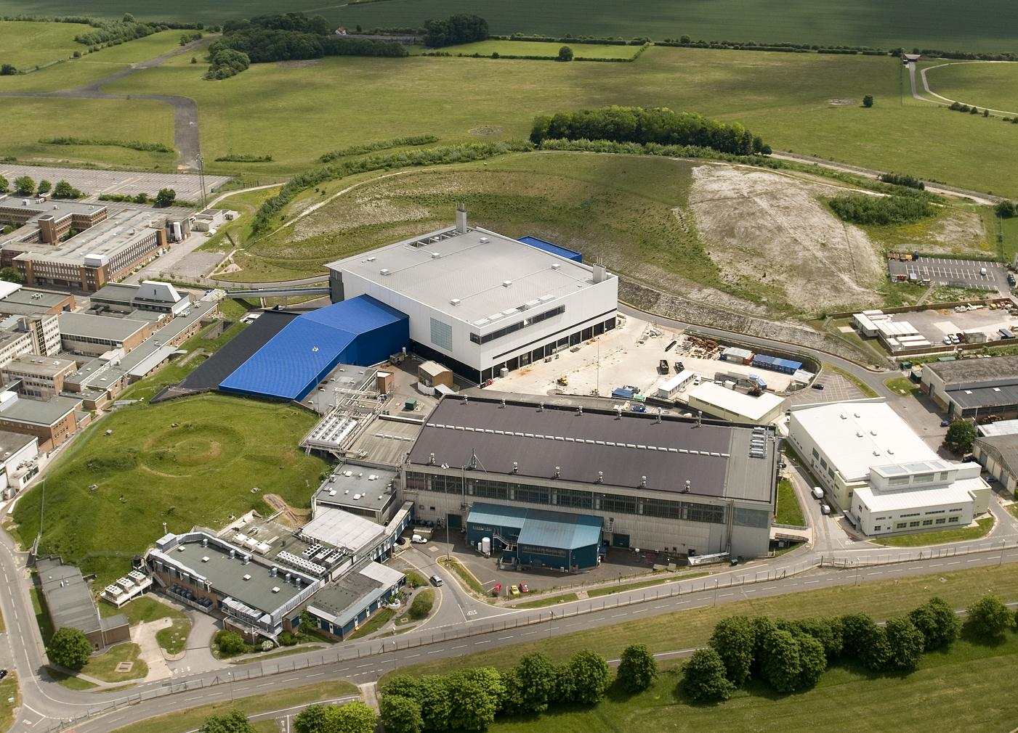
Challenges of building beamlines in an Operational Facility
TS2
Matt Fletcher
IKON 8 5/2/15

Slide 2
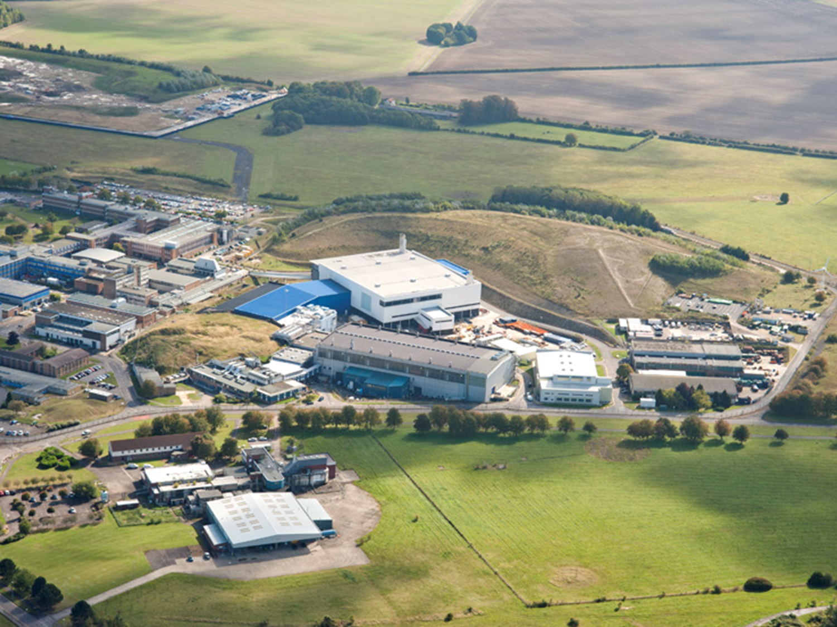
Talk outline
Installation constraints (mainly shutdowns)
People (Communication and expertise)
Infrastructure

Slide 3
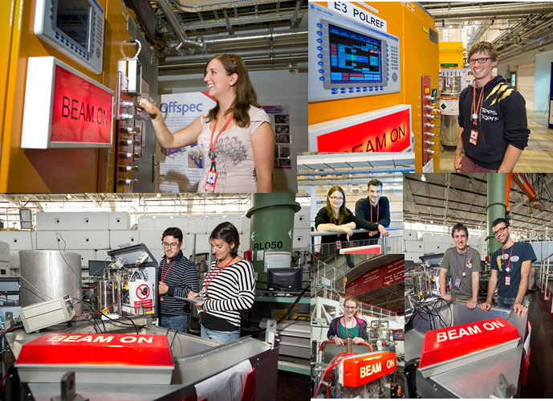
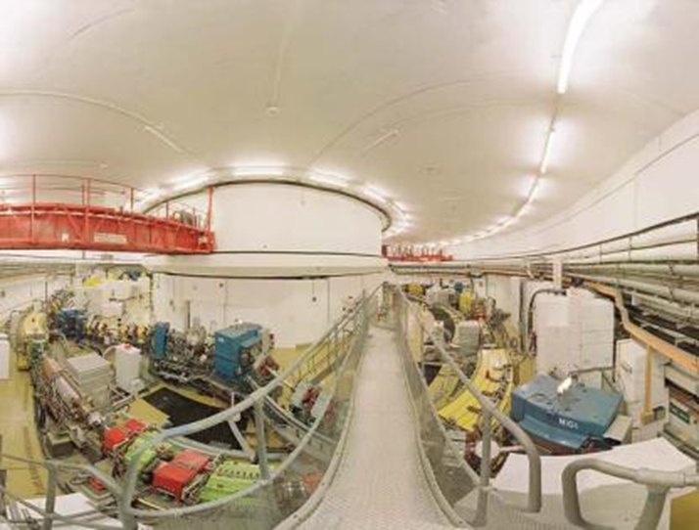
The need to be on.
Dominates much of the thinking
Drives the need for reliability (accelerator / target / instruments)
Has to be tensioned against maintenance……
…. and build of new equipment

Slide 4
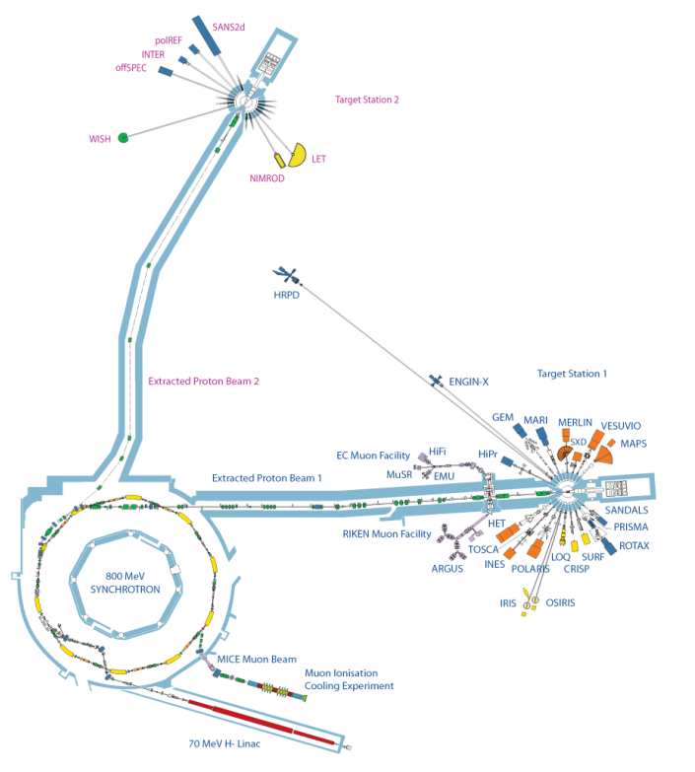
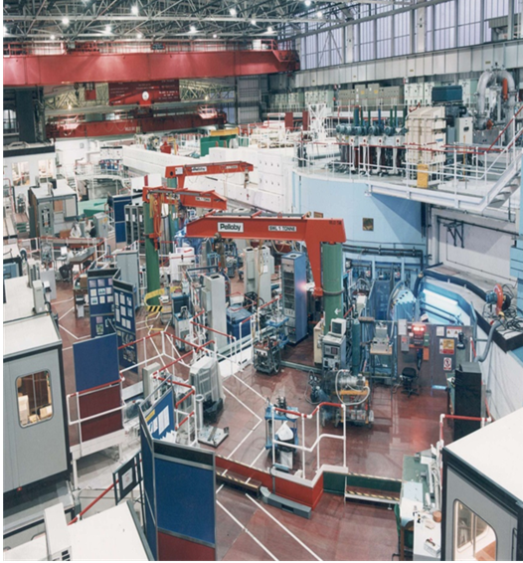
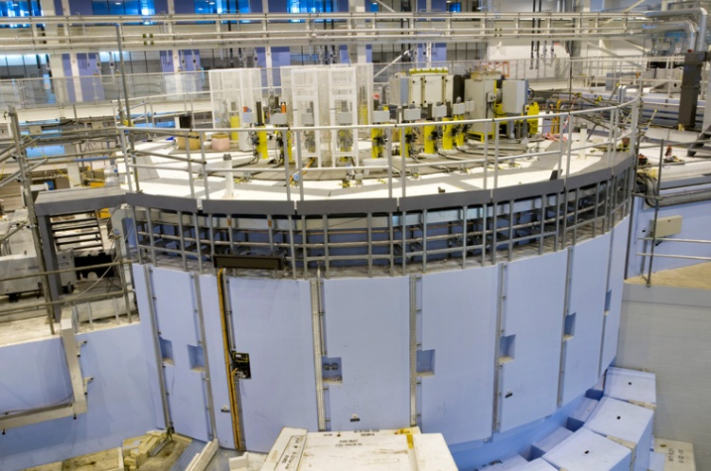
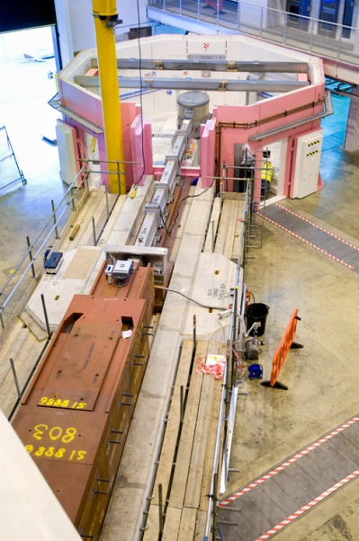
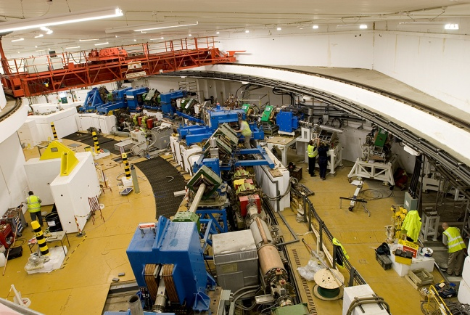
Instruments
Targets
Accelerator
Instrument builds fit in to shutdowns

Slide 5
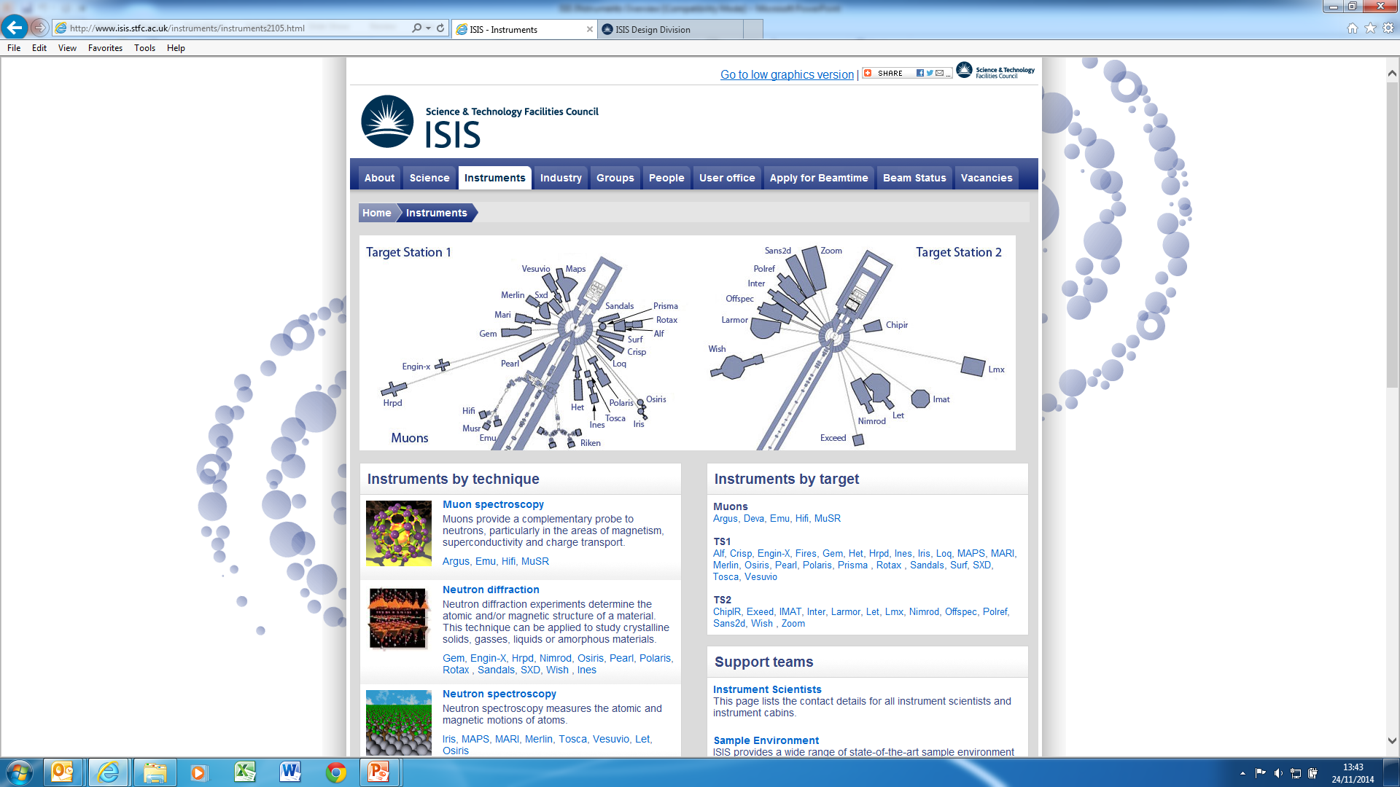
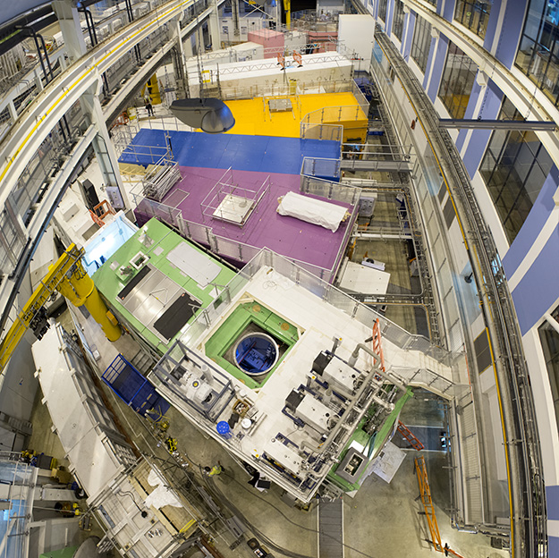
Target Station 2
TS2 currently has 7 operational instruments, 4 more with Phase 2
Almost constant build of instruments from 2005 - today – and beyond
The first instrument, Inter, took neutrons in August 2008 – Zoom to open in Aug 2016
Installed in a mixture of operational and shutdown periods

Slide 6
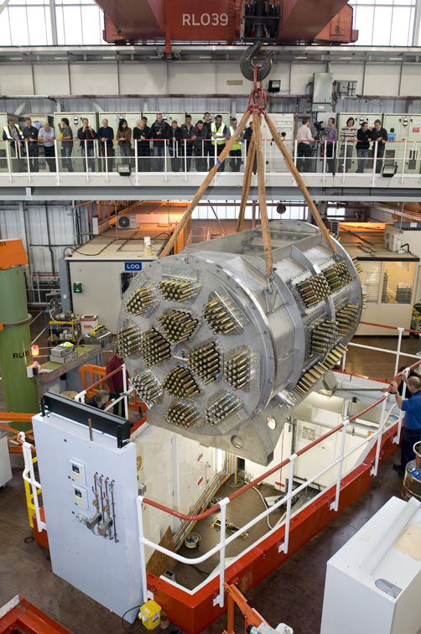
Full suite of Instruments including the Muon Beamlines
First instrument on TS1 1984
Currently Running 44 Upgrade projects (Maps / Tosca are large examples)
Installation happens in a mixture of operational and Shutdown periods depending on the work to be done
Polaris detector tank installed 2011

Slide 7
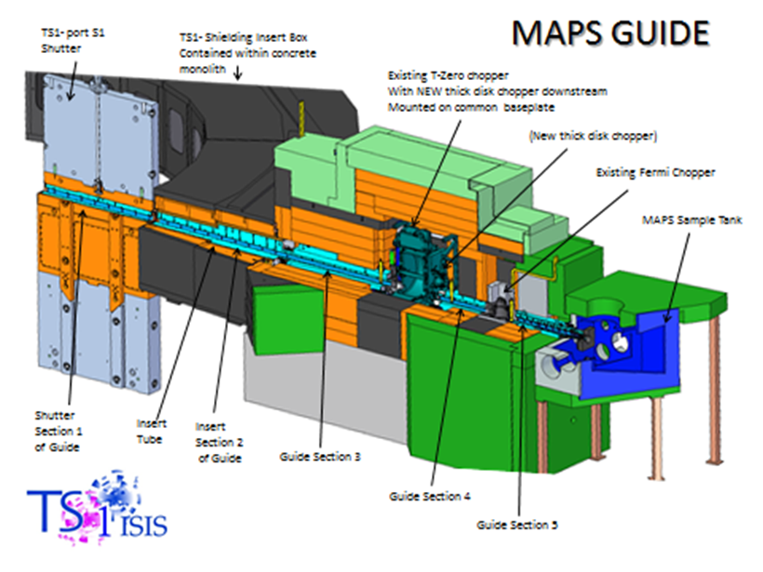
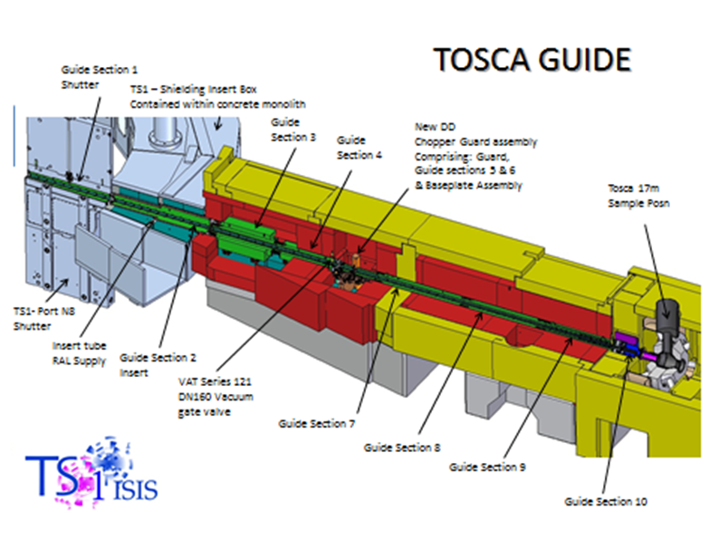

Shut downs at ISIS are planned in some detail
We would always like to do more
  Crane and people mostly the limiting factor
Having a team dedicated to new build work is beneficial - Tension between operational and new build
DOCUMENTATION

Slide 8

Radiation
Limits
  3mSv/year (0.2mSv/day) Classified workers
  UK legal limit 20mSv/year
Complicates the build sequence
  Additional Temporary shielding
Restricted work areas close to the monolith
Survey requirements – Prior Risk Assesments
Accumulated dose to staff
Costs and handling of active equipment

Slide 9
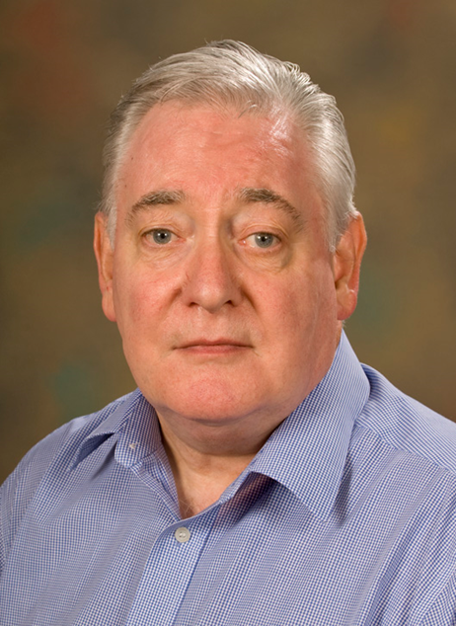
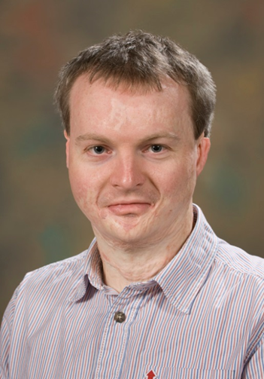
People
Communication
  When is this ever not important?
When is experience not useful?
  Innovation…. (Doing things differently)
ISIS science leads on instruments also run the instruments
Operational experience can be built into the design through science / engineering / operational staff
There is a lot of support need from teams that work across a number of projects.
Many tens of people contribute to an instrument design / build
People change during the project – documentation is useful, but not perfect

Slide 10
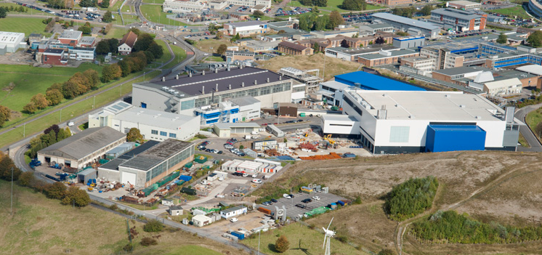
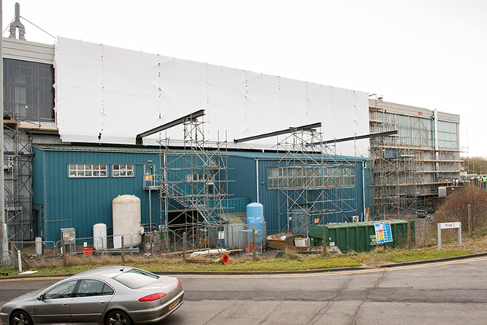
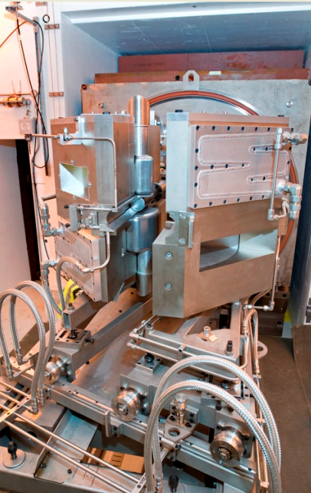

Existing Infrastructure
Examples to critique from
  Physically see it
Boundaries
  Provide startpoint
  Also limit
It has grown over the years
  Organic
Needs repair (always fixing /adding something with buildings)
Multiple draws on space
Communication of potential use
Access to storage / services

Slide 11
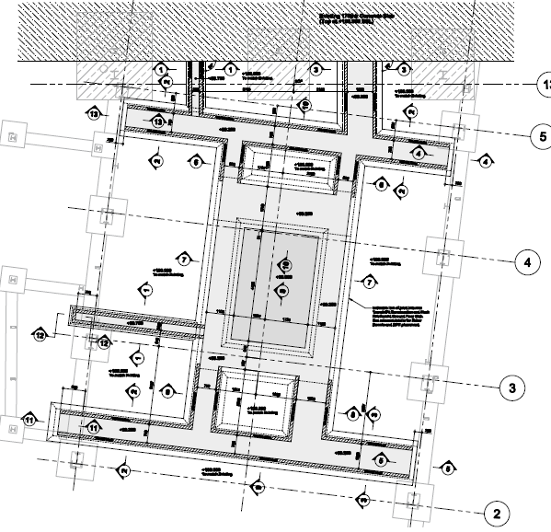
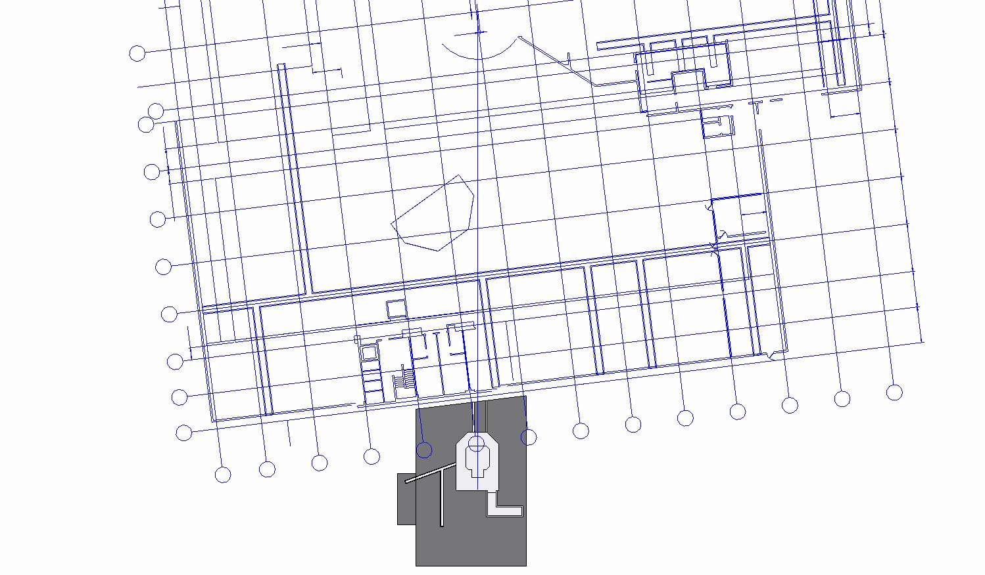
Never forget services – they need space too
Original services trench design
Revised, greatly extended services trench design

Slide 12
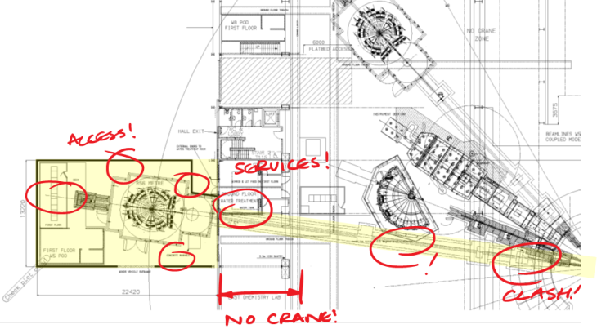
Instruments have to interface with existing and future structures.
Be kind to the next guy.

Slide 13

Funding
Uncertainty of operational budgets in future years
  Make planning and resourcing incredibly difficult this has a knock on effect on spend across FY
Competing against other projects for finance
  Pressures to make builds cheaper potential to compromise science.
Spend across financial years
  Pressure to spend in the correct financial year rather than at the correct point in the project means the ideal spending decisions are not made

Slide 14
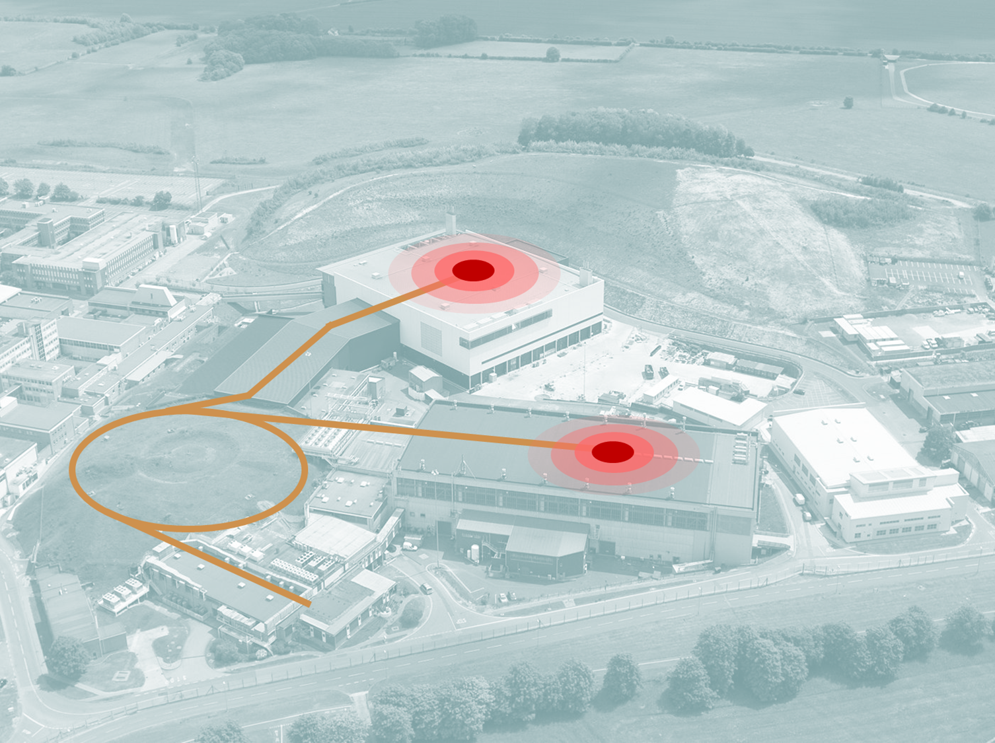
Summary
Instruments are long and complex projects and need to fit into the run schedule
You should always be building / upgrading instrumentation
The science comes first - we will move whatever needs to be moved to build the best beamline possible – but this will cost – and the pot is not infinite
Instruments interface with the buildings – buildings to be as flexible or it will either limit possibilities (or Cost)
Experience really helps (but can limit innovation)
Think Ahead to the next instrument
Communication is always important

