Slide 1

Science Support Systems
-
Lessons Learned from Phase 1 LoKi and NMX
Anders Pettersson (SSS4LoKi)
Zoë Fisher (SSS4NMX)
Arno Hiess
Scientific Activities Division
www.europeanspallationsource.se

Slide 2
Science Support Systems – Scope
Science Support Systems
Scientific Coord.
User Office
Temperature
Field
High Pressure
Mech. Proc.
Fluids, Colloids
Suspensions
Deuteration
Crystallisation
Sample handling
general labs
Mechatronics
Integration
‘Scientific Support Systems’ will deliver scientific and technical environment supporting needs for the user program and enable research using neutrons by providing platforms for:
Temperature, Magnetic and Other Fields
High Pressure and mechanical Processing
Fluids incl. Gases, Vapor and Complex Fluids
Deuteration and Macromolecular Crystallization
Sample Handling and General User Labs
Mechatronics and Software Integration
Scientific coordination and User Office.
The Scientific Activities Division (SAD) in charge of NSS Work Package ‘Science Support Systems’.

Slide 3


Lessons learned on Science Support Systems during Phase 1 of NMX and LOKI
One SAD contact acting as interface for instrument team.
More interactions in phase 1 than all parties initially anticipated.
Interactions started late 2014 but with efficient and intense exchange we:
Identified challenges and priorities
Refined strategy for ‘Science Support Systems’
Established time lines and ‘work breakdown structure’ (WBS)

Slide 4
SSS Challenges and Possibilities
Challenges and Possibilities | Needs and Requirements
Research infrastructure User operation service | Safety, Reliability, Efficiency, Flexibility, Ease-of-use, Modularity, Maintainability, Robustness, Standardization, Access modes
Focusing optics, flexible resolution Small samples | Increased positioning precision and stability
Increase throughput, Parametric studies Sample activation | Fast parameter change / no wait (incl. back to ‘ambient’), Automated sample handling, Track and optimize ‘sample pipeline’, Waste
Complex samples Weak scattering | Increased parameter precision Low neutron background
Kinetic and stroboscopic experiments More extreme conditions and reduced gauge volume | (in-situ / ex-situ) combined parameter control Optimization specific equipment requirements (volumes, geometries)
4

Slide 5
Priorities
Laboratories and Workshops
Preparations for subsequent activities MESI, FLUCO ,PREMP, TEFI
Conventional Facilities entering final design SULF
Developmental Technologies to meet ESS challenges:
Examples: Robotic Sample Change (MESI), Remote Control Processing (FLUCO), Micro-beams (PREMP), Fast Temp. Change (TEFI)
Interfaces
Interfaces within ESS: MCA, ICS, DMSC, ESH, CF, CRYO, COMM, SV, LU …
Interfaces to instrument teams
Readily Available Technologies
Procurement (cash or in-kind) in time for operational phase incl. training.
Examples: humidity (FLUCO), clamp cells (PREMP), PTRs (TEFI)

Slide 6
Strategy
‘First things first’ as only core functionalities are within NSS budget
Prioritize in respect to instrument construction schedule.
ESS challenges require developmental activities on different timeline.
Emphasis on standardization and integration of commercial components.
Instrument specific sample environment and labs are part of instrument.
‘Pool’ sample environment and common labs are for whole instr. suite.
Involve (university) partners with unique competences considering their budget and spending constraints within in-kind scenario.
Additional functionalities require third-party funding beyond in-kind.
6

Slide 7
Milestones for Science Support Systems related to Instrument Construction Schedule
Instrument
Construction
Commissioning and Operation
Instrument Proposal
Phase-0
Preparation for Preliminary Design
Phase-1
Preliminary Design
Phase-2
Detailed Design
Phase-3
Procurement, Construction & Installation
Phase-4
Cold Commissioning
Phase-5
Hot Commissioning
Phase-6
User Operations
Tollgate 1
Tollgate 2
Tollgate 3
Tollgate 4
Tollgate 5
Sample Environment
SE 1
Instrument specific S. Env. €
SE 2
SE 3
Pool S. Env. €
SE 4
Infrastructure for S. Env. €
SE 5
SE 6
Support Laboratories
LAB 1
Instrument specific labs €
L 2
LAB 3
Common labs €
LAB 4
Sample workflow (safety) €
LAB 5
Scientific Coord. & User Office
Scientific partners, users, sample workflow
SCUO 1

Slide 8
13.3 Science Support Systems SSS
13.3.1 Management, Administration and Interactions
13.3.4 Mechatronics and Software Integration MESI
13.3.7 Pressures and Mechanical Processing PREMP
13.3.6 Fluids incl. Gases, Colloids and Suspensions FLUCO
13.3.5 Deuteration and macro-molecular crystallisation DEMAX
13.3.3 Sample Handling and General Use Labs SULF
13.3.2 Scientific Coordination
and User Office SCUO
13.3.8 Temperature and Fields TEFI
Management
Instrument Construction
External Projects

Slide 9
13.3 Science Support Systems
13.3.1 Management
Interactions
INSTRUMENT NN
@ SSS
External Projects
NN-specific
laboratories
NN-specific
SE equipment
SE Mechanical Integration Handling
SE Control Box and Software Integration
LAB Safety and sample workflow
SE Equipment 1
SE Equipment 2
Lab 1
Lab 2
Instrument Construction
NN4SSS
utilities supply
GENERIC INSTRUMENT

Slide 10
13.3 Science Support Systems
13.3.1 Management Interactions
LOKI @ SSS
13.6.3.2.3 Sample Environment Equip.
Sample changer, ambient T
Sample changer;
-20C < T < 150C
Flow cell with
HPLC pumps
quartz cells
13.6.3.5.7 SE Control Box
External Projects
Rotating holders for sediment. samples
Instrument Construction
LOKI4SSS
utilities supply
13.6.3.5.7 SW Integration
No lab on instrument
More equipment
SANS mini-pool
LoKi

Slide 11
13.3 Science Support Systems
13.3.1 Management Interactions
NMX @ SSS
13.6.4.2.3.3
SE Integration
13.6.4.5.7
SE Control Box
External Projects
Instrument Construction
NMX4SSS
utilities supply
NMX sample prep
NMX SE-Equipment
Cryostream
Humidity Control
NMX

Slide 12

What could be easily improved
SAD should preferably be involved earlier in the instrument projects now starting, through a dedicated contact person in SAD.
SAD should be on the same information channel as the instruments regarding information on toll gates, templates and required input.
Set SSS@NN expectations and scope three months (?) prior to TG2 to avoid last minute panic.

Slide 13
Lessons learned on Science Support Systems during Phase 1 of NMX and LOKI
One SAD contact acting as interface for instrument team.
More interactions in phase 1 than all parties initially anticipated.
Interactions started late 2014 but efficient and intense exchange.
Instrument have different ways how they deal with SSS: specific equipment, (mini-) pool, shared (part-time) resources
Instrument teams have different view on what to expect from SAD.
Developed expectations together (on short notice) but …. we made it successfully through TG2.

Slide 14
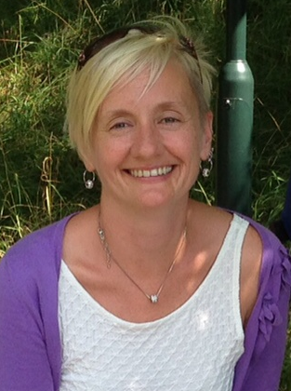



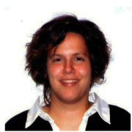
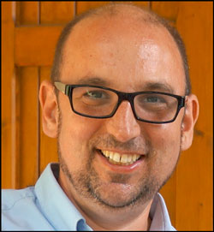
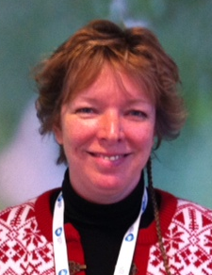
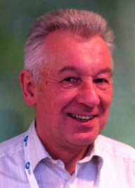

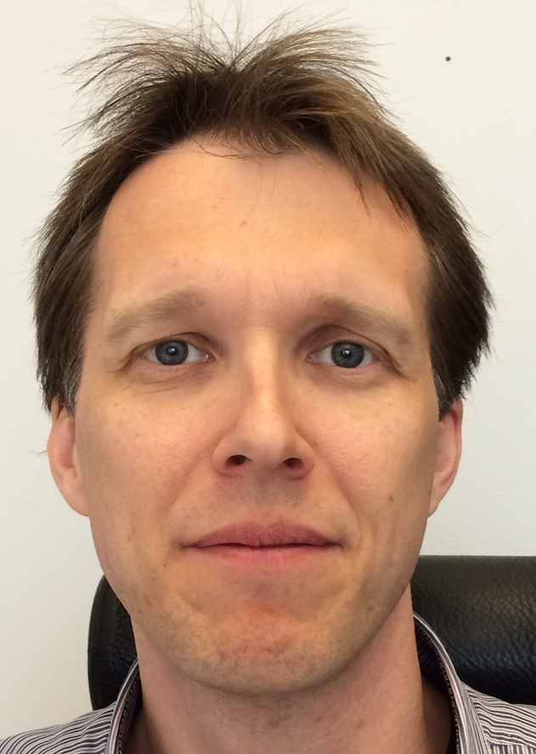
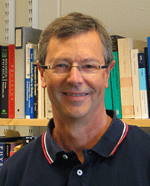
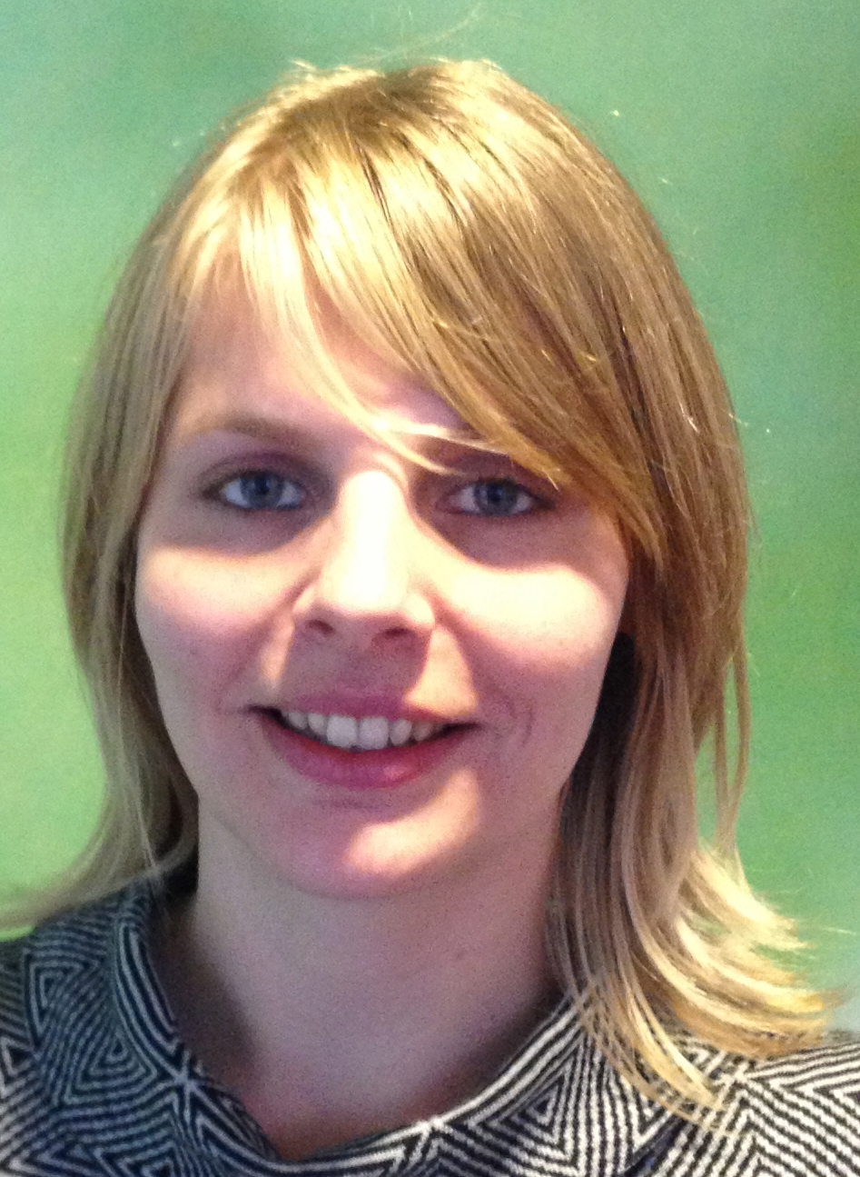

Scientific Activities Division – core team and beyond
Heloisa Bordallo Scientific Advisor; U Copenhagen
Michelle Everett Scientific Engineer ‘General Labs’
Zoe Fisher Scientist ‘Deuteration/Crystallisation’
Malcom Guthrie Scientist ‘High Pressure’
Stephen Hall Scientific Advisor; LTH Lund
Monika Hartl Radio-Chemistry (SLA target)
Arno Hiess Head of Scientific Activities Division
Bea Linnenberg Team Assistant
Michael Meissner Scientific Advisor; Berlin
Sindra Petersson Senior Advisor
Anders Pettersson Engineer ‘Mechatronics’
Peter Schurtenberger Scientific Advisor; Chemistry Lund
Camille Theroine PostDoc Fundamental Physics
Alexander Holmes Scientific Engineer ‘Temperatures / Fields’
NN Scientific Engineer ‘Fluids’

