Slide 1
The German Contribution to ESS
Andreas Schreyer
Helmholz-Zentrum Geesthacht
Germany

Slide 2
http://www.helmholtz.de/en/research/structure_of_matter/research_with_photons_neutrons_and_ions_pni/neutrons/
Notes:
interdisciplinary topic: Data management
cross program initiative: LSDMA

Slide 3
https://www.sni-portal.de/kfn/Archiv/Neutronenforschung-2013.pdf

Slide 4
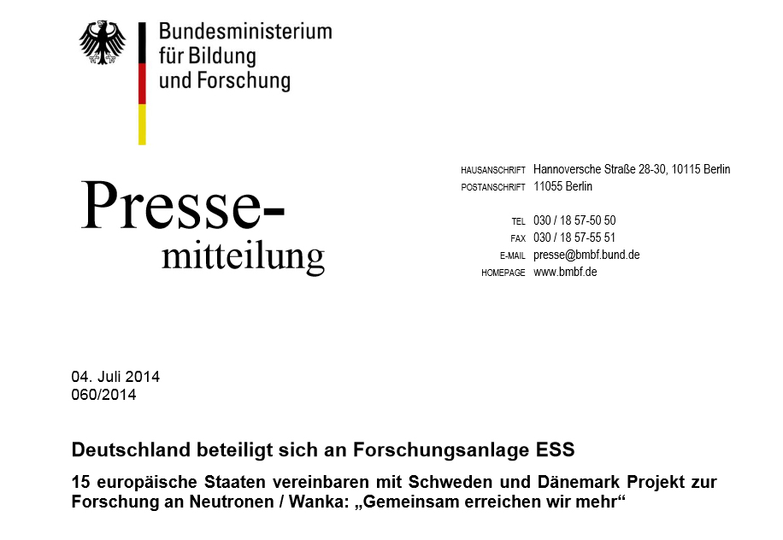
Deutscher Beitrag
4

Slide 5
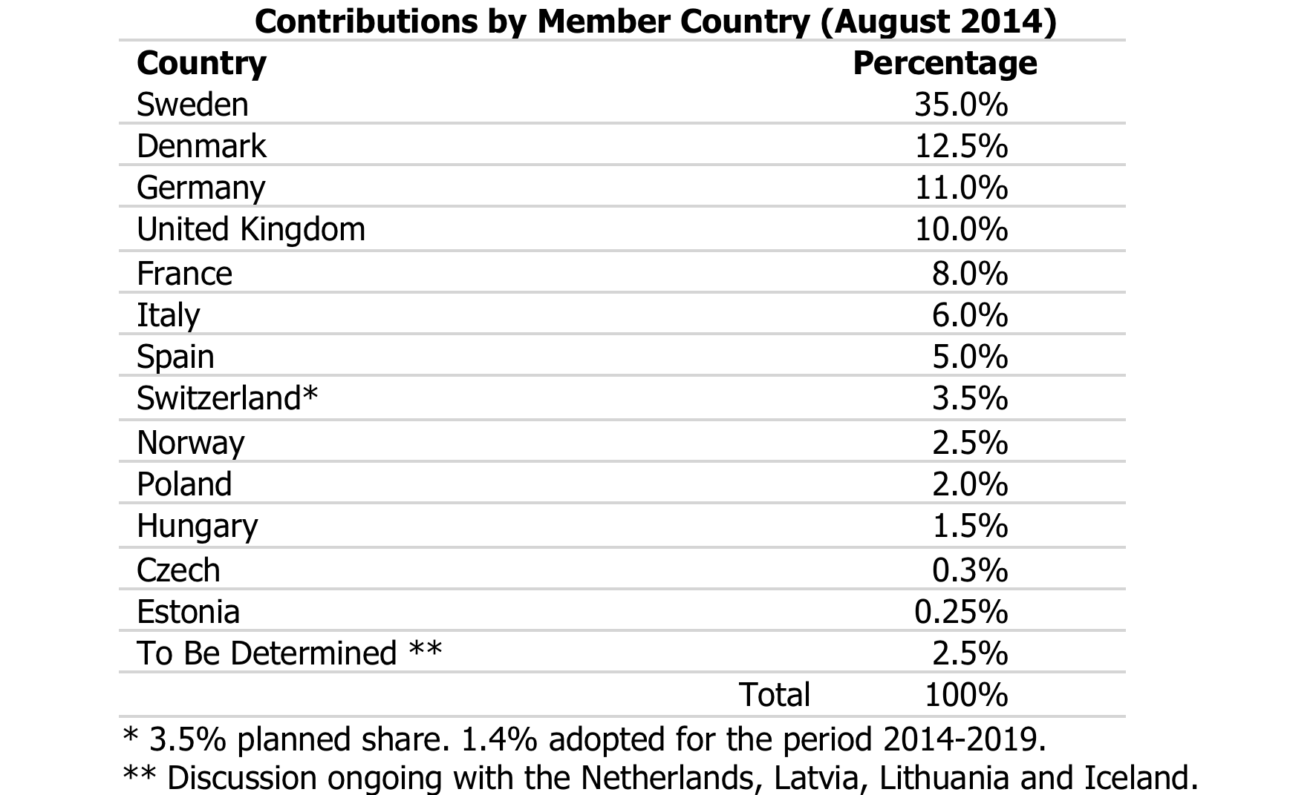
German Contribution
Press Release:
„Germany contributes 202.5 million Euro to the construction cost and 15 million Euro annually to the operation cost.“
Construction:
Construction is funded
Operation:
140M€ annually estimated, division in the long term unclear

Slide 6
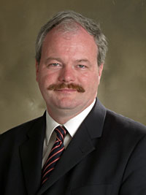
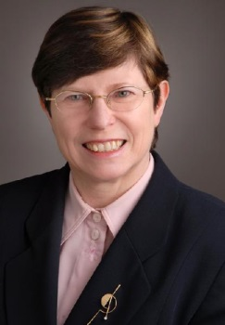
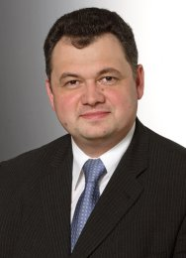
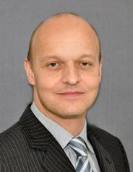
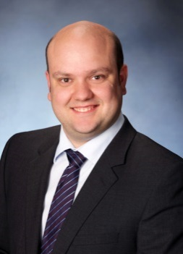
German ESS Design-Update Project (2010-2014)
Chair of the German Steering Committee
Members of the ESS Steering Committee
Project Coordination

Slide 7
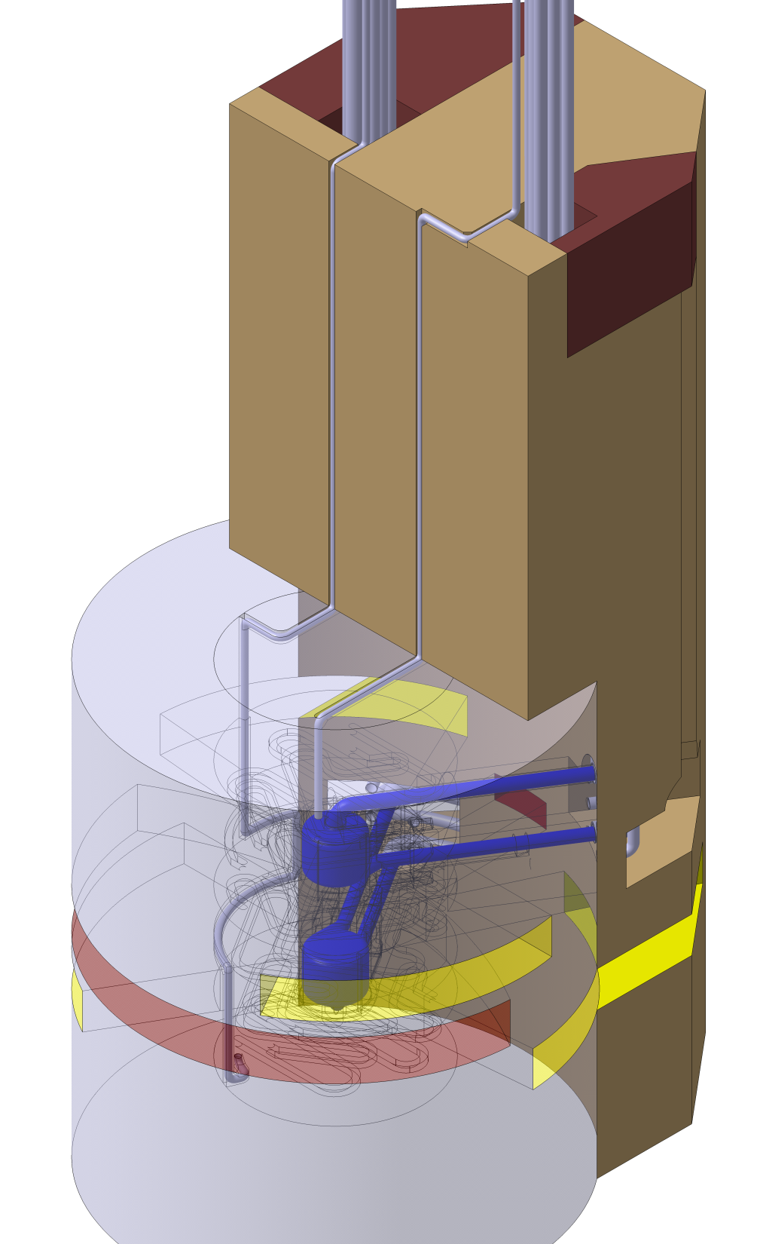
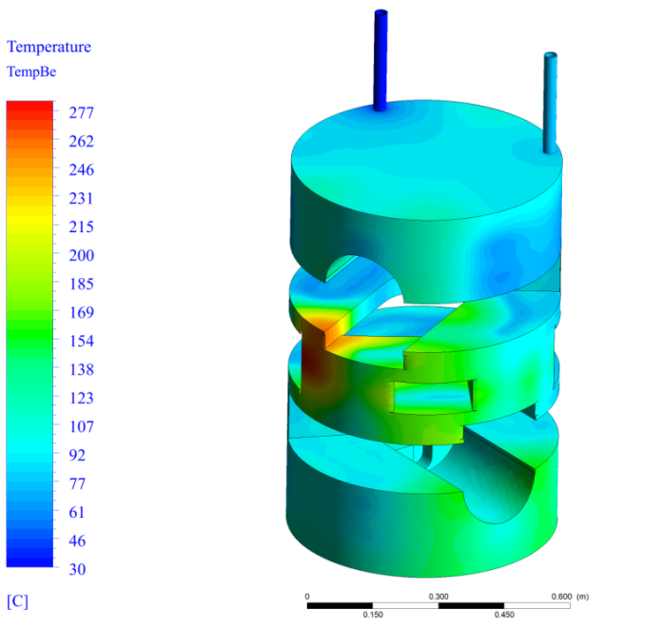
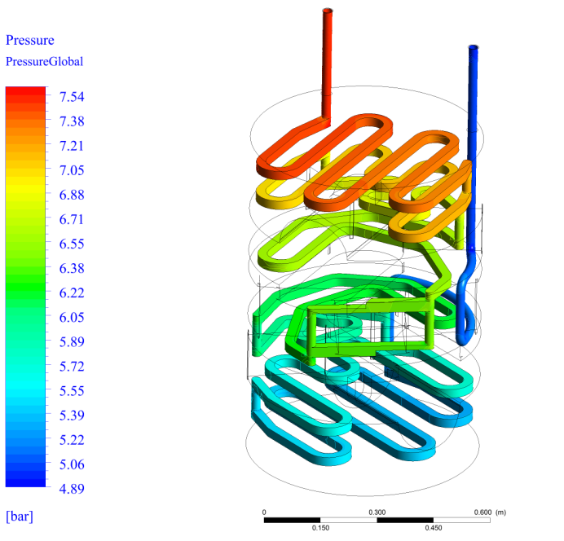
Moderator and Reflector
Concept not finalized, In-Kind Package not yet open for application
FZJ is the only potential Partner for a leading contribution

Slide 8
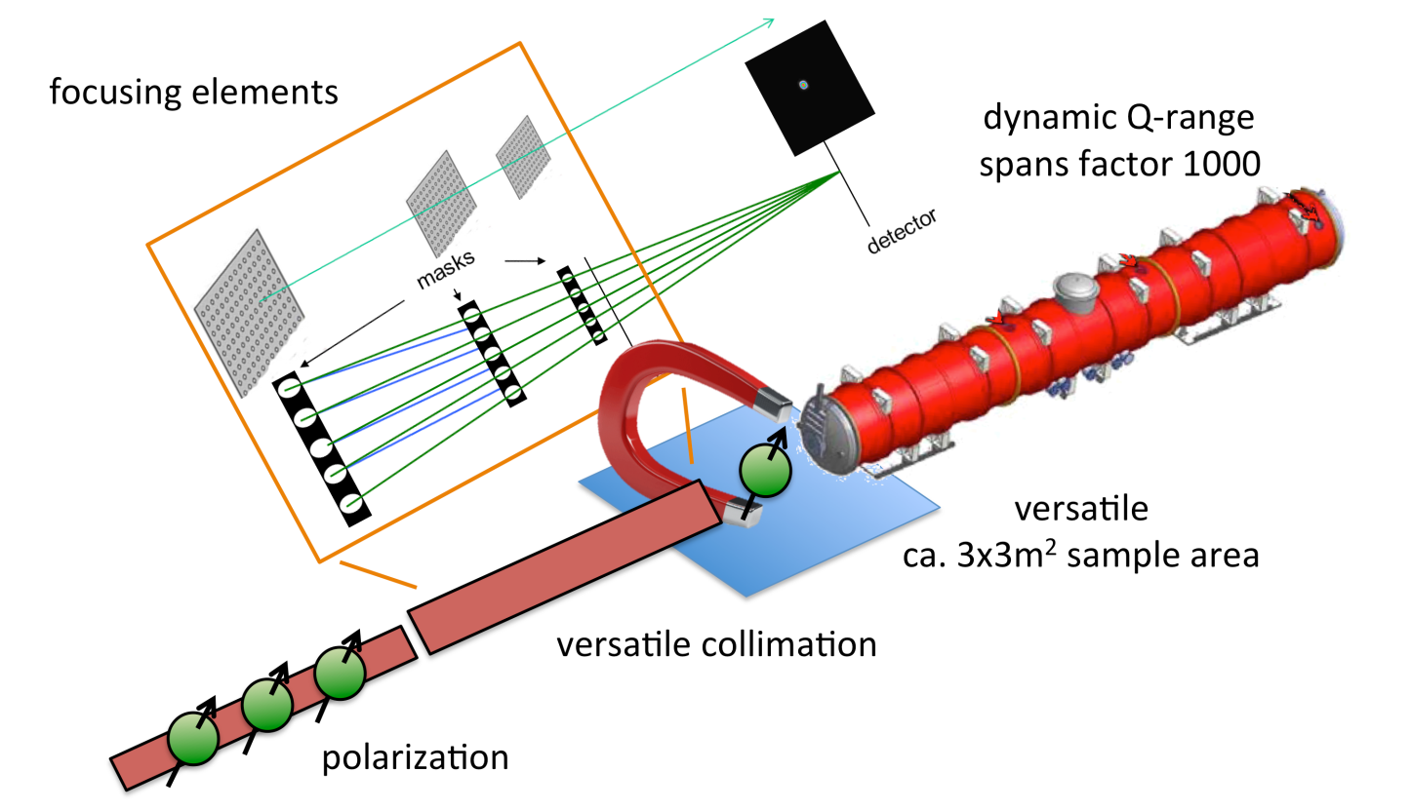
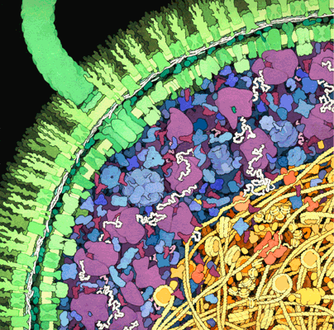
The SKADI Small K Advanced Diffractometer
Successful instrument proposal,
recommended for phase 1
E. Coli (Goodsell)
20 m
Science case: Soft Matter, Biology, Magnetism
Type: Small Angle Neutron Scattering with polarization
Labs: FZJ, LLB

Slide 9
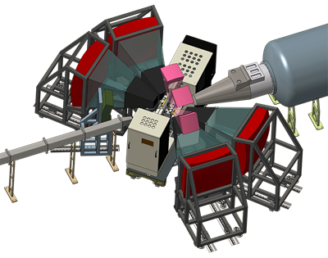
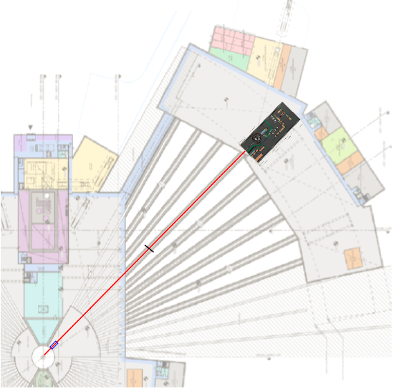
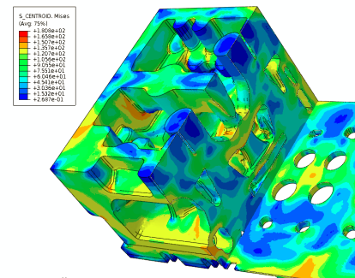
The BEER Beamline for European materials and Engineering Research
Successful instrument proposal,
recommended for phase 1
150 m
Strain, Phase, and Texture
Analysis
Science case: Materials for Engineering
Type: Bispectral engineering diffractometer
Labs: HZG and NPI (Czech Republic)

Slide 10
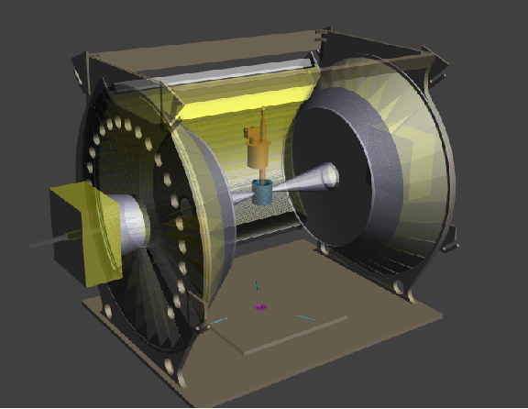
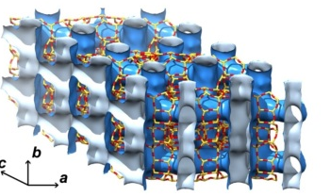
The DREAM Powder Diffractometer
Diffraction Resolved by Energy and Angle Measurements
Successful instrument proposal,
recommended for phase 1
flexibility: high intensity / high resolution
Δd = 0.00028 Å
multiple length scales
superconductors
MOFs
batteries
Science case: Chemistry, Physics, Material Science
Type: High resolution powder diffractometer
Labs: FZJ leading, potential partner: LLB Saclay

Slide 11
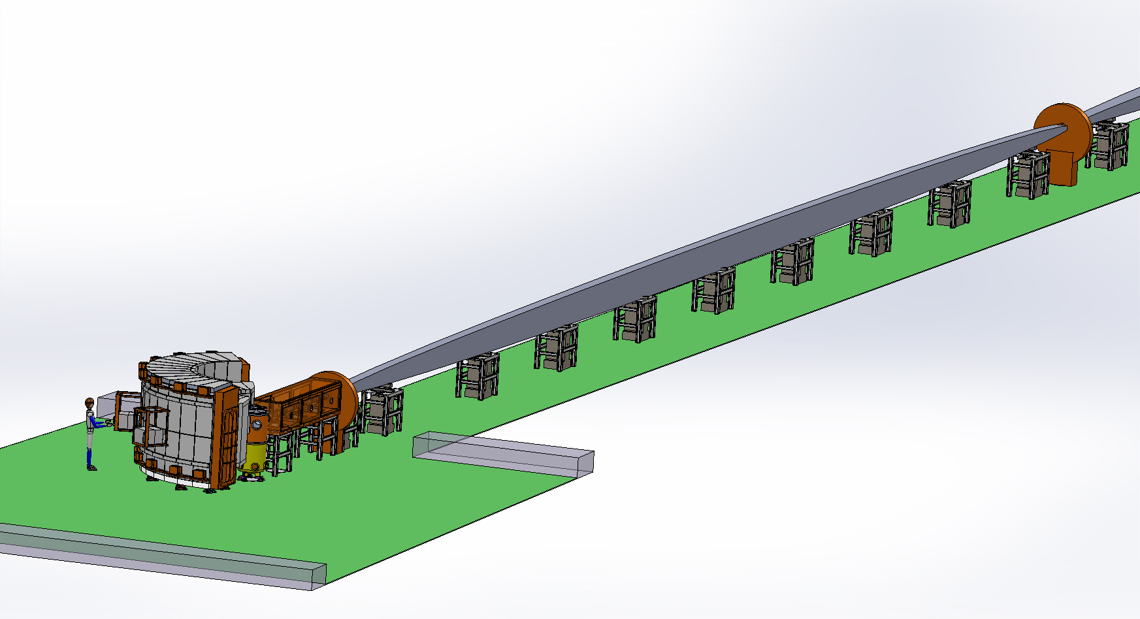
C-SPEC: cold chopper spectrometer
Successful instrument proposal,
recommended for phase 1
medium to high energy resolution (40 – 170 µeV @ 5 Å)
rate repetition multiplication / multi energy mode for optimum utilization of pulse
Science Case: energy materials, materials and geosciences, soft matter and life sciences, magnetism
Labs: TUM,LLB

Slide 12
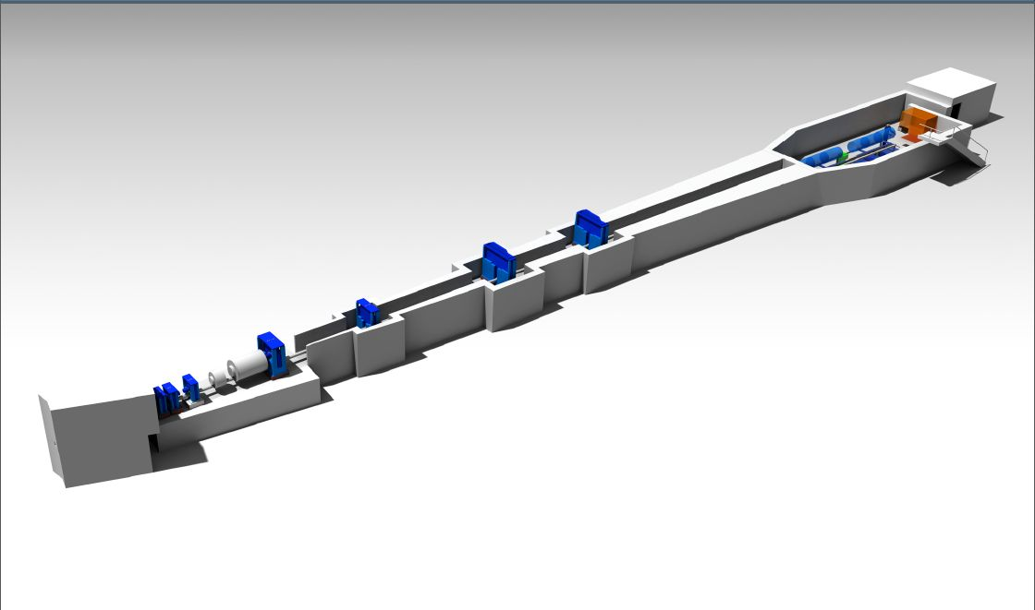
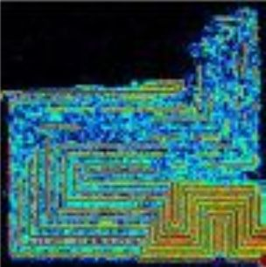
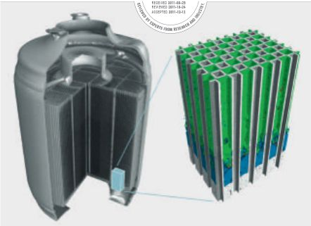
ODIN - Optical and Diffraction Imaging with Neutrons
already in phase 1
Cold and thermal TOF imaging, Diffraction and SANS option, polarization possible
Fuel cell (NIST)
Diesel soot particle filter (PSI)
Science case: Engineering, stress and strain, archaeology, cultural heritage, magnetism, hard matter, soft matter and biology,
Labs: TUM, PSI (50/50)
Engineering Images: Stewart Pullen

Slide 13
Preparations for phase 1
(first engineering design, detailed costing => budget) for
SKADI, BEER, DREAM, C-SPEC, ODIN:
negotiations with ESS on resources
(e.g. splitting of resources between partners, etc.)
in-kind agreements, MoU with ESS and between
partners
proposal to the BMBF (template focussing on phase1,…)
More Instrument Proposals
Resubmission
ESSENSE (FZJ), Neutron Spin-Echo
T-REX (FZJ, Perugia), Time-of-Flight Spectrometer
New Proposals
RESPECT (TUM)
HERITAGE (FZJ, HZG, LLB, Soleil, Budapest),Reflectometer
13
Notes:
(

Slide 14
Chairs: B. Vierkorn-Rudolph, Sebastian Schmidt
Strategierat
Zentrenleitung, Institutsleiter, Projektträger, Zuwendungsgeber
German ESS Construction Project
Chair:
A. Schreyer
STC der deutschen Zentren
Zentrenleitung, Institutsleiter, Bereichsleiter
Projekt
Koordination
Koordinator A. Wischnewski
Manager M. Röder
Teilprojekte Beschleuniger
Teilprojekte
Target
Teilprojekte Instrumente
Teilprojekte Komponenten
Gesamt-Controlling
Bereichsleiter
Bereichsleiter
Bereichsleiter
Bereichsleiter
Bereichsleiter
…
Moderator & Reflektor
BEER
Detektoren
Controlling
DESY
Teilprojektleiter
Teilprojektleiter
Teilprojektleiter
Vertreter Partnerinst.
Teilprojektleiter
Target Wheel
CSPEC
…
Controlling
FZJ
Teilprojektleiter
Teilprojektleiter
Teilprojektleiter
Vertreter Partnerinst.
Vertreter Partnerinst.
Vertreter Partnerinst.
Vertreter Partnerinst.
DREAM
Controlling
HZG
Teilprojektleiter
Vertreter Partnerinst.
SKADI
Controlling
KIT
Teilprojektleiter
DRAFT
Vertreter Partnerinst.
…
Controlling
Außenstelle
Teilprojektleiter
Vertreter Partnerinst.
Vertreter Partnerinst.
Vertreter Partnerinst.

Slide 15
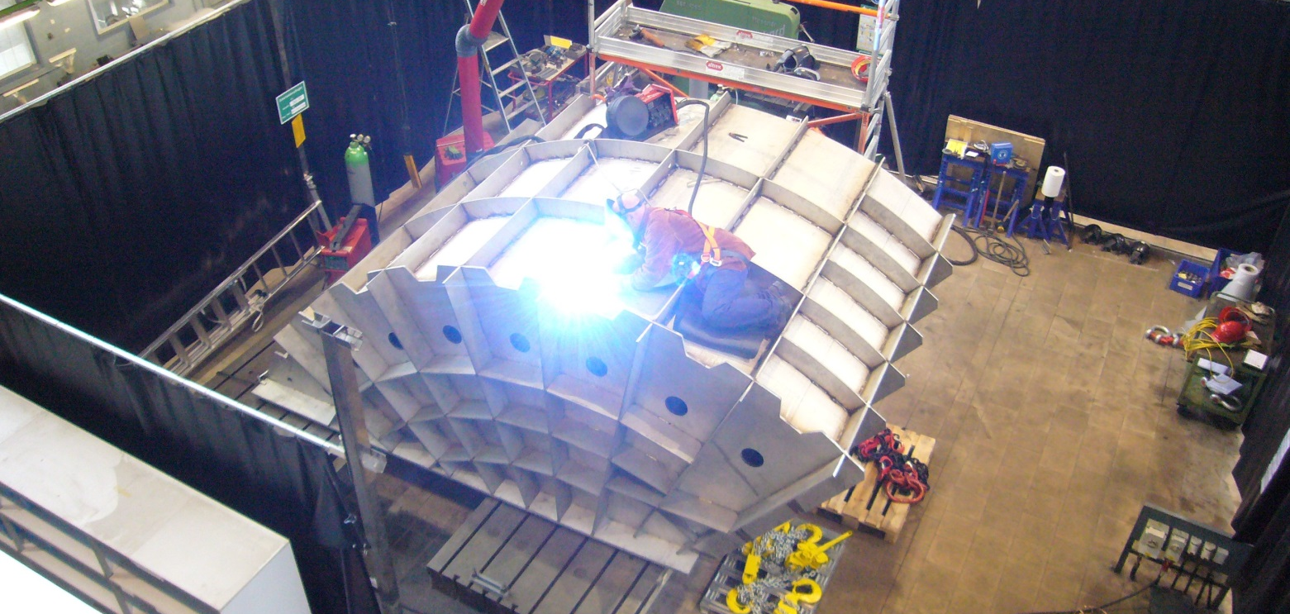
German ESS Construction Project
Image: Construction of TOPAS for MLZ
Interested Partner Institutions: FZJ, HZG, TUM,…
Current funding of ESS activities from internal funds (BMBF: 10% construction cost)
Application for BMBF funding is in progress, waiting for
resolution of VAT issues with ERIC
commitment by institutions for InKind contributions to operation costs (15 Mio.)
Construction money is in the federal budget, issues should be resolved soon

Slide 16


