Slide 1
Phase II Instruments Design and Development
Kevin Jones
ISIS New Instrument Group Leader

Slide 2
ISIS Beamline talks
Phase II overview and instrument developments (Kevin Jones)
IMAT development (Jim Nightingale)
Scientist and engineer interaction (Winfried Kockelmann)
Building instruments on an operating facility (Matt Fletcher)

Slide 3
Introduction
Overview of phase II instrument project
Then and now - major changes through project lifecycles.
Key factors that influence change
Summary of key points

Slide 4
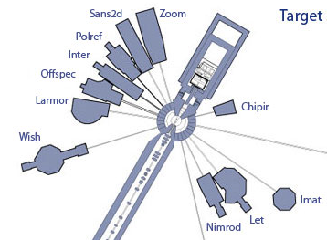
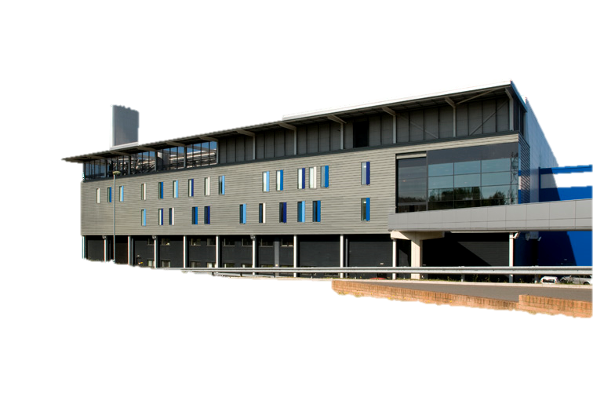
Target Station 2 and Phase II
The second target station at ISIS was competed in 2008
This project included 7 instruments that are now fully operational
Phase 2 instrument project is a £34M project that will add another 4 beamlines

Slide 5
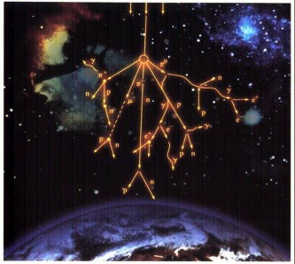
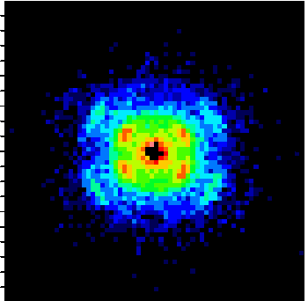
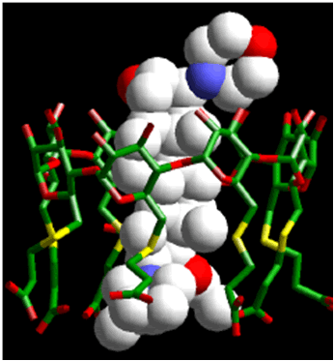
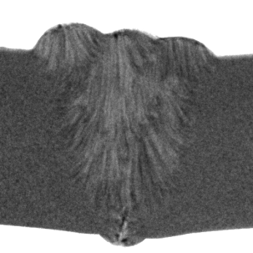
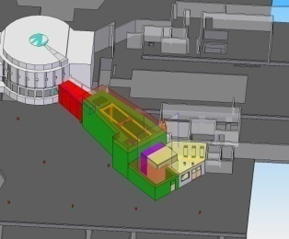
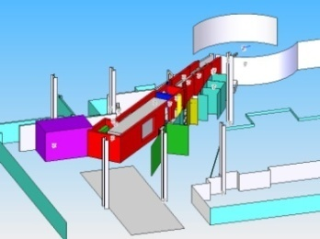
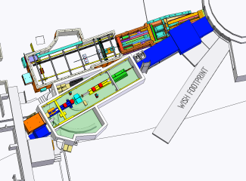
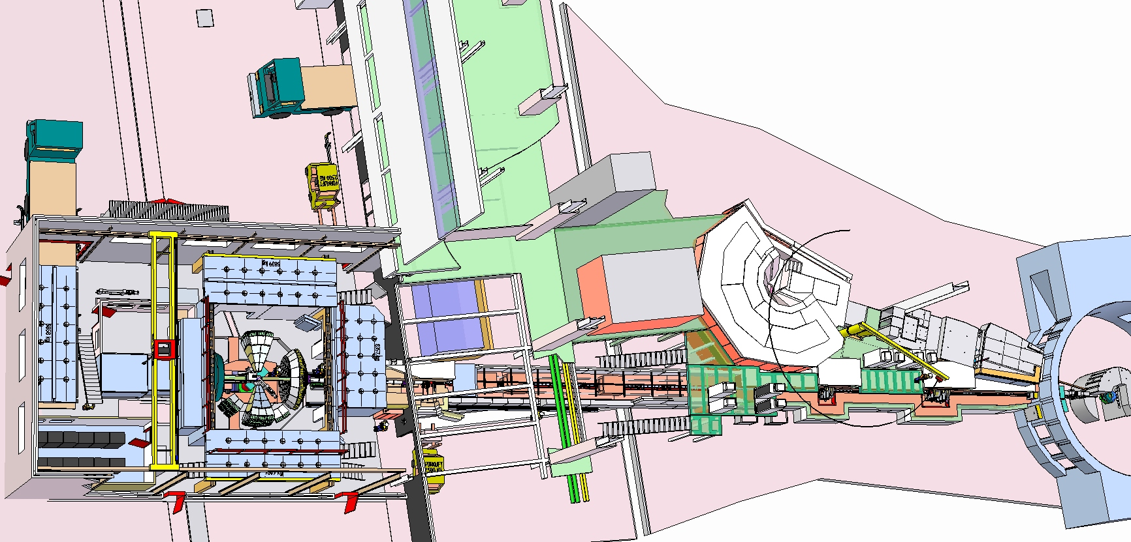
Phase II Overview
Deliver 4 science-led phase II instruments focussing on strategic challenges
  Staged delivery approach
Take the opportunity to add flexibility and function to the reflector
CHIPIR
ZOOM
LARMOR
IMAT

Slide 6
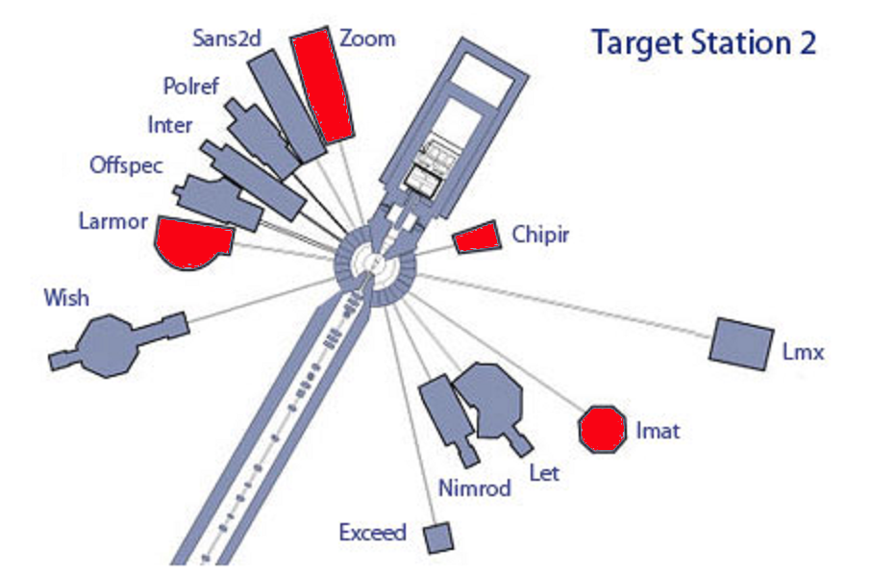

Slide 7
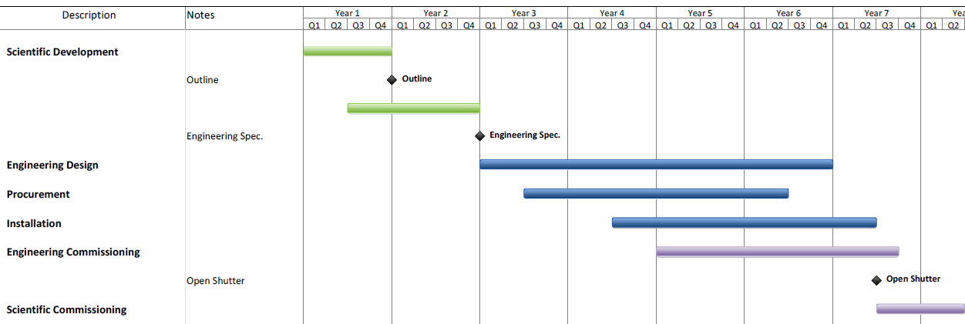
Instrument timeline

Slide 8
Project Aims
  World class science
  User friendly instrument
  Safety
  Delivered on
  Budget
  Time
  Specification

Slide 9
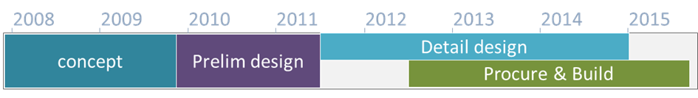
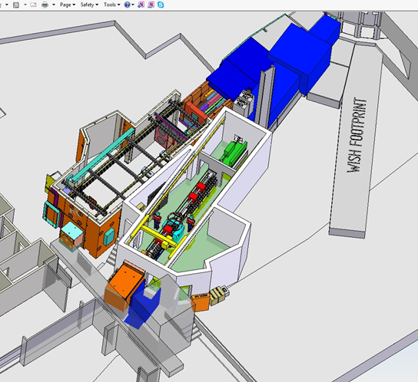
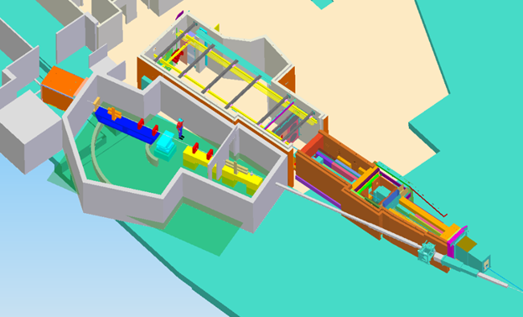
Larmor Layouts

Slide 10

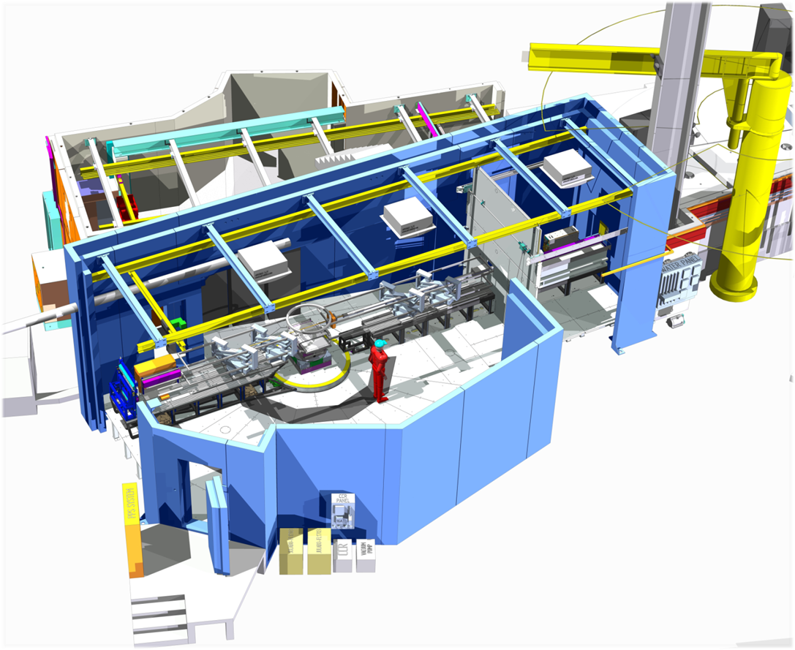
Larmor

Slide 11
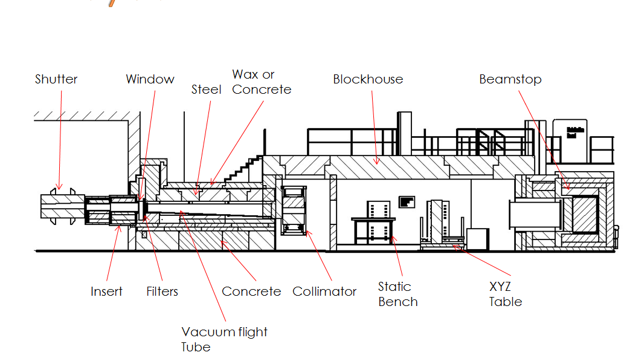
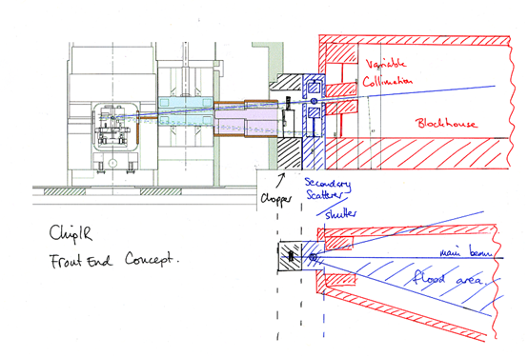
ChipIR Layouts

Slide 12
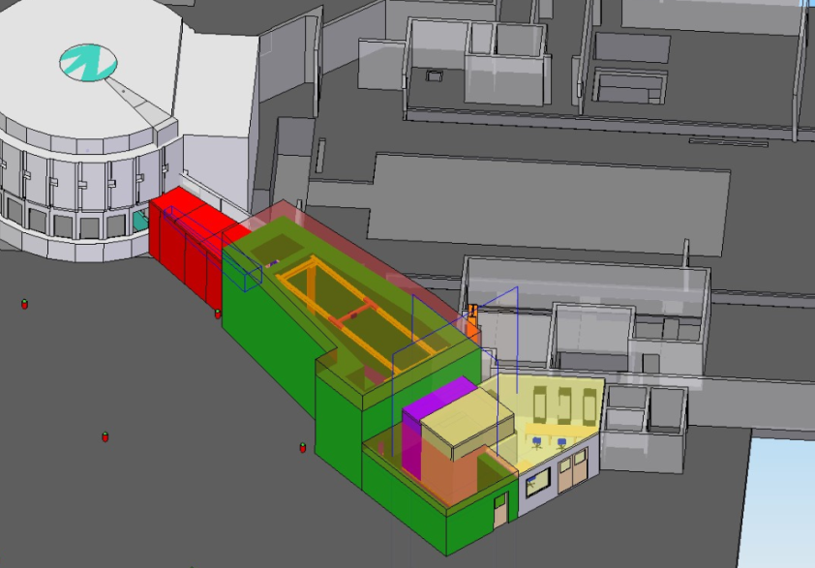
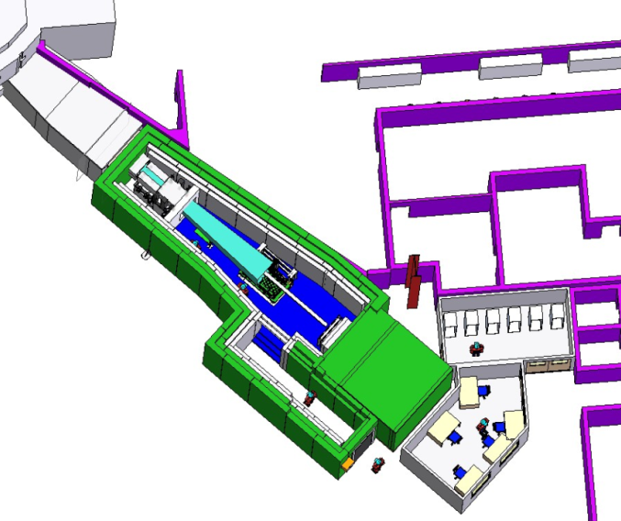
ChipIR Layouts

Slide 13
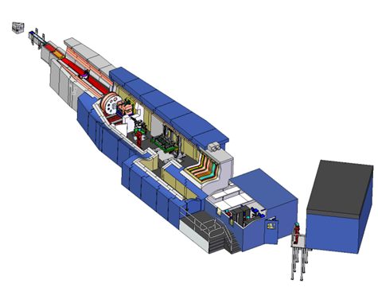
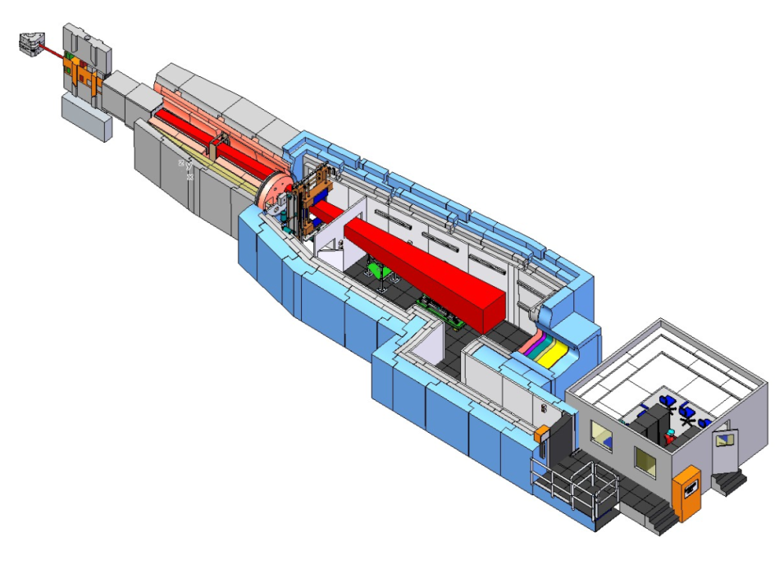
ChipIR Layouts

Slide 14
Influencing factors
Project
People
Advancing Technology
Finances
Time
Existing Infrastructure
Experience

Slide 15
Process
Outline specification/Design
Detailed Specification and Design
Delivery

Slide 16
Summary
Beamlines are long complex projects with many influencing factors
Flexibility is incredibly important in delivering a good beamline
Clarity about the project objectives
Clarity about the control process and what is driving change
Communication
Relationship between scientist and engineer is key

