Slide 1

Status of Swiss Contributions to NSS
Christian Rüegg (Swiss ESS national coordinator and ICB for PSI) Laboratory for Neutron Scattering and Imaging
Paul Scherrer Institute and University of Geneva
IKON8, Milton Hill House, 4th February 2015

Slide 2

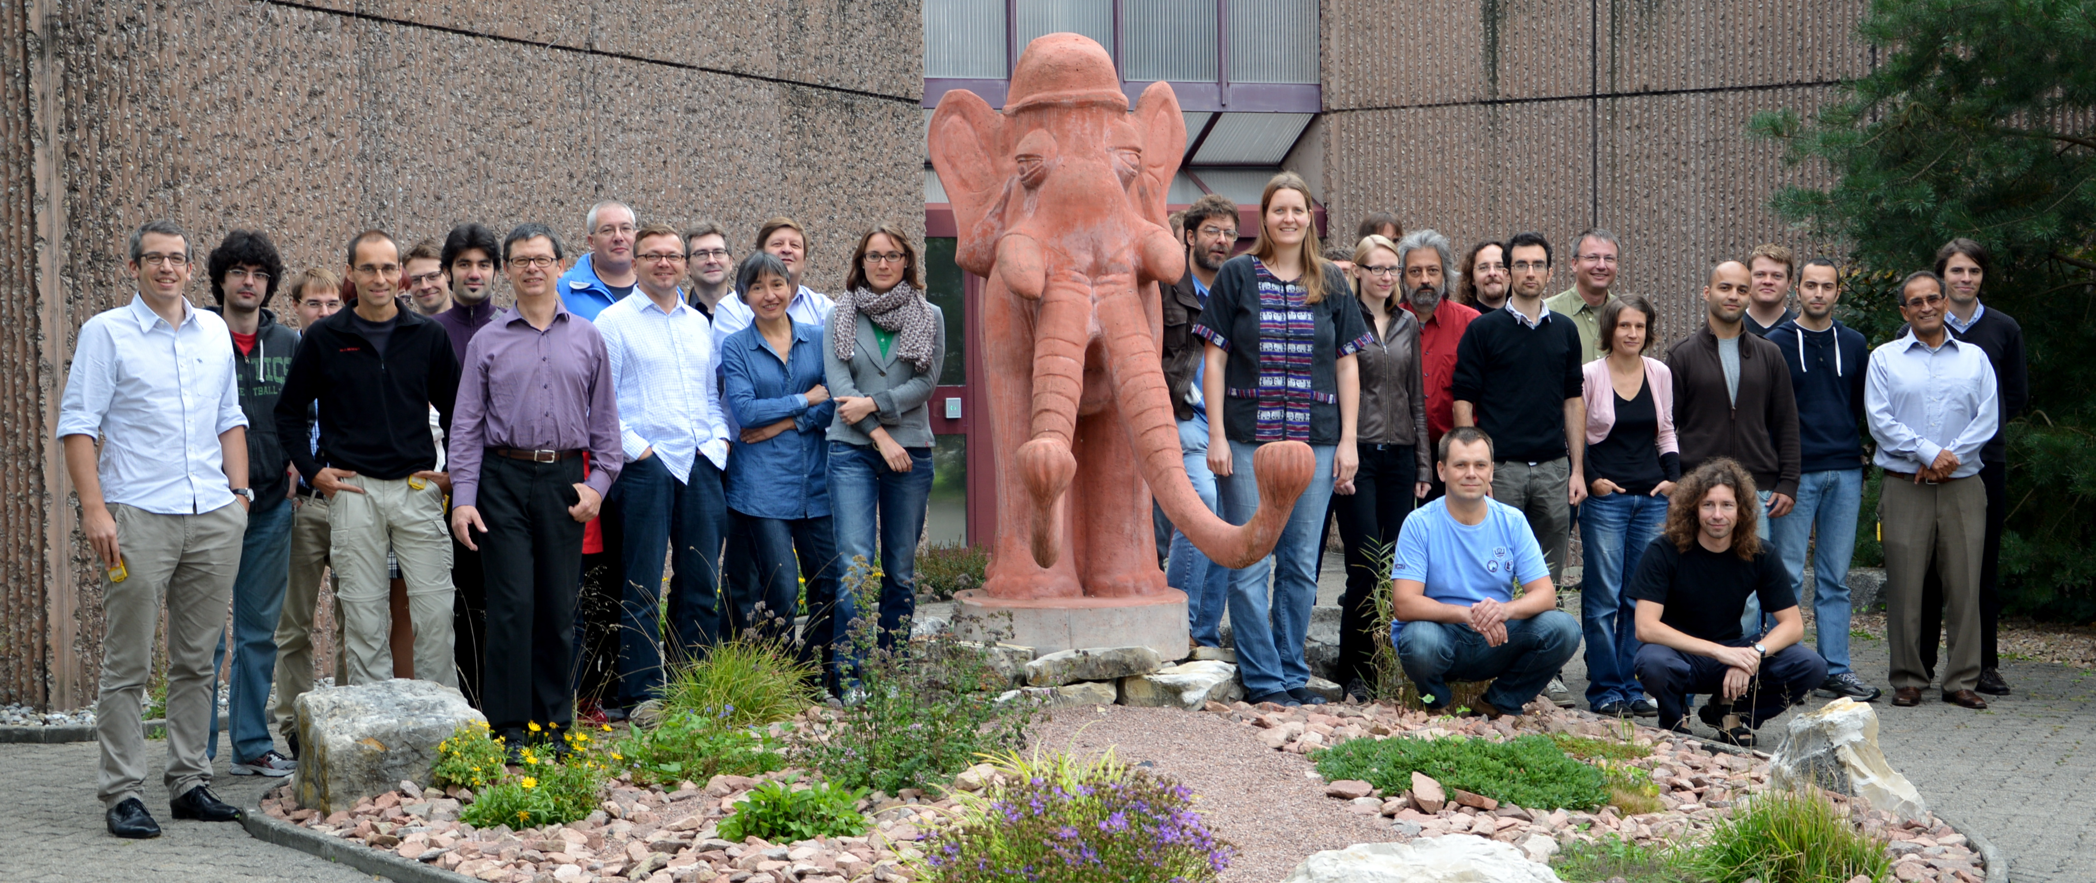
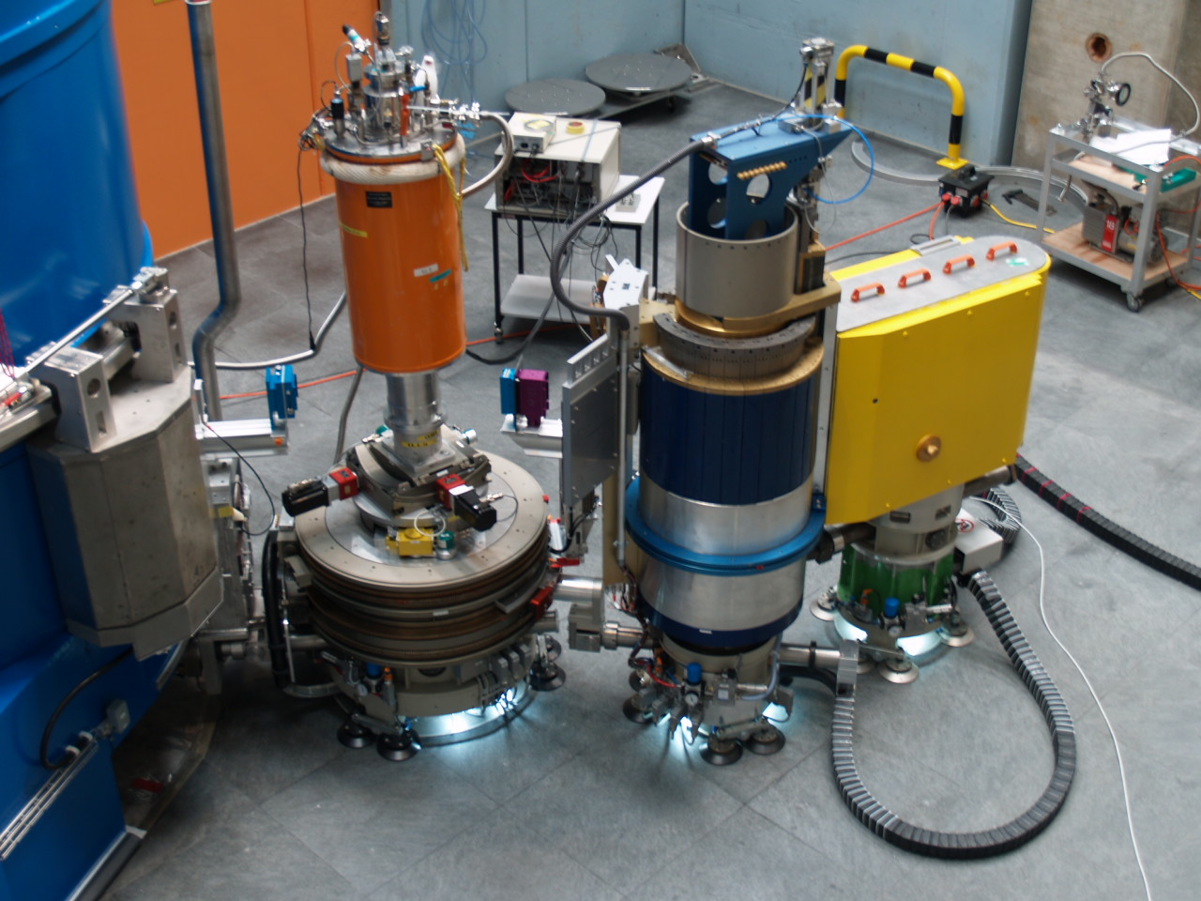
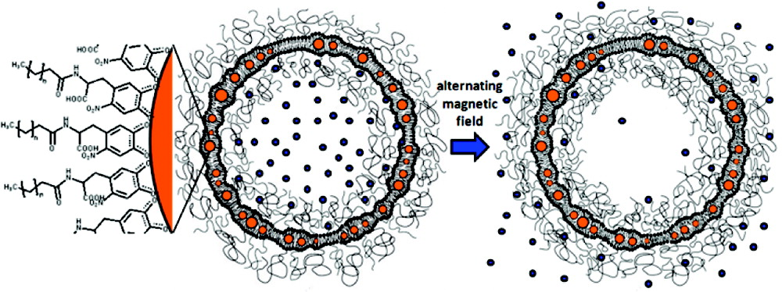
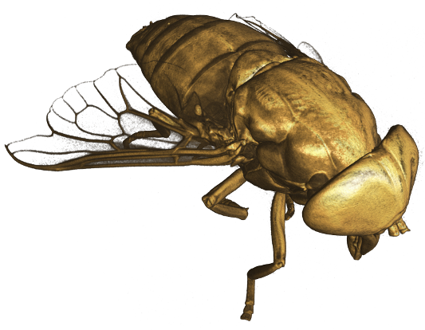
Laboratory for Neutron Scattering and Imaging
STAFF:
26 Scientists (Head: Prof. Ch. Rüegg, PSI/UniGE)
12 Postdocs
12 Ph.D. students
INSTRUMENTS AT SINQ:
13 instruments at SINQ with 400 experiments per year
SCIENCE:
Fundamental, materials-driven research with neutrons
Key topics: atomic and magnet structures, magnetism,
electronic correlations, soft matter and biology,
energy storage and conversion, health care
150 publications per year (40% in high-impact journals)
EDUCATION:
Ph.D. program, student practicals (EPFL, ETH, Uni Basel), lectures, schools
FUNDING:
PSI, SNF, SBFI, EU, national and international partners (EPFL, UniGE, DANSCATT)

Slide 3
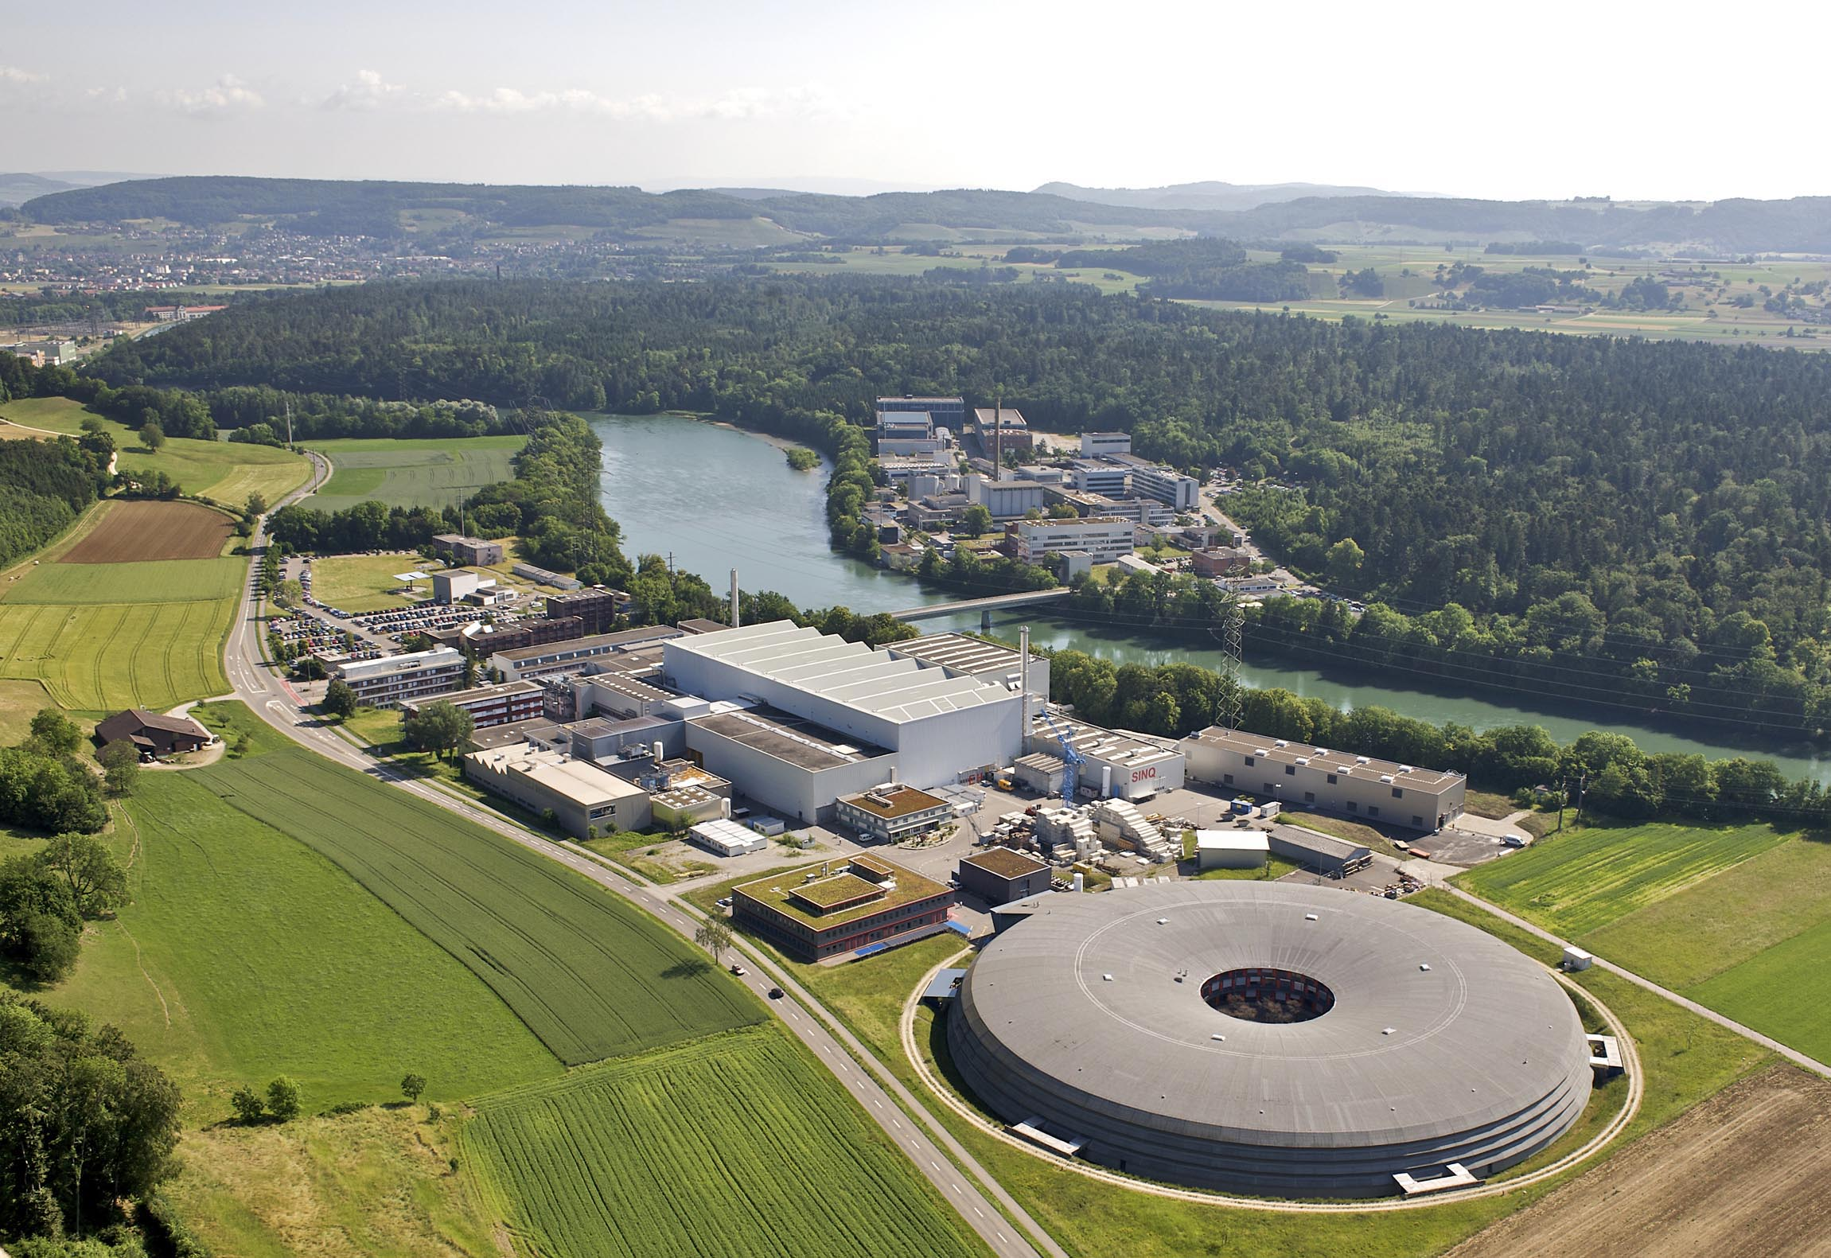
Paul Scherrer Institute
Energy
SwissFEL:
photons
Nano
Bio
Physics
SINQ:
neutrons
UCN:
neutrons
μSR:
muons
SLS:
photons

Slide 4
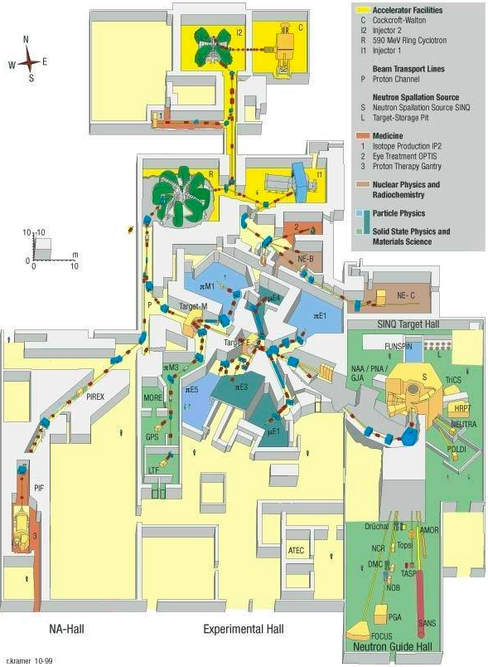
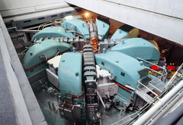
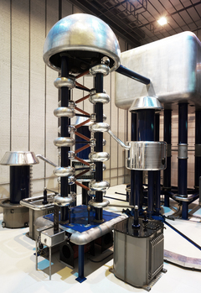
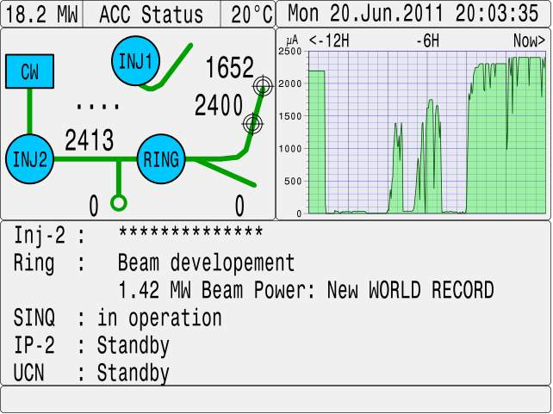
Proton Accelerator (590 MeV, 1.42 MW, 2.4 mA)

Slide 5
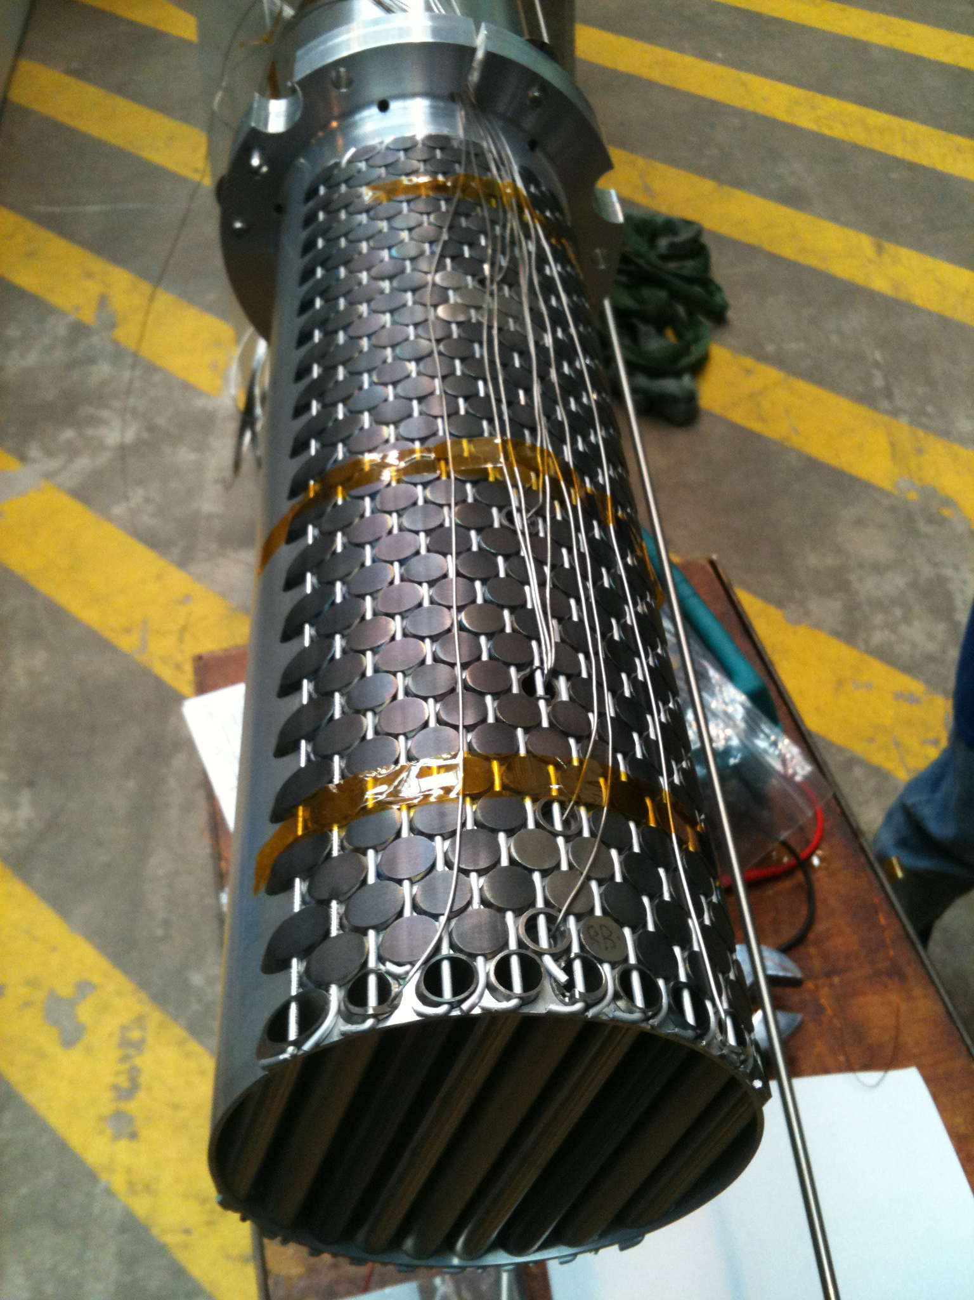
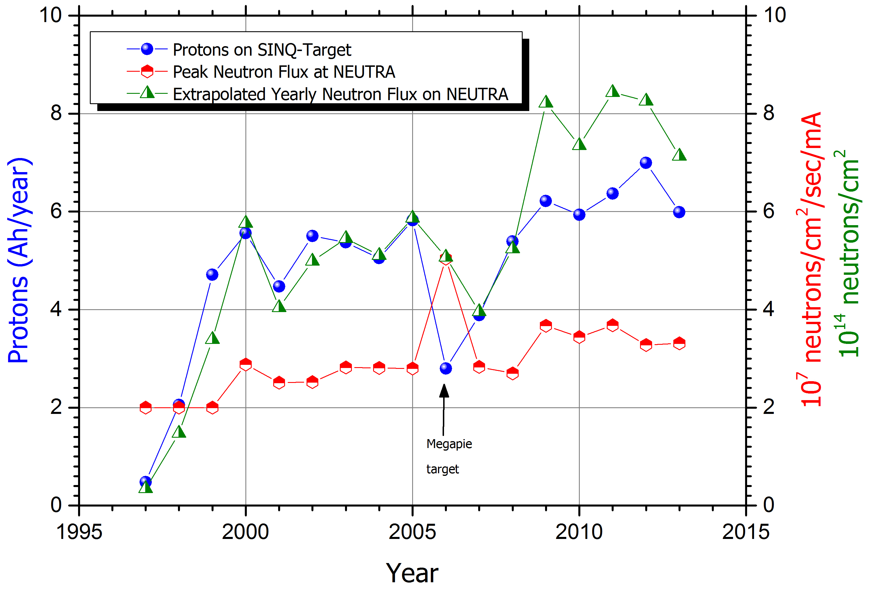
Swiss Spallation Neutron Source SINQ

Slide 6
Swiss Spallation Neutron Source SINQ

Slide 7
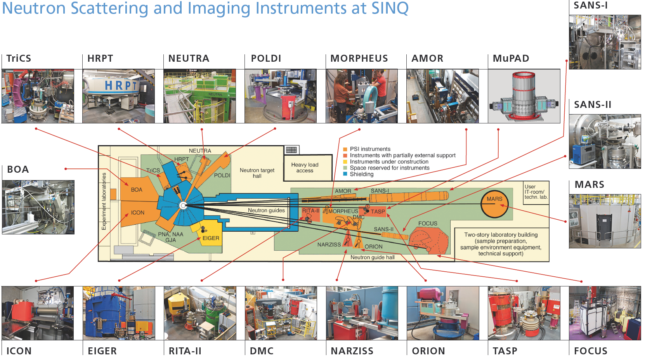
Instruments at SINQ
Diffraction
Spectroscopy
SANS + Ref.
Imaging

Slide 8
SINQ User Program
SINQ key numbers 2014 (2013)
New Proposals : 358 (438)
Visits : 962 (870)
Individual Users : 515 (486)
Experiments : 453 (431)
Experimental days : 1965 (1841)
• Source: S. Janssen, PSI User office

Slide 9


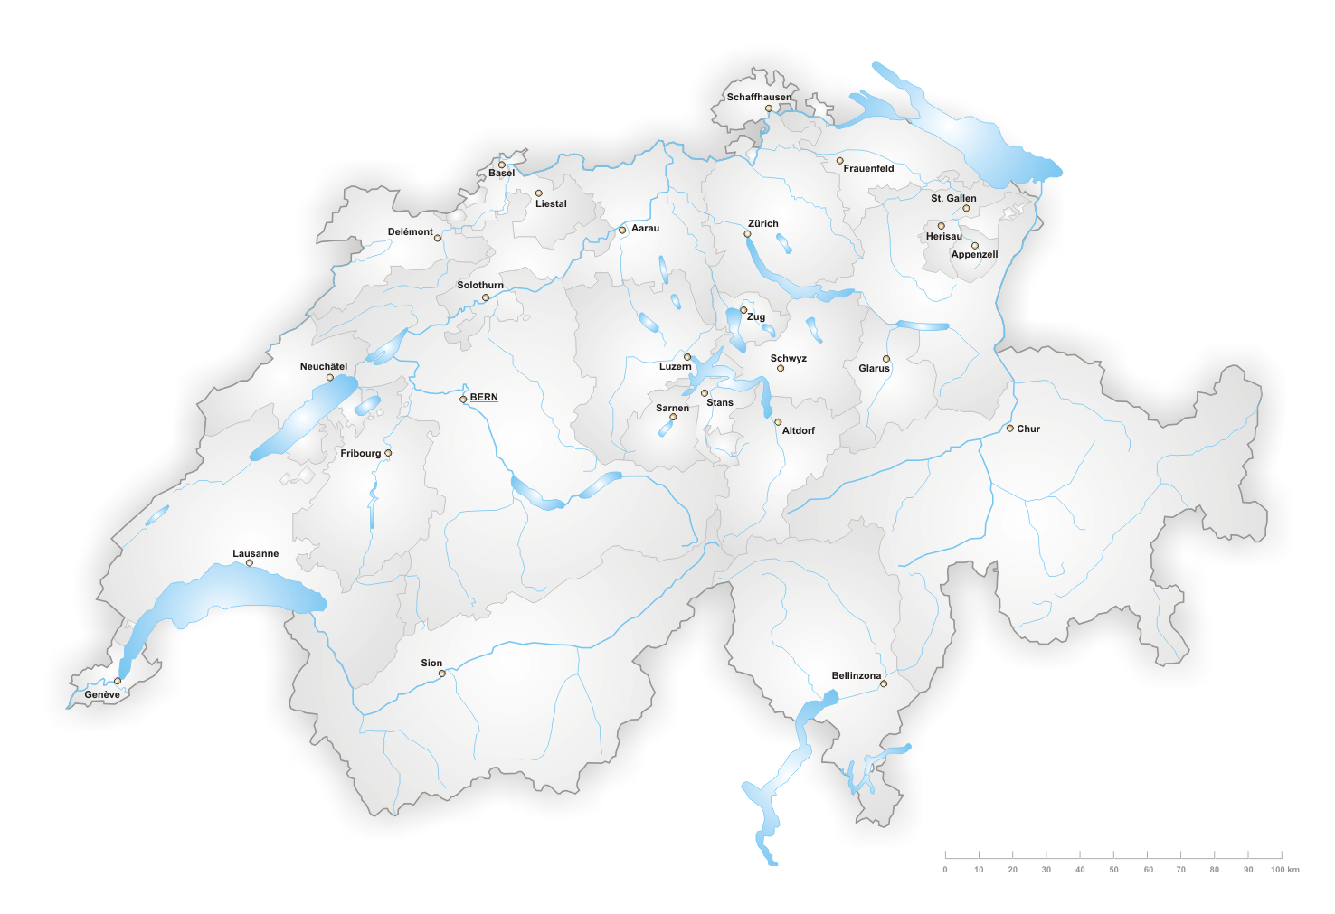


Swiss SINQ users
Uni Basel
Uni Bern
Uni Fribourg
• Source: S. Janssen, PSI User office

Slide 10
SINQ User Program
Distribution of SINQ users in 2014
• Source: S. Janssen, PSI User office

Slide 11

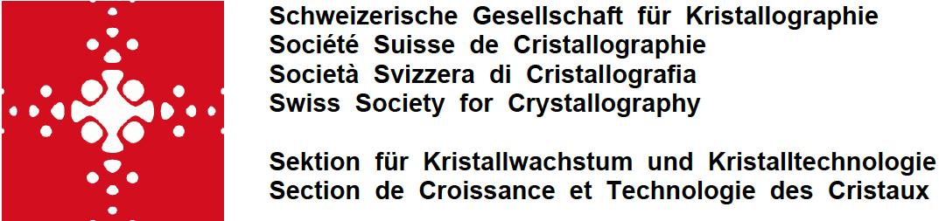
SINQ and Swiss Neutron Scattering Strategy
Neutron Scattering in Switzerland
I) SINQ as national source
State-of-the-art instrumentation, medium flux
Partner of Swiss universities for research and education, 2000 experiment days
II) Institut Laue-Langevin ILL
Complementary, high-flux instruments (3rd Millennium Program ENDURANCE)
Technology development (detectors, etc), 160 experiment days
III) European Spallation Source ESS
Complementary, high-flux instruments
Future European centre for neutron scattering in 2025+, 90 experiment days
IV) Other Partner Institutes
Access to other neutron sources in Europe, US and Japan, 100 experiment days
Complementary capabilities (high fields, high-energy spectroscopy)
upgrade SINQ
build ESS

Slide 12




Swiss Contributions to ESS and NSS
Funding
Universities and Organizations
Science
Instrumentation
Technology
Laboratory for Neutron Scattering and Imaging (LNS, PSI)
Laboratory for Developments and Methods (LDM, PSI)
Further laboratories at PSI (moderators, materials, etc)
Swiss Universities and User Organizations
Swiss Industry

Slide 13
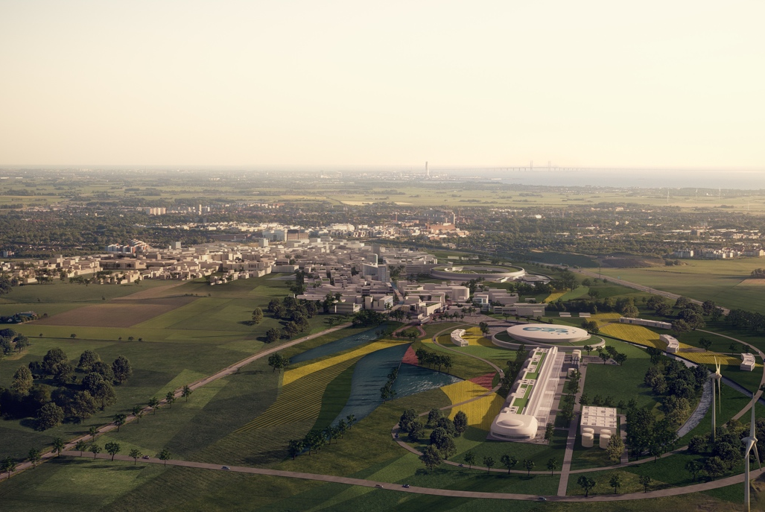


New European Spallation Source
European Spallation Source ESS
to be built in Lund, Sweden
- 17 European countries
- operational by 2019
- 16 instruments by 2025, capacity for more
- 1.8 BEuro project, 140 MEuro for operation
Swiss Contributions to the ESS
- Pre-construction activities at PSI (2012/2013)
- Construction and operation (Nationalrat 2015)
3.5% or 130 MCHF (2014-2026)
70% in-kind (instruments, accelerator)
- CH-DK-D work on instruments
- CH work on optics, moderators & shielding

Slide 14

Instruments for the ESS
CH-DK: Extreme Environment Spectrometer – CAMEA
Submitted proposal 2013, approved for construction by SAC and StC
CH-DK: Focusing Reflectometer - ESTIA-SELENE Submitted proposal 2013, approved for construction by SAC and StC
CH-DK: Compact Chopped SANS - BioSANS
Submitted proposal 2012/13, science covered by ESS instrument
CH-DK: Diffraction Instrument - HEIMDAL
Submitted proposals 2013, approved for construction by SAC and StC
D-CH: Neutron Imaging - ODIN
Submitted proposal 2012, construction started
Neutron Optics and Background Simulations
Continuous activity in collaboration with ESS

Slide 15
Instruments for the ESS
CH-DK: Extreme Environment Spectrometer – CAMEA
PHASE 0, PHASE 1 in 2016, instrument consortium (DTU, KU, PSI)
CH-DK: Focusing Reflectometer - ESTIA-SELENE PHASE 1 in 2015, instrument consortium (PSI, DTU, KU)
CH-DK: Compact Chopped SANS - BioSANS
No construction planned
CH-DK: Diffraction Instrument - HEIMDAL
PHASE 0, PHASE 1 in 2016, instrument consortium (AU, DTU, PSI)
D-CH: Neutron Imaging - ODIN
PHASE 1 since 2014, instrument consortium (TUM, PSI)
Neutron Optics and Background Simulations
Continuous activity in collaboration with ESS

Slide 16
Swiss NSS projects – Next Steps
Final approval of Swiss participation in ESS
- Positive vote in Ständerat (autumn 2014) and Nationalrat (spring 2015)
- 3.5% or 130 MCHF (2014-2026) for construction and operation
70% in-kind (instruments, accelerator)
- Legal procedure (join ERIC, in-kind and consortium contracts)
- Challenge: CH salary costs, CHF/EURO exchange rate
Instrument Projects
- Proceed with ODIN in collaboration with TUM and ESS, complete PHASE 1
- Start ESTIA PHASE 1, hire instrument lead scientist in spring 2015
- Prepare PHASE 1 of CAMEA and HEIMDAL with DK Universities
- Establish further contacts to Swiss Industry
Technology Projects
- Continue work on optics and shielding for ESS (U. Filges, PSI)
- New software and instrument control projects (M. Koennecke, PSI)
- EPICS developments
- Joint developments with ESS e.g. EC EINFRA projects with DMC
Knowhow developed at ESS should also be available to partners in Europe

Slide 17
Positions at the Paul Scherrer Institute
ESS-ESTIA Lead Scientist
- 3 years at PSI, then move to ESS
- Start as soon as possible, 10+ year perspective
- Contact: J. Stahn or Ch. Rüegg
ESS-Instrumentation Positions
- ESS-ESTIA engineer and ESS-ODIN scientist/engineer
- Scientists for CAMEA and HEIMDAL (workplace in DK)
- Contact: Ch. Rüegg, M. Kenzelmann, N. Christensen
Scientist Engineering Diffraction
- Co-responsible for POLDI difractometer at SINQ
- Contact: J. Schefer or Ch. Rüegg
Diffraction Group Leader
- Advertisement in Summer 2015
- Responsible for ESS-HEIMDAL work at PSI and ZEBRA instrument project at SINQ
- Contact: Ch. Rüegg

Slide 18
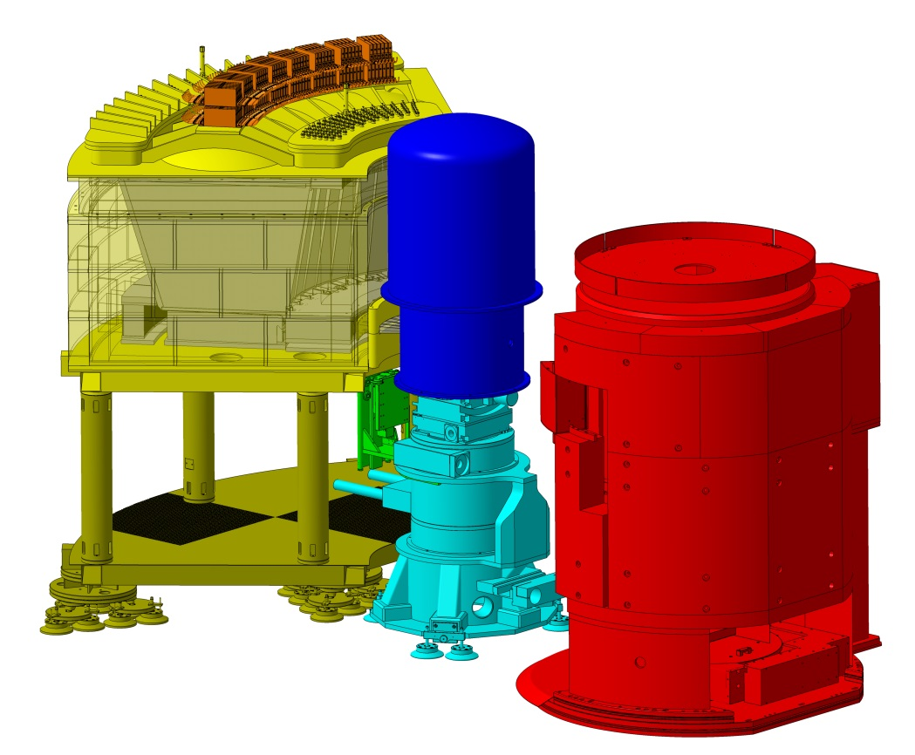
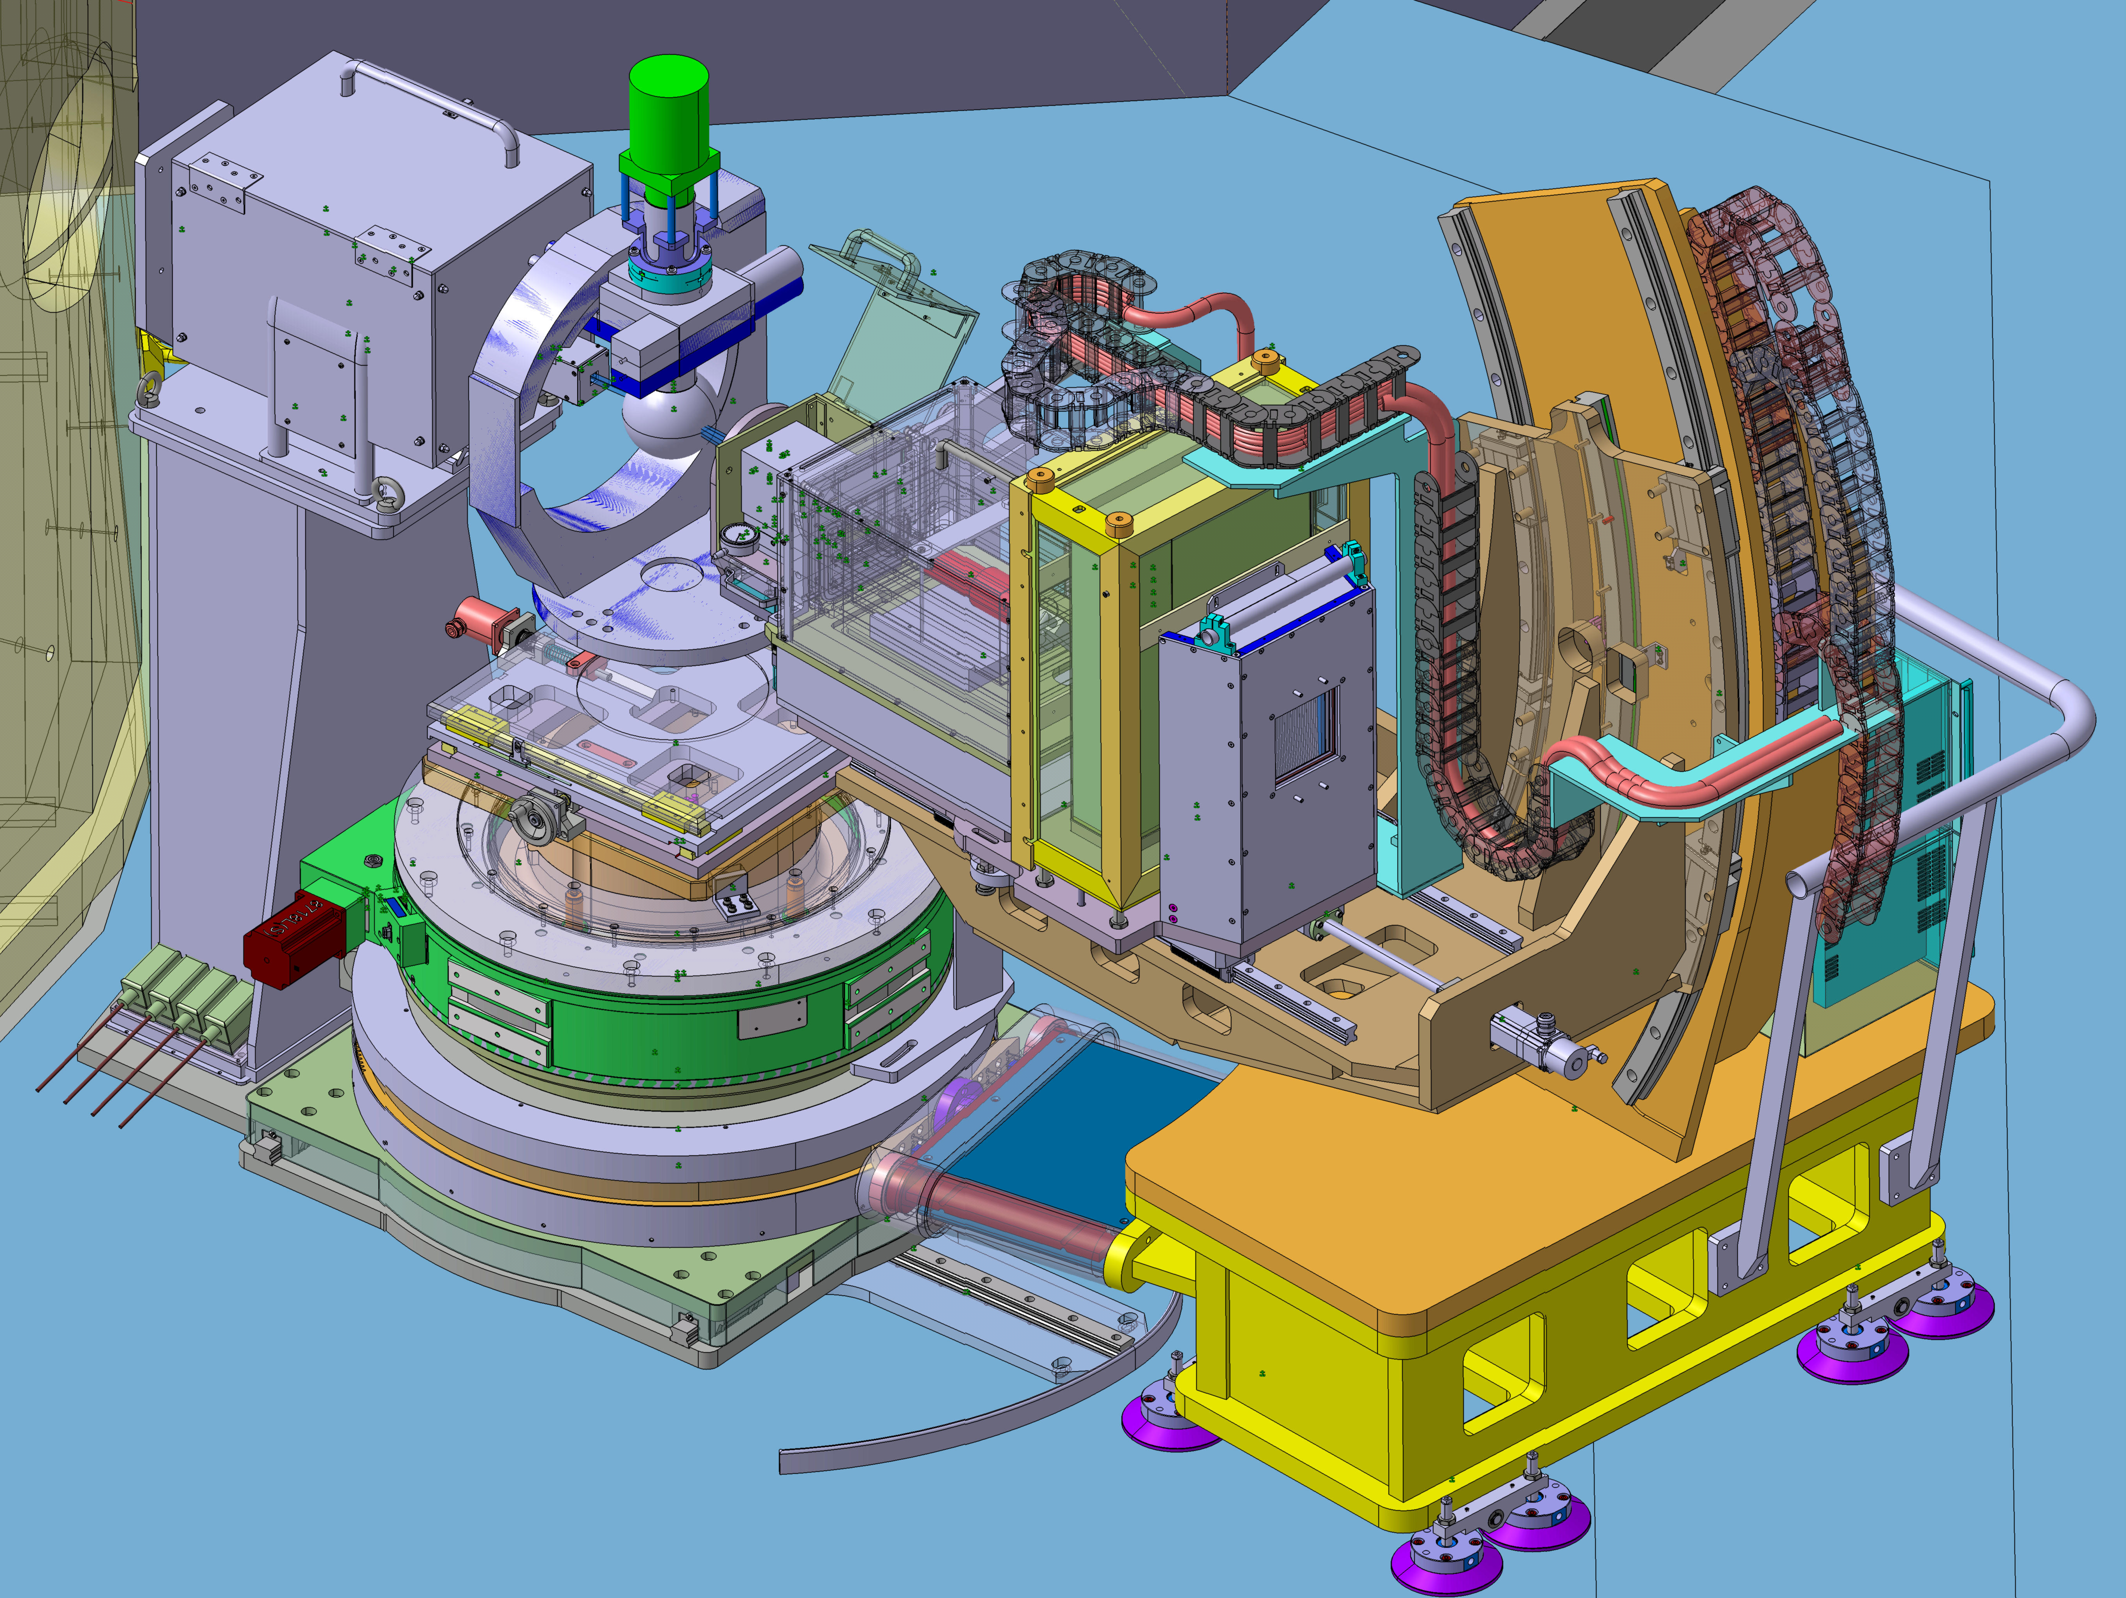
SINQ Instruments – CAMEA and ZEBRA
Design coals
Small samples of new emergent materials, thin films, heterostructures
Multi-extreme conditions (temperature, pressure, magnetic and electric fields)
CAMEA
Upgrade of cold TAS RITA-II at SINQ
Collaboration: PSI-EPF Lausanne (H. Ronnow)
Projet leader: Ch. Niedermayer
Funding: SNF R‘equip, EPFL, and PSI
ZEBRA
Upgrade of diffractometer TriCS at SINQ
Collaboration: PSI-University of Fribourg
Projet leader: O. Zaharko
Funding: SNF R‘equip and PSI

Slide 19
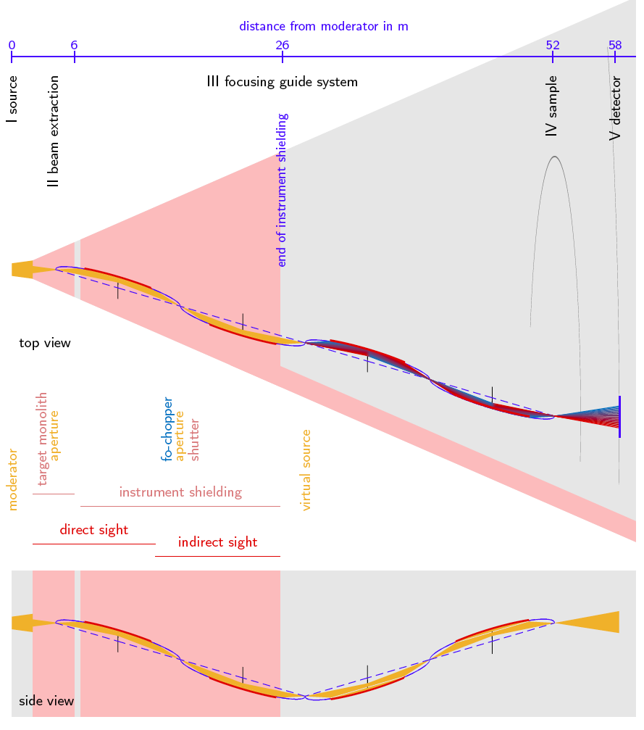
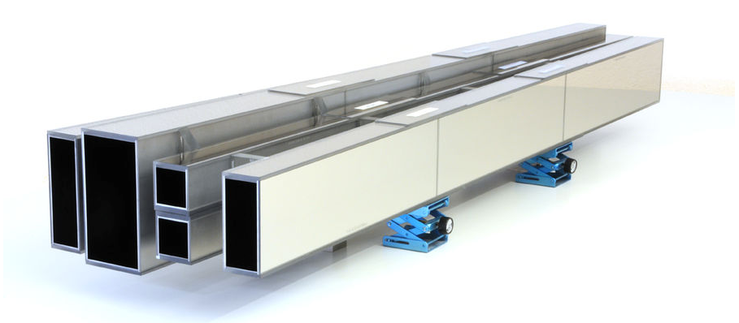

SINQ Guide System – Neutron Optics
Super-Mirror Advanced Neutron Optics for SINQ
SINQ built as first neutron source using super-mirror technology
Swiss know-how: Swiss Neutronics, PSI spin-off
Advanced neutron optics and guides are integral part of future instruments
New guide system (10-12 MCHF): New science and increased efficiency
Fully focussing super-mirror
guide system SELENE

Slide 20
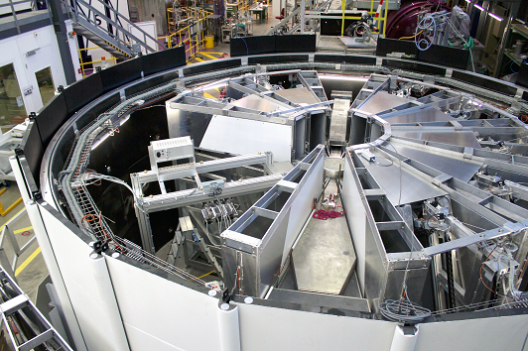
ToFTAS Spectrometer - CAMEA
Extreme environment spectrometer – CAMEA
Extending neutron spectroscopy to samples 1000x smaller then current limit
- Best spectrometer for limited vertical access
- Detector similar to PSI-CAMEA
- Optimized for small samples and extreme conditions
- Clear science case
Prototype installed on MARS at SINQ
Layout for proposed ESS instrument

Slide 21
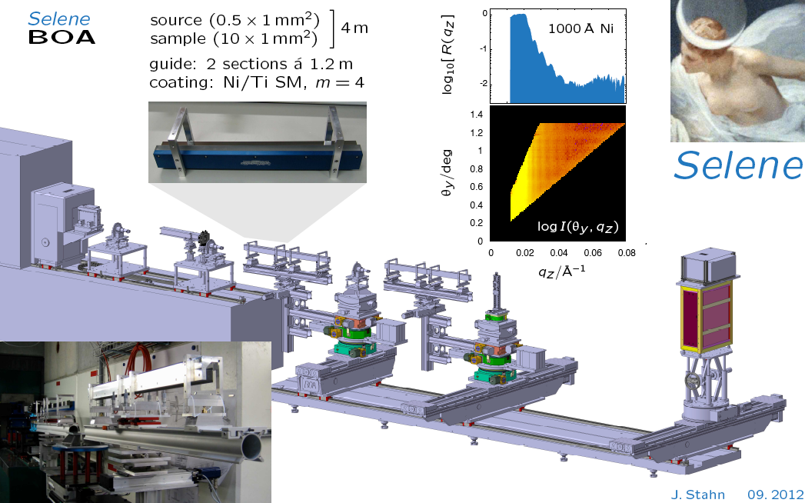

Reflectometer - ESTIA-SELENE
Focusing reflectometer for small samples – ESTIA
Extending neutron reflectometry to functional heterostructures and devices
- Based on Selene double focusing guide
- Angle-dispersive wavelength encoding
- Optimized for small hard and soft matter samples
- Clear science case
Prototype installed on BOA at SINQ
Layout for proposed ESS instrument

Slide 22
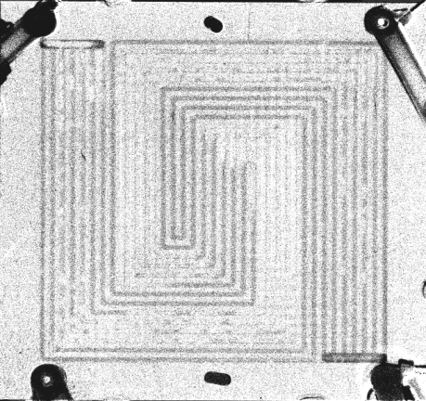
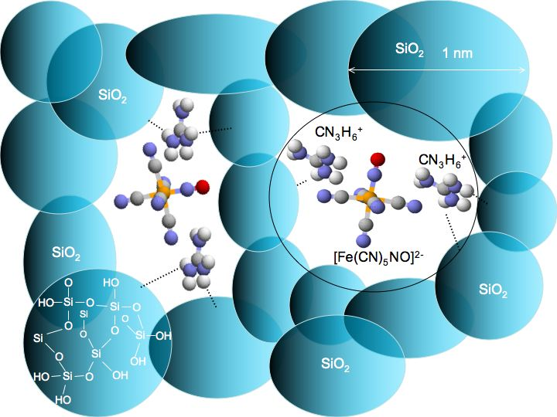
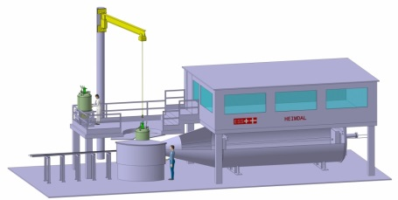
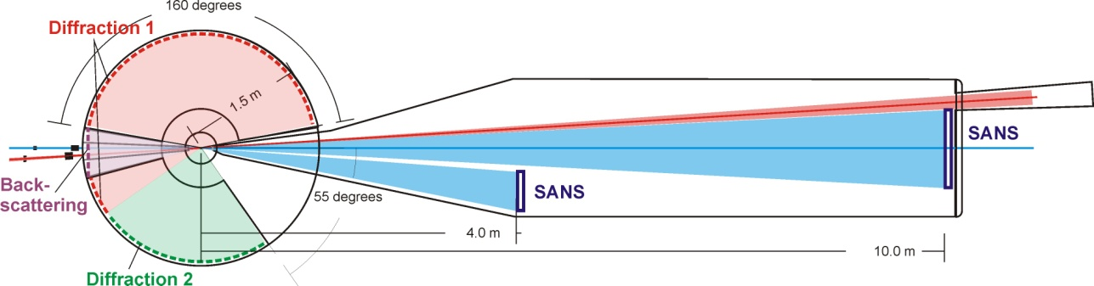
Diffraction Instrument - HEIMDAL
HEIMDAL – Probing Multiple Length Scales in-situ/in-operando
Cold Powder Diffraction
Scale: 10⁻⁸ to 10⁻¹⁰m
magnetism
Thermal Powder Diffraction
Atomic positions
Scale: 10⁻⁸ to 10⁻¹¹m
SANS Example:
Interaction to surfaces
Scale: 10⁻⁵ to 10⁻⁹m
Imaging
Selecting the
point of interest
Scale: 10⁻² to 10⁻³m
HEIMDAL – Powder Diffraction Instrument with SANS/Imaging

Slide 23
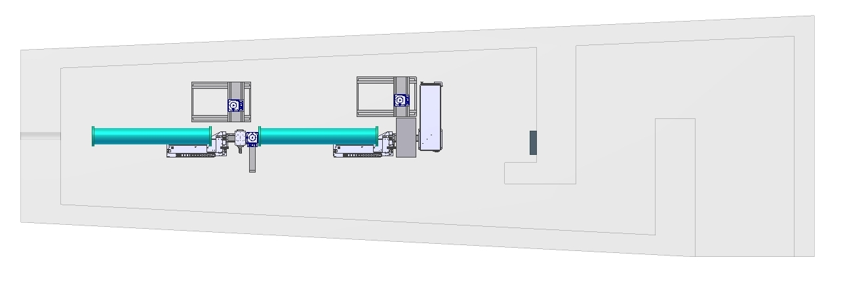
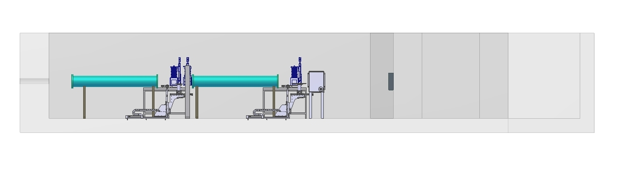
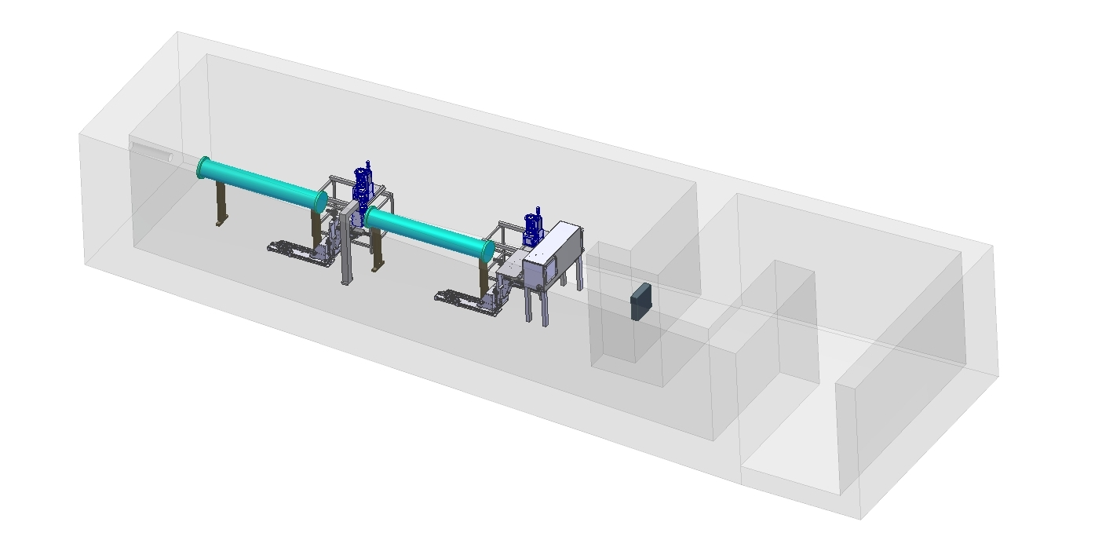
Neutron Imaging - ODIN
20m
Camera boxes for micro-medium sized samples and diffraction
neutrons
Beam dump
Flight tubes
Positioning stages
Camera box for macro samples
LNS NIAG Group: E. Lehmann, Ch. Grünzweig, M. Morgano

