Slide 1
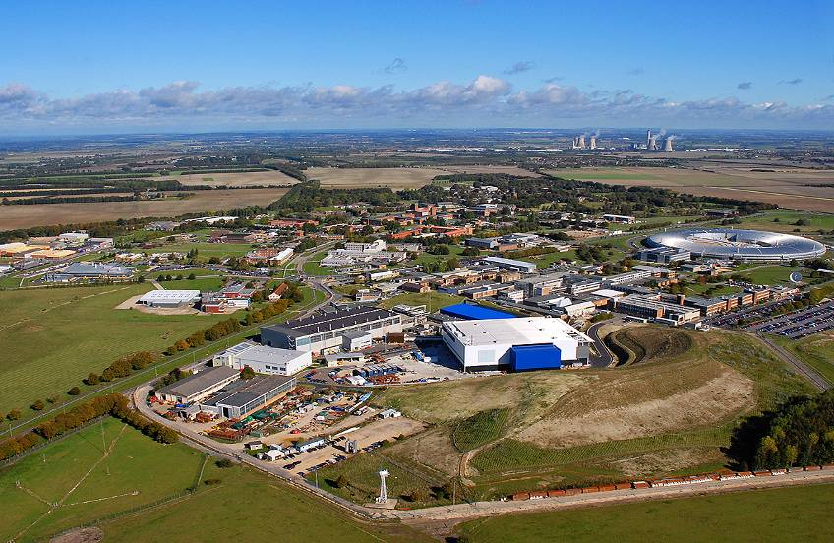
ISIS Target Station 2 project
Lessons learned
Robert McGreevy

Slide 2
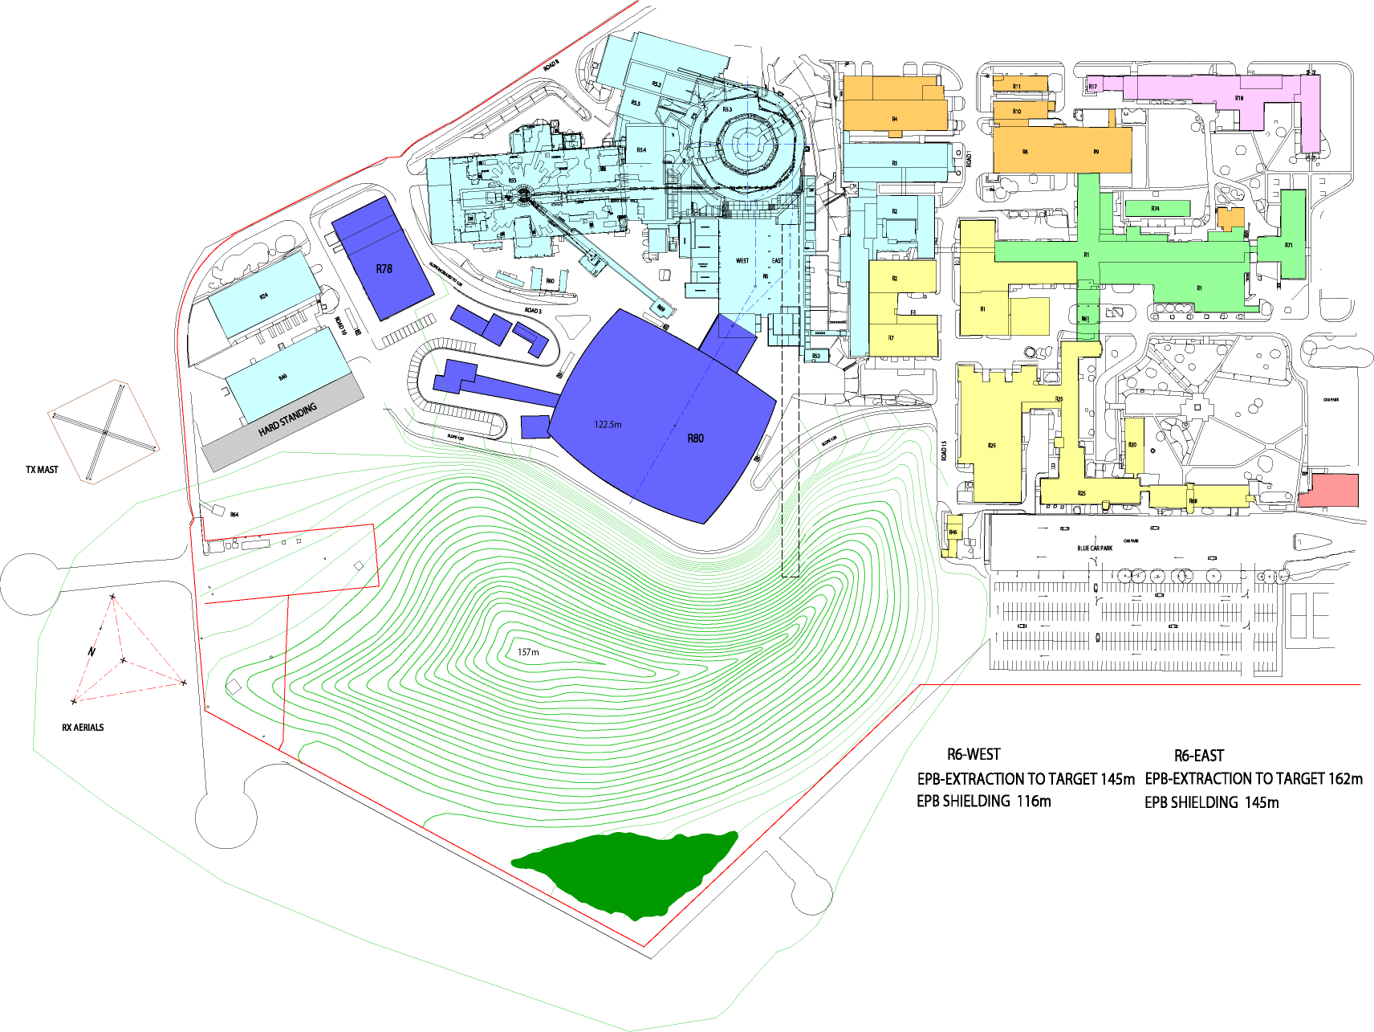
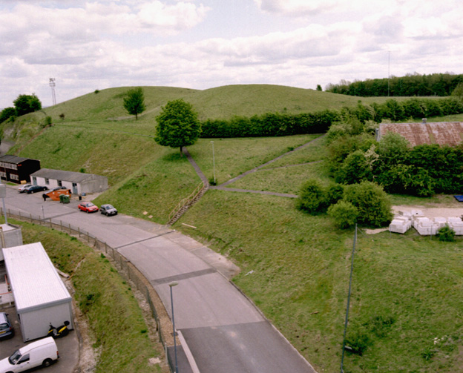
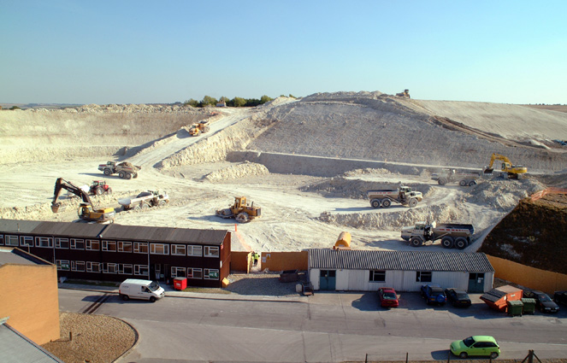
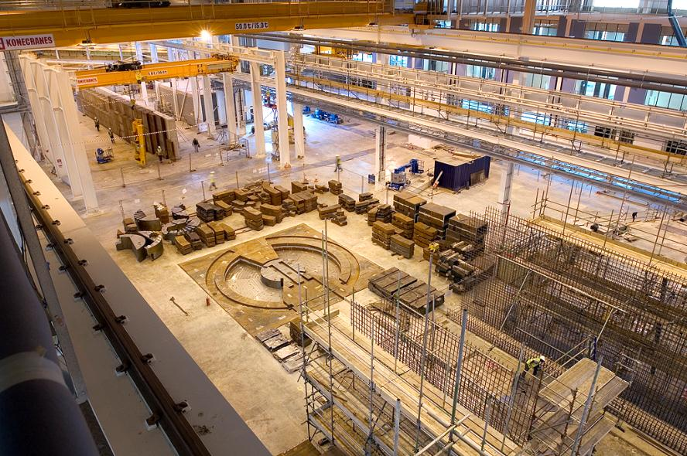
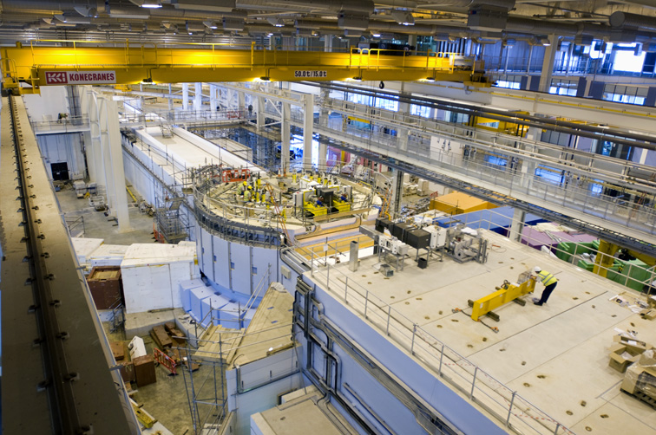
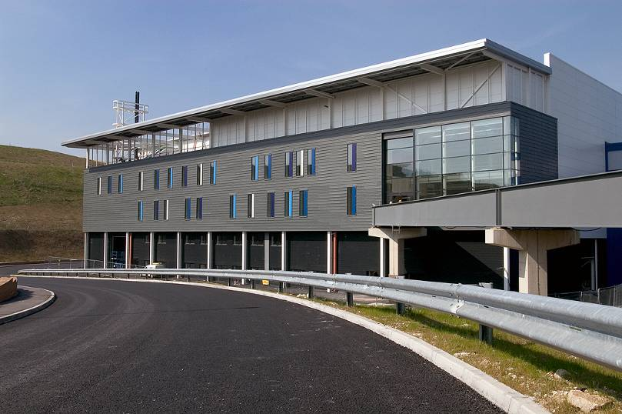
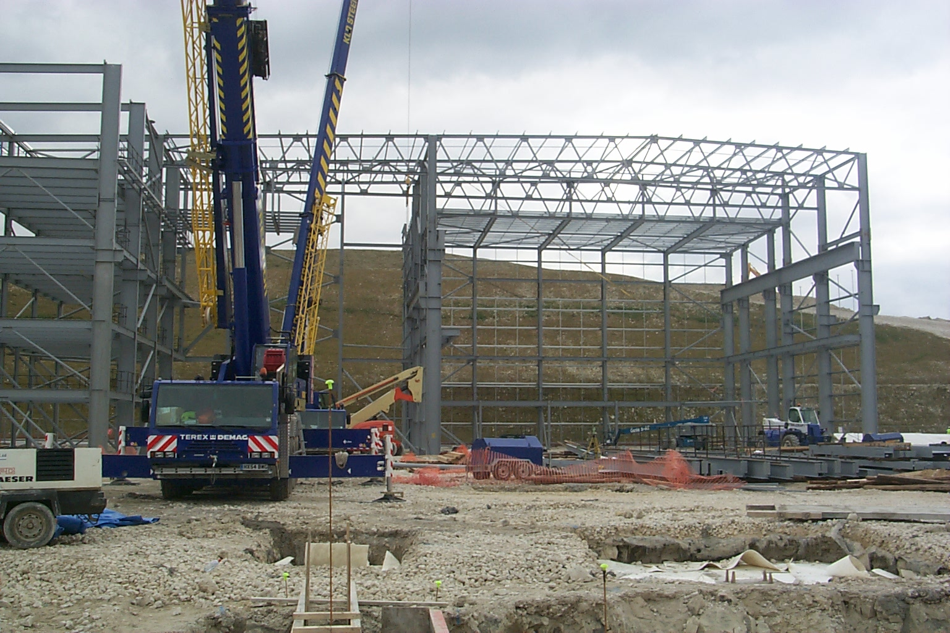
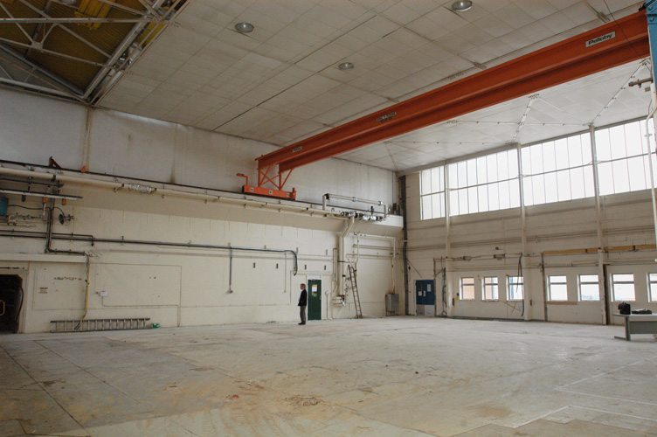
ISIS TS2 Phase I project – on time and on budget

Slide 3
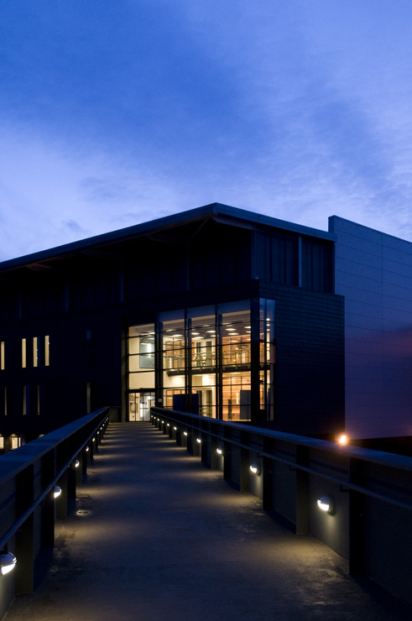
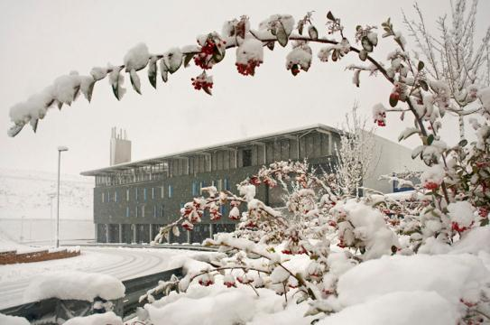
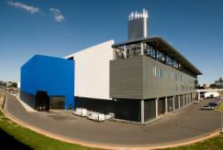
and looking good ...

Slide 4
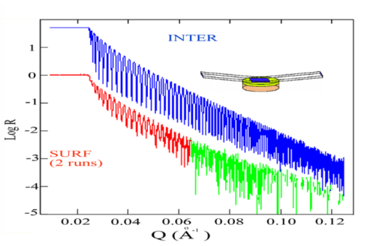
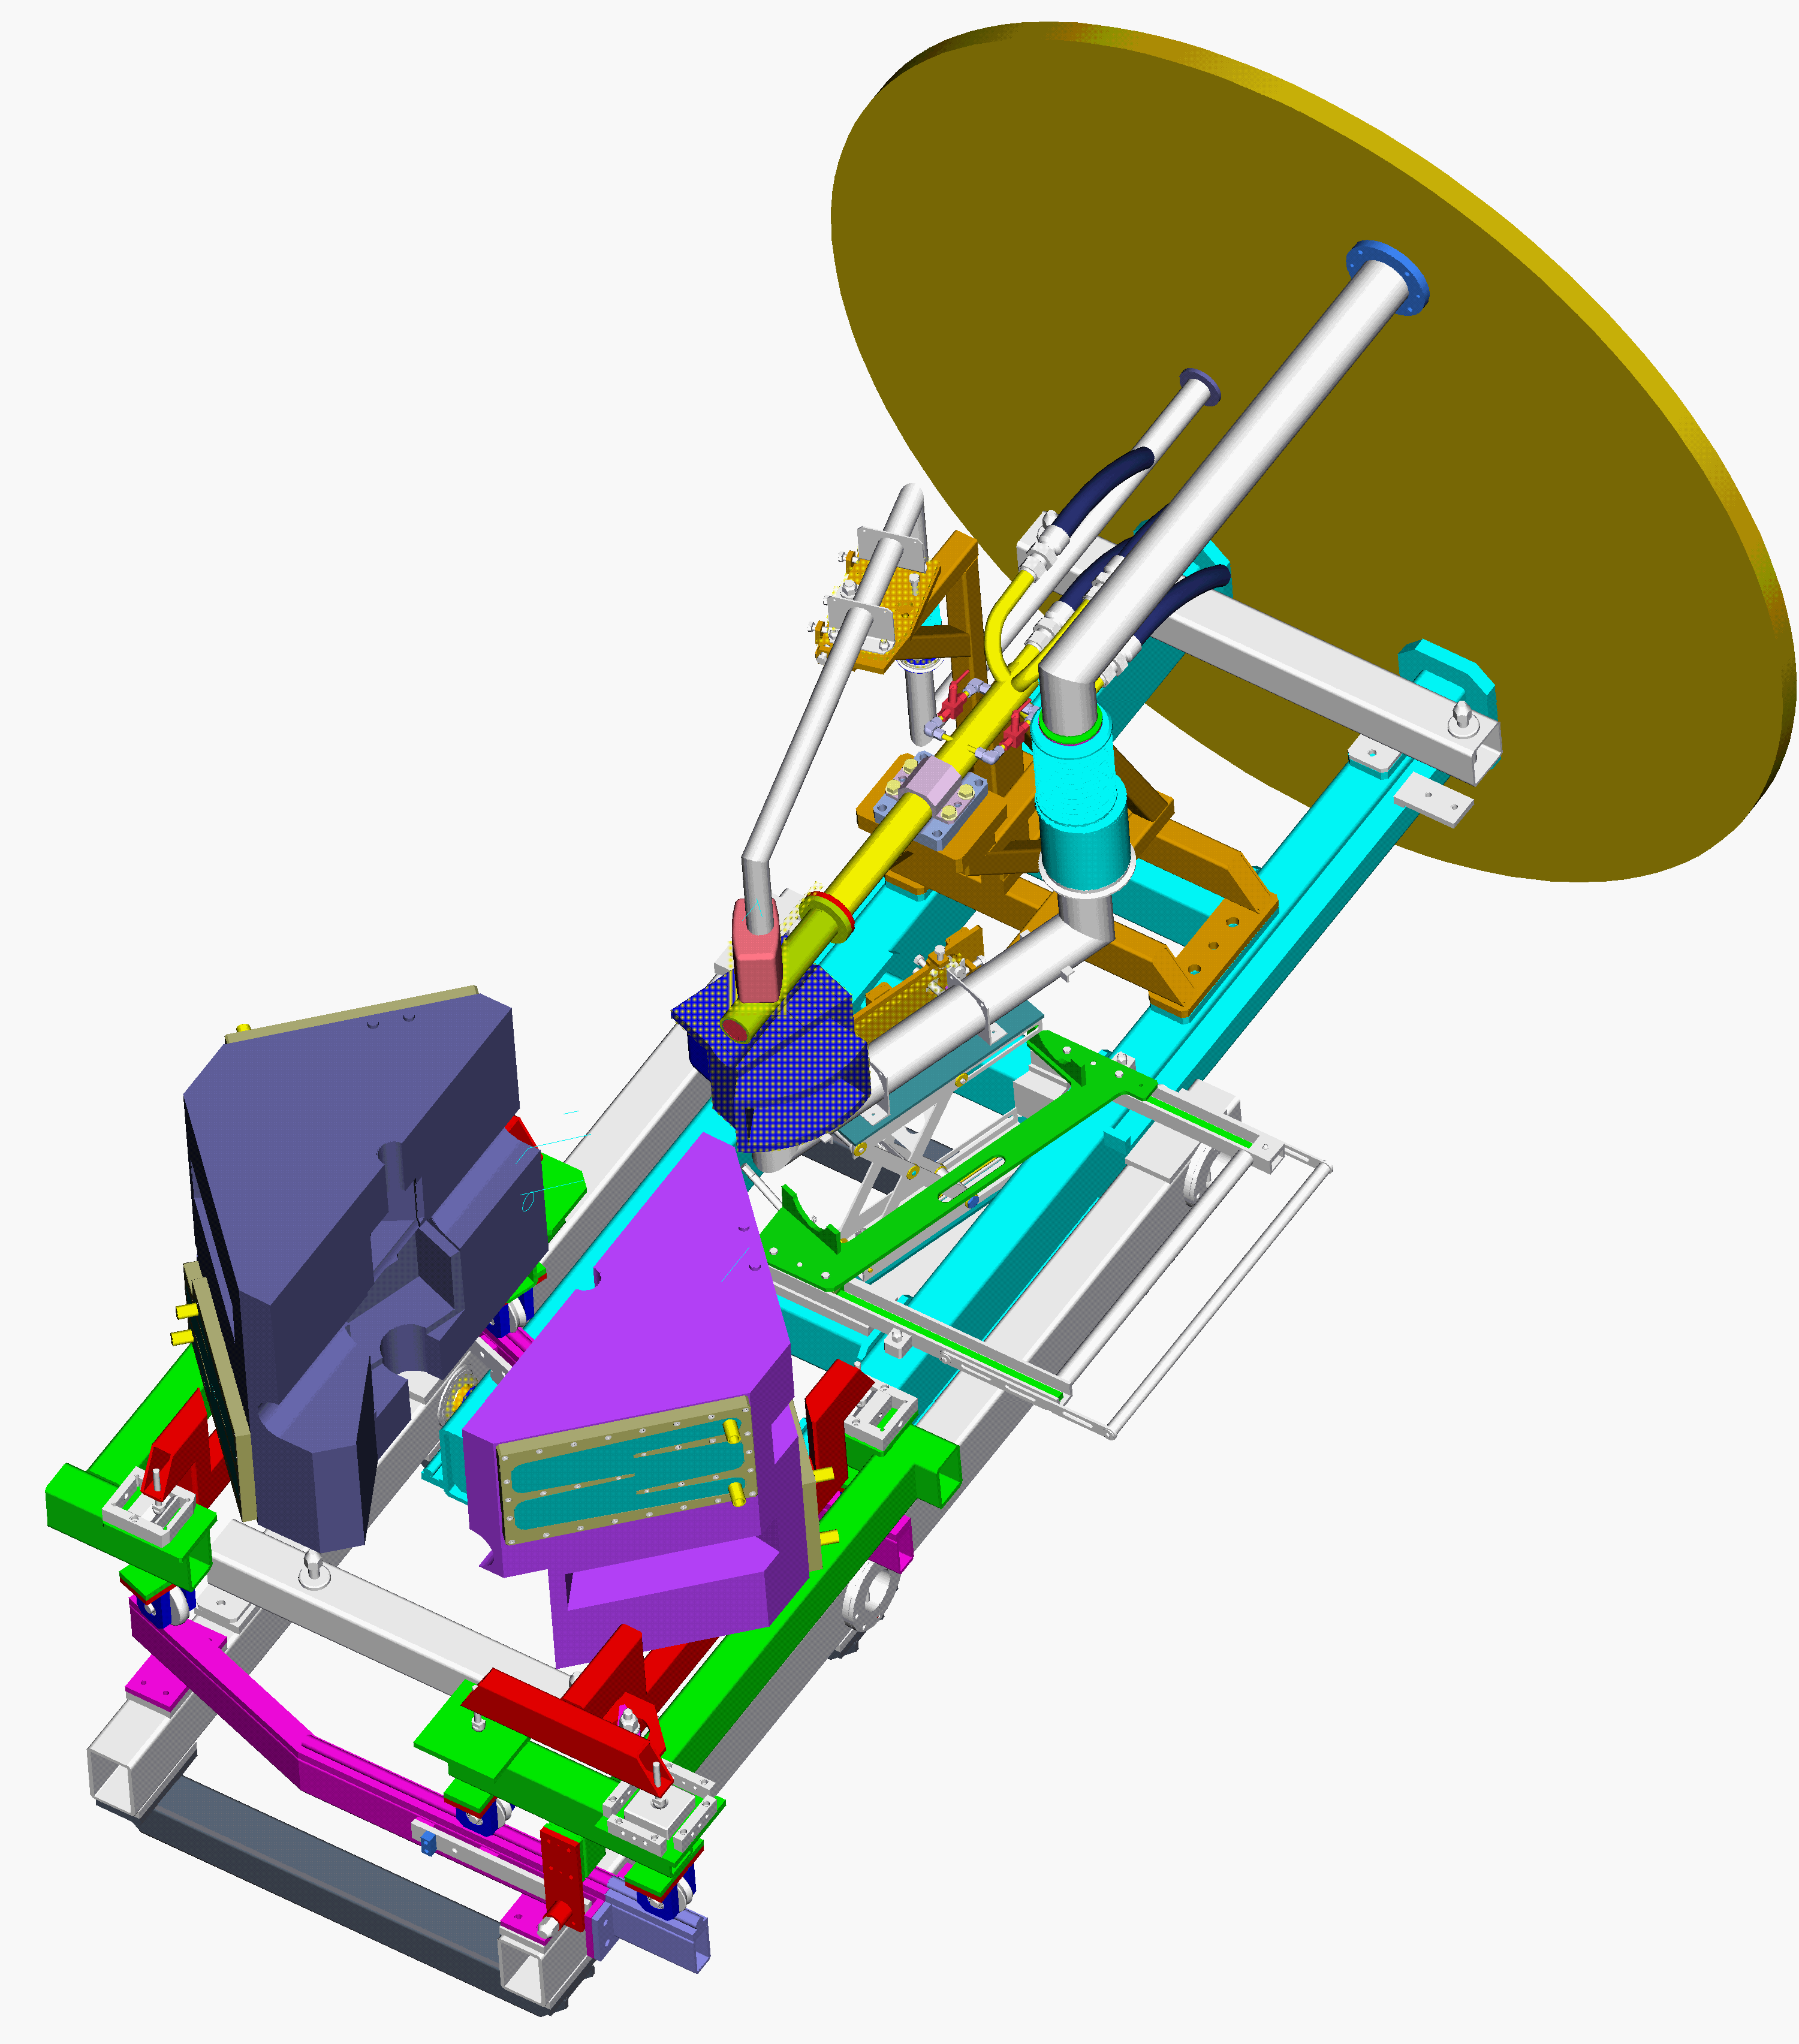
ISIS TS2 – basic principles
Low power (48 kW)
tantalum clad tungsten target
small edge cooled target, higher density
closer moderators, innovative design
Low frequency (10 Hz)
100 ms time frame
cold neutrons, high resolution
Optimisation
target, moderators, instruments

Slide 5
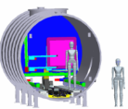
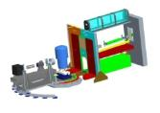
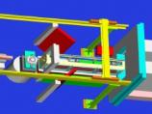
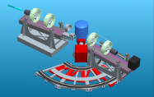
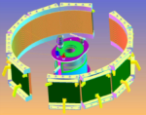
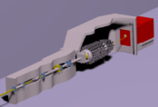
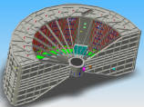
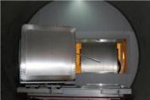
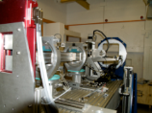
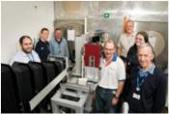
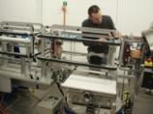
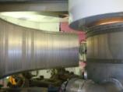
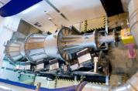


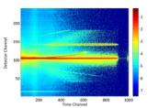
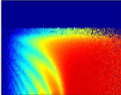

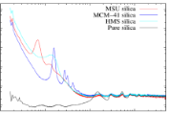
It works - Phase 1 instruments are outstanding!
SANS2D
POLREF
INTER
OFFSPEC
WISH
NIMROD
LET
Sean Langridge – TS2 Instruments, 18:30 Wednesday

Slide 6
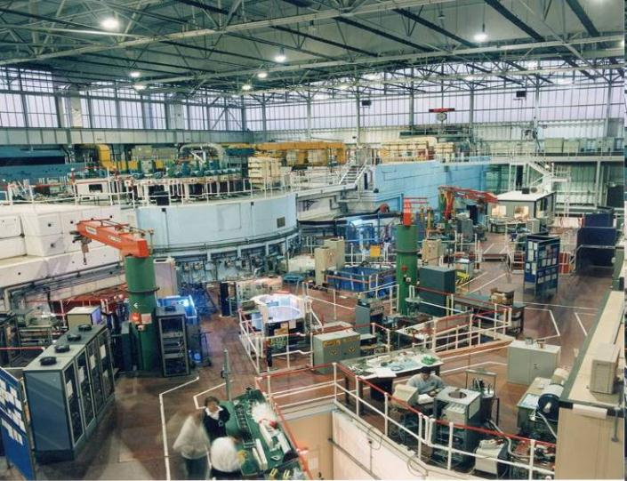
1 + 1 > 2

Slide 7
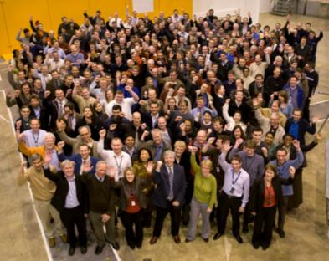
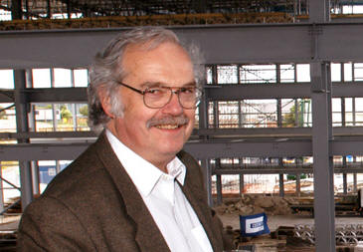
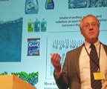
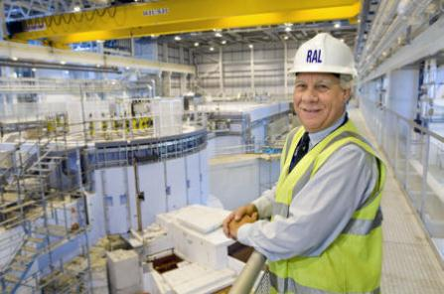
A top team – experience and dedication

Slide 8
Space – is worth every cent(imetre) ...

Slide 9
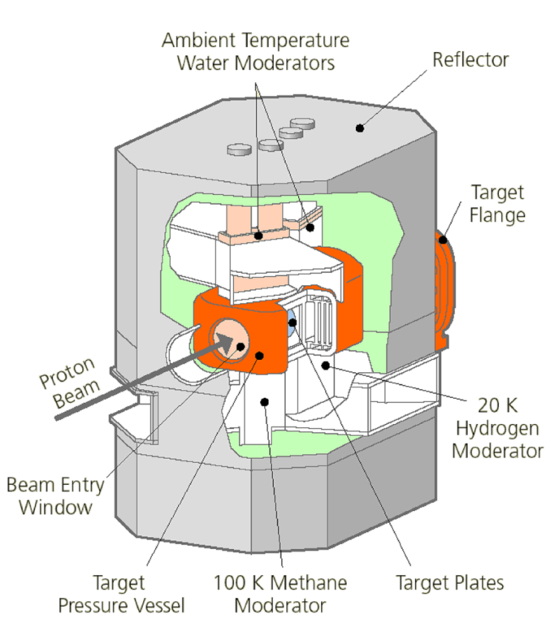
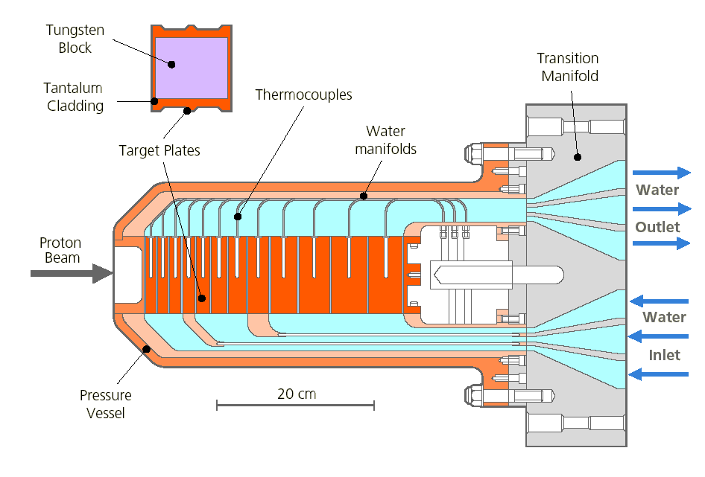
Target, reflector, moderator design/optimisation
Notes:
Moderation in the target causes extra absorbtion

Slide 10
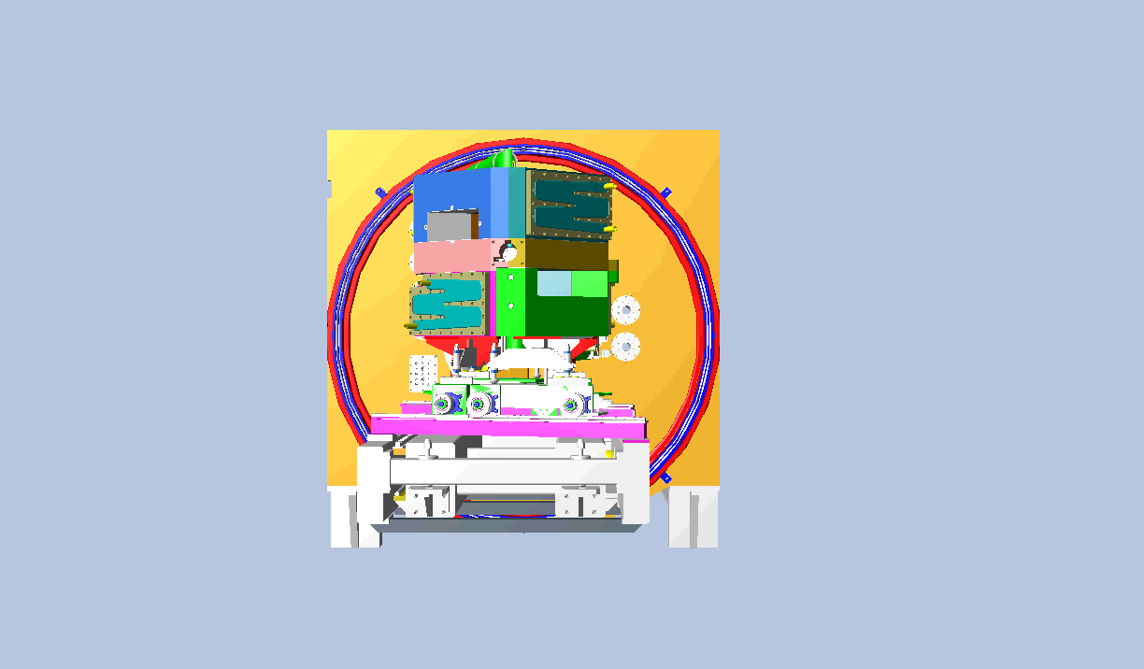
Target, reflector, moderator design/optimisation
David Jenkins – TS2 Target/moderators, 18:10 Wednesday
Notes:
The

Slide 11
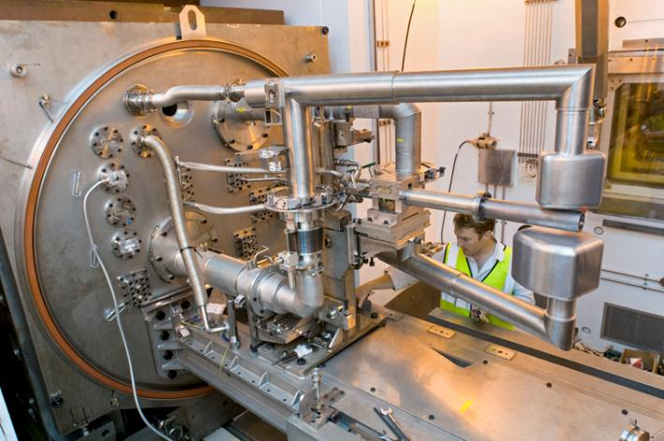
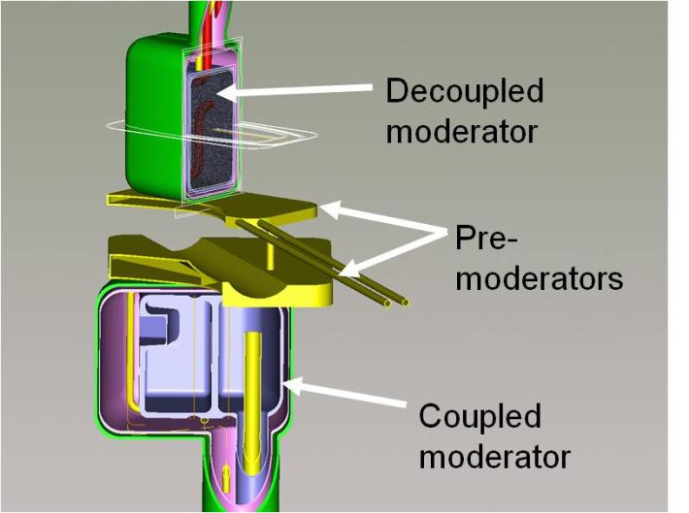
Target, reflector, moderator design/optimisation
Notes:
Moderation in the target causes extra absorbtion

Slide 12
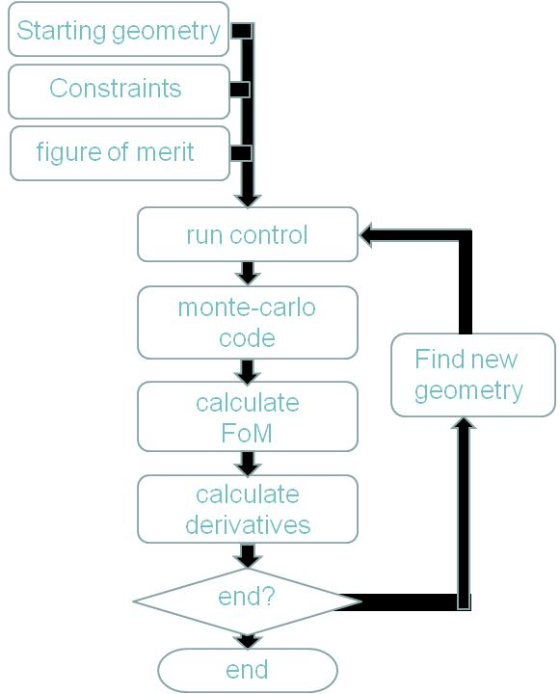
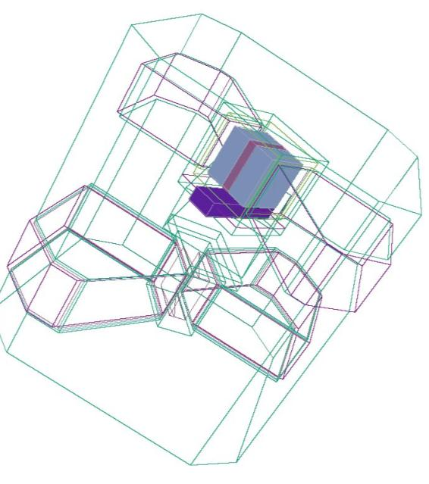
Target, reflector, moderator design/optimisation
Notes:
400 – 500 runs per day
Will maximize the performance of the target station, but sometimes you will not understand the results.
Either trust the code or spend some time thinking about what it is actually doing.

Slide 13
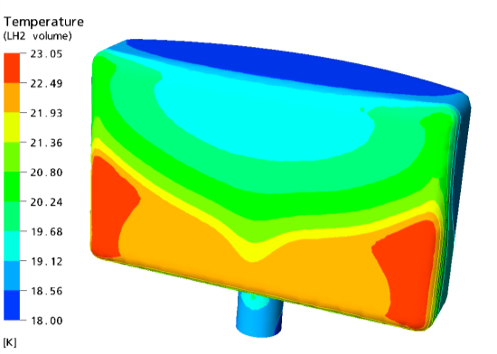
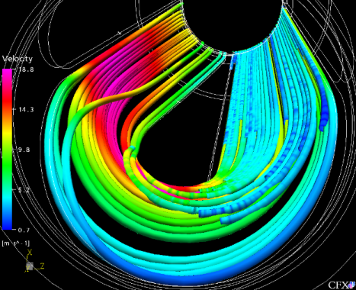
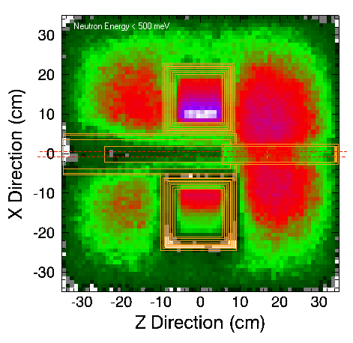
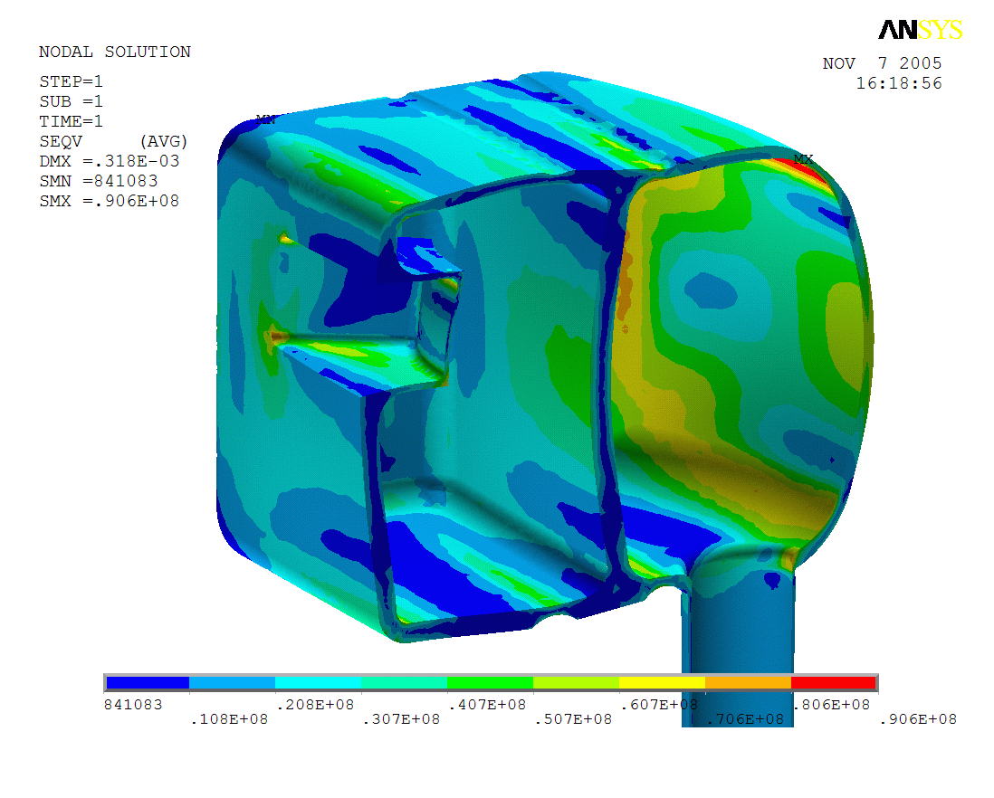
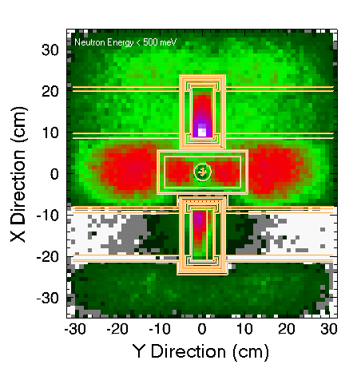
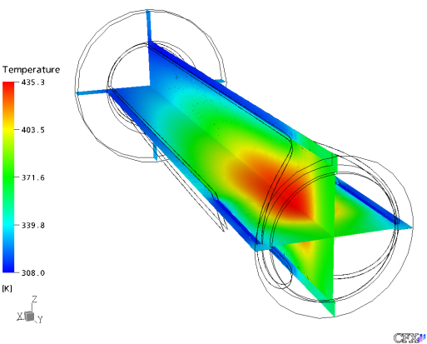
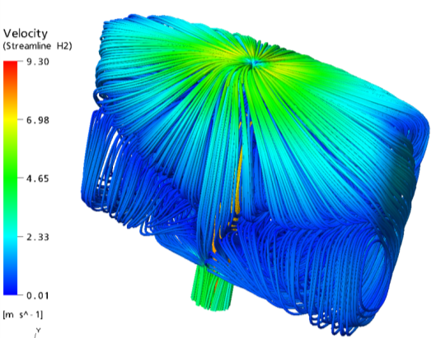
Target, reflector, moderator design/optimisation
Neutron transport
Monte-Carlo transport codes
Radiation damage
Monte-Carlo transport codes
Stress/ strain
Finite element analysis
Hydro- dynamics
Heat transport

Slide 14

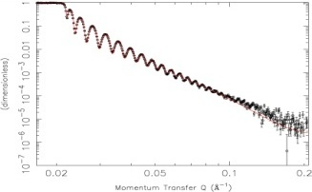

Target, reflector, moderator performance
Flux high (as predicted) →
← Background low (lower than expected)
Peak widths broader than predicted →

Slide 15

Target, reflector, moderator performance

Slide 16
Performance optimisation
v
Robust/reliable engineering

Slide 17
Pushing materials to their limits
in a
High radiation environment

Slide 18




Extracted proton beam - space and suppliers

Slide 19


Procurement and tendering – specify carefully

Slide 20


Steel and shutters

Slide 21




Instruments
Standardisation
Performance cost/benefit
Component suppliers
Software – start yesterday
Risk management
Phase them

Slide 22


Project management – it’s done for a reason
Risk management
Stakeholder management
Early specification
Design reviews/change control
Involve operations staff in design/installation
Design→Construction→Commissioning→Operation

Slide 23




Separate budgets

Slide 24




In-kind contributions

Slide 25



Communication

