Slide 1
Providing Detectors for ISIS
IKON 8
Milton Hill House, Steventon, Oxon UK
04 February 2015
Nigel Rhodes

Slide 2
Introduction
Description of some of the ISIS detectors
Some of the key stages in delivering detectors to ISIS
Timescales
Strategy
Notes:
2
S

Slide 3
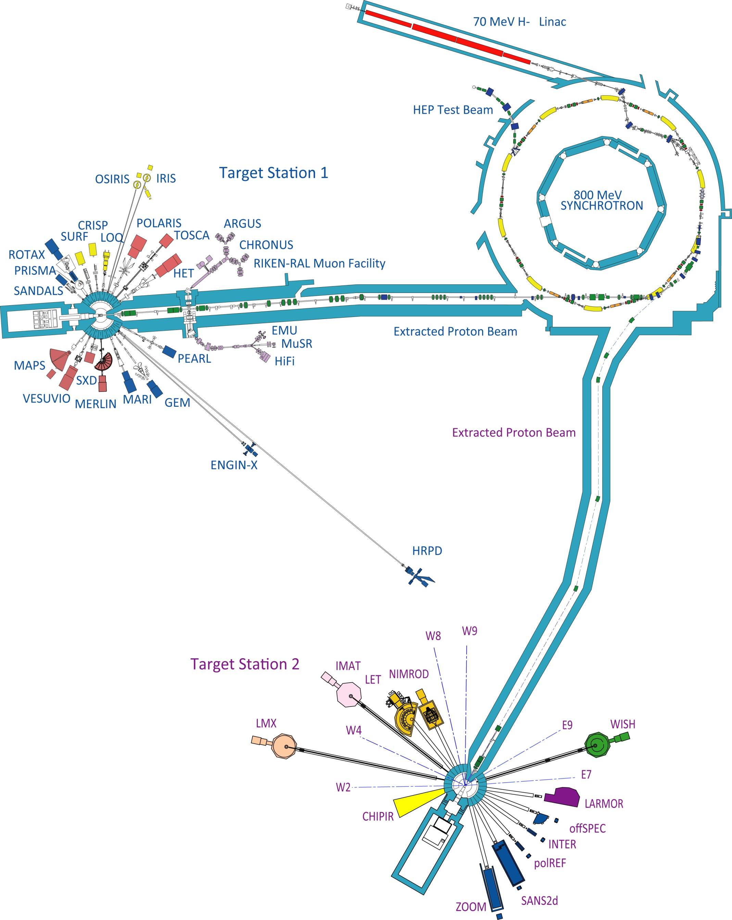


The ISIS Instrument Suite
26 Neutron instruments
4 More under construction 7 Muon instruments
50% Scintillation detector technology
50% 3He Gas detector technology
Notes:
3

Slide 4
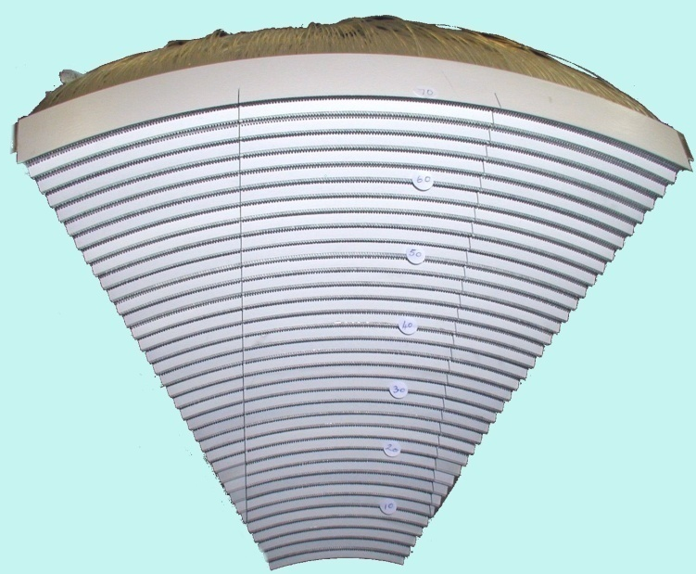
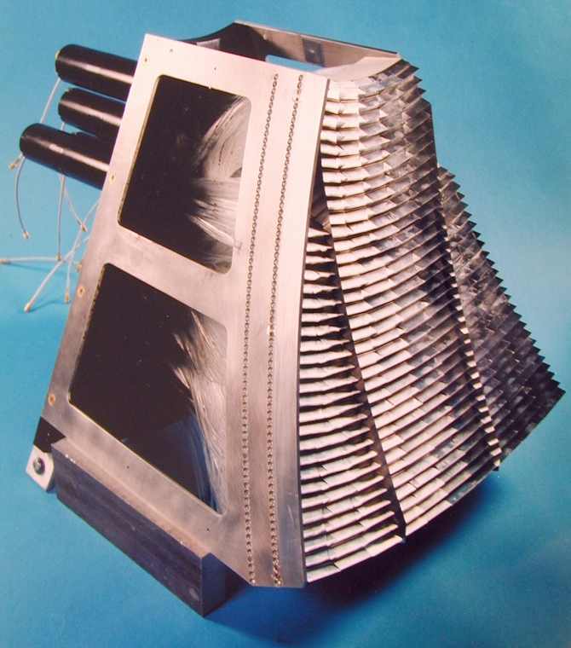
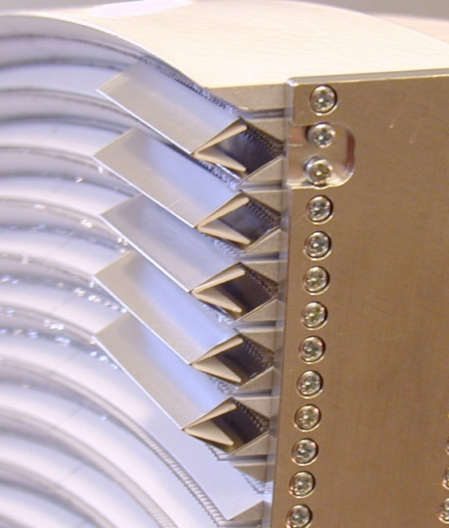
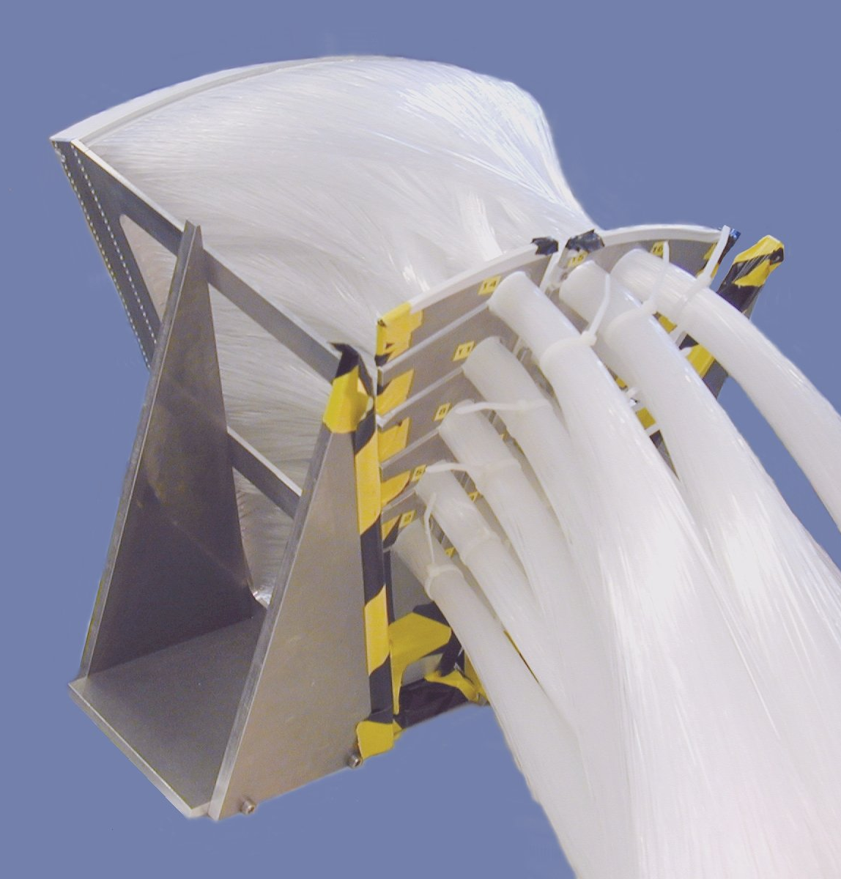
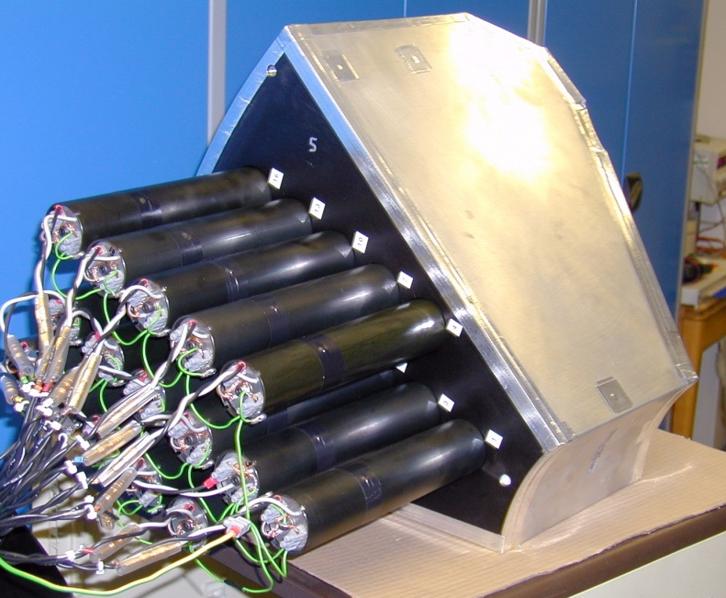
Scintillation Detectors: OSIRIS
Notes:
4

Slide 5
ZnS scintillator geometry
ZnS:Ag/⁶LiF
+ High light output - Long afterglow
Good neutron / gamma discrimination Opaque
N
N
N
20% at 1Å
32% at 1Å
50% at 1Å
SCINTILLATOR
FIBRE
REFLECTOR
To optimise instrument requirements
Different scintillator size
Different scintillator geometry
Different fibre codes
Notes:
5

Slide 6
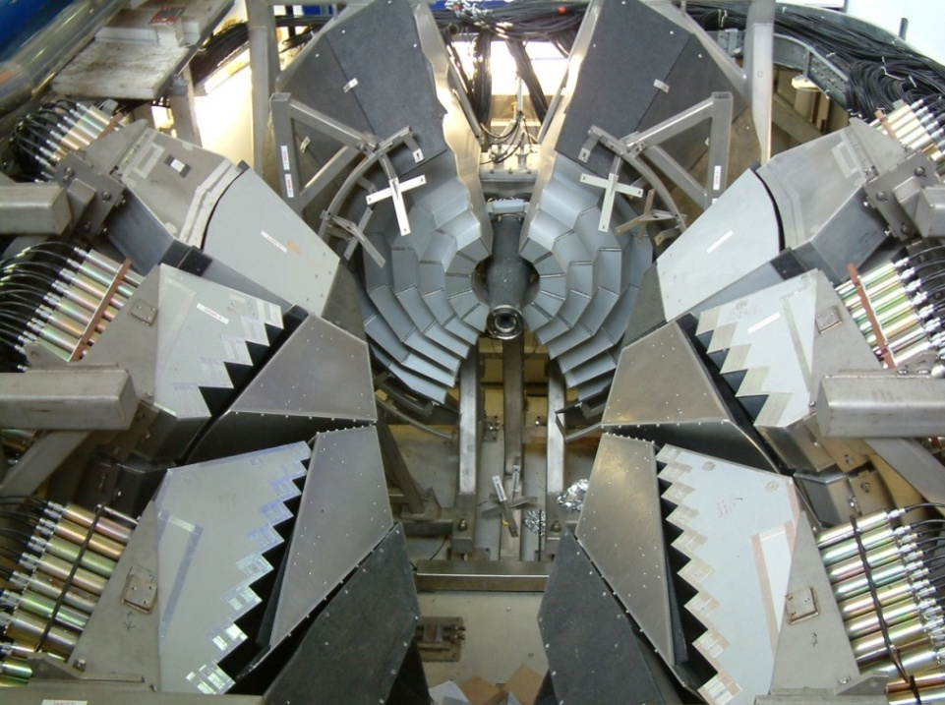

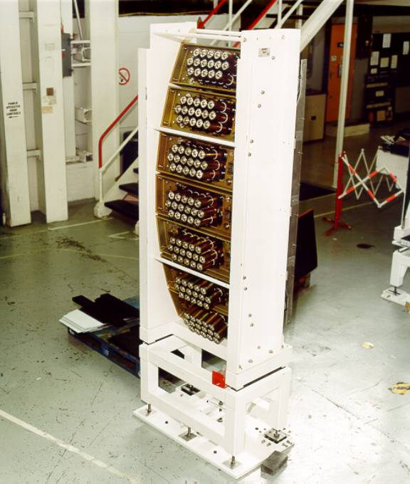
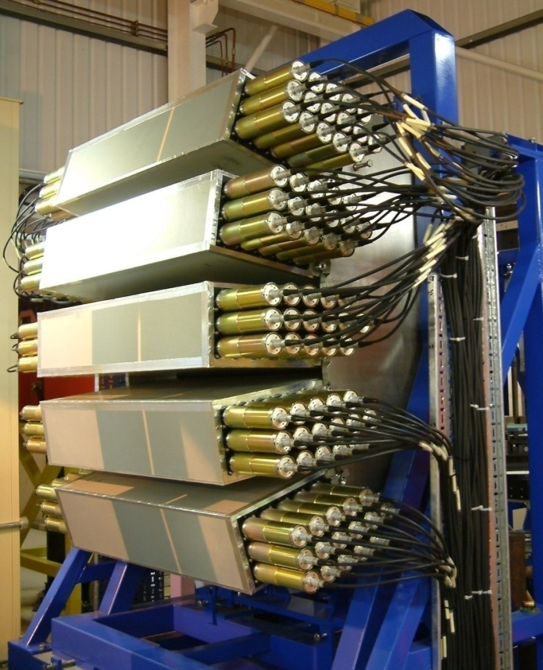
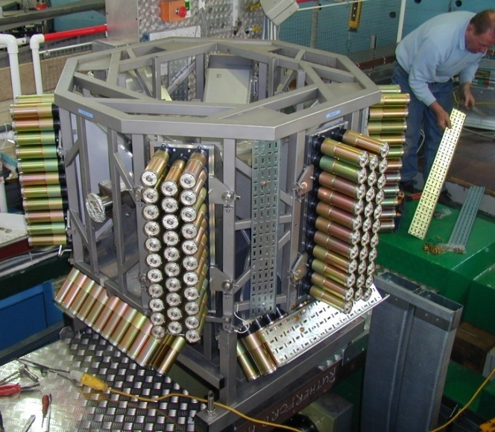
ISIS Scintillation Detectors
Notes:
6

Slide 7
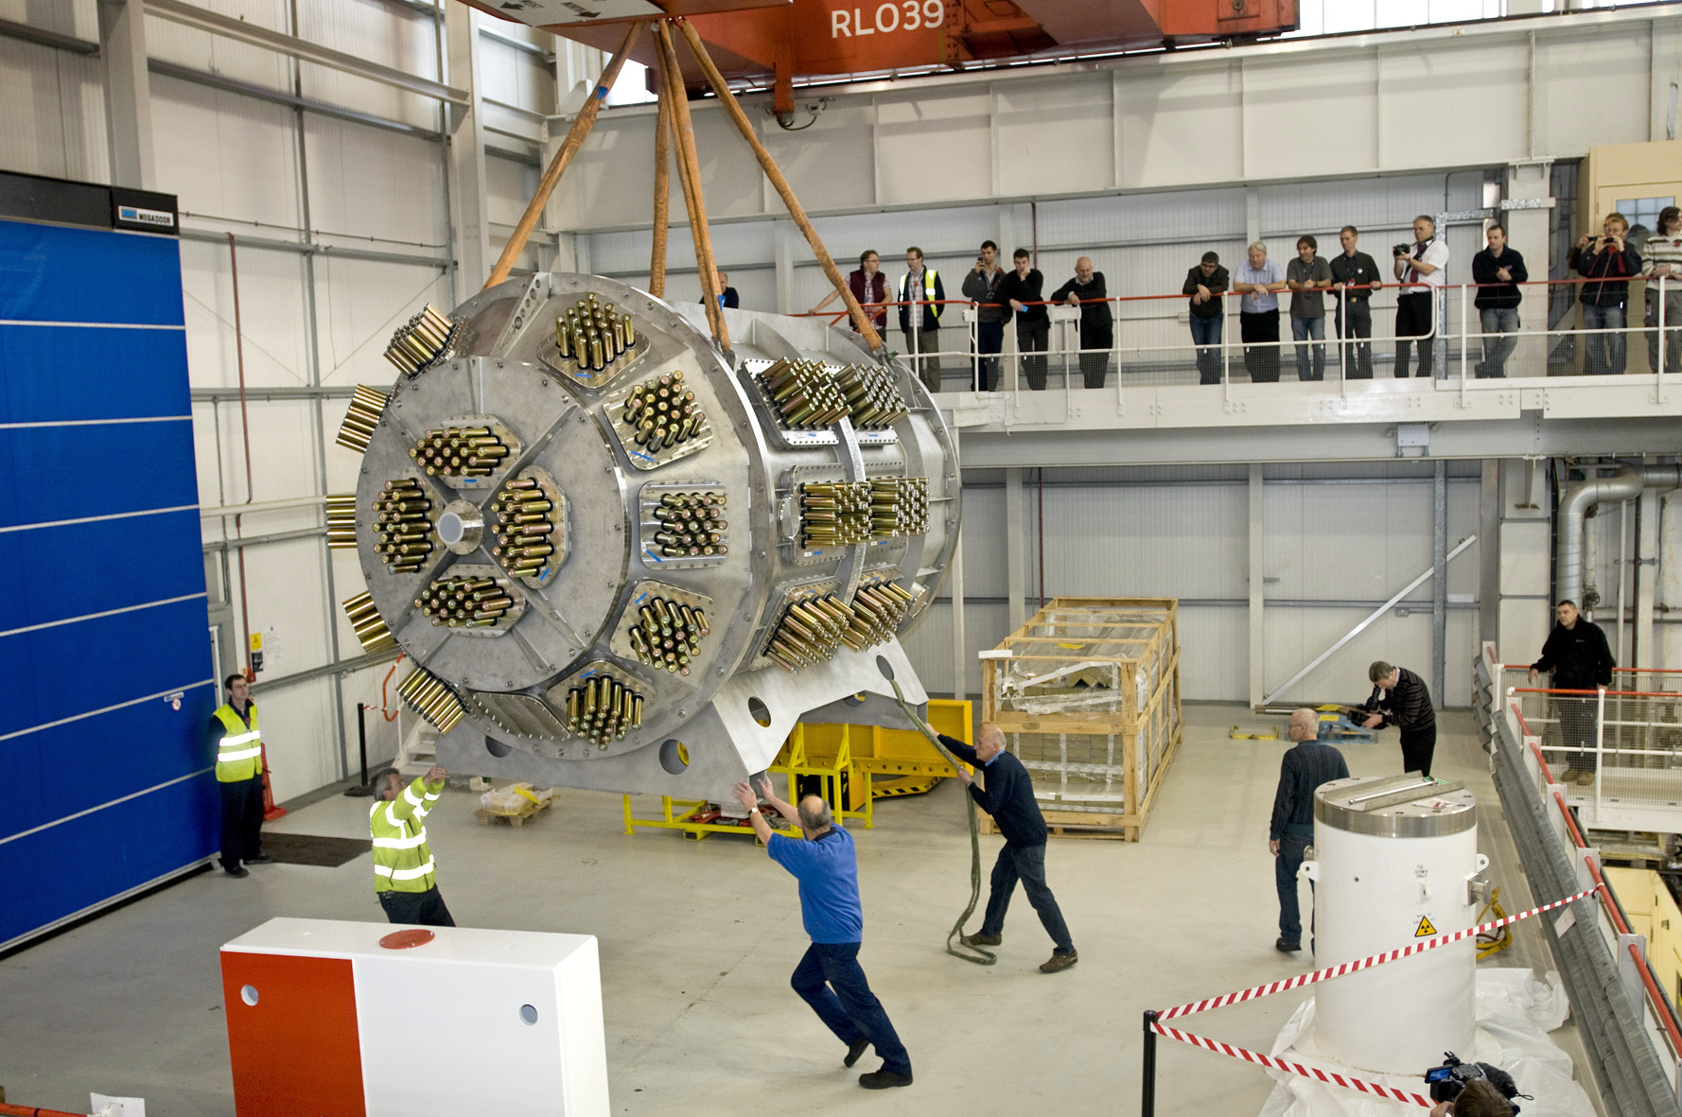
POLARIS
38 Modules in 6 banks 924 PMTs
460 km fibre optics 2,954 detector pixels
Notes:
7
S

Slide 8
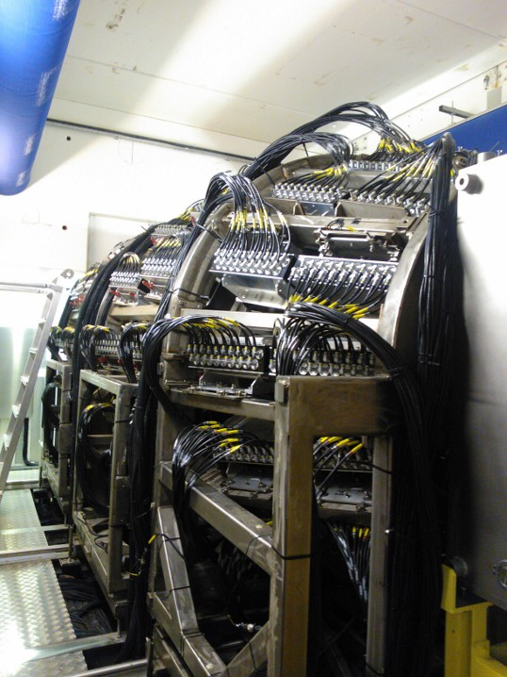
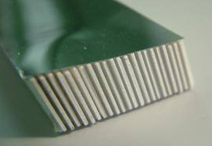
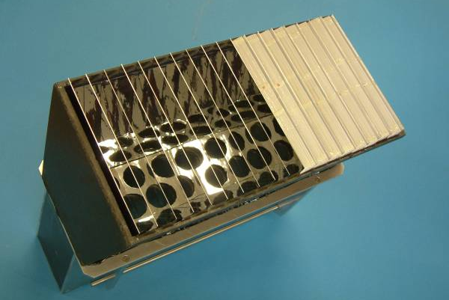
Scintillation Detectors: non-fibre coupled
NIMROD WISH
84 modules operational
Optimised for epithermal range
+ fibre coupled Low Angle bank
Notes:
8

Slide 9
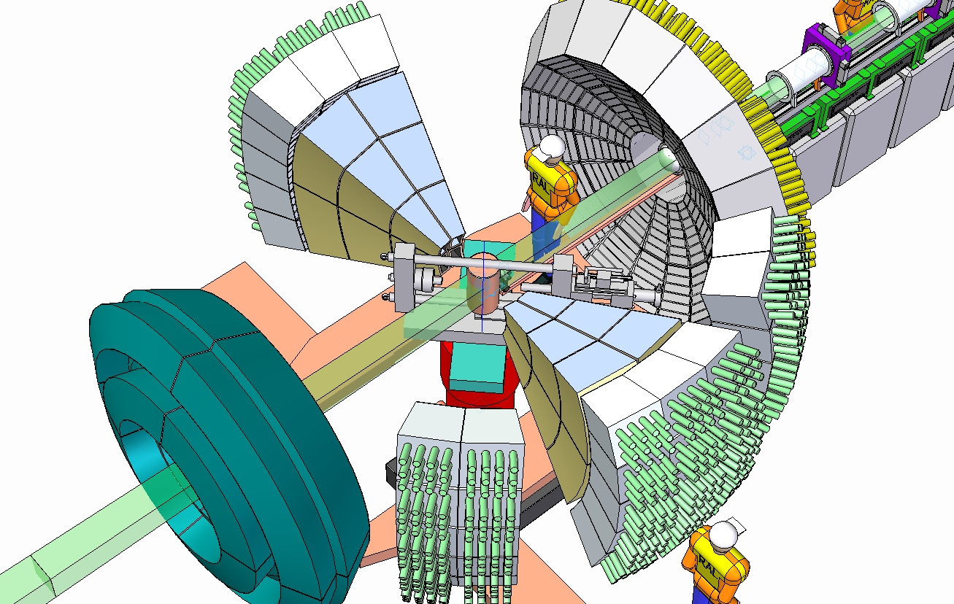
Imaging and Materials Beam Line
First Dedicated ISIS imaging instrument
Complimentary large area diffraction detector
Stress and texture analysis
4 x area POLARIS
4 x no of pixels per unit area
Need a more cost effective solution
Notes:
9

Slide 10
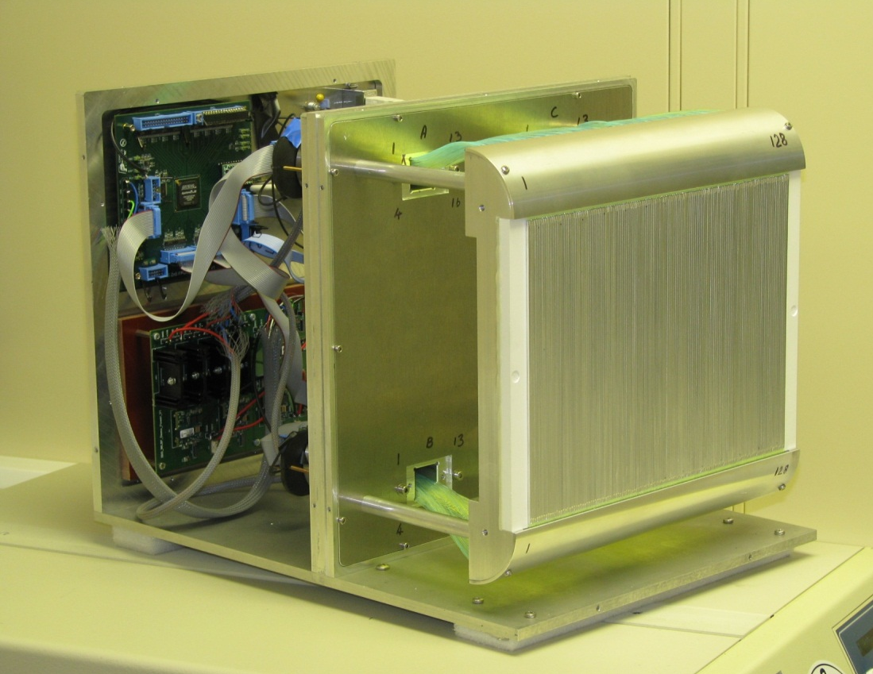
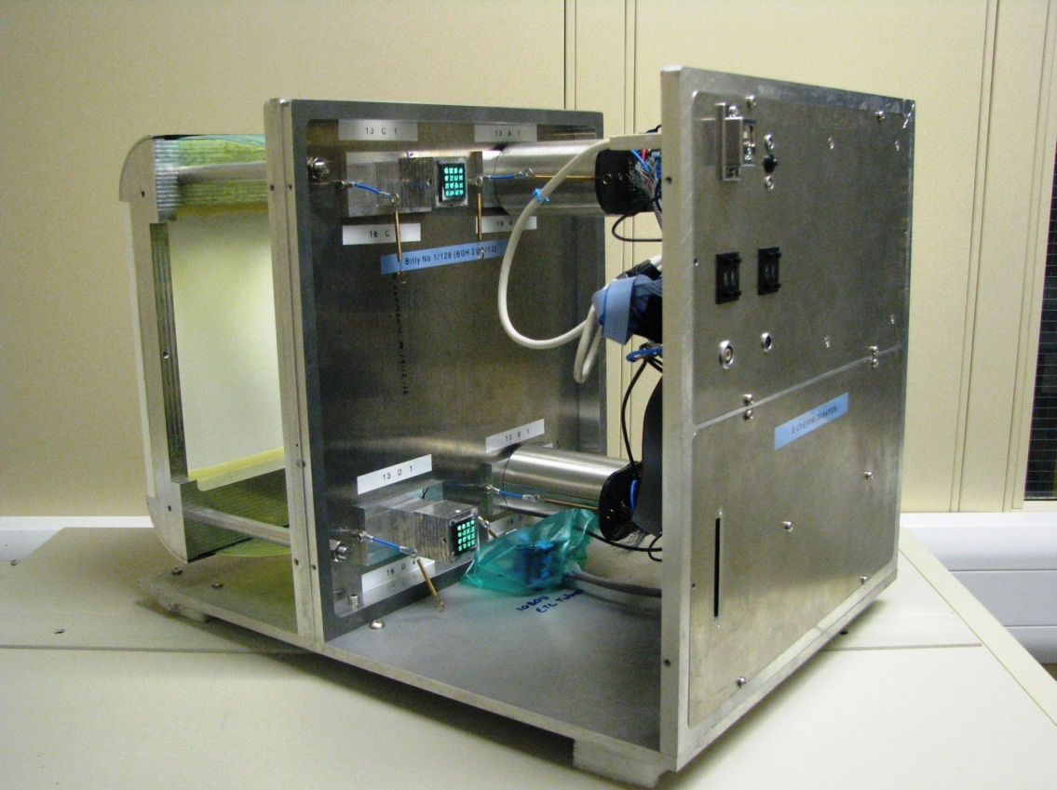
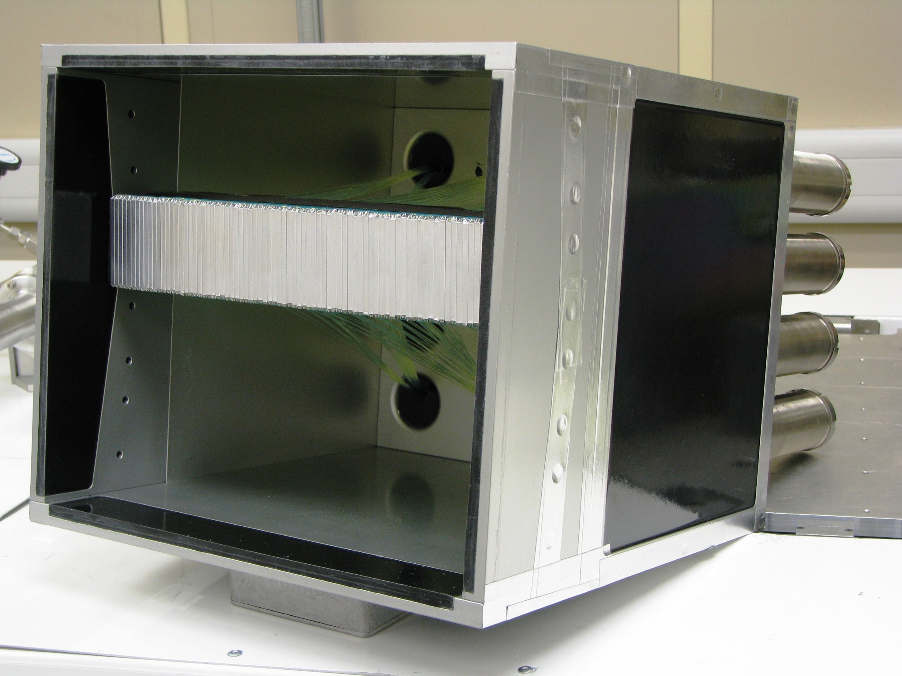
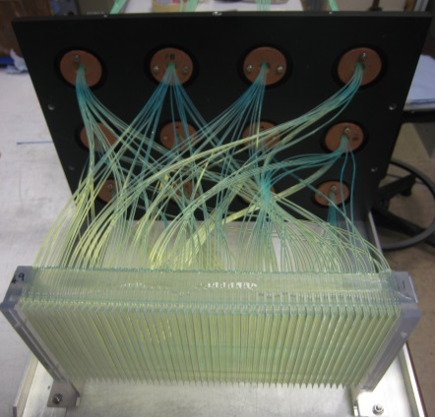
IMAT detector designs
Notes:
10

Slide 11
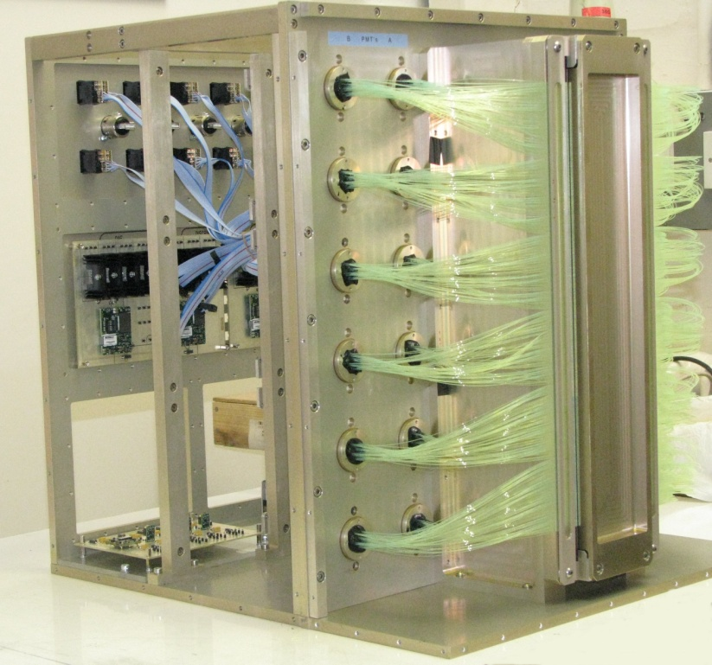
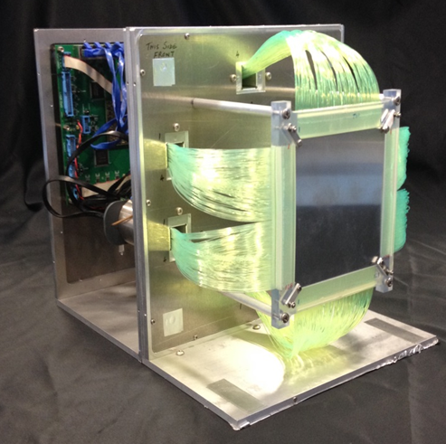
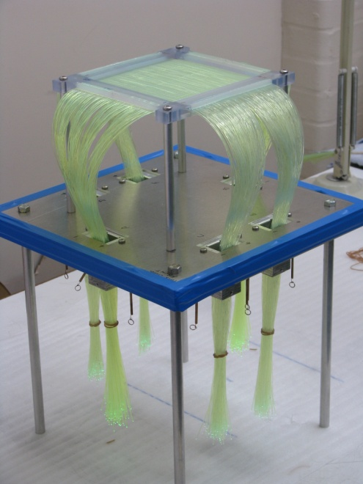
Reflectometry and Single Crystal diffraction
Linear PSD
0.5 x 60 mm²
2D PSD
1 x 1 mm²
Notes:
11

Slide 12
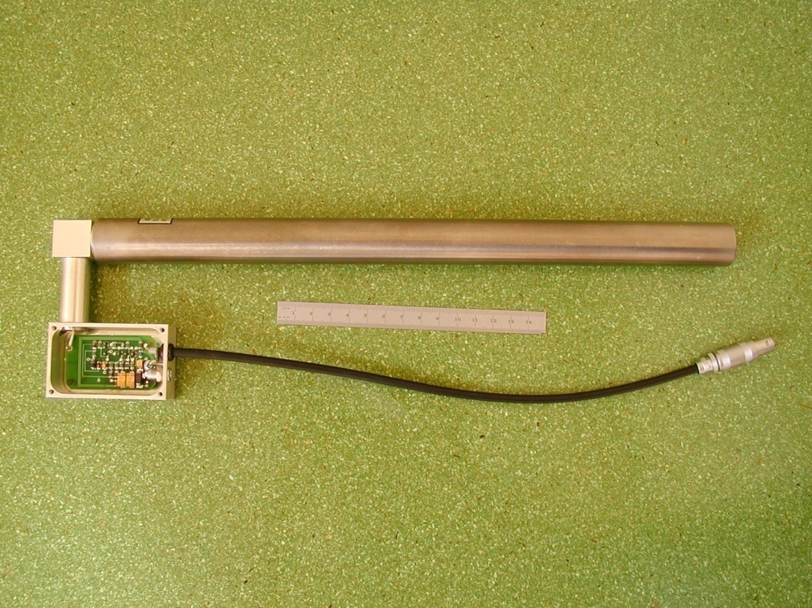
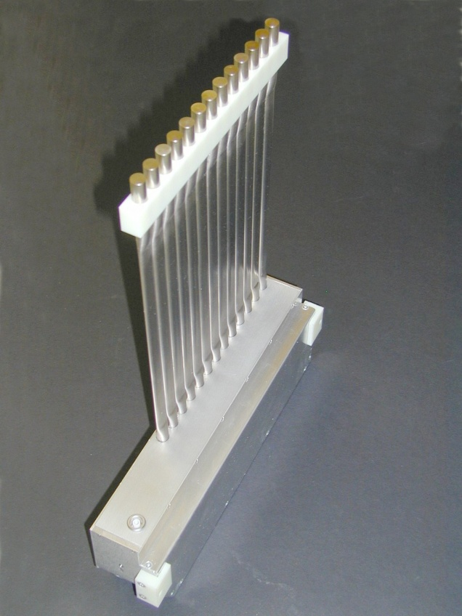
3He Detectors
Chopper spectrometers MARI
Molecular spectroscopy TOSCA
Squashed detectors for accurate ΔT
MARI : 900+ detectors
300 mm long
Notes:
12

Slide 13
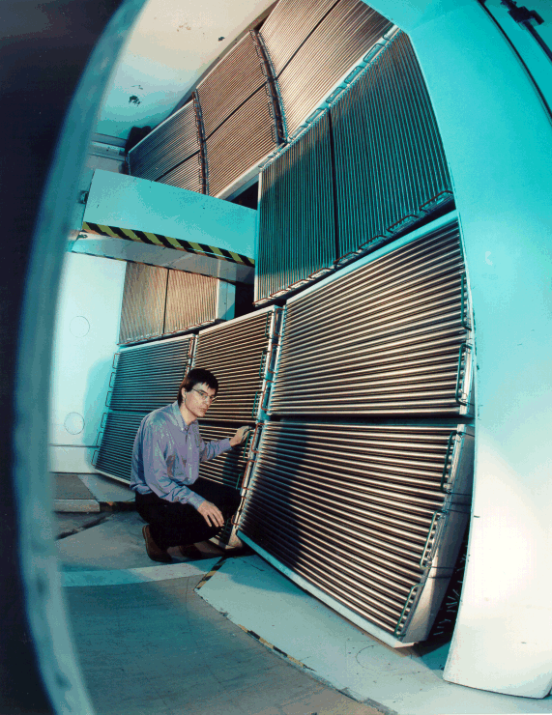
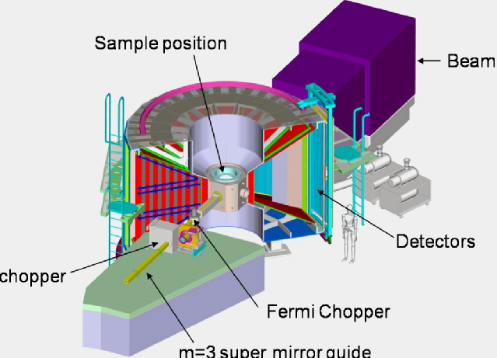
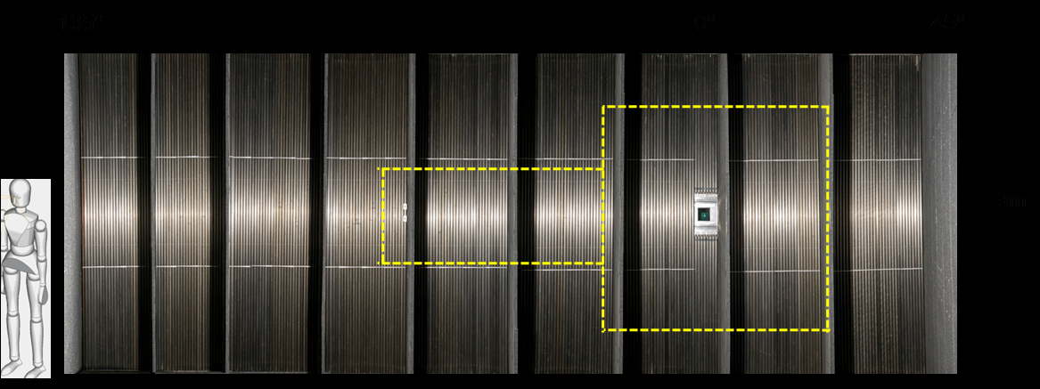
3He RW Detectors: MAPS and MERLIN
The MERLIN detector projection
Notes:
13

Slide 14
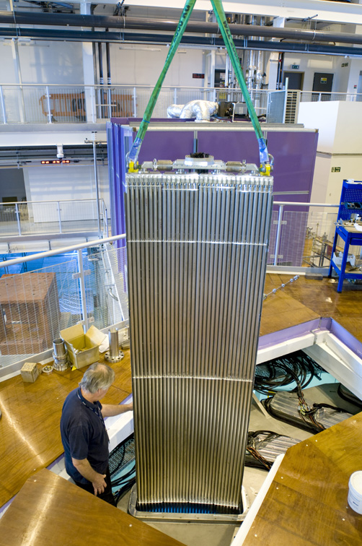
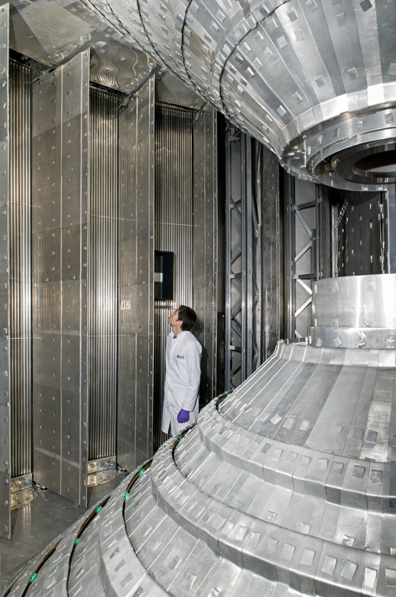
3He RW Detectors: LET
Notes:
14

Slide 15
3He RW Detectors: WISH
8 mm
1520 detectors
+190,000 pixels
Notes:
15

Slide 16
Key stages in delivering detectors to ISIS
Specification
Research and development
Prototyping, Evaluation
Final design
Pre production prototype
Production
Final assembly
Test
Installation
Commissioning
Maintenance
Notes:
16
S

Slide 17
Detector delivery: Specification
Detector characteristic | 10 bar 25 mm dia ³He | WLS ZnS detector
Neutron Efficiency | 70% at 1 A | 50% at 1 Å
Gamma sensitivity | 10⁻⁶ | 10⁻⁶ but dependent on pulse processing
Background | 10 – 15 c hr⁻¹m⁻¹ | limiting and dependent on speed and light coupling
Width | 25 mm | not significantly limiting
Length | 1 – 3 m | not significantly limiting
Resolution | 15 -25 mm at FWHM | cost dependent
Placement reliability
Local rate capability | 50 kHz on a pixel | 16 kHz on a pixel
Global Rate capability | 50 kHz on a tube | Dependent on code and size of module
Signal recovery time |  | Decay time dependent
Timing Resolution | 1 μs
Dynamic range
Stability |  | 0.1 % per degree
Area | 15 - 40 m² | cost dependent
Environment | Cryogenic vacuum
Cost
Notes:
17

Slide 18
Detector development: scintillation detectors
Small changes in ZnS/Ag;6LiF clear fibre coded detectors relatively easily accomplished
Shape, Size not necessary to prototype
Improving linear position resolution – needed to prototype
Going from 1D to 2D position resolution a major change
Developing WLS fibres technology
Fibre type, diameter, dye content, pitch
Coincidence level
PMT type
Optical cross talk, PMT cross talk,
Signal processing algorithm
Jeff will talk about these in more detail in his talk in the detector session tomorrow
Notes:
18
Some

Slide 19
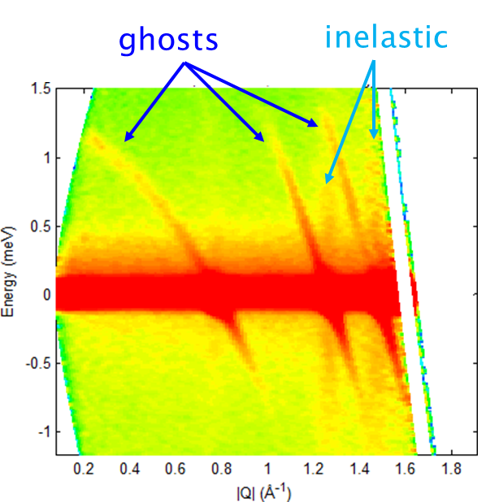
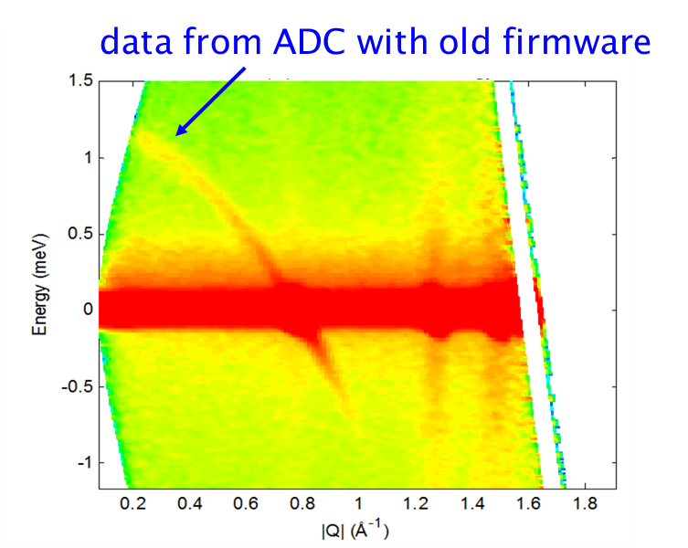
Detector development: gas detectors
LPSDs purchased from industry
Electronics developed in house
Peak flux in detector peak ~ 80kHz
Notes:
19
Some

Slide 20
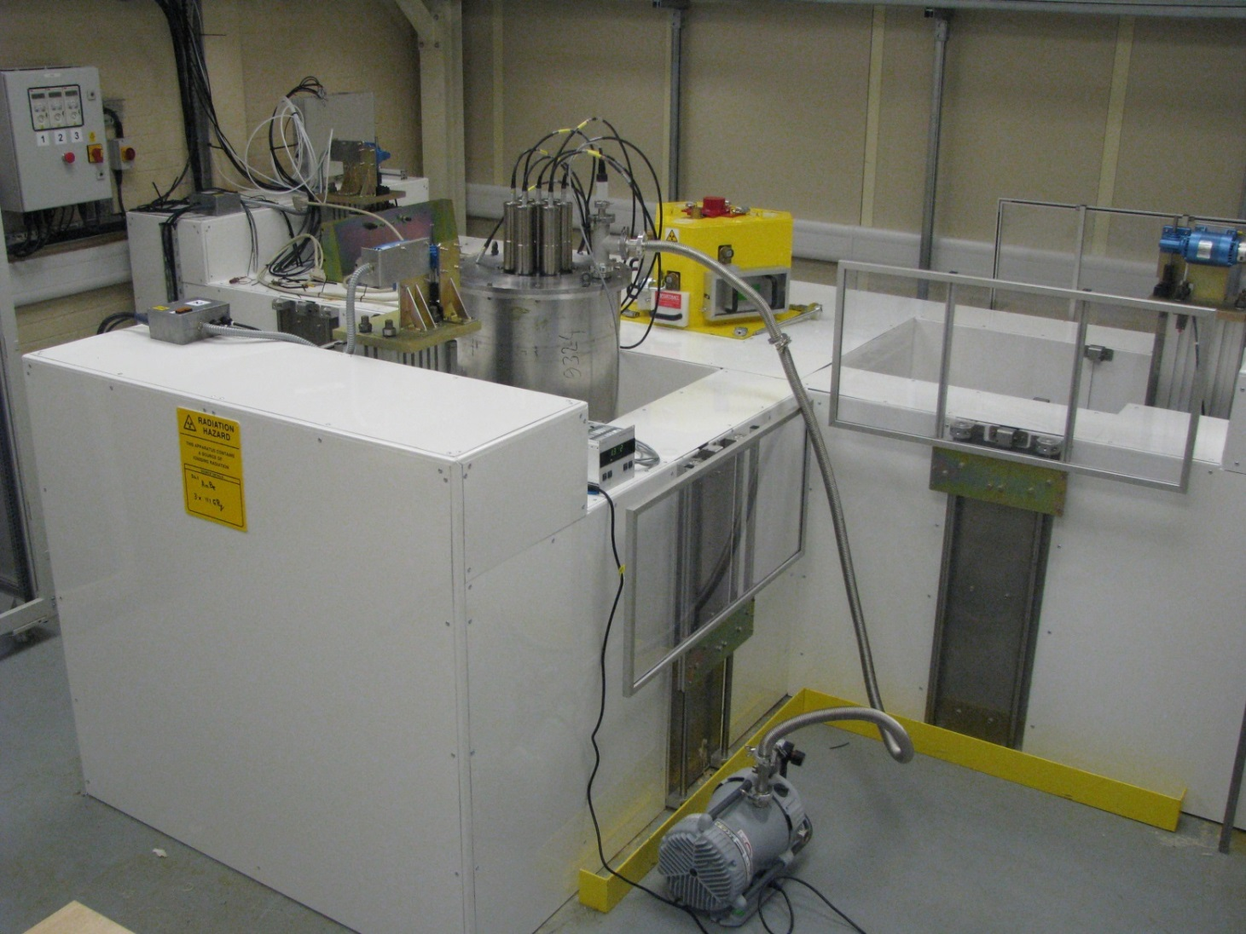
Detector testing
Two Detector test facilities
Water moderated AmBe
Some things cannot be done with out the need for access to ISIS neutrons
Rate capability Wavelength response
Notes:
20
Some

Slide 21
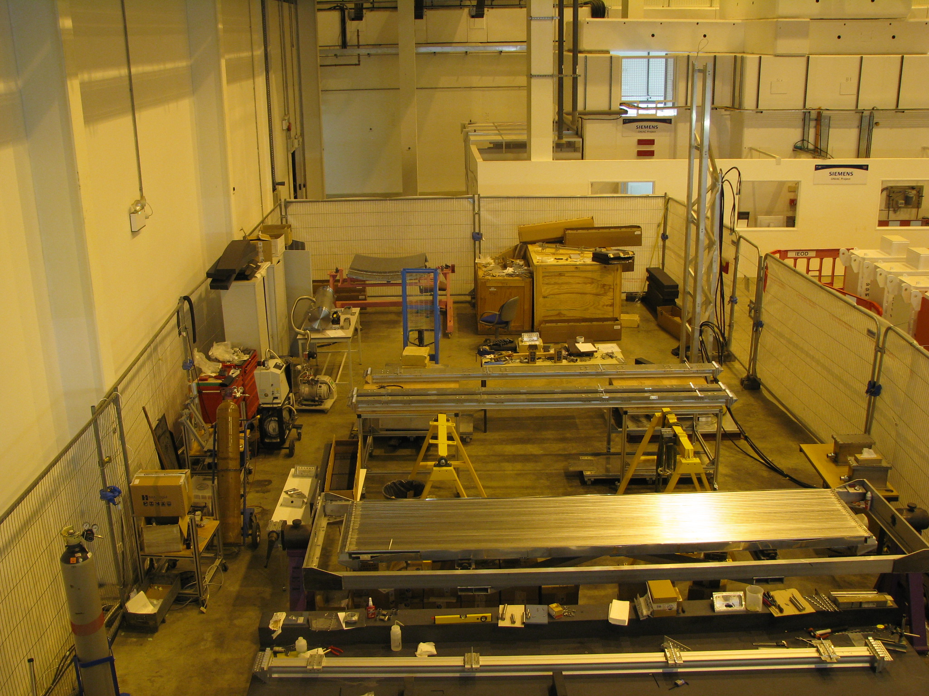
Detector testing
WISH Detector Assembly
Vertical test stand
Mobile neutron source
Horizontal test stand
Vacuum test kit
Pressure test kit
Detector frame Assembly
Detector alignment table
Notes:
LET Assembly area AmBe source HDPE moderator Stop on the tour tomorrow

Slide 22

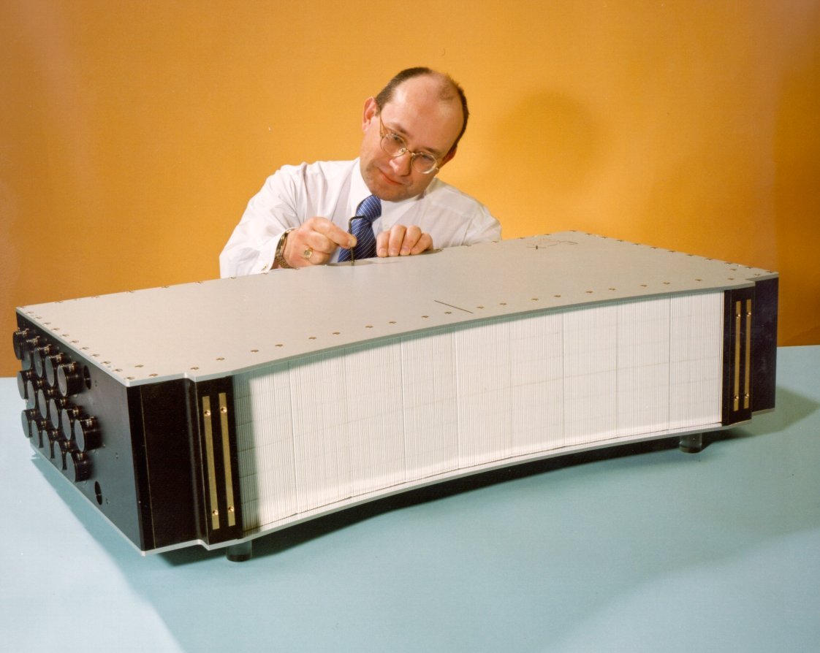
Pre-production module
Existing
Notes:
22

Slide 23
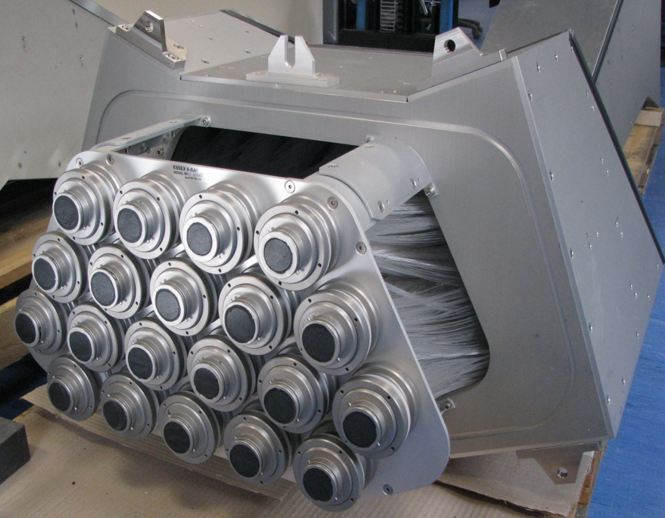
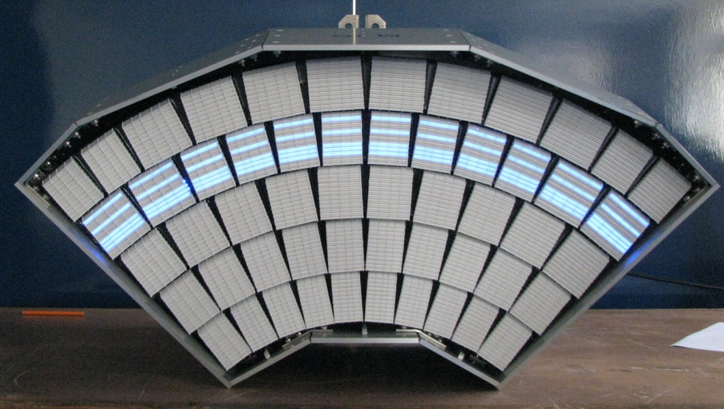
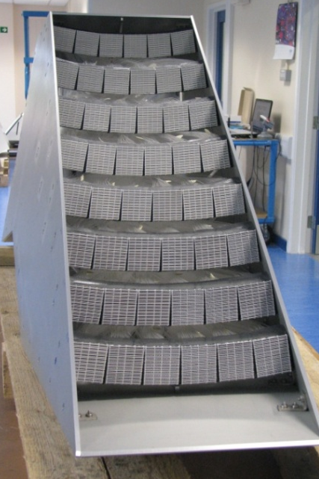
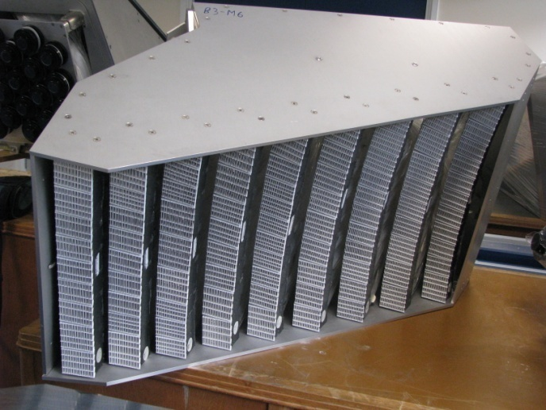
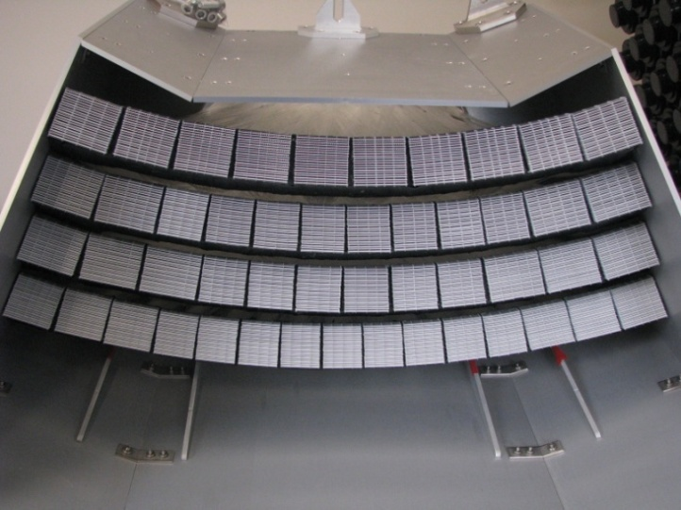
Manufacture
Notes:
23
Some of the 38 POLARIS detector modules

Slide 24
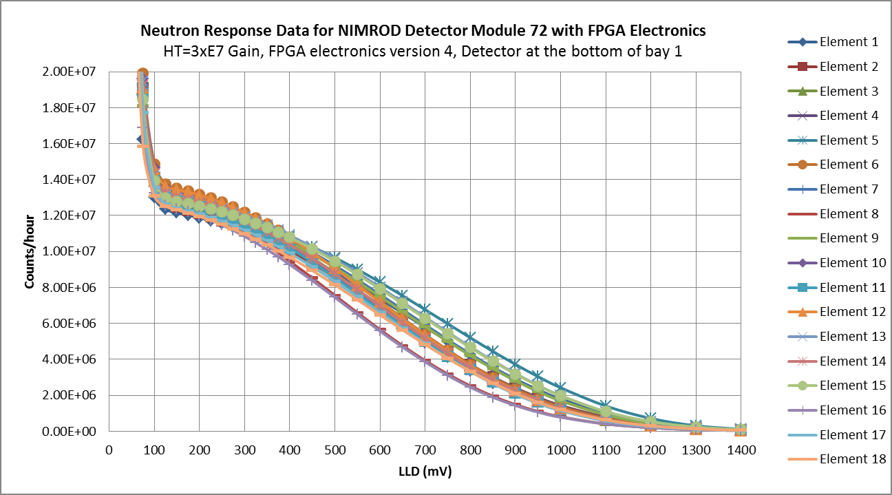
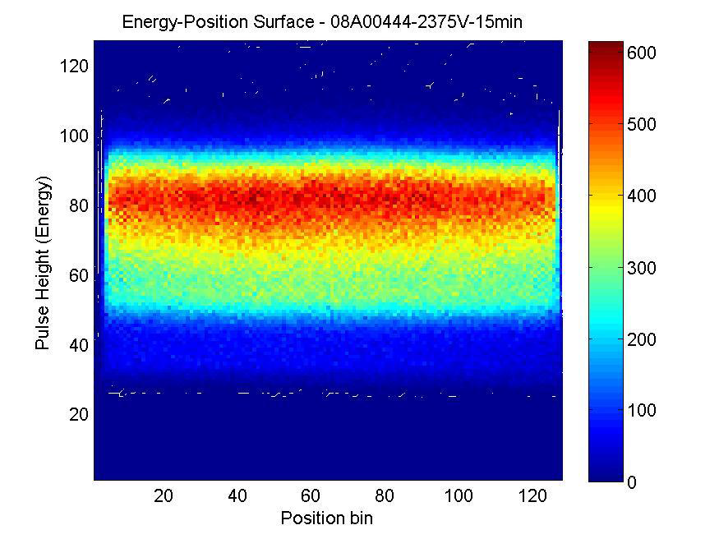
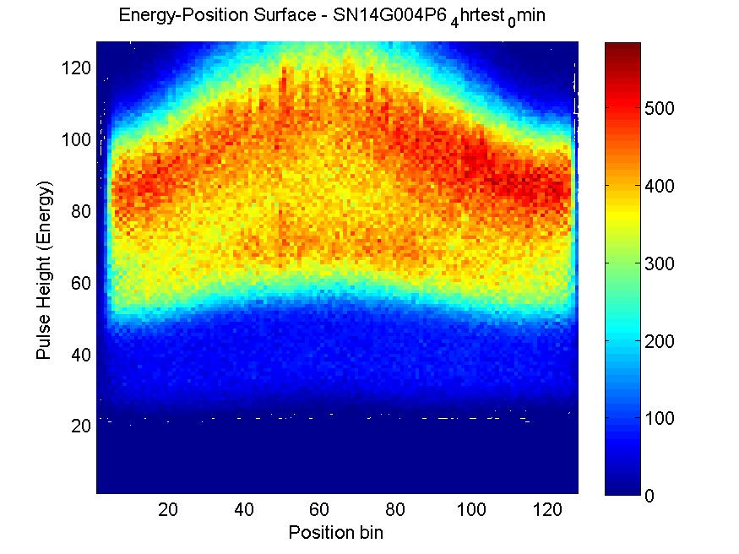
Testing Production Detectors
Notes:
24

Slide 25
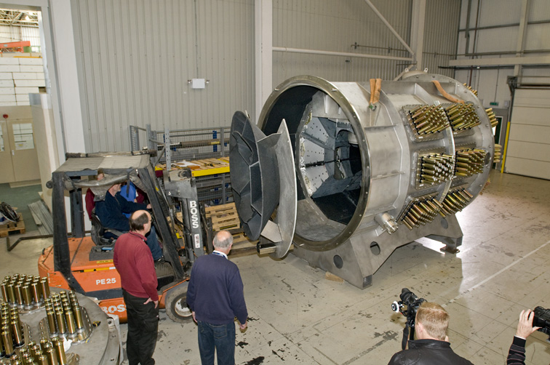
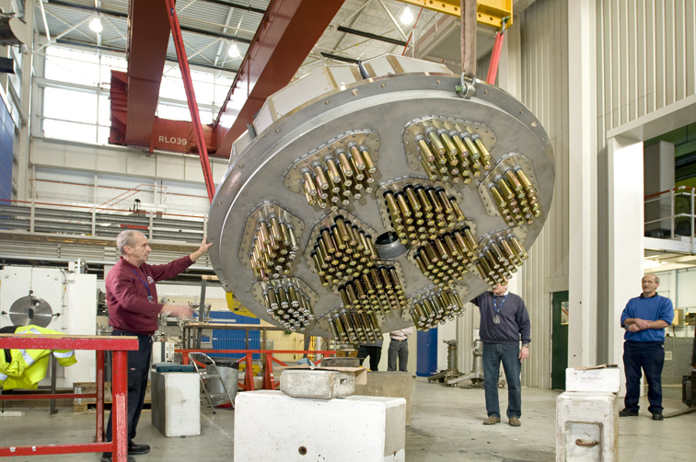
Installation
Notes:
25

Slide 26
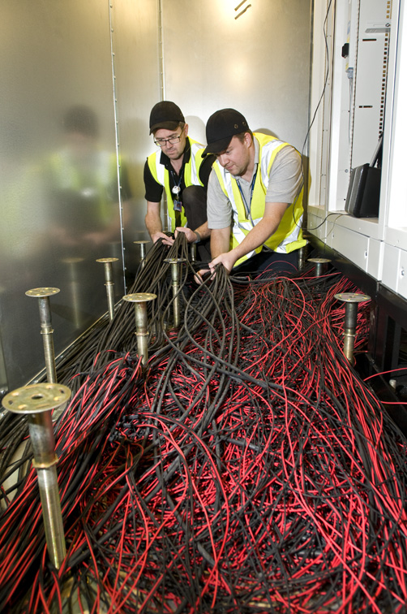
Installation
Cabling is a significant task
Notes:
26

Slide 27
Commissioning
Relatively quick – days/weeks
Most of the work has been done in pretesting all the detectors
And by Julian’s group in pre testing all the electronics
Maintenance
Access to the detectors for maintenance is essential
Try to build into the design
Easy removal of PMT electronics
Easy removal of gas tubes
Notes:
27

Slide 28
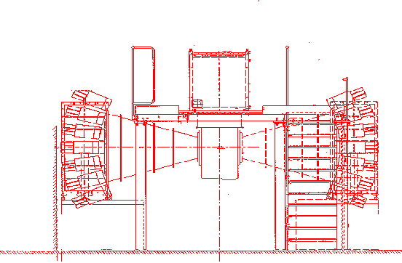
Timescales
Layout of the 14 HRPD 90° detector modules
1680 elements 1.68m²
The north bank ready for assembly
Detector designed and completed in 14 months
Notes:
28

Slide 29
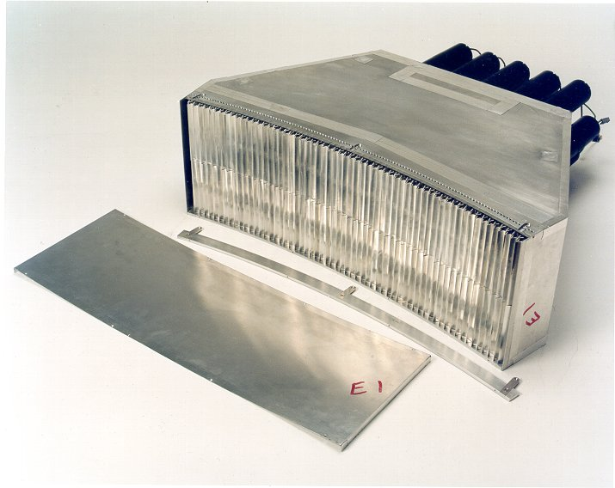
Timescales
However, design had already been proven on GEM
Only needed to modify the radius of curvature.
POLARIS
Detector technology well established
Needed to verify vacuum integrity of fibre bundles
And robustness of reflector foils on let up
4 year project
6 banks of detectors
Design, Production, final detector assembly, testing,
ran concurrently
All the detectors had to be in place before the tank could be completed
Notes:
29

Slide 30
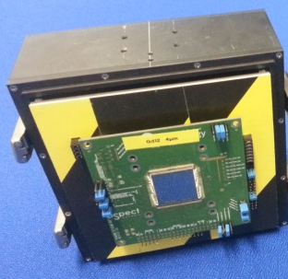
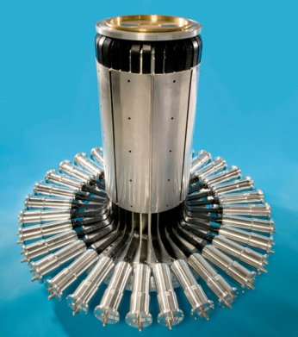
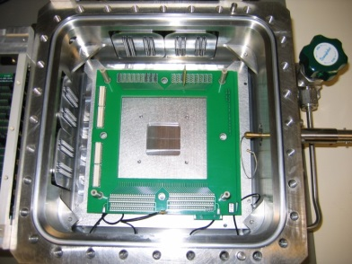

Strategy
ZnS/Ag:6LiF clear fibre coded technology has satisfied many or our diffraction needs
RW gas technology has satisfied our inelastic scattering needs
Have benefited greatly being able to adapt these technologies to a number of different instruments
Developing a technology is time consuming and expensive. Ideally new technology needs to be applicable to a number of instruments.
As instruments get more complicated and demands on detectors increase our technology at ISIS diversifies
Diffraction SANS Reflectometry, Imaging MuSR
VSANS
Notes:
30

Slide 31
Conclusion
Providing detectors for ISIS has been challenging
Will become more challenging in the future
The ESS brings is very own flavour of new detector challenges and new opportunities.
Collaboration is essential if we are going to meet future requirements with the resources available.
Notes:
31
Detector Development Wavelength Shifting Fibre Detectors for reflectometry and beyond

