Slide 1
Motion Control & Automation for NMX -Work & Results of Phase 1-
Thomas Gahl
Group Leader Motion Control & Automation
www.europeanspallationsource.se
February 04, 2015
Notes:
Most of the slides are from a presentation of my colleague Paul Barron, who is the responsible for NMX support in my group

Slide 2
Motion Control & Automation (MCA) Works in Phase 1
Extract MCA requirements out of the instruments requirements
Motion axes table
Technical solutions for generic motion control, special purpose motion control and other automation
Technical solutions for EPICS integration
List of MCA related ESS standards to be issued
Work units scope, budget, schedule

Slide 3
Motion Control & Automation (MCA) Works in Phase 1
Extract MCA requirements out of the instruments requirements
Motion axes table
Technical solutions for generic motion control, special purpose motion control and other automation
Technical solutions for EPICS integration
List of MCA related ESS standards to be issued
Work units scope, budget, schedule
Support of tollgate 2 review process
Techn. Design Document
Project Document

Slide 4
Instruments Requirements define Functionality
Requirement 13.6.4.12.1 Motion Control
The ICIS shall allow all motion axes and vacuum control components to be controlled through the EPICS.
Rationale: Integrated control allows the users and ESS staff to control everything from one terminal.
Verification: Test.

Slide 5
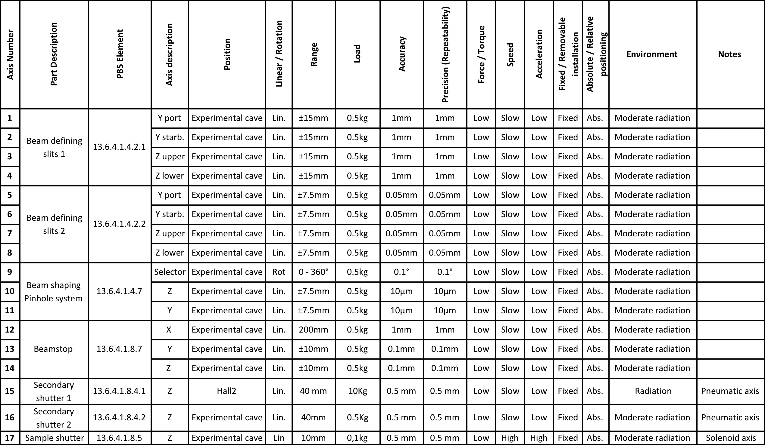
Table of Axes

Slide 6
Generic Motion Control
6
4
1
2
3
4
4
5

Slide 7
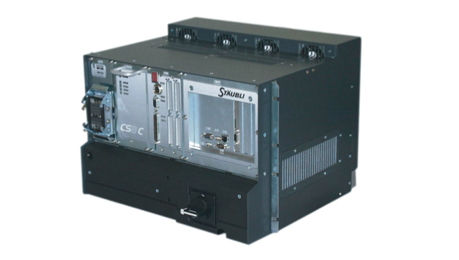
Special Purpose Motion Control
6
1
2
3
5
Notes:
:

Slide 8
Vacuum Control
6
1
2
3
5

Slide 9
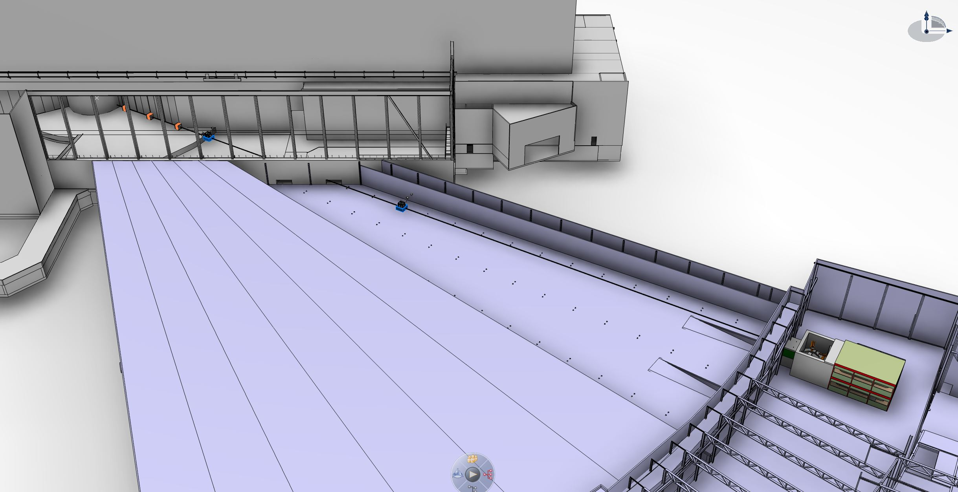
Modular Control Concept
160m
1
n
Instrument Control, Data Acquisition, GUI
2
EPICS
Timing
CB
CB
CB
CB
CB+
CB
CB
CB
CB
CB+
3
Shutter
Collimation
Monitors
PSS
Sample Table
Detector
Chopper
Chopper
Vacuum
Sample Environment
Beam Extraction + Bunker Area
Beam Transport & Conditioning Area
Sample Area

Slide 10
EPICS Integration
EPICS
Transfer absolute timing information from Control Box to the local HW control unit:
Synchronise a timer on the control unit
Timestamp in the control unit direct readings of the sensor with minimal latencies
Transfer the sensor readings through the Control Box into EPICS
Local distribution of control unit functionalities with real time field busses
Timing
Control Box
Pulse (14 Hz)
Clock
Command Interface
Motion Control Unit
Timer
Stamping
RT Field Bus
(i.e. ETHERCAT)
Driver
I/O
Motor
Encoder

Slide 11
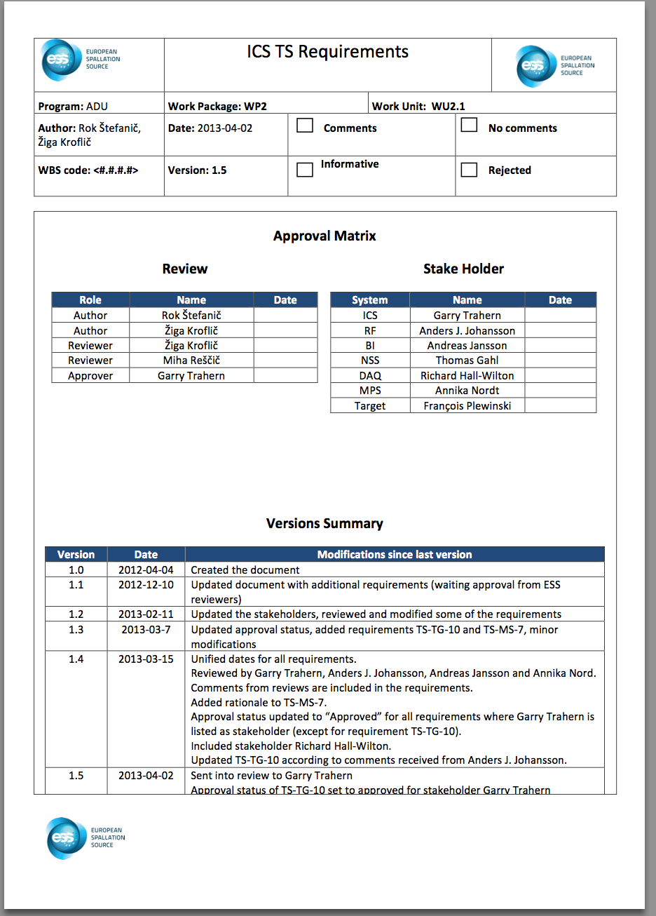
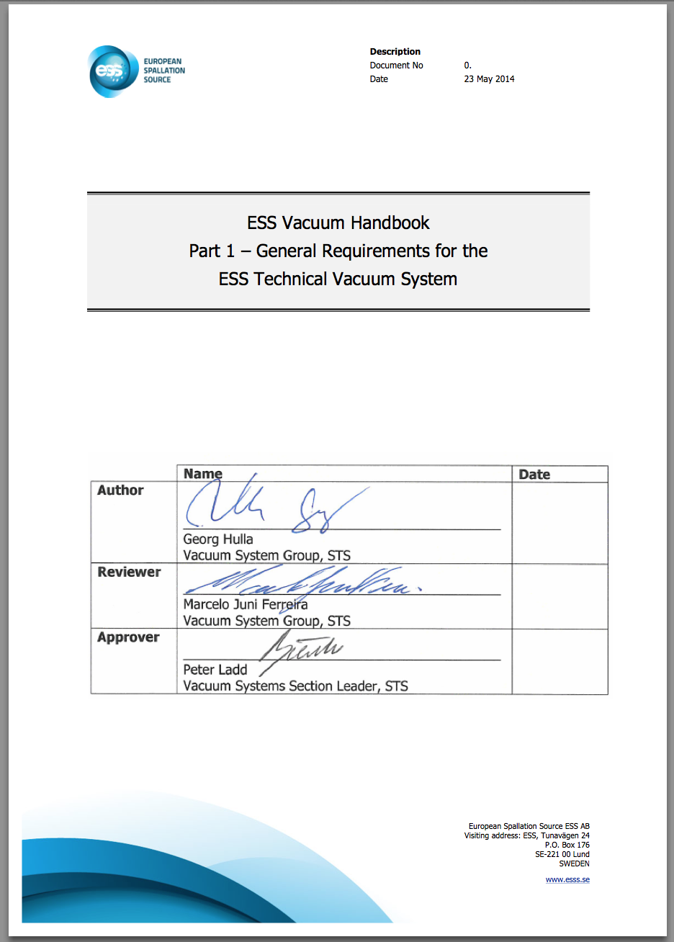
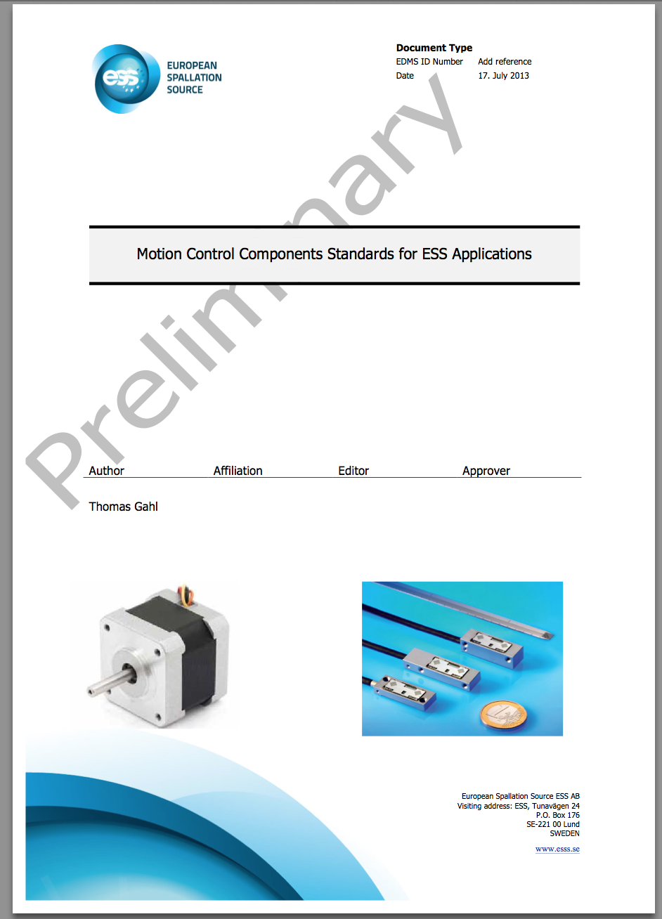
MCA standards issuing
MCA standard | - Motor, encoder, end-switches |  |  |  |  | End 2014
doc set I | - Cables, connectors (Motion Control) |  |  |  |  | End 2015
 | - Earthing, grounding |  |  |  |  | 2015
doc set II | - Generic Motion Control Unit |  |  |  |  | End 2015
 | - Racks, cooling, power, UPS |  |  |  |  | 2016
 | - Cabling, shielding, cable trunks |  |  |  |  | 2016
doc set III | - Vacuum Handbook (Vacuum Group) |  |  |  |  | issued
 | - Cables, connectors (vacuum etc.) |  |  |  |  | 2015
doc set IV | - ESS timing system |  |  |  |  | 2015
 | - Control Box |  |  |  |  | 2015

Slide 12
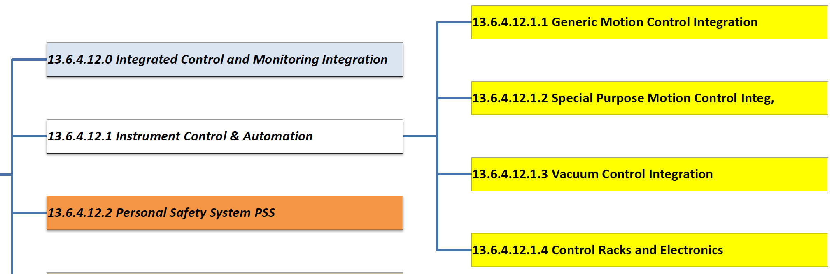
Work Breakdown Structure
Integration and support tasks (13.6.4.12.1.1, 13.6.4.12.1.2, 13.6.4.12.1.3)
Hardware deliverable (13.6.4.12.1.4)

Slide 13
Tasks Included for Generic Motion Control
Support and review of mechanical design Design
Electrical design/Custom programming Design
Schematic drawings (Electrical CAD) Design
Review of procurement Procurement
Factory Acceptance Test Procurement
Site Installation Test Installation
Programming/Commissioning EPICS integration Commissioning
Documentation Commissioning
Notes:
Differences for Special Purpose Motion Control:
EPICS driver has to be written for robotics where as it doesn’t for General Purpose and Vacuum Control, heavily involved in the procurement of the robot.

Slide 14
Tasks and Costs Excluded
Installation & cabling: we will give specifications, plans and procedures
EPICS Integration -> delivered by ICS (for Generic Motion Control)
Control Box and timing network -> delivered by ICS
Local vacuum control - > Vacuum Group
Notes:
We give our plans, drawings, procedures and installation standards to the installation team and they will go away and do it.

Slide 15
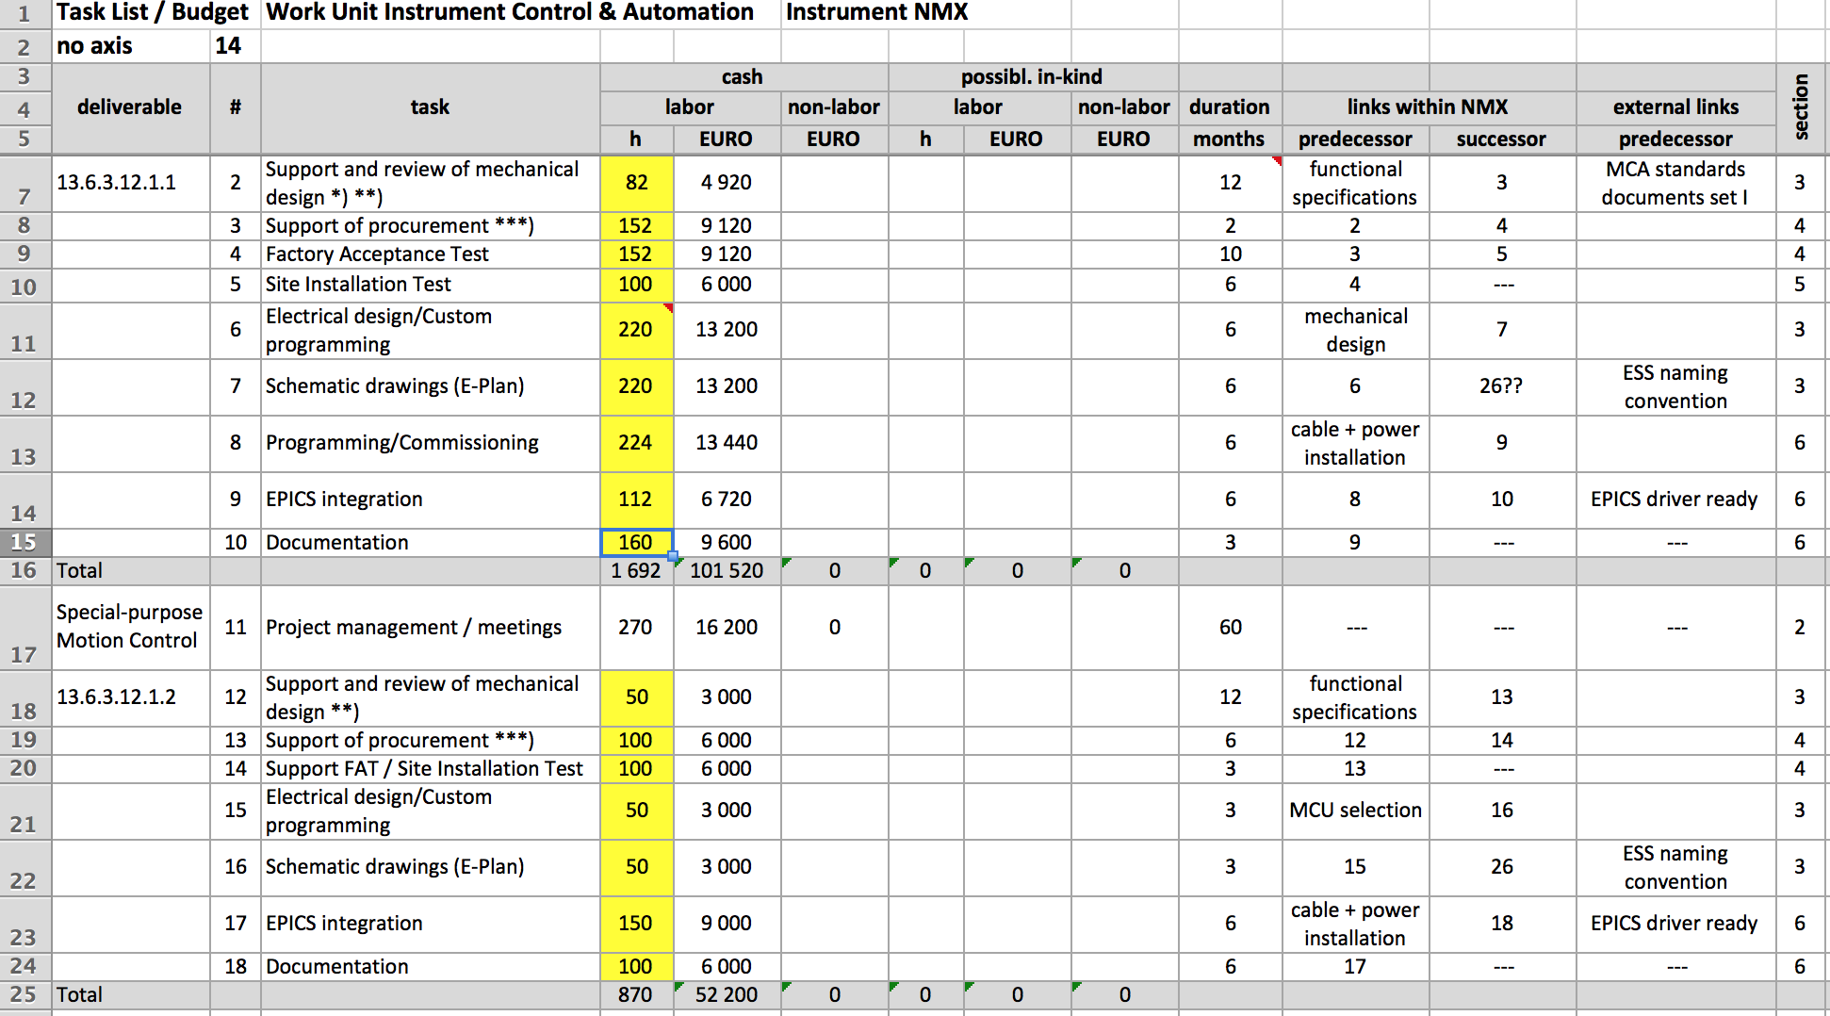
Task List/Budget to calculate Manpower, Costs and Schedule

Slide 16
Equipment Costs
Calculation of Equipments cost:
 |  | quant. | unit |  | EUR/unit | EUR total
Racks, Cooling, UPS |  | 3 | piece |  | 10 000 | 30 000
Cables, connectors, mechanics etc. |  | 3 | racks |  | 1 500 | 4 500
Control Box |  | 4 | piece |  | 0 | 0
Generic Motion Control Unit |  | 4 | 8 axes |  | 8 000 | 32 000
PLC system |  | 3 | system |  | 5 000 | 15 000
Pneumatic system |  | 2 | system |  | 2 500 | 5 000
Total |  |  |  |  |  | 86 500
Motor |  | 14 | axis |  | 400 | 5 600
Encoder |  | 14 | axis |  | 500 | 7 000
Endswitch |  | 14 | axis |  | 200 | 2 800
Cable/connectors |  | 14 | axis |  | 500 | 7 000
Consumables |  | 14 | axis |  | 50 | 700
Notes:
EPICS driver has to be written for robotics where as it doesn’t for General Purpose and Vacuum Control, heavily involved in the procurement of the robot.

Slide 17
Considerations for other Instruments Projects
Same approach for LOKI and ODIN
Some instruments do not have special purpose motion control
Some instruments require a high number of flexible / exchangeable motion control hardware
Instrument consortia led by in-kind partners: What could be the same, what is different?
Phase 1 is to define interfaces, tasks and distribution of manpower

Slide 18
Considerations for other Instruments Projects
Same approach for LOKI and ODIN
Some instruments do not have special purpose motion control
Some instruments require a high number of flexible / exchangeable motion control hardware
Instrument consortia led by in-kind partners: What could be the same, what is different?
Phase 1 is to define interfaces, tasks and distribution of manpower
We are happy to support your instrument project and to receive input in to the standardisation process !

Slide 19
Questions?
Notes:
You are welcome to the parallel sessions tomorrow for more details and discussions

Slide 20
(end of presentation)
Notes:
You are welcome to the parallel sessions tomorrow for more details and discussions

Slide 21
Manpower
One FTE (Full time equivalent for a year) corresponds to 1800h
Total Manpower 4652h corresponding to 2.6 FTE
 | Manpower (h) |  | Possible in-kind (h) |  | h
 | Labor | Rate | Labor | Rate | TOTAL
General Purpose Motion Control | 1692 | 60 € |  |  | 1692
Special Purpose Motion Control | 870 | 60 € |  |  | 870
Vacuum Control & Automation | 1010 | 60 € |  |  | 1010
Control Racks & Electronics | 720 | 60 € | 360 | 48 € | 1080
 |  |  |  | total | 4 652

Slide 22
Budget
Tasks 1-3 are integration & support, task 4 is delivering hardware.
Numbers based on fixed price plus a specified number of hours per task per axes which makes it scalable e.g. 2 days per axis for commissioning
Based on experiences from other facilities e.g. ISIS, Diamond etc.
 | Cash (€) |  | Possible in-kind (€)
 | Labor | Non-labor | Labor | Non-Labor | TOTAL
General Purpose Motion Control | 101 520 | 0 | 0 | 0 | 101 520
Special Purpose Motion Control | 52 200 | 0 | 0 | 0 | 52 200
Vacuum Control & Automation | 60 600 | 0 | 0 | 0 | 60 600
Control Racks & Electronics | 43 200 | 0 | 17 280 | 86 500 | 146 980
 |  |  |  | total | 361 300
Notes:
These are the numbers for our cost estimates; full details in budget spreadsheet on the NMX server.
Deliverables 1-3 are integration and support so they have no non-labor costs associated with them, deliverable 4 is the hardware.
The costs are based on a fixed price component per instrument and a per axis component that is scalable with the number of axes.
The intention is for an in-kind partner to build the racks for us, this means buying all the components including electronics and putting them in the racks to deliver to us. The planning will be done here at ESS.

Slide 23
Schedule
All support and review tasks will follow the mechanical design phases; factory and site acceptance tests are relatively short tasks.
A considerable time is taken by the electrical design + the schematics drawing / cabling documents ( up to 6 months), but will fit between end of design phase and start of installation phase
Commissioning is calculated with 2 days/axis, based on experiences from other facilities e.g. ISIS, Diamond etc. and can start when the last mechanics and the rack and cables are installed
The only deliverable where MCAG holds the whole responsibility is the delivery of the cabinets and electronics. Design can start together with the design of the external cabling and production will take in average (xx) months.

Slide 24
Generic Motion Control Interfaces Phase 1 – Concept Phase
6
4
1
2
3
4
4
5
Notes:
During the concept phase we are looking at the overall integration concept; the motors/encoders are not really applicable at this stage.

Slide 25
Generic Motion Control Interfaces Phase 2 - Design
4
1
2
3
4
4
Notes:
For the design phase we will make the electrical design for the motion control racks
ICS will do the design of the control box and the instrument team will do the design for the motor/encoder/limit switch integration.
This diagram is slightly deceiving we will do electrical schematics will include the whole instrument.

Slide 26
Generic Motion Control Interfaces Phase 3 - Procurement
4
1
2
3
4
4
Notes:
During the procurement phase there are interfaces between us and ICS for the control box and the instrument team for the mechanics, electrical field devices, connectors and cables.
We plan to only source the motion controllers, power supplies, racks etc.
We are not responsible for but we supper procurements documents/tenders and FATs.

Slide 27
Generic Motion Control Interfaces Phase 4 - Installation
4
1
2
3
4
4
Notes:
- Installation is not within our scope; this will be performed by the installation team.
- We give our plans, drawings, procedures and installation standards to the installation team and they will go away and do it while we have a fika.

Slide 28
Generic Motion Control Interfaces Phase 5 - Commissioning
4
1
2
3
4
4
Notes:
- Then we come to commissioning where we will have our biggest input.
- We will be responsible for commissioning all parts of the motion system from one end to the other with a little help from ICS.
- The main point I’m trying to show with this slide is that the MCA responsibility changes throughout the project phases.

