Slide 1

Summary of “On the Inquiry into the scientific case for and technical feasibility of intense very cold neutron beams”
M.R. Fitzsimmons
Neutron Science Directorate, Oak Ridge National Laboratory
Department of Physics and Astronomy, University of Tennessee
Notes:
Intent is to provide a summary of the ‘16 ORNL workshop

Slide 2
Outline
Historical context
Intent of the 08.2016 VCN workshop at ORNL
  How might VCN beams enable science at the STS?
Science opportunities (in condensed matter)
VCN spectra—dreams not realized yet
Expectations for instrument performance
Secondary factors
Science opportunities enabled by VCN beams

Slide 3
Historical context
R. Golub, Ultracold neutrons: Their role in studies of condensed matter, Rev. of Mod. Phys., 68, 329 (1996).
08.2005: Workshop on Application of a Very Cold Neutron Source (Argonne National Lab)
  https://www.osti.gov/biblio/1248367-proceedings-workshop-applications-very-cold-neutron-source
  Consisted of 3 sections:
    Science opportunities
    Spectra
    Instrumentation
2016: Workshop at ORNL https://conference.sns.gov/event/18/
Notes:
Golub’s paper very helpful setting forth opportunities pioneered by him and others.
Much thinking about VCN promoted by J. Carpenter since IPNS times…

Slide 4
Intent of the 08.2016 VCN workshop at ORNL
How might VCN beams enable science at the Second Target Station (STS)?
What is STS science?
  Challenges set forth in the BESAC* report of 2007
    Directing Matter and Energy: Five Challenges for Science and the Imagination
    https://www.osti.gov/servlets/purl/935427
  Opportunities set forth in the BESAC report of 2015
    Challenges at the Frontiers of Matter and Energy: Transformative Opportunities for Discovery Science
    https://www.osti.gov/biblio/1283188-challenges-frontiers-matter-energy-transformative-opportunities-discovery-science
    *BESAC = Basic Energy Sciences Advisory Committee
Notes:
We need to define what is meant by STS Science. Science evolves and the thinking since ‘07 has too.
Our thinking is guided by our customer DOE-BES.

Slide 5
Goal: Control matter and energy (the basic currency of science, technology and society)
5 Challenges (2007 report)
How do we control material processes at the level of electrons?
How do we design and perfect atom and energy-efficient synthesis or revolutionary new forms of matter with tailored properties?
How do remarkable properties of matter emerge from complex correlation of the atomic or electronic constituents and how can we control these properties?
How can we master energy and information on the nanoscale to create new technologies with capabilities rivaling those of living things?
How do we characterize and control matter away—especially very far away—from equilibrium?
5 Transformative Opportunities (2015 report)
Mastering Hierarchical Architectures and Beyond-Equilibrium Matter
Beyond Ideal Materials and Systems: Understanding the Critical Roles of Heterogeneity, Interfaces and Disorder
Harnessing Coherence in Light and Matter
Revolutionary Advances in Models, Mathematics, Algorithms, Data and Computing
Exploiting Transformative Advances in Imaging Capabilities across Multiple Scales
Notes:
DOE-BES has provided guidance on what science it would like to fund staring with the ‘07 report identifying 5 grand challenges.
Since ‘07, DOE-BES has organized many workshops that feed back to the challenges set forth by the ‘07 report.
The ‘15 report was taken as the foundation to develop STS Science. What can STS do that is transformative along the list of 5 that facilitates progress on the challenges?
The 5 on the right are NOT correlated with the 5 on the left!
In the next 5 slides I discuss each.

Slide 6
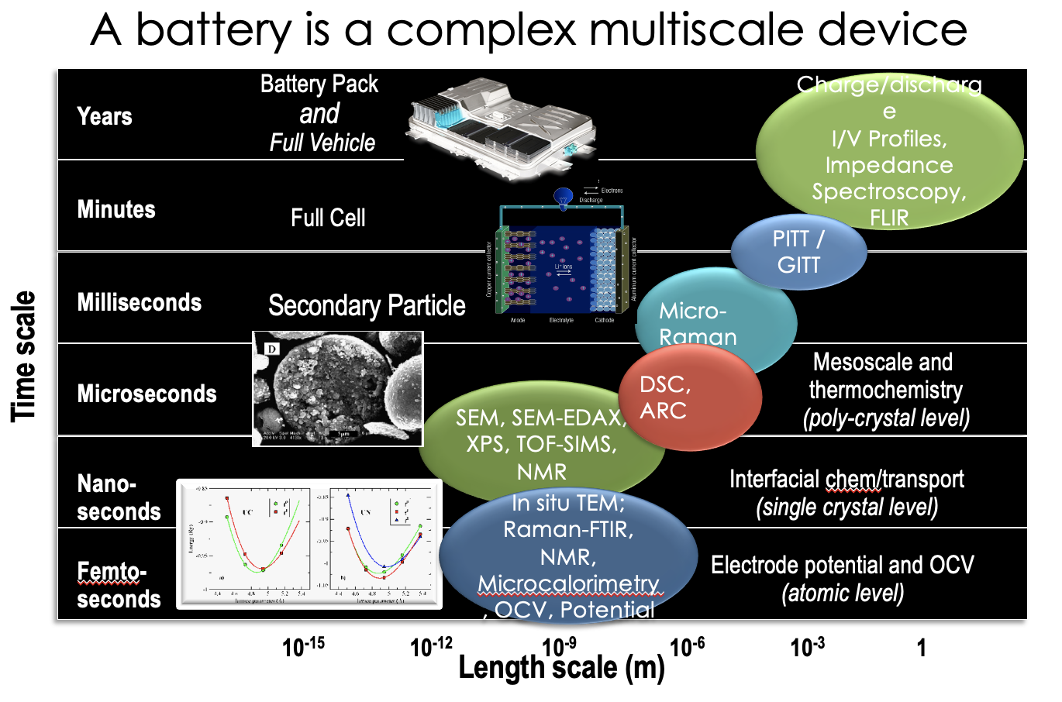
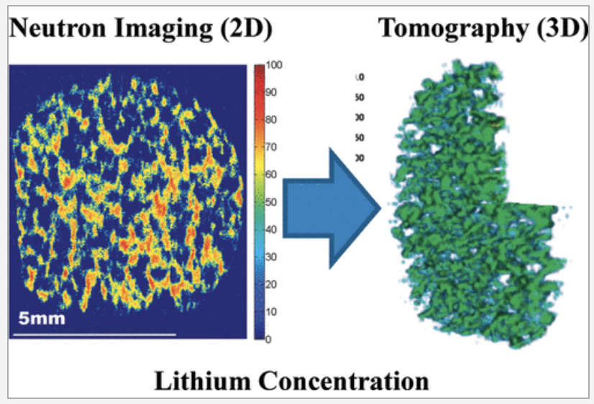
Mastering Hierarchical Architectures and Beyond-Equilibrium Matter
Control synthesis of hierarchical and beyond equilibrium matter.
  Predictive modeling
  Mastering synthesis and assembly
  In situ characterization and evolution during synthesis.
Hi Mike,
We did this early on at HFIR (cold beam). We would need a resolution of ~ 1 um to see Li plating. So, a 100x improvement is needed. 10x can map dendrites.
Cheers,
Hassina
Various electrochemical and transport process in multiple length and time scales
J. Nanda et al. Adv. Func Mater. 21, 3282 (2011); J. Nanda et al., J. Phys. Chem. C 116, 8401 (2012); Wang & Nanda, Nano Letts. 14, 4334, (2014) Ruther & Nanda et al., J. Phys. Chem. C 119, 18022 (2015)
https://pubs.acs.org/doi/10.1021/jp3016003
Notes:
Definition of hierarchical materials: Hierarchical architectures and beyond-equilibrium matter represent a palette consisting of multidimensional materials across length scales that necessarily include materials that are not at thermodynamic equilibrium.
Materials systems are no longer monolithic. They are composed of a myriad of components of different (macroscopic) dimensions and length scales to the atomic scale. The granularity of the inhomogeneous components means the system is not in equilibrium (but must somehow be stabilized over life of the system).
In example, understanding how to make better batteries requires correlating electrochemical changes at the nm level with the macroscopic property/response of the battery
Shuttling of Li ions impacted by boundaries at nanoscale. In first reference micrometer resolved Raman spectroscopy monitors location of Li during charging and discharging (operando).
Microstructure changes with operation (e.g. Li motion, heating…). Even after one charging cycle morphology and phase are affected by chemical segregation and diffusion leading to voltage fade.

Slide 7
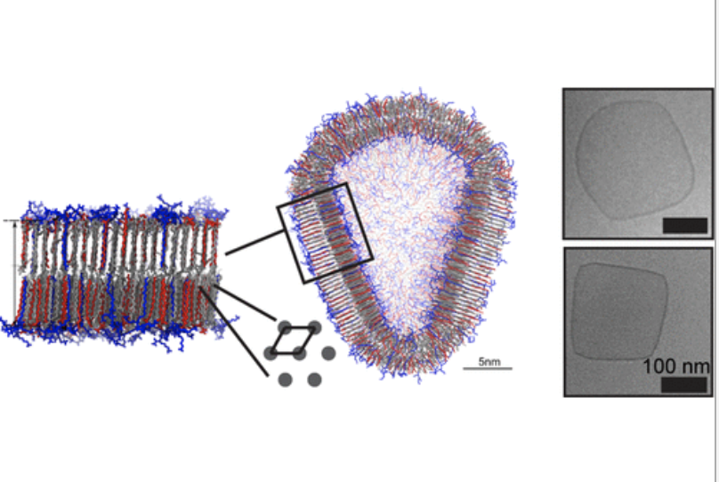
Beyond Ideal Materials and Systems: Understanding the Critical Roles of Heterogeneity, Interfaces and Disorder
Understand role of heterogeneity on properties of real materials under realistic conditions
  Heterogeneity of phases (gas, liquid, solid) imply interfaces and disorder.
  Need to characterize heterogeneity over multiple spatial and temporal scales
  Must move beyond spatially and/or temporally averaged structures
  Understand degradation
C.Y. Leung et al., https://pubs.acs.org/doi/abs/10.1021/nn304321w
Notes:
A subset issue of the hierarchical materials problem.
Examples of importance of interfaces is induced magnetism at interfaces due to change of valence, loss of center of symmetry (structure), rotation or its suppression of oxygen octahedra, ….
Well studied by neutrons but in “frozen state—temporally averaged state”.
We have been challenged by sample degradation (e.g., loss of ferroelectric polarization) after Mcycles of operation needed to acquire meaningful neutron data. The samples change too quickly (e.g, during a 10h measurement), so the data are not temporally averaging the same structure. (ferroelectric induced/controlled ferromagnetism)
In the picture the pH controls the ionization of the amphiphiles (lipids having fat loving and water loving components) which affect electrostatic interactions along the surfaces and interfaces which in turn control the morphology, from rounded corners to right angled ones.

Slide 8
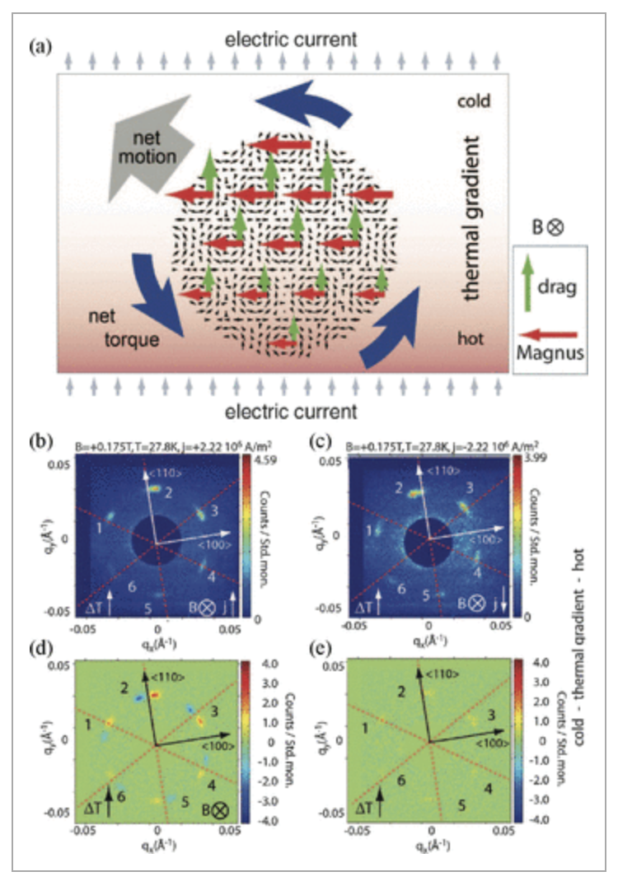
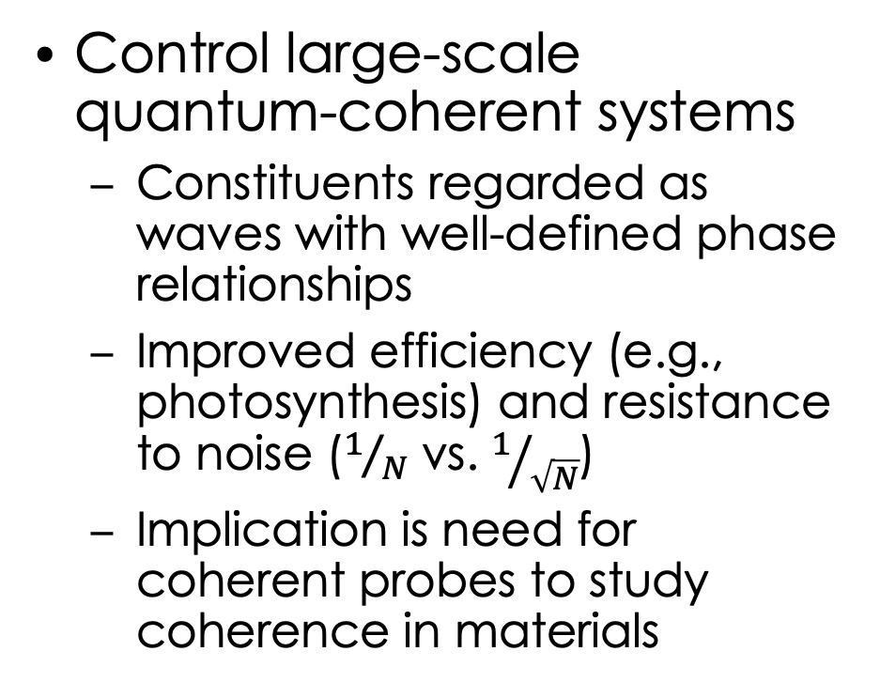
Harnessing Coherence in Light and Matter
But, incoherent probe of coherent spins…
Control large-scale quantum-coherent systems
  Constituents regarded as waves with well-defined phase relationships
  Improved efficiency (e.g., photosynthesis) and resistance to noise ($1/N$ vs. $1/{\sqrt{N}}$)
  Implication is need for coherent probes to study coherence in materials
T. Nakajima and T. Arima J. Phys. Soc. Jpn. 88, 081006 (2019) https://journals.jps.jp/doi/10.7566/JPSJ.88.081006
Notes:
Important to realize what is intended by this transformative opportunity is to probe and control coherent states (coherency) of matter.
The section is written as if coherent x-ray beams are the tool of choice. When is a coherent beam needed to probe coherency?
Some of the example of coherency are short duration, e.g., as to fs.
Is interesting that quantum coherency is understood to facilitate the high efficiency of photosynthesis.

Slide 9
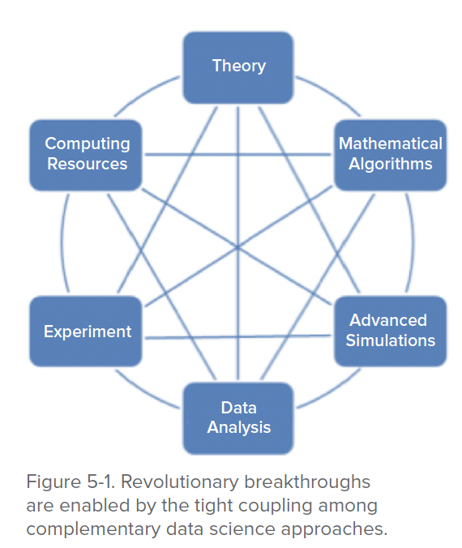
Revolutionary Advances in Models, Mathematics, Algorithms, Data and Computing
Convergence of theory, computation modeling and experiment poised to achieve predictive growth and control of materials
  Challenge is to create synergistic teams (leadership and money)
  How to facilitate compelling and transparent transitions from scattering Q,E to real space and time?
  For simulation to achieve prediction
  For data to extract hidden information
    https://www.osti.gov/biblio/1283188-challenges-frontiers-matter-energy-transformative-opportunities-discovery-science
Notes:
Idea to create synergy between theory, modeling, synthesis, characterization is not new.
Nevertheless, the synergy doesn’t happen as often as we like.
Maybe an opportunity for n.s. facilities to think more broadly about the product these facilities produce, maybe the whole package, after all many find it difficult to make the transition from Q,E to understanding, which perhaps is easier from real space and time?
This section identifies simulation as a means to achieve predictive capabilities.
And, simulation to extract hidden information.

Slide 10
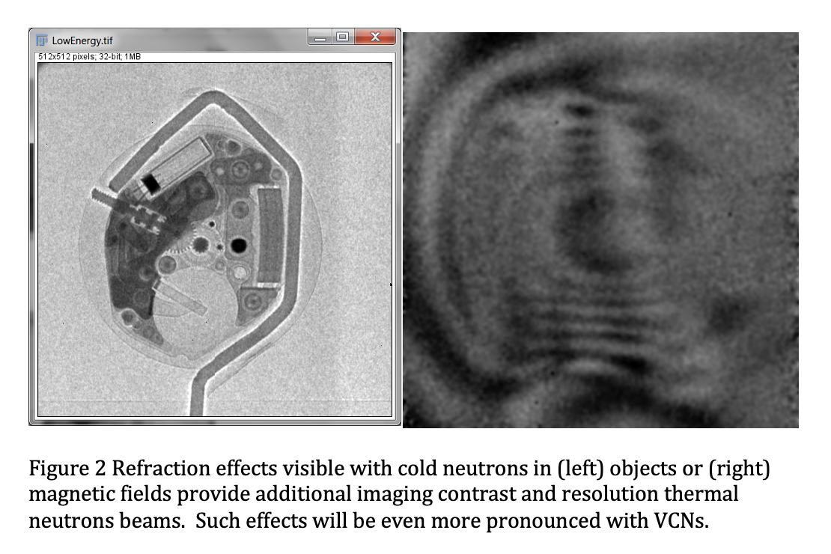
Exploiting Transformative Advances in Imaging Capabilities across Multiple Scales
To facilitate materials synthesis, understanding of chemical processes, solving longstanding challenges between structure and properties of inhomogeneous matter.
  Time scales of interest as to fs
  Length scales of interest nm-mm
Anton Tremsin (UC-Berkeley), https://conference.sns.gov/event/18/
Notes:
Again, many find looking at a picture in real space and how the picture evolves (a movie) more enlightening than Q,E space.
What is the opportunity for VCN beams for neutron imaging. Neutron imaging is useful for some problems in batteries. What other fields of science are opened up if the resolution was improved and time scales reduced?

Slide 11
Science opportunities and challenges for VCN’s
Complex materials systems with multiple length and time scales possibly ranging over a few decades
  VCN implies specialization to a subset of length and time scales
  Opportunity for multimodal (non-neutron) instrumentation add-ons?
Need to observe synthesis in situ (and process in operando)
  More intense VCN instrumentation is only part of the answer
Need to observe coherency
  Is there a unique niche for spin-coherent VCN beams?
Ability to probe living systems
  Integrated synthesis, measurement and modeling demonstrated
Transition from scattering to imaging facilitated by VCN beams
Notes:
This slide is intended as the “bottomline” summary of the main points of the ‘15 BESAC report. These in bold face.
At the end of the talk we revisit the grayed out bits hopefully serves as discussion starter.

Slide 12
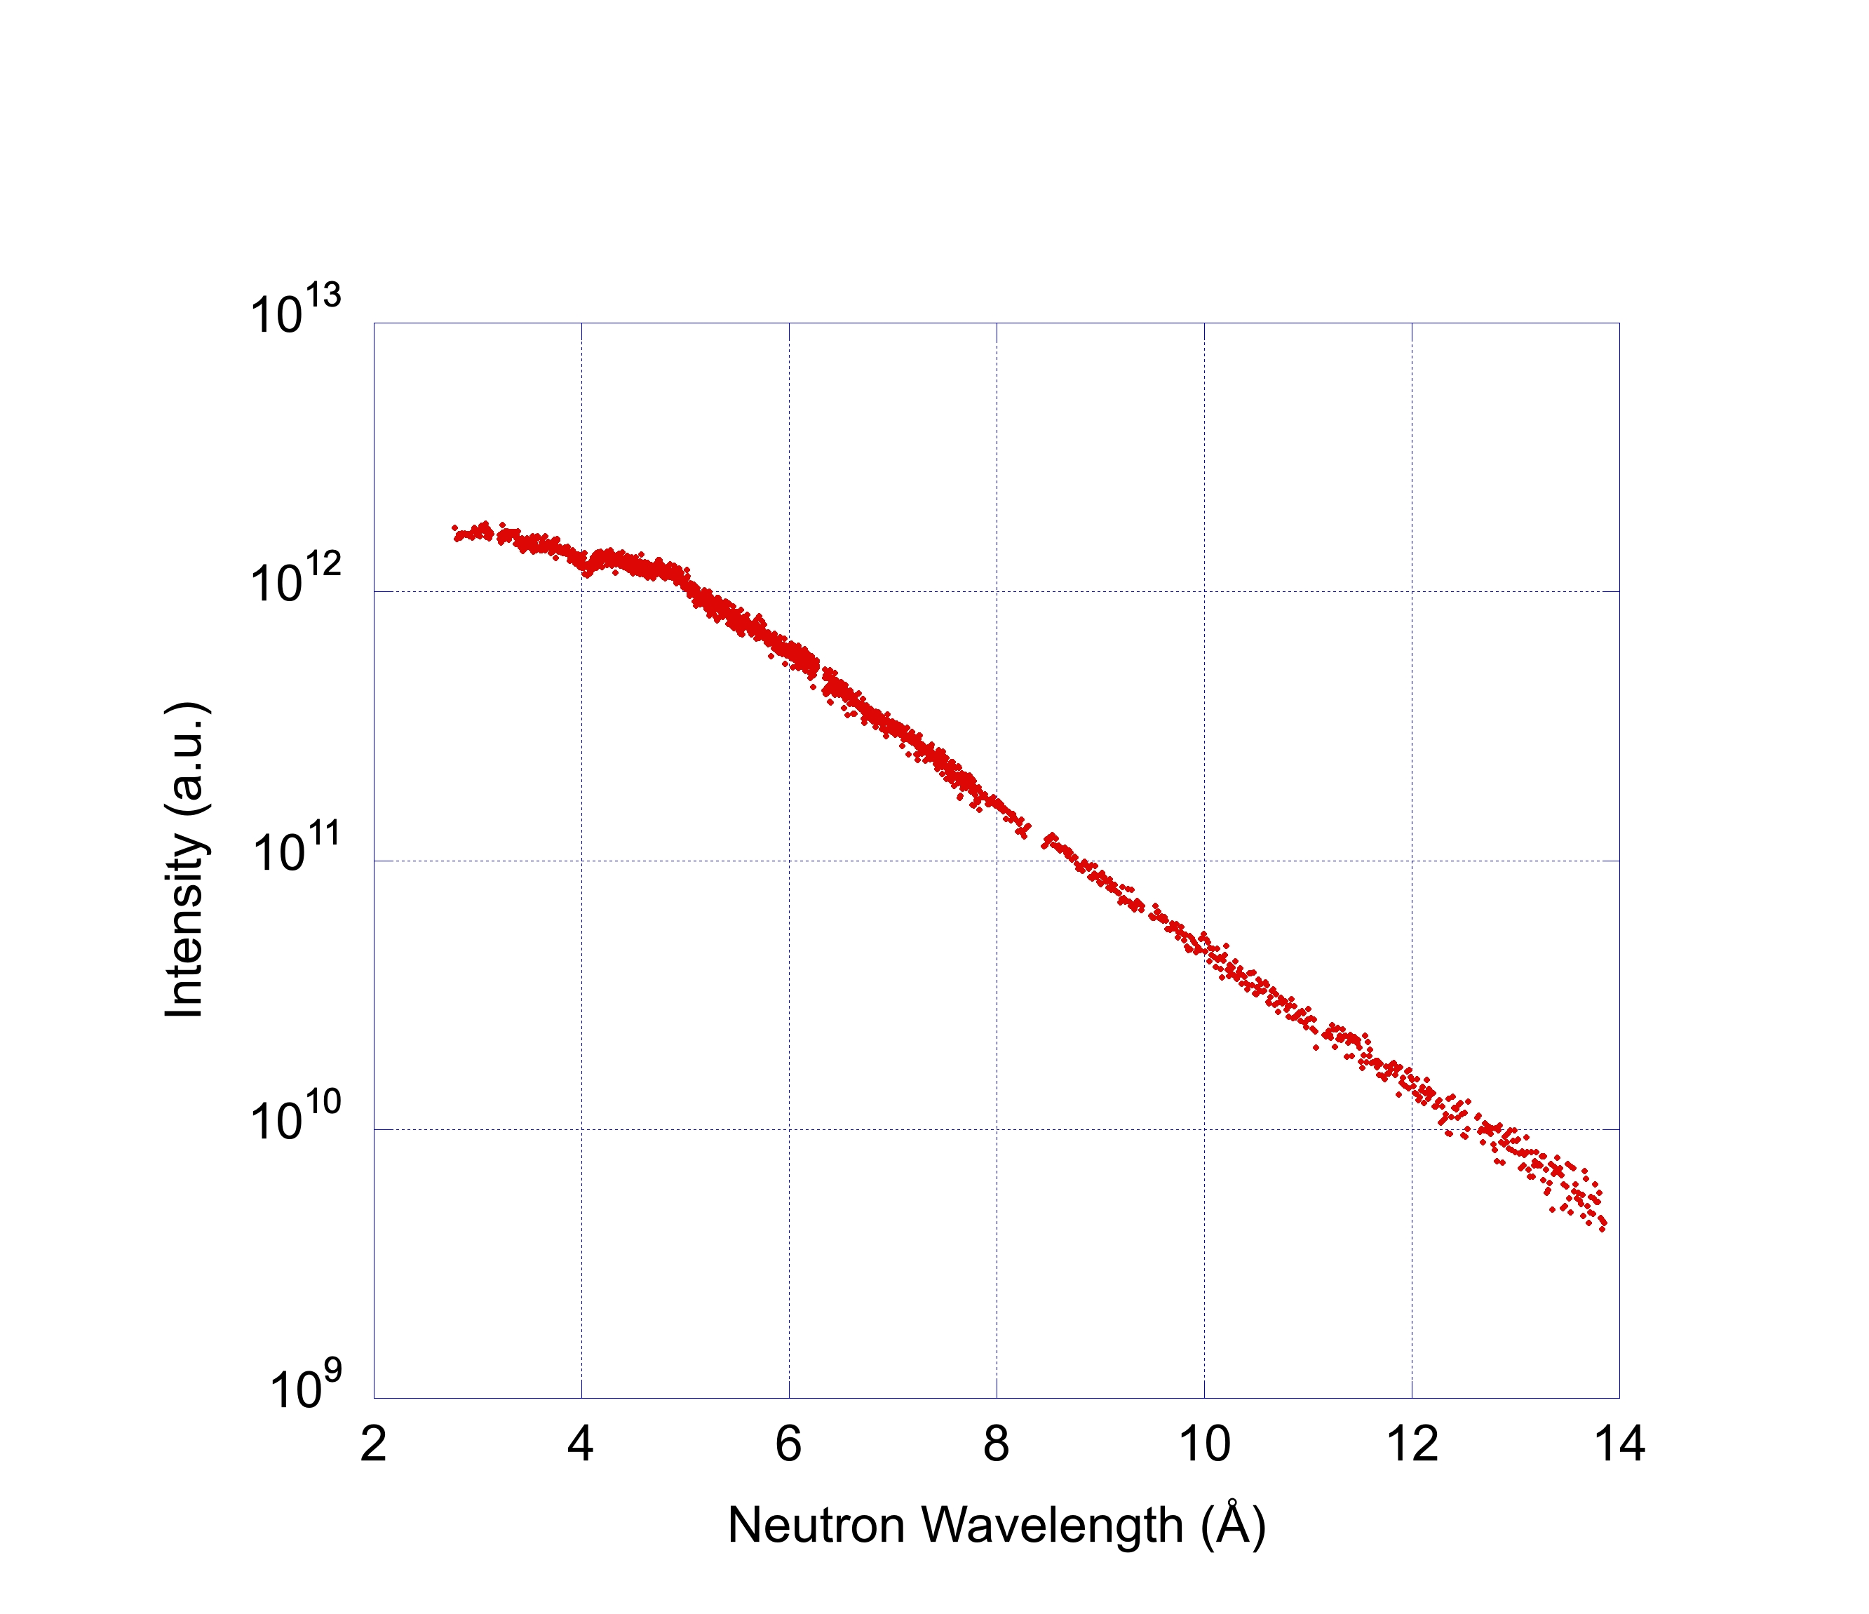



Spectra—strategies
Energy (meV) | Temperature (K) | Wavelength (Å)
5 | 58 | 4
1.7 | 20 | 7
0.8 | 9.3 | 10
STS design case
ORNL workshop recognized: STS is optimized to produce 5 meV neutrons—a different configuration might be realized if optimized for 0.8 meV neutrons.
Develop a cannibal moderator.
Develop a colder moderator.
BL4A @ FTS (unpolarized beam)
$$λ^{−1}$$
$$λ^{−5.2}$$
Constant $λ$-bins
https://www.ncnr.nist.gov/staff/hammouda/distance_learning/chapter_4.pdf
Notes:
Jack’s point is that if the metric had been different the design might have been different.
Example of the spectrum at 4A on FTS. (hopefully will get one for 4B which has a less severe bender.) The point is that the decay with wavelength depends on where you look.
The point of the table is the temperature of the moderator isn’t really indicative of where you’d expect the peak of the black body radiation. So a 20K moderator actually produces a peak in the spectrum closer to 3 than 7. Likewise, Snow’s 4K moderator produced a peak closer to 6-7A.

Slide 13
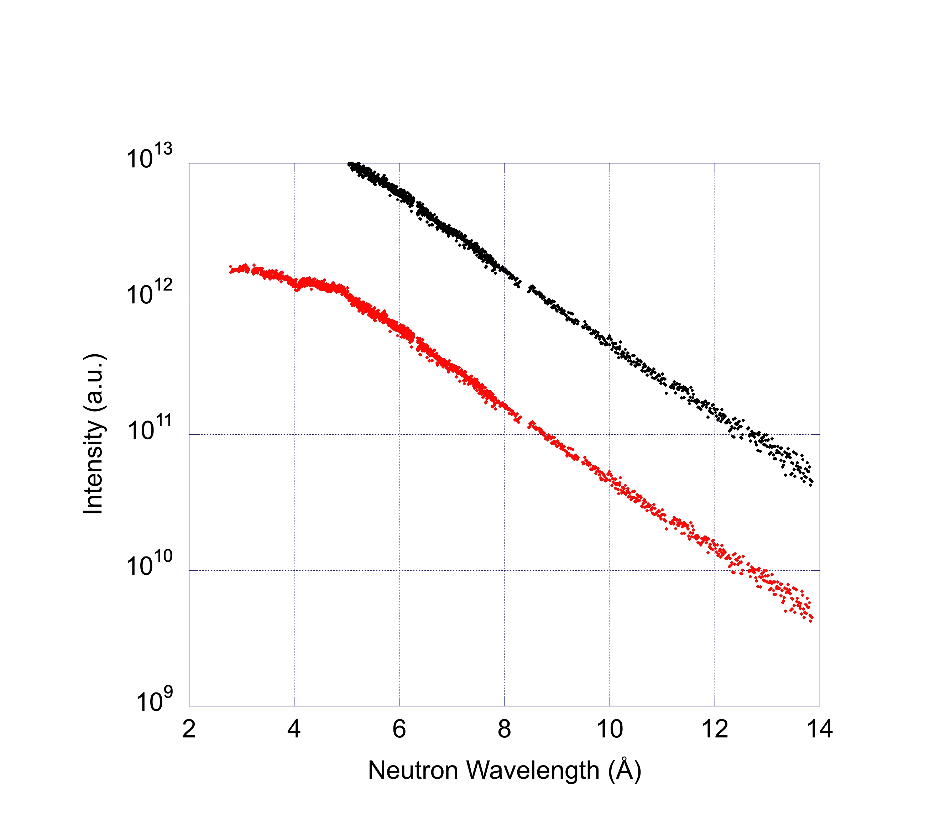
Spectra—strategies
Energy (meV) | Temperature (K) | Wavelength (Å)
5 | 58 | 4
1.7 | 20 | 7
0.8 | 9.3 | 10
ORNL workshop recognized: STS is optimized to produce 5 meV neutrons—a different configuration might be realized if optimized for 0.8 meV neutrons.
Develop a cannibal moderator.
Develop a colder moderator.
Cannibal moderator
Notes:
How might we get more VCN’s.
To us VCN’s are >10 A so that’s why the arrow is there.
One way is the cannibal moderator (called moderator of Type 4 in the ‘16 report)

Slide 14
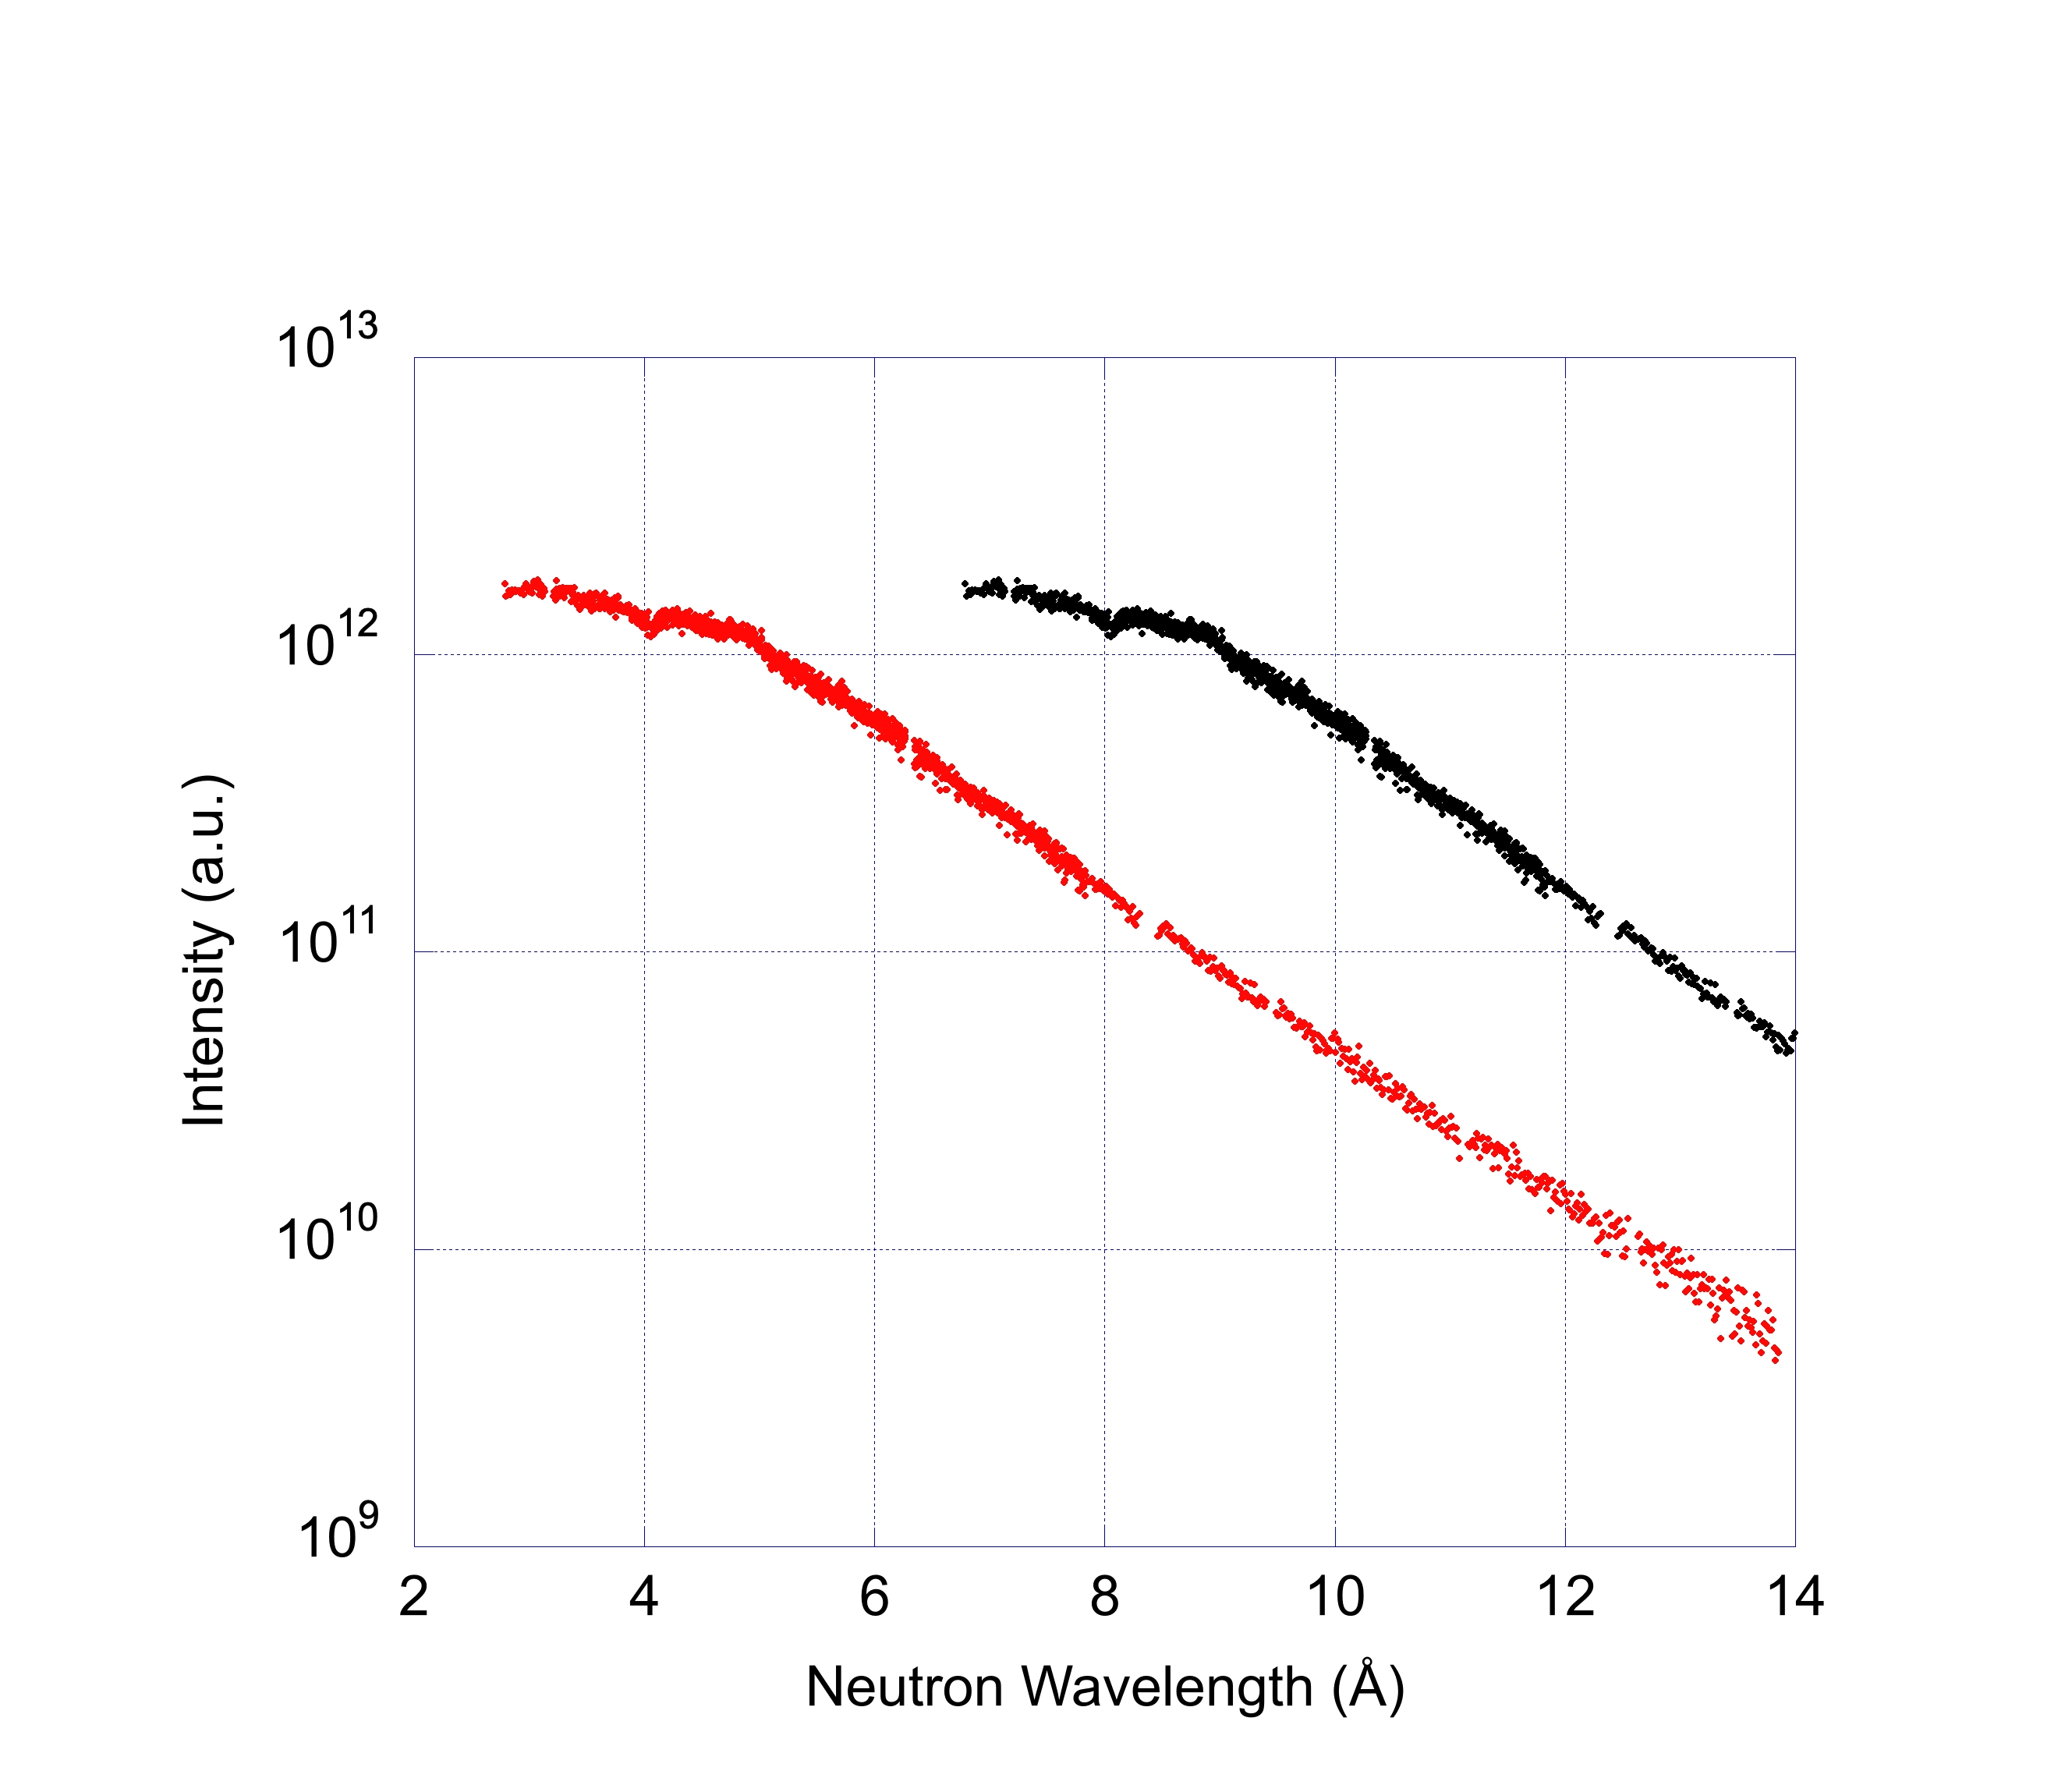
Spectra—strategies
Energy (meV) | Temperature (K) | Wavelength (Å)
5 | 58 | 4
1.7 | 20 | 7
0.8 | 9.3 | 10
ORNL workshop recognized: STS is optimized to produce 5 meV neutrons—a different configuration might be realized if optimized for 0.8 meV neutrons.
Develop a cannibal moderator.
Develop a colder moderator.
Colder moderator
Notes:
Another way is develop a colder moderator (in the report moderator of Type 5, or elevated moderator, envisaged as being above the hot neutron production zone of the STS moderators). Cause n and gamma heating are problems.

Slide 15
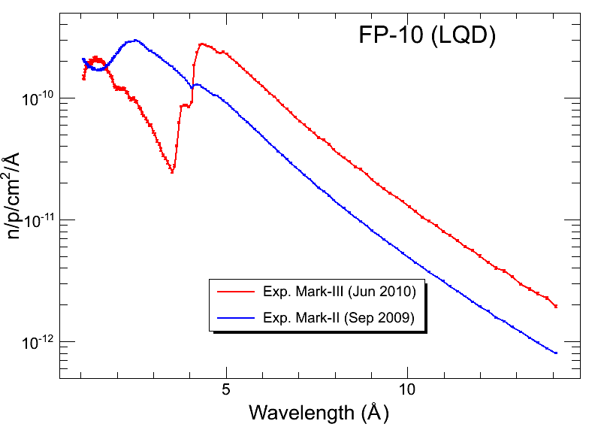
A cannibal moderator at LANSCE
H₂
Be
H₂O
n
Spectrum shifted up 2.5x
R. Hjelm, M. Hartl, M. Mokol
Notes:
Cannibal moderator at LANSCE. Russell and Mokol
Actual data from FP10 before and after transition.
MRF noted that rate meter knob needed to be increased one notch after transition on FP11.

Slide 16
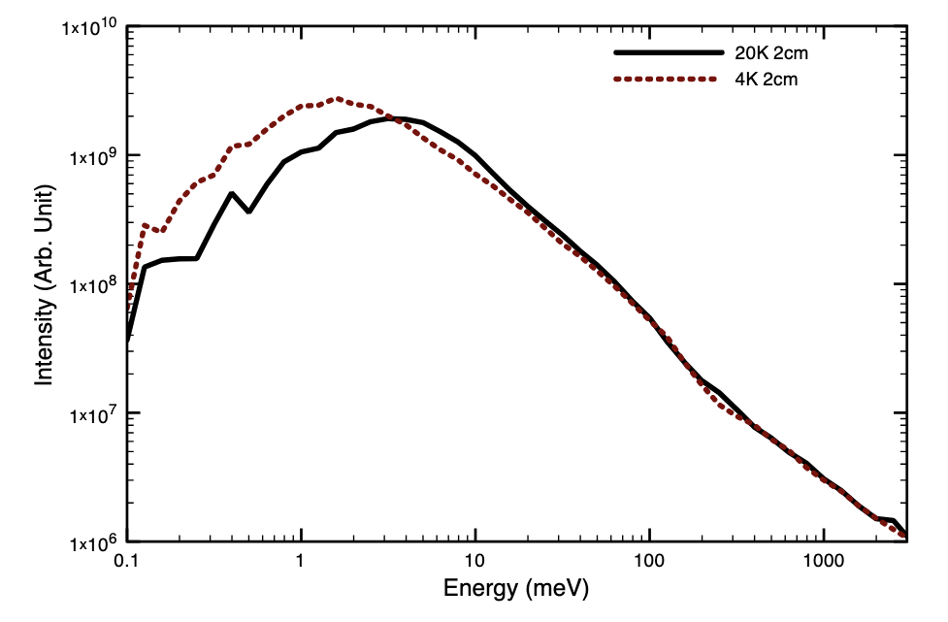
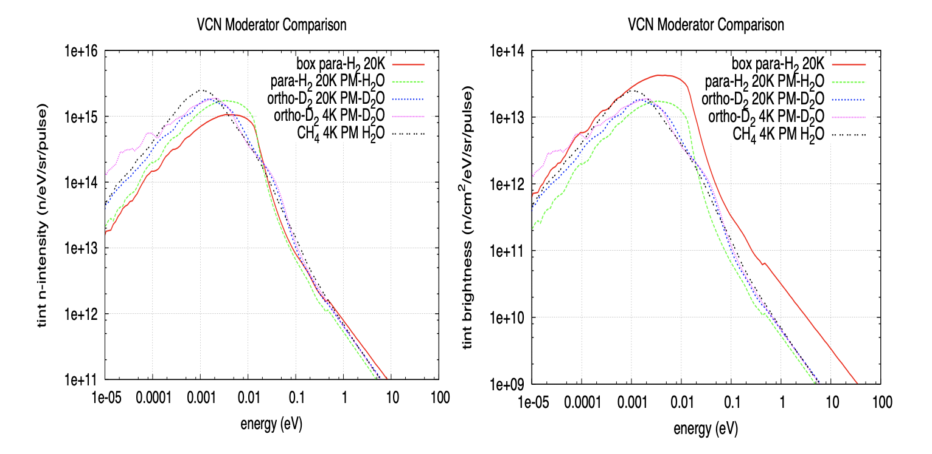
A colder moderator
Modest success(?)—coldest to date is a 4 K moderator with a spectrum of a 19K source.
‘16 workshop hypothesis: no or few low energy modes to excite
Shift left
Y. Shin, et al., NIMA 620, 375 (2010)
F. X. Gallmeier et al., J. Phys.: Conf. Ser. 1021 012083 (2018)
Notes:
Left is a measurement from Snow’s work. Right is best cases Franz G. found for the STS configuration.
It matters whether you want integrated intensity or brightness.
From Franz:
to a scattering kernel such as for para-H2[5], water
ice[5], beryllium[5], ortho-D2[6], CH4[7], and neon[8] all solid at temperatures of 4-6 K.
Although being at single digit Kelvin
temperatures, beryllium, water ice and para-hydrogen did not significantly cool the neutrons to lower
temperatures. Solid CH4 performed most promising as it was the only candidate that moved the
spectral peak down to 1 meV. None of the configurations considered was able to approach the
brightness of the box-type coupled
Investigated different sizes, different kernals and low T, nothing helped for his studies.

Slide 17
Source considerations
Cannibal moderator
  Provided 2.5x more cold flux at LANSCE (possibly unique to LANSCE)
  Adaptation of a conventional concept
  Demonstrated and low risk
Colder moderator
  Snow’s is colder but still produces a 19K spectrum from 4K liquid
  2x estimated increase of integrated intensity (not brightness)
  Higher risk
’16 (and ‘05) workshop concluded case for VCN would be very exciting if 10x increase in “performance” could be realized.
  Probably not coming from just the source, where else then?
Notes:
Bottom line is that we haven’t found a solution to produce a 10x increase of VCN.
A10x increase is may be possible when considering other factors beyond just the spectrum.
For example, performance of some conventional n.s. techniques may scale with wavelength in a way that a combination of the spectrum and use of instrument at longer wavelengths creates a 10x improvement.

Slide 18
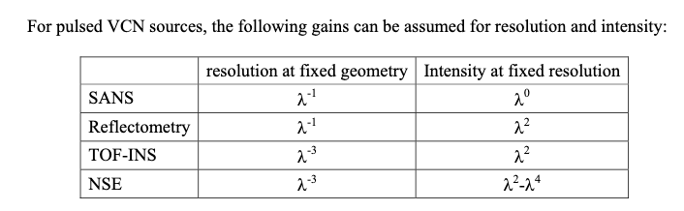

Instrument improvement with wavelength?
Wrong
Assumes $λ^{−5}$ Maxwellian tail
  https://www.osti.gov/biblio/1248367-proceedings-workshop-applications-very-cold-neutron-source
Notes:
This table comes from the ‘05 report. Shows how resolution for fixed geometry varies (so in all case the resolution gets better using longer wavelengths) and how intensity changes for fixed resolution assuming the spectrum decays as lambda^-5.
There is an error for reflectometry. The table comes from Feri’s presentation which for reflectometry says lambda ^-2. The – sign was omitted in the report.

Slide 19
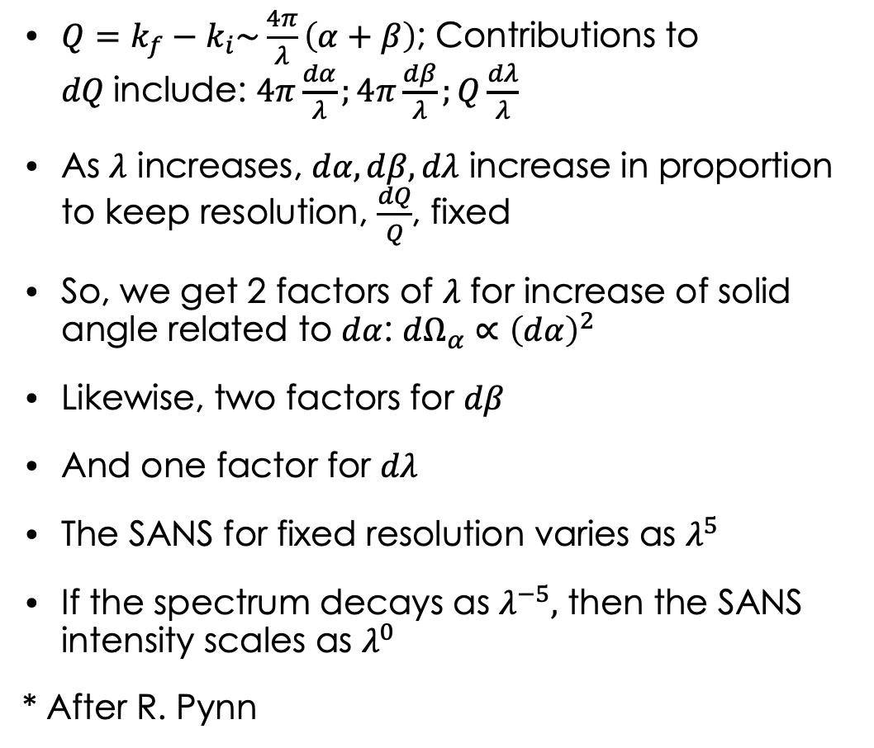





Case for SANS: How does intensity scale for fixed Q and constant resolution*?
$Q=k_{f}−k_{i}\sim \frac{4π}{λ}\left(α+β\right)$; Contributions to $dQ$include: $4π\frac{dα}{λ};4π\frac{dβ}{λ};Q\frac{dλ}{λ}$
As $λ$ increases, $dα, dβ, dλ$ increase in proportion to keep resolution, $\frac{dQ}{Q}$, fixed
So, we get 2 factors of $λ$ for increase of solid angle related to $dα$: $dΩ_{α}{∝\left(dα\right)}^{2}$
Likewise, two factors for $dβ$
And one factor for $dλ$
The SANS for fixed resolution varies as $λ^{5}$
If the spectrum decays as $λ^{−5},$ then the SANS intensity scales as $λ^{0}$
* After R. Pynn
$$k_{f}$$
$$dβ$$
$$dα$$
$$k_{i}$$
$$dλ$$
Notes:
Discuss how the intensity for SANS varies with wavelength, this is a simple envelope argument.
In the end the intensity doesn’t change with wavelength in this situation though you do get better resolution (for VCN the scattering at fixed Q is further from beam stop…)
Golub notes: we expect UCN scattering to be
interesting for the study of slow motions of large objects
and we are led to the domain of large molecules—
polymers and biological molecules.
So SANS plus inelastic

Slide 20

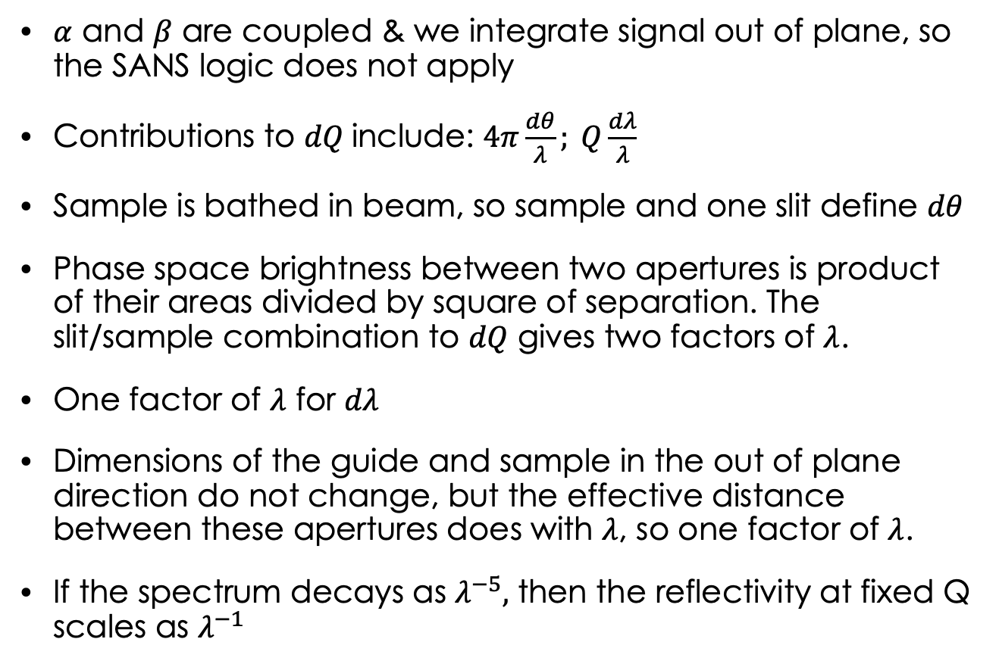





Case for Reflectometry: How does intensity scale for fixed Q and constant resolution?
$α$ and $β$ are coupled & we integrate signal out of plane, so the SANS logic does not apply
Contributions to $dQ$include: $4π\frac{dθ}{λ}; Q\frac{dλ}{λ}$
Sample is bathed in beam, so sample and one slit define $dθ$
Phase space brightness between two apertures is product of their areas divided by square of separation. The slit/sample combination to $dQ$ gives two factors of $λ$.
One factor of $λ$ for $dλ$
Dimensions of the guide and sample in the out of plane direction do not change, but the effective distance between these apertures does with $λ$, so one factor of $λ$.
If the spectrum decays as $λ^{−5},$ then the reflectivity at fixed Q scales as $λ^{−1}$
$$k_{i}$$
$$k_{f}$$
$$θ$$
Q in plane
$$L∝\frac{1}{λ}$$
$$θ_{c}^{′}$$
$$θ_{c}$$
L’
Q out of plane
Notes:
For specular reflectometry alpha and beta are coupled so you will lose one factor of lambda compared to the SANS case.
The argument above works for specular or off specular reflectometry.
If the out of plane collimation is fixed by slits then you lose another two factors of lambda yielding performance that varies as lambda^3 so with Maxwellian tail overall lambda^-2 as in Feri’s presentation.
However, to be fair the ”out of plane” slits are set by the fixed dimensions of the sample and the relevant guide dimension. As you go to longer lambda, the end of the guide is utilized so the distance between where the last guide reflection occurs that sends the neutron to the sample is shorter than for short wavelengths. This gives a factor of lambda, so with this consideration we get lambda^4 and with Maxwellian decay lambda^-1. This is an argument against using VCN for reflectometry.
Golub notes for traditional reflectometry UCN probably cannot compete; however, with the long wavelengths, more sensitive(higher resolution) measurements of the near surface region obtained at Qc maybe an opportunity.

Slide 21
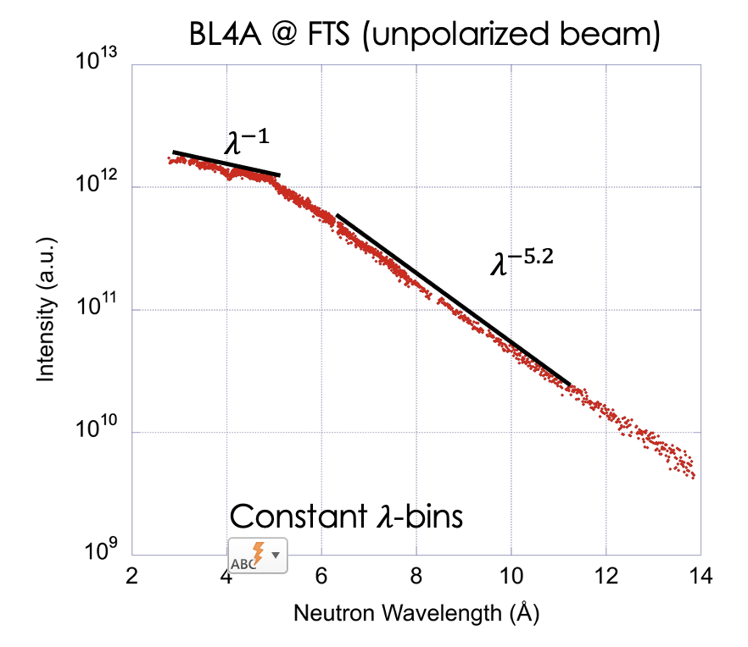
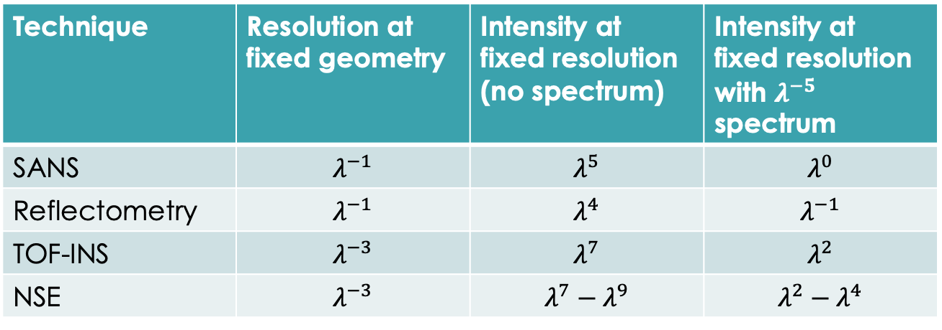
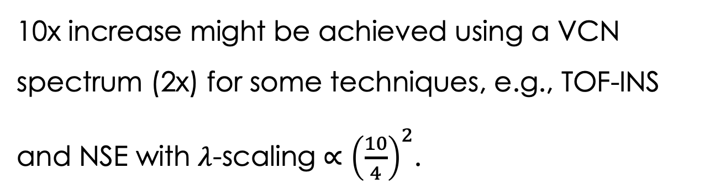


Instrument improvement with wavelength due to the spectrum?
Technique | Resolution at fixed geometry | Intensity at fixed resolution (no spectrum) | Intensity at fixed resolution with $λ^{−5}$ spectrum
SANS | $$λ^{−1}$$ | $$λ^{5}$$ | $$λ^{0}$$
Reflectometry | $$λ^{−1}$$ | $$λ^{4}$$ | $$λ^{−1}$$
TOF-INS | $$λ^{−3}$$ | $$λ^{7}$$ | $$λ^{2}$$
NSE | $$λ^{−3}$$ | $$λ^{7}−λ^{9}$$ | $$λ^{2}−λ^{4}$$
$R(Q_{max})$signal $∝λ^{3}$
10x increase might be achieved using a VCN spectrum (2x) for some techniques, e.g., TOF-INS and NSE with $λ$-scaling $∝{\left(\frac{10}{4}\right)}^{2}$.
$R(Q_{max})$signal $∝λ^{−1.2}$
Consideration germane now
Notes:
Without considering resolution, SANS and reflectometry are not drivers for VCN. We can discuss whether better resolution is really needed…
The cases for TOF-INS and NSE appear more promising.
On the right I show how the lambda^4 variation for reflectometry argues that 5 Angstroms is much better to use than 2 Angstroms for the spectrum at 4A. This assumes you can reach the Qmax you desire with 5 Angstroms.

Slide 22
Secondary factors enabled by VCN beams
Detectors
  VCN beams can be absorbed in much thinner regions
  Enables better spatial definition of where the neutron was detected
    Important for MIEZE
  Possibly fabricated with lithographic techniques
    Smaller pixel sizes, detectors closer to samples…
    Faster response time
Focusing
  Focusing relying on the index of refraction is easier.
  Phase space manipulation
Notes:
Phase space manipulation,
Gravity focuser lqd
gravity monochromator describef in golub review
Resolution argumentBoualem Hammouda, from toolbox

Slide 23
Science opportunities and challenges for VCN’s
Complex materials systems with multiple length and time scales possibly ranging over a few decades
  VCN implies specialization to a subset of length and time scales
  Opportunity for multimodal (non-neutron) instrumentation add-ons?
Need to observe synthesis in situ (and process in operando)
  More intense VCN instrumentation is only part of the answer
Need to observe coherency
  Is there a unique niche for spin-coherent VCN beams?
Ability to probe living systems
  Integrated synthesis, measurement and modeling demonstrated
Transition from scattering to imaging facilitated by VCN beams
Notes:
A point to make here, is that most believe neutron instrumentation needs to be tailored/optimize to measure a specific Q and E.
This argues that it’s difficult to measure a broad range of Q and E with a single instrument.
For case of VCN beams, the Qmax is necessarily much smaller than for cold or thermal beam instruments.
The science drivers for new materials systems, want data over large length and time scales. This implies we’ll need to use lots of instruments.
The drivers also want to observe synthesis in situ over large ranges of length and time scales.
We’re going to need a way to correlate in situ measurements from different n instruments to achieve the transformative opportunity. Does this mean multimodal instrumentation?
Should discuss when we must use coherent beams to probe coherency?
There is no such thing as a spin-coherent photon beam. What science needs spin-coherent beams?
Katsaras has demonstrated integrated synthesis, measurement and modeling of living systems. More opportunities for neutrons?
With improvements in detectors, focusing how far can we go with neutron imaging? We do battery science now, what else?

Slide 24
Spin-Echo Length [microns]
Data taken with Larmor using 10 Å neutrons
Courtesy of R. Pynn

