Slide 1
Outlook
Valentina Santoro ESS
On behalf of the HighNESS Consortium

Slide 2
WORKING GROUPS
WG1 UCN liquid He based sources
Martin Fertl
Estelle Chanel
Alan Takibayev
WG2 UCN solid D2 based sources
Dieter Ries
Bernhard Lauss
Ignacio Marquez-Damian
WG3 VCN sources
Tobias Jenke
Thomas Gutberlet
Valery Neshnizevsky
Luca Zanini
WG4 Alternative concepts
Albert Young
Günter Muhrer
Douglas DiJulio
START THURSDAY @ 15:00
WG5 fundamental physics
Skyler Degenkolb
Leah Broussard
David Milstead
Valentina Santoro
WG6 condensed matter
Markus Strobl
Roger Pynn
Peter Falus
Esben Klinkby
START THURSDAY @ 16:15
2

Slide 3
WG1: liquid He based sources
Additional option for the UCN source - neutron optic to have a high neutron brightness outside the monolith (Oliver’s idea)
Polarized or unpolarized UCN source
and - the flexibility is needed
Space requirements around the
instrument (cooling / cryogenic) and experiments go more in the way of large beam port position. The space requirement might be extended for the vertical/horizontal extraction question that was not discussed.
Simulations and tools- there was
a strong interest for exchange of kernels (superfluid helium ...)
3

Slide 4
WG2: solid D2 based sources
1. sD2 at 5K seems impossible inside lD2 or twister or shielding block
for heat load reasons.
2. sD2 source between NNBar port and cold moderator: heat load vs
distance tradeoff.
3. multiple shapes possible should be investigated, e.g. slab (5cm) vs
thin film (1mm)
4. UCN transport to outside bunker is possible with acceptable losses.
Action point: Very detailed heat load simulations are necessary for cold
installations close to the target for eventual UCN sources.
4

Slide 5
WG3 VCN Sources
Suggestion:
Setup a working group that develops completely new instruments.
Test beam facilities for R&D.
The ESS should provide a VCN source that can simultaneously feed different experiments. Swiss army-knife approach (T. Jenke)
A dedicated source is preferable, as the source parameters can be tuned. The extraction
from the existing cold source always needs compromises with the other users. (H. Shimizu)
5

Slide 6
WG4: alternative concepts
Main Discussion Points
1) Establishing the baseline for the VCN source
2) Importance of including coupling of the neutron transport system to the VCN source during the optimization.
3) How close can the guide system be brought to the moderator
4) We also discussed some far-fetched ideas.
Action Point
1) Establishing the baseline for the VCN source
6

Slide 7
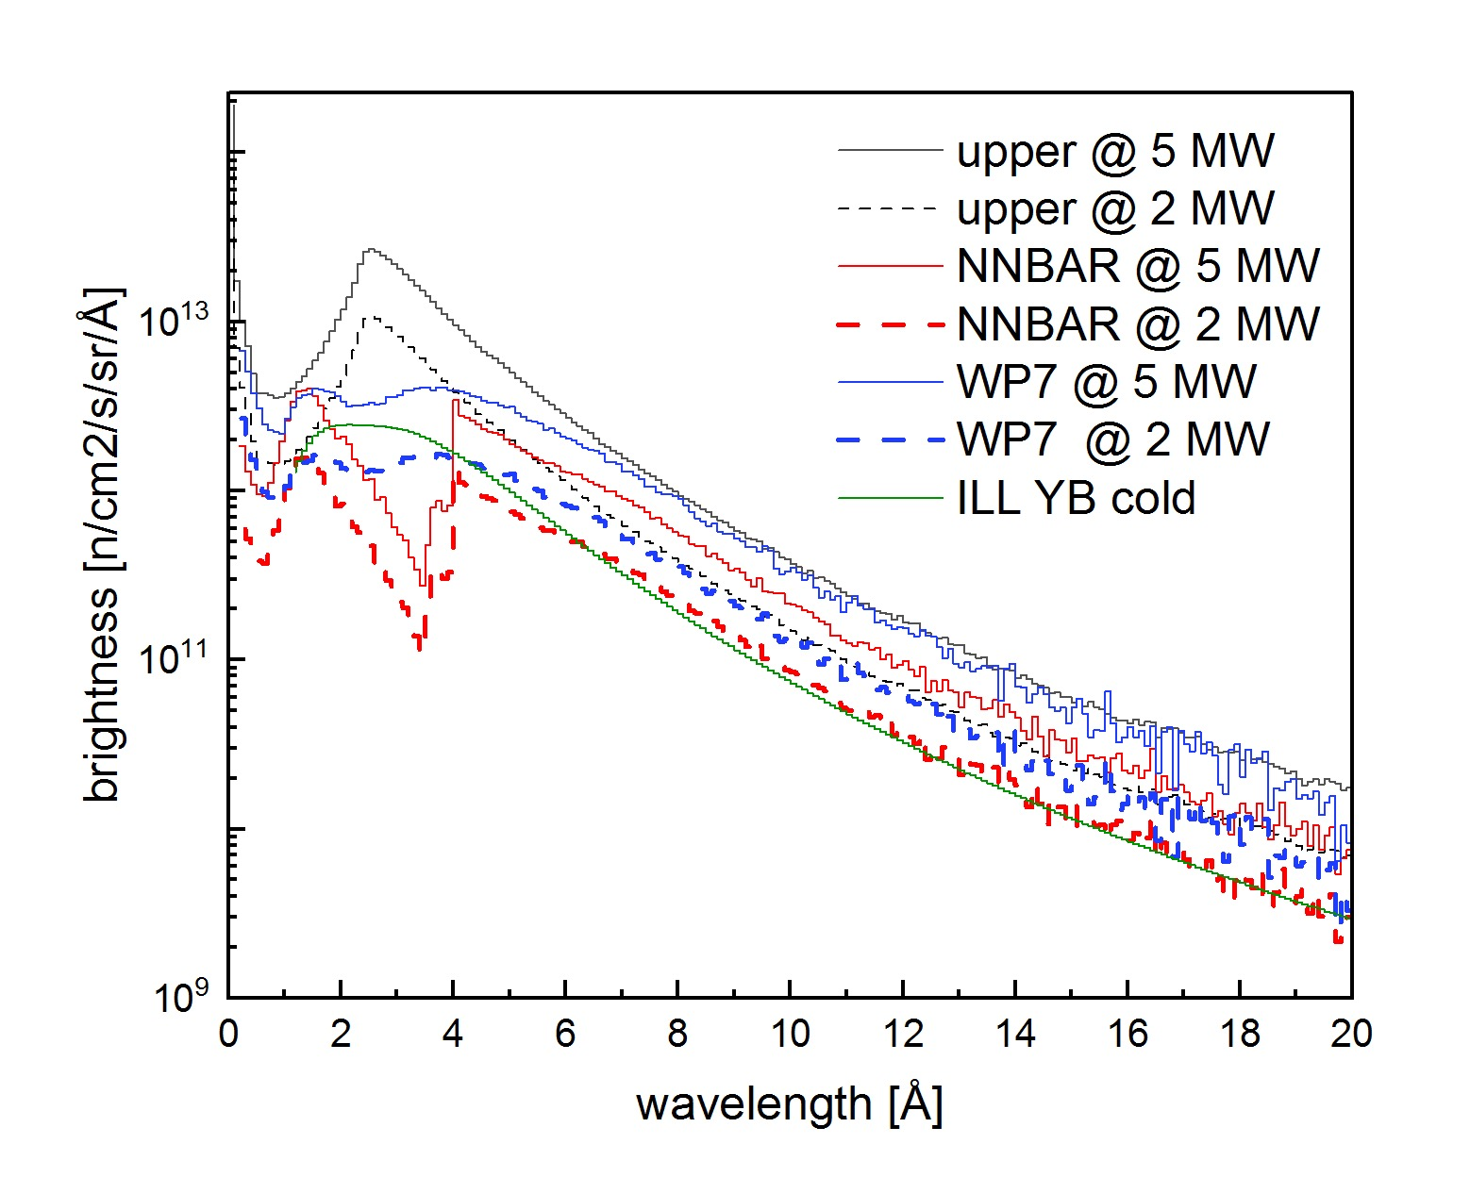
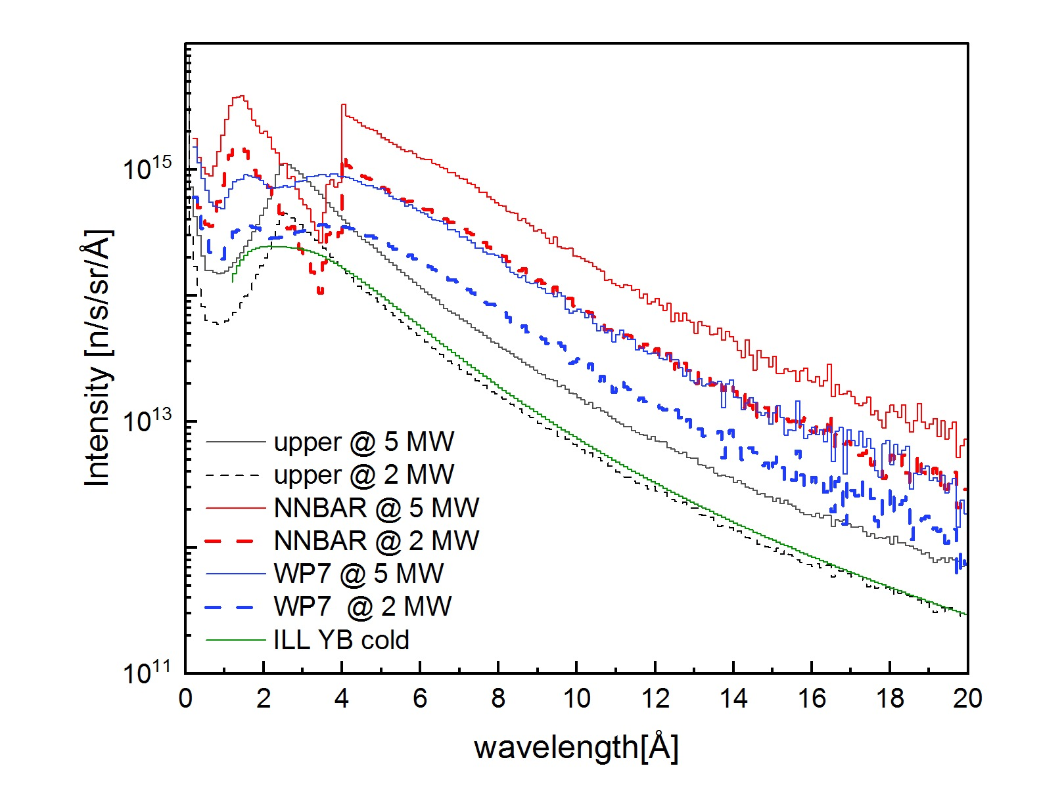
ESS lower moderator performance (brigthness and intensity) is very high also at 2 MW
PRELIMINARY
PRELIMINARY
(assumed viewed surface of ILL moderator 10X10 cm²)
7

Slide 8
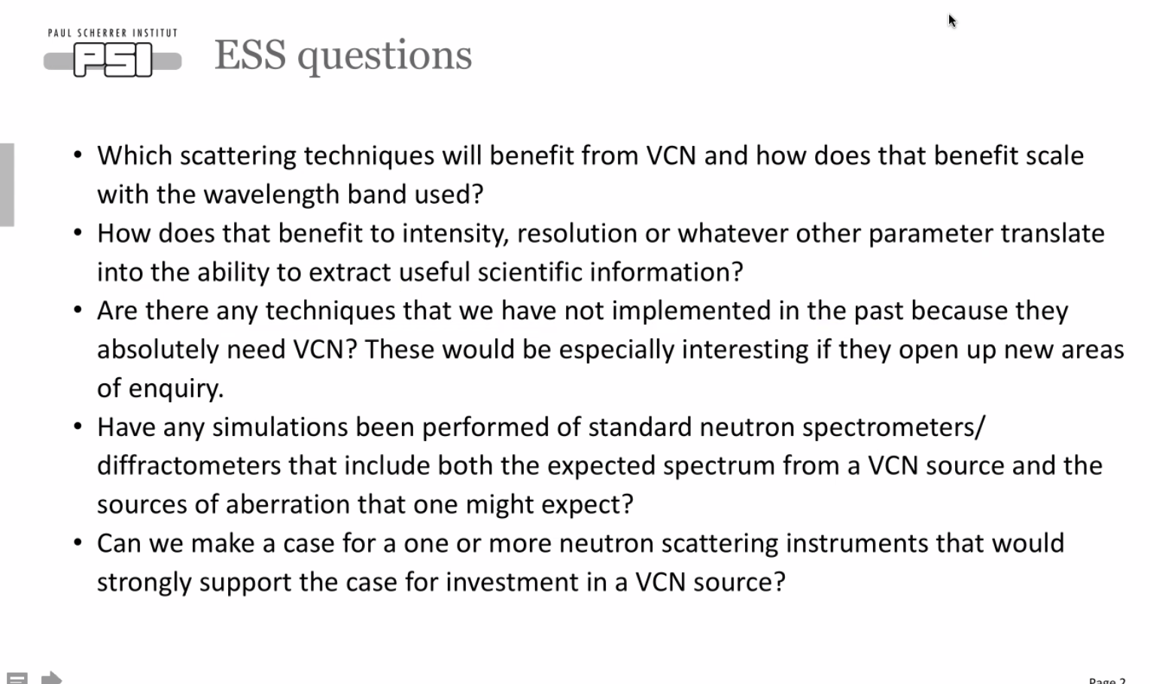
WG6: Condensed matter
8

Slide 9
WG6: Condensed matter
Still preliminary but very promising
8

Slide 10
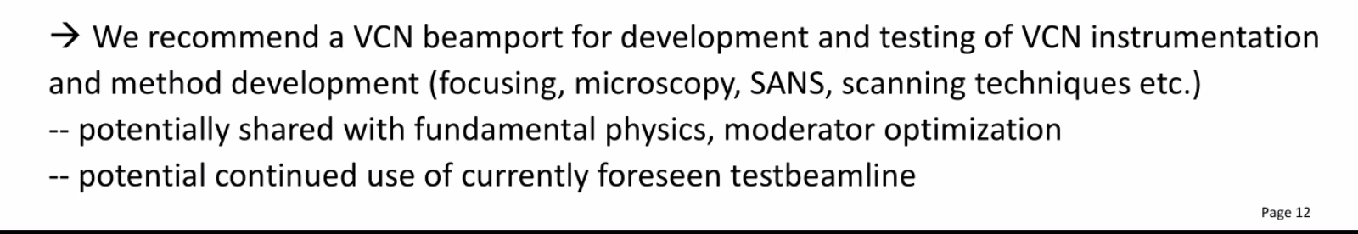
WG6: Condensed matter
9

Slide 11
Future HighNESS events
Moderator meeting every week on Thursday lead by Luca (it will be great to have external guests from time to time)
HighNESS afternoons (every 6 months) special events dedicated to young postdocs and PhD
PSI focussing workshop
Follow up workshop around Feb 2022 (hopefully in person) HighNESS team will be starting to write the CDR at that time
Scattering Kernel school (summer 2023)
HighNESS external collaborator mailing lists (if you are interested send an email to me)
10

Slide 12
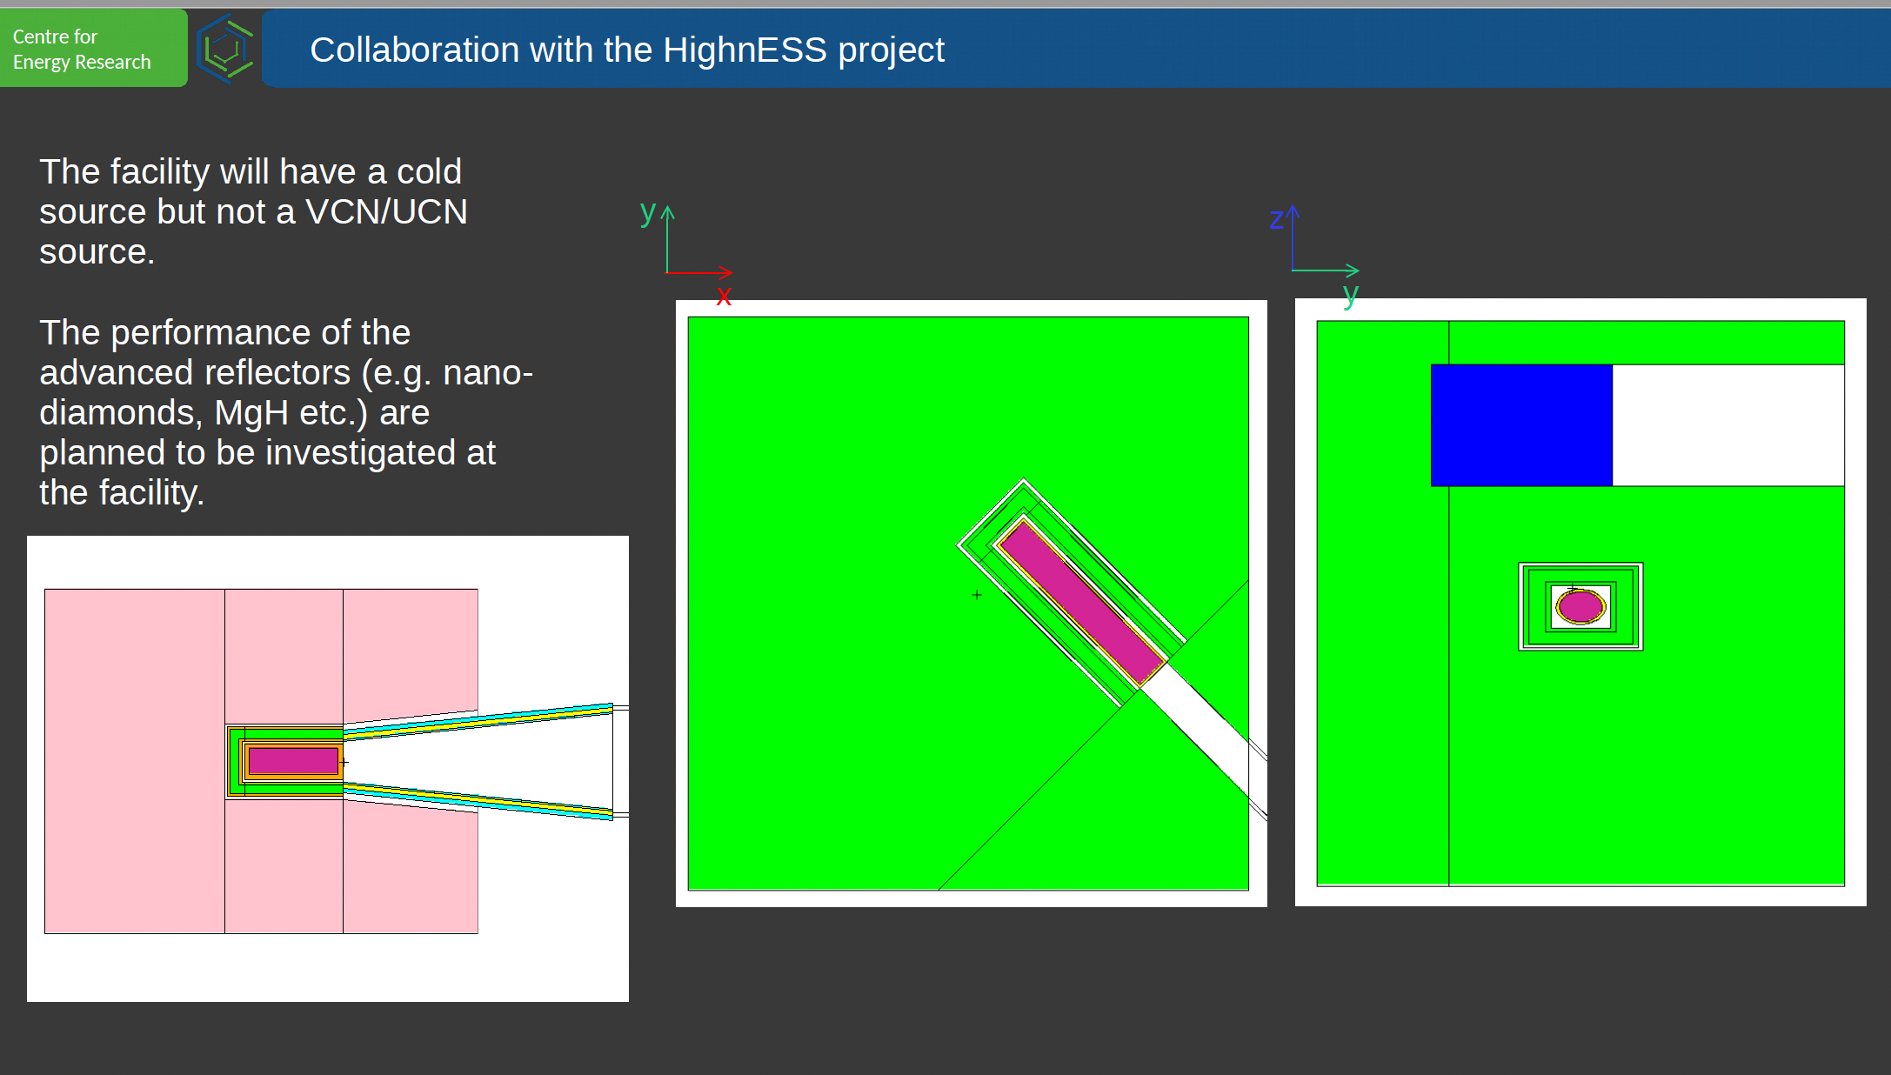
Beam extraction with advanced reflector in Budapest
11

Slide 13
Future events /no HighNESS
LENS moderator meeting
ESS Fundamental physics workshop (end of February beginning of March dates need to be finalized)
12

Slide 14
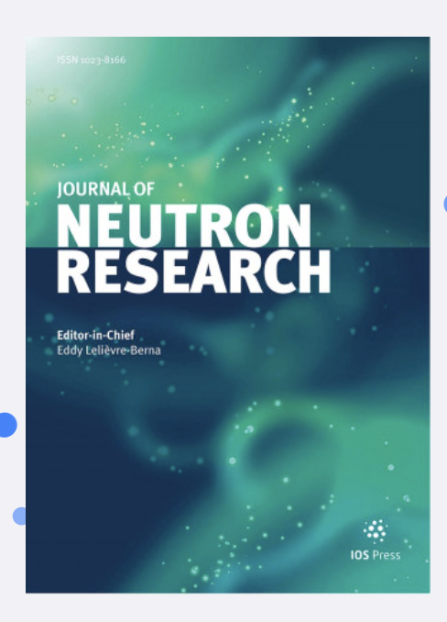
Proceedings
The proceeding of the conference will be published open source. in a dedicated issue of the Journal of Neutron Research
All the instructions are available in indico
The deadline to submit your contributions is Friday 18th of March, 2022
13

Slide 15
Proceedings
The proceeding of the conference will be published open source. in a dedicated issue of the Journal of Neutron Research
All the instructions are available in indico
The deadline to submit your contributions is Friday 18th of March, 2022
THANKS A LOT TO ARNO HIESS AND ANDREW JACKSON FOR SPONSORING THE PROCEEDING IN ADDITION TO THE HIGHNESS PROJECT
13

Slide 16
HighNESS repository
https://github.com/highness-eu
14

Slide 17

Special thanks
Ess Science Focus Team
Zsuzsa Helyes
15

Slide 18
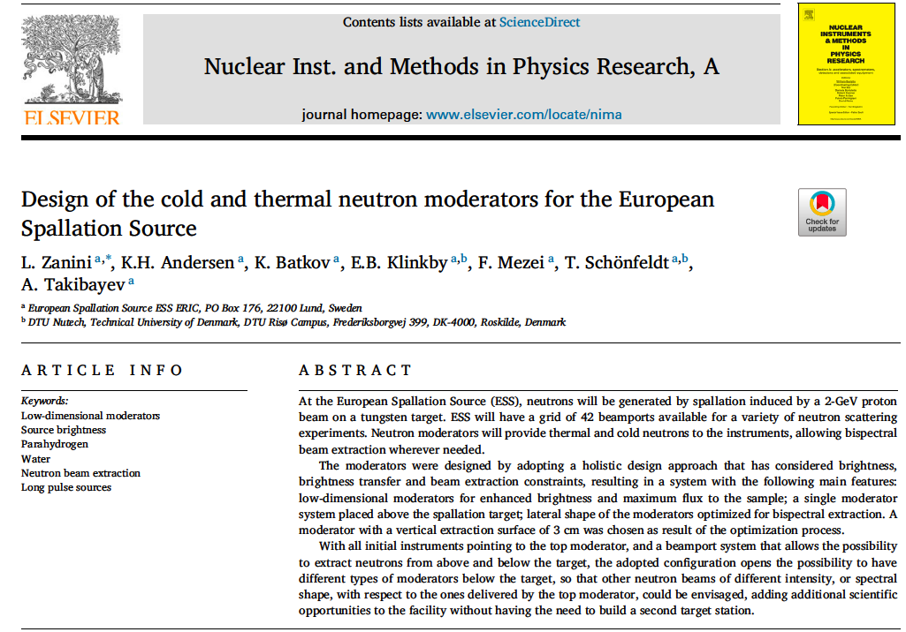
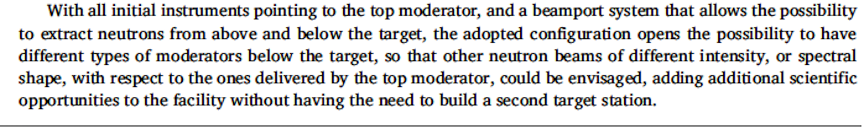
The path to the ESS upgrade
16

Slide 19
The path to the ESS upgrade
Lower Moderator is almost a green field
17

Slide 20
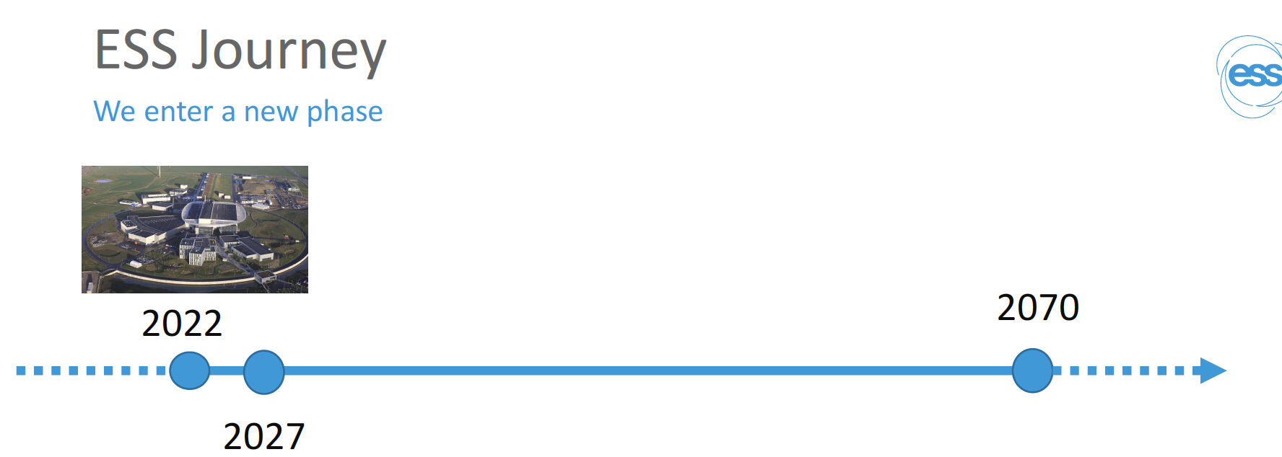
Conclusions
ESS Journey has just began
18
Notes:
ESS is going to be in operation for more than 50 years
The ESS journey has just began

Slide 21
www.highness.eu https://cordis.europa.eu/project/id/951782
highness@ess.eu
valentina.santoro@ess.eu

