Slide 1
Alessandra Luchini & Sven Schütz :: ESTIA Core Team :: Paul Scherrer Institut
Estia – Project Update
STAP meeting 12/10/2021

Slide 2
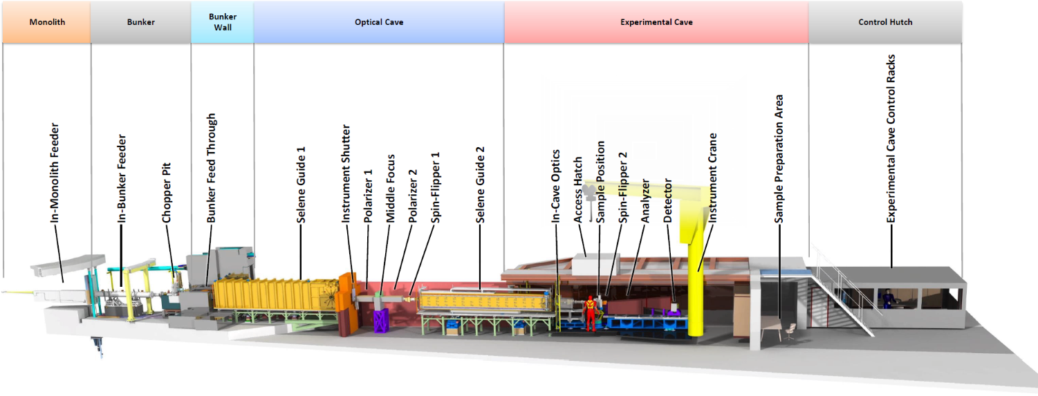
ESTIA instrument overview

Slide 3
ESTIA instrument overview
FAT NBOA

Slide 4
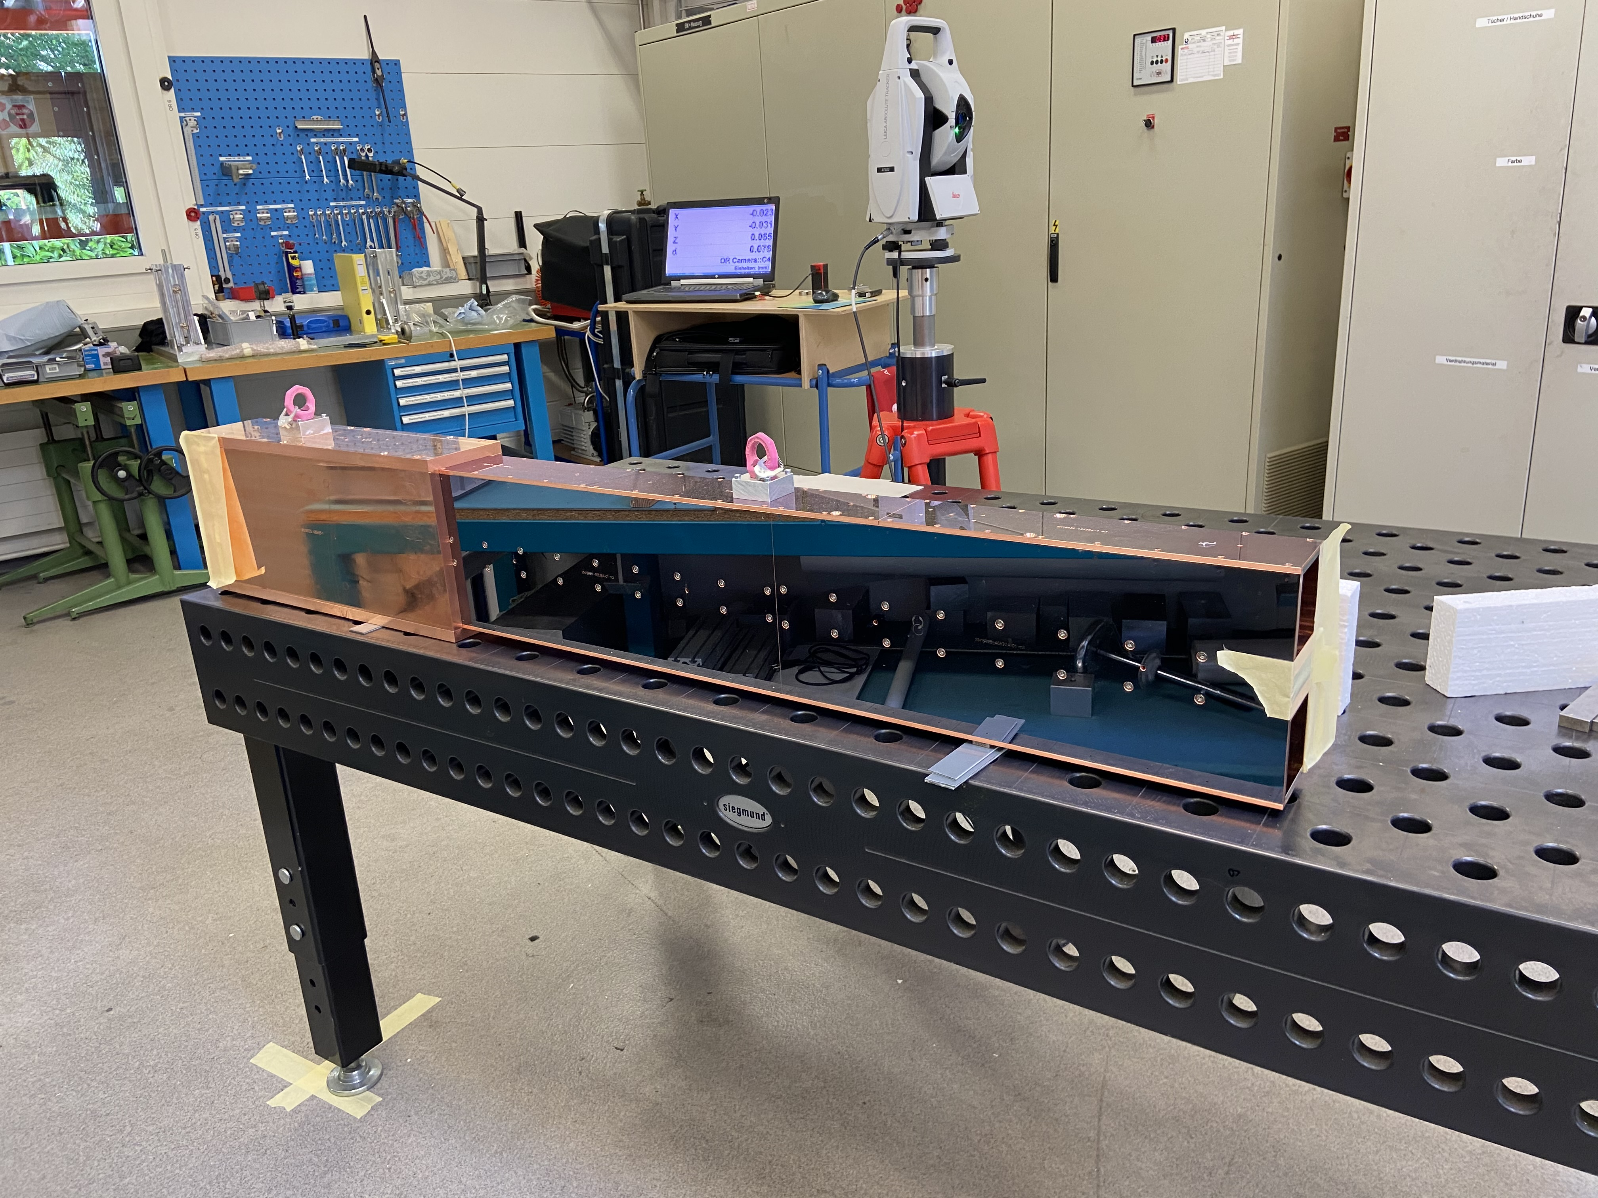
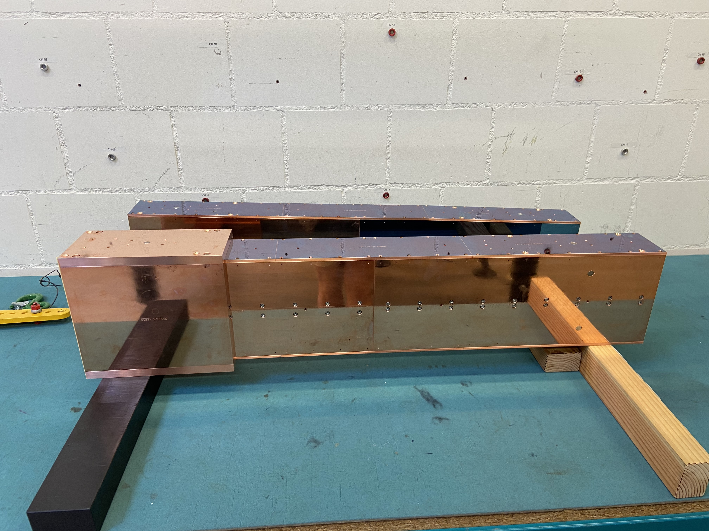
ESTIA- NBOA
FAT of the NBOA: test with light source to check focusing properties of the guide
Ready for shipment to ESS in Oct 2021

Slide 5
ESTIA instrument overview
FAT NBOA
FAT Feeder, Chopper Pit in production

Slide 6
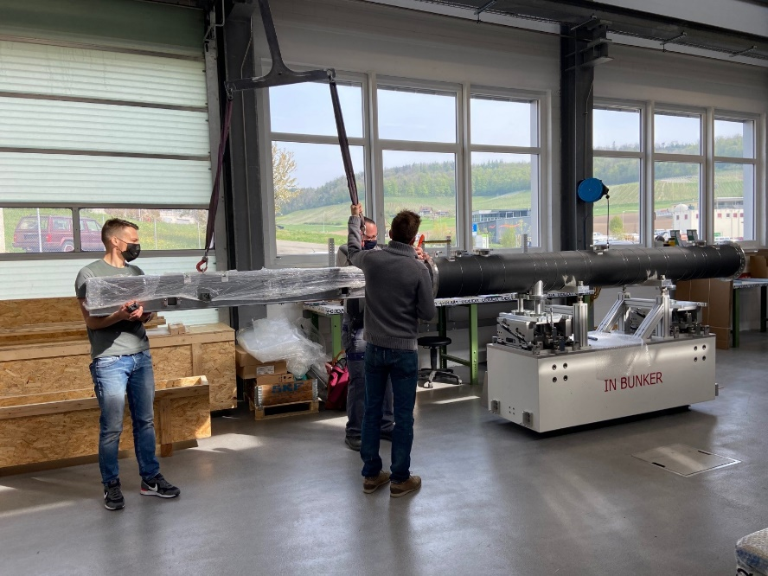
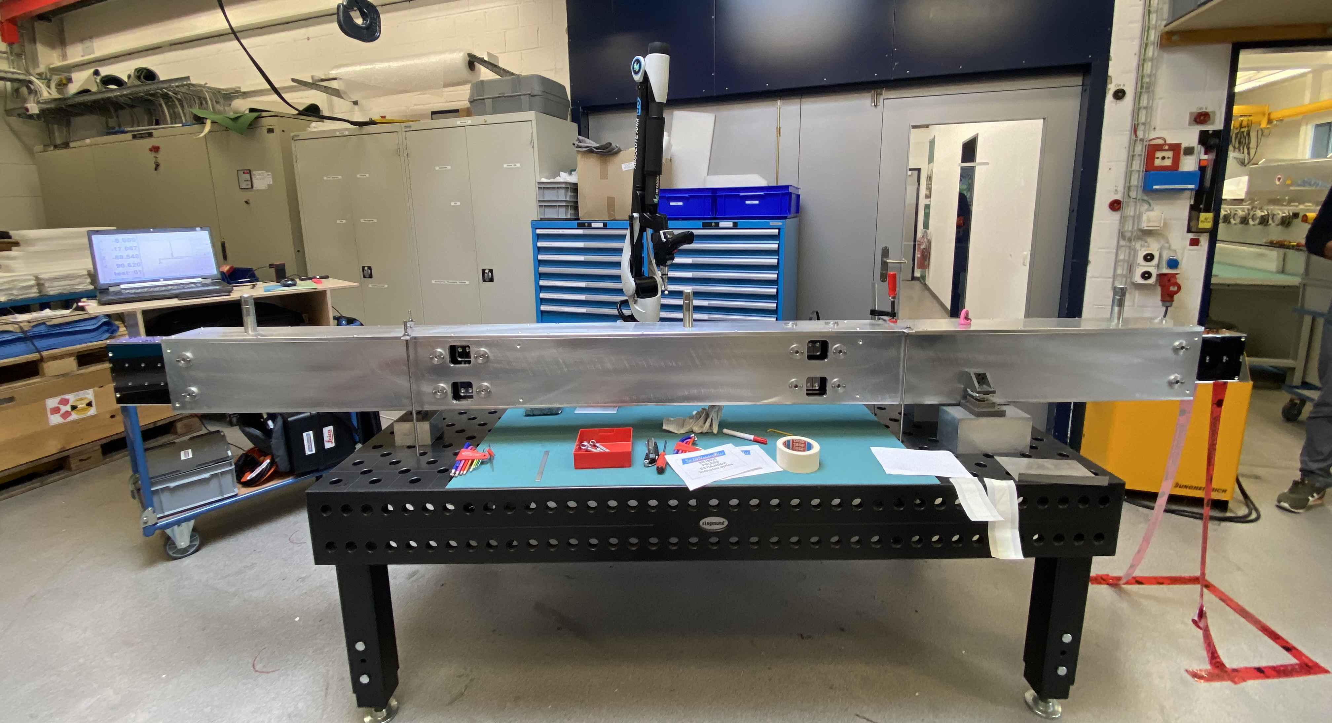
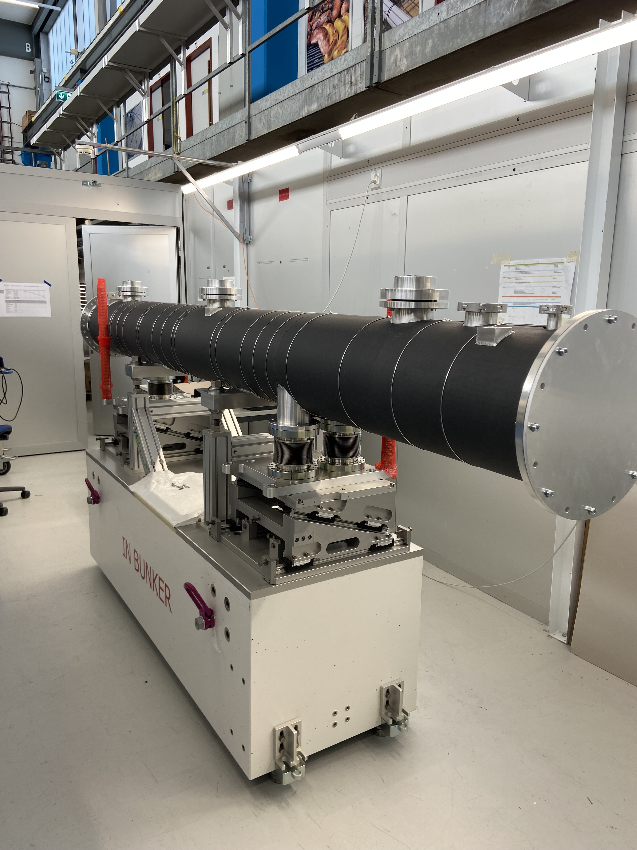
ESTIA- In-bunker Feeder
Installed at PSI
FAT of in- bunker feeder support, vacuum chamber and alignment mechanics (May 2021)
FAT of the in-bunker feeder optics (Aug 2021)
Additional pre-installation test at PSI prior to shipment at ESS (Jan/Feb 2022)

Slide 7
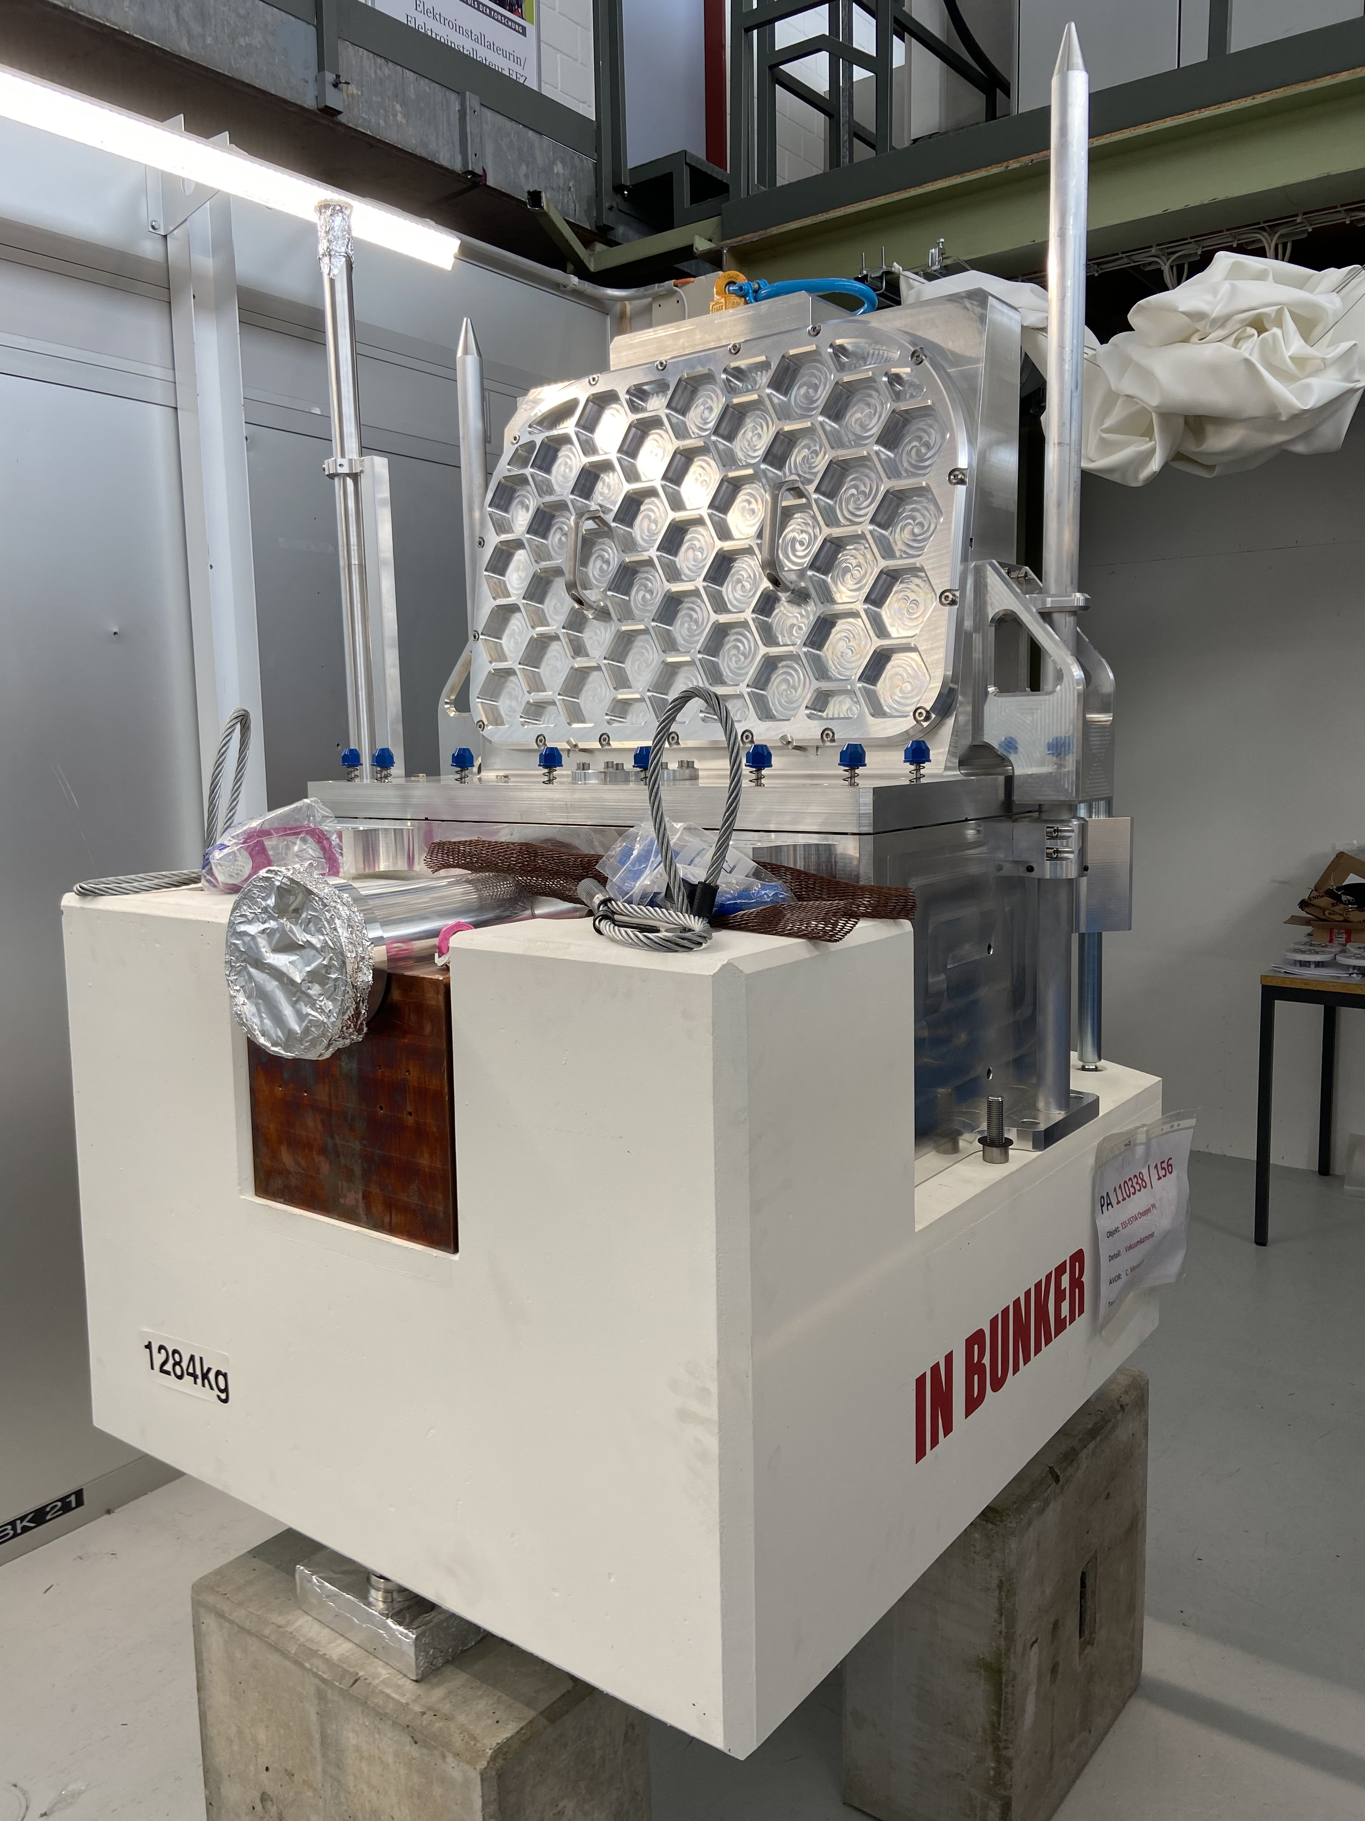
ESTIA - Chopper Pit
Chopper Pit Vacuum chamber contains:
Chopper
Virtual source

Slide 8
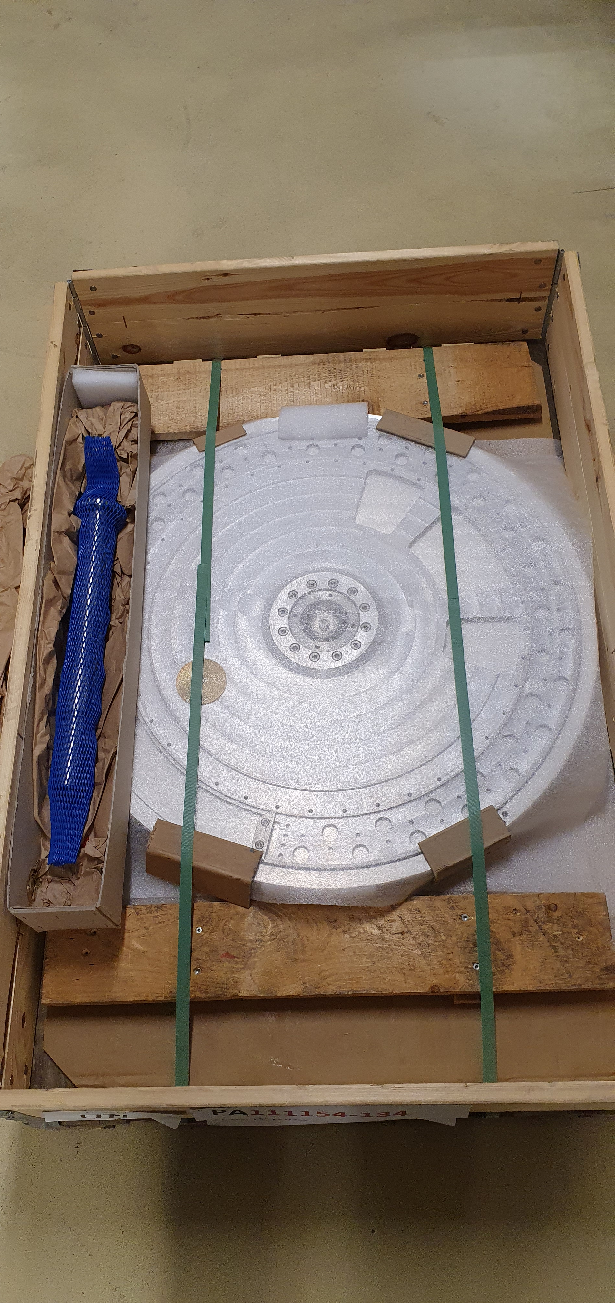
ESTIA - Chopper Pit
Chopper Pit Vacuum chamber contains:
Chopper
Virtual source
Chopper:
Chopper disk produced and shipped to ISIS for coating and balancing (Sept 2021)
Spindle tested at ESS and ready for shipment for additional tests at PSI together with the chopper disk (Jan/Feb 2021)

Slide 9
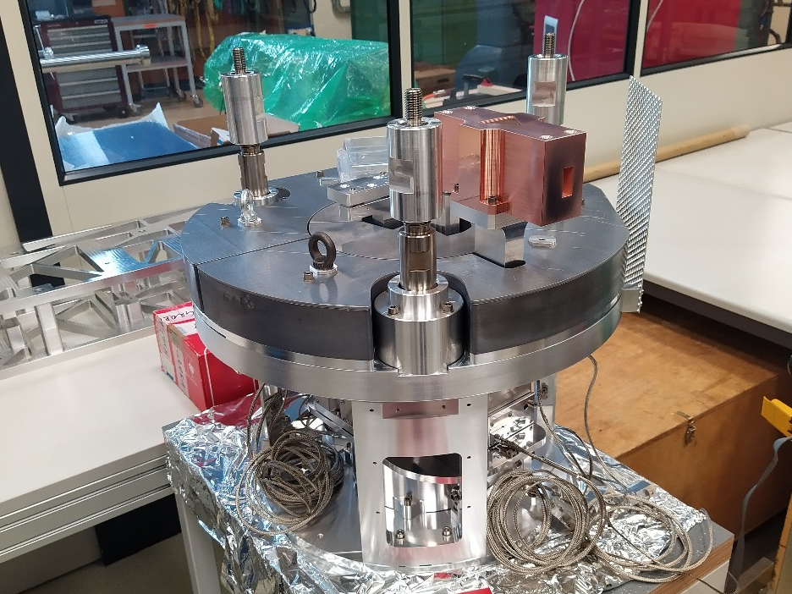
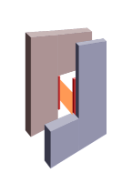
ESTIA - Chopper Pit
Chopper Pit Vacuum chamber contains:
Chopper
Virtual source
Virtual Source:
Support is mechanically assembled and integration of the motors in TwinCat and Epics is in progress
The 2 L-shaped blades are produced and ready for testing

Slide 10
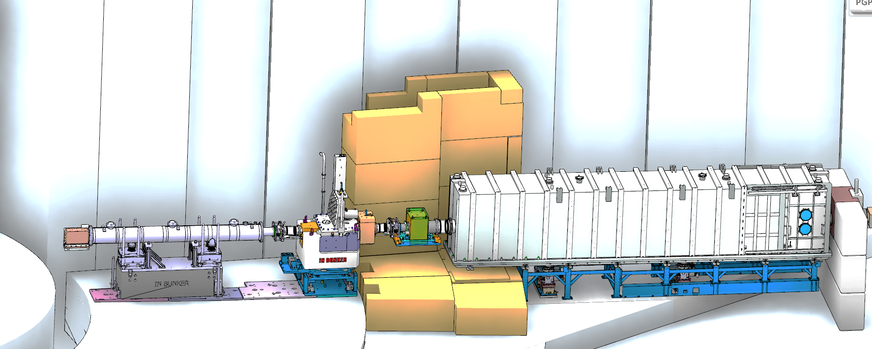
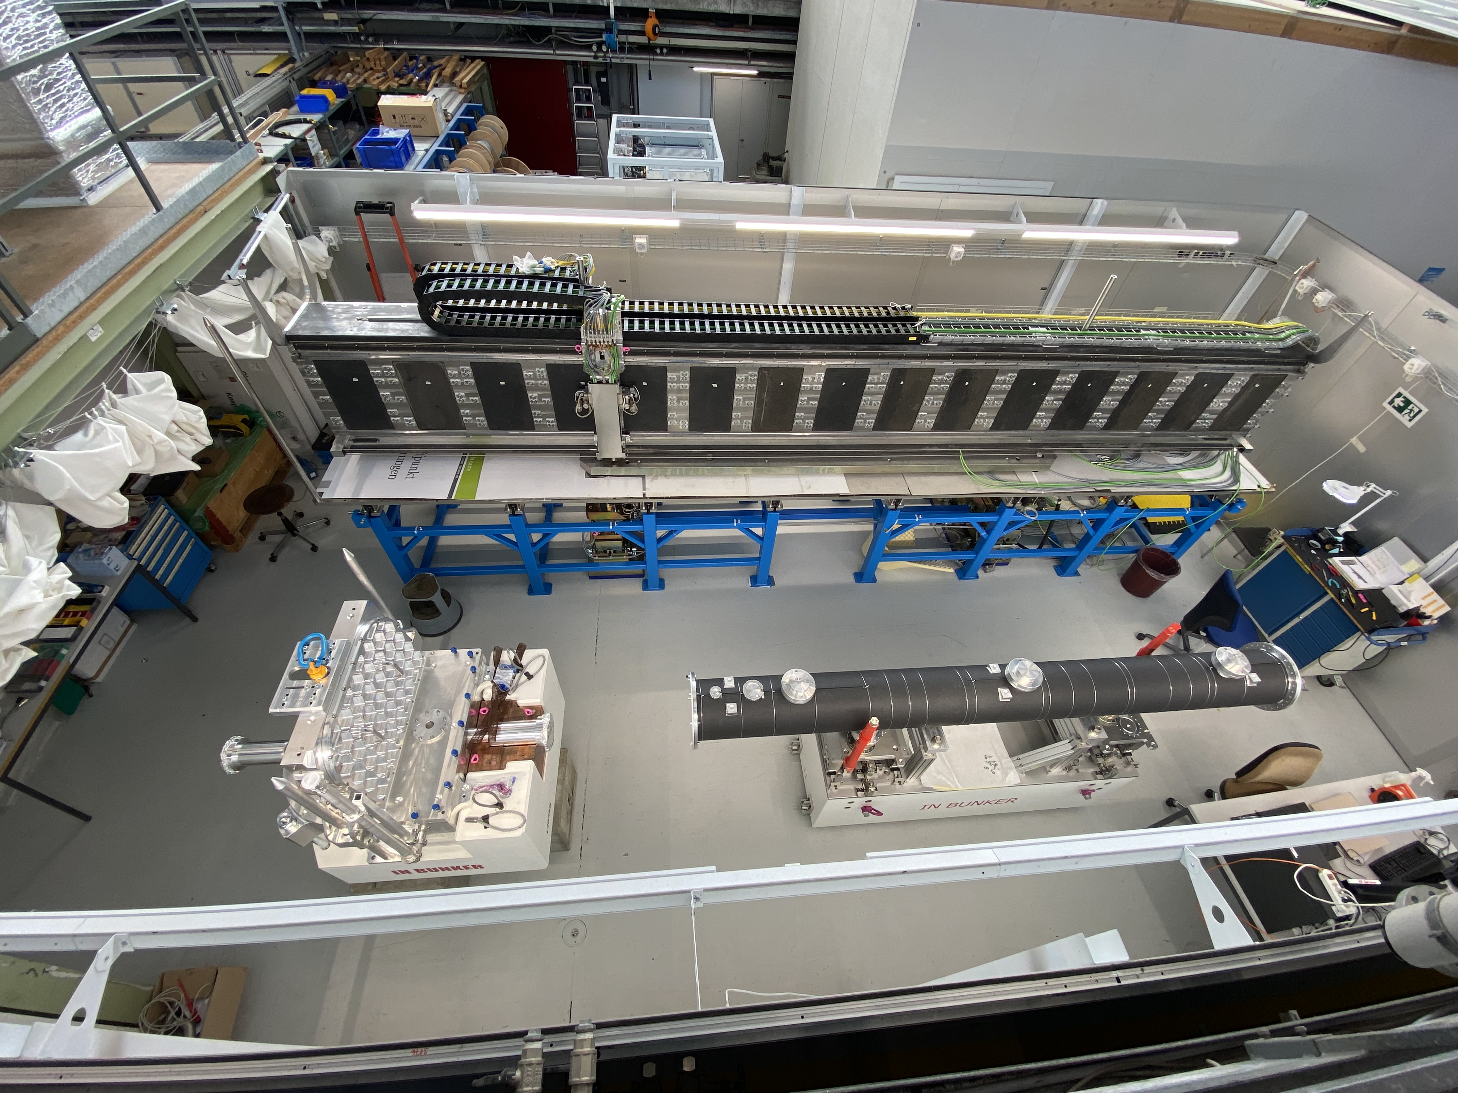
ESTIA - Chopper Pit
Test at PSI of the In-buker feeder and Chopper Pit assembly (Oct/Nov 2021):
Mechanical assembly
Vacuum test
Shipment to ESS (Mar/Apr 2022) for early in-bunker installation (Apr-Jun 2022)

Slide 11
ESTIA instrument overview
FAT NBOA
Selene 1 at ESS, Selene 2 at PSI, MF design
FAT Feeder, Chopper Pit in production

Slide 12
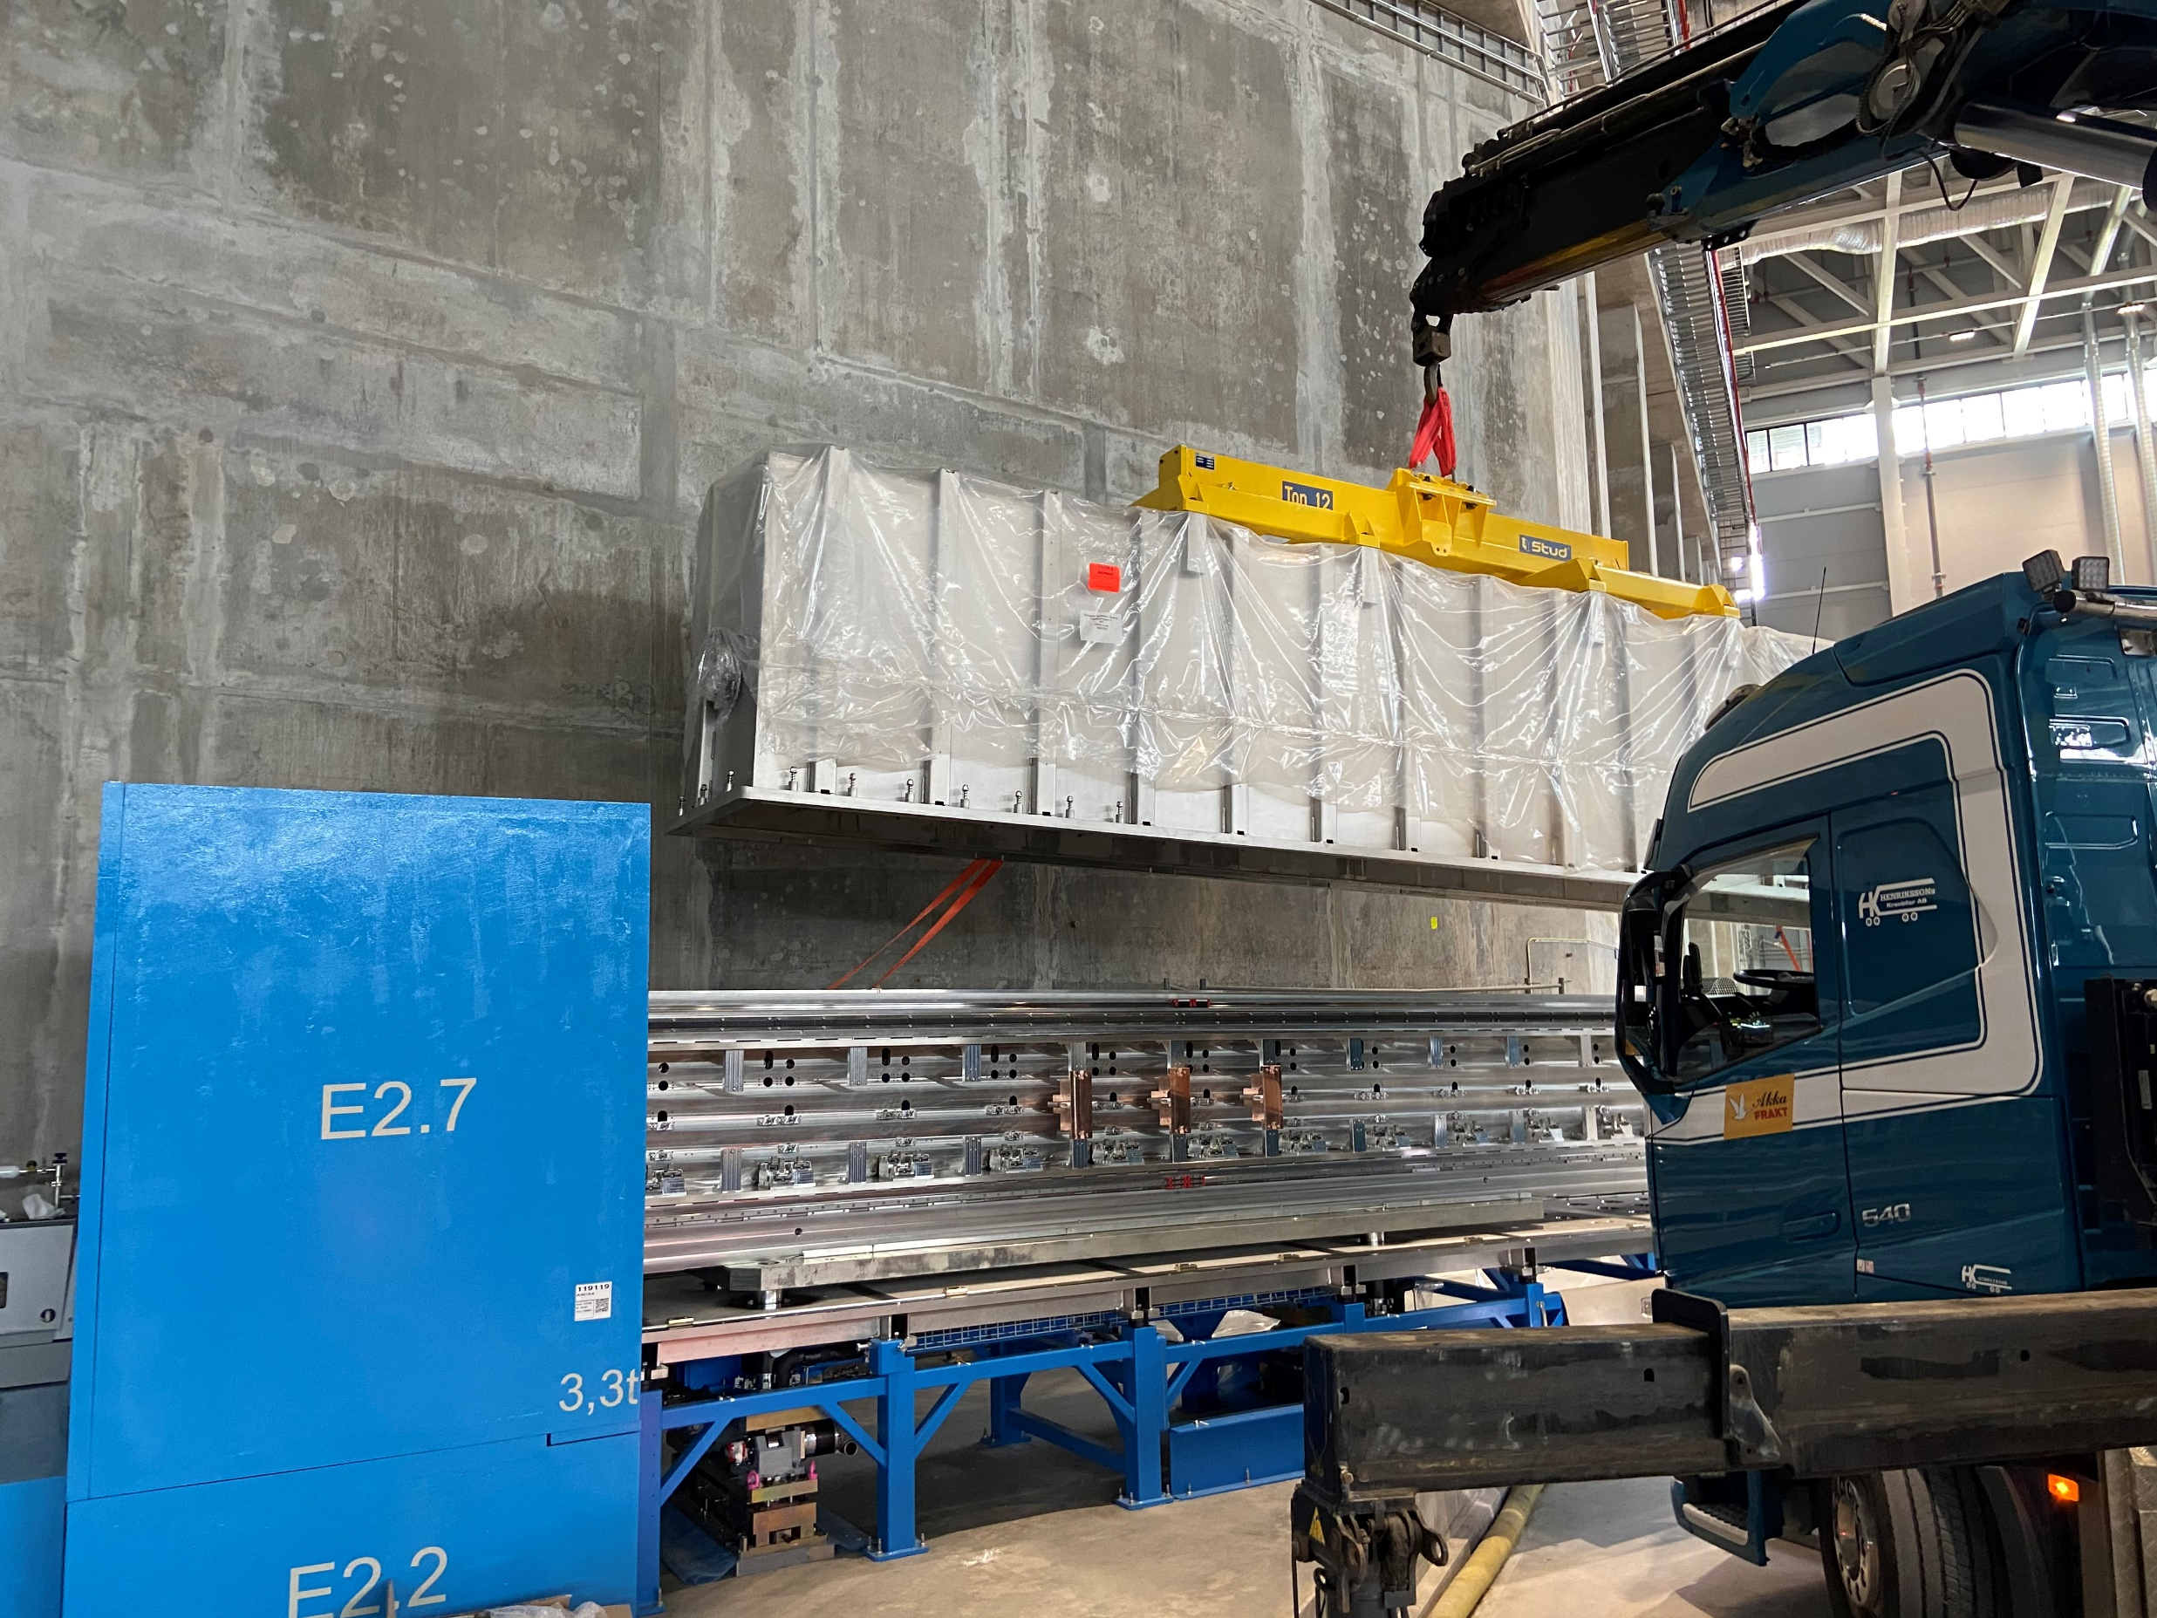
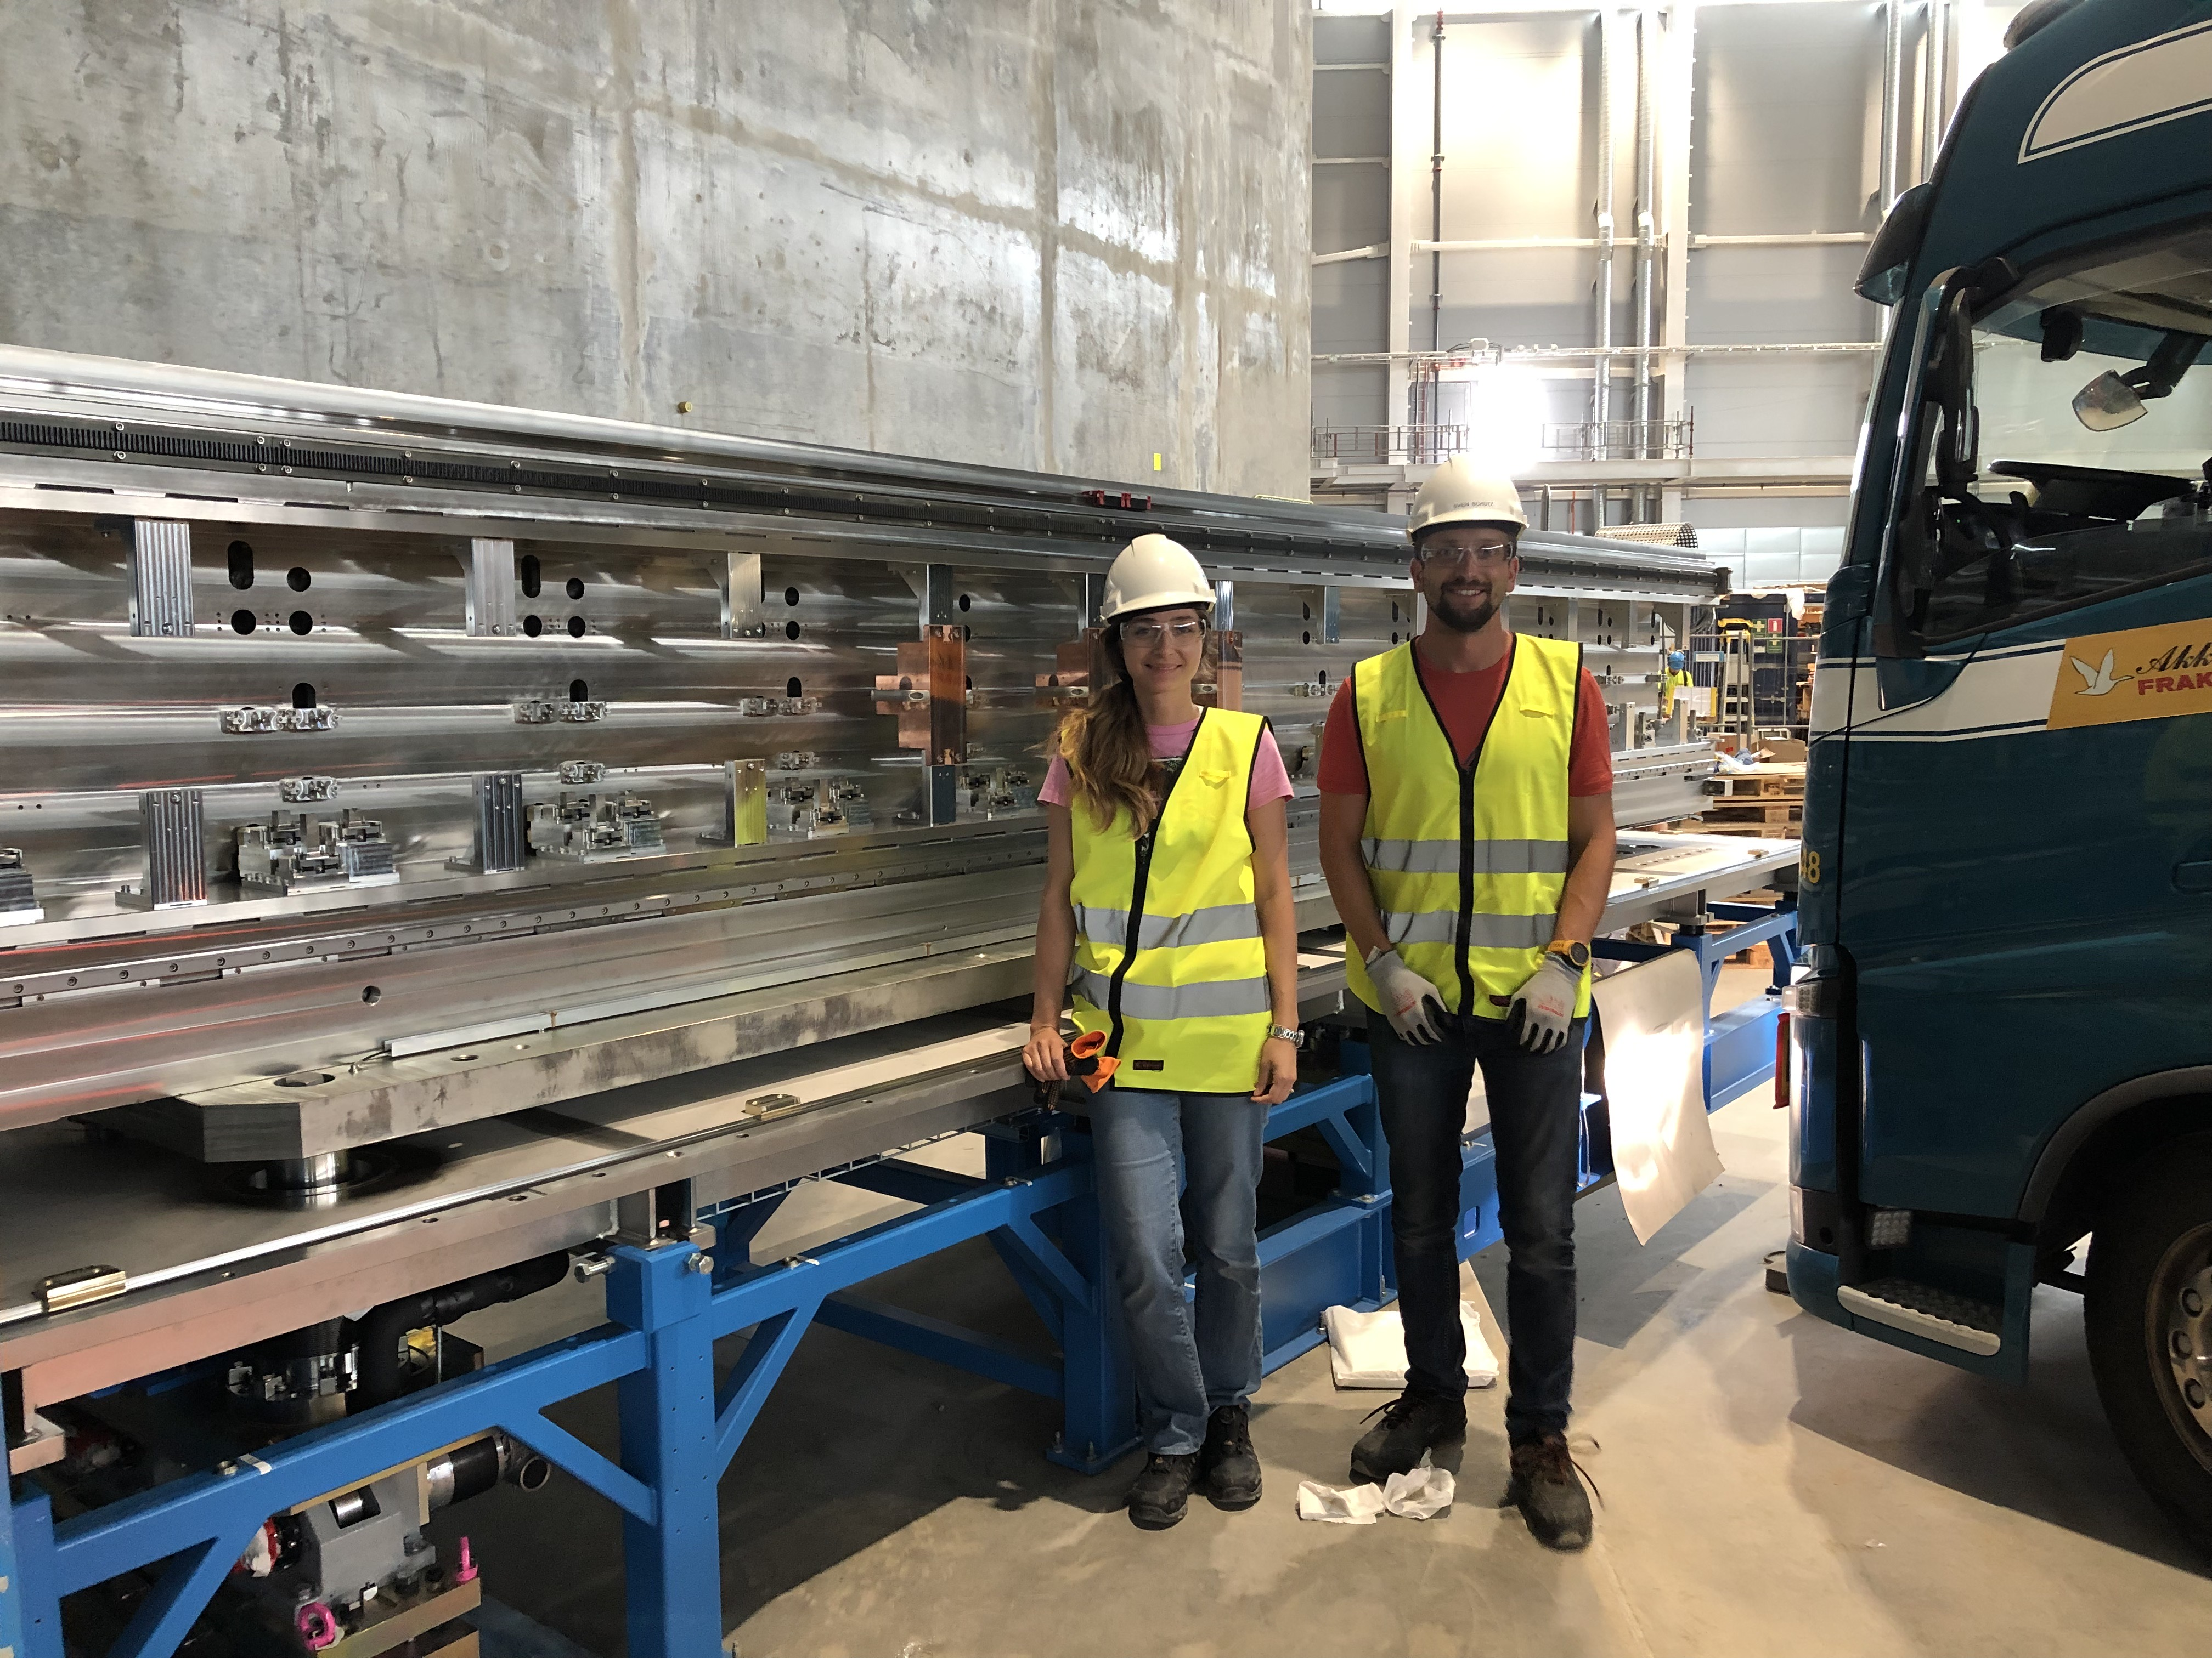
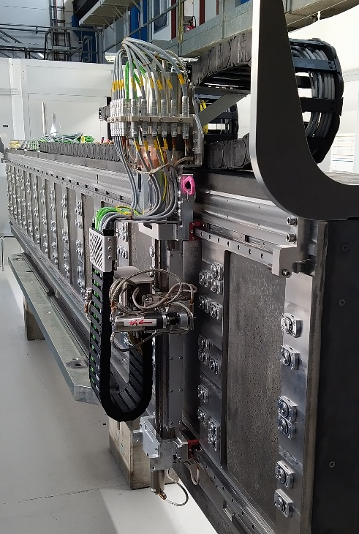
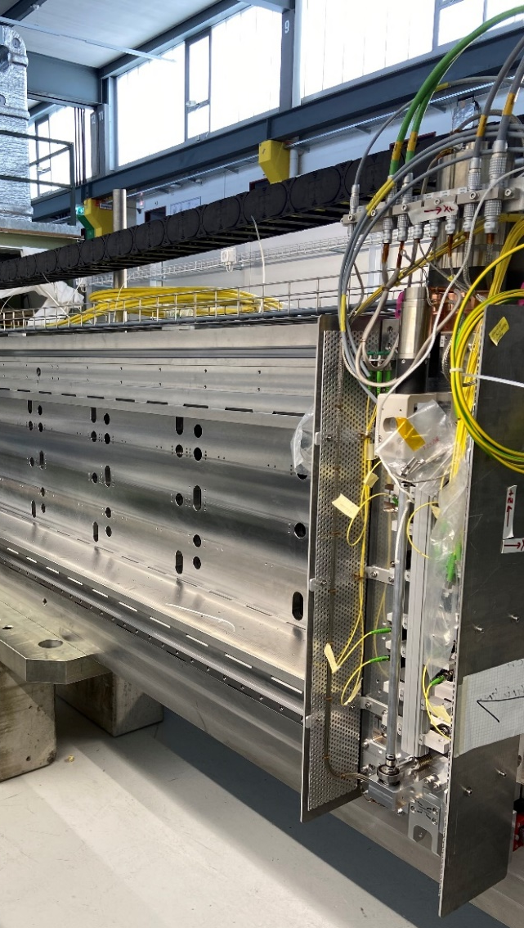
ESTIA – Selene 1
Selene guide 1 carrier and vacuum vessel are installed at ESS
Currently in progress:
Characterization of the mirrors at PSI with interferometry
Integration in TwinCat and Epics of metrology cart and alignment robot (in progress)
Alignment robot
Metrology cart
Installation of the mirrors and robots at ESS in summer 2022

Slide 13
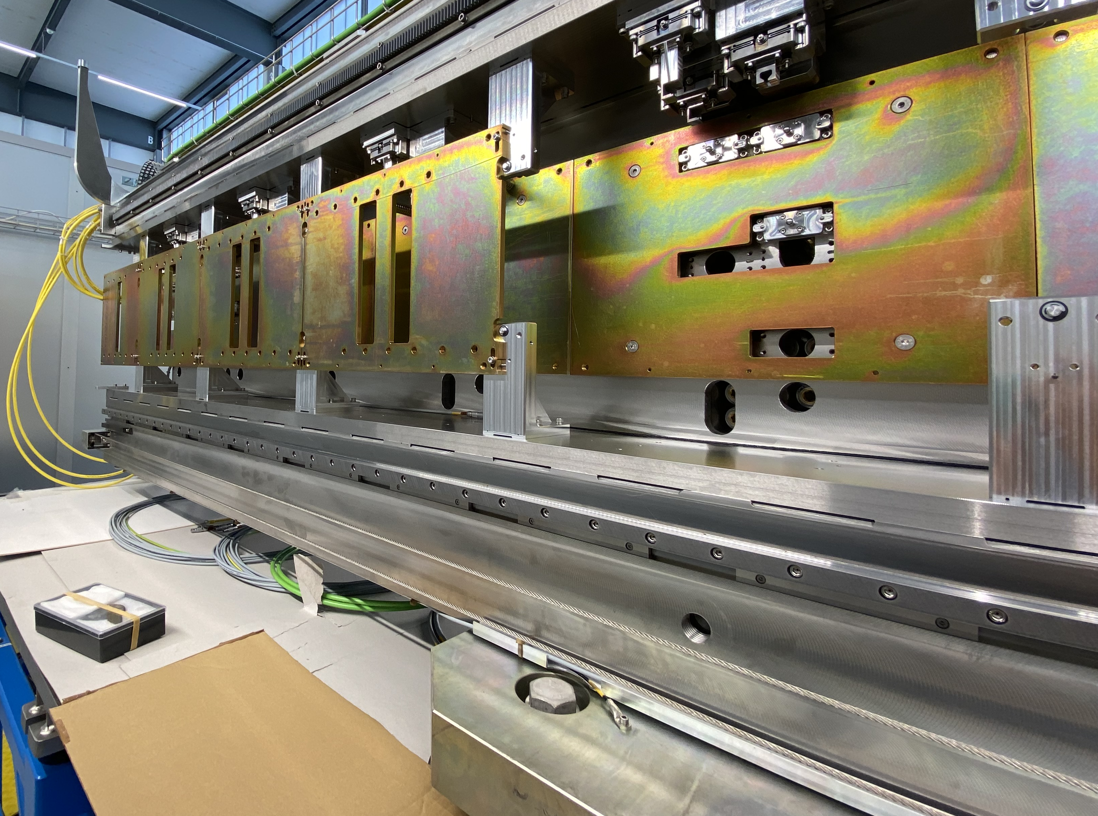
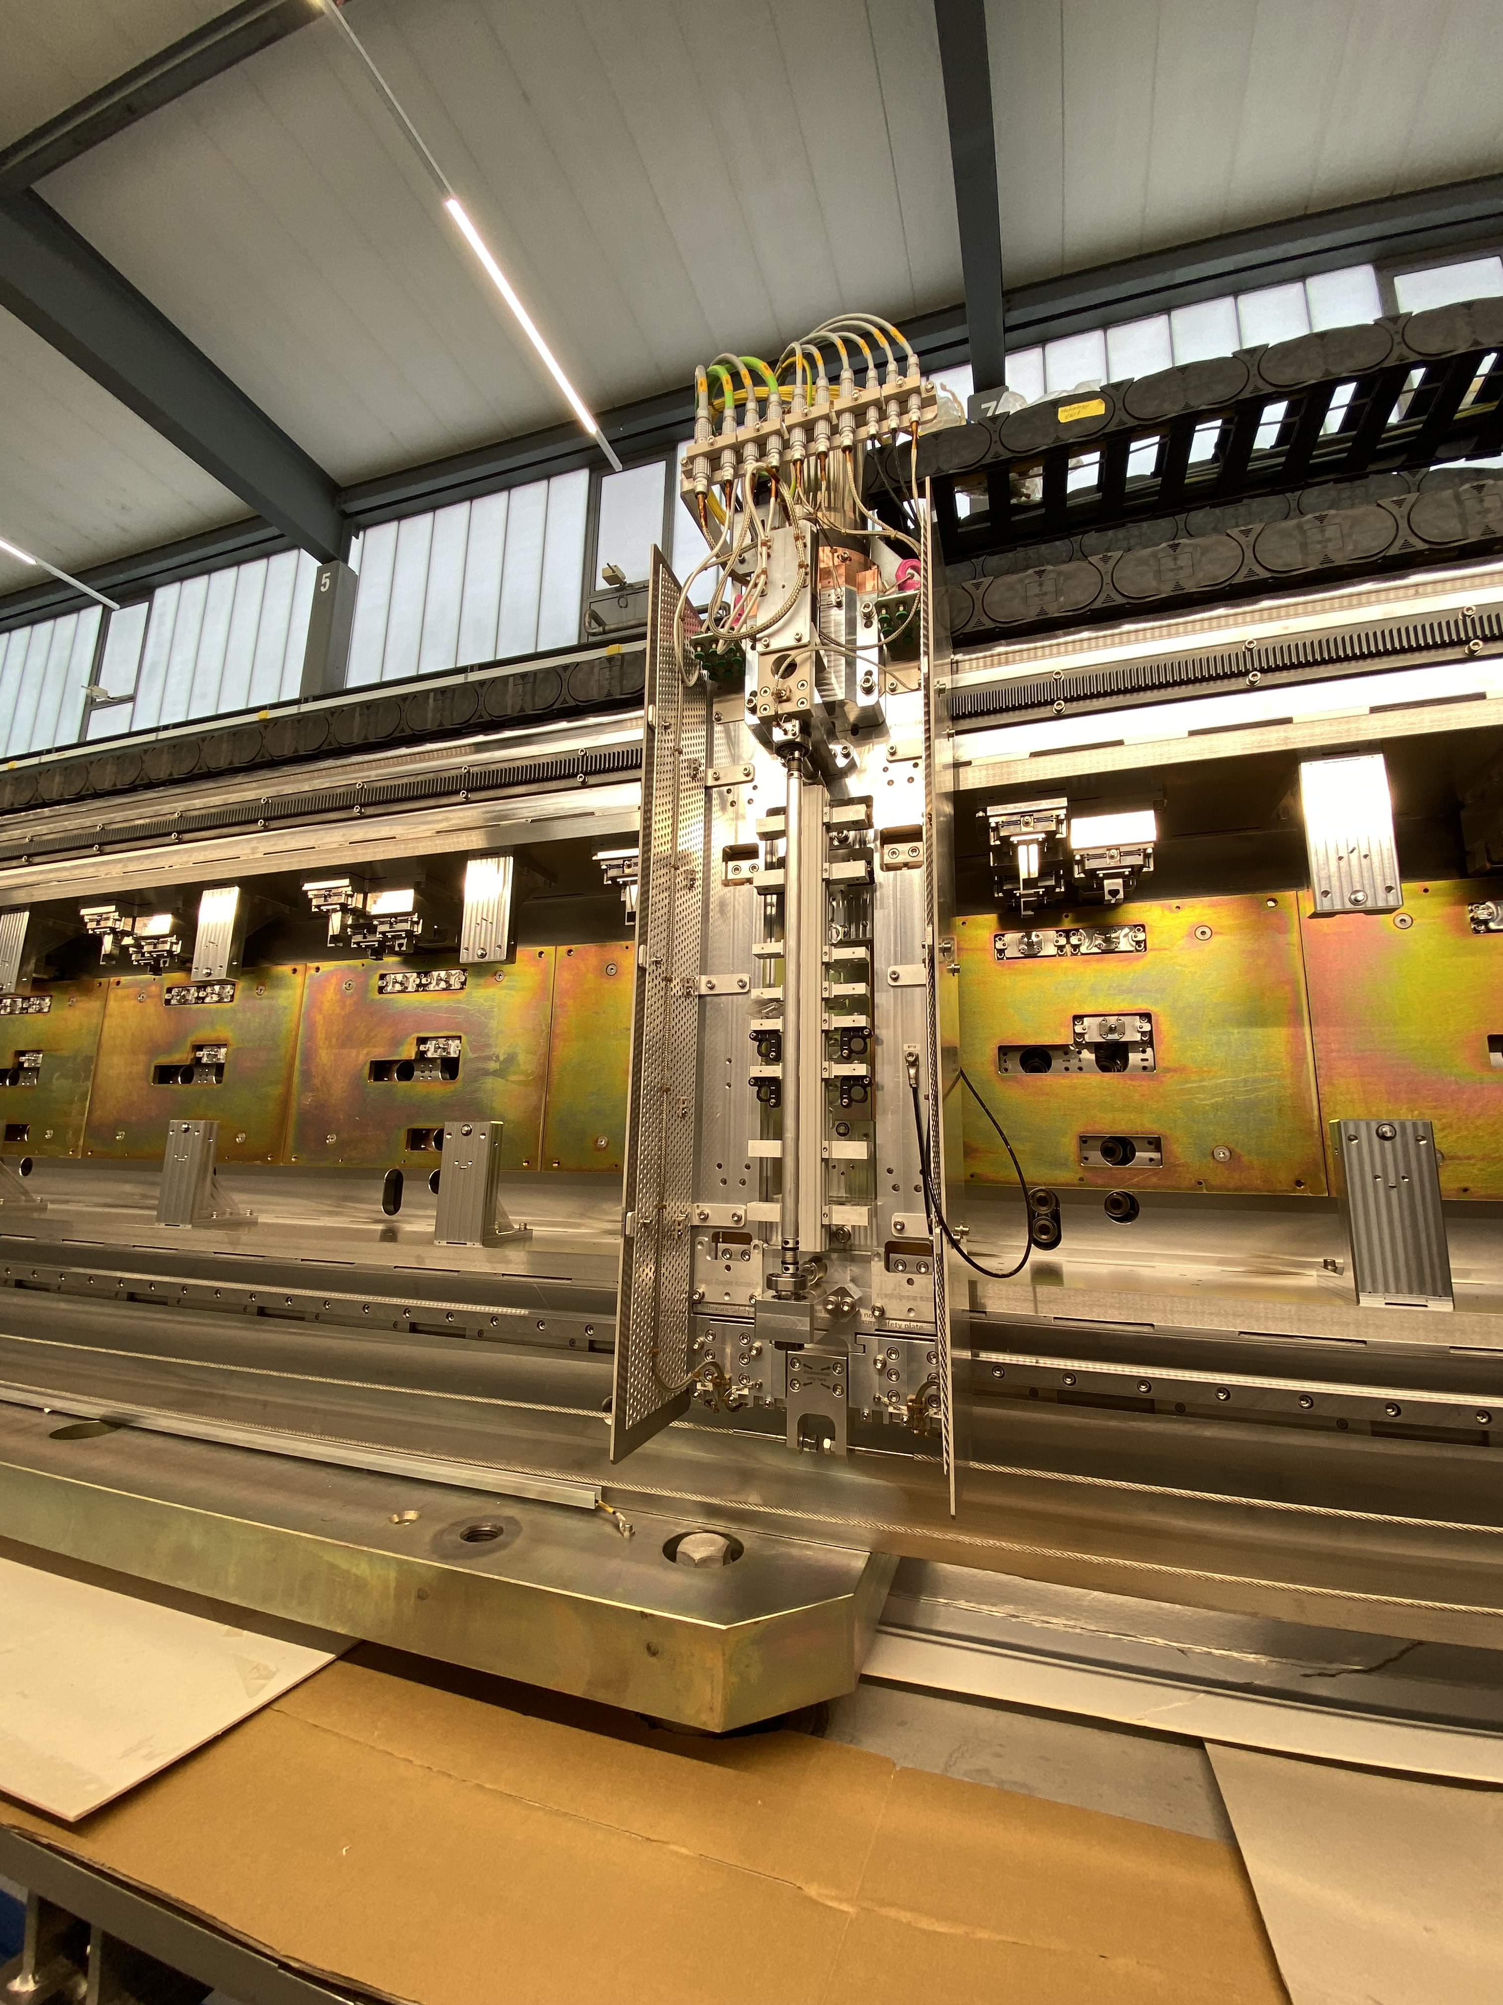
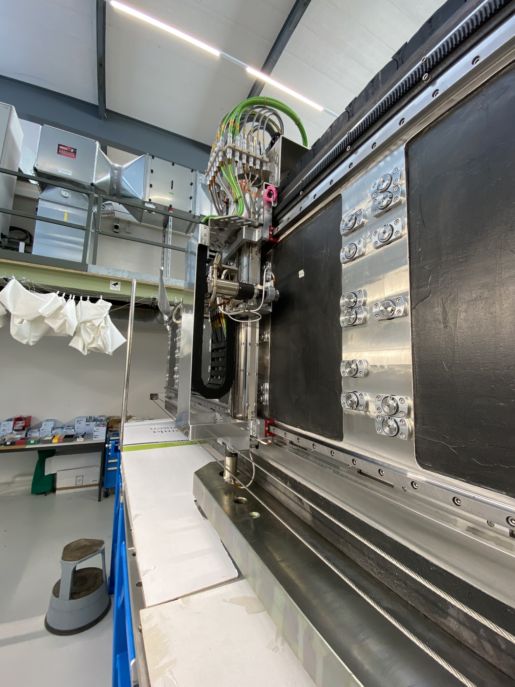
ESTIA –Selene 2
Pre-installation of the carrier at PSI
Shipment to ESS (Dec 2021)
Installation at ESS (summer 2022)
Integration TwinCat and Epics of metrology cart and alignment robot
preliminary tests (Oct 2021)
Guide field installation and testing

Slide 14
ESTIA Middle Focus
Orginal concept: the two polarisers are placed one before and one after the MF
New concept: the two polarisers are both placed before the MF
Advantages:
Similar performances as the orginal concept
Both polarisers are placed on the same motorised support
The spin flipper can be located in correpondance of smaller beam
Reduced costs
Currently in progress: from conceptual design to detailed design

Slide 15
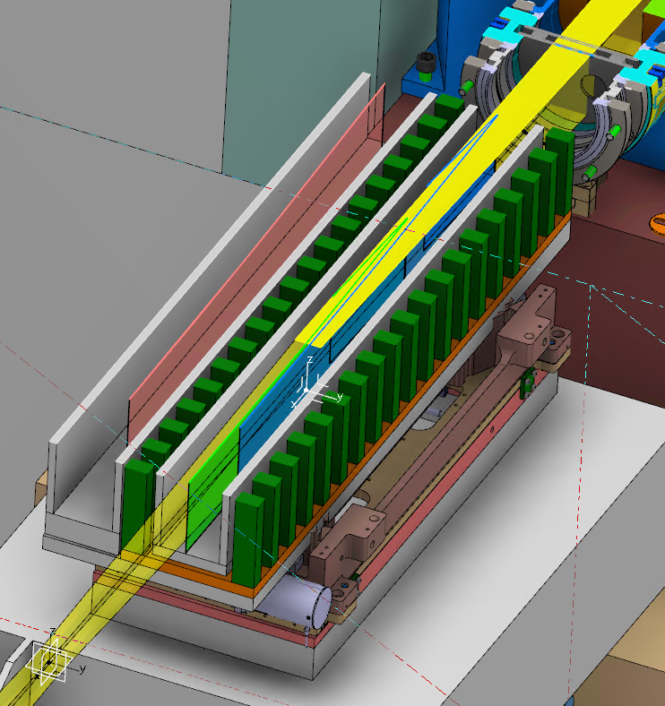
ESTIA Middle Focus
New concept: the two polarisers are both placed before the MF
Polarisers are Si/Fe supermirrors m=5/5.5
Polarisers have V-shape: logarithmic spiral segment + linear segment. Optimised shape to accommodate large beam divergence.
FOM is Ni-coated Si wafer with logarithmic spiral shape (nuetrons with wavelength above 30 Å are removed)
McStas simulation currently in progress to confirm the results

Slide 16
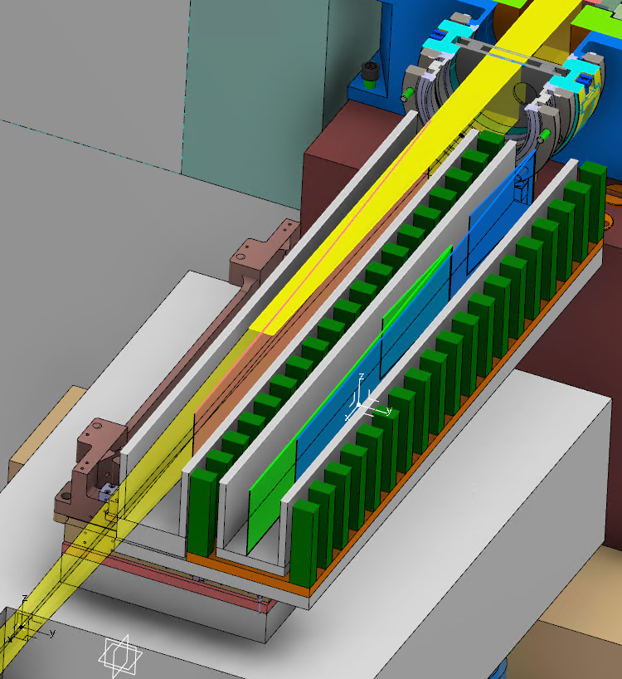
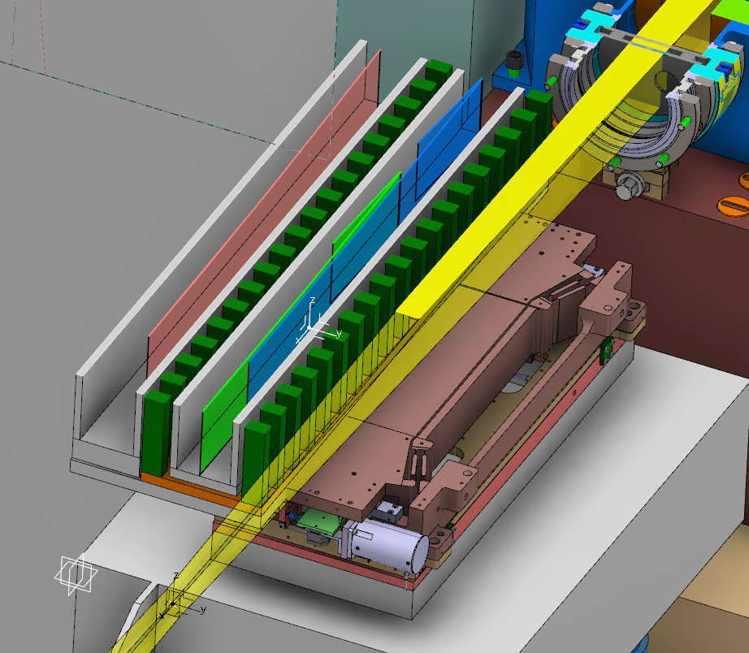
ESTIA Middle Focus
FOM
Polarisers
Free Position

Slide 17
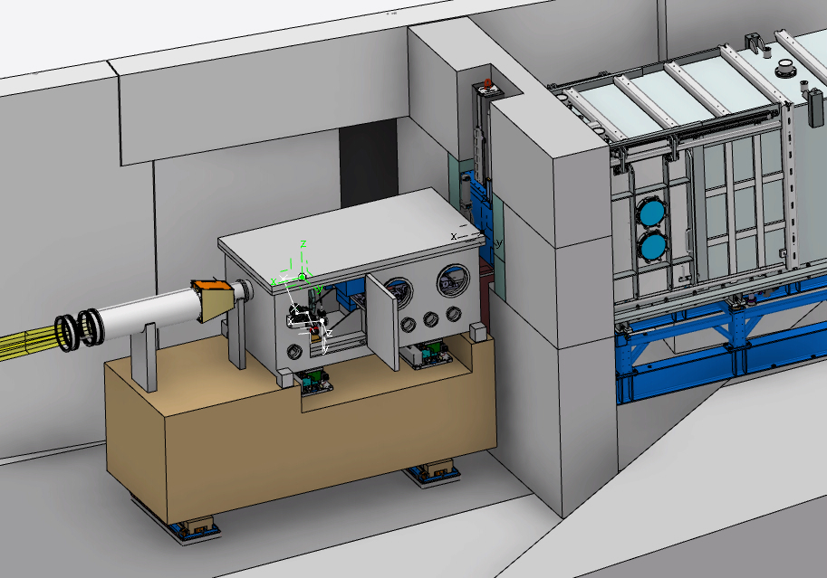
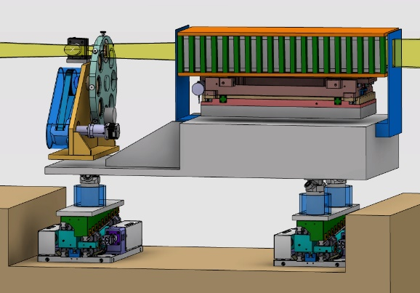
ESTIA – Middle Focus
Design in progress
Selene 1
Polarisers
and FOM
Shutter
Mask changer
Middle Focus
Motorised support:
Moving polarisers or FOM in or out of the beam
Alignment of the polarisers and FOM

Slide 18
ESTIA – Middle Focus
Design in progress
Selene 1
Polarisers
and FOM
Shutter
Mask changer
Middle Focus
Spin flipper:
Same design as AMOR
Produced at PSI

Slide 19
ESTIA instrument overview
FAT NBOA
Selene 1 at ESS, Selene 2 at PSI, MF design
FAT Feeder, Chopper Pit in production
Sample Stage and Detector Arm design

Slide 20
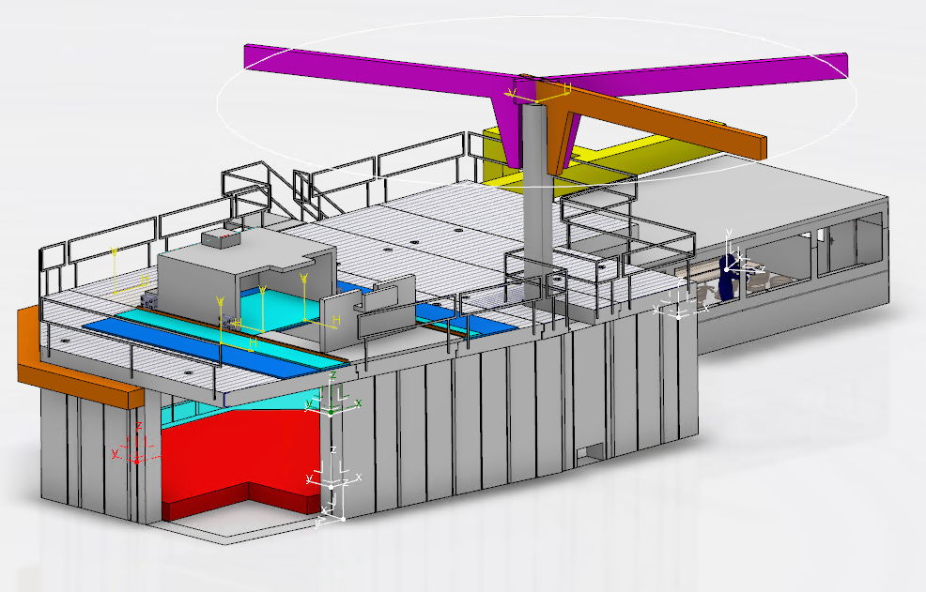
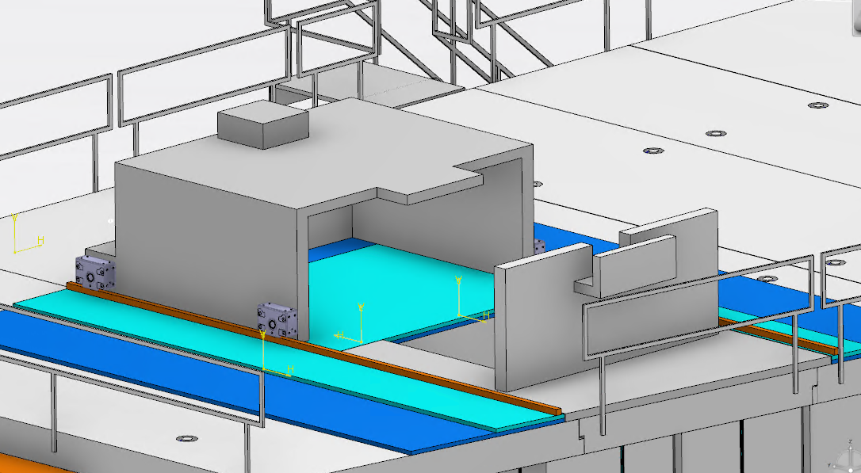
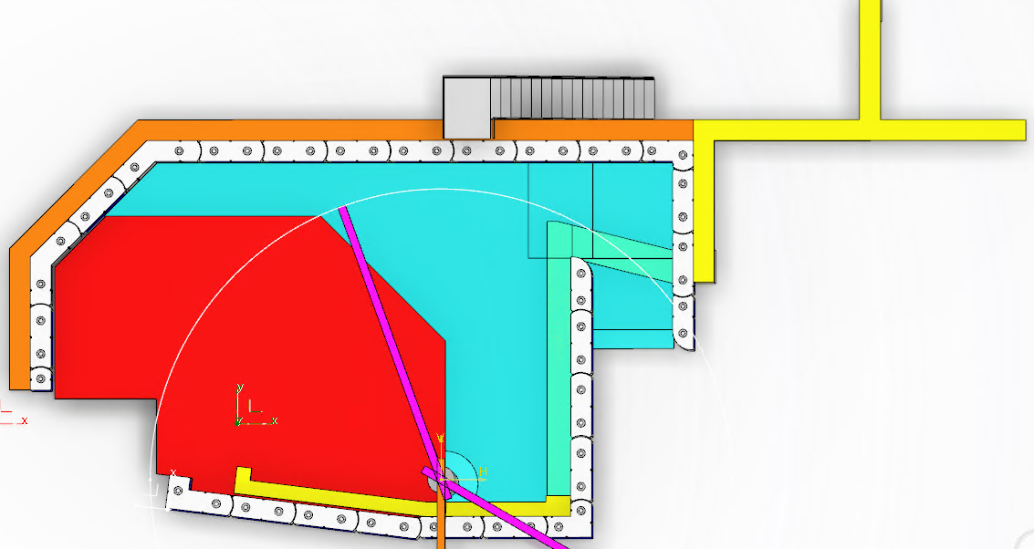
ESTIA – Experimental Cave
Top view
False floor
Conceptual design finalised
Critical Tender Verification (CTV) Oct 2021
Procurement spring 2022
Precision floor

Slide 21
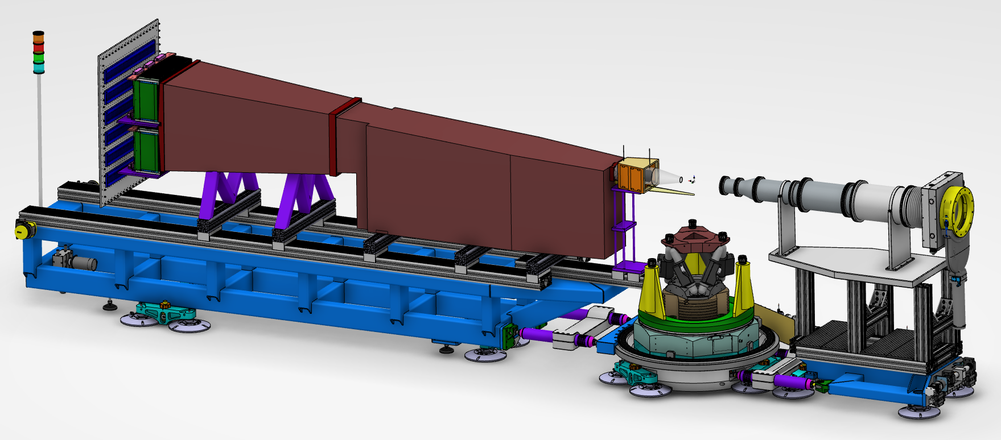
ESTIA – Sample Stage & Detector Arm
Conceptual design almost finalised

Slide 22
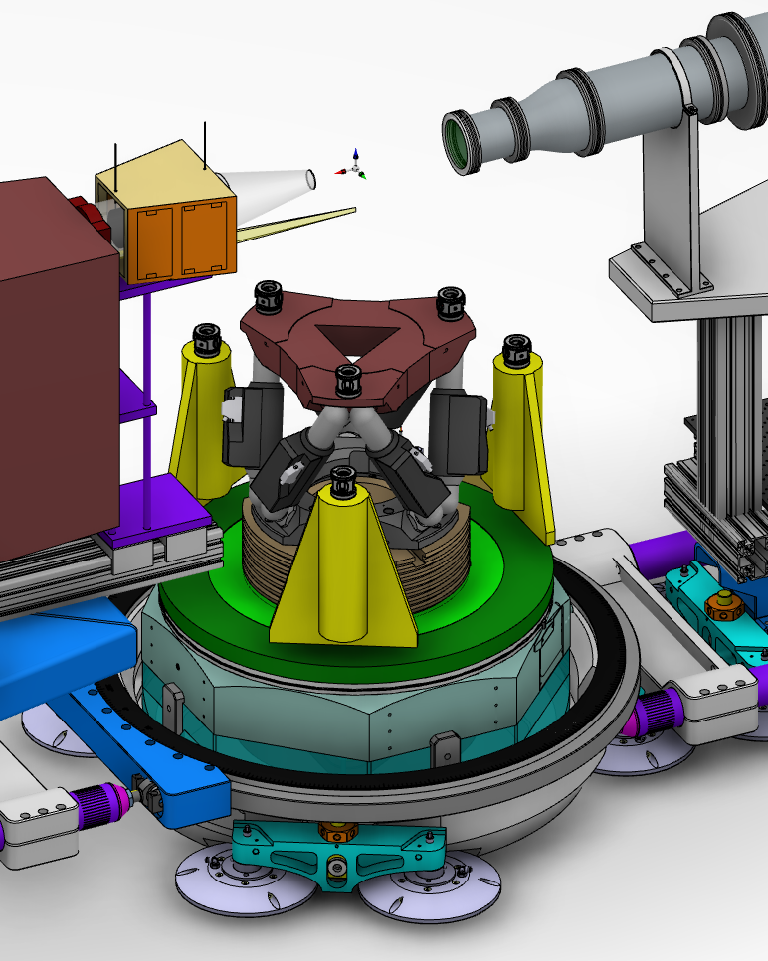
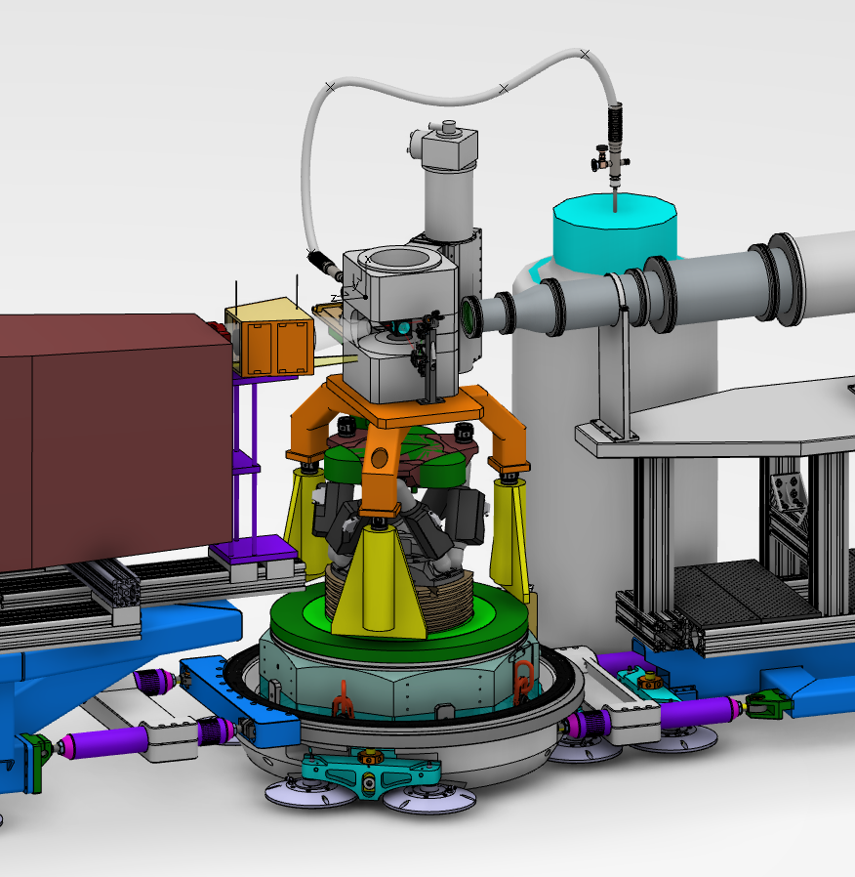
ESTIA – Sample Stage & Detector Arm
Sample stage
Example with SE: Warm Bore Magnet
Hexapod
Omega stage
Solid/liquid sample changer
The sample is mounted on the hexapod and can be roated inside the magnet

Slide 23
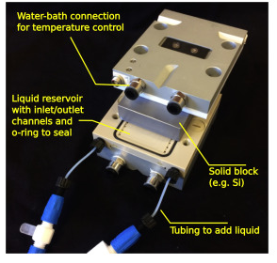
ESTIA – Sample Stage & Detector Arm
Sample stage
Sample environment for HC
Solid/liquid cells + sample changer + accessories: the project in collaboration with Prof. Adrian Rannie at Uppsala University
Test on AMOR for divergent beam and standard solid/liquid cells
Hexapod
Omega stage
Solid/liquid sample changer

Slide 24
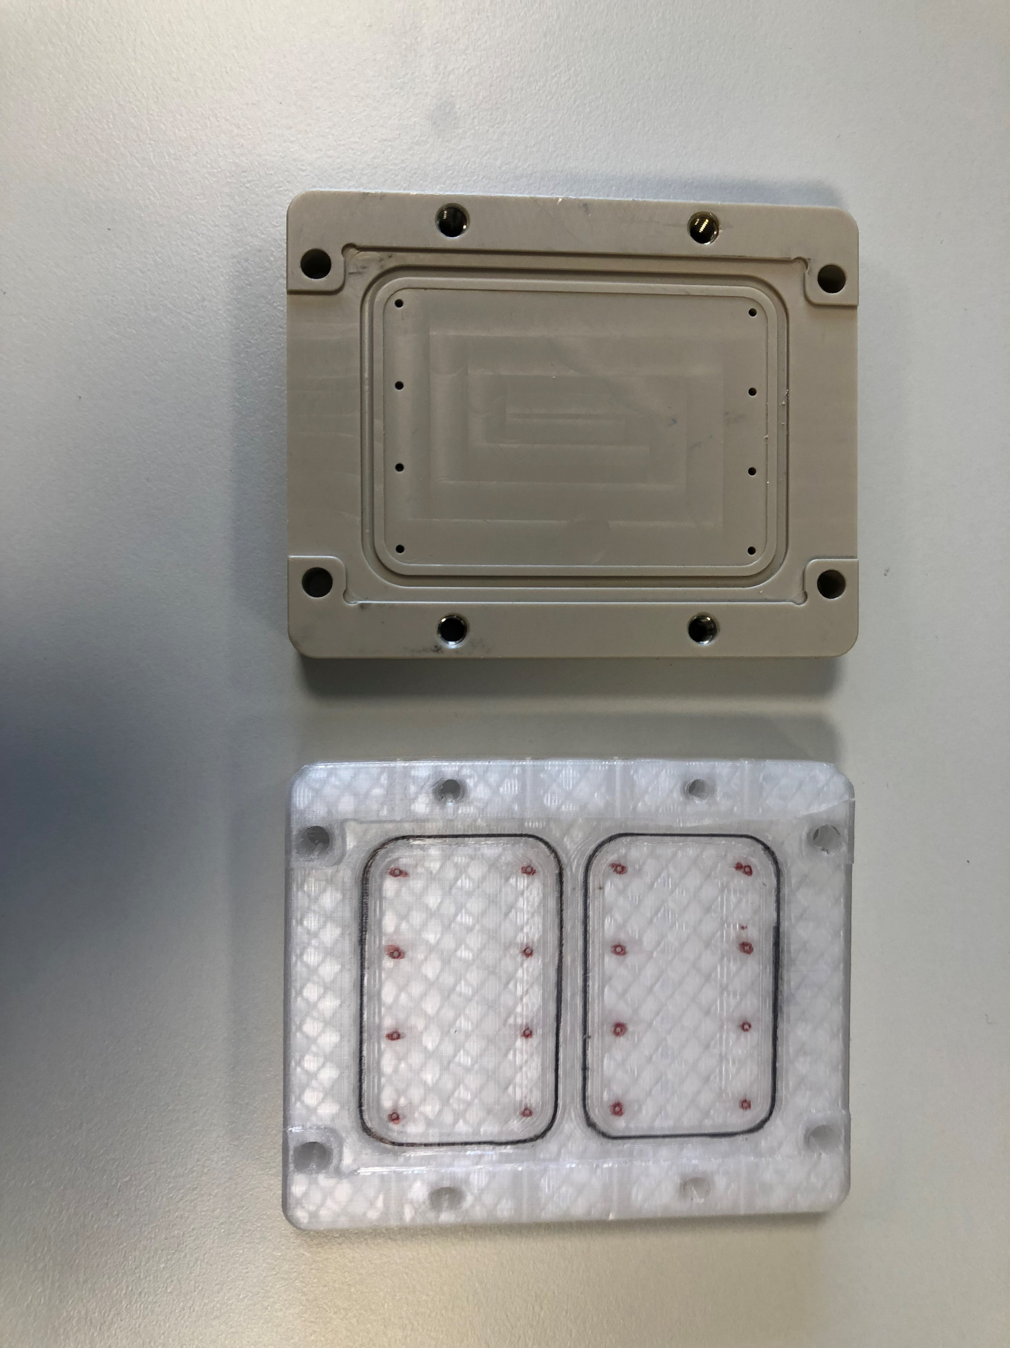
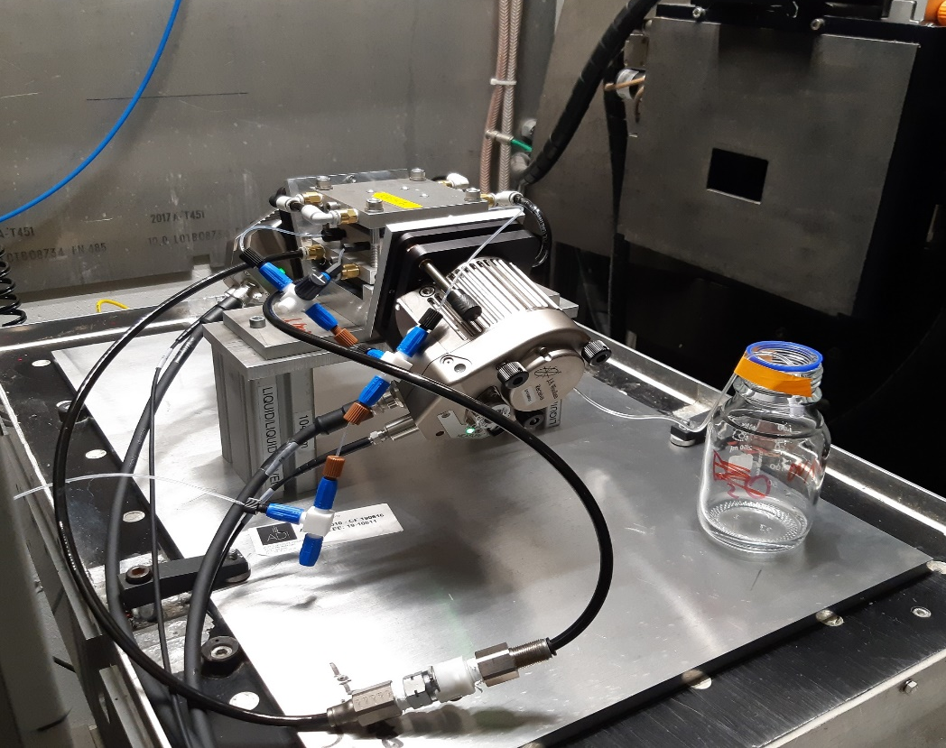
ESTIA – Sample Stage & Detector Arm
Sample stage
Sample environment additional projects
SPLICs: Nico Paracini at Malmö University/ ESS
Combined ATR-FTIR, Ellipsometry, NR: Prof. Thomas Ederth, Linköping University
Hexapod
Omega stage
Solid/liquid sample changer

Slide 25
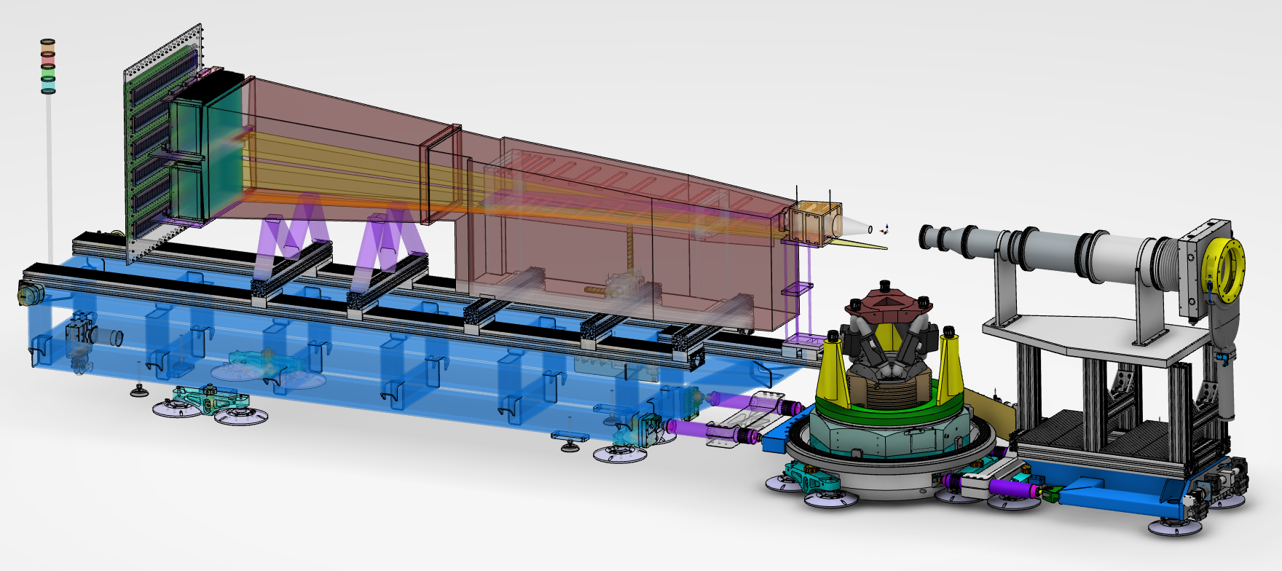
ESTIA – Sample Stage & Detector Arm
Detector Arm
Analyser ca be placed in and out side of the beam
Spin flipper design similar to MF
Design of the detector vessel in progress
Satisfying tests were performed on AMOR for detector prototype
A new detector (same design) will be installed on AMOR in Dec 2021

Slide 26
ESTIA instrument - Outlooks
Shipment of Selene 2 to ESS and finalisation of MF design
NBOA at ESS
Start of Common Electrical and Common Utilities Projects
Test of the Feeder & Chopper Pit Assembly at PSI
Finalisation of Sample Stage & Detector Arm design

Slide 27
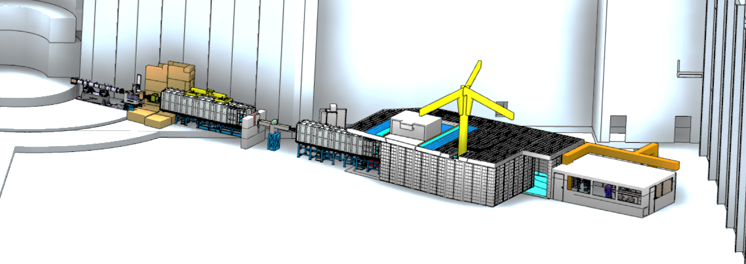
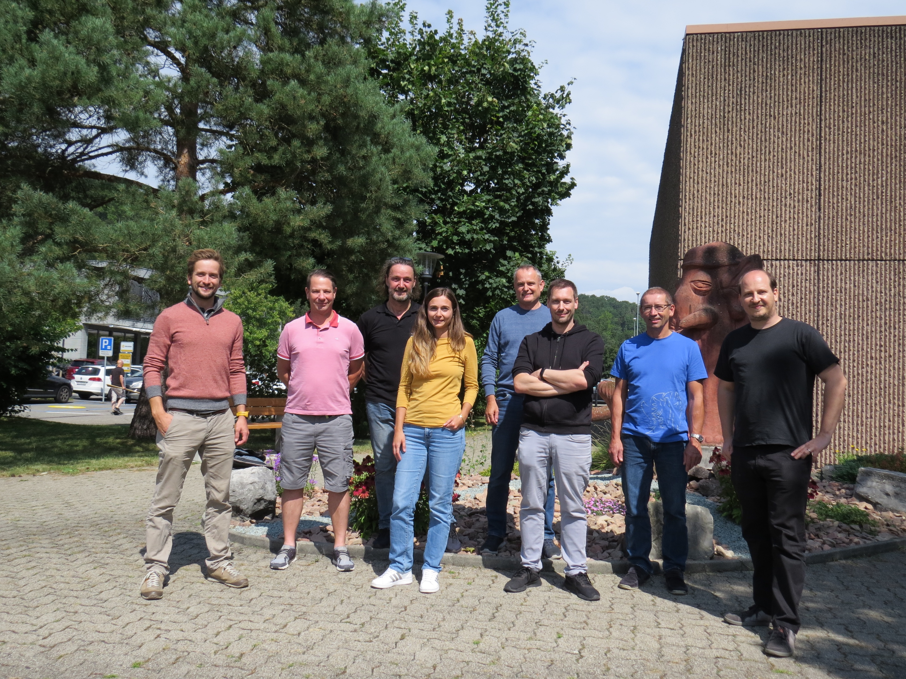
Thank you for your attention!
Any questions?
Page 27
Notes:
27

Slide 28
Risk Report
Current Top 5 Risks
Title | Severity | Category | Responsible | Response | Trend
Activation Analysis | 12 | Cost | PSI | Avoid | Steady
Common Utilities Project | 9 | Schedule | ESS | Observe | New
PSS standards | 9 | Schedule | ESS | Observe | New
Experimental Cave delivery | 6 | Schedule | ESS |  | Falling
Communication to ESS | 6 | Schedule | ESS | Reduce | Steady
09.03.2021 - Top 5 Risks
Title | Severity | Category | Responsible | Response | Trend
Installation Resources | 16 | Schedule | ESS | Avoid | Steady
Activation Analysis | 12 | Cost | PSI | Avoid | Steady
Communication to ESS | 12 | Schedule | ESS | Reduce | Falling
PSI / ESS scope transfer | 8 | Schedule | ESS |  | Falling
Shared shielding ESTIA/Skadi | 4 | Schedule |  |  | Falling

Slide 29
Financial Report

