Slide 1

Multi-Blade detector status
Francesco Piscitelli
2021/10/12

Slide 2
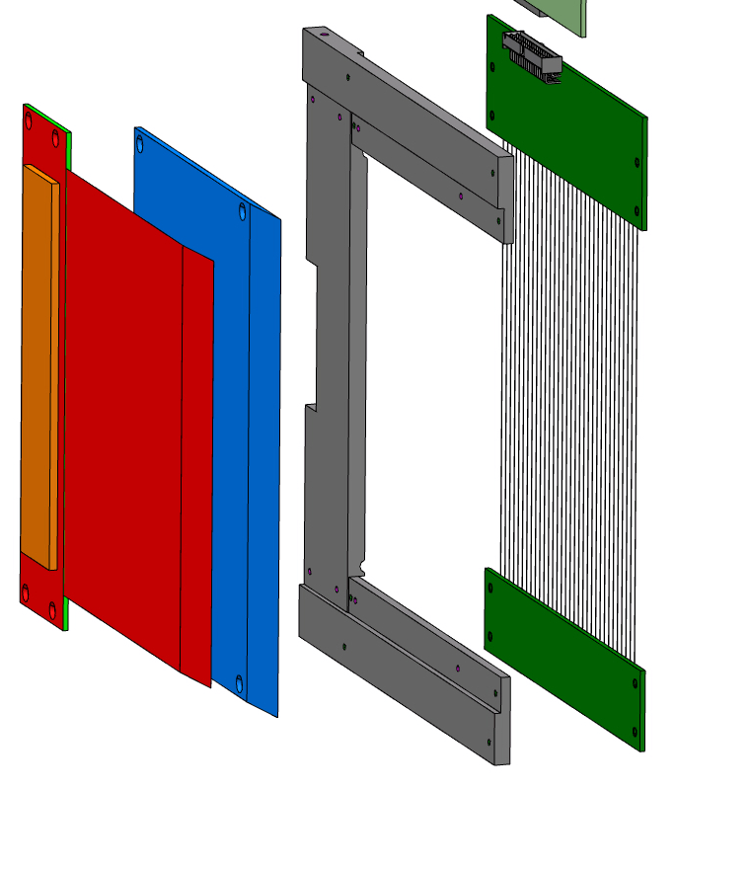
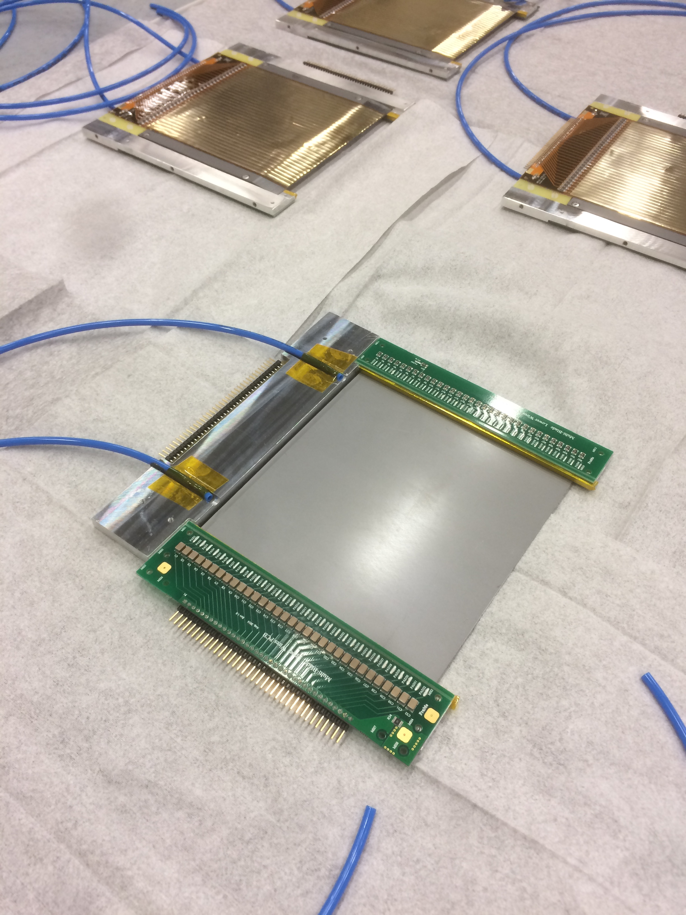
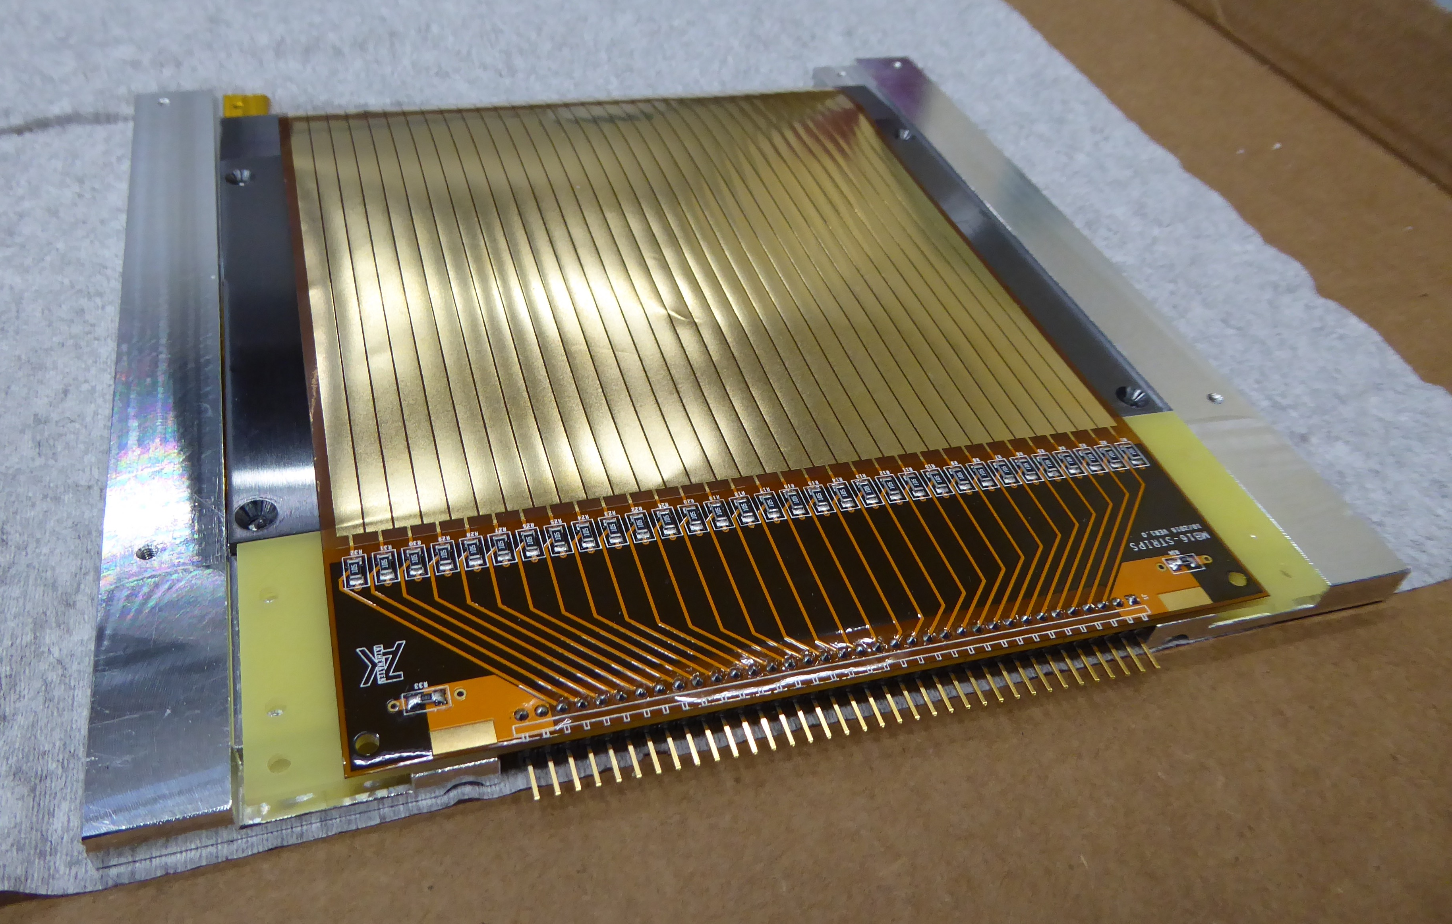
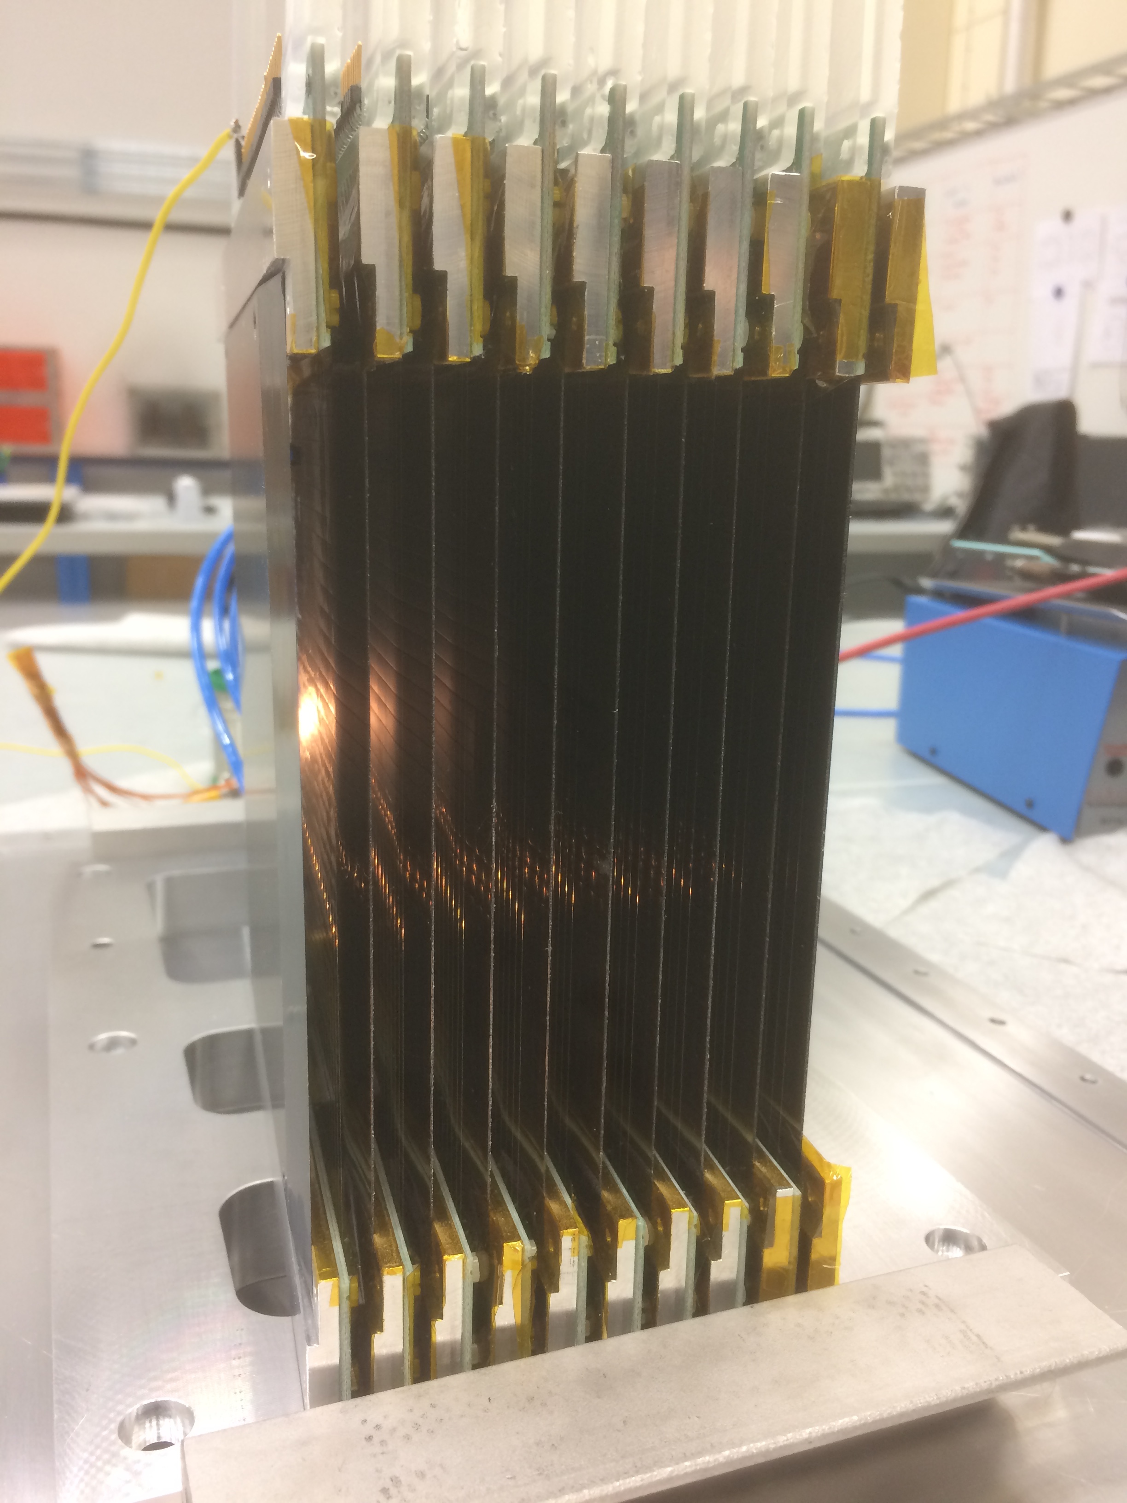
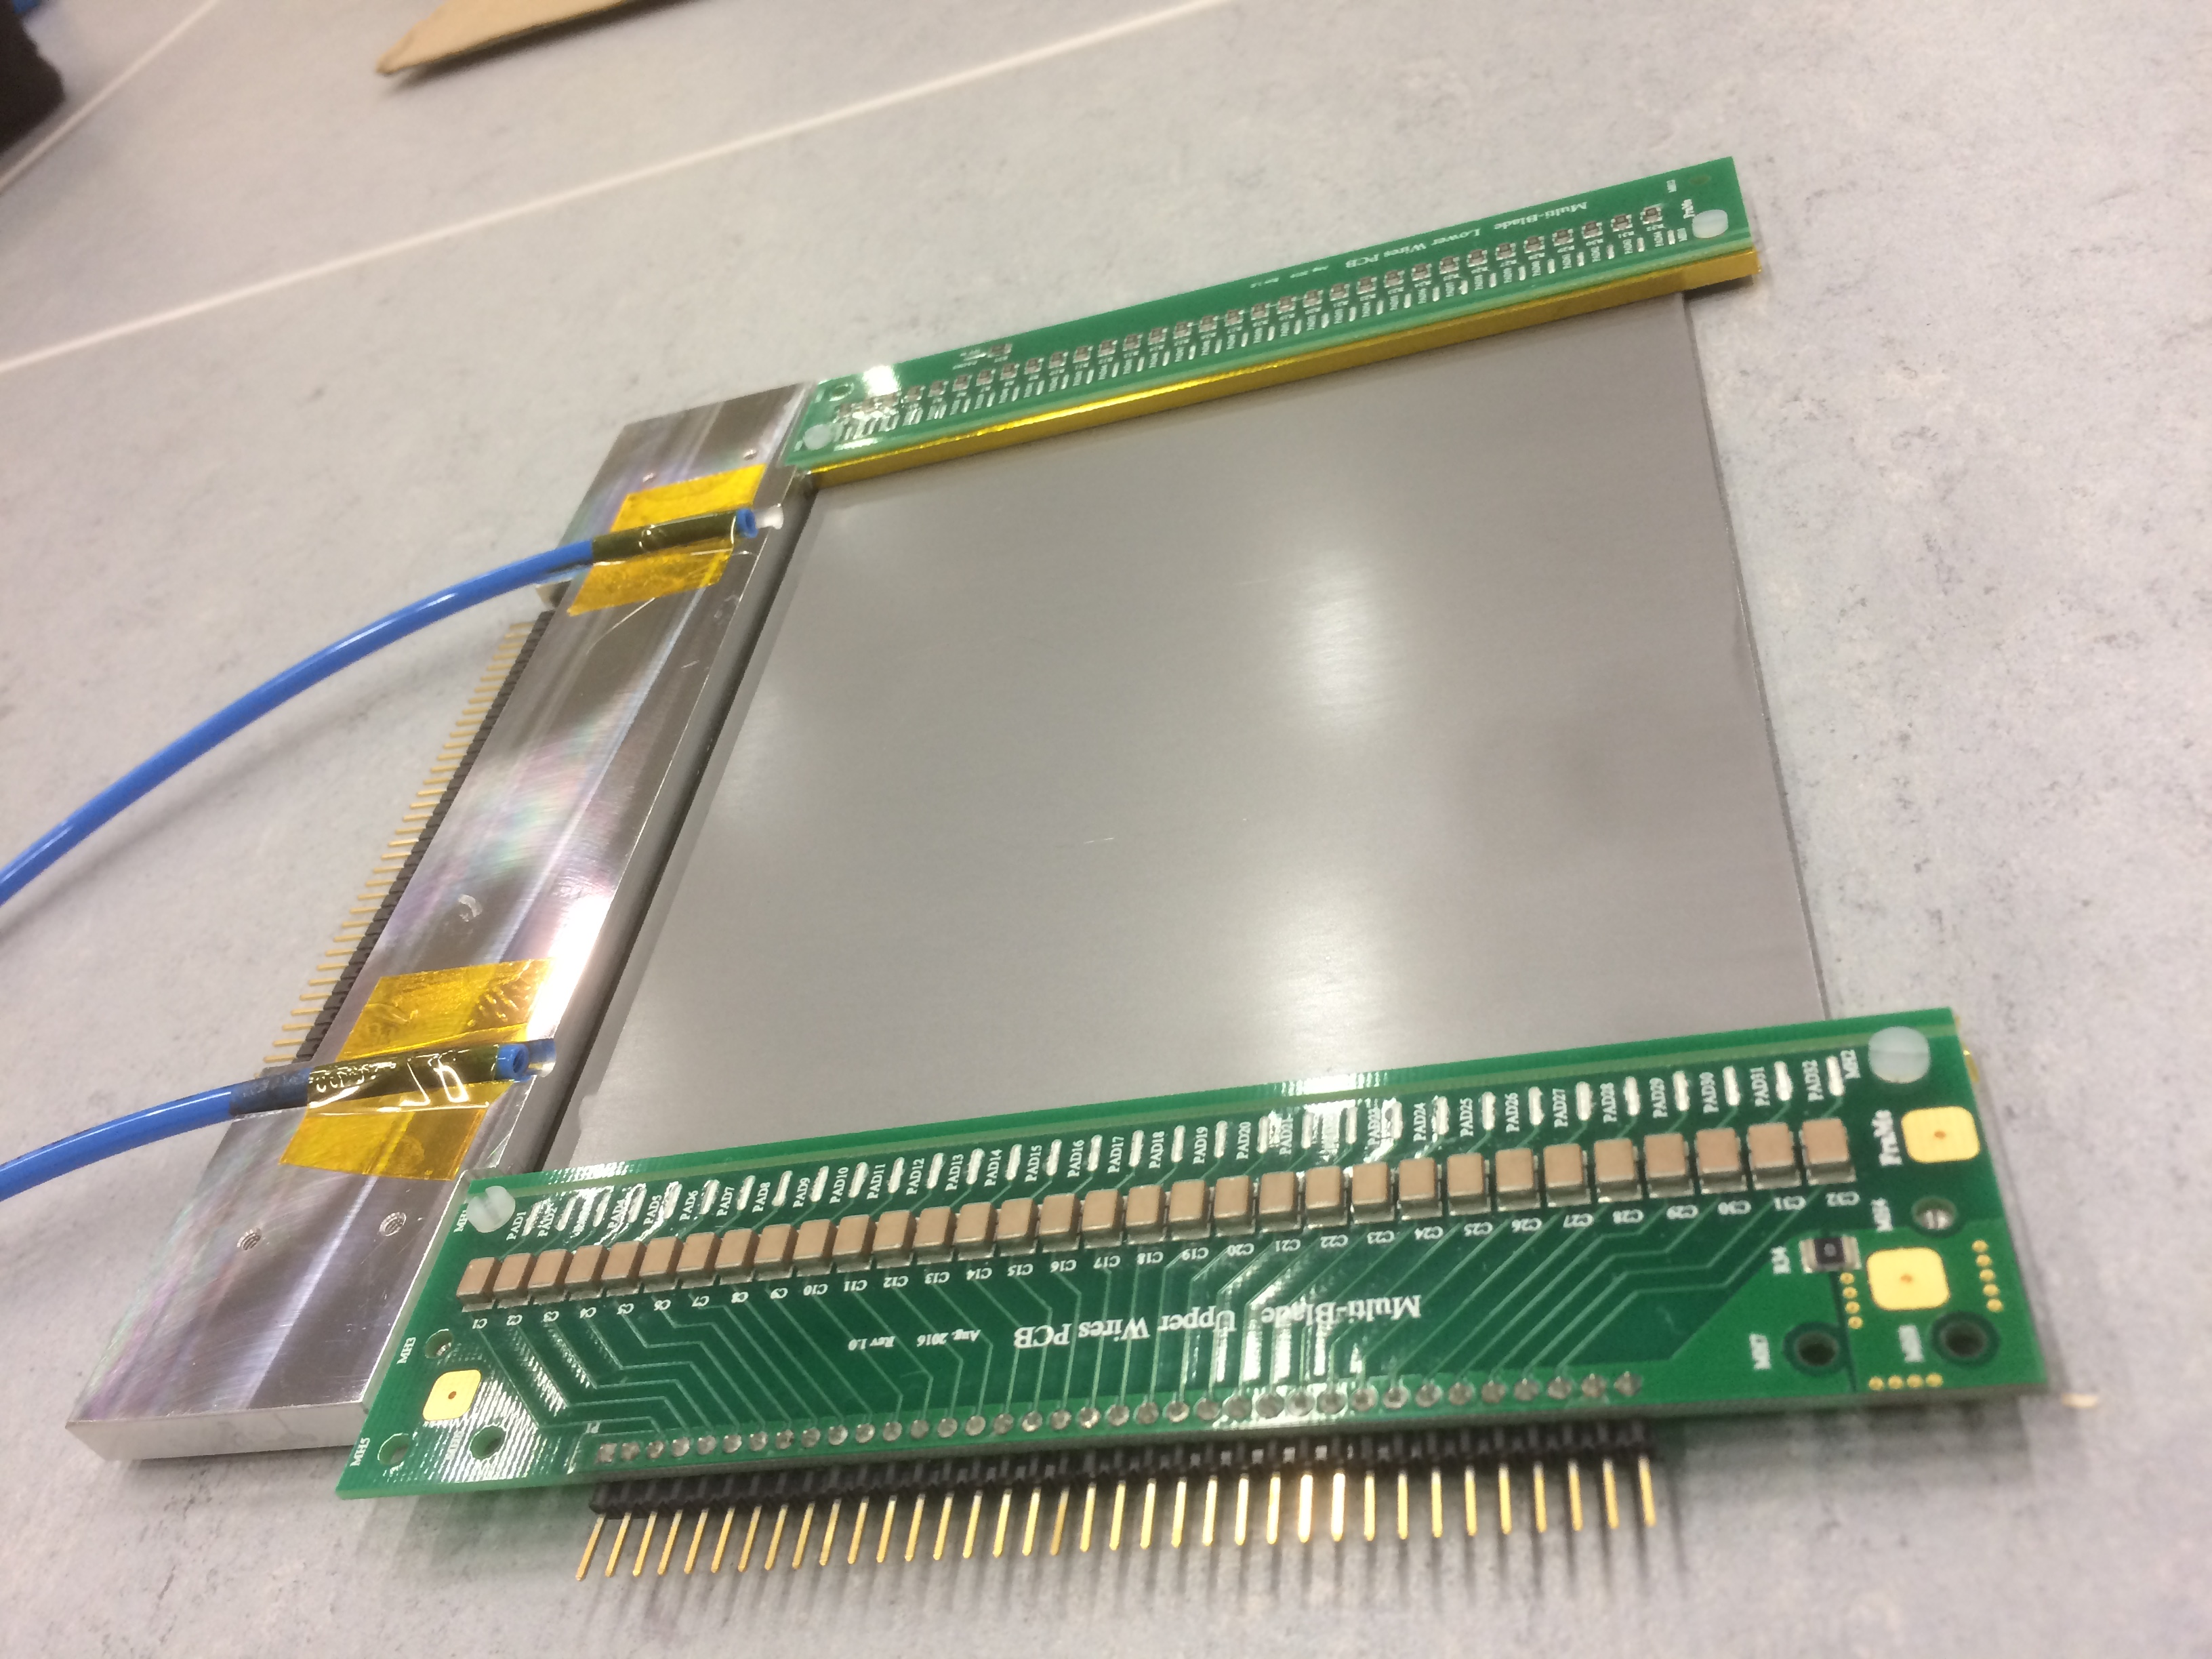

wires X
¹⁰B₄C substrate
Ti substrate
¹⁰B₄C
holding frame
neutrons
strips Y
cathode strips
anode wires
θ
A unit
A unit
θ = 5 degrees
Unit
back
32 Wires
MWPC
130mm
Unit
front
neutrons
100mm
neutrons
Multi-Blade
sample

Slide 3
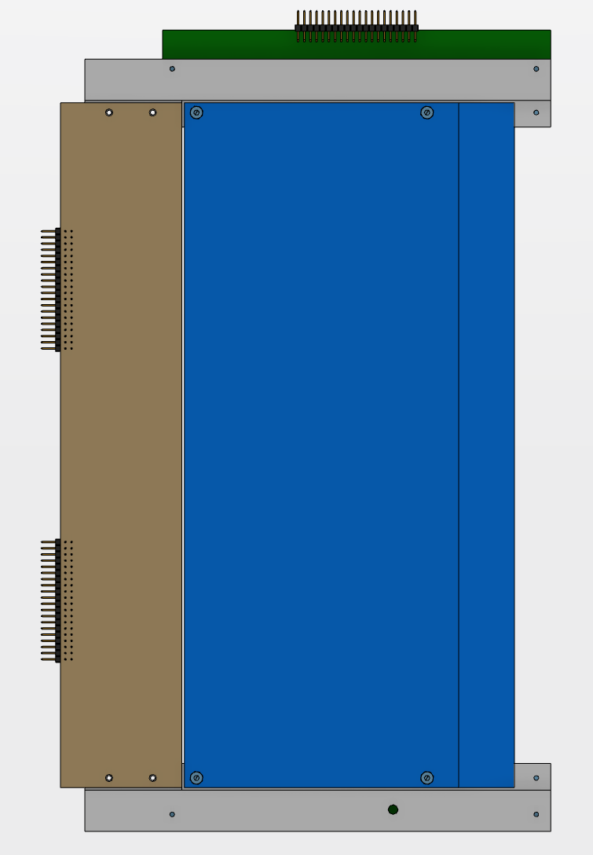
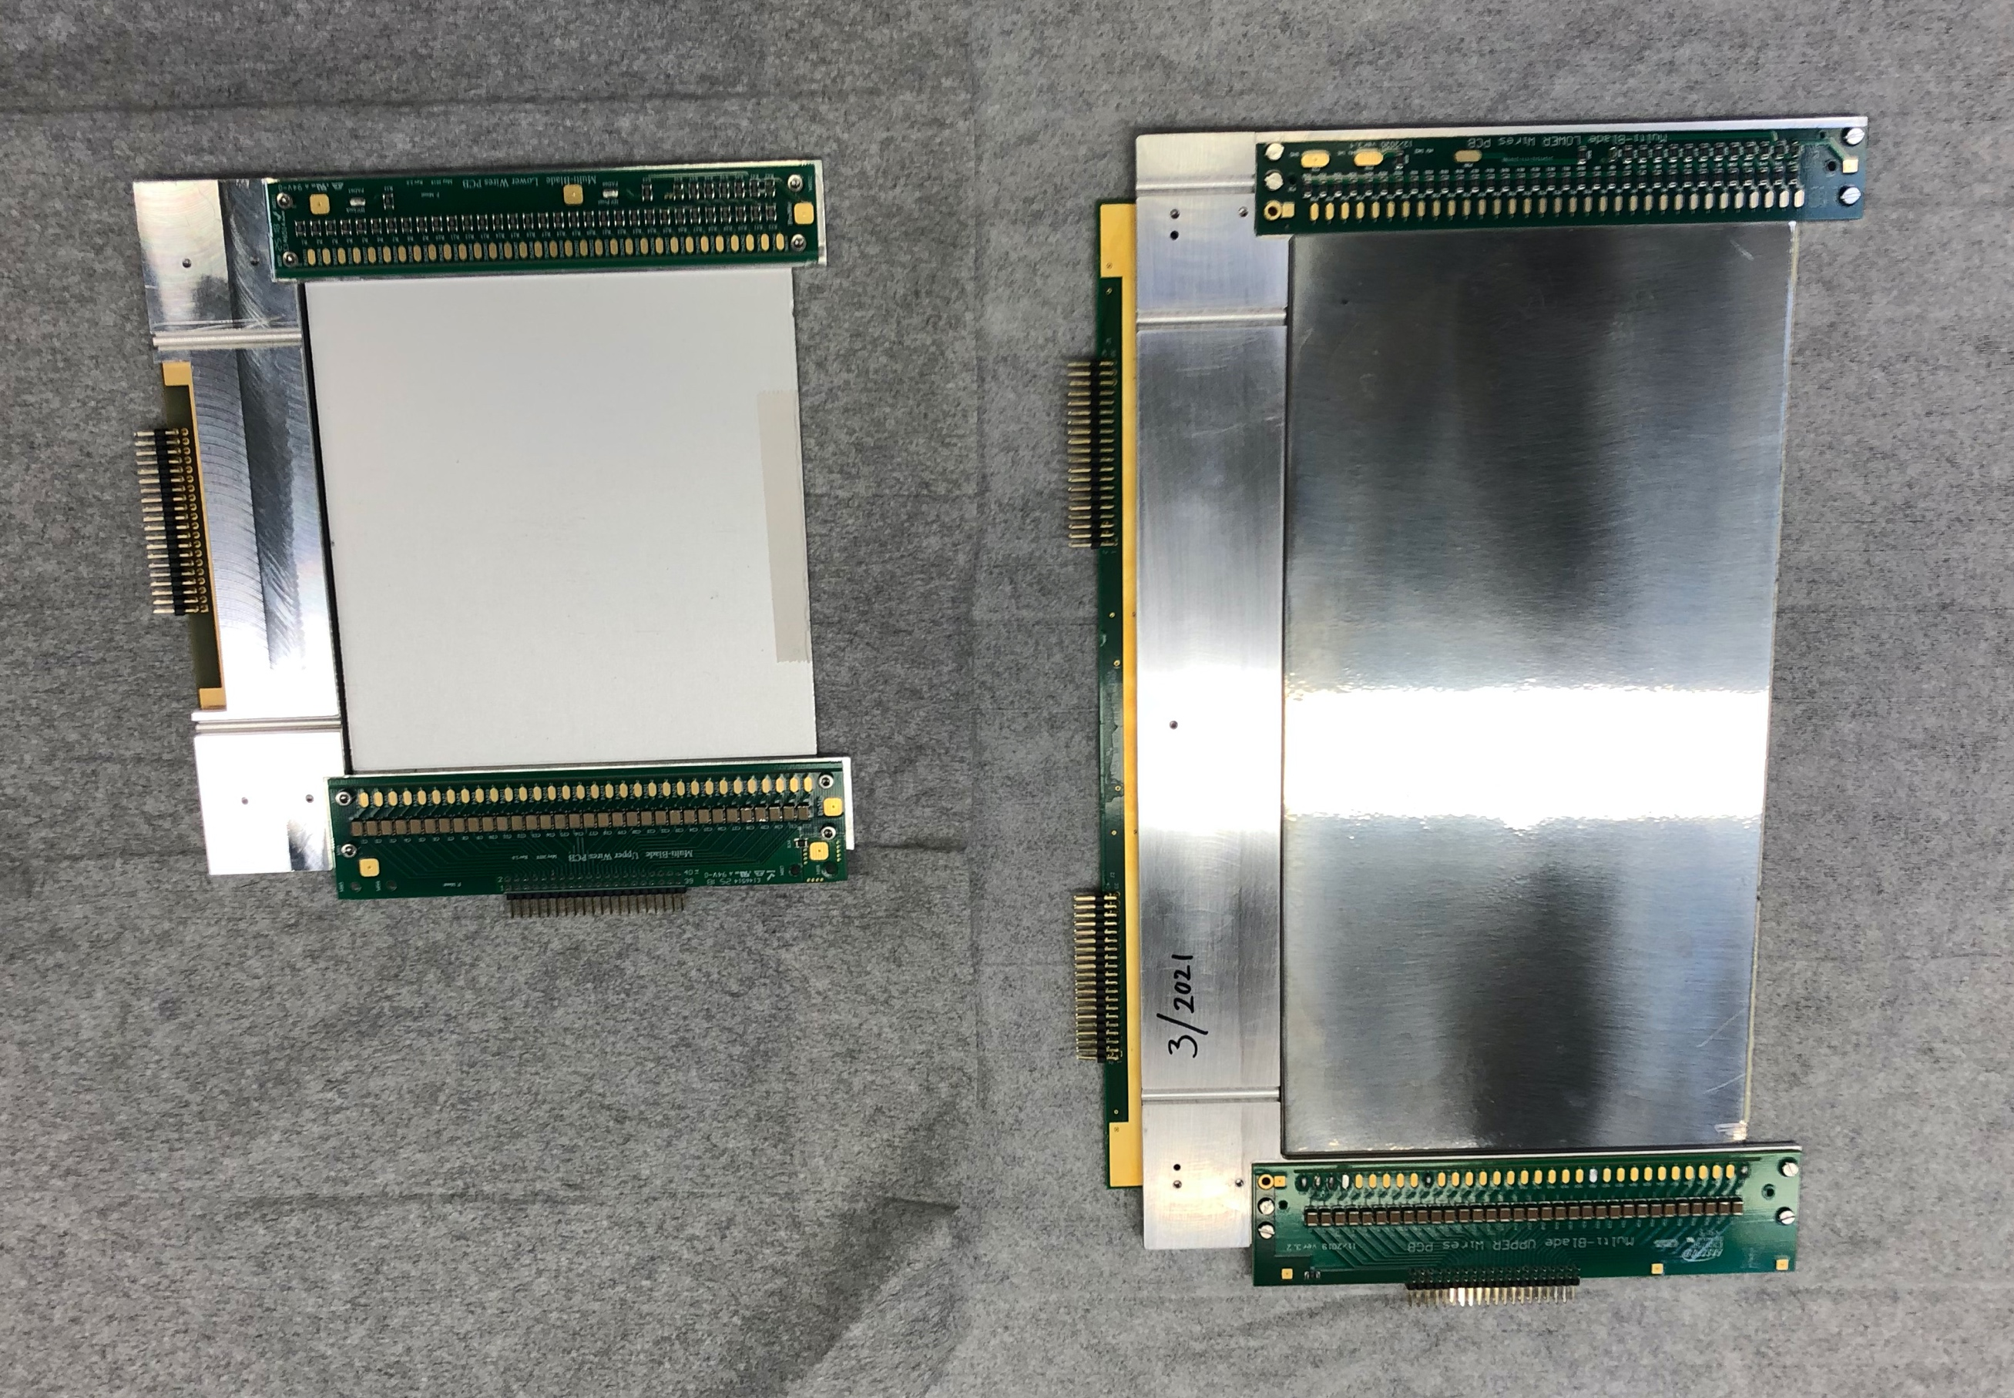
Multi-Blade
AMOR 14 units
Estia 48 units
FREIA 32 units
ALL IDENTICAL
Final unit
prototypes
130mm
260mm

Slide 4
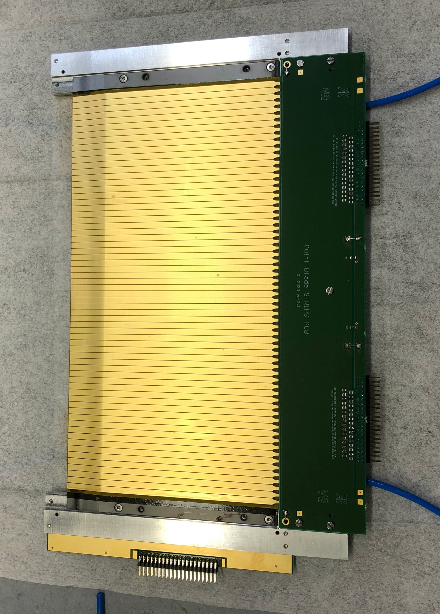
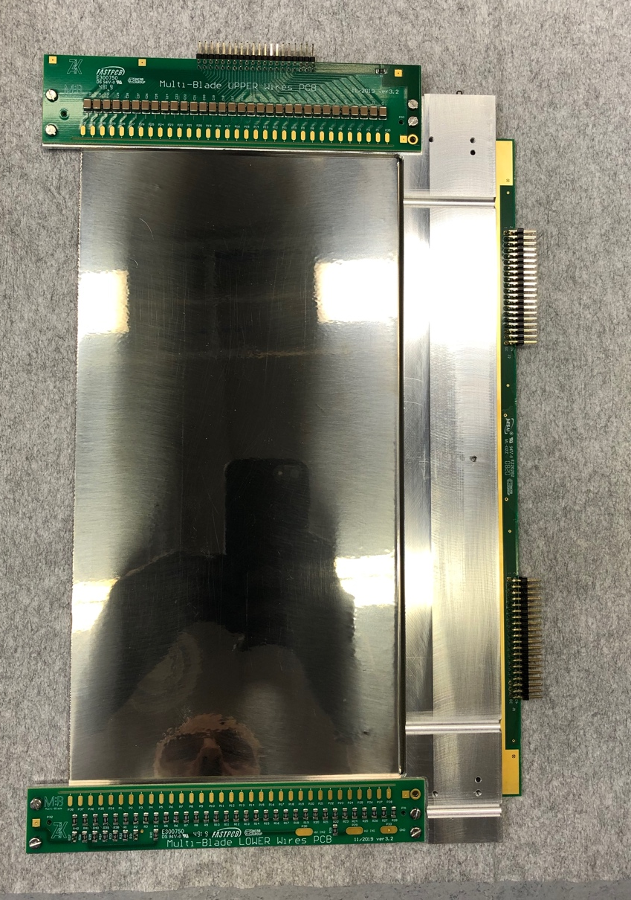

Final unit
Ti blade coated with 10B4C
cathode strips
anode wires
U-frame
260mm
FRONT
BACK

Slide 5
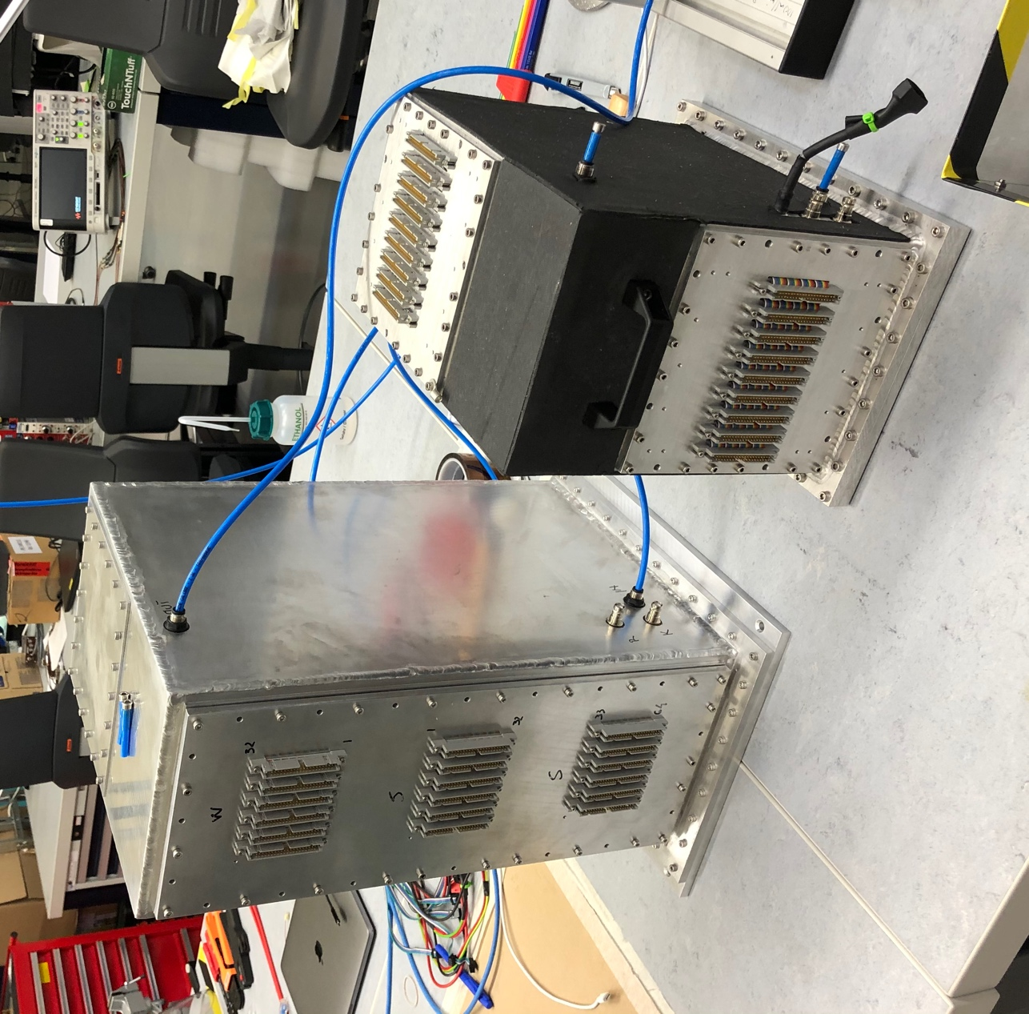
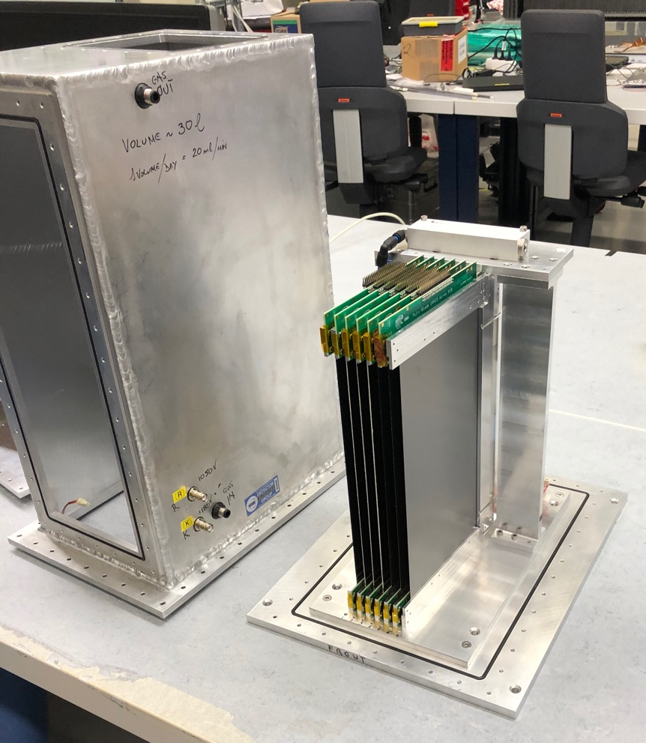
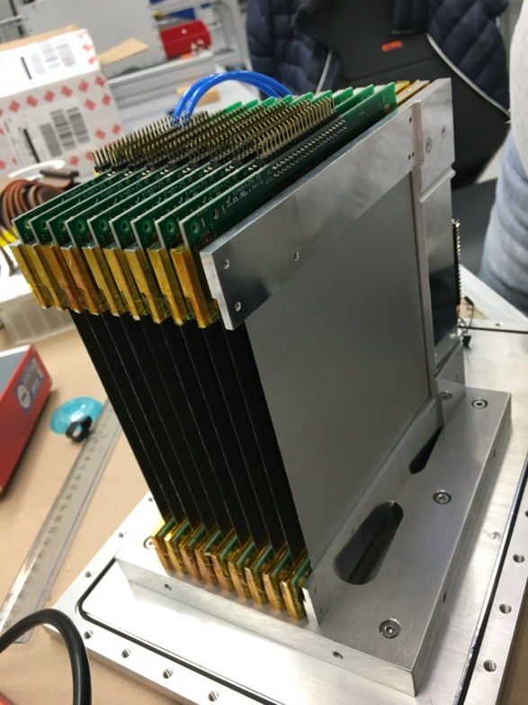
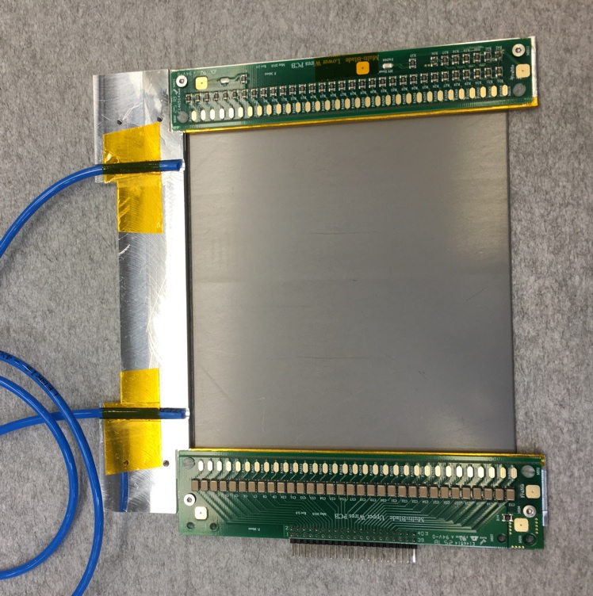
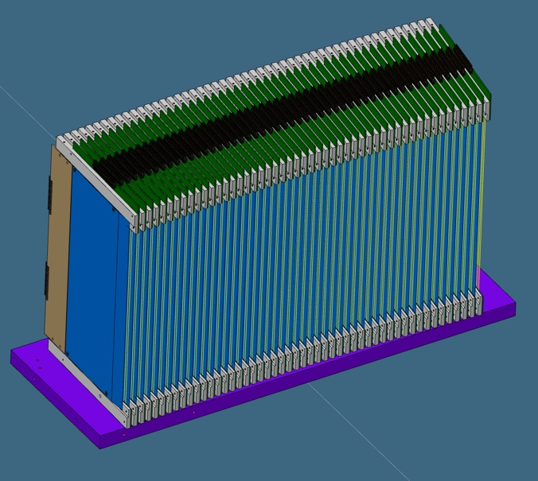
MB300L
MB18
6-unit full length detector
9-unit detector
(half length)
260mm
48-unit detector
Estia and FREIA
use the same 260mm units:
48 for Estia, 32 for FREIA, 14 for AMOR
130mm

Slide 6
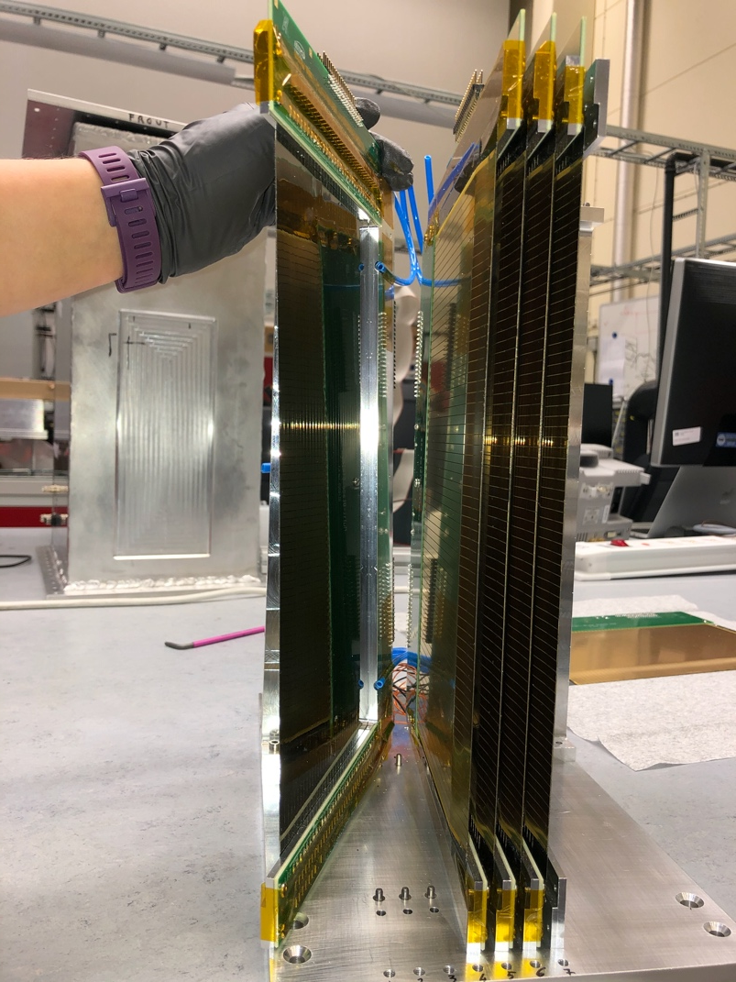
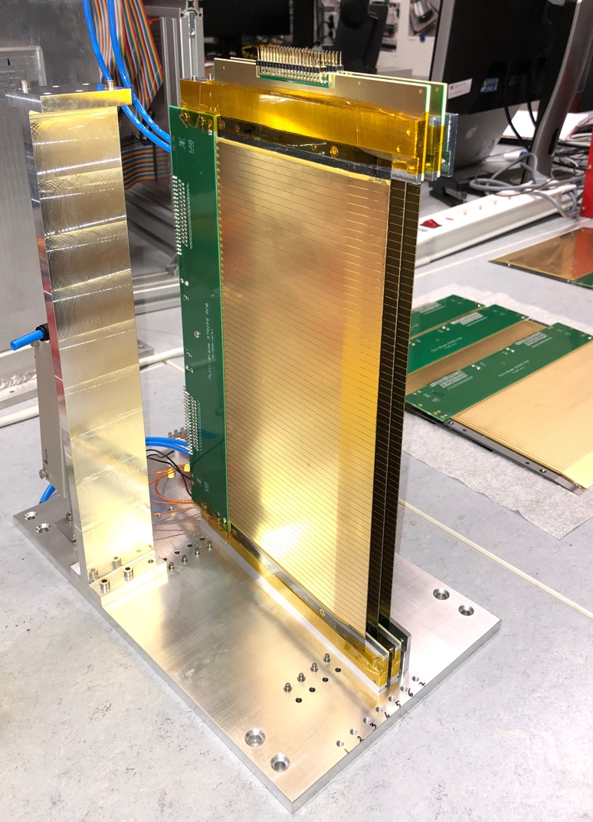
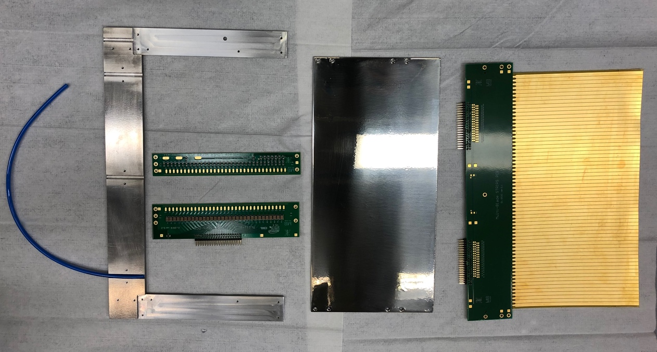
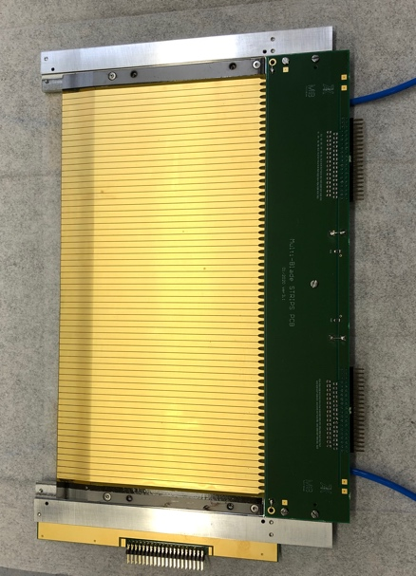
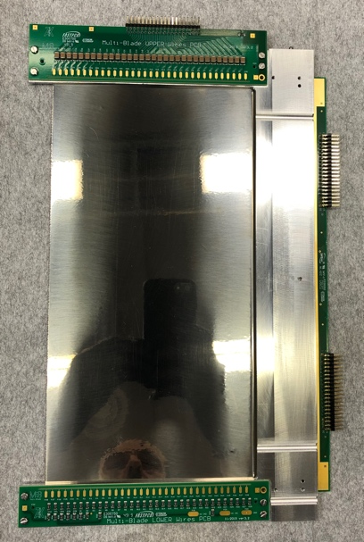
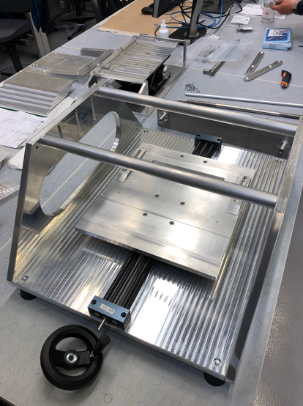
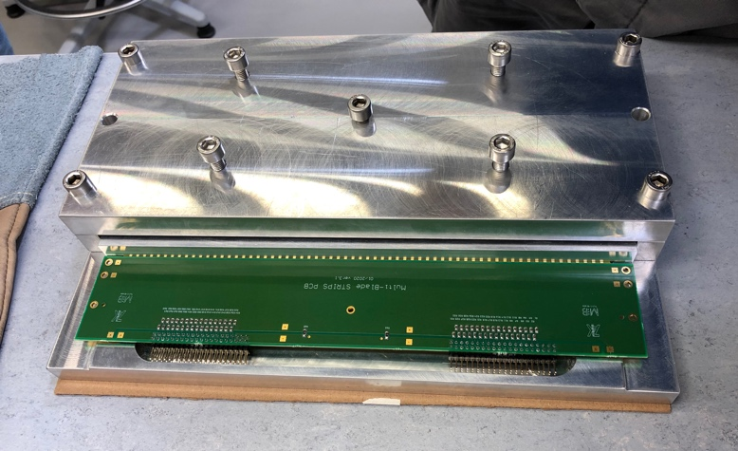
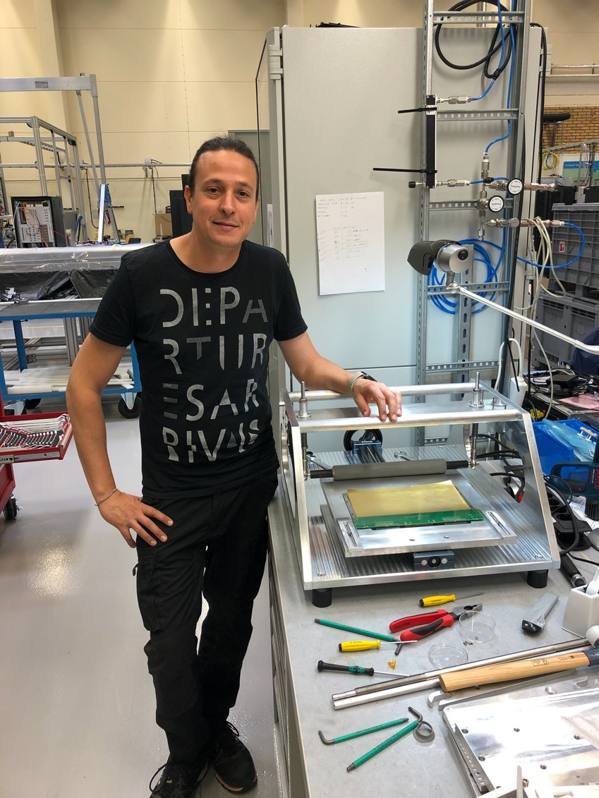
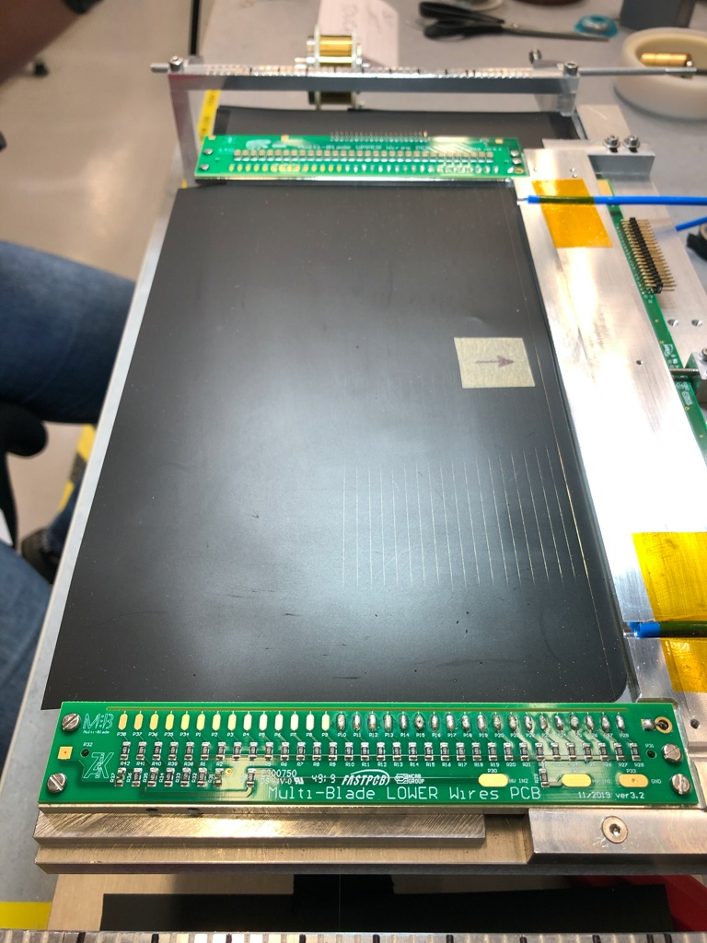
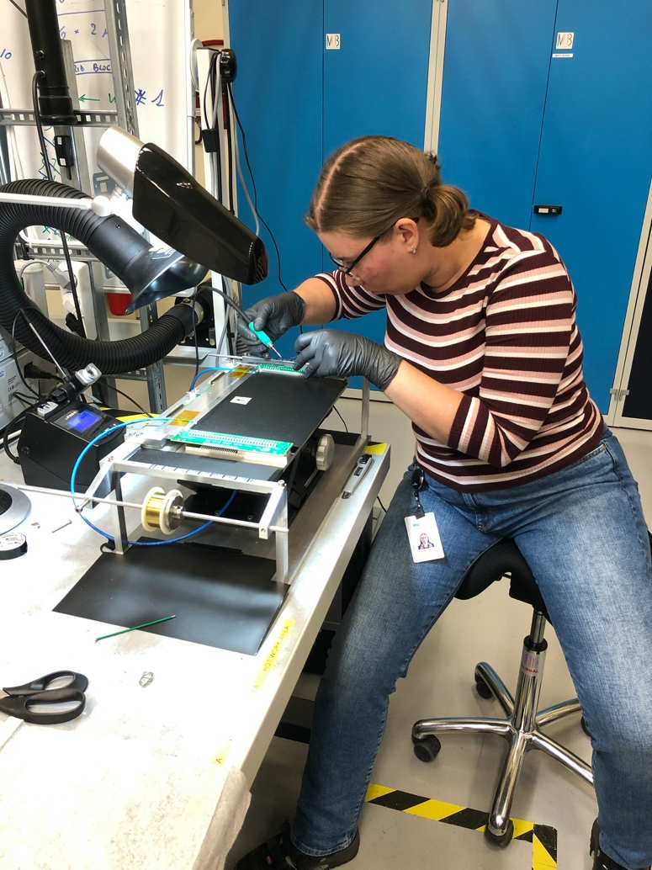
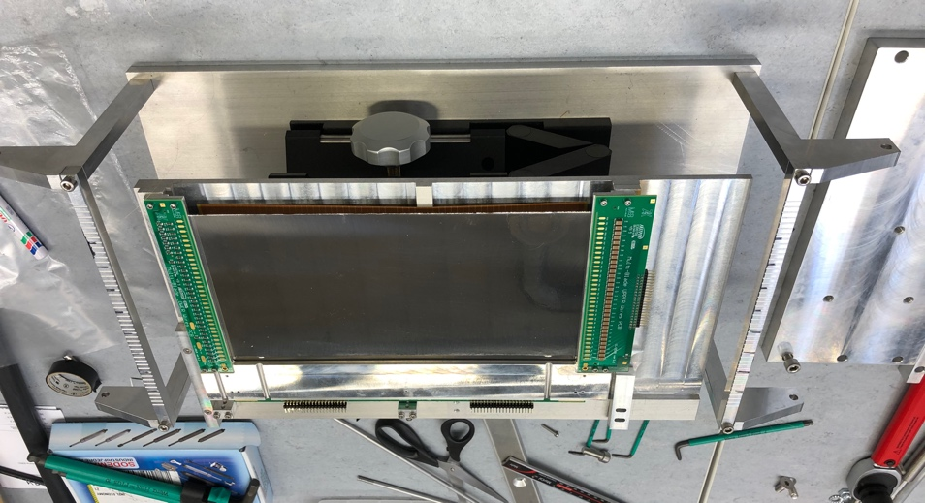
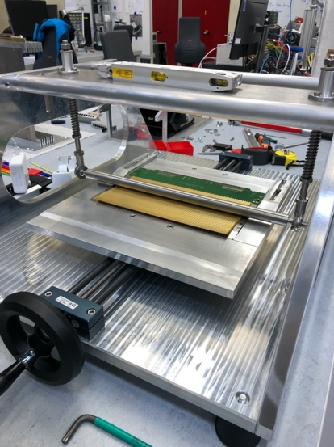
Multi-Blade: TOOLING is complete and tested on MB300L
parts
A unit
cathode strips
Gluing machine KV-1
Oven clamp
6-unit detector
Wiring machine K-7

Slide 7
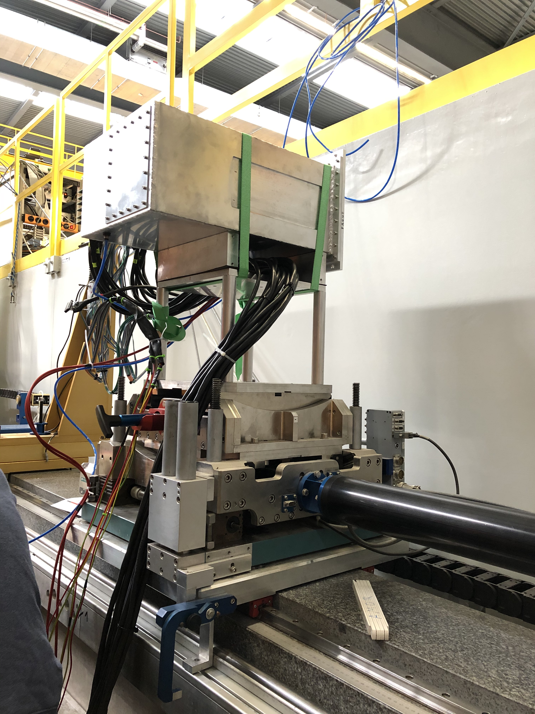
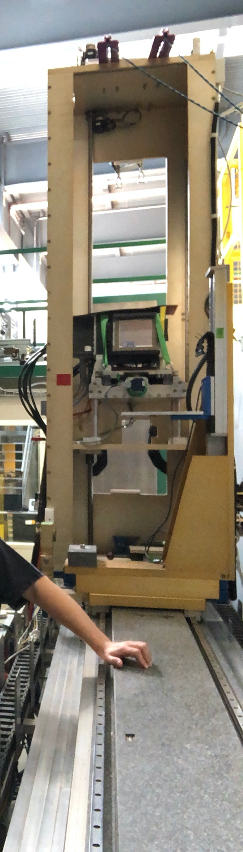
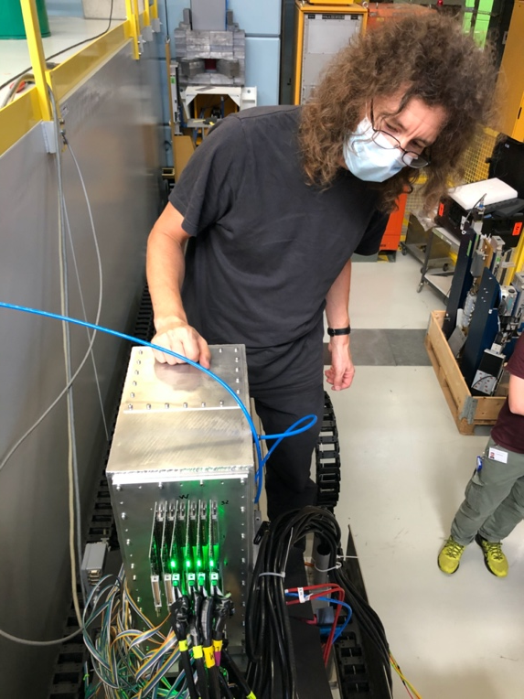
AMOR reflectometer @ PSI
MB18 permanently installed at AMOR since Sept 2020 for the commissioning of the beam line and for friendly user operations.
MB300L Tested at AMOR
MB300L
MB18
Many thanks to
Jochen Stahn
for the support

Slide 8
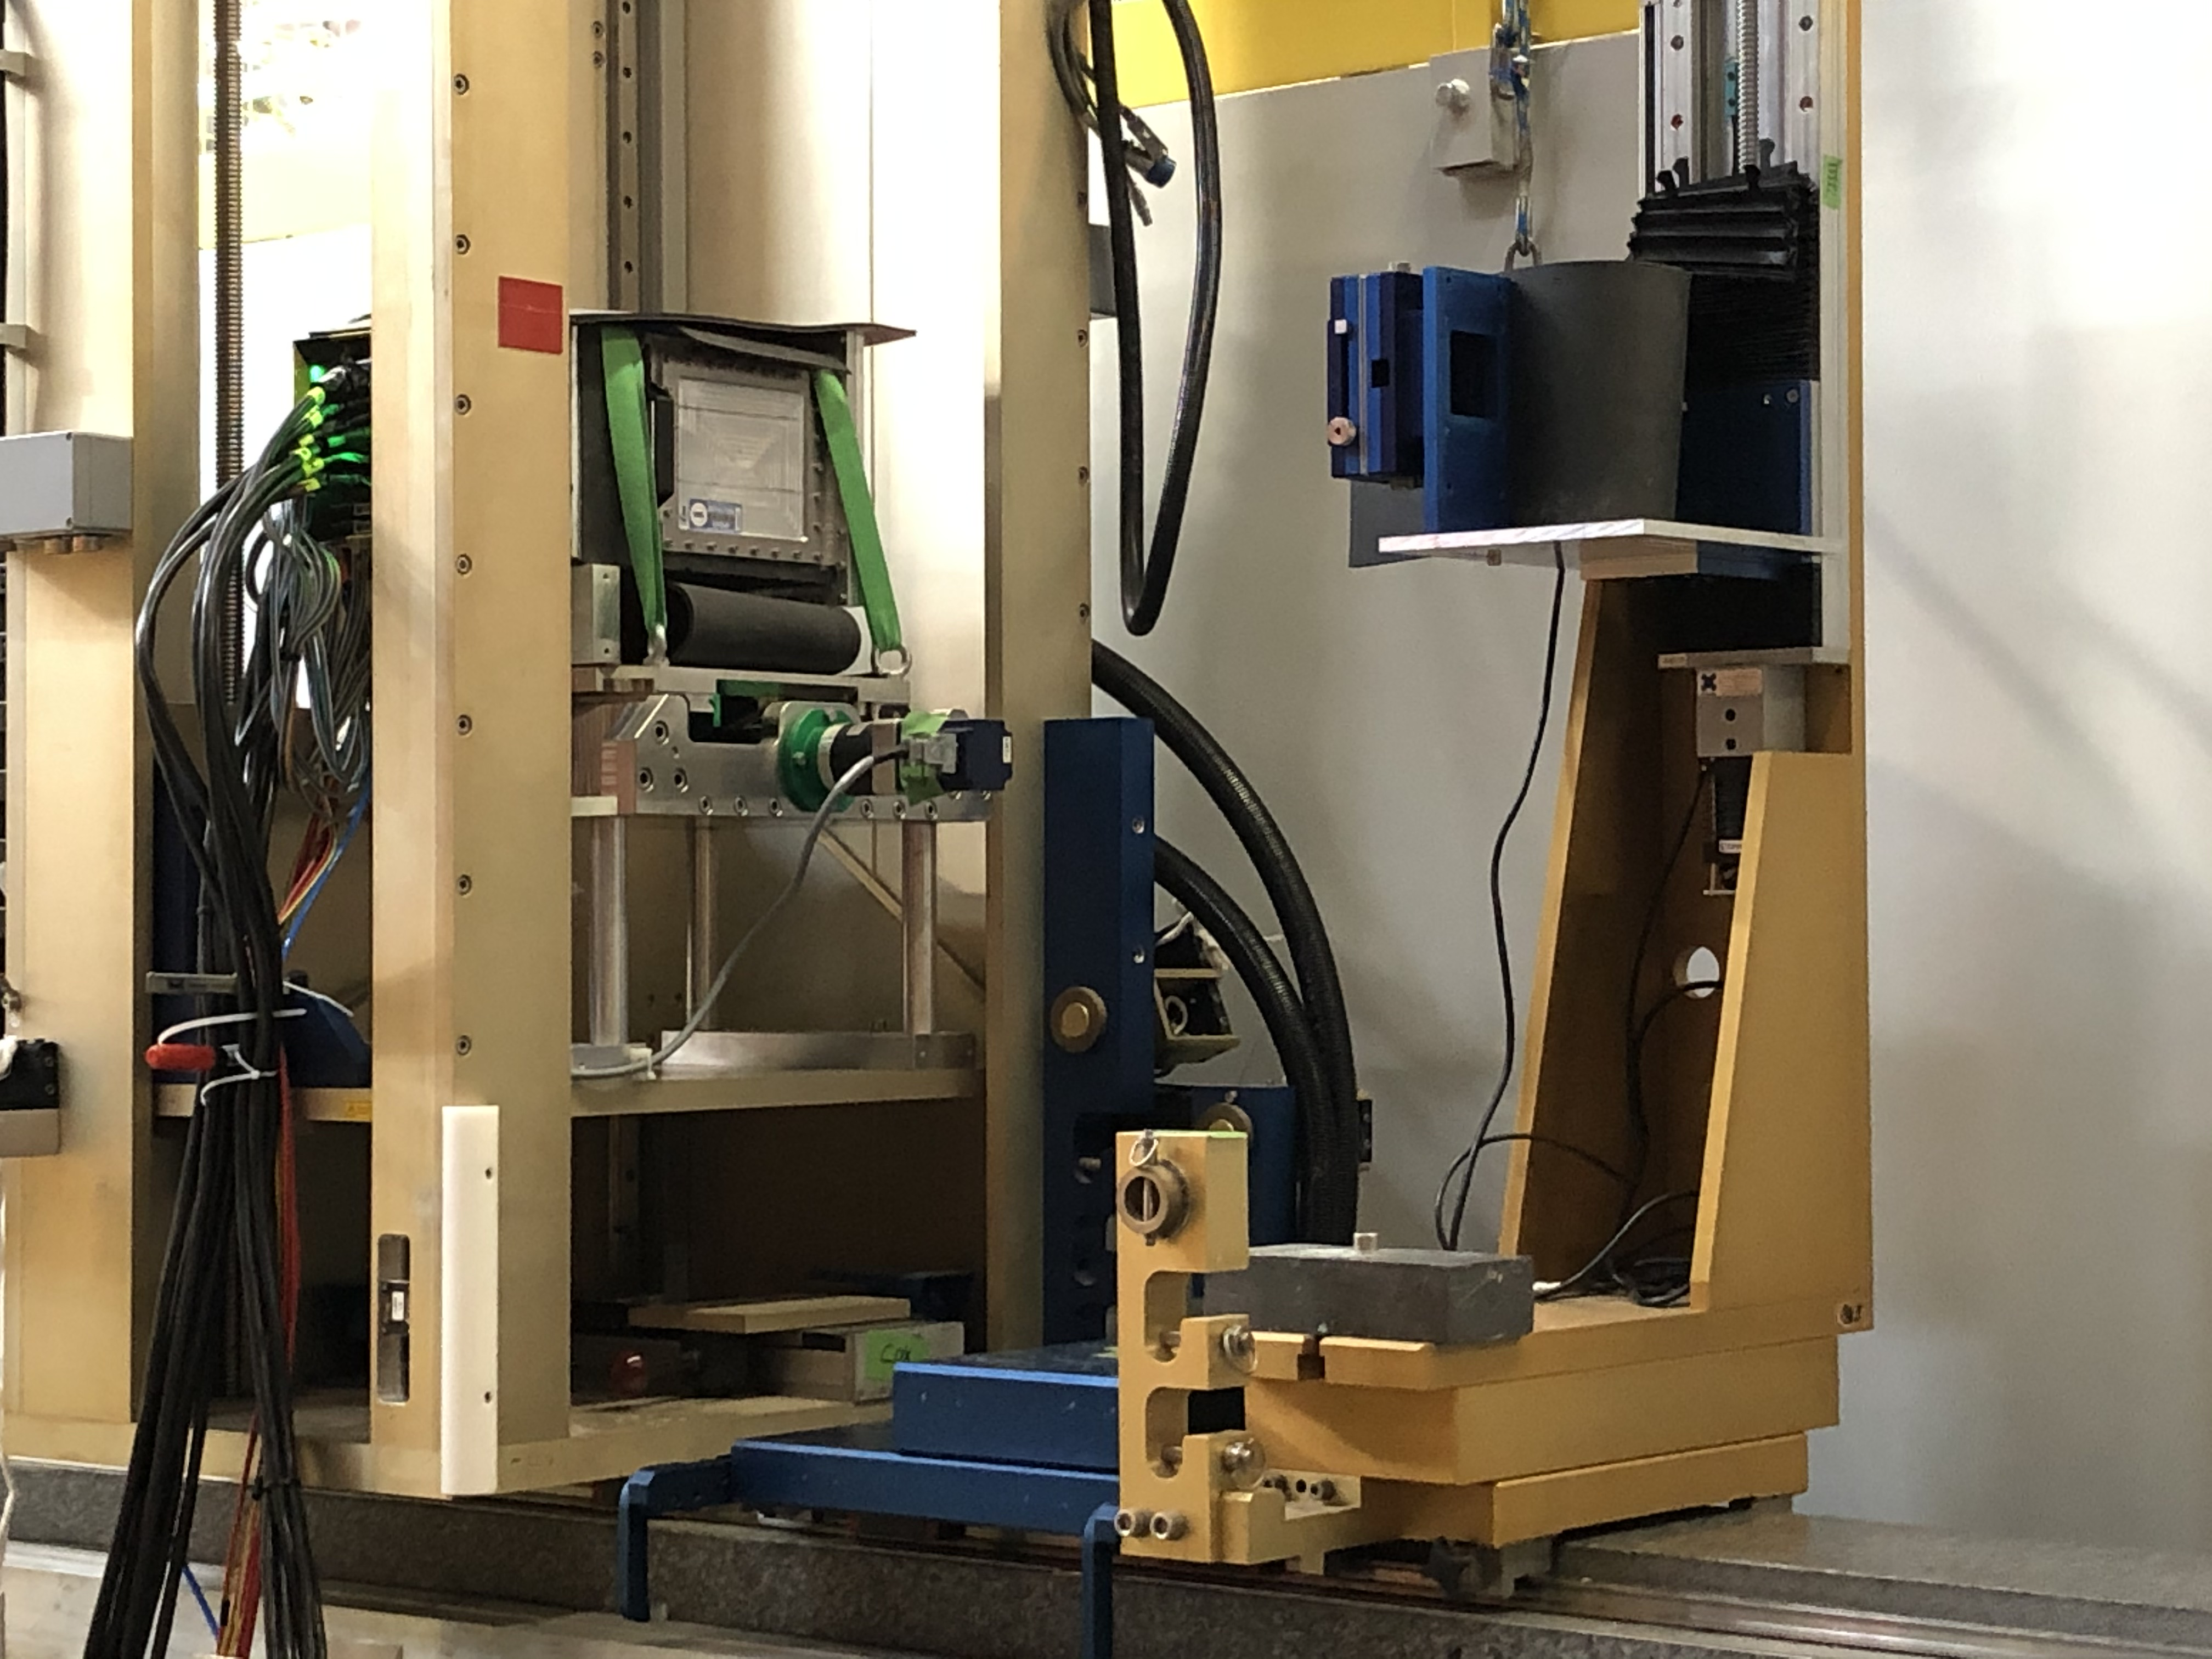
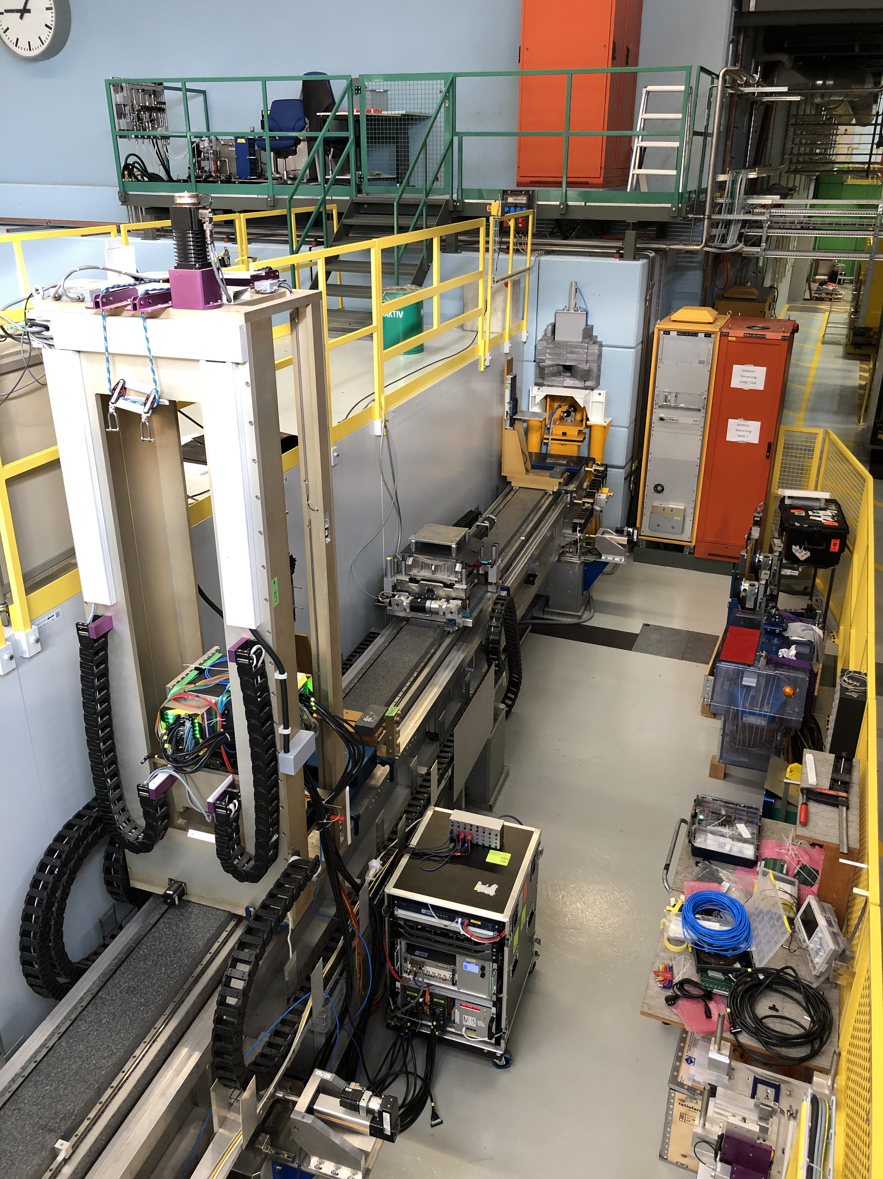
Tower
MB18
MB18

Slide 9
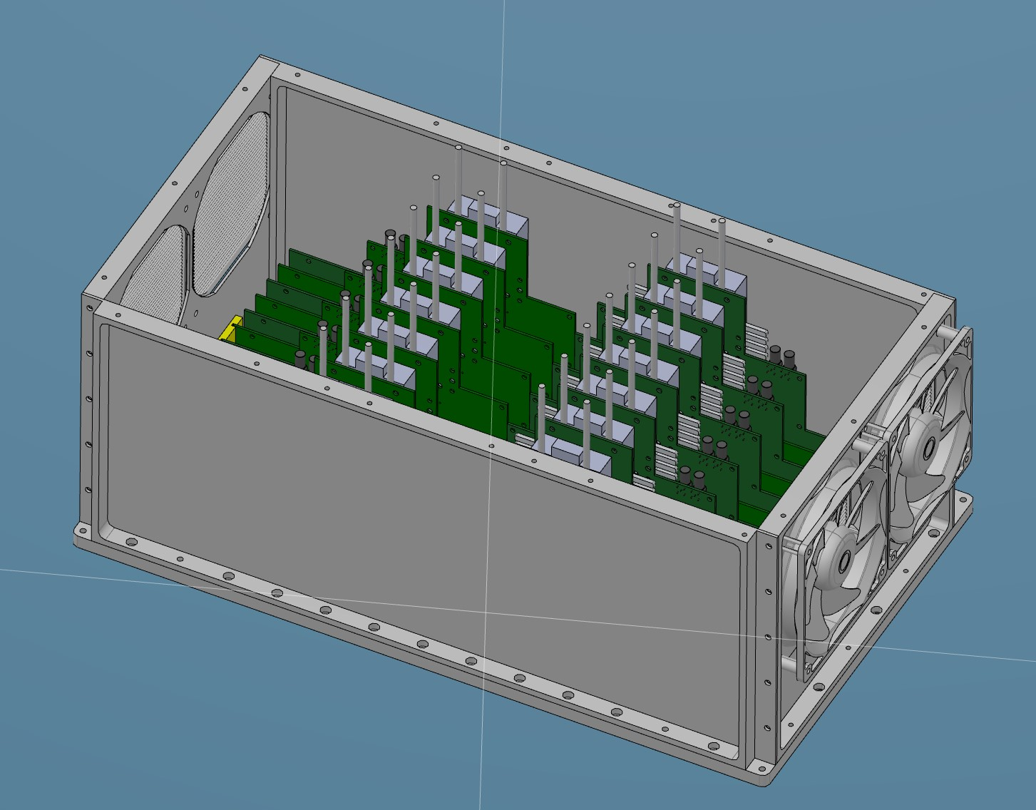
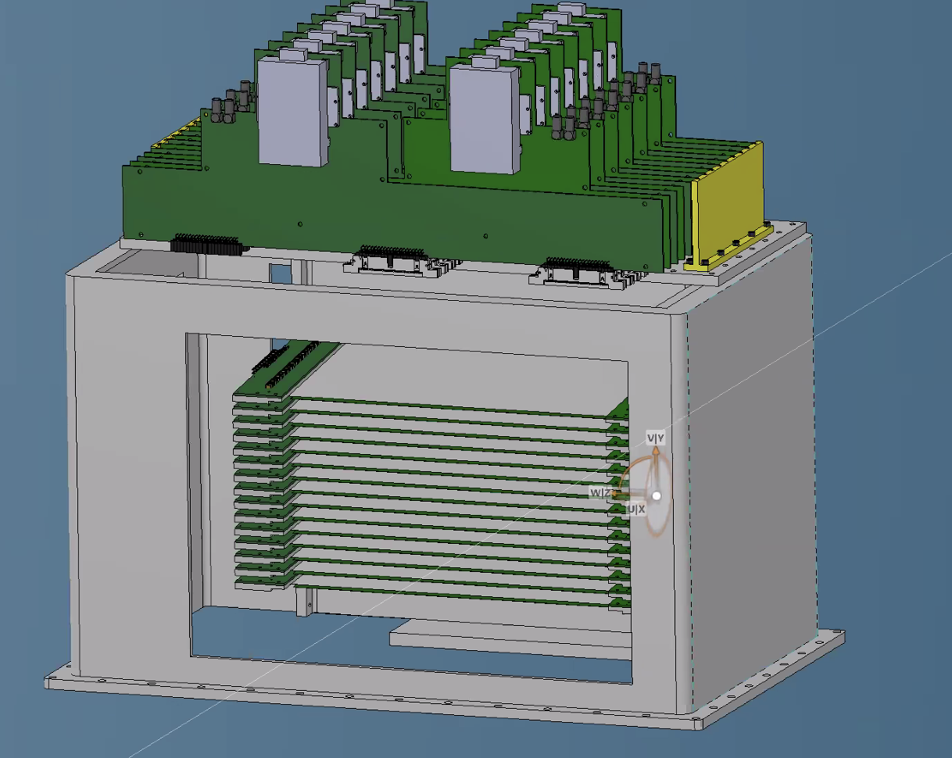
14 UNIT DETECTOR FOR AMOR, SAME UNITS AS ESTIA AND FREIA, SAME ELECTRONICS
This is the front end electronics, there is a box with fans to encapsulate them
BLADES
~340mm
Installation Dec 2021
neutrons
532mm
330mm

Slide 10
SCATTERING ISSUE AT EDGE

Slide 11
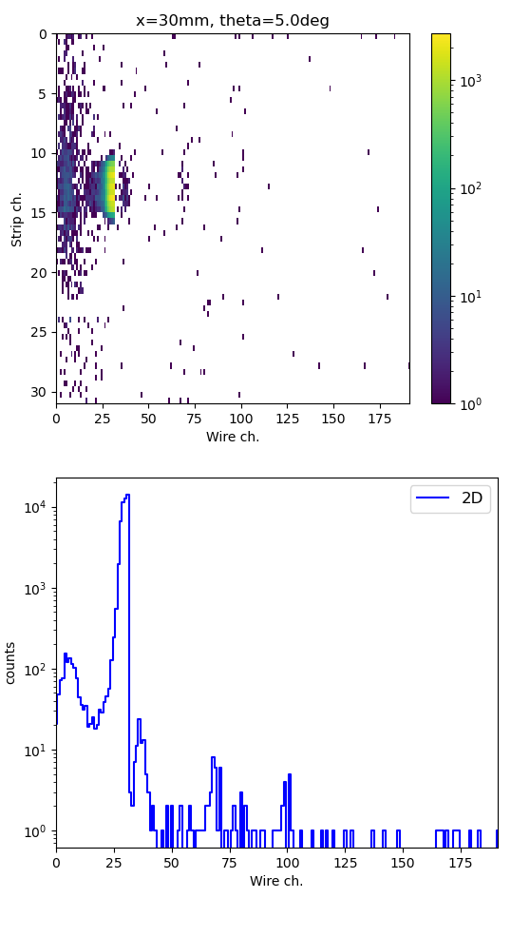
Scattering happening at the PCB below the edge
wires X
substrate
¹⁰B₄C
neutrons
strips Y
θ
A cassette (unit)
No clear evidence that this effect will cause a visible
effect on the scientific output of a measurement
It is happening only under very specific circumstances

Slide 12
All aspects matching the requirements and scientific measurements performed,
Last issue solved this year
wires X
OLD BLADE
substrate
¹⁰B₄C
neutrons
strips Y
θ
5.0∘
A cassette (unit)
neutrons
Scattered neutrons
5.0∘
Solution 1: GdOx at edge
THIS DID NOT WORK!
NEW BLADE
2.5∘
Solution 2: Blades edge at 2.5deg instead of 5deg

Slide 13
Centre of blade
Explicitly wrong lower incl.
1 deg off
Nominal
Explicitly wrong higher inclination
4.0∘
5.5∘
5.75∘
5.0∘
5.0∘
OLD BLADE
No clear evidence that this effect will cause a visible
effect on the scientific output of a measurement

Slide 14
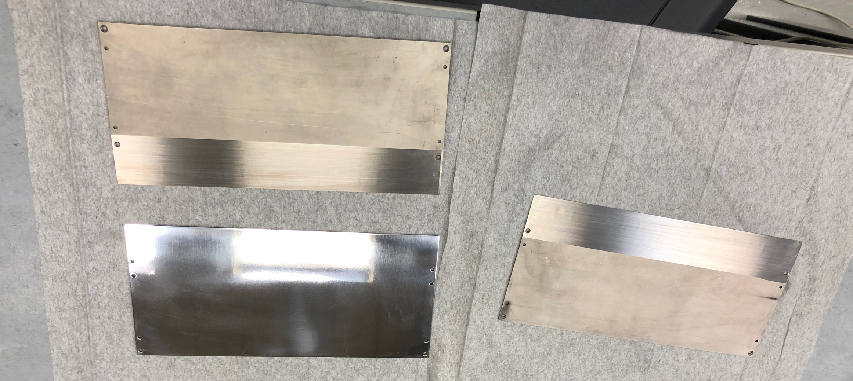
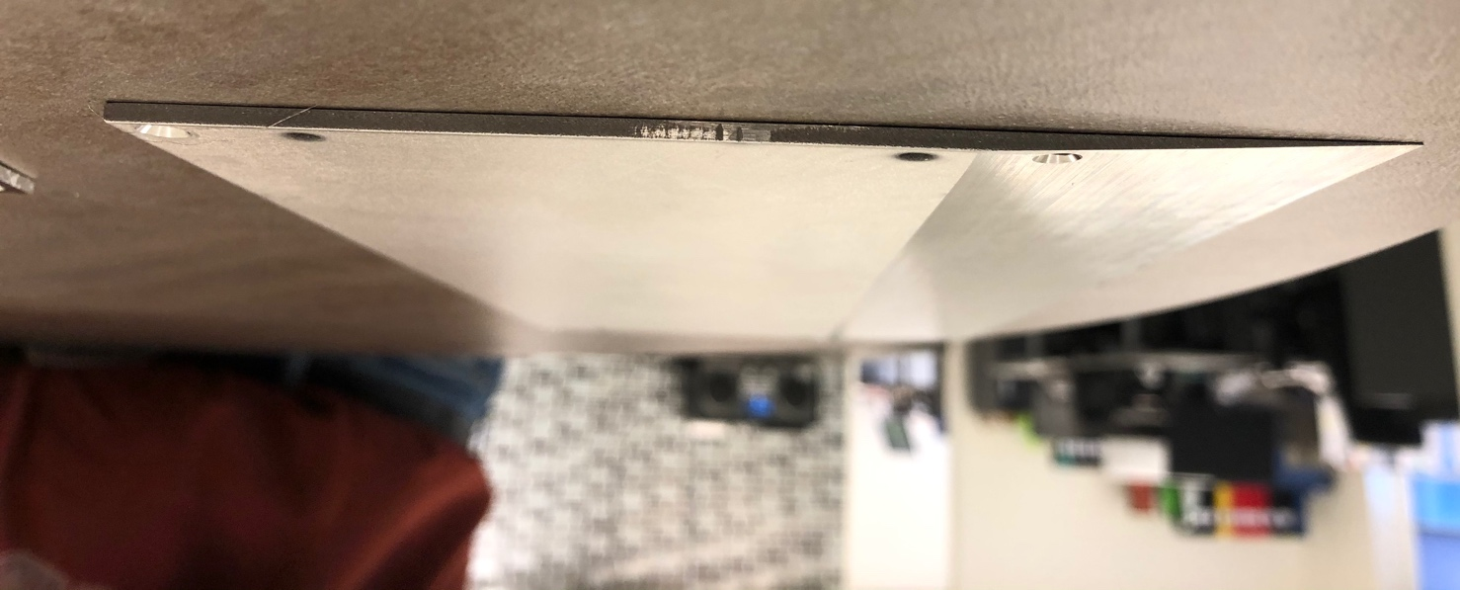
Ti
Ti
Ti
NEW BLADE
2.5∘
Solution 2: Blades edge at 2.5deg instead of 5deg

Slide 15
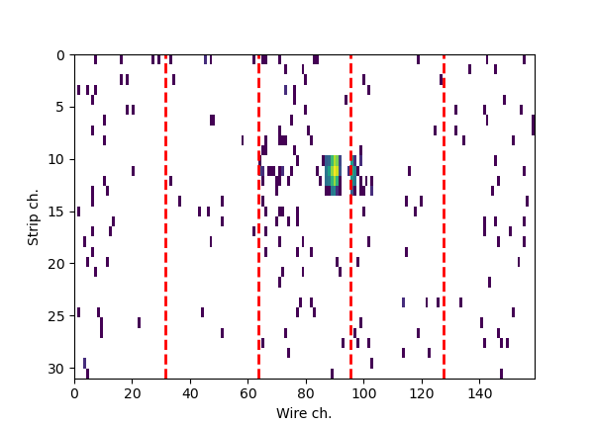
OLD BLADE
NEW BLADE
Edge 5.0∘
Edge 2.5∘

Slide 16
FINAL ELECTRONICS
(C-spec, T-rex, NMX, Estia and FREIA)

Slide 17
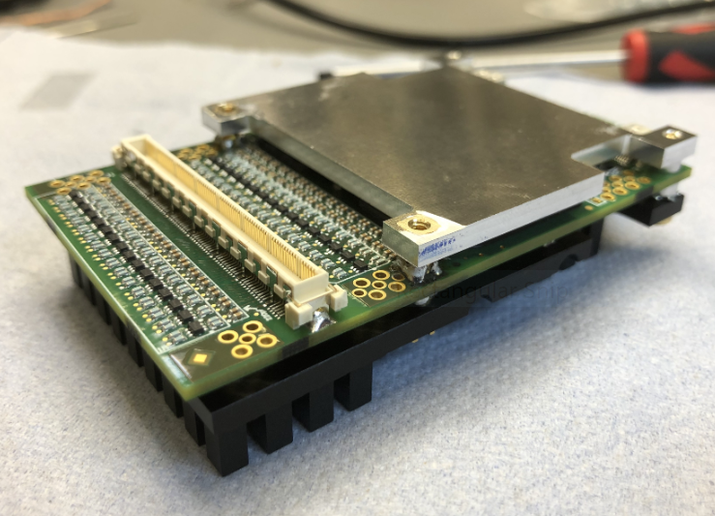
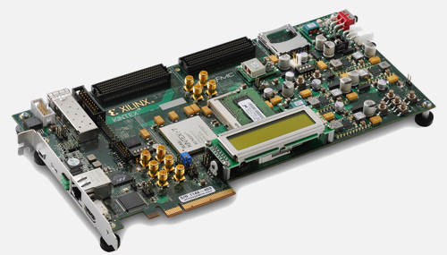
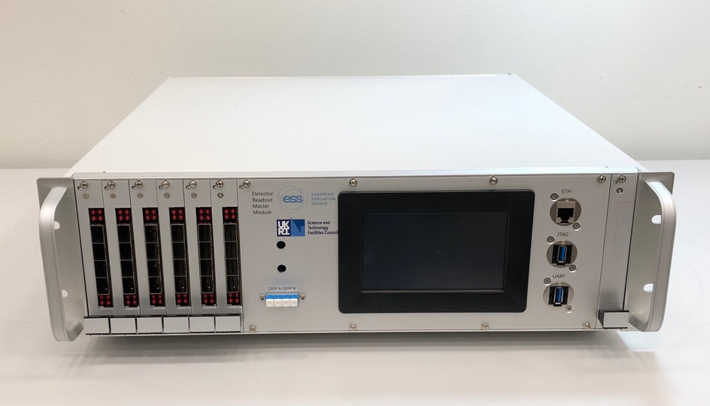
AMOR
detector
N = 14
blade assembly
1 2 3 4 … 12 13 14 15
wires
wires
¹⁰B₄C
=
strips
half blade
(contains only strips,
no wires)
strips
half blade
(contains only wires,
no strips)
…
A blade assembly (unit)
substrate
cassette
One cassette 96ch
(32 of hybrid unused)
1 2 3 … 12 13 14
0
1
2
3
12
13
…
Hybrid
hybrids
VMM 0
VMM 1
FEA = Front-End Assister
FEA 0
FEA 6
…
FEA 1
Ring 0
Hybrid = one board
with 2 VMMs = 128ch
Beam
Monitors
R0
R1
R2
R10
R11
Master back-end
(12 rings)

Slide 18
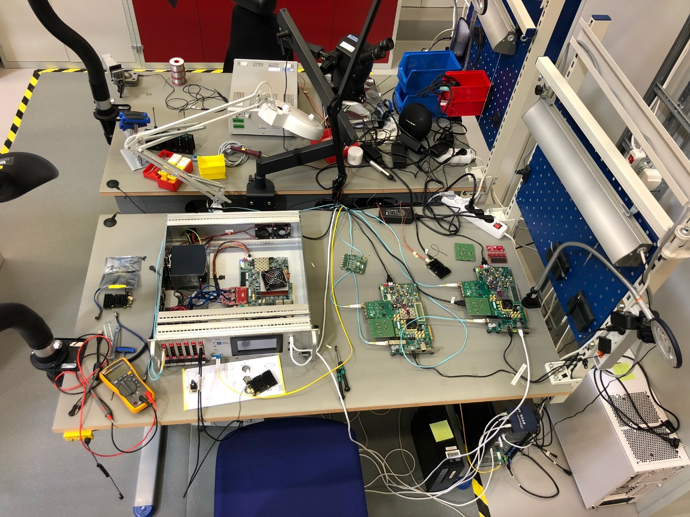
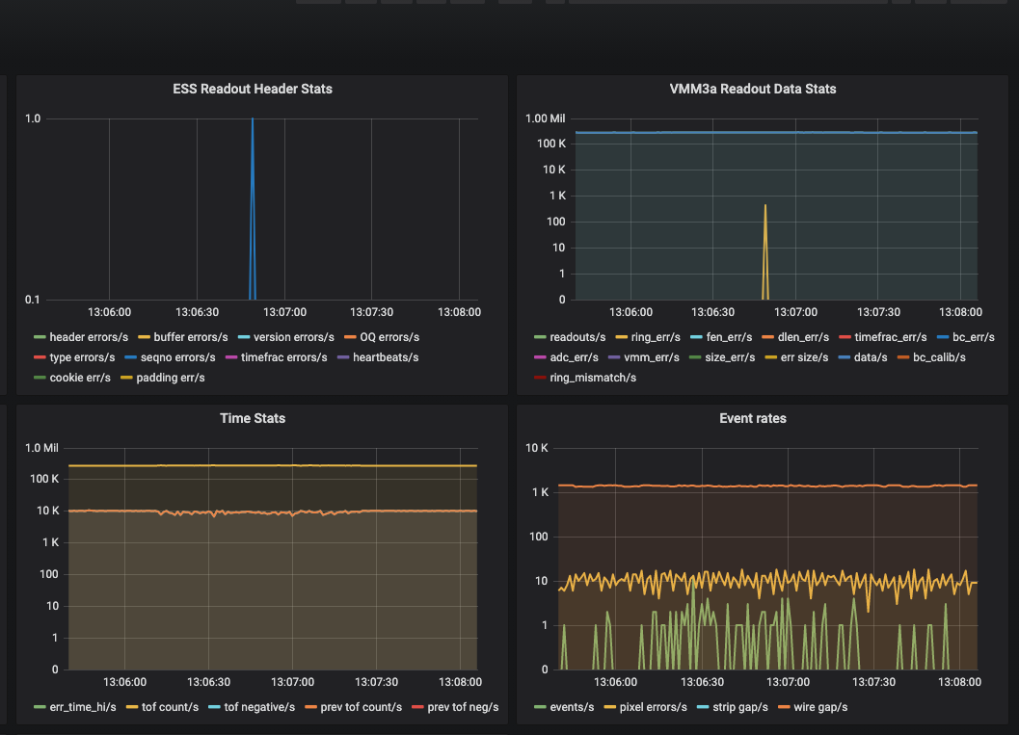
Test of whole readout chain
Stared Summer 2021
Team effort of detector group and DMSC
3 hybrids connected to two assisters, data taken with EFU and Grafana
Whole readout chain working, end-end data seen through the DAQ systems with VMM Front-End
Perfectionating performance and debugging small issues at the moment

Slide 19
Backup

Slide 20
ESS Readout Architecture
DMSC (science data)
ICS (timing/slow control)
Backend Master
MFE
Internal Routing and Aggregation
ICS
MFE
DMSC
MFE
MFE
MFE
MFE
FEA
FEE
FEA
FEE
FEA
FEE
FEA
FEE
FEA
FEE
FEA
FEE
FEA
FEE
FEA
FEE
FEA
FEE
ADC
ADC
ADC
ADC
ADC
ADC
ADC
ADC
ADC
…
…
…
…
…
…
…
…
…
Detector Channels
Steven Alcock, Detector Group, 29th September 2021

Slide 21
Master Module Production
The Backend Master design, procurement, and documentation is essentially finalised.
We have five units that are almost identical to the final product, all of which are in active use at ESS and partner sites.
Steven Alcock, Detector Group, 29th September 2021

Slide 22
VMM Update
The VMM3A is the primary choice for the MultiBlade, MultiGrid and NMX detectors in order to satisfy high channel count requirements (see Dorothea Pfeiffer’s talk).
Significant development already undertaken by CERN RD51 to readout and control this ASIC, but targeting the SRS readout system.
The RD51 Hybrid PCB is not readily compatible with the ESS Readout System.
What, then, is the easiest way of leveraging this work for ESS?
Steven Alcock, Detector Group, 29th September 2021

Slide 23
VMM Assister Board
Use a commercially-available development board to provide “glue logic” into the ESS backend.
Avoids potentially expensive and risky modifications to VMM Hybrid (both hardware and firmware).
Does not preclude the use of custom solutions in the future with smaller size/weight/power.
Early indications are that this will work well – see Dorothea’s talk.
Steven Alcock, Detector Group, 29th September 2021

Slide 24
Readout chain
Frontend Assister card (FEA)
1 to n EFUs
DAQ software Event Formation Unit (EFU) at DMSC
1 GB UDP
Switch
Detector
Slow control
Kintex 7
2x 100 Gbit/s Ethernet (data)
FMC to HDMI
card, max.
5 hybrids
FMC to SFP+
card
Wire and/or grid channels
MFE
Ring 1
MFE
Connector/adapter
Backend
Master
module
VMM
VMM
Ethernet (config)
RD51 hybrid
FEA
Master frontends
FPGA
(MFE)
Ring n
LVDS - HDMI cable
2 x 400 Mbit/s (data/config)
ICS
FEA
Power
Fibre 2 x 6 Gbit/s (data/config)
MFE
Ring 12
MFE

Slide 25
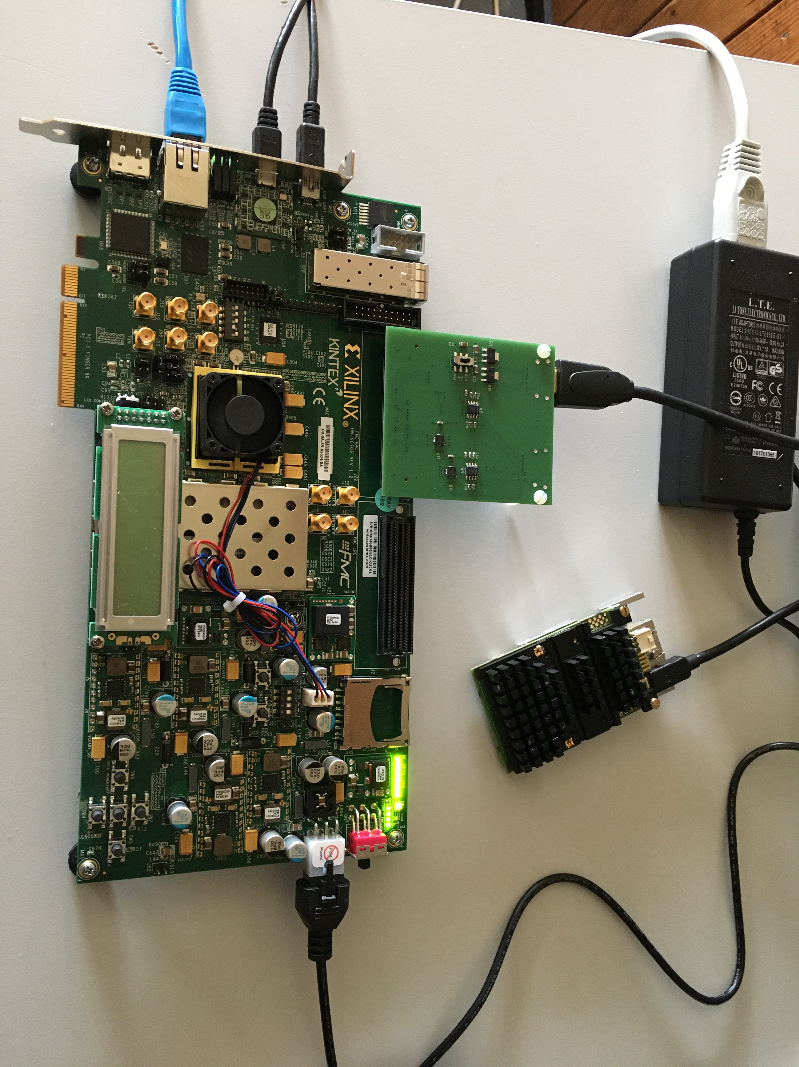
FEA for RD51 hybrid
Integration of RD51 hybrid into ESS readout
Adapter card connects two RD51 hybrids to the FMC connector of the Kintex KC705 evaluation board
SRS FEC Virtex6 firmware ported to FEA Kintex 7, and integration into assister firmware finished
Data transmission via rings, 1 GB UDP kept for debugging purposes
Slow control still uses individual 1 GB port on the assister, together with the well established SRS slow control tool up to 8 assisters can be controlled
Inkind partner university of Talinn is implementing the ESS slow control that sends configuration via the master module

Slide 26
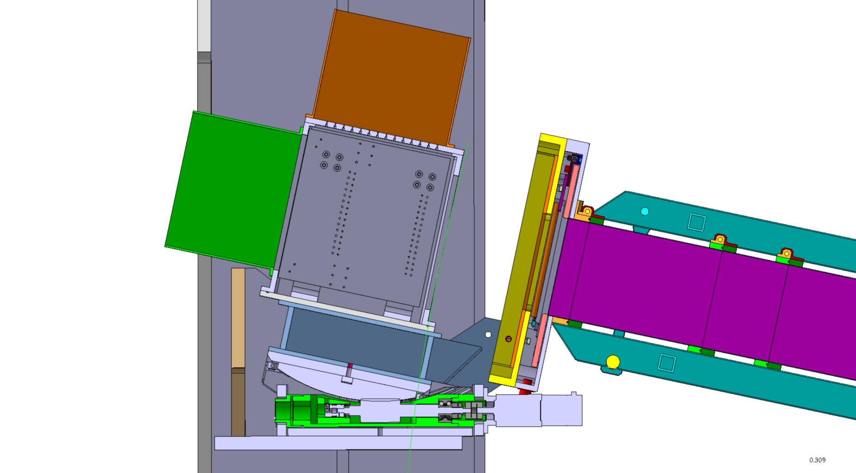
Went for orange box solution
Tower
Electronics VMM
This is not there!
MB side view
neutrons
Can lift and pivot

Slide 27
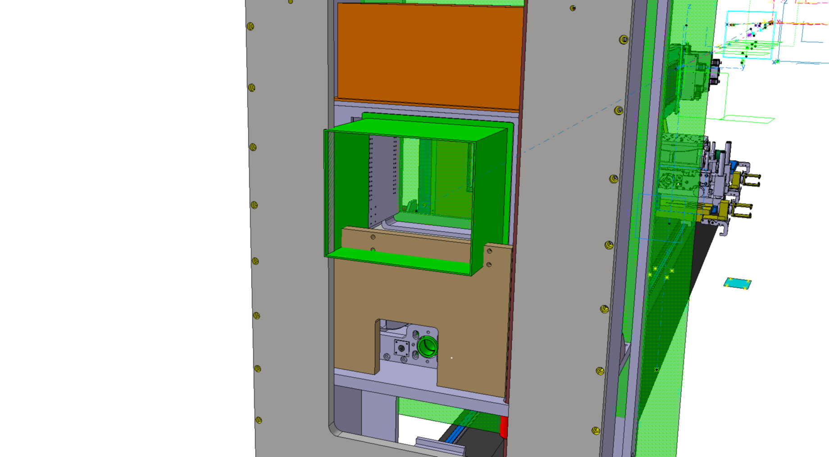
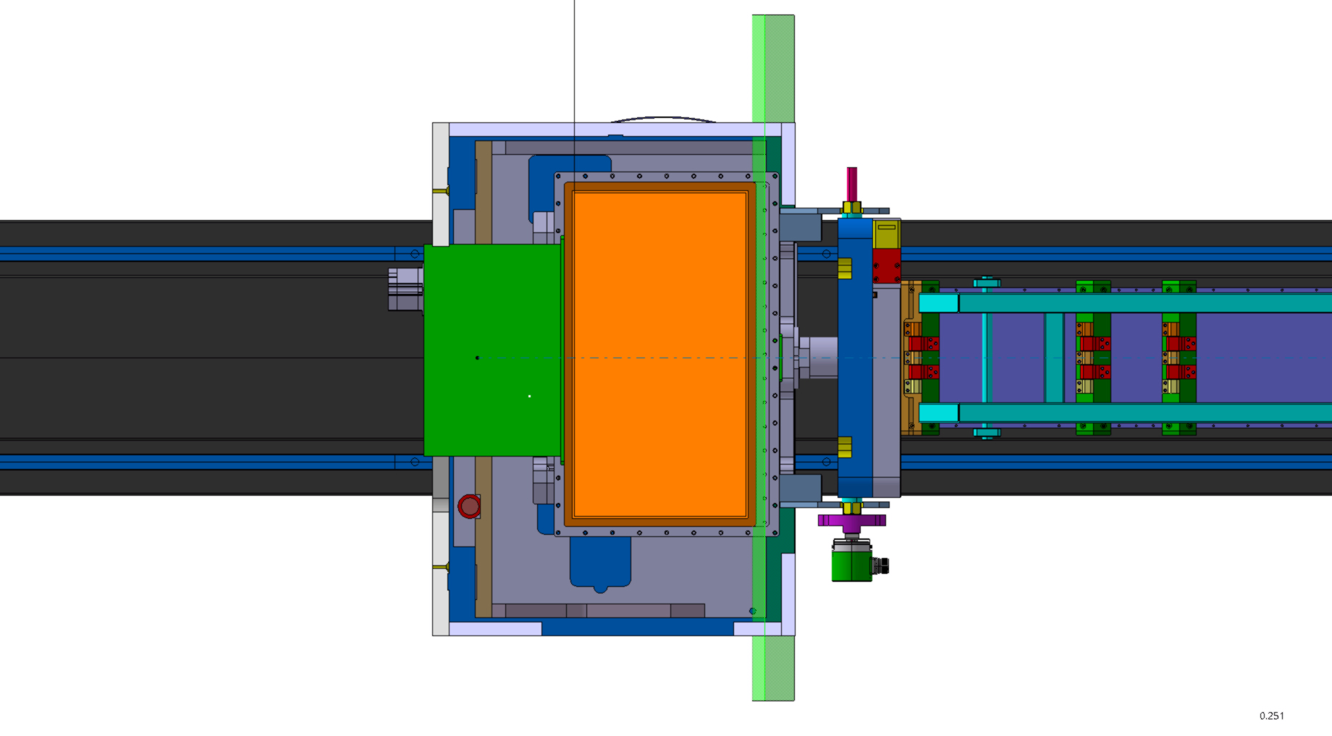
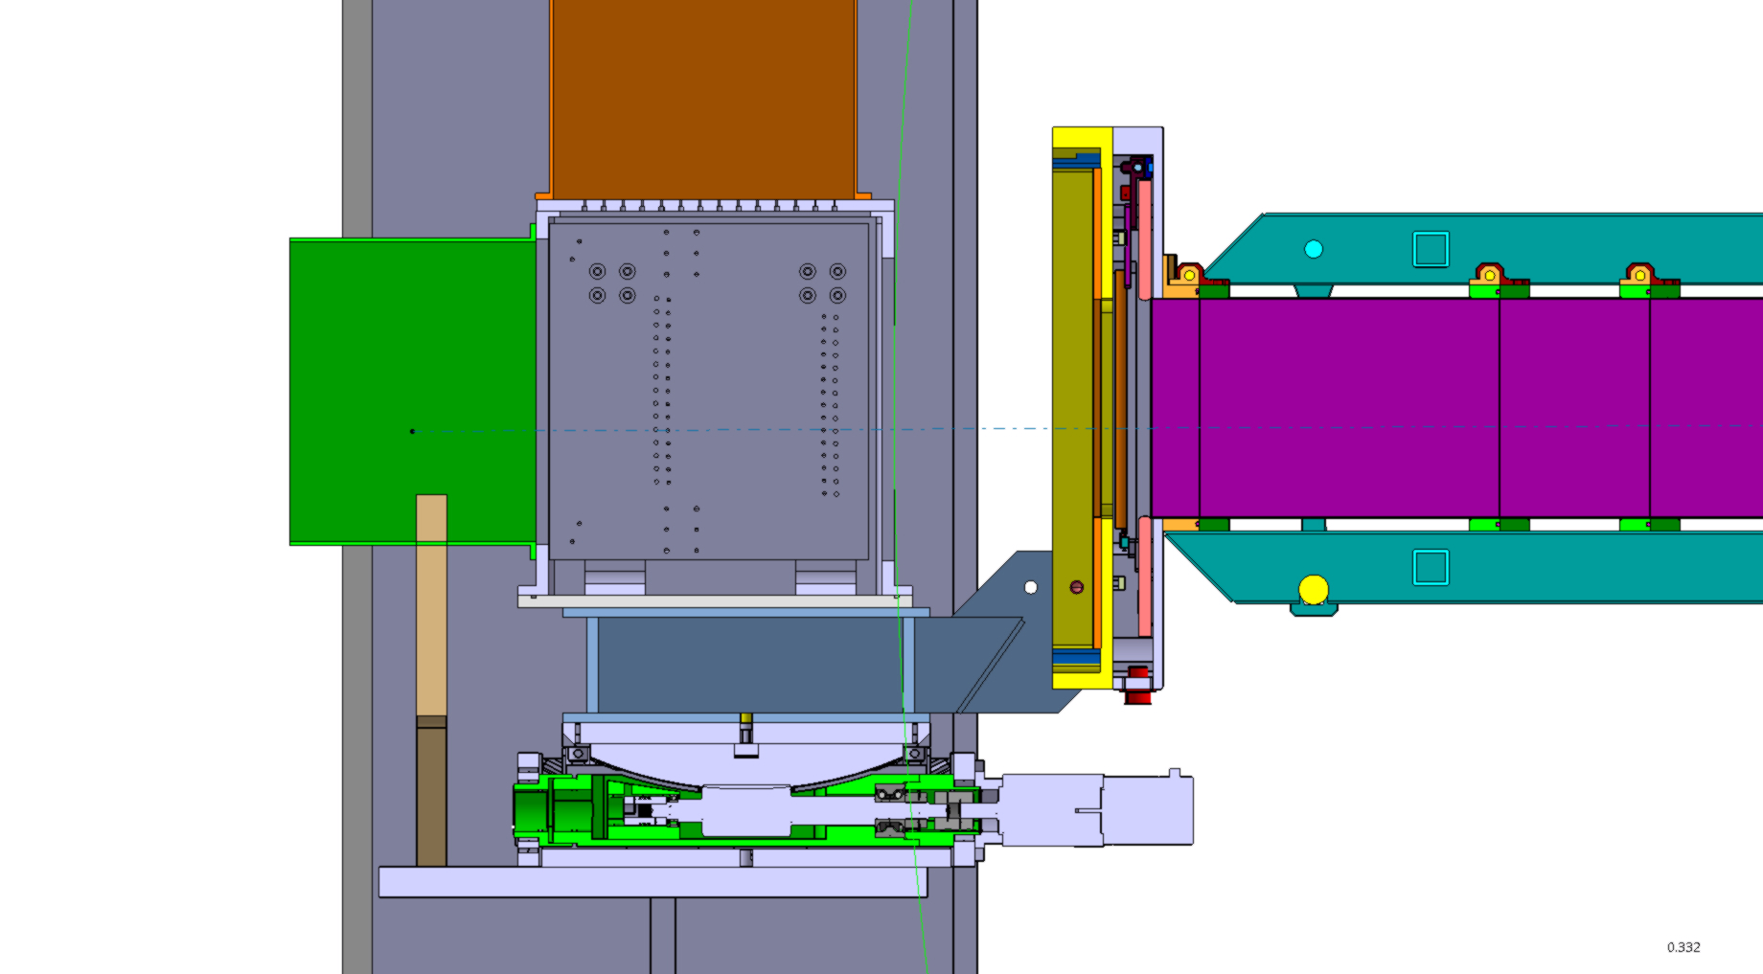

Slide 28
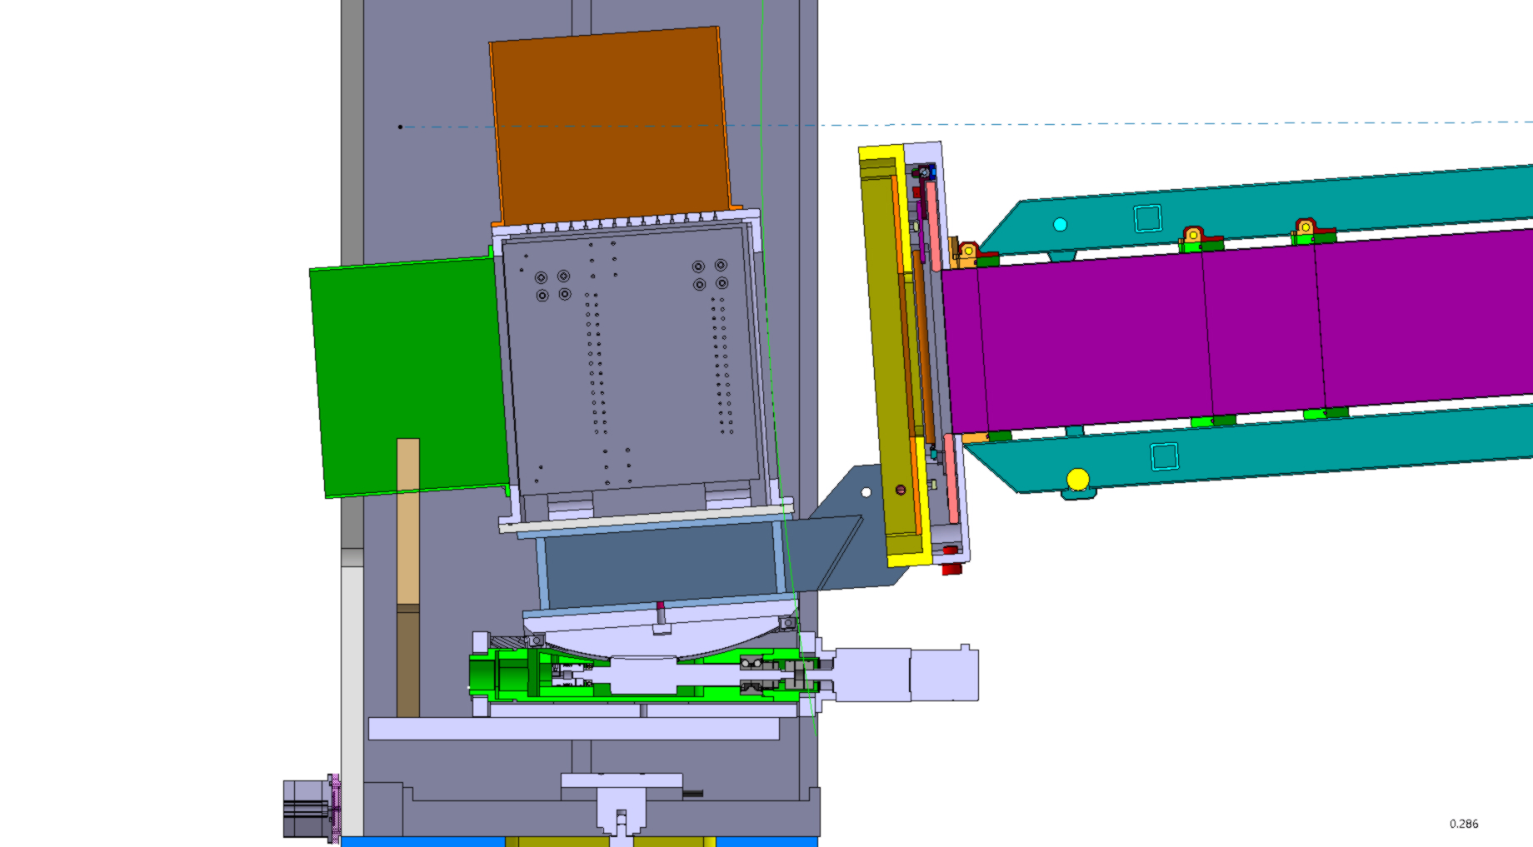

Slide 29
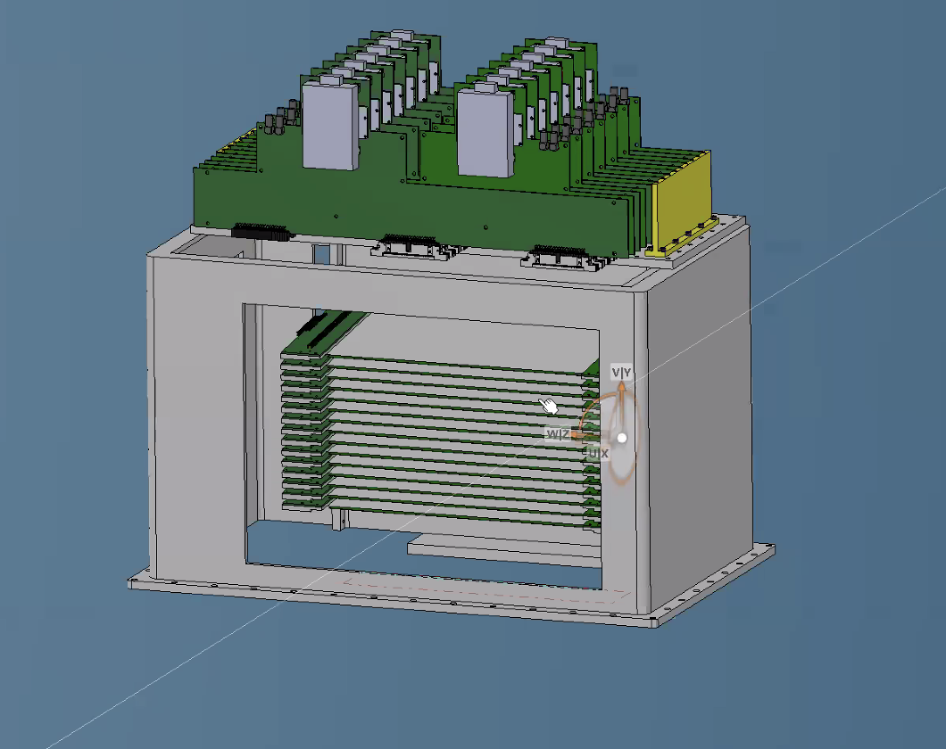
VMMs hybrids
14 cassettes = 14 VMMs hybrids
In two rows 7 odd and 7 even
Electronics VMM: enclosure around the VMMs
blades
neutrons

Slide 30
Readout chain
Frontend Assister card (FEA)
1 to n EFUs
DAQ software Event Formation Unit (EFU) at DMSC
1 GB UDP
Switch
Detector
Slow control
Kintex 7
2x 100 Gbit/s Ethernet (data)
FMC to HDMI
card, max.
5 hybrids
FMC to SFP+
card
Wire and/or grid channels
MFE
Ring 1
MFE
Connector/adapter
Backend
Master
module
VMM
VMM
Ethernet (config)
RD51 hybrid
FEA
Master frontends
FPGA
(MFE)
Ring n
LVDS - HDMI cable
2 x 400 Mbit/s (data/config)
ICS
FEA
Power
Fibre 2 x 6 Gbit/s (data/config)
MFE
Ring 12
MFE

Slide 31
FEA for RD51 hybrid
Integration of RD51 hybrid into ESS readout
Adapter card connects two RD51 hybrids to the FMC connector of the Kintex KC705 evaluation board
SRS FEC Virtex6 firmware ported to FEA Kintex 7, and integration into assister firmware finished
Data transmission via rings, 1 GB UDP kept for debugging purposes
Slow control still uses individual 1 GB port on the assister, together with the well established SRS slow control tool up to 8 assisters can be controlled
Inkind partner university of Talinn is implementing the ESS slow control that sends configuration via the master module

Slide 32
Test of whole readout chain
Stared Summer 2021
Team effort of detector group and DMSC
3 hybrids connected to two assisters, data taken with EFU and Grafana
Whole readout chain working, end-end data seen through the DAQ systems with VMM Front-End
Perfectionating performance and debugging small issues at the moment

Slide 33
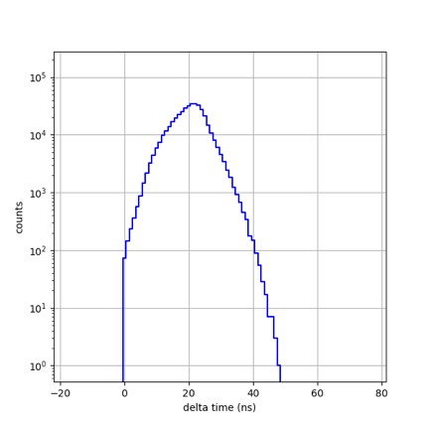
Test of whole readout chain
Timestamps, jitter and resolution
Charge injected into two different channels on two different hybrids on two different rings
Low time difference between channels
Time calibration of VMMs will further improve the time jitter

