Slide 1

SNS chopper - Approach to the problem, past experience at SNS and proposal for ESS specific conditions.
A. Aleksandrov
Spallation Neutron Source
Oak Ridge, USA

Slide 2
Outline
SNS chopper requirements
  Purpose
  Requirements
  Implementation
LEBT chopper
  performance and problems
MEBT chopper
  performance and problems
Future plans
ESS chopper thoughts

Slide 3
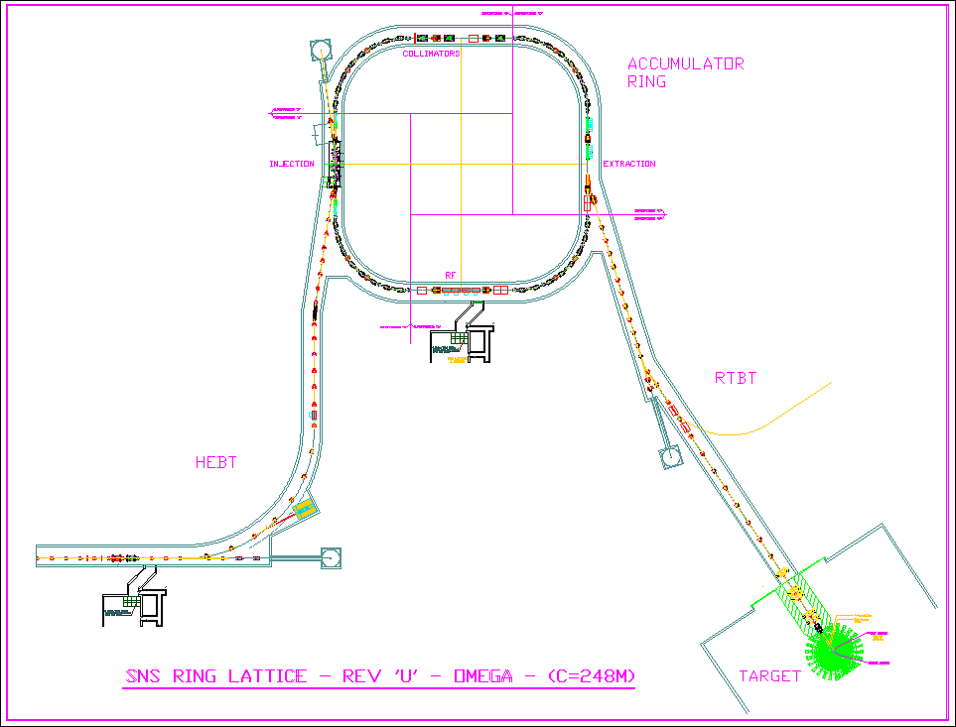
SNS Accelerator Complex
Front-End: Produce a 1-msec long, chopped, low-energy H- beam
LINAC: Accelerate the beam to 1 GeV
Accumulator Ring: Compress 1 msec long pulse to 700 nsec
H- stripped to protons
Deliver beam to Target
2.5 MeV
86.8 MeV
186 MeV
387 MeV
1000 MeV
Ion Source
RFQ
DTL
CCL
SRF, β=0.61
SRF, β=0.81
Chopper system makes gaps
945 ns
mini-pulse
Current
Current
1 ms macropulse
1ms

Slide 4
Why do we need chopper?
Answer: to provide low loss single-turn extraction from the ring
End of accumulation
Extraction
Stripping foil
From linac
V=0
V=V_{max}
To target
Electromagnetic extraction deflector

Slide 5
Extraction losses
?
volts
extraction
V_{max}
Deflector can’t switch on instantly
Typical rise-time ~ 200ns
Deflector rise-time
accumulation
time
Half-deflected beam misses extraction channel and hits the wall
Power of lost beam
V<V_{max}
Unacceptably high.

Slide 6
How to mitigate extraction losses ?
Revolution period 1us
Deflector rise-time
Stripping foil
Answer:
645ns
300ns
Divide beam on separate chunks synchronized with ring revolution period
Gap between chunks longer than deflector rise-time
Switch on deflector during the gap
No beam during deflector rise-time. No extraction losses.
V<Vmax
Electromagnetic extraction deflector
Requirements :
beam current in the gap less than 10⁻⁴ of peak current
rise/fall time < 50ns

Slide 7
SNS Beam pulse structure
Macro-pulse
Structure (made by the Ion Source)
16.7ms (1/60 Hz)
15.7ms
1ms
Mini-pulse
Structure (made by the choppers)
945 ns (1/1.059 MHz)
645 ns
300 ns
260 micro-pulses
Micro-pulse
structure
(made by the RFQ)
2.4845 ns (1/402.5 MHz)

Slide 8
How to make the gaps ?
Answer: use “chopper” (has nothing to do with helicopters or motorcycles)
Possible scheme of a chopper:
beam absorber
(target)
HV pulse generator
a
deflector
L
Gap cleanness depends on:
  deflection angle
  distance to target
  beam transverse size and quality (tails)

Slide 9
Transients in chopped beam
Rise/fall time of chopped pulse depends on:
  HV pulse generator rise/fall time
  deflector response time
  particle travel time in the deflector
In case of electrostatic deflector:
a,V
a
t

Slide 10
Why transient time is important?
Answer: transients produce partially deflected beam, which can increase losses in the downstream accelerator
Nominal beam size
Effective beam size during transient

Slide 11
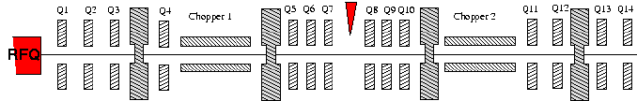
How to avoid partial deflection losses?
Answer:
  switch on chopper during the gap between bunches
    faster than 2.5ns for SNS
  use anti-chopper to compensate partial kick
  live with losses if they are small enough
chopper + anti-chopper compensation scheme:

Slide 12
Where to place chopper?
Answer: at low energy
  lower energy beam is easier to deflect
  chopper target has to absorb less power at lower energy
    Example: in SNS 65kV LEBT ~ 50W (800W peak)
    in SNS 2.5MeV MEBT ~ 1.9 kW (32kW peak)
  but not at too low
  difficult to make fast deflector when particles are slow and travel time through deflector is high
Optimized solution : two stage chopping
  remove most of the power at low energy with slow chopper
  clean up gap at intermediate energy with fast chopper

Slide 13
SNS Front End chopping system
Two stage: LEBT + MEBT
Mitigation of partial chopping: compensation using anti-chopper
Chopper | LEBT | MEBT
Ion energy | ~25 kV | 2.5 MeV
β = v/c | ~ 0.0073 | .073
Max Voltage | ± 3 kV | ± 2.5 kV
gap | ~ 14 mm | 18 mm
Effective length | ~ 27 mm | ~370 mm
Max deflection | 14 º | 1.07 º
Time of flight | ~ 12 ns | ~ 17 ns
MEBT chopper (10ns, 1e-4)
LEBT chopper (50ns, 1e-2)
current
time
Compensated by using slow traveling wave deflector

Slide 14
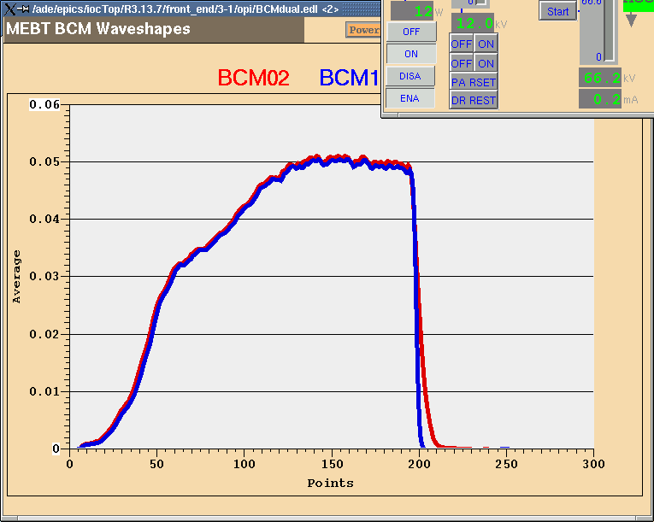
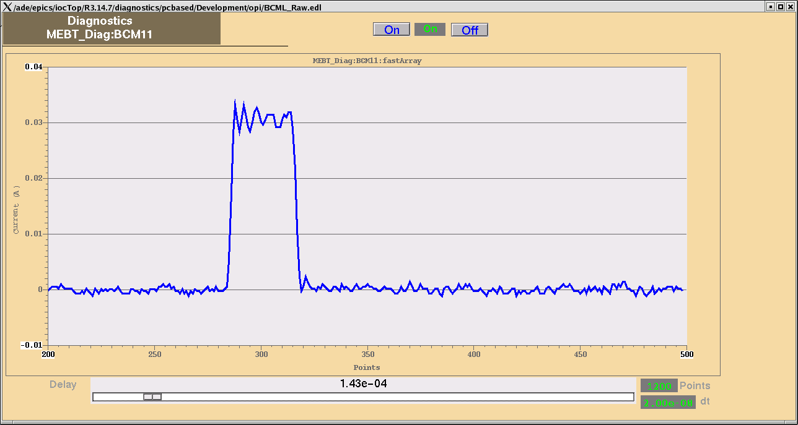
What other use the SNS chopper has?
Answer: macro-pulse shaping
  cut off beam during the ion source transient
  create single mini-pulse for turn-by-turn measurements in the ring
  decimate mini-pulses (N-on-M-off ) to facilitate injection painting tuning
  ramp up current at the beginning of the macro-pulse to help LLRF system in compensating beam loading effects
single
mini-pulse
Ion source
transient
Chopper
window

Slide 15
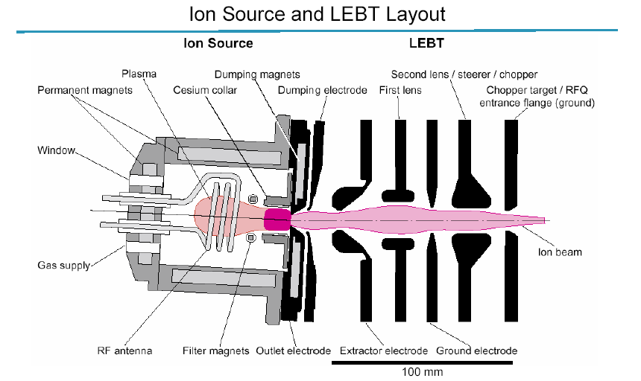

Slide 16
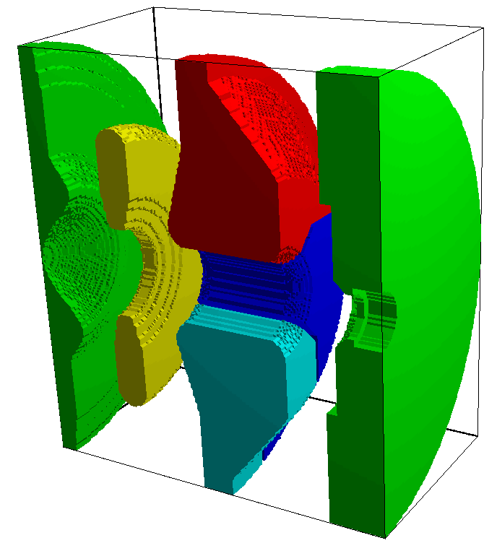
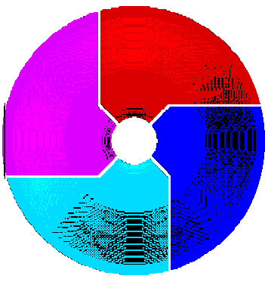
The LEBT chopper:
Lens 1
Lens 2
RFQ entrance
The 2nd lens in the LEBT is divided into four electrically insulated quadrants, which serve as steerer and chopper
All chopper and steerer voltages operate on top of ~45 kV.

Slide 17
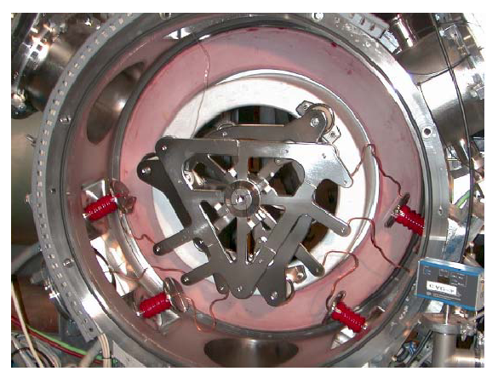

Slide 18
The LEBT chopper: Electric Schematic
Chopper electrodes have to be AC coupled to the pulse generator
Network of Rs and Cs in oil filled “mixer box” to combine all signal together
Commercial HV pulser custom designed by DEI:
- bipolar
- 3kV max voltage
- 60ns rise/fall time (capacitive load, 150pF + 4’ of RG-59 cable )
- - -
3 kV 33 mA supply
3 kV 33 mA supply
- -
-
E_{y}
d
Lens 2 supply ~ 45 kV
3 kV 33 mA supply
3 kV 33 mA supply
E_{x}
R_{s}
R_{s}
R_{c}
C_{c}
EPICS
+3 kV 400 mA supply
HV pulser
HV pulser
Quad Gate Driver
- 3 kV 400 mA supply
HV pulser
HV pulser

Slide 19
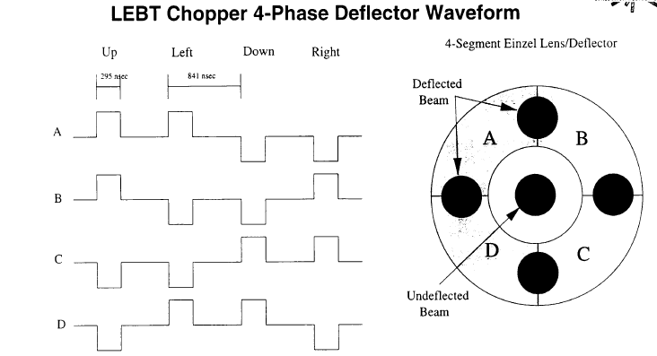
Because of AC coupling 4-Phase deflection scheme has to be used:

Slide 20
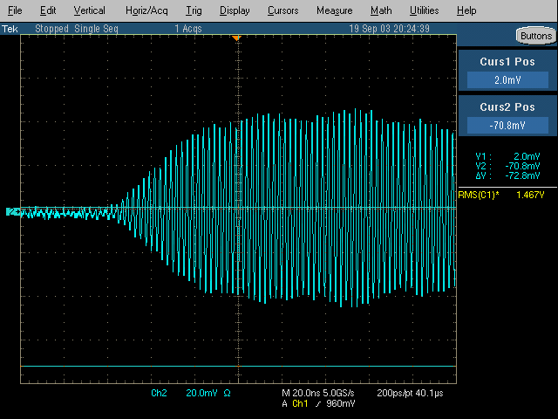
LEBT chopper gap cleanness and rise time satisfy requirements

Slide 21
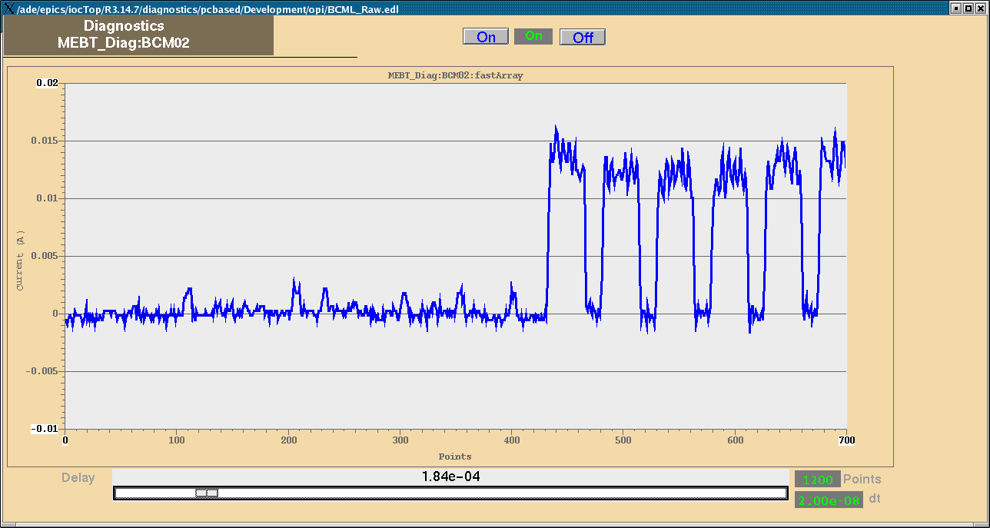
Finite transition speed between 4 states during beam-off cycle cause beam leakage
1
2
4
3
Nominal chopping pattern
1
2
4
3
Beam-off pattern

Slide 22
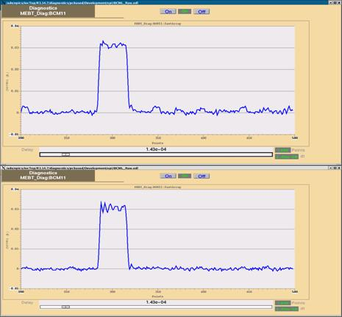
Experimental verification of using MEBT chopper to clean the “islands”
Single mini-pulse generated with LEBT chopper alone
Single mini-pulse generated with LEBT and MEBT choppers

Slide 23
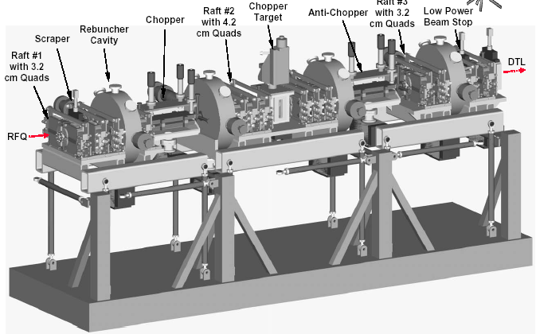
MEBT layout

Slide 24
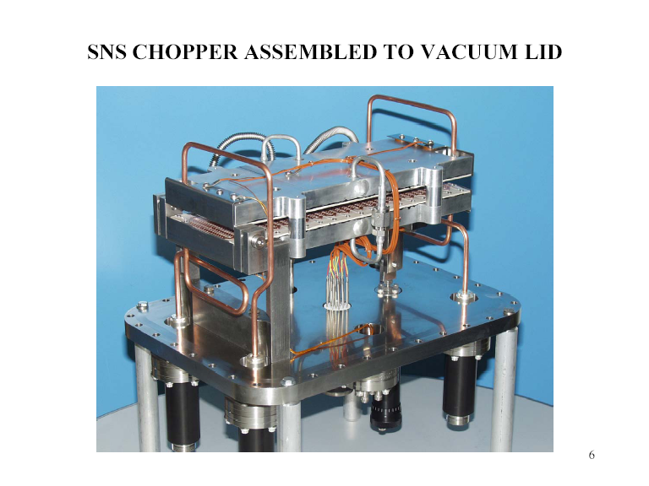

Slide 25
Slow traveling wave deflector
When beam is deflected by traveling wave, deflection transient depends on relative velocities of particle and the wave:
There are many ways to slow down wave in transmission line: folded lines, dielectric or ferrite loaded line, corrugated line, etc.

Slide 26
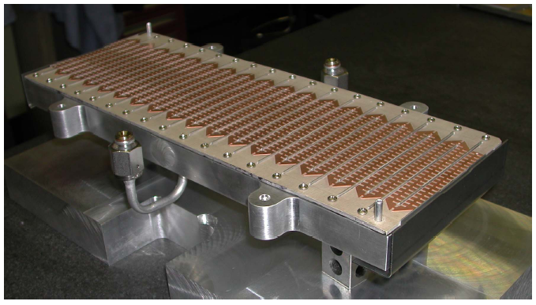
MEBT chopper deflector : slow traveling wave folded (meander) strip line

Slide 27
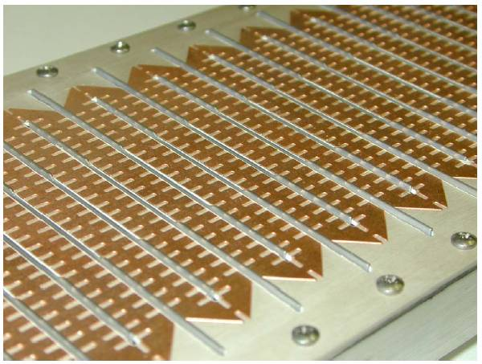

Slide 28
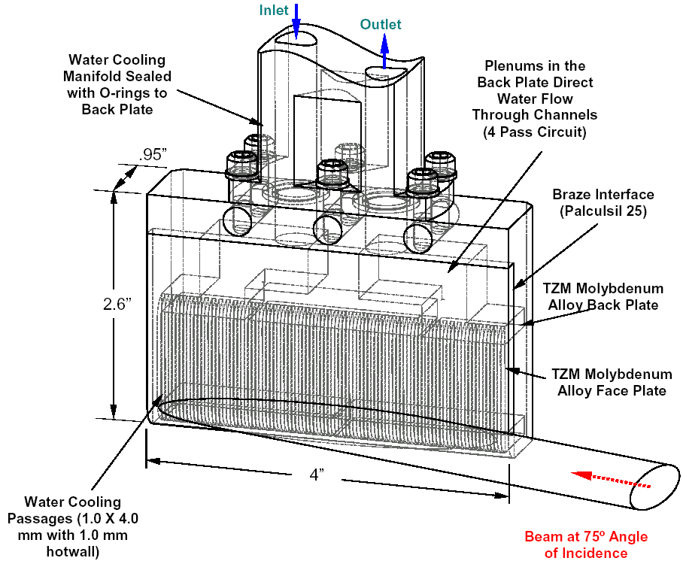
The MEBT chopper target
Moly (TZM) target used
Microchannel water cooling
Beam hits at 75° glancing angle
Can dissipate 500 W of average power.
Max energy per pulse: 8.4J (for design beam spot size)
Without LEBT pre-chopping
Tpulse[38 mA] < 88 μs
Tpulse[20 mA] < 170 μs
Estimated lifetime due to material sputtering: ~100 years

Slide 29

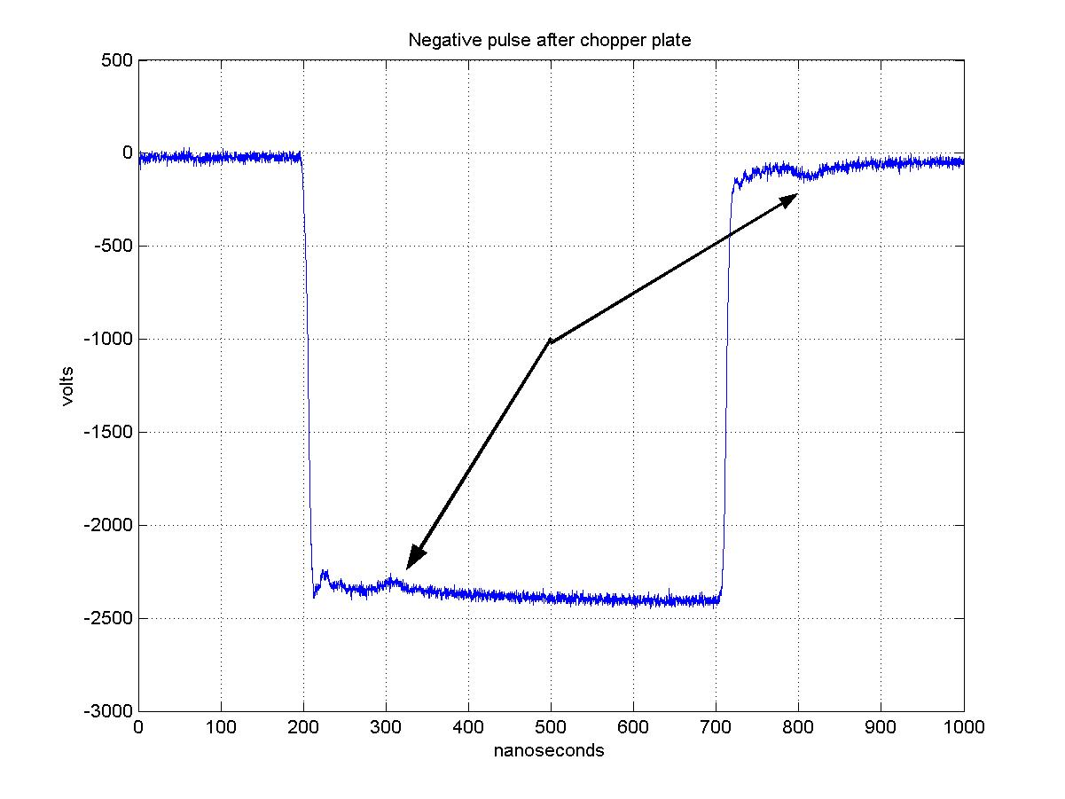
The MEBT chopper: Electric Schematic
EPICS
HV pulser
Pos HV supply
Control Interface
50 Ω
50 Ω
Neg HV supply
HV pulser
Commercial HV pulser custom designed by DEI:
- two unipolar units
- 3kV max voltage
- 10ns rise/fall time (matched 50 Ohm load)
- 60 A peak current

Slide 30
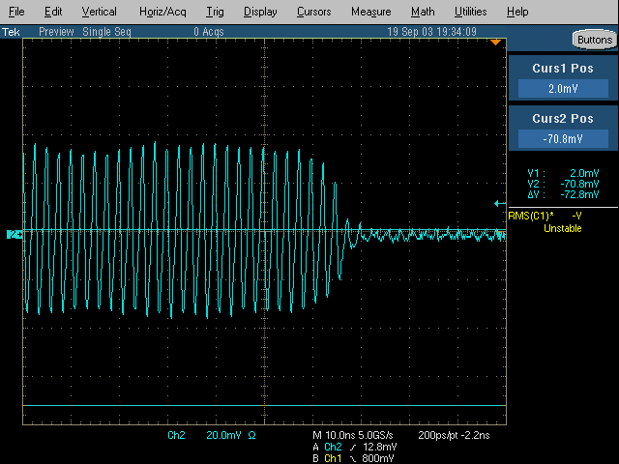
MEBT chopper rise time satisfy requirements. Did not measure gap cleanness

Slide 31
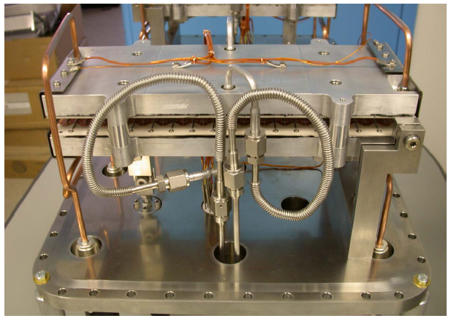
Water cooling of MEBT chopper structure

Slide 32
MEBT Chopper after anti-chopper removal
Deflector
Target

Slide 33
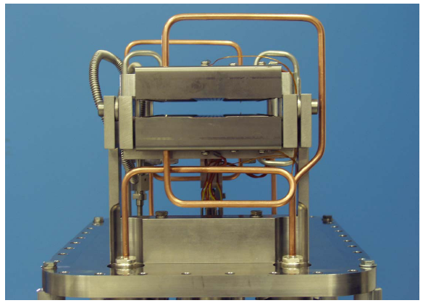
Beam scrapers at the entrance

Slide 34
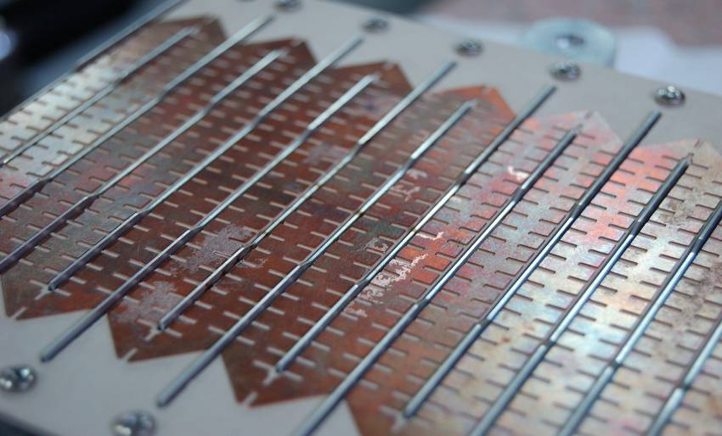
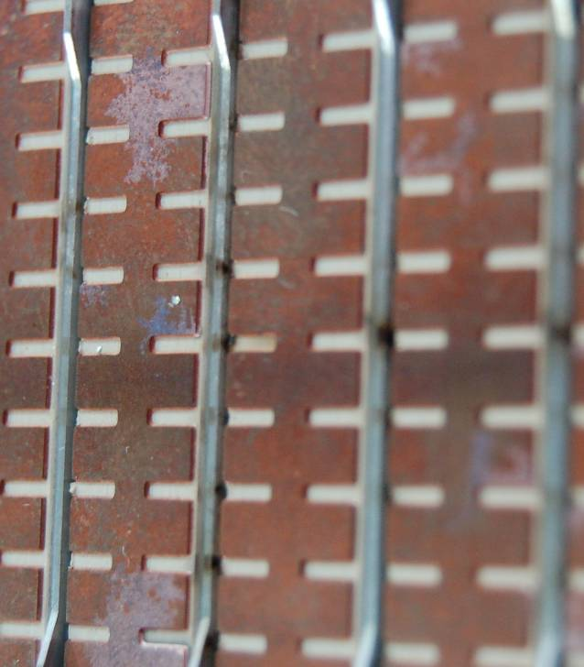
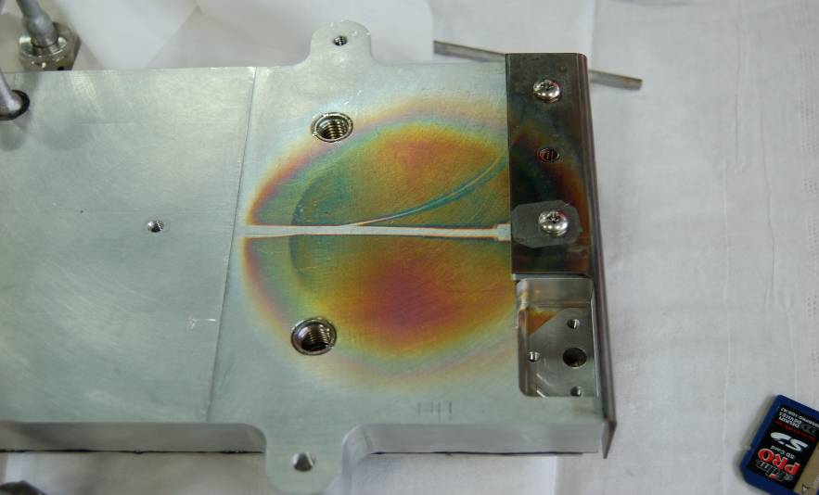
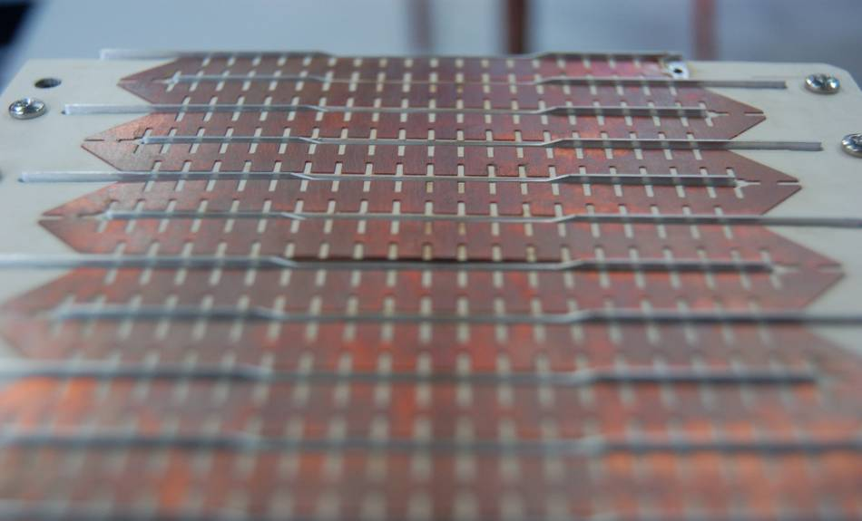
Damage to MEBT chopper deflecting structure

Slide 35
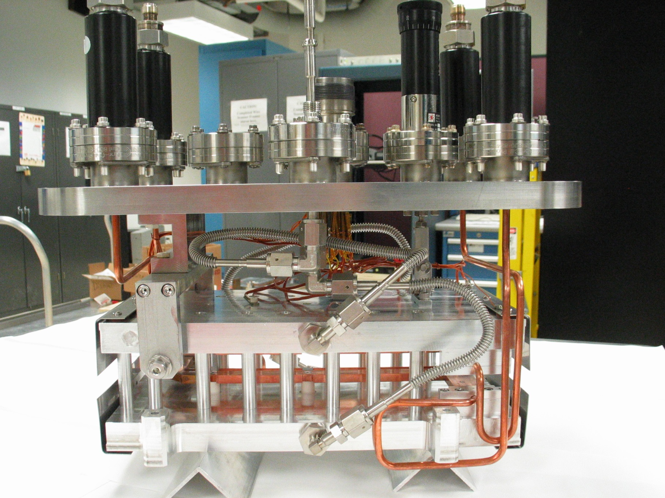

Slide 36
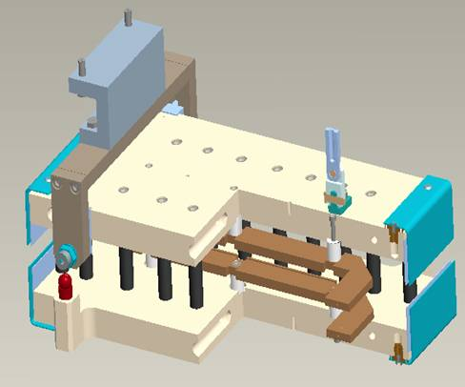
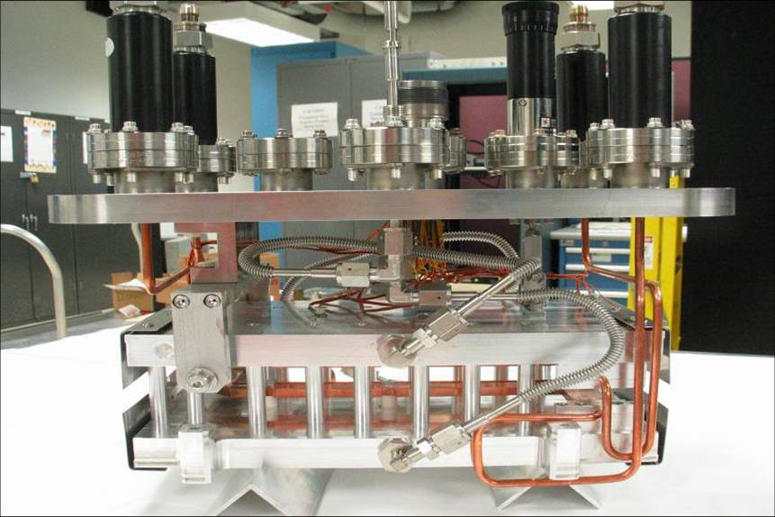
New SNS chopper design
35 cm strip-line : 17 ns transient
25% more efficient than old meander line
2x17 cm strip-lines : 8 ns transient

Slide 37
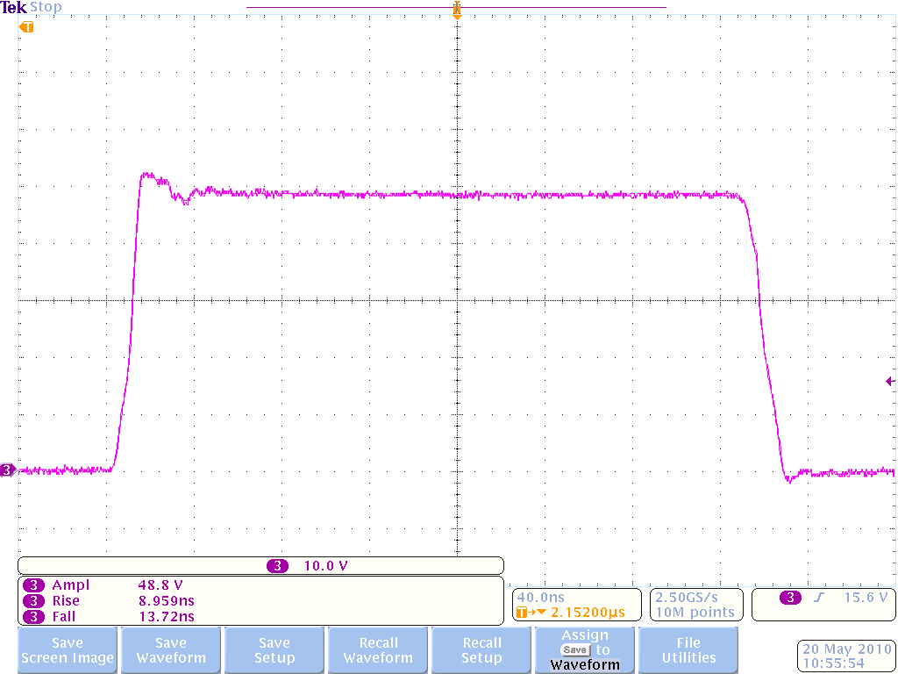
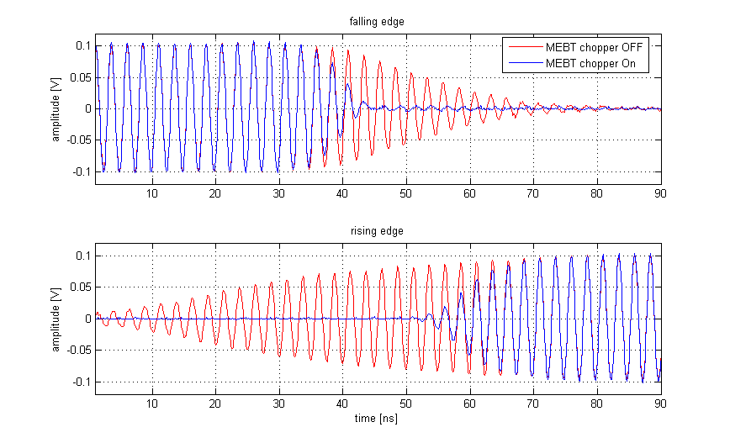
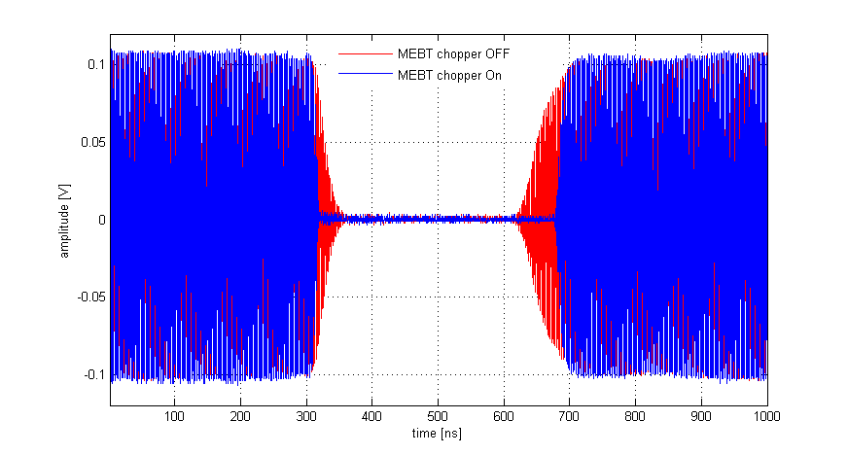
SNS chopper performance (1MW operation)
High voltage pulse: ~9ns rise time, ~14ns fall time
~ 10 ns fall time
~ 15 ns rise time
Beam current: pre-chopper only is in red, pre-chopper and MEBT chopper is in blue
Measured extinction ratio is < 10⁻⁴

Slide 38
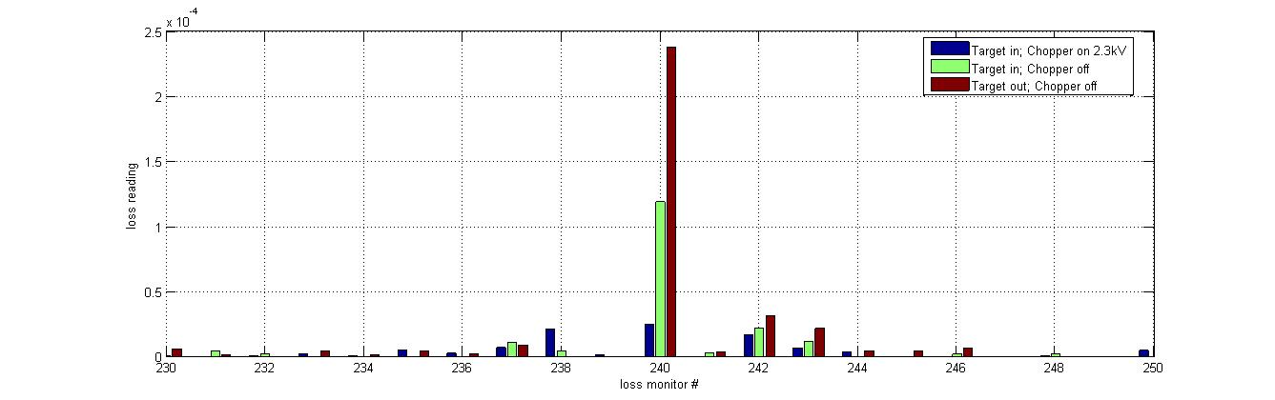
Effect of MEBT chopper on extraction losses

Slide 39
MEBT chopper target failure in September 2014
Massive water leak in the MEBT during maintenance (no beam running)
Whole MEBT vacuum chamber completely filled with water, pressure relief valves opened
1mm thick wall of cooling channels in MEBT chopper target failed
Resulted in >30days of downtime for clean up and recover
Chopper target was removed making MEBT chopper inoperable
Chopper deflector is still in place to provide scraping functions
  Collecting a list of equipment to put in place of the deflector: scrapers, diagnostics
There is no plans to recover chopper while SNS is operating at up to 1.4MW beam power

Slide 40
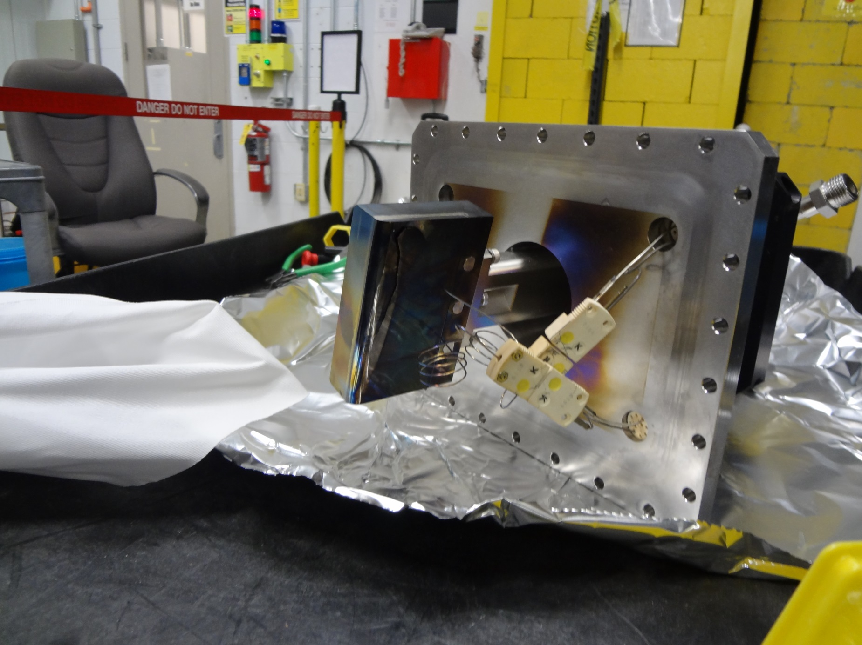
MEBT chopper target after failure

Slide 41
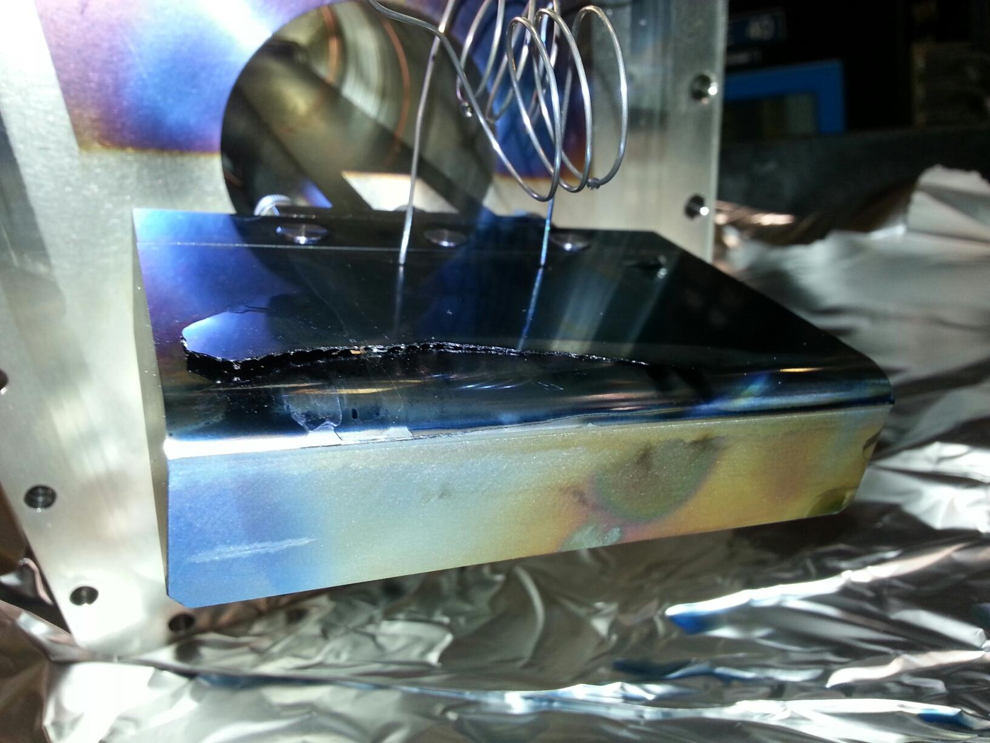
MEBT chopper target after failure

Slide 42
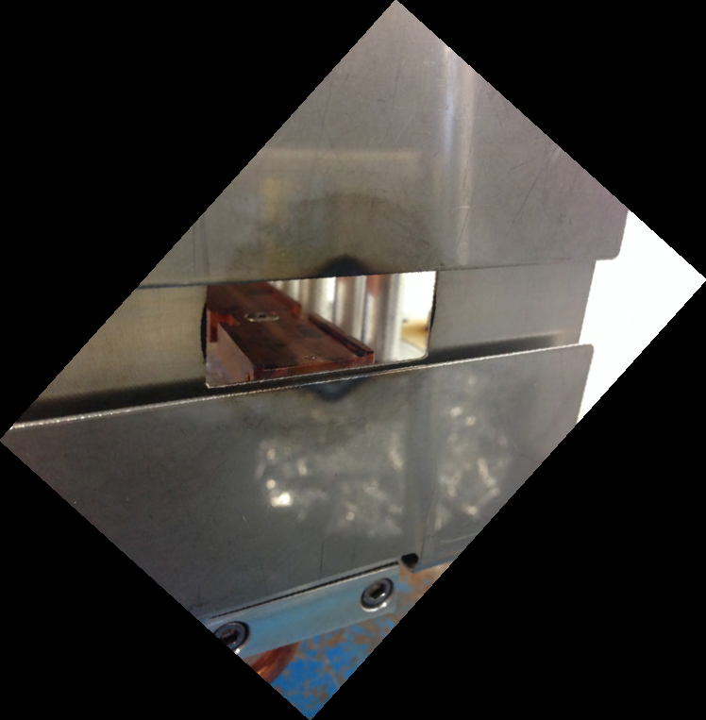
Entrance scraper of the MEBT chopper

Slide 43
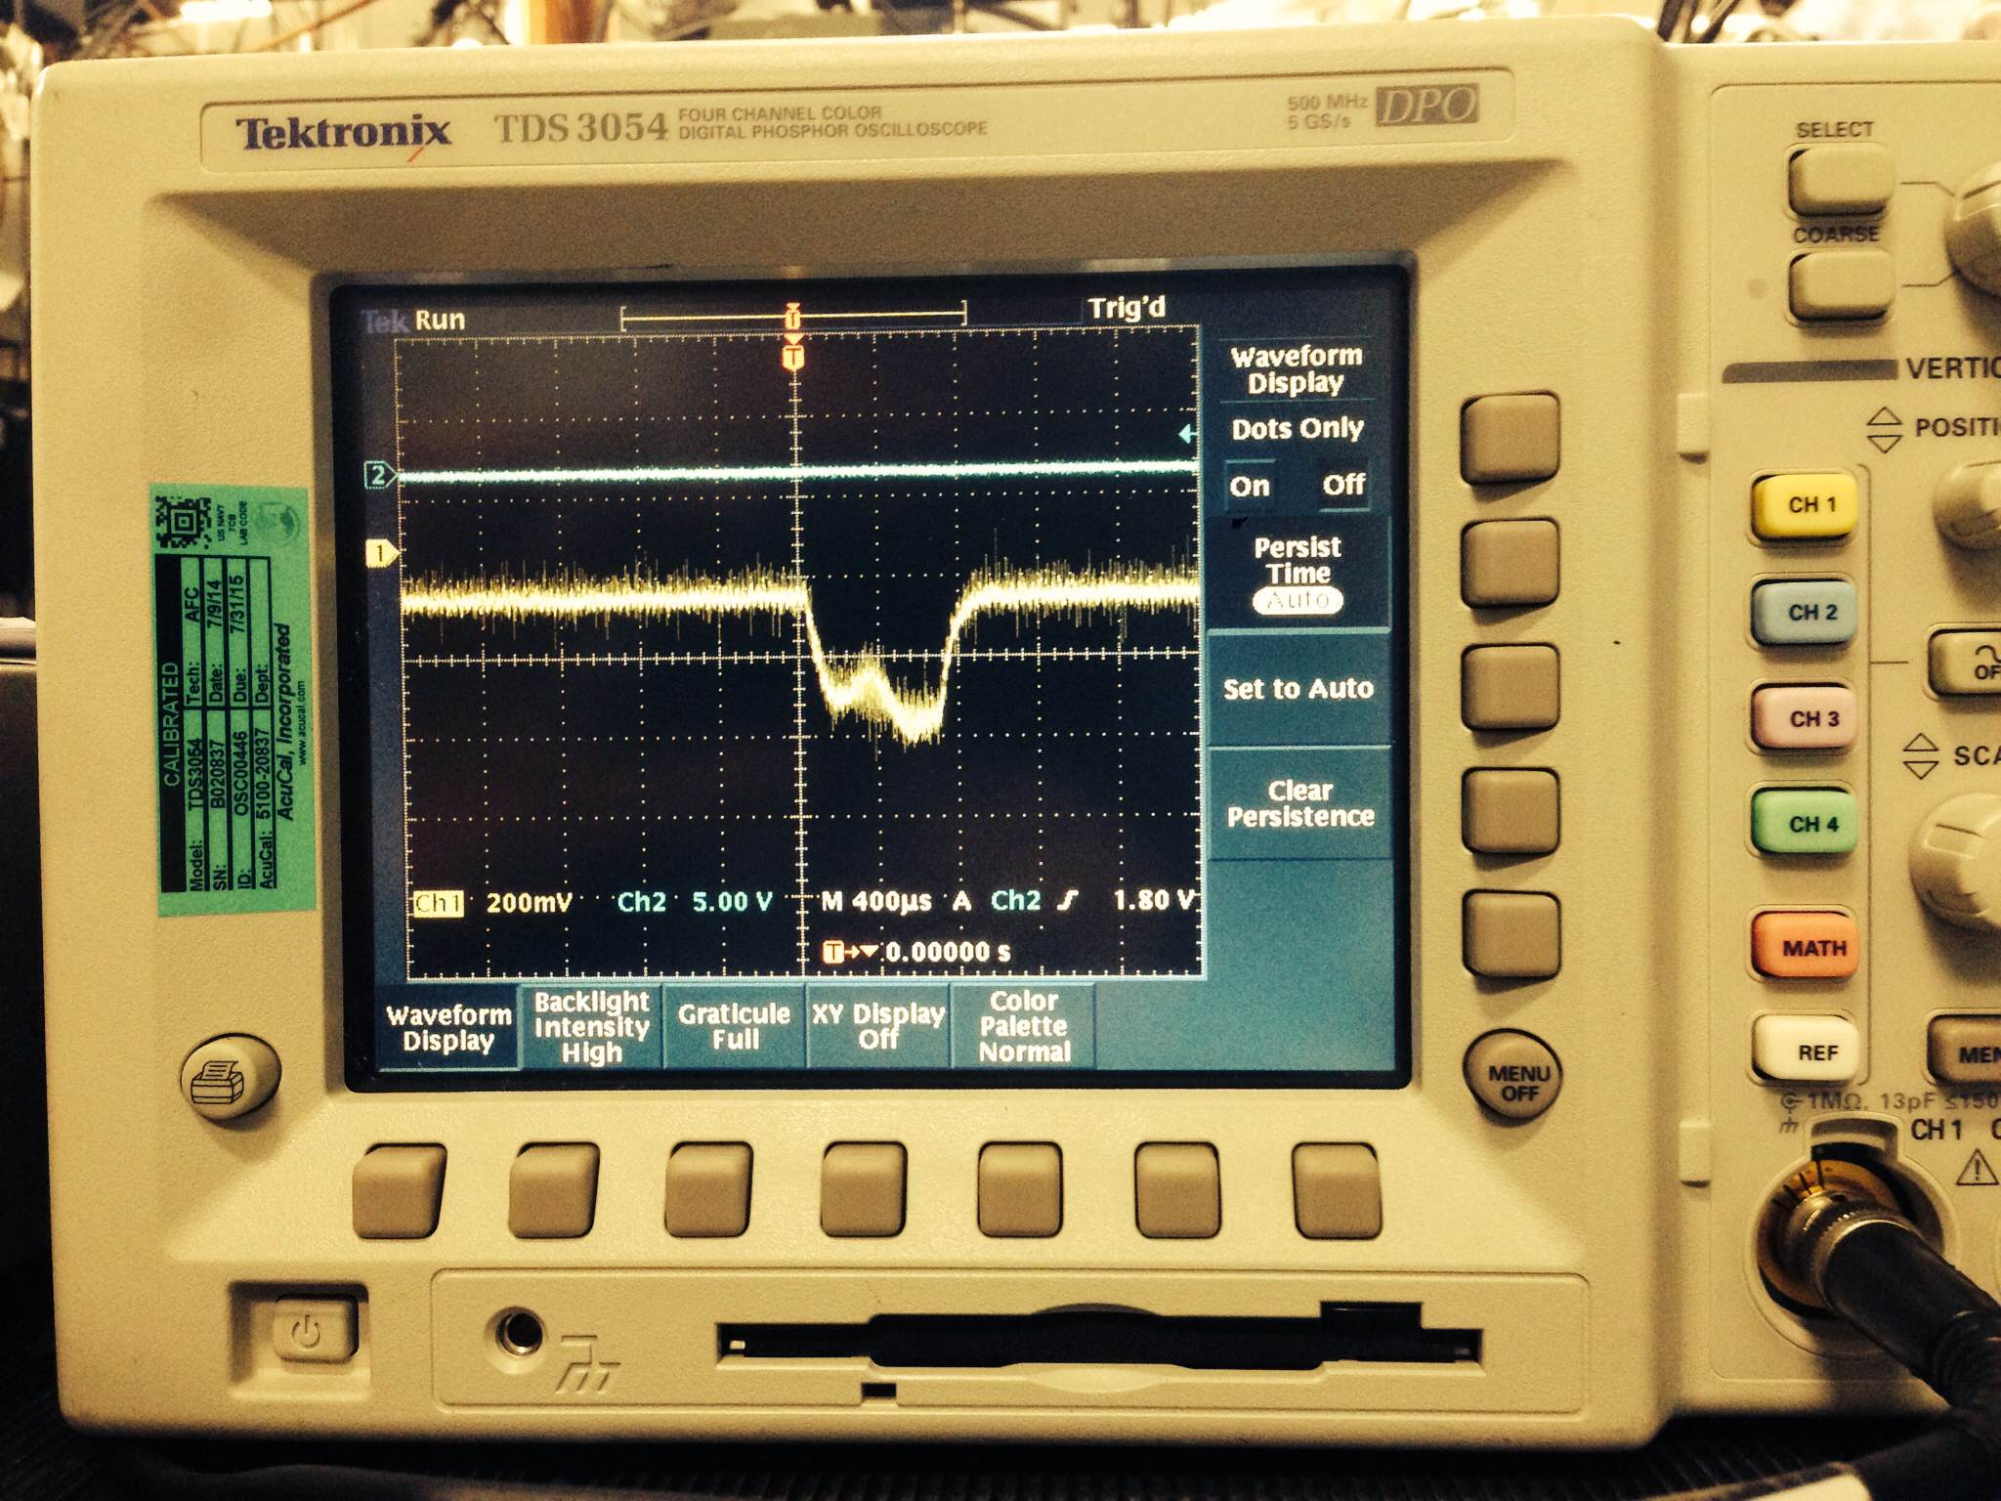
Beam current measured on the entrance scraper
Peak current ~ 10uA;
corresponds to 25W peak or 1.5W average power
HV =+ 50V

Slide 44
Chopper development plans at SNS
New magnetic LEBT for SNS Front End
  Chopper design should be as closed to the existing LEBT chopper as possible. Same HV pulser
  May need to reinstall MEBT chopper If magnetic LEBT chopper will perform worse than the current LEBT chopper
Beam line switch deflector for Neutron Moderator Demonstration Facility
  Should finish design in FY15

Slide 45
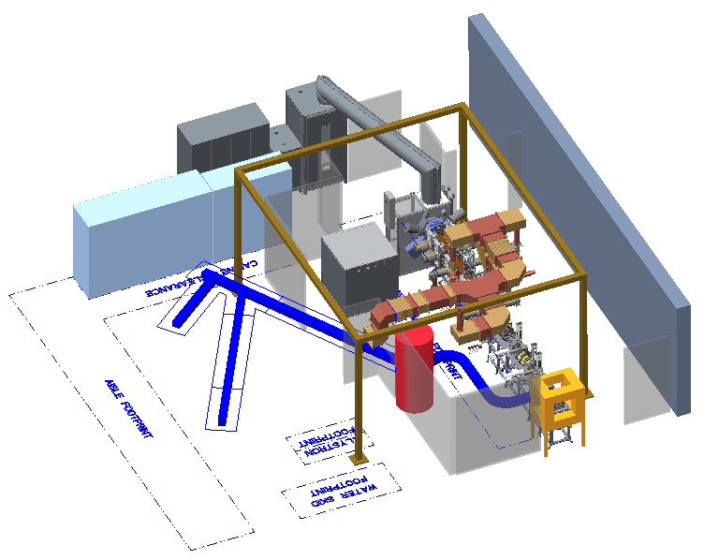
NORTH
MODERATOR DEMONSTRATION FACILITY

Slide 46
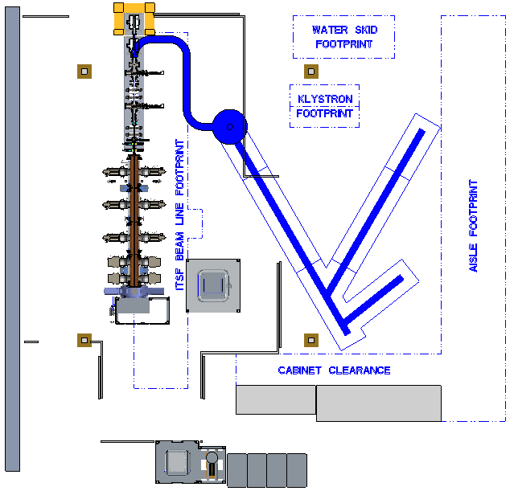
chopper
Pulse width: 1- 20us
Repetition rate: 60Hz
Rise/fall time: <20ns
Electrostatic deflector
30-40cm long
6-10kV pulse V
SECTION VIEW THROUGH UPPER BEAM LINE

Slide 47
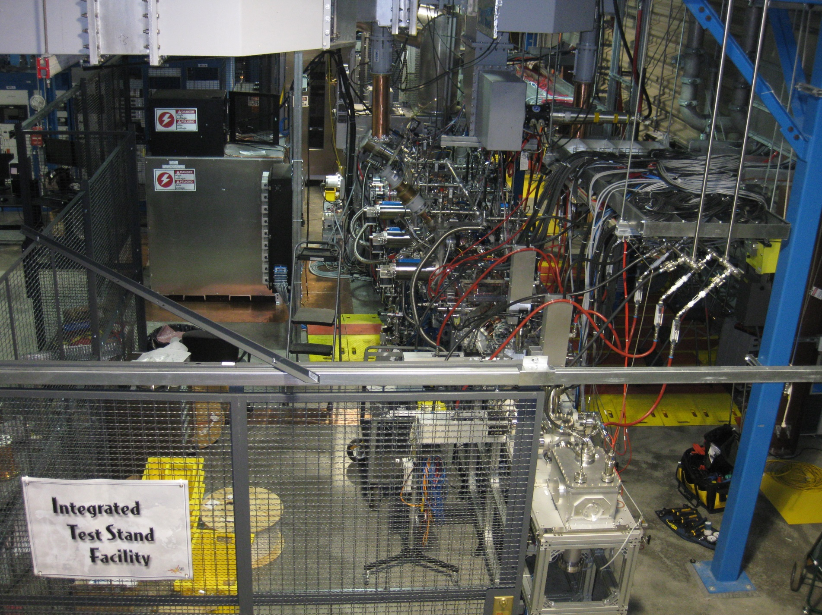
Integrated Test Stand Facility in January 2015

Slide 48
Relevance of SNS experience for ESS MEBT chopper
How difficult will be incorporating the idea of (new) SNS chopper structure for ESS MEBT (design and fabrication of driver, electrodes, etc.)?
  The new SNS MEBT chopper kicker is very simple to design and easy to build
  The most difficult part was to find suitable vacuum feedthrough

Slide 49
Relevance of SNS experience for ESS MEBT chopper
2)-In case of using SNS chopper technology for ESS MEBT chopper structure, How difficult will be modification of its power driver based on available standard components in the market (we have 4kV/10 ns with flat top of minimum 20 us)?
  The SNS HV pulse driver still requires significant development to achieve acceptable reliability. Maybe it is easier to start from scratch with modern components
  The SNS HV pulse driver has much higher average power requirements compared to ESS chopper

Slide 50
3)-Apart from the 'new' SNS Chopper, what do you think as an other mature proven(tested) option of chopper structure and its power supply for ESS MEBT parameters? (considering our limited resources of 1-2 persons and 1-2 years time) First beam tests are foreseen for 2018 in Lund. Considering the developments and Lab. tests we have to perform in-house…
  Electrostatic kicker
    Very simple mechanically
    Only one or two non-RF HV feedthroughs
    No need for HV high power load
    Commercial HV switches are available: 10kV, 50A, 20ns
  Matched stripline kicker with disconnected load
    Commercial HV switches for commissioned
    Upgrade to high power HV driver if needed

