Slide 1
SPL Wire Position Monitor System
Wojciech Żak
CERN/ESS Fellow
with the support of A.Vande Craen and V.Parma, CERN, TE-MSC
5th Open Collaboration Meeting on Superconducting Linacs for High Power Proton Beams
18-19 March 2015

Slide 2
Outline
SPL Short Cyromodule
Application of the OWPM in the SPL Mock-up
Idea of the Optical Wire Position Monitor
Calibration at warm
Tests at liquid nitrogen
Intermediate conclusions
Fiber optics
Future steps

Slide 3
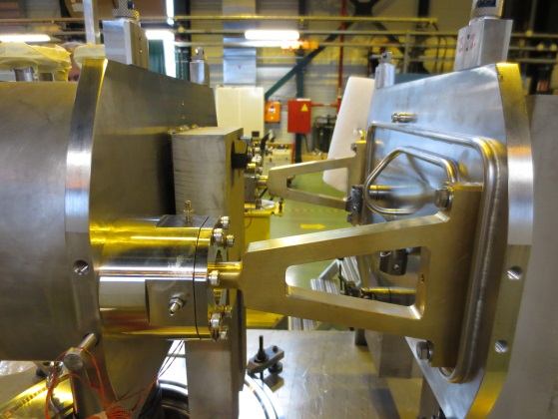
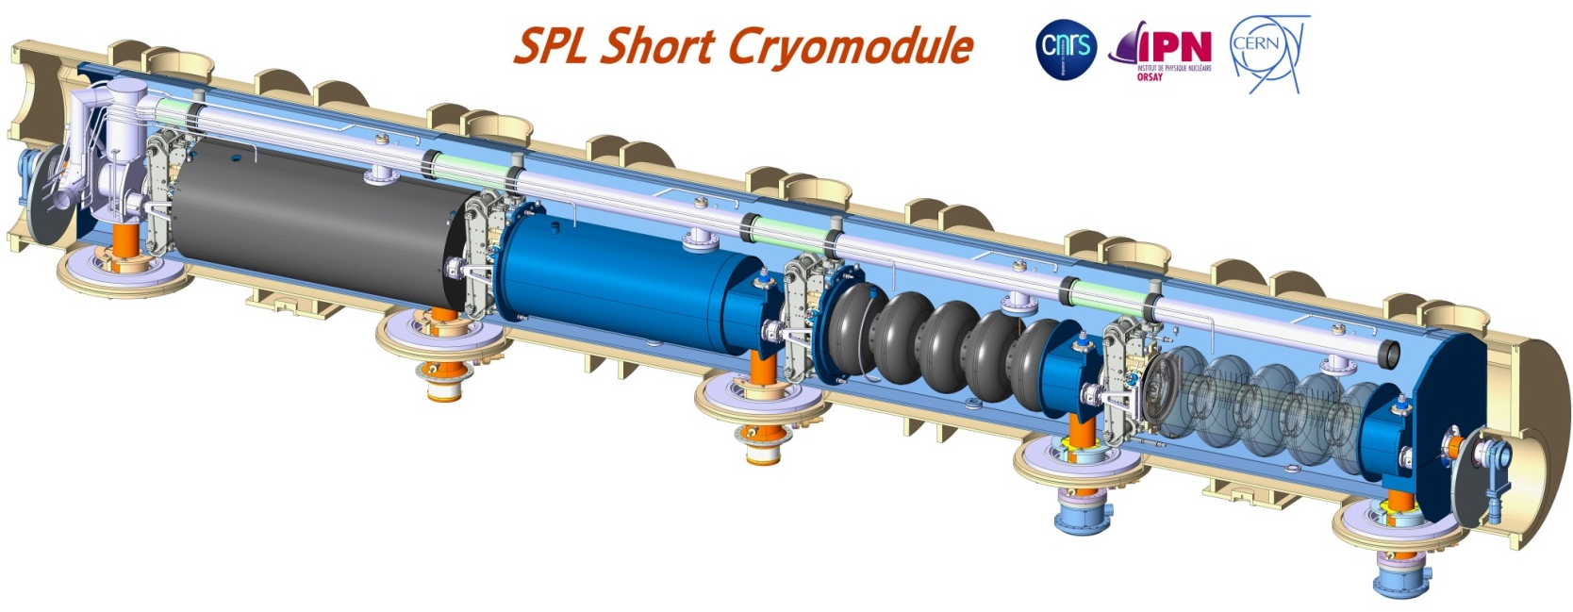
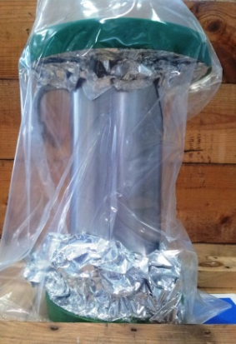
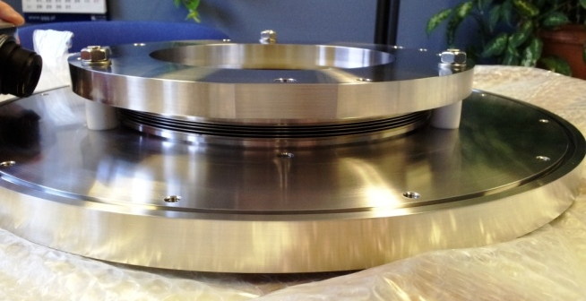
SPL Short Cryomodule
IC support
DWT
DWT flange

Slide 4
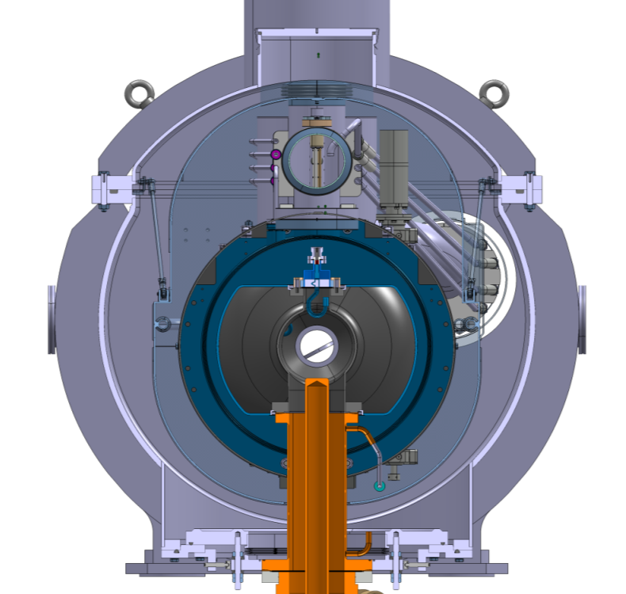
OWPM position on the SPL SCM
Stretched wire measuring system interface
Courtesy of CNRS

Slide 5
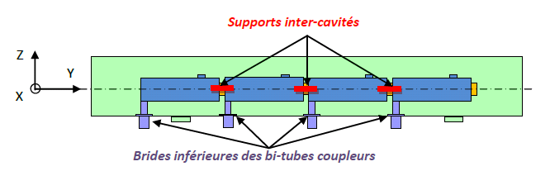
SPL SCM Cavity position monitoring specs:
Static position or slow movements: absolute movements (x,y,z) of each of 4 cavities during steady state operation and cool-down/warm-ups (300-2K)
Vertical range 0-2 mm
Precision < 0.05 mm
Resolution < 0.01 mm
Possibly vibration measures (0-1 kHz)
Stretched wire
Opto-coupler sensors
Last cavity support
Courtesy of V. Parma

Slide 6
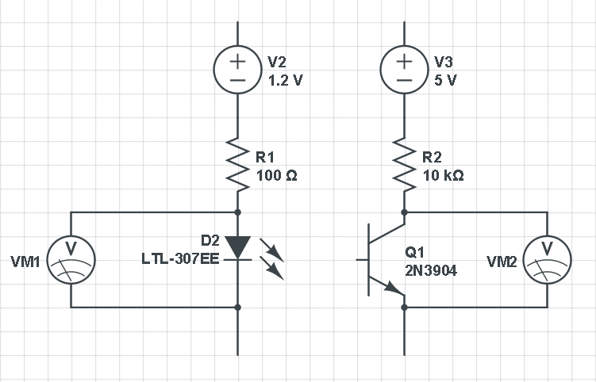
How does it work?
wire

Slide 7
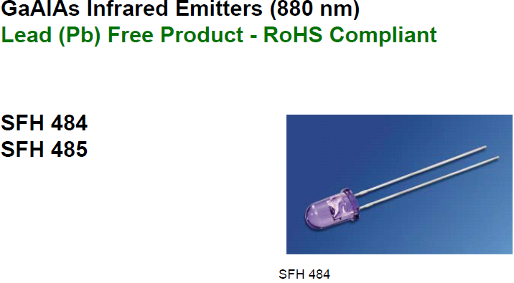

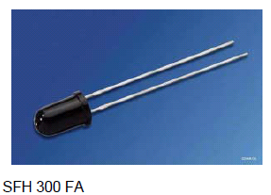
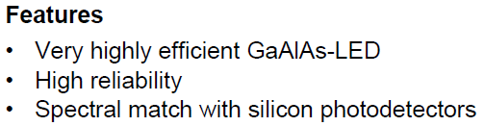
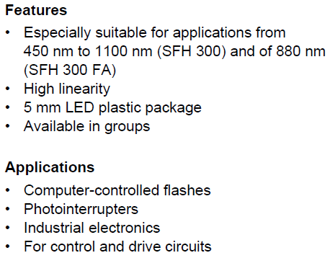

LED and photo-transistor

Slide 8
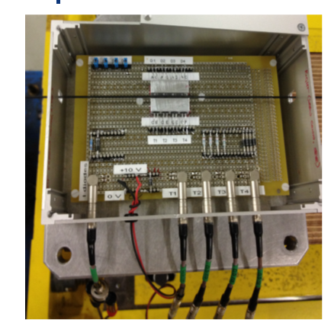
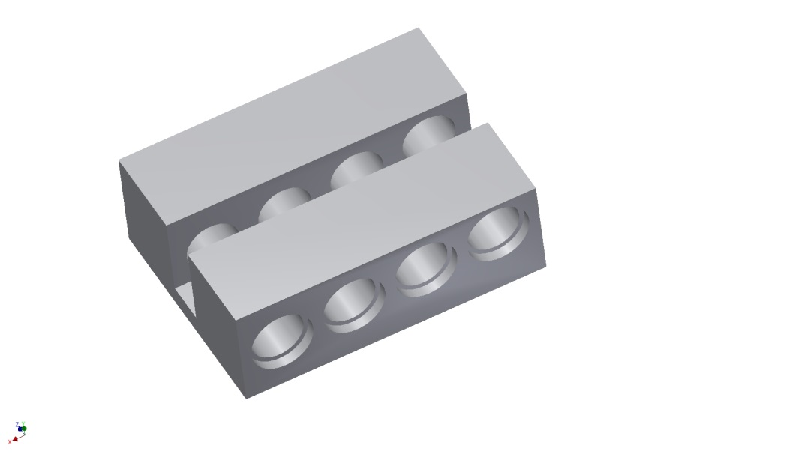
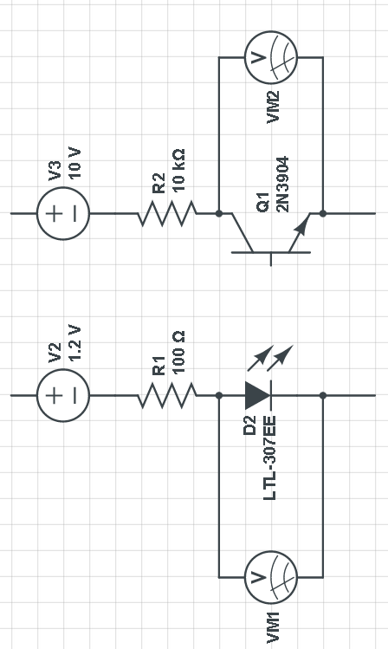
Tests setup for room temp
We expect to cover 0.5 mm range with one LED and phototransistor, to fullfill requirement our sensor will be equiped with 4 set
wire
Wire was move by high-precision, linear stages, providing an accuracy of 1 µm on 150 mm maximum displacement.
Box to shield the environment light noise,
setup with 2.5mm wire

Slide 9
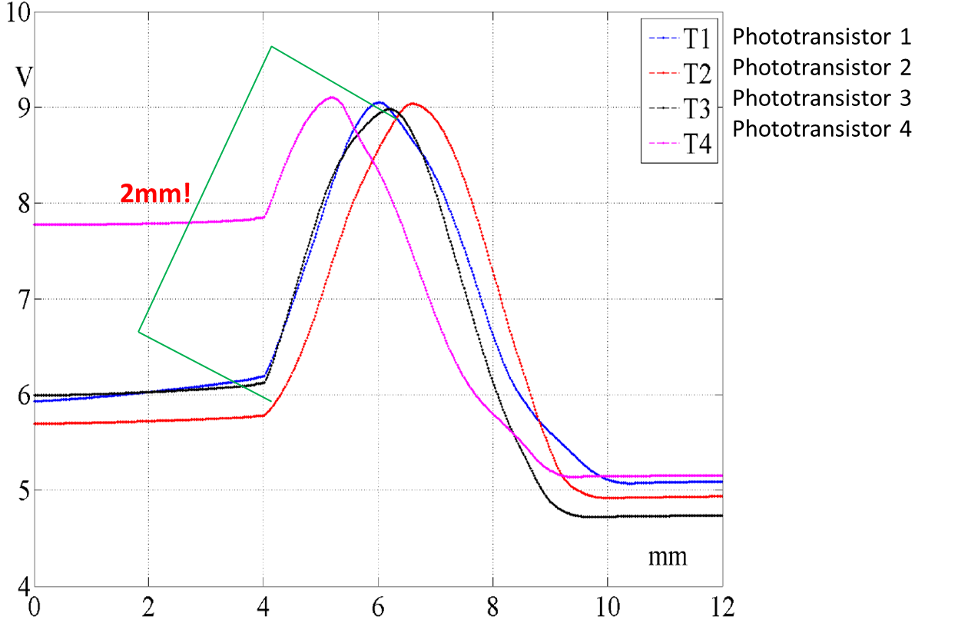
Results
Output voltage signal variations according to the movement of the 2.5mm wire
Courtesy of C. Petrone

Slide 10
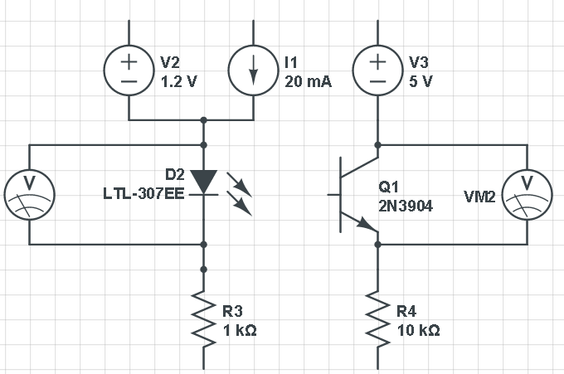
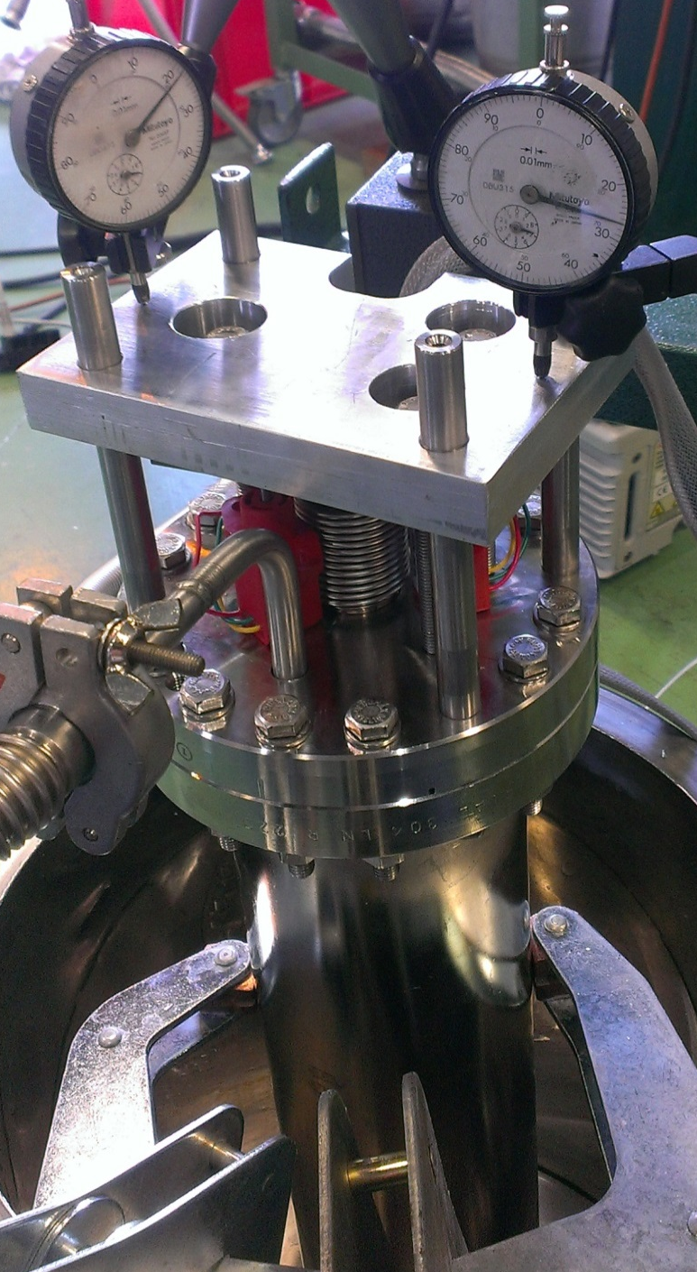
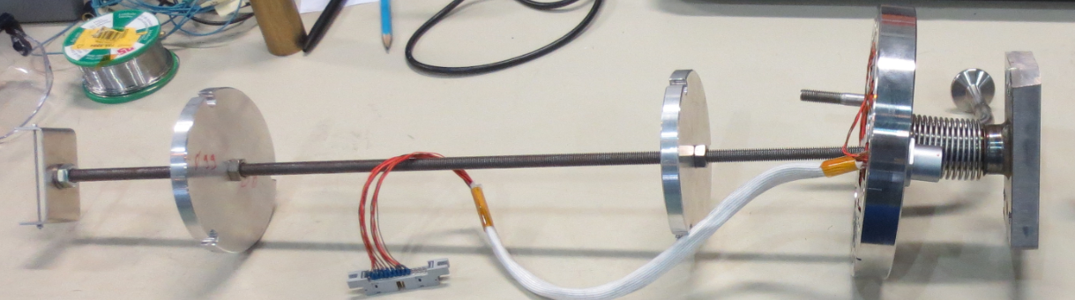
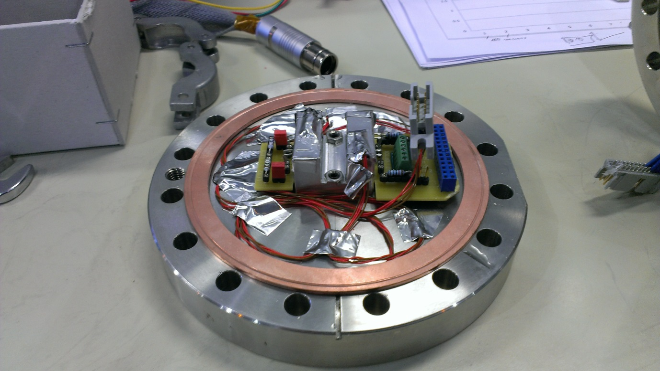
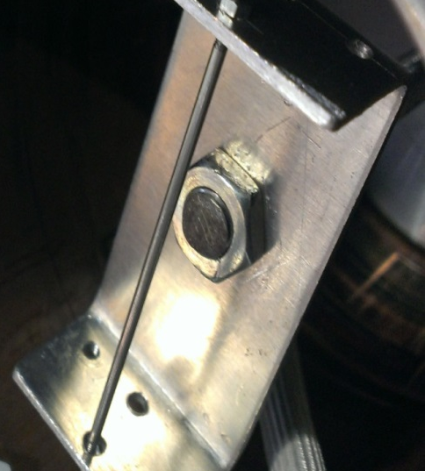
Test setup for LN

Slide 11
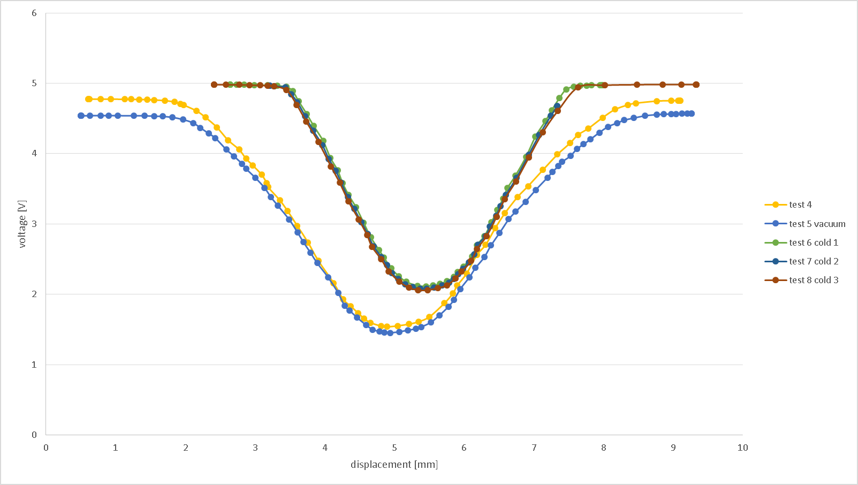
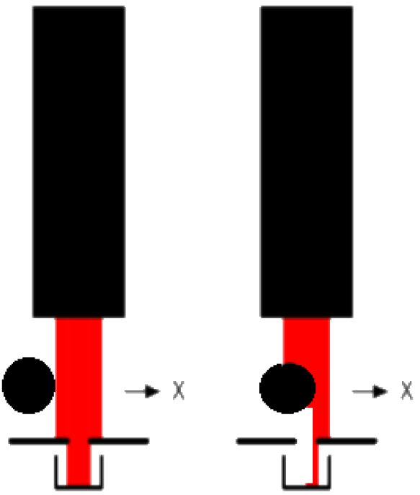
Results of tests in LN (φ2.5 mm wire, no current adjusting: no reference LED and phototransistor)
1.5mm

Slide 12
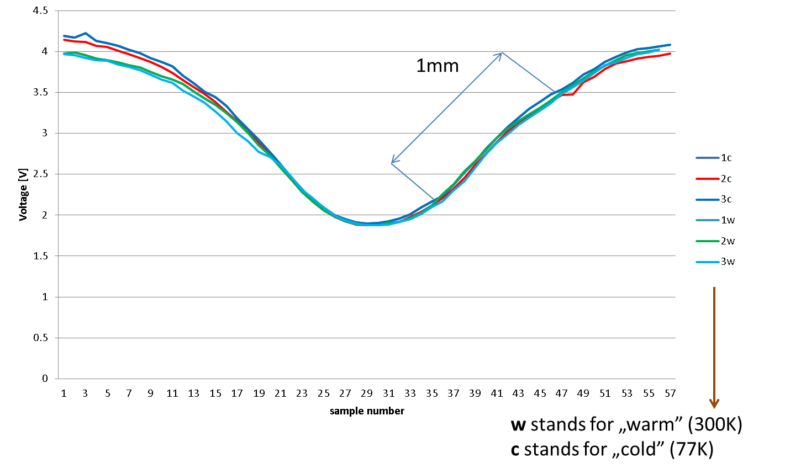
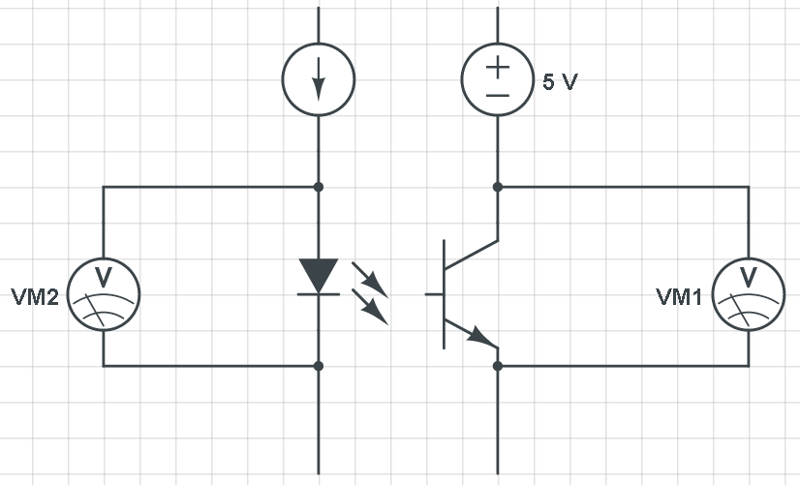
Results of tests in LN (φ1.5 mm wire, adjusting current: system equipped with reference LED and phototransistor)
Reference LED and phototransistor

Slide 13
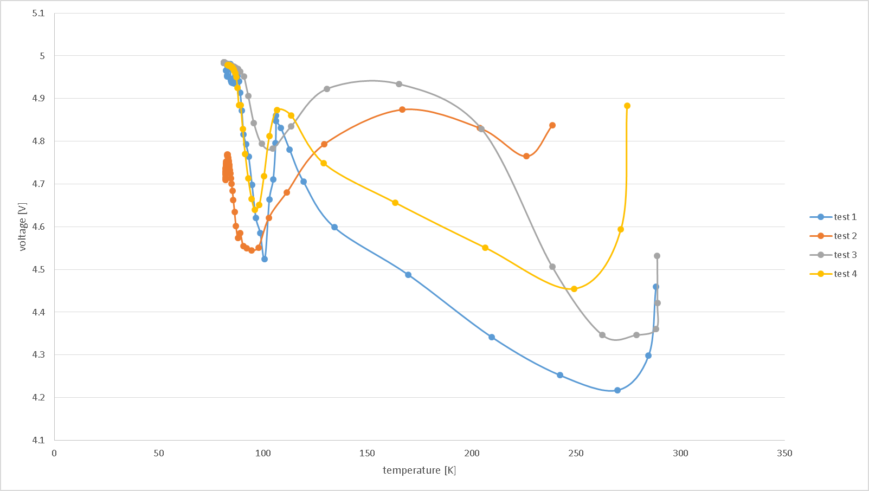
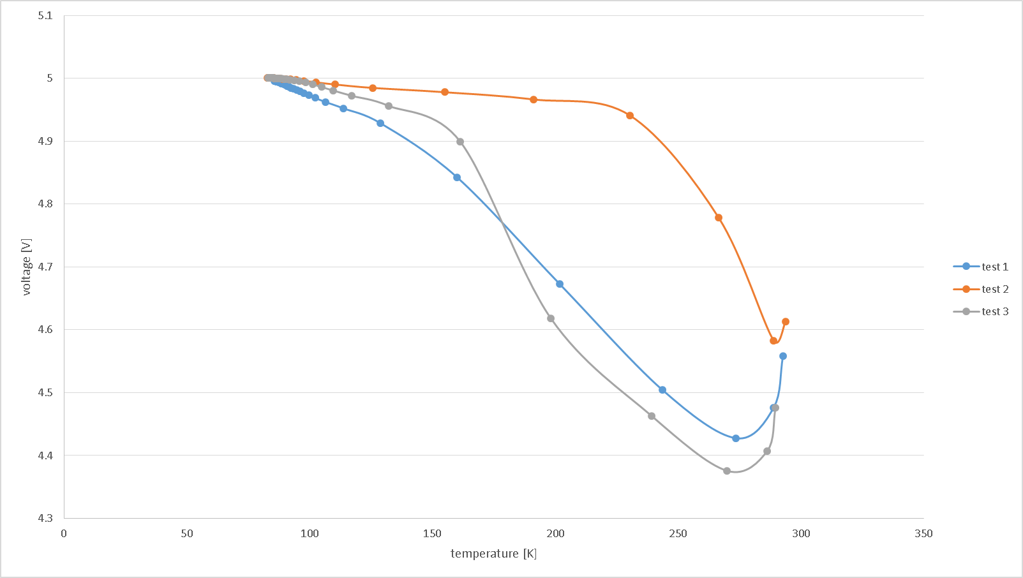
Voltage drop over time for phototransistors
NO linear response and unreproducible behavior with temperature

Slide 14
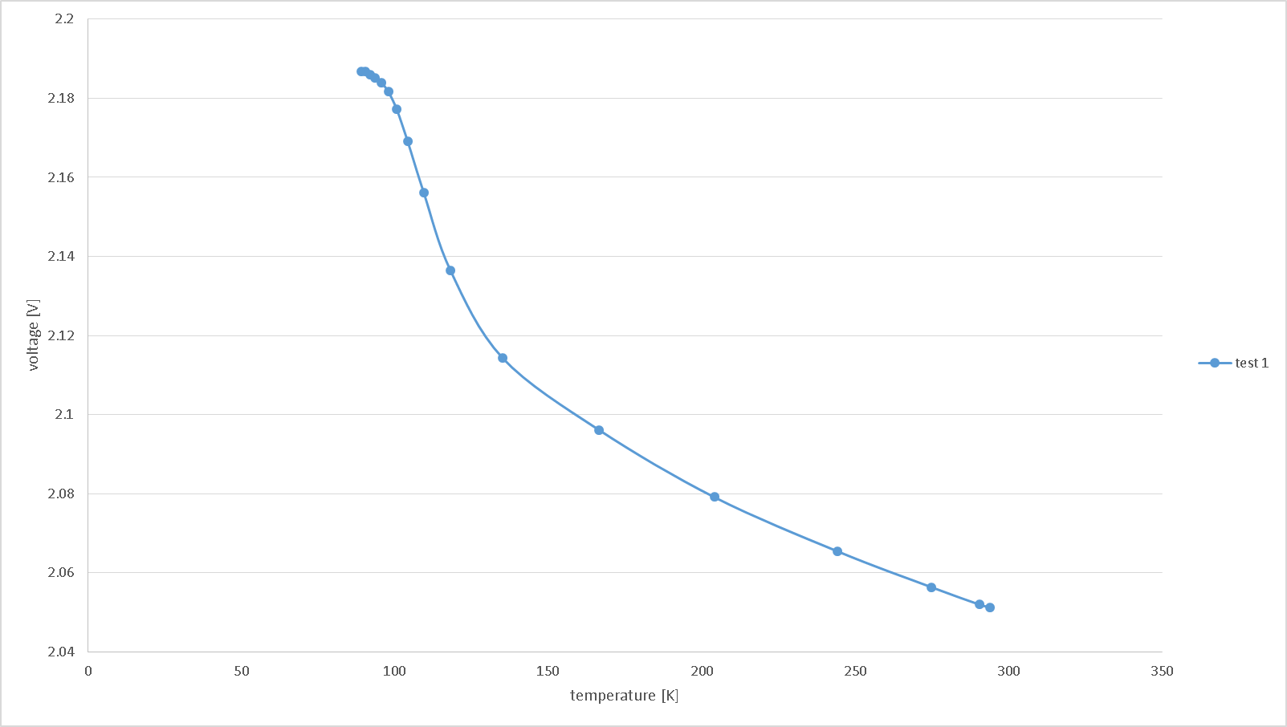
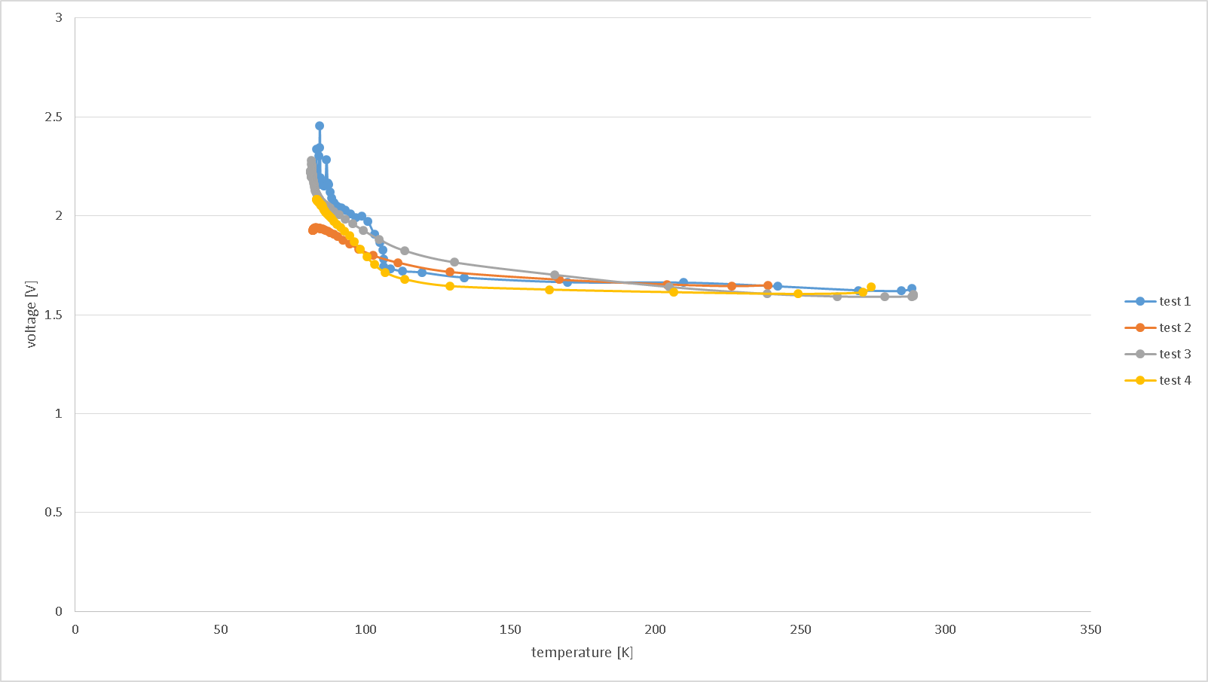
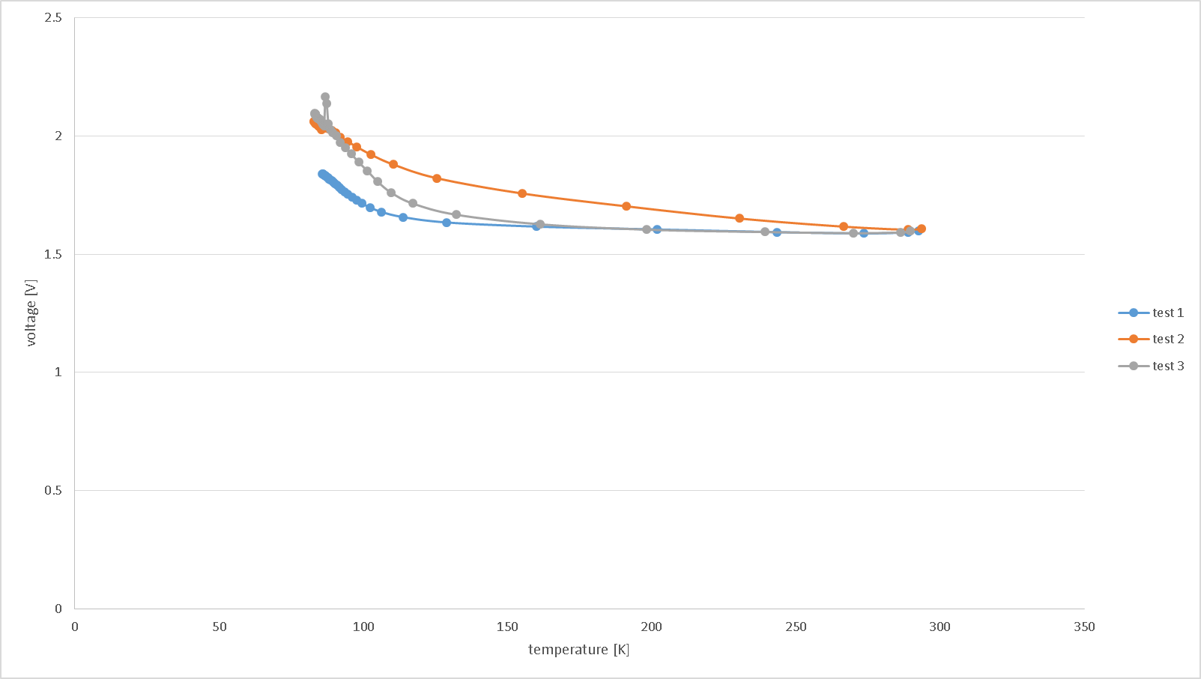
Voltage drop over time for LEDs
NO linear response and unreproducible behavior with temperature

Slide 15
Intermediate conclusions
Despite quite good results at room temperature and steady state conditions in low temperature the are some disadvantages:
No linear reaction with temperature
We’re “blind” during transient period
Properties of phototransistors and LEDs strongly depends on the temperature
Receiver/LED has different behavior even from the same series
We need “Cinderella” to find enough pairs for our sensors (64 in total)
Sensors should be equipped with a temperature sensors
Final application: 64 sensors => 10 wires each => 640 cables
temperature independent sensor
put as much as possible electronic outside the cryostat

Slide 16
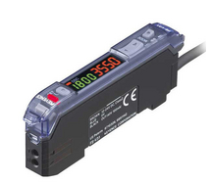
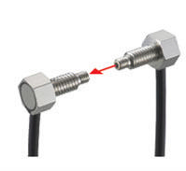
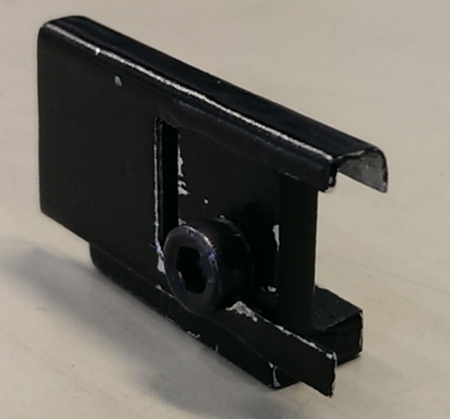
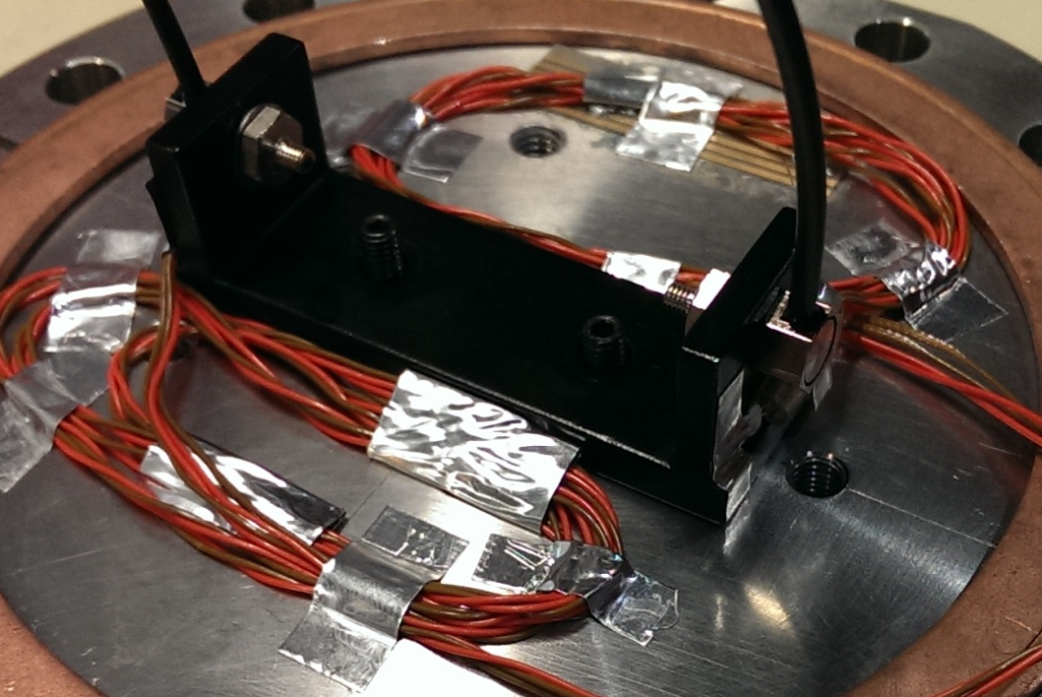
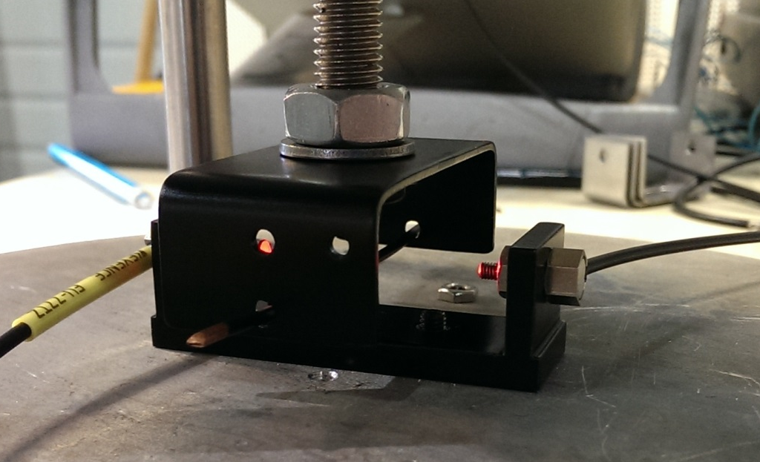
Fibre optic
Commercially available product:
Out of the shelf
Relatively inexpensive
Really easy to use
Flexible in configuration
But never:
tested in cryogenic temperature
used for this application
Couresty of Keyence Corporation
Collimator
Most of the parts have been anodized in black optic

Slide 17
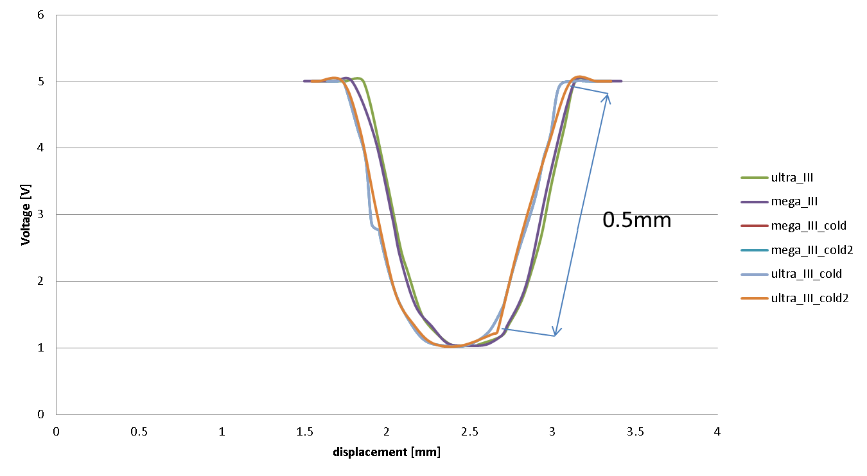
Results (φ1mm wire, φ1.3mm fiber)
NO change after ~20 thermal cycle

Slide 18
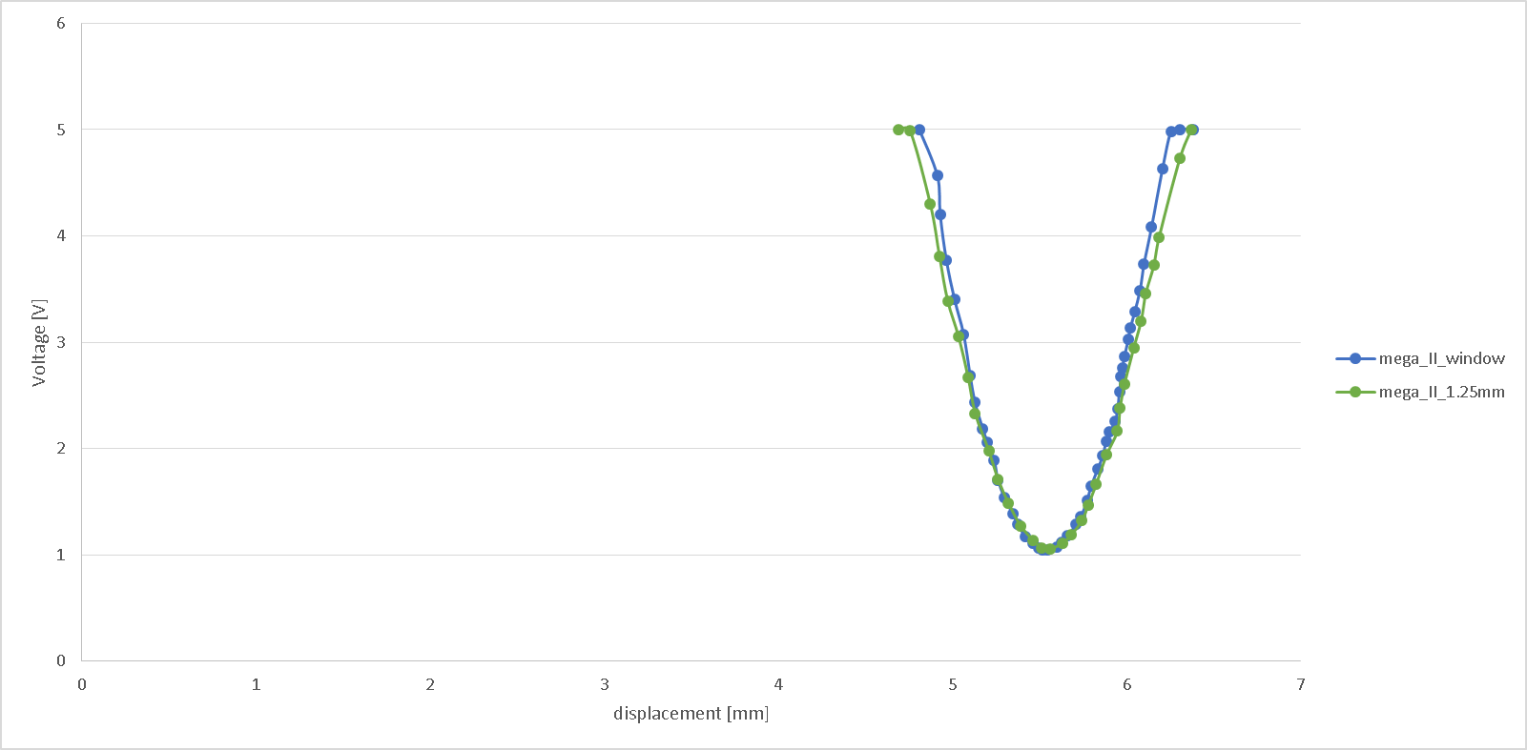
Results (φ1.3mm wire, fiber φ1.5mm)
0.65mm

Slide 19
Voltage change with temperature for fibre optic
0.7mV
~1 nm
Temperature INDEPENDENT

Slide 20
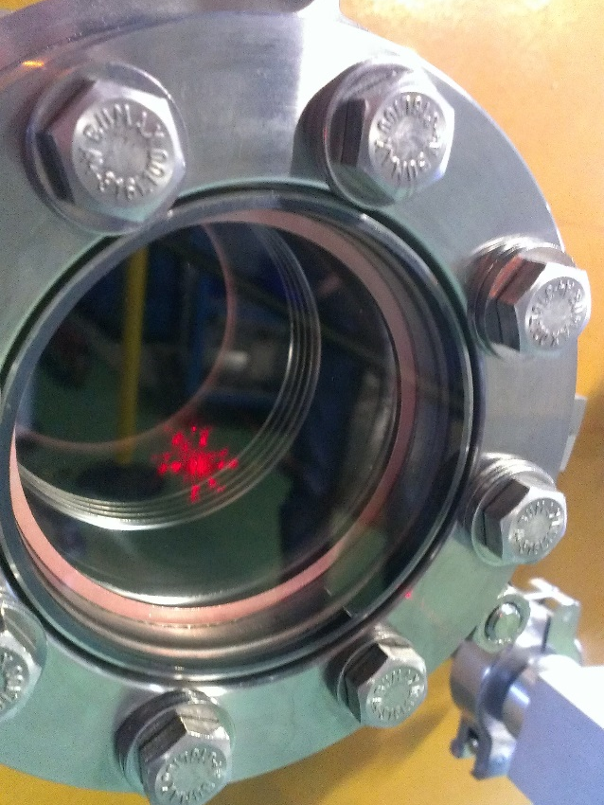
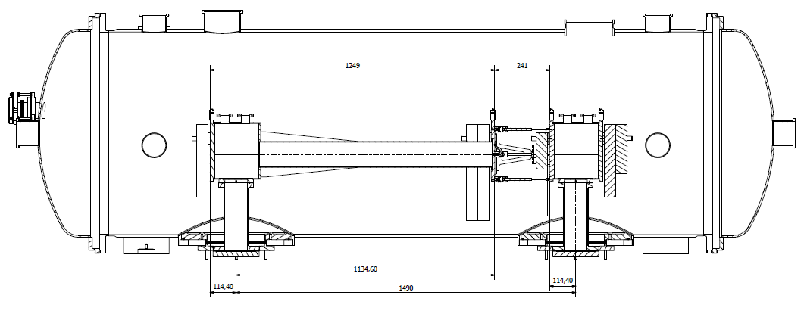
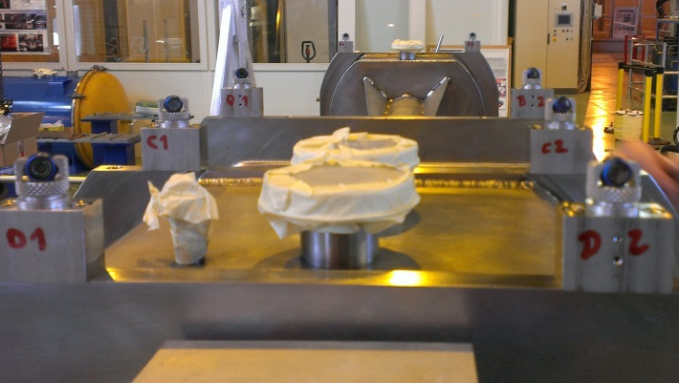
Future steps
Test bigger fibers (φ2 mm internal)
Build the feed thru
Check cross-talk
Procure more components
Try to make a test in helium
Cross-check with laser tracker
Test everything in the SPL mock-up

Slide 21
Thank you for you attention!
Questions?

