Slide 1

Progress on ESS development of the SML long pulse klystron modulator
Carlos A. Martins
ESS – Accelerator Division - RF Electrical Power Systems
www.europeanspallationsource.se
March 18th , 2015

Slide 2
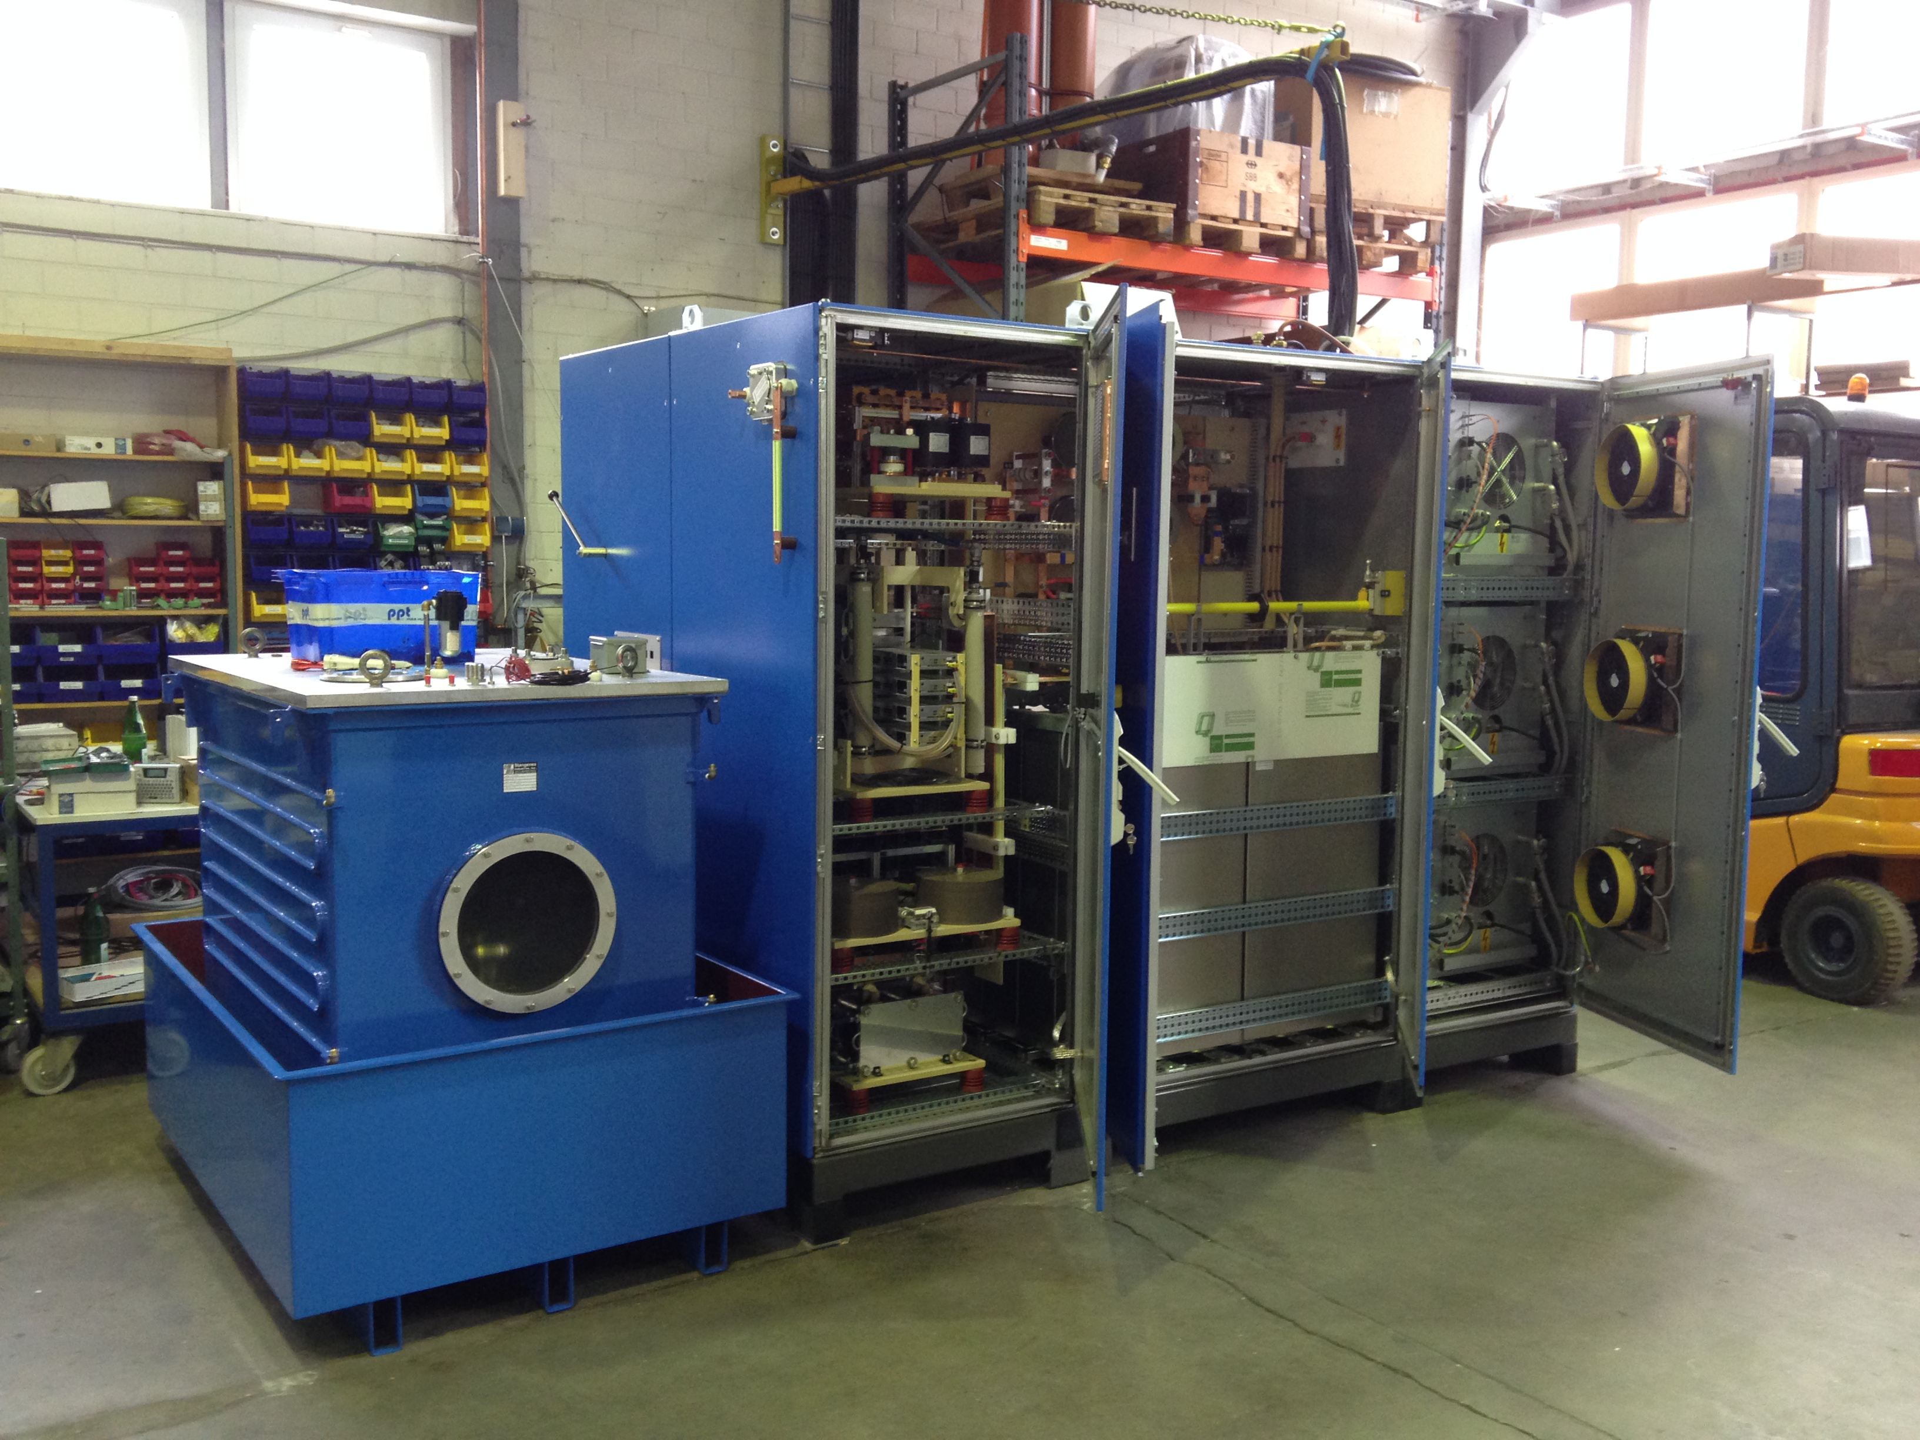
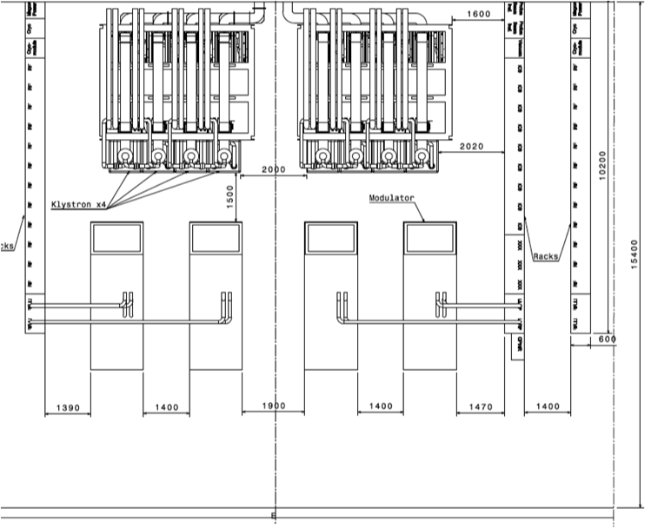
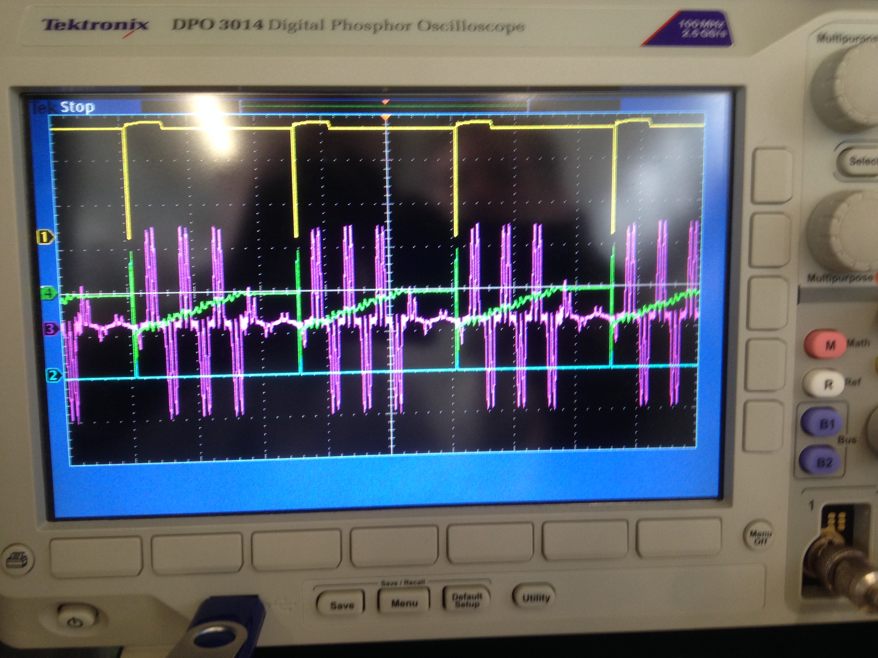
Motivations - I
Introduction
Klystron / IOT modulator strategy
1) – CERN RF Test Stand modulator
One section of the RF Gallery (8x 704 MHz RF sources)
Able to drive only one 704 MHz klystron
No space available for klystrons, RF distribution;
Flat-top droop: ~3%;
Efficiency: ~88%;
Large capacitor bank : high level of stored energy;
High cost (=0.5 p.u. x 130 = 75 p.u.);
Prohibitive flicker level on the AC grid, poor power quality
Purple: AC line current
Green: Capacitor bank voltage
2

Slide 3
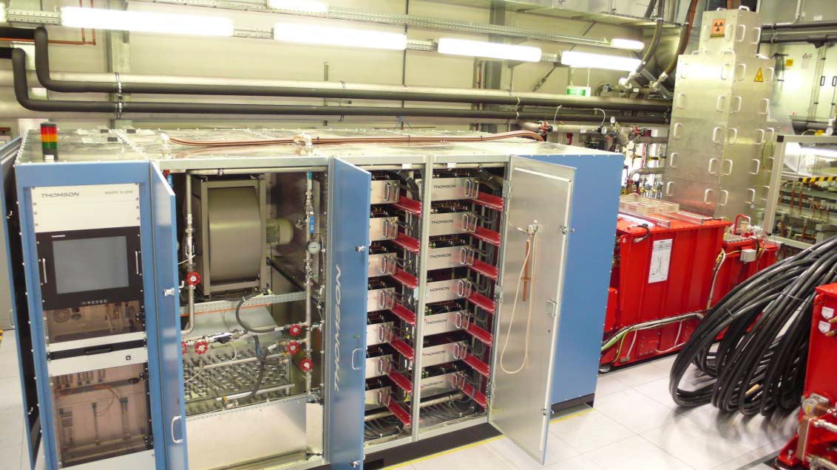
Motivations II
Introduction
Klystron / IOT modulator strategy
2) – XFEL modulator
One section of the RF Gallery (8x 704 MHz RF sources)
Can drive two 704 MHz klystrons in parallel;
Do not fit in the RF Gallery;
High components count;
Large Pulse Transformer in oil tank;
Considerably costly (= 0.75 p.u. x 65 = 48 p.u.);
3

Slide 4
Motivations III
Main requirements for ESS klystron modulators
Able to drive four 704 MHz klystrons in parallel (i.e. 12 MW pulsed power for 3.5ms/14Hz ; 660kVA average power on the AC grid);
High power density -> reduced footprint;
High efficiency (> 92 %);
Modular system allowing to facilitate maintenance;
Minimal number of components in the HV oil tank;
High pulse quality (low rise time, high flat-top accuracy) COMBINED WITH High AC grid power quality (very low flicker, low THD, unitary power factor)
Cost effective (= 1 p.u. x 35 = 35 p.u.);
4

Slide 5
The Stacked Multi-Level (SML) modulator- Topology
One module
AC grid
50Hz
400V
High Voltage
DC or long pulsed
One module:
HF
Transf.
Filter
AC /
DC
DC /
DC
DC /
AC
AC /
DC
AC grid
50Hz
400V
DC-link
1.1 kV
AC
15 kHz
1 kV
AC
15 kHz
25 kV
AC + DC
15 kHz
25 kV
DC
(25 kV,
klystrons)
(12.5 kV,
IOT’s
Capacitor bank
1 kV
5

Slide 6
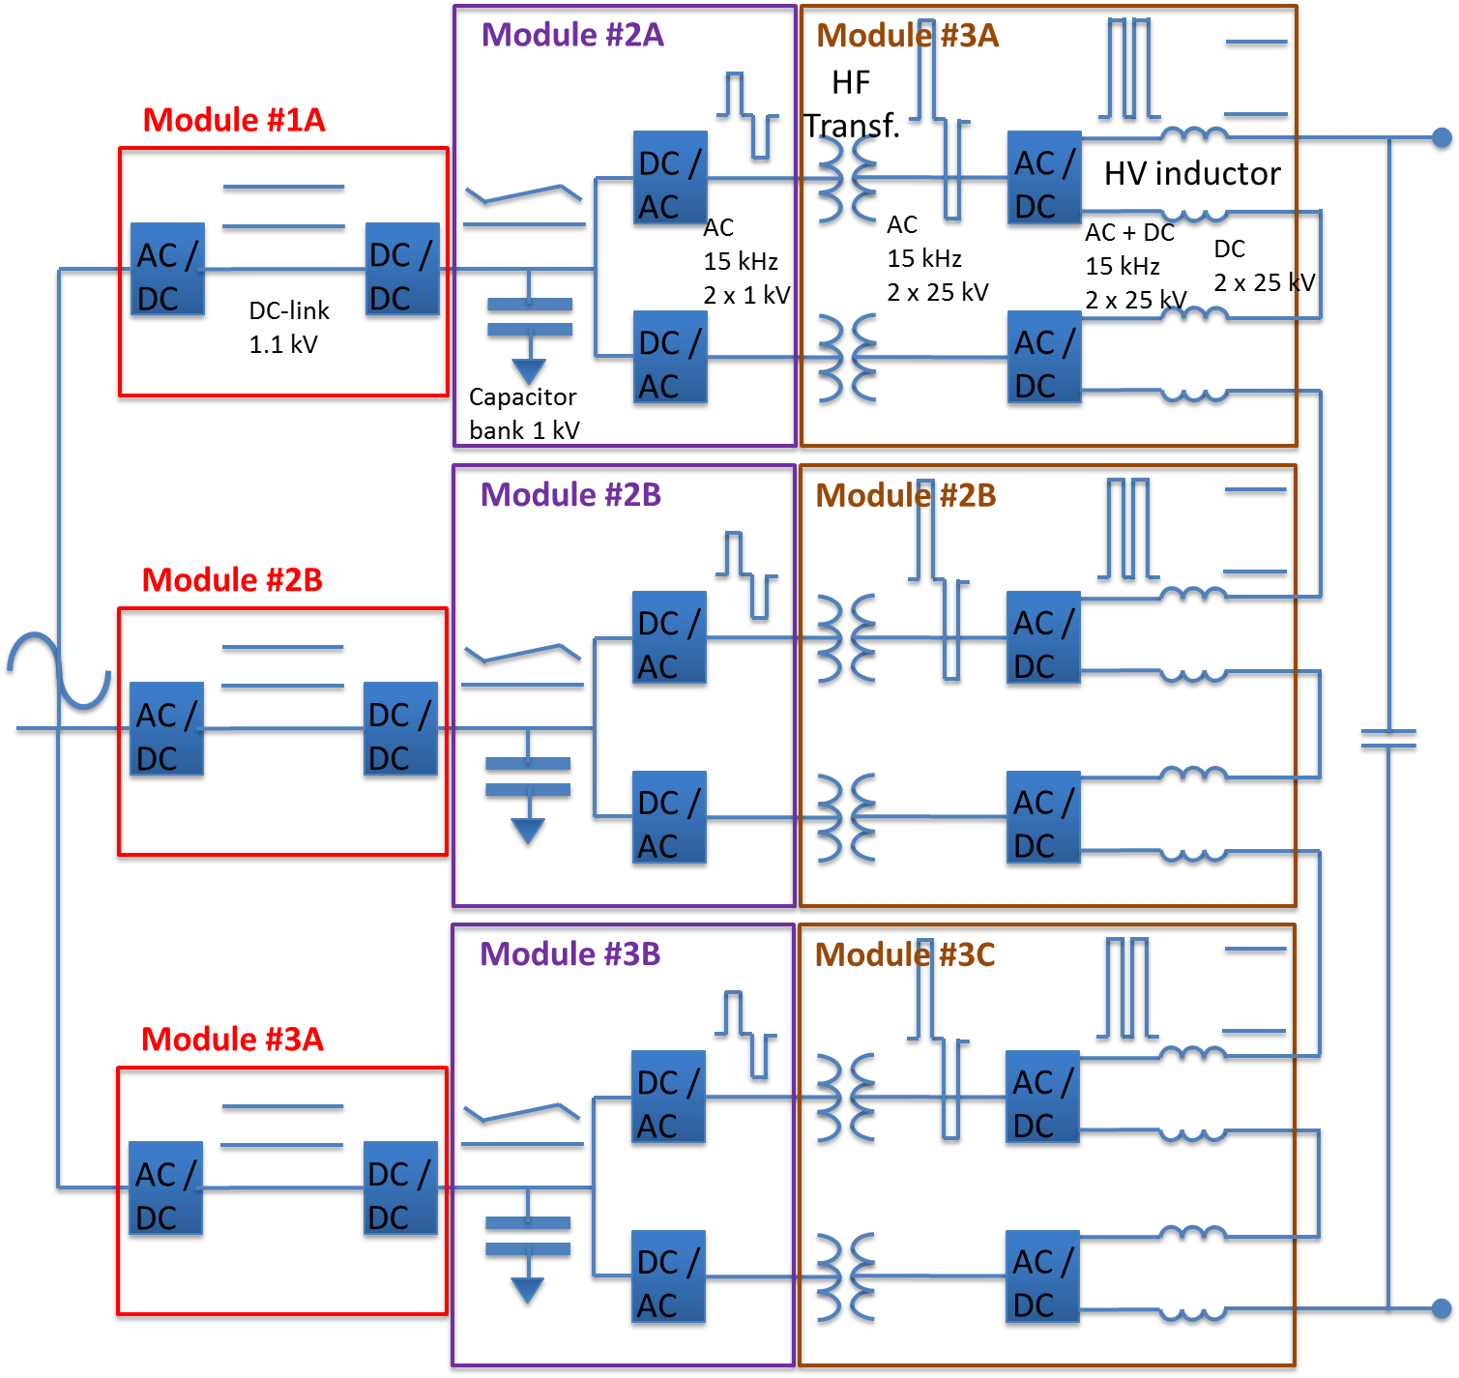
The Stacked Multi-Level (SML) modulator- Topology
6

Slide 7
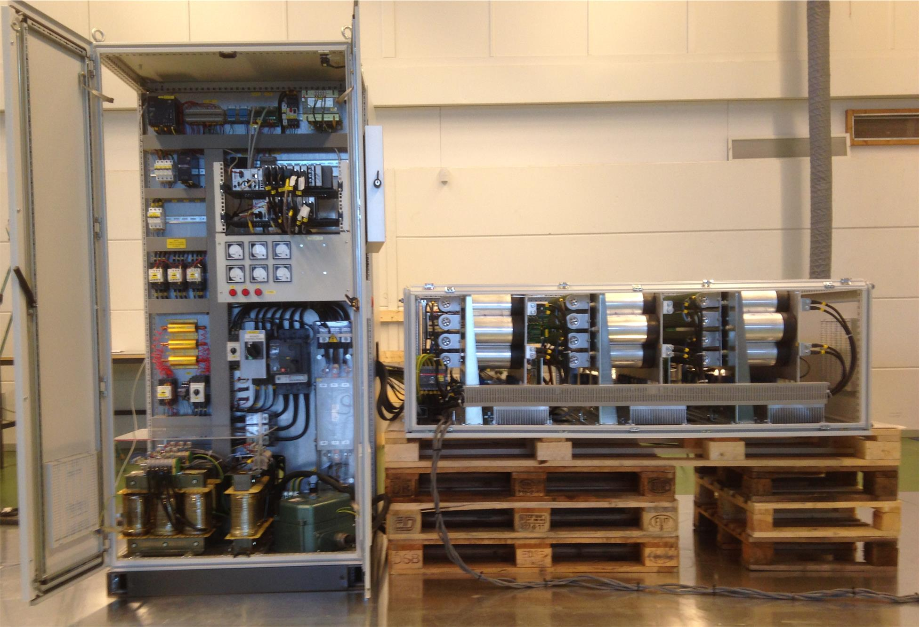
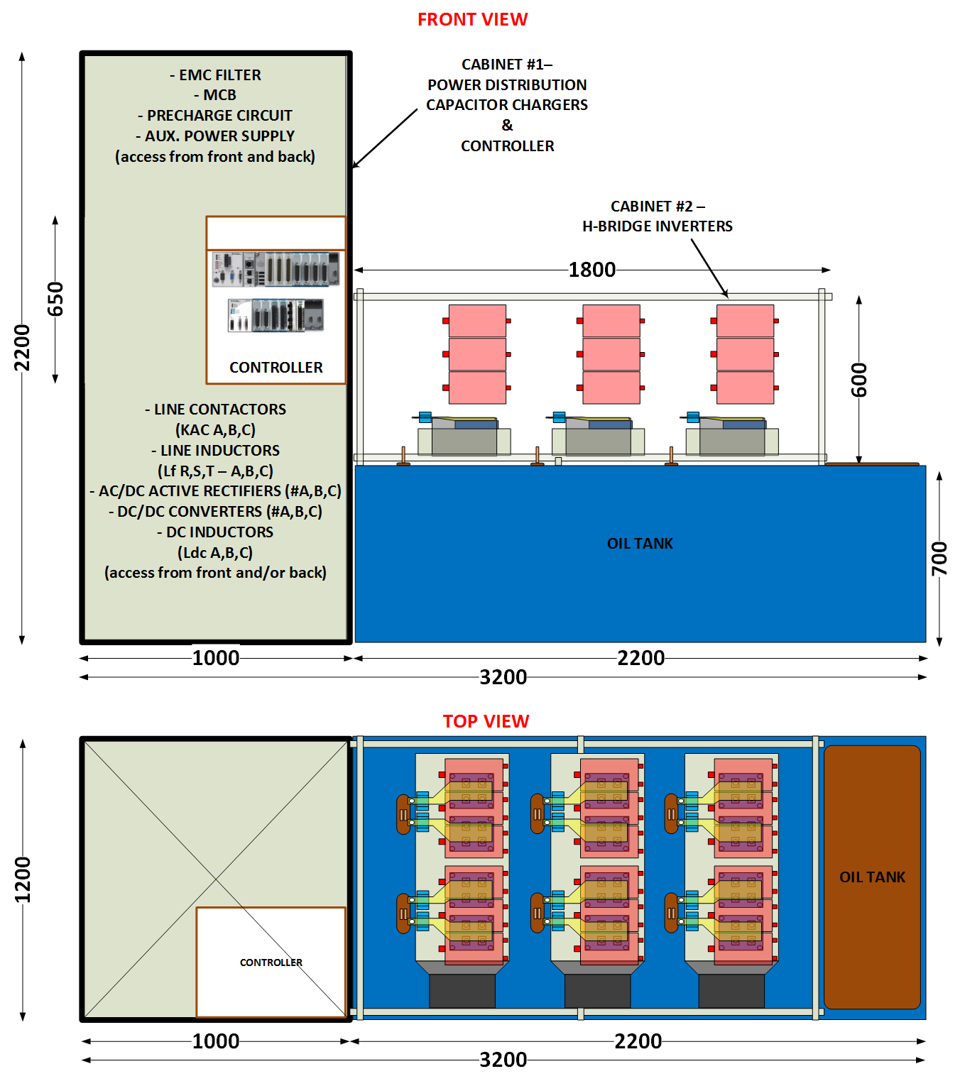
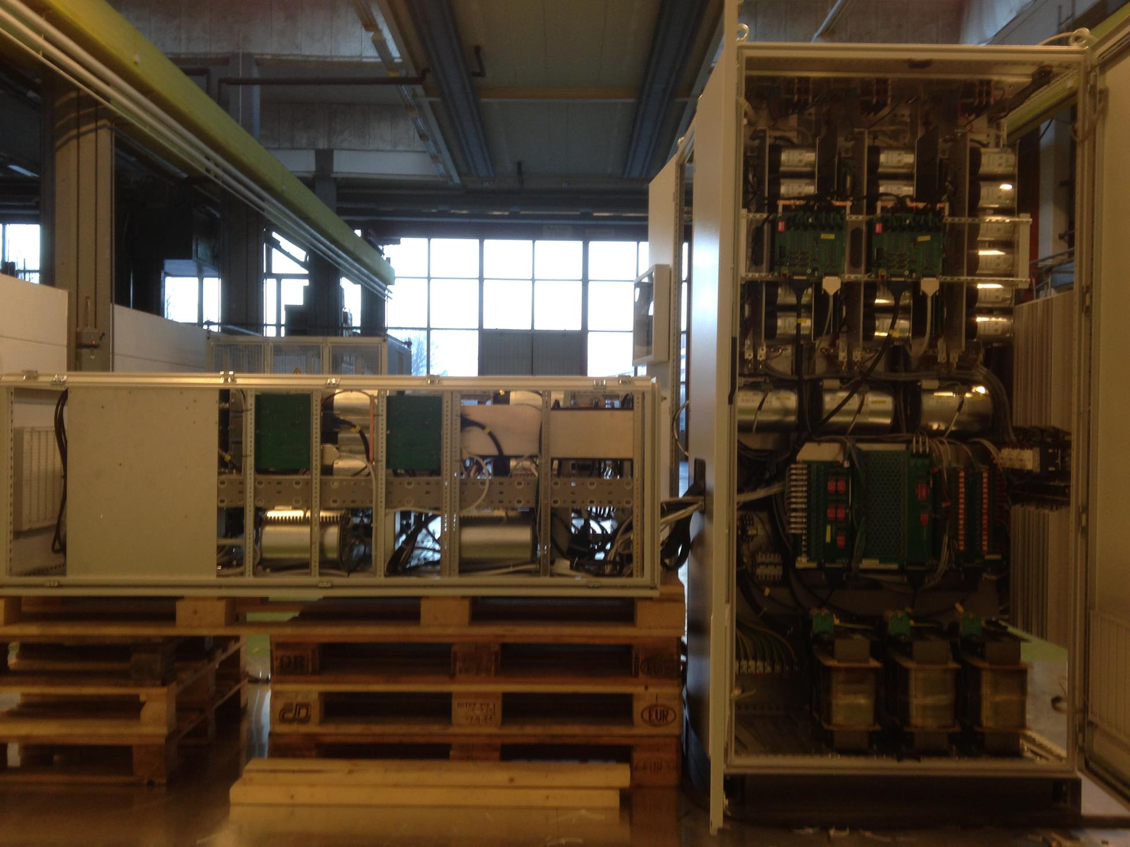
The Stacked Multi-Level (SML) modulator: - Mechanical layout
Design of HV oil tank assembly and components’ prototyping
FRONT VIEW
REAR VIEW

Slide 8
The Stacked Multi-Level (SML) modulator - Keypoints
Modular concept, allowing the increase of rated power by adapting the number of modules, keeping their size and weight under control. Facilitates maintenance;
Up to 660 kVA average power possible, allowing the supply of 4 x 1.2MW klystrons / IOT’s in parallel;
Compatible both with PULSED and CW operations and with different types of RF amplifiers (Klystrons, IOT’s, tetrodes, etc.);
Lower cost due to usage of standard LV components into a great extent (about 45% price reduction with respect to other topologies);
No active power electronic devices inside oil tanks (facilitates maintenance);
Reduced footprint/volume due to minimal sub-systems count;
Improved efficiency (~94%), due to minimal number of conversion stages;
Good pulse quality (~100µs rise time, <0.15% flat-top ripple, <1% voltage droop);
Good AC grid power quality (AC/DC + DC/DC allow constant power absorption = flicker-free operation, sinusoidal current absorption, unitary power factor);
8

Slide 9
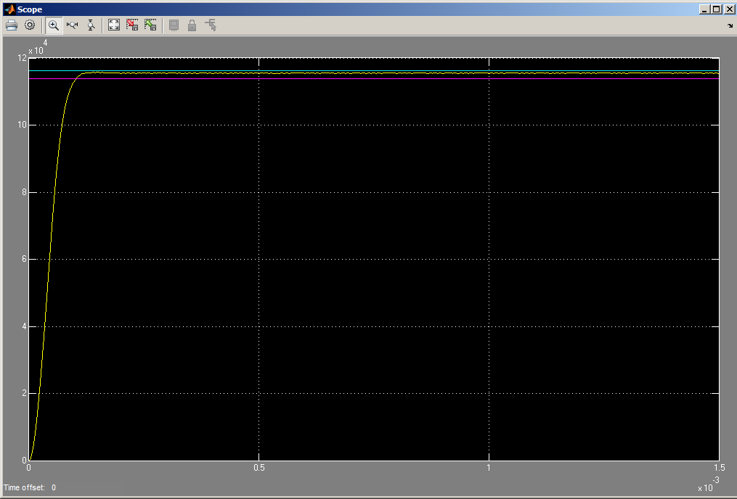
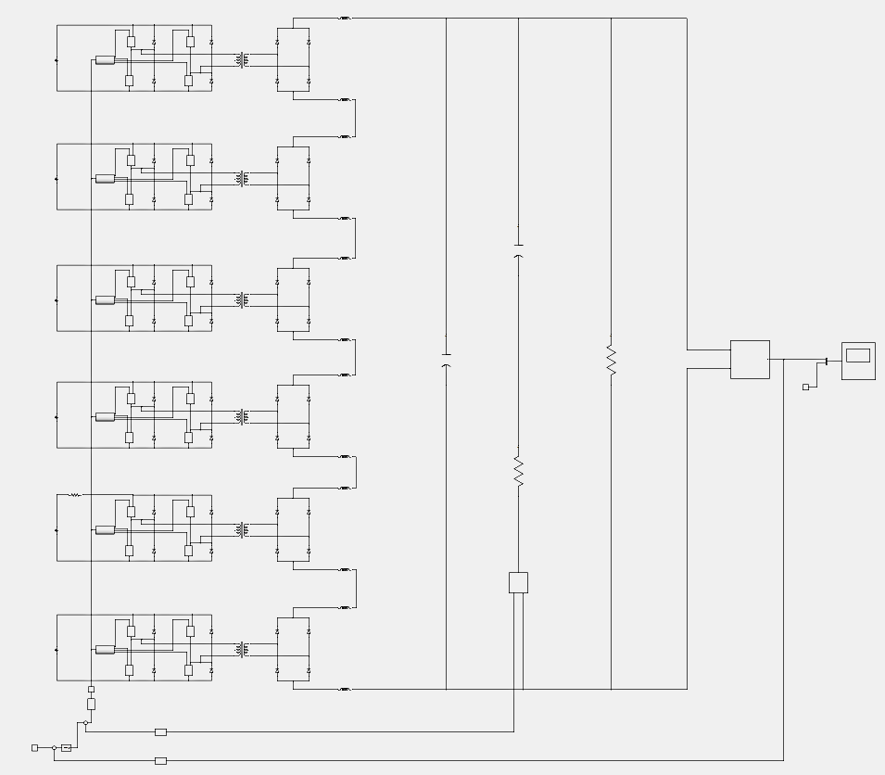
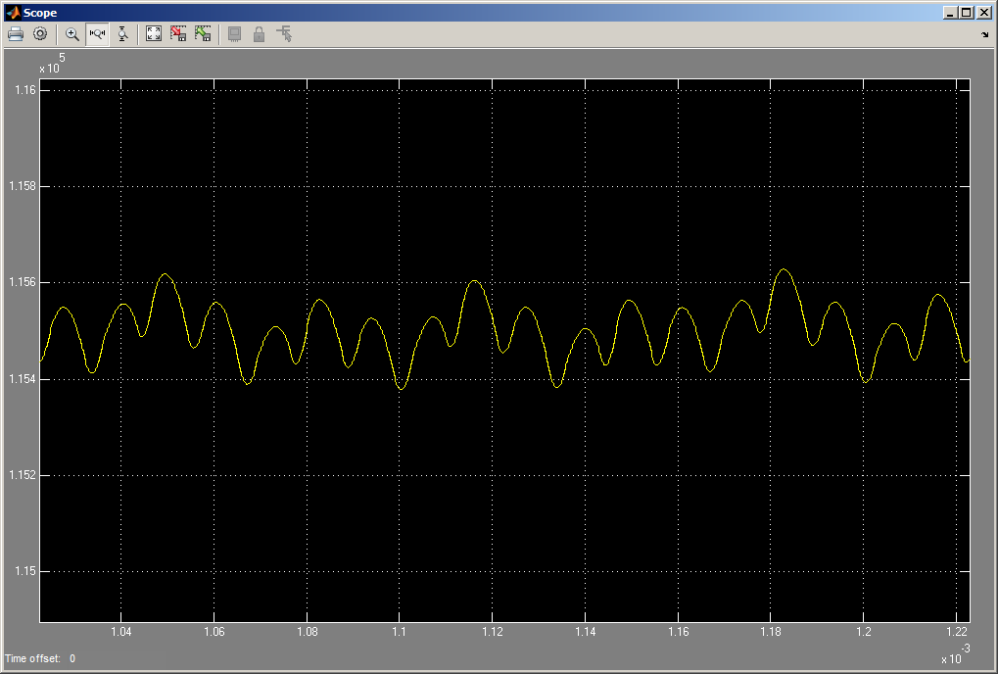
High Voltage Pulse Generation – Simulation results with models incorporating parasitic elements
Rise time (0..99%)= 100µs
Flat-top ripple (pk-pk)= 0.13% @ 90kHz
200V

Slide 10
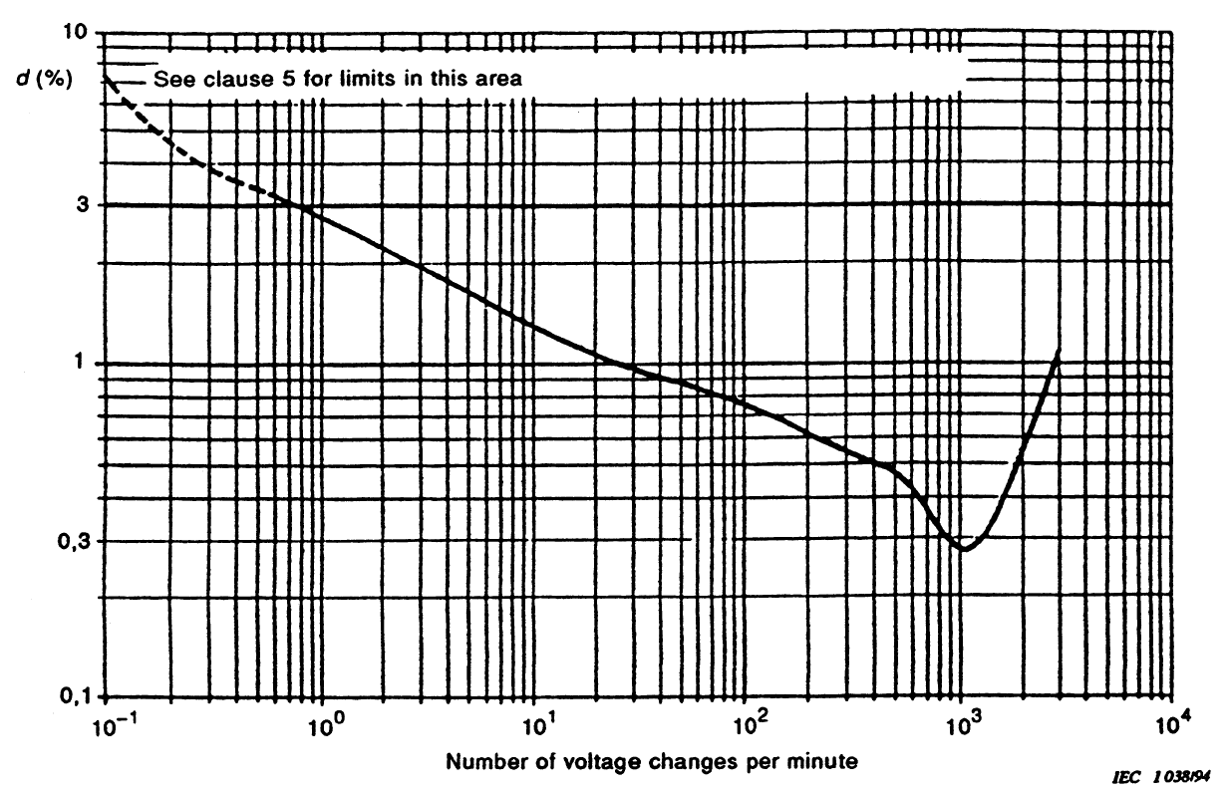
AC grid power quality – an All In One approach
Grid power quality (IEC 61000-x-x)
(dictated by the capacitor charger)
EMC (conducted noise, immunity & susceptibility)
Current harmonic distortion (depends on the capacitor charger topology)
Flicker (depends on the capacitor charger topology & on the charging control scheme)
Flicker standard IEC 61000-3-2 and IEC 61000-3-11 (low voltage public grids)
(ΔV/V)_{max}=0.3%
Capacitor Charger:
Active Front End + DC/DC converter with constant power regulation
14 Hz
Active Front End
10

Slide 11
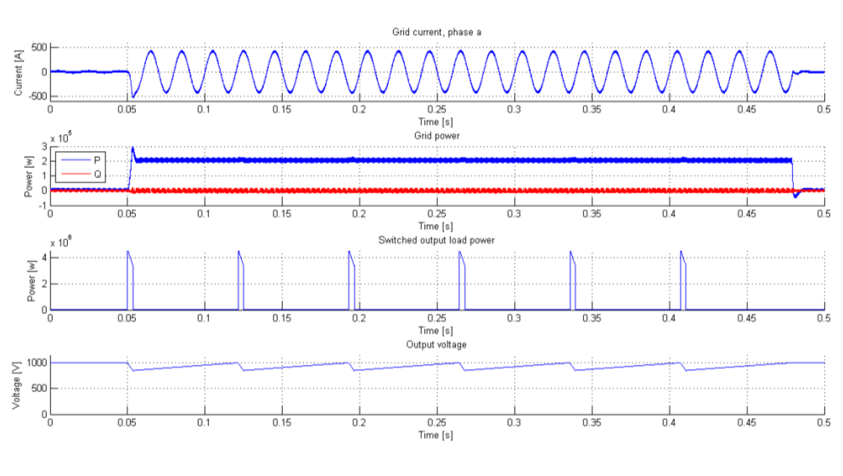
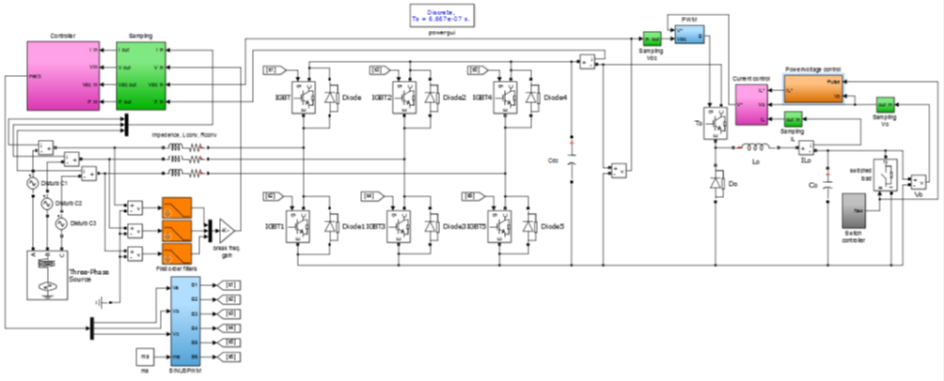
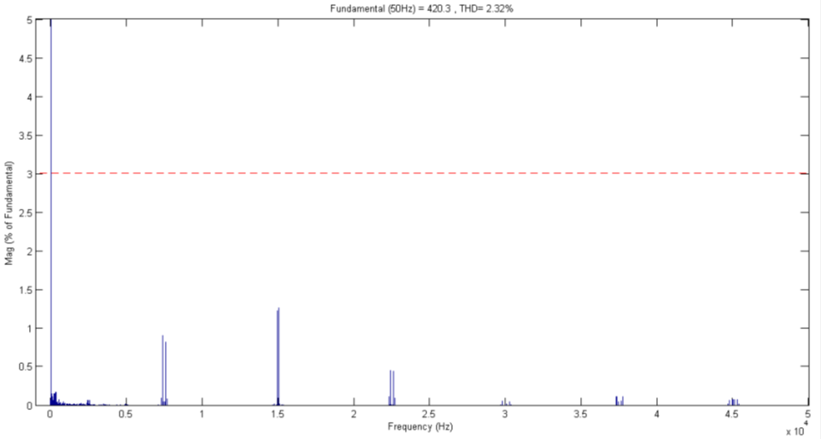
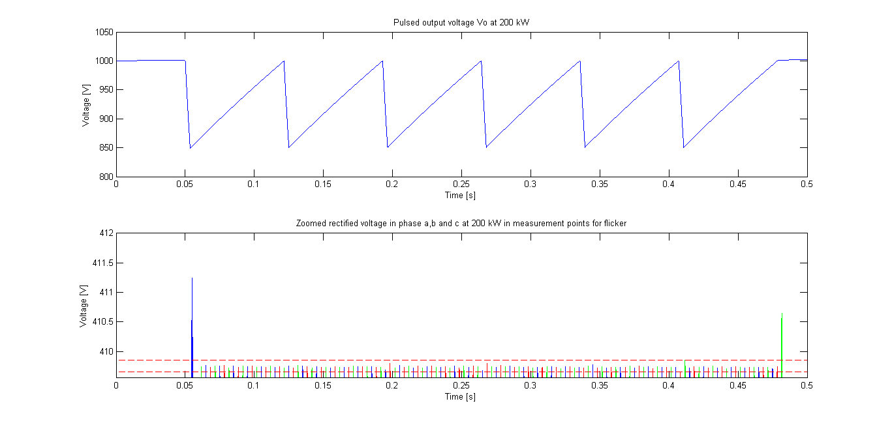
AC grid power quality – an All In One approach
Simulation results (1 module: AC grid AFE + DC/DC charger)
AC grid power quality, including Flicker
AC line current
AC grid active power
AC grid reactive power
Load pulse power
Harmonic spectrum of AC line current
Capacitor bank voltage
Capacitor bank voltage (zoom)
limit as per IEC 61000-3-2
Compliance with IEC 61000-3-2, class C
(THD = 2.3% wrt 13%@class C)
AC line voltage (zoom) - Flicker
Compliance with IEC 61000-3-3
(ΔV/V = 0.06% wrt 0.3%@14Hz)
11

Slide 12
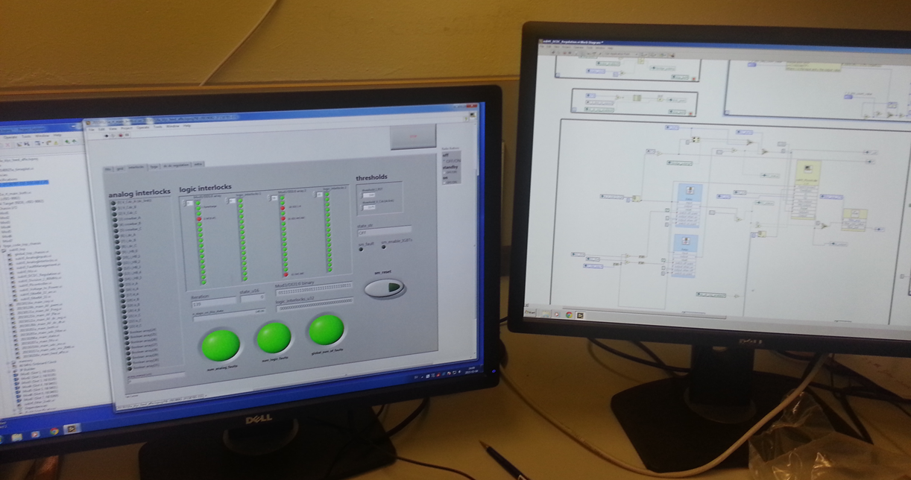
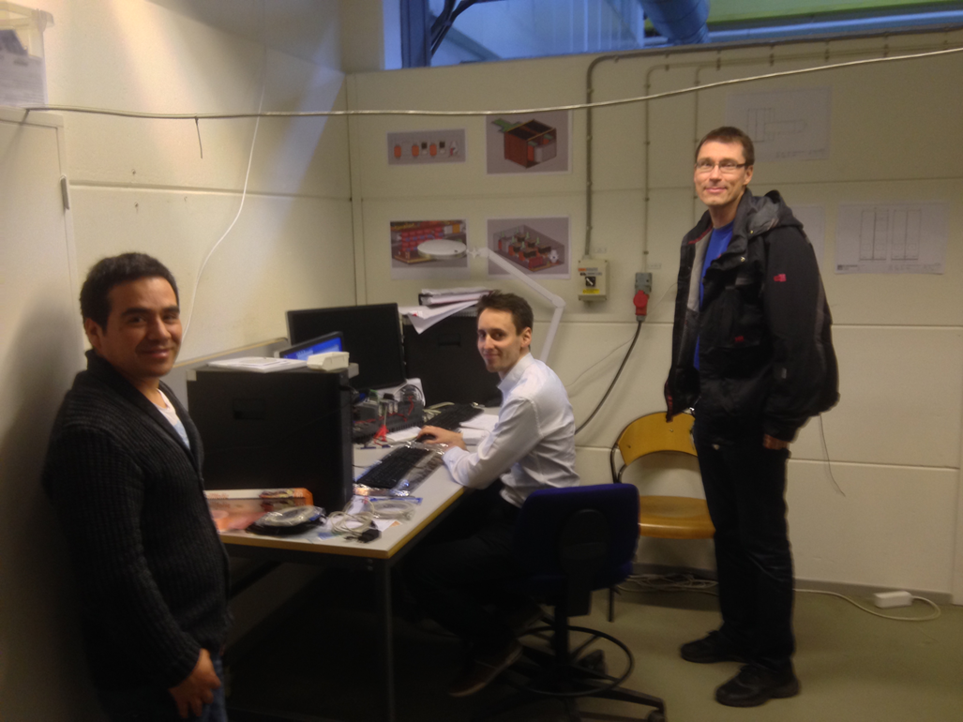
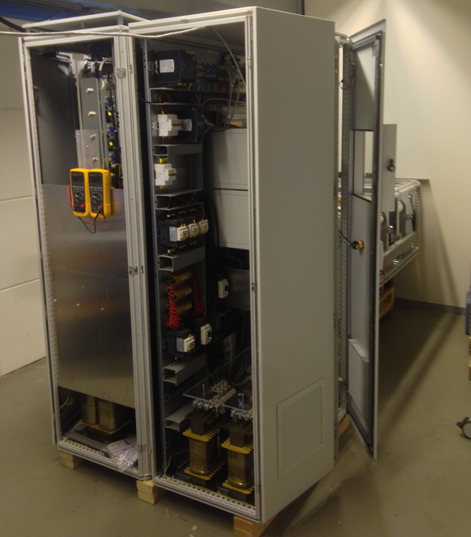
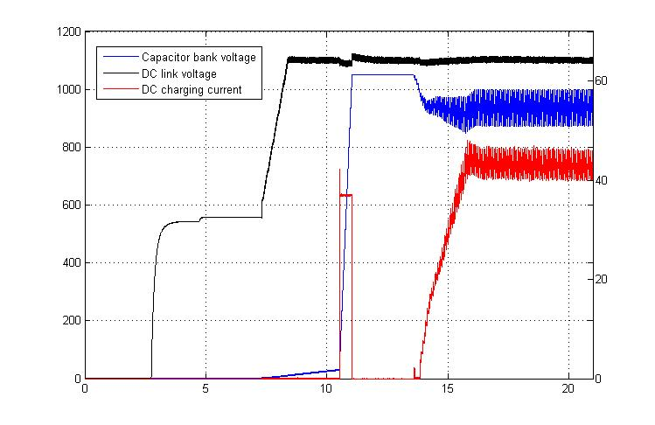
Experimental Results:- Low Voltage power conversion stage
(1 module: AC grid AFE + DC/DC charger + 2 x H bridges)
Reduced Scale Modulator Prototype
- Testing of Low Voltage stage at full power
Controls & Human Machine Interface (labview)
Automatic start-up sequence (state machine)
Standby
DC link bus voltage ready
Cap. bank voltage ready
Pulse soft start
DC link bus voltage setting
Cap. bank voltage setting
Pulsing ready
Low voltage power converter stage
12

Slide 13
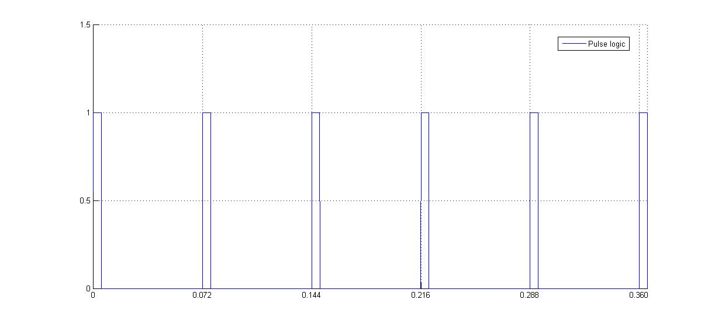
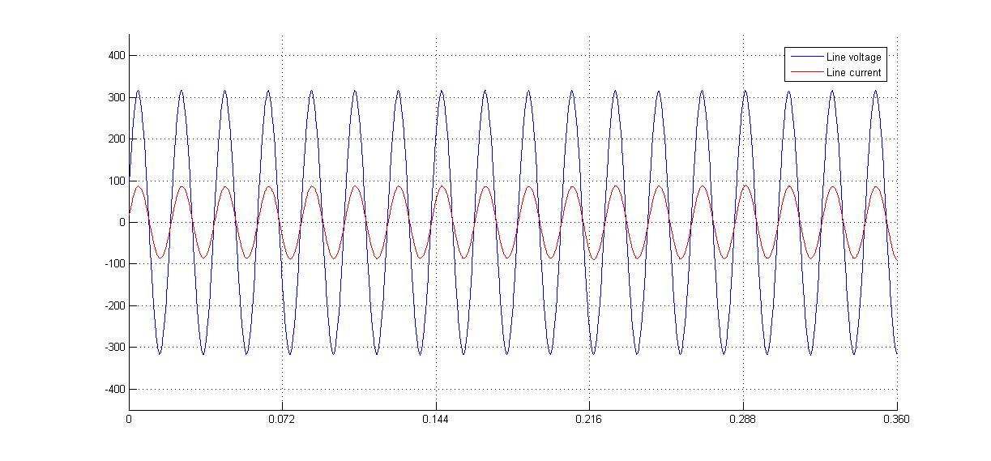
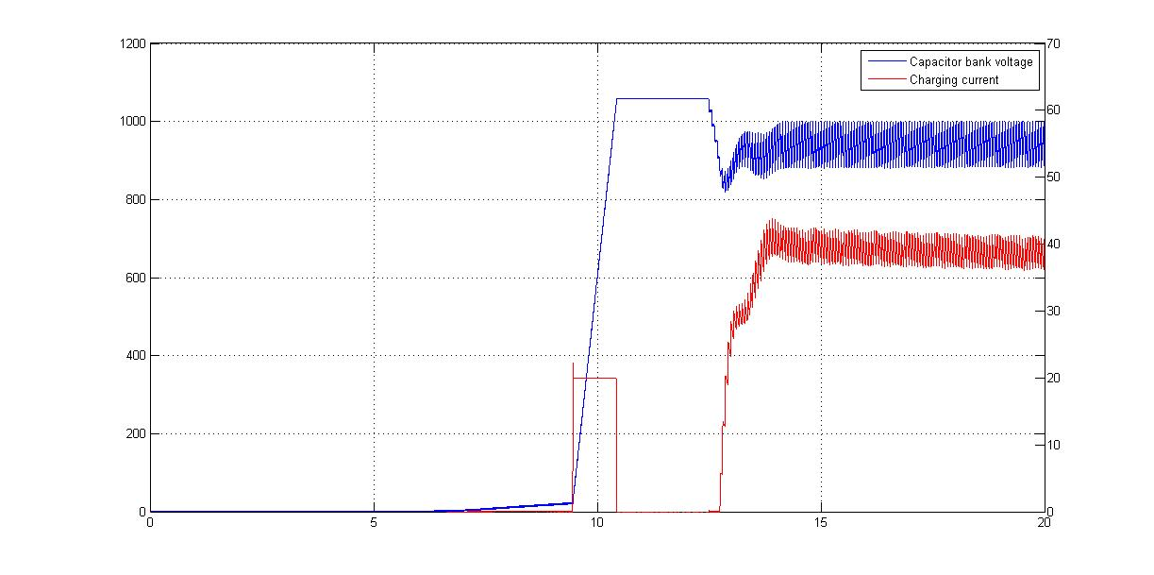
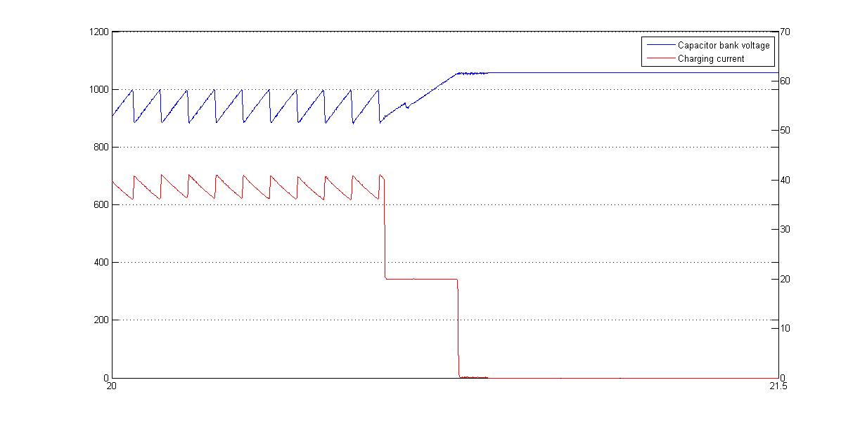
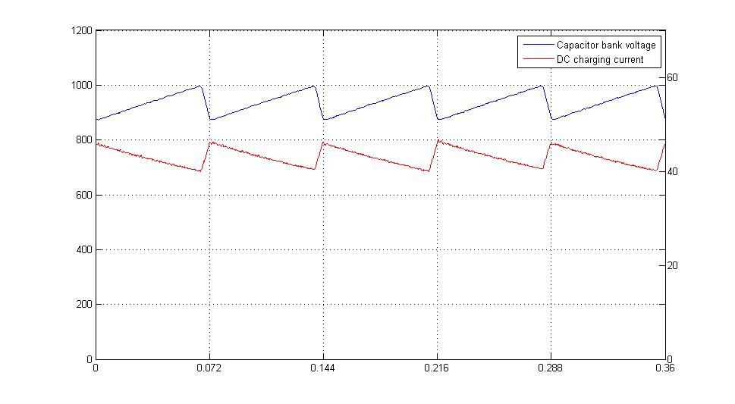
Experimental Results:- Low Voltage power conversion stage
(1 module: AC grid AFE + DC/DC charger + 2 x H bridges)
Reduced Scale Modulator Prototype
- Testing of Low Voltage stage at full power
Pulse (1kV)
Initialization mode
Pulsing mode
Voltage tapping mode
AC line voltage
Note:
- different time scales in the 3 modes
AC line current
Unitary power factor;
Sinusoidal line current, constant amplitude -> No flicker
Capacitor bank voltage
Capacitor bank voltage
Capacitor bank voltage
Capacitor bank charging current
Capacitor bank charging current
Capacitor bank charging current
Charging current adapted as an inversed function of the voltage;
Constant power flow
Jun ’13
Design and specifications:
ESS and LTH;
13

Slide 14
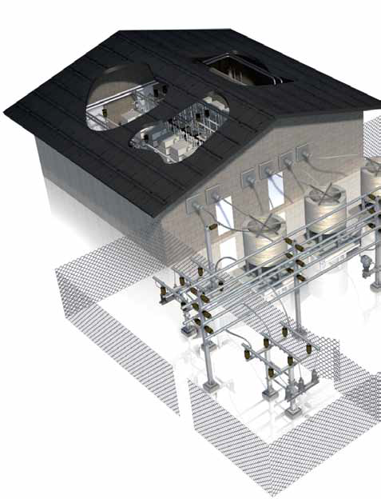
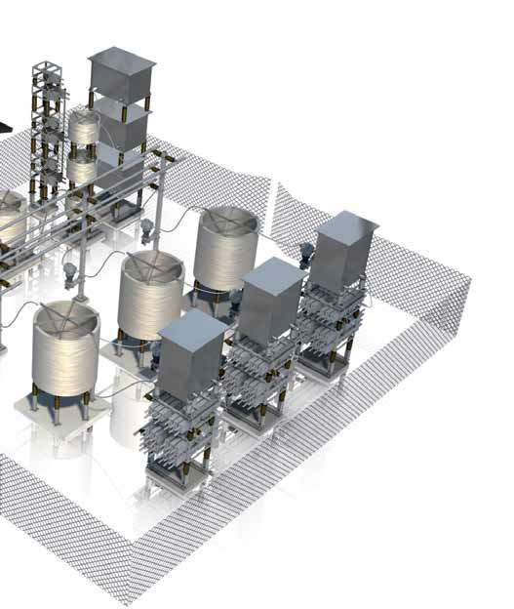
AC grid power quality – A classical approach with external grid compensators
140 kV
20 kV
20 kV
SVC
SVC
400V
400V
600V
400V
400V
600V
Modulators
Modulators
Modulators
Cryo compressors
Modulators
Cryo compressors
Beam Instrumentation
Beam Instrumentation
Neutron Instruments
Neutron Instruments
- SVC footprint (outdoors): 2 x (10m x 15m) = 300 m²
- SVC estimated cost : 2 x ~6 M€ = ~12 M€
14

Slide 15
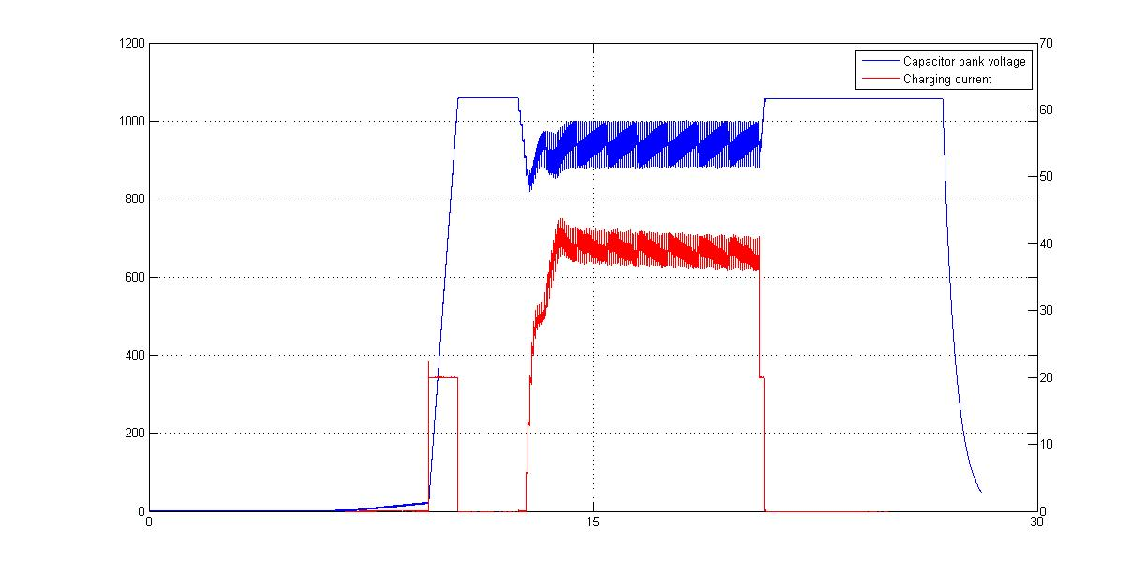
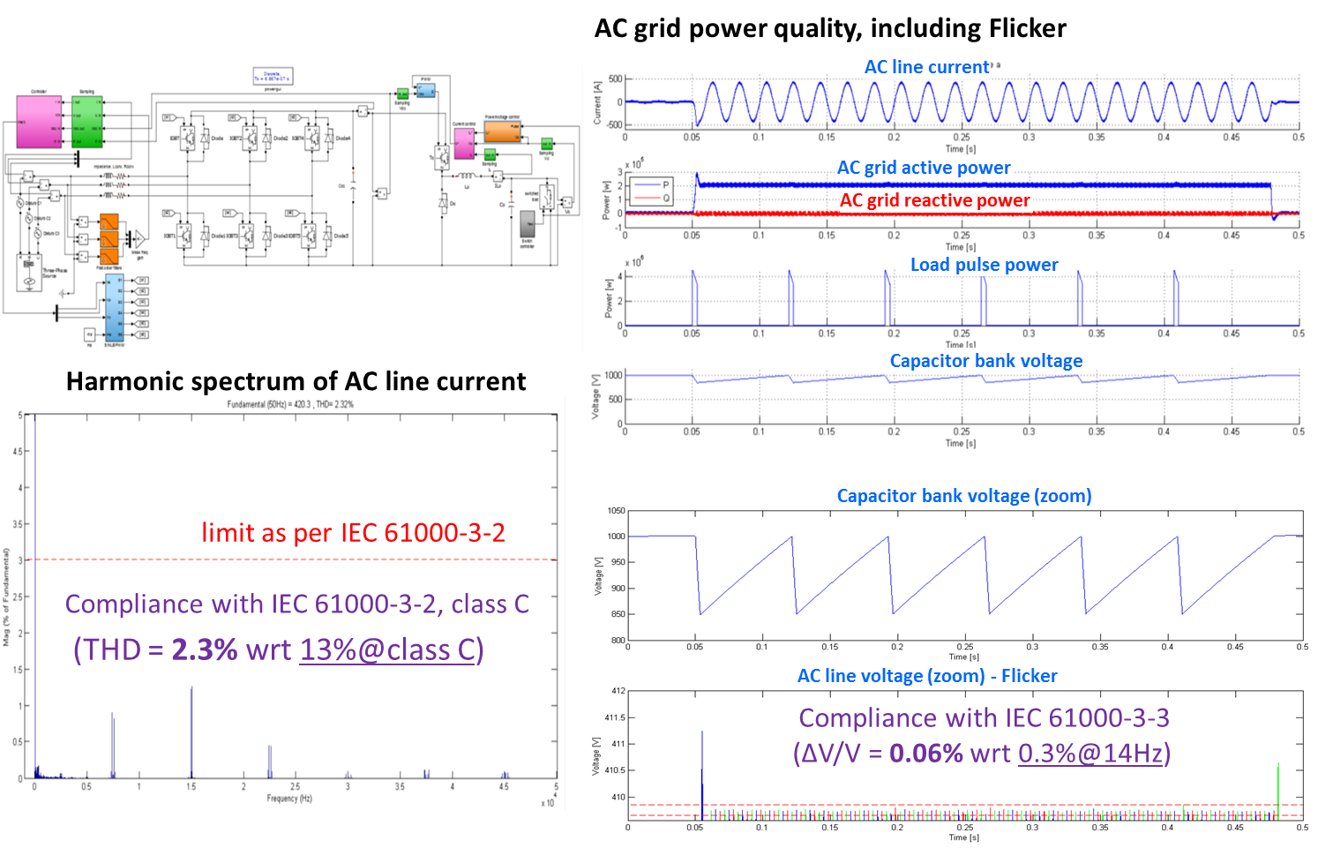
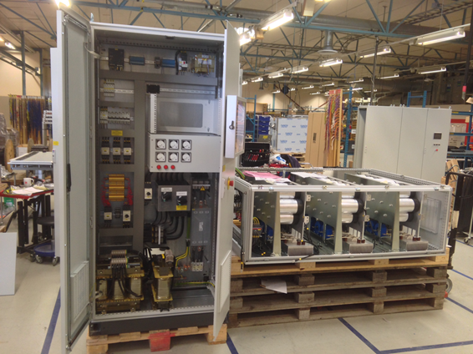
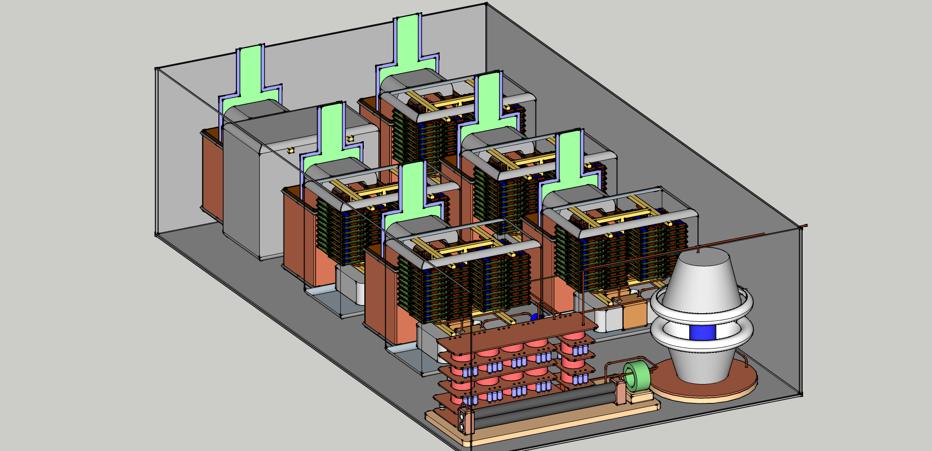
From a conceptual design to reality…
The Stacked Multi-Level (SML) modulator:
– Development roadmap
Construction and testing of High Voltage Oil tank assembly
Feb’15 to Aug’15
Jun ’13
Experimental results, low voltage stage
Sept ’13 – May ’14
Jan ’15
Apr ’14
May ’14
Aug ’14
15

Slide 16
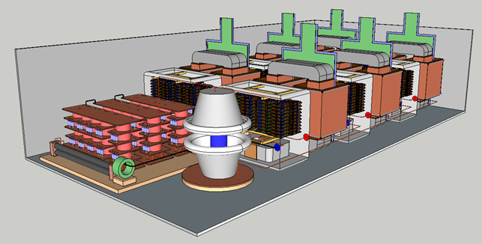
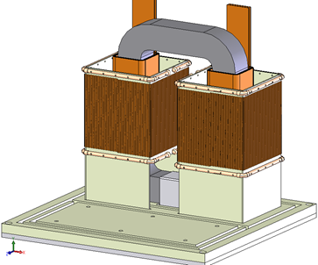
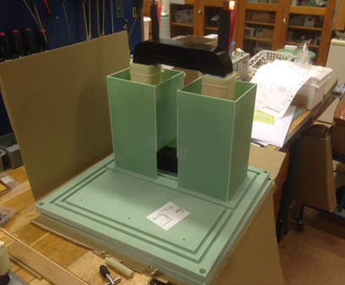
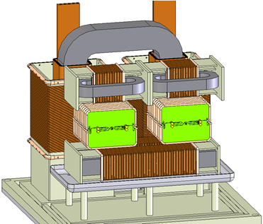
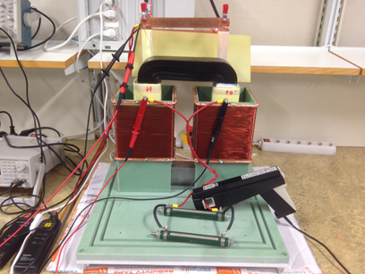
High Voltage oil tank assembly:
Design in view of construction
HV module
HV oil tank assembly
(Collaboration between ESS and LTH)
Design of the whole system undergoing;
HV module (HV transformer + HV rectifier)
Construction and validation of one HV module prototype is undergoing:
  - HV transformer assembled (first test results obtained two weeks ago);
  - HV rectifier is under construction (PCB’s delivered last Tuesday)
control signal
primary voltage
secondary voltage
secondary current

Slide 17
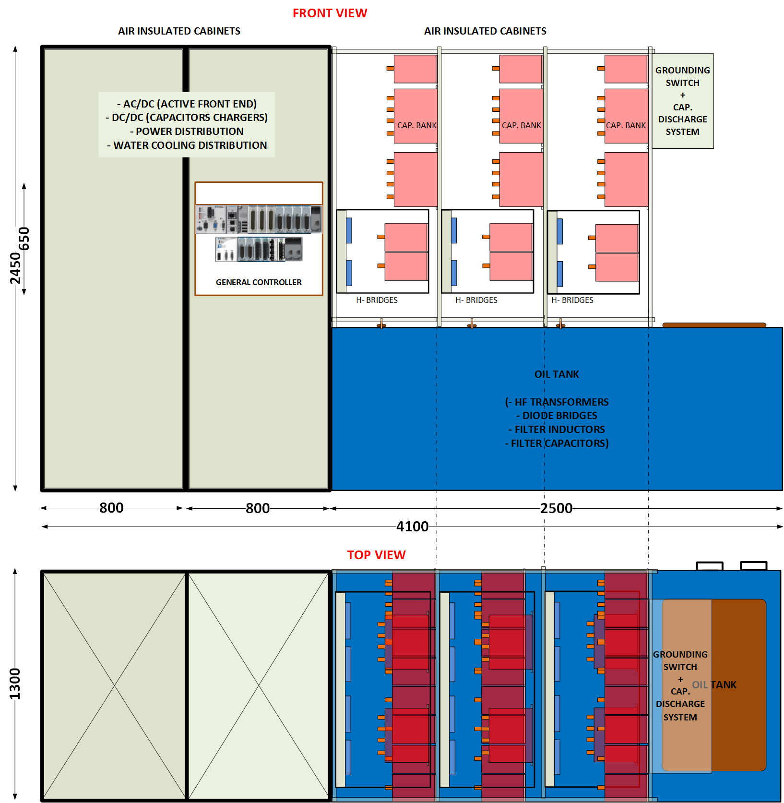
From a conceptual design to reality…
The Stacked Multi-Level (SML) topology
- Scaling up to full power
Reduced scale prototype:
115kV / 20A ; 3.5 ms / 14Hz
(130 kVA – 1x 704 MHz klystron)
Full scale system
115kV / 100A ; 3.5 ms / 14Hz
(660 kVA – 4x 704 MHz klystrons)

Slide 18
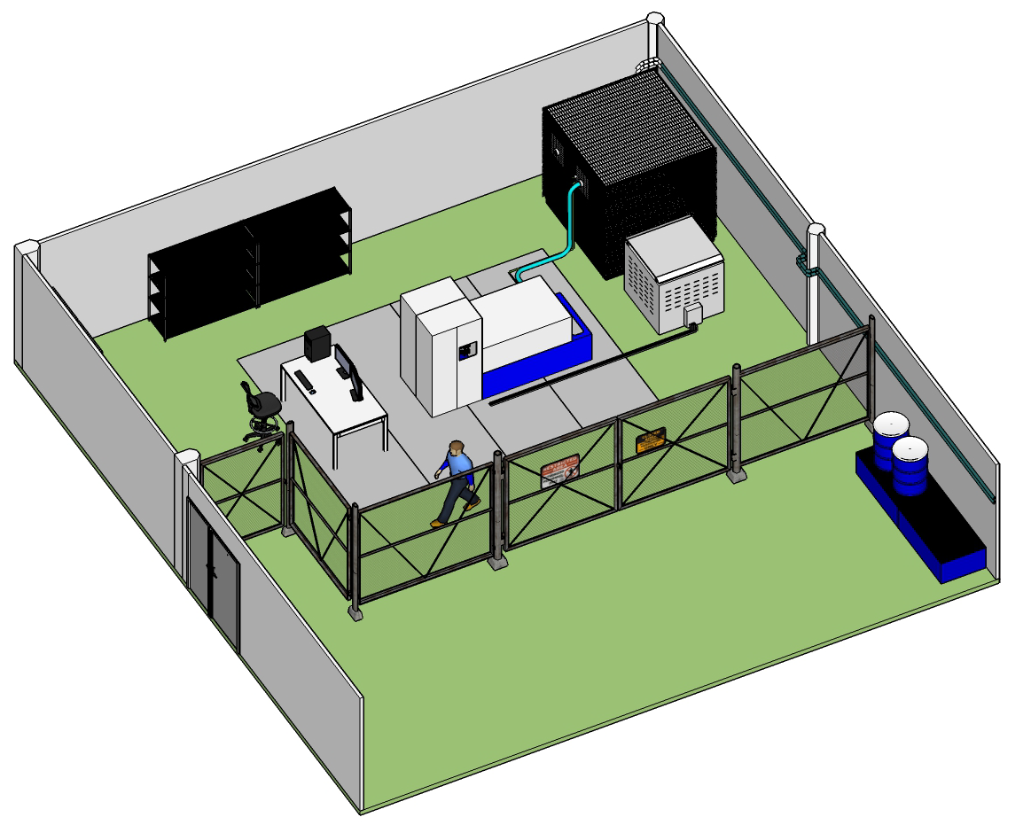
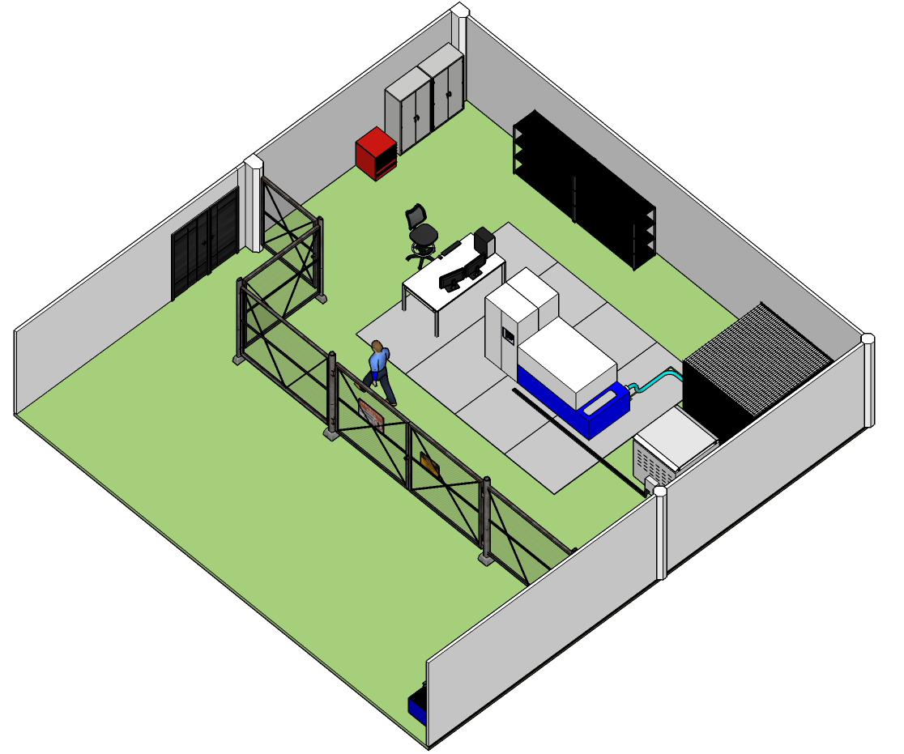
High Voltage power converters laboratory at LTH
Design of HV oil tank assembly and components’ prototyping
HV dummy load
LV dummy load
control desk
modulator
Next Steps:
Test the High Voltage module prototype to full voltage and power (HVHF transformer, HV rectifier bridge, HV filter inductors);
Procure and test the HV oil tank assembly;
Integrate the Low Voltage power converter stage with the HV oil tank assembly;
Test of the entire system upto full voltage and power.

