Slide 1
Beam Instrumentation to Protect a Superconducting Linac
Thomas Shea
SLHiPP
2015-03-19

Slide 2
Outline
Protection
Beam Instrumentation for Machine Protection
Beam Current Monitors (BCM)
Beam Loss Monitors (BLM)
Outlook

Slide 3
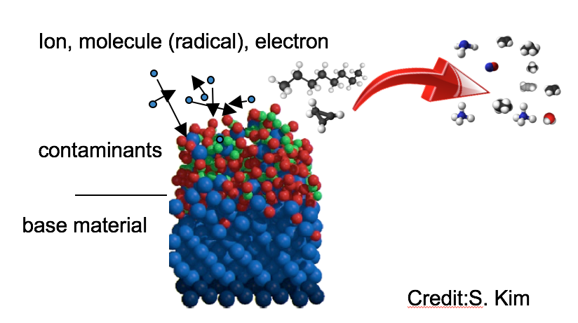
Protection
Irradiation management
Activation (maintenance, ALARA)
Component degradation
DPA (average current density)
integrated dose (secondary shower)
surface effects (SRF cavity degradation)
per pulse
integrated
Prompt damage
slow heating (>thermal time constant)
Impulse (<thermal time constant)
rapid fatigue (some finite number of pulses)

Slide 4
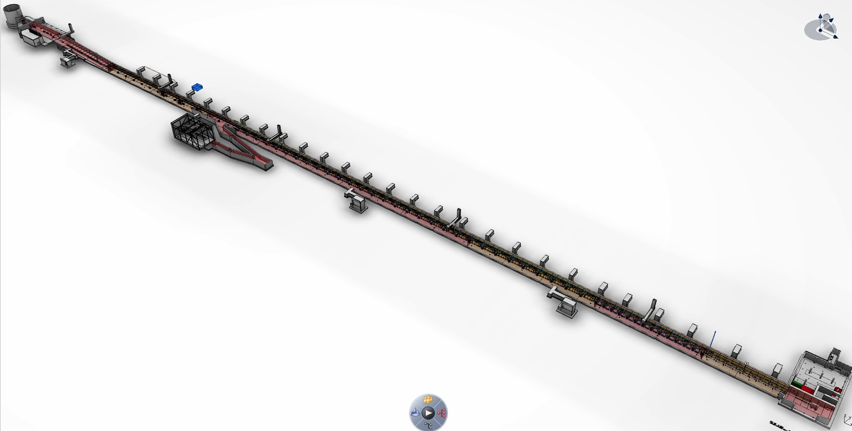
Layout and Latency in ESS Linac
BCM
concentrator
few µs
concentrator
Master
BCM
concentrator
beam
High Beta
BCM
BCM
2 µs
Medium Beta
> 100 loss monitors distributed along linac
Spokes
1 µs

Slide 5
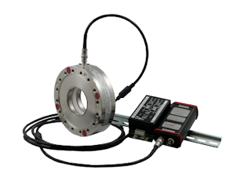
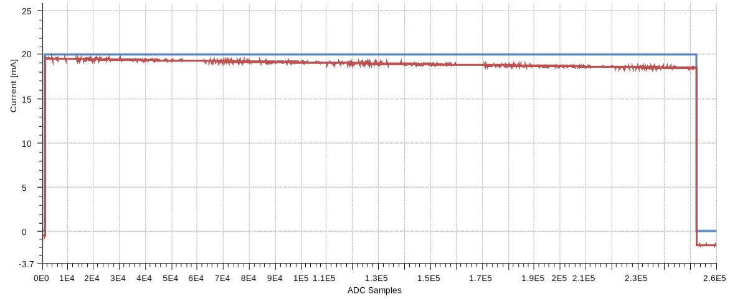
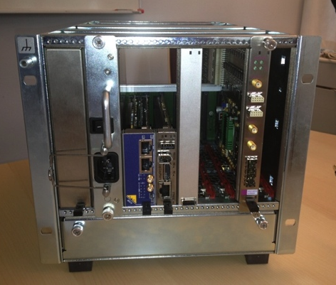
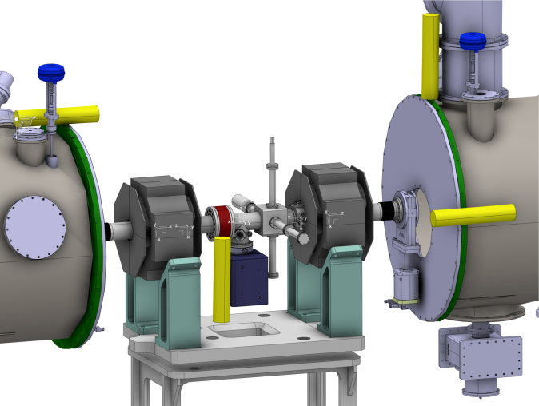
Current Monitor for ESS Linac
Droop correction over long pulse
Initial integration demonstrated
EPICS
Timing system
Data on demand
Control room screen
Hooman Hassanzadegan

Slide 6
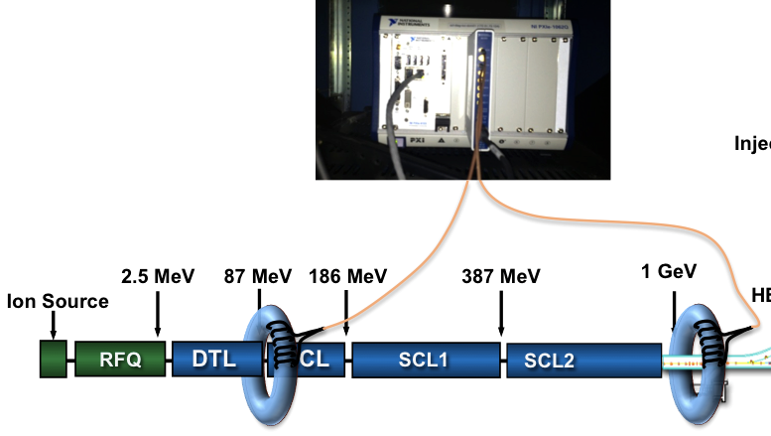
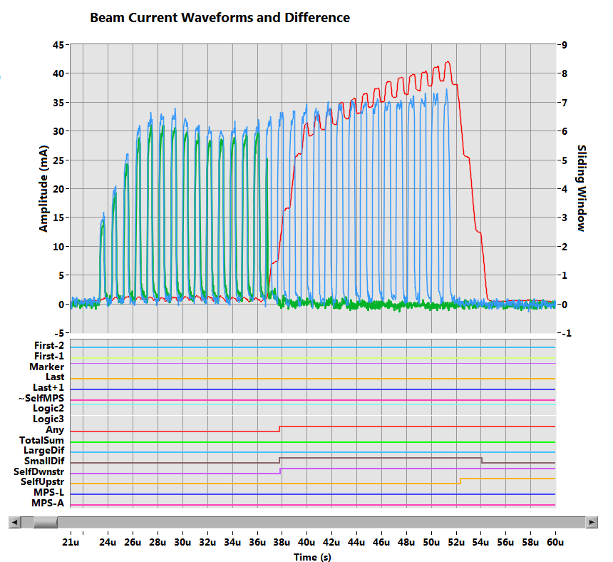
SNS Differential Current: difference in locations
Waveforms:
Upstream (Blue)
Downstream (Green)
Difference after short sliding window (Red)
Alert to MPS
Alert on small window difference
Alert on pulse-to-pulse downstream
Alert was given in <1.5 µs (could be faster with lower thresholds and still avoid false alerts)
Alert on pulse-to-pulse upstream
due to a Warm Linac RF drop
DBCM waveforms
6
Blokland

Slide 7
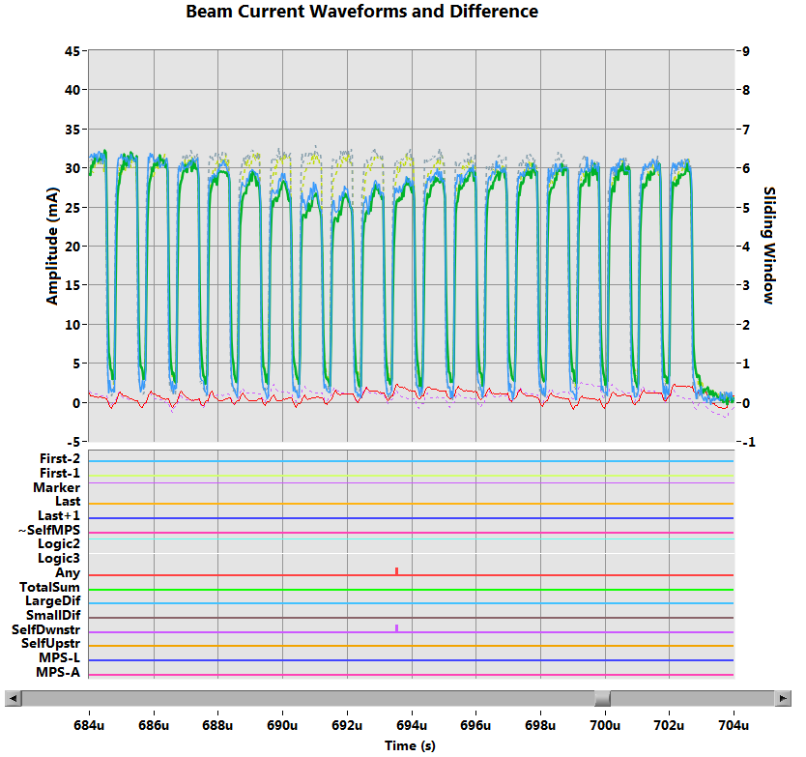
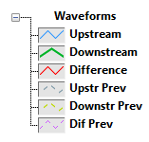
SNS Differential Current: difference in time
Example of slow drop in current from pulse-to-pulse
Analyzed to be due to RF Fill problem [2,3]
Pre-mortem Analysis!
Waveforms for errant AND previous beam pulse:
Upstream
Downstream
Difference
Alert to MPS
Alert on pulse-to-pulse downstream
DBCM waveforms
Blokland

Slide 8
SNS Differential Current: difference in time
More dramatic pulse to pulse difference
Chopper issue in front end. Downstream, no loss monitor trip
Blokland

Slide 9
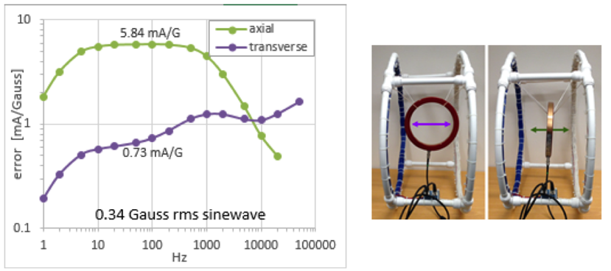
Example Current Monitor Issue: Effect of Magnetic Field
Jenna Crisp

Slide 10
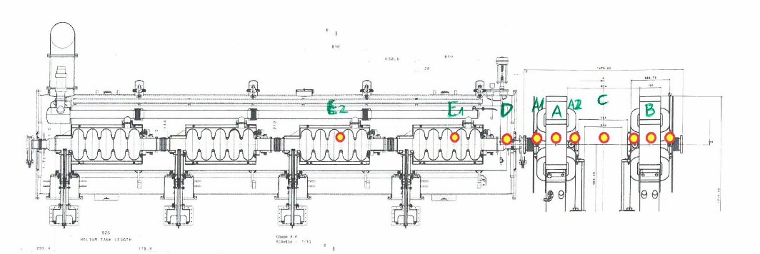
Beam Loss Simulation In ESS Medium Beta
Angle: 3 mrad (upwards, in the direction of the beam)
Location: top of the beampipe, longitudinal locations marked on the picture attached
Loss character: 500 MeV point loss preserving 1W/m loss limit (all the losses from quads+cryomodule focused in one point; in this case, point loss of 7.5 W)
Monte Carlo simulation with MARS
Michal Jarosz

Slide 11
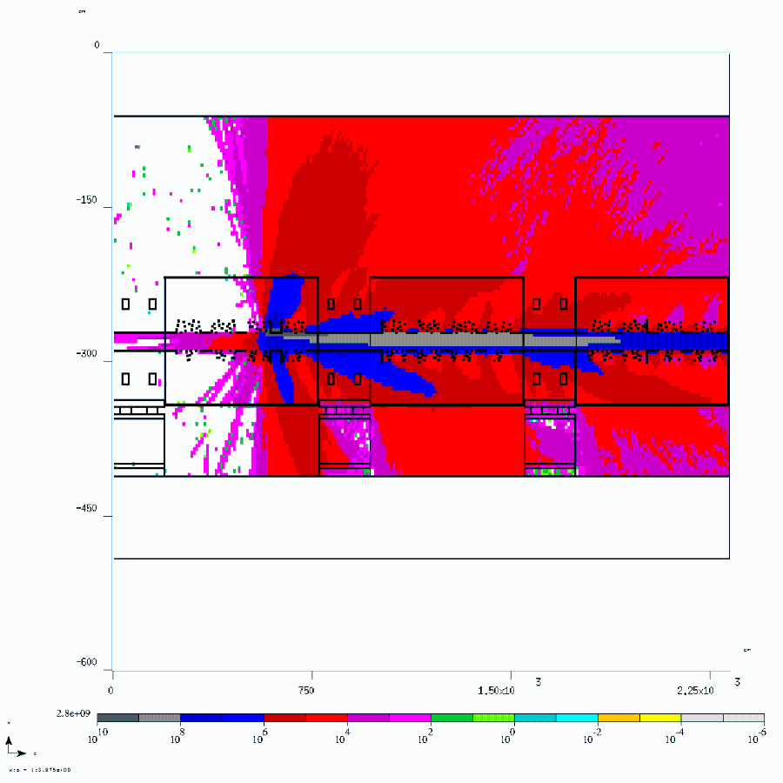
Protons from Point Loss ESS Medium Beta
particles/cm^2/s
Michal Jarosz

Slide 12
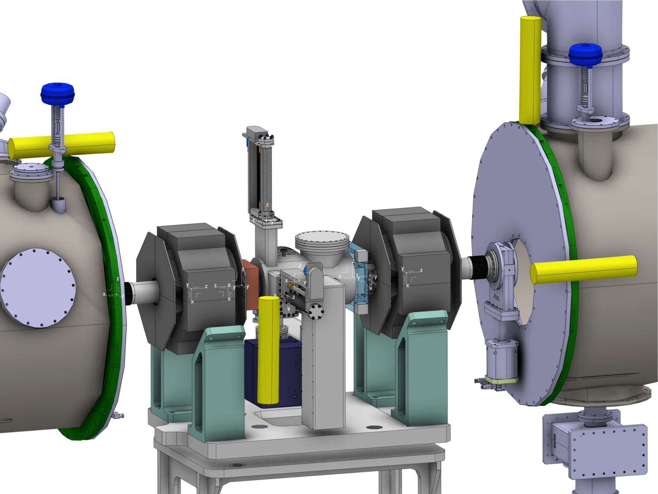
Loss Monitor Placement ESS Warm Unit
Protection: full coverage - position insensitivity
Diagnostics: position sensitivity
Ion chambers:
LHC-style
a few µs to detect 10% beam loss (including electronics)
Michal Jarosz
T. Grandsaert

Slide 13
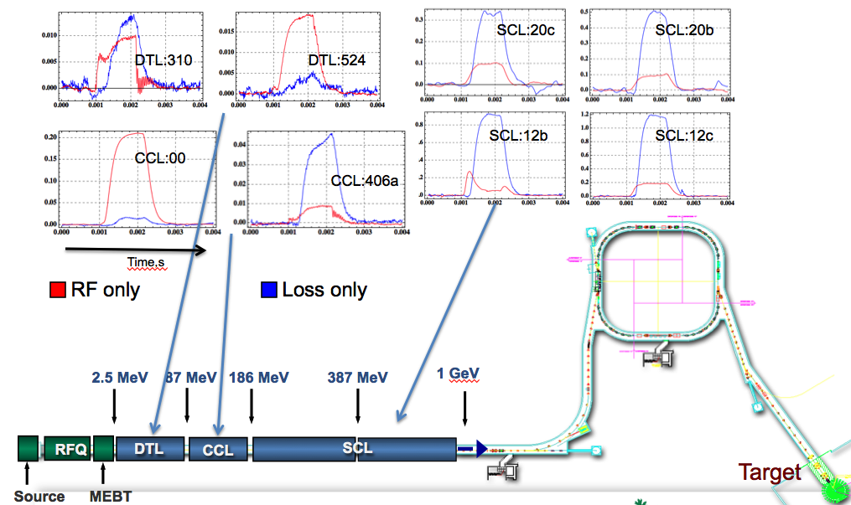
Example Loss Monitor Issue: Background from Cavities at SNS
Zhukov - ORNL

Slide 14
Configuration Management
Instrumentation Electronics
6
1
PCIe link to µP
2 functions, 1 device:
Interlock
Tight configuration control
Low latency
Diagnostics
Agile deployment to support commissioning and operations
Data-on-demand (event-driven data acquisition) and other high-level functionality
Memory Interface
BAR 1
BAR 2
RTM
configuration
From Timing
data
Diagnostic
functions
Interlock interface
Protection
Threshold and comparison
Interlocks
Secure
Memory
Interface
M. Donna

Slide 15
Outlook
Diverse and redundant loss detection systems
Robust protection against fast and slow beam loss
For cavity protection, how do we set performance requirements for detection of errant beam?

