Slide 1
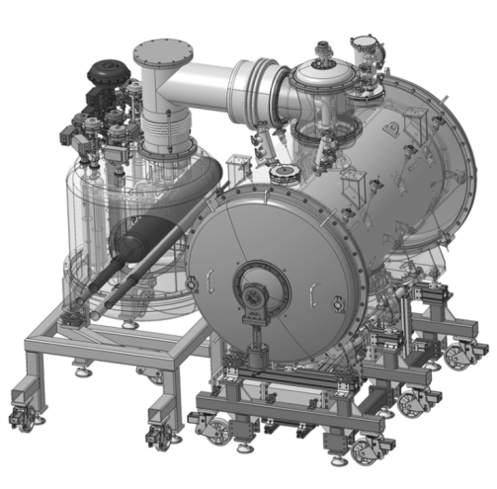
Spoke cryomodule and valve box designs
SLHiPP 5
2015 March 18th
ESS – WP4
P. DUTHIL (CNRS-IN2P3 IPN Orsay / Division Accélérateurs)
on behalf of the IPNO team

Slide 2
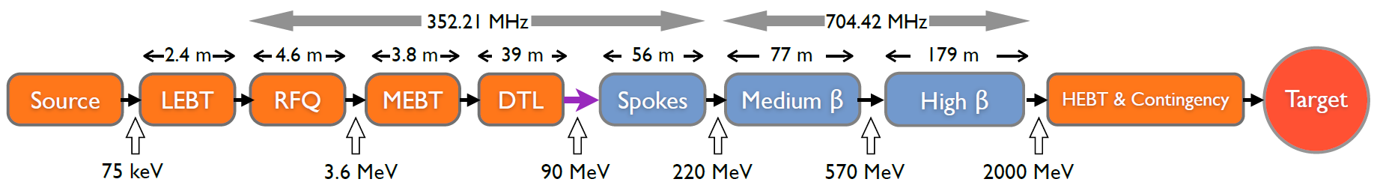
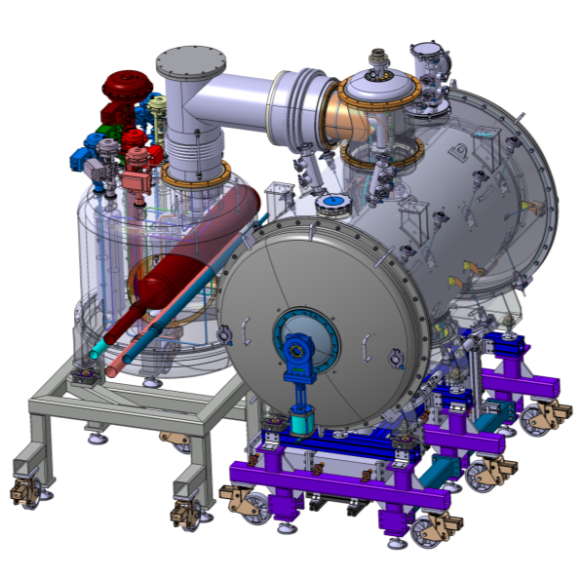
WP4 & CNRS contribution
CNRS’ contribution:
Spoke cryomodule & Cryogenic Distribution System for Spoke section
Valve box
    13 cryomodules;
    Spoke Cryogenic Distribution System (CDS):
      13 valve boxes
      Cryogenic Distribution Line (CDL)
      1 end box
Spoke cryogenic distribution line
Spoke cryomodule
Cryomodule support

Slide 3
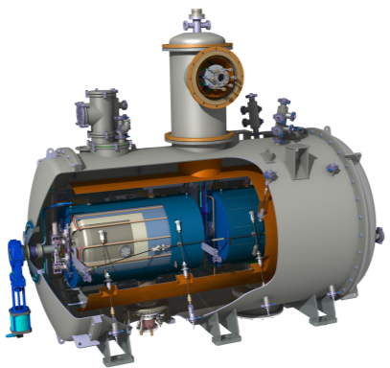
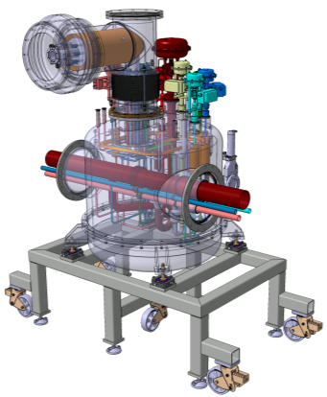
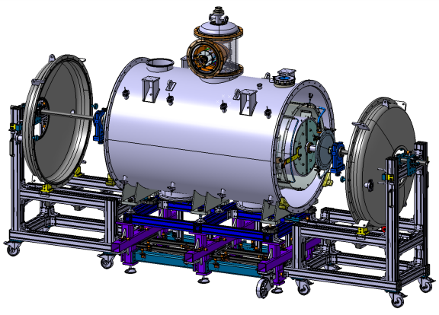
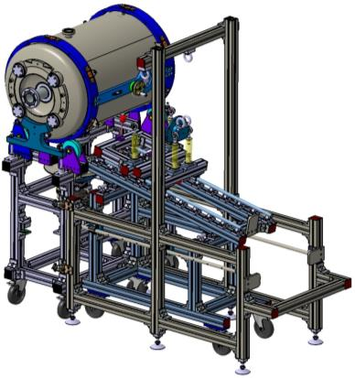
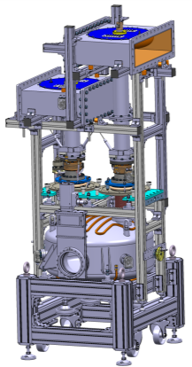
Spoke section: contents
Cryomodule components
Valve box
Tooling and test of components

Slide 4
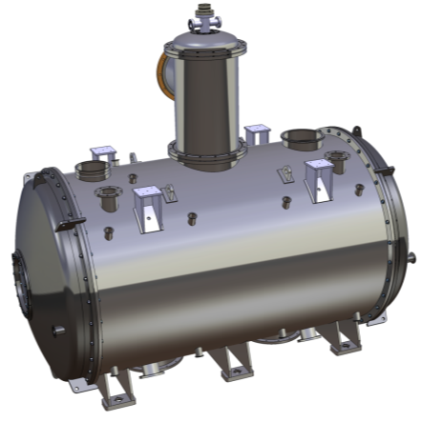
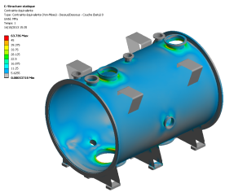
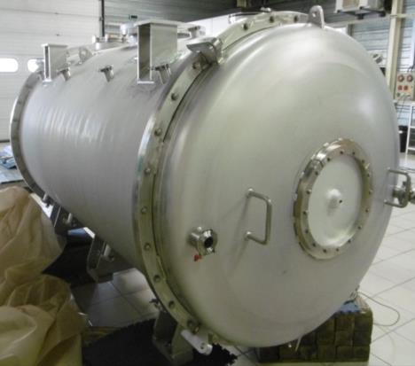
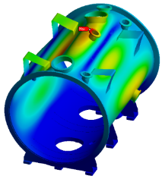
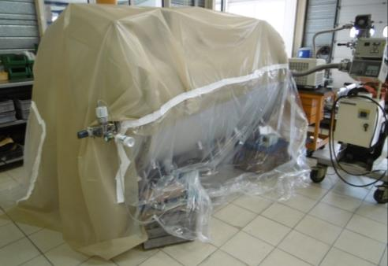
The Spoke cryomodule
Vacuum vessel
✓ Static analysis
✓ Manufacturing done
σ_{max} = 65 MPa
✓ Linear buckling analysis
Ø = 1.3 m
P_{crit} = 1.2 MPa
L = 2.37 m
(2,86 m for CM)
⇨ Thickness = 8 mm
    ✓ Measured global leak rate: OK
    Dimensional controls have to be achieved before shipment to IPNO
    ⇨ reception of the vaccum vessel at the beginning of April

Slide 5
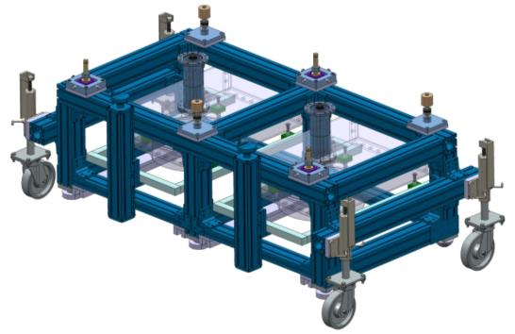
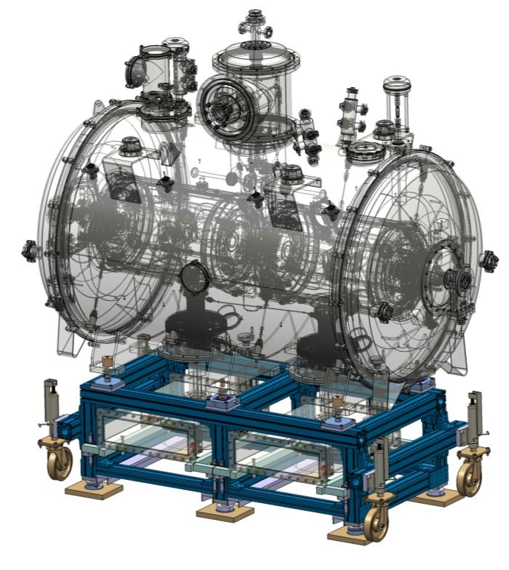
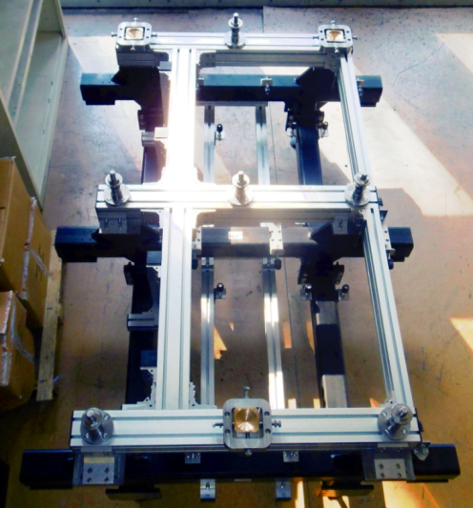
The Spoke cryomodule
Cryomodule support
    ✓ Support delivered

Slide 6

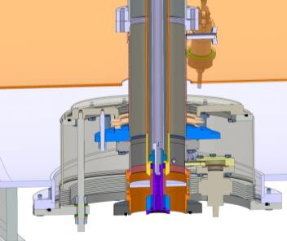
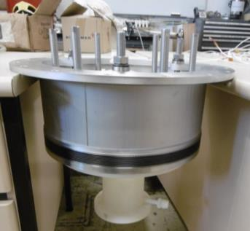
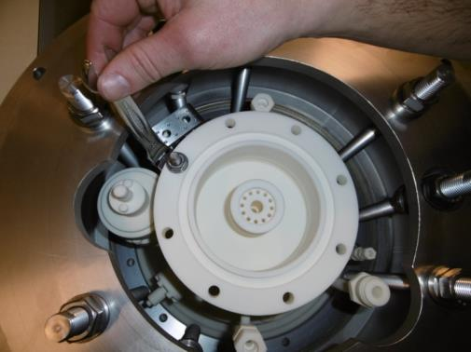
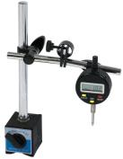
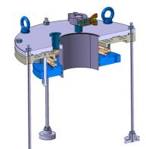
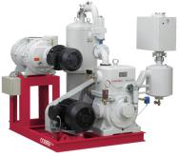
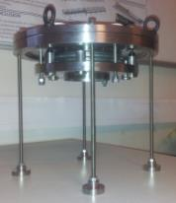
The Spoke cryomodule
RF couplers / vacuum vessel interfaces: compensators
    Goal: To compensate the forces acting on the coupler and due to vacuum forces and thermal restrain. To avoid cavity misalignment
3D printed mock-up of the RF Coupler double wall
RF Coupler double wall
Connecting sleeve
    ✓ Test of the assembly
    ✓ Measurement of displacements and forces compensations
3D printed mock-up of the RF Coupler double wall

Slide 7
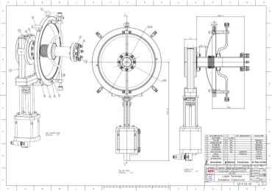
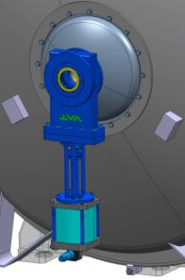
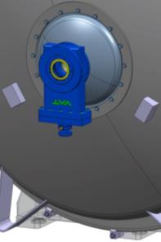
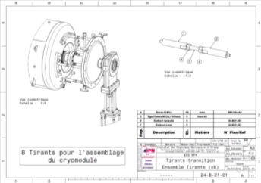
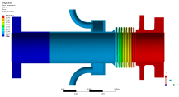
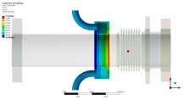
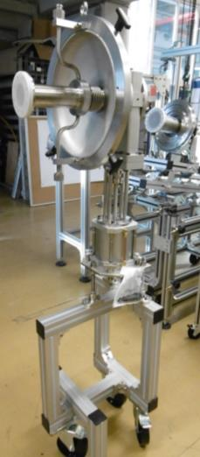
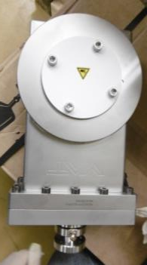
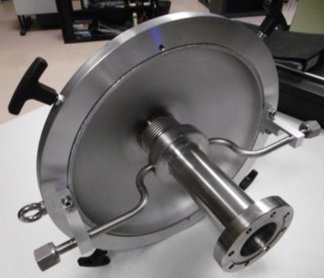
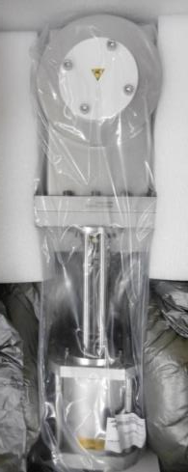
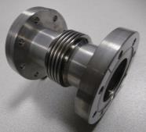
The Spoke cryomodule
Beam line components
✓ Cold warm transitions
Cold warm transitions assembly test
✓ Gate valves
✓ Inter-cavities belows

Slide 8
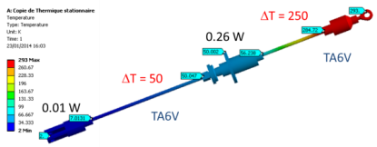
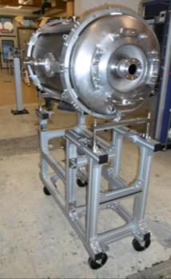
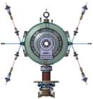
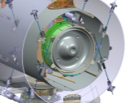

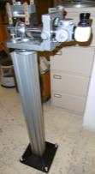
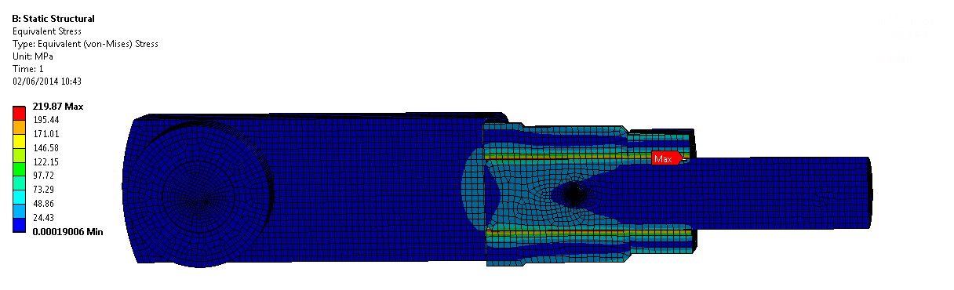
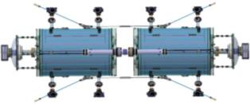
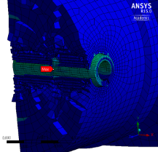
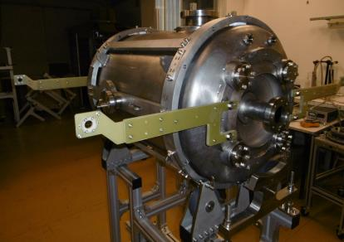
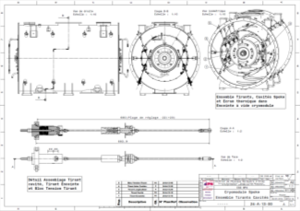
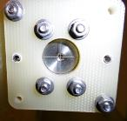
The Spoke cryomodule
Cavities support and alignment system
    Thermal and thermo-mechanical analysis
    ✓ Measurement of the coaxiality of the cavities beam axis
    Supporting system :
    rods based solution
    ⇨ possibility of adjusting the alignment under vacuum and cryogenic working conditions
    ✓ Optical monitoring system for alignment diag. inside the cold CM
    Rod made of two parts for cryostating
    Call for tender of the alignment systems done
    Ordered this week
Outer rod
Adjustable interface with the vacuum vessel
Inner rod
Elastic interface with the thermal shield

Slide 9
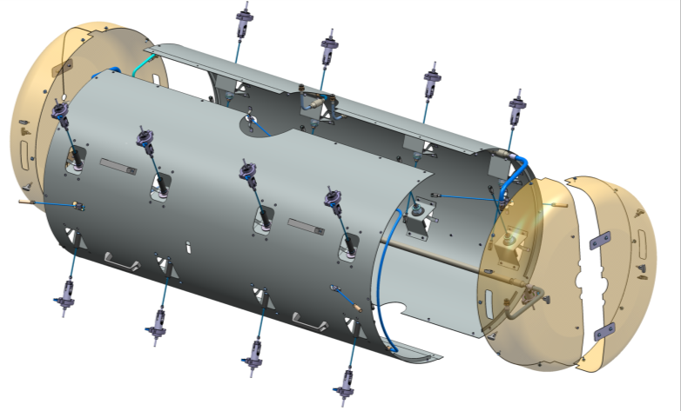
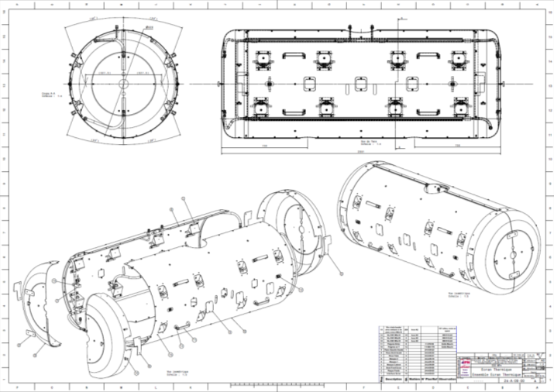
The Spoke cryomodule
Cryomodule thermal shield
    Call for tender done
    Ordered this week
    Material: Al6060
    Thickness: 2 mm

Slide 10
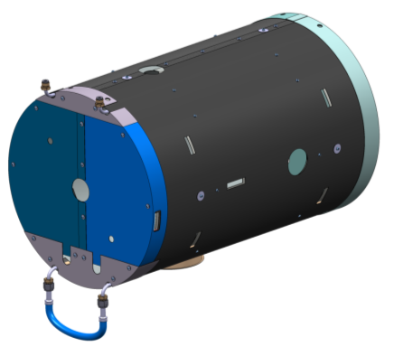
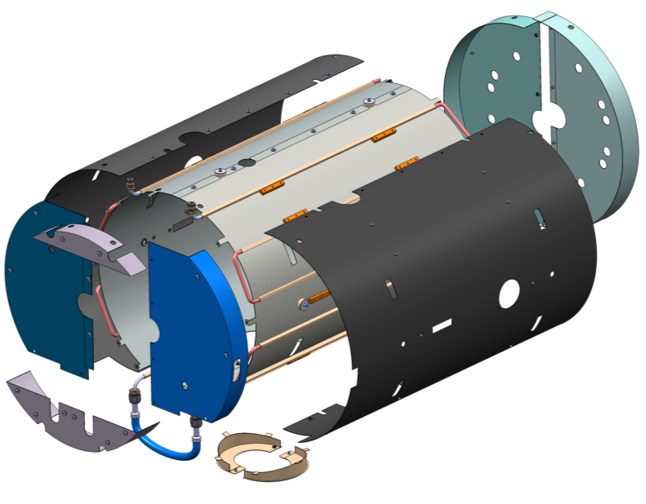
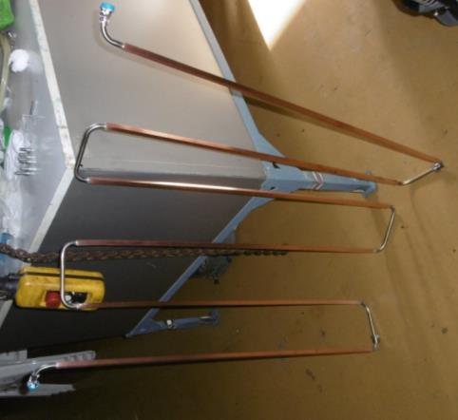
The Spoke cryomodule
Cavities magnetic shield
Cooling circuit
Internal shield
Tuner side ends
External shield
Shrim
Cavity bellow side ends
Shield support
Coupler shield
✓ Material: Cryophy®
    Cooling circuit received
    Magnetic shields to be received by the end of March

Slide 11









The Spoke cryomodule
RF power couplers
Double wall tube
(SHe cooled)
RF coupler
(ceramic window)
    Leak tests of the couplers and double walls
    Verification of the pressure drops inside the double walls cooling circuits

Slide 12


Tooling
Example of the clean room tooling for
✓ assembly of the RF coupler on the cavity:
✓ assembly of the string of cavities:

Slide 13






Assembly tooling
Testing of the tooling
3D printed mock-ups of:
✓ Test of the protections and transportation tooling
the RF coupler
the double wall tube
✓ Test of the assembly procedure

Slide 14





Testing-qualifying tools
Conditionning bench for the RF couplers
✓ Integration of the condionning bench at CEA Saclay
Conditionning bench received
(1 doorknob still missing)
RF cavity of the conditionning bench
Electronics being developped and manufactured at IPN Orsay

Slide 15








Testing-qualifying tools
Conditionning bench for the RF couplers
  RF cavity: simulating the cooling requirements
RF simulation (ANSYS-HFSS)
Coupler port area
(place of peaks of H field)
Plunger area
Thermal simulation (ANSYS)
P_{RF} = 400 000 W; DC = 5%
Water mass flow rate: 3.6 g/s
Stainless steel cavity
Fluid
Cooling circuit
Plunger area

Slide 16






Testing-qualifying tools
Conditionning bench for the RF couplers
  RF cavity: preliminary test of the cooling capacity
    Verification with the simulation
    (rough agreement)
IR heating inside the cavity
Radiated heat: up to 1 kW for the tests
    Verification of the pressure drop inside the cooling circuits

Slide 17


Spoke Cryogenic Distribution System
    13 cryomodules;
    Spoke Cryogenic Distribution System (CDS):
      13 valve boxes
      Cryogenic Distribution Line (CDL)
      1 end box
courtesy of ess
Prototype valve box

Slide 18

Spoke valve box
PID
Machine
version

Slide 19

Spoke valve box
PID
Prototype
version
Main differences:
instrumentation
He and N2 supply
  ⇨ RF coupler cooling:
  Cold vapours used
  (but SHe in HNOOS FREIA)
Interfaces with the infrastructures

Slide 20


Spoke valve box
PID
Proto
version
From a liquefier

Slide 21


Spoke valve box
UPPSALA / IPNO integration
  Studies of the integration of the valve box (and the Spoke CM):
    at IPNO site (SUPRATECH technological platform)
    at FREIA test stand in Uppsala.
  Cryogenic interfaces
  To be validated with Uppsala
Interfaces for the supply of cryoliquids
Interfaces for the vapours exhausts

Slide 22





Prototype valve box
Valve box connection to the cryomodule: the jumper
Vacuum barrier
    Mech. Analysis (pressure forces + thermal shrinkage)
    Thermal analysis
    0.25 W @ 2K
    7.4 W @ 50 K

Slide 23
Conclusion
Crymodule components
  Mechanical package: all components received except:
    vacuum vessel, cavities supporting system and thermal shield
    qualification of components under progress
  Assembly phases started
    start of real components assemblies
    but also test of the assembly procedures
Spoke prototype valve box
  Specifications for the heat exchanger and the cryovalves are being written
    → to be ordered by end of April
  Detailed design of the valve box is still under progress (finalizing)
    Detailed drawing started
    Technical specifications to be written
  Goal: to order the valve box this spring
  cf. S. Bousson’s presentation on Spoke RF cavities and cold tuners

Slide 24
Thank you for your attention
This work was achieved by the WP4 IPNO team:
CSP12
28 Novembre 2014
Sébastien BOUSSON
Sylvain BRAULT
Patricia DUCHESNE
Patxi DUTHIL
Nicolas GANDOLFO
Guillaume OLRY
Matthieu PIERENS
Emmanuel RAMPNOUX
Denis REYNET
Jérôme DAULT
Frédéric CHATELET
Virginie LAURENCIER
David LONGUEVERGNE
Richard MARTRET
Thierry PEPIN-DONAT
Véronique POUX
Fetra RABEHASY
Ludovic RENARD
Philippe SZOTT
Elodie MOUREY

