Slide 1
ESS HPRF Distribution: Technology Enhancement for High Temperature RF Loads
Author: Rutambhara Yogi

Slide 2
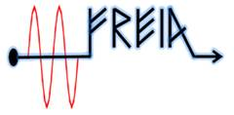
Many thanks to
Suppliers:
Colleagues:
ESS: David McGinnis, Anders Sunnesson, Morten Jensen, A. Johansson
Carlos Martins, Rihua Zeng, Rafael Montano, Chiara Marrelli,
Stevo Calic, Daniel Lundgreen, Carl Johan Hardh
FREIA: Rolf Wedberg, Lars Hermansson, Roger Ruber & other colleagues
CERN: Eric Montesinos, Olivier Bruner
SNS: Crofford Mark

Slide 3
Overview:
ESS RF systems
Earlier plans for Load Cooling
Present plans for High Temperature cooling
Technology enhancement & New Developments
* Resistive Loads
* Ferrite ER Load
* Ferrite load (ferrite tiles)
* Water Load

Slide 4
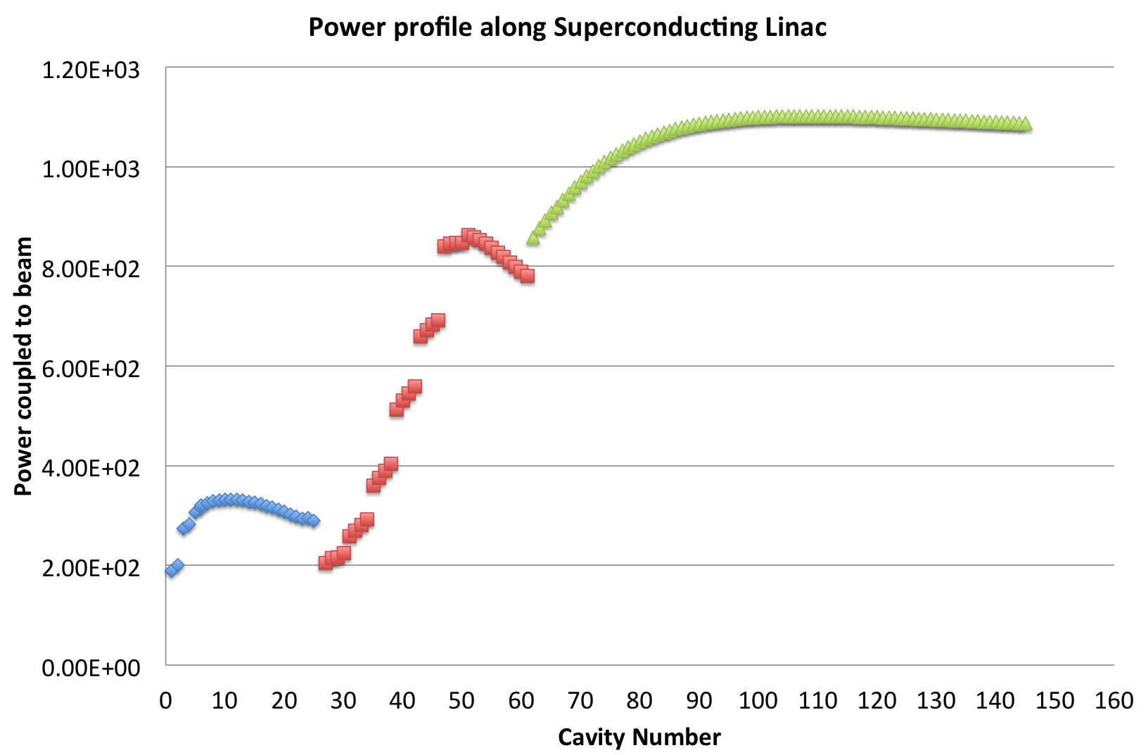
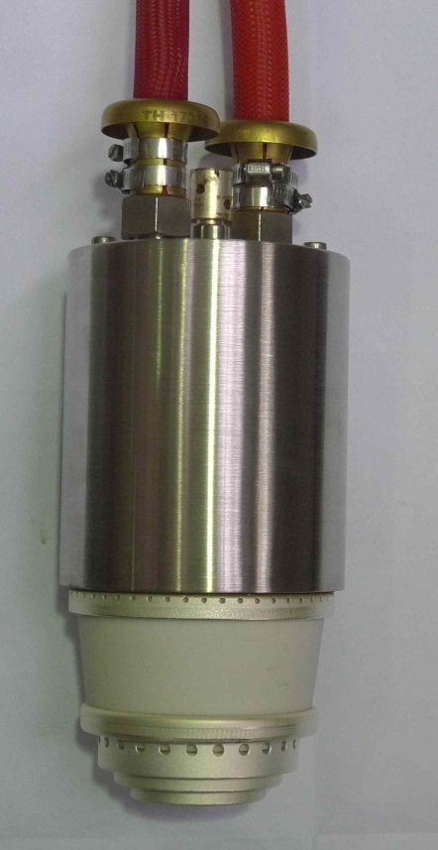
ESS HPRF Systems
1500 kWp
84 High Beta cavities
704 MHz
New development: IOT
Backup solution: Klystron
1200 kWp
26 Spoke Cavities,
352 MHz
400kWp
Tetrode
36 Medium Beta cavities
704 MHz
1.5MWp Klystron
Klystron
Warm Linac
-1 RFQ & 5 DTL
352 MHz
3MWp Klystrons
-3 MEBT
352 MHz
30kWp Solid State Amplifiers

Slide 5
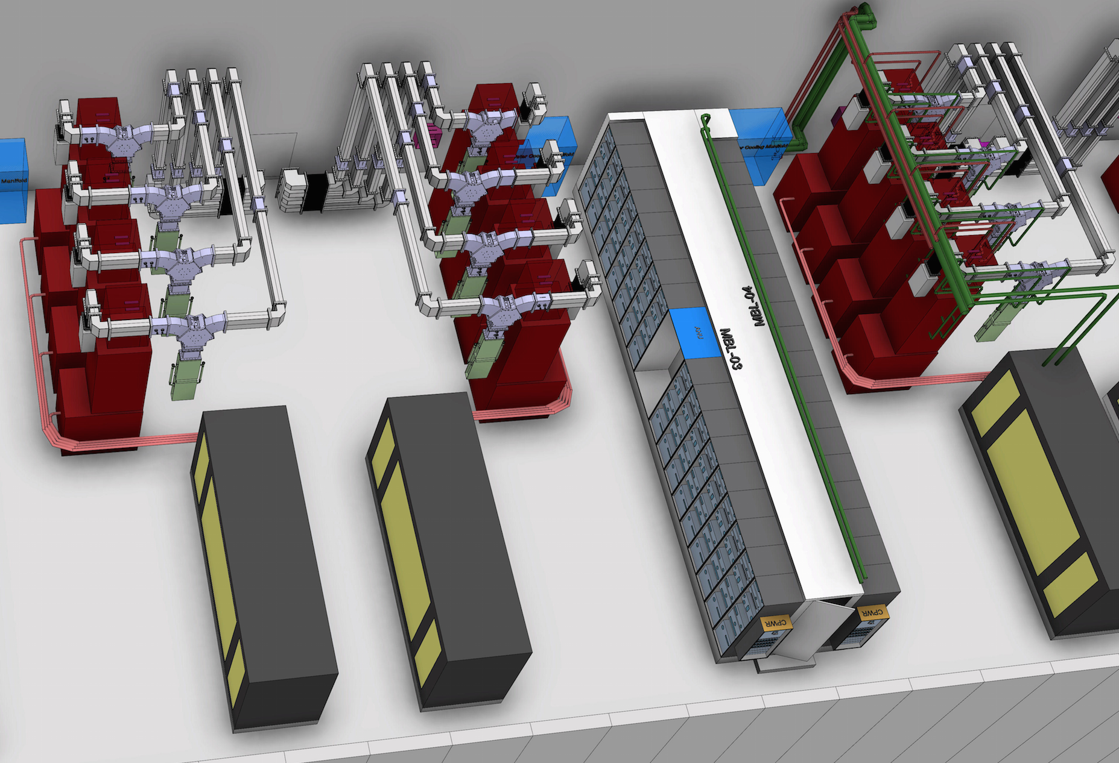
RF Loads
RF loads: Matched terminations
Isolator Load: Used with circulator to protect amplifier
To dissipate RF power during Amplifier testing
HB/MB Linac
100 loads
Frequency = 704 MHz,
Power = 1.5 MWp
(Isolator loads)
Flow requirement:
70 lpm x 100
Load
Klystron
Circulator
FAT at AFT

Slide 6
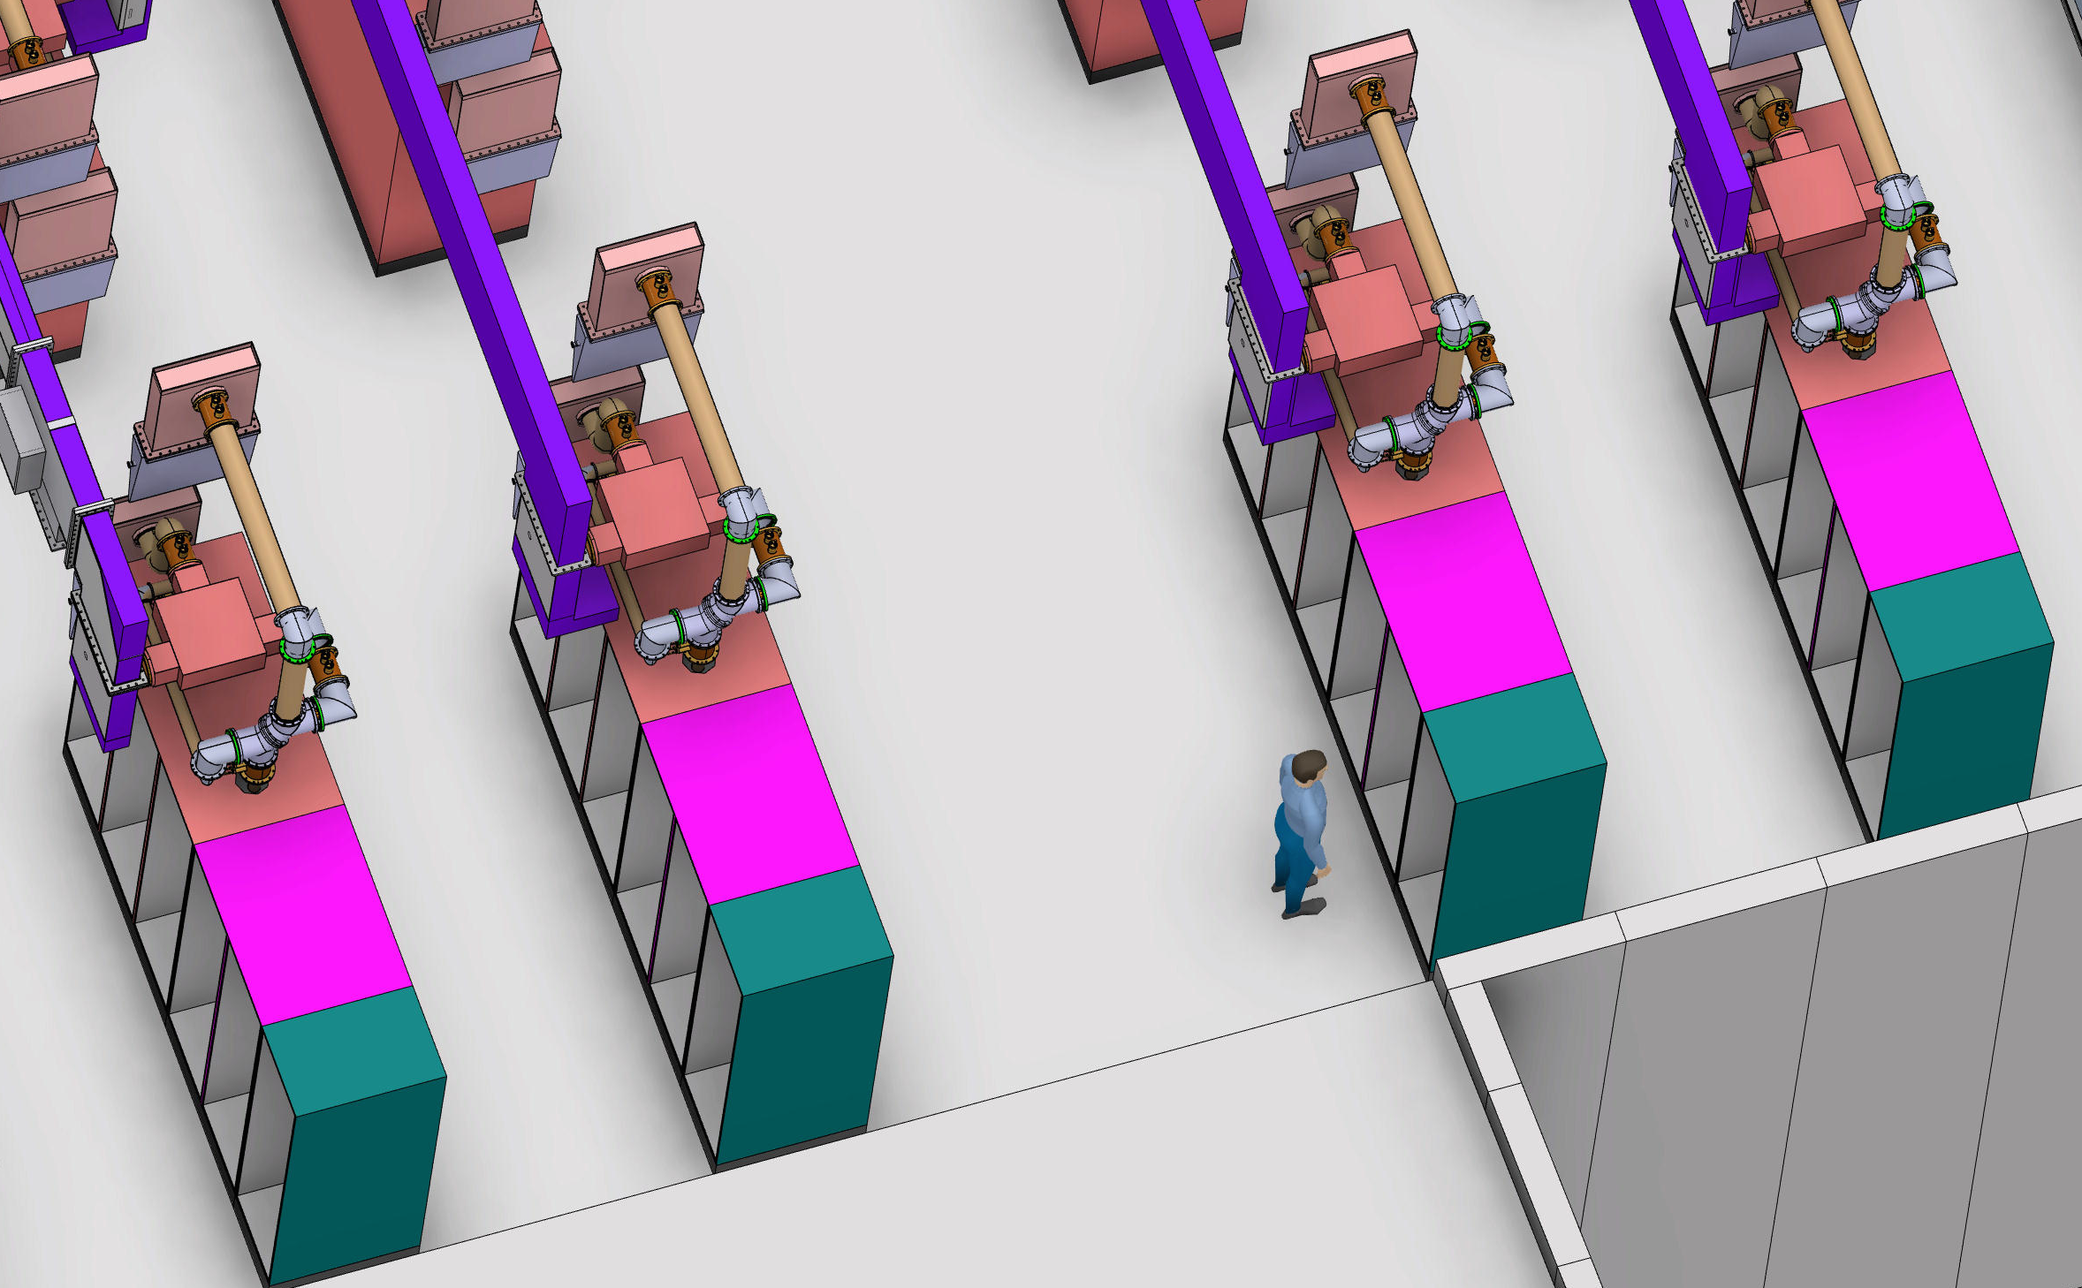
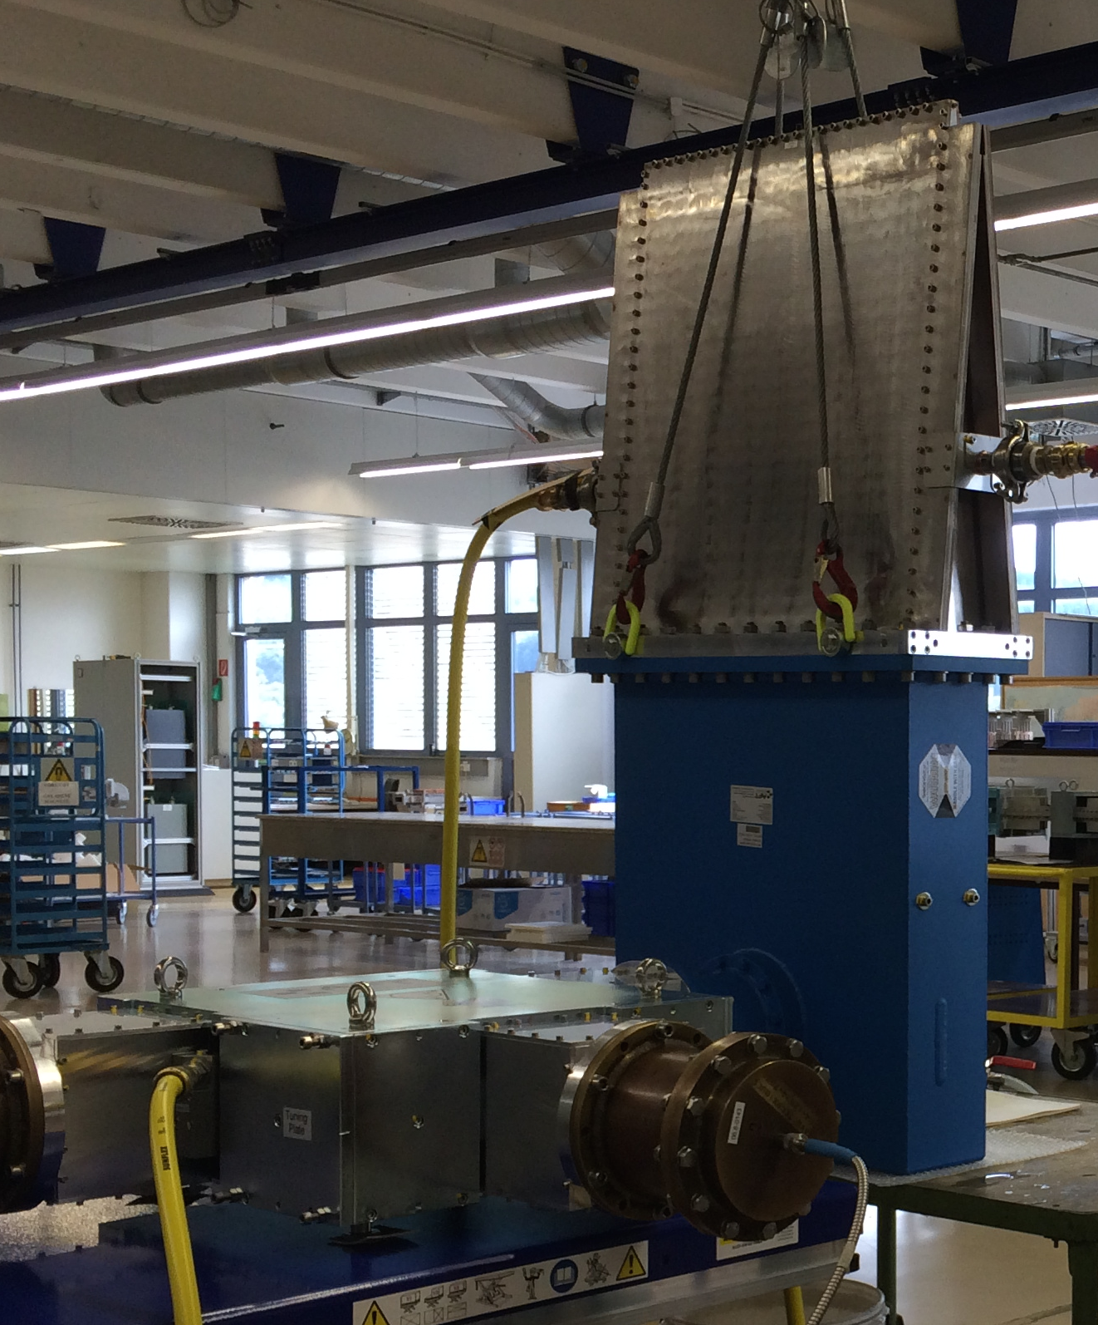
Reject load: RF load with 3 dB Combiner (Hybrid coupler)
Spoke Section:
52 Loads
352 MHz
Isolator loads:
400 kWp,
Qty: 26
Reject loads:
100 kWp,
Qty:26
Flow requirement:
30 lpm x 100
Reject
Load
Isolator
Load
Circulator
Hybrid
coupler
Courtesy: FREIA

Slide 7
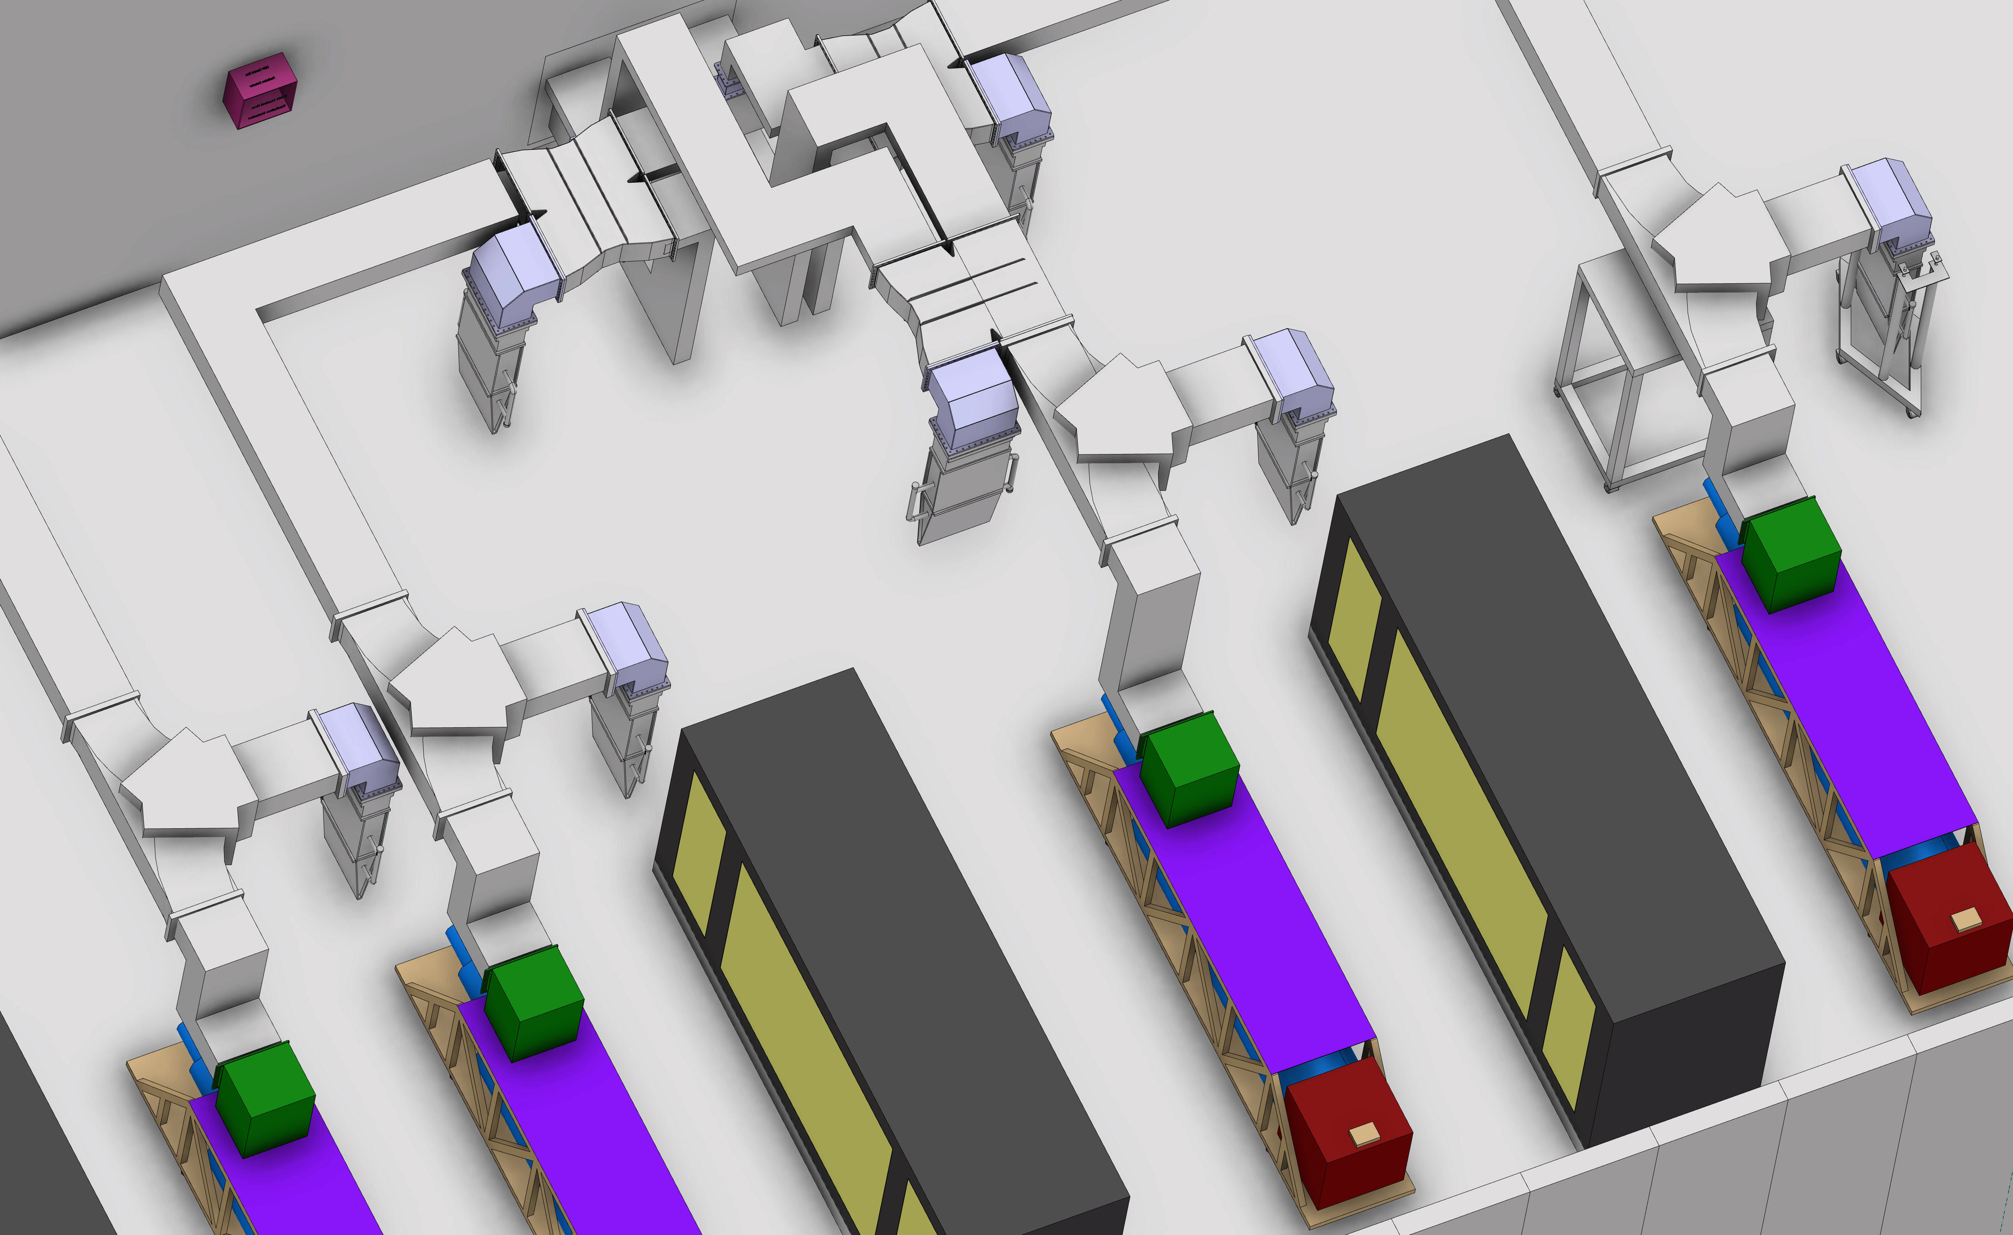
RF load with 3 dB Splitter (Hybrid coupler) as Reject load:
RFQ/DTL
12 Loads
352 MHz
Isolator loads:
3 MWp,
Qty: 6
Reject loads:
0.75 MWp,
Qty:6
Flow requirement:
135 lpm x 12
Circulator
Hybrid
coupler
Isolator
Load
Reject
Load
Klystron
(3 MWp)
ESS needs 170 loads !
Huge load requirement
Huge flow requirement
Note-Layout is not finalized

Slide 8
Earlier Plans for Load Cooling
ESS will have three cooling circuits: 10ºC, 25ºC, 50ºC
Loads were on medium temperature circuit ie. 25ºC
Electricity
Not energy efficient
Solution !
Hot water
from Lund city
50ºC
Heat Pump
50ºC to 25 ºC
Medium temp
Water at 25 ºC
# Decided to have
loads on 50ºC
cooling circuit
# Components shall
be in series without
affecting
Reliability.
Electricity
To Lund
city
Heat Pump
40ºC to 80 ºC
Loads
ΔT ≈ 1ºC
80 ºC
Max load outlet
temperature:
40ºC
Hence technology enhancement !

Slide 9
New Cooling Concept (22 Jan 2015)
HB / MB Linac
Spoke Linac
Normal beam operation
30% overhead
Tetrode1
Tetrode2
Load
Beam Pulse
ΔT ≈ 1ºC
P_{Load}
Klystron
Load1
Load2
Power
2.86 ms
N Number
N Number
N Number
N Number
Amplifier testing
Amplifier
Pulse
ΔT ≈ 10ºC
P_{Load}
3.5 ms
Tetrode1
Tetrode2
Load
Time
But reliable, low maintenance loads were not
existing with minimum 50ºC inlet and 80ºC outlet !!!
Load1
Load2
Klystron
50ºC
Outlet temp
Controlled to 60ºC
50ºC
Outlet temp
Controlled to 60ºC
Courtesy:
Cooling task force,
Morten Jensen

Slide 10
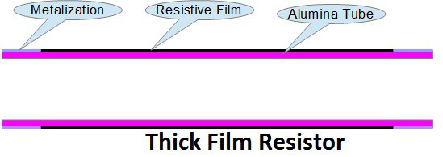
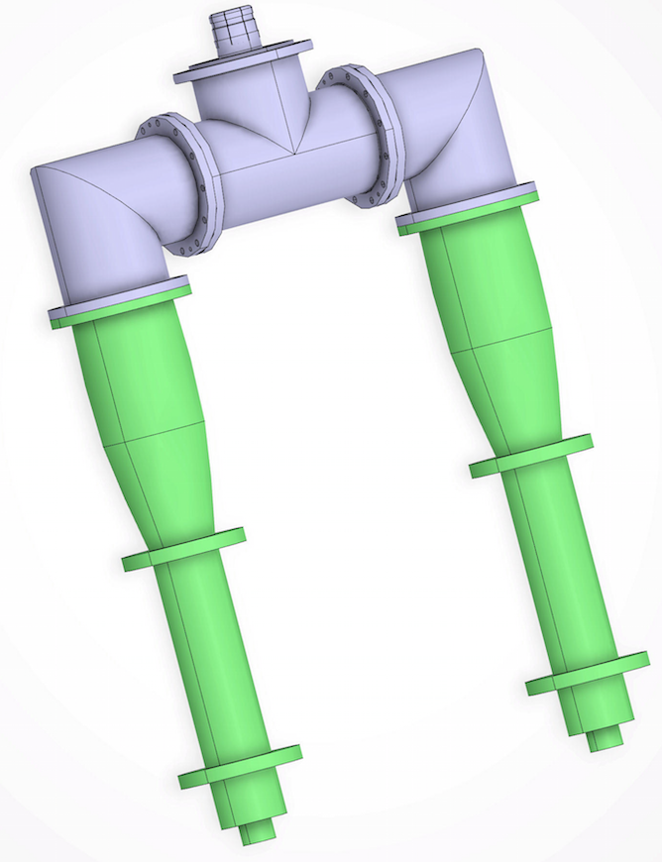
Resistive loads
Technology Enhancement
Maximum outlet temperature 90ºC
Maximum power load
available today = 200 kWp
Metallization
d α Ip
L α Average power
d
L
For spokes:
400kWp
Metallization: provides rf contact to the resistive coating
Indigenously
Developed
TEE combiner
New resistor being developed
for ESS: 750 kWp @ 704 MHz
d ≈ 8 inch, L ≈ 28 inch
Courtesy:
FREIA
Courtesy:
FREIA

Slide 11
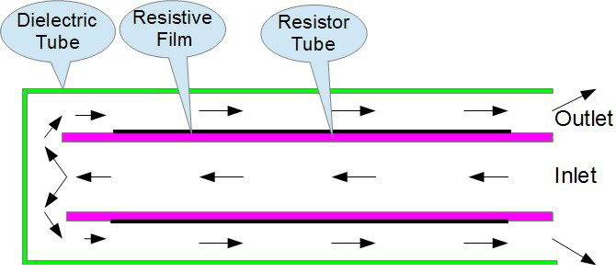
Resistive loads
Cooling water
Outlet
Needs maintenance !
In spite of Gold plating, after three years, resistor need to be replaced.
Cooling water
Inlet
Heat removal is efficient
Corrosive effects of high-purity DI water causes erosion of rf contacts. Thus resistor needs to be replaced.
To avoid fast erosion: The RF contacts are plated with Gold.
Courtesy: Doug Horan (ANL)
-Increase in running cost of accelerator
-Increase in Man power requirement

Slide 12
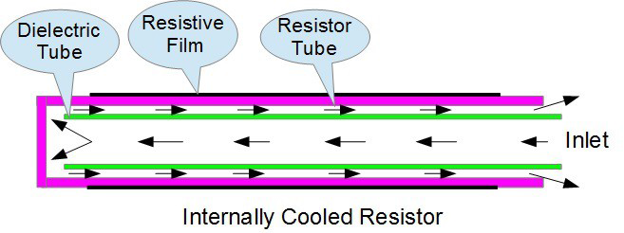
Technology Enhancement
Now DI water no more interacts with metallization
Outlet
Thus needs
zero maintenance !
Heat removal is less efficient compared to earlier design
- Load becomes more compact as dielectric tube inside ceramic

Slide 13
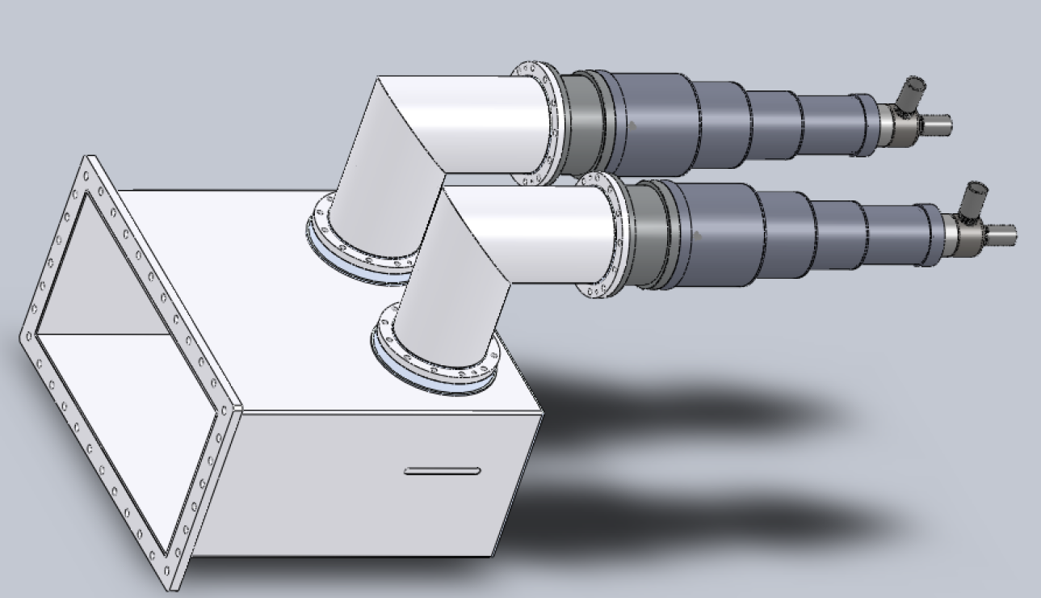
New development for ESS
Proposed design
For HB/MB load
New resistor
Development
Zero maintenance

Slide 14
Technology Enhancement
Ferrite Load using ferrite tiles
Ferrite tiles glued with water cooled wall
Zero maintenance
RF and water circuit separate
Earlier Maximum return
temperature ≈ 40ºC
Hot surface
Ferrite
Adhesive
AFT changed gluing technology
- To take care of heat transfer to the cooling channels
- Adhesive withstands >> 80ºC
- To tare care of different thermal expansions of ferrite and Al,
thermal stresses
Aluminum plate
Cooling channels
Now outlet temperature = 80ºC

Slide 15
New development for ESS
Ferrite Energy Recovery Load
Max Outlet temperature 80º C
Lossy ferrite powder used as absorber
Development by MEGA, following merger of MCI into MEGA
(Basic R&D was carried in CERN by Fritz Casper for loads at high frequency)
H-plane septa
Staggering of
plates to self cancel
reflection
# Lossy Ferrite in powder form is mixed with adhesive
# Applied on water cooled Septa
Eliminates risk of fracture due to thermal stresses
As ferrite molecular density is reduced, Watt /area reduces
Surface area increases, thus increasing avg. power handling capability

Slide 16
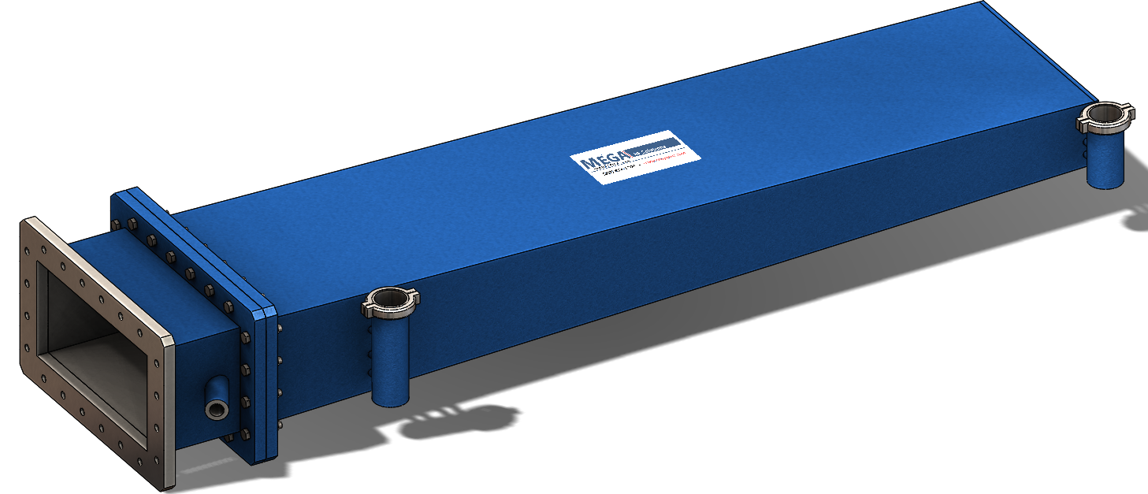
Proposed design for HB/MB load
Zero maintenance
RF and water circuit
separate
1450 mm

Slide 17
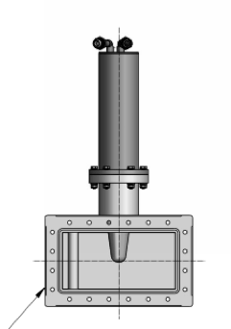
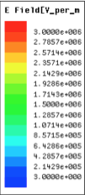
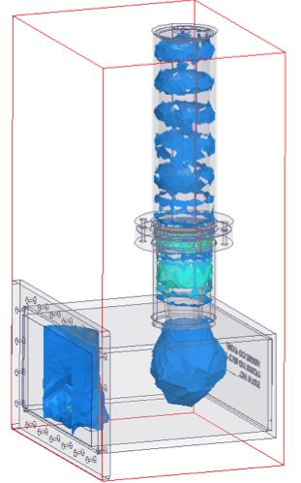
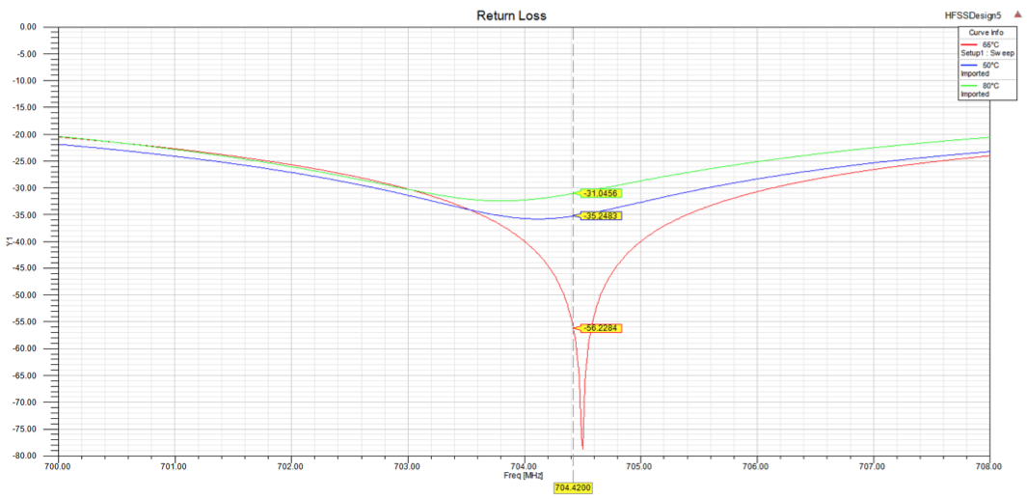
Technology Enhancement
Water Load
DI water is used as absorbent
Proposed design for HB/MB load
Water filled
cylindrical
column
E field < 0.8 MV/m
For input power 1500 MWp
Length≈ 700 mm
Teflon cone
Return loss for load
T=80ºC
T=50ºC
T=65ºC
50ºC-80ºC: S11 > 30 dB

Slide 18
ESS will be first one to use high temperature water cooled loads for Energy recovery.
The load designs are either NEW or with TECHNOLOGY ENHANCEMENT !
RF GROUP IS TAKING RISK
Thank you !

Slide 20
Different Operating scenarios
Power to the load during matched
Beam operation
6000 hours/year: When machine is running
Increase in outlet temperature < 1ºC
30% overhead
Beam Pulse
Pdiss
2.86 ms
Power to the load during Amplifier testing
Testing time < 600 hours / year
Increase in outlet temperature ≈ 10 ºC
Amplifier
Pulse
3.5 ms
Time
Power dissipated
in load
Pdiss across load
Time

