Slide 1
PIP-II
Valeri Lebedev
SLHiPP-5
18-19 March 2015

Slide 2
Outline
PIP-II Performance Goals
Design Concept and Design Choices
  Linac
  Transfer line
  Booster
  Recycler and MI
Summary

Slide 3
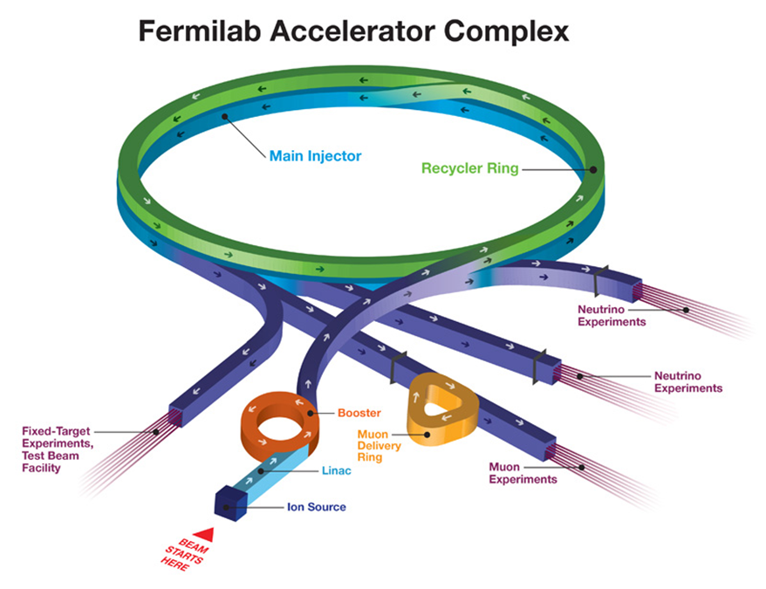
From PIP to PIP-II
PIP – Existing proton improvement plan (2011 – 2017)
  Booster rep. rate:
  ~6 Hz -> 15 Hz
  Booster RF upgrade
  Fixing deficiencies
  affecting future
  machine reliability
PIP-II – next step
in development of
FNAL accelerator
complex
  Reincarnation of
  Project X Stage I

Slide 4
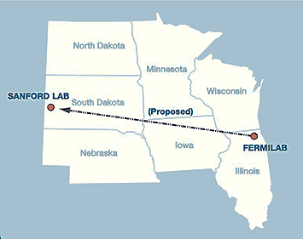
PIP-II Performance Goals
Increase MI power from 700 kW (NOvA) to >1 MW (LBNF) in the energy range 60 – 120 GeV
Increase Booster power from 80 to 160 kW
  8 GeV program: SBNE, …
Future upgrades
  Mu2e at 0.8 GeV and ~100 kW
  (from 7 kW @ 8GeV)
  Beam power to LBNF to >2 MW
  Provide a platform supporting
  a high duty factor/CW operation
  for future intensity frontier
  experiments

Slide 5
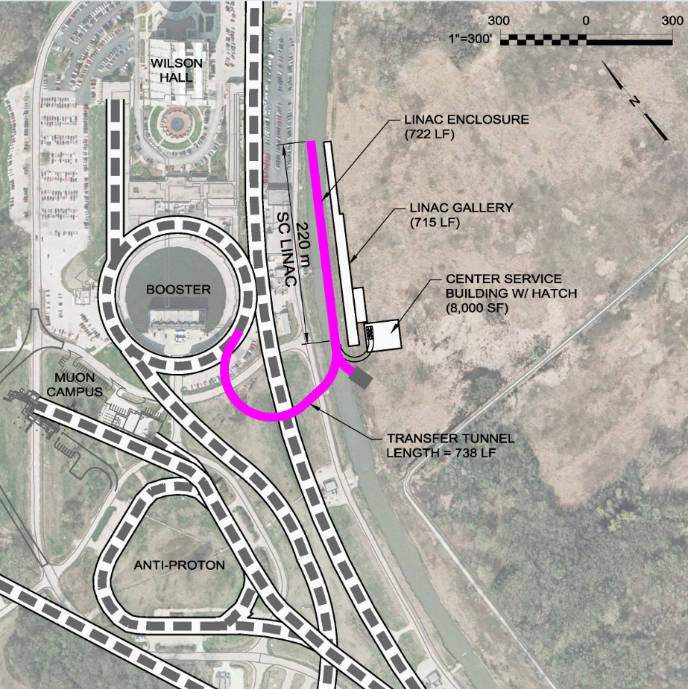
PIP-II Components
New 0.8 GeV linac
  L≈220 m
    Includes 4 empty slots at the linac end, L≈40 m
      Beam energy stabilization
      Possible energy upgrade
New Linac-to-Booster transfer line
  L≈280 m
Upgraded Booster
  20 Hz, 800 MeV injection
    New injection girder
    More RF cavities
Upgraded Recycler & MI
  RF and collimation

Slide 6
Approach to the PIP-II Accelerator Physics Design
New SC Linac
  Design compatible with CW operation
  => Small beam current (actually an advantage)
  MEBT bunch-by-bunch chopper chops out bunches at boundaries of RF buckets and from the extraction gap
  Energy stability of ~10⁻⁴ to support longitudinal painting
  Emittance less than 0.3 mm mrad (rms, norm)
    to minimize injection loss, and support of tailless transverse painting
Booster upgrade
  Rep. rate: 15 -> 20 Hz (leaves more power at 8 GeV)
  Injection energy: 400 -> 800 MeV => intensity×1.5, reduction ΔQ_{SC}
  Transverse and longitudinal painting: small I_{beam} helps
    Reduces tails and ΔQ_{SC}
Recycler
  Rep. rate increase
  => larger momentum separation in slip-stacking => smaller loss

Slide 7
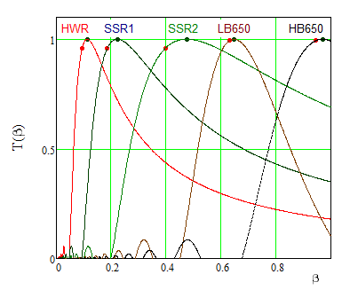
SC Linac Design Concept
Only SC linac can be compatible with high duty factor operation (≥30%)
Warm frontend
  Bunch-by-bunch chopping
    2.1 MeV beam energy
      high enough for
      beam dynamics
      Low enough to avoid
      residual radiation of
      chopped bunches
SC part
  5 types of SC cavities
    to cover required
    frequency range

Slide 8
PIP-II Linac Technology Map
IS
LEBT
RFQ
MEBT
β=0.11
β=0.22
β=0.47
β=0.61
β=0.9
RT
SC
162.5 MHz
0.03-10.3 MeV
325 MHz
10.3-180 MeV
650 MHz
180-800 MeV
Section | Freq | Energy (MeV) | Cav.per CM/CM | Type
RFQ | 162.5 | 0.03-2.1 | - | -
HWR (β_{opt}=0.11) | 162.5 | 2.1-10.3 | 8/1 | HWR, solenoid
SSR1 (β_{opt}=0.22) | 325 | 10.3-35 | 8/ 2 | SSR, solenoid
SSR2 (β_{opt}=0.47) | 325 | 35-185 | 5/7 | SSR, solenoid
LB 650 (β_{opt}=0.65) | 650 | 185-500 | 3/11 | 5-cell elliptical, doublet*
HB 650 (β_{opt}=0.97) | 650 | 500-800 | 6/4 | 5-cell elliptical, doublet*
*Warm doublets external to cryo-modules All components CW-capable
Notes:
Multiple corrections to the table and picture

Slide 9
SC Linac Design Choices
  Separate SC cryomodules
    Collimators between cryomodules to minimize beam loss inside them
    Solenoidal focusing for HWR, SSR1&2
      SC solenoids inside cryomodules (with attached BPMs and built-in trims)
  Doublet focusing between cryo-modules for LB650 and HB650
    Warm correctors and BPMs
  Energy stability of ≈10⁻⁴ is supported by the beam based feedback
    Cavities of the last cryo-module are used for correction
    4 empty slots at the linac end are used for time-of-flight energy measurements
  All beam instrumentation with exception of BPMs in HWR and SSR1&2 cryo-modules is located between cryomodules

Slide 10
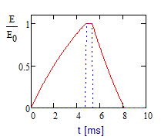
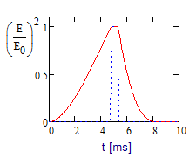
Cryogenic Requirements
Reusing Tevatron cryogenics enables considerable cost reduction
Temperature of cooling circuit, K | 70 | 5 | 2
Cooling power, W | 5720 | 1250 | 490
It requires operation in the pulsed regime
  Beam duty factor – 1.1%
  Fast cavity discharge using RF power with inverted phase
    Cryogenic duty factor ~ 5%
    RF duty factor ~12%
    Four times peak power increase in RF
    couplers at phase flip
  Fast tuner is required for pulsed operation
HWR can operate only in CW (no fast tuner)

Slide 11
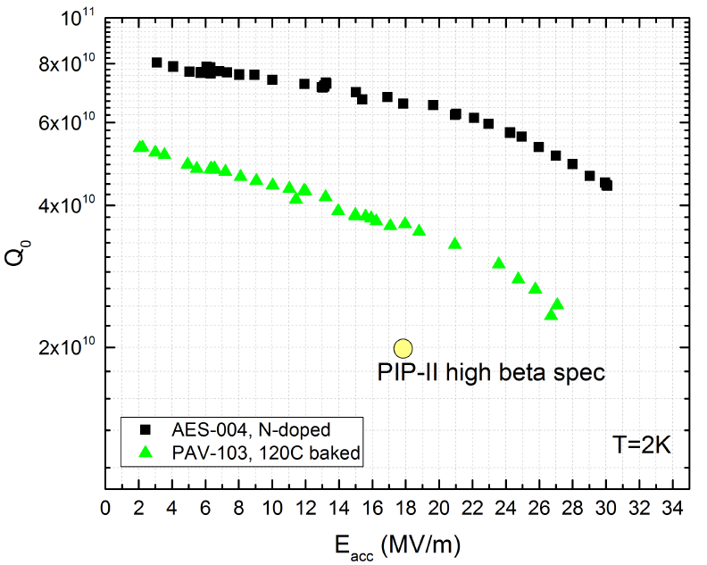
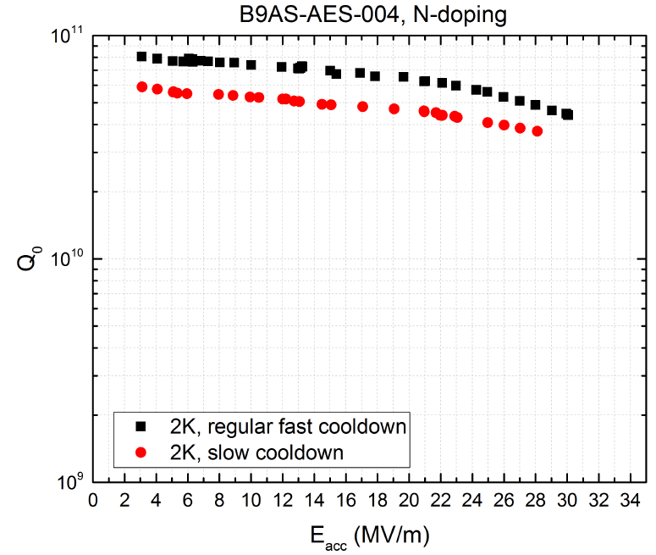
High Q₀ Studies
3 times increase of Q₀ was demonstrated in the vertical tests
  If this increase is transferred to the cryomodule
    10 times increase of beam duty factor from 1% to 10% (for the same cryo-plant)
      Corresponding cryo duty factor changes from 5% to 15%
Dependence of Q₀ on accelerating voltage for (1) 120C baked cavity and (2) N doped cavity; 2K, 650 MHz
Dependence of Q₀ on acc. voltage for N doped 650 MHz cavity for fast and slow cool downs.

Slide 12
Microphonics and Lorentz Force Detuning in SC Linac
HWR can only operate in CW
All other cryo-modules operate in pulsed regime (cryo limits)
  LFD shifts resonant frequency by ~5 bandwidth
    Cavities cannot operate without fast tuners
      High reliability of the tuners
      Ability to change non-functional tuners in the tunnel
Cavity design should minimize sensitivity to He pressure and LFD
Redundant RF power for microphonics suppression is anticipated
Minimization of vibrations in the tunnel and
suppression of their effect on resonant frequencies of cavities is one of major design goals

Slide 13
Suppression of Microphonics and LFD
Tested HWR & SSR1 demonstrated better than specified df/dP
df/dE² for SSR1
  However Δf_{E} ~5 times larger than the cavity bandwidth
    Cannot operate in pulsed regime without fast (piezo) tuner
Mechanical design of HB650 is initiated
  Aimed at reduction of df/dP and df/dE²
CM type | HWR | SSR1 | SSR2 | LB650 | HB650
Sensitivity to He pressure (FRS), df/dP , Hz/Torr | <25 | <25 | <25 | <25 | <25
… (measurements), df/dP , Hz/Torr | 13 | 4.0 | - | - | -
Estimated LFD sensitivity, df/dE², Hz/(MV/m)² | - | -5.0 | - | -0.8 | -0.5
… (measurements), df/dE², Hz/(MV/m)² | -1.5 | -4.4 | - | - | -
Estimated LFD at nominal voltage (FRS), Hz | - | -500 | - | -192 | -136
… (measurements ) at nominal voltage, Hz | -122.4 | -440 | - | - | -

Slide 14
RF Power Requirements
RF power requirements include
  Up to 20 Hz microphonics driven detuning
  1 dB allowance for regulation
  Power transfer inefficiency:
    0.5dB - HWR&SSR (coaxial);
    0.25 dB – LB&HB (wave guide)
CM type | Power trans-ferred to beam per cav. (kW) | Cavity half-bandwidth, f / 2Q_{L}, (Hz) | Peak RF power per cavity (kW)
HWR | 4 | 33 | 6.5
SSR1 | 4.1 | 43 | 6.1
SSR2 | 10 | 28 | 17
LB 650 | 23.8 | 29 | 38
HB 650 | 39.8 | 29 | 64

Slide 15
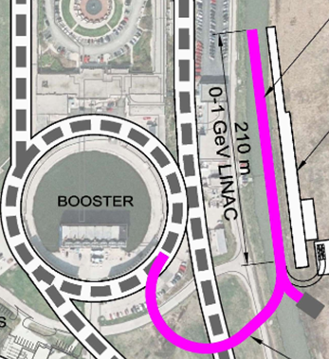
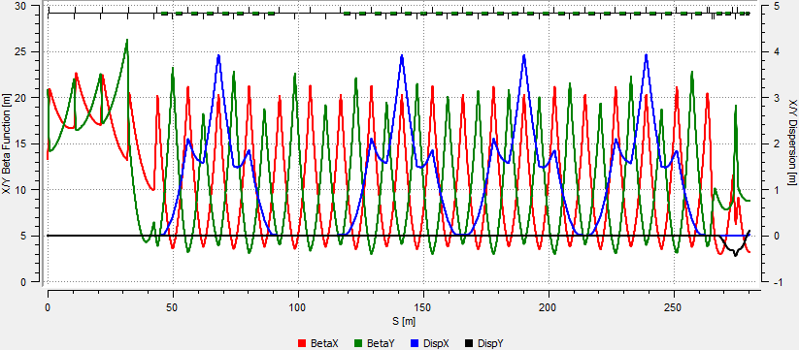
Linac to Booster Transfer Line
H⁻ Lorentz stripping (<10⁻⁸ m⁻¹) limits dipole field to 2.77 kG
for 1 GeV beam => the bending radius of dipoles to 20.7 m
Simple optics: all dipoles and most of quads have the same strength
Two arcs and a short straight between them
Sufficient place for collimators and possible debunching cavities

Slide 16
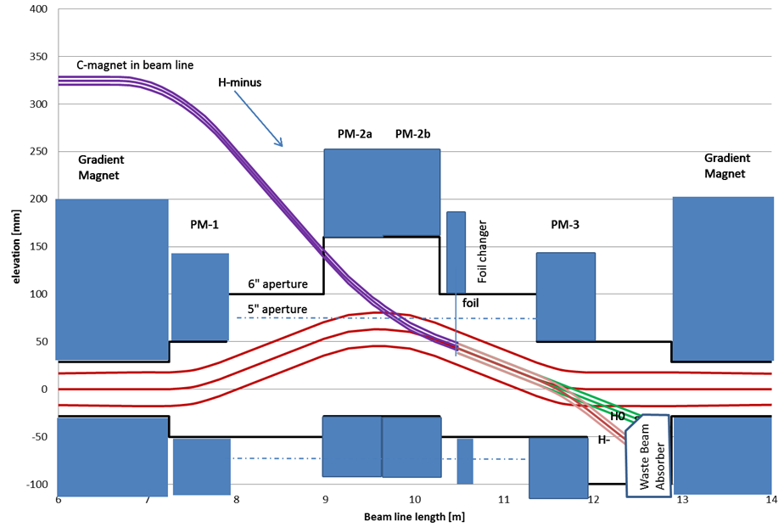
Booster Injection
H⁻ strip injection occurs through vertical dogleg allowing simple suppression of vertical dispersion
Vertical painting is done by changing dogleg dipoles and fast correctors in the beam line or by the correctors only
  linac beam stays
  at the same point
  on the foil
Booster correctors
are used for
horizontal
painting

Slide 17
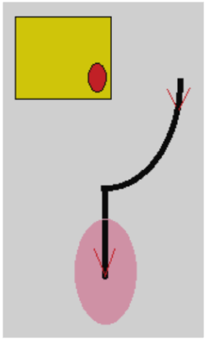
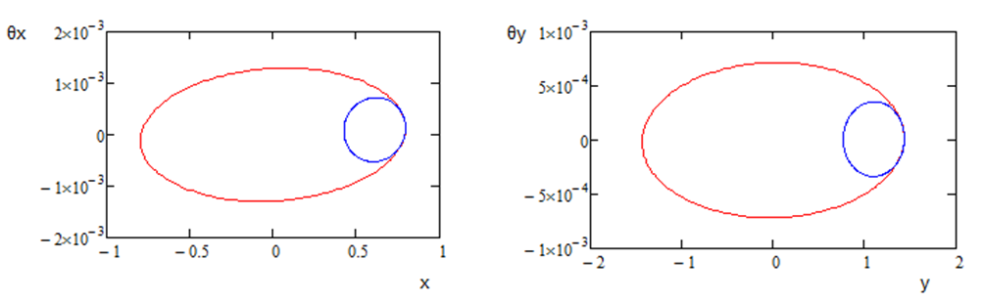
Transverse Painting
H⁻ strip injection
  Linac beam comes to the foil corner
    Like in the SNS
  Reduced beta-functions for linac beam to reduce secondary heats of stripping foil
Zero dispersion of linac beam
Non-zero Booster dispersion and non-zero momentum offset reduce secondary hits

Slide 18
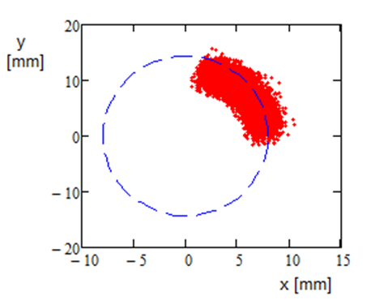
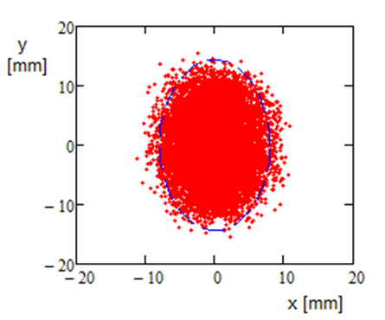
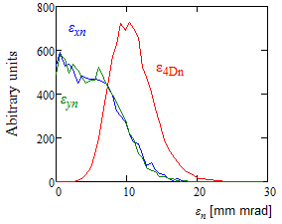
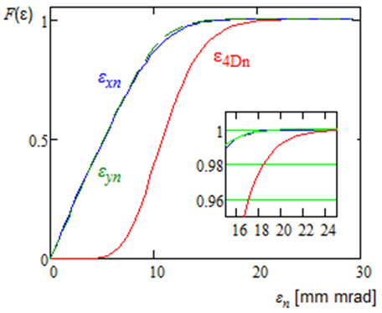
Transverse Painting (continue)
X and Y coordinates of injected particles relative to the current orbit position for particles incoming to the Booster (left) and at the end of injection process (right).
Left - the particle distribution over transverse CS invariant.
Right– the integrals of particle distributions (normalized to unity) presented in the left pane; ε_{95%n}=17 mm mrad

Slide 19
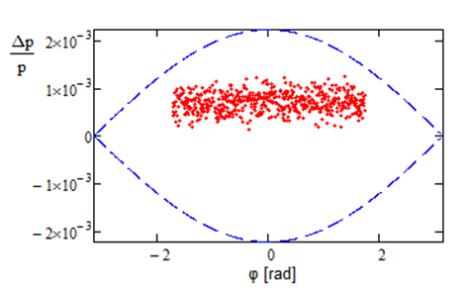
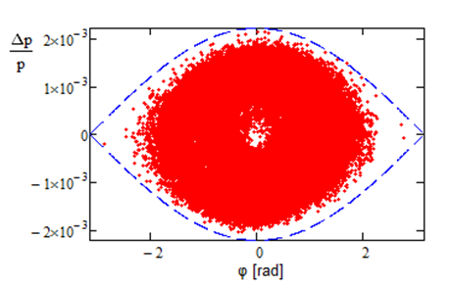
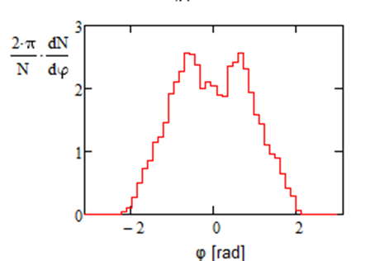
Longitudinal Painting in the Course of Booster Injection
Linac current | 2 mA
Duration of injection | 0.55 ms
- || - | 290 turns
- || - | 7 synchr. periods
Linac rms mom. spread | 2∙10⁻⁴
Booster bucket height | 2.2∙10⁻³
Momentum offset | +7∙10⁻⁴
Small tails in L. distribution
=> 10⁻⁴ energy stability

Slide 20
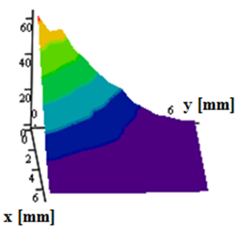
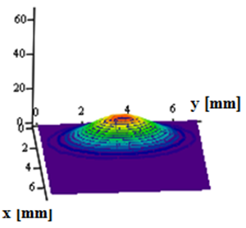
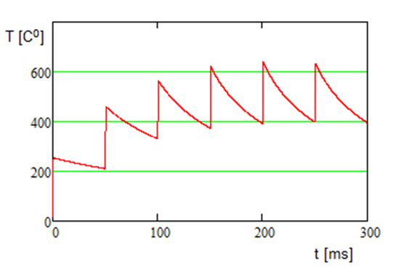
Foil Heating in the Course of Transverse Painting
Secondary foil heats make major contribution to the foil heating
Foil thickness - 600 μg/cm² => ~100% stripping efficiency
  Negligible effect on emittance growth
  0.1% single scattering loss
  Total beam loss <2% (mostly particles missing the foil)
Foil temperature is below 650Cº => long lifetime

Slide 21
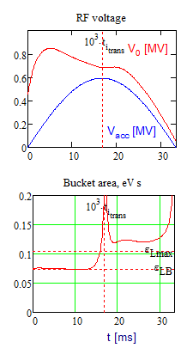
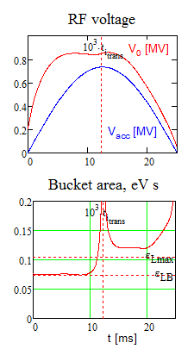
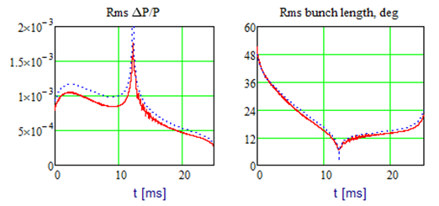
Acceleration in Booster
Transition from 15 to 20 Hz rep. rate does not require additional RF voltage if beam current is not changed
  Due to smaller slip factor at injection
Increase of beam current (planned for PIP-II) requires additional voltage
  Deceleration due to RW impedance
  Suppression of quadrupole oscillations after transition
15 Hz 20 Hz

Slide 22
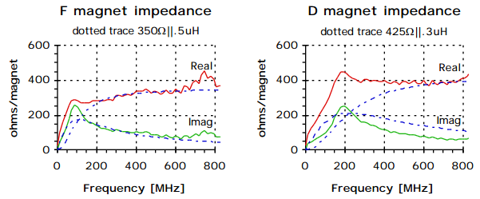
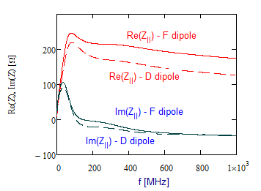
Booster Longitudinal Impedance
Beam aperture in the Booster is formed by poles of laminated combined function dipoles
  That greatly amplifies Booster impedance
Theoretical model yields results close to the wire measurements (J. Crisp, 2001)
  But there is a discrepancy between measurements of F and D dipoles

Slide 23
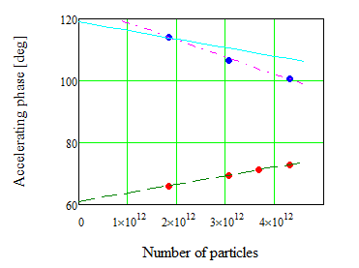
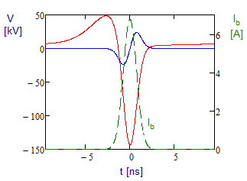
Beam Based Calibration of Booster Longitudinal Impedance
Measurements are based on dependence of the accelerating phase with beam intensity
  That resulted in minor correction of parameters used in the model
Deceleration achieves its maximum at the transition (shortest bunch)
  ~150 kV/turn in the bunch center for PIP-II parameters

Slide 24
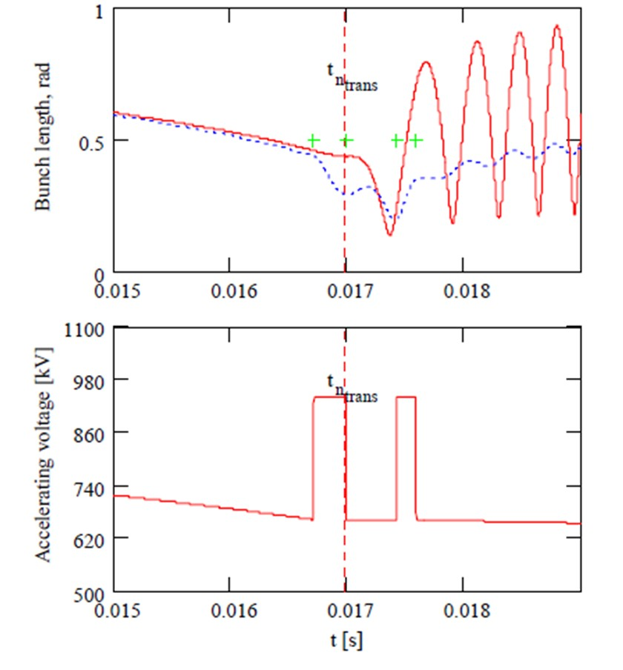
Booster Transition Crossing
RF voltage jump technique looks as a most promising method for transition crossing
Requires additional RF voltage ~300 kV
  150 kV due to impedance
  deceleration
  And 150 kV for voltage jump
Total required RF voltage – 1.1 MV
Only odd part of the voltage
dependence on coordinate
contributes to excitation of
quadrupole oscillations
  Major contribution comes from
  the space charge impedance

Slide 25
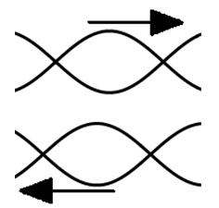
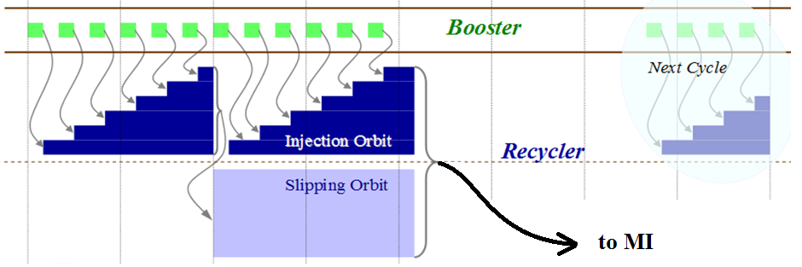
Slip Stacking in Recycler
Twelve Booster batches are slip-stacked in Recycler
An increase of Booster rep. rate from 15 to 20 Hz results in faster slipping
=> larger momentum separation
=> larger RF bucket size
=> smaller loss at slip stacking

Slide 26
Summary
The PIP-II proposal is described in detail in PIP-II Reference Design Report
The concept is solid and did not get significant changes during last year
Better understanding of transition crossing in Booster and beam stability in Recycler is required
Designs of SSR2, LB650 and HB650 will require significant time and this work needs to be accelerated
Highest priority work in Fermilab
  CD0 is expected at the end of this year

Slide 27
Backup Slides

Slide 28
Beam Optics in MEBT
Goals
  Optimize conditions for chopping (2 kickers, 180º phase advance)
  Differential pumping to prevent residual gas flux to SC part
  Triplet based transverse focusing (compensates strong SC force)
  3 rebunching cavity to control longitudinal phase space

Slide 29
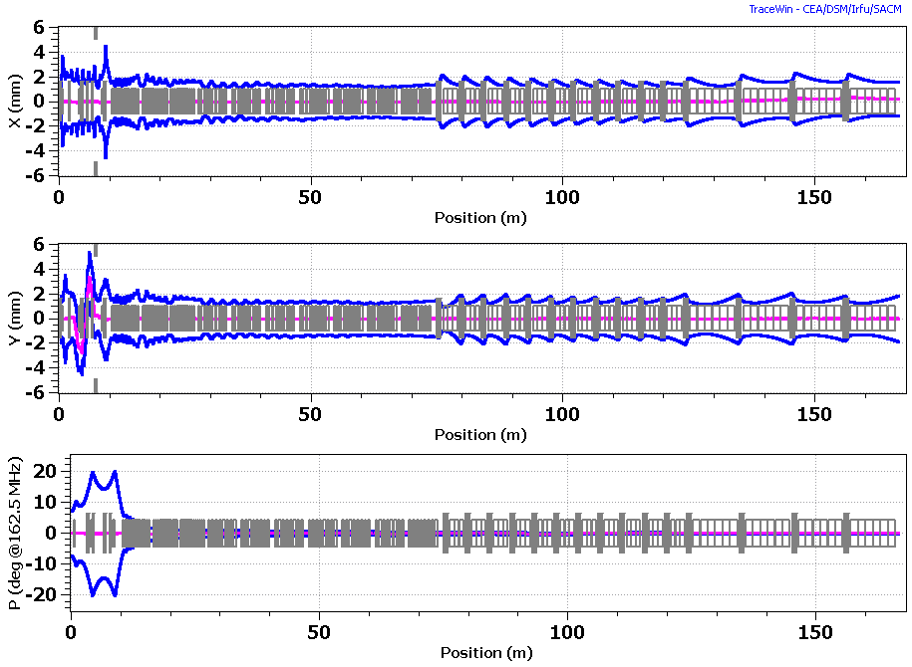
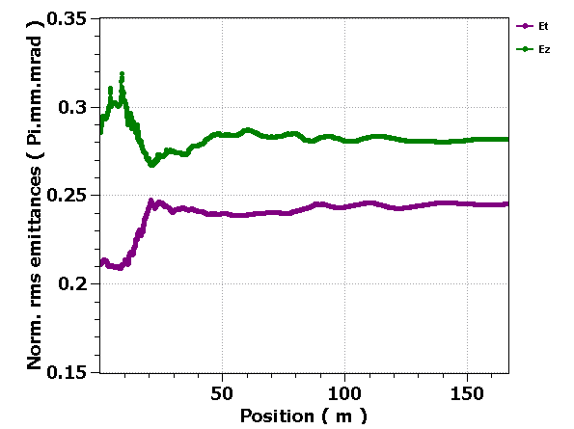
Beam Optics in SC Part
Beam is close to equipartitioning
  Helps to prevent uncontrolled emittance growth
  L to ⊥ emittance
  exchange is found
  in simulations
Strong ⊥ defocusing
due to cavity fields

Slide 30
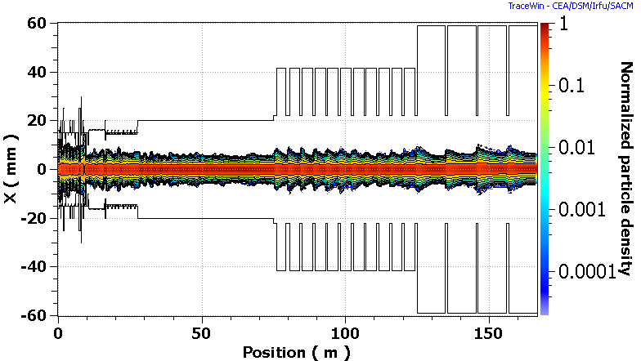
Beam Optics in SC Part (continue)
Simulations do not show dangerous halo growth
  Verified by SNS experience at ~twice larger value of N_{b}/ε⊥
  Ratio of beam size to aperture stays approximately the same downstream of HWR

Slide 31
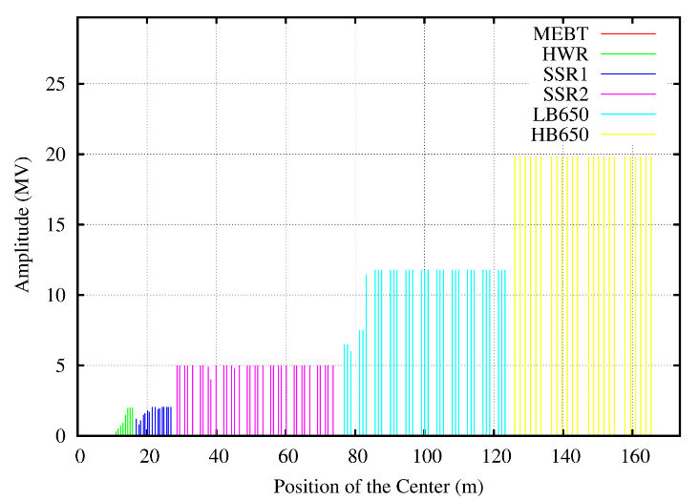
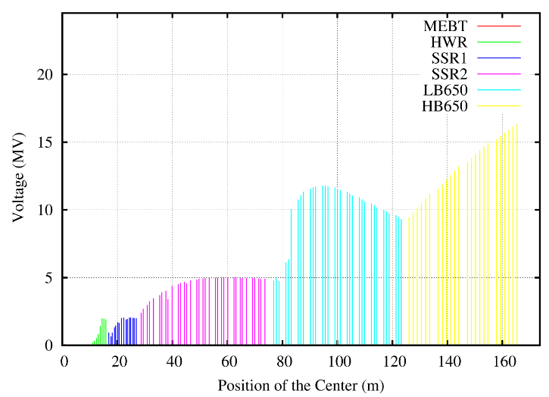
Accelerating Voltage
First HWR cavity has about half of nominal voltage to prevent longitudinal overfocusing
  Slow voltage increase in downstream cavities
Voltage is adjusted at the boundaries between different types of cryomodules
Accelerating voltage per cavity along SC Linac; optics is tuned to 5 mA RFQ beam current;
left – the voltage amplitude at the optimal beta,
right – the voltage amplitude with the transit-time factors accounted

Slide 32
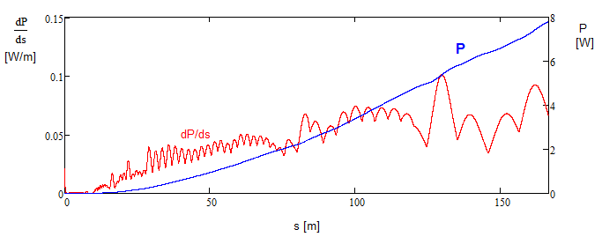
Beam Loss
Intrabeam stripping is the main source of particle loss in the SC linac
  The loss value (<0.1 W/m) for CW beam (2 mA, with 5 mA RFQ) is well within requirements
    Not an issue for PIP-II operating at ~1% duty factor

Slide 33
General Parameters of SC cryomodules
Conservative choice for Q₀ is based on the results obtained in real cryomodules
CM type | Cavities per CM | Number of CMs | CM configu-ration* | CM length (m) | Q₀ at 2K (10¹⁰) | Surface resis-tance, (nW) | Loaded Q (10⁶)
HWR | 8 | 1 | 8 × (sc) | 5.93 | 0.5 | 9.6 (2.75♠ ) | 2.7
SSR1 | 8 | 2 | 4 × (csc) | 5.2 | 0.6 | 14 (10#) | 3.7
SSR2 | 5 | 7 | sccsccsc | 6.5♦ | 0.8 | 14.4 | 5.8
LB650 | 3 | 11 | ccc | 3.9♦ | 1.5 | 12.7 | 11.3
HB650 | 6 | 4 | cccccc | 9.5♦ | 2 | 13 | 11.5
* “c” - denotes accelerating cavity; “s” - focusing solenoid.
♦ This number represents the present estimate of cryomodule length. It will be finalized with advances in the cryomodule design.
♠ Based on recent measurements of two HWR cavities at 2 MV accelerating voltage.
# Based on recent measurements of SSR1 cavities made of CABOT niobium.

Slide 34
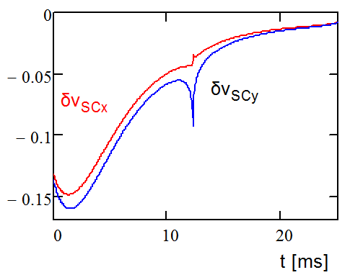
Coulomb Tune Shifts
Increased injection energy and KV-like transverse distribution reduce tune shifts due to beam space charge by more than factor of 2 relative to the present operation
Betatron tune shifts due to beam space for horizontal and vertical planes within accelerating cycle. The reduction of tune shifts due to non-Gaussian shape of the particle distribution is taken into account

Slide 35
Beam Stability in Recycler and MI
A study shows that instabilities related to beam interaction with vacuum chamber do not present outstanding problem
However, presently, a strong transverse instability is observed in Recycler
  The only credible explanation is related with electron multipacting which results in the ep instability
    Studies are going on
    An instability threshold is increasing with time
      Vacuum chamber conditioning is the most probable reason
  A number of actions is planned to mitigate the problem for NOvA
Better understanding of instability is required to make reliable prediction of beam stability for PIP-II parameters

Slide 36
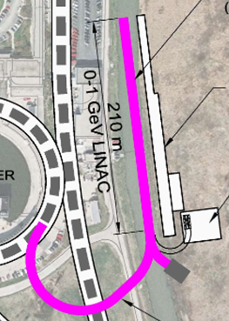
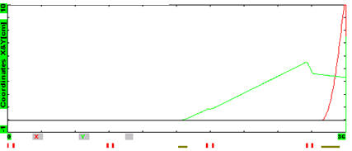
Beam Based Energy Stabilization
Local cavity feedback should stabilize its voltage and phase to better than 0.1% and 0.1º rms
Beam based stabilization
  Beam is sent to the beam dump for 10 - 30 μs
  Time of flight energy measurement is used
  to stabilize energy to 0.01% rms
    4 empty slots are reserved at the linac end,~40m
    Fast kicker and septum switch the beam
    from the beam dump to the Booster
Beam trajectories for the beam switching

Slide 37
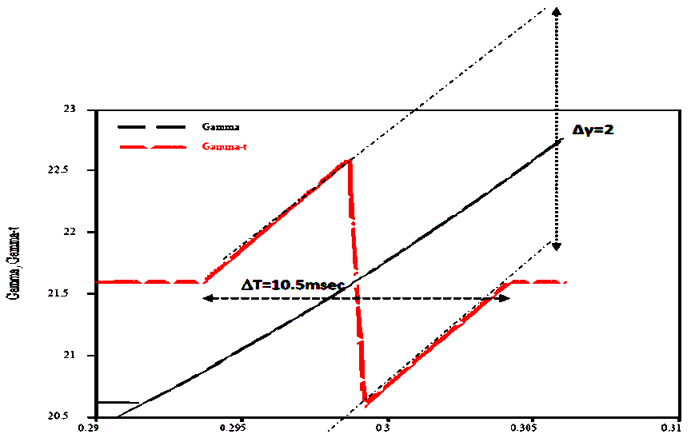
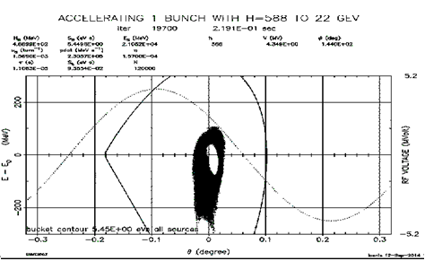
MI Transition Crossing
Increased beam intensity and larger longitudinal emittance complicate transition crossing
γ_{t} jump is preferred method for transition crossing in MI
ESME simulations do not show significant increase of L. emittance and longitudinal tails
Additional hardware for fast tune change is required
Phase space distribution after transition in MI. The hole in the center is a result of slip stacking

Slide 38
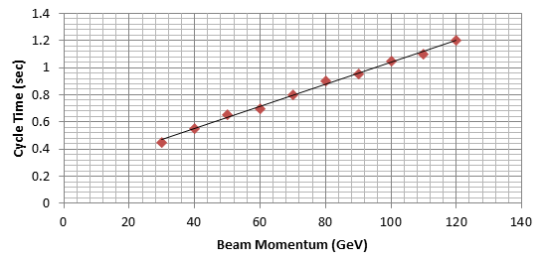
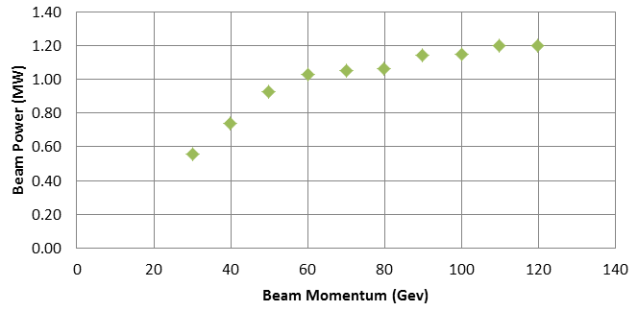
Beam Acceleration in MI
The accelerating rate in MI is determined by maximum slue rate of magnetic field and RF voltage
  That determines the dependences of
  (1) cycle time duration
  and (2) beam power
  on the final beam energy
MI RF power upgrade is required to support the beam intensity increase

Slide 39
PIP-II Primary Challenges/Risks
Construction of new SC Linac (SCL)
  5 new types of SC cavities
  Microphonics and LFD detuning suppression
  Bunch-by-bunch chopping (CW capable)
Booster operation at 1.5 times larger intensity
  Transition crossing with 1.5 times larger beam current
  but with the same L & ⊥ emittances
Slip stacking in Recycler
  Slip stacking with 1.5 times larger beam intensity
    ep instability
    Efficiency of instability damping for slipping bunches is unknown
Main injector
  Lossless transition crossing
  Beam stability with increased current

Slide 40
PIP/PIP-II Performance Goals
Performance Parameter | PIP | PIP-II
Linac Beam Energy | 400 | 800 | MeV
Linac Beam Current | 25 | 2 | mA
Linac Beam Pulse Length | 0.03 | 0.5 | msec
Linac Pulse Repetition Rate | 15 | 20 | Hz
Linac Beam Power to Booster | 4 | 18 | kW
Linac Beam Power Capability (@>10% Duty Factor) | 4 | ~200 | kW
Mu2e Upgrade Potential (800 MeV) | NA | >100 | kW
Booster Protons per Pulse | 4.2×10¹² | 6.5×10¹²
Booster Pulse Repetition Rate | 15 | 20 | Hz
Booster Beam Power @ 8 GeV | 80 | 160 | kW
Beam Power to 8 GeV Program (max) | 32 | 80 | kW
Main Injector Protons per Pulse | 4.9×10¹³ | 7.6×10¹³
Main Injector Cycle Time @ 60-120 GeV | 1.33* | 0.7-1.2 | sec
LBNF Beam Power @ 60-120 GeV | 0.7* | 1.0-1.2 | MW
LBNF Upgrade Potential @ 60-120 GeV | NA | >2 | MW
*NOvA operates exclusively at 120 GeV

