Slide 1



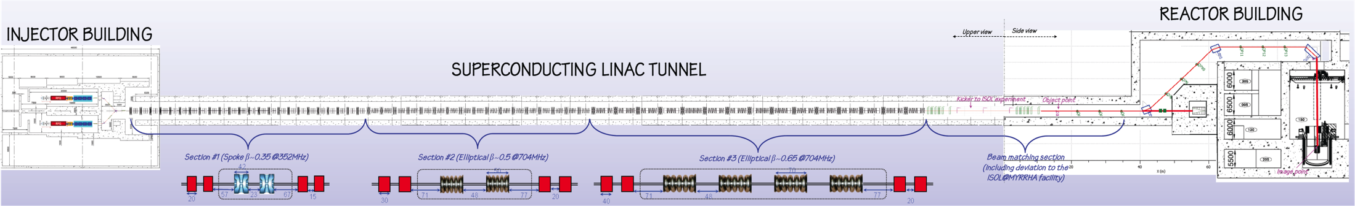
Progress in design and construction of the MYRRHA LEBT
Dirk Vandeplassche
for the SCK•CEN – LPSC – IPNO collaboration
ESS, Lund, Sweden
March 18, 2015

Slide 2
Overview
Status overview
2015 Accelerator R&D activities
Notes:
Apologies ...

Slide 3
MYRRHA status
no path to construction (yet)
R&D activities:
  2010 – 2014 characterized by
    exp. PbBi loops + FEED on reactor
    reduced effort on accelerator
  2015: keyword = "ongoing"
  reinforcing at 3 levels:
    SCK•CEN
    Belgian Federal Government
    European support

Slide 4
Reactor R&D status
safety related issues from
  new regulations (Fukushima)
  new R&D results
result: ever increasing size
scope & design to be reviewed

Slide 5
Accelerator R&D status
FP7 project MAX now finalized
Horizon2020 project MYRTE ready to start
  integrated project, 12 M€ total, 9 M€ granted
  4-year activity
  7 Work Packages, 27 partners
  sizeable accelerator effort : 5.4 M€ total WP2 (13 p.)
under-represented, missing activities
extra budget expected

Slide 6
MYRTE: accelerator WP2
Realisation of a full size MYRRHA-type RFQ demonstrator
Construction of a prototype Solid State RF power amplifier
Digital LLRF development
Beam diagnostics development
Control System development in a highly reliable accelerator context
Beam simulation code development, global coherence
Injector commissioning
Space Charge experiments
Linac4 reliability analysis
MYRRHA SRF spoke R&D
SRF CH demonstration with beam
MYRRHA linac cost estimation

Slide 7
LEBT general
daily reality in 2015
bilateral collaboration project LPSC-SCK
partly financed by ongoing FP7 project MARISA
2 main objectives:
  prerequisite for MYRTE – RFQ task:
    beam optical requirement
  experimental platform
    space charge
    non-destructive diagnostics
    controls architecture
    design choices

Slide 8
LEBT design

Slide 9
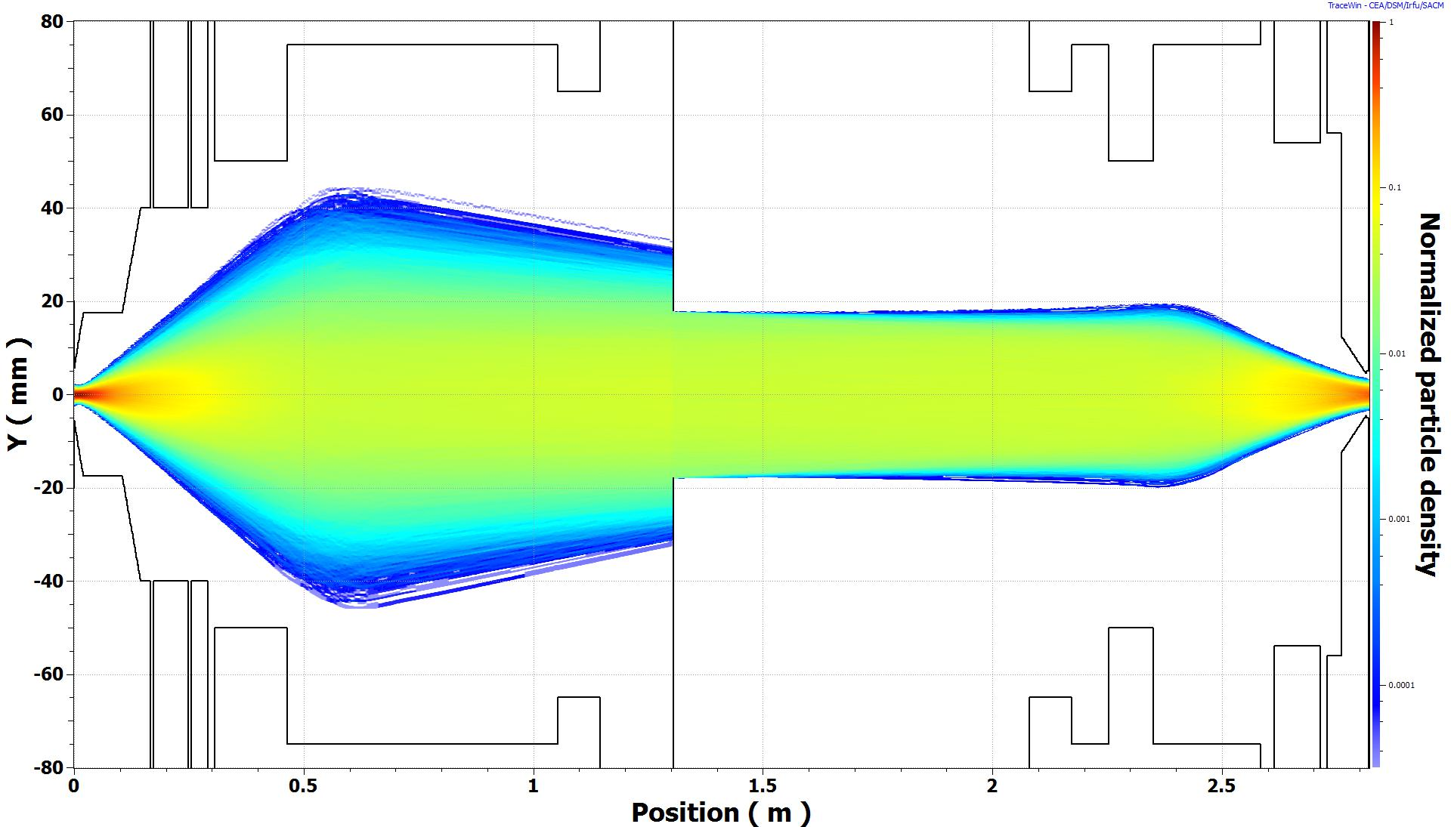
LEBT design

Slide 10
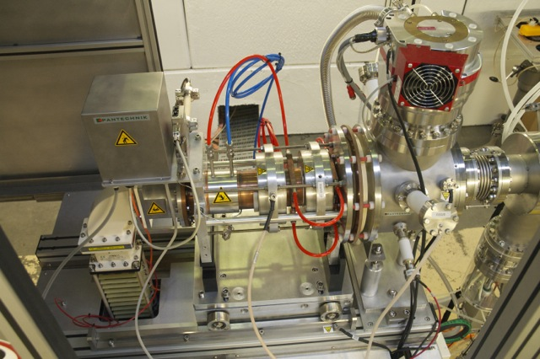
LEBT components: IS
DSC_3804.jpg

Slide 11
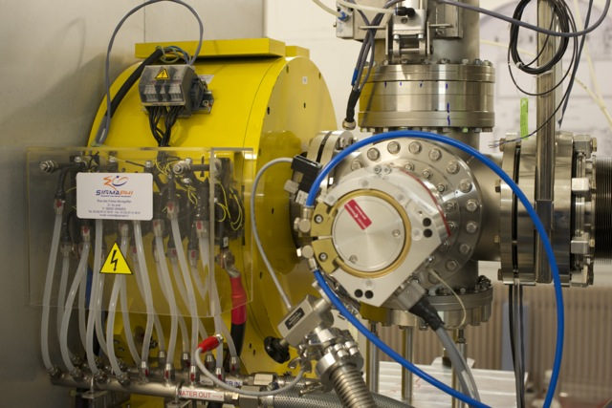
LEBT components: solenoids

Slide 12
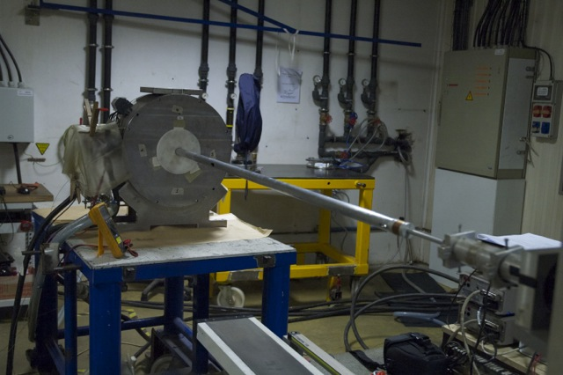

LEBT components: solenoids
Power Converter by JEMA sa
2 × 120 A, 50 V, 10⁻⁴ stab.
4 × ±5 A, 5 V, 10⁻³
1 common Profibus controller

Slide 13
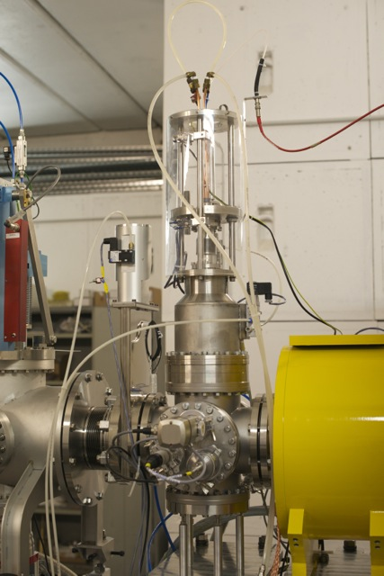
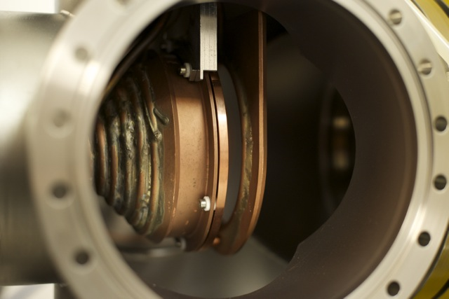
LEBT components: cross
Faraday Cup Ø 100 mm
design IPN Lyon, constr. CRC
1.2 kW for σ = 3 mm
biased ring for SE correction
pneumatic driver

Slide 14
LEBT components: diagnostics

Slide 15
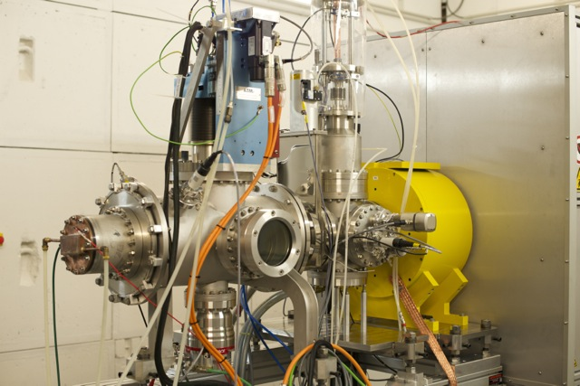
LEBT components: diagnostics

Slide 16
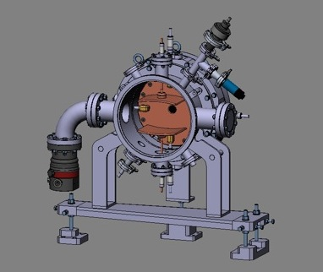
LEBT components: chopper

Slide 17
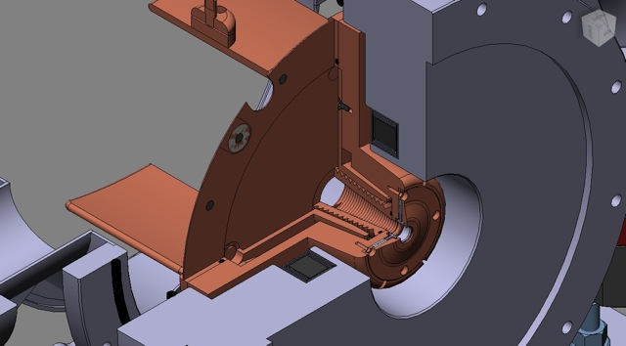
LEBT components: chopper

Slide 18
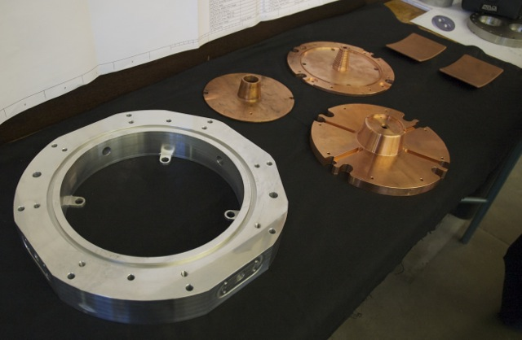
LEBT components: chopper

Slide 19
Experimental program
tool: emittance measurements (Allison scanner at different positions)
program:
  beam characterization and matching (started)
  space charge:
    steady state aspects
    transients → dynamics of compensation
    simulations
  long run behaviour
    predictive correlations with continuous observables

Slide 20
First emittances

Slide 21
First emittances

