Slide 1
ADS Project and Material Irradiation Facility in China
Yuan He
On behalf of ADS Linac Team
Institute of Modern Physics, CAS
Notes:
This talk is based on the experience and understanding on our demo linac and SARAF

Slide 2
Outlines
Introduction of CIADS
R&D Progress of CIADS
Introduction of CMIF
Summary

Slide 3
Motivation (development of NPP in China)

Slide 4
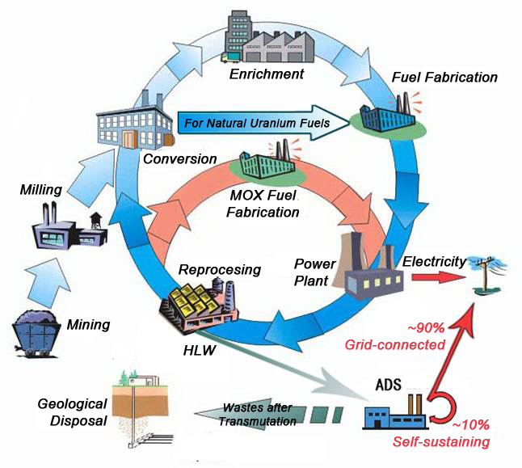
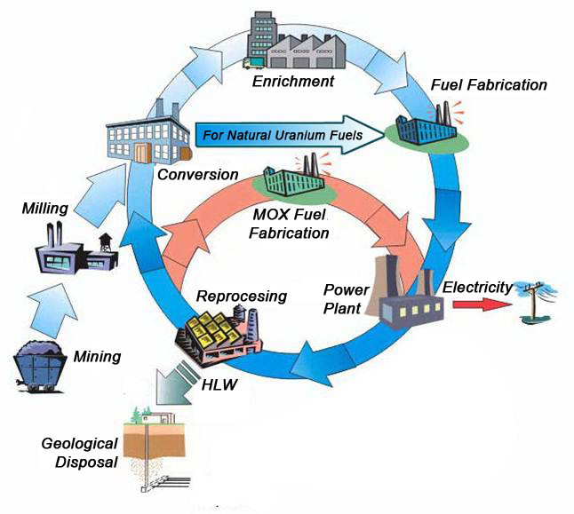
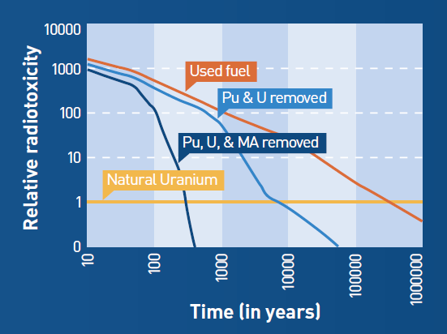
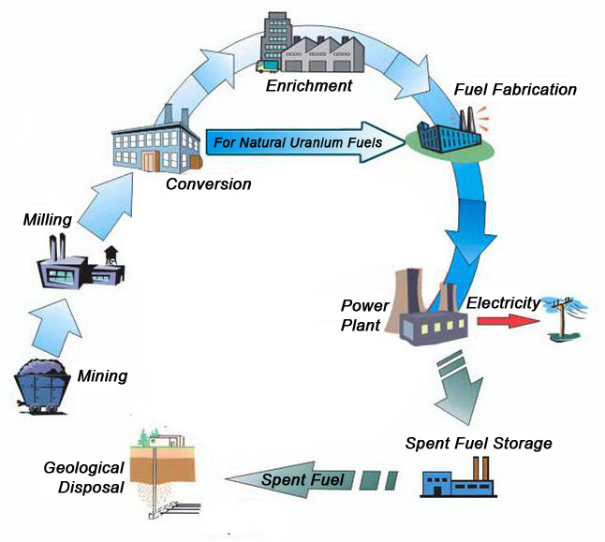
Nuclear Fuel Cycle (IAEA-TECDOC-1613)
ADS + Close Cycle is better at burning waste.
Open
Cycle
ADS+Close Cycle
Close Cycle
Total radiotoxicity of spent fuel relative
to that of natural uranium ore.
Used fuel → Open Cycle (~300,000y)
Pu & U removed →Close Cycle (~5000y)
Pu, U, & MA removed → ADS + Close Cycle (~300y)

Slide 5
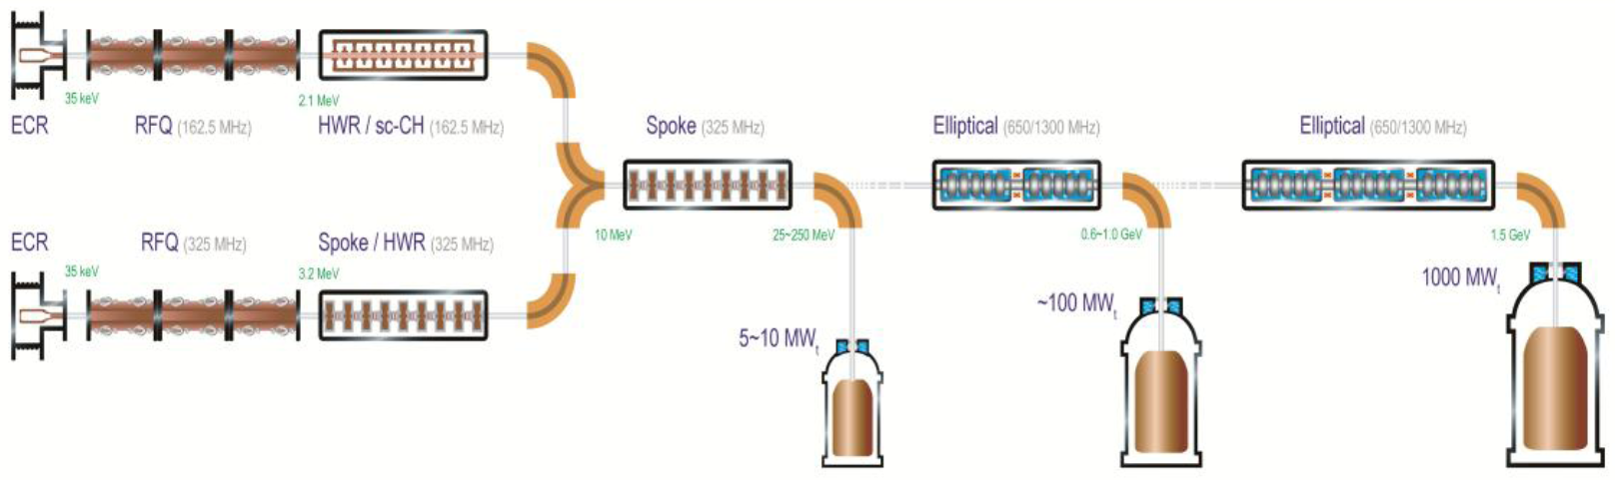
Roadmap of ADS project in China
2014.06, 2.1 MeV/10 mA/CW
Goal in 2015.06, 5 MeV
Injector II, 162.5 MHz
Goal in 2015.12, 10 MeV
Goal in 2016.09, 25 MeV
Injector I, 325 MHz
Stage 1: Research facility (CIADS)
(250 MeV, 10 mA, 10 MWt)
Y2017-2022, 2.25 B CNY
“Strategic Technology Pilot Project”
of the Chinese Academy of Sciences
Key technology R&D
Y2011-2017, 1.78 B CNY
Stage 2: Demo facility (CDADS)
(1.2~1.5GeV, 10~25 mA, 100 MWt)
Y2030

Slide 6
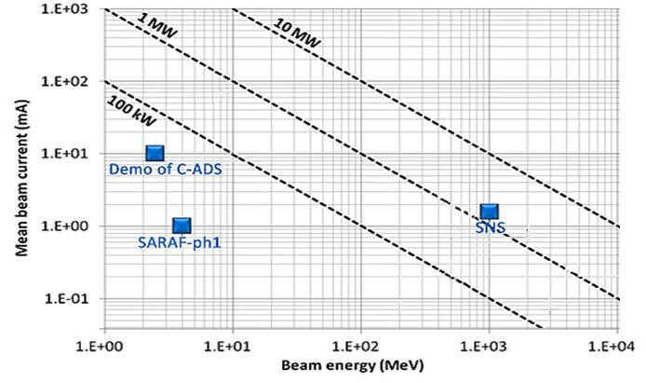
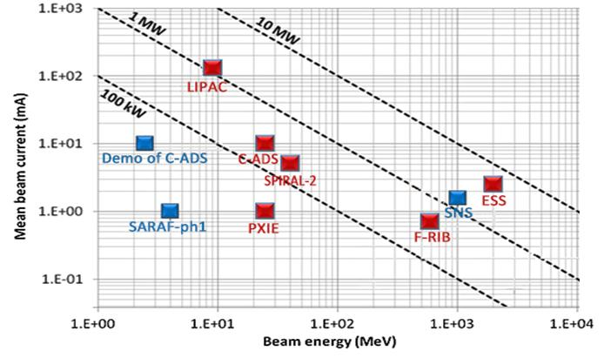
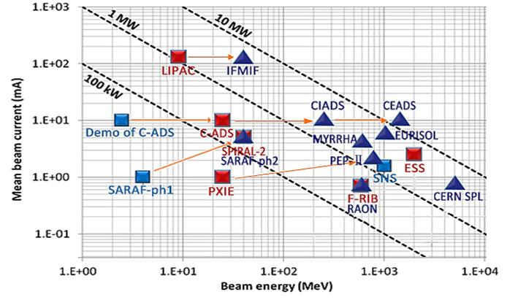
High power SRF Linacs in the world
Existing SC machines
Under construction SC machines
Planned SC machines
CDADS
Non exhaustive plot!

Slide 7
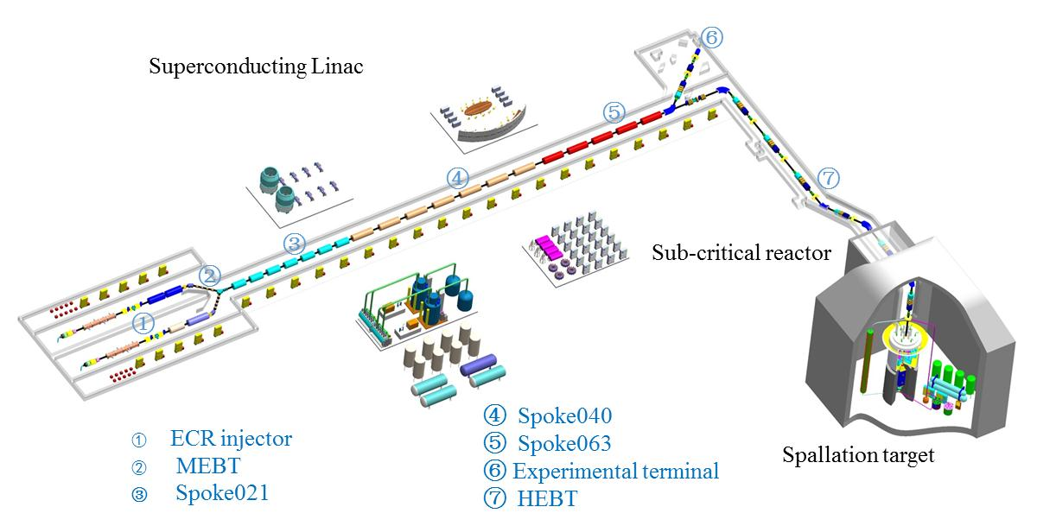
New Project CIADS (2017-2022)
China Initiative Accelerator Driven System
Proposal listed in the “twelfth-five plan for large scale research facility
Budget: ~2.25 B CNY
LINAC: 250 MeV@10 mA with CW mode
Spallation Target: granular flow spallation target, 2.5 MW
Sub-critical core: 10 MWt
Location: Huizhou, Guangdong Prov.

Slide 8
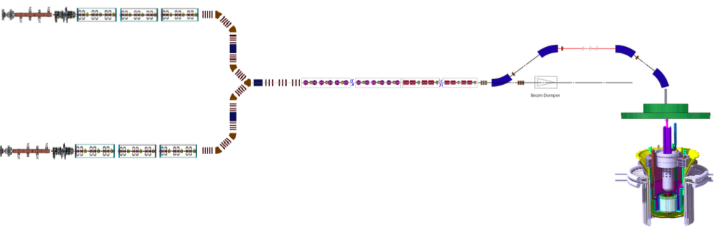
Accelerator configuration of CIADS
Two injectors Down Selection
162.5 MHz RFQ+HWR
Main Linac, spoke, ellip, 250 MeV
Main Parameters
Particle | Proton
energy | ~250 | MeV
Max current | ~10 | mA
Max beam power | ~2.5 | MW
Duty factor | 100 | %
Beam loss | <1 | W/m
ECR ion sources
Resonators of SRF Linacs
energy | 35 | keV
emittance | 0.2 | πmm.mrad
Max current | 15 | mA
Freq. | 162.5 | 162.5 | 325 | 325 | 650 | MHz
βg | 0.1 | 0.15 | 0.21 | 0.4 | 0.63 | -
Aperture | 40 | 40 | 50 | 50 | 100 | mm
Uacc | 0.78 | 1.82 | 1.64 | 2.86 | 10.3 | MV
Epeak | 25 | 32 | 24/31 | 25/32 | 29/38 | MV/m
Bpeak | 50 | 40 | 50/65 | 50/65 | 50/65 | mT
Temp. | 4.5 | 4.5 | 4.5 | 2 | 2 | K
Ploss | 10 | 10 | 10 | 6.5 | 21 | W
Number | 6 | 6 | 28 | 72 | 28
RFQs
Energy of exit | 2.1 | MeV
frequency | 162.5 | MHz
Long. Emitance at exit | 0.09 | πMeV.deg

Slide 9
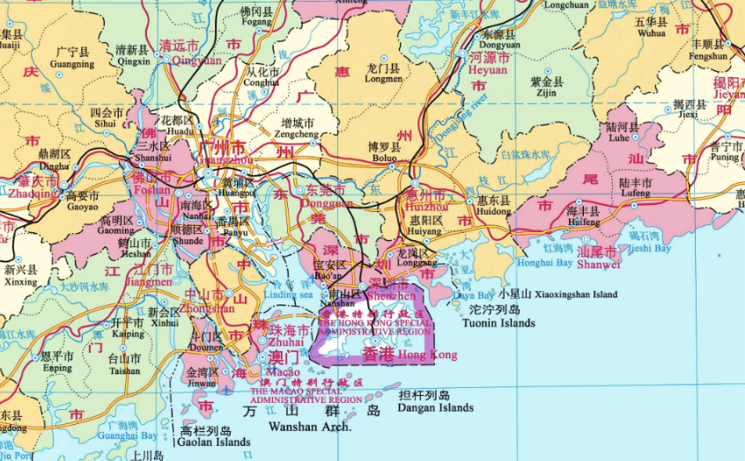
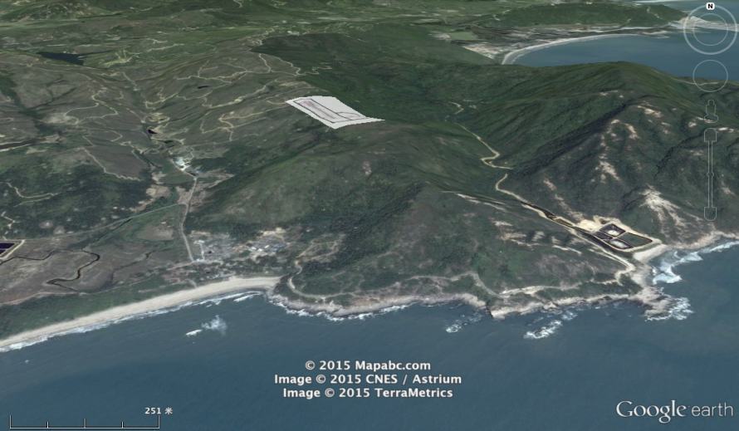
Location of CIADS
CIADS
Daya Bay
CSNS

Slide 10
Outlines
Introduction of CIADS
R&D Progress of CIADS
Introduction of CMIF
Summary

Slide 11
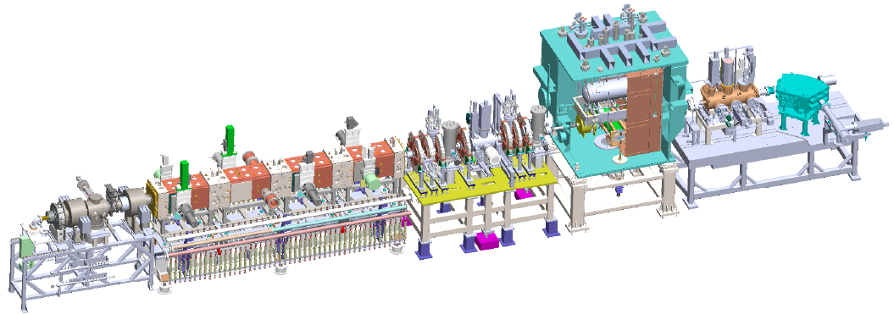
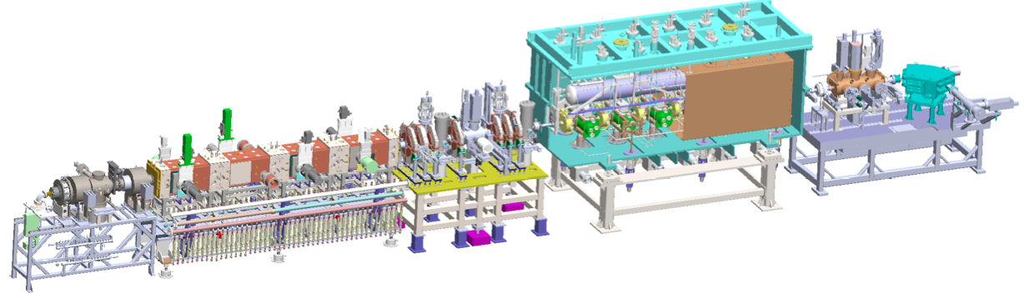
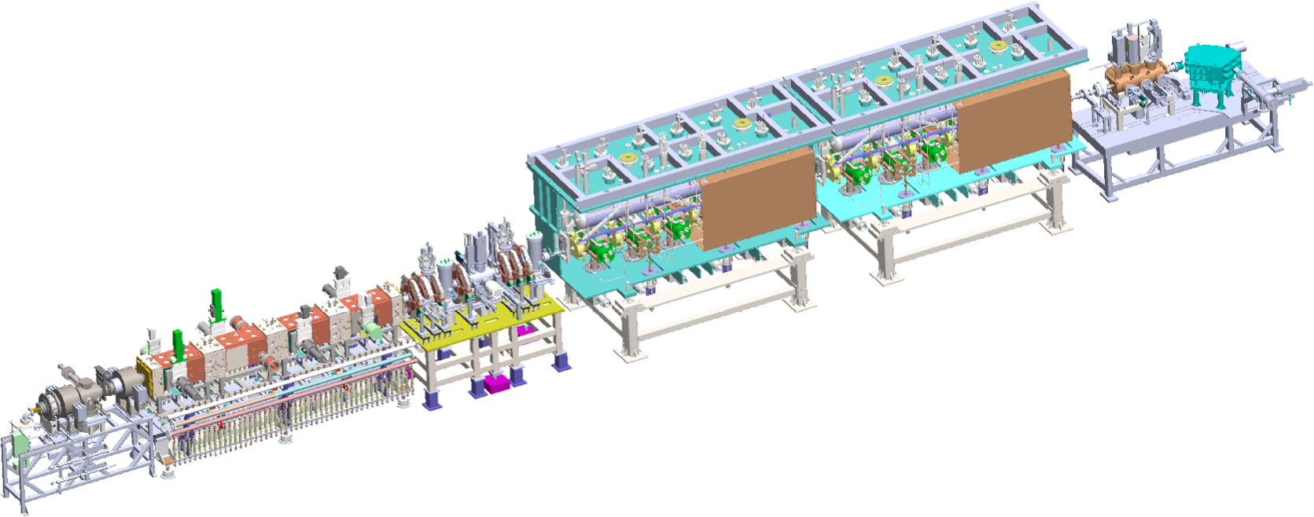
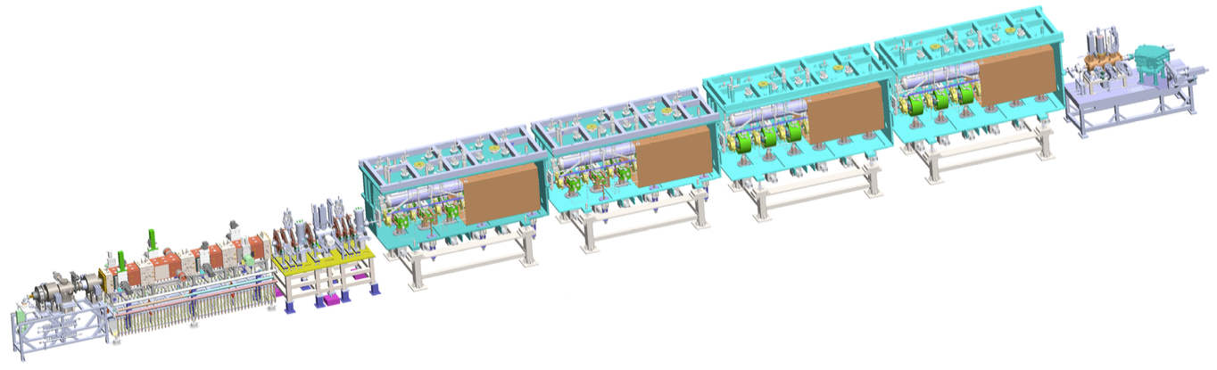
Demo of SRF LINAC for CIADS in 2011-2016
ECRIS + LEBT + RFQ + MEBT + TCM1, 2.5 MeV
RFQ commissioning, validate CM design.
Ongoing to CW at 10 mA
1
162.5 MHz HWR010
ECRIS+LEBT+RFQ+MEBT+CM6, 5 MeV
Beam commissioning in March 2015
2
162.5 MHz HWR010
ECRIS + LEBT + RFQ +
MEBT + 2xCM6 +HEBT, 10 MeV
Dec. 2015—Feb. 2016
3
162.5 MHz HWR010
325 MHz Spoke021
4
162.5 MHz HWR010
~25 MeV, Sept. 2016 – 2017
Cooperate with IHEP

Slide 12
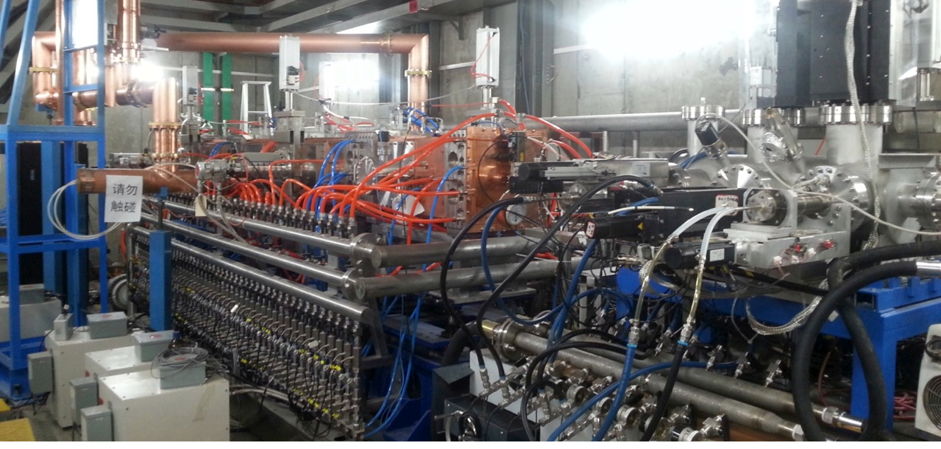
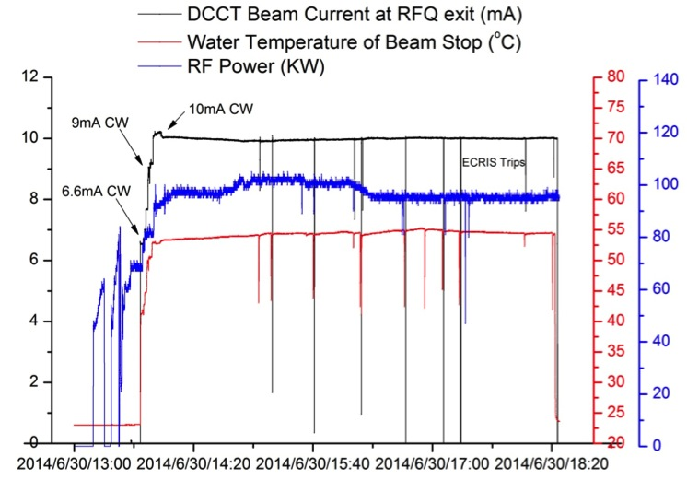
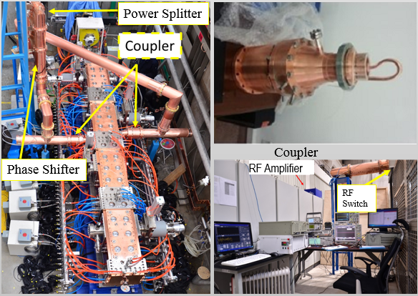
Commissioning of 162.5-MHz CW RFQ
Details will presented by Dr. Zhijun Wang
June 30th, 2.1 MeV/10 mA/CW, 4.5 hours, 21.6 kW, efficiency is 95%
Total operation time is ~900 hours, including CW@10mA around 10 hours；Record of non-trip operation is ~220 hours

Slide 13
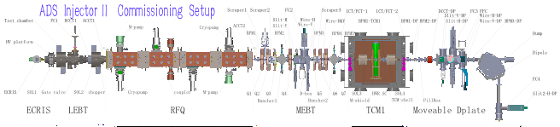
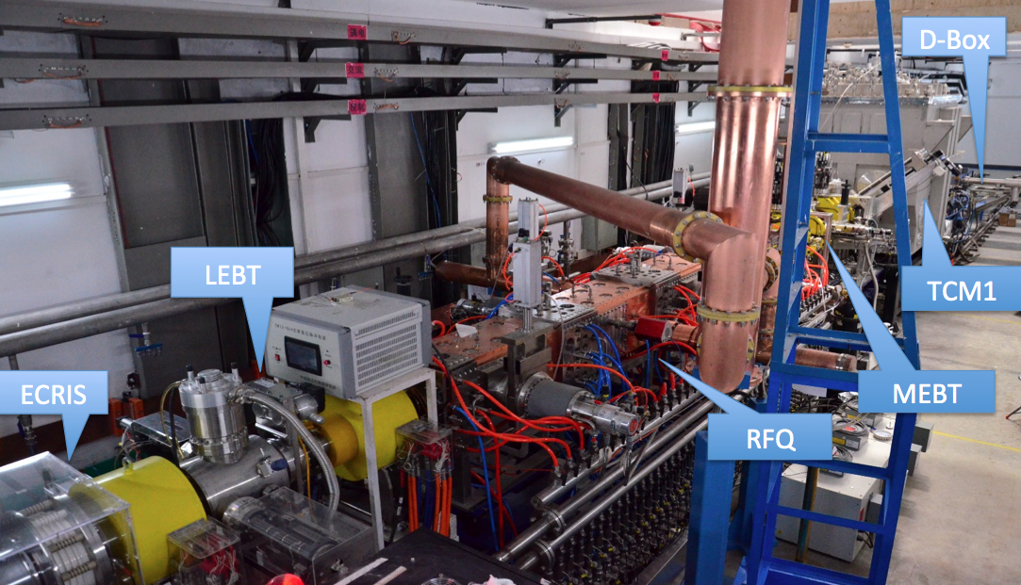
Commissioning of MEBT and TCM(HWR)
4K and HWR technique proven, injector
Details will presented by Dr. Zhijun Wang
Sept. 29th, 2014, first beam from TCM1, 2.6 MeV, 2.3 mA, Transmission ~100%
Feb. 13th, 2015, 2.55MeV/~11mA/CW, 28kW.
Total operation time was ~ 200 hours. The non-stop operation is ~46 hours.

Slide 14
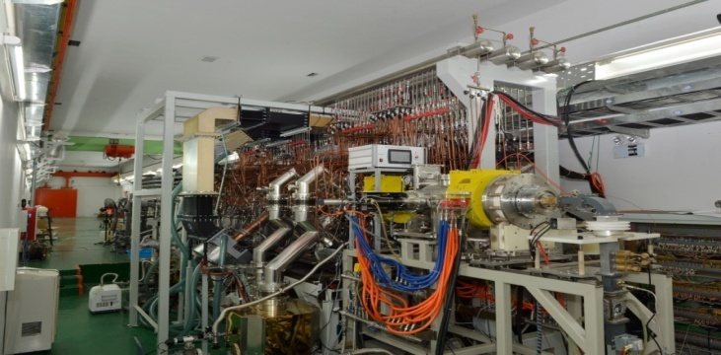
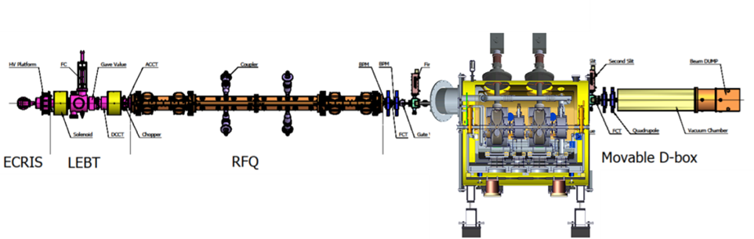
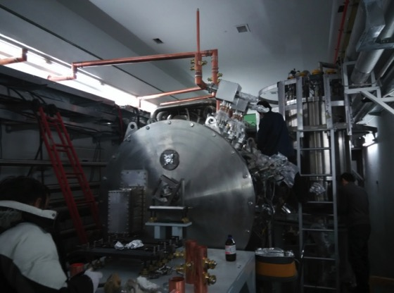
Commissioning of 325-MHz Linac
Pules: 11 mA, 50 Hz, duty factor>90%
Efficiency > 97%（duty factor 70%）
Energy 3.2 MeV, average power > 31 kW
2K and spoke technique proven, main linac
Two spokes
Pules: 10 mA, 30~130 us, 1 Hz
Efficiency > 99.7%
Energy 3.61MeV

Slide 15
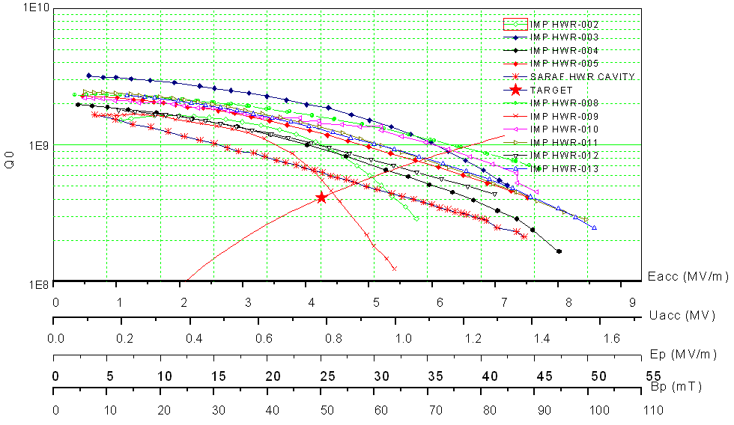
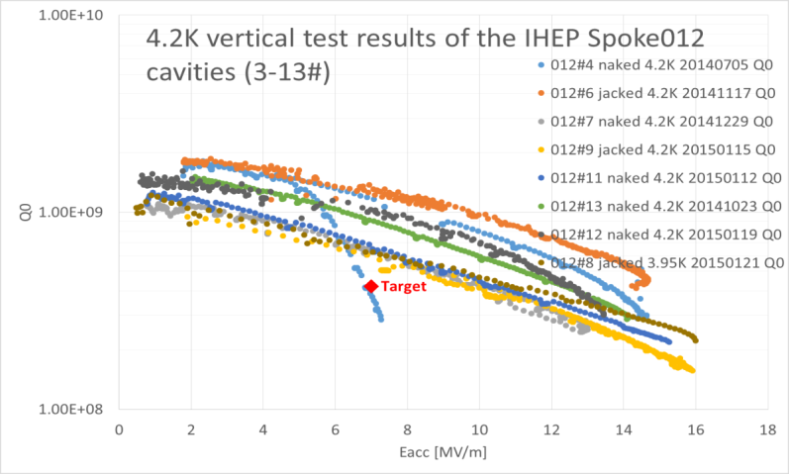
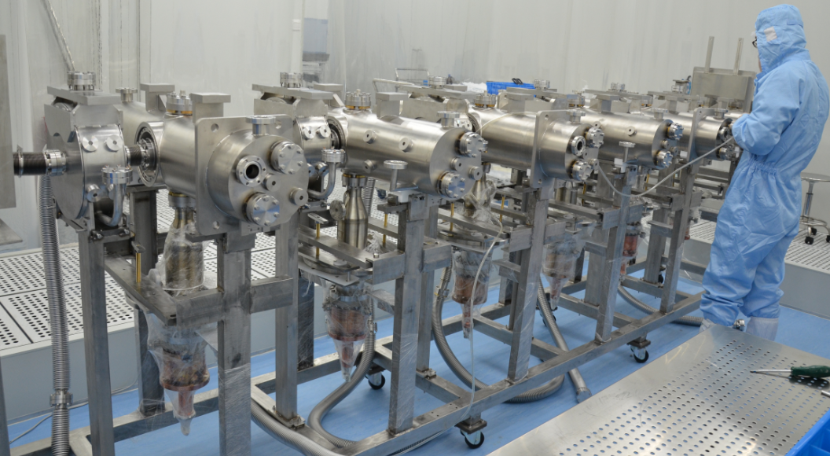
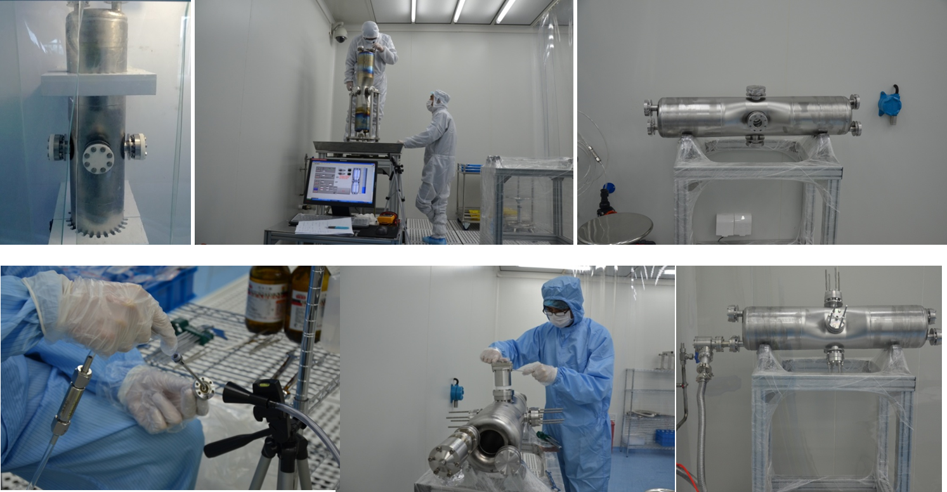
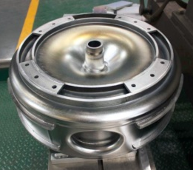
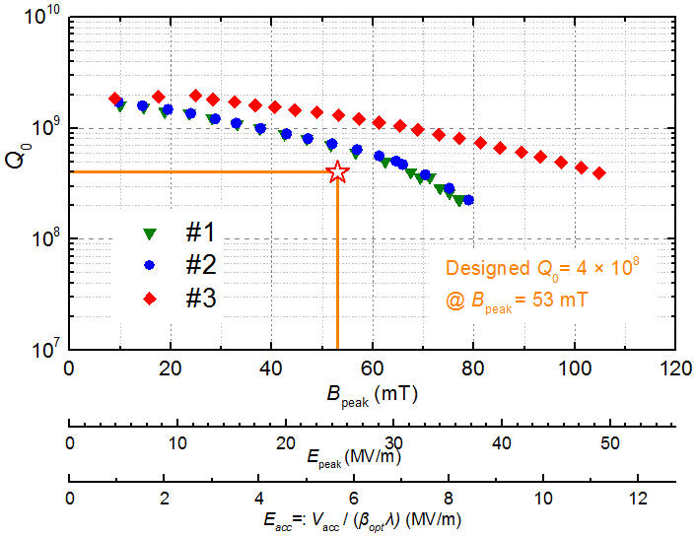
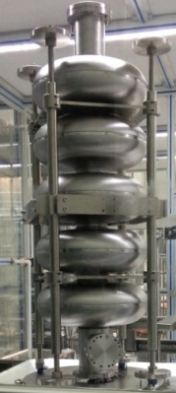
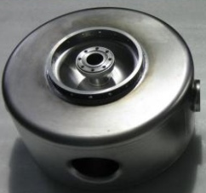
Status of SRF Resonators
HWR010@4.2K
Spoke012@4.2K
Spoke021@4.2K

Slide 16
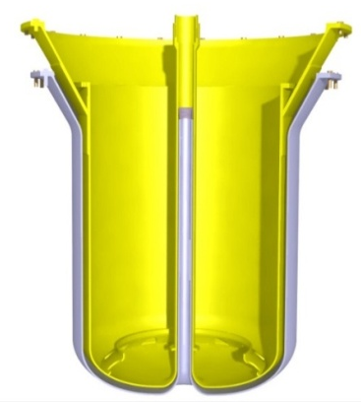
Reactor and target coupling of CIADS
LBE coolant sub-critical reactor
Pipe of target goes through and is insulated with reactor

Slide 17
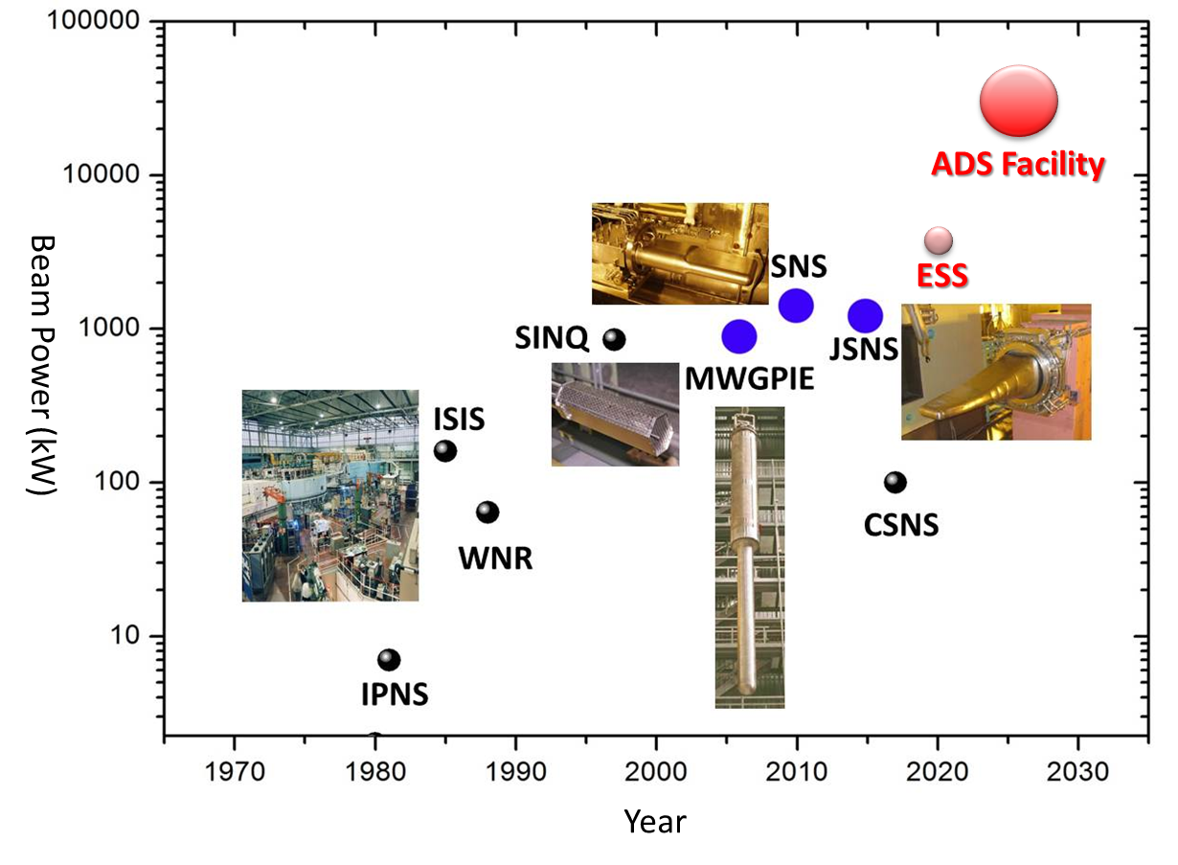
High Power Targets
Beam intensity ：
？>500 μA/cm^2
? : tens of MW
Beam intensity ：
<20 μA/cm^2
rotating target
Liquid target
Beam intensity：
<10 μA/cm^2
Porosint target:
Packed beds (rod, ball, etc), increasing coolant contact surface.
Beam intensity ：
<50 μA/cm^2
Solid target:
rotating target can enlarge relatively the beam spot
For HP-target, now the off-line heat exchange is one of best choice.

Slide 18
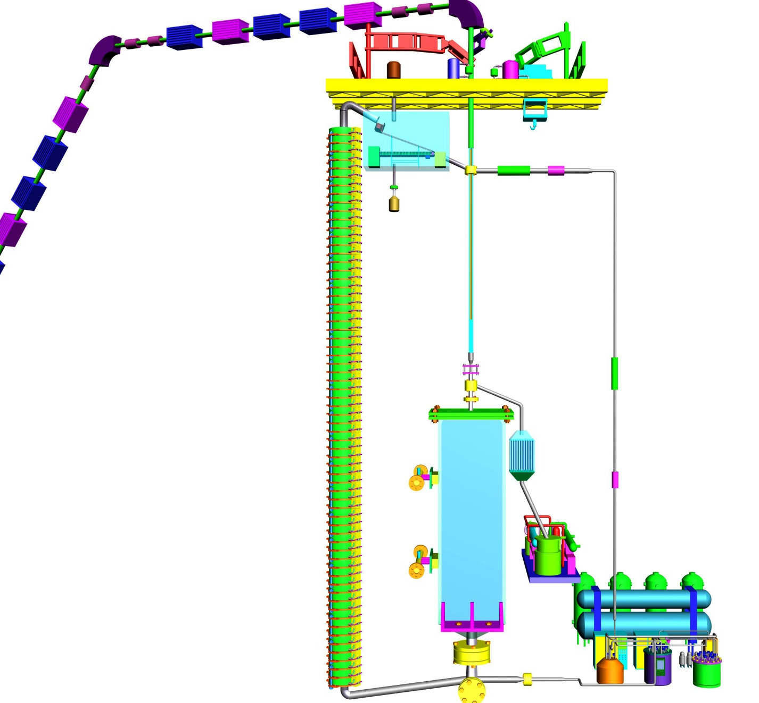

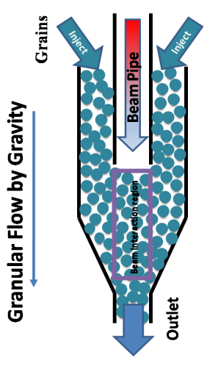
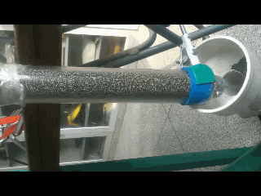
Granular Target

Slide 19
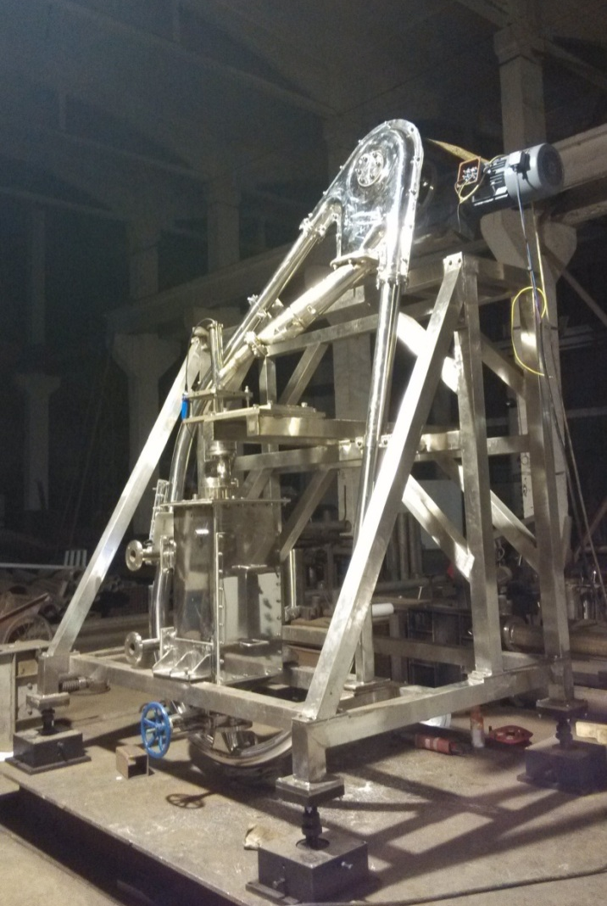
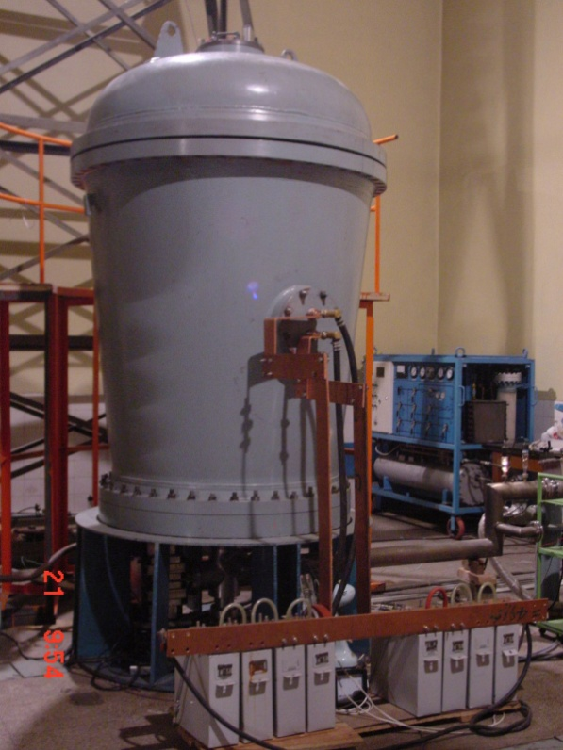
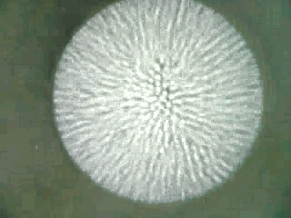
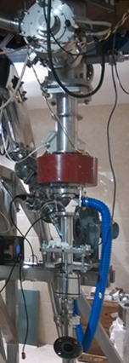
Target test with electron beam
Power density on target is comparable with the proton beam of 2.5 MW or much higher.
Tungsten particles <1000kg
Lifter setup
Target
Heat exchanger
<20mA@2.5MeV e

Slide 20
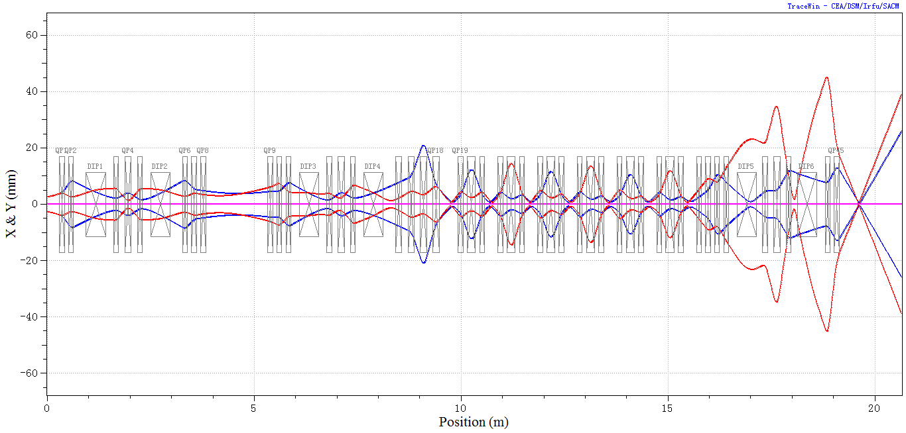
Granular Target Testing Setup
Vacuum differential
HEBT of 25 MeV
Target: tungsten granular, windowless, vacuum differential
Beam: 25 MeV, 10 mA, 250 kW
Lifter: mechanical
Notes:
20

Slide 21
Outlines
Introduction of CIADS
R&D Progress of CIADS
Introduction of CMIF
Summary

Slide 22
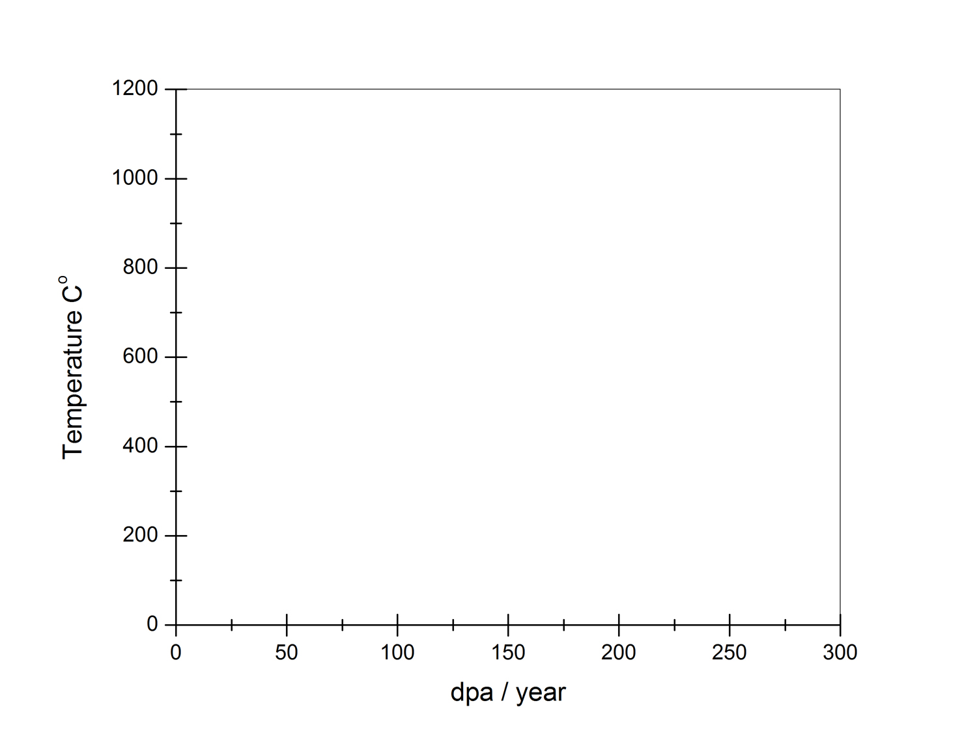
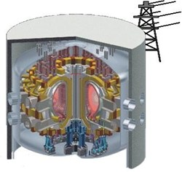
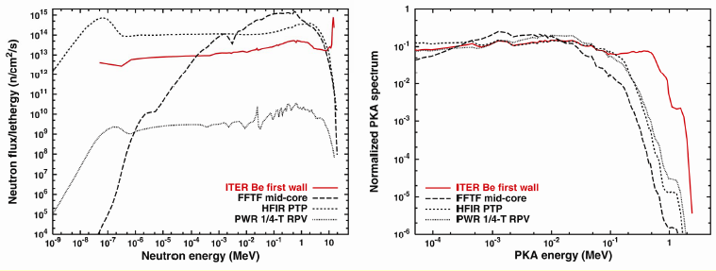
Material problems in fusion reactor
The accelerator-based neutron source can simulate 14 MeV neutrons from Deuterium-Tritium fusion reactions rather than fission reactors.
FUSION REACTOR
VHTR
GFR
MSR
LFR
SCWR
SFR
Gen. II & III

Slide 23
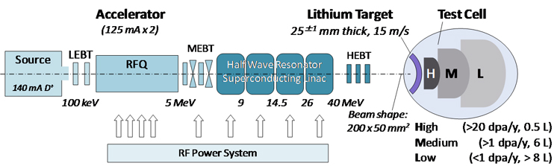
Concept of IFMIF
The International Fusion Materials Irradiation Facility (IFMIF)
Target | High Neutron Flux High Neutron Yield 10 MW Liquid Li Jet Target
Beam | 40 MeV@125 mA *2 (CW)
Radio Protection | integral neutron flux ~2*10¹⁷ n/s
IFMIF technology is very challenging (125 mA accelerator; jet target)
High Cost , budget €665M (2003) → >€1B (2012)
Long Time (Operational>2028)

Slide 24
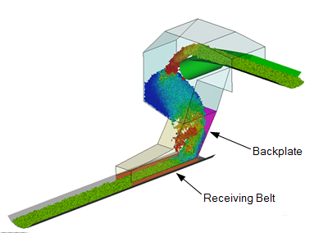

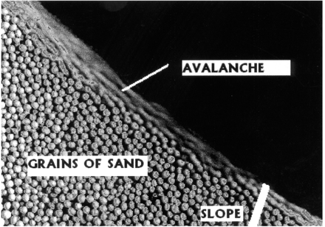
Concept of CMIF
The Compact Materials Irradiation Facility in China(CMIF)
Target | High Neutron Flux Low Neutron Yield Small Sample Size ~1 MW granular Be Target
Beam | 50~100 MeV@(5~10) mA (CW)
Cost | Low
New fluidized granular Beryllium alloy target system for high power density in small size;
Based on techniques of Chinese ADS project .
Superconductor Linac
Granular Target
LEBT
MEBT
HEBT + scanning + Vacuum differential
ECR
RFQ
Superconductor DTL
Granular lift system
Dense granular flow
sample
Heat exchanger
Granular deposited

Slide 25
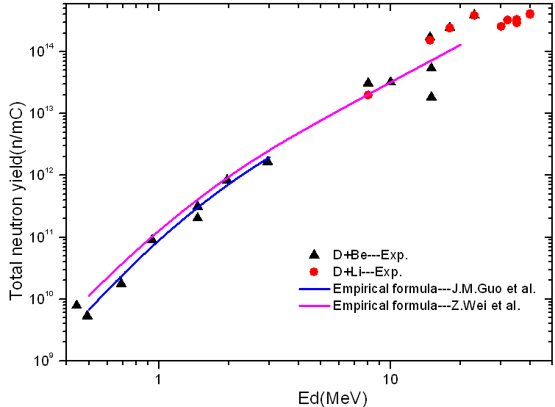
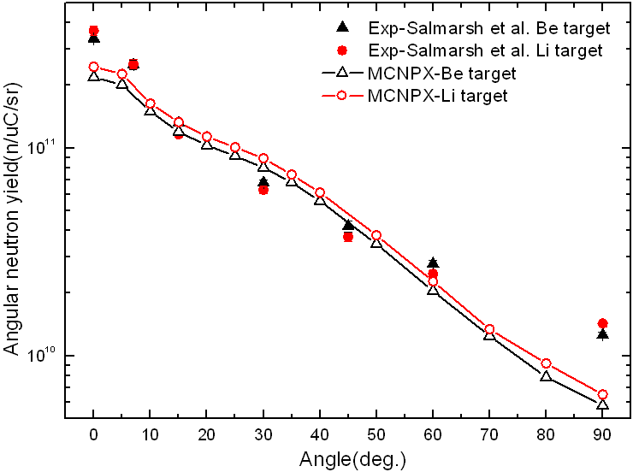
Neutron yield compare
For different D energy, the neutron yield on Be target and Li targets.
Angular distribution:
Thin targets
40 MeV D+Be/Li

Slide 26

Simulation of flux at the sample
Deutron beam
Simple 1：from back 1 mm
Simple 2：from back 10 mm
 | Energy | 20 MeV | 50 MeV
1 | Flux (D-Be) | 3.6*10¹³ @ 5 mA | 1.99*10¹⁴ @ 10 mA
 | Y (n·cm⁻²·mA⁻¹·s⁻¹)
 | Flux (D+Li) | 2.41*10¹³ | 7.85*10¹³
2 | Flux (D-Be) | 9.81*10¹² @ 5 mA | 7.54*10¹³ @10 mA
 | Y (n·cm⁻²·mA⁻¹·s⁻¹)
 | Flux (D+Li) | 7.79*10¹² | 3.96*10¹³
Energy spectrum

Slide 27


Development roadmap of CMIF
 | Specifications | Cost and Time | dpa/year
Phase I (Test Facility) 2014-2018 | 100kW=20MeV @5mA | ~35 M$ 4.5 years | Sample size L╳W╳H(mm) | 30╳30╳10 | 20╳20╳5 | 10╳10╳2.5
 |  |  |  |  | 2.5 | 8.5
Phase II (User Facility) | 500kW~1MW=50~100MeV @(5~10)mA | +2.5 years | Sample size L╳W╳H(mm) | 30╳30╳10 | 20╳20╳5 | 10╳10╳2.5
 |  |  |  | 15.4 | 30.2 | 93

Slide 28
Compare between IFMIF and CMIF
 | IFMIF | CMIF
Reaction Channel | D+Li | D+Be
Deuterium Beam | 40 MeV@125 mA*2 | 50~100 MeV@(5~10) mA
Neutron peak Energy | ~14 MeV | ~14 MeV
Sample Size | ~10 cm | 1~3 cm
dpa | 20~50 dpa/year | 20~50 dpa/year
Neutron Total Yield | High | Low
Technical challenges | 125 mA LINAC | ~10 mA SRF LINAC
 | 10 MW liquid jet target | 0.5~1 MW granular Be target*
 | Large Sample Size Large Scale Facility High Radiation Dose High Construct & operation cost | Small Sample Size# Small Scale Facility Low Radiation Dose Low Construct & Operation Cost
 |  | Based on Chinese ADS Tech; Short time of Construction period ~7years
#Small Sample techniques need to be developed
*The international patent application in processing

Slide 29
Outlines
Introduction of CIADS
R&D Progress of CIADS
Introduction of CMIF
Summary

Slide 30
Summary
Chinese Initiative ADS project (CIADS) will be approved. 250 MeV SRF proton linac, Granular target and 10 MWt subcritical LBE FR are chosen.
A demo SRF linac with 25 MeV/10 mA/CW will be build in 2016 and coupled with granular target.
The prototype of 2.5 MeV/10 mA/CW SRF linac is in operation around 200 hours, 11 mA/CW/1 hr was achieved.
Material Irradiation Facility in China (CMIF) was proposed. It is a compact, high-flux neutron source base on D-Be reaction and SRF linac.
The first stage of CMIF is supported by MOST. A 20 MeV/5 mA SRF linac of Deutron will be built in 2018.

Slide 31

Acknowledgements
Thanks for your attention
&
Team of China ADS Linac
Thanks for the helps
from LBNL, ANL, J-Lab, MSU/FRIB, FNAL, ORNL, TRIUMF, CEA/Saclay, IPN/Orsay, IAP, RIKEN, KEK, ……
HIT, PKU, SINAP,……
Welcome Collaboration!

