Slide 1
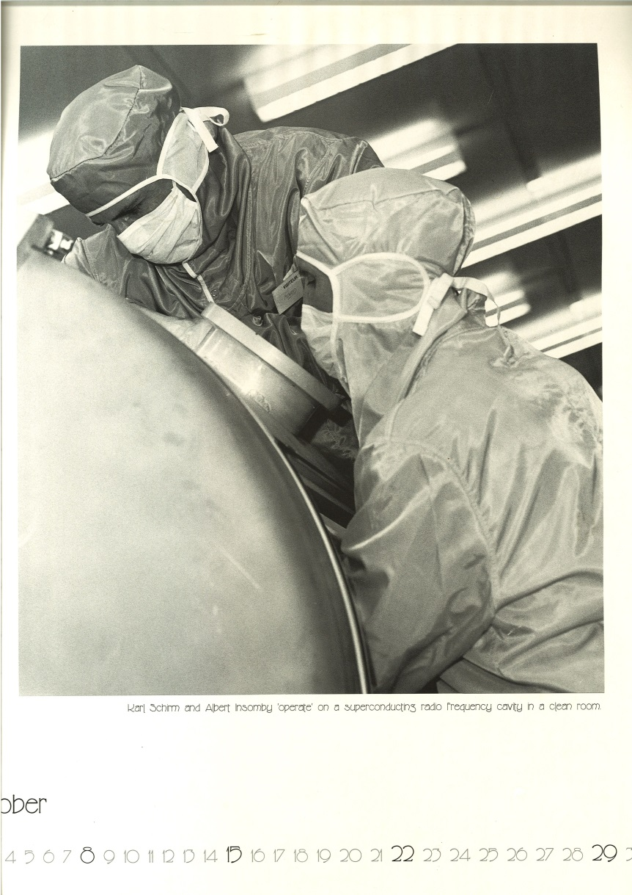
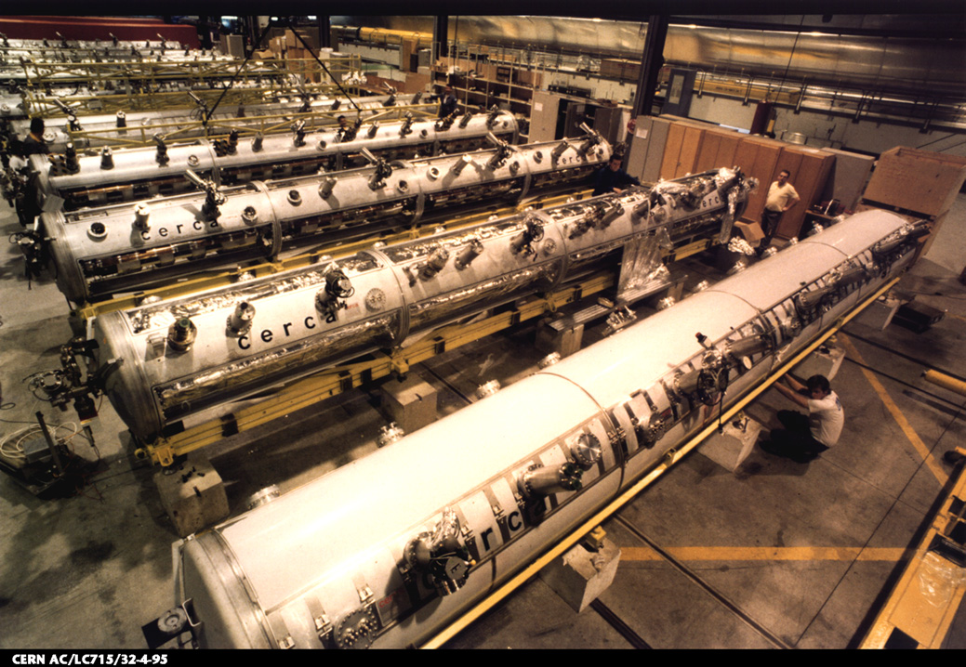
SRF Activities at CERN – Overview
SM18 in the 1990’s

Slide 2
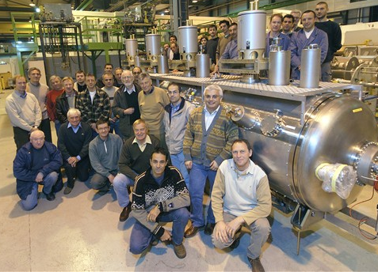
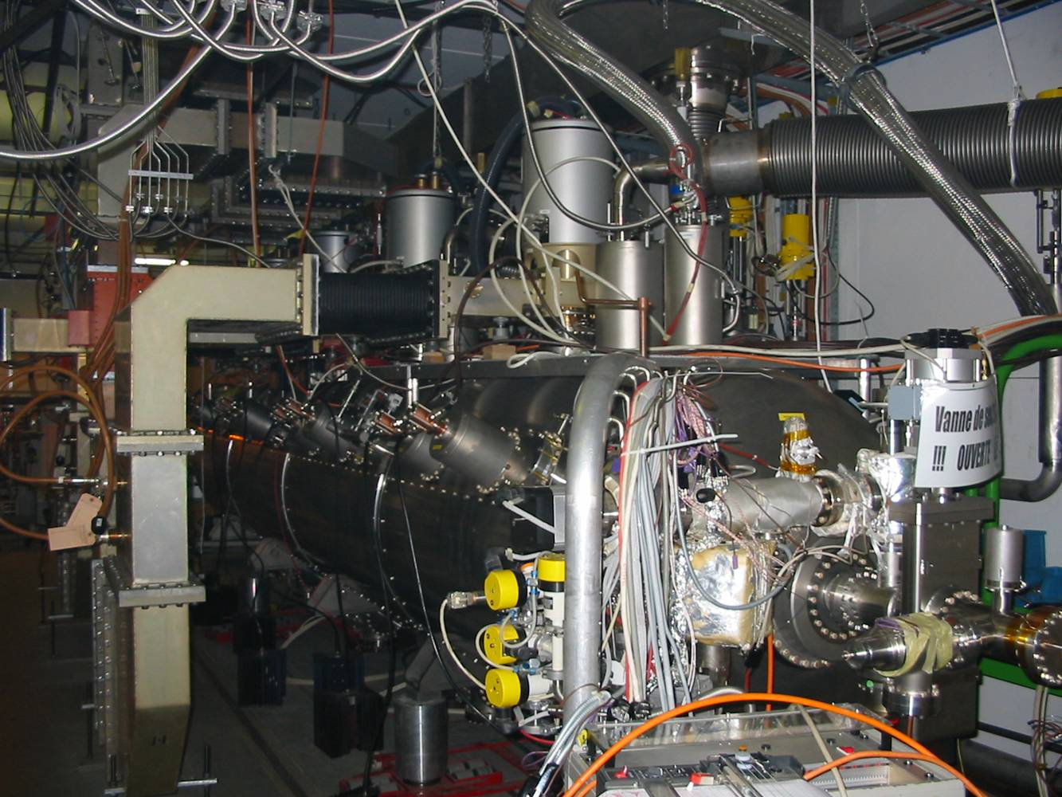
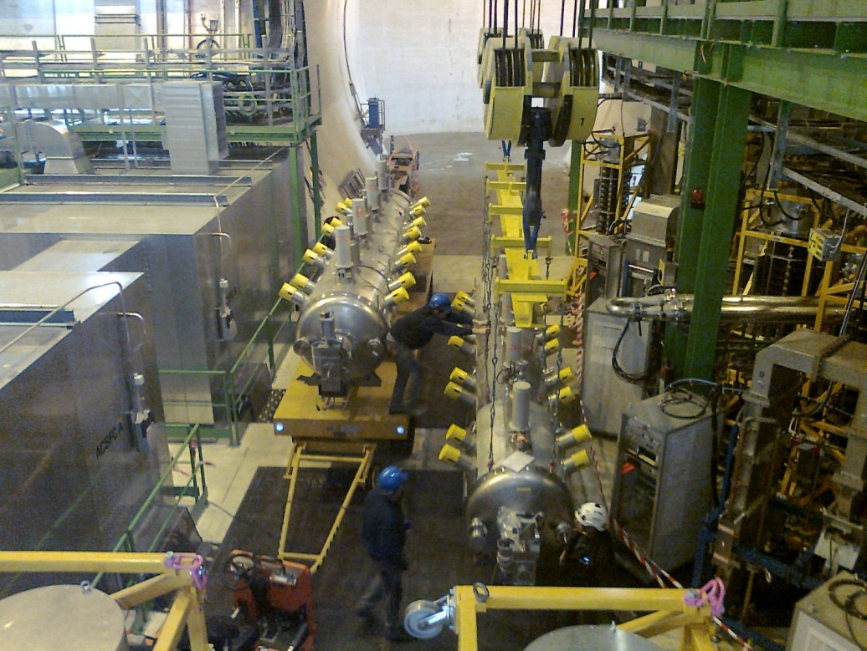
The LHC SRF
First module swap last year
Spare module needs refurbishing
Spare cavity programme underway
SLHiPP5 – ESS, March 2015

Slide 3
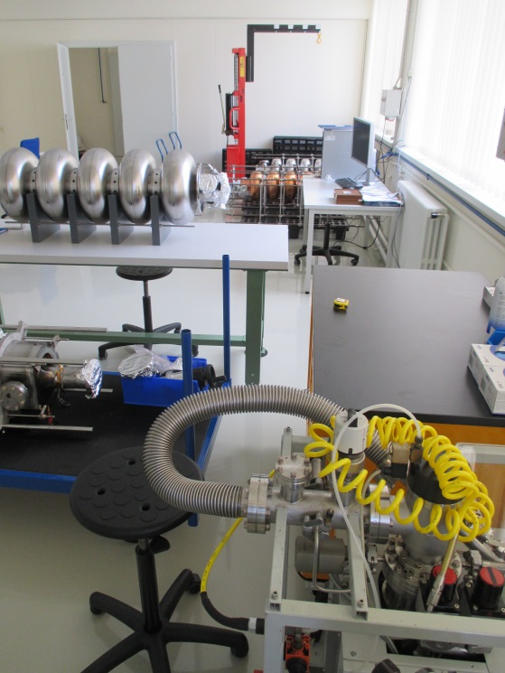
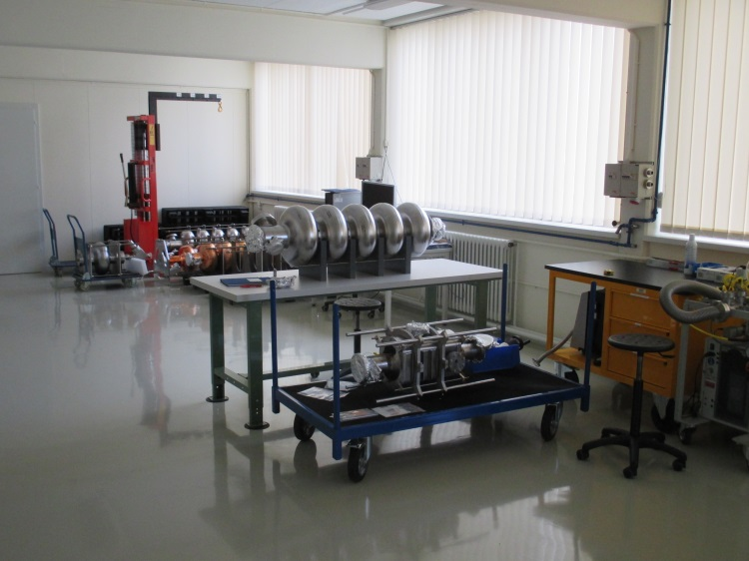
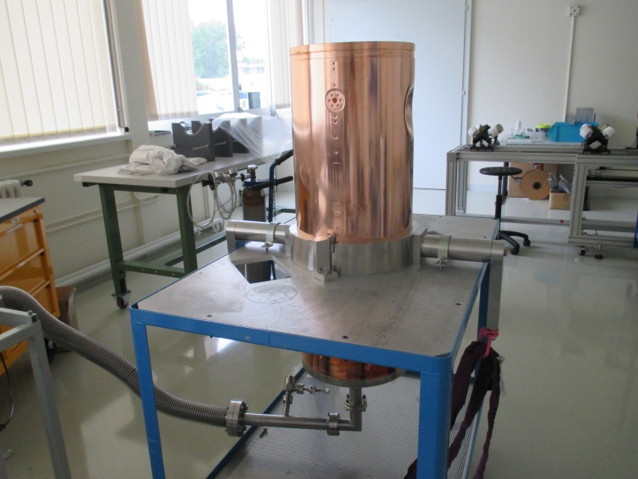
Bldg. 252: Cavity Production and Reception Area

Slide 4
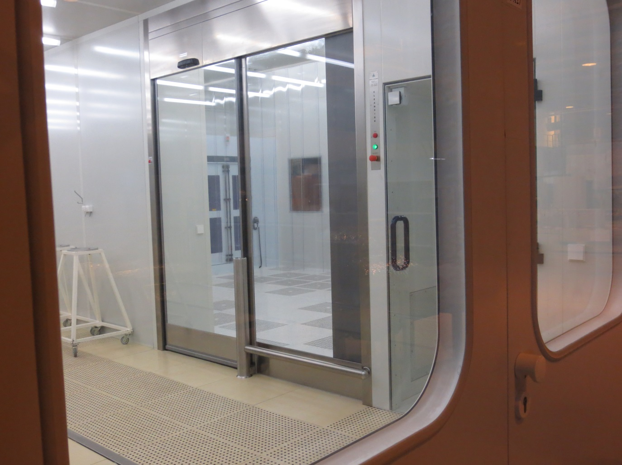
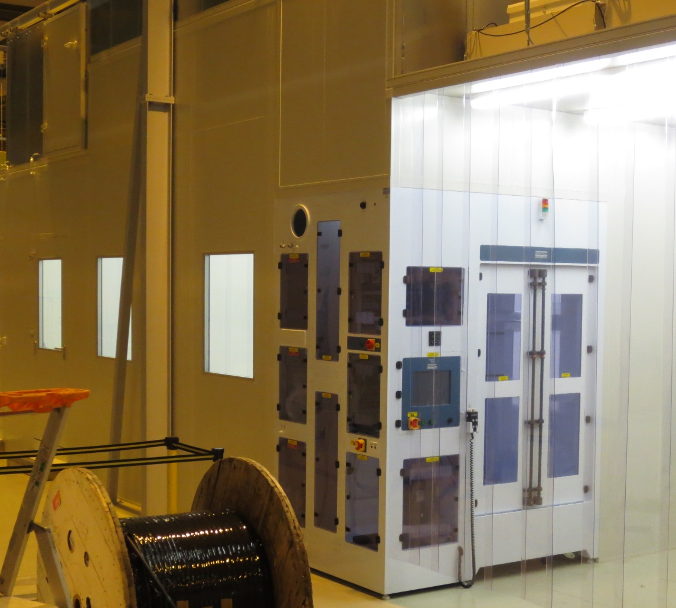
Clean Room Upgrade and Extension

Slide 5
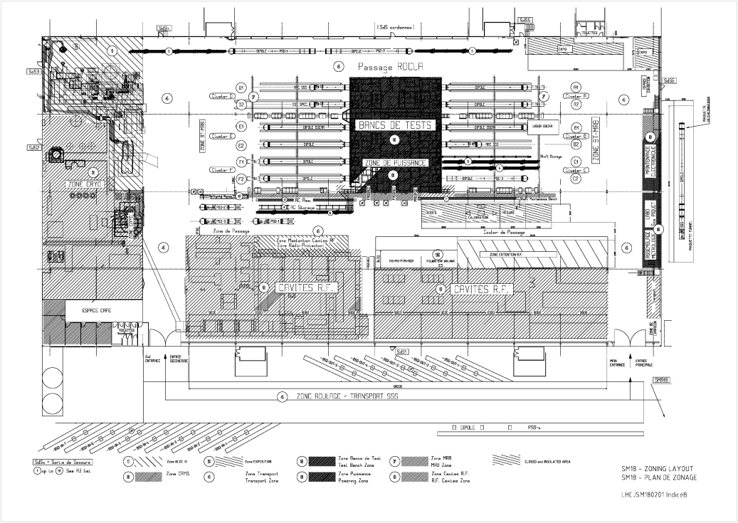
The SM18 Share of Activities
SLHiPP5 – ESS, March 2015

Slide 6
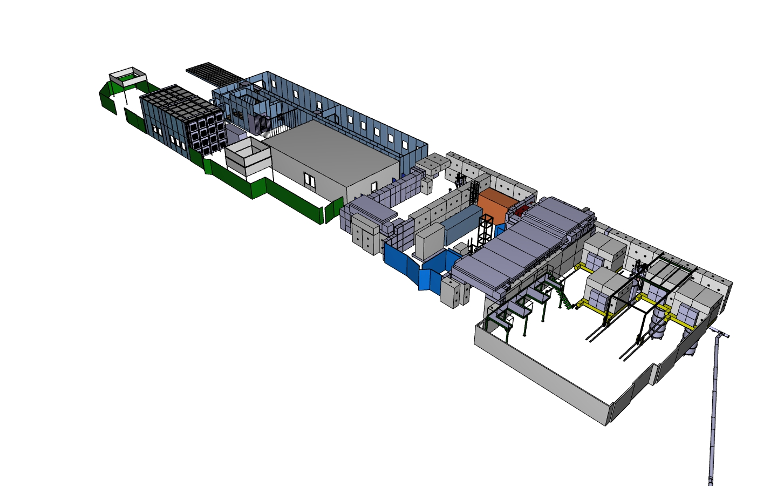
SM18 SRF New Infrastructure
P. Maesen: “CERN SM18 infrastructure…”
SLHiPP5 – ESS, March 2015

Slide 7
The SRF SM18 Test Area
M7
V3
V4
SM18 RF Area
SLHiPP5 – ESS, March 2015

Slide 8
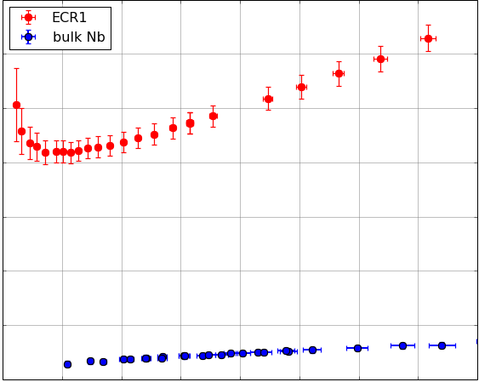
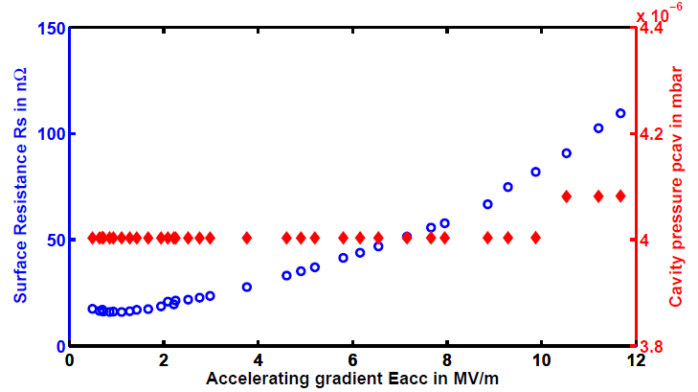
SRF Research in the Cryolab
1.3 GHz HIPIMS Cavities
Sample Testing with the
Quadrupole Resonator
High precision tests of HIPIMS cavities
Understanding, controlling and minimizing field dependent losses of Nb/Cu cavities
Effects studied:
Low temperature baking
Thermal cycling
Thermal boundary resistance
140
Surface Resistance [nΩ]
20
0
40
RF Magnetic Field [mT]
Measurement of the cavity’s
inner surface temperature
RRR does not seem to be the cause of the Q-Slope of Nb Films.
Simultaneous measurement of R_{S} and pressure of helium gas introduced in the cavity as a function of E_{acc} show that global warming is not the cause for the field dependent surface resistance of Nb/Cu cavities
Cooling Rate [mK/s]
Thermal cycling has a strong impact on the R_{S.}

Slide 9
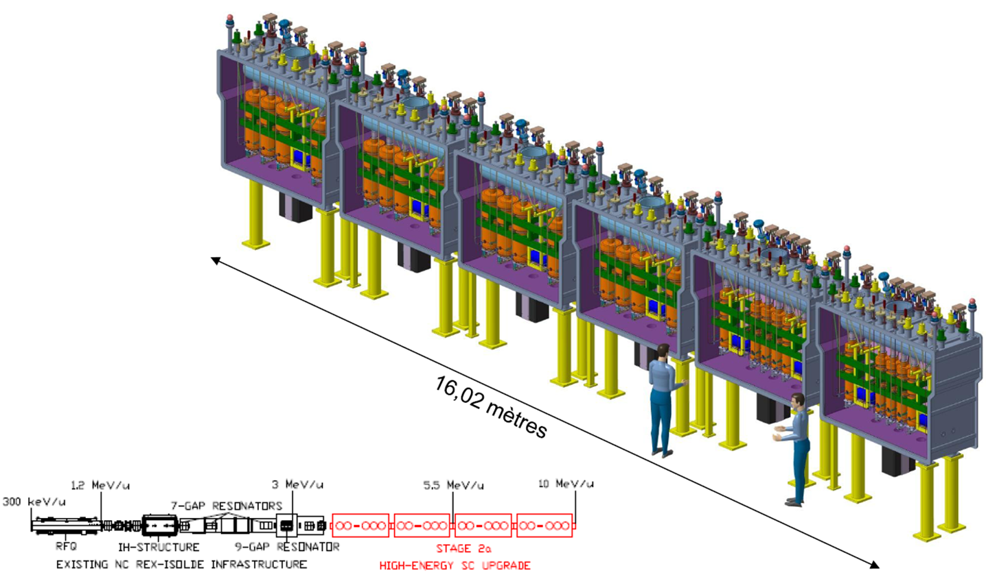
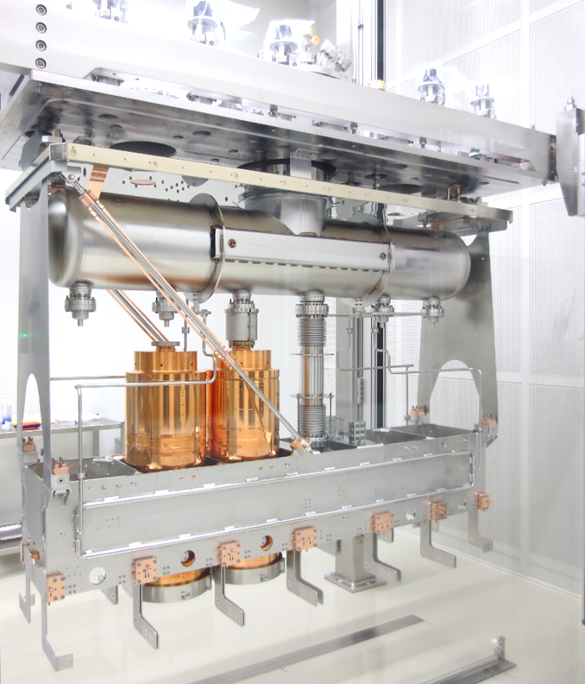
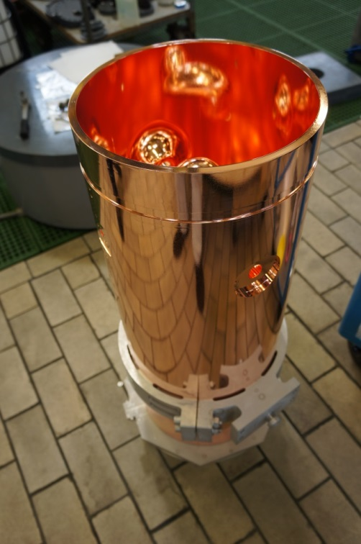
The HIE-ISOLDE Project

Slide 10
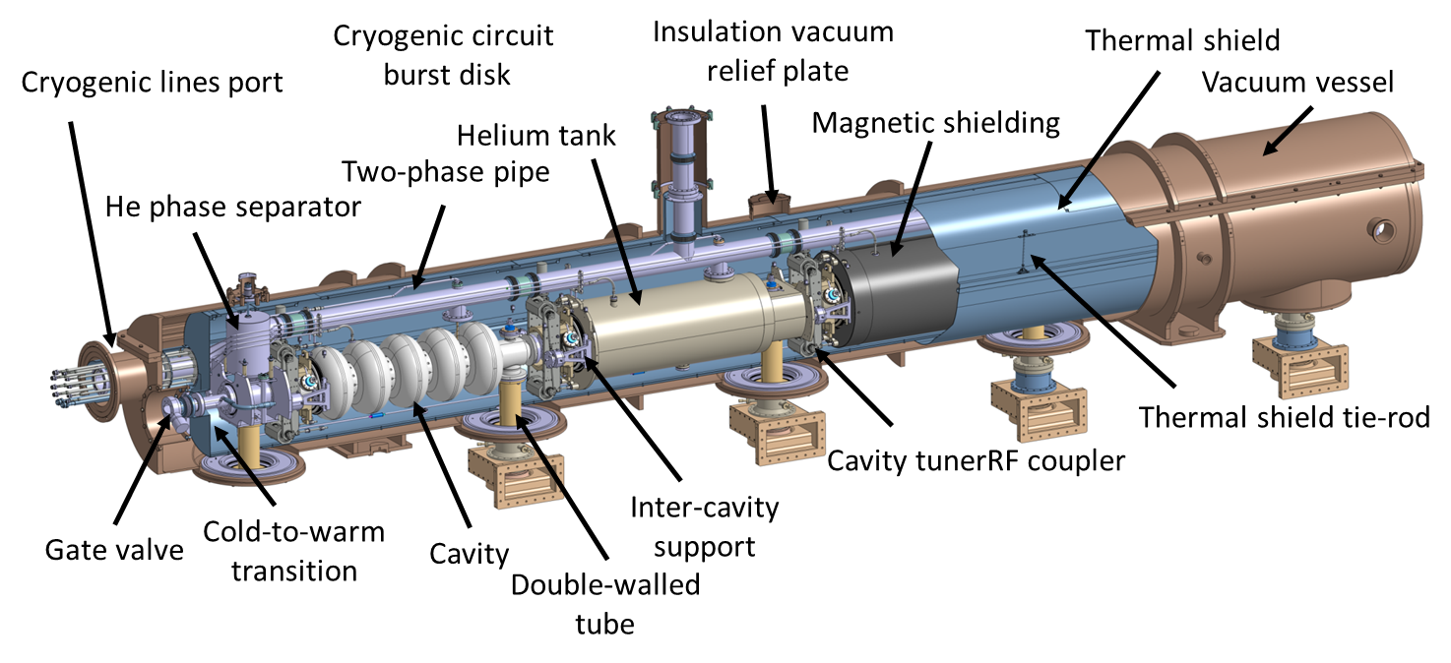
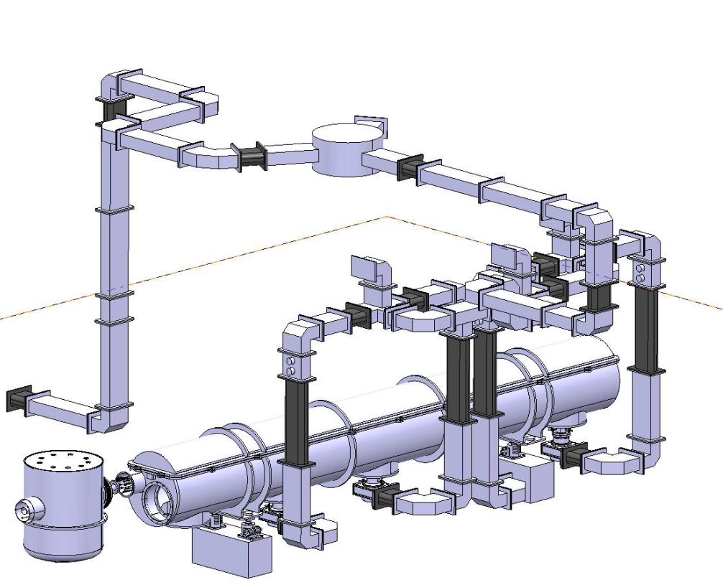
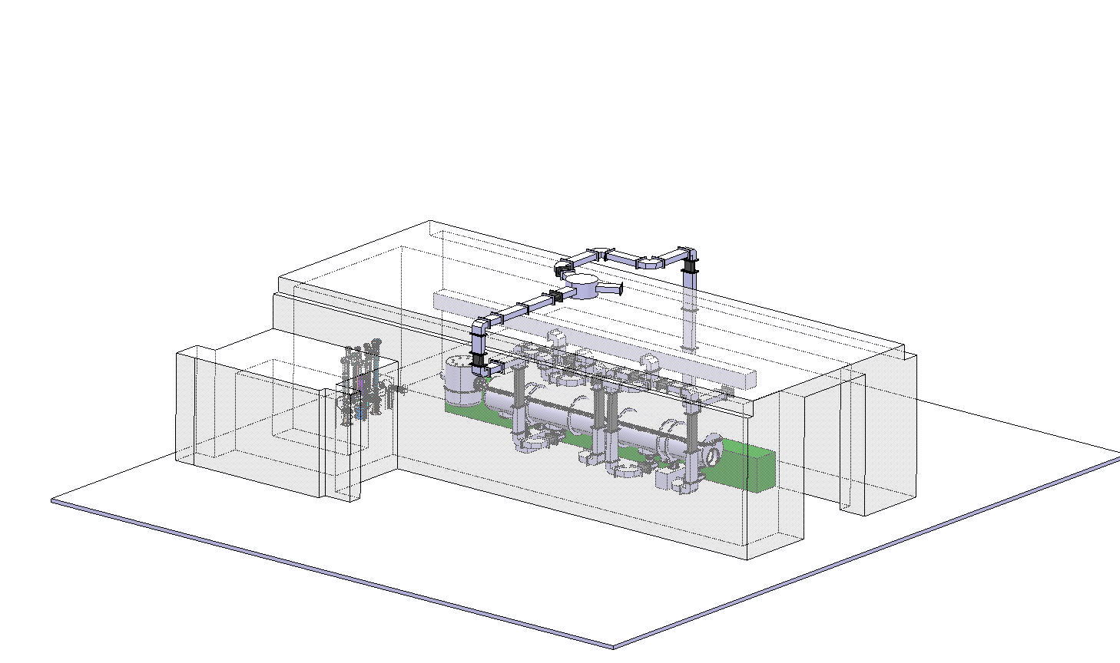
SPL 704 MHz half-module
A. Macpherson; “Status of the SPL…..”

Slide 11
HL-LHC: SRF Crab cavities

Slide 12
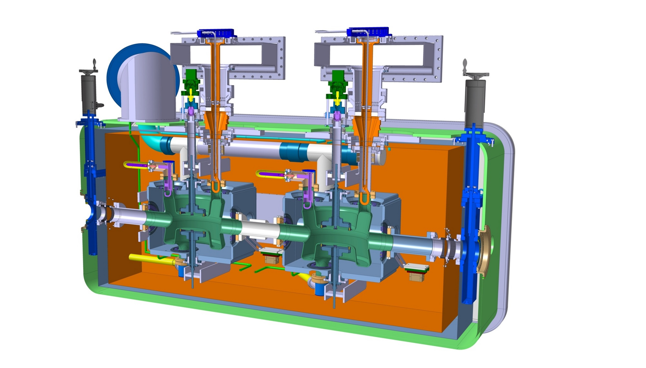
Cryomodule
Cryomodule with DQW cavities
Fundamental Power Coupler
Tuning system
Helium vessel
High Order Modes Suppressor
Thermal shielding
Cavity
Alignment monitoring system
Warm magnetic shielding
Vacuum vessel

Slide 13
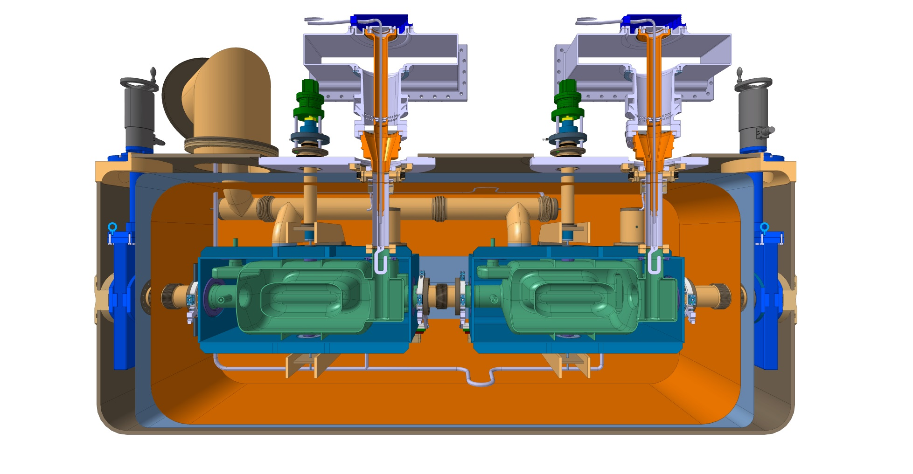
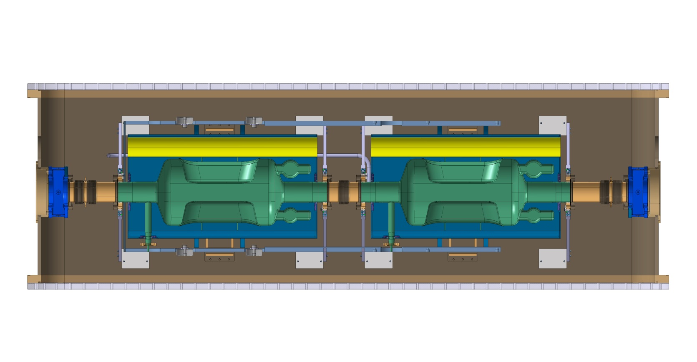
Cryomodule
Cryomodule with RFD cavities

Slide 14
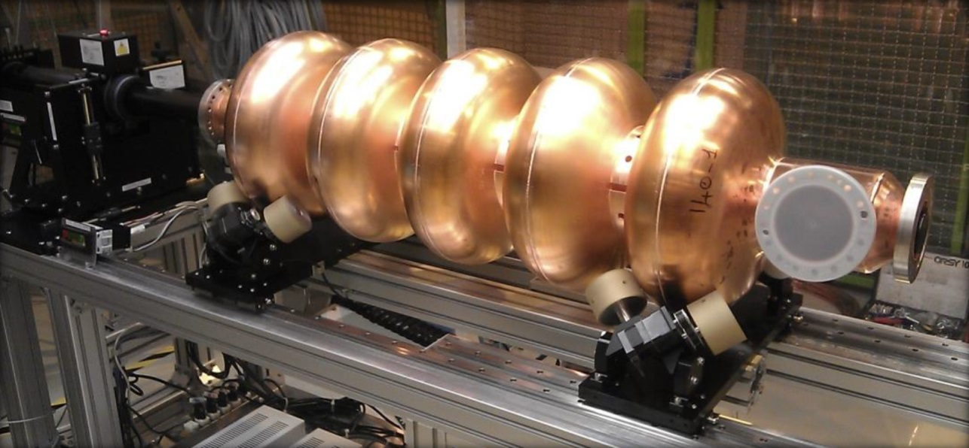
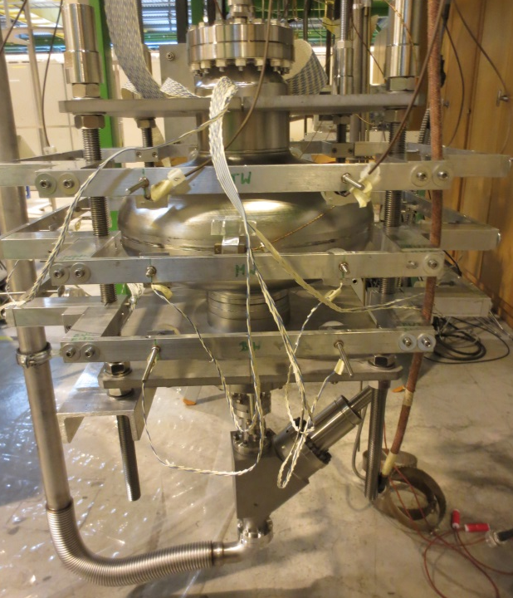
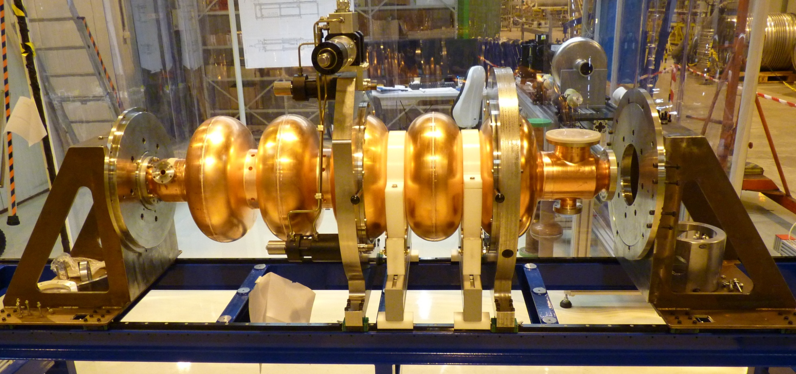
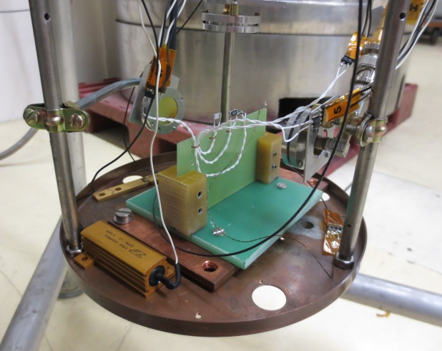
Ancillaries and Diagnostics

Slide 15
Horizontal bunker M7
New long term decision
As M9 will be used for :
LHC cryomodule
HIE-ISOLDE cryomodule
And later FCC 400 MHz project
M7 will be used for :
SPL half cryomodule
CRAB cryomodule
And later new LHC 800 MHz project
-------> Need to redesign a multipurpose cryo box !!

Slide 16
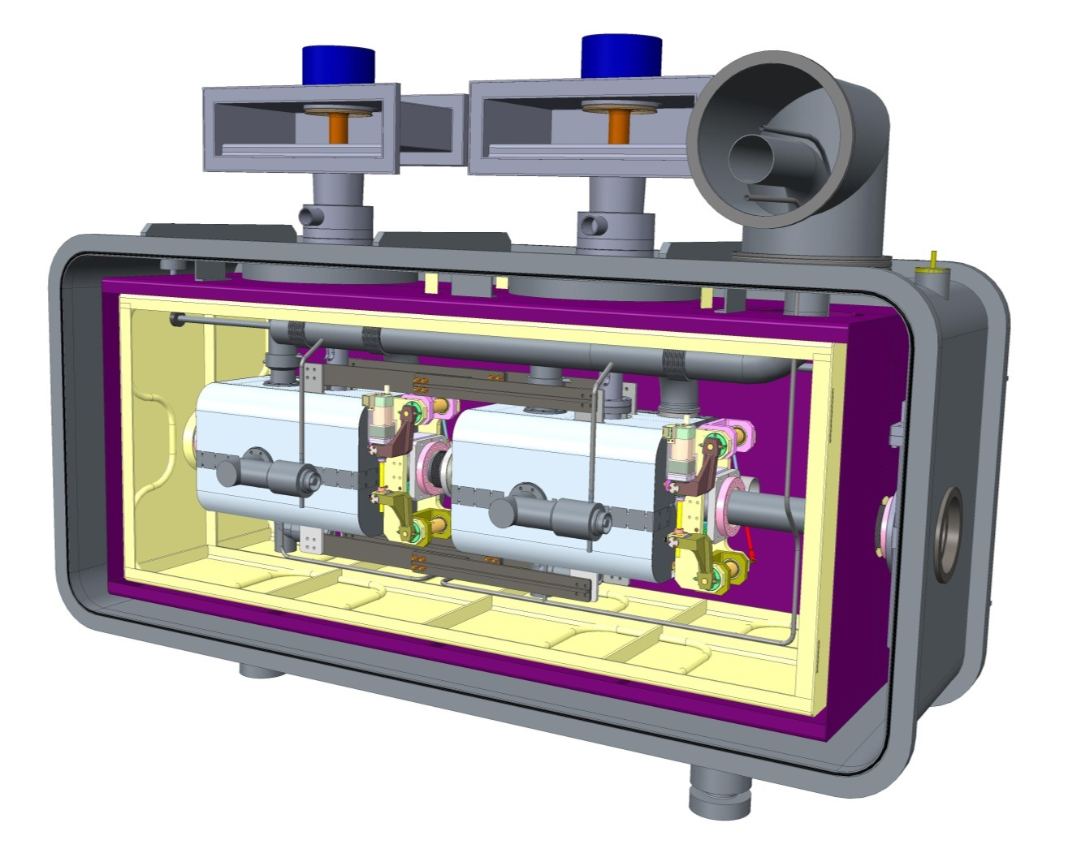
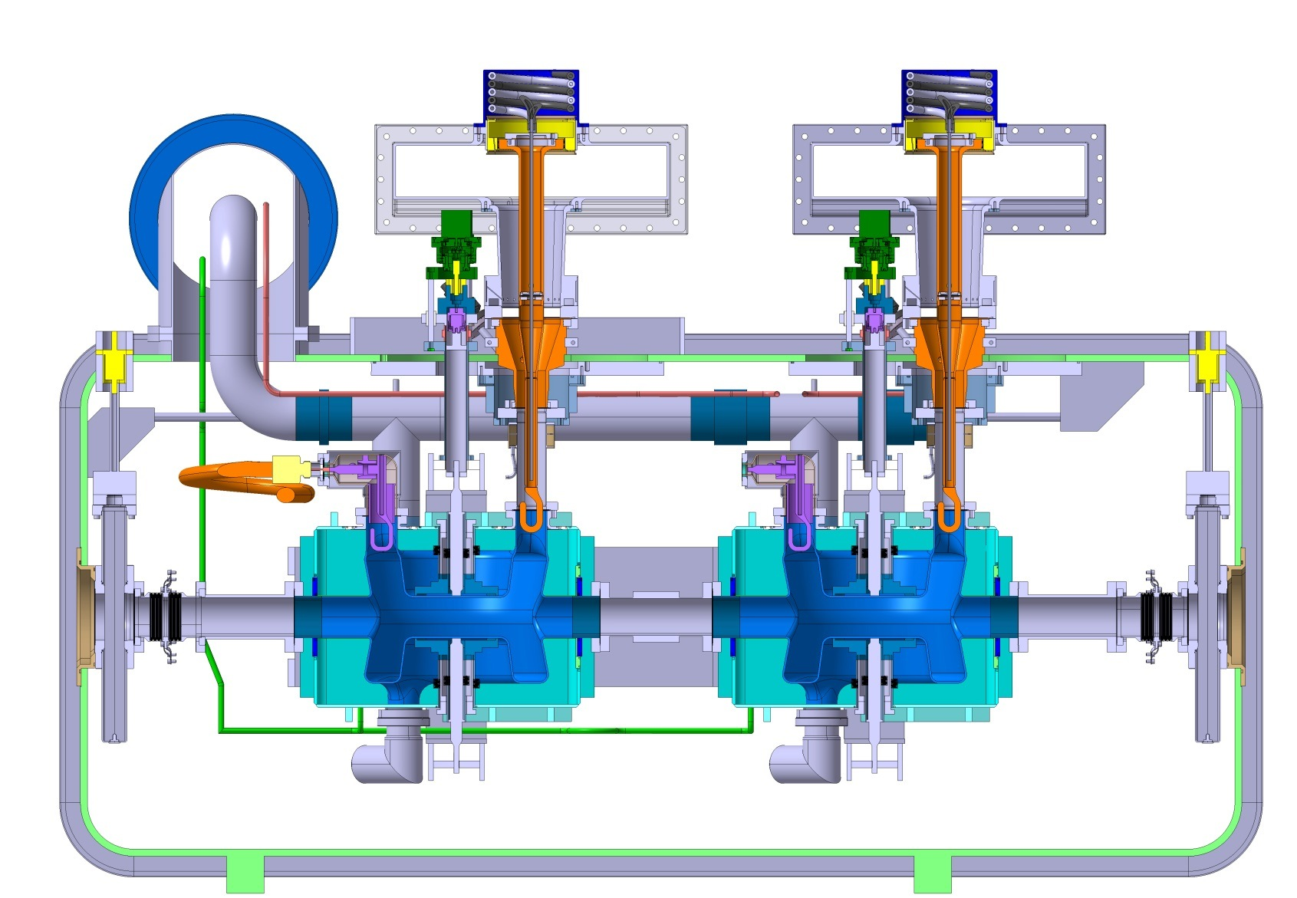
Summary: Cold Testing
Programme | Frequency (MHz) | Cavities | Units | Modules
LHC | 400 | 2 + 8 | 2 + 4 | 1 + 1
HIE-ISOLDE | 101 | 25 | 0 | 4
CRAB | 400 | ? | ? | 16 + 2 + 2
SPL | 704 | 5 + ? | 4 | 1
FCC | 800 (400) | ? | ? | ?
SLHiPP5 – ESS, March 2015

Slide 17
Conclusion
CERN SRF infrastructure and personnel today not sufficient for the medium term plan.
Material Budget available for partly compensation of needs.
Student and fellow requests underway for ramp-up of activities. Exchange with collaborations encouraged.
Some projects rely on In-Kind contributions from collaborations – follow-up essential.
SLHiPP5 – ESS, March 2015

