Slide 1
ESS Spoke Cavities:
First experimental results
On behalf of the IPN Orsay Team
Sebastien Bousson
5th SLHiPP Meeting – 18th & 19th March 2014 - Lund

Slide 2
Outlook
Recall on the ESS double spoke cavity design
Cavity surface processing
chemical etching
clean room assembly
Experimental results on the prototypes
cavity performances
cold tuning system performances
Future work

Slide 3
Overview of the ESS Spoke Cavities Design

Slide 4
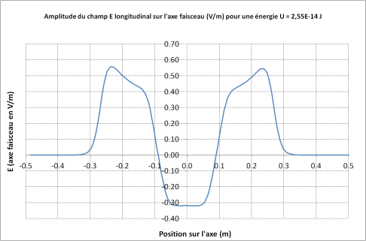
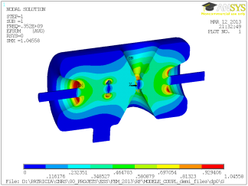
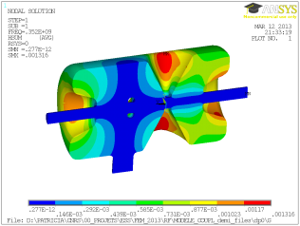
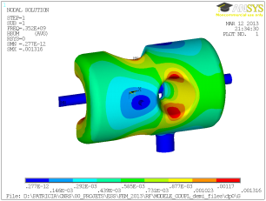
ESS Spoke Cavity
DOUBLE-SPOKE CAVITY
Frequency [MHz] | 352.21
Beta_optimum | 0.50
Operating gradient [MV/m] | 9.0 (8.8)
Temperature (K) | 2
Bpk [mT] | 61
Epk [MV/m] | 38
G [Ohm] | 133
r/Q [Ohm] | 427
Lacc (=beta optimal x nb of gaps x λ /2) [m] | 0.639
Bpk/Eacc [mT/MV/m] | 6.8
Epk/Eacc | 4.3
P max [kW] | 335
Cavity RF design performed with CST Microwave Studio – Checked with Ansys
E_{pk}
B_{pk}
B_{pk}

Slide 5
ESS Spoke Cavity
DOUBLE-SPOKE CAVITY
Frequency [MHz] | 352.21
Beta_optimal | 0.50
Operating gradient [MV/m] | 9.0
Temperature (K) | 2
Bpk [mT] | 61
Epk [MV/m] | 38
G [Ohm] | 133
r/Q [Ohm] | 427
Lacc (=beta optimal x nb of gaps x λ /2) [m] | 0.639
Bpk/Eacc [mT/MV/m] | 6.88
Epk/Eacc | 4.34
P nominal [kW] | 335
The following goal was taken to perform the cavity EM design:
Epk< 40 MV/m
Bpk < 70 mT
V= 5.75 MV
For Eacc = 9 MV/m
Bpk = 62 mT
Epk = 39 MV/m
DOUBLE-SPOKE CAVITY
Qo at low field | 6.3 10⁹
assuming a Rres (nΩ) | 20
and op. temperature (K) | 2
Qo @ nominal gradient | 1.6 10⁹
i.e. assuming a Qo drop of a factor | 4
r/Q [Ohm] | 427
Operating gradient [MV/m] | 9.0
This gives a dynamic heat load per cavity (eq. in CW) : 2.0 W
Req. : less than 2.5 W

Slide 6
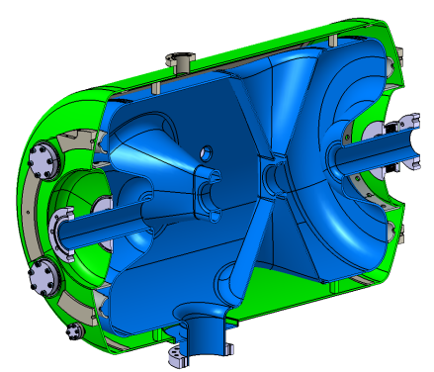
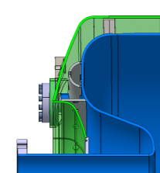
ESS Spoke Cavity
Cavity:
Material: Niobium
Thickness: 4mm
Donut at each end cup of the cavity
Needed for leak tests
4 HPR ports on one end cup of the cavity
Better cleaning of the cavity
beam port aperture = 56 mm (int.)
power coupler port diameter = 100 mm
Helium vessel:
Material: Titanium grade 2
Thickness: 4mm
Helium vessel made with standard dished end-cups
Rings linking the cavity to the helium vessel
Reduce critical stress areas around the small ports
Reduce K_{P} and K_{L}
Pick-up Port
4 HPR Ports
Bellows
Coupler port
Ring
(left and right side)
Donut
(left and right side)

Slide 7
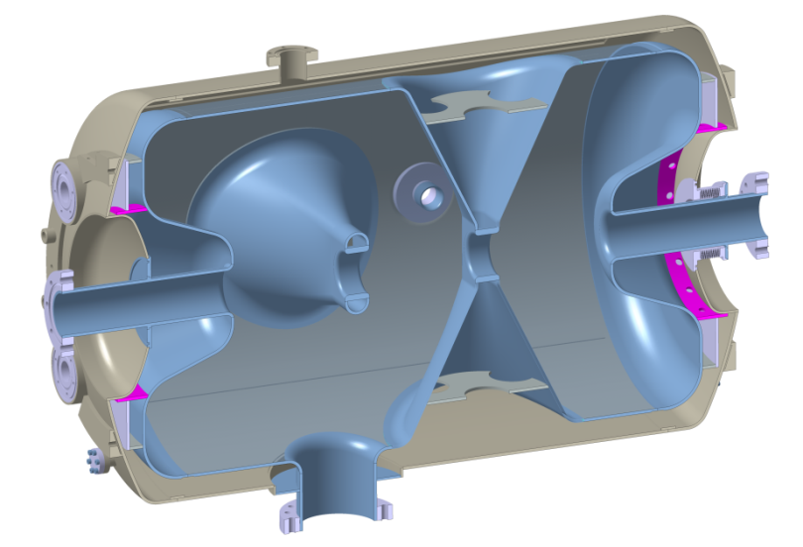
ESS Spoke Cavity
Stiffeners on the Spoke bars
Titanium disk

Slide 8
Spoke Cavity
Main mechanical parameters of the prototype cavity
 | Initial design |  | Final optimization
Thickness of the cavity walls | 4 mm |  | 4 mm
Critical pressure | 1.47 bar |  | 2.77 bar
Stiffness of the cavity | 20 kN/mm |  | 20 kN/mm
Tuning sensitivity Δf/Δz | 135 kHz/mm |  | 128 kHz/mm
Sensitivity to helium pressure fluctuation K_{P} without CTS with CTS | +16.5 Hz/mbar +26.0 Hz/mbar |  | + 15.5 Hz/mbar + 23.9 Hz/mbar
Lorentz forces detuning factor K_{L} without CTS with CTS | -5.1 Hz/(MV/m)² -4.4 Hz/(MV/m)² | For 9 MV/m: Δf = - 415 Hz Δf = - 356 Hz | ~ id.
Cavity bandwidth = 1530 Hz (Ql = 2.3 10⁵) at nominal

Slide 9
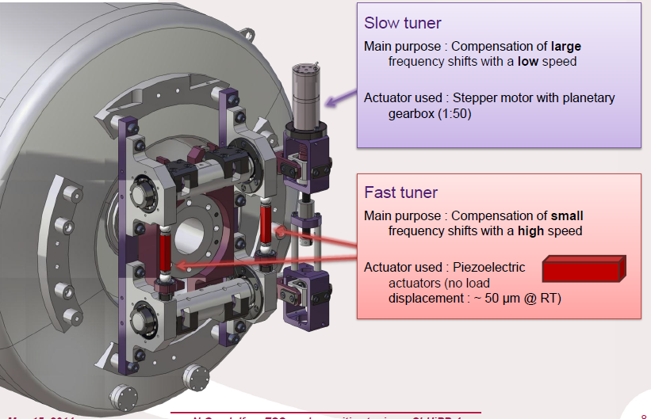
Spoke Cold Tuning System

Slide 10
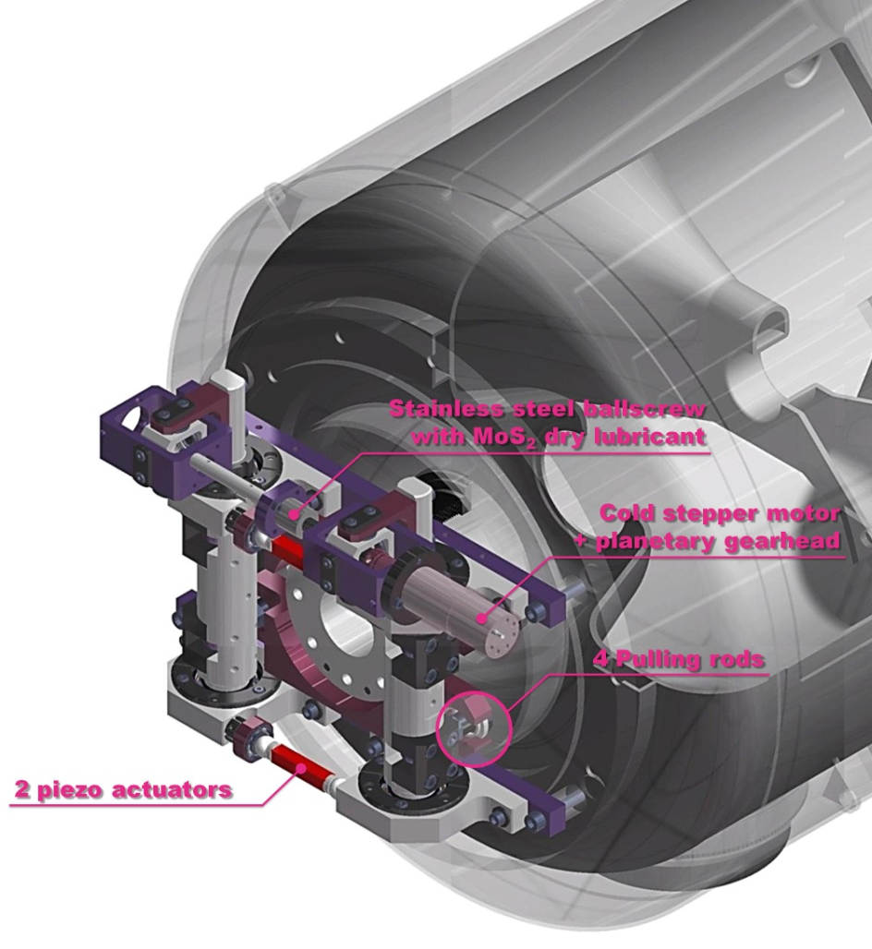
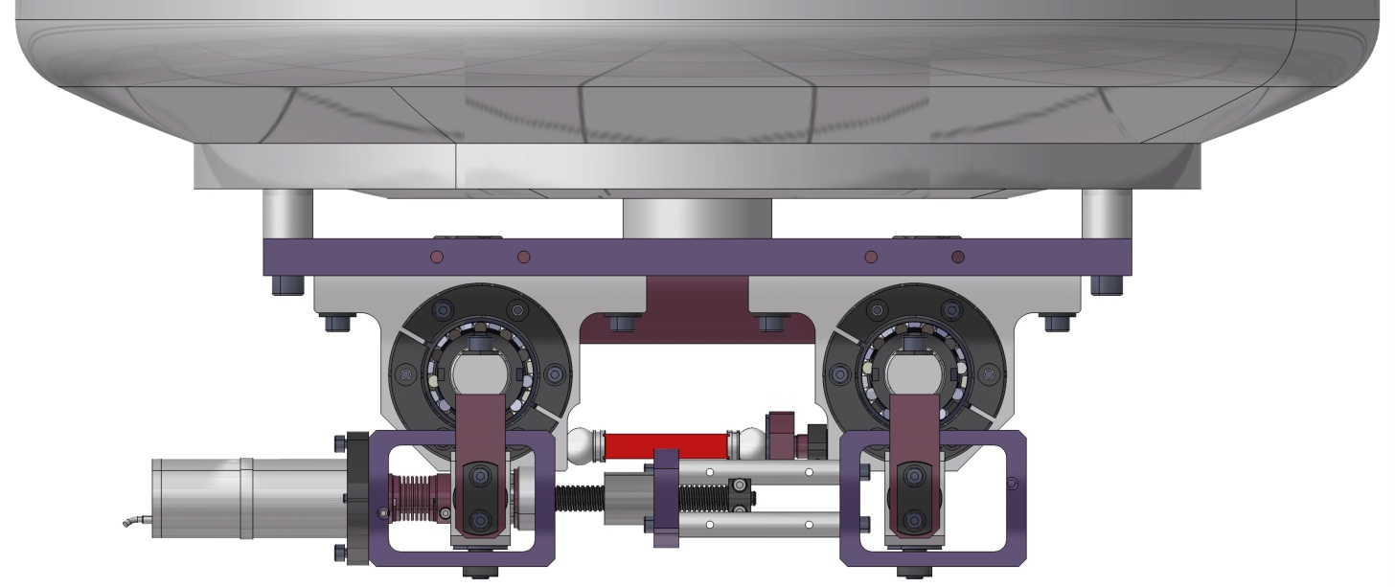
Spoke Cold Tuning System
CTS parameters / results
Cavity sensitivity | 128 kHz/mm
Cavity stiffness | 20 kN/mm
Max cavity deformation | 1.28 mm
Course / Tuning range | 1.28 mm / 160 kHz
Resolution | 1 Hz/step
Piezo tuning range @ RT @2 K | 1.5 kHz ~ 700 Hz

Slide 11
Fabrication of the ESS spoke cavities prototypes

Slide 12
Fabrication of the spoke cavities
3 spoke cavity prototypes have been fabricated:
#1 fabricated by SDMS (Fr)
#2 and #3 fabricated by ZANON (It)
For all 3, Niobium is from Tokyo Denkaï (Japan)
Some dates:
Cavity design achieved in Fall 2012
Call for tender for cavity fabrication released Nov. 2012
Kick-off meetings
in April 3rd, 2013 with SDMS
in April 9th, 2013 with ZANON
Originally planned (contracted) lead time:
SDMS: 13 months (achieved 18)
ZANON: 13 months (achieved 19)

Slide 13
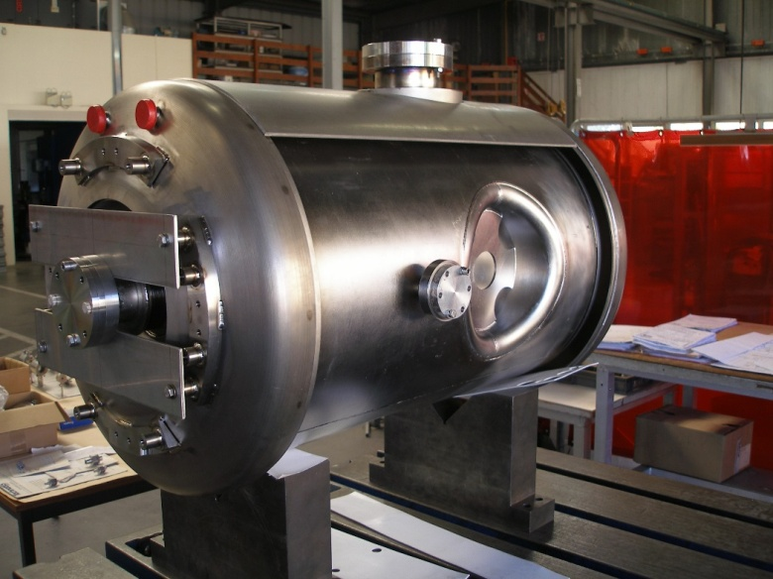
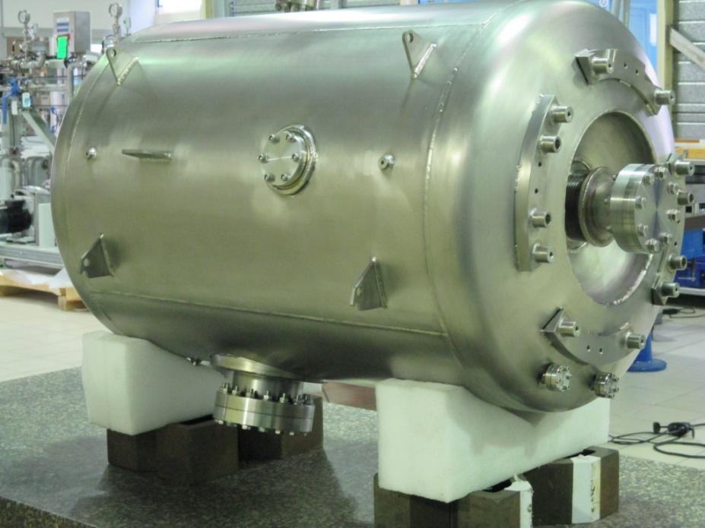
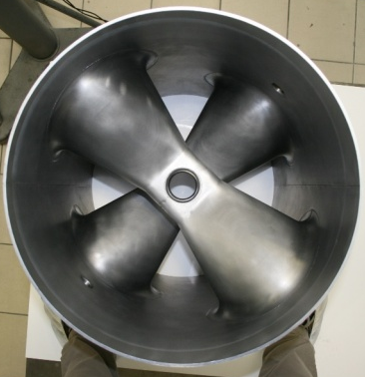
Fabrication of the spoke cavities
3 spoke cavity prototypes have been fabricated:
#1 fabricated by SDMS (Fr)
#2 and #3 fabricated by ZANON (It)
For all 3, Niobium is from Tokyo Denkaï (Japan)
SDMS: cavity fully achieved, delivered to Orsay on Oct 14th, 2014
SD 01
Germaine

Slide 14
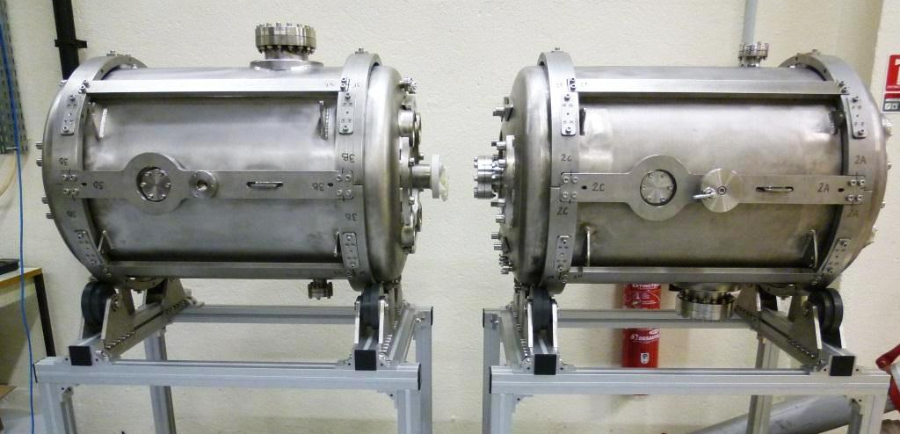
Fabrication of the spoke cavities
3 spoke cavity prototypes have been fabricated:
#1 fabricated by SDMS (Fr)
#2 and #3 fabricated by ZANON (It)
For all 3, Niobium is from Tokyo Denkaï (Japan)
ZANON: cavities fully achieved, delivered to Orsay on Nov. 20th, 2014
ZA 01
Romea
ZA 02
Giulietta

Slide 15
Preparation of the first prototypes cavities

Slide 16
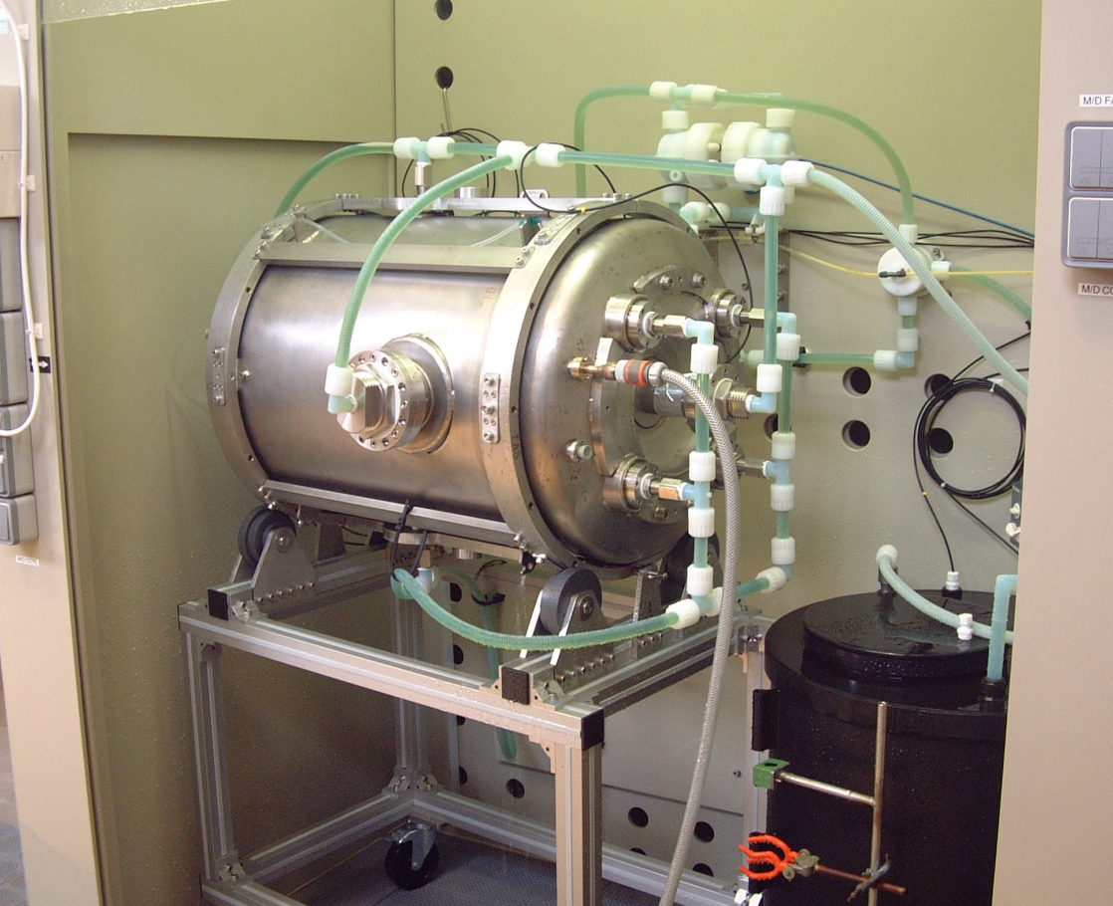
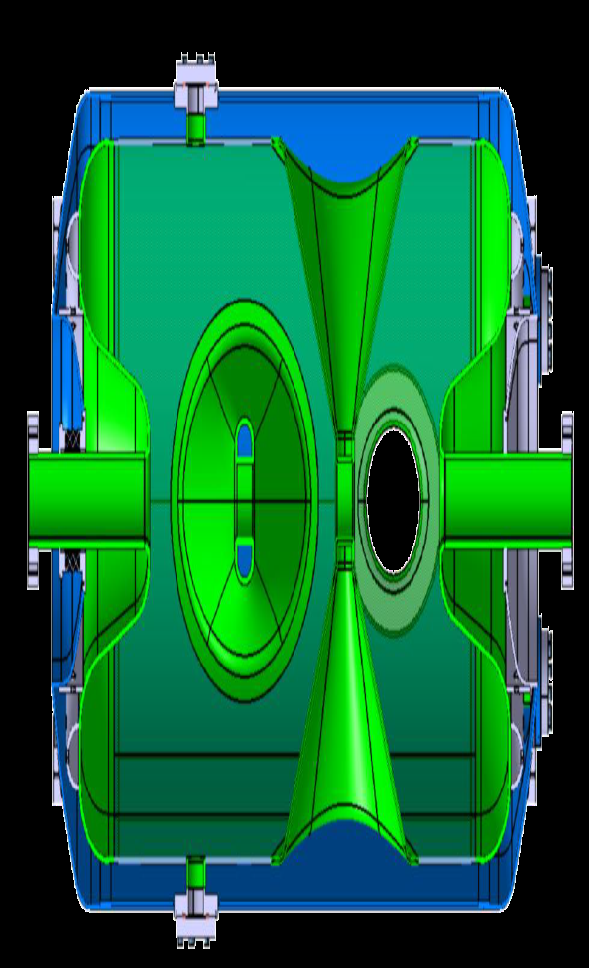
Cavity surface processing
Chemical etching:
Ultra-sonic degreasing : done @ Saclay : thanks to the CEA team !
Chemical etching (FNP 1:1:2.4), done in 2 steps (intermediate rinsing and weighing)
1st in horizontal position : ~ 240 minutes of etching, ~ 1800 g of niobium removed, corresponding to an average of 100 µm thickness reduction
Water cooling
FNP inlet

Slide 17
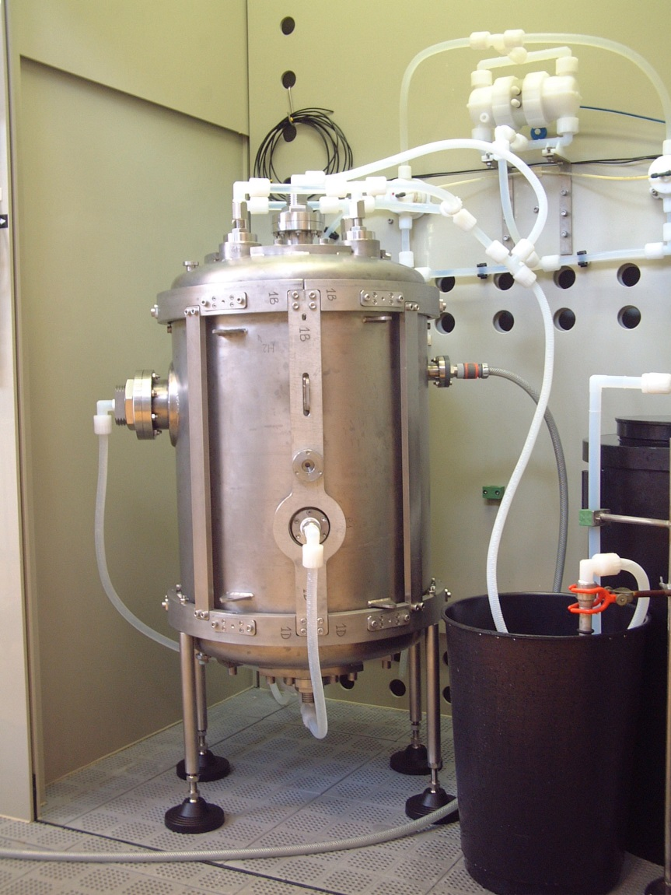
Cavity surface processing
Chemical etching:
Chemical etching (FNP 1:1:2.4), done in 2 steps (intermediate rinsing and weighing)
2nd step in vertical position : 240 minutes of etching, ~ average of 100 µm
Water cooling
FNP inlet

Slide 18
SD01 – “Germaine”
SD01 (Germaine) – 1st cavity to be prepared (dec. 2014)
Chemical etching:
horizontal: 260 minutes of etching, 1900 g of niobium removed, corresponding to an average of 115 µm thickness reduction
vertical: 240 min, 100 µm removed
High pressure rinsing with ultra-pure water in clean room
Assembly (flanges, valves, antenna) for vertical test in clean room
Leak check
The cavity was found to leak, but not located close to a flange…
Precise leak (hole) localization with endoscope : cavity partially filled with water and air pressure in the He tank.
Leak was located on a EB weld

Slide 19
SD01 – Leak repair
Fortunately, the leak was accessible (in sight) from one beam tube: a repair action was possible.
The cavity was sent back to SDMS in dec. 2014
After some dry run, SDMS performed a precise “surgery” on the cavity with the electron beam: a re-melting of the leaky area was performed
The cavity returned to IPNO in end January 2015
Leak test at reception: OK !
New cavity surface preparation (done):
light chemical etching (2x15 µm)
HPR & Clean room assembly
Cavity now ready for VT test
(planned 1st week of April)

Slide 20
ZA01 – “ROMEA”
Surface preparation:
Ultra-sonic degreasing: done @ Saclay : thanks to the CEA team !
Chemical etching: updated procedure with respect to what was done for Germaine chemical etching
1st step: horizontal, 120 minutes
2nd step: horizontal, 120 minutes
3rd step: vertical, fresh acid, 240 minutes
HPR in clean room:
Main HPR : several passes through the 4 HPR ports
Also HPR through power coupler port and beam ports

Slide 21
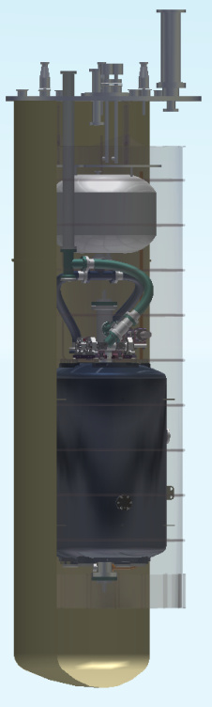
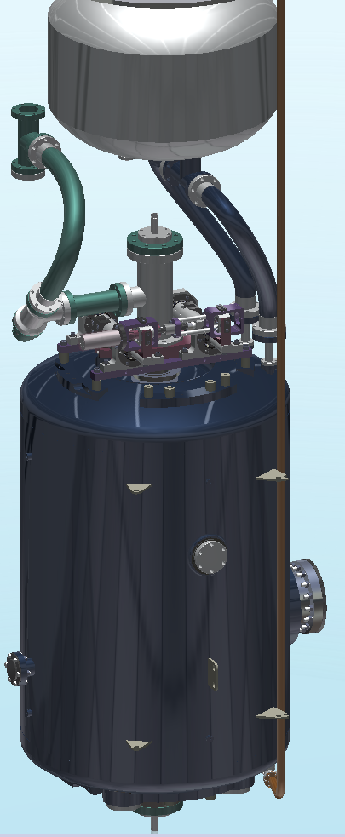
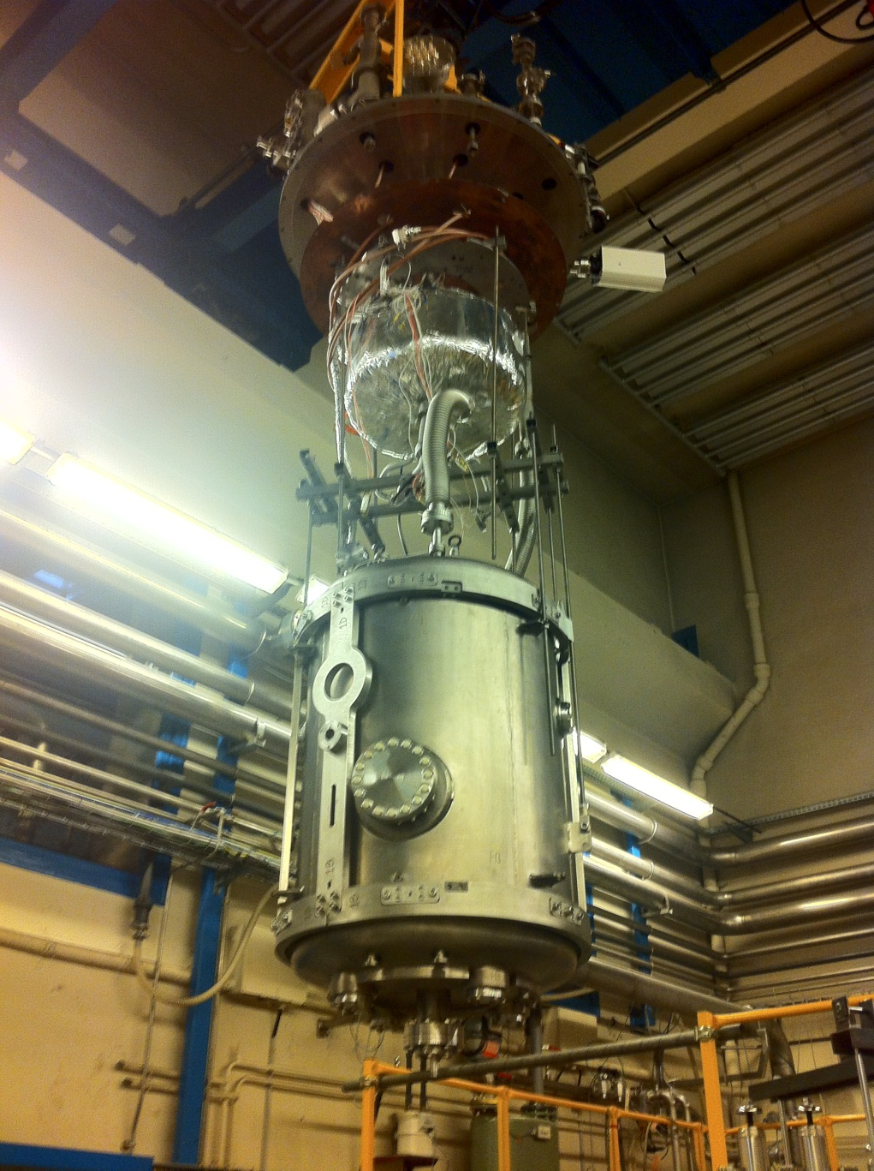
The cryo test in vertical cryostat
Test in vertical cryostat:
Use of our 800 mm diameter vertical cryostat
The cavity is in a vertical position
Not the nominal one (horizontal in the cryomodule), cooling of the spoke bar is different (horizontal position)
Not ideal for He gas evacuation

Slide 22
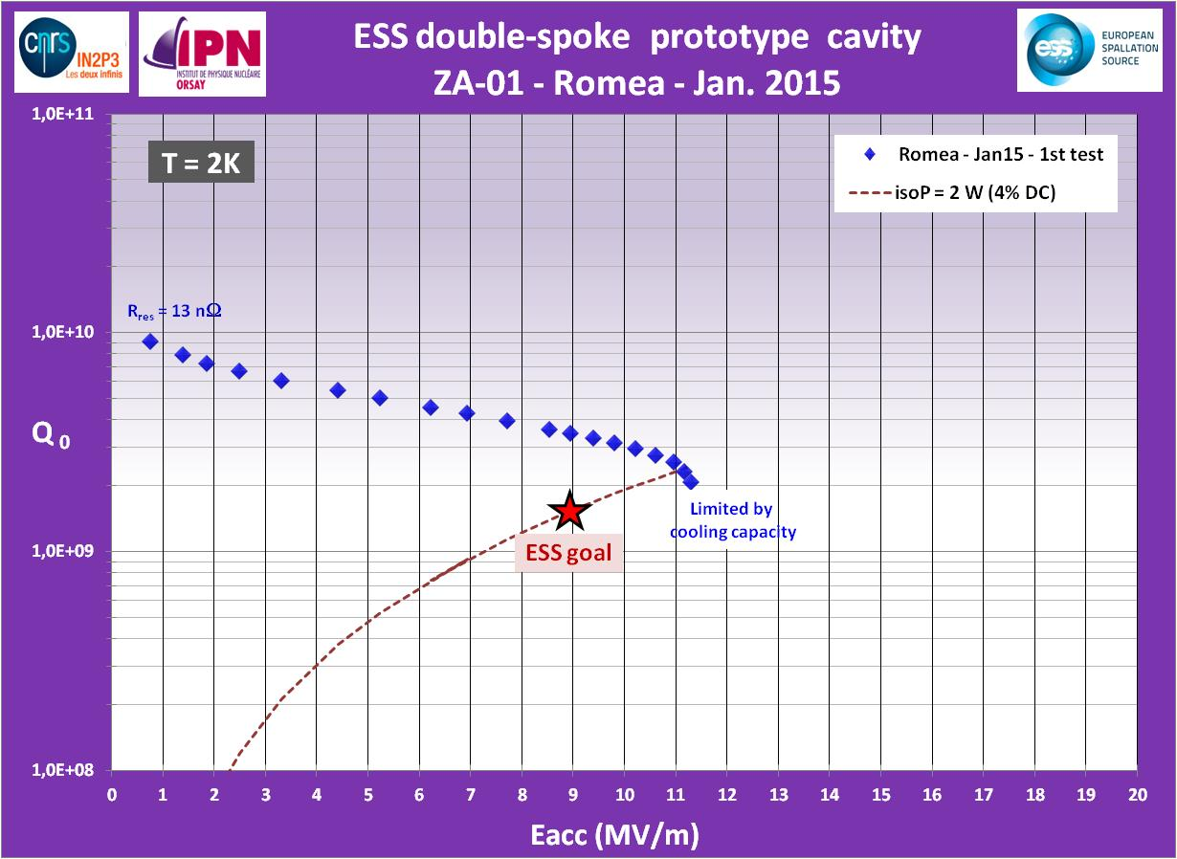
ZA01 – “ROMEA”
Test results (January 2015):
Very good achieved performances, well within specification: max achieved Eacc is 11.4 MV/m, limited by cooling capacities (not stable)
Several MP barriers, but quite easily processed. Still heavy FE @ max gradient
Lorentz force detuning @ 2K:
- 8.5 Hz/(MV/m²)
Sensitivity to pressure:
26 Hz / mbar

Slide 23
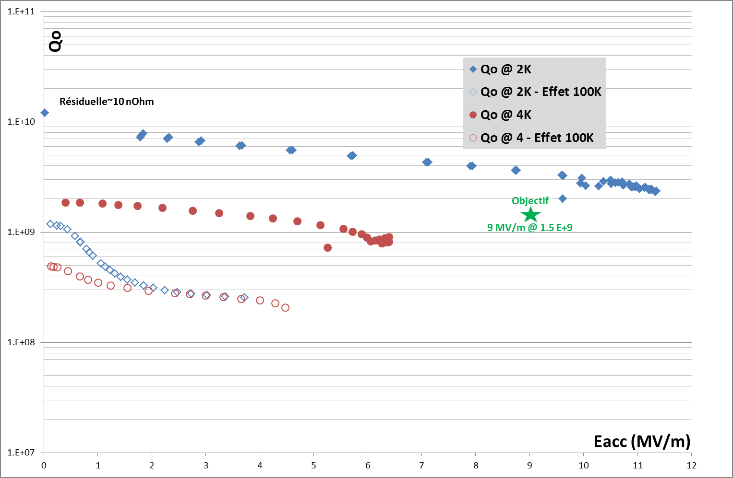
ZA01 – “ROMEA”
Test results (January 2015) – con’t:
test of the 100 K effect: cavity left for 6 hours @ 90 K: as expected, strong cavity performances degradation -> requirement for the cavity heat treatment (Hydrogen degassing) confirmed.

Slide 24
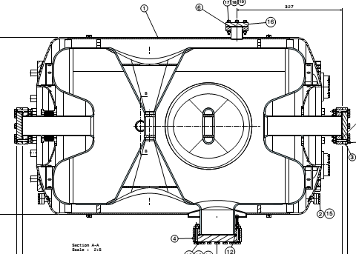
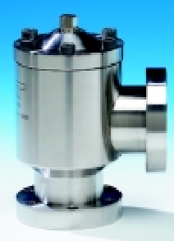
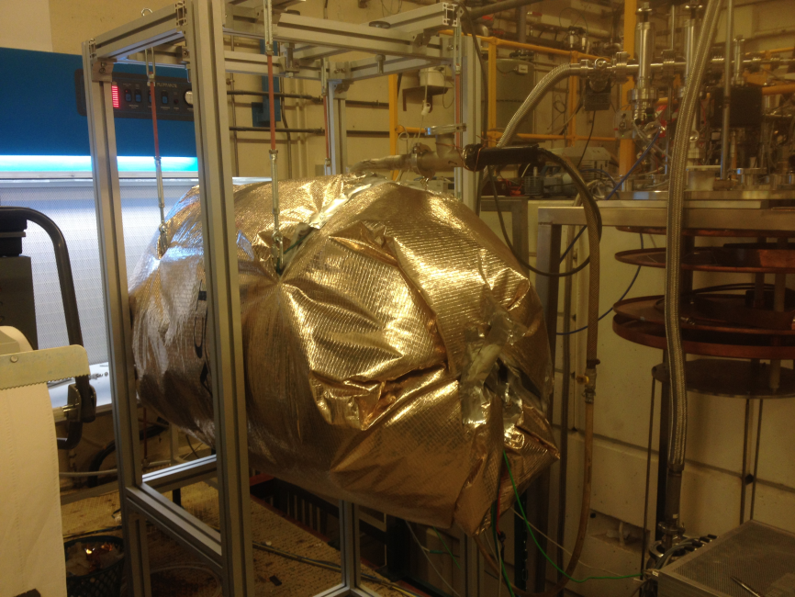
ZA01 – “ROMEA”
First attempt to perform cavity baking
Aim: potential improvement in the Qo curve slope (as we successfully experimented on the Spiral-2 16 QWRs)
A basic set-up for performing the cavity baking (objective 110 °C for 24 hours) was quickly prepared and experimented on Romea
Hot Air (600W)
Difficulties to reach a uniform
temperature: several changes of the parameters during the process
Isolation blanket not efficient enough: to gain time, use of standard isolator media (used for buildings)
Pumping
Thermocouple
Heater

Slide 25
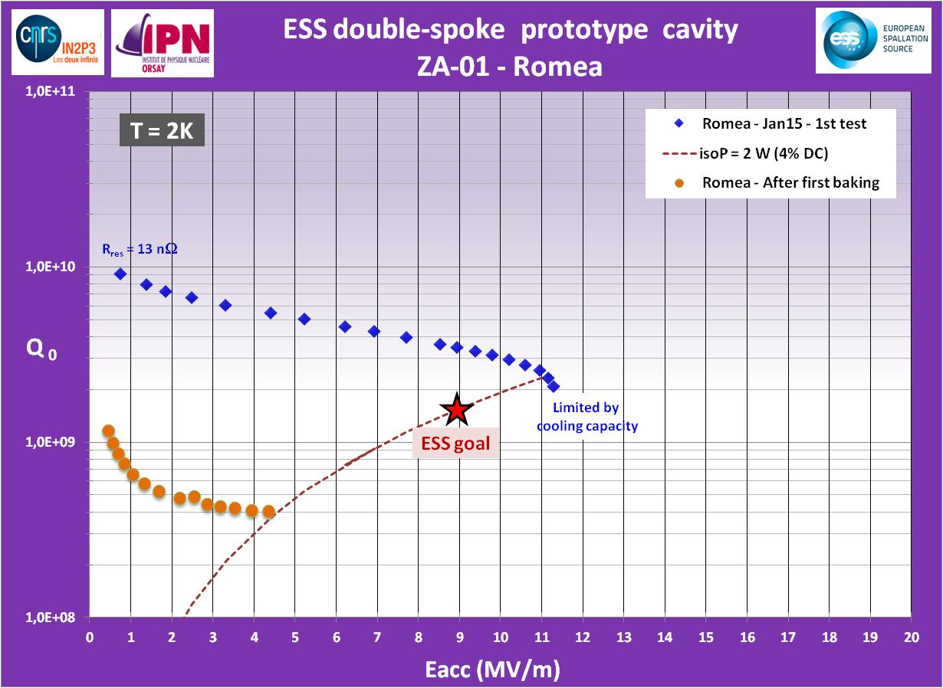
ZA01 – “ROMEA”
Test results after the first baking attempt (march 2015):
Strong decrease of the cavity performances
Obvious sign of surface contamination: baking @ too high T and for too long !
First baking:
24h @ 80°C-100°C
28h @ ~ 120°C
Vacuum = 4E-7 mbar

Slide 26
ZA02 – “GIULIETTA”
Surface preparation:
Ultra-sonic degreasing: done @ Saclay : thanks to the CEA team !
Chemical etching: slightly updated procedure with respect to what was done for Romea (to reduce increase of acid T°)
1st step: horizontal, 120 minutes
2nd step: horizontal, 120 minutes
3rd step: vertical, fresh acid, 240 minutes
HPR: added a 3rd pass (increased HPR time)

Slide 27
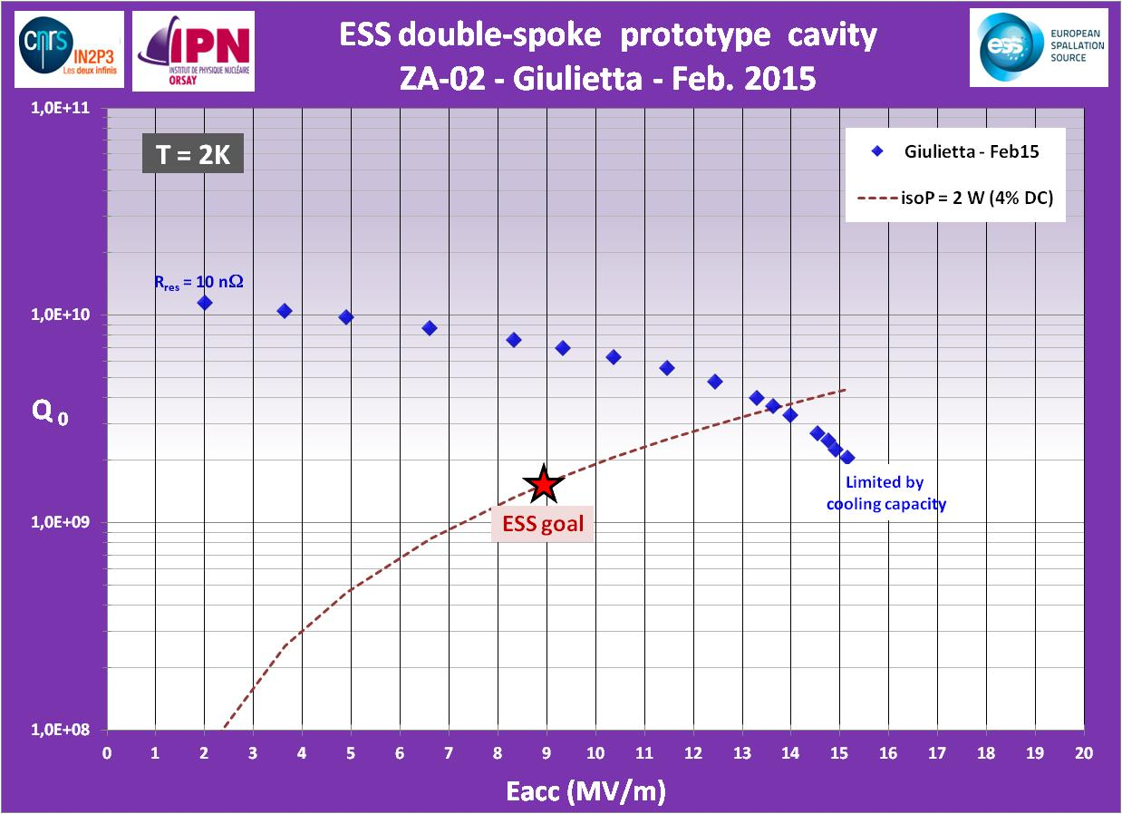
ZA02 – “GIULIETTA”
Test results (February 2015):
Excellent performances, well within specification: max achieved Eacc is 15.1 MV/m, also limited by cooling capacities (not stable)
Several MP barriers, but quite easily processed. Still some FE @ max gradient
Lorentz force detuning @ 2K:
-6.8 Hz/(MV/m²)
Sensitivity to pressure:
28 Hz / mbar

Slide 28
First experimental results on the spoke cold tuning system at cryo temperature

Slide 29
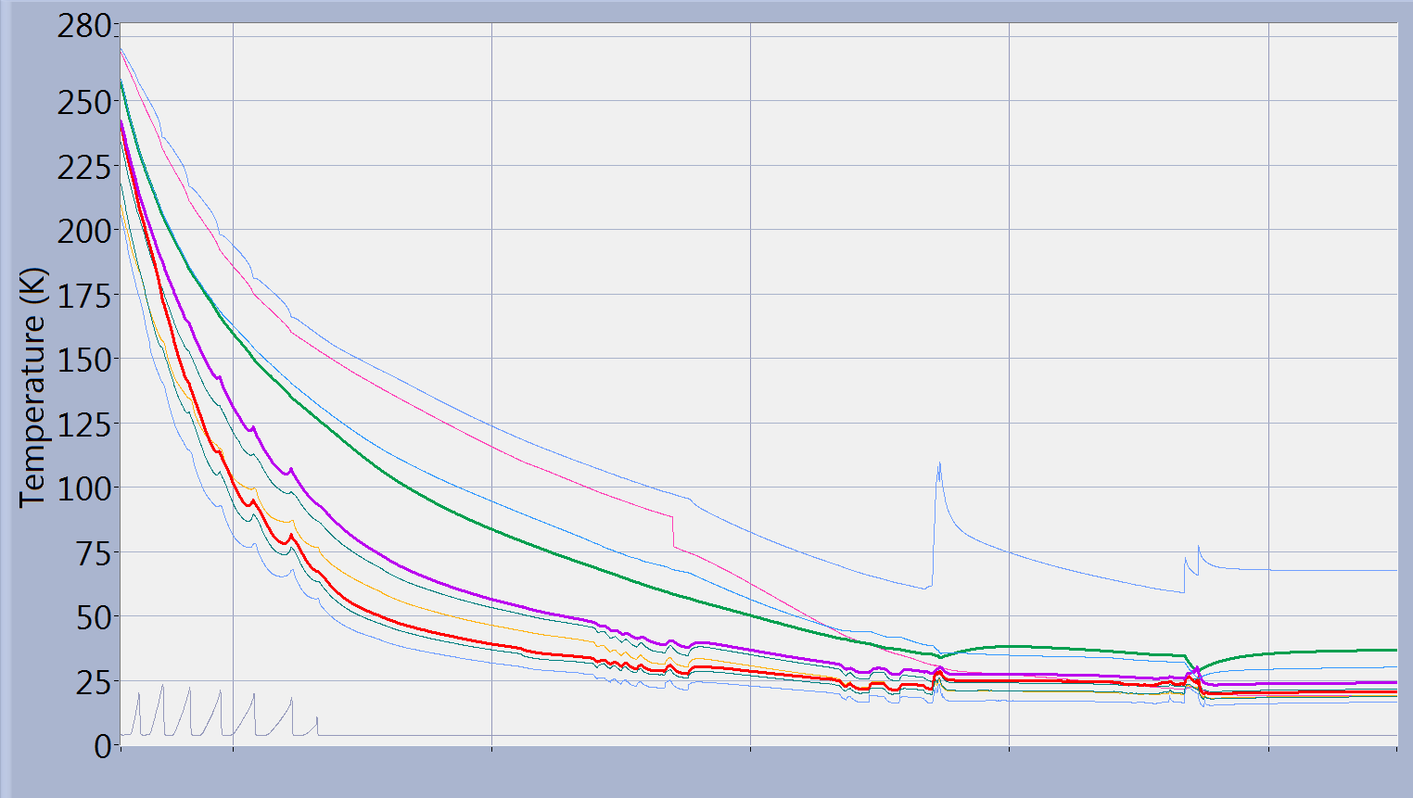
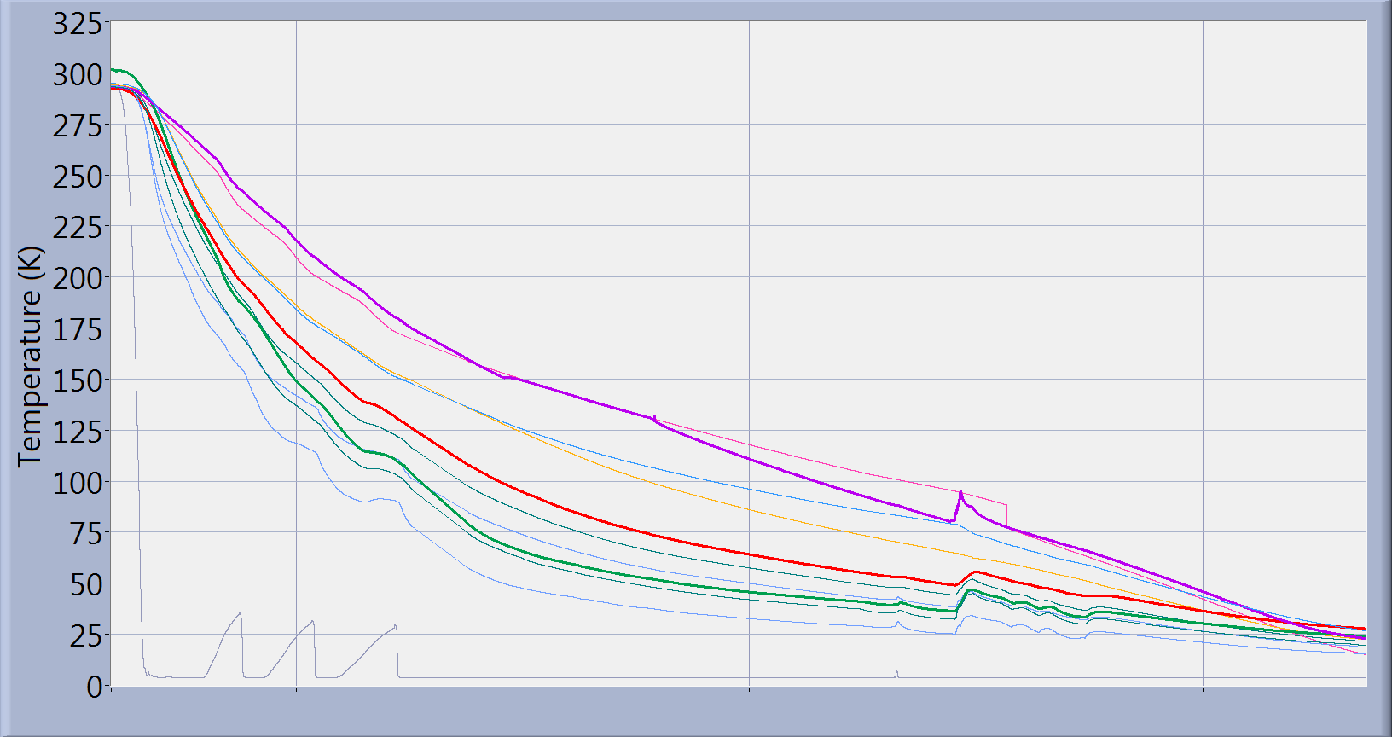
CTS test: cooling time
Test results in VT:
T<50 K in 3 days
3 days to reach
T < 50K
will be improved for the “Germaine” test.
3 days to reach T<50 K
ZA02
09 fev.
10 fev.
11 fev.
12 fev.
13 fev.
14 fev.
ZA01
05 janv.
06 janv.
07 janv.
08 janv.

Slide 30
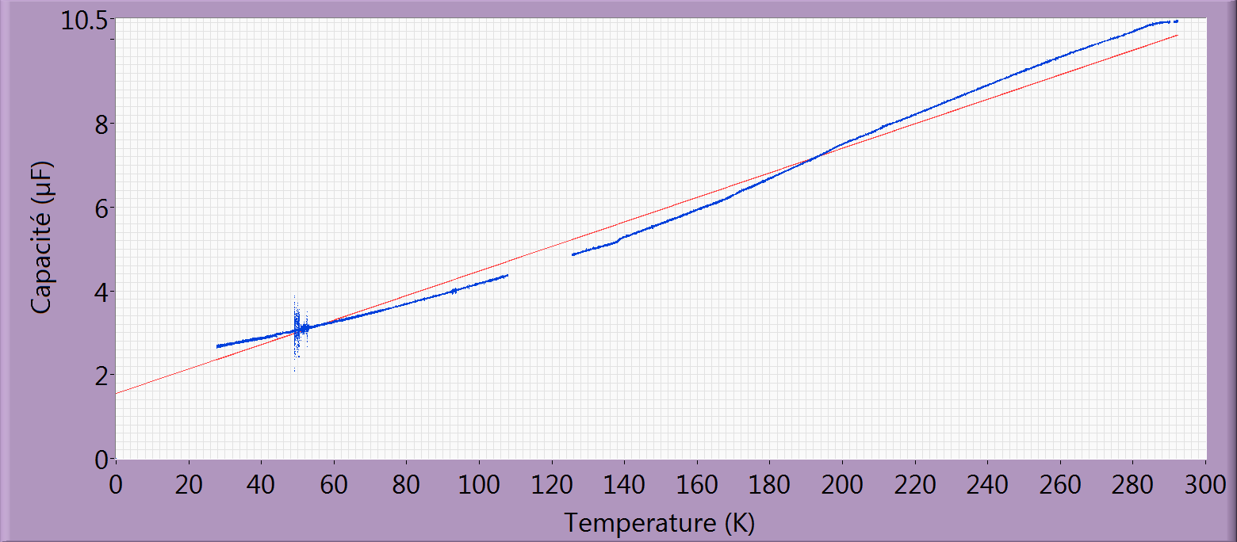
CTS test: piezo capacitance
Test results in VT:
ZA02
Same capacity measured on both piezo sets:
- ZA01 : 29.3 nF/K - ZA02 : 27.2 nF/K
ZA01

Slide 31
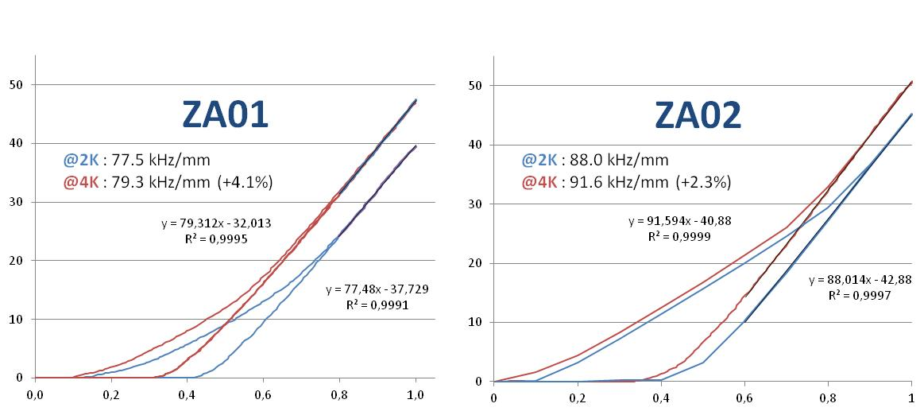
CTS test: motor dynamics
Test results in VT:
Same behavior for the 2 tests, linear behavior once CTS in contact
Sensitivity less than calculated, but range still sufficient

Slide 32
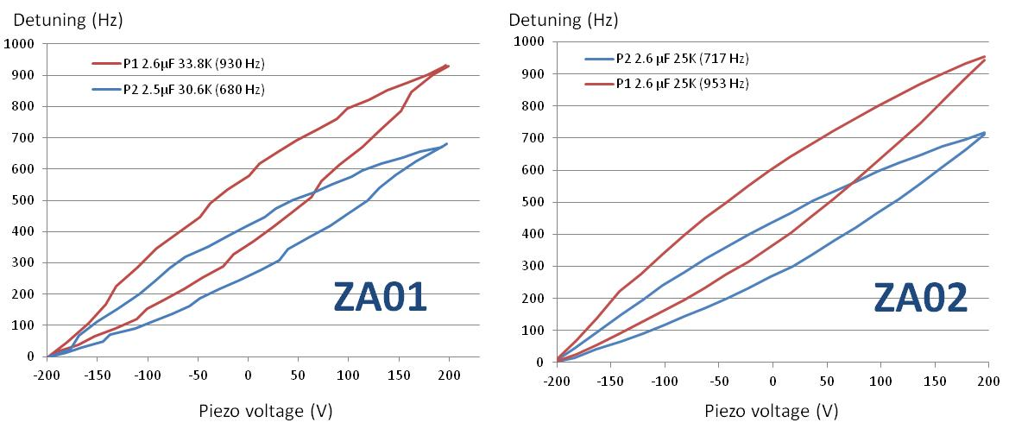
CTS test: piezo dynamics
Test results in VT:
Same behavior for the 2 tests
Tuning range obtained is max ~ 900 Hz, but at the maximum Piezo voltage

Slide 33
Future work

Slide 34
Future work for 2015
Test of the 3rd prototype (Germaine) in 1st week of April
Achieve final set-up for the cavity baking and define the precise baking procedure – then test it
Perform the cavity heat treatment (600 °C, H degassing)
Next major milestone: test of a cavity equipped with its power coupler in Uppsala, in the horizontal cryostat HNOOS in the Freia Hall
Prepare two fully dressed cavities for the spoke prototype cryomodule assembly

Slide 35
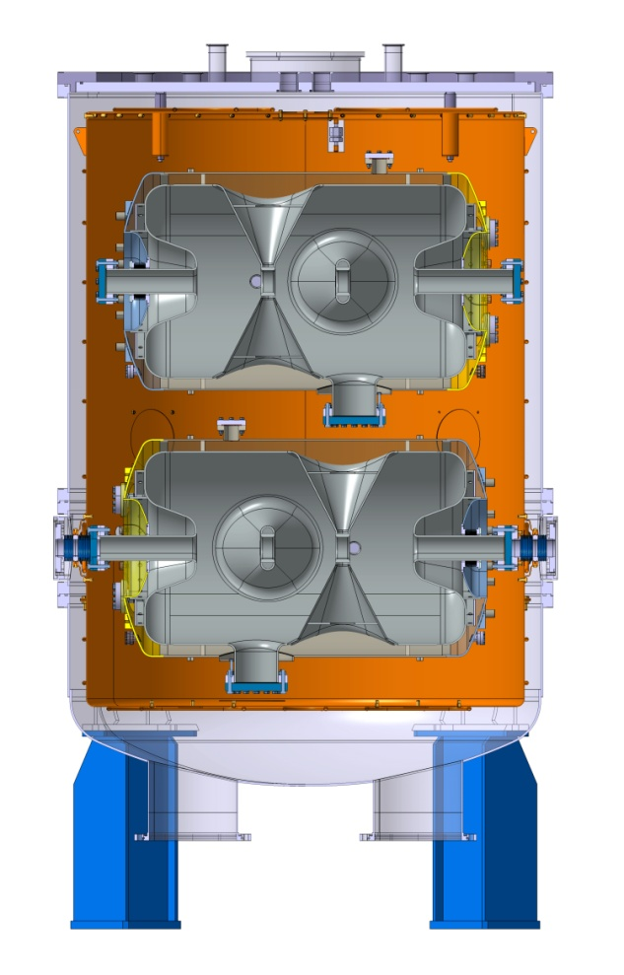
Test stands
At IPN Orsay: all infrastructure required for the prototyping phase are already available and operational: chemistry facility, clean room, vertical cryostat, cryogenic facilities...
Preliminary: a study is ongoing at IPNO for the potentiality of a new vertical cryostat for spoke cavity series tests : 2 cavity at the same (cryo) time

Slide 36
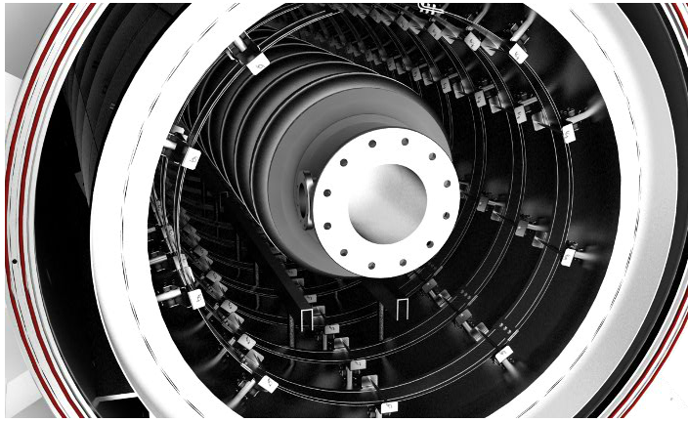
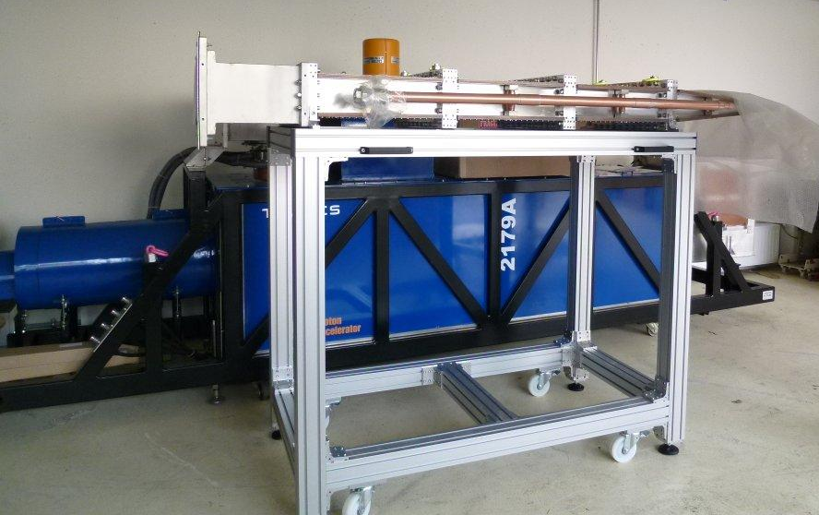
Test stands
At IPN Orsay: for the series, two more equipments will be available:
A vacuum furnace for SC cavities H degassing
Fabrication is ongoing.
Delivery and installation at IPNO scheduled for Nov. 2015.
A 352 MHz High Power RF Source for spoke coupler conditioning
2.8 MW Thales Klystron already at IPNO, as well as RF load & circulator.
Modulator under construction (Sigmaphi-DTI)
Expected to be ready in Fall 2015

Slide 37
The IPNO Team
Thanks to all the contributors to this work:
Sébastien BOUSSON Sylvain BRAULT Frédéric CHATELET
Patricia DUCHESNE Patxi DUTHIL Nicolas GANDOLFO
Virginie LAURENCIER
David LONGUEVERGNE
Richard MARTRET
Guy MICHEL Guillaume OLRY
Thierry PEPIN-DONAT
Matthieu PIERENS
Véronique POUX
Fetra RABEHASY
Emmanuel RAMPNOUX Ludovic RENARD
Denis REYNET Philippe SZOTT
And Christine DARVE from ESS !

Slide 38
More experimental results at the 6th SLHiPP meeting – stay tuned !

